Slide 1
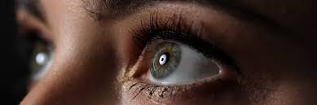
Anatomy of the eye
Dr : Khalil M. Abu Nada

Slide 2
General characteristics
_ The adult eye is a complex organ contained within the orbital cavity (composed of 7 bones). Each eye has multiple layers and chambers and is surrounded by 6 extraocular muscles.
Layers of the eye:
  Fibrous layer: sclera and cornea
  Vascular layer (the uvea): choroid, ciliary body, and iris
  Neural layer: retina and optic nerve
Chambers of the eye:
  Anterior: between cornea and iris
  Posterior: between iris and lens
  Vitreous: between lens and posterior eye wall

Slide 3
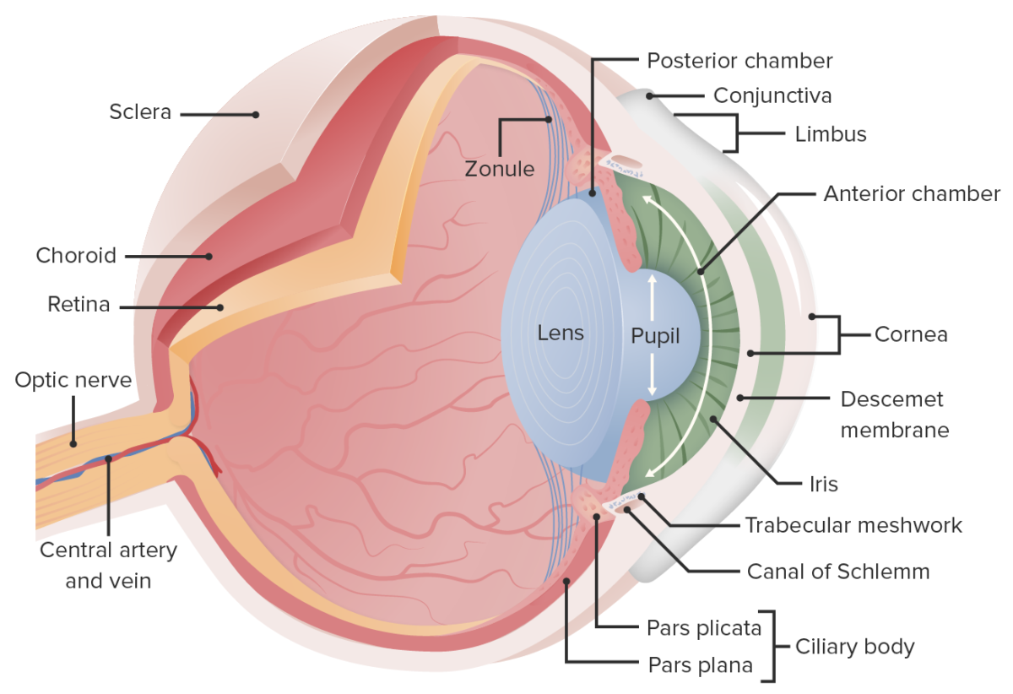
Components of the orbit:
  7 extraocular muscles:
    Levator palpebrae superioris
    Superior oblique
    Inferior oblique
    Lateral rectus
    Medial rectus
    Inferior rectus
    Superior rectus
  Lacrimal apparatus:
    Lacrimal glands and their associated ducts
    Produce tears to provide lubrication
  Nerves and blood vessels

Slide 4
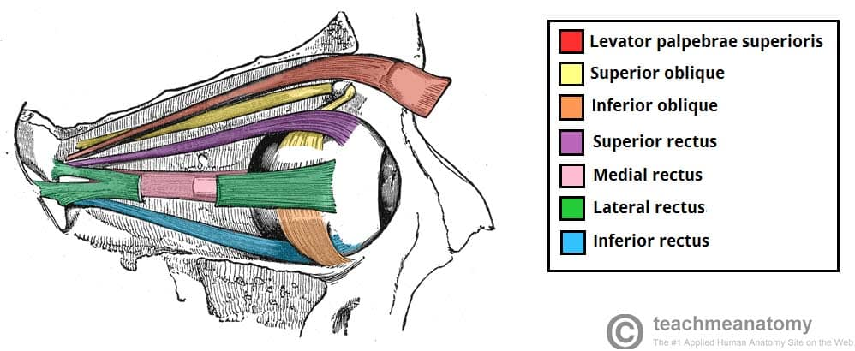

Slide 5
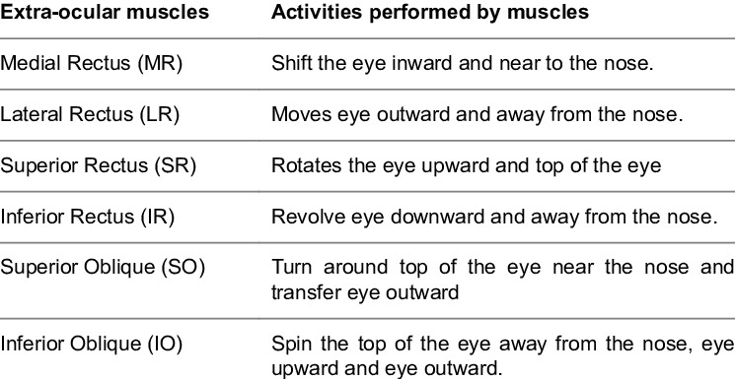

Slide 6
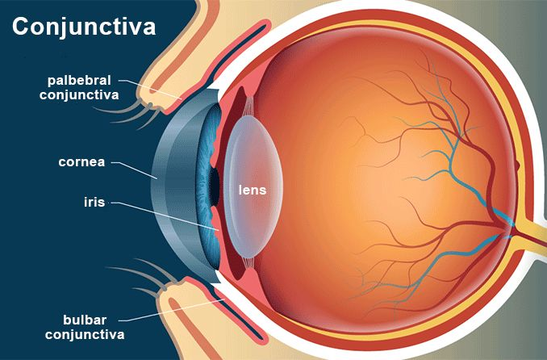
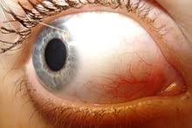
Layers of the eye
_ The eye is composed of 3 layers ( fibrous , vascular, neural) and a transparent connective tissue covering (conjunctiva).
1_ Conjunctiva:
Loose, transparent connective tissue that covers the eye (bulbar conjunctiva).
Adheres firmly to the limbus of the cornea
Reflects back on itself to form the inner layer of the eyelid (palpebral conjunctiva )
Highly vascular
Maintains normal lubrication of the eye

Slide 7
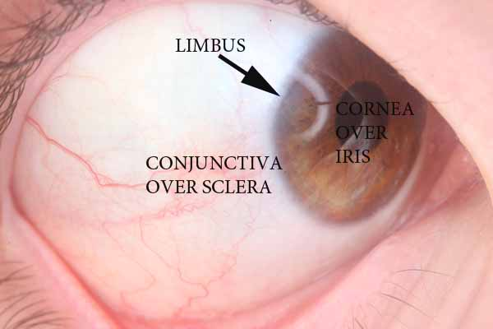
2_ Fibrous layer:
Cornea:
  Covers anterior aspect of eye
  Approximately 15% of fibrous layer
  Transparent, avascular, and richly innervated
  Responsible for initial refraction of light
Sclera:
  Continuous with cornea
  Covers posterior aspect of eye > 80% of fibrous layer
  Seen as the white part of eye
  Site of attachment for extraocular muscles
Limbus:
  Border between cornea and sclera
  Site of surgical incision for cataract and glaucoma surgery

Slide 8
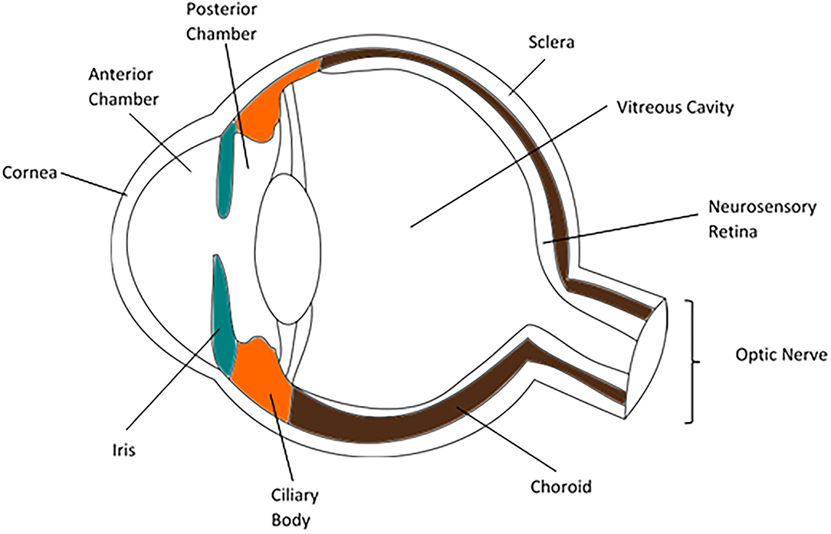
3_ Vascular layer:
Uvea, or uveal tract:
  Composed of the iris, ciliary body, and choroid
  Lies between sclera and retina
  Anterior portion is the iris and ciliary body.
  Posterior portion is the choroid.

Slide 9
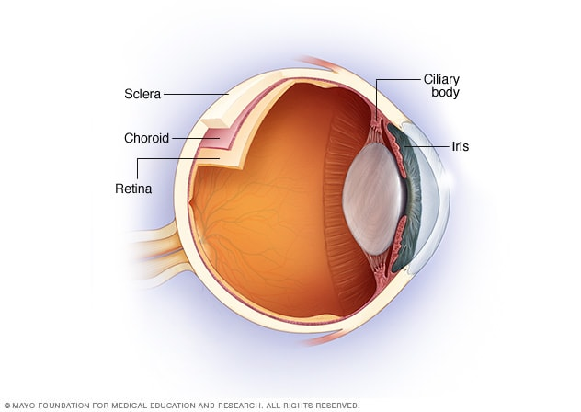
Choroid (posterior uvea):
  Reddish brown layer between the sclera and retina
  Contains large external vessels and an innermost capillary bed
  Source of oxygen/nutrients to retina
  Continuous anteriorly with ciliary body
Ciliary body:
  Muscular structure that connects the choroid with circumference of iris.
  Alters shape and thickness of lens (accommodation)
  Ciliary processes secrete aqueous humor

Slide 10
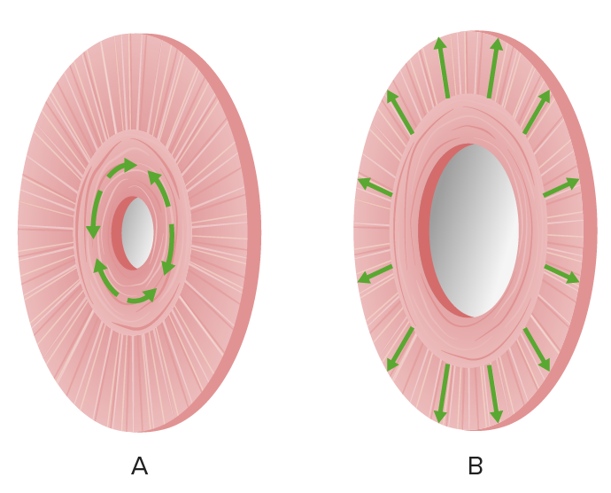
Iris:
  Pigmented diaphragm with central aperture (pupil)
  On anterior surface of lens
  Sphincter muscles within the iris adjust pupillary size in response to light and the autonomic nervous system
  Light exposure/parasympathetic stimulation:
    Narrows the pupil(miosis)
    Sphincter pupillae muscle
  Darkness/sympathetic stimulation:
    Widens the pupil (mydriasis)
    Dilator pupillae muscle

Slide 11
4_ Neural layer:
  Neural layer:
    Light-receptive
  Pigmented cell layer:
    Single layer of cells
    Absorbs light to reduce scattering of light within eye
  Optic disc or papilla:
    Known as the "blind spot": no photoreceptors
    Located in the fundus of the retina, which is the location where sensory fibers of the optic nerve enter the eyeball.
  Macula:
    Contains special photoreceptor cones for visual acuity
    Lacks blood vessels
  Fovea:
    Located in center of macula
    Responsible for high-acuity vision
    Densely saturated with cone photoreceptors

Slide 12
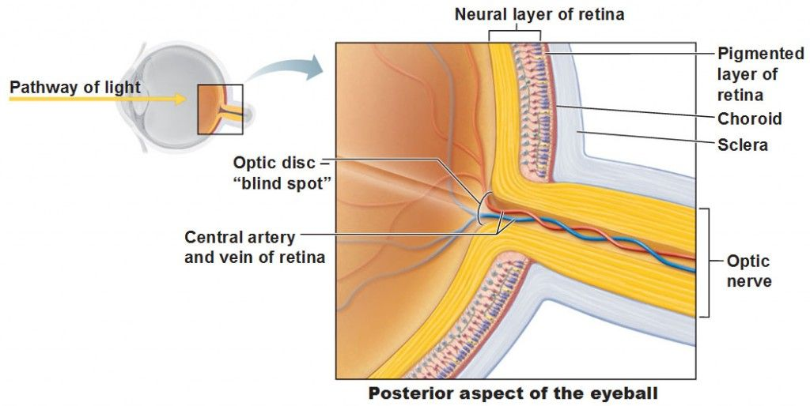

Slide 13
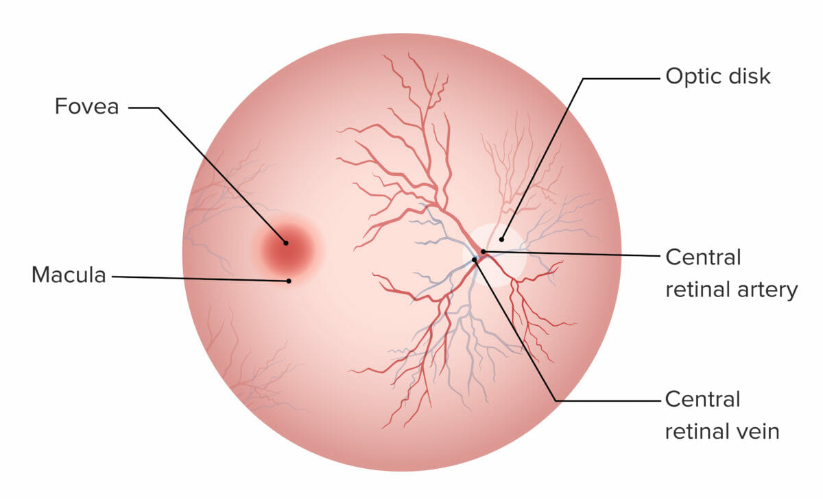

Slide 14
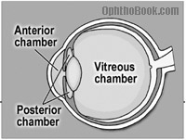
Chambers of the eye
The eye consists of 3 fused chambers:
  Anterior: between cornea and iris
  Posterior: between iris and lens
  Vitreous: between lens and posterior eye wall
Aqueous humor:
  Produced by the ciliary processes of the ciliary body
  Travels to the anterior and posterior chambers
  Absorbed via the lymphatics in the Schlemm canal
Vitreous body (also known as vitreous humor ):
  Occupies the vitreous chamber
  Encased in the vitreous membrane
  Fluid-like at center and gel-like at edges
  Attaches firmly to the serrata, optic disc, retinal vessels, lens capsule , and macula

Slide 15
Blood supply
The entire arterial supply of the eye is provided by branches of the ophthalmic artery and drained by a system of veins that unite to form the central vein of the retina.
Ophthalmic artery, branch of the internal carotid artery , in turn gives off branches:
  Central retinal artery:
    1st branch of the ophthalmic artery
    Supplies the inner layer of the retina and all nerve fibers that form the optic nerve
  Lacrimal artery:
    2nd branch of the ophthalmic artery
    Supplies the eyelids , lacrimal gland, and conjunctiva
  Ciliary arteries:
    Include the long and short posterior ciliary arteries and anterior ciliary artery
    Supply the choroid and iris
  Supraorbital artery:
    Bifurcates to form a superficial and deep branch
    Supplies the upper eyelid, levator palpebrae muscle, skin of the forehead and scalp

Slide 16
Ethmoidal arteries :
  Include the anterior and posterior ethmoidal arteries
  Supply the ethmoid sinuses
Medial palpebral artery:
  Also known as the internal palpebral arteries —superior and inferior
  Arises from the ophthalmic artery near its terminal branches
  Supplies the eyelids
Muscular arteries :
  Medial and lateral branches of the ophthalmic artery
  Supply the extraocular muscles
Terminal branches:
  Dorsal nasal artery: supplies the lacrimal sac and tip of the nose
  Supratrochlear artery: supplies the medial forehead

Slide 17
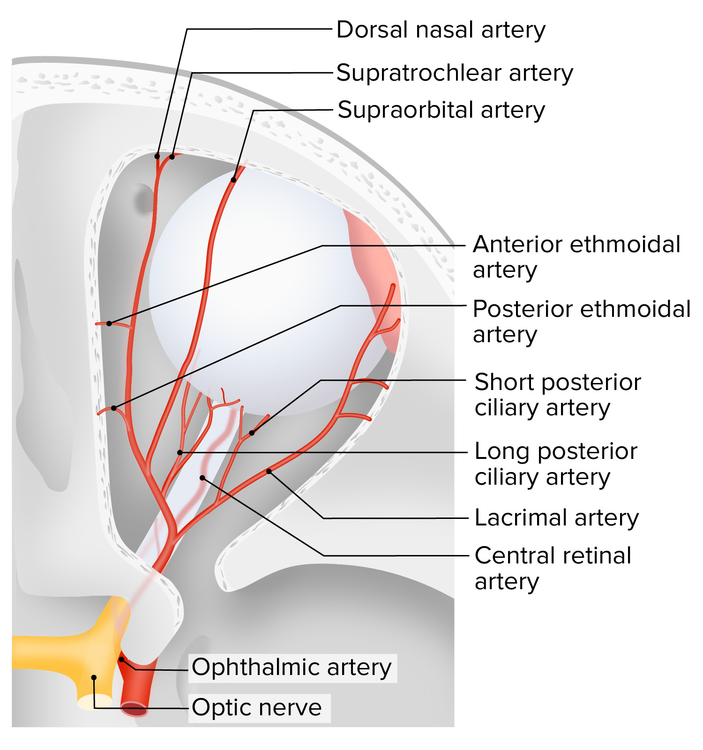

Slide 18
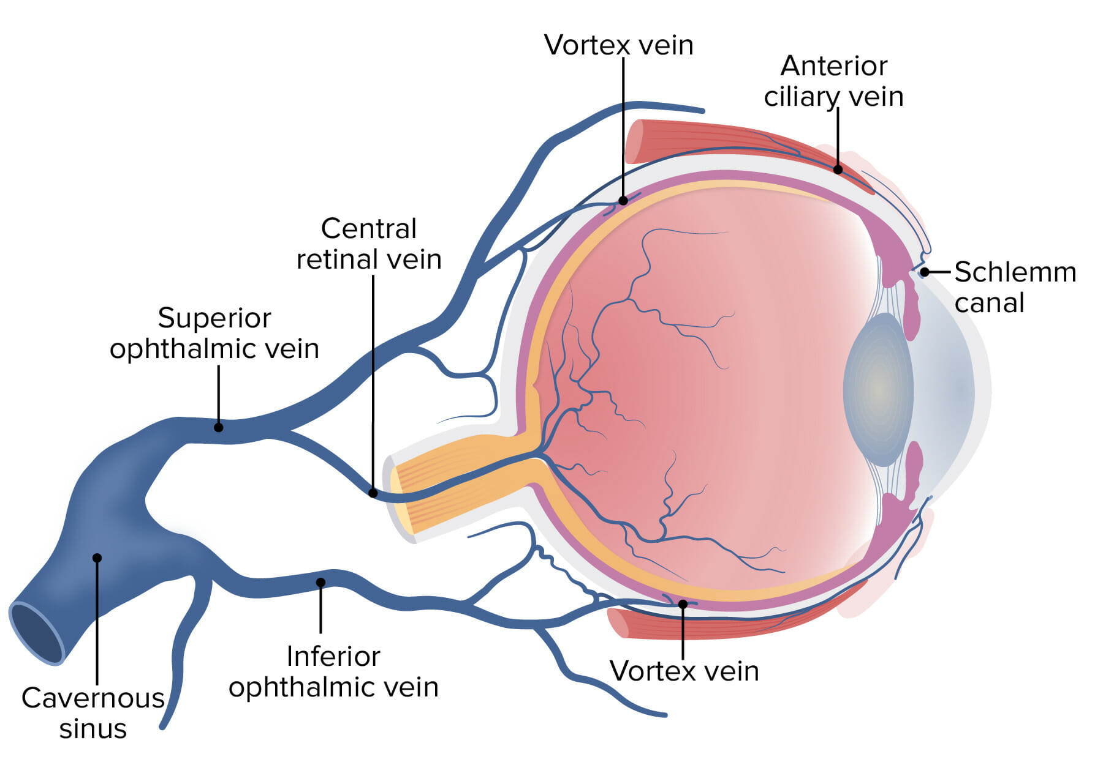
Venous drainage:
  Central retinal vein and vortex veins merge with superior and inferior ophthalmic veins
  These veins drain into the cavernous sinus, pterygoid venous plexus, and facial vein.

Slide 19
Innervation
Vision :
  Optic nerve (CN II)
  Innermost retinal layer contains photoreceptors that convert light stimuli into neural impulses that are transmitted by the optic nerve :
    Rods: best in dim light; about 120 million in each retina
    Cones: color vision ; about 6 million in each retina
Miosis:
  Pupillary constriction
  Parasympathetic fibers of short ciliary nerves to the constrictor pupillae muscle
Mydriasis:
  Pupillary dilation
  Sympathetic fibers of long ciliary nerves to the radial dilator pupillae muscle
Accommodation :
  Thickening of the lens to allow for near vision
  Short ciliary nerves (branch of cranial nerve III) innervate the ciliary muscles , which change the shape of the lens.
Sensation: ophthalmic branch (V1) of the cranial nerve V (trigeminal nerve )

Slide 20
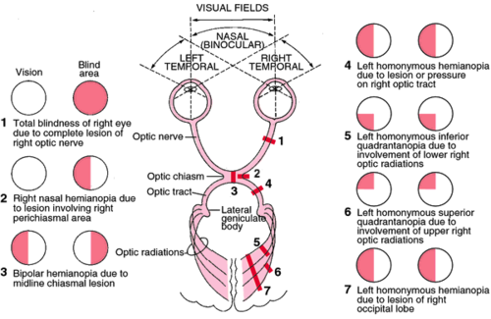

Slide 21


