Slide 1
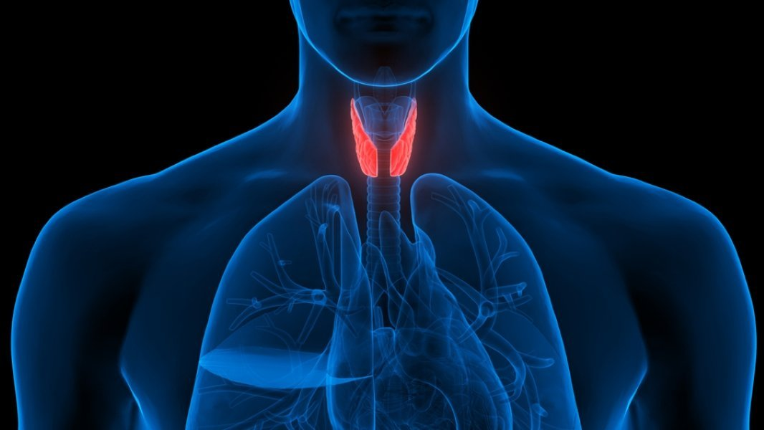
Embryology of Endocrine system
Dr. Amjad A. Abu Alqumboz
Palestinian Board of General Surgery
Al Makassed hospital – Jerusalem

Slide 2
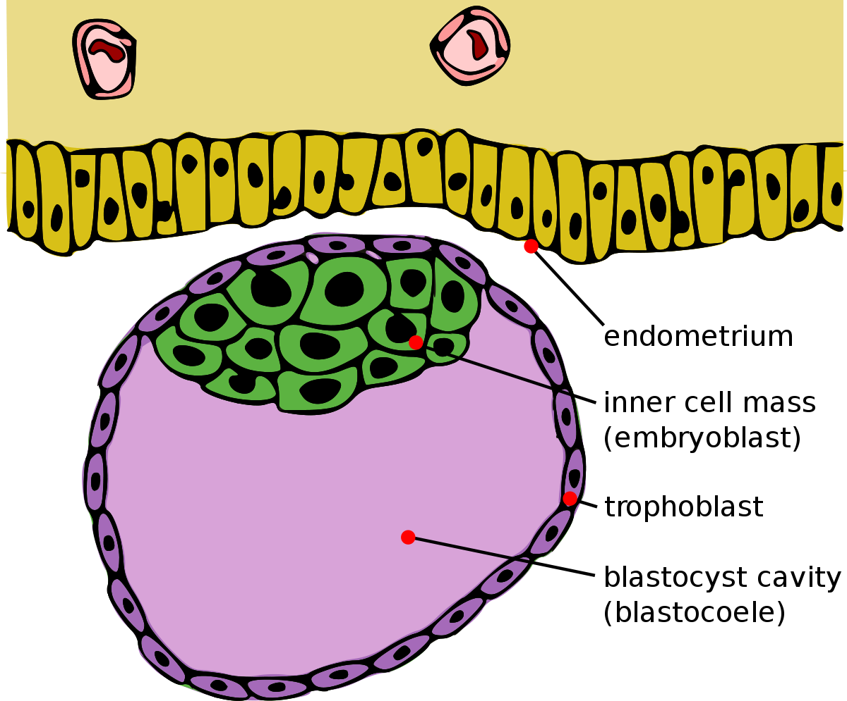
Inner cell mass (embryoblast)

Slide 3
Inner cell mass (embryoblast)
Epiblast :
contribute to the main embryo
form a primitive streak
Hypoblast :
contribute partially to the yolk sac
the remainder >> apoptosis

Slide 4
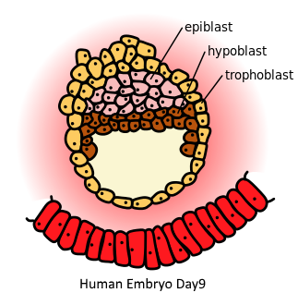

Slide 5
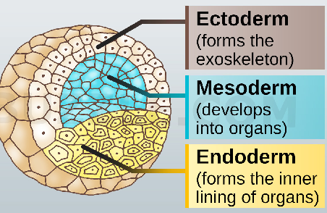
Epiblast,
differentiates into the three primary germ layers, ectoderm, mesoderm, and endoderm.

Slide 6
# Ectoderm (outer) :
epidermis of skin , epithelial lining of mouth & rectum , nervous system.
# Mesoderm (middle) :
skeleton , muscle , dermis of skin , circulatory system , excretory sys. “ADRENAL CORTEX” , reproductive syst. , outer layers of respiratory & digestive sys.
# Endoderm (inner) :
Epithelial lining of respiratory & digestive systems

Slide 7
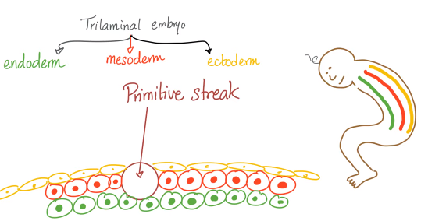

Slide 8
Ectoderm
>> Surface ectoderm : epithelium
>> Neuro-ectoderm
1. Neural tube : CNS neurons
- Forebrain (pros encephalon) > develop into the telencephalon (cerebrum) and the diencephalon (optic vesicles and hypothalamus).
Midbrain (mes encephalon) > stays as the midbrain.
- Hindbrain (rhomb encephalon) > develops into
the metencephalon (the pons and cerebellum) and the myelencephalon (the medulla oblongata).
- Spinal cord.

Slide 9
2. Neural crest :
- Peripheral nervous system (PNS)neurons
craniofacial cartilage and bone,
Schwann cells ,
ADRENAL MEDULLA

Slide 10
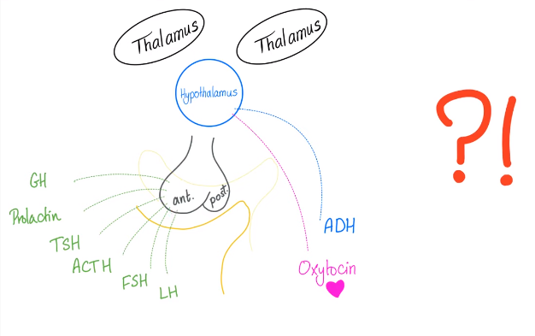

Slide 11
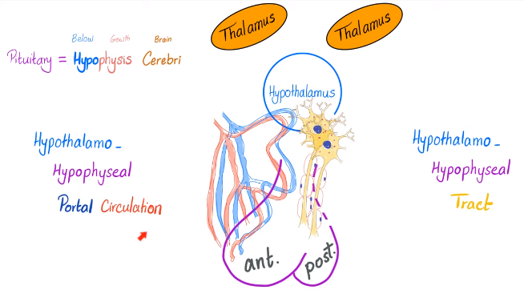

Slide 12
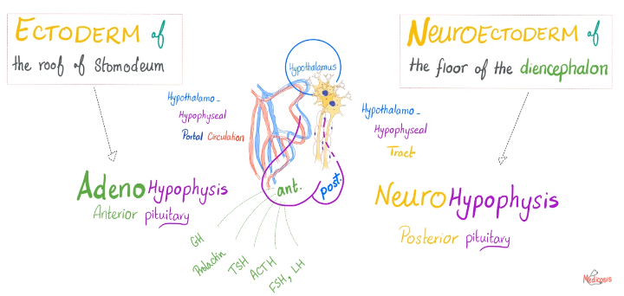
Embryological Development of the PITUITARY GLANDS

Slide 13
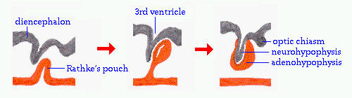
Embryological Development of the PITUITARY GLANDS
Rathke's pouch : ectodermal diverticulum which grows upwards from the roof of stomodeum and will develop into the anterior pituitary or adenohypophysis.
Infundibulum : ectodermal diverticulum which grows inferiorly from the floor of diencephalon , will become the posterior pituitary or neurohypophysis.

Slide 14
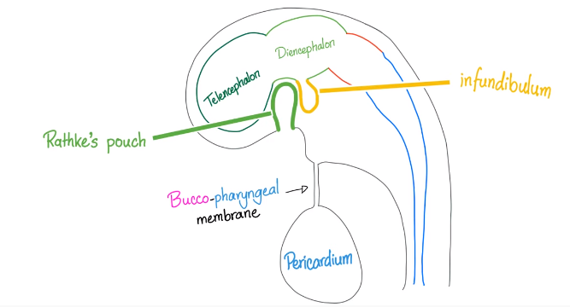
Embryological Development of the PITUITARY GLANDS

Slide 15
During 2nd month >> Rathke’s pouch contact with anterior surface of infundibulum then loss connection with stomodeum .
Cells in anterior wall of pouch increase rapidly and form PARS DISTALIS of pituitary gland.
Upward extension of pars distalis around the stalk of infundibulum >> PARS TUBERALIS
Posterior wall of pouch >> PARS INTERMEDIA

Slide 16
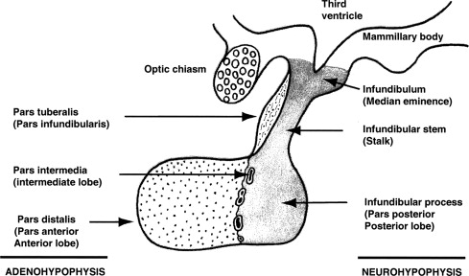

Slide 17
Cavity of Rathke’s pouch is reduced to narrow cleft that may completely disappear.
Infundibulum has differentiated into Stalk & Pars Nervosa of pituitary gland.

Slide 18
Congenital anomalies of pituitary gland
Agensis : complete absence of the pituitary glands ( incompatible with life)
Absence of anterior lobe : No TSH,ACTH,FSH/LH
why?? Failure of development of Rathke’s pouch.
Pharyngeal hypophysis :
pituitary @pharynx @Rathke’s pouch @pharyngeal pouch

Slide 19
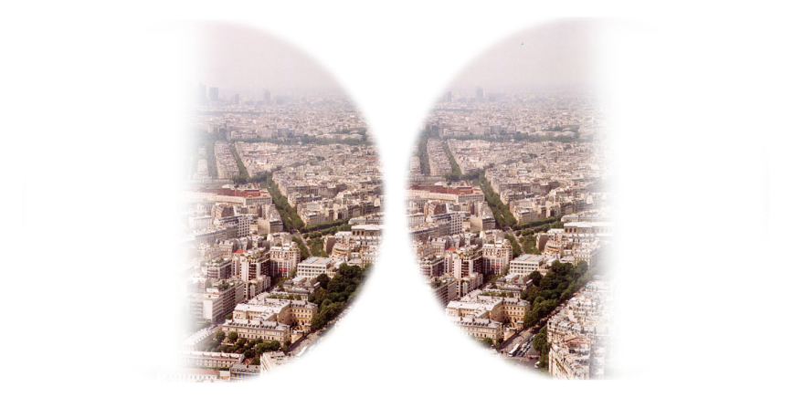
CRANIOPHARYNGIOMA
Brain tumor arises from remnants of Rathke’s pouch and may cause pituitary dysfunction.
Can compress the optic chiasma >> bitemporal hemianopia

Slide 20
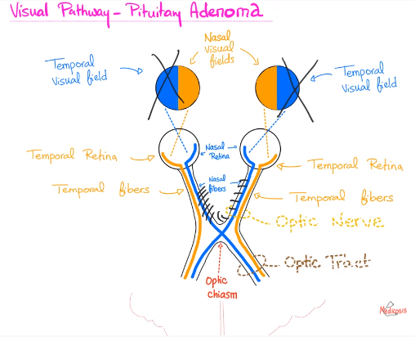

Slide 21
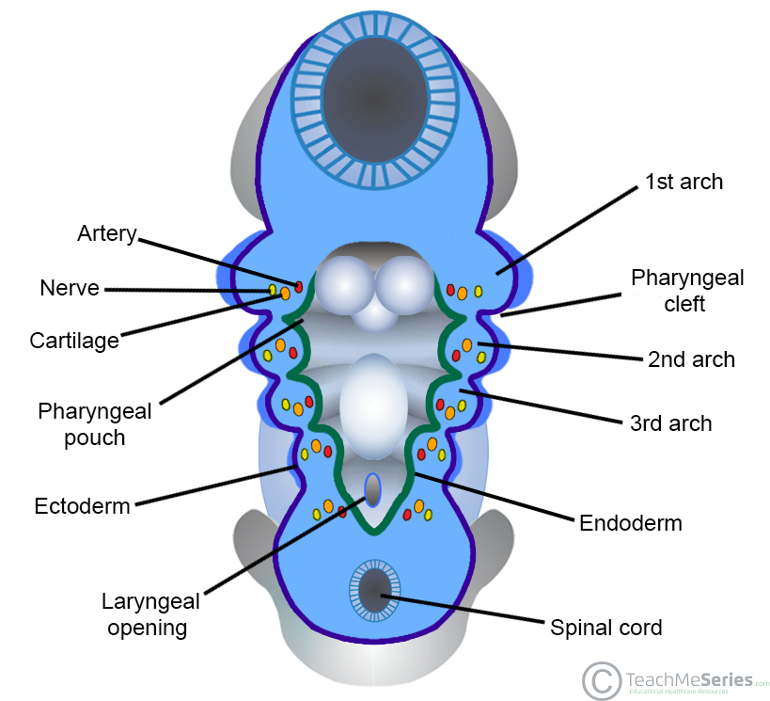

Slide 22
Pharyngeal pouches:
- form on the endodermal side between the pharyngeal arches.
- there is FOUR , as the fifth and sixth are
comprised within the fourth .
1st > middle ear + Eustachian tube
2nd > palatine tonsil
3rd > inferior parathyroid + thymus
4th > superior parathyroid + small part of thyroid

Slide 23
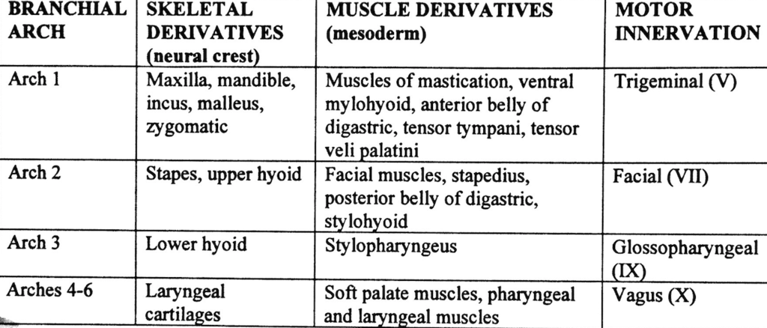
Pharyngeal arches mesoderm
There are five pairs of pharyngeal arches, numbered 1, 2, 3, 4, and 6 for comparative embryology reasons

Slide 24
Pharyngeal clefts
ectoderm
There are initially four pharyngeal clefts. However, only the 1st cleft gives rise to a permanent structure in the adult – the external auditory meatus.
The 2nd, 3rd and 4th clefts only form temporary cervical sinuses – which are then obliterated by the rapidly proliferating 2nd pharyngeal arch.

Slide 25
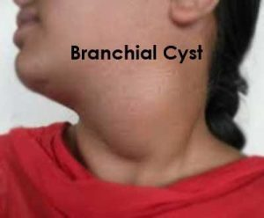
Branchial cyst
Due to failure of obliteration of 2nd, 3rd & 4th branchial clefts .

Slide 26
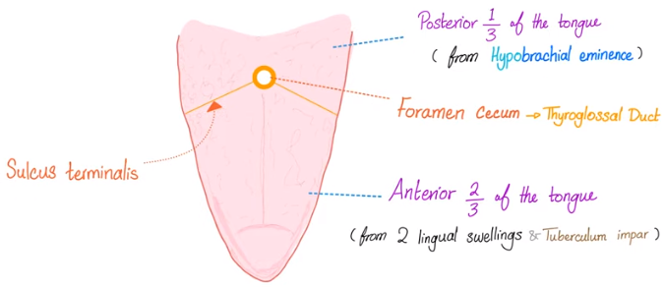
Development of Tongue

Slide 27
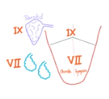
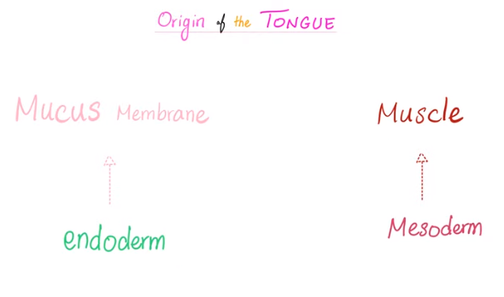

Slide 28
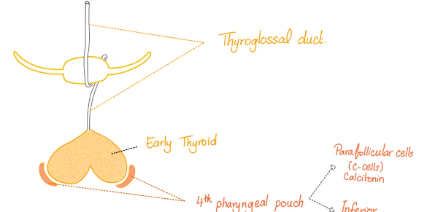
Development of THYROID GLAND

Slide 29
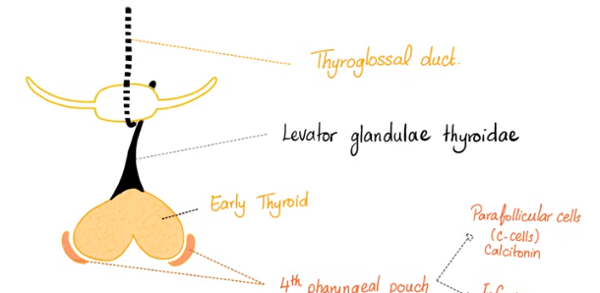
Development of THYROID GLAND

Slide 30
Thyroid gland initially arises as a midline diverticulum in the floor of the pharynx. This tissue consists of cells of endodermal origin.
This point of origin corresponds to the foramen cecum of the base of the tongue in a fully developed human.
The main portion of this cellular structure descends into the neck and develops into a bilobed solid organ. This structure becomes the thyroglossal duct, which is reabsorbed after 6 weeks of age.
The distal aspect of this path of descent may be retained as a pyramidal lobe in the adult thyroid.

Slide 31
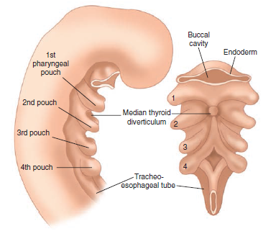

Slide 32
Calcitonin-producing C cells arise from the 4th pharyngeal pouch and migrate from the neural crest into the thyroid.
These cells migrate into the lateral and posterior upper two thirds of the thyroid lobes and are distributed among the follicles.
In adults, they remain limited to the upper and middle areas of the gland, usually in the posterior and medial aspects.
These C cells are the only component of the adult gland not of endodermal origin.

Slide 33
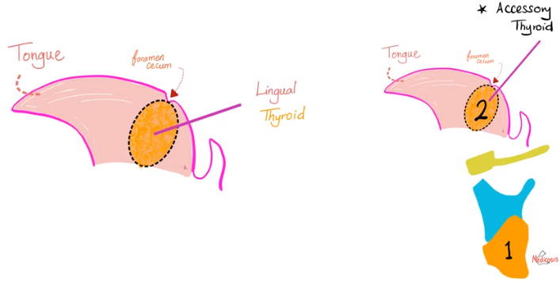
Lingual thyroid

Slide 34
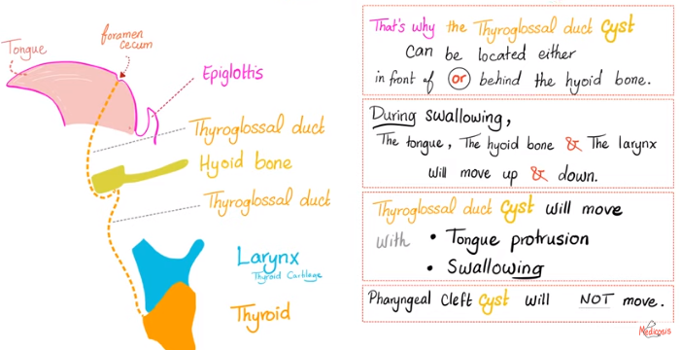
Thyroglossal duct

Slide 35
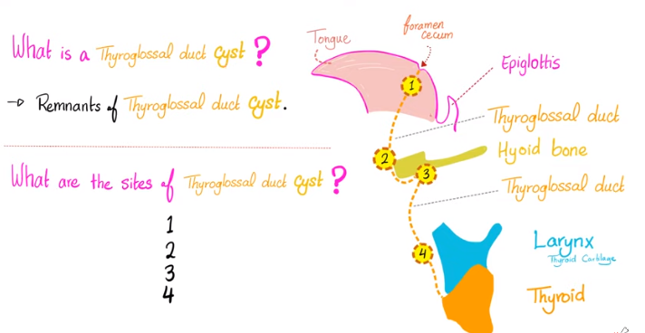

Slide 36
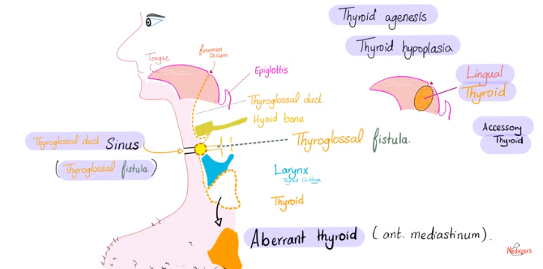
Congenital anomalies of thyroid

Slide 37
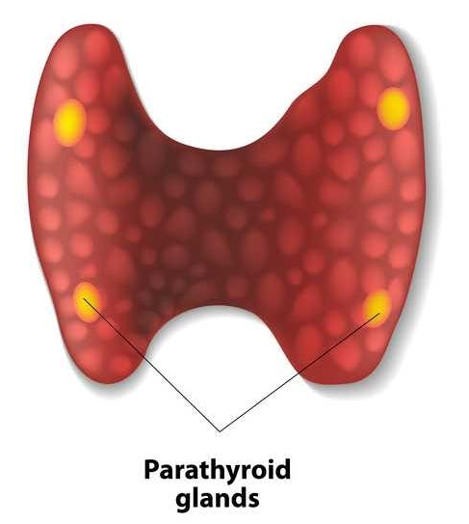
Development of PARATHYROID GLANDS
arise from endodermal epithelial cells
consist of a combination of chief and oxyphil cells, adipose tissue, and fibrovascular stroma.

Slide 38
Development of PARATHYROID GLANDS
3rd pharyngeal pouch
inferior Parathyroid glands + Thymus
4th pharyngeal pouch
superior Parathyroid glands

Slide 39
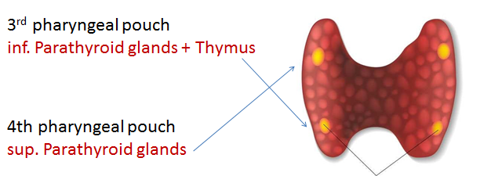
Di George’s syndrome
1. Congenital heart defects
2. Immune deficiency (thymus absence)
3. Hypocalcaemia (parathyroid absence)

Slide 40
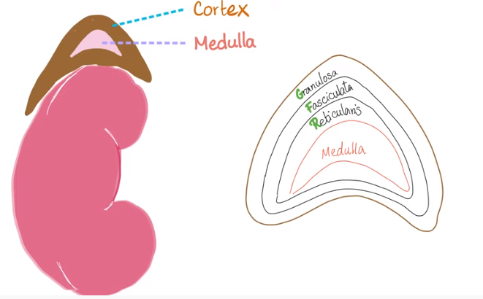
Adrenal Glands

Slide 41
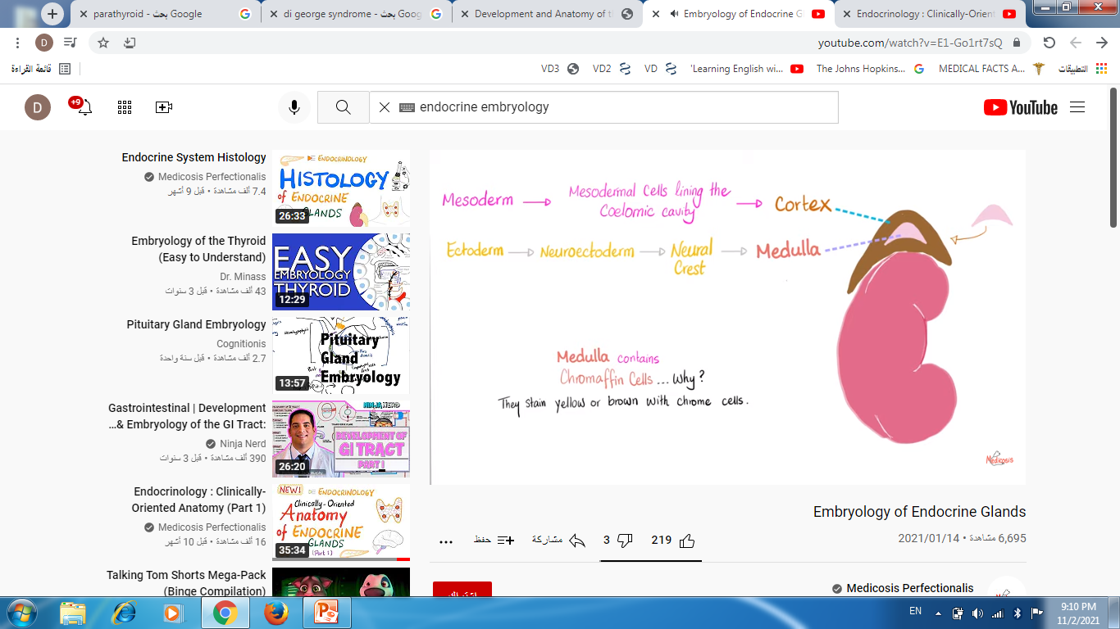
Mesoderm >> mesodermal cells lining the coelomic cavity
Ectoderm > Neuroectoderm > neural crest

Slide 42
Cortex arises from the coelomic mesodermal tissue near the cephalic end of the mesonephros during the 4th to 5th week of gestation.
Biosynthetic activity can be detected as early as the 7th week.
Cortical cell mass dominates the fetal adrenal at 4 months of development, and steroidogenesis is maximum during the third trimester.

Slide 43
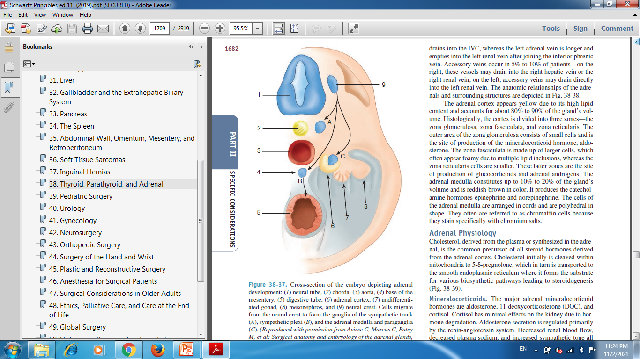

Slide 44
The adrenal medulla arises from the ectodermal tissues of the embryonic neural crest.
It develops in parallel with the sympathetic nervous system, beginning in the 5th to 6th week of gestation.
Neural crest cells migrate to paraaortic and paravertebral areas and toward the medial aspect of the developing cortex to form medulla.

