Slide 1
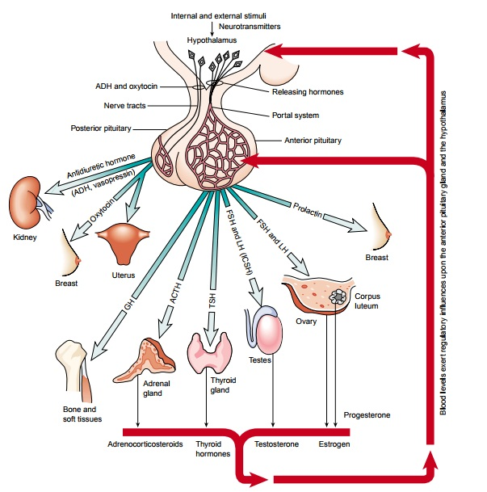
PITUITARY GLAND DISORDERS
Dr.Samaher J. Younis
BCPS

Slide 2
The peptide hormones of the anterior pituitary are essential for the regulation of growth and development, reproduction, responses to stress, and intermediary metabolism. Their synthesis and secretion are controlled by hypothalamic hormones and by hormones from the peripheral endocrine organs. A large number of disease states, as well as a diverse group of drugs, also affect their secretion. The complex interactions among the hypothalamus, pituitary, and peripheral endocrine glands provide elegant examples of integrated feedback regulation. Clinically, an improved understanding of the mechanisms that underlie these interactions provides the rationale for diagnosing and treating endocrine disorders and for predicting certain side effects of drugs that affect the endocrine system. Moreover, the elucidation of the structures of the anterior pituitary hormones and hypothalamic-releasing hormones makes it possible to produce synthetic peptide agonists and antagonists that have important diagnostic and therapeutic applications

Slide 3
The anterior pituitary hormones can be classified into three different groups based on their structural features.
Growth hormone (GH) and prolactin (PRL) belong to the somatotropic family of hormones, which in humans also includes placental lactogen.
The glycoprotein hormones—thyroid-stimulating hormone (TSH, also called thyrotropin), luteinizing hormone (LH), and follicle- stimulating hormone (FSH)—share a common α-subunit but have different β-subunits that determine their distinct biological activities. In humans, the glycoprotein hormone family also includes human chorionic gonadotropin (hCG).
Corticotropin (adrenocorticotropic hormone; ACTH) and α-melanocyte-stimulating hormone (α-MSH) are part of a family of peptides derived from pro-opiomelanocortin (POMC) by proteolytic processing.

Slide 4
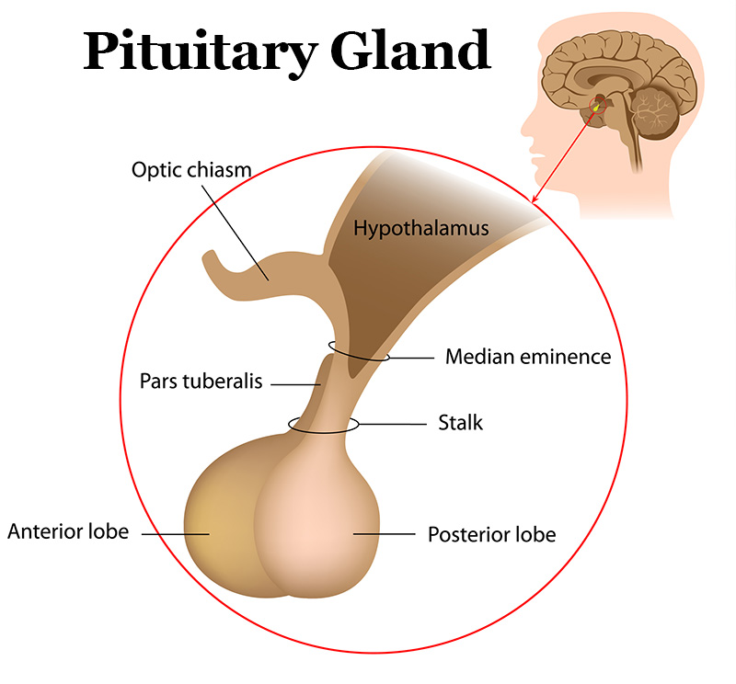
Hypothalamic regulations
The synthesis and release of anterior pituitary hormones are influenced by the central nervous system. Their secretion is positively regulated by a group of peptides referred to as hypothalamic releasing hormones, which are released from hypothalamic neurons in the region of the median eminence and reach the anterior pituitary through the hypothalamic- adenohypophyseal portal system. The hypothalamic releasing hormones include growth hormone– releasing hormone (GHRH), gonadotropin-releasing hormone (GnRH), thyrotropin-releasing hormone (TRH), and corticotropin-releasing hormone (CRH). Somatostatin (SST), another hypothalamic peptide,
negatively regulates pituitary secretion of growth
hormone and thyrotropin. The catecholamine
dopamine inhibits the secretion of prolactin by
lactotropes.

Slide 5
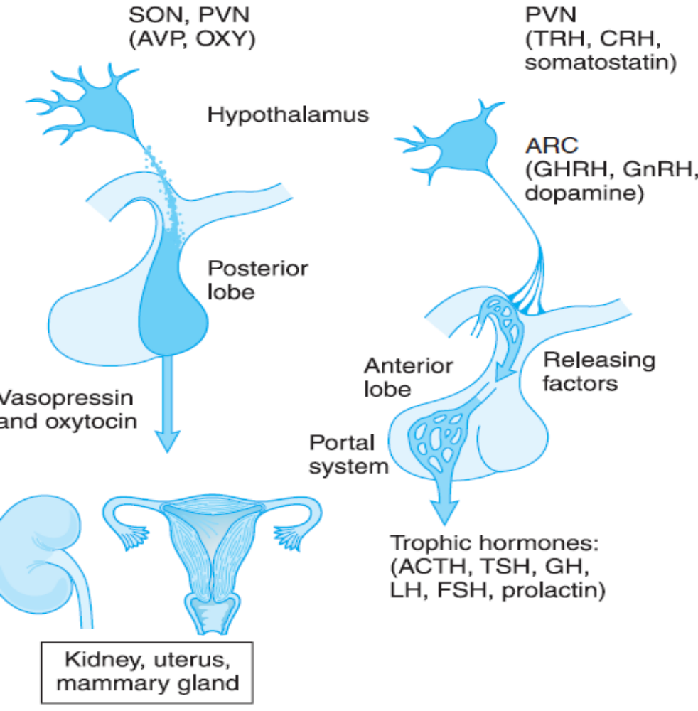
Organization of the anterior and posterior pituitary gland. Hypothalamic neurons in the supraoptic (SON) and paraventricular (PVN) nuclei synthesize arginine vasopressin (AVP) or oxytocin (OXY). Most of their axons project directly to the posterior pituitary, from which AVP and OXY are secreted into the systemic circulation to regulate their target tissues. Neurons that regulate the anterior lobe cluster in the mediobasal hypothalamus, including the PVN and the arcuate (ARC) nuclei. They secrete hypothalamic releasing hormones, which reach the anterior pituitary via the hypothalamic-adenohypophyseal portal system and stimulate distinct populations of pituitary cells. These cells, in turn, secrete the trophic hormones, which regulate endocrine organs and other tissues.

Slide 6
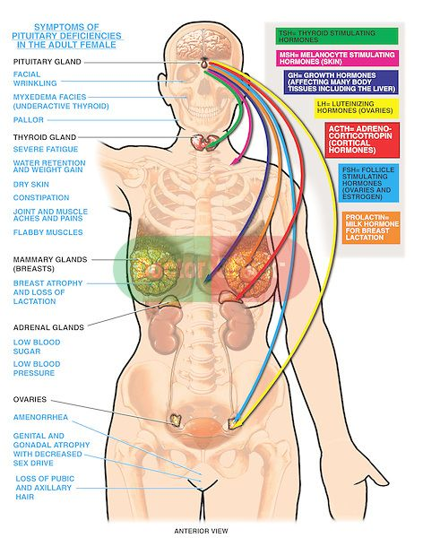
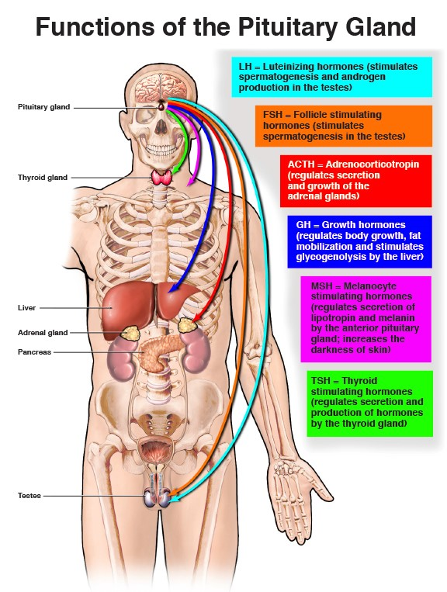

Slide 7
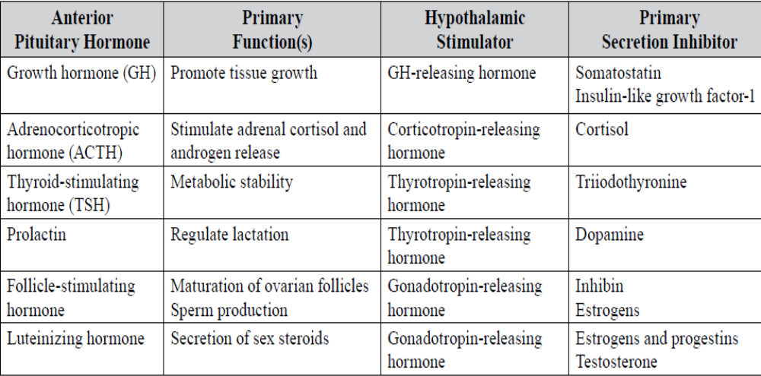

Slide 8
Classification (focus on the common anterior pituitary disorders)
1. Hypersecretory diseases
a. Acromegaly and gigantism: Usually caused by growth hormone (GH)-secreting pituitary adenoma
b. Hyperprolactinemia
i. Most common cause is prolactinomas (prolactin-secreting pituitary tumor).
ii. Drug induced (e.g., serotonin reuptake inhibitors and some antipsychotics)
iii. Central nervous system lesions
2. Hyposecretory disease
a. GH deficiency
i. Congenital abnormality caused by GH gene deletion, GH-releasing hormone deficiency
ii. Other causes are pituitary aplasia, head trauma, and central nervous system infection.
iii. Idiopathic
b. Panhypopituitarism: Result of partial or complete loss of anterior and posterior pituitary function.
Can be caused by primary pituitary tumor, ischemic necrosis of the pituitary, trauma from surgery,
or irradiation. Results in adrenocorticotropic hormone (ACTH) deficiency, GH deficiency, hypothyroidism,
gonadotropin deficiency

Slide 9
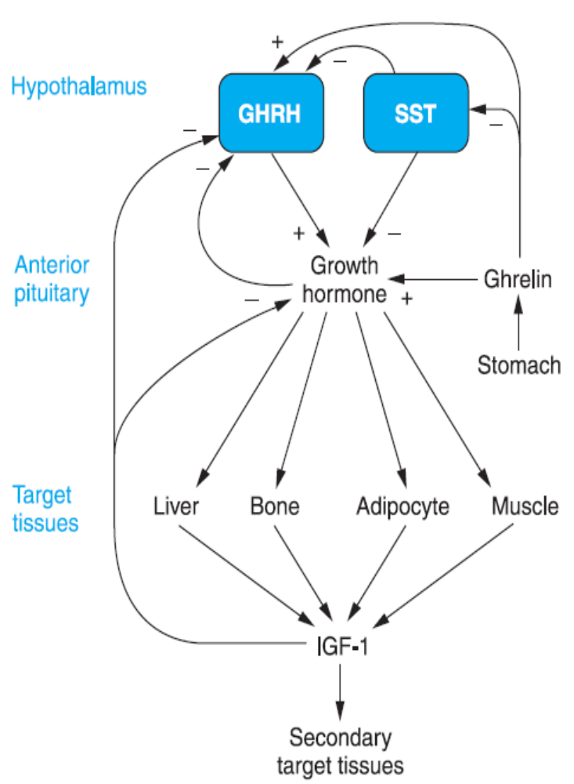
Hypersecretion of GH (Acromegaly)
Secretion and actions of growth hormone.
Two hypothalamic factors, growth hormone-releasing hormone (GHRH) and somatostatin (SST), act on the somatotropes in the anterior pituitary to regulate growth hormone secretion. SST also inhibits GHRH release. Growth hormone exerts direct effects on target tissues and indirect effects mediated by stimulating the release of insulin-like growth factor-1 (IGF-1). The gastric peptide ghrelin enhances growth hormone release, directly by actions at the anterior pituitary and indirectly by multiple actions on the hypothalamus. IGF-1 feeds back at the anterior pituitary to inhibit growth hormone secretion and also to inhibit further GHRH release by the hypothalamus.
Therapeutics
a. Treatment of choice is surgical resection of tumor, if causative.
b. Pharmacotherapy usually reserved for:
i. Control before surgery or irradiation
ii. When surgery is not possible (usually requires lifelong pharmacotherapy)
iii. Surgical failures or relapses after period of remission after surgery

Slide 10
Somatostatin is synthesized as a 92-amino-acid precursor and processed by proteolytic cleavage to generate two predominant forms: SST-14 and SST-28. The somatostatins exert their effects by binding to and activating a family of five related G protein–coupled receptors that signal through Gi to inhibit cyclic AMP accumulation and to activate K+ channels and phosphotyrosine phosphatases. Each of the SST receptor subtypes (abbreviated SSTR or sstr) binds SST with nanomolar affinity; whereas receptor types 1 to 4 (SSTR1–4) bind the two SSTs with approximately equal affinity, type 5 (SSTR5) has a ten- to fifteenfold greater selectivity for somatostatin-28. SSTR2 and SSTR5 are the most important for regulation of GH secretion. SST exerts direct effects on somatotropes in the pituitary and indirect effects mediated via GHRH neurons in the arcuate nucleus.
Ghrelin is synthesized predominantly in endocrine cells in the fundus of the stomach, but also is produced at lower levels at a number of other sites. Both fasting and hypoglycemia stimulate circulating ghrelin levels. In human beings and experimental animals, ghrelin stimulates appetite and increases food intake
Several neurotransmitters, drugs, metabolites, and other stimuli modulate the release of GHRH and/or SST and thereby affect GH secretion. 5-hydroxytryptamine, and α2 adrenergic receptor agonists stimulate GH release, as do hypoglycemia, exercise, stress, emotional excitement, and ingestion of protein-rich meals. In contrast, β adrenergic receptor agonists, free fatty acids, insulin-like growth factor- 1 (IGF-1), and GH itself inhibit release, as does the administration of glucose to normal subjects in an oral glucose tolerance test. These observations form the basis for provocative tests to assess the ability of the pituitary to secrete GH. Provocative stimuli include arginine, glucagon, insulin-induced hypoglycemia, clonidine, these agents all increase circulating GH levels in normal subjects within 45 to 90 minutes. At present, insulin-induced hypoglycemia is preferred by some authorities, whereas the FDA recommends two independent tests of GH deficiency to establish the diagnosis. When excess GH secretion is suspected, the failure of an oral glucose load to suppress GH is diagnostically useful. Finally, GH secretion in response to GHRH can be used to distinguish pituitary disease from hypothalamic disease.

Slide 11
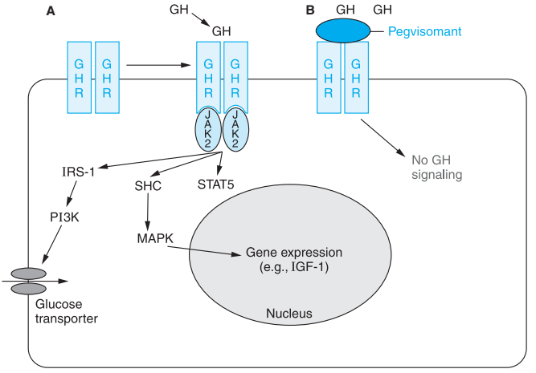
Mechanisms of growth hormone and prolactin action and of GH receptor antagonism. A. The binding of GH to
two molecules of the growth hormone receptor (GHR) induces autophosphorylation of JAK2. JAK2 then phosphorylates cytoplasmic proteins that activate downstream signaling pathways, including signal transducer and activator of transcription (Stat)5 and mediators upstream of mitogen-activated protein kinase (MAPK), which ultimately modulate gene expression. The structurally related prolactin receptor also is a ligand-activated homodimer that recruits the JAK-Stat signaling pathway. The GHR also activates the insulin receptor substrate-1 (IRS-1), which may mediate the increased expression of glucose transporters on the plasma
membrane. The diagram does not reflect the localization of the intracellular molecules, which presumably exist in multicomponent signaling complexes. B. Pegvisomant, a recombinant pegylated variant of human GH, contains mutations that increase the affinity for the GHR but do not activate downstream signaling by the GHR. It thus interferes with GH signaling in target tissues. JAK2, Janus
kinase 2; IRS-1, insulin receptor substrate-1; PI3K, phosphatidyl inositol-3 kinase; STAT, signal transducer and activator of transcription; MAPK, mitogen-activated protein kinase; SHC, Src homology containing.

Slide 12
ACROMEGALY
Diagnosis and clinical presentation
a. Failure of an oral glucose tolerance test (OGTT) to suppress GH serum concentrations but with elevated IGF-1 (GH serum concentrations alone are unreliable, given the pulsatile pattern of release in the body.)
Clinical presentation (Note that the disease has a slow onset, and many symptoms do not appear for years.)
i. Excessive sweating
ii. Osteoarthritis, joint pain, paresthesias, or neuropathies
iii. Coarsening of facial features
iv. Increased hand volume or ring size, increased shoe size
v. Hypertension, heart disease, cardiomyopathy
vi. Sleep apnea
vii. T2D
Therapy goals
a. Reduce GH and IGF-1 concentrations
b. Decrease mortality
c. Improve clinical symptoms
d. Normalize IGF-1 concentrations and suppressed GH concentrations after OGTT

Slide 13
Dopamine agonists (e.g., bromocriptine, cabergoline)
i. Mechanism of action: Dopamine agonist that, in acromegaly, causes paradoxical decrease in GH production
ii. Dosing (bromocriptine is most commonly used agent)
(a) Initial: 1.25 mg/day by mouth
(b) Maximal: 20–30 mg/day (can titrate once or twice weekly, as needed)
iii. Adverse effects
(a) Fatigue, dizziness, nervousness
(b) Diarrhea, abdominal pain
iv. Efficacy: Normalization of IGF-1 concentrations in about 10% of patients. More than 50% of patients experience symptomatic relief.

Slide 14
Somatostatin analog (e.g., octreotide, Lanreotide )
Mechanism of action: an 8-amino-acid synthetic derivative of somatostatin that has a longer half-life and binds preferentially to SSTR-2 and SSTR-5 receptors. Blocks GH secretion; 40 times more potent than endogenous somatostatin.
Dosing
(a) Initial: 50–100 mcg subcutaneously every 8 hours or 20 mg orally twice daily (Oral use is typically reserved for patients who require long-term maintenance and have responded to injectable octreotide)
(b) Maximal: Little benefit greater than 600 mcg/day or 80 mg daily with oral administration
(c) Bioactivity is virtually 100%, peak effects are seen within 30 minutes, serum half-life is approximately 90 minutes, and duration of action is approximately 12 hours.
(d) If response is adequate, can be changed to long-acting octreotide formulation administered once monthly(sandostatin LAR)
(e) Orally with a glass of water on an empty stomach at least 1 hour before a meal or at least 2 hours after a meal
Adverse effects
(a) Diarrhea, nausea, cramps, flatulence, fat malabsorption
(b) Arrhythmias
(c) Hypothyroidism
(d) Biliary tract disorders
(e) Changes in serum glucose concentrations (usually reduces)
iv. Efficacy: 50%–60% of patients experience normalization of IGF-1 concentrations with good
symptomatic relief as well. May shrink tumor mass in some patients

Slide 15
GH receptor antagonist (e.g., pegvisomant)
i. Mechanism of action: GH derivative binds to liver GH receptors and inhibits IGF-1
ii. Dosing
(a) Initial: 40 mg once-daily subcutaneous injection loading dose and then 10 mg once daily
(b) Maximal: 30 mg/day
iii. Adverse effects
(a) Nausea, vomiting
(b) Flulike symptoms
(c) Reversible elevations in hepatic transaminase
iv. Efficacy: More than 95% of patients attain normal IGF-1 concentrations, and most have improved symptoms.

Slide 16
GH DEFICIENCY
Treatment of Growth Hormone Deficiency.
Humans do not respond to GH from nonprimate species. GH for therapeutic use formerly was purified from human cadaver pituitaries and thus was available in very limited quantities and carried the risk of Creutzfeldt-Jakob disease.
The production of human GH by recombinant DNA technology not only increased availability of the hormone, but also eliminated the risk of disease transmission associated with the pituitary-derived hormone.
GH is used for replacement therapy in GH-deficient children, whether the deficiency is congenital or acquired. By convention, somatropin refers to the many GH preparations whose sequences match that of native GH.
To mimic the normal pattern of secretion, they typically are administered to GH-deficient children in a dose of 40 μg/kg per day subcutaneously in the evening; although the circulating half-life of GH is only 20 minutes, its biological half-life is in the range of 9 to 17 hours, and once-daily administration is sufficient. Higher daily doses (e.g., 50 μg/kg) are employed for patients with Turner’s syndrome, who have partial GH resistance. In children with overt GH deficiency, measurements of serum IGF-1 levels are used to monitor initial response and compliance; long-term response is monitored by close evaluation of height, sometimes in conjunction with measurements of serum IGF-1 levels.
Once- or twice-monthly long-acting depot formulation is also available.

Slide 17
Hyperprolactinemia
Therapy goals
a. Normalize prolactin concentrations
b. Normalize gonadotropin secretion
c. Relieve symptoms
4. Therapeutics
a. Surgical resection of tumor, if tumor is very large, causes severe compression of adjacent tissues, or patient does not respond to pharmacotherapy
ii. When surgery is not possible (usually requires lifelong pharmacotherapy)
iii. Surgical failures or relapses after period of remission after surgery(Pharmacotherapy)
c. Discontinue causative agent if drug induced.
i. Recheck prolactin concentration 3 days after discontinuation.
ii. Select agent with similar action but no known effect on prolactin concentrations.
iii. If discontinuation of causative agent not feasible, consider dopamine agonist
Causes
a. Direct: Pituitary tumor (lactotroph adenoma = prolactinoma accounting for around 40% of tumors)
b. Indirect: Drug induced (most common nontumor cause), renal failure, hypothyroidism, breastfeeding
c. Potential causative drugs: Typical antipsychotics, opiates, non-dihydropyridine calcium channel blockers, antidepressants
2. Diagnosis and clinical presentation
a. Elevated serum prolactin concentrations; may be challenging to find specific cause (unless drug induced)
b. Clinical presentation
i. Amenorrhea, anovulation, infertility, hirsutism, and acne in women
ii. Erectile dysfunction, decreased libido, gynecomastia, and reduced muscle mass in men
iii. Headache, visual disturbances, bone loss

Slide 18
Dopamine agonists(preferred to surgery in most cases)
Cabergoline (preferred agent according to the Endocrine Society guidelines, long-acting oral
agent; adverse effect profile similar to that for bromocriptine but fewer gastrointestinal [GI] adverse effects)
(a) Initial: 0.5 mg once weekly
(b) Maximal: 4.5 mg/week
Bromocriptine (see previous text)
Efficacy: May restore fertility in more than 90% of women. Cabergoline may be easier for patients to take, given its weekly administration.
Consider tapering or discontinuing after 2 years of therapy if asymptomatic, prolactin concentrations normalized, and no tumor remnant by imagery

