Slide 1
Immunologic endocrine diseases
Malak Alshaikhali
MD, Al-Quds University
MSc Integrated Immunology, University Of Oxford.

Slide 2
Learning outcomes
Understand autoimmune disease of the pancreas.
Understand autoimmune disease of thyroid gland and parathyroid.
Understand autoimmune disease of the adrenal gland.
Understand autoimmune disease of other glands: pituitary and the ovaries.
Understand autoimmune polygandular syndromes.

Slide 3
Endocrine glands
Endocrine cells may be localized in a defined glandular organ such as the pancreas (islet cells) or in other glands such as adrenal gland, thyroid gland and the pituitary gland.
Others may be distributed throughout a non-endocrine gland such as the stomach.

Slide 4
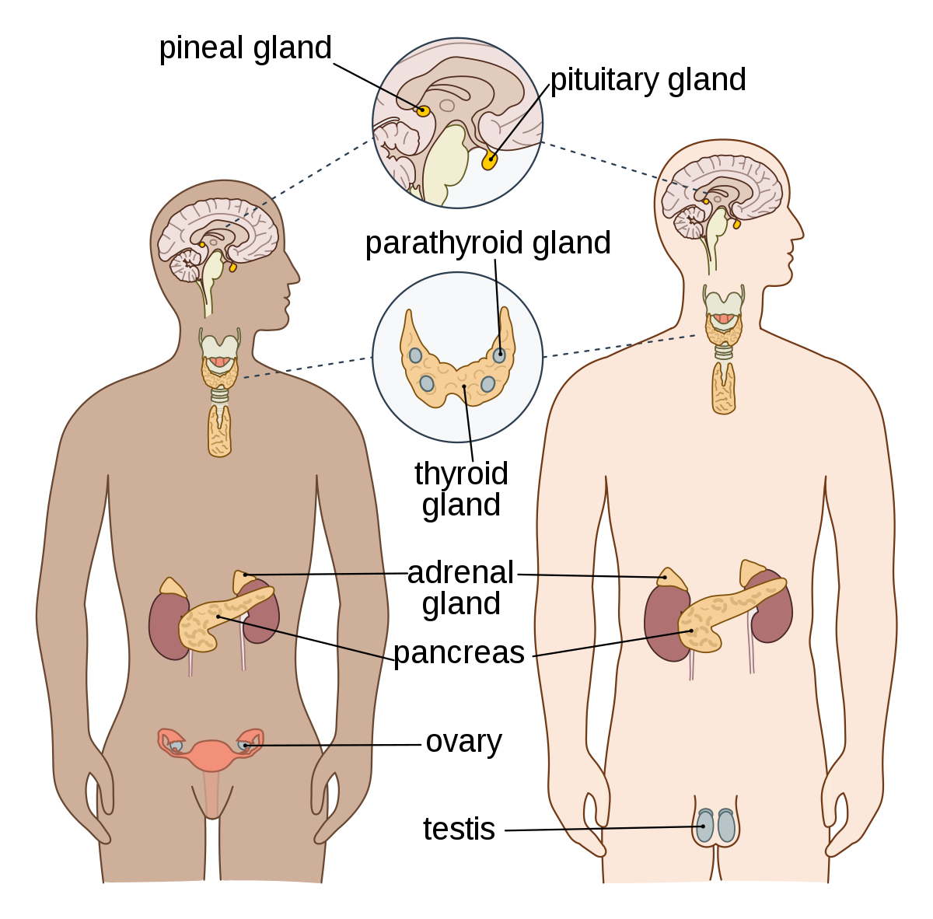
Endocrine glands

Slide 5
Endocrine glands
Functional disorders of the endocrine gland may result from over-activity of the glands or atrophy.
Over-activity results in overproduction of a given hormone.
Atrophy is a failure to produce the hormone.
The endocrine system is affected by several autoimmune diseasesـــ the impact and severity is different according to the organs involved.

Slide 6
Endocrine glands
Autoimmune thyroid disorders (i.e. Hashimoto’s thyroiditis and Graves’ disease) and type 1 DM are the most common autoimmune endocrine disorders.
Pathophysiology comprises a complex interplay of genetic predisposition and environmental/ endogenous factors.
Autoimmune diseases are the result of a failure of T- and B-cell tolerance to self-antigensـــ this causes cellular and humoral immune responses that specifically target the affected tissue.

Slide 7
Endocrine autoimmunity
The breakdown of immunological self-tolerance leads to a cascade of events:
Presentation of host antigens.
Activation and expansion of autoreactive T cells.
Release of pro-inflammatory cytokines.
Differentiation of self-reactive B cells with production of organ-specific autoantibodies.
These events are responsible for the classic tissue damage observed in autoimmune diseases, leading to dysfunction of the target organ.
Notes:
these events are responsible for the classic tissue damage observed in
autoimmune diseases, leading to dysfunction of the target organ.

Slide 8
Mechanisms of autoimmune tissue injury
Tissue damage in autoimmune diseases can occur through several mechanisms, which are analogous to three of the classical types of hypersensitivity reactions:
Type II: caused by antibodies against altered self proteins e.g. Graves disease.
Type III: caused by immune complexes (antigen-antibody complexes).
Type IV: delayed-type hypersensitivity, mediated by T cells e.g. IDDM and Hashimoto disease.

Slide 9
Autoimmune disease of the pancreas: Diabetes Mellitus
Previously referred to as insulin-dependent diabetes mellitus (IDDM) or juvenile onset diabetes mellitus.
The new term is type 1 DM: type 1A for immune-mediated diabetes.
Non–immune-mediated diabetes with severe insulin deficiency is termed type 1B.

Slide 10
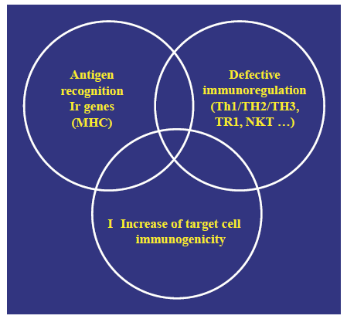
Diabetes Mellitus: Etiology

Slide 11
Diabetes Mellitus: Etiology
Like most other autoimmune diseases, IDDM is multifactorialـــ interaction of genetic and environmental factors.
IDDM has a strong hereditary component: mainly related to MHC genes.
HLA-predisposing genes: HLA DR3 and DR4 or DQA&B haplotypes.
Environmental triggers: pancreatotropic viruses e.g. Coxsackie B4, ?Cow’s milk proteins.
Environmental factors can also be protective: hygiene hypothesis.

Slide 12
Diabetes Mellitus: Pathophysiology
Type 1 diabetes develops due to destruction of pancreatic β cells.
Type 1A disease of autoimmune etiology includes: the slow-progressing insulin-dependent DM (SPIDDM) and the rapid onset type, which is typical of conventional IDDM.
In both forms of type 1A, the anti-islet autoantibody is detectedـــ but not in type 1B.
Notes:
SPIDDM is a disease form that presents clinical features close to type 2 diabetes
mellitus but progresses over several years with depression of pancreatic cell function and
ultimately into an insulin-dependent status.

Slide 13
Diabetes Mellitus: Pathophysiology
There is selective destruction of β cellsـــ other islet cells, glucagon-producing cells, remain intact.
The β-cell destruction is due to apoptosis ـــ free radicals and cytokines mediated.
There is initial phase of peripheral insulitis that progress to aggressive β cells destruction.
Notes:
.

Slide 14
Diabetes Mellitus: Pathophysiology
The inflammation is T-cell-mediated: CD4+&CD8+ T cells specific to various β-cell autoantigens (insulin, GAD, IA.2, tyrosine phosphatase).
CD4+ T cells also have direct diabetogenic action through cytokine release.
No role for islet-specific autoantibodies, or for B cells in the pathogenesis of the disease.
Notes:
GAD glutamic acid decarboxylase
IA2 insulinoma- associated-autoantigen 2

Slide 15
Clinical features
There are no symptoms specific to type 1 DM.
Symptoms: weight loss, polyuria and thirst due to marked hyperglycemia.
Patients are prone to diabetic coma.
Some patients develop common cold-like symptoms such as upper abdominal pain, fever, and headache before the onset of diabetes mellitus.

Slide 16
Laboratory findings
(1) Routine tests: blood glucose, HbA1c.
(2) Endocrine tests: serum and urinary C peptide levels are lowered due to depressed insulin secretory function (not with SPIDDM).
(3) Immunological tests: Patients are positive for a variety of anti-islet autoantibody such as anti-GAD antibody, anti-insulin autoantibody (IAA), and IA-2 antibody.
Patients often possess HLA-DR4 or -DR9 and are negative for HLA-DR2.

Slide 17
Diagnosis & treatment
Diagnostic criteria for DM: blood sugar and HbA1c
The presence of pancreatic autoantibodies: at least one type in 90% of individuals affected present at diagnosis.
Anti-GAD antibody can be measured routinely and must be determined positively when type 1 diabetes mellitus is suspected.
Treatment: insulin replacement.
Screening for other autoimmune diseases e.g. HT and Celiac disease.

Slide 18
Autoimmune thyroid diseases: Graves disease
Graves’ disease Graves’ disease is an organ-specific autoimmune disease of the thyroid mediated by stimulatory (agonistic) autoantibodies.
Autoantibodies to the thyroid-stimulating hormone receptor (TSHR) cause hyperthyroidism in patients with Graves’ disease.
TSAb bind to and activate the TSH receptor on thyroid cells.
Notes:
GD is defined as a form of hyperthyroidism associated with a diffuse hyperplastic goiter, resulting from the stimulation of the TSH receptor (TSHR) by a TSHR autoantibody, known as thyroid stimulating antibody (TSAb).

Slide 19
Graves disease
GD can present as an isolated disorder or as an overlap disorder with thyroiditis.
It affects the eyes (Graves’ ophthalmopathy) and the skin (localized dermopathy or myxedema), cause??
Exophthalmos and pretibial myxedema cannot be explained by excess thyroid hormones ــــ considered to be due to the reactions of antibody to TSH receptors in adipocytes.

Slide 20
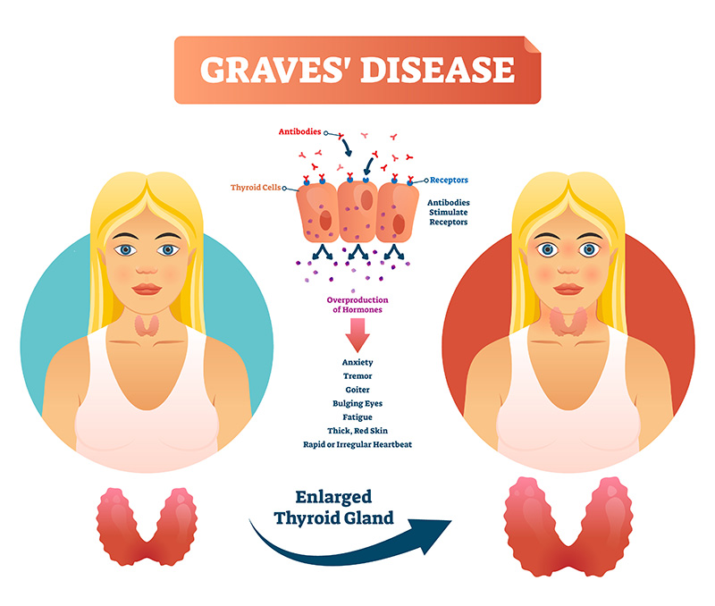

Slide 21
Graves disease: Pathogenesis
GD occur in genetically susceptible individuals.
More in females.
HLA genes involved: HLA-DR3 and HLA DQA1.
The anti-TSHR autoantibodies are pathogenic.
They inhibit binding of TSH to its receptor by binding to TSHRــــ they stimulate TSHR signaling, causing increased production of thyroid hormone.
Notes:
The pathogenicity of anti-TSHR autoantibodies is demonstrated by the occurrence of neonatal Graves’ disease after passive transplacental transfer of IgG thyroid-stimulating autoantibodies from a mother with Graves’ disease to the fetus.

Slide 22
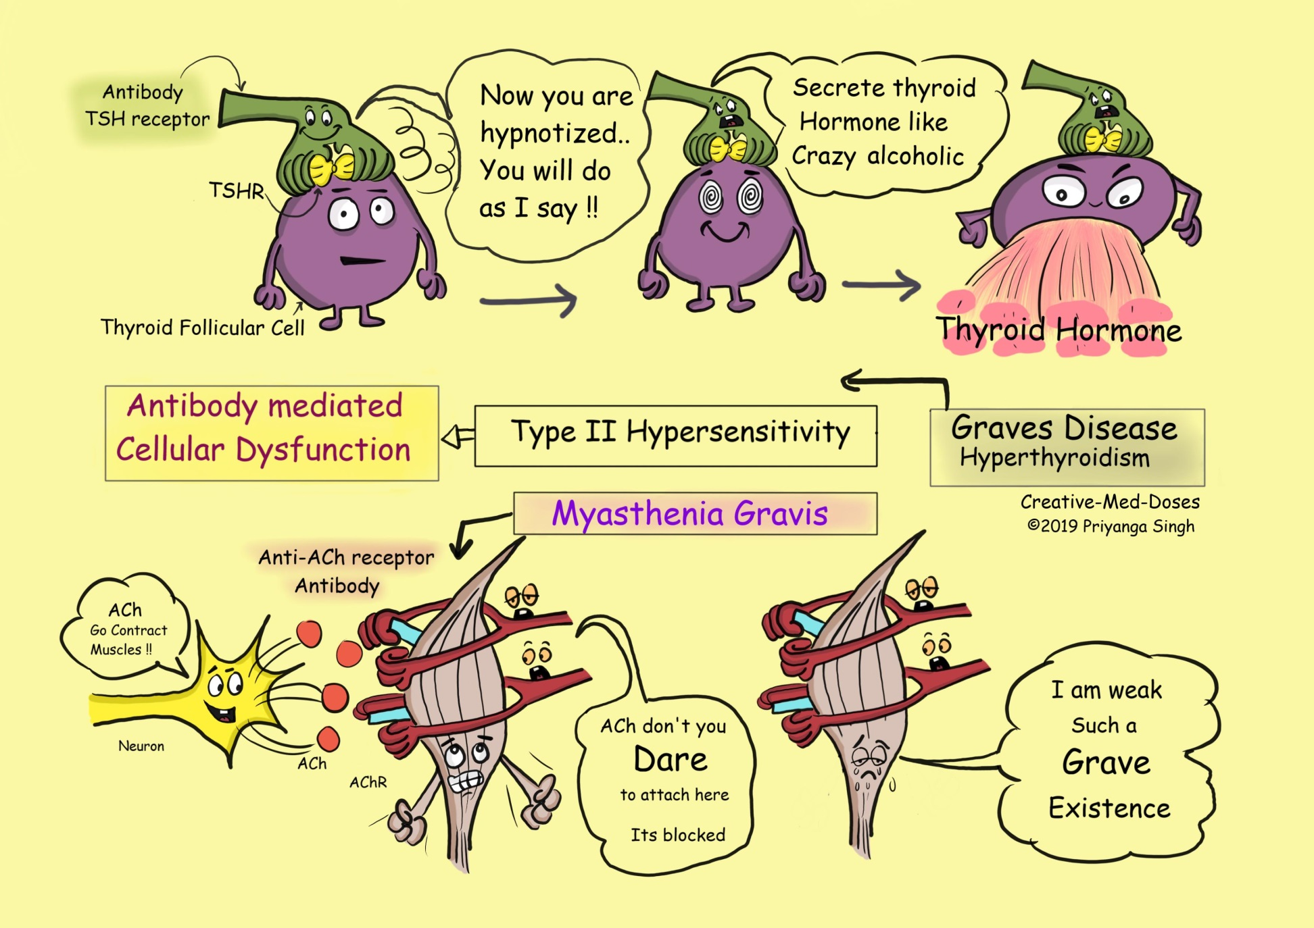

Slide 23
Pathogenesis
Thyroid autoantibodies develop by sensitization to a number of thyroid antigens in thyroid tissue ـــthyroid peroxidase, TSHR, thyroglobulin, and the sodium-iodide cotransporter.
The production of TSAb depends on T cells that recognize multiple epitopes of the TSHR.
Autoantibodies can be stimulating, inhibitory or blocking.
Clinical hyperthyroidism develops if TSAb predominates in the circulation.
Notes:
TSAb Thyroid stimulating antibodies.

Slide 24
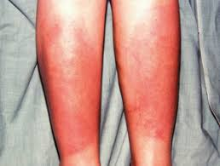
Clinical features
Merseburg’s triad: palpitations, Goiter, and exophthalmos.
Physical findings include:
diffuse throid enlargement.
ocular symptoms: exophthalmos, lid lag
tachycardia and atrial fibrillation
(4) warm moist skin
(5) Tremors
(6) pretibial myxedema.

Slide 25
Laboratory findings
Endocrine tests: Low serum TSH level and increased free T3 and free T4, elevated radioactive iodine uptake.
Immunological tests: Patients are positive for anti-TSH receptor antibody or thyroid stimulating antibody (TSAb).
Imaging diagnosis: USS shows diffuse enlargement of the thyroid.

Slide 26
Diagnosis & Treatment
Diagnosis clinical and biochemical appearance of hyperthyroidism + positivity of TSHR antibodies (TRAb, 99% sensitivity and specifity).
Treatment:
Antithyroid drugs: methimazole, propylthiouracil
Radioactive iodine therapy: if drugs cannot be used or no response to them.
Subtotal thyroidectomy: for refractory juvenile cases with notable enlargement of the thyroid

Slide 27
Autoimmune thyroid diseases: Hashimoto’s Disease
Hashimoto thyroiditis (HT) is an organ-specific chronic progressive autoimmune thyroiditis that affect middle-aged women.
Differentiated from transient thyroiditis syndromes associated with postpartum disease, de Quervain thyroiditis, by the presence of high-titer antithyroid antibodies and clinical presentation (persistent).

Slide 28
Hashimoto’s Disease: Pathogenesis
Thyroiditis occur in genetically susceptible populations.
Environmental triggers: some viruses are thought to induce autoimmunity in the thyroid, e.g. the human T-cell lymphotropic virus type 1.
T cells play a critical role in the development of HT, interacting with thyroid follicular cells and extracellular matrix.

Slide 29
Pathogenesis
T cells may destroy thyroid tissue by direct cytotoxicity or indirectly by cytokine secretion e.g IL-1β, IL-6,IL-2, IL- 8, and IL-10.
Most patients with autoimmune hypothyroidism caused by HT have serum antibodies to thyroglobulin (TG) and thyroid peroxidase (TPO) and occasionally to the TSHR.

Slide 30
Pathogenesis
Thyroglobulin antibody positivity alone is not sufficient to cause thyroid dysfunction, ??role in disease perpetuation??
Thyroid peroxidase is a major autoantigen, and autoantibodies to TPO are closely associated with disease activity.
It is not clear whether immune responses to these autoantigens initiate thyroiditis or if they are secondary to thyroid destruction.

Slide 31
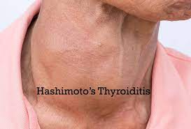
Clinical features
Firm diffuse enlargement of the thyroid.
Thyroid hypofunction.
Signs and symptoms of hypothyroidism: weight gain, cold sensitivity, hoarseness, bradycardia.

Slide 32
Laboratory findings
Endocrine tests: Serum free T3 and free T4 are lowered and TSH is elevated.
Immunological tests: Patients are positive for anti-thyroid peroxidase (TPO) antibody and for anti-thyroglobulin (TG) antibody.

Slide 33
Diagnosis & Treatment
Diagnosis: primary hypothyroidism without any other cause+ positive autoantibodies, anti-thyroperoxidase (TPO-Ab) and anti-thyroglobulin (Tg-Ab).
TPO-Abs are present in 95% of affected patients: considered the best serological marker for diagnosis (most sensitive and specific).
Treatment: thyroid hormone replacement.
Notes:
]

Slide 34
Autoimmune disease of the adrenal gland: Addison’s disease
Addison’s disease is a chronic disorder of the adrenal cortex, characterized by deficient production of adrenocortical hormones together with increased secretion of pituitary adrenocorticotrophic hormone (ACTH).
Causes:
Autoimmune : idiopathic, most common cause of primary adrenal failure in developed countries.
Infections: TB, 2nd most common cause
Metastatic Tumors
Drugs.
Notes:
TB tuberculosis
In developed countries, the most common cause of primary adrenal failure is autoimmunity (75% to 80% of the cases of adrenal insufficiency), whereas TB is the 2nd most frequent cause.

Slide 35
Addison’s disease
Autoimmune Addison’s disease (AAD) can present in three main clinical forms:
As part of autoimmune polyendocrine syndrome type1 & type2 (APS-1&2).
As an isolated disease.
More than half of patients with AAD have other autoimmune disorders: e.g. 10% of patients with AAD have type I DM.
Notes:
Approximately 50% to 60% of patients with autoimmune Addison’s disease (AAD) have
during their lifetime other autoimmune disorders. AAD can present in three main clinical forms: autoimmune polyendocrine
syndrome type 1 (APS-1), autoimmune polyendocrine syndrome type 2 (APS-2), and as an isolated disease.

Slide 36
Addison’s disease: Pathogenesis
AD is caused by destruction of the adrenal cortices resulting in chronic adrenocortical insufficiency.
There is major association is with HLA B8 and DR3, and HLA-DR4 haplotypes.
Characterized by the presence of antibodies to the adrenal cortex enzyme 21-hydroxylase ــــfound in more than 90% of recent onset cases.
The role of autoantibodies in the pathogenesis of AAD is unclearـــ clinically useful because they have a high diagnostic accuracy.

Slide 37
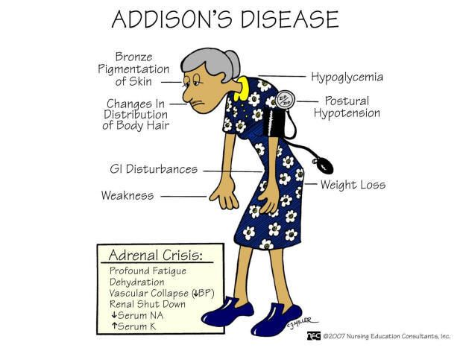
Clinical features
Hyperpigmentation due to increased secretion of ACTH is a characteristic clinical feature.
Aldosterone-cortisol-adrenal androgen deficit symptoms are also noted.

Slide 38
Laboratory findings
Routine tests: Hypoglycemia, hyponatremia, hyperkalemia, and peripheral blood eosinophilia.
Endocrine tests: Diagnostic findings include elevated plasma ACTH, low plasma and urine cortisol levels, low plasma aldosterone, and no or low plasma cortisol in the rapid ACTH test.
Immunological tests: Autoantibodies recognizing steroid-synthesizing enzymes.

Slide 39
Diagnosis and treatment
AAD is diagnosed by measurement of serum morning cortisol+ ACTH level and ACTH stimulation test.
Measurement of 21-hydroxylase autoantibodies: usually present>90% of AAD cases.
Treatment: lifelong oral hydrocortisone and fludrocortisone replacement.
Patients’ need life-long evaluation for other autoimmune diseases.

Slide 40
Autoimmune parathyroid disease: Idiopathic hypoparathyroidism.
Idiopathic hypoparathyroidism (IH) results from deficient parathyroid hormone (PTH) secretion without an identifiable cause.
An autoimmune cause for IH has been suggested because of its association with other autoimmune conditions.
It can happen as a component of APS-1 or sporadically ـــmost often in women affected by HT.

Slide 41
Idiopathic hypoparathyroidism: Pathogenesis
Autoantibodies to the parathyroid glands mitochondrial antigens were detected: not specific.
The function of the parathyroid antibodies is that they inhibit the secretion of PTH by binding to the cell surfaces of human parathyroid cells.
Antibodies to the calcium sensing receptor were also detected.

Slide 42
Idiopathic hypoparathyroidism
Clinical manifestations are related to hypocalcaemia: Positive Chvostek’s /Trousseau’s signs, muscle cramps, tetany, fatigue, anxiety.
Diagnosis: low calcium levels, elevated serum phosphorus levels, and low/absent PTH.
Specific autoantibodies testing if autoimmune form is suspected and search for the associated diseases if an APS is suspected.
Treatment: calcium and vit D supplementation

Slide 43
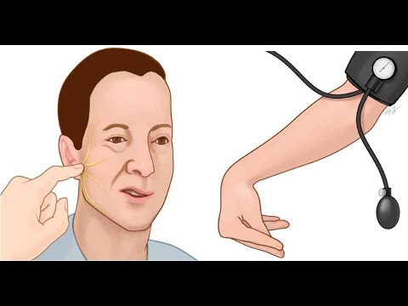
Chvostek’s &Trousseau’s signs
Notes:
Chvostek's sign twitching of facial muscles in response to tapping over the facial nerve.
Trousseau's sign carpopedal spasm induced by pressure applied to the arm by an inflated sphygmomanometer cuff

Slide 44
Premature ovarian failure POF
This is a condition of ovarian failure that occurs before or after puberty.
POF is defined as amenorrhea, elevated gonadotropin levels, and hypoestrogenism before age 40 years.
The incidence of POF is approximately 1%.
There is association of POF with several autoimmune conditions.

Slide 45
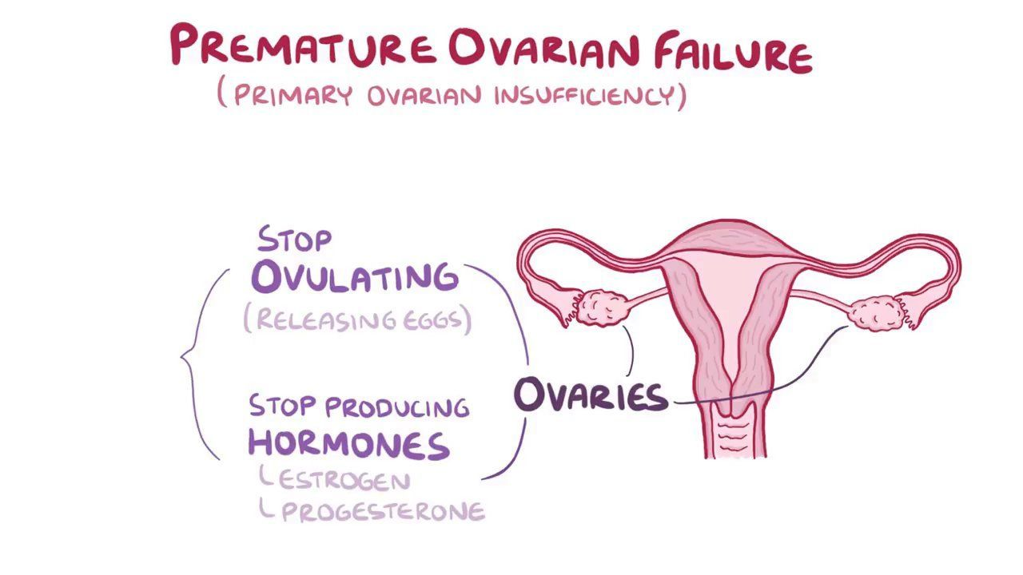

Slide 46
Premature ovarian failure POF
Two distinct clinical scenarios can be identified with this condition:
First: Idiopathic POF with adrenal autoimmunity.
About 25% of women with AAD have amenorrhea, and 10% have ovarian failure.
Proposed mechanism: Steroid cell autoantibodies in AAD cross-react with the theca internal/granulosa layers of the ovarian folliclesــــ its presence is a marker for the association of Addison’s disease and ovarian failure.
Immunologic findings in steroid cell autoantibody–positive ovarian failure: Lymphocytic oophoritis, T cells invasion.
Notes:
Patients with steroid cell autoantibody–positive Addison’s
disease without ovarian failure are at high risk of developing ovarian failure, although the latency period can
be long. Lymphocytic oophoritis is a consistent finding in patients with steroid cell autoantibody–positive ovarian
failure, supporting the autoimmune nature of idiopathic ovarian failure. The expression of MHC class II on granulosa
cells of patients with ovarian failure may allow T lymphocytes to potentiate a local autoimmune response.

Slide 47
Premature ovarian failure POF
Second: Idiopathic POF with exclusive manifestations of ovarian autoimmunity.
The great majority (90% to 98%) of women with ovarian failure neither have Addison’s disease nor steroid cell autoantibodies.
Lymphocytic infiltration is absent.
14% have thyroid autoimmunity.
Ovarian follicles remainــــ patients have resistant ovary syndrome that is insensitive to ovulation induction with exogenous gonadotrophins

Slide 48
Clinical features

Slide 49
Treatment
Autoimmune ovarian failure is a waxing and waning disease susceptible to spontaneous remissions and occasional conceptions.
Screening for other autoimmune endocrinopathies (eg, Addison’s disease, thyroid autoimmunity, pernicious anemia) should be considered in patients with idiopathic POF.
Ovum donation is the treatment of choice for infertility.

Slide 50
Autoimmune polyendocrine syndromes APS
The autoimmune polyendocrine syndromes are a group of autoimmune disorders characterized by multiple autoimmune disorders, including endocrine gland failure or hyperactivity (eg, Graves’ disease).
Characterized by the coexistence of at least two glandular autoimmune mediated diseases.

Slide 51
Autoimmune polyendocrine syndromes APS
They comprise a wide spectrum of autoimmune disorders and are divided into :
Very rare juvenile (APS type I)
Relatively common adult type (APS II)
Without adrenal failure type (APS III)
Notes:
In APS, several organ-specific autoimmune diseases are clustered. Although PAS I is caused by loss of central
tolerance, the precise aetiology of PAS II is unknown.

Slide 52
APS: Pathogenesis
Cell-mediated immune processes play an important role in the immunopathogenesis of APS.
Lymphocyte infiltrations of the various glands are associated with functional loss of epithelial cells with scarring.
The cellular defect in APS may be associated with abnormal balances in cytokine production by T-cells.
Notes:
A polarized Th2 response is associated with Graves’ disease (GD) and Th1 with T1DM.

Slide 53
APS: Pathogenesis
APS I results from biased Th2 immune responses to self-antigens and defective protective Th1 responses against invasion of yeast Candida albicans.
A dominance of T-helper cells and a deficiency of T suppressor cells is seen in endocrine autoimmunity

Slide 54
APS: Immunogenesis
A hypothesis for the pathogenesis of APS is as follows: mainly APS I
A genetically predisposed person might develop an autoimmune process after initiation by an infectious agent.
This might initiate a TH2-dependent immune process which is primarily of humoral origin and partly local.
This immune process becomes chronic due to deficient T-suppressor cell activity.

Slide 55
Autoimmune polyendocrine syndrome type 1
The major components of APS-1 are chronic mucocutaneous candidiasis, hypoparathyroidism, and autoimmune adrenal insufficiency (Addison disease).
To define this syndrome, at least two of these diseases had to be present in one individual.
It is a rare disorder, usually manifests in infancy or childhood at age 3–5 or in early adolescence.

Slide 56
APS 1
In most patients, mucocutaneous candidiasis precedes the other immune disorders, usually followed by hypoparathyroidism.
Cause: mutations of the AIRE (autoimmune regulator) gene.
The spectrum of associated minor clinical diseases include: other autoimmune endocrinopathies, autoimmune GI diseases, chronic active hepatitis, autoimmune skin diseases, ectodermal dystrophy, keratoconjunctivitis, asplenia, cholelithiasis, and mucosal cancer.

Slide 57
APS 1: Treatment
Hormonal substitution is the mainstay of treatment for the different endocrine failures.
Mucocutaneous candidiasis is treated with antifungal drugs such as fluconazole and ketoconazole.
Oral candidiasis requires aggressive therapy, because mucosal cancer is thought to be preventable with antifungal therapy.
Screening of affected individuals for other new associated disorders is necessary.

Slide 58
Autoimmune polyendocrine syndrome type 2
APS-2, also known as Schmidt’s or Carpenter’s syndrome.
The most common of the immunoendocrinopathies.
It occurs more frequently in females.
Commonly diagnosed between 20 and 40 years of age.
APS-2 is usually defined by the occurrence of two or more of the following:
AAD, type 1 DM, and autoimmune thyroid disease.
Other endocrine and nonendocrine disorders are associated with APS-2.

Slide 59
APS2: Treatment
The treatment of APS 2 includes early diagnosis of associated disorders and long-term follow up.
Patients with suspected AAD and hypothyroidism should be evaluated and treated for adrenal insufficiency before replacement of thyroid hormones to avoid Addisonian crisis.

