Slide 1
Introduction and Methods in medical research
Mohammed Zimmo
PhD
Al Azhar University

Slide 2

What characterizes research?
Searching for knowledge
Using a scientific method
Systematic approach
Detailed documentation
Publication
Ethical principles

Slide 3

Introduction to Research: General Concepts
What is research?
Characteristics of the Scientific Method
Characteristics of Scientific Knowledge
General Approaches to Research
Types of Research in Public Administration
What is research?
Characteristics of the Scientific Method
Characteristics of Scientific Knowledge
General Approaches to Research
Types of Research in Public Administration

Slide 4
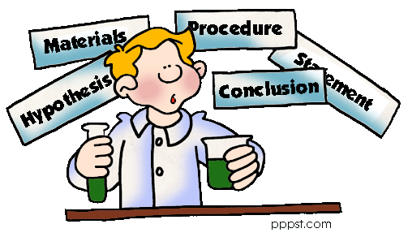
Research is an organized inquiry carried out to provide information for solving problems.
It is the cornerstone of every science.

Slide 5
What is research?
Re Searh
Process
Step by step
Phases
again
find

Slide 6
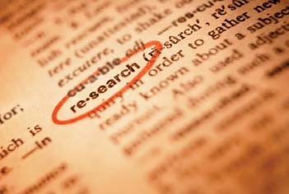
Wikipedia
Research can be defined to be
  Search for knowledge
  Or any systematic investigation to establish facts

Slide 7

Research is
To see what everybody else has seen
To think what nobody else has thought
Albert Szent-Gyorgyi (1893 – 1986)

Slide 8
Research is
Research is the systematic process of collecting and analyzing information to increase our understanding of the world in general and of the phenomenon under study in particular.
Albert Szent-Gyorgyi (1893 – 1986)

Slide 9
Who conduct research?
Students, professors, researchers, research centers, government, practitioners, newspaper people, TV networks, market research firms, schools, hospitals, social service, political parties, consulting firms, HR departments, public interest organizations, insurance, law firms conduct research as part of their jobs

Slide 10

Why conduct research?

Slide 11
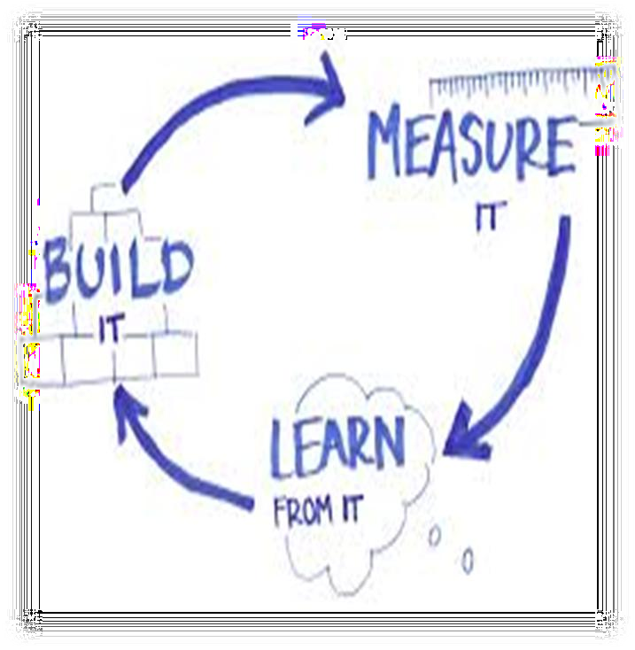
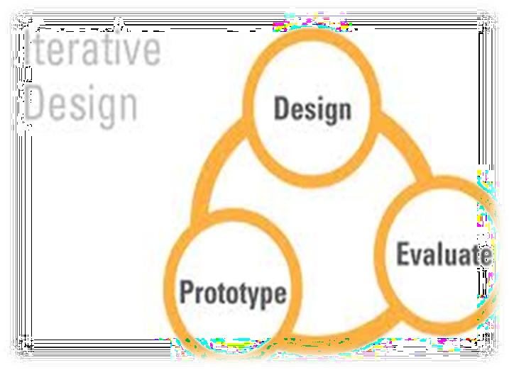
Why conduct research?
RESEARCH concerns with WHAT (facts and conclusions) and HOW (scientific; critical components).
Research is a iterative process that eventually seeks to explain or solve an identified problem.

Slide 12

Research principles
Truth
Honesty
Transparency/complete openness
Systematic errors prevented by…
  good design
Random errors corrected by…
  statistical methods
Other “errors” are corrected over time and by experience ....

Slide 13

What is medical research?

Slide 14
Medical and health care research
Activities that are carried out with scientific methodology to provide new knowledge about health and disease

Slide 15

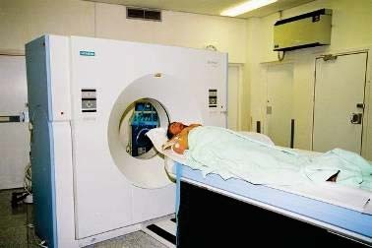


Research vs. health care

Slide 16
Research vs. health care
Health care:
  Aims at producing health
Research:
  Aims at producing knowledge

Slide 17
Purpose of Research
explore
describe
explain

Slide 18
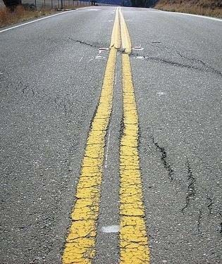
Differences between health research and health care
Aims
Funding
Documentation
Ethics
Legal regulations
………………….
November 25, 2015
13

Slide 19

Health Research Act
”The aim of this act is to promote good and ethical responsible medical research”
Notes:
The Act applies to all medical and health research on human beings, human biological material or personal health data
Such research also includes pilot studies and experimental treatments

Slide 20

Legal requirements
Medical research should be organized as a project and have:
Responsible institution
Project leader
Protocol (in which all funding should be described)

Slide 21
Four basic principles for medical research
Safe and sound
  Limits to what we are allowed to do, a general, superior principle
Board review
  Approval from an independent body
Informed consent
  Autonomy
Proportionality
  Acceptable risk, i.e. risks and burdens should be proportionate to potential benefits

Slide 22
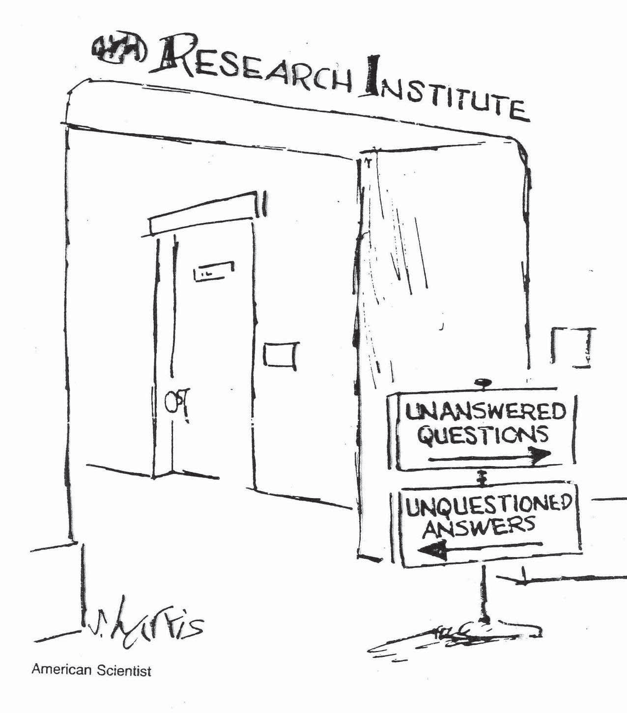
November 25, 2015
35

Slide 23
Research Steps
Identifying research topics/questions
Budget + Budget Justification Problem statement
Data Analysis
Study objectives
Data collection
Study methods
Study variables
Study Population
& Sampling

Slide 24
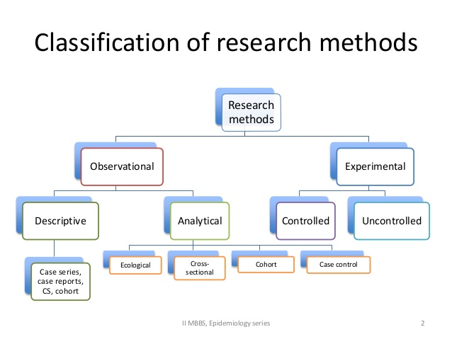

Slide 25

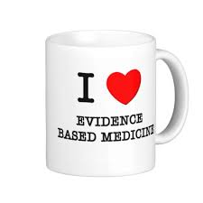
What is evidence?
What is Evidence Based Medicine?
Notes:
What is Evidence Based Medicine?

Slide 26
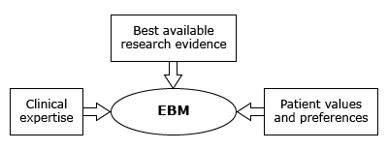
Evidence Based Medicine
Is the care of patients using the best available research evidence to guide clinical decision making
  Sackett DL, Straus SE, Richardson WS, et al. Evidence-based medicine: How to practice and teach EBM, 2nd ed, Churchill Livingstone, Edinburgh 2000.
  Sackett DL, Rosenberg WM, Gray JA, et al. Evidence based medicine: what it is and what it isn't. BMJ 1996; 312:71.
Notes:
It is the care of patients using the best available research evidence to guide clinical decision making
As shown in this figure

Slide 27
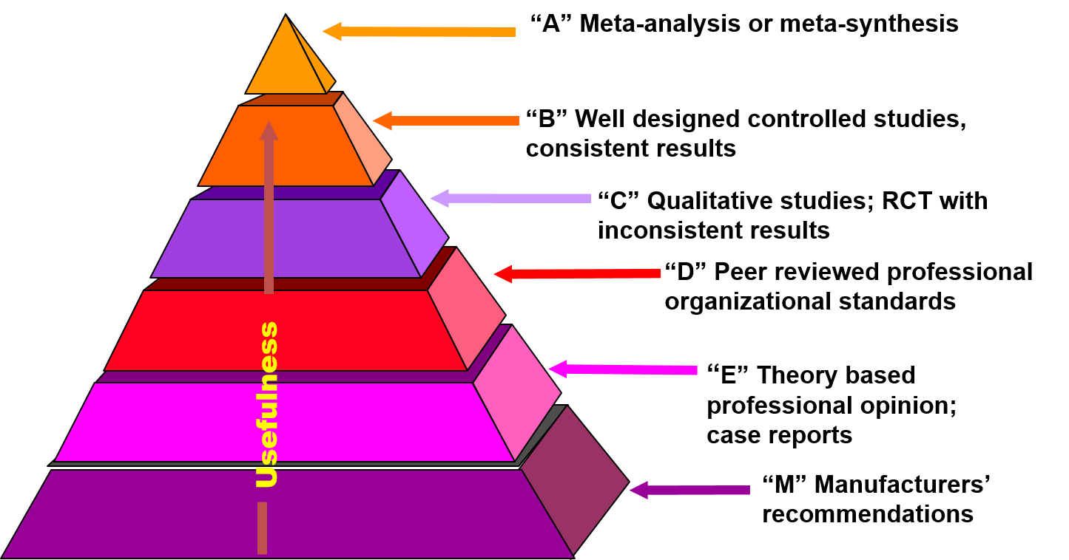
Levels of evidence
Evidence Based Medicine
Armola RR, Bourgault AM, Halm MA, et al. AACN levels of evidence: what's new? J.Crit Care Nurse. 2009;29(4):70-3
Notes:
This pyramid illustrates different levels of evidence.
Evidence levels are A, B, C, D, E and M
The strongest evidence is level A, such as meta-analysis
The weakest is level M such as manufacturers’ recommendation

Slide 28
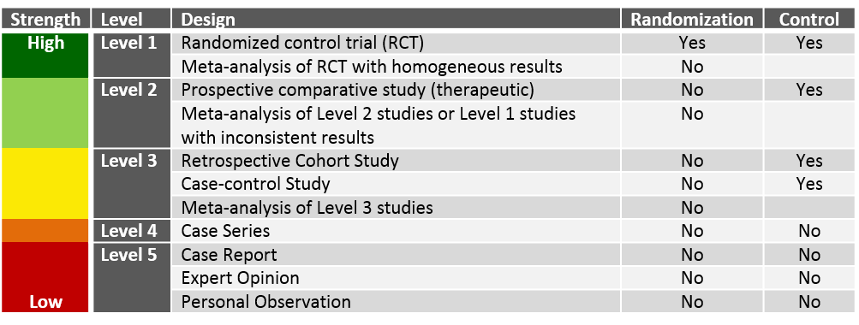
Levels of evidence
Evidence Based Medicine
https://www.hydroassoc.org/research-101-levels-of-evidence-in-hydrocephalus-clinical-research-studies/
Notes:
This is another way to classify levels of evidence from 1 to 5
Level one includes meta-analysis and randomized controlled trials
Level 5 includes case reports, expert opinions and personal observations

Slide 29

Many ways of classifying tools – describe your methods!
A combination of different tools is frequently used

Slide 30

Research methods in epidemiology and clinical medicine
Knowledge research
Descriptive methods
description of reality
Analytical methods testing one or more hypotheses

Slide 31
Research methods in epidemiology and clinical medicine
Knowledge research
Descriptive methods
description of reality
Analytical methods testing one or more hypotheses

Slide 32

Knowledge research
Systematic reviews
A review of the literature on a single question that tries to identify, appraise, select and synthesize all high quality research evidence relevant to that question
Meta-analyses
Combines the results of several studies that address the same research question
November 25, 2015
39

Slide 33
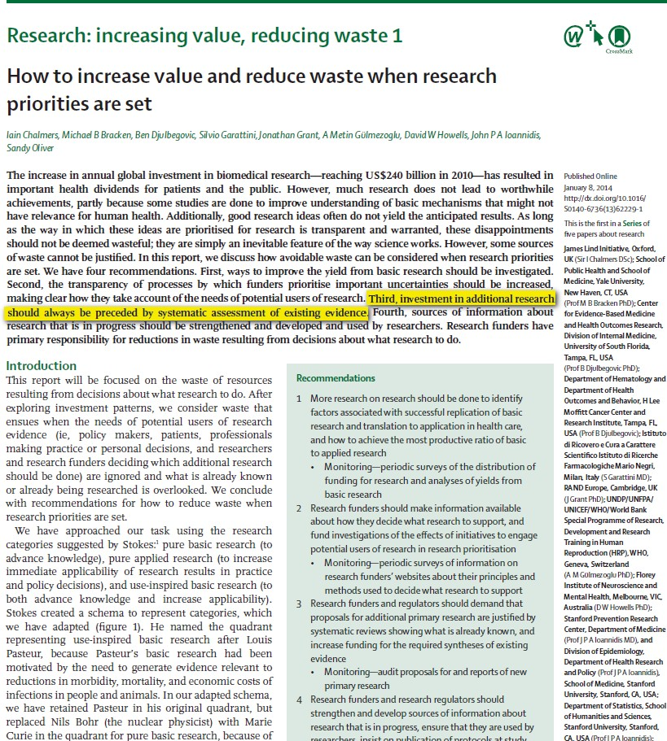
Systematic
assessment of existing research is always needed

Slide 34

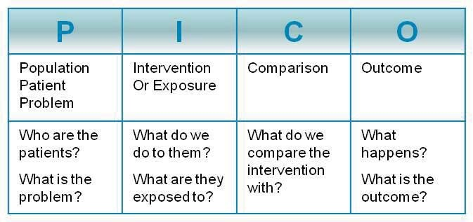


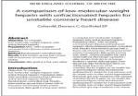
Systematic review
Formulate Question
Systematic literature search
Choose studies
Assess study quality
Extract data, synthesize (& GRADE)
Synthesis of comparable results
Write report
Two results:
Estimated effect
Quality of evidence
All relevant single studies

Slide 35
Research methods in epidemiology and clinical medicine
Knowledge research
Descriptive methods
description of reality
Analytical methods testing one or more hypotheses

Slide 36
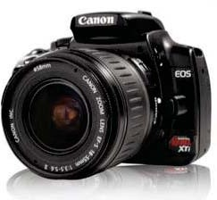
Descriptive methods – no hypothesis
Case reports
Descriptive epidemiology
Qualitative studies

Slide 37
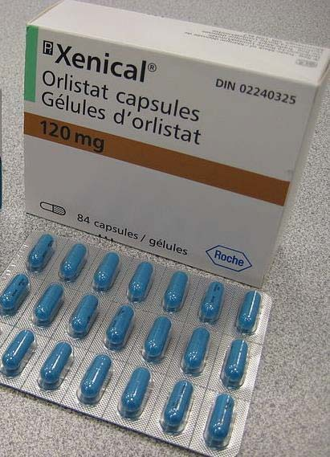
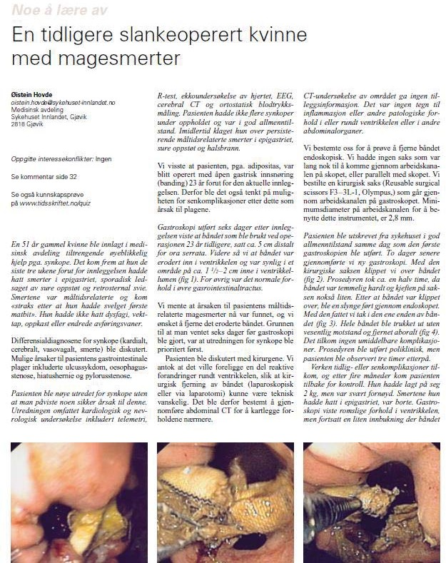
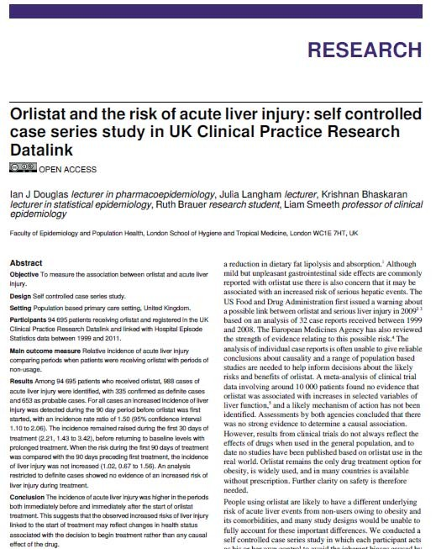
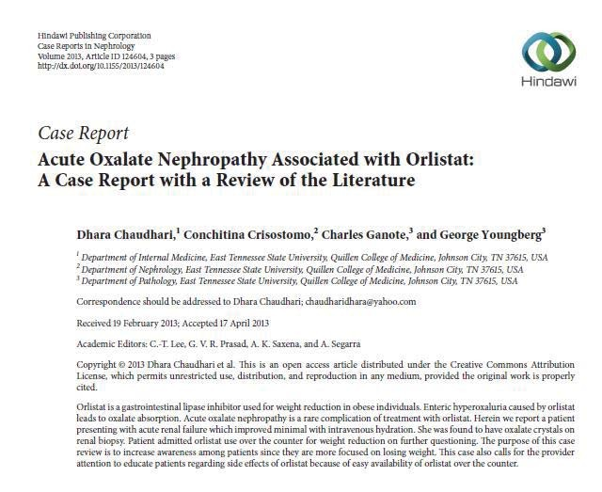
Case reports

Slide 38
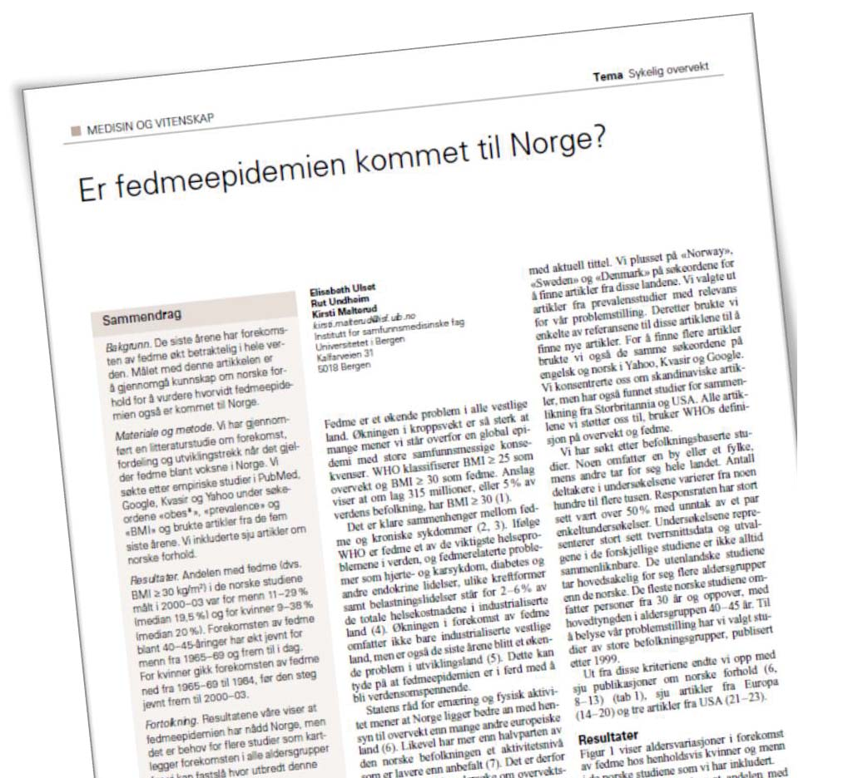


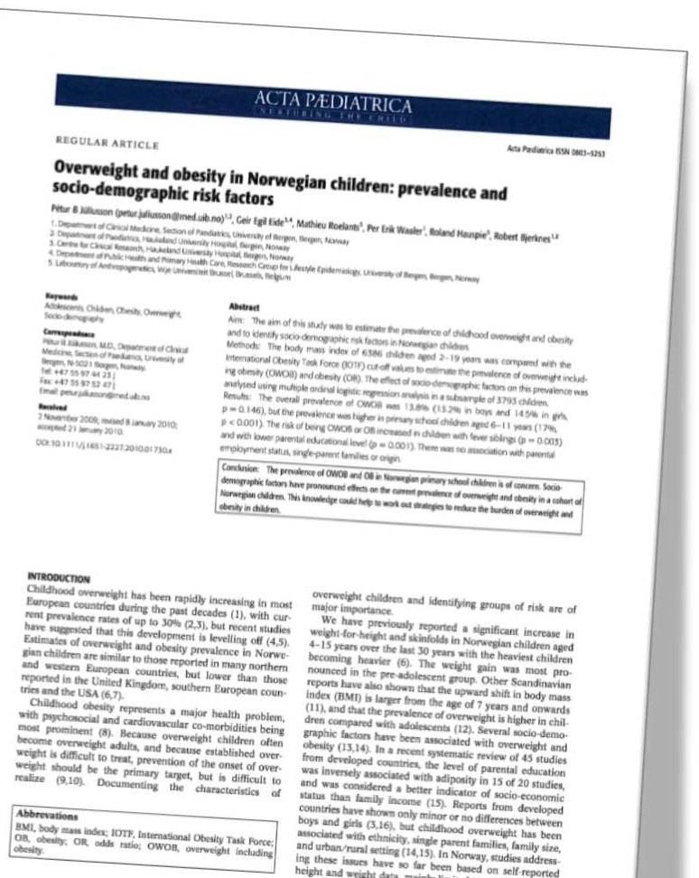
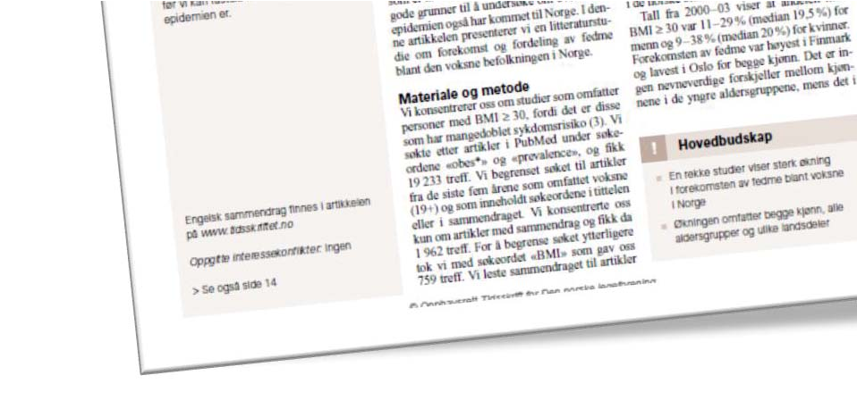


Descriptive epidemiology

Slide 39
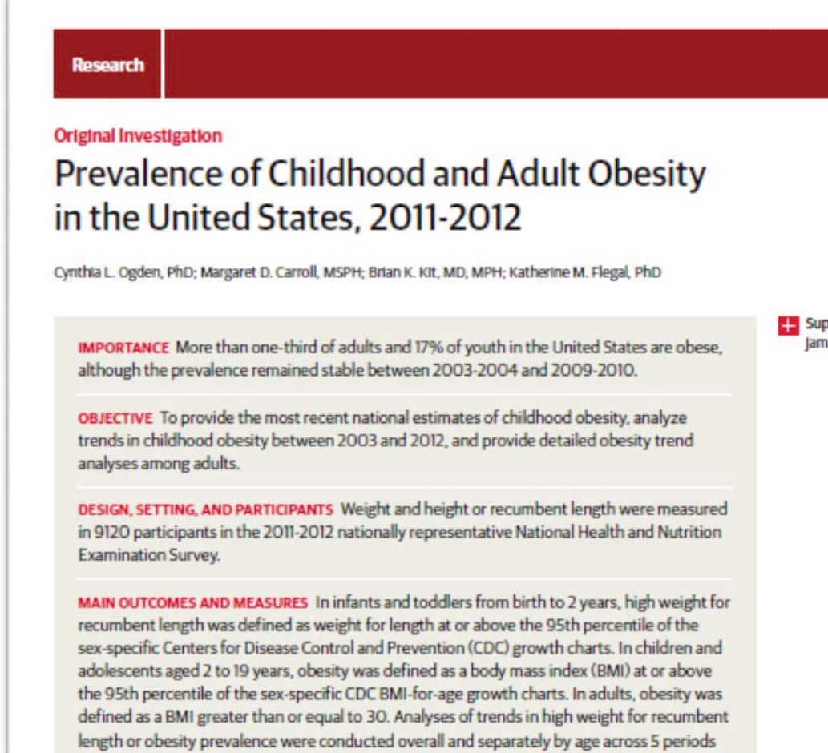

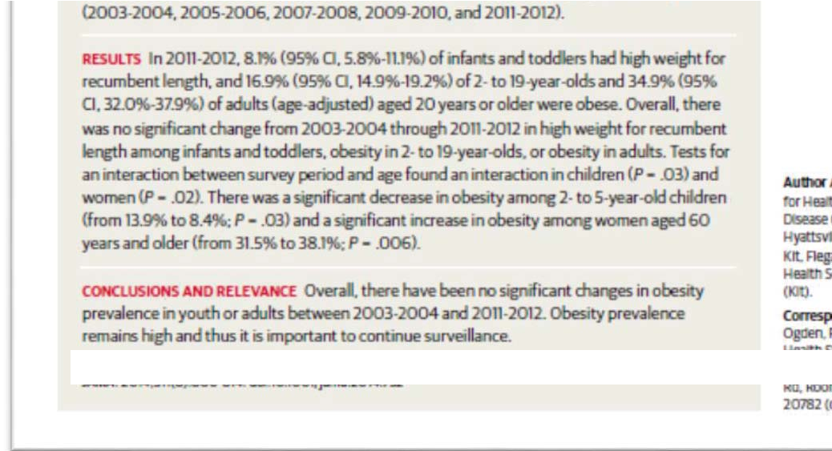


Slide 40

Qualitative research
Qualitative research methods
Involve the systematic collection, organization, and interpretation of textual material derived from talk or observation
It is used in the exploration of meanings of social phenomena as experienced by individuals themselves, in their natural context
– Malterud K. Lancet 2001
Investigates (why and how ….not just what, where, when) Wikipedia

Slide 41
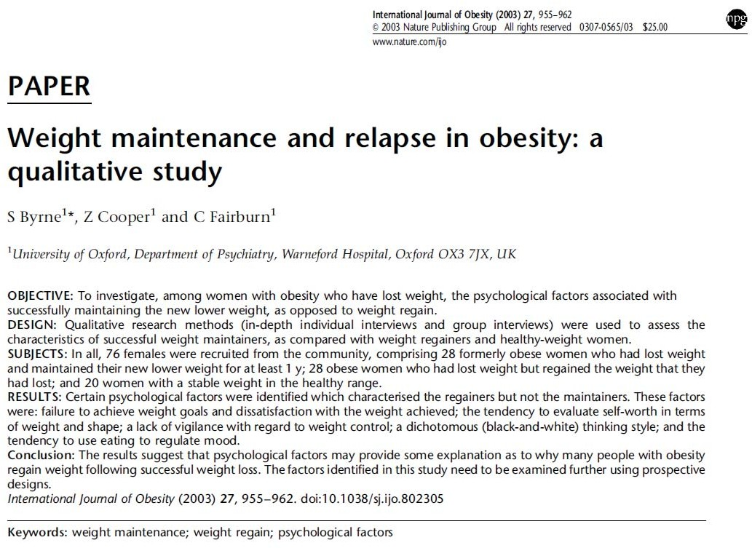

Qualitative research
“Qualitative researchers aim to gather an in-depth understanding of human behavior and the reasons that govern such behavior. The qualitative method investigates the why and how of decision making, not just what, where, when.
Hence, smaller but focused samples are more often used than large samples.”
Wikipedia

Slide 42
Research methods in epidemiology and clinical medicine
Knowledge research
Descriptive methods
description of reality
Analytical methods testing one or more hypotheses

Slide 43
Hypothesis
Proposed explanation for an observable phenomenon
Assumption that can be confirmed (verified) or disproved (falsified)
Hypotheses must
  Be specific
  Not include value-laden words
  Be “testable”

Slide 44
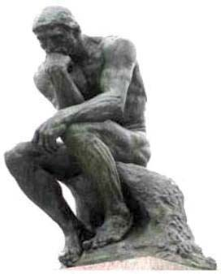
Analytical methods
Observational
  cross-sectional studies
  case-control studies
  cohort studies
Experimental
  controlled clinical trials
  interventional studies

Slide 45


Cross-sectional studies
Hypotheses are tested by examining a cross section of the population
Everything happens at the same time
Must find an appropriate group (representativeness)
Can not explain causal links

Slide 46
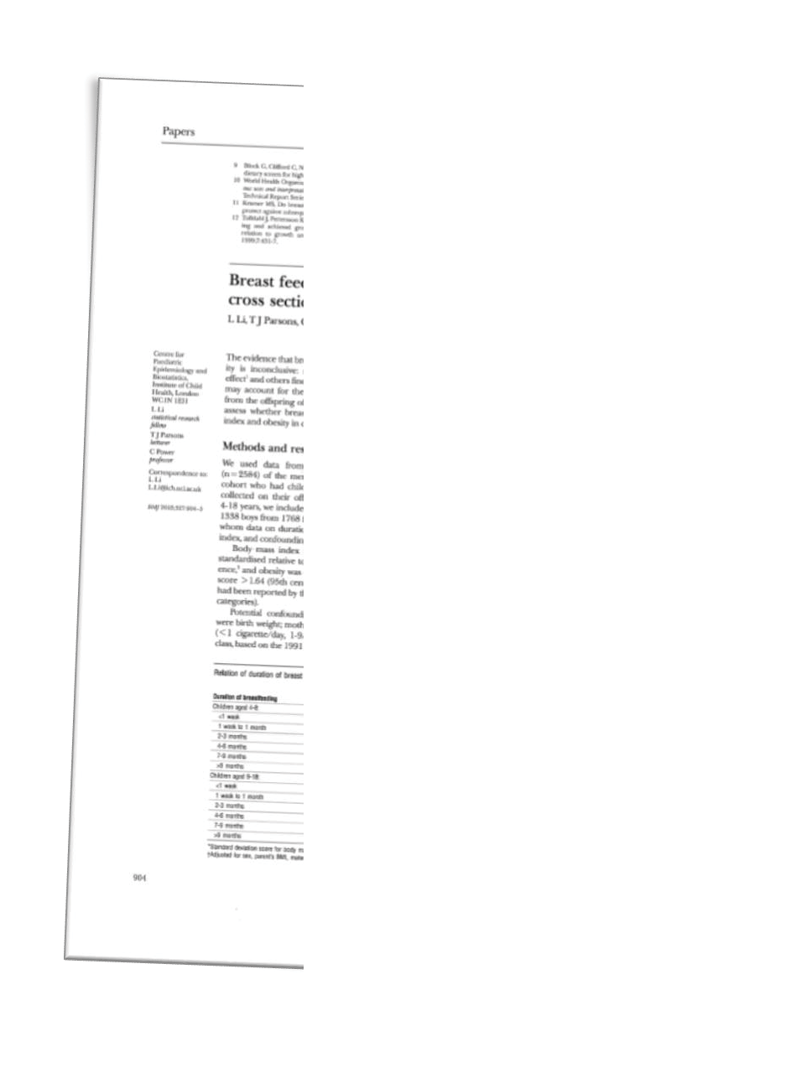
Cross-sectional study
Does breast feeding protect against obesity?
Study among children of a randomly selected sample (n=2584) of the members of the 1958 British birth cohort.
2631 children included: data on breast feeding, BMI and confounding factors (birth weight, mother’s smoking, social class).
We found no evidence that breast feeding influenced body mass index or obesity and no dose dependent trend in either age group»

Slide 47
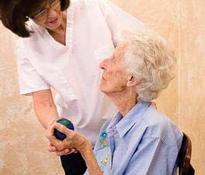
Case-control studies
Retrospective studies (looking back in time)
Compares "cases" (with disease) with controls (without disease) to find differences
Especially well suited for rare disorders
Method problems
  Bias
  Selection of controls

Slide 48
Case-control study – retrospective study
Time
Exposed
Not exposed
Research
Cases (with disease)
Controls (without disease)
Exposed
Not exposed

Slide 49
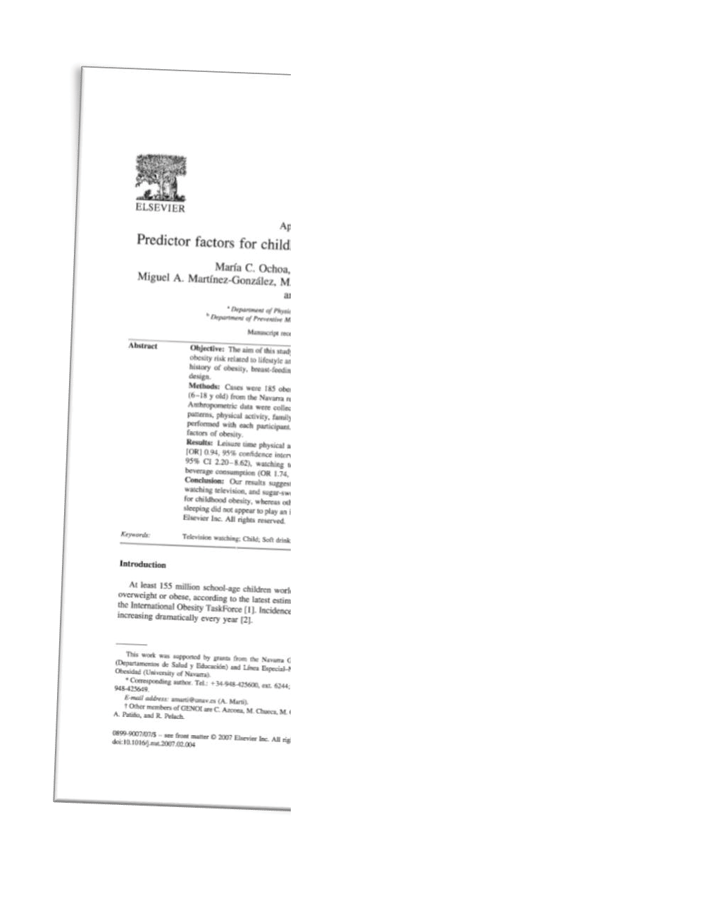
Cases were 185 obese children (6- 18 years) - controls matched by sex and age
Protective factor against obesity:
  Leisure time activity
Associated with a higher risk:
  Family history of obesity
  Watching television
  Sugar-sweetened beverage consumption
Of no importance:
  Breast feeding
  Birth weight
  Time spent sleeping

Slide 50


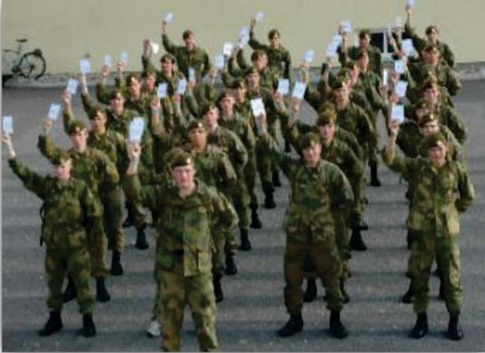

Cohort study
Prospective (looking forward in time)
Compare a group with a characteristic/exposure with a group without this characteristic/exposure
Expensive and time consuming design

Slide 51
Cohort study – prospective study
Exposed
Outcome
Population
Unexposed
Outcome
November 25, 2015
60

Slide 52
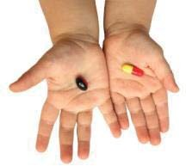
Experimental studies
Interaction
The goal is complete control over all aspects
Aiming at isolating the phenomenon investigated by correcting for other factors
November 25, 2015
63

Slide 53
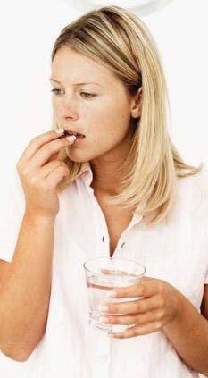
Controlled clinical trials
Follow patients over time
Comparing the intervention group with control group
Randomizing technices
Blinding?
November 25, 2015
64

Slide 54
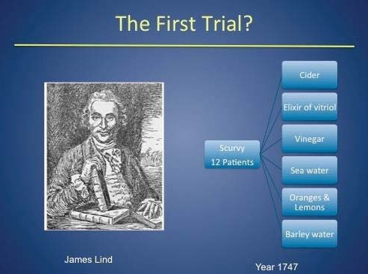
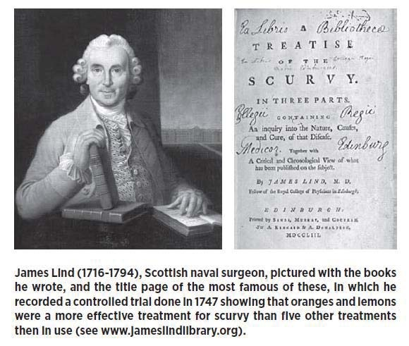

Slide 55
What is good research?
Research is producing new understanding of reality by “cultivating” facts.
Research provides simple statements with generalizability
  Albert Einstein (1879 1955)

Slide 56


Good research
High quality research….
  Based on scientific methods
  Can provide new knowledge about health and illness
  Safe for participants (ethically and medically acceptable)

Slide 57
Summing up
Health research is different from health care
Research methods should be chosen according to the question to be answered
Describe your method so others can understand what you did
To play by the rules, you have to know the rules

Slide 59


