Slide 1
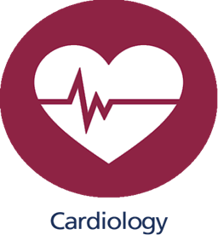
Regulation of blood pressure & blood flow
Dr. Amir Al-Jaradli
Cardiologist

Slide 2
LOCAL CONTROL OF BLOOD FLOW IN
RESPONSE TO TISSUE NEEDS :
Some of the specific needs of the tissues for blood
flow include the following:
1. Delivery of oxygen to the tissues
2. Delivery of other nutrients such as glucose, amino
acids, and fatty acids
3. Removal of carbon dioxide from the tissues
4. Removal of hydrogen ions from the tissues
5. Maintenance of proper concentrations of ions in
the tissues
6. Transport of various hormones and other substances
to the different tissue.

Slide 3
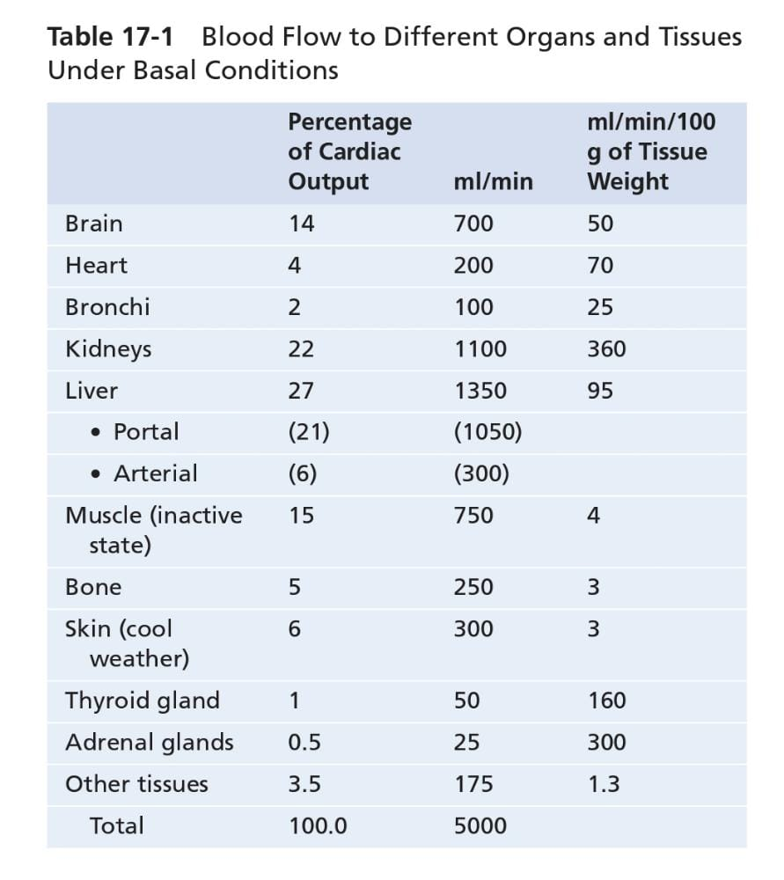
Variations in Blood Flow in Different Tissues and
Organs :
note the extremely large blood flow through the
kidneys—1100 ml/min. This extreme amount of flow
is required for the kidneys to perform their function of
cleansing the blood of waste products and regulating
composition of the body fluids precisely.

Slide 4
MECHANISMS OF BLOOD FLOW CONTROL :
Local blood flow control can be divided into two phases :
1. Acute control
2. Long-term control

Slide 5
Acute control :
Is achieved by rapid changes in local vasodilation or vasoconstriction
of the arterioles, metarterioles, and precapillary
sphincters that occur within seconds to minutes
to provide rapid maintenance of appropriate local tissue
blood flow.

Slide 6
Short-Term Regulation of Blood Pressure:
Short-term regulation of blood pressure is controlled by the autonomic nervous system (ANS).
Changes in blood pressure are detected by baroreceptors. These are located in the arch of the aorta and the carotid sinus.
Increased arterial pressure stretches the wall of the blood vessel, triggering the baroreceptors. These baroreceptors then feedback to the autonomic nervous system. The ANS then acts to reduce the heart rate via the efferent parasympathetic fibres (vagus nerve). This reduces the blood pressure.

Slide 7
Decreased arterial pressure is detected by baroreceptors, which trigger a sympathetic response. This stimulates an increase in heart rate and cardiac contractility leading to increased blood pressure.
Baroreceptors cannot regulate blood pressure long-term. This is because the mechanism that triggers baroreceptors resets itself once a more adequate blood pressure is restored.

Slide 8
Long-term control :
Means slow, controlled
changes in flow over a period of days, weeks, or even
months.
In general, these long-term changes provide even
better control of the flow in proportion to the needs of
the tissues.
These changes come about as a result of an
increase or decrease in the physical sizes and numbers of
blood vessels supplying the tissues.

Slide 9
Long-Term Regulation of Blood Pressure
There are several physiological mechanisms that regulate blood pressure in the long-term, the first of which is the renin-angiotensin-aldosterone system (RAAS).
Renin-Angiotensin-Aldosterone System (RAAS)
Renin is a peptide hormone released by the granular cells of the juxtaglomerular apparatus in the kidney. It is released in response to:
Sympathetic stimulation
Reduced sodium-chloride delivery to the distal convoluted tubule
Decreased blood flow to the kidney
Renin facilitates the conversion of angiotensinogen to angiotensin I. This is then converted to angiotensin II using angiotensin-converting enzyme (ACE).

Slide 10
Angiotensin II is a potent vasoconstrictor. It acts directly on the kidney to increase sodium reabsorption in the proximal convoluted tubule. Sodium is reabsorbed via the sodium-hydrogen exchanger. Angiotensin II also promotes the release of aldosterone.
Aldosterone promotes salt and water retention by acting at the distal convoluted tubule to increase expression of epithelial sodium channels. Furthermore, aldosterone increases the activity of the basolateral sodium-potassium ATP-ase. This consequently, increases the electrochemical gradient for movement of sodium ions.

Slide 11
More sodium collects in the kidney tissue and water then follows by osmosis. This results in decreased water excretion and therefore increased blood volume and blood pressure.
ACE also breaks down a substance called bradykinin which is a potent vasodilator. Therefore, the breakdown of bradykinin increases the constricting effect. This potentiates the overall increase in blood pressure.

Slide 12
Anti-Diuretic Hormone (ADH)
The second mechanism by which blood pressure is regulated is via the (ADH). It is produced in the hypothalamus and stored and released from the posterior pituitary gland. This is usually in response to thirst or an increased plasma osmolarity.
ADH acts to increase the permeability of the collecting duct to water by inserting aquaporin channels (AQP2) into the apical membrane.
It also stimulates sodium reabsorption from the thick ascending limb of the loop of Henle. This increases water reabsorption thus increasing plasma volume and decrease osmolarity

Slide 13
Other factors that can affect long-term regulation of blood pressure are natriuretic peptides. These include:
Atrial natriuretic peptide (ANP) is synthesised and stored in cardiac myocytes. It is released when the atria are stretched and indicates high blood pressure.
ANP acts to promote sodium excretion. It dilates the afferent arteriole of the glomerulus, increasing the glomerular filtration rate (GFR). Moreover, ANP inhibits sodium reabsorption along the nephron. Conversely, ANP secretion is low when blood pressure is low.
Prostaglandins act as local vasodilators to increase GFR and reduce sodium reabsorption. Moreover, they act to prevent excessive vasoconstriction triggered by the RAAS and sympathetic nervous system.

Slide 14
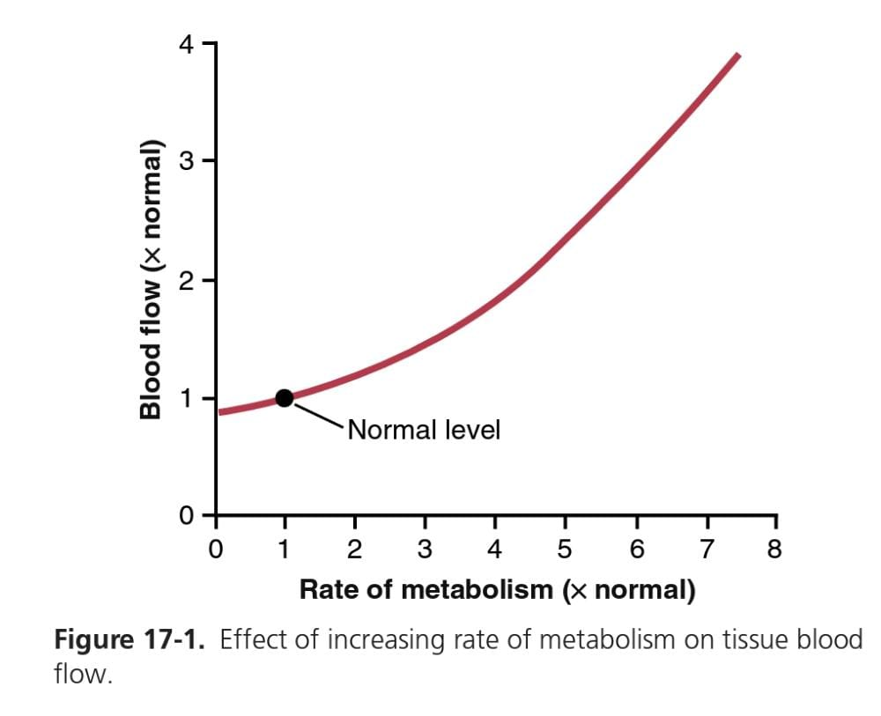
ACUTE CONTROL OF LOCAL BLOOD FLOW
Such as in a skeletal muscle. Note that an increase in
metabolism up to eight times normal increases the blood
flow acutely about fourfold.

Slide 15
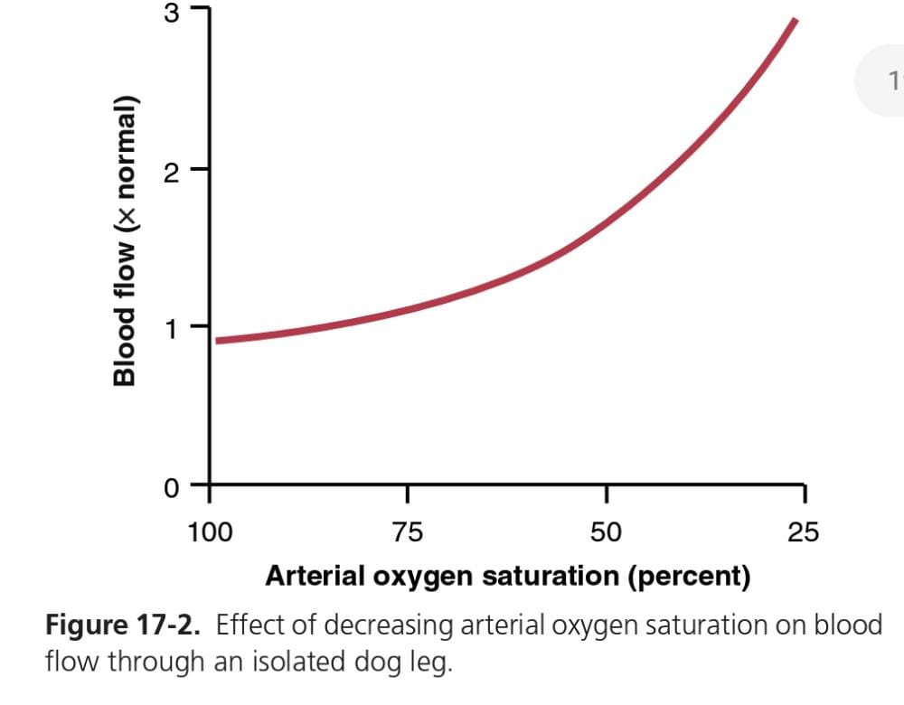
One of the most necessary of the metabolic nutrients
is oxygen. Whenever the availability of oxygen to the tissues decreases, such as during the following:
(1) at a high altitude at the top of a high mountain .
(2) in pneumonia .
(3) in carbon monoxide poisoning .

Slide 16
Autoregulation of Blood Flow During Changes in Arterial Pressure
In any tissue of the body, a rapid increase in arterial pressure
causes an immediate rise in blood flow. However,
within less than 1 minute, the blood flow in most tissues
returns almost to the normal level, even though the arterial
pressure is kept elevated. This return of flow toward
normal is called autoregulation.

Slide 17
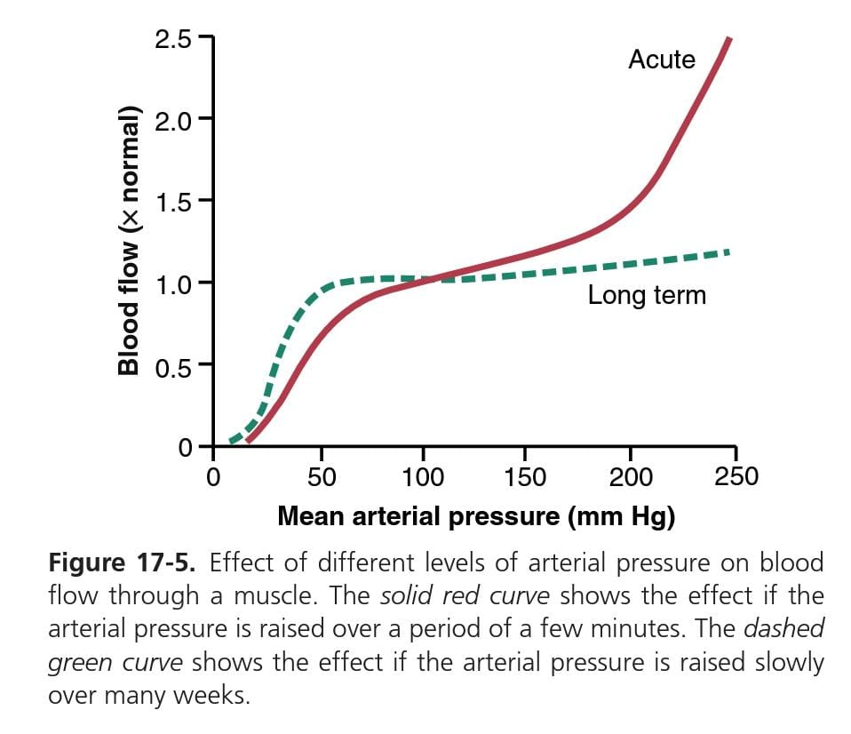
Autoregulation of Blood Flow During Changes in Arterial Pressure

Slide 18
Control of Tissue Blood Flow:
Endothelium-Derived Relaxing or Constricting Factors
The endothelial cells lining the blood vessels synthesize
several substances that when released, can affect the
degree of relaxation or contraction of the vascular wall.

Slide 19
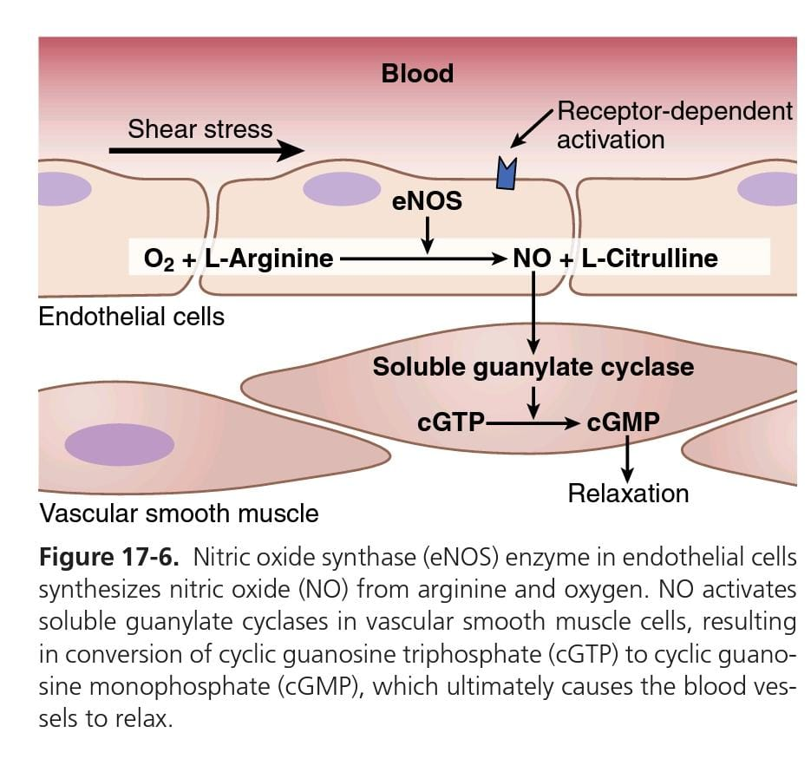
Nitric Oxide Is a Vasodilator Released from Healthy Endothelial Cells.

Slide 20
Endothelin Is a Powerful Vasoconstrictor Released
From Damaged Endothelium
This substance is present in the endothelial cells of all or most blood vessels but greatly increases when the vessels are injured.
The usual stimulus for release is damage to the endothelium, such as
that caused by crushing the tissues or injecting a traumatizing
chemical into the blood vessel.
After severe blood vessel damage, local release of endothelin and subsequent vasoconstriction helps prevent extensive bleeding from
arteries

Slide 21
LONG-TERM BLOOD FLOW REGULATION :
Is especially important when the metabolic demands of a tissue change.
Thus, if a tissue becomes chronically overactive and requires
increased quantities of oxygen and other nutrients, the
arterioles and capillary vessels usually increase both in
number and size within a few weeks to match the needs
of the tissue, unless the circulatory system has become
pathological or too old to respond.

Slide 22
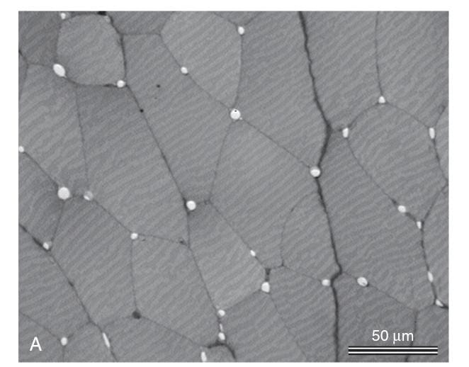
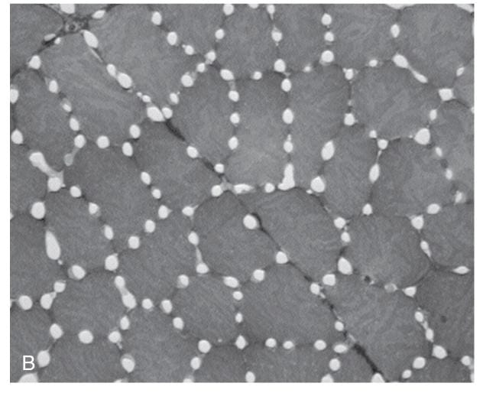
Blood Flow Regulation by Changes in Tissue Vascularity :
A key mechanism for long-term local blood flow regulation is to change the amount of vascularity of the tissues.
For example, if the metabolism in a tissue is increased for a prolonged period, vascularity increases, a process generally called angiogenesis; if the metabolism is decreased, vascularity decreases.

Slide 23
Blood Flow Regulation by Development of Collateral Circulation :
In most tissues of the body, when an artery or a vein is
blocked, a new vascular channel usually develops around
the blockage and allows at least partial resupply of blood
to the affected tissue.

Slide 24
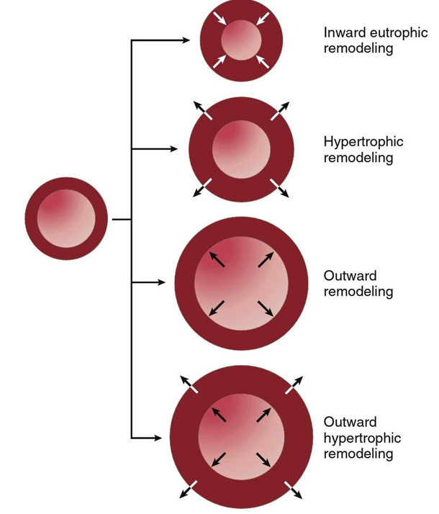
Vascular Remodeling in Response to
Chronic Changes in Blood Flow or Blood
Pressure :
Vascular growth and remodeling are critical components of tissue development and growth and occur as an adaptive response to long-term
changes in blood pressure or blood flow.
For example, after several months
of chronic exercise training, vascularity of the trained
muscles increases to accommodate their higher blood
flow requirements.

Slide 25
HUMORAL CONTROL OF THE CIRCULATION :
Means control by substances
secreted or absorbed into the body fluids, such
as hormones and locally produced factors. Some of these
substances are formed by special glands and transported
in the blood throughout the entire body. Others are
formed in local tissue areas and cause only local circulatory
effects.

Slide 26
VASOCONSTRICTORS :
Norepinephrine and Epinephrine :
is an especially powerful vasoconstrictor hormone; epinephrine
is less powerful as a vasoconstrictor and, in some tissues,
even causes mild vasodilation.
Angiotensin II :
The effect of angiotensin II is to constrict the small
arterioles powerfully. If this constriction occurs in an isolated
tissue area, the blood flow to that area can be severely
depressed.

Slide 27
Vasopressin :
also called antidiuretic hormone,
is even more powerful than angiotensin II as a vasoconstrictor,
thus making it one of the body’s most potent
vascular constrictor substances. It is formed in nerve cells
in the hypothalamus of the brain .

Slide 28
VASODILATORS :
Bradykinin :
Several substances called kinins cause powerful
vasodilation when formed in the blood and tissue
fluids of some organs.
Histamine :
has a powerful vasodilator effect on the
arterioles and, like bradykinin, has the ability to increase
capillary porosity greatly, allowing leakage of fluid and
plasma protein into the tissues.

Slide 29
VASCULAR CONTROL BY IONS AND
OTHER CHEMICAL FACTORS :
1. An increase in intracellular calcium ion concentration
causes vasoconstriction
2. An increase in potassium ion concentration, within
the physiological range, causes vasodilation
3. An increase in magnesium ion concentration causes
powerful vasodilation.

Slide 30
4. An increase in hydrogen ion concentration (decrease
in pH) causes dilation of the arterioles.
5. Acetate and citrate, both of which cause mild degrees
of vasodilation.
6. An increase in carbon dioxide concentration causes
moderate vasodilation in most tissues but marked
vasodilation in the brain.

Slide 31
NERVOUS REGULATION OF THE
CIRCULATION :
- Sympathetic Stimulation Increases Heart Rate and
Contractility .
- Parasympathetic Stimulation Decreases Heart Rate
and Contractility.

Slide 32
Role of the Nervous System in Rapid Control of Arterial Pressure :
Its rapidity of response, beginning within
seconds and often increasing the pressure to two times
normal within 5 to 10 seconds. Conversely, sudden inhibition
of nervous cardiovascular stimulation can decrease
the arterial pressure to as little as half-normal
within 10 to 40 seconds.
Therefore, nervous control is the most rapid
mechanism for arterial pressure regulation.

Slide 33
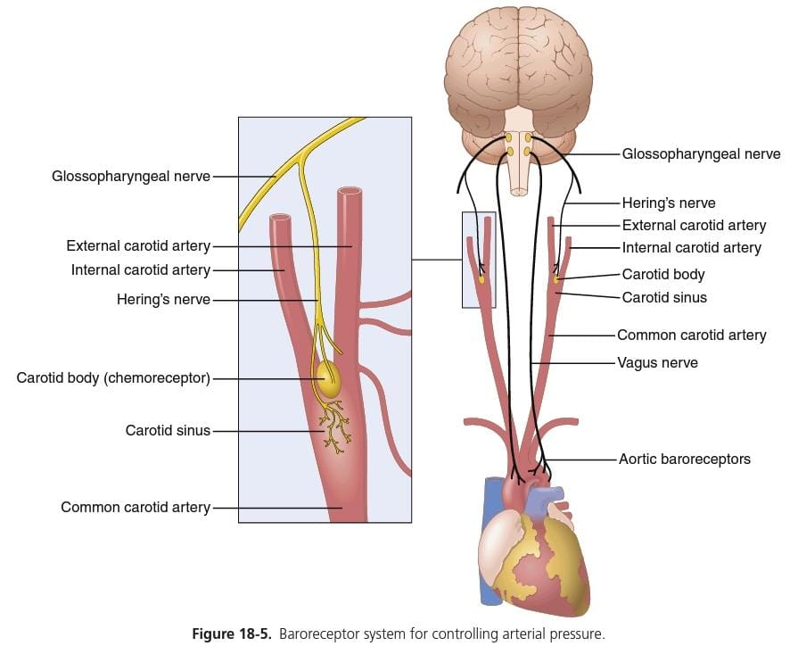
Baroreceptor Arterial Pressure Control System :
located at specific points in the walls of
several large systemic arteries. A rise in arterial pressure
stretches the baroreceptors and causes them to transmit signals into the CNS.
Feedback signals are then sent back
through the autonomic nervous system to the circulation to reduce arterial pressure down toward the normal level

