Slide 1

Cardiac output & Venous return
Dr. Amir AlJaradli
Cardiologist

Slide 2
Cardiac output :
Cardiac output is the quantity of blood pumped into the
aorta each minute by the heart.
the sum of the blood flow to all the tissues of the
body, it is one of the most important factors to consider in
relation to function of the cardiovascular system.

Slide 3
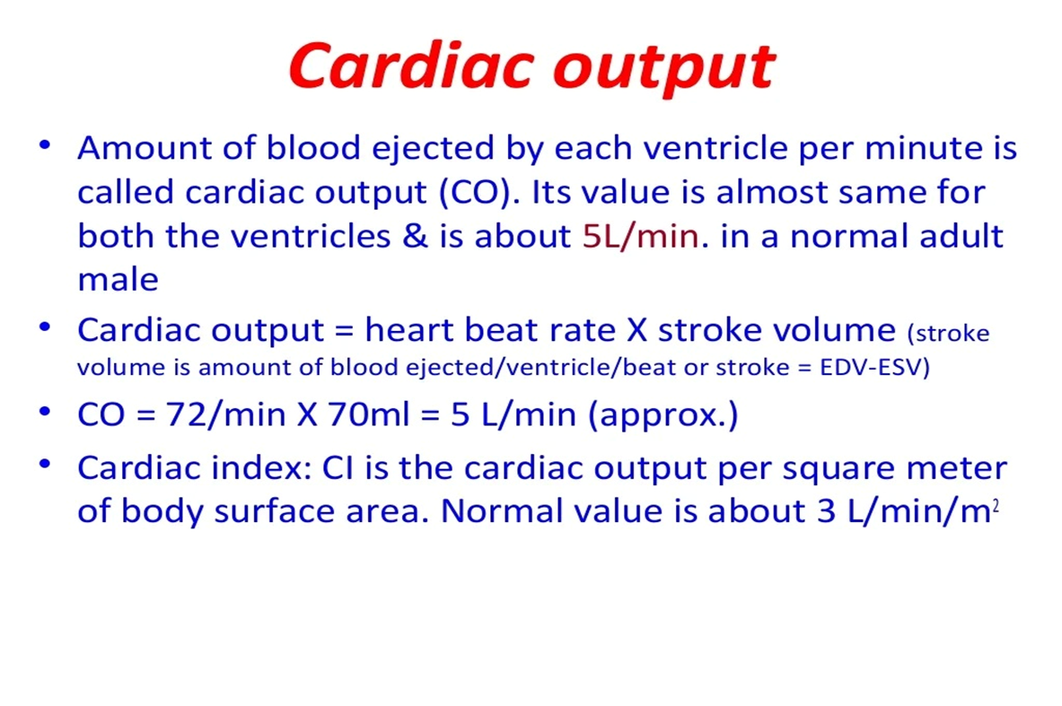

Slide 4
Venous return :
The quantity of blood flowing from the veins into the right
atrium each minute.
The venous return and the cardiac
output must equal each other except for a few heartbeats
when blood is temporarily stored in or removed from the
heart and lungs.

Slide 5
The following factors, among others, directly affect cardiac output:
(1) the basic level of body metabolism.
(2) whether the person is exercising.
(3) the person’s age .
(4) the size of the body.
For young healthy men, resting cardiac output averages
about 5.6 L/min. For women, this value is about 4.9 L/min

Slide 6
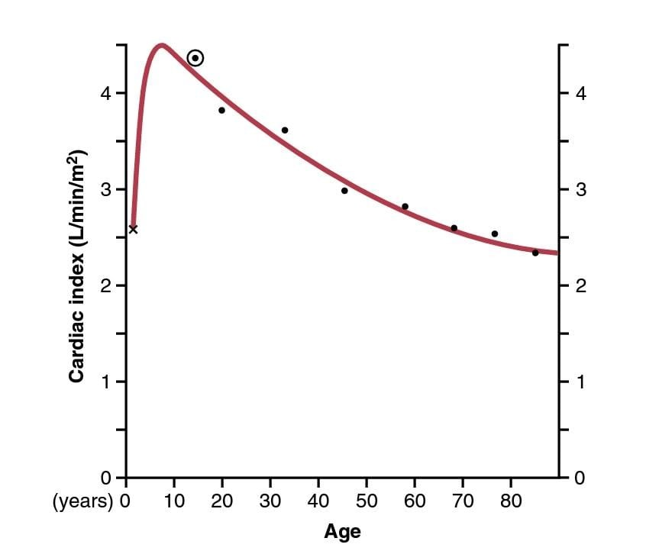
Effect of Age on Cardiac Output.
The cardiac index rises rapidly to a level greater
than 4 L/min/m2 at age 10 years and declines to about 2.4
L/min/m2 at age 80 years.

Slide 7
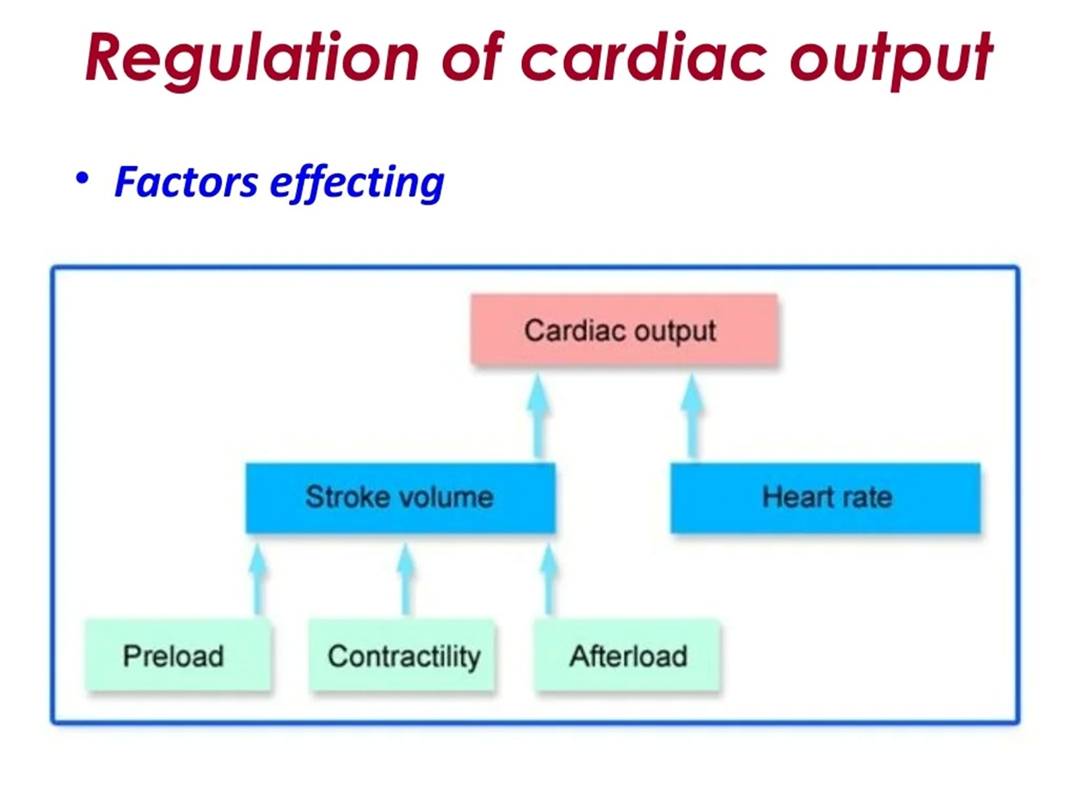

Slide 8
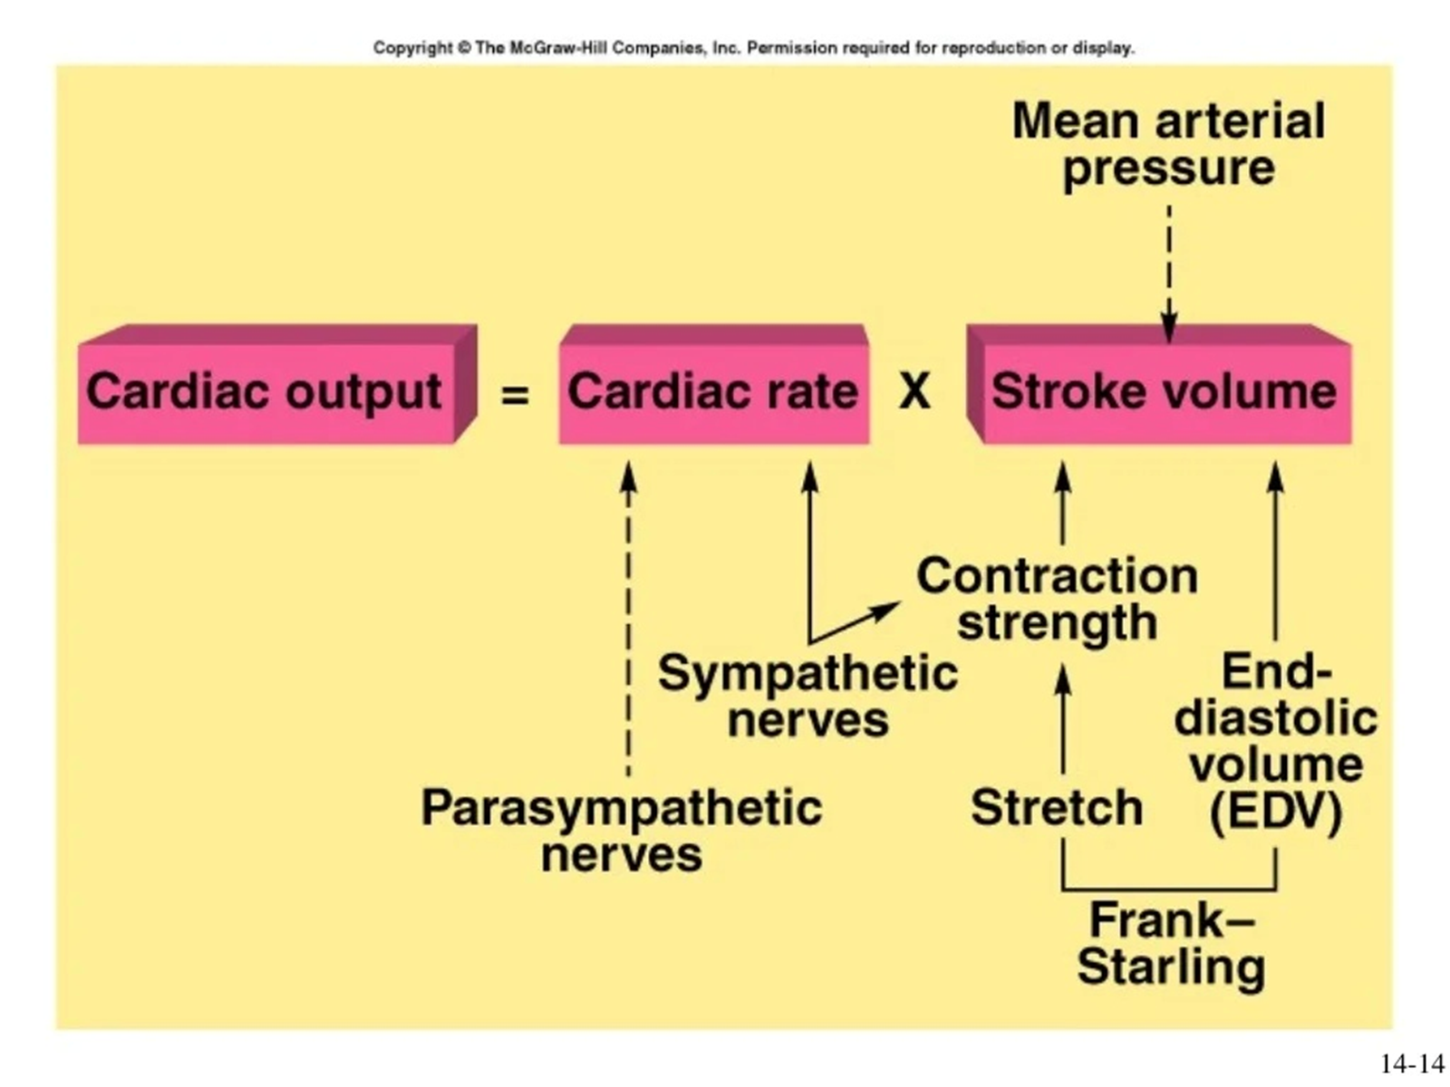

Slide 9
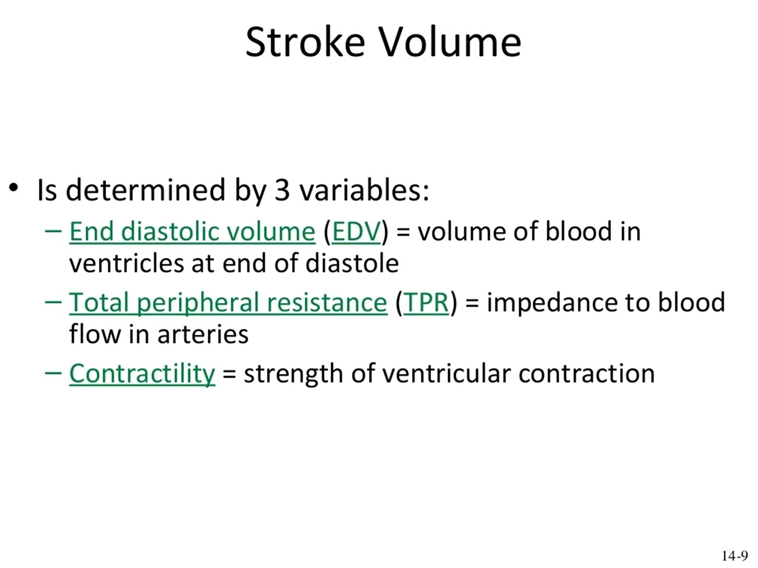

Slide 10
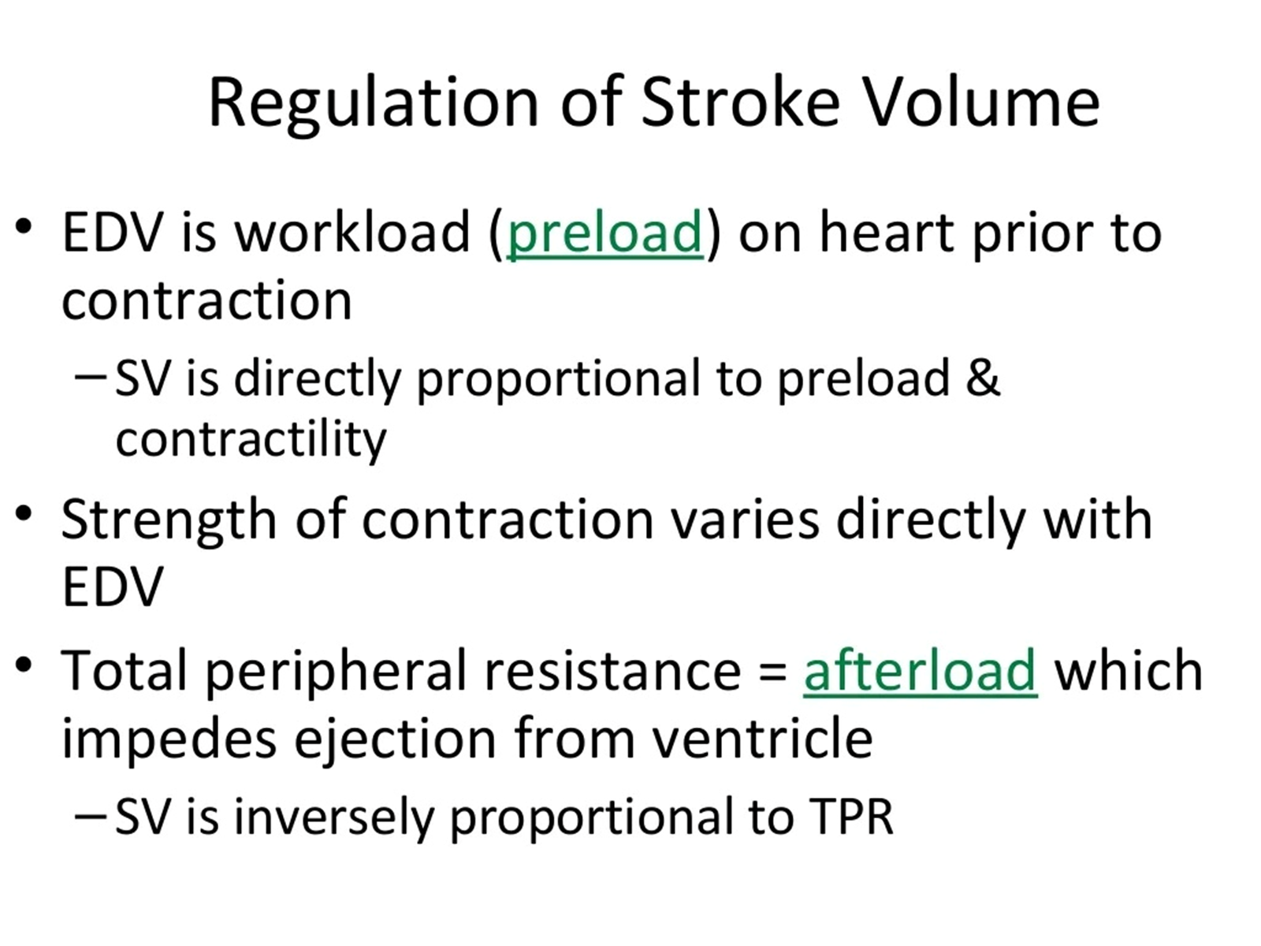

Slide 11
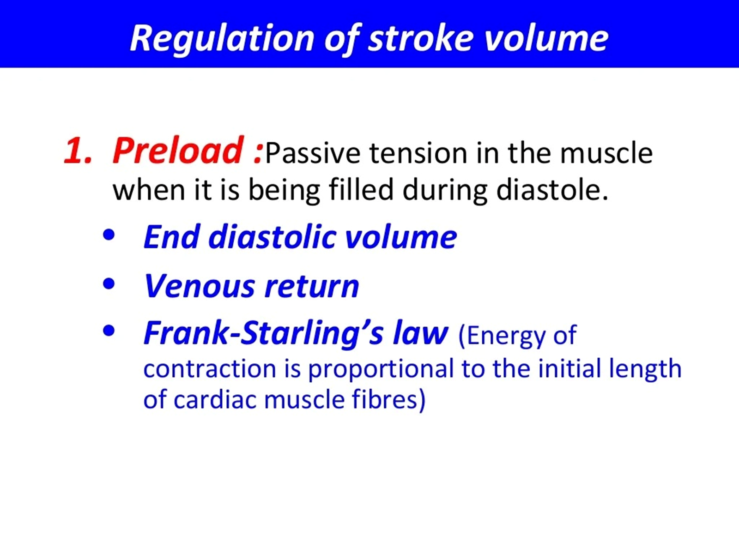

Slide 12
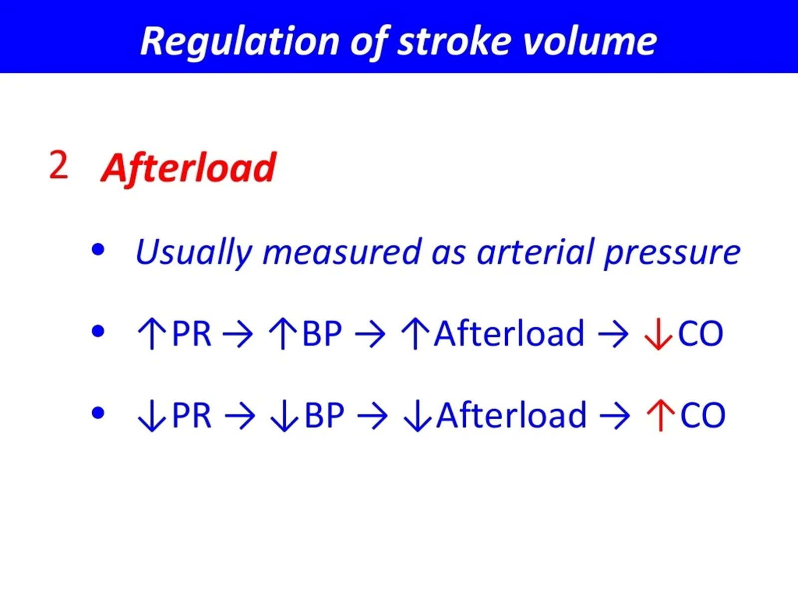

Slide 13
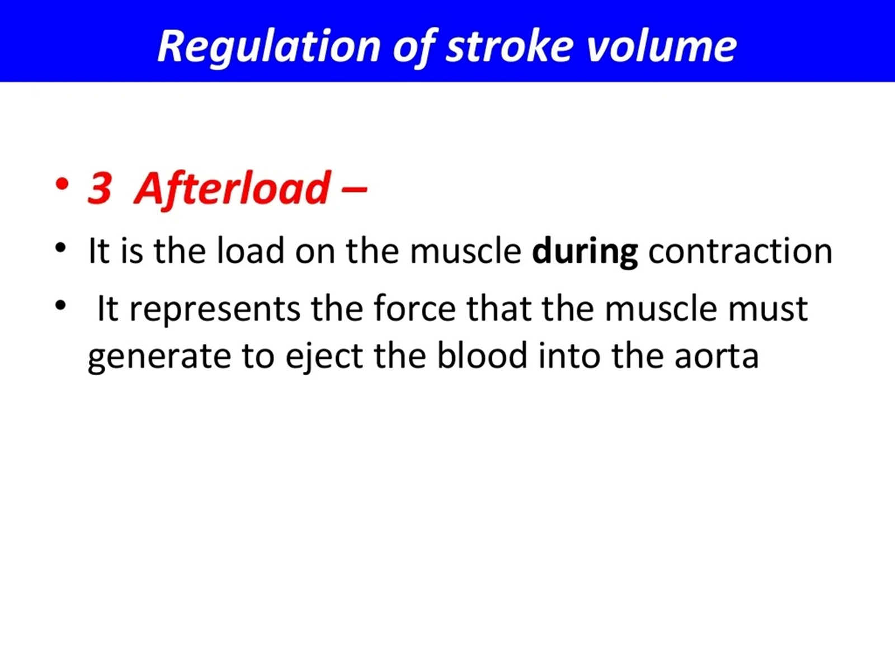

Slide 14
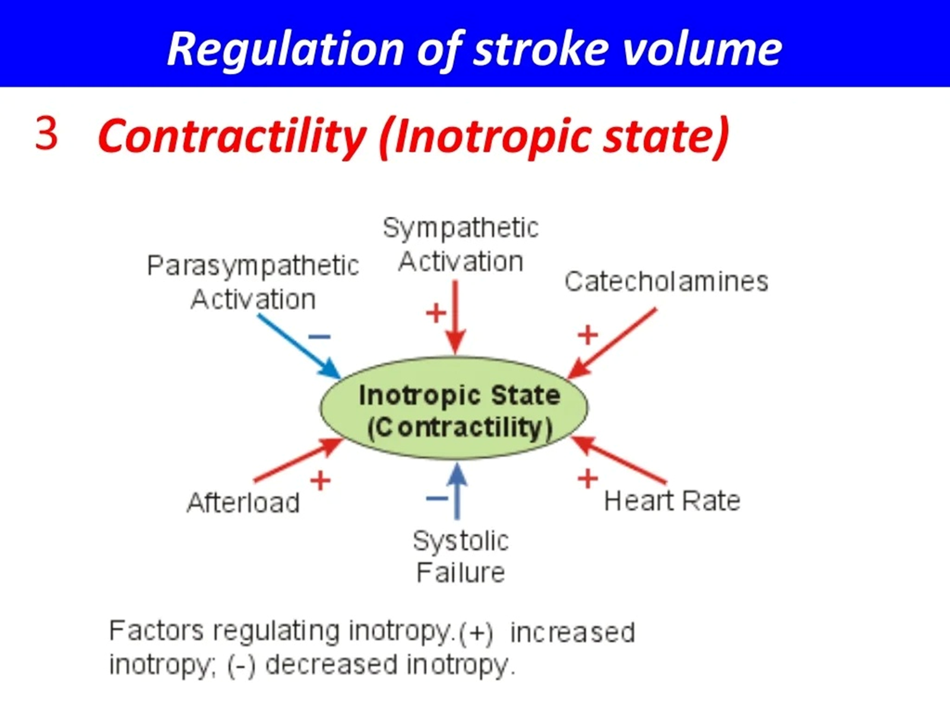

Slide 15
RETURN—FRANK-STARLING
MECHANISM OF THE HEART
This law states that when increased quantities of blood flow into the heart,
the increased volume of blood stretches the walls of the heart chambers.
As a result of the stretch, the cardiac muscle contracts
with increased force,
and this action ejects the extra blood.
. Therefore, the blood that flows into the heart is automatically pumped
without delay into the aorta and flows again through the
circulation.

Slide 16
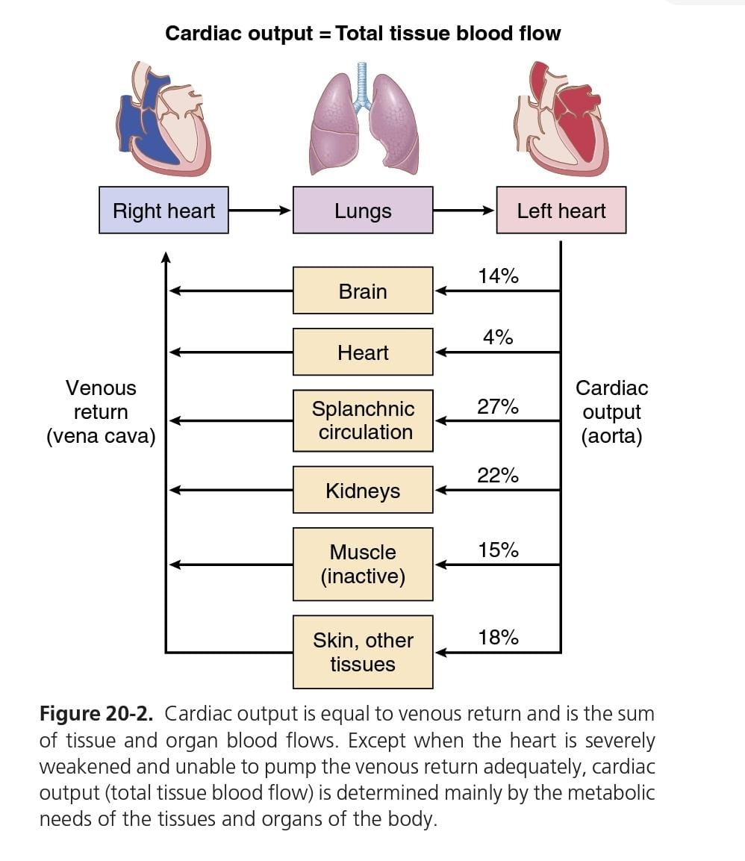
Cardiac Output Is the sum of all tissue blood flow .

Slide 17
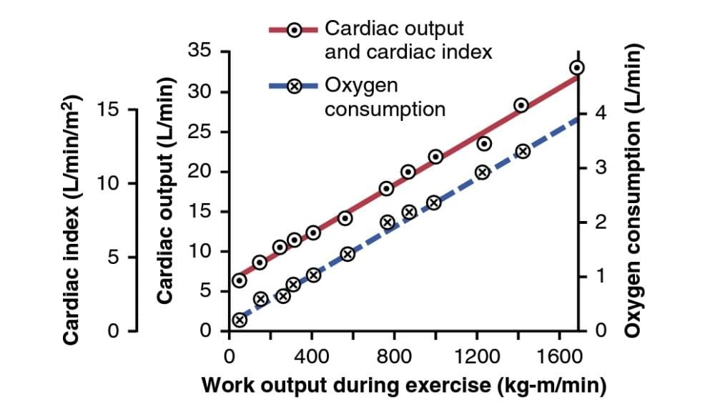
Effect of increasing levels of exercise to increase cardiac
output (red solid line) and oxygen consumption (blue dashed line).

Slide 18
Effect of total peripheral resistance
Cardiac output = Arterial pressure/ Total peripheral resistanc
Thus, any time the long-term level of total peripheral
resistance changes (but no other functions of the circulation
change), the cardiac output changes quantitatively in
exactly the opposite direction.

Slide 19
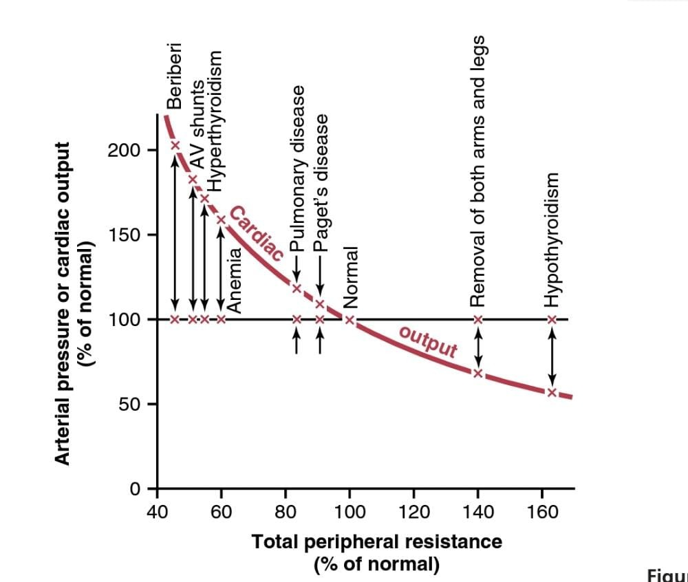
Chronic effect of different levels of total peripheral
resistance on cardiac output, showing a reciprocal relationship them .

Slide 20
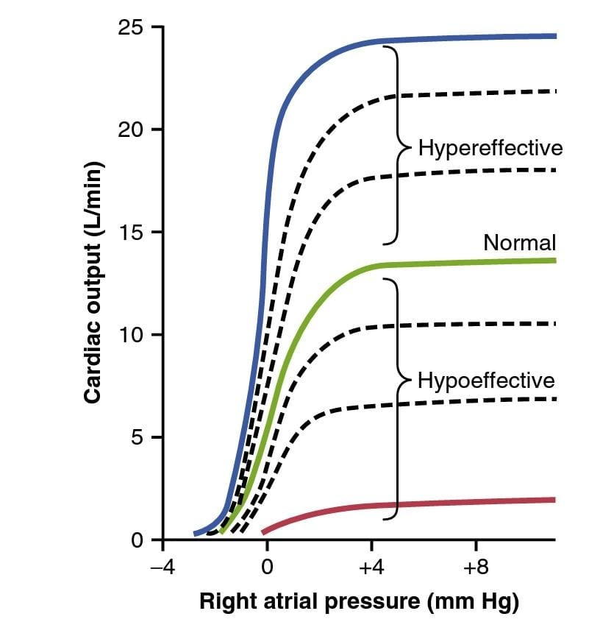
Limits for the Cardiac Output :
The plateau level of this normal cardiac output curve is about 13 L/min, 2.5 times the normal cardiac output of
about 5 L/min.
This means that the normal human heart,
functioning without any special stimulation, can pump a venous return up to about 2.5 times the normal venous return before the heart becomes a limiting factor in the control of cardiac output.
The uppermost
curves are for hypereffective hearts that are pumping
better than normal.
The lowermost curves are for hypoeffective
hearts that are pumping at levels below normal.

Slide 21
Factors That Cause a Hypereffective Heart
Two general types of factors that can make the heart a stronger pump than normal are :
nervous stimulation : Increase Heart Pumping
hypertrophy of the heart muscle: Increase Pumping Effectiveness.

Slide 22

Nervous stimulation :
(1) it greatly increases the heart rate—sometimes, in
young people, from the normal level of 72 beats/min up to
180 to 200 beats/min—and
(2) it increases the strength of heart contraction to twice
its normal strength.
Combining these two effects, maximal
nervous excitation of the heart can raise the plateau
level of the cardiac output curve to almost twice the plateau
of the normal curve, as shown by the 25-L/
min level of the uppermost curve .

Slide 23
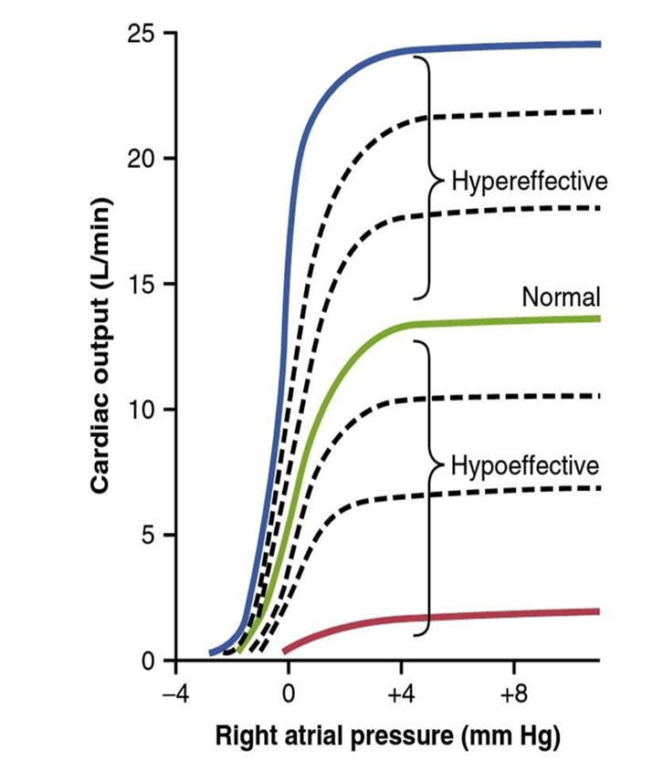
hypertrophy of the heart muscle
It causes the heart muscle to
increase in mass and contractile strength in the same way
that heavy exercise causes skeletal muscles to hypertrophy.
For example, the hearts of marathon runners may be increased
in mass by 50% to 75%. This factor increases the
plateau level of the cardiac output curve, sometimes 60% to100%,
and therefore allows the heart to pump much greater than the usual amounts of cardiac output.

Slide 24
Factors That Cause a Hypoeffective Heart
• Severe hypertension .
• Inhibition of nervous excitation of the heart .
• Pathological factors that cause abnormal heart .
rhythm or rate of heartbeat .
• Coronary artery blockage, causing a heart attack .
• Valvular heart disease .
• Congenital heart disease .
• Myocarditis, an inflammation of the heart muscle .
• Cardiac hypoxia .

Slide 25
Effect of Nervous System to Increase Arterial Pressure
During Exercise.
when local tissue blood vessels dilate and
increase venous return and cardiac output above normal,
the nervous system plays a key role in preventing the arterial
pressure from falling to disastrously low levels.
During exercise, the nervous system goes even further, providing
additional signals to raise the arterial pressure above normal,
which serves to increase the cardiac output an extra
30% to 100%.

Slide 26
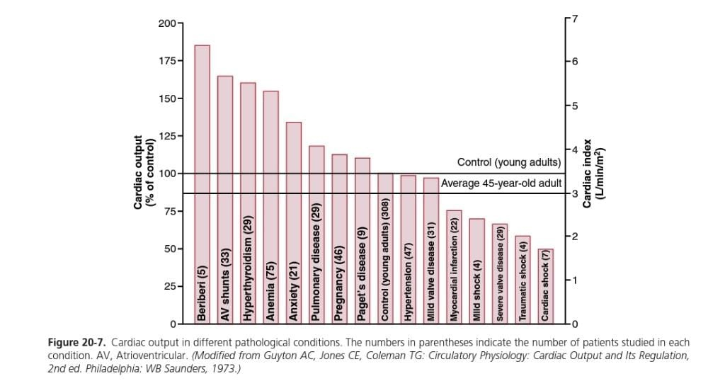
Cardiac output in different pathological conditions.

Slide 27
Decreased Cardiac Output Caused by Noncardiac Peripheral Factors—Decreased Venous Return
Decreased blood volume :from hemorrhage.
Acute venous dilation .
Obstruction of the large veins
Decreased tissue mass , as skeletal muscles .
Decreased metabolic rate of the tissues.

Slide 28
Circulatory shock :
Regardless of the cause of low cardiac output, whether it
is a peripheral factor or a cardiac factor, if the cardiac output
ever falls below the level required for adequate nutrition
of the tissues, the person is said to experience circulatory
shock. This condition can be lethal within a few minutes to
a few hours.

Slide 29
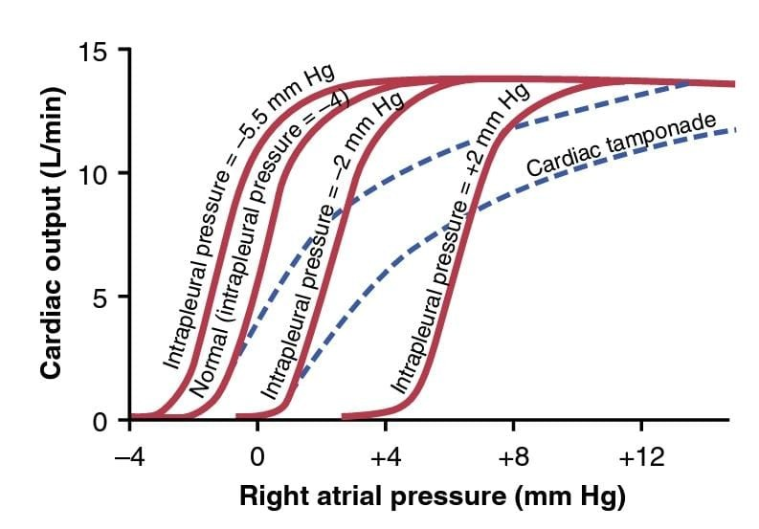
Effect of External Pressure Outside the Heart on
Cardiac Output Curves
The normal external pressure is equal to the normal intrapleural pressure (the pressure in the
chest cavity), which is about −4 mm Hg.
a rise in intrapleural pressure, to −2 mm Hg, shifts the entire cardiac output curve to the right by the same amount.

Slide 30

An increase in intrapleural pressure to +2 mm Hg requires a 6 mm Hg
increase in right atrial pressure from the normal −4 mm
Hg, which shifts the entire cardiac output curve 6 mm Hg to the right.

Slide 31

Some factors that can alter the external pressure on the heart and thereby shift the cardiac output curve are the following:
Cyclical changes of intrapleural pressure during respiration: ,
which are about ±2 mm Hg during normal
breathing but can be as much as ±50 mm Hg during
strenuous breathing .
Breathing against a negative pressure :
, which shifts the curve to a more negative right atrial pressure (to
the left).

Slide 32
Positive-pressure breathing : which shifts the curve to the right
Opening the thoracic cage: which increases the intrapleural pressure to 0 mm Hg and shifts the cardiac output curve to the right by 4 mm Hg
5. Cardiac tamponade, which means accumulationof a large quantity of fluid in the pericardial cavity around the heart with a resultant increase in external cardiac pressure and shifting of the curve to the right

Slide 33
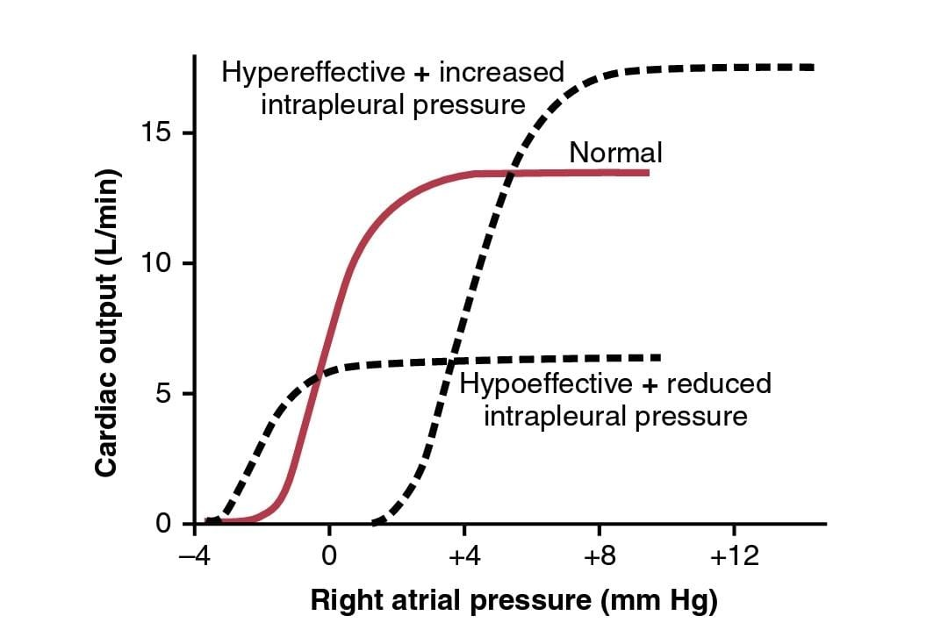
Combinations of Different Patterns of Cardiac Output Curves.
Shows that the final cardiac output
curve can change as a result of simultaneous changes in the following: (1) external cardiac pressure
(2) effectiveness of the heart as a pump

Slide 34
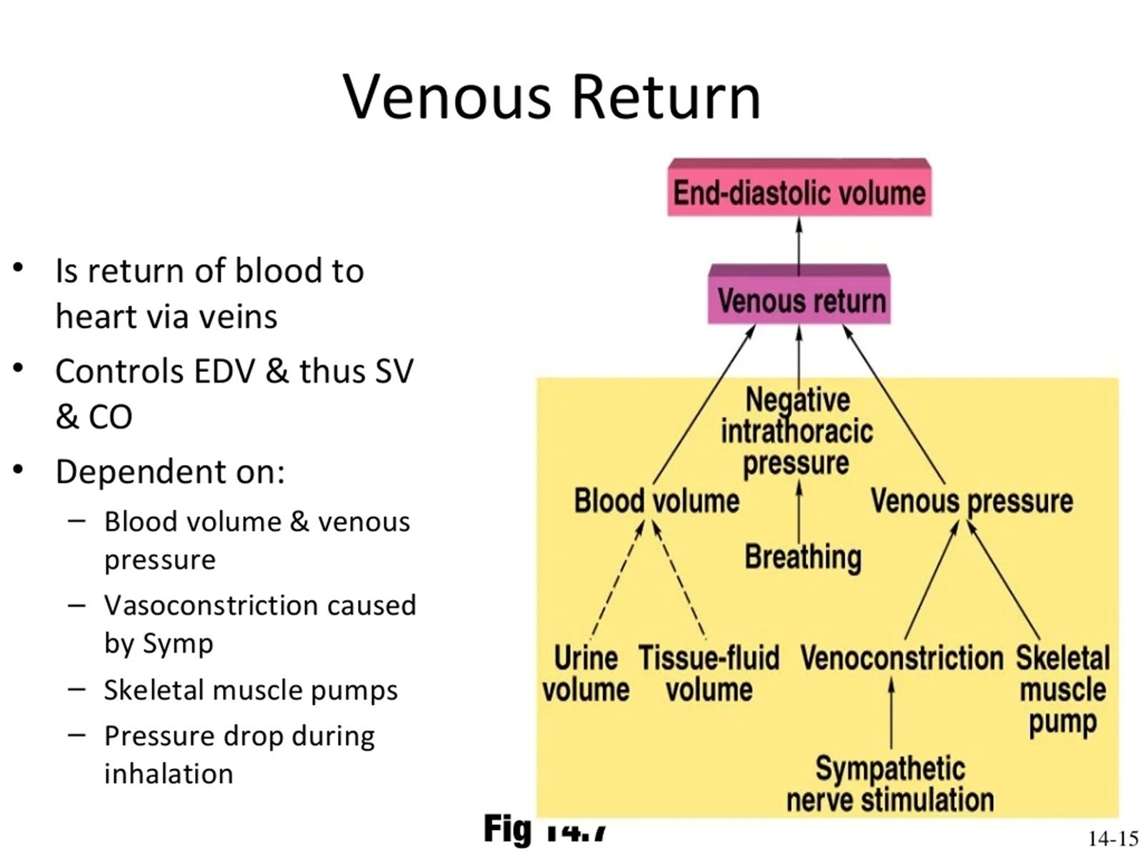

Slide 35
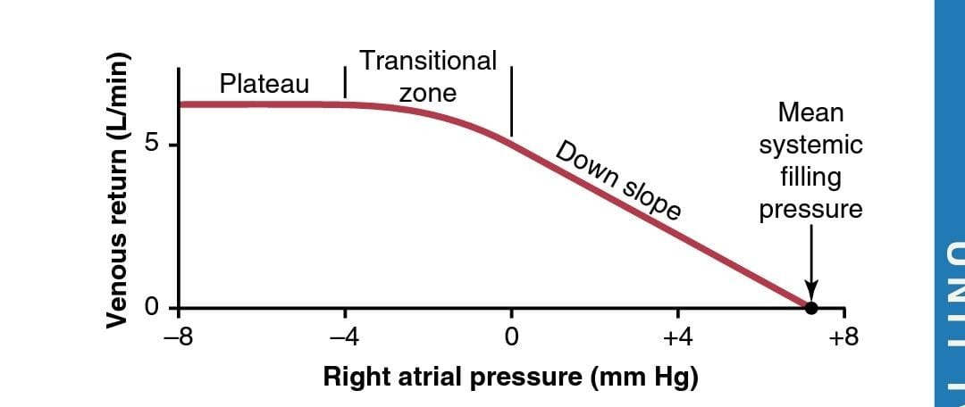
Normal venous return curve.
The plateau is caused by collapse of the large veins entering the chest when the right atrial pressure falls below atmospheric pressure.
Note also that venous return becomes zero when the right atrial pressure rises to equal the mean systemic filling pressure.

Slide 36
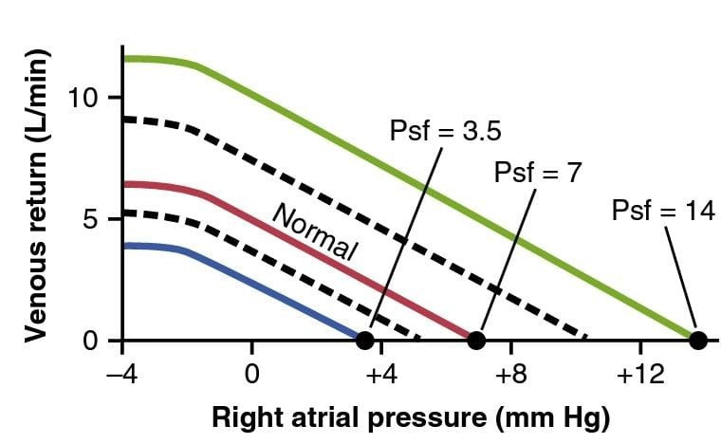
Mean Systemic Filling Pressure and Relationship to
Mean Circulatory Filling Pressure.
The mean systemic filling pressure (Psf). It is the pressure measured everywhere in the systemic circulation after blood flow has been stopped by clamping the large blood vessels at the heart,
so the pressures in the systemic circulation can be measured independently from those in the pulmonary circulation
The mean systemic filling pressure, although almost impossible to measure in a live animal, is almost always nearly equal to the mean circulatory filling pressure.

Slide 37
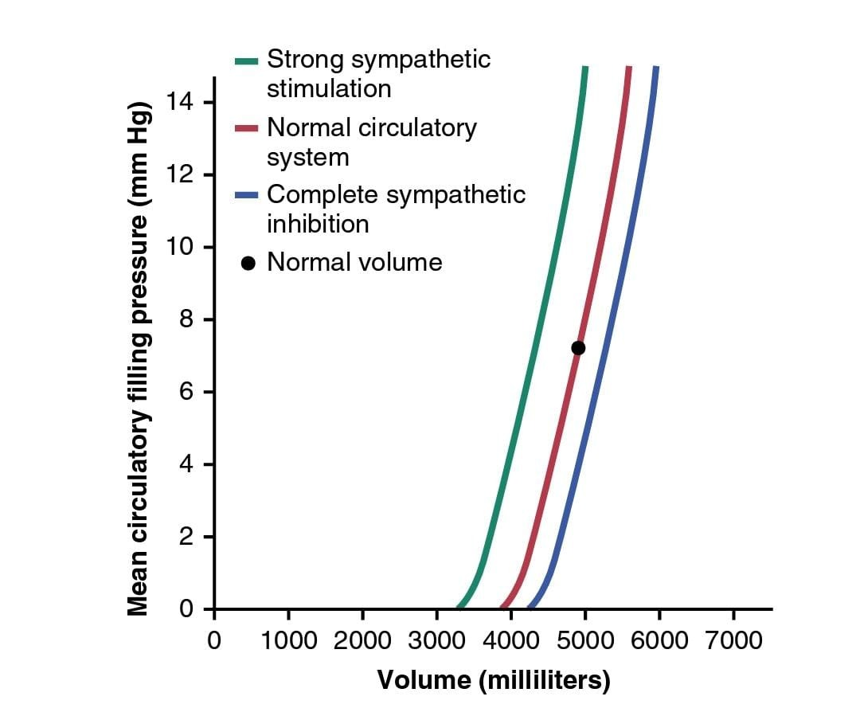
Sympathetic Nervous Stimulation Increases Mean
Circulatory Filling Pressure.
Effect of changes in total blood volume on the mean circulatory filling pressure (volume-pressure curve for the entire circulatory system).
These curves also show the effects of strong sympathetic stimulation and complete sympathetic inhibition.

