Slide 1

Electrical Cardiac Activity .
Dr. Amir AlJaradli
Cardiologist

Slide 2
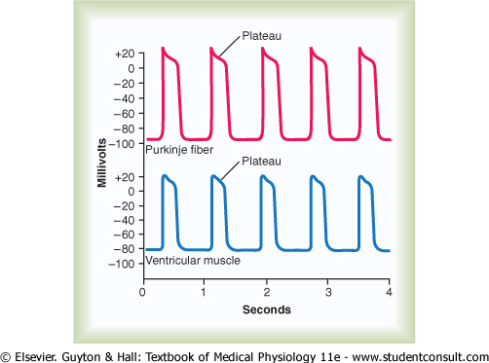
Action potantial of cardiac muscle :

Slide 3
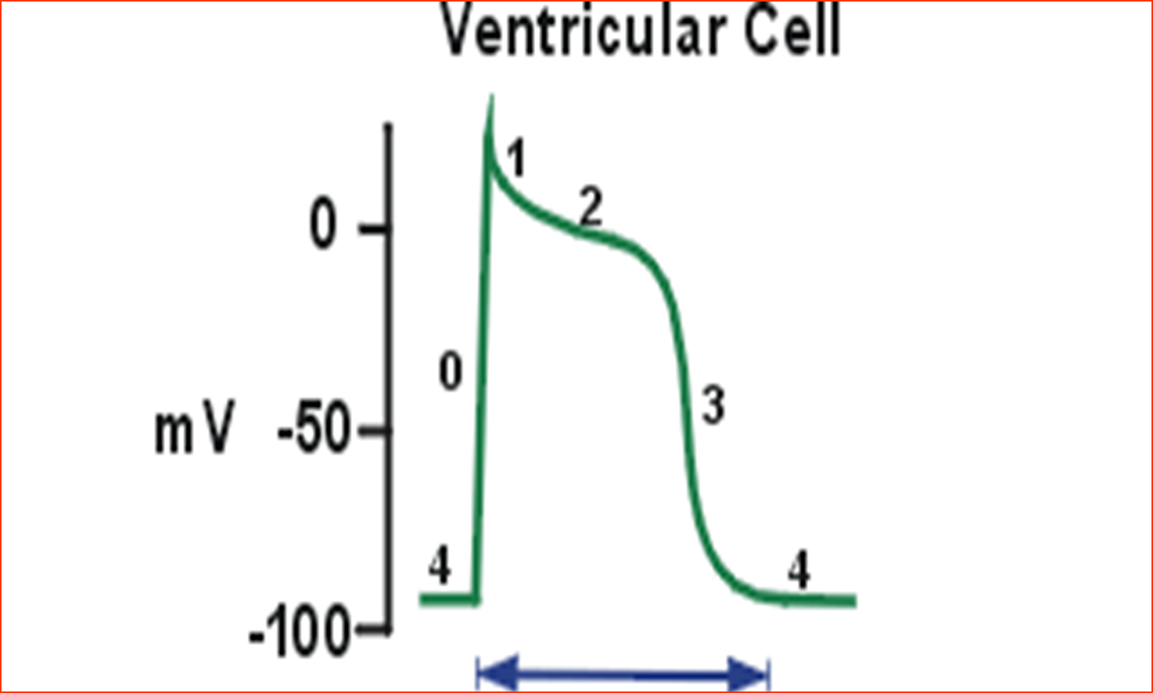
Cardiac action potntial
Depolarization
Repolarization
200 msec

Slide 4
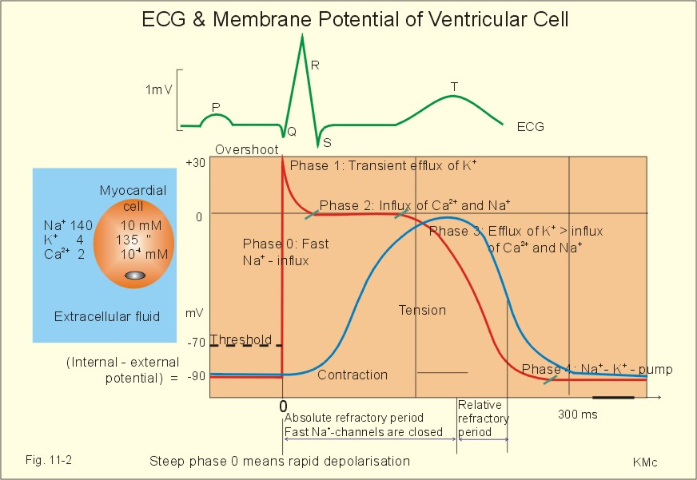
Cardiac action potential

Slide 5
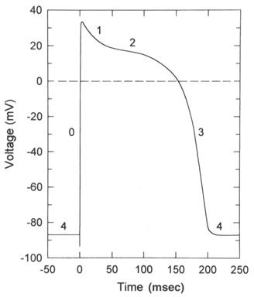
Action potential in the cardiac muscle .
The cardiac action potential is made of 3 phases:
Depolarization : caused by the
opening of Fast Na channels &
slow Ca channels
Plateau : remaining of slow Ca
Channels open for several m seconds , drawing large amount of Ca inside which prolong depolarization
Replarization:
Opening of potassium channels

Slide 6
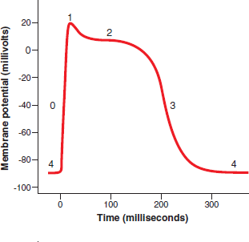
Action potential in the cardiac muscle .
The presence of Plateau in the action potential causes ventricular contraction to last as much as 15 times as long in cardiac muscle as in skeletal muscle
Guyton pp 110

Slide 7
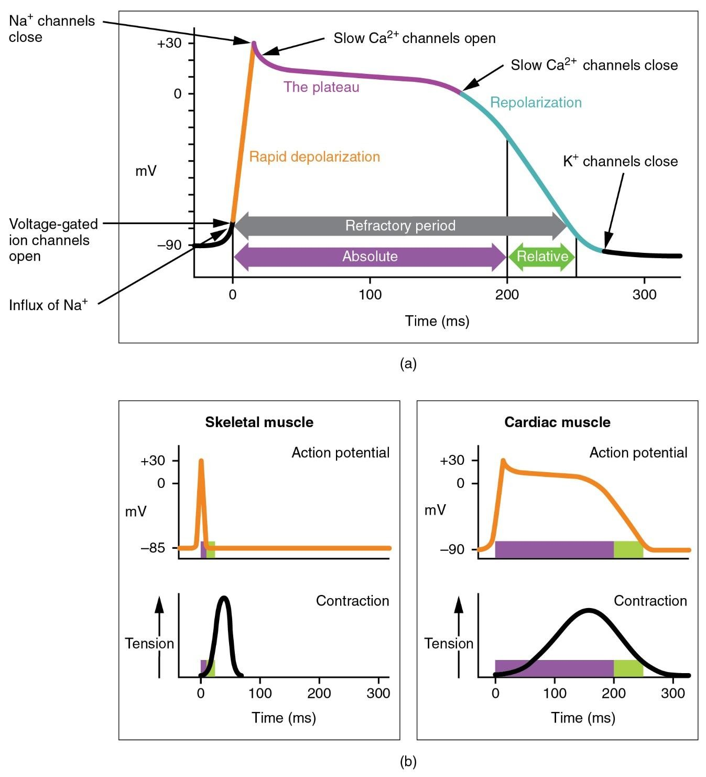
Action potential in the cardiac muscle .

Slide 8
Phase 0 (depolarization): Fast sodium channels open.
Voltage gated sodium channels (fast sodium channels) open and cell depolarize.
Membrane potential reaches about +20 millivolts before the sodium channels close.
Phase 1 (initial repolarization): fast sodium channels close.
Cell begins to repolarize, and potassium ions leave the cell through open potassium channels.

Slide 9
ACTION POTENTIAL IN THE CARDIAC MUSCLE
Phase 2 (Plateau), calcium channels open and fast potassium channels close. Initial repolarization
Occurs. Potassium ion efflux and increased calcium ion influx
causes the action potential to plateau.
Phase 3 (rapid repolarization), calcium channels close
and slow potassium channels open. The closure of calcium
ion channels and increased potassium ion permeability,
permitting potassium ions to rapidly exit the cell
Phase 4 (resting membrane potential) averages about
−90 millivolts.

Slide 10
WHY PLATEAU OCCURS
Voltage activated sodium channels, called fast channels
Voltage-activated calcium-sodium channels(L-type
calcium), slow to open, called slow channels.
Opening of fast channels causes spike of AP
Prolonged opening of the slow calcium-sodium channels
allows calcium to enter, cause plateau.
Moreover, voltage-gated potassium channels are slower to open. This delays the return of the membrane potential to −80 to −90 millivolts.

Slide 11
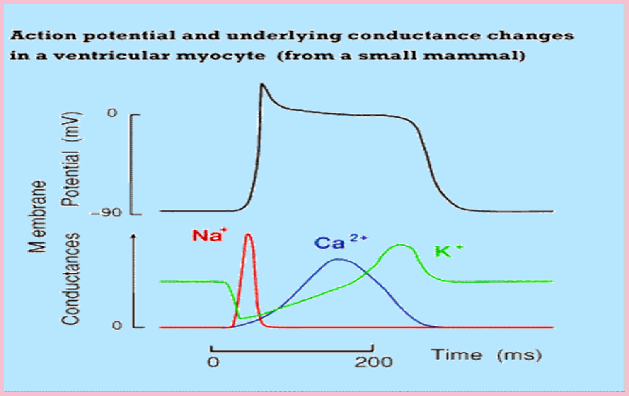
Plateau :

Slide 12
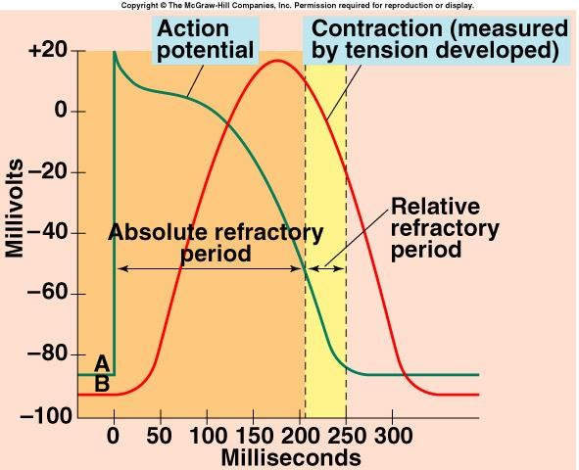
Refractory Periods
Heart contracts as
syncytium.
Contraction lasts
almost 300 msec.
Refractory periods last almost as long as contraction.
Myocardial muscle cannot be stimulated to contract again until it has relaxed.
Summation cannot
occur.

Slide 13
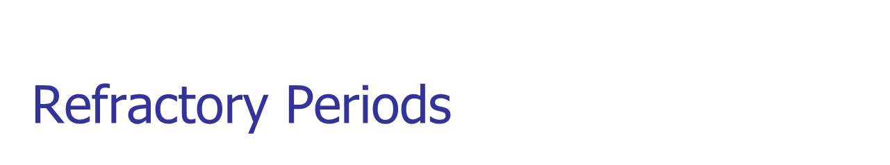
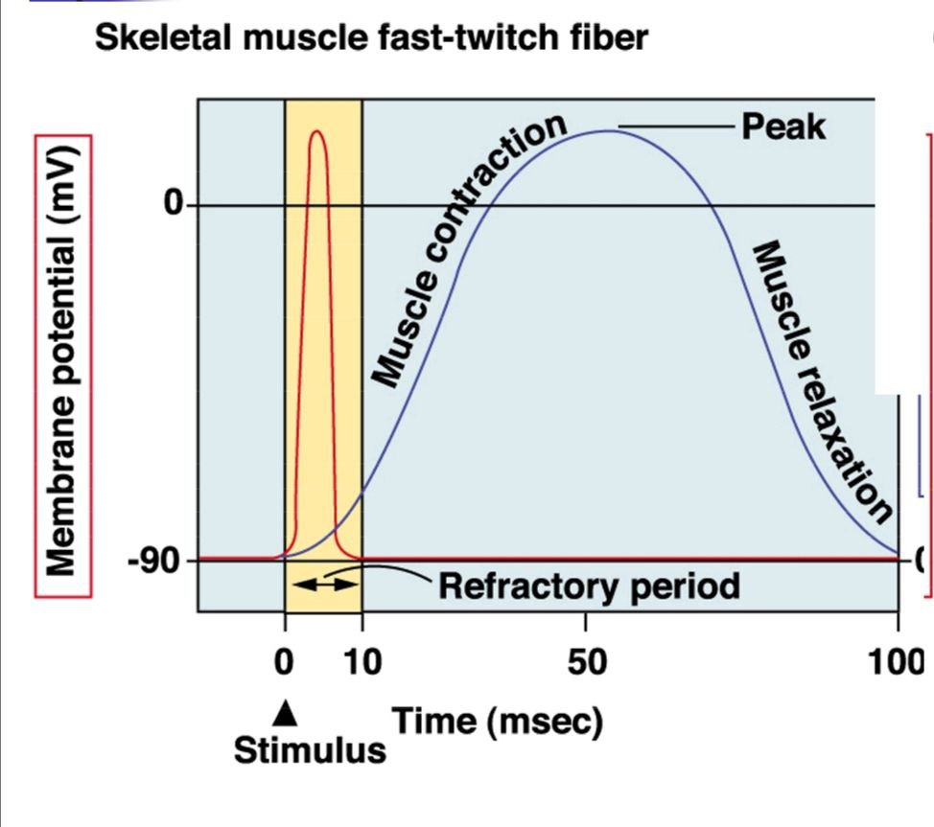
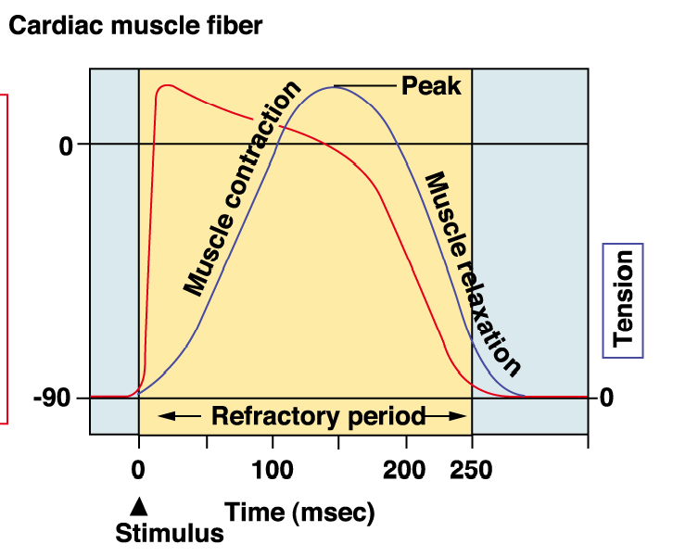
The refractory period is short in skeletal muscle, but very long in cardiac muscle.
This means that skeletal muscle can undergo summation and tetanus, via repeated stimulation
Cardiac muscle CAN NOT undergo sum action potentials or contractions and can’t be tetanized

Slide 14
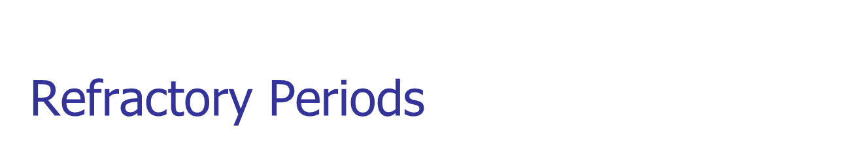


Long refractory period prevent ventricles from contracting at too high rates so that enough time is allowed for refill of the ventricles
Because long refractory period occurs in conjunction
with prolonged plateau phase,
Ensures alternate periods of contraction and
relaxation which are essential for pumping blood

Slide 15
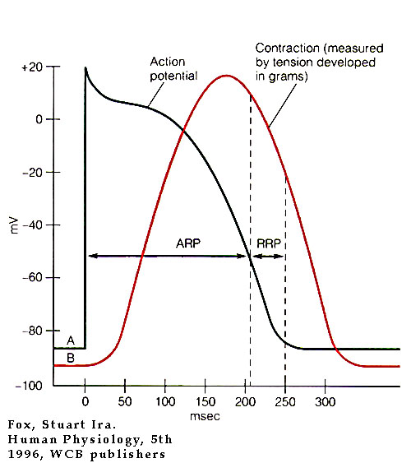
Refractory period
ARP: During normal cardiac impulse cannot be re-excited,
RRP: Strong excitation singal can be re-excited the cardiac muscle
RP: 0.15 sec atrium, 0.25-0.30 sec ventricles

Slide 16
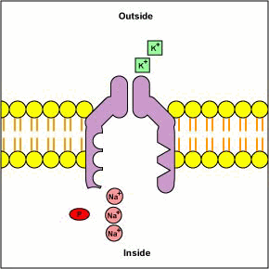
The Sodium-Potassium Pump (Na+K+ATPase)

Slide 17
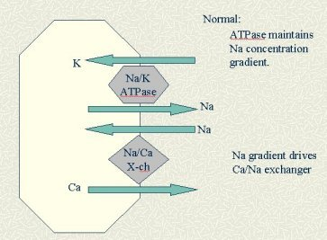
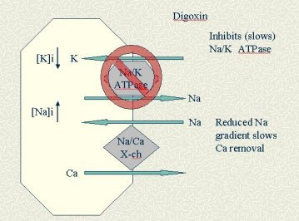
Digoxin

Slide 18
Velocity of action potantial
Velocity of cardiac action potantial:
0.3-0.5 m/sec in atrial and ventricular muscle (1/250 the velocity of large nerve fibers, 1/10 the velocity of skeletal muscle fibers)
4 m/sec in purkinje system

Slide 19
Skeletal muscle vs Heart muscle
Skeletal muscle | Heart muscle
Fast Na Chanal Ca : intracelluar SR SR more developed AP short Contraction short T tubule small | Fast Na Chanal, Slow Ca Chanal Ca: extracellular and SR SR less developed AP long (plateau phase) Contraction long (15 times)in ventericular muscle T tubule large( 5 times great) SR less developed

Slide 20
Contraction and relaxation
Excitation-Contraction Coupling

Slide 21
Three major types :
Contractile cells:
Atrial muscle
Ventricle muscle
Autorhythmic (or automatic) cells
Specilized excitatory and conductive muscle fibers.

Slide 22
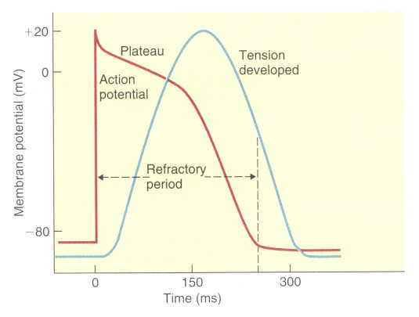
Excitation-Contraction Coupling

Slide 23
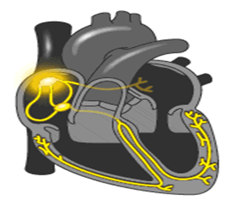
Rhythmical Excitation of the Heart :

Slide 24
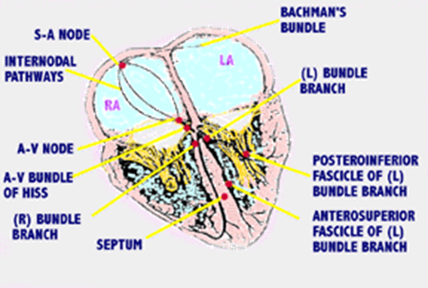
Conduction system

Slide 25
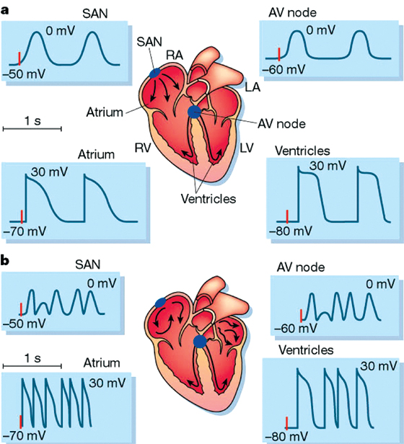
AP in the heart

Slide 26
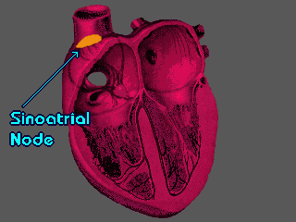
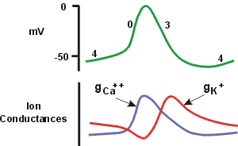
S-A Node :
The Sinoatrial (or sinus ) node is located in the superior posterolateral wall of the right atrium below and slightly lateral to the opening of the superior vena cava.

Slide 27
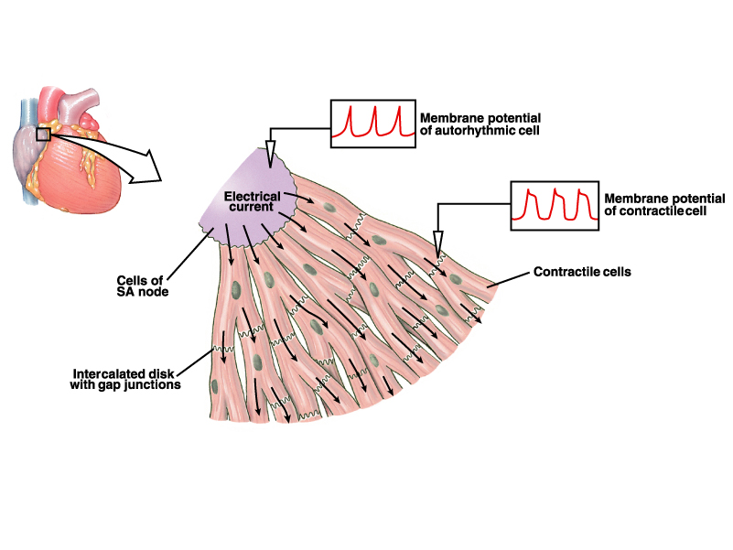
S-A Node
The SA node controls the heart rate and is called the pacemaker of the heart
SA nodal fibers connect directly with atrial muscle fibers.
No contractile muscle filament
AP that begins in SA node speared immediately to atrial muscle
SA node has the fastest rate of autorhythmicity.

Slide 28
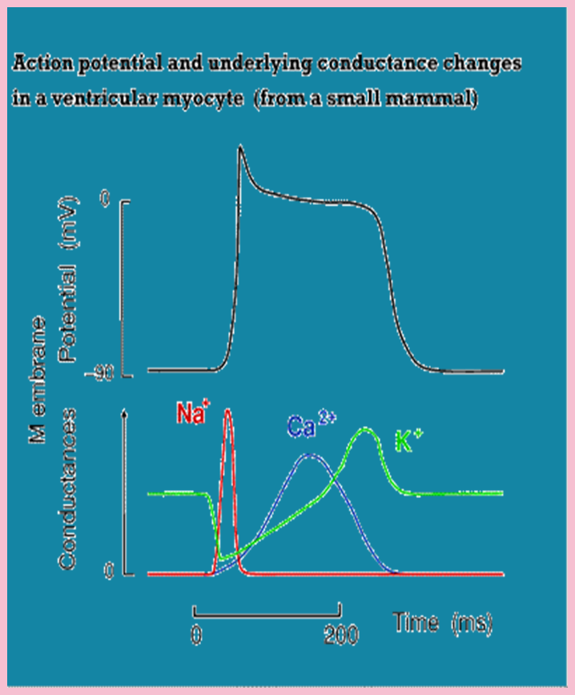
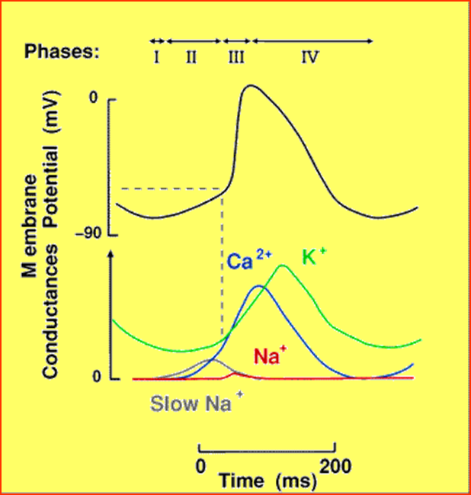
AP in the SA node

Slide 29
Pacemaker potential in SA node
The resting membran potential (prepotential, resting potantial) of nodal cells is (- 55 to - 60 mv)
The upstroke of the AP (phase 0) has a slower rise time ( fast Na channel inactiveted, Ca-Na channel can open, after 100-150 msec closed)
A plateau is absent (phase 1,2 not found) (-40 activeted T type Ca channel, after that L type Ca, then increased number of K channel open)
Phase 3: Repolarization is more gradual,exces of positive potasium charge out the cell.
Phase 4: Activation of Na-K ATP ase and self-ecxitation to cause new AP.

Slide 30
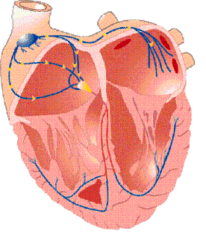
Self - excitation of SA node
High Na ion concentration in the extra cellular fluid , and negative electrical discharge inside the SA node fibers. The Na ions even normally tend to leak to the inside. Therefore between two beats the AP gradually rise, when the potential rises to -50 millivolts, the Na-Ca channels become activated leading to rapid entry of Ca and Na ions. After 100-150 milliseconds. These channel become inactivated, and K channels open. This process continuous a person’s life.

Slide 31
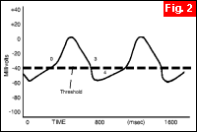
Hyperpolarization
Hyperpolarization (increased premeability of K, increased negativity into the cell. -60>>>>-70)

Slide 32
CARDIAC IMPULSE FROM SA NODE TO ATRIAL MUSCLE
The cardiac impulse after it’s origin in the SA node spreads
through out the atrial muscle through two routes
Ordinary Atrial muscle fibers
Anterior, middle and posterior conducting bundles
Anterior internodal bundle of Bachman
Middle internodal bundle of Wenkebach
Posterior internodal bundle of Thoral
These inter nodal pathways conduct the impulses at a faster rate than atrial muscle fibers, because of specialized conduction fibers.

Slide 33
CARDIAC IMPULSE FROM SA NODE TO ATRIAL MUSCLE
The velocity of conduction in most atrial muscle is about 0.3m/sec.
In the specialized internodal pathways the conduction velocity may reach upto 1m/sec.
The impulse after leaving SA node takes
0.03 sec to reach the AV node.

Slide 34
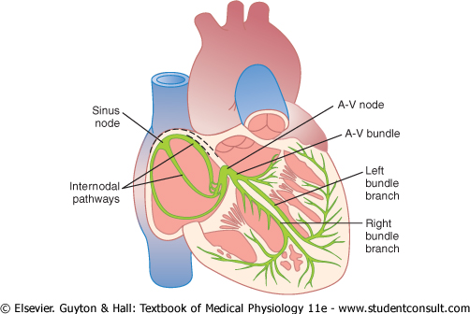
Atrial excitation
SA connceted directly to surrounding atrial muscle fibers.
After 0.09 sec, two atrium completlly depolarized.

Slide 35

Interatrial and Internodal pathway
Anterior interatrial band (Bachman pathway): pass through the anterior wall of the atrium to the left .
Intranodal bands:
anterior (Bachman) ,
middle (Wenckebach),
posterior (Thorel).

Slide 36
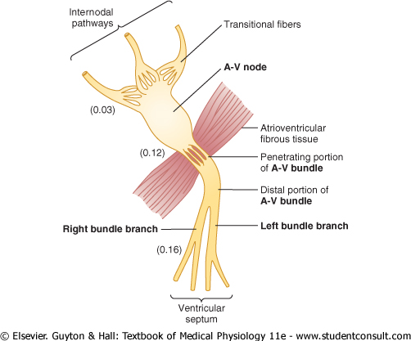
Interatrial and Internodal pathway
After 0.03 sec the AP reaches to the AV node.

Slide 37
Atrioventricular node (A-V node)
Located in the posterior wall of the right atrim, immediately behind tricuspid valve and adjacent to the opining of the coronary sinus.
The impulse reaches the A-V node about 0.03 sec after its origin of S-A node.
Delay about 0.09 sec in the A-V node, And 0.04 sec in the AV bundle (0.13 sec) allows time for the atrial filling their blood into the ventricles befor ventricular contraction.
Total delay: 0.16 sec from SA node to ventricular excitation

Slide 38
AV NODE :
The AV node is located in the posterior wall of the right atrium immediately behind the tricuspid valve.
Slow Conduction in the AV Node:
The cause of slow conduction
is mainly
diminished number of
gap
cells in the
junctions
between the successive
conducting pathways.

Slide 39
Significance of AV nodal delay :
The cardiac impulse does not travel from the atria to the ventricles too rapidly.
This delay allows time for the atria to empty their blood into the ventricles before ventricular contraction begins.
This increases the efficiency of the pumping action of the heart.

Slide 40
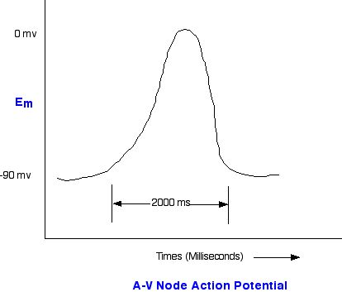
AP in A-V node

Slide 41
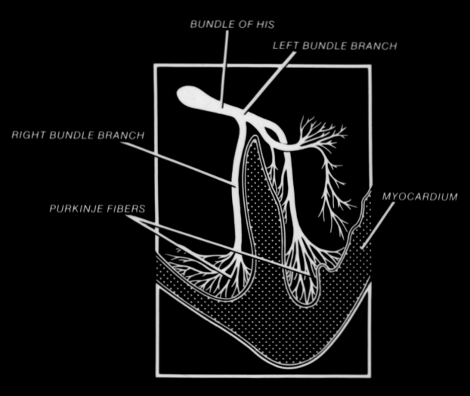
Bundle branches :

Slide 42
Bundle branches :
Impulse conduction between bundle branches to purkinje system: 0.03 sec
Endocardium to epicardium (muscle):0.03 sec
Total from initial of ventricular septum muscle fiber:0.06 sec (synchronous contraction)
Total from SA node to epicardium surface : 0.22 sec

Slide 43
RIGHT AND LEFT BUNDLE BRANCHES
Bundle of His splits into two branches which are called right and left bundle branches present on the respective sides of the ventricular septum.
From the time the cardiac impulse enters the bundle branches until it reaches the terminations of Purkinje fibers , the total time averages only 0.03 sec.

Slide 44
PURKINJEE FIBERS
Purkinje fibers are very large fibers and they transmit AP at a velocity of 1.5 to 4.0 m/sec.
The rapid transmission of action potentials through the Purkinje fibers is believed to be caused by a very high level of permeability of gap junctions at the intercalated discs between the successive cells of Purkinje fibers.
The rapid conduction through the purkinje fibers ensures that different parts of ventricles are excited almost simultaneously; this greatly increases the efficiency of heart as a pump.

Slide 45
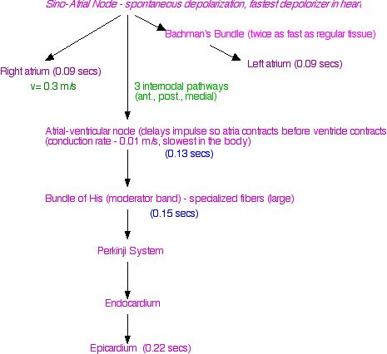
Conduction system

Slide 46
CONDUCTION OF IMPULSE
APs from SA node spread quickly at rate of 0.8 - 1.0 m/sec.
Time delay occurs as impulses pass through AV node.
  Slow conduction of 0.03 – 0.05 m/sec.
Impulse conduction increases as spread to Purkinje fibers at a velocity of 4.0 m/sec.
  Ventricular contraction begins 0.1–0.2 sec. after
contraction of the atria.

Slide 47

One-Way conduction
SA Node interatrial pathway AV Node His of bundle bundle branch endocardium surface ventricular muscle epicardium surface

Slide 48
ONE- WAY CONDUCTION THROUGH AV BUNDLE
A special characteristic of the A-V bundle is it’s inability of action potentials to travel backward from the ventricles to the atria.
This prevents re-entry of cardiac impulse by this route from the ventricles to the atria.
The atrial muscle is separated from the ventricular muscle by a continuous fibrous barrier which acts as an insulator to prevent the passage of cardiac impulse between the atrial and ventricular muscle

Slide 49
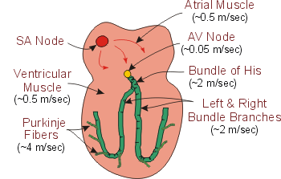
Velocity of AP

Slide 50
Control of the excitation and condution
Intrinsic Rythmical rate of :
SA node : 60 - 100 per minute (usually 70 - 80 per minute)
AV node & AV bundle : 40 - 60 per minute
Bundle branches & Purkinje fibers : 15 - 40 per minute
SA node: rhythmical discharge is greater than AV node or purkinje system >>> Pacemaker

Slide 51
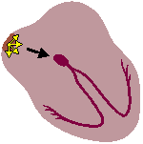
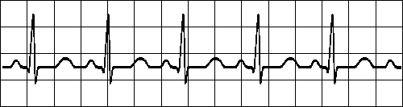
SA node
 | All complexes normal, evenly spaced Rate > 100/min

Slide 52
AV node ectopic beat
AV node Beat
QRS is slightly different but still narrow,
indicating that conduction through the
ventricle is relatively normal
there is no p wave, indicating that it did not originate anywhere in the atria, but since the QRS complex is still thin and normal looking. The beat is therefore called a “nodal” beat

Slide 53
ventricular ectopic beat
QRS is wide and much different ("bizarre") looking than the normal beats. This indicates that the beat originated somewhere in the ventricles and consequently, conduction through the ventricles did not take place through normal pathways. It is therefore called a “ventricular” beat
Ventricular
Ectopic Beat
there is no p wave, indicating that the beat did not originate anywhere in the atria

Slide 54
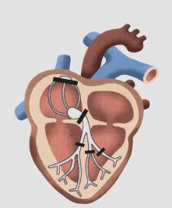
Ectopic pacemaker

Slide 55
Stokes-Adams syndrome
Stokes-Adams attacks occur most frequently in patients after sudden complete atrioventricular heart block and a pulse of 40 or less per minute (the purkinje system begins after 5-20 sec )
Sudden loss of consciousness about 4-5 sec
Lack of blood flow to brain

Slide 56
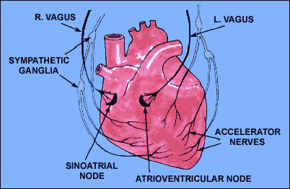
Control of heart rhythmicity

Slide 57
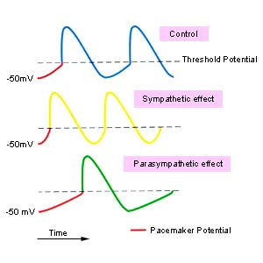
Sympathetic stimulation
Stimulation: the hormone norepinephrine
Increases permeability of fibers to Ca and Na ions
More positive AP

Slide 58
Sympathetic system (NE)
Increased the rate of SA node discharge: positive chronotropy
Increased the rate of conduction:
Positive dromotropy
Increased the force of contraction:
Positive intropy

Slide 59
Parasympathetic system (Ach)
Stimulation: the hormone acetylcoline
Increases the permeability of K ions
Longer threshould potential

Slide 60
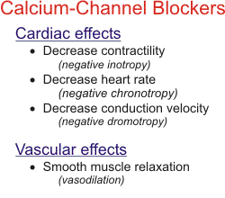
Parasympathetic system (Ach)

Slide 61
Autonomic nerve system
Heart rate:
Chronotropic
Conduction velocity:
Dromotropic
The force of contraction:
Intropic
The force of relaxation:
Lusitropic

Slide 62
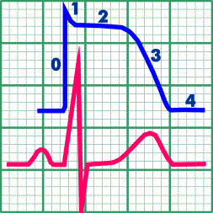
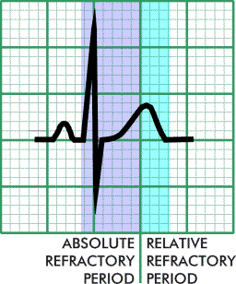
AP and ECG

