Slide 1
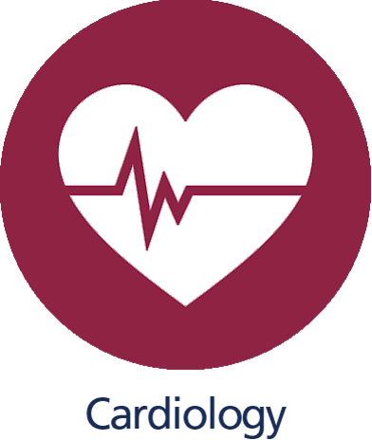
Mechanical activity of the heart & Cardiac cycle
Dr. Amir Al-Jaradli
Cardiologist

Slide 2
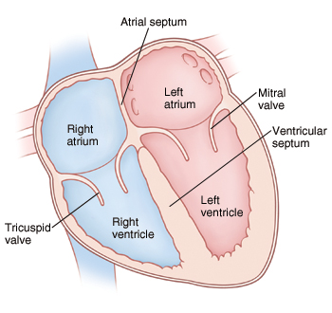
Chambers :
The heart’s weight:
280-340 gm in men
and 230-280 gm in women.
Two pumps:
Right heart: Pulmonary circulation
Left heart : Peripheral circulation
The heart has four chambers:
Right Atrium, Right Ventricle
Left Atrim, Left Ventricle

Slide 3
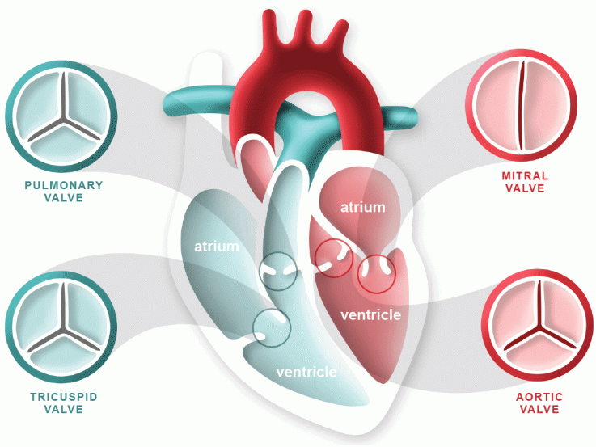
Valves :
Mitral valve
( LA , LV)
Tricuspid valve
( RA,RV)
Aortic valve
( LV, aortic artery)
Pulmonic valve
(RV, pulmonary artery)
Mitral valve and tricuspid valve:
Atrioventricular valves
Pulmonic and aortic valve :
Semilunar valves

Slide 4
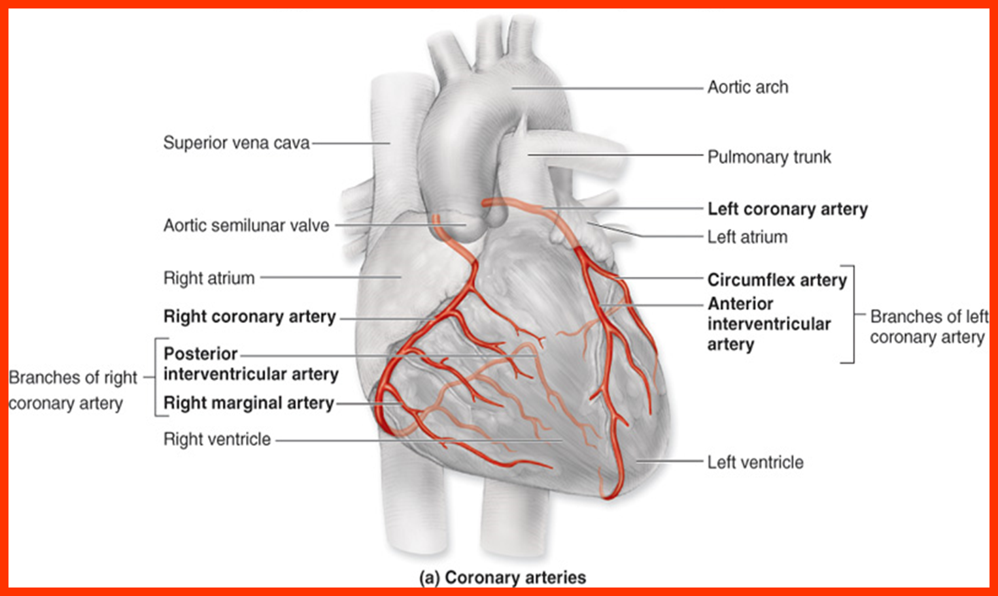
Coronary arteries :

Slide 5
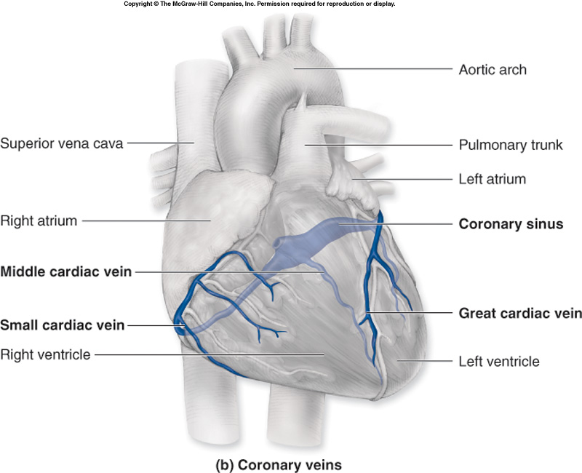
Coronary veins :

Slide 6
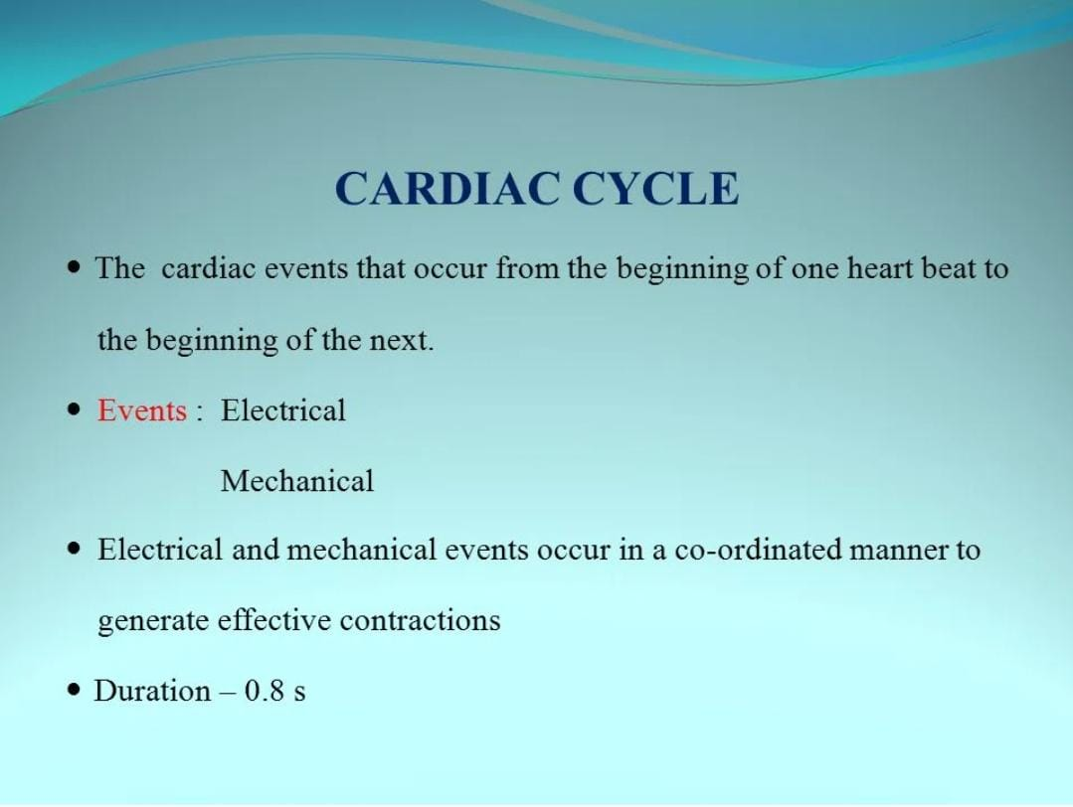

Slide 7
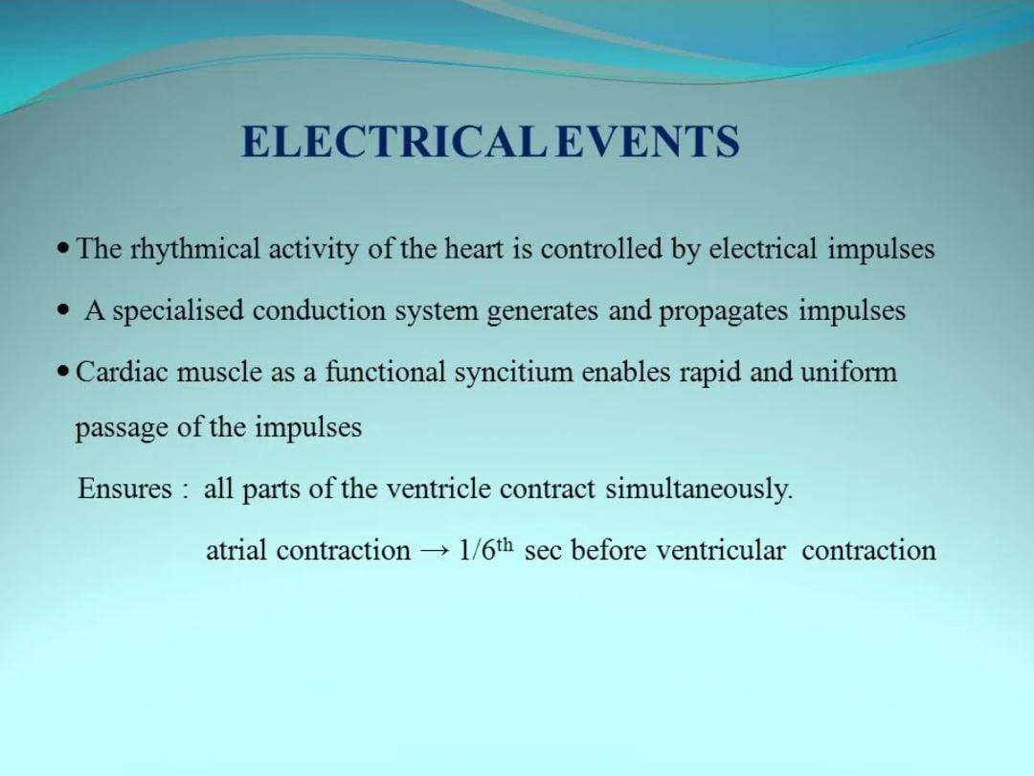

Slide 8
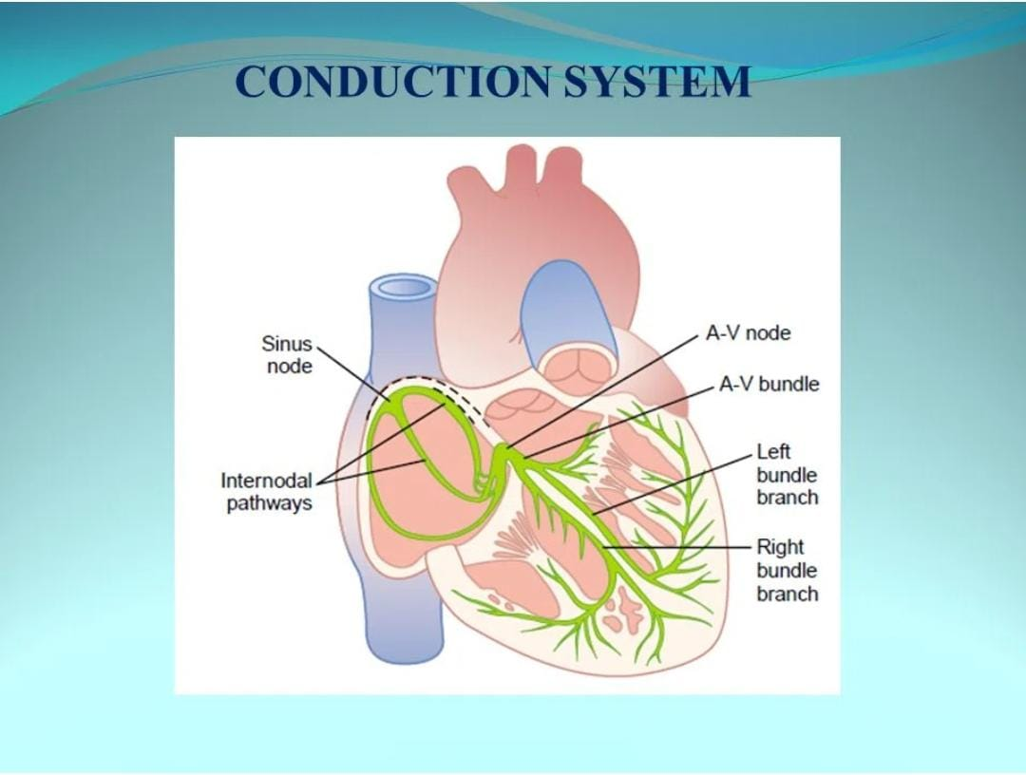

Slide 9
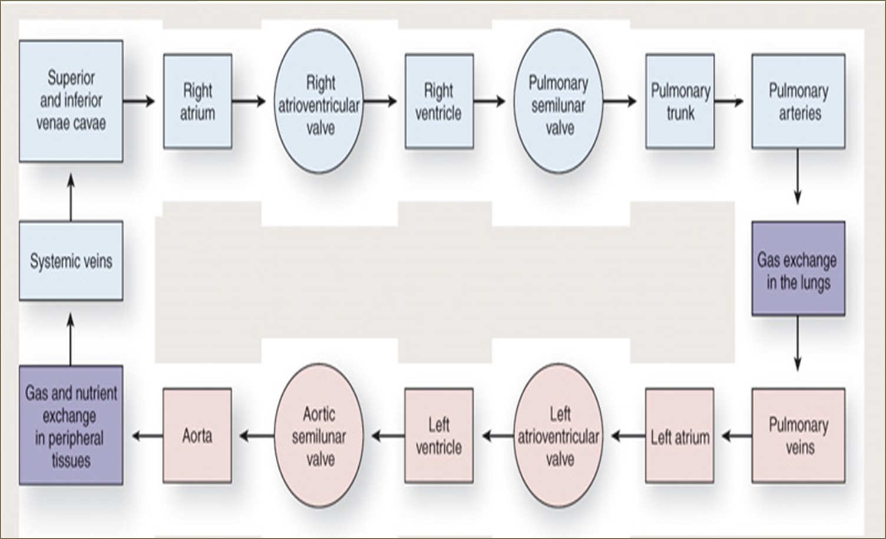

Slide 10
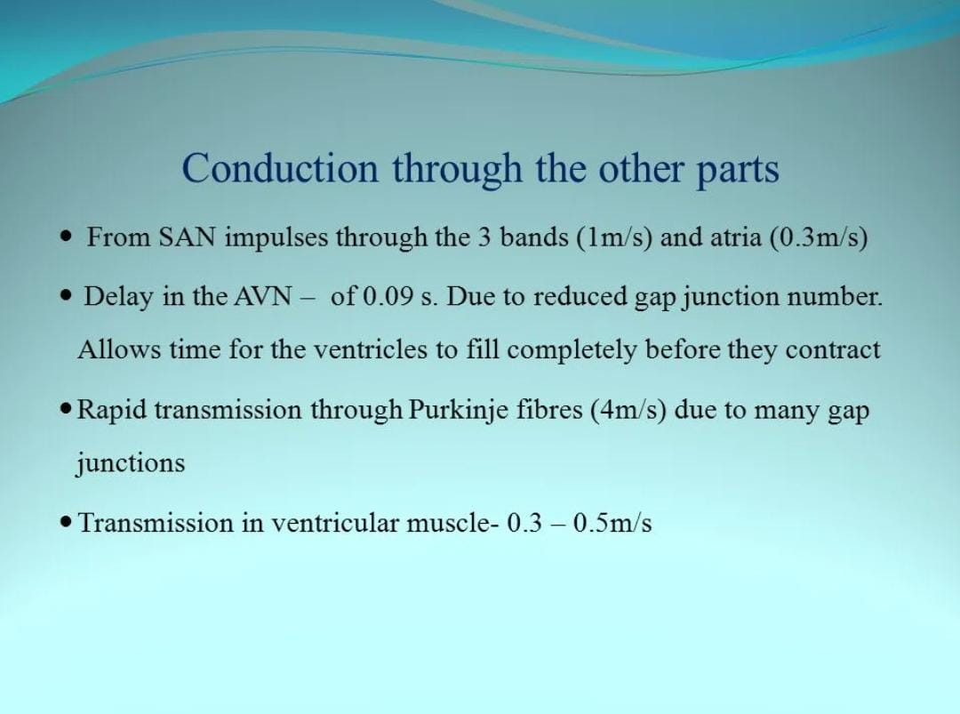

Slide 11
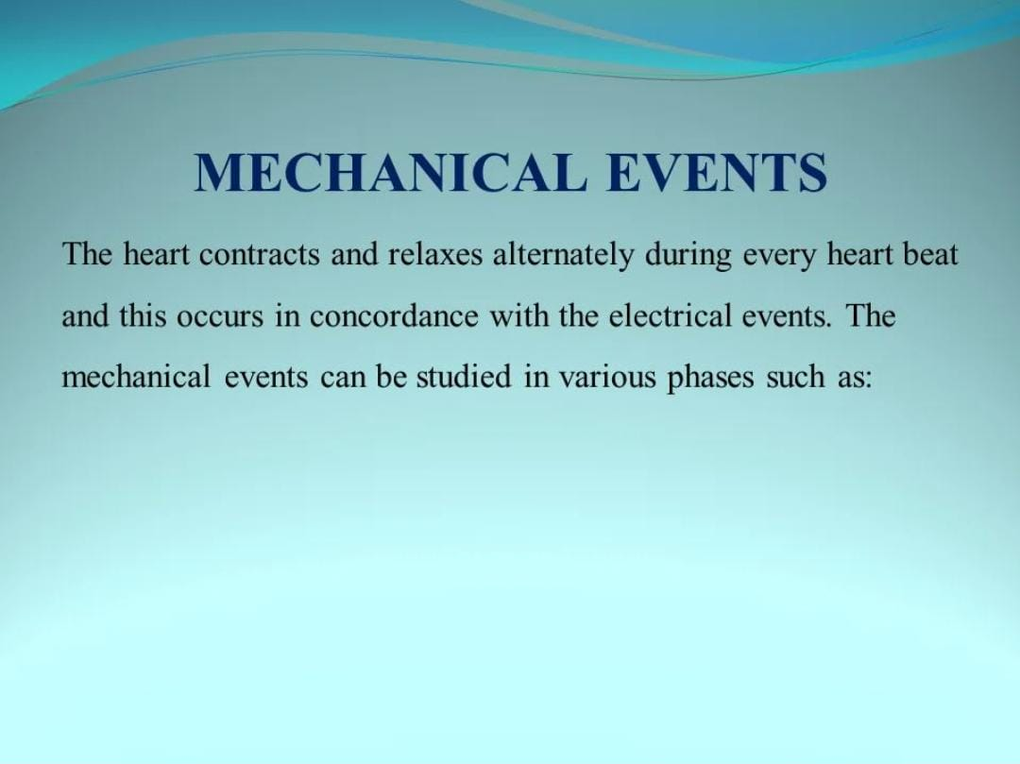

Slide 12
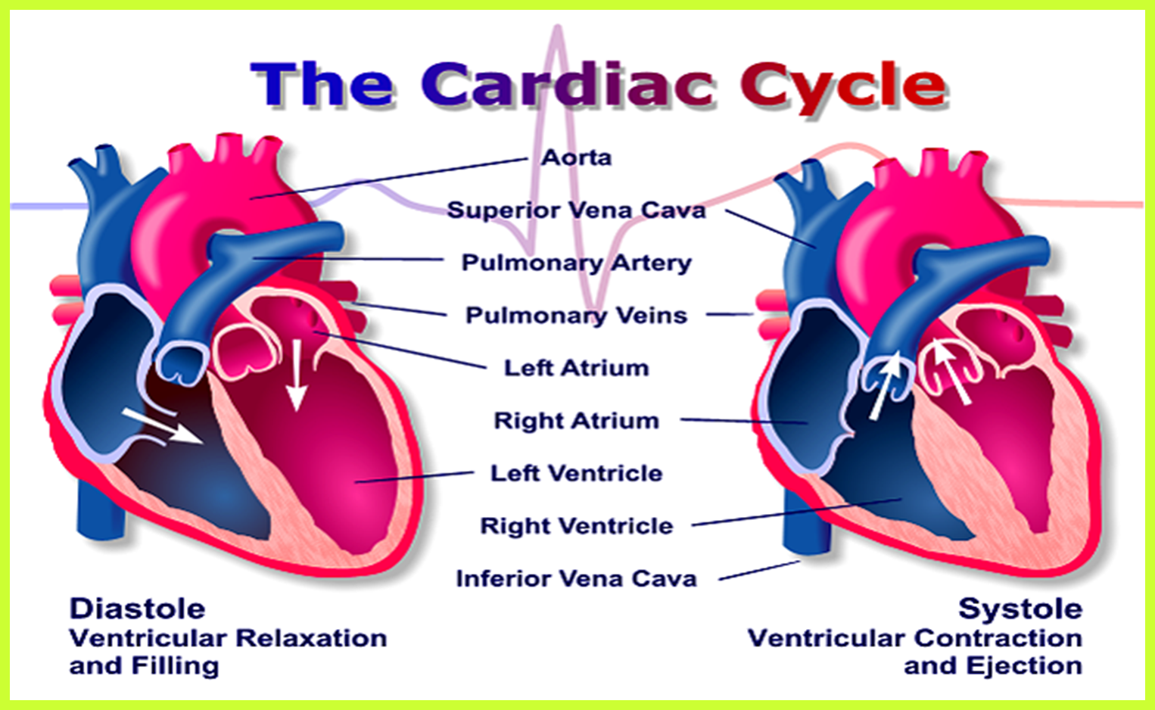

Slide 13
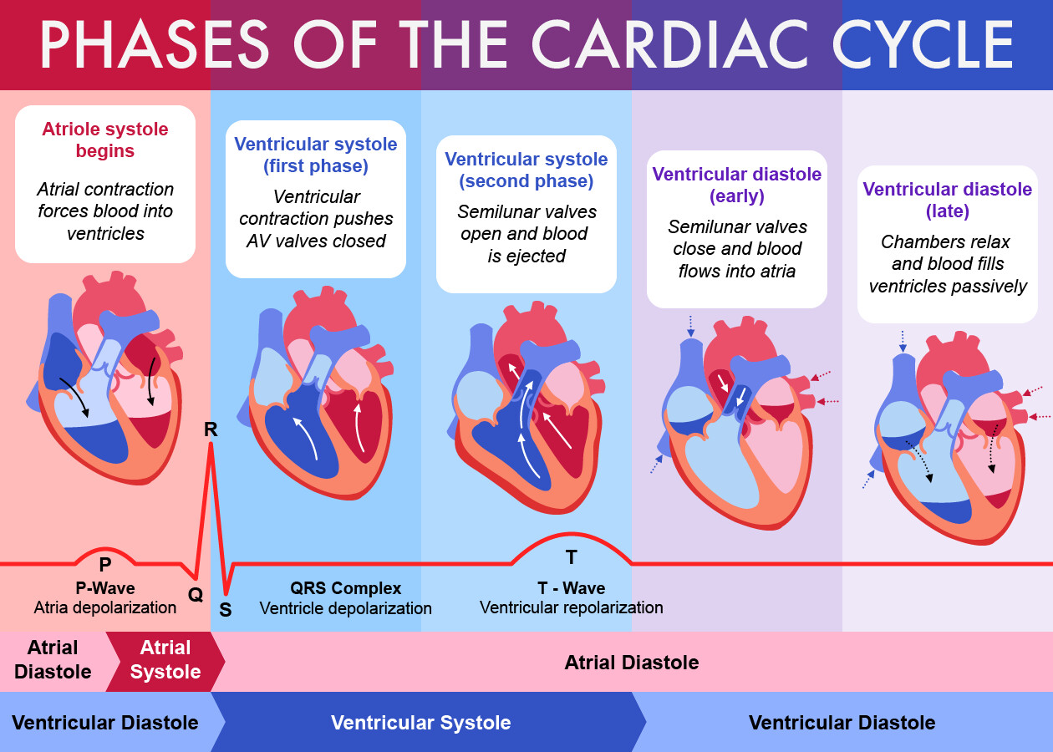
Cardiac cycle :

Slide 14
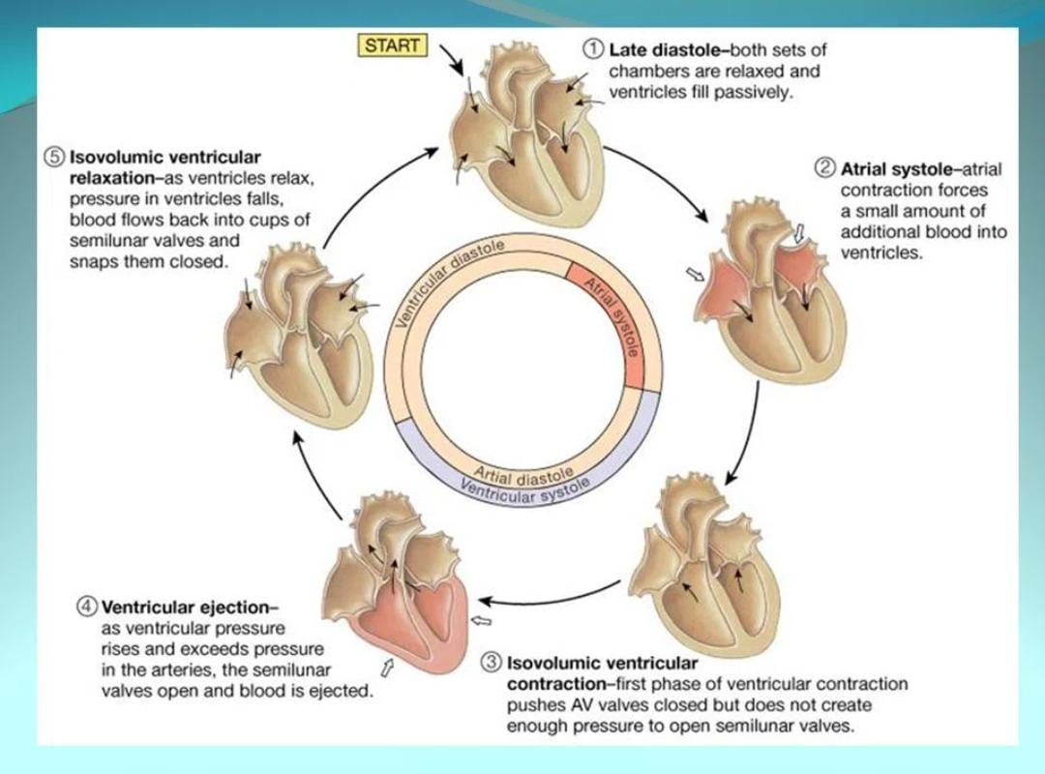

Slide 15
Systole :
Definition :
Mechanical : mitral valve closure to aortic valve closure
Can be divided into 4 phases:
Atrial systole .
Isovolumic contraction phase .
Maximum ejection phase .
Minimum ejection phase .

Slide 16
Diastole :
Definition :
Mechanical: The interval from Aortic valve closure (end-systole) to Mitral valve closure (end-diastole)
Can be divided into 4 phases:
Protodiastolic phase .
Isovolumic relaxation phase .
Rapid filling phase .
Slowly filling phase (Diastasis)

Slide 17
Each cycle we should understand this points :
Atrial pressure
Ventricular pressure
Ventricular volume
Aorta
Valves
Heart sounds
ECG

Slide 18
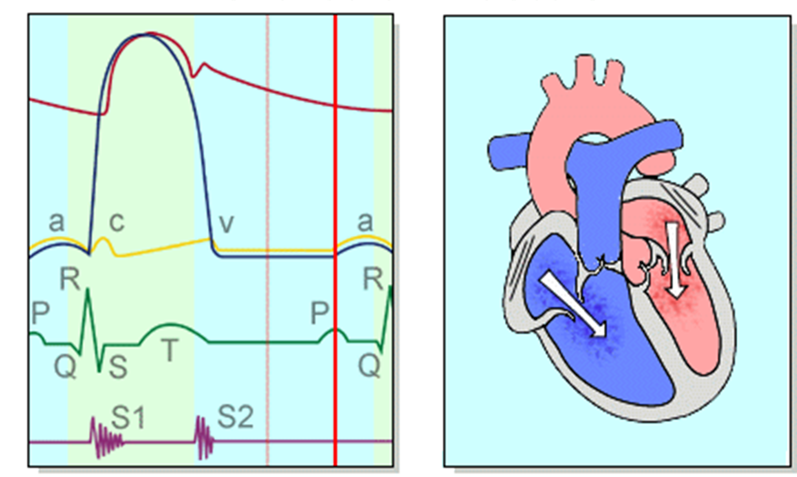
Atrial systole :

Slide 19
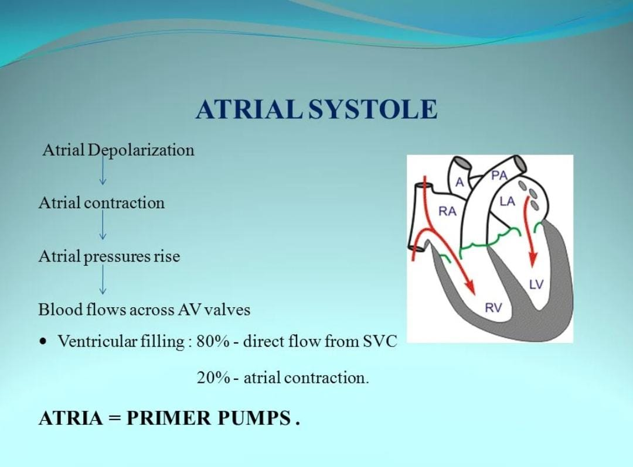

Slide 20
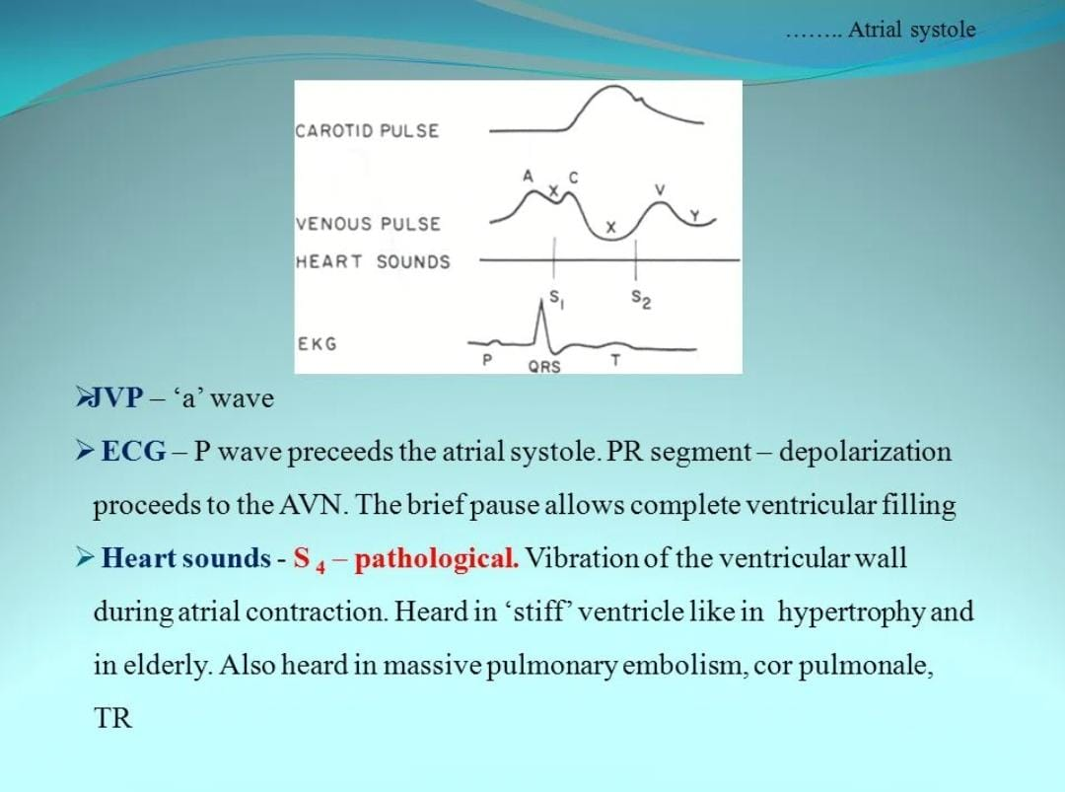

Slide 21
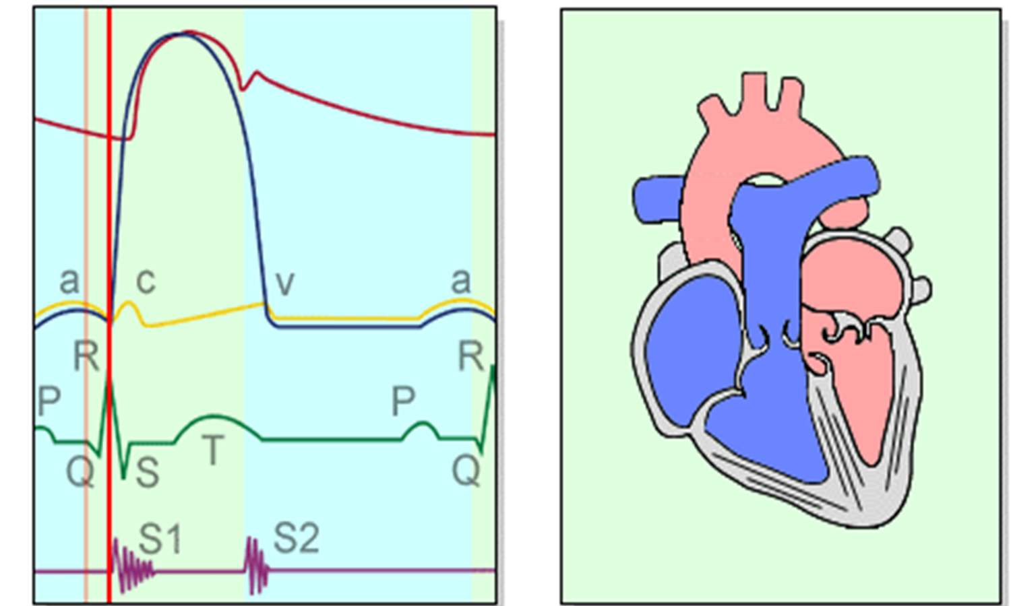
Isovolumic contraction :

Slide 22
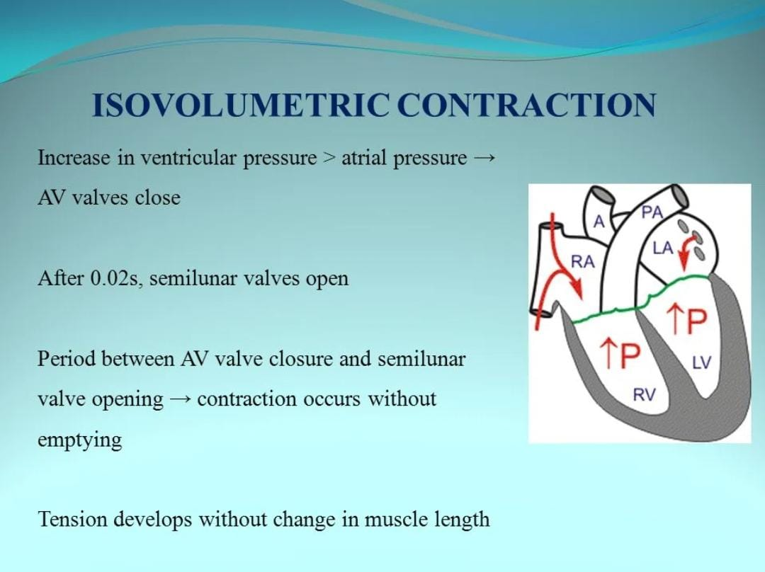

Slide 23
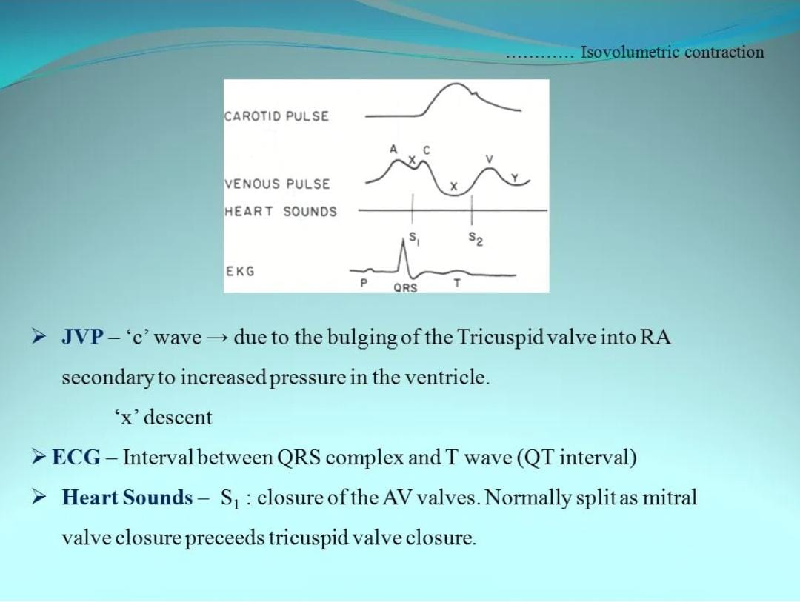

Slide 24
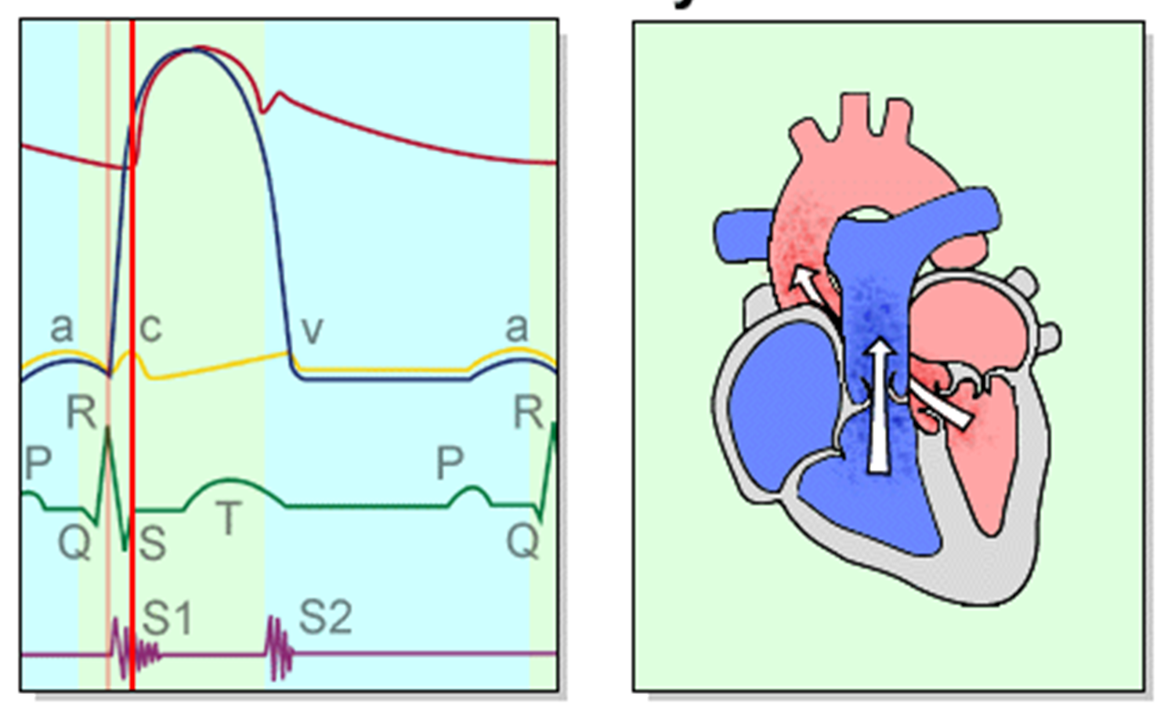
Ejection :

Slide 25
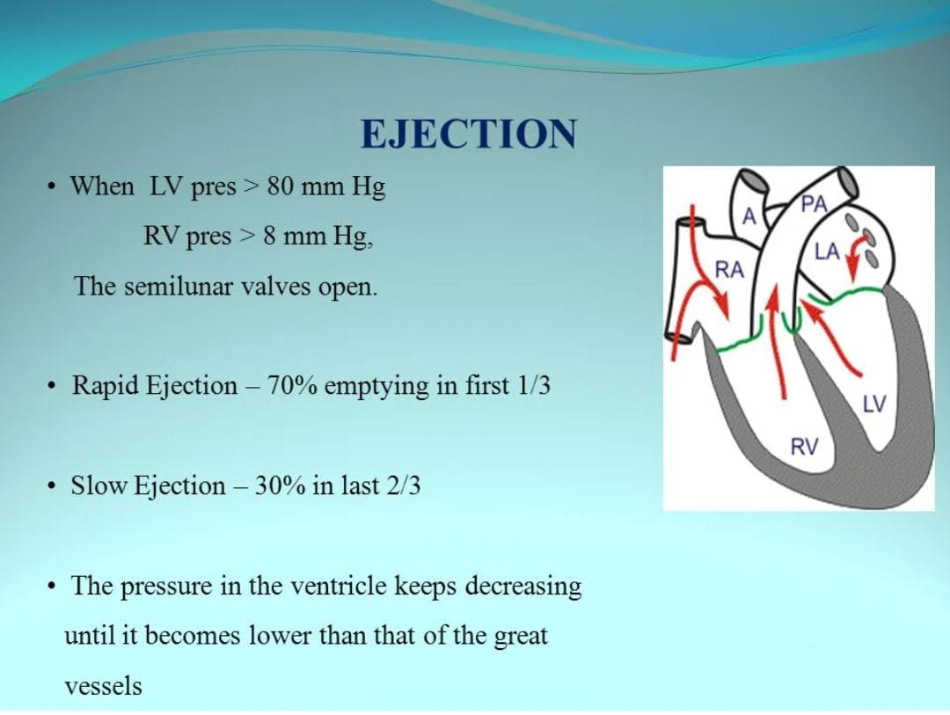

Slide 26
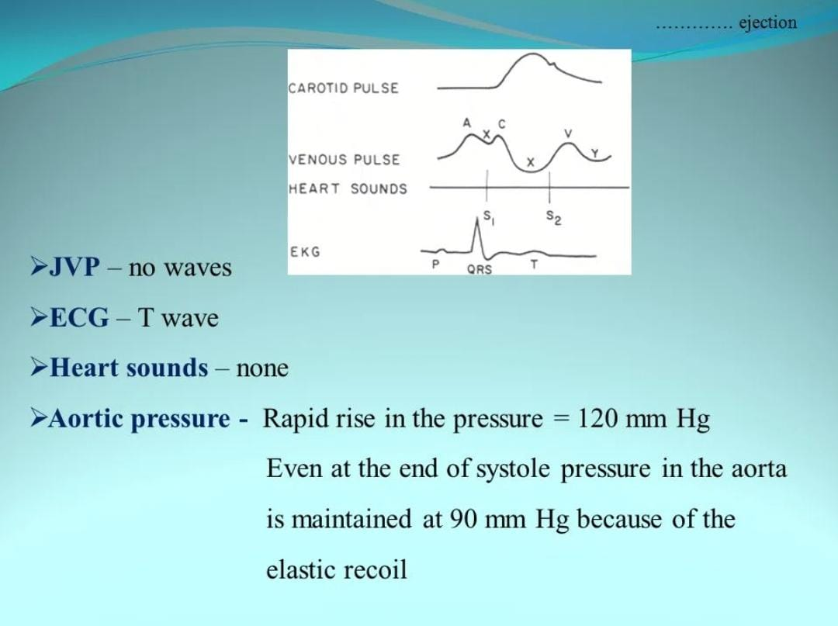

Slide 27
Protodiastolic phase :
In this Phase Aortic pressure increase more than ventricular pressure but blood move in one direction and aortic valve closed suddenly so blood does not return to ventricle .
And ventricular pressure decrease , ventricular volume decrease , aortic pressure increase .
Atrium pressure same .

Slide 28
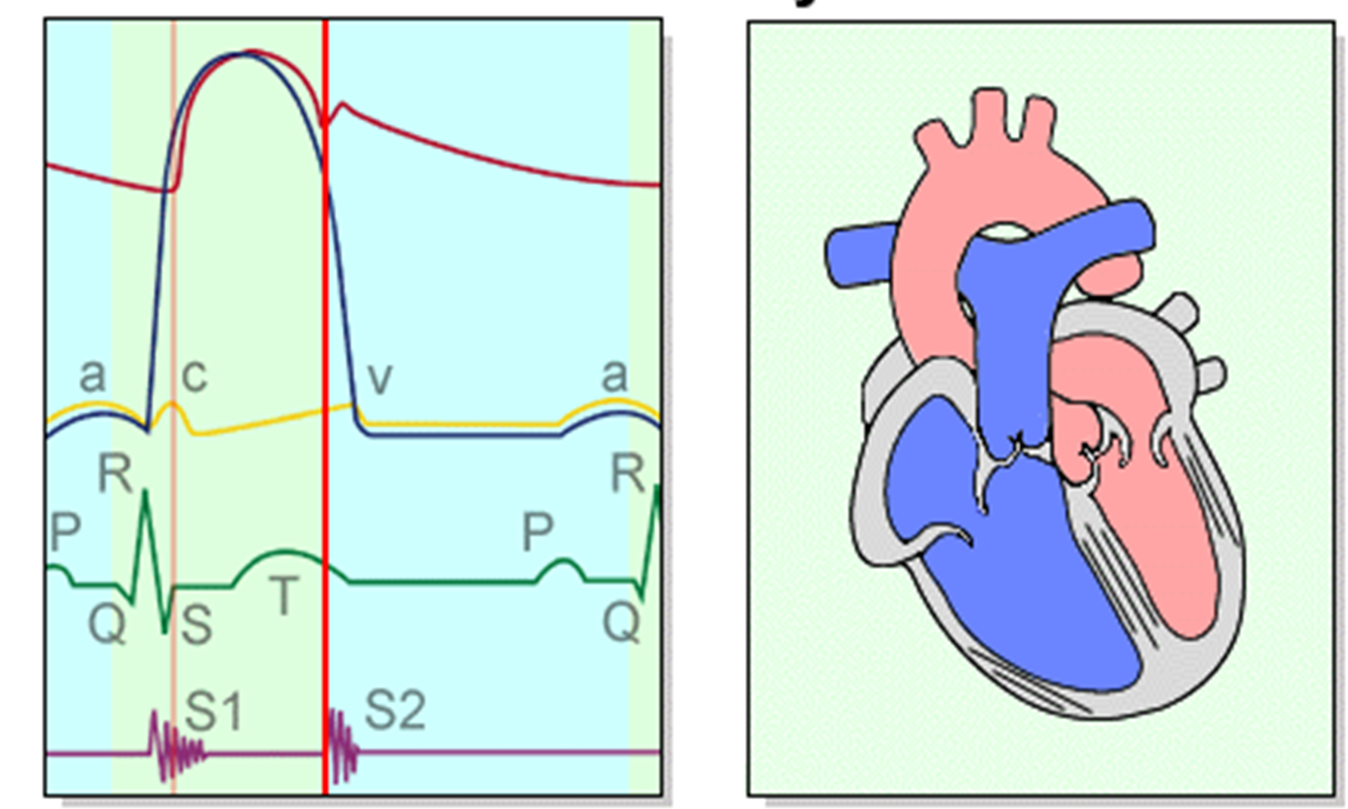
Isovolumic relaxation :

Slide 29
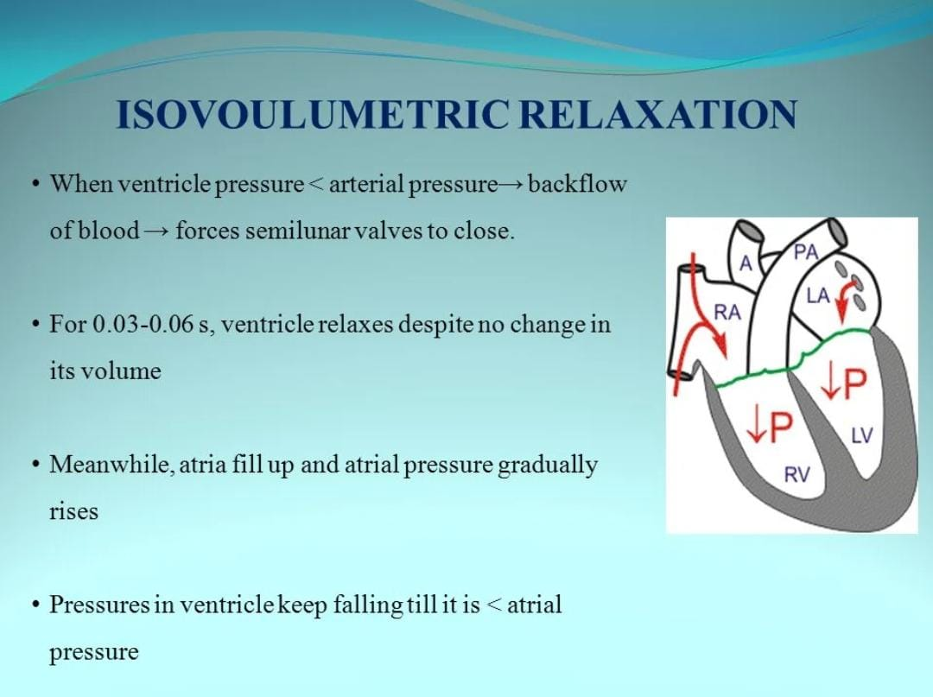

Slide 30
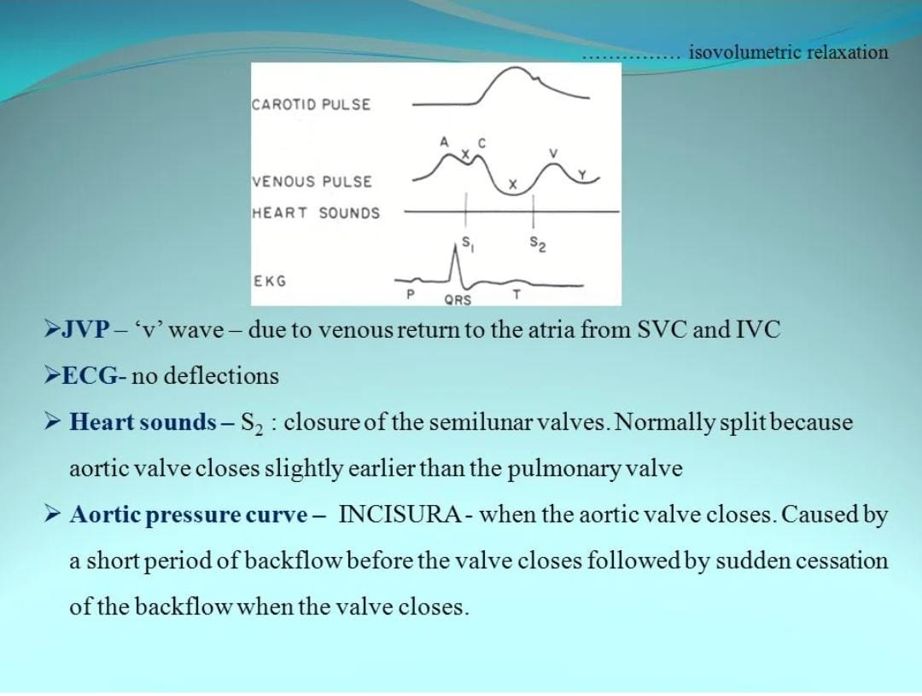

Slide 31
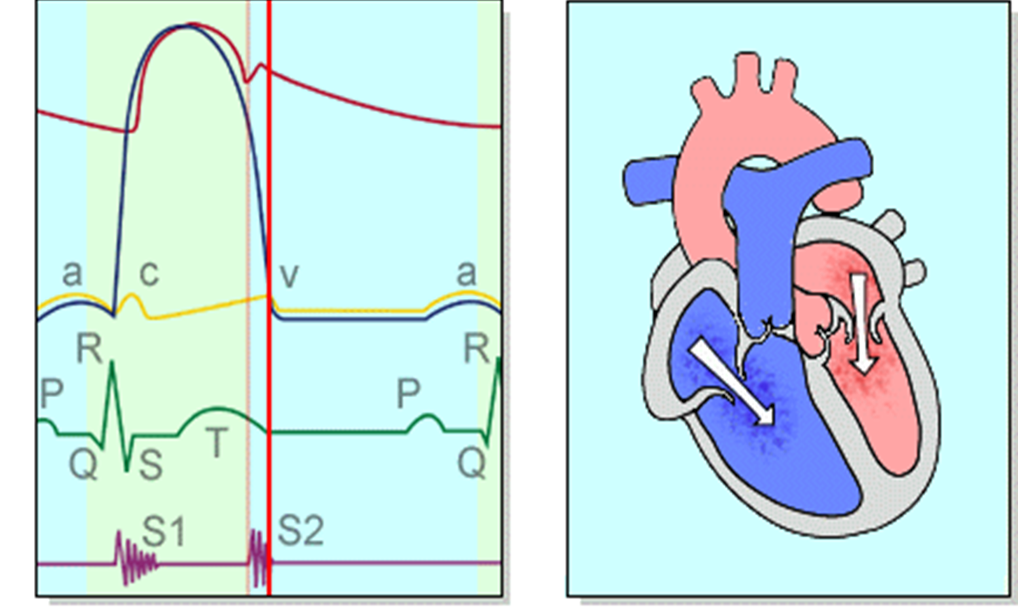
Early filling :

Slide 32
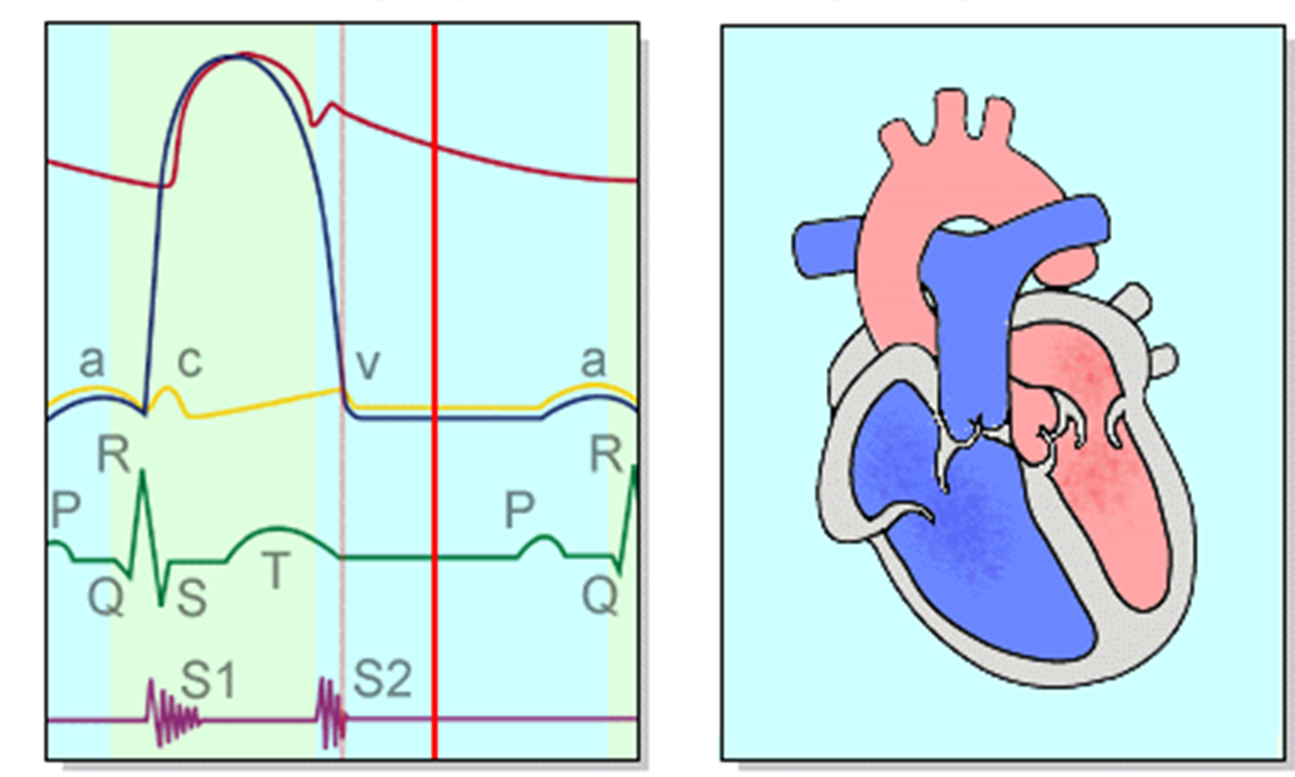
Diastesis :

Slide 33
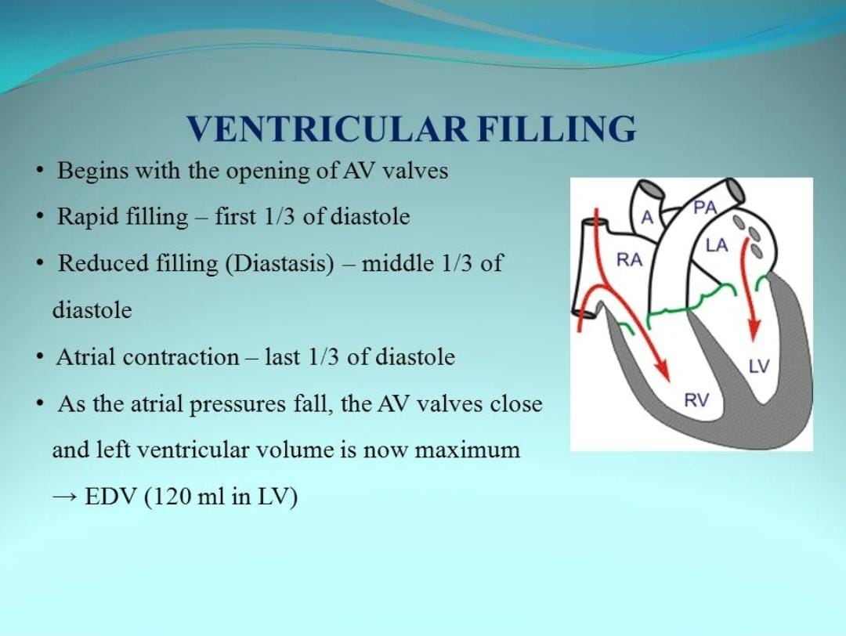

Slide 34
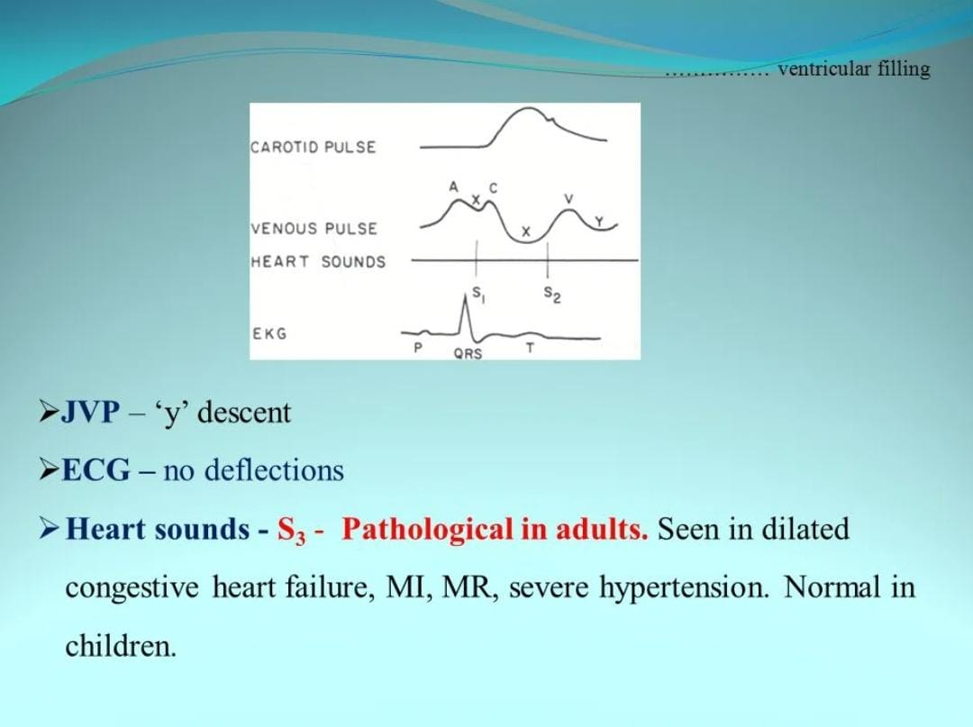

Slide 35
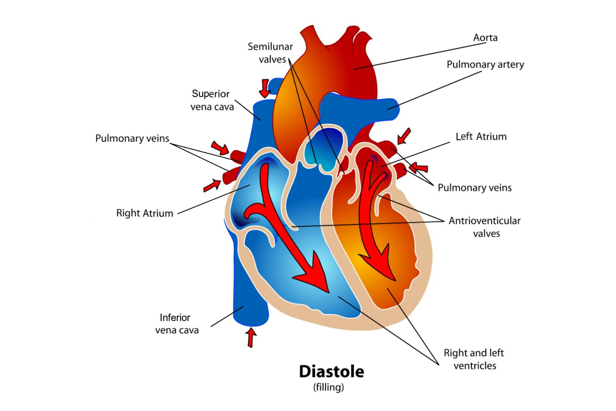

Slide 36
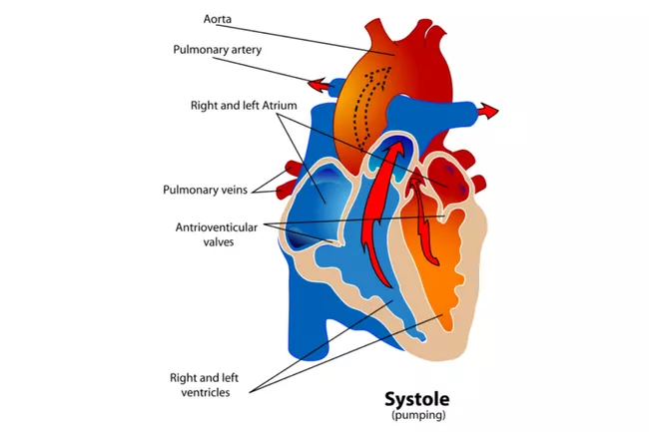

Slide 37
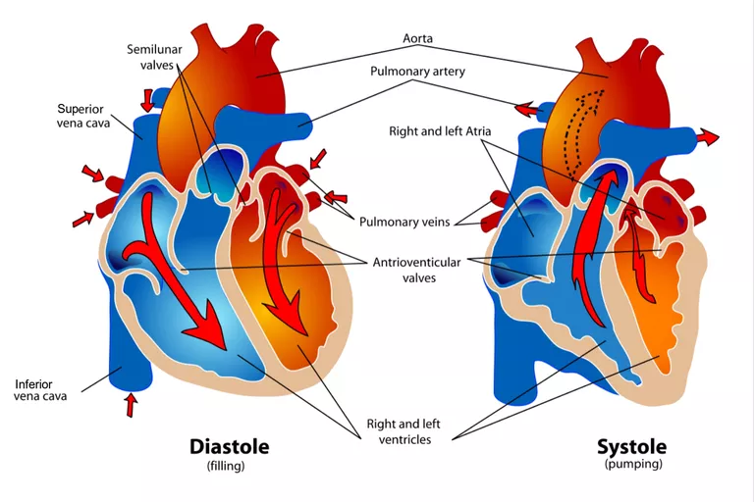

Slide 38
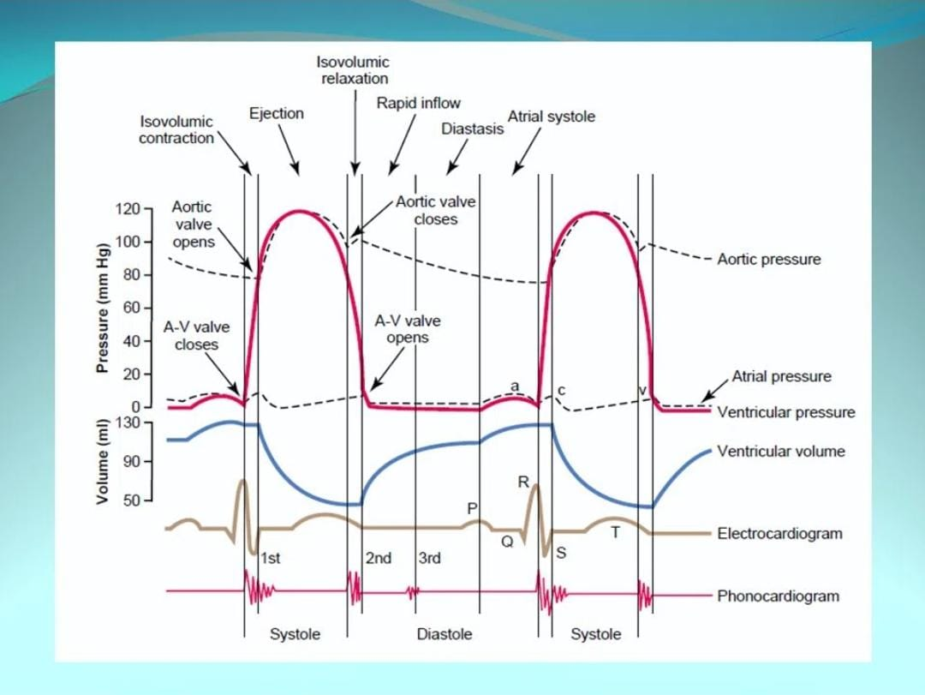

Slide 39
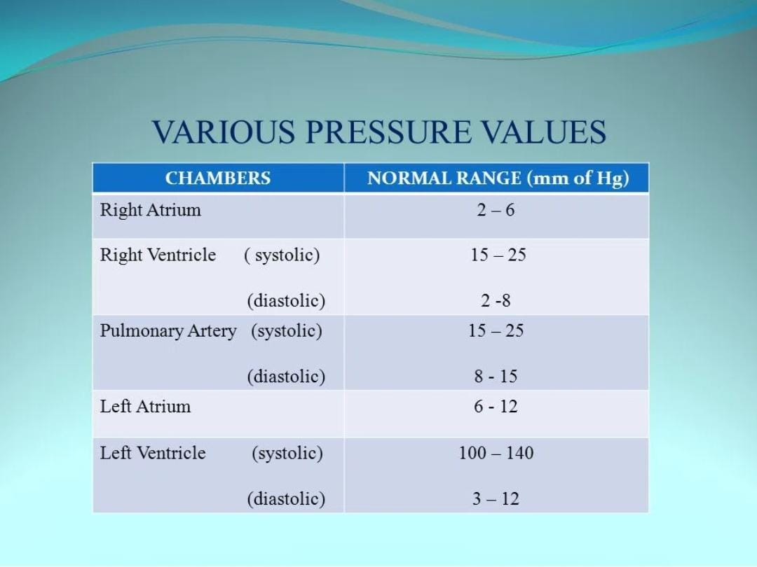

Slide 40
Stroke volume :
End –diastolic volume: 130 ml
End –systolic volume: 50 ml
Stroke volume: end-diastole __ end-systole= 80 ml
Ejection fraction: SV/ end-diastolic volume= 80/130 = 61%
Cardiac output: SV X HR

Slide 41
Work output of the heart :
Stroke work output: the amount energy that the heart converts to work during each heart beat while pumping into the artery.
RV work output is normally about one sixth the work output of the LV. ( because sixfold different in arterial pressure).

Slide 42
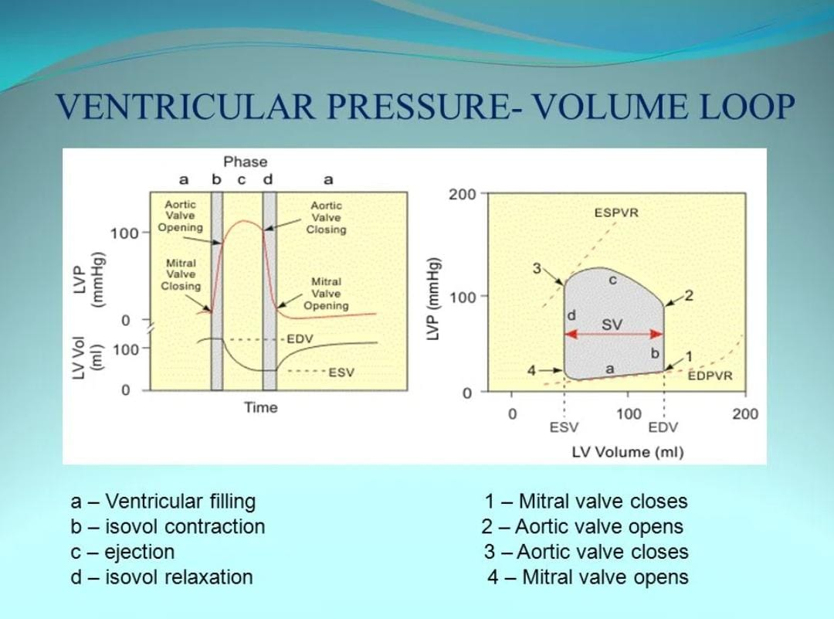

Slide 43
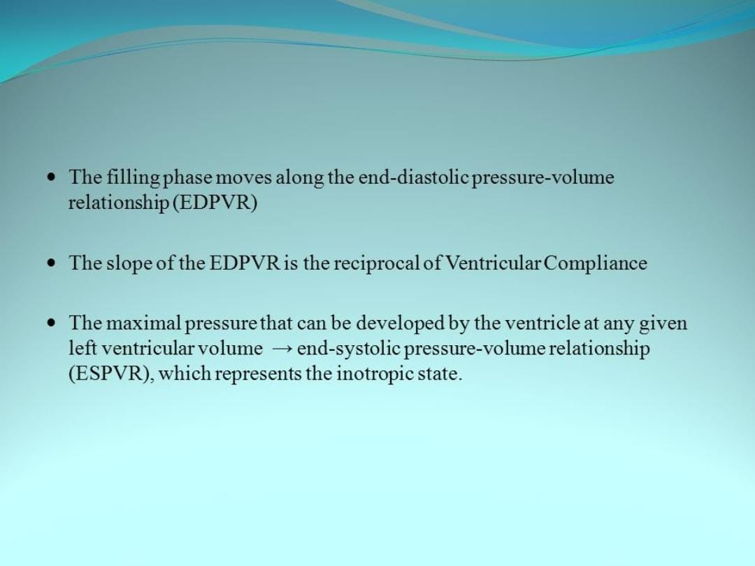

Slide 44
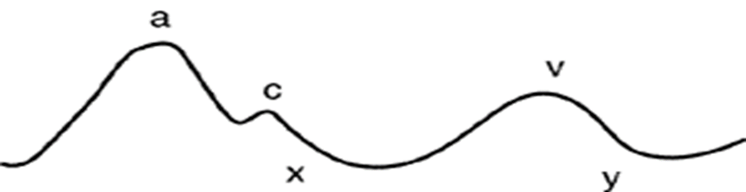
Jugular vein pressure :
A wave: first and most prominent, backflow of blood to the SVC during atrial contraction.(RA 4-6 mmHg, LA 7-8 mmHg) (Atrial Systole)
C wave: backward blood by closure the tricuspid valve during ventricular contraction .(Isovolumetric vent con.)
V wave: increasing volume of blood in the RA in the end of ventricular contraction .
X slope: passive atrial filling .
Y slope : rapid filling in the ventricle after open tricuspid valve .

Slide 45
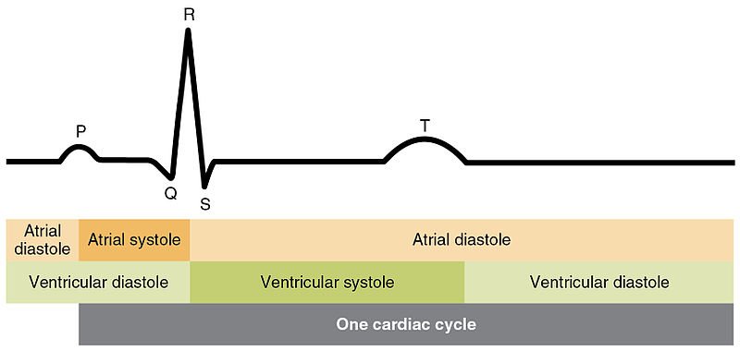
ECG & Cardiac cycle :

Slide 46
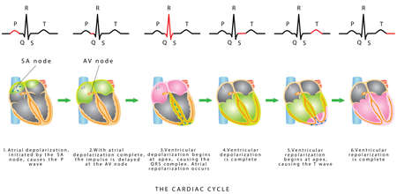
The sequence of heart excitation is associated with the deviation of ECG waves by tracing :

Slide 47
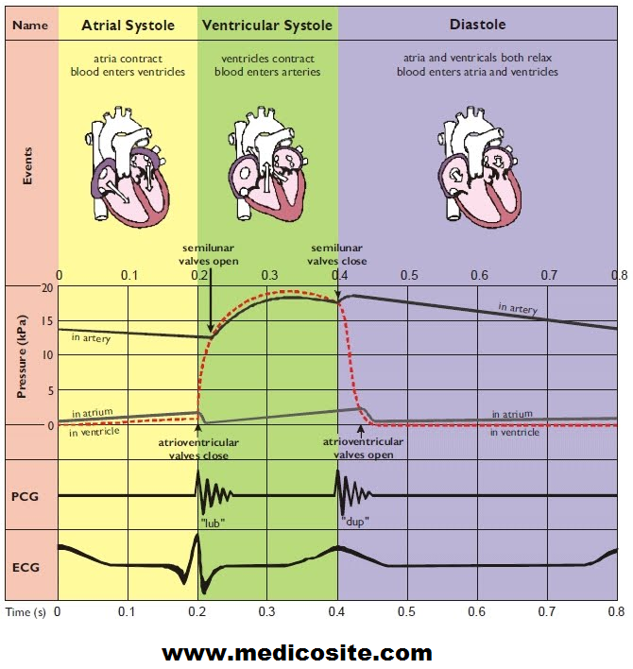

Slide 48
Preload :
Preload: Preload is the muscle length prior to contractility, and it is dependent of ventricular filling (or end diastolic volume.) This value is related to right atrial pressure. The most important determining factor for preload is venous return.
The pressure during filling of the ventricle

Slide 49
Afterload :
Afterload: is the tension (or the arterial pressure) against which the ventricle must contract.
If arterial pressure increases, afterload also increases. Afterload for the left ventricle is determined by aortic pressure, afterload for the right ventricle is determined by pulmonary artery pressure

Slide 50
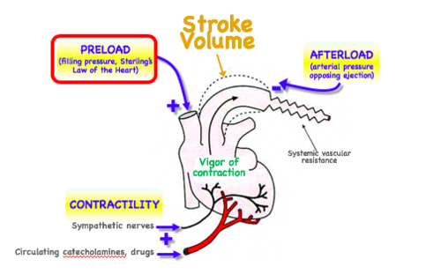

Slide 51
Contractility :
This is the ability of the heart to increase its strength of contraction.
It can do it in two ways: The first is by an increase of Ca++ ions infused into the myocardial cells. By increasing the [Ca++] the number of actin/myosin crossbridges are exposed leading to a stronger, more forceful contraction. There will also be a greater emptying of the ventricle as a result which will also increase the stroke volume. This is the inherent inotropy of the heart

Slide 52
Regulation of the heart pumping :
Intrinsic cardiac regulation :
Frank starling mechanism; Starling´s law of the heart: With an increased ventricular filling during diastole (venous return), the ventricular fibre length increases, so the ventricular contraction and stroke volume increases. - This is an intrinsic adaptation of the pumping capacity to the venous return

Slide 53
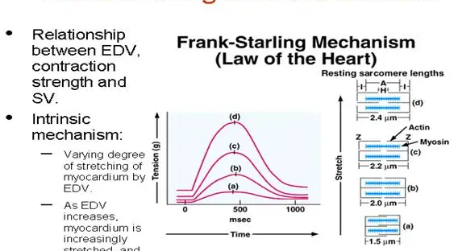

Slide 54
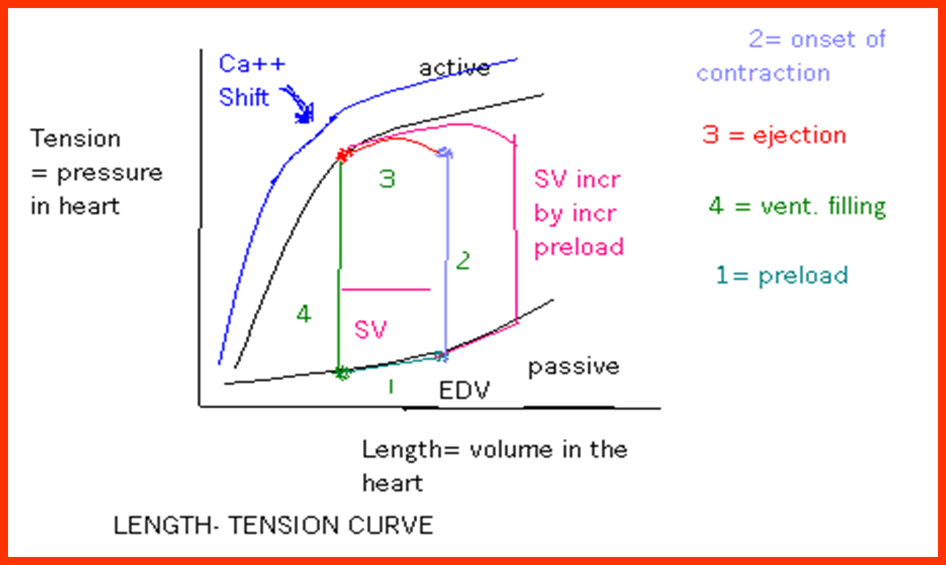
Frank starling mechanism :

Slide 55
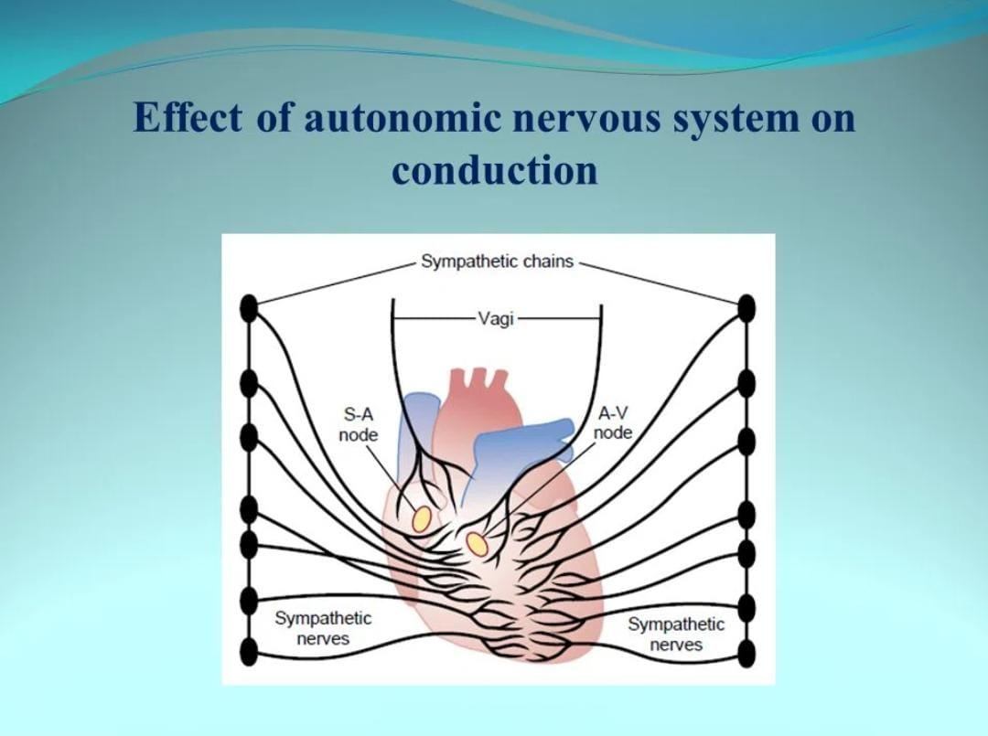

Slide 56
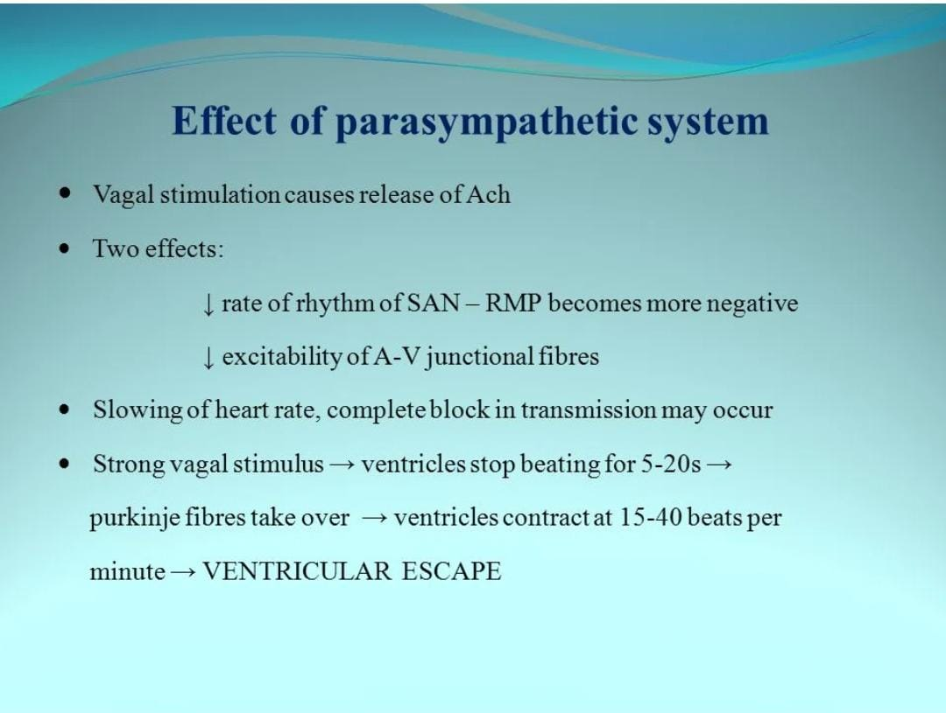

Slide 57
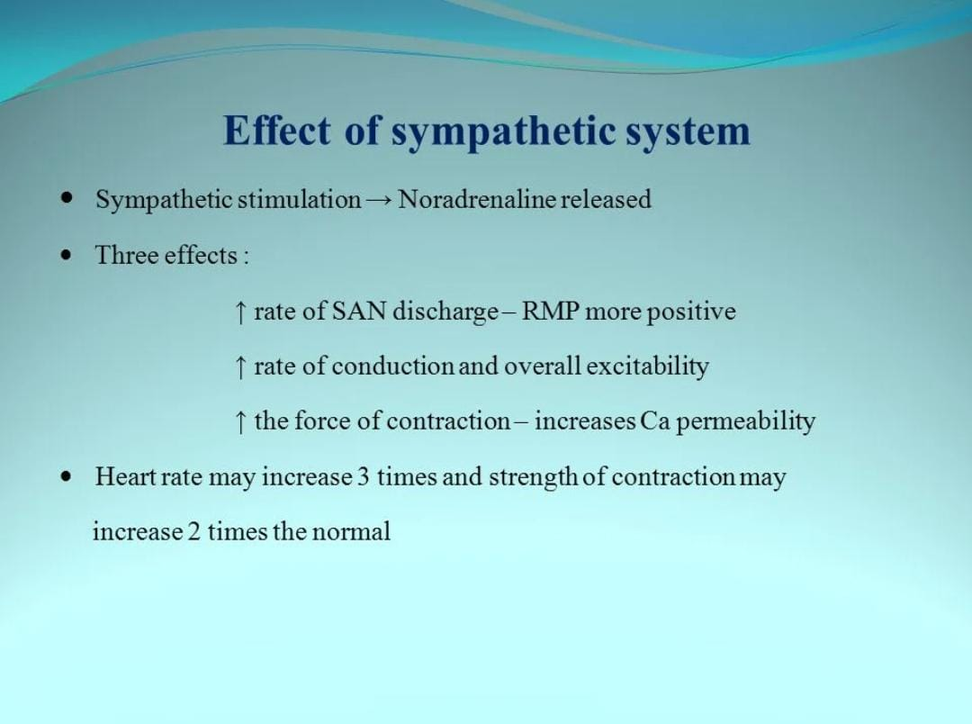

Slide 58
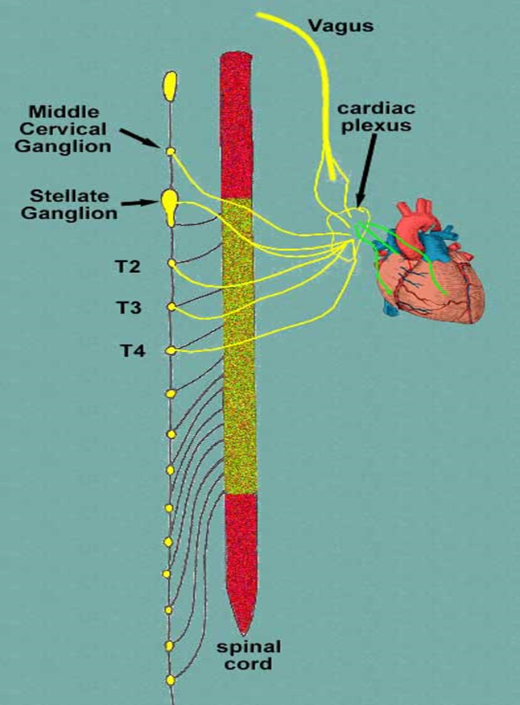

Slide 59
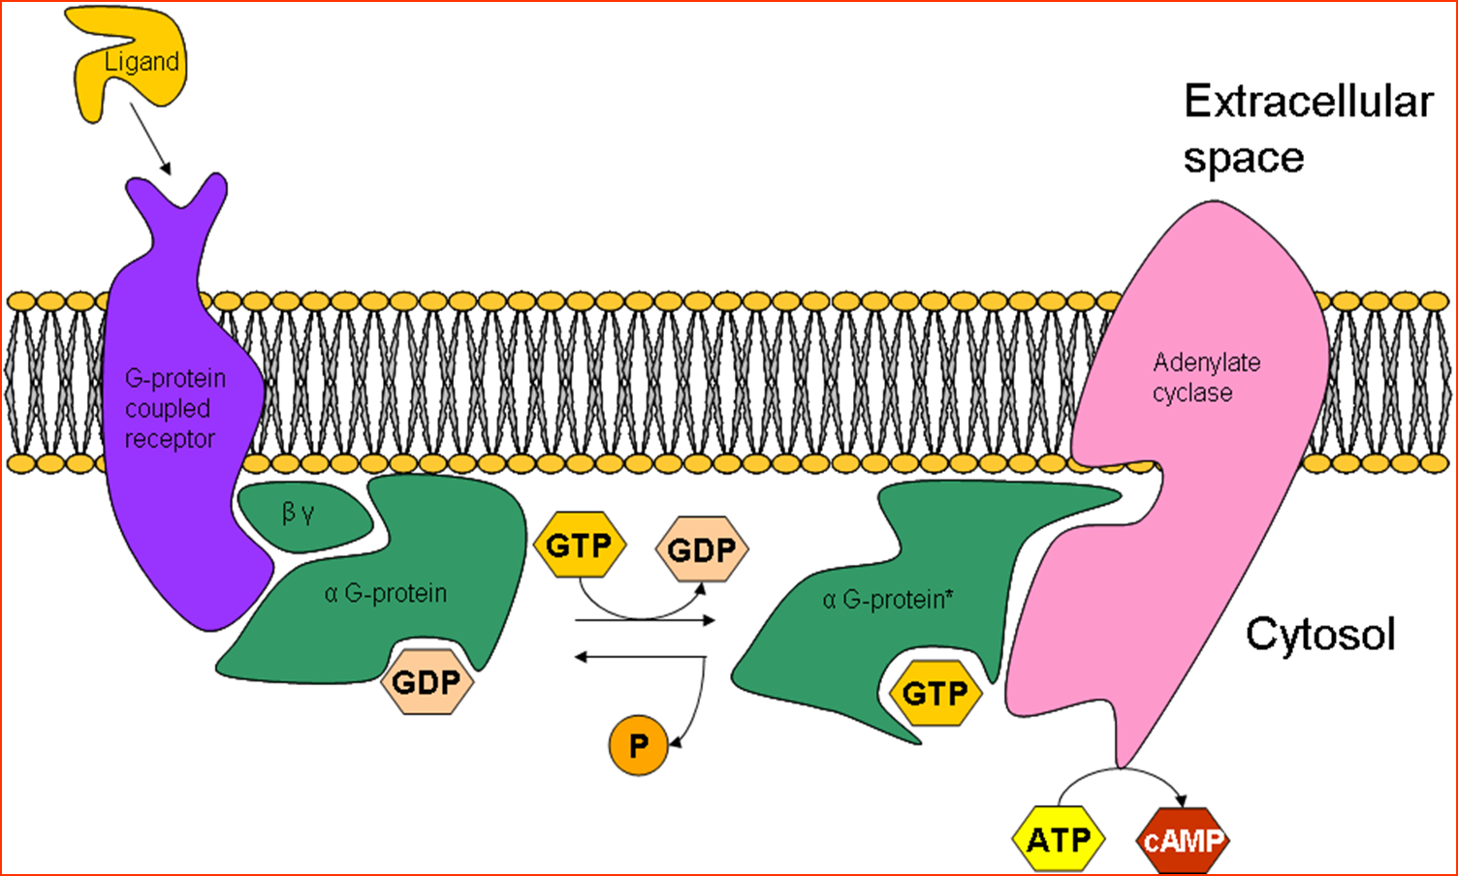
Control of the heart :

Slide 60
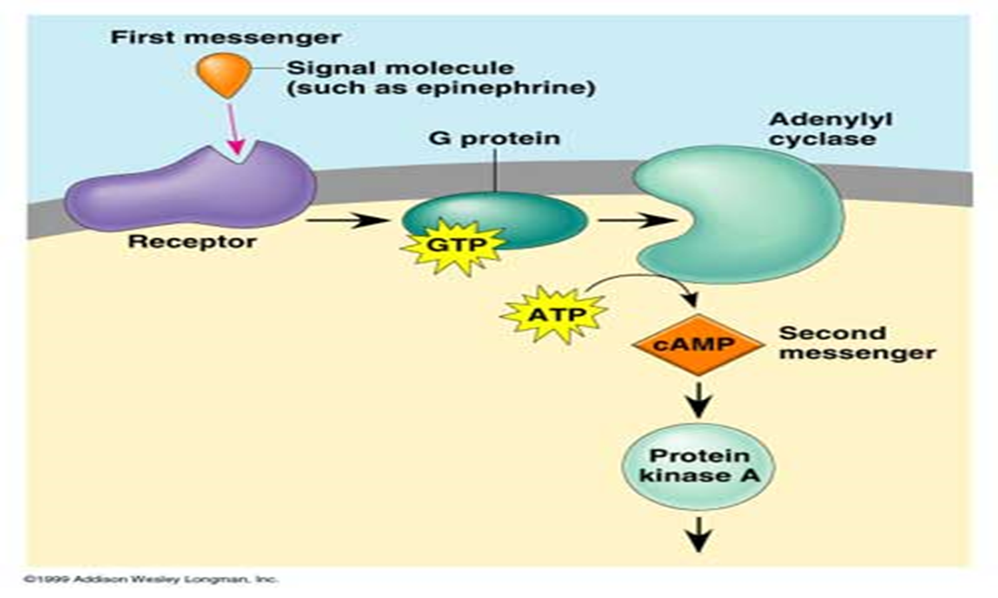
Sympathetic system :
Ca ChanneL (ca) + INTROPIC
SR (RYR) (CA) LUSITROPIC
Troponin I (LUSITROPIC)

Slide 61


Parasympathetic(vagal) system :
ACh
M2

Slide 62

Autonomic nerve system :

Slide 63

Autonomic nerve system :

Slide 64
Effect of K and Ca :
K:
increase: weakness of the heart and cardiac arrest during diastole, decrease heart rate
Decrease: increase of heart rate
Ca:
increase: Spastic heart, cardiac arrest during systole, short QT
Decrease: Prolong QT

Slide 65

Effect of temperature :
Increased temperature: increased heart rate .
Decreased temperature: decreased heart rate .

Slide 66


Slide 67

Thank you

