Slide 1
Normal
ECG
Prepared by: Yaser Aref Hamam

Slide 2
cardiac muscle cells
There are two major types of cardiac muscle cells:
1. Myocardial contractile cells
Constitute the bulk (99%) of the cells in the atria and ventricles
Responsible for contractions that pump blood through the body
2. Myocardial conducting cells (1%)
Form the conduction system of the heart.
Disseminate the action Potential.
Have no contractile function.

Slide 3
Conduction system of the heart
Definition: the collection of nodes and specialized conduction cells that initiate and coordinate contraction of the heart muscle.
Conduction system of the heart parts are:
Sinoatrial node
Atrioventricular node
Bundle of His
Purkinje fibers

Slide 4
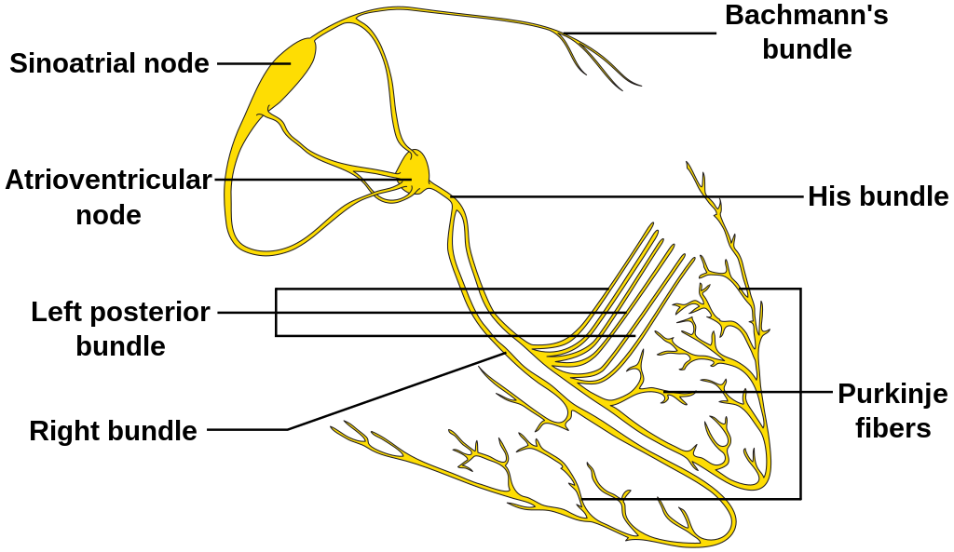

Slide 5
Overview of the conduction system of the heart
Name | Anatomic localization | Characteristics | Frequency
Sinoatrial node | Upper wall of the right atrium (at the junction where the SVC enters) | Natural pacemaker center of the heart. ➔ spontaneously generates electrical impulses that initiate a heartbeat | ca. 60–80/min
Atrioventricular node | Within the AV septum | Receives impulses from the SA node and passes these impulses to the bundle of His Delays conduction for 60–120 ms (allowing the ventricles to fill with blood; without this delay, the atria and ventricles would contract at the same time) | ca. 40–50/min

Slide 6
Overview of the conduction system of the heart
Name | Anatomic localization | Characteristics | Frequency
Bundle of His | Within the membranous part of the interventricular septum | Receives impulses from the AV node Splits into left and right bundle branches (Tawara branches) → terminate into terminal conducting fibers (Purkinje fibers) of the left and right ventricle Prevents retrograde conduction Filters high-frequency action potentials so that high atrial rates (e.g., in atrial fibrillation) are not conducted to the myocardium | ca. 30–40/min
Purkinje fibers | Terminal conducting fibers in the sub-endocardium | Conduct cardiac AP faster than any other cardiac cells Ensure synchronized contraction of the ventricles | ca. 30–40/min

Slide 7
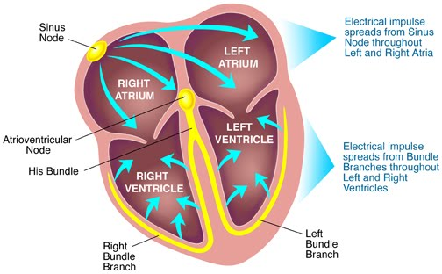

Slide 8
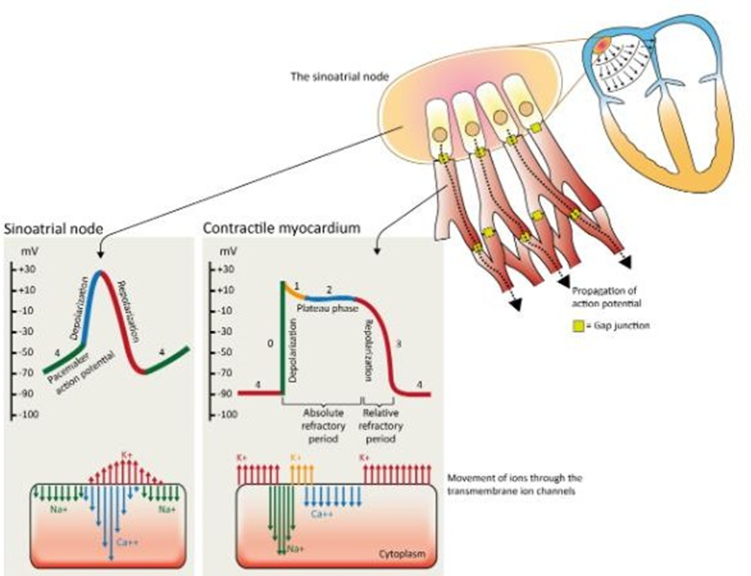
Cardiac action potential

Slide 9
cardiac muscle Action Potential

Slide 10
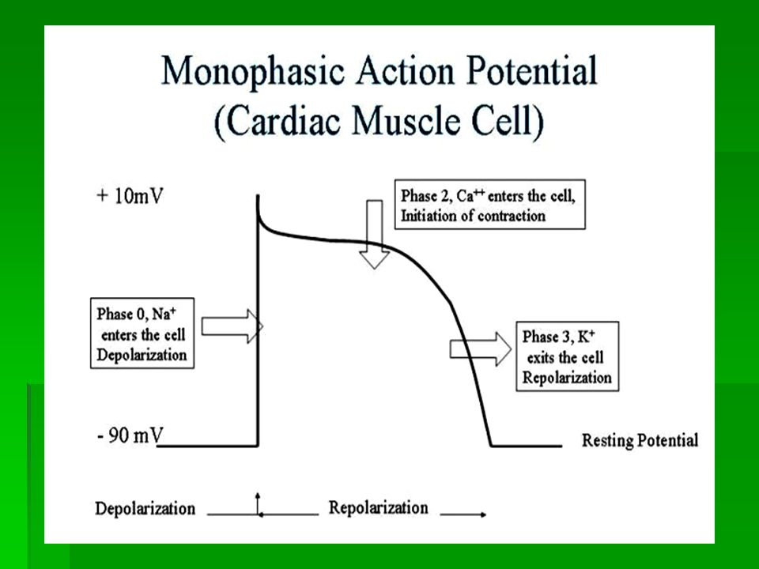
cardiac muscle Action Potential
The action potential in cardiac muscle cells follows a distinctive pattern, consisting of several phases:The action potential begins with a rapid depolarization phase.
Phase 0 (Depolarization):
It is initiated by the influx of sodium ions (Na+) through fast voltage-gated sodium channels.
This rapid sodium influx leads to a sharp upstroke, causing a rapid increase in the membrane potential from its resting state of around -90 mV to a peak of approximately +20 to +30 mV.
This depolarization phase spreads across the cell membrane and triggers the contraction of the cardiac muscle fibers.

Slide 11
cardiac muscle Action Potential
Phase 1 (Early Repolarization):
After the rapid depolarization, there is a brief and rapid initial repolarization phase.
This phase is characterized by the closure of the sodium channels and the transient opening of some potassium channels, resulting in a partial repolarization of the membrane potential.

Slide 12
cardiac muscle Action Potential
Phase 2 (Plateau):
Following the rapid repolarization in phase 1, there is a plateau phase in the action potential.
This phase is primarily caused by the balance between the continued influx of calcium ions (Ca2+) through voltage-gated calcium channels and the efflux of potassium ions (K+) through potassium channels.
The plateau phase is responsible for the prolonged duration of the cardiac action potential and helps to sustain the contraction of the cardiac muscle, allowing for efficient ejection of blood from the heart.

Slide 13
cardiac muscle Action Potential
Phase 3 (Repolarization):
After the plateau phase, there is a gradual repolarization of the membrane potential.
The calcium channels close, reducing the influx of calcium ions, while the potassium channels remain open, allowing potassium ions to continue exiting the cell.
This repolarization phase restores the membrane potential to its resting state, preparing the cardiac muscle cell for the next action potential.

Slide 14
cardiac muscle Action Potential
Phase 4 (Resting Potential):
The resting potential of cardiac muscle cells is approximately -90 mV.
During this phase, the membrane potential is relatively stable until the next action potential is triggered.
The resting potential is maintained by the activity of various ion channels, including potassium channels, which allow a small outward flow of potassium ions, and sodium-potassium pumps, which actively transport sodium ions out of the cell and potassium ions into the cell.

Slide 15
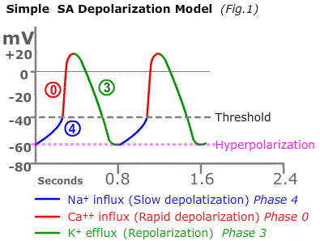
Sinoatrial Node Action Potentials
The SA node cells have an intrinsic automaticity, meaning they can spontaneously depolarize and generate action potentials without external stimulation.
The action potential in the SA node consists of 3 phases:
1- Phase 4 (Pacemaker Potential):
The resting membrane potential of the SA node cells is around -60 mV.
During phase 4, a slow depolarization occurs due to a mixed influx of sodium (Na+) and calcium (Ca2+) ions through special channels called "funny" channels (If channels).
These channels are unique to the SA node cells and are responsible for the gradual depolarization, leading to the threshold potential.

Slide 16
Sinoatrial Node Action Potentials
2- Phase 0 (Depolarization):
Once the threshold potential is reached (around -40 to -50 mV), voltage-gated calcium channels (L-type channels) open, allowing a rapid influx of calcium ions into the cell, resulting in the depolarization of the SA node cell.
This depolarization spreads to the neighboring atrial cells, initiating the contraction of the atria.

Slide 17
Sinoatrial Node Action Potentials
3- Phase 3 (Repolarization):
Following depolarization, the voltage-gated calcium channels close, and voltage-gated potassium channels (Ito and IK channels) open, allowing potassium ions (K+) to move out of the cell.
This outward movement of potassium ions repolarizes the SA node cell membrane, bringing it back to its resting potential and preparing it for the next cycle.
➔ Once again, it reaches the Phase 4 (Resting Potential): After repolarization, the SA node cell returns to its resting membrane potential of around -60 mV. The "funny" channels (If channels) once again become active, allowing the slow depolarization to restart, leading to the initiation of the next action potential.

Slide 18
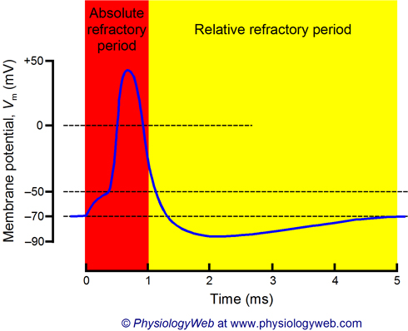
Refractory period
Absolute Refractory period:
➔ The time during an action potential when an additional stimulus cannot trigger a second action potential, regardless of the intensity of the stimulus
The absolute refractory period is followed by a relative refractory period, during which a strong stimulation may trigger a new action potential.

Slide 19
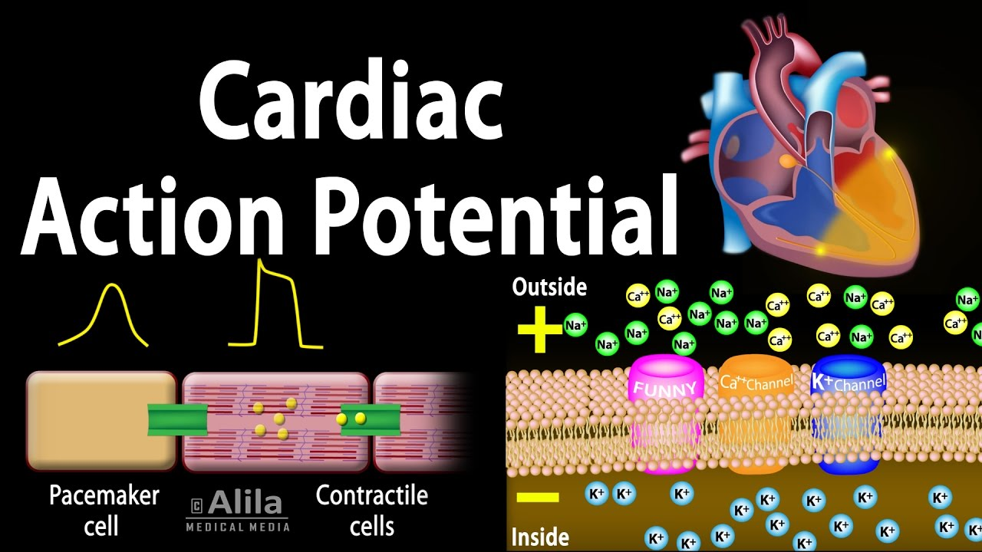
gap junctions
Propagation of the action potential is possible because all cardiac cells are electrically interconnected by gap junctions.
Gap junctions are protein channels that connect the cell membranes of adjacent cells and enable flow of ions between cells. This means that the action potential spreads from one cell to another via gap junctions.
The density of gap junctions within the Purkinje network is very high, which explains the rapid impulse transmission in the network. Cells of the atrioventricular node, on the other hand, have very low density of gap junctions, which explains the slow impulse conduction through the atrioventricular node.

Slide 20
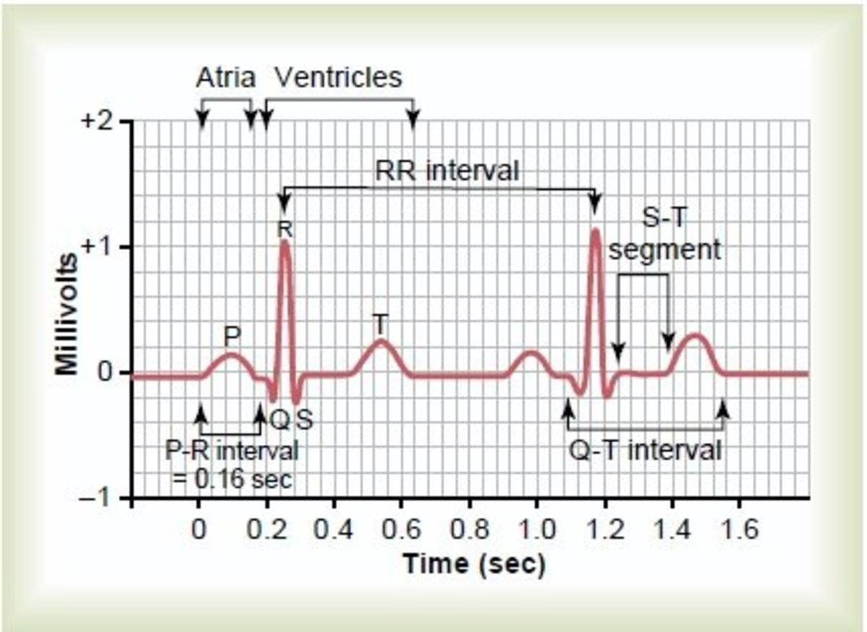
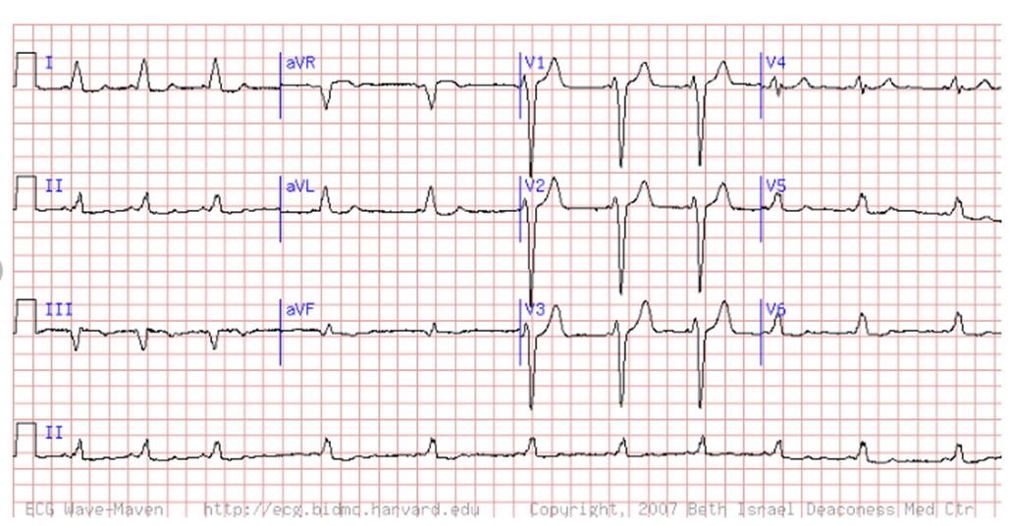
ECG
ECG: Graphic Registration of the electrical activity of the heart from chest surface

Slide 21
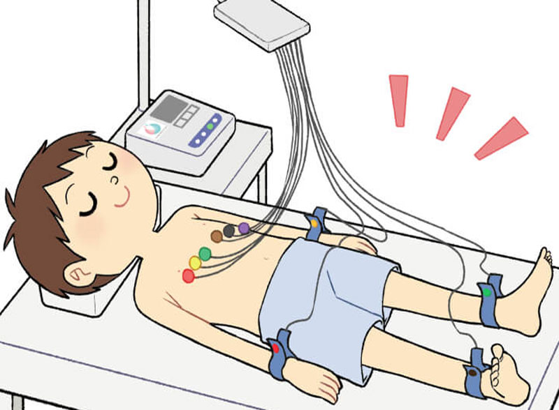
ECG
Electrode: a conductive pad that is attached to the skin and enables recording of electrical currents.
Lead: graphical description of the electrical activity of the heart and it is created by analyzing several electrodes

Slide 22
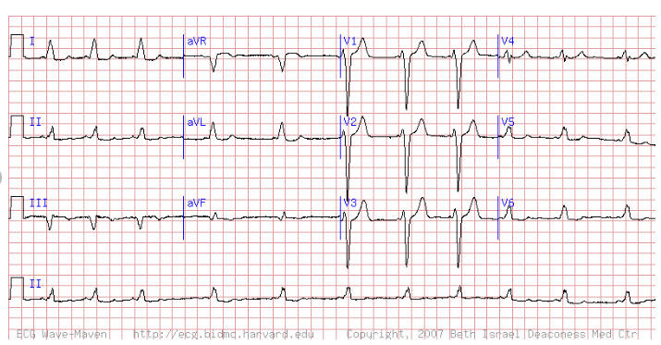

ECG
12 lead ECG trace obtained using 10 electrodes.
At any given instant during the cardiac cycle, all ECG leads analyze the same electrical events but from different angles.

Slide 23
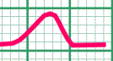
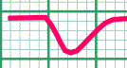
Heart Leads
++++++
ــــ ــــ ــــ ــــ ــــ
ــــ ــــ ــــ ــــ ــــ
ــــ ــــ ــــ ــــ ــــ ــــ ــــ ــــ + + + + + + + + + + + + + + + + + + + + + + + + + + + + + + + +
_
+
-
+
Lead
+
-
Lead

Slide 24
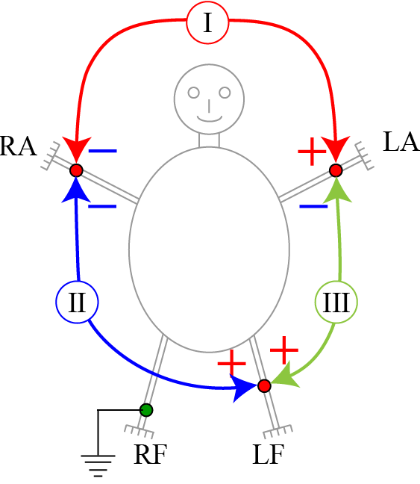
ECG leads
Each lead has one exploring (positive) electrode and the other as reference (negative) electrode.
The 12 ECG leads are divided into:
A- 3 Bipolar limb lead:
I lead: reference electrode (Rt arm) [-ve] ➔ exploring electrode (Lt arm) [+ve]
II lead: reference electrode (Rt arm) [-ve] ➔ exploring electrode (Lt leg) [+ve]
III lead: reference electrode (Lt arm) [-ve] ➔ exploring electrode (Lt leg) [+ve]
B- 9 Unipolar lead:
3 augmented Limb leads (aVL, aVR, aVF) and 6 Chest leads (V1-6): all of them are considered as [+ve] electrode and have an imaginary reference electrode [-ve] in the center of the heart.

Slide 25
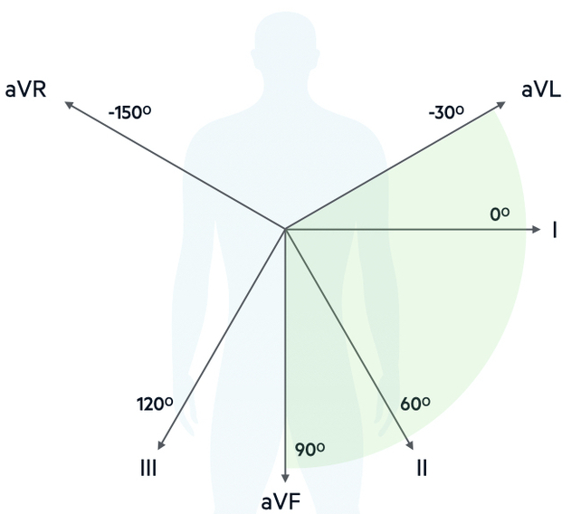
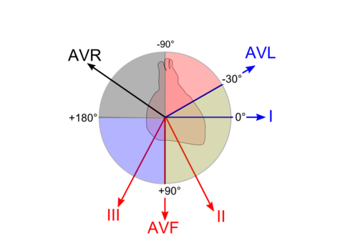

Slide 26
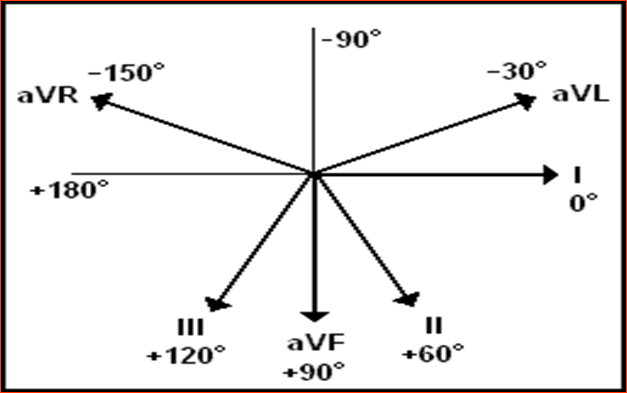

Slide 27
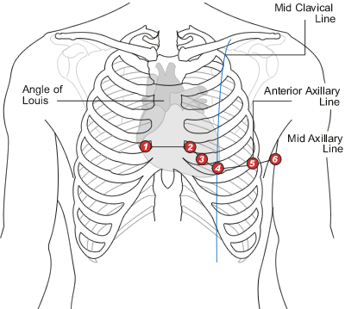
ECG electrodes
A- Chest electrodes
Placement of chest (precordial) electrodes
V1 ➔ 4th intercostal space (ICS), RIGHT margin of the sternum
V2 ➔ 4th ICS along the LEFT margin of the sternum
V3 ➔ midway between V2 and V4
V4 ➔ 5th ICS, mid-clavicular line
V5 ➔ 5th ICS, anterior axillary line (same level as V4)
V6 ➔ 5th ICS, mid-axillary line (same level as V4)

Slide 28
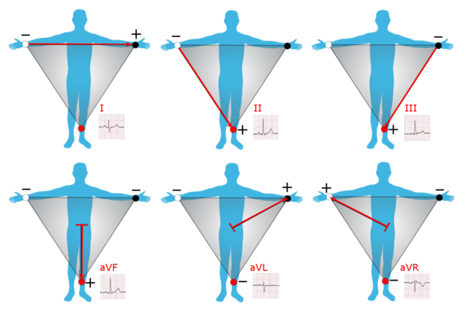
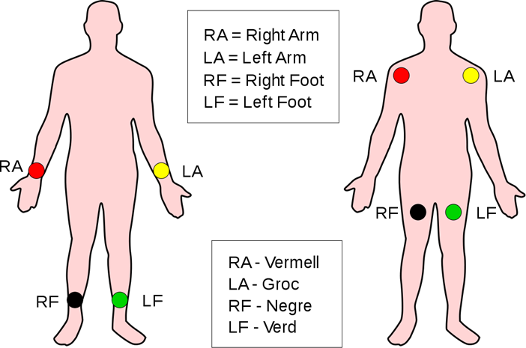
ECG electrodes
B- Limb electrodes
Limb Bipolar leads (I, II, III), Augmented unipolar leads (aVF, aVL, aVR) are all derived using three electrodes, which are placed on the right arm, the left arm and the left leg.
The electrode on the right leg is not included in any lead, but serves as a ground wire.

Slide 29
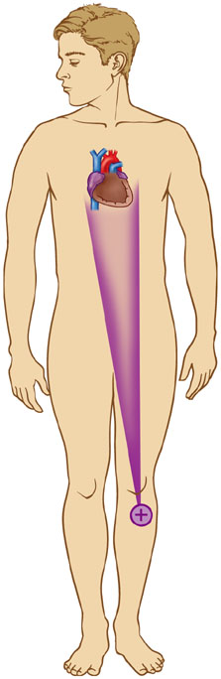
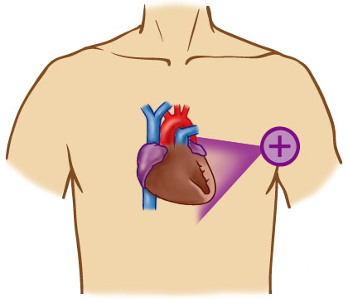
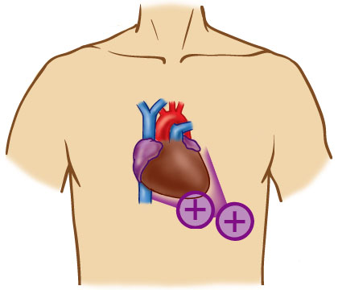
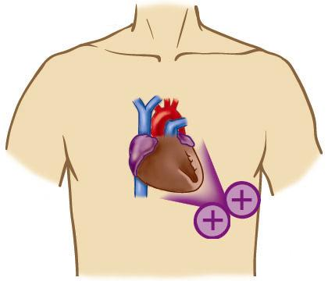
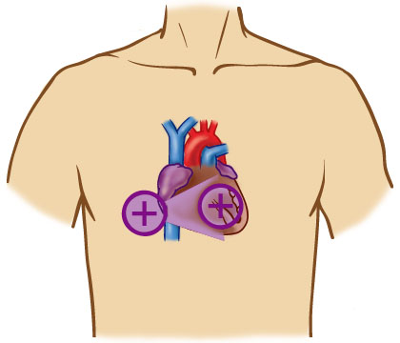
Topographism
Where the positive electrode is positioned, determines what part of the heart is seen!
I and AVL
V3 & v4
II, III and AVF
V1 & v2
V5 & v6

Slide 30
Topographism
Anatomical aspects of the limb leads
II, III, aVF: are inferior limb leads and they primarily observe the inferior aspect of the left ventricle.
aVL, I: are called lateral limb leads and they primarily observe the lateral aspect of the left ventricle.
Anatomical aspects of the chest (precordial) leads
V1-V2 (Septal leads): Primarily observes the ventricular septum, but may occasionally display ECG changes originating from the right ventricle.
V3-V4 (Anterior leads): Observes the anterior wall of the left ventricle.
V5-V6 (Anterolateral leads): Observes the lateral wall of the left ventricle.

Slide 31
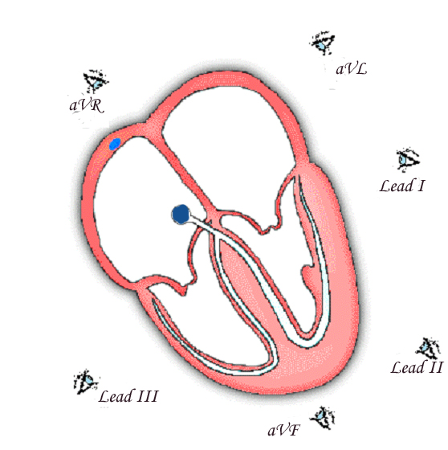
Views from Augmented and Limb Leads- Frontal

Slide 32
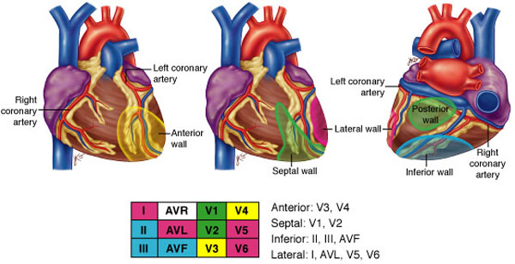
Summary of Leads

Slide 33
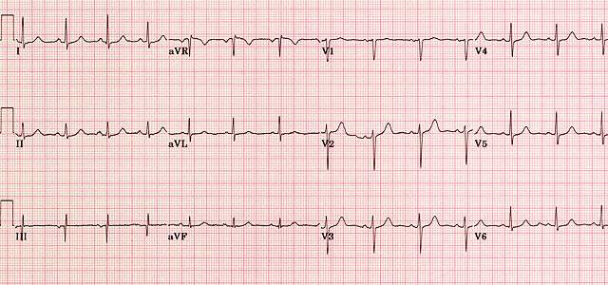
ECG Paper

Slide 34
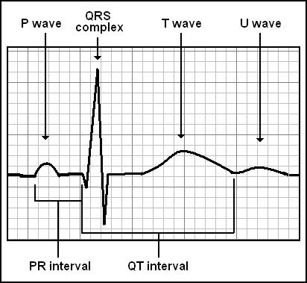
Waveforms and Intervals

Slide 36
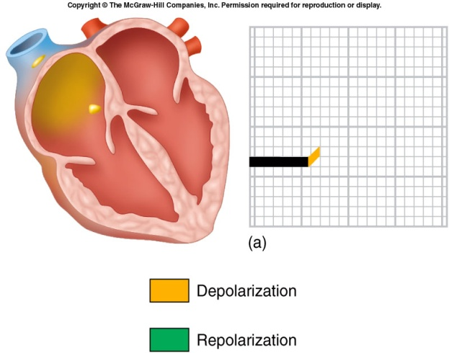
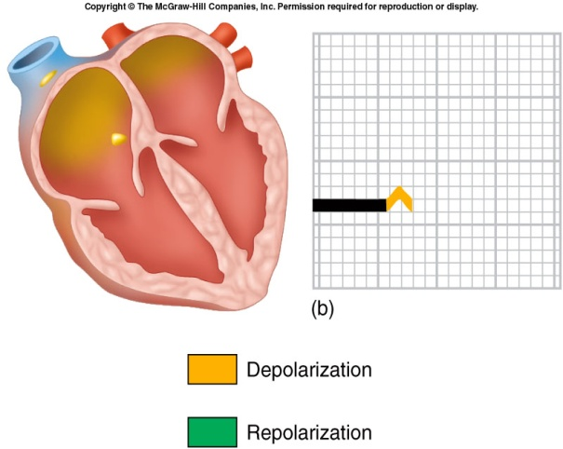
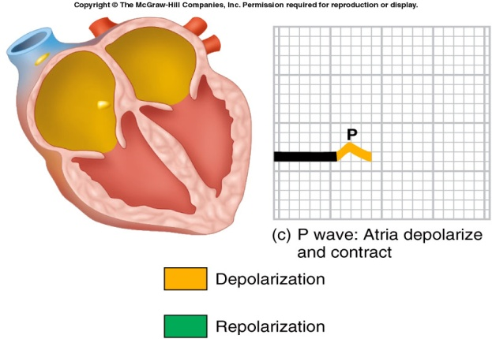
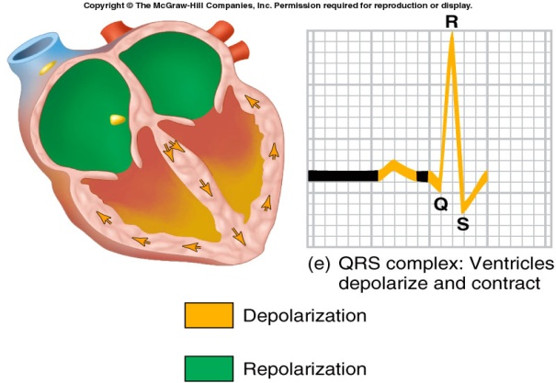
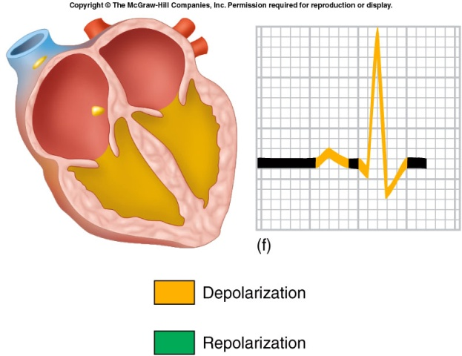
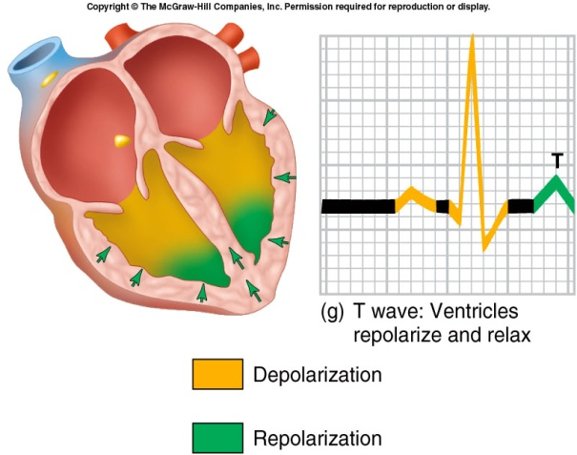
ECG
3 distinct waves are produced during cardiac cycle
P wave caused by atrial depolarization
QRS complex caused by ventricular depolarization.
[Q wave representing septal depolarisation.
R wave representing ventricular depolarisation.
S wave representing basal depolarization]
T wave results from ventricular repolarization

Slide 37
ECG Paper

Slide 38
ECG Paper
The ECG presents one diagram for each lead.
Voltage is presented on the vertical (Y) axis and Time on the horizontal (X) axis of the diagram.
The ECG paper has small boxes (thin lines) and large boxes (heavy lines).
Small boxes are squares of 1 mm² and there are 5 small boxes inside each large box.

Slide 39
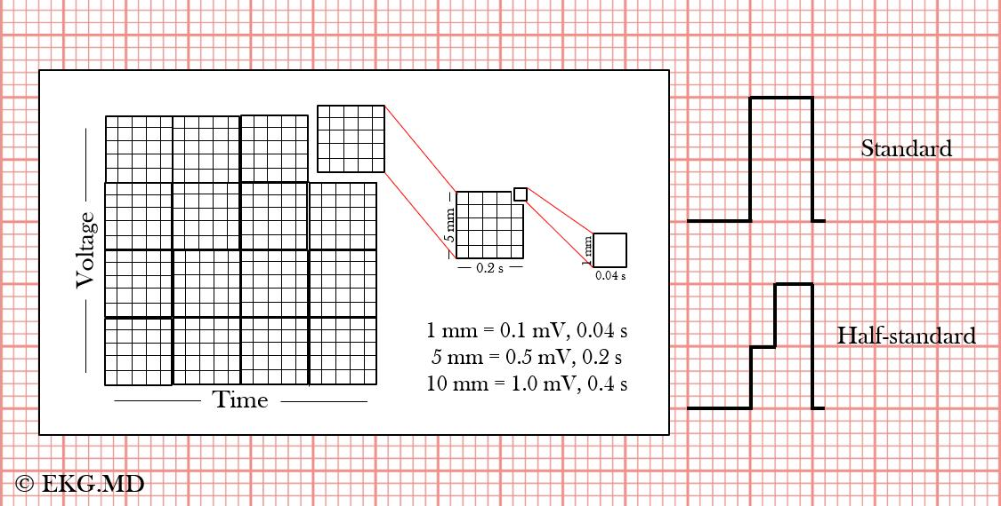
ECG Paper
ECG Paper Calibration:
Standard calibration: 10 mm ( = 2 large boxes = 10 small boxes) on the vertical axis corresponds to 1 mV.
Thus, 1 mm = 1 small box corresponds to 0.1 mV.
Other types of calibration:
Half Standard: 5 mm/1 mv
Double Standard: 20 mm/1 mv

Slide 40
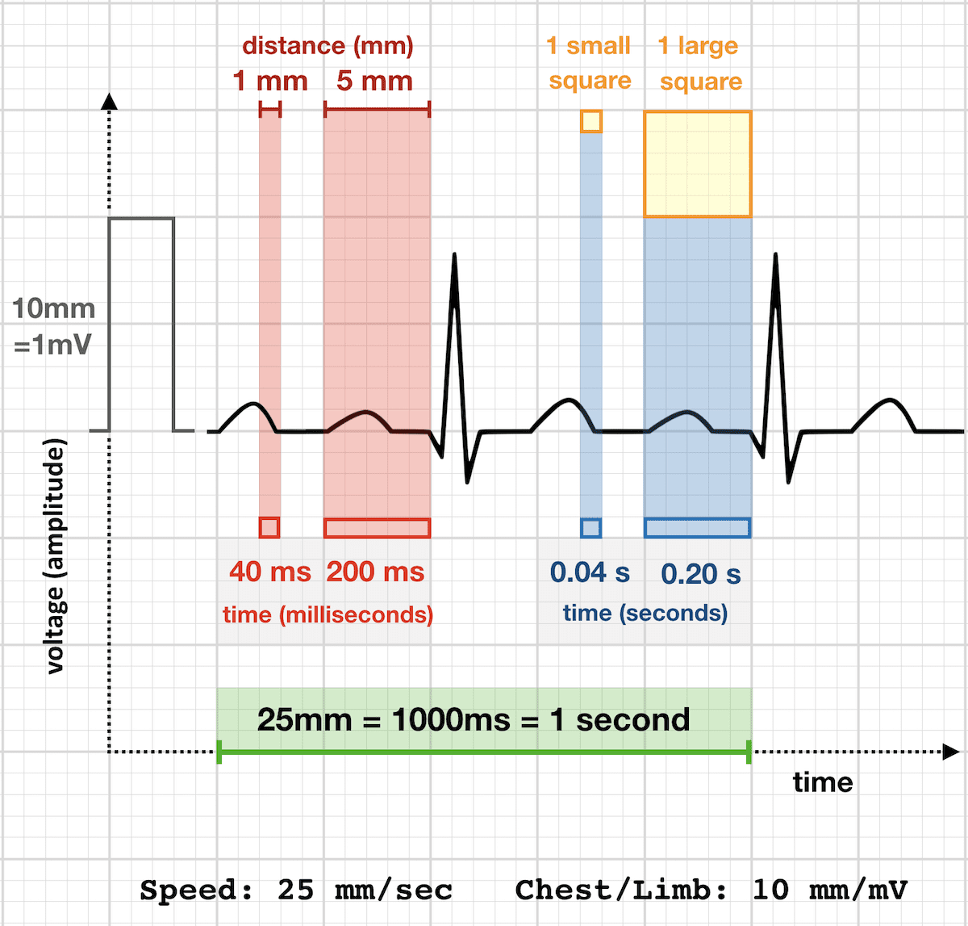
ECG Paper
ECG Paper measurements
Each small block of ECG paper is 1 mm2
Runs at a paper speed of 25 mm/sec (=25 small box/sec.), so one small block equals 0.04 s
Five small blocks make up 1 large block which translates into 0.20 s (200 msec)
Hence, there are 5 large blocks per second

Slide 41
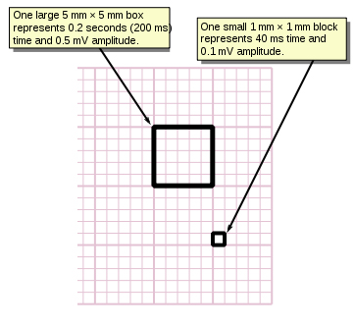
ECG Paper
ECG Speed 25mm/sec

Slide 42
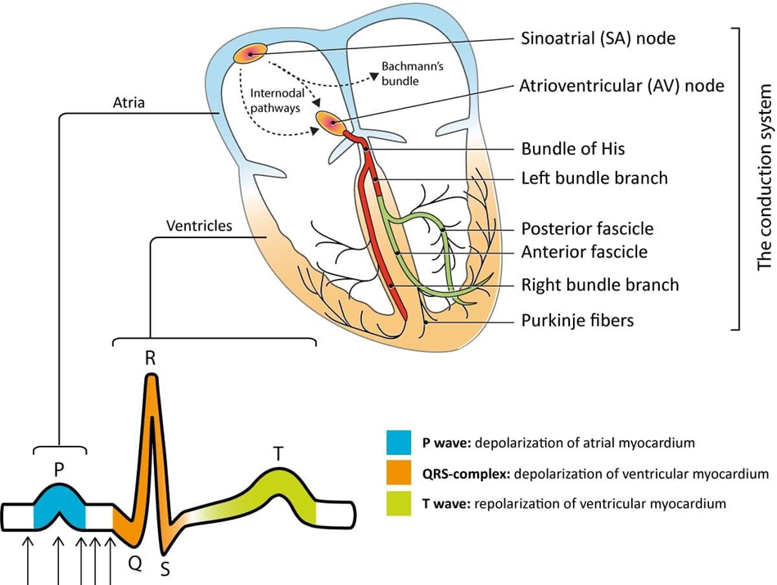
ECG Paper
Electrical Representation Of Waves
P wave: Atrial Depolarization
QRS complex: Ventricular Depolarization
Q wave: 1st -ve deflection, Represents Septal Depolarization
R wave: The +ve deflection, Represents depolarization of major parts of ventricles
S wave: 2nd -ve deflection, Represents basal depolarization
T wave: Ventricular Repolarization
u wave: Papillary Muscle Activity
Note: Atrial Repolarization wave masked by isoelectric line Or QRS complex

Slide 43
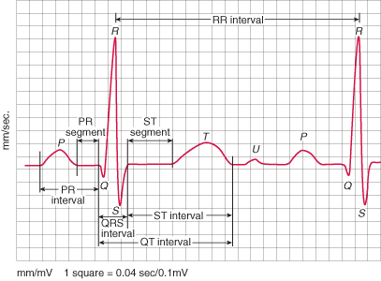
ECG Paper
ECG Segments & Intervals
Definitions:
Segments: The region between two waves, e.g. PR segment starts at the end of the P wave and ends at the start of the QRS complex.
Intervals: The duration of time that includes one segment and one or more waves, e.g. The PR interval starts at the start of the P wave and ends at the start of the QRS.

Slide 44
Reading ECG paper
1.Determining the Heart Rhythm
We should determine if the heart rhythm is sinus or not + regular or not.
1. In Normal Sinus Rhythm ➔ Each P wave is followed by a QRS ➔ if not, it is not sinus rhythm.
P wave rate 60 - 100 bpm with <10% variation:
HR <60 = sinus bradycardia
HR >100 = sinus tachycardia

Slide 45
Reading ECG paper
Determining the Heart Rhythm
Determining the Heart Rate
Determining the Axis of the Heart
Segment, Wave and Interval assessment ( ST segment, QRS duration, QRS amplitude

Slide 46
Reading ECG paper
1.Determining the Heart Rhythm
2. Regular or not: according to QRS complex
  Regular: RR interval constant
  Irregular
    Regularly
    Irregularly

Slide 47
2. Determining the Heart Rate
Heart rate is calculated with different methods accordings to the heart rhythm:
A- Regular rhythm:
➔Rule of 300:
Recall above that 300 large squares is equal to 1 minute at a paper speed of 25mm/sec
We can thus calculate bpm by dividing 300 by the number of LARGE squares between each R-R interval (space between two consecutive R waves = one beat)

Slide 48
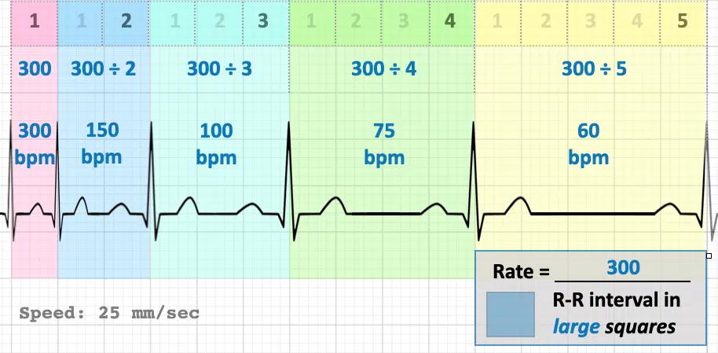
The Rule of 300
It may be easiest to memorize the following table:
# of big boxes | Rate
1 | 300
2 | 150
3 | 100
4 | 75
5 | 60
6 | 50

Slide 49

Rule of 6 sec
B. Irregular rhythm:
➔ Rule of 6 sec
Count off 30 large boxes = 6 seconds (remember 1 large box = 0.2 seconds, so 30 large boxes = 6 seconds) ➔ Then, count the number of R-R intervals in six seconds and multiply by 10. This is the number of beats per minute.
Example:
- Count 30 large boxes, starting from the first R wave.
- There are 8 R-R intervals within 30 boxes. Multiply 8 x 10 = Rate 80

Slide 50

What is the heart rate?
www.uptodate.com

Slide 51
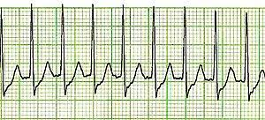
What is the heart rate?
SVT

Slide 52
Rate irregular
Six-second method:
Count off 30 large boxes = 6 seconds (remember 1 large box = 0.2 seconds, so 30 large boxes = 6 seconds). Then, count the number of R-R intervals in six seconds and multiply by 10. This is the number of beats per minute. This is most useful if you have an irregular rhythm (like atrial fibrillation) when you want to know an average rate
Count 30 large boxes, starting from the first R wave.
There are 8 R-R intervals within 30 boxes. Multiply 8 x 10 = Rate 80

Slide 53
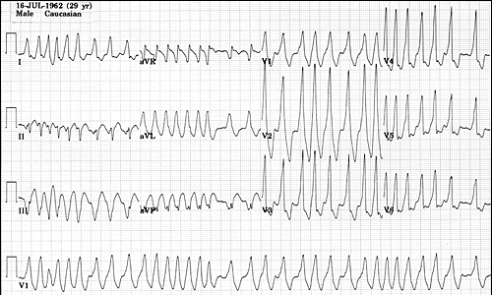
What is the heart rate?
198 bpm

Slide 54
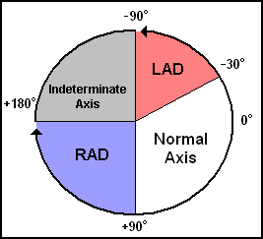
Determining the Axis
The normal QRS axis is defined as ranging from -30° to +90°.
-30° to -90° is referred to as a left axis deviation (LAD)
+90° to +180° is referred to as a right axis deviation (RAD)

Slide 55
Determining the Axis
The Quadrant Approach
The Equiphasic Approach

Slide 56
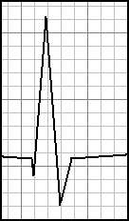
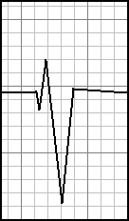
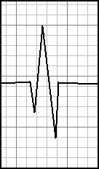
Determining the Axis
Predominantly Positive
Predominantly Negative
Equiphasic

Slide 57
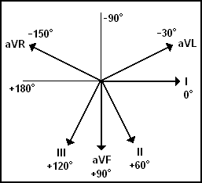
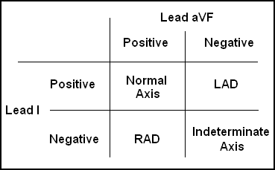
The Quadrant Approach
1. Examine the QRS complex in leads I and aVF to determine if they are predominantly positive or predominantly negative. The combination should place the axis into one of the 4 quadrants below.

Slide 58
The Quadrant Approach
2. In the event that LAD is present, examine lead II to determine if this deviation is pathologic. If the QRS in II is predominantly positive, the LAD is non-pathologic (in other words, the axis is normal). If it is predominantly negative, it is pathologic.

Slide 59
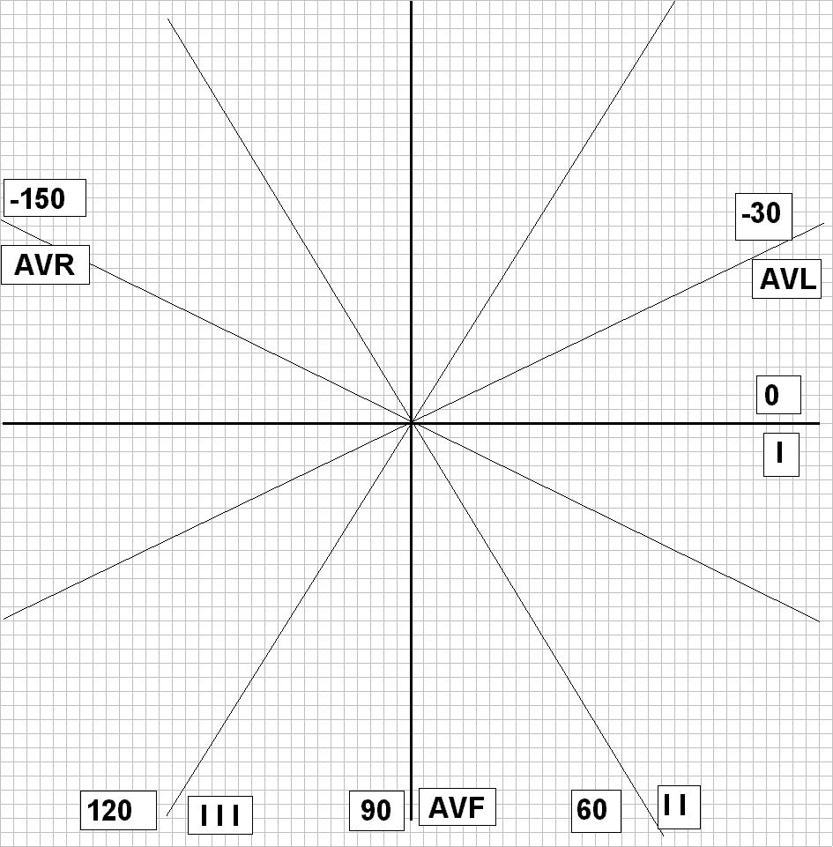
Axis Determination – Quick Locate Step 1
Lead I
If lead I is mostly positive, the
axis must lie in the right half of
of the coordinate system; the main vector is moving mostly toward the lead’s positive electrode.

Slide 60
Axis Determination – Quick Locate Step 2
Lead aVF
If lead aVF is mostly positive, the
axis must lie in the bottom half of
of the coordinate system; the main vector is moving mostly toward the lead’s positive electrode

Slide 61
Axis Determination – Quick Locate Step 3
I
aVF
Combining the two plots, we see
that the axis must lie in the bottom
right hand quadrant

Slide 62


Slide 63


Quadrant Approach: Example 1
Negative in I, positive in aVF → RAD
Notes:
Negative in I, positive in aVF → RAD

Slide 64


Quadrant Approach: Example 2
Positive in I, negative in aVF ➔ Predominantly positive in II ➔
Normal Axis (non-pathologic LAD)

Slide 65
The Equiphasic Approach
1. Determine which lead contains the most equiphasic QRS complex. The fact that the QRS complex in this lead is equally positive and negative indicates that the net electrical vector (i.e. overall QRS axis) is perpendicular to the axis of this particular lead.
2. Examine the QRS complex in whichever lead lies 90° away from the lead identified in step 1
If the QRS complex in this second lead is predominantly positive, than the axis of this lead is approximately the same as the net QRS axis.
If the QRS complex is predominantly negative, than the net QRS axis lies 180° from the axis of this lead.

Slide 67


Equiphasic Approach: Example 1
Equiphasic in aVF → Predominantly positive in I → QRS axis ≈ 0°

Slide 68

Equiphasic Approach: Example 2
Equiphasic in II → Predominantly negative in aVL → QRS axis ≈ +150°

Slide 69

Most equiphasic lead is: aVR ➔ Perpendicular to it is : Lead III (predominantly negative) ➔ add 180 ➔ -60 degree ➔ LAD

Slide 70

normal waves and interval in ECG
Normal ECG values for waves and intervals are as follows:
P wave: 80 milliseconds (0.08sec)
QRS complex: 80-100 milliseconds (0.8-0.1 sec)
T wave: 160 milliseconds (0.16 sec)

Slide 71

normal waves and interval in ECG
Normal ECG values for waves and intervals are as follows:
PR interval: 120-200 milliseconds (=0.12-0.2 sec or 3-5 small squares)
PR segment: 0.05-0.12 sec
ST segment: 0.8-0.120 sec.
QT interval: 0.36 – 0.44 sec.

Slide 72
What types of pathology can we identify and study from ECGs?
Chamber hypertrophy
Myocardial ischemia and infarction
Arrhythmias
Others
  Pericarditis
  Electrolyte disturbances (i.e. hyperkalemia, hypokalemia)
  Drug toxicity (i.e. digoxin and drugs which prolong the QT interval)

Slide 73
Thank

