Slide 1
Vascular System
Anatomy Lab
Dr. Essa Al-lahham
M.D , T.A

Slide 2
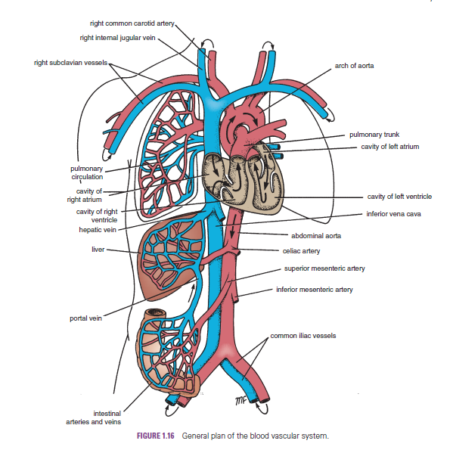

Slide 3
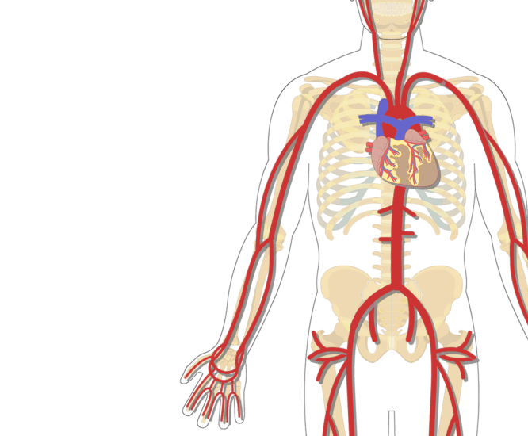
Large Arteries of the Thorax

Slide 4
Large Arteries of the Thorax
Aorta:
The aorta is the main arterial trunk that
delivers oxygenated blood from the left
ventricle of the heart to the tissues of
the body.
It is divided into the following parts:
ascending aorta, arch of the aorta,
descending thoracic aorta, and abdominal aorta.

Slide 5
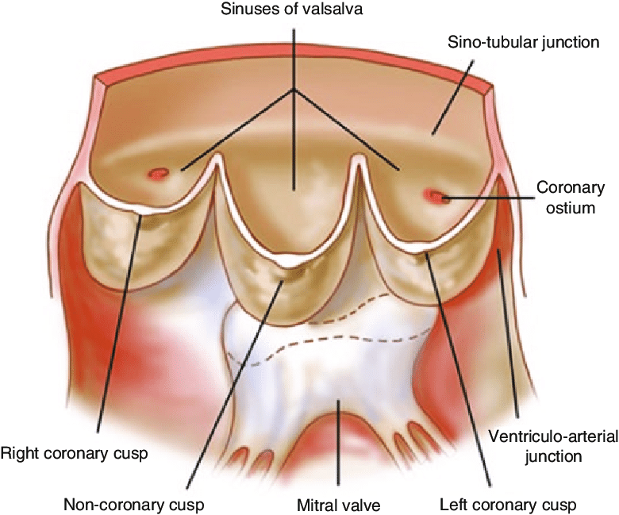
Ascending Aorta
The ascending aorta is 2 inches long in length and arises from the aortic orifice from the left ventricle and ascends to become the aortic arch.
At its root, it possesses three bulges, the sinuses of the aorta, one behind each aortic valve cusp.

Slide 6
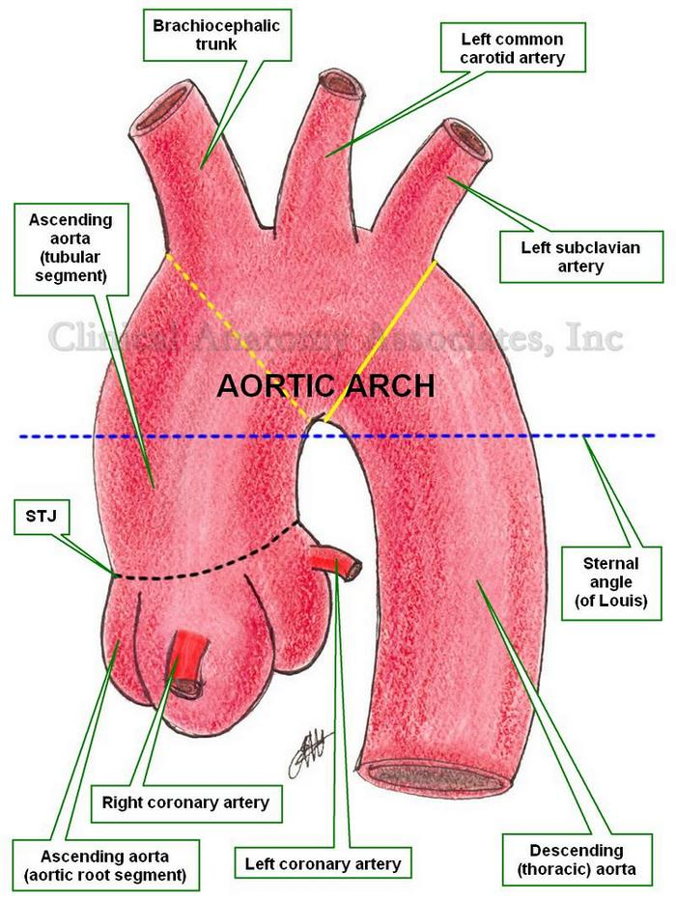

Slide 7
Ascending Aorta
1. The right coronary artery arises from the right aortic sinus of the ascending aorta and runs forward between the pulmonary trunk and the right auricle.
It descends almost vertically in the right atrioventricular groove, and at the inferior border of the heart.
2. The left coronary artery arises from the left aortic sinus.

Slide 8
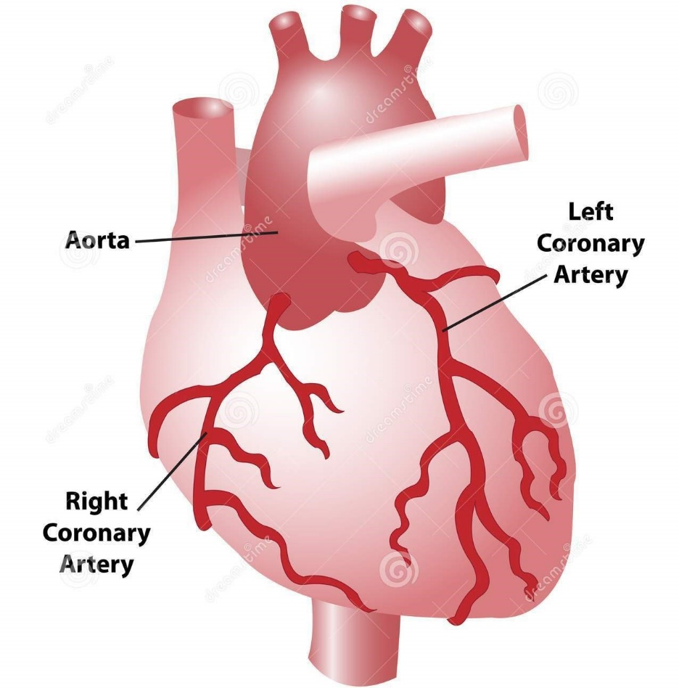

Slide 9
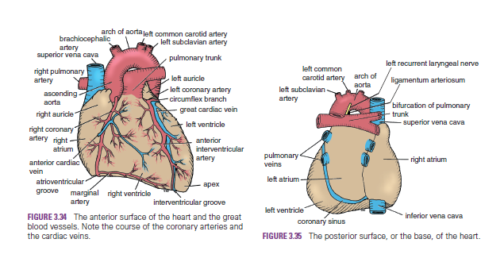
Ascending Aorta

Slide 10
Arch of Aorta
The arch of the aorta is a continuation of the ascending aorta. Starts at the level of sternal angle behind the manubrium sterni and arches upward, backward, and to the left in front of the trachea (its main direction is backward).
It then passes downward to the left of the trachea and, at the level of the sternal angle, becomes the descending aorta, which lies in posterior mediastinum.

Slide 11
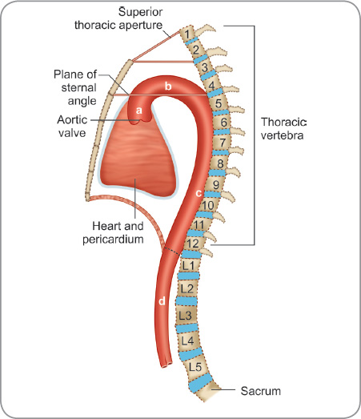
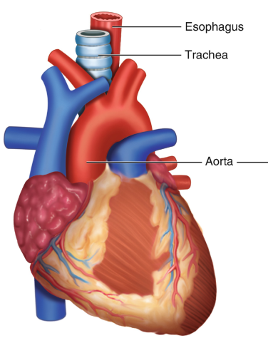

Slide 12
Arch of Aorta - Branches
The brachiocephalic artery (innominate artery). It passes upward and to the right of the trachea and divides into the right subclavian artery and right common carotid artery.
2. The left common carotid artery: It runs upward and to the left of the trachea.
3. The left subclavian artery: arises from the aortic arch behind the left common carotid artery.
They all branch from the convex area of arch of aorta.

Slide 13
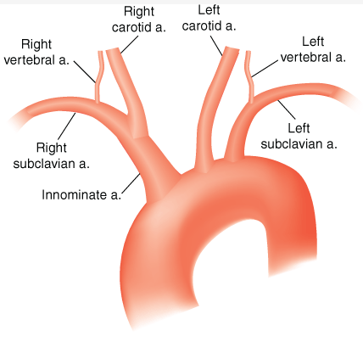
Arch of Aorta

Slide 14
Common Carotid Arteries (CCA)
The right CCA arises from the brachiocephalic artery at the level of the right sternoclavicular joint. .
The left CCA arises directly from the arch of the aorta.
The left and right common carotid arteries ascend up the neck, lateral to the trachea and the esophagus within the carotid sheath (with the internal jugular vein and vagus nerve), under the anterior border of the sternocleidomastoid muscle. They do not give off any branches in the neck.

Slide 15
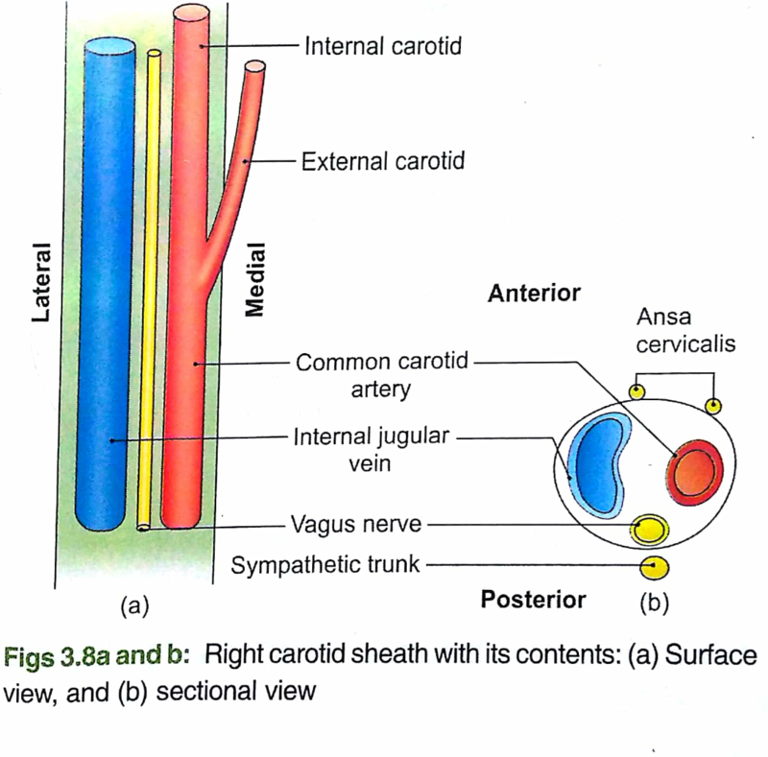
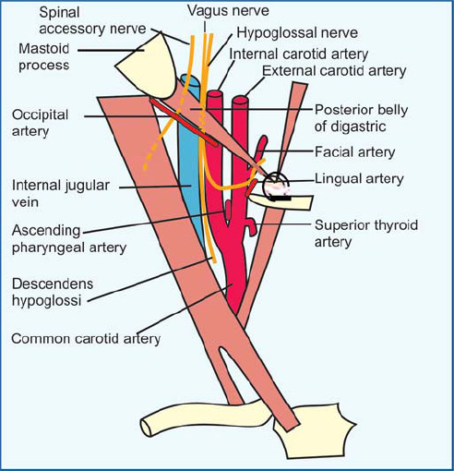

Slide 16
At the level of the superior margin of the thyroid cartilage (C4)
the carotid arteries split into the external and internal carotid arteries. This bifurcation occurs in an anatomical area known as the carotid triangle .
The common carotid and internal carotid are slightly dilated here, this area is known as the carotid sinus, and is important in detecting and regulating blood pressure.

Slide 17
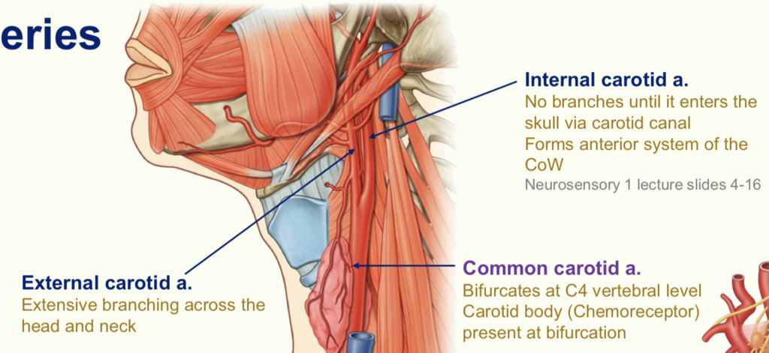

Slide 18
The carotid sinus is a dilated portion of the common carotid artery and proximal internal carotid artery. It contains baroreceptors: specialised sensory cells. The baroreceptors detect stretch as a measure of blood pressure. The glossopharyngeal nerve feeds this information to the brain, and this is used to regulate blood pressure.
External to the carotid sinus, there is a cluster of nervous cells known as the carotid body. These cells act as peripheral chemoreceptors; detecting the O2 content of the blood and relaying this information to the brain to regulate breathing rate.

Slide 19
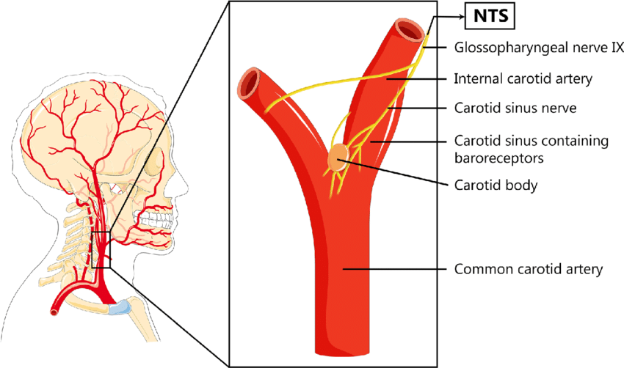

Slide 20
External Carotid Artery (ECA)
The external carotid artery supplies structures in the neck, face, and scalp; it also supplies the tongue and the maxilla.
After arising from the common carotid artery at the level of the upper border of the thyroid cartilage, it travels up the neck, passing posteriorly to the mandibular neck and anteriorly to the lobule of the ear.
The artery ends within the parotid gland posterior to the neck of the mandible by dividing into the superficial temporal artery and the maxillary artery.

Slide 21
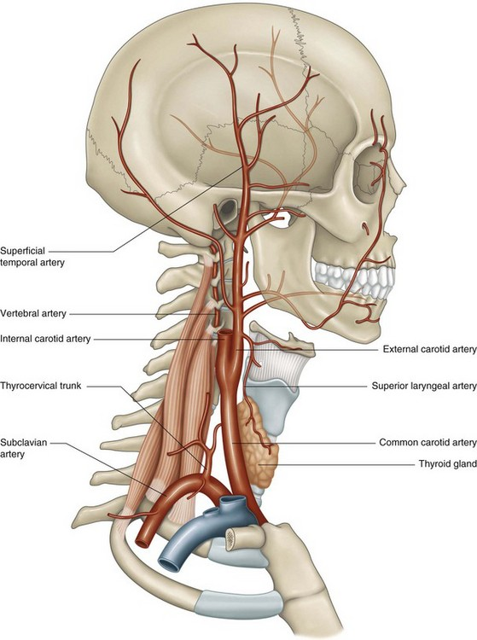

Slide 22
Branches of ECA
Superior thyroid artery
Ascending pharyngeal artery
Facial a.
Occipital a. FOL
Lingual a.
Posterior auricular a.
Superficial temporal a.
Maxillary a.

Slide 23
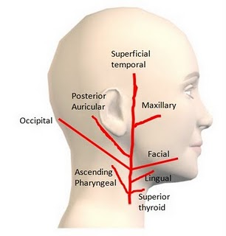

Slide 24
Internal Carotid Artery (ICA)
It begins at the bifurcation of the CCA at the level of the upper border of the thyroid cartilage.
The internal carotid arteries do not supply any structures in the neck, entering the cranial cavity via the carotid canal in the petrous part of the temporal bone.
Within the cranial cavity, the internal carotid artery supplies:
the brain , eyes and forehead.

Slide 25
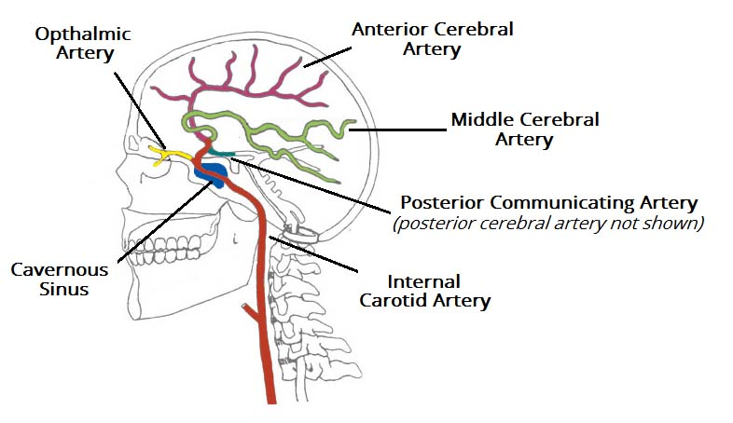
Branches of the ICA
Ophthalmic a.
Posterior communicating a.
Anterior cerebral a.
Middle cerebral a.

Slide 26
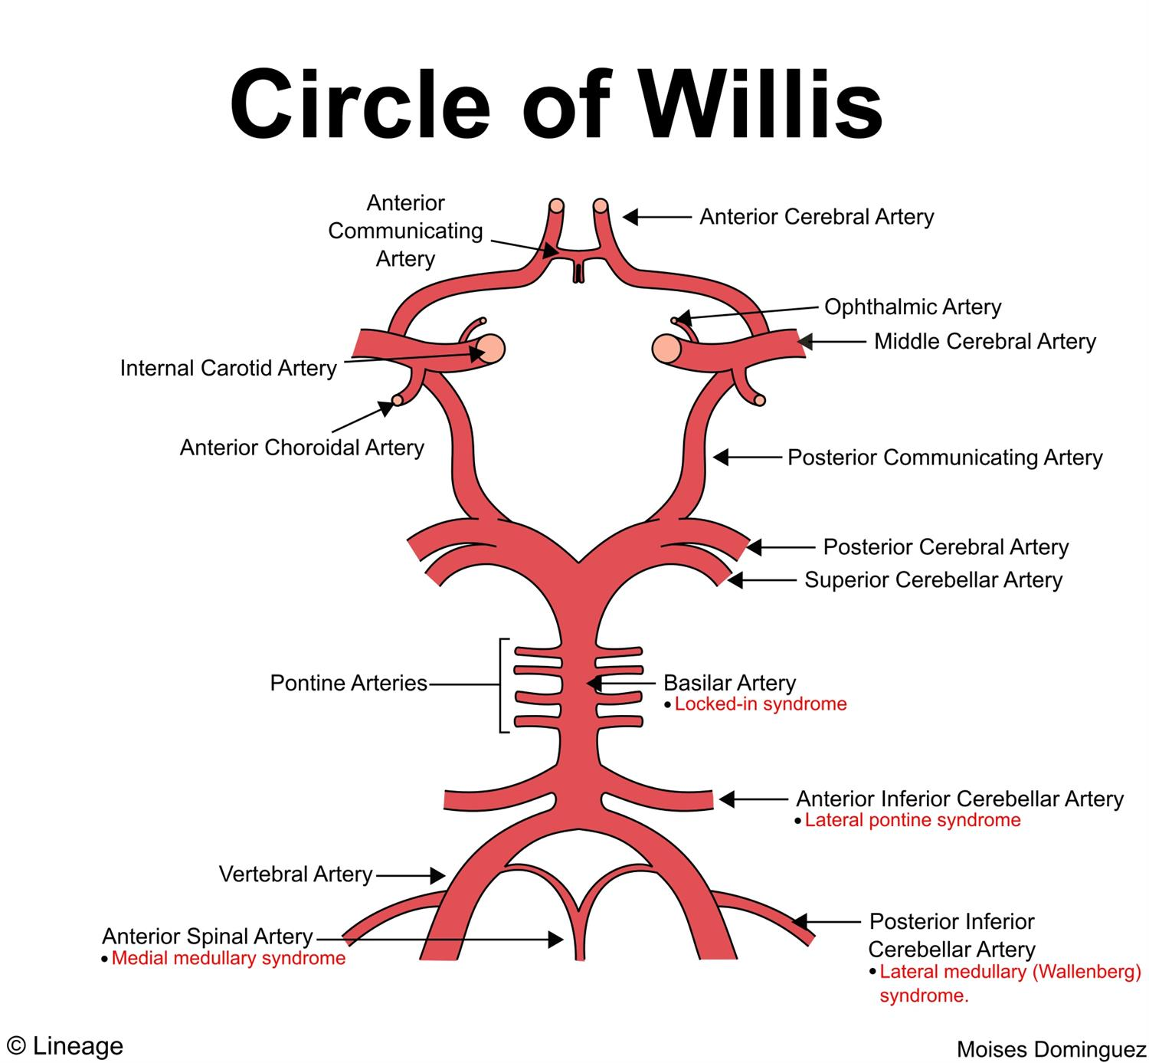

Slide 27
Subclavian Artery
On the right, the subclavian artery arises from the brachiocephalic trunk. On the left, it branches directly from the arch of aorta.
The subclavian artery travels laterally towards the axilla. It can be divided into three parts based on its position relative to the anterior scalene muscle:
First part – origin of the subclavian artery to the medial border of the anterior scalene.
Second part – posterior to the anterior scalene.
Third part – lateral border of anterior scalene.
At the lateral border of the first rib, the subclavian artery enters the axilla – and is renamed as axillary artery.

Slide 28
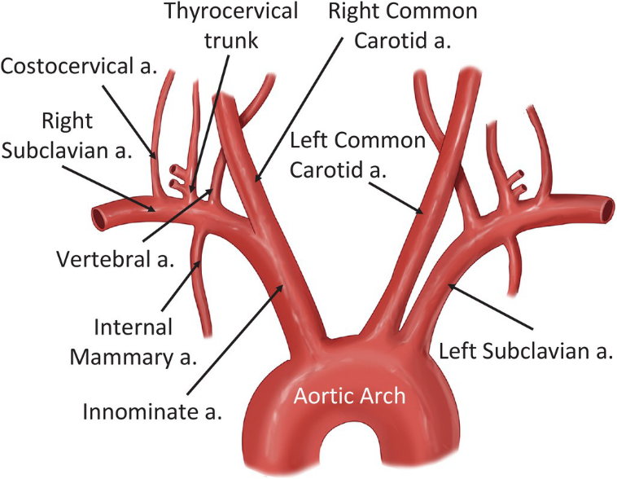

Slide 29
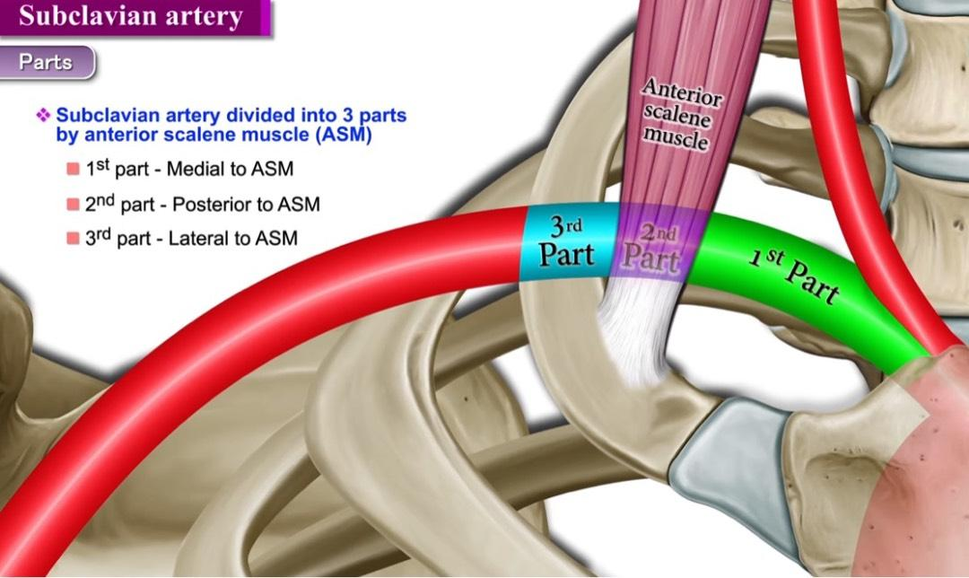

Slide 30
Axillary Artery
The axillary artery lies deep to the pectoralis minor m.
Importantly, the artery can be divided into three parts based on its position relative to the pectoralis minor muscle:
First part – proximal to pectoralis minor
Second part – posterior to pectoralis minor
Third part – distal to pectoralis minor
At the lower border of the teres major muscle, the axillary artery is renamed the brachial artery.

Slide 31
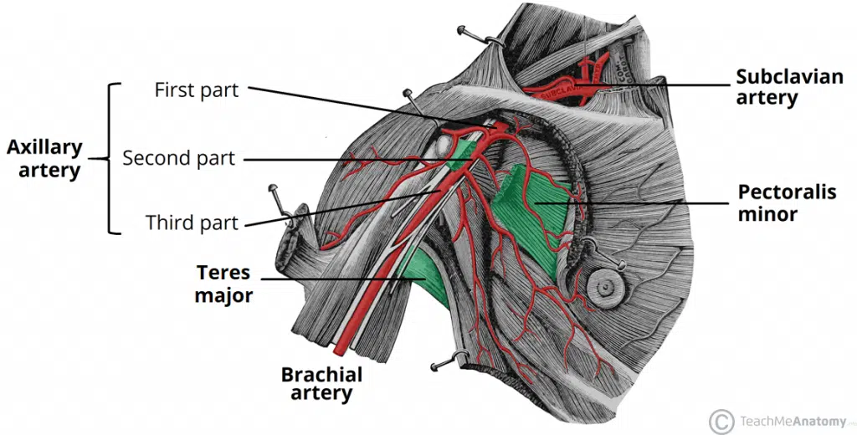

Slide 32
Brachial Artery
The brachial artery is a continuation of the axillary artery past the lower border of the teres major. It is the main supply of blood for the arm.
The brachial artery proper descends down the arm. As it moves through the cubital fossa, underneath the bicipital aponeurosis, the brachial artery terminates by bifurcating into the radial and ulnar arteries (at the level of the neck of the radius) .

Slide 33
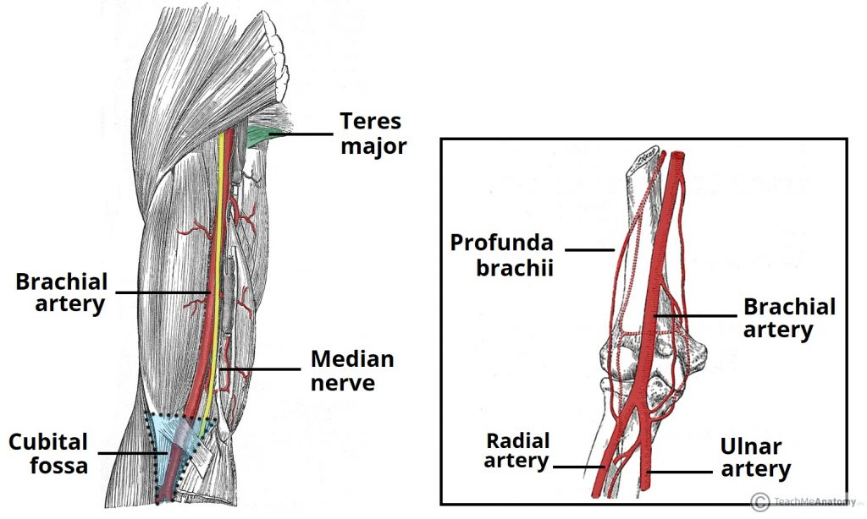

Slide 34
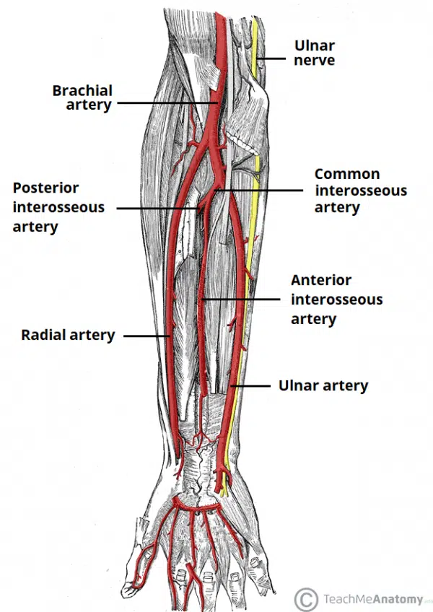

Slide 35
Clinical Relevance: Coarctation of the Aorta
Coarctation of the aorta refers to congenital snarrowing of the vessel, usually at the insertion of the ligamentum arteriosum . The narrow vessel has an increased resistance to blood flow, which leading to left ventricular hypertrophy.
Blood supply to the head, neck and upper limbs is not compromised as the vessels that supply them emerge proximal to the coarctation. However, blood supply to the rest of the body is reduced. This results in a weak, delayed femoral pulse which presents clinically as radio-femoral delay.

Slide 36
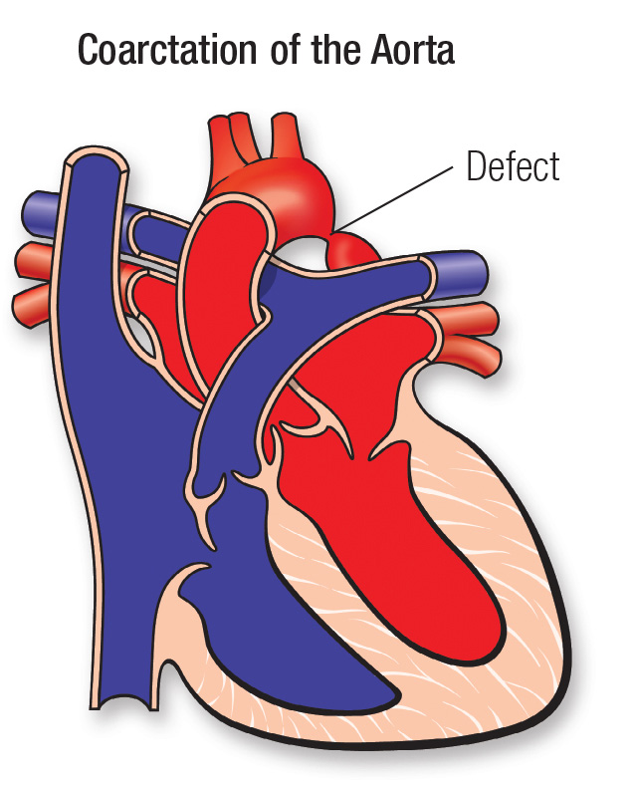
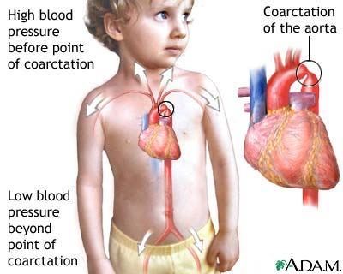

Slide 37
Descending Aorta
The descending aorta is the largest part of the aorta. It arises as a continuation of the aortic arch after the branching of the left subclavian artery.
The descending aorta is divided into the thoracic aorta and the abdominal aorta, which are anatomically separated by the diaphragm.

Slide 38
Descending Aorta
The descending thoracic aorta lies in the posterior mediastinum and begins as a continuation of the arch of the aorta on the left side of the lower border of the body of the T4 (opposite the sternal angle).
It runs downward in the posterior mediastinum to the left of the vertebral column but approaches the midline as it descends.
At the level of the T12 , it passes behind the diaphragm (through the aortic opening) in the midline and becomes continuous with the abdominal aorta.

Slide 39
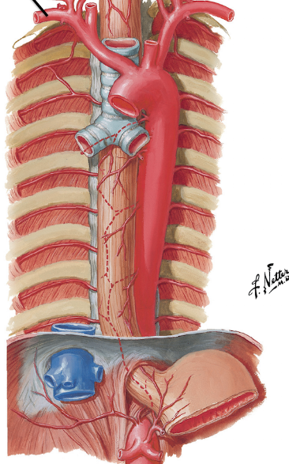
Descending Aorta

Slide 40
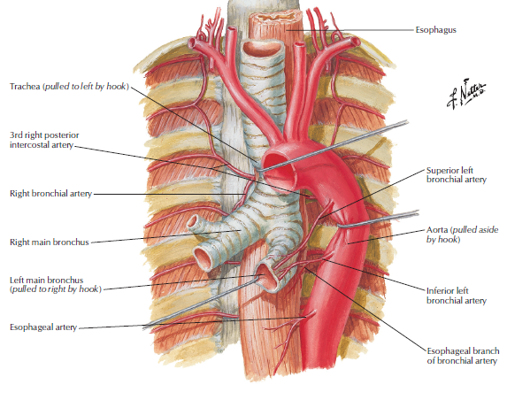
Descending thoracic Aorta - Branches
Bronchial arteries:
paired visceral branches arising laterally to supply bronchial and peribronchial tissue and visceral pleura.
However, most commonly, only the paired left bronchial artery (Superior and inferior left bronchial arteries) arises directly from the aorta whilst the right branches off usually from the 3rd posterior intercostal artery.

Slide 41
Descending thoracic Aorta - Branches
Mediastinal arteries: Small unpaired arteries that supply the lymph glands and loose areolar tissue in the posterior mediastinum.
Esophageal branches: consist of four or five unpaired vessels that supply blood to the esophagus and arise from anterior surface of descending aorta.
Pericardial arteries: Small unpaired arteries that arise anteriorly to supply the dorsal portion of the pericardium.

Slide 42
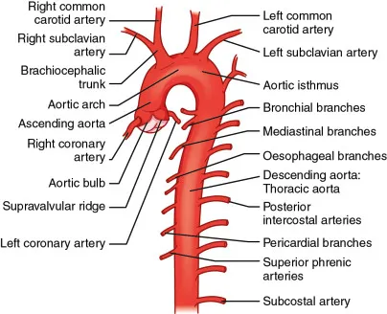

Slide 43
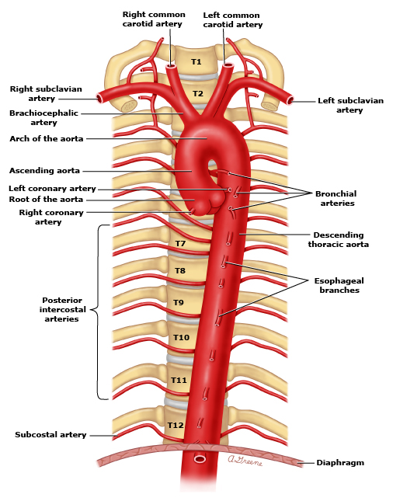
Descending thoracic Aorta - Branches
5. Posterior intercostal arteries are given off to the lower nine intercostal spaces on each side. They consist of 9 pairs of arteries that run between the ribs and supply the intercostal spaces.
6. Subcostal Arteries: given off on each side and run along the lower border of the 12th rib to enter the abdominal wall.

Slide 44
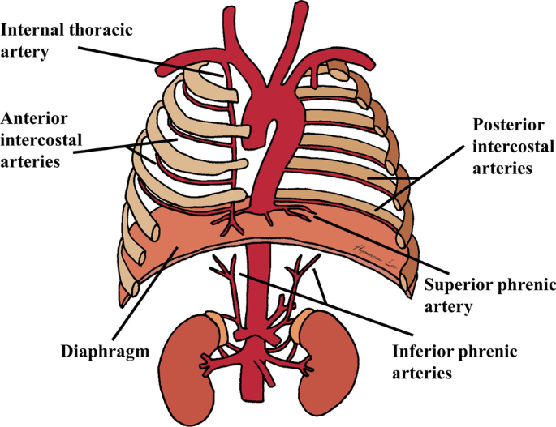
Descending thoracic Aorta - Branches
7. Superior phrenic arteries:
Paired parietal branches that supply the superior portion of the diaphragm.

Slide 45
Descending thoracic aorta
Visceral branches:
Bronchial, pericardial, esophageal, mediastinal arteries
Parietal branches:
Posterior intercostal, subcostal arteries and superior phrenic arteries

Slide 46
Large Arteries of the Thorax – Pulmonary Trunk
The pulmonary trunk conveys deoxygenated blood from the right ventricle of the heart to the lungs.
Pulmonary trunk leaves the upper part of the right ventricle, then runs upward, backward, and to the left.
It is about 2 in. (5 cm) long and terminates in the concavity of the aortic arch by dividing into right and left pulmonary arteries for left and right lungs respectively.

Slide 47
Pulmonary Trunk
The right pulmonary artery runs to the right behind the ascending aorta and superior vena cava to enter the root of the right lung.
The left pulmonary artery runs to the left in front of the descending aorta to enter the root of the left lung.
The ligamentum arteriosum.

Slide 48
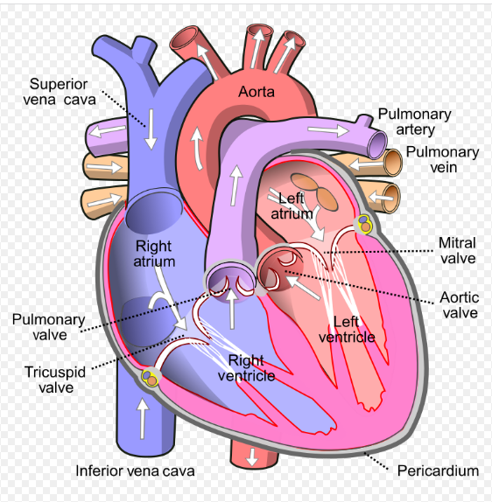
Pulmonary Trunk

Slide 49
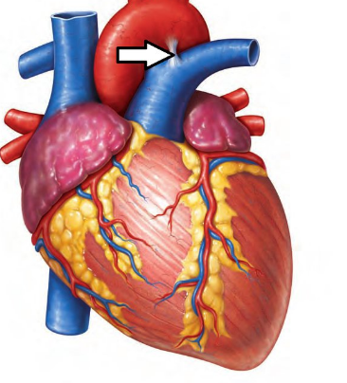
Ligamentum Arteriosum
fibrous band that connects the left pulmonary artery to the the aortic arch.
- The ligamentum arteriosum is the remenant of the ductus arteriosus, which in the fetus conducts blood from the pulmonary trunk to the aorta, thus bypassing the lungs.

Slide 50
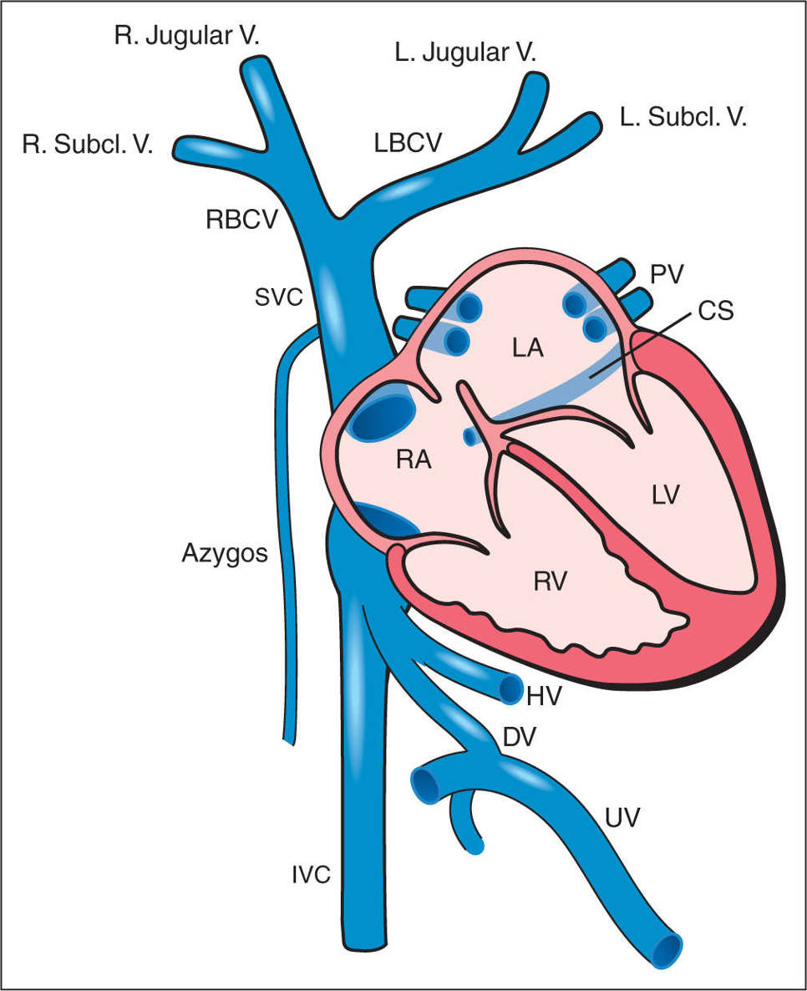
Large Veins of the Thorax

Slide 51
Superior Vena Cava
The superior vena cava with a 7 cm length recieves all the venous blood from the head and neck and both upper limbs.
  It arises from the union of the left and right brachiocephalic veins, posterior to the 1st right costal cartilage. It descends vertically through the superior mediastinum to the right of the aorta and trachea.
  It terminates by emptying into the superior aspect of the right atrium at the level of the 3rd costal cartilage.

Slide 52
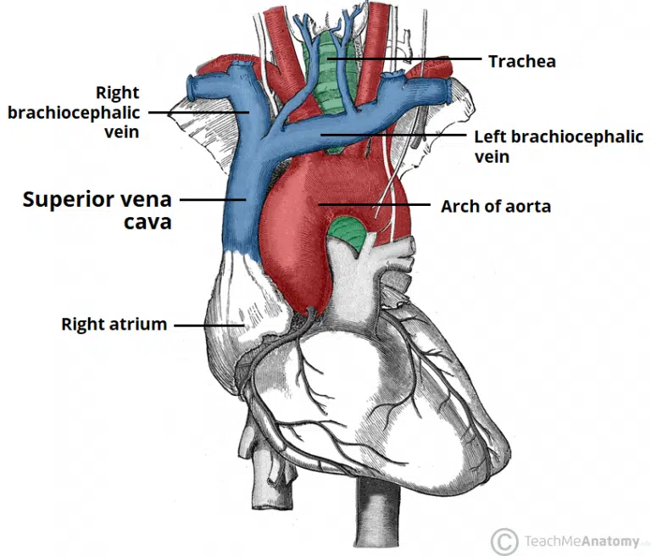

Slide 53
Brachiocephalic Veins (Innominate Veins):
The right brachiocephalic vein is formed at the root of the neck by the union of the right subclavian and the right internal jugular veins.
The left brachiocephalic vein has similar origins.
The right and left brachicephalic veins joins each other to form Superior Vena Cava.

Slide 54
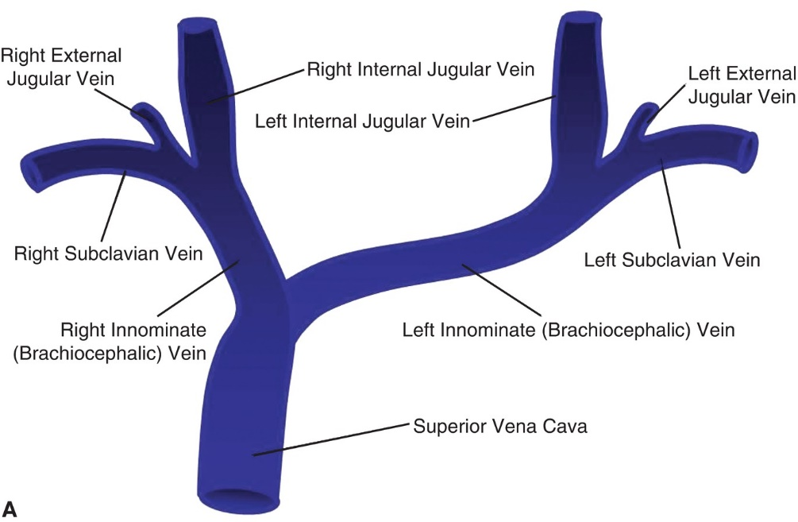

Slide 55
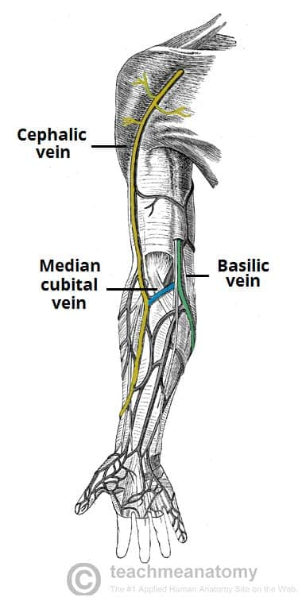

Slide 56
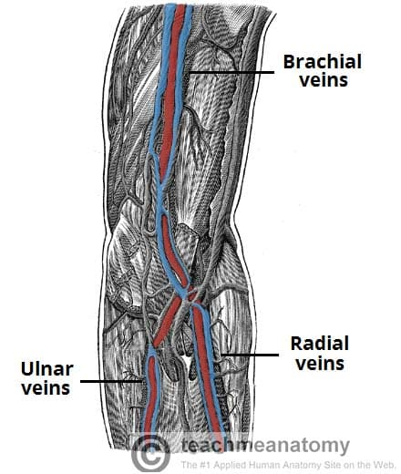

Slide 57
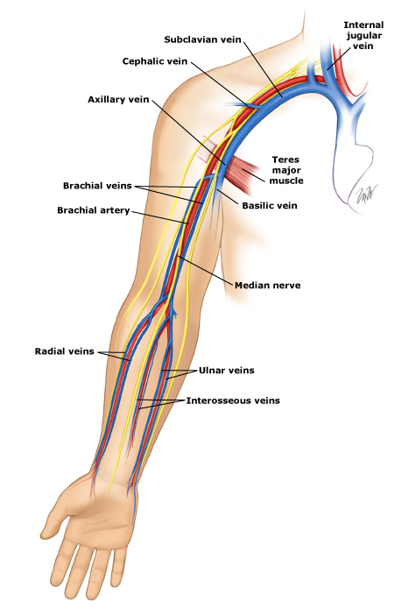

Slide 58
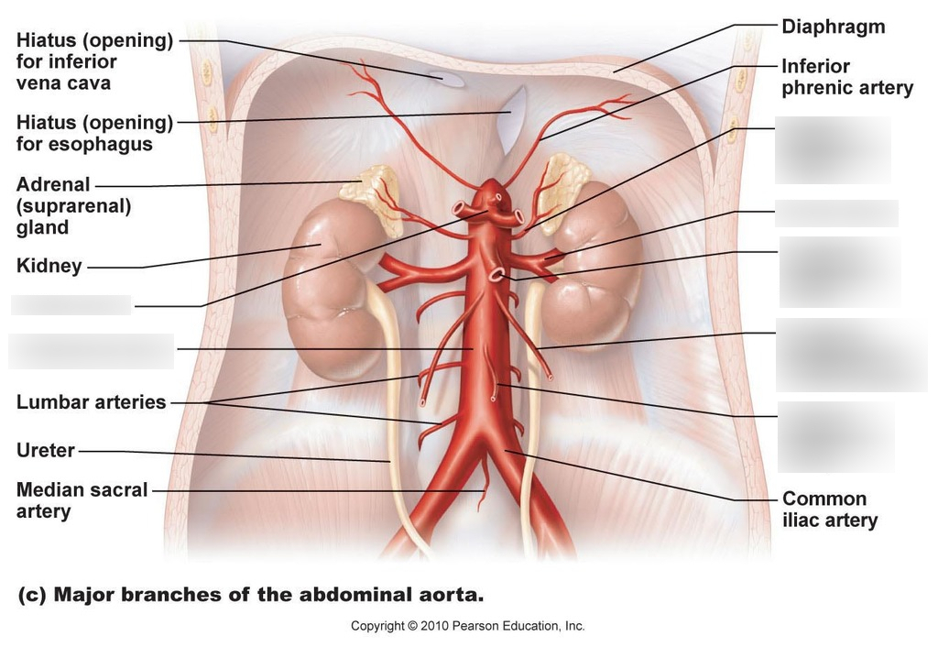
Abdomen – Abdominal Aorta
The abdominal aorta is a continuation of the thoracic aorta beginning at the level of the T12 vertebrae. It is approximately 13cm long and ends at the level of the L4 vertebra. At this level, the aorta terminates by bifurcating into the right and left common iliac arteries that supply the lower body.

Slide 59
Abdominal Aorta - Branches
3 anterior visceral branches
The celiac artery , with three branches: Splenic artery, common hepatic artery and left gastric artery.
The Superior mesenteric artery: artery of midgut.
The inferior mesenteric artery: artery of hindgut.
3 lateral visceral branches
Renal (paired)
Suprarenal (paired)
Gonadal arteries (testicular or ovarian artery). (paired)

Slide 60
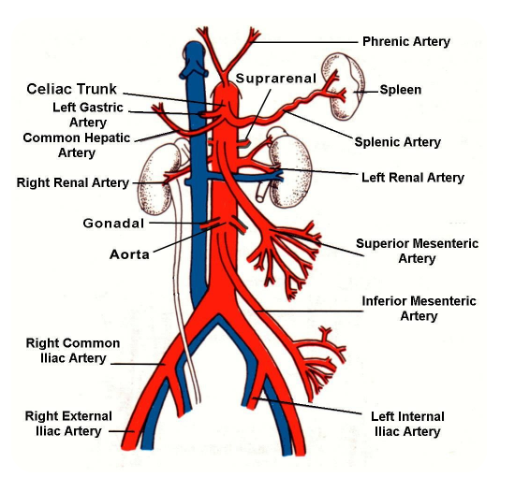

Slide 61
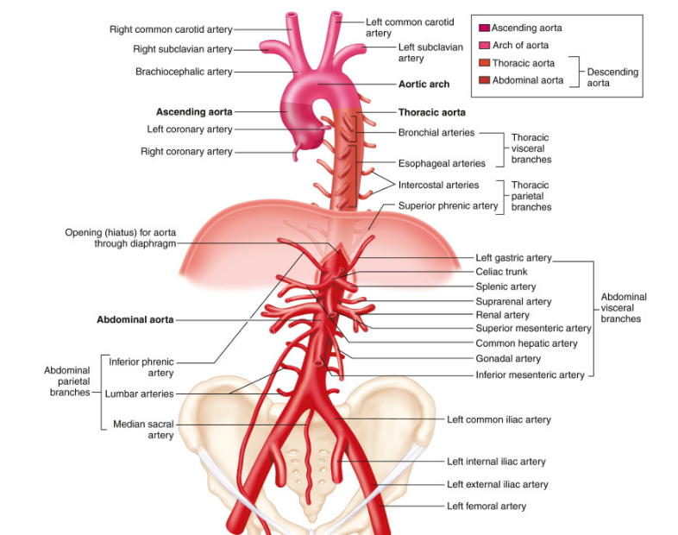

Slide 62
Abdominal Aorta - Branches
5 lateral parietal branches
4 lumbar arteries (paired)
Inferior phrenic artery (paired)
3 terminal branches
The 2 common iliac arteries
The median sacral artery.

Slide 63
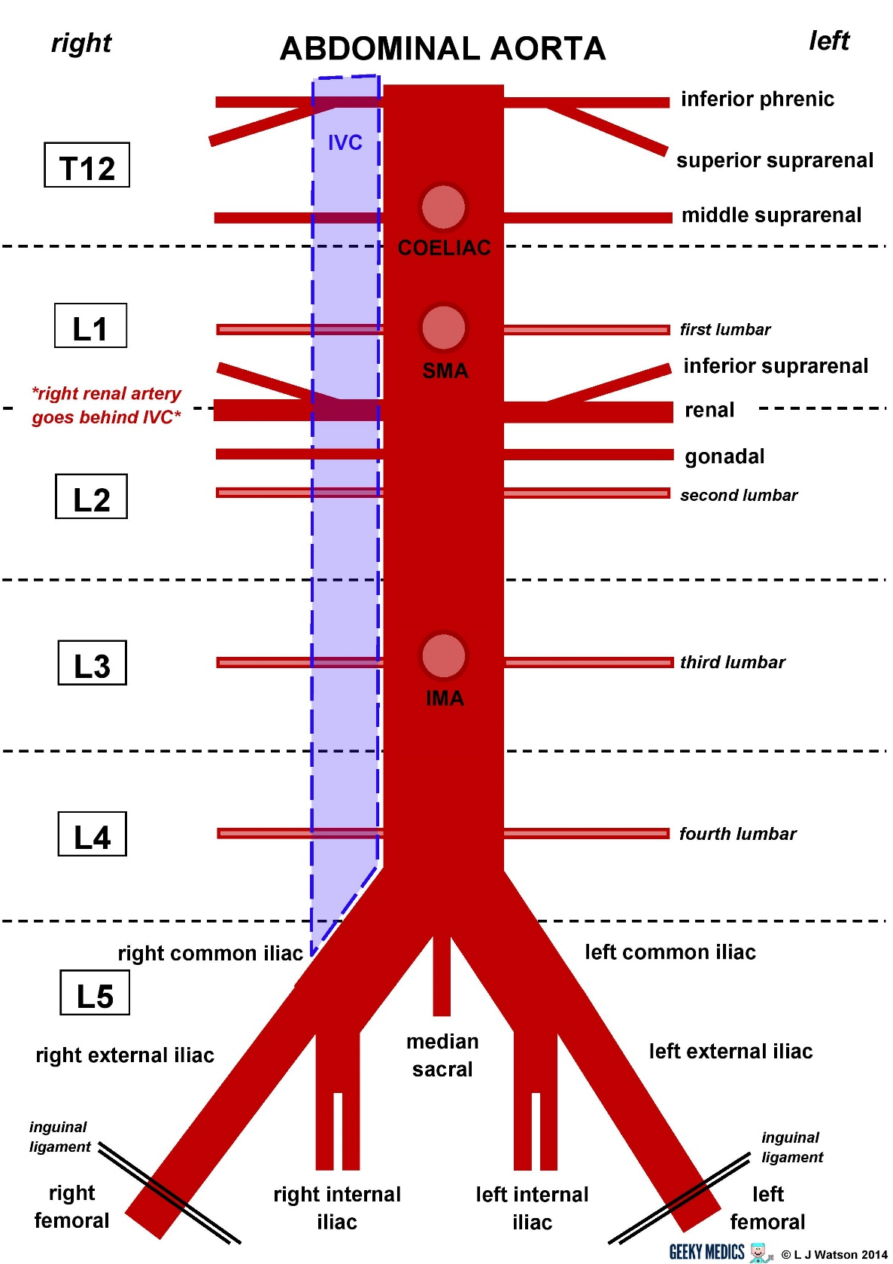

Slide 64
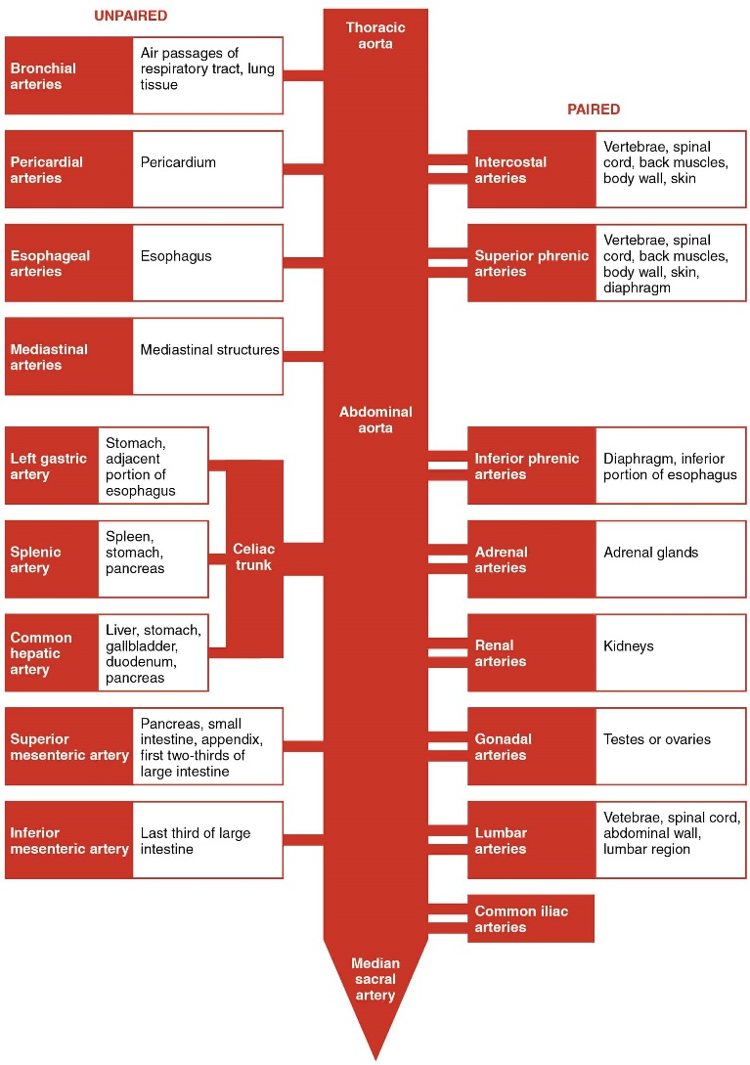

Slide 65
Abdominal Aorta – Celiac Trunk
Arises on the anterior aspect of the aorta just inferior to the aortic orifice of the diaphragm at the level of the lower border of T12 vertebra. Shortly after its origin, the trunk gives off its three branches; left gastric artery, hepatic artery and splenic artery.

Slide 66
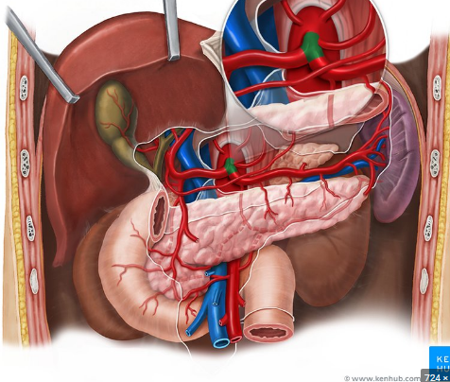
Abdominal Aorta – Celiac Trunk

Slide 67
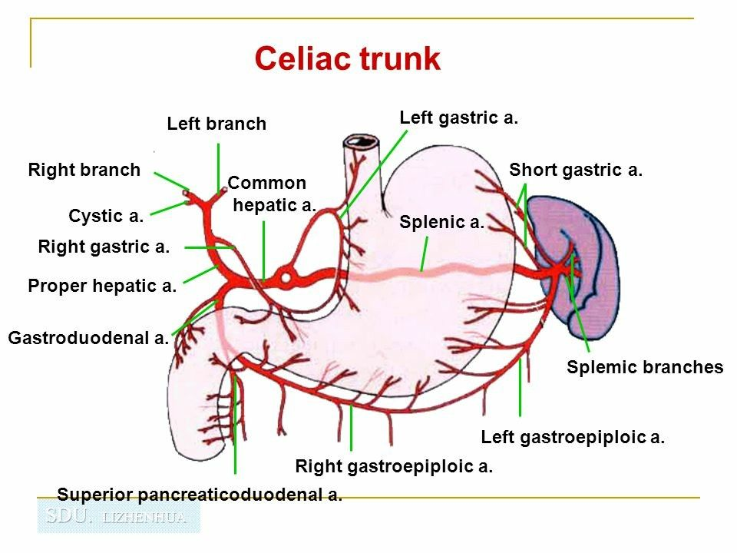
Celiac Trunk

Slide 68
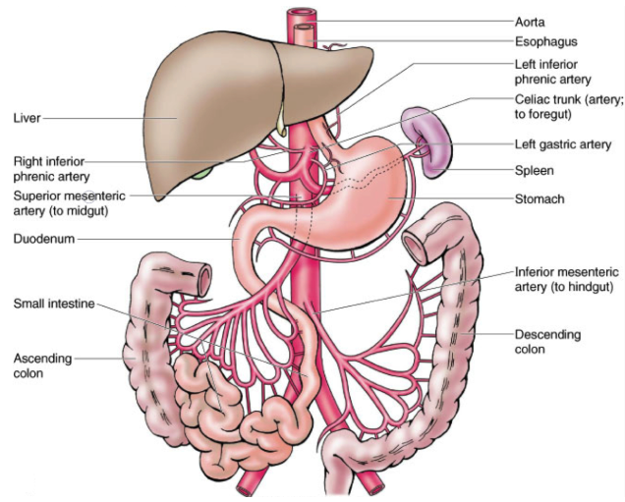
Abdominal Aorta – Superior and Inferior Mesenteric Artery

Slide 69
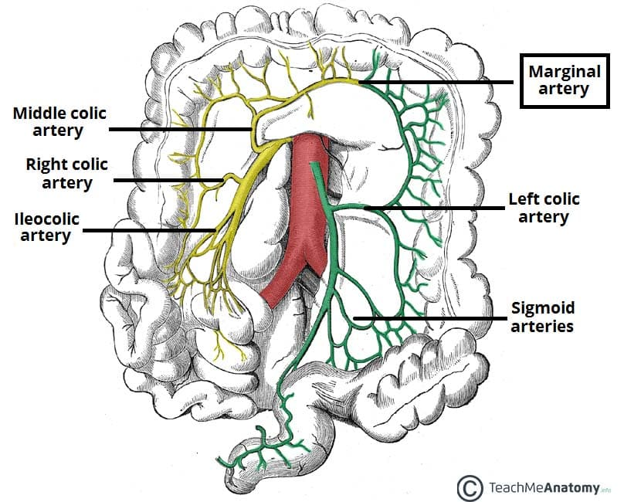
  Superior and Inferior Mesenteric Artery

Slide 70
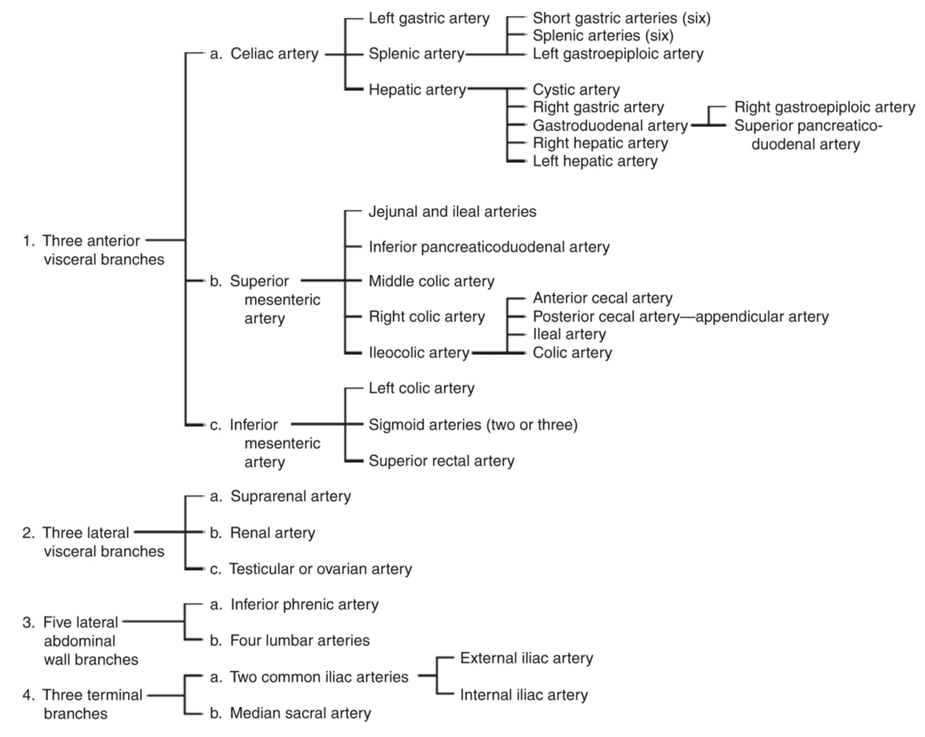

Slide 71
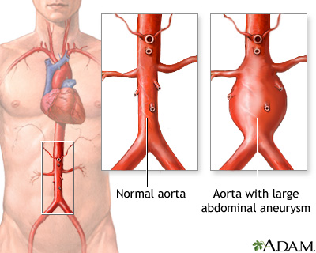
Clinical Relevance: Aortic Aneurysm
Aortic aneurysm describes a dilation of the artery to more than 1.5 times its original size. The abdominal component of the aorta is the most common site for aneurysmal changes.

Slide 72
Patients suffering with an abdominal aortic aneurysm may experience abdominal pulsations, abdominal pain and back pain. The aneurysm may also compress nerve roots causing pain/numbness in the lower limbs. A patient with an aortic arch aneurysm may have a hoarse voice due to the dilation stretching the left recurrent laryngeal nerve. Patients may also not have any symptoms at all.

Slide 73
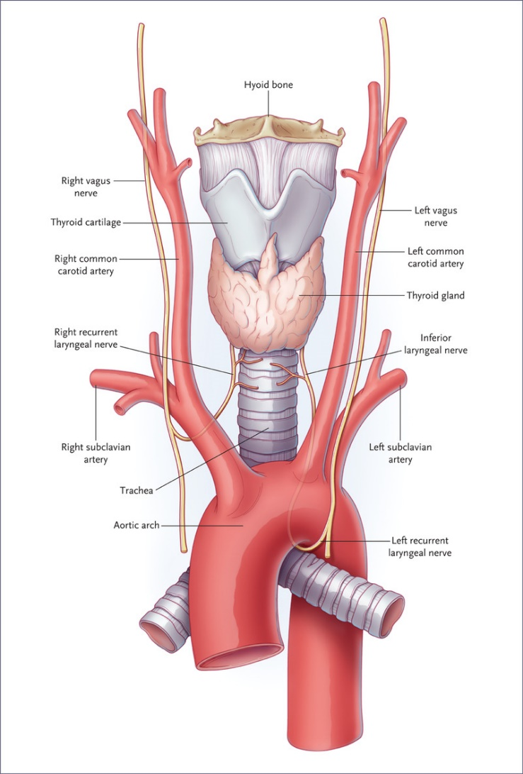

Slide 74
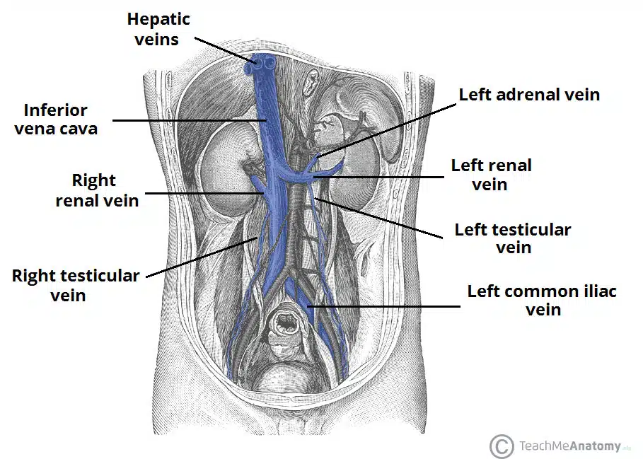
Inferior Vena Cava (IVC)

Slide 75
Large Veins of abdomen
Inferior Vena Cava
The inferior vena cava is located on the posterior abdominal wall; anterior to the vertebral column and to the right of the Abdominal Aorta
The vessel is formed by the union of the 2 common iliac veins at the L5 vertebral level just inferior to the bifurcation of the abdominal aorta.
. It ascends superiorly, and leaves the abdomen by piercing the central tendon of the diaphragm at the T8 level (the caval hiatus). Within the thorax, the inferior vena cava drains into the right atrium of the heart.

Slide 76


Slide 77

IVC tributaries
2 anterior visceral tributaries
hepatic veins
3 lateral visceral tributaries
Renal veins, right Gonadal and right suprarenal vein
5 lateral abdominal wall tributaries
inferior phrenic vein
4 lumbar veins
3 veins of origin

Slide 78

Gonadal and suprarenal Veins
.
Right Gonadal and right suprarenal vein drains into the inferior vena cava directly, while left gonadal and left suprarenal vein drains into left renal vein

Slide 79

Great Vessels of the Lower Limbs

Slide 80

Common iliac arteries
After the aorta terminates by bifurcating into the right and left common iliac arteries at the level of L4 , each common iliac artery gives the internal and external iliac arteries . This approximately occurs at vertebral level L5-S1 .
The common iliac artery is about
4 cm long .

Slide 81

Internal iliac artery
It originates at the bifurcation of the common iliac artery at vertebral level L5-S1.
As the artery descends inferiorly , At the superior border of the greater sciatic foramen , it divides into anterior and posterior trunks.

Slide 82
Branches of Anterior Trunk
Obturator artery
Umbilical artery – Gives rise to the superior vesical artery
Inferior vesical artery
Vaginal artery (female)
Uterine artery (female) OVM 2U 3I
Middle rectal artery
Internal pudendal artery
Inferior gluteal artery – The terminal branch of the anterior trunk

Slide 83


Slide 84
Branches of Posterior Trunk
Iliolumbar artery
Lateral sacral arteries (superior and inferior)
Superior gluteal artery – The terminal branch of the posterior trunk

Slide 85


Slide 86
External iliac artery
After the external iliac artery has branched from the common iliac artery, it travels down and passing posteriorly to the inguinal ligament to enter the thigh.
Before the external iliac artery passes under the inguinal ligament, it gives off two major branches
The two branches are the inferior epigastric artery and the deep circumflex iliac artery.

Slide 87


Slide 88
The external iliac artery becomes the femoral artery as the vessel passes under the inguinal ligament to enter the femoral triangle in the anterior aspect of the thigh.
it passes through the adductor hiatus to become the popliteal artery on entering the posterior compartment of the thigh and soon thereafter divides into the anterior and posterior tibial arteries.

Slide 89


Slide 90

Femoral Triangle
From lateral to medial :
the femoral nerve (N)
the femoral artery (A)
the femoral vein (V)
lymphatic vessels. (Y)
The femoral artery can be palpated in the femoral triangle just inferior to the inguinal ligament and midway between the anterior superior iliac spine and the pubic symphysis

Slide 91



Slide 92
Femoral artery branches
The femoral artery gives off:
5 branches in the femoral triangle:
Superficial epigastric artery
Superficial circumflex iliac artery
Superficial external pudendal artery
Deep external pudendal artery
Profunda femoris
1 branch in the adductor canal:
Descending genicular artery

Slide 93


Slide 94


Slide 95
Veins of Lower Limb
Deep veins are located underneath the deep fascia of the lower limb, accompanying the major arteries.
Superficial veins are found in the subcutaneous tissue. They eventually drain into the deep veins

Slide 96

Deep veins

Slide 97
Superficial veins
The Great Saphenous Vein
The great saphenous vein is formed by the dorsal venous arch of the foot, and the dorsal vein of the great toe. It ascends up the medial side of the leg, passing anteriorly to the medial malleolus at the ankle, and posteriorly to the medial condyle at the knee.
The great saphenous vein terminates by draining into the femoral vein immediately inferior to the inguinal ligament.
Surgically, the great saphenous vein can be harvested and used as a vessel in coronary artery bypasses.

Slide 98

Great Saphenous Vein

Slide 99
The Small Saphenous Vein
The small saphenous vein is formed by the dorsal venous arch of the foot, and the dorsal vein of the little toe. It moves up the posterior side of the leg, passing posteriorly to the lateral malleolus, along the lateral border of the calcaneal tendon. It moves between the two heads of the gastrocnemius muscle and empties into the popliteal vein in the popliteal fossa.

Slide 100



Slide 101
Thank you

