Slide 1
Immunological aspects of cardiovascular disorders
Malak Alshaikhali
MD, Al-Quds University
MSc Integrated Immunology, University Of Oxford.

Slide 2
Learning outcomes
Understand the clinical presentation of rheumatic fever and it immunopathology.
Overview of autoimmune carditis and dilated cardiomyopathy.
Overview of vasculitis and the underlying immunopathology.

Slide 3
Rheumatic fever
Acute rheumatic fever (ARF) is a delayed, nonsuppurative sequela of a pharyngeal infection with the group A streptococcus (GAS).
It develops as a complication of untreated or inadequately treated streptococcal throat infection.
A latent period 2-3 weeks follows the initial streptococcal pharyngitis.

Slide 4
Rheumatic fever
Incidence is now increasing.
Mainly affects children (5-15 yrs) but can be seen in adults.
Clinical features include carditis, polyarthritis, chorea, cutaneous nodules, erythema marginatum, prolonged PR interval on ECG, and raised CRP/ESR, together with evidence of previous streptococcal infection with (GAS).

Slide 5
Rheumatic fever
The onset of disease is usually characterized by an acute febrile illness, which may manifest itself in one of three classical ways:
Migratory arthritis predominantly involving the large joints of the body.
Isolated or concomitant signs of carditis and valvulitis.
Central nervous system involvement as Sydenham’s chorea.

Slide 6
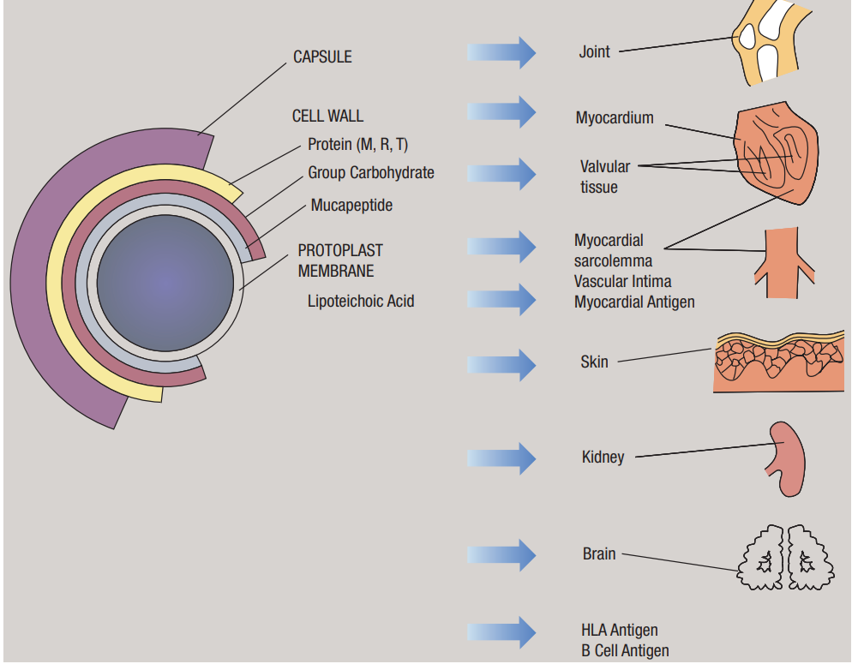
Notes:
Schematic representation of the various structures of the group A streptococcus. Note the wide variety of cross-reactions between its antigens and mammalian tissues

Slide 7
Rheumatic fever: immunopathology
The immunopathology of rheumatic fever involve an abnormal immune response triggered by the bacterial infection.
Initial Infection: rheumatic fever typically follows an untreated or inadequately treated streptococcal pharyngitis.
GAS expresses various antigens on its surface, including the M protein, which is a major virulence factor.
The initial immune response is triggered by the recognition of GAS antigens by the host's immune cells, particularly T lymphocytes.

Slide 8
Rheumatic fever: immunopathology
Antigenic Mimicry: The M protein of GAS exhibits molecular mimicry, sharing structural similarities with certain host tissues, particularly cardiac proteins.
This resemblance can lead to a cross-reaction where the immune system, while targeting the GAS antigens, also targets the host tissues.
Autoantibodies are produced that target self-antigens present in cardiac tissues, such as myosin and cardiac valve proteins.

Slide 9
Rheumatic fever: immunopathology
Activation of Immune Cells: The recognition of GAS antigens by T lymphocytes triggers an immune response.
CD4+ T helper cells produce inflammatory cytokines which activate and recruit other immune cells- including B cells.
B lymphocytes are stimulated by Th cells to produce antibodies.
These antibodies are specific to GAS antigens and contribute to the clearance of the bacteria.
However, due to molecular mimicry, some antibodies may also cross-react with self-antigens.

Slide 10
Rheumatic fever: immunopathology
In ARF, there is an aberrant immunological response to the streptococcal M-proteins (M-proteins 5, 14, 24)-to which antibodies are generated and cross-react with human sarcolemmal proteins and myosin.
M-protein types 1, 5, and 18 also cross-react with cartilage epitopes, thus potentially leading to arthritis.

Slide 11
Rheumatic fever: immunopathology
Immune Complex Formation: The antibodies produced against GAS antigens can form immune complexes when they bind to the bacterial or self-antigens.
These immune complexes circulate in the bloodstream and can deposit in various tissues, including the heart, joints, skin, and blood vessels.
The deposition of immune complexes triggers an inflammatory response- complement activation, release of chemotactic factors.

Slide 12
Rheumatic fever
Diagnosis: clinical, no specific immunological tests- ECG findings, elevated acute-phase proteins, and raised antistreptolysin O titre (ASOT).
Management: Antibiotics to eliminate the organism, NSAIDs for arthralgia, corticosteroids for carditis.
Long-term penicillin prophylaxis is required as the syndrome will recur on subsequent group A streptococcal infection.

Slide 13
Myocarditis and cardiomyopathy
Myocarditis is generally considered an inflammatory condition of the heart muscle, often caused by viral infections or autoimmune processes.
Cardiomyopathy (mainly the dilated type DCM) is a chronic form of heart disease characterized by right ventricular dilation and impaired contraction.

Slide 14
Myocarditis and cardiomyopathy
Myocarditis and DCM can occur at any age (mostly in younger adults).
Myocarditis can occur as an isolated condition or as part of systemic autoimmune disease- eg connective tissue diseases, especially SLE, and vasculitis, particularly Churg–Strauss syndrome.
There may be familial forms of DCM with genetic predisposition.

Slide 15
Myocarditis and cardiomyopathy
In both myocarditis and DCM, there appears to be an association with prior Coxsackie virus infections.
DCM can also be triggered by enteroviruses, adenoviruses, or HHV-6.
They both may present with congestive heart failure, arrhythmias, and chest pain.
Notes:
HHV-6 human herpesvirus 6

Slide 16
Myocarditis and cardiomyopathy: immunopathology
Viral infection can lead to myocardial inflammation and subsequent autoimmune reactions.
Molecular mimicry, where viral proteins resemble cardiac proteins, can trigger the autoimmune response and contribute to the pathogenesis of myocarditis and DCM.
This autoimmune response results in immune cells activation, cytokines release, myocardial infiltration and myocardial cell damage (directly, CD8+ cells & or indirectly).

Slide 17
Myocarditis and cardiomyopathy: immunopathology
Many patients with myocarditis and with DCM develop autoantibodies to a number of cardiac constituents.
In myocardittis, there is association with autoantibodies seen in autoimmune diseases, such as anti-heart-specific antibodies (anti-myosin, anti-troponin) or anti-neutrophil cytoplasmic antibodies (ANCA).
There also appears to be an association with anti-ribonucleoprotein (antiRNP) antibodies seen in MCTD and SLE.
Notes:
MCTD mixed connective tissue disease.

Slide 18
Myocarditis and cardiomyopathy: immunopathology
DCM is associated with anti-cardiac antibodies, which may also have features of myocarditis on biopsy.
Antibodies directed against cardiac atrial cells producing atrial natriuretic peptide are also seen.
DCM is also associated with M7 anti-mitochondrial antibodies recognizing mitochondrial flavoproteins, including riboflavin.

Slide 19
Myocarditis: immunopathology
The pathogenic role of these autoantibodies is indeterminate, however they are thought to contribute to the pathogenesis of myocarditis and DCM by promoting inflammation, cellular damage, and dysfunction of cardiac myocytes.

Slide 20
Myocarditis and cardiomyopathy
Diagnosis: clinical presentation, cardiac imaging, autoantibody testing and biopsy.
Management: immunosuppressive agents + supportive treatment for heart function (ACEI/ARBS, diuretics, aldosterone antagonists).

Slide 21
Vasculitis
Vasculitis refers to a group of disorders characterized by inflammation of blood vessels, leading to vessel wall damage and subsequent tissue injury.
The effects of the process depend on the location of the inflammatory change and the size and type of the vessel involved.
It is unclear why there is selectivity for vessels of a certain type, size, or location.
Vasculitis is primary or secondary.

Slide 22
Vasculitis
Primary vasculitis: classified based on the size of the vessel involved and on the presence or absence of granulomata.
However, there is considerable overlap in the size of vessels involved.
Secondary vasculitis: many causes involved e.g. infections, malignancy, drugs, AID, IBDs.

Slide 23
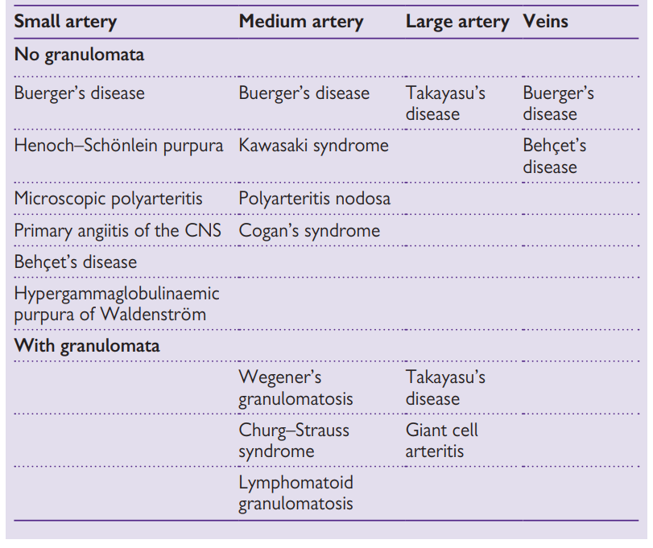
Classification of primary vasculitis

Slide 24
Vasculitis
Genetic and environmental factors play a role in the susceptibility to vasculitis.
Genetic variations, such as HLA alleles, are associated with an increased risk of developing vasculitis.
Environmental factors, such as infections or exposure to certain toxins, can trigger or exacerbate the immune response in individuals with genetic susceptibility.

Slide 25
Vasculitis: immunopathogenesis
Vasculitis includes a diverse group of disorders with varying clinical presentations and histological patterns.
The immunopathogenesis can differ among different types of vasculitis, reflecting distinct underlying mechanisms.
For example, ANCA-associated vasculitis involves ANCAs targeting specific intracellular antigens, while immune complex-mediated vasculitis, such as IgA vasculitis (Henoch-Schönlein purpura), is characterized by deposition of immune complexes in vessel walls.

Slide 26
Vasculitis: immunopathogenesis
The immunopathogenesis of vasculitis begins with the activation of the immune system.
The exact triggers for immune activation in vasculitis are not fully understood, but they may include infections, drugs, toxins, or autoimmune processes.
These triggers can lead to the release of pro-inflammatory cytokines and activation of immune cells, such as neutrophils, T lymphocytes, and B lymphocytes.

Slide 27
Vasculitis: immunopathogenesis
Endothelial Cell Activation and Injury in response to immune activation.
This leads to the expression of adhesion molecules and chemokines on the endothelial cell surface which facilitate the recruitment and adhesion of immune cells to the vessel walls.
This promotes neutrophils rrecruitment and infiltration of blood vessels with subsequent tissue damage.

Slide 28
Vasculitis: immunopathogenesis
In some forms of vasculitis, immune complexes can form in the circulation, and they can deposit in the vessel walls, particularly in small vessels.
These immune complexes activate complement cascades, leading to the recruitment and activation of inflammatory cells.

Slide 29
Vasculitis: immunopathogenesis
Both T lymphocytes and B lymphocytes play crucial roles in the immunopathogenesis of vasculitis.
T lymphocytes release pro-inflammatory cytokines, activate other immune cells, and contribute to the recruitment of inflammatory cells into the vessel wall.
B lymphocytes produce antibodies- e.g ANCAs autoantibodies in ANCA-associated vasculitis, are involved in the pathogenesis of specific vasculitic disorders.
Notes:
such as antineutrophil cytoplasmic antibodies (ANCAs)
AAV comprises a group of vasculitides, including AAV comprises a group of vasculitides, including granulomatosis with polyangiitis (GPA, formerly Wegener's granulomatosis), microscopic polyangiitis (MPA), and eosinophilic granulomatosis with polyangiitis (EGPA, formerly Churg-Strauss syndrome).

Slide 30
Vasculitis: immunopathogenesis
The immune-mediated inflammation and tissue injury result in damage to the vessel walls.
The vessel walls may become weakened, leading to aneurysm formation or rupture.
The inflammation can cause luminal narrowing or occlusion, leading to tissue ischemia and organ damage.

Slide 31
Vasculitis
Diagnosis: the most important diagnostic test is often biopsy of the affected organ.
Imaging is essential in cranial vasculitis (MRI, MRA).
Autoantibody testing should include ANA, ENA, dsDNA, and ANCA (including MPO and PR3).
Role of anti-endothelial cell antibodies (AECA) is not determined as these antibodies do not seem to be disease-specific.

