Slide 1
Other Pics

Slide 2
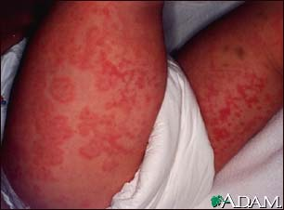
HSB

Slide 3
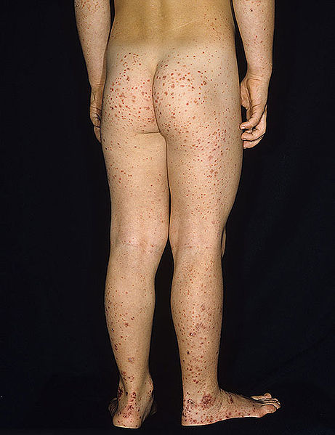

Slide 4
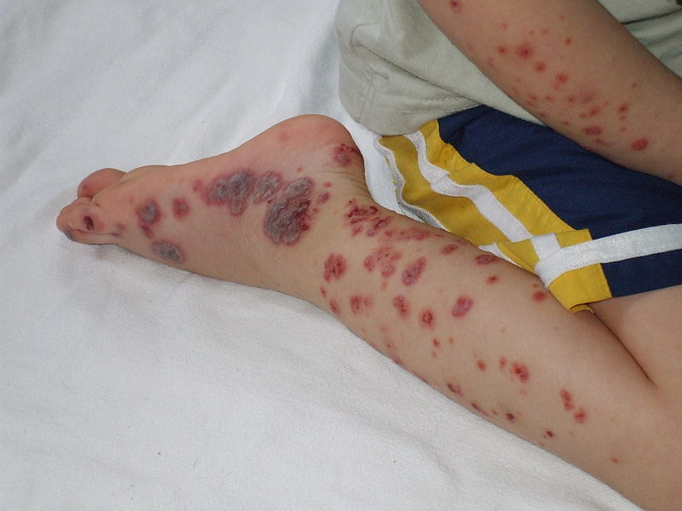
Sever form of HSB in this pic it looks like meningiococemia the difference is that in MC the pt is very sick adn unstable and the senario is differnet :))

Slide 5
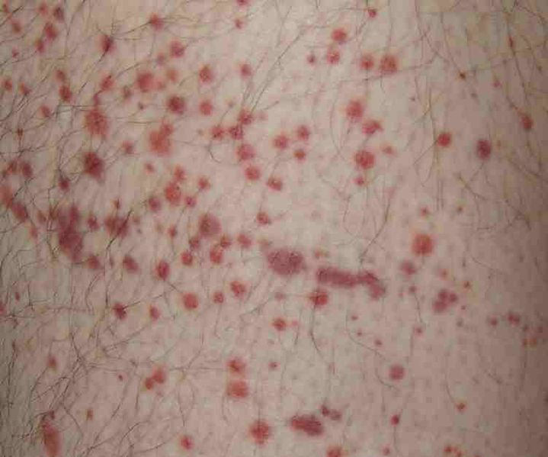

Slide 6
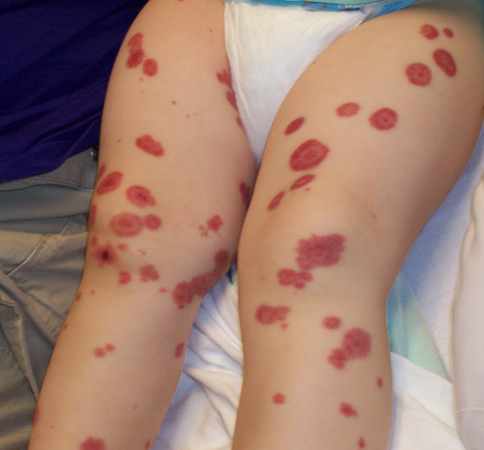

Slide 7
Henoch chenolin purpura
5 yrs old boy is seen with macupapular rash on the legs and buttocks , he complains of abd. Pain . He recently recoverd from a viral URT infction. CBC electrolytes . Coagulation studies are normal . Heamturia is noticed on urine analysis .
Normal platlet

Slide 8
Facts:
  IgA mediated small vessel vasculitis
  Most common in kids
History / PE:
  H/O recent URI
  Rash, arthralgias
  Abdominal pain
  Scrotal swelling
  Renal disease (hematuria)

Slide 9
Diagnosis:
IgA deposition in kidneys , elevated ESR , CRP , WBCs , IgA , IgM
Urine analysis : RBCs , WBCs , Casts , Albumin
Stool analysis : occult blood
Diagnostic criteria :
Palpable rash in abscence of thrombocytopenia
Bowel angina
Diagnostic biopsy : granulocytes on wall of arteriols and venules
Pediatric age group <20 at onset of symptoms

Slide 10
Treatment:
NSAIDs
Steroids ( if there is complications
Monitor renal functioning
ASA if antiphospholipid or anti cardiolpin +ve
Complications:Intussusception
Bowel perforation
Reanl failure
Testicular torsion
Scrotal edema
GI bleeding

Slide 11
Imformations from dr. Nabil about HSP
Other diagnisis : ITP meningiococemia , RA
Investigations : ESR , CRP , X-ray , KFT , RF factor . Urine dipstick , BP , serum IgA
Give pain relief NSAIDs 4-6 wks
Criteria for admission : CNS manifistation
Shock
Sever abd. Pain
Bowel obstruction

Slide 12
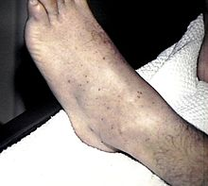
ITP

Slide 13
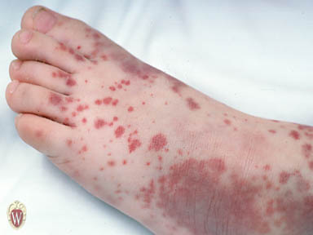

Slide 14
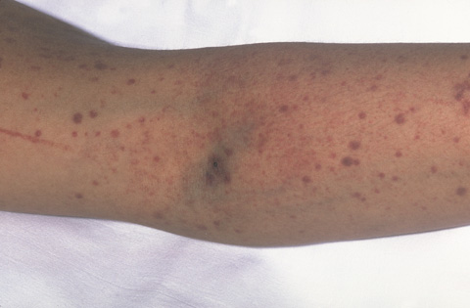
Purpura and Petechiae

Slide 15
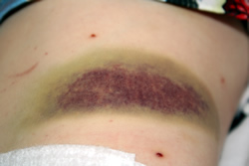
Bruising ~
With ITP the blood doesn't clot and makes you more susceptible to bruising. When the platelets are very low spontaneous bruising (like these) can appear.

Slide 16
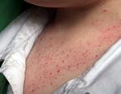

Slide 17
ITP
A 4 year old child was perviously normal presents with petechie , purpura and excessive bleeding after falling of his bicycle
Paltlet is low
The case in our exam was :
a patient presented 2 weeks after an URI with petechial hemorrhage (I've forgotten the exact hx but it's a typical case of ITP)
ddx,investigations,management

Slide 18
DDx :
Autoimmunse Dz
HSP
Chronic infection
Wiskott aldrich
VWB type 2b
X-linked thrombocytopenia
malignancy

Slide 19
Investigations : CBC low plt
Bonr marrow biopsy : normal to increased megakaryocytes
I remmeber that I added : stool analysis , urine analysis

Slide 20
TTT
They wanted us to wite it as if it was an order to the nurse :
Admission and observation if sever
IV fluids
IV immunoglobulins for 1-2 days
Prednisone
IV anti D
Transfusion if life threatining bleeding
Splenectomy for severe dz or if refractory to ttt

Slide 21
Ambigous genitalis
a pic of ambiguous genitalia:
what abnormalities can u see? Mention 2
what is your ddx? Congenital adrenal hyperplasia
What plasma biochemical investigations? General related to the biochemical derangement, e.g. Na,K,glucose….
How would u confirm? 17-hydroxyprogesterone, 11-deoxycortisone, plasma cortisone and aldosterone levels

Slide 22
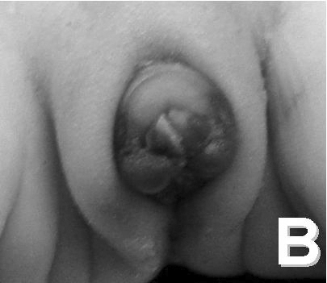

Slide 23
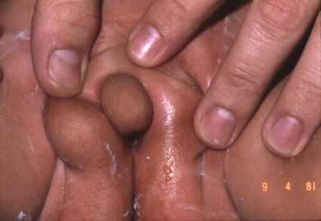

Slide 24
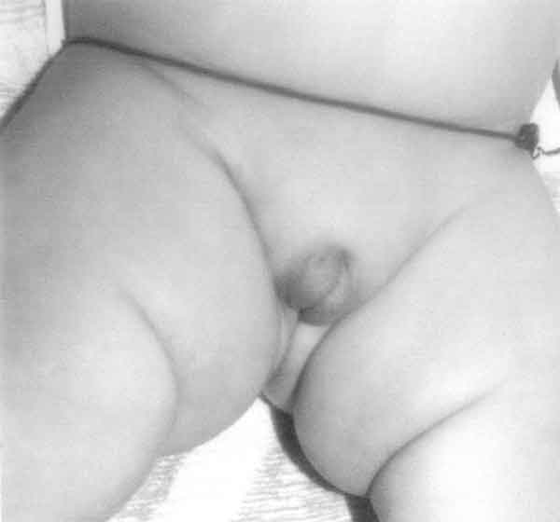

Slide 25
what abnormalities can u see :
ambiguous genitalia :D sho el tanya wallah azen alafet :S
Unusual appearing genitalia
micropenis,fusion of posterior forchite
Hay el jawab ta2reeban ☺

Slide 26
what is your ddx? Congenital adrenal hyperplasia
What plasma biochemical investigations? ( salt losing )
Hypoglycemia , hyponatremia , hyperkalemia , low aldesterone ,high renin
How would u confirm? 17-hydroxyprogesterone, 11-deoxycortisone, plasma cortisone and aldosterone levels

Slide 27
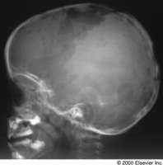
Histocytosis X

Slide 28
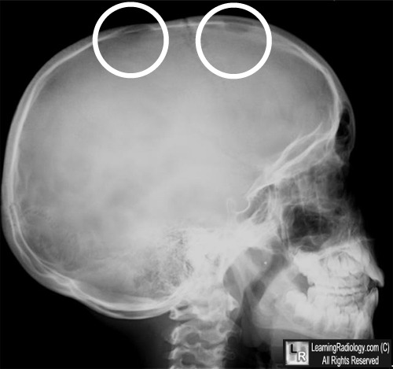

Slide 29
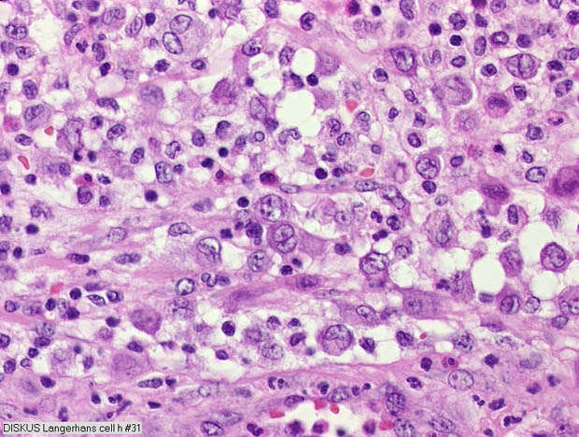

Slide 30
A pt with hepatosplenomegaly, seborrhic dermatitis, lymaphadenopathy, X-ray skull with lytic lesions. the doctor also mentioned that he has diabetes insepidus
Ddx: Histocytosis X
Investigations and management

Slide 31
Investigations :
Chest X-ray : bilateral, symmetric, ill-defined nodules and reticulonodular infiltrates then cystic changes
Ct scan of chest
Pulmonary functions test
Blood smear : might shouw easinophilia
Histological examination show Langerhans cells grouped around the small airways.

Slide 32
Managment :
Supplemental oxygen therapy for those with clinically significant hypoxemia
Aggressive treatment for pulmonary infections with prompt initiation of antibiotic therapy
Bronchodilator therapy in the presence of an obstructive ventilatory defect
Steroids , IL2, anti TNF alpha

Slide 33
Infectious mononucleosis
Pic. of a throat with punctuate hemorrhages over the palate, 2 other blood film with atypical lymphocytes. What are the abnormalities (u have to mention the description I've just made!) ?
what's the ddx? Infectious mononucleosis
What is the responsible organism? EBV
Complications? They want 3 you can mention whatever u want but choose the commoner
What drug is contraindicated? Ampicillin

Slide 34
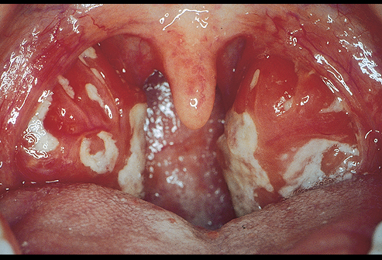

Slide 35
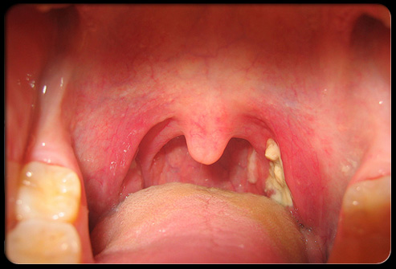

Slide 36
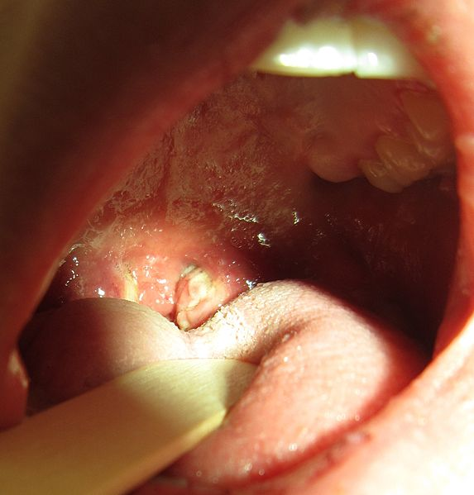
Exudative pharyngitis

Slide 37
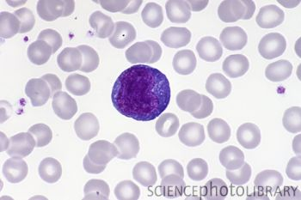

Slide 38
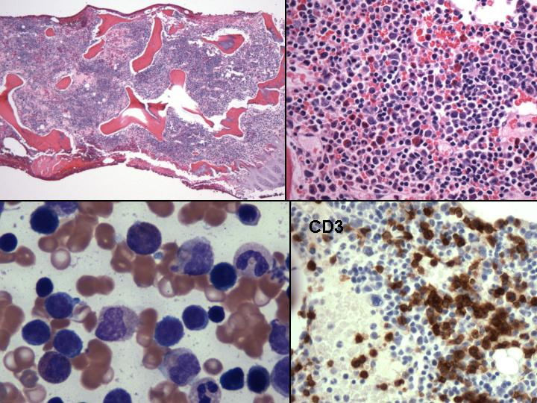

Slide 39
What are the abnormalities :
Congested erythematous throat
atypical lymphocytes
reactive lymphocytes
what's the ddx? Infectious mononucleosis
What is the responsible organism? EBV

Slide 40
Complications : splenic hge or rupture
Gullian barre syndrome
Air way obstruction
Aplastic anemia
Interstitial pneumonia
myocarditis

Slide 41
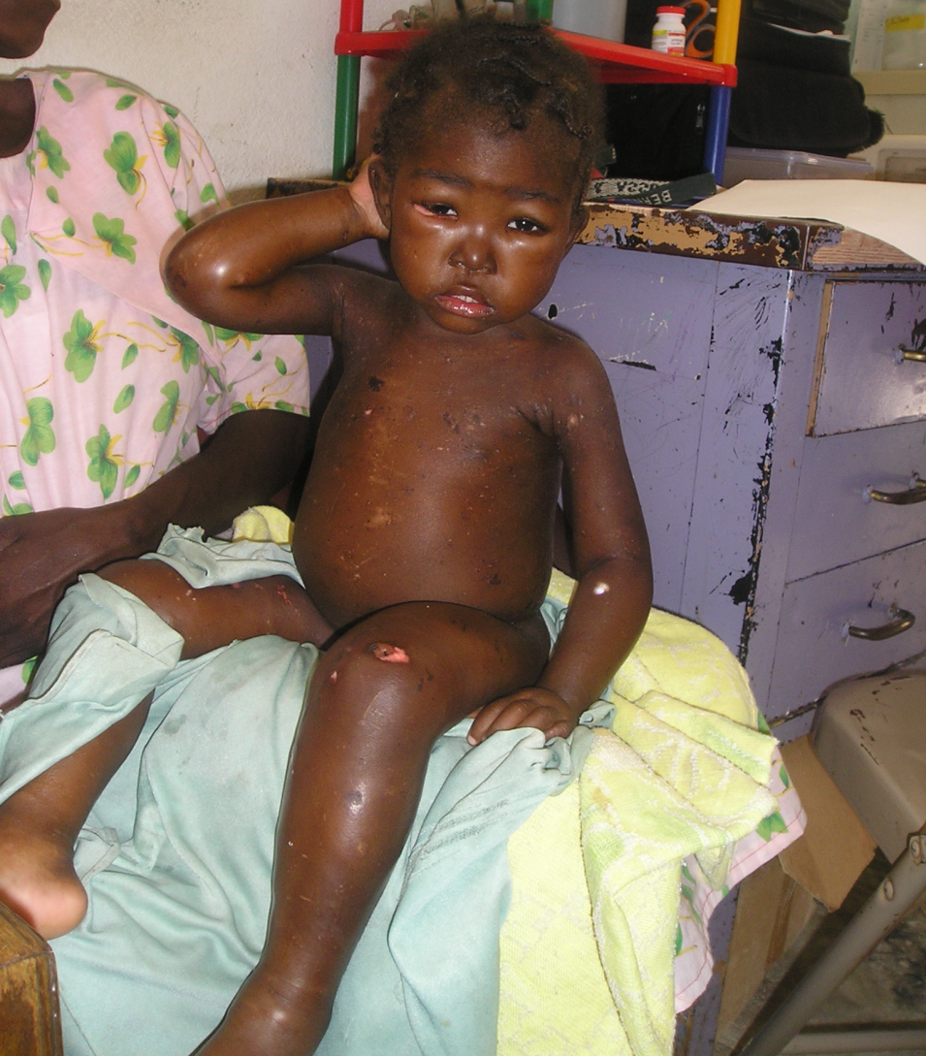
Kwashiorkor

Slide 42
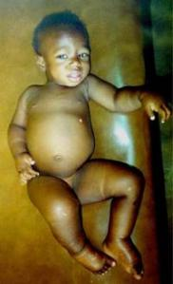

Slide 43
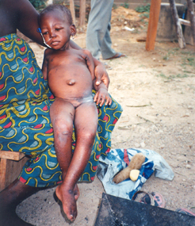

Slide 44
Question 1 1. What three important signs are present on the Picture related to his disease?
- Edema.
- Skin manifestations.
- Abdominal distention/hair changes

Slide 45
Mention three other constant manifestations of his disease?
- Growth retardation/ decreased weight
- Decreased muscle to fat ratio.
- Mental changes

Slide 46
What is the most likely diagnosis?
Kwashiorkor
Mention two important lines to treat his problems?
    Supply sufficient proteins and calories
Supply Vitamins /mineral.

Slide 47
Erythema nodosum
A pic of a teenager girl
Diagnosis : erythema nodosum
Causes : drugs
Group A strept. Infection
TB
IBD
Cllagen Dz > SLE
Sarcoidosis

Slide 48
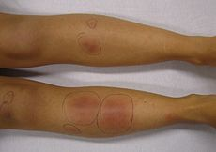
TTT : NSAIDs
Flumonic acid

Slide 49
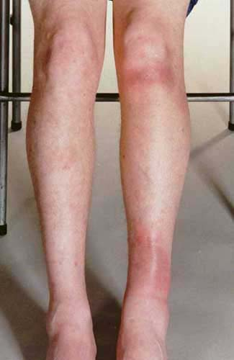

Slide 50
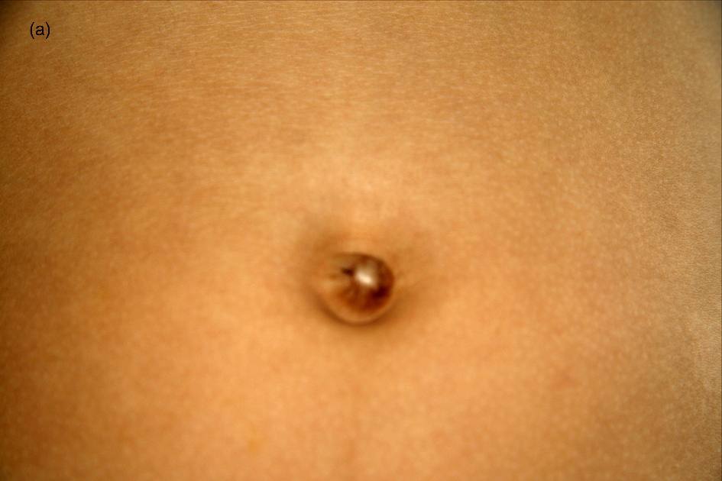
Umblical fistula vetillain fistula

Slide 51
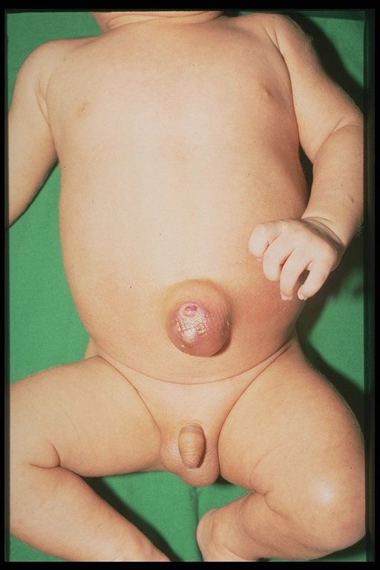

Slide 52
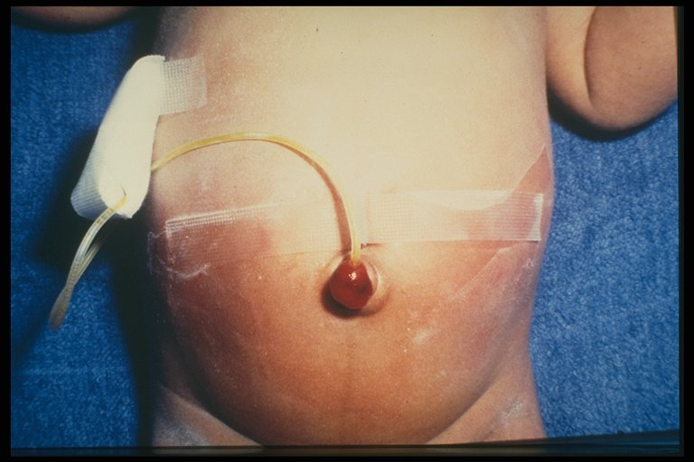

Slide 53
If there is a fistula at umblicus region and urin getting out of it : uracus

Slide 54
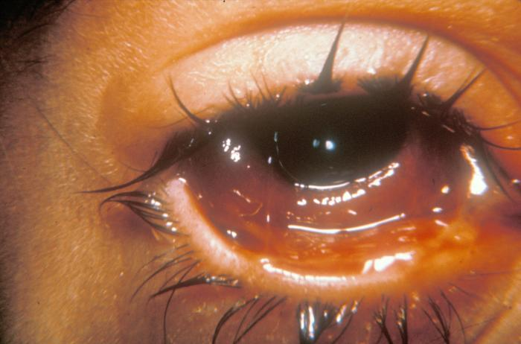
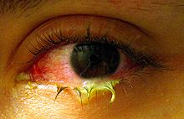
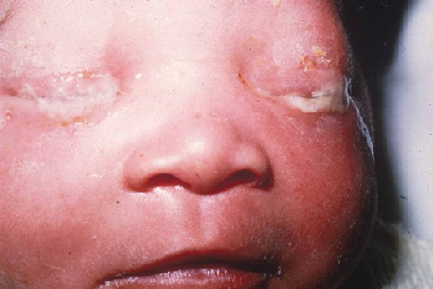
Conjuctivits

Slide 55
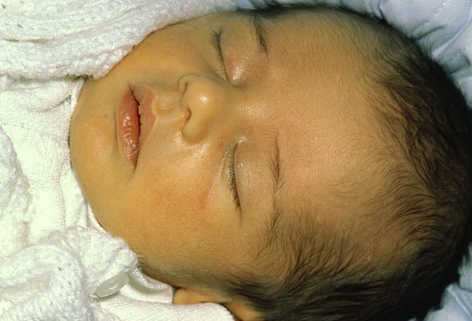
Juandice in 1st o 2nd day of life

Slide 56
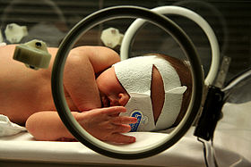

Slide 57
Causes if in the 1st or 2nd day this is mostly pathologic
DD : ABO incompatiabliy
RH incompitability
Neonatal sepsis , delayed cord , IUGR , tein-tein trasfusion
Investigations : total billirubin , dircet , indirect billirubin
CBC
Coombs test
Neanatal screen ( TORCH screen)
TSH , T3, T4

Slide 58
TTT : Rehydration IV fluids
Phototherapy
Exchange trasfusion

Slide 59
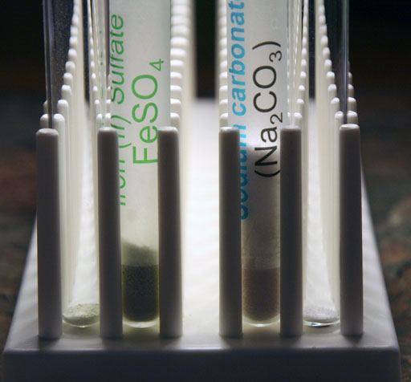
Iron poisining

Slide 60
Please study : lead poisining , organophosphorus , acetmaphin and isron poisining from kaplan :D

