Slide 1
Cerebellum

Slide 2
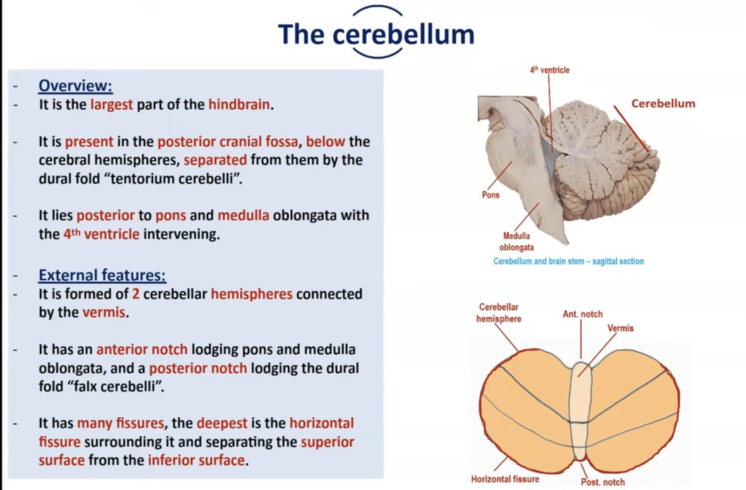

Slide 3
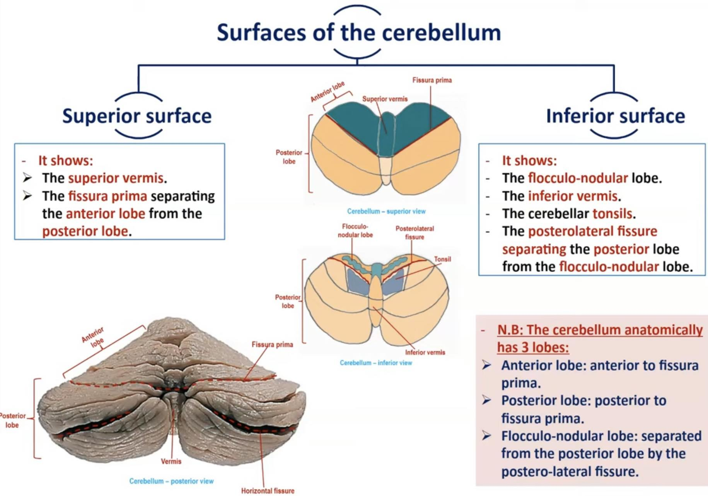

Slide 4
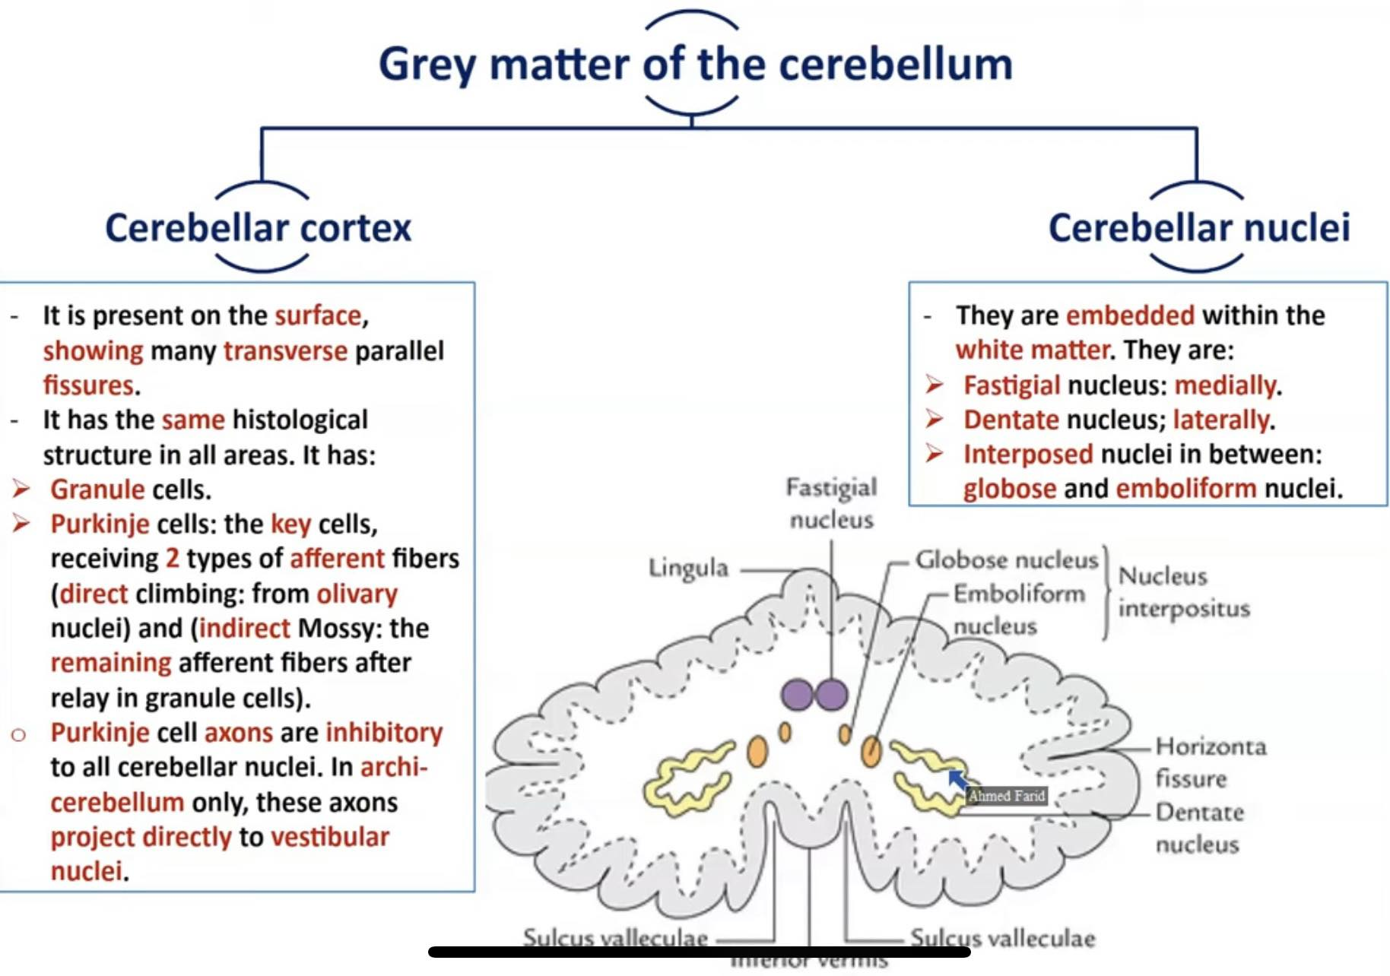

Slide 5
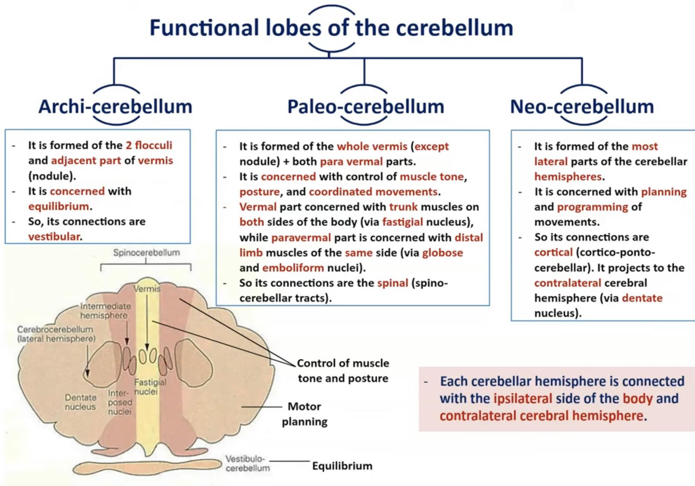

Slide 6
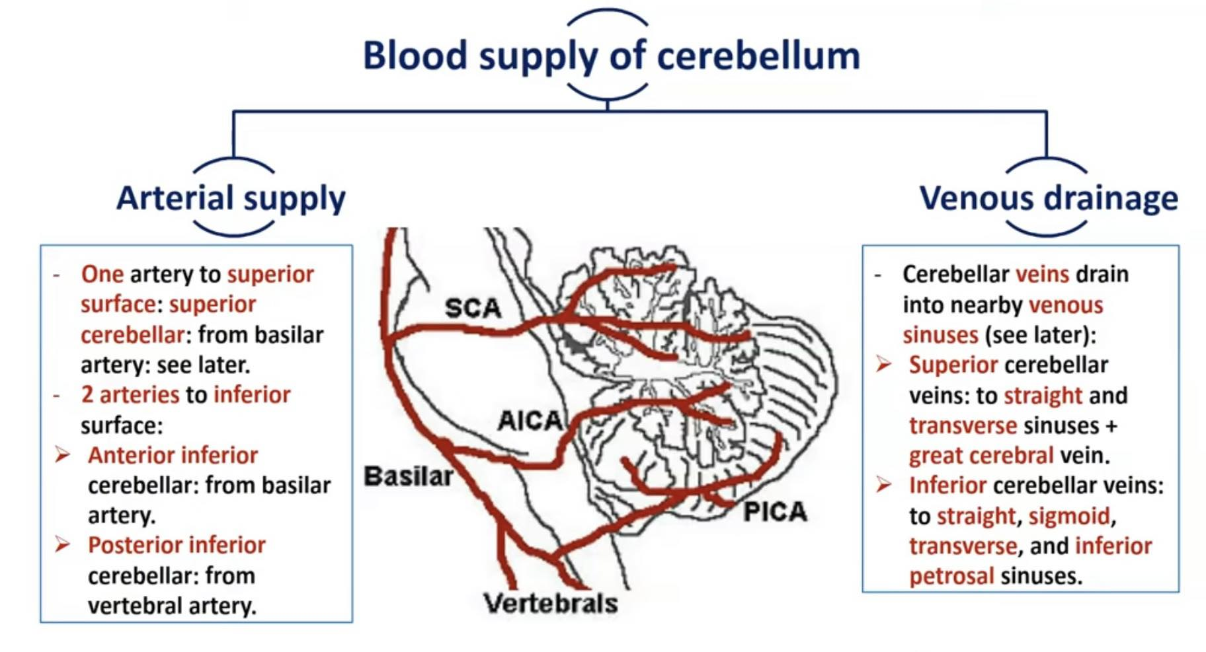

Slide 7
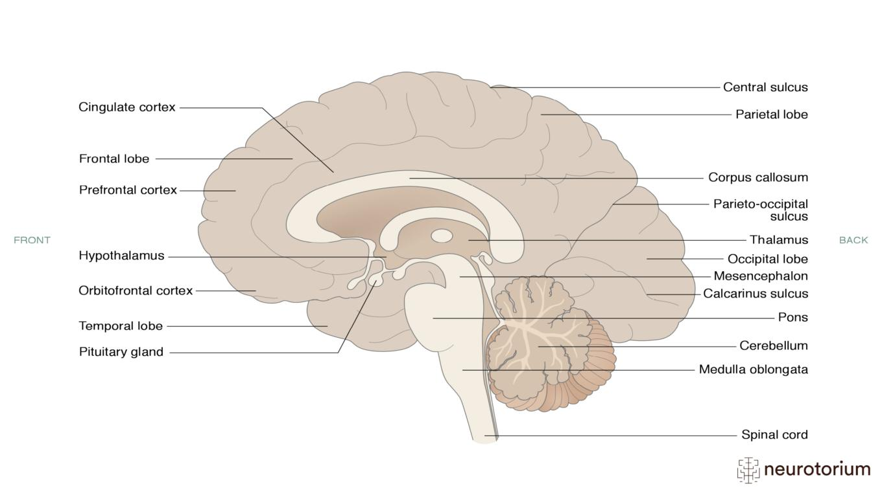

Slide 8
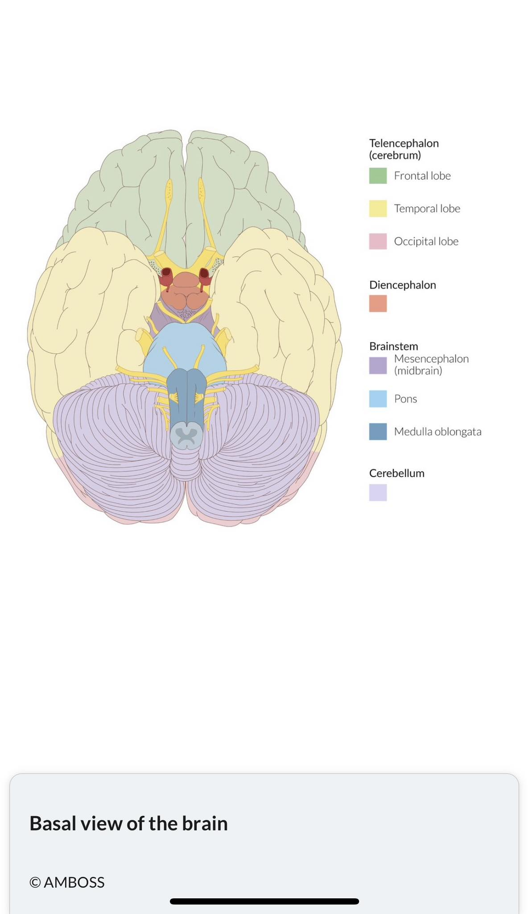

Slide 9
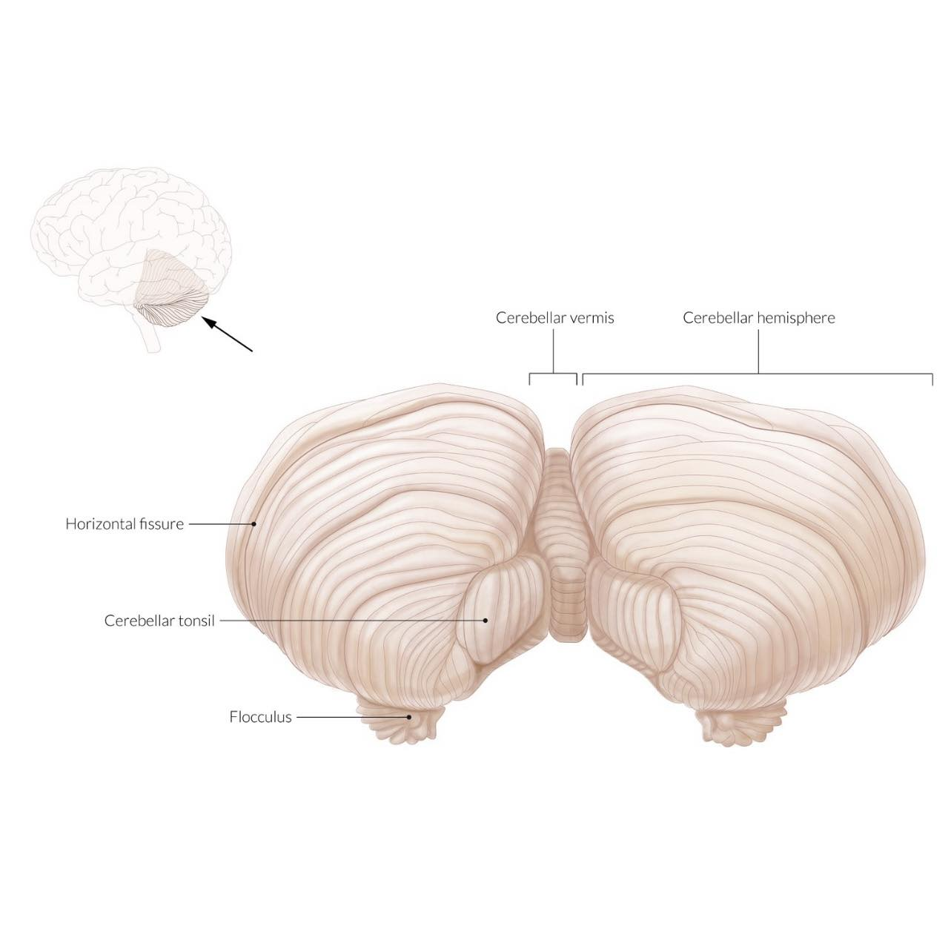

Slide 10
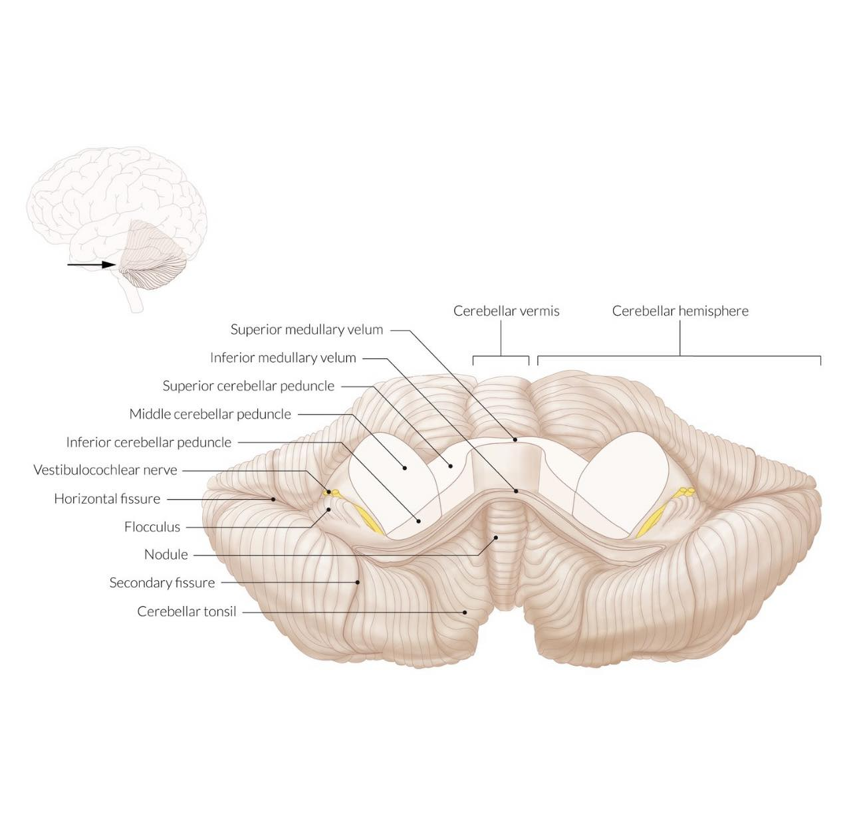

Slide 11
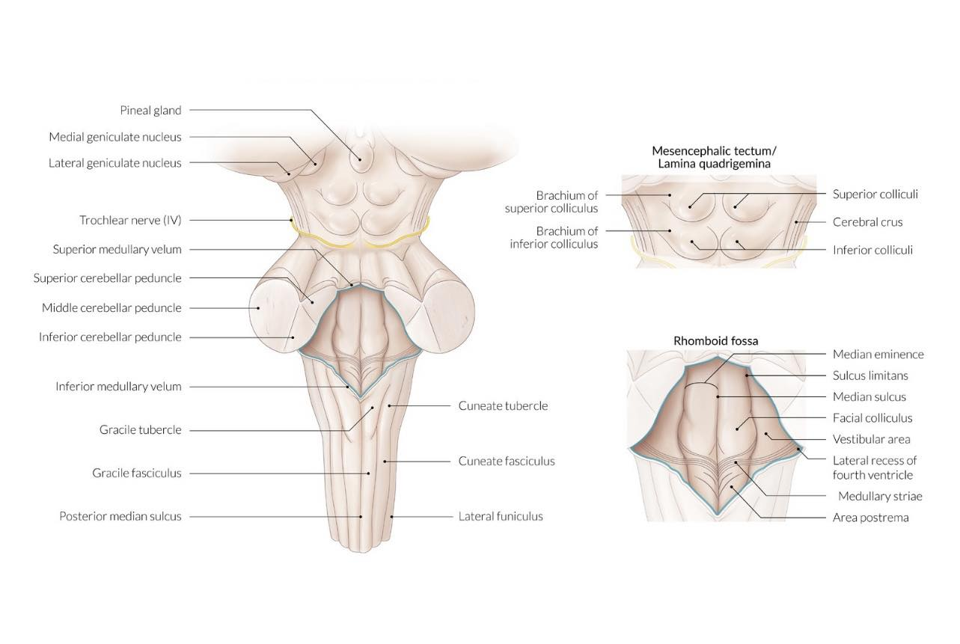

Slide 12
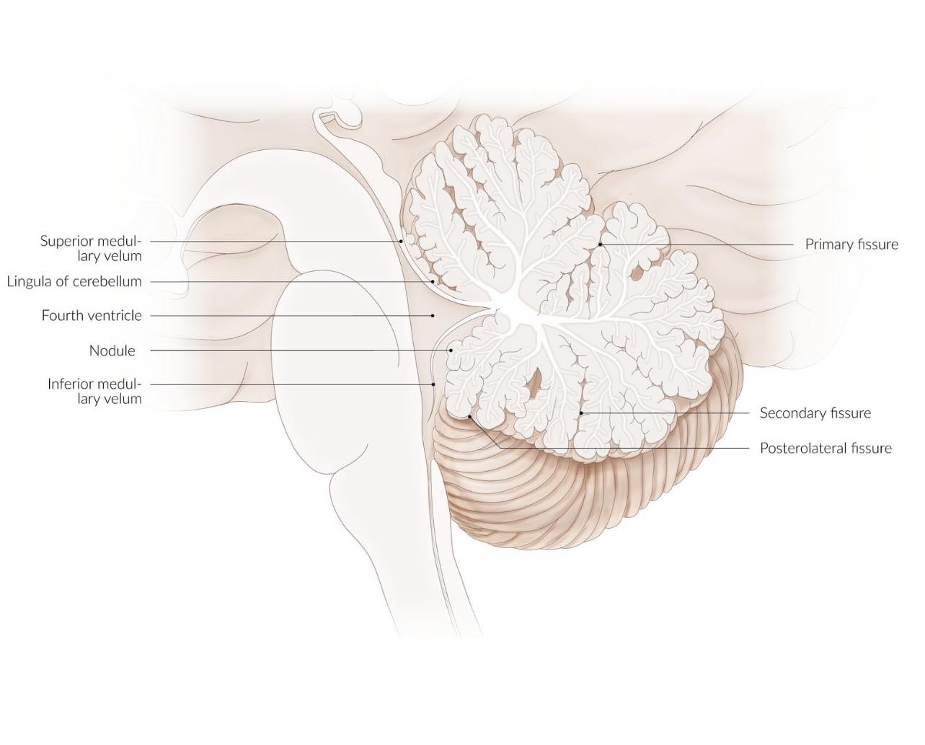

Slide 13
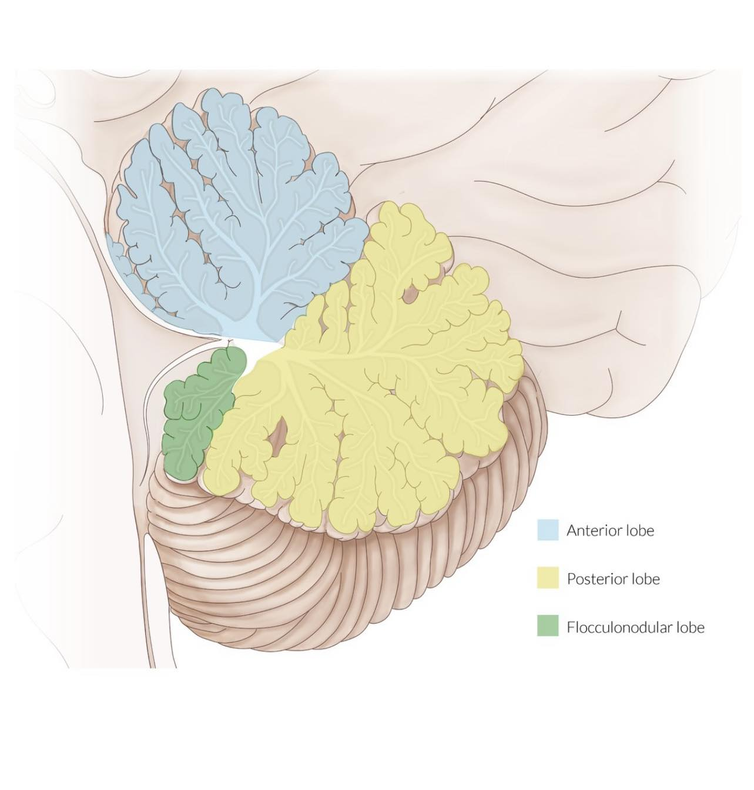

Slide 14
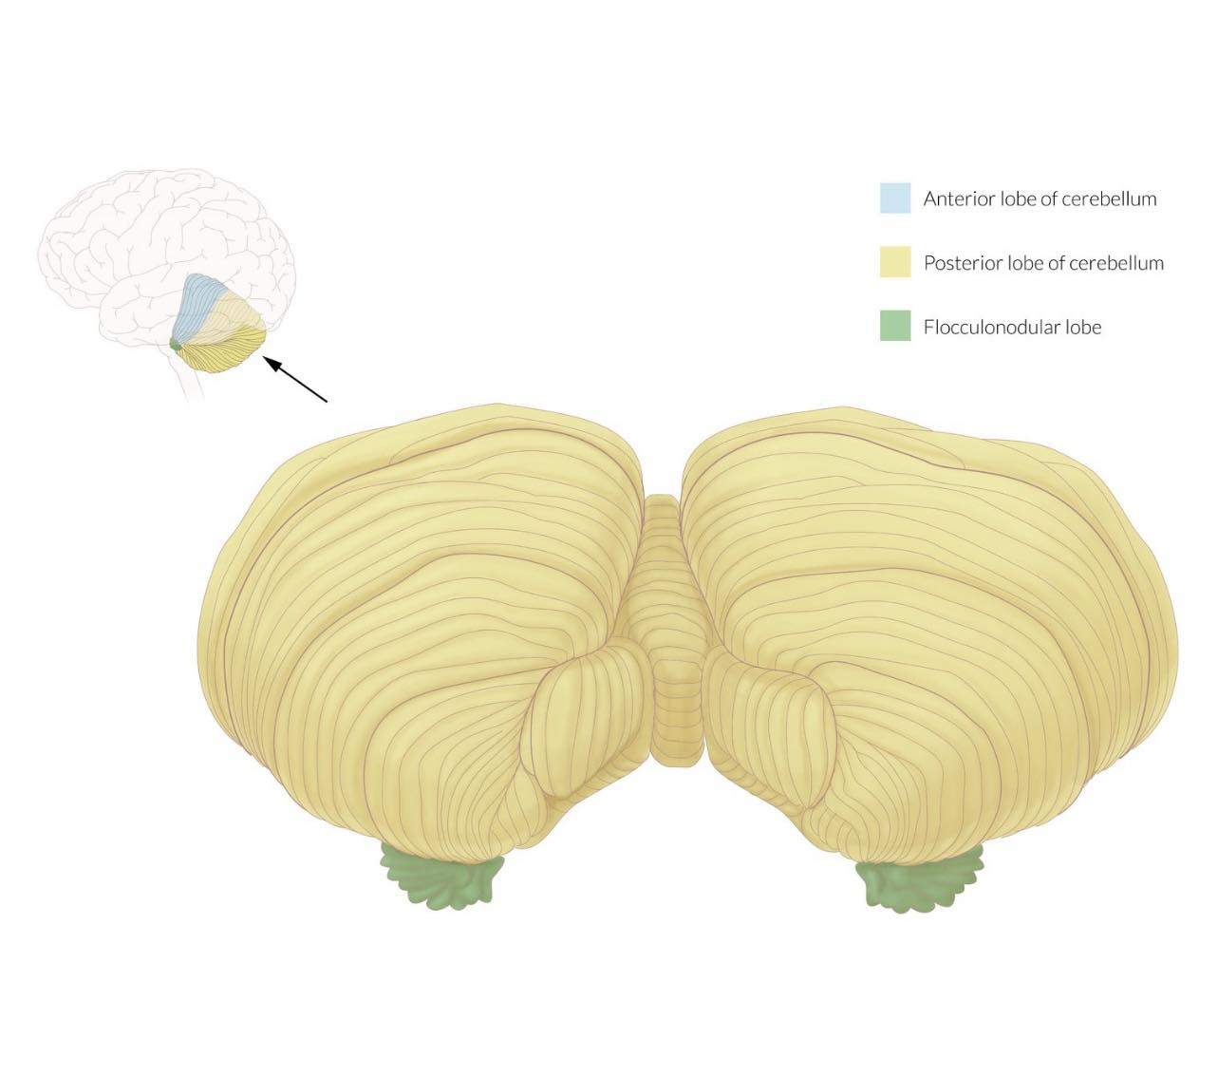

Slide 15
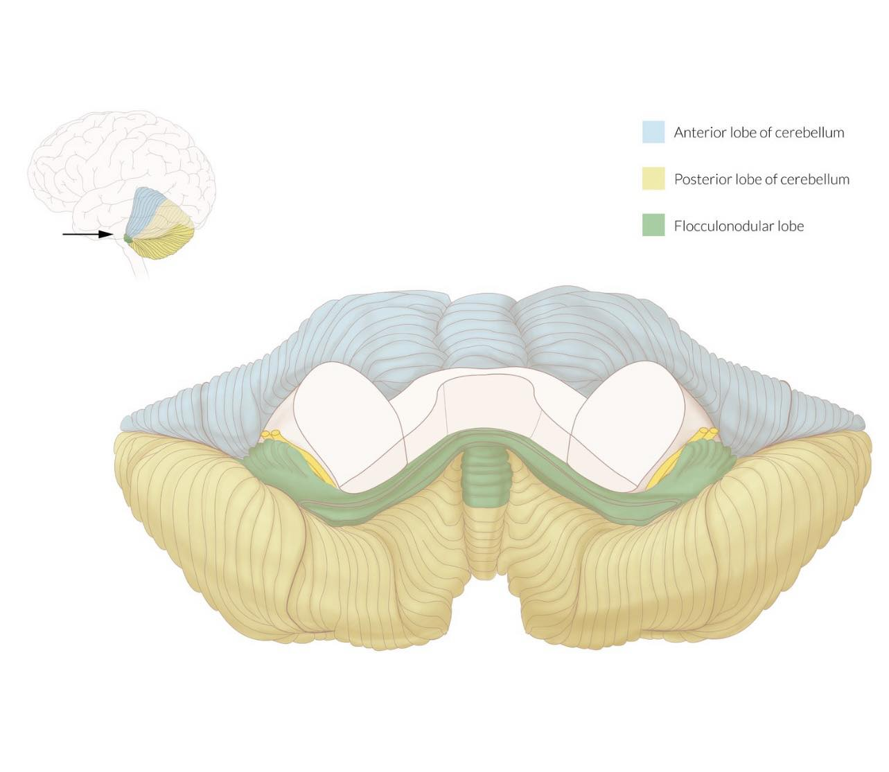

Slide 16
Cerebellar peduncles
Afferent and efferent cerebellar tracts travel through the peduncles to and from the ipsilateral cerebellar cortex.

Slide 17
Peduncle | Characteristics | Tracts
Superior cerebellar peduncles (SCP) | Connects the cerebellum to the midbrain Major efferent pathway | Efferent tracts from the deep nuclei of the cerebellum to the contralateral cortex
Middle cerebellar peduncles (MCP) | Connects the cerebellum to the pons Largest peduncle Major afferent pathway | Afferent tracts from the contralateral cortex (pontocerebellar mossy fiber pathway)
Inferior cerebellar peduncles (ICP) | Connects the cerebellum to the medulla and spinal cord Afferent and efferent pathways | Afferent tracts carrying ipsilateral proprioceptive information from the spinal cord Efferent tract composed primarily of Purkinje cell axons

Slide 18
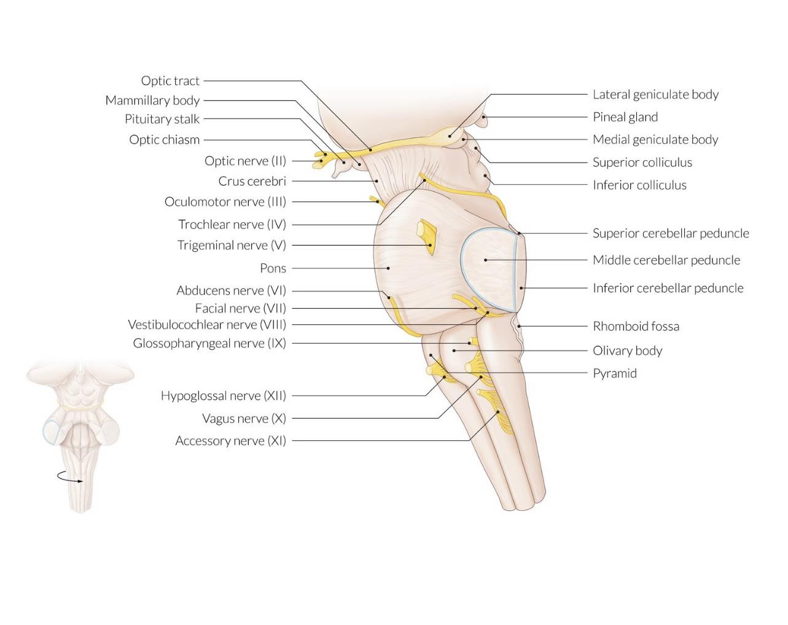

Slide 19
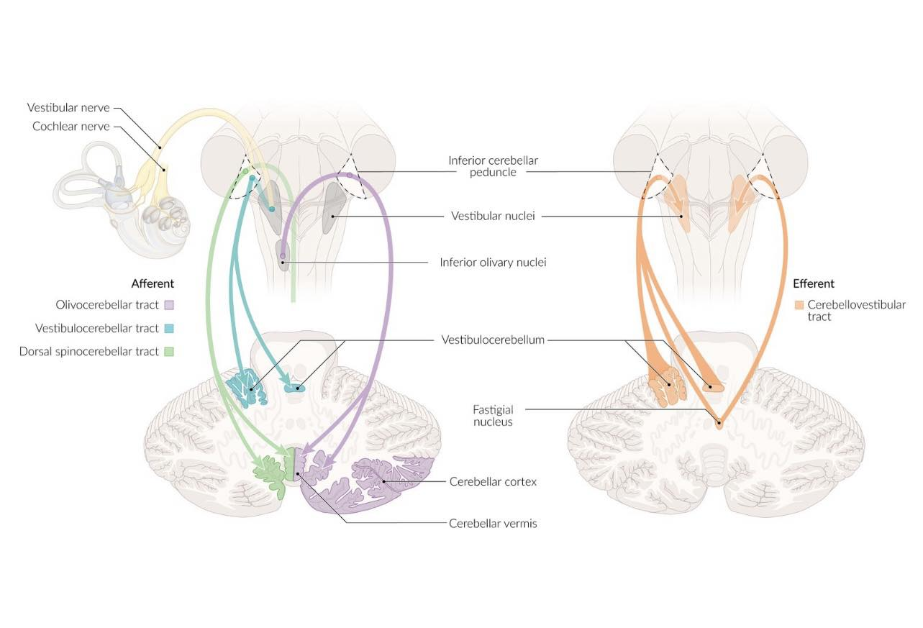

Slide 20
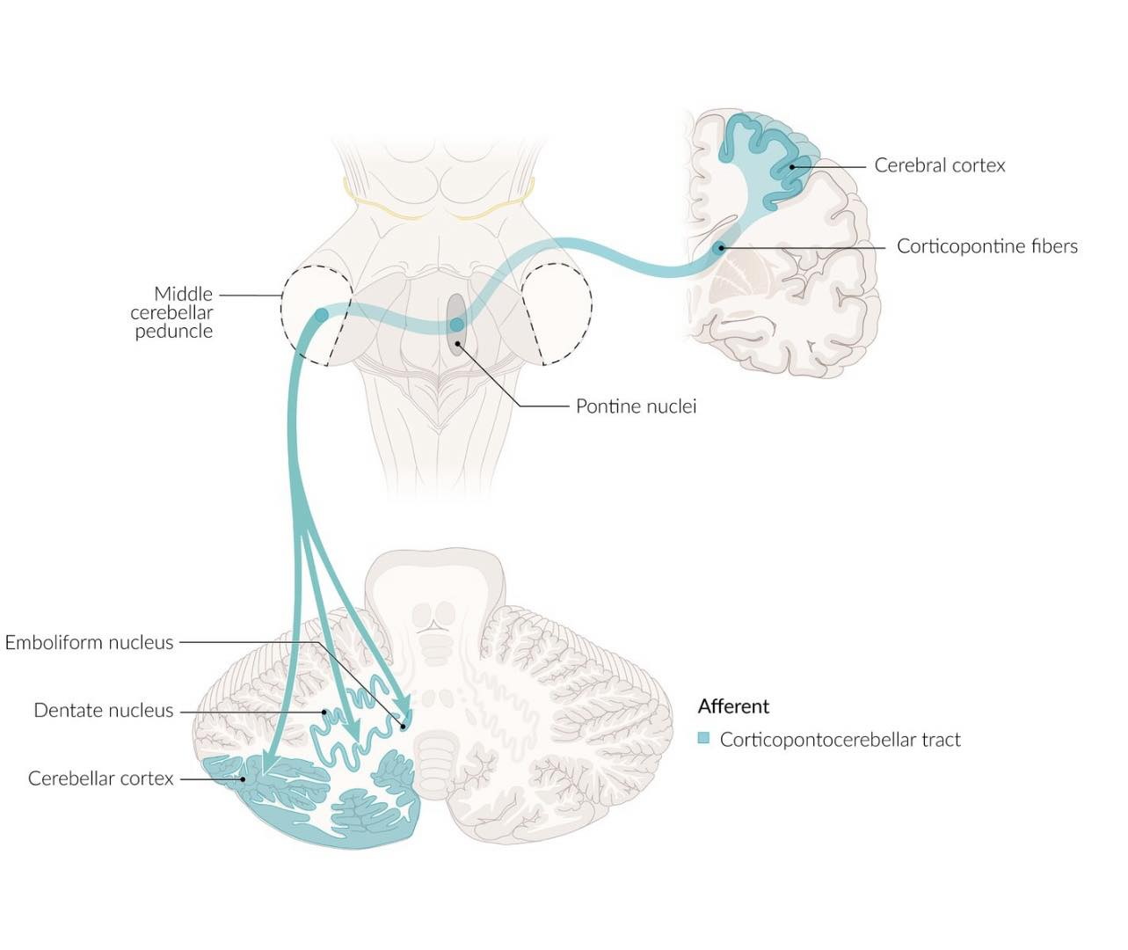

Slide 21
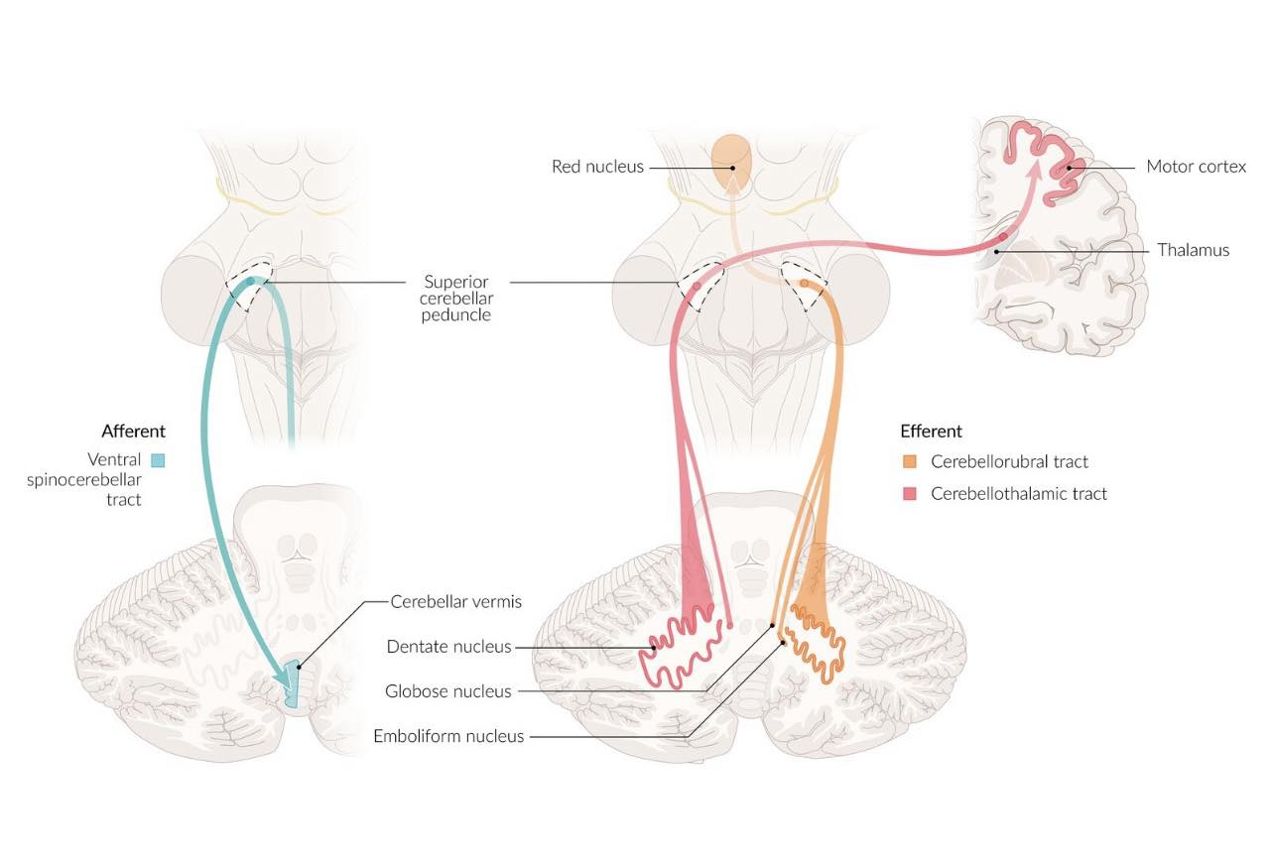

Slide 22
Cerebellar lesions cause neurological deficits on the ipsilateral side!

Slide 23
Vasculature of the cerebellum
Arteries
  Basilar artery
    Superior cerebellar artery (SCA) → superior surface of the cerebellum
    Anterior inferior cerebellar artery (AICA)→ anterior surface of the cerebellum
  Vertebral artery
    Posterior inferior cerebellar artery (PICA)→ posterior surface of the cerebellum

Slide 24
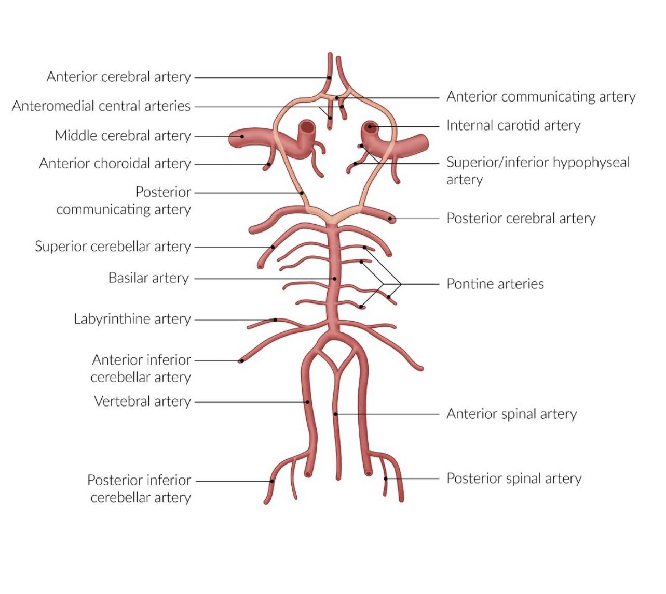

Slide 25
Functional zones of the cerebellum
Zones of cerebellum
 | Cerebrocerebellum | Spinocerebellum | Vestibulocerebellum
Corresponding cortex | Lateral hemispheres | Vermis and intermediate zones | Flocculonodular lobe
Corresponding nuclei | Dentate nucleus | Emboliform nucleus Globose nucleus | Vestibular nuclei Fastigial nucleus
Input | Cerebral cortex The inferior olivary nucleus of the medulla | Spinal cord Vermis: input from the trunk and proximal portions of the limbs Intermediate zones: distal portion of the limbs | Vestibular nuclei of cranial nerve VIII Superior colliculi and visual cortex

Slide 26
Function | Planning and execution of movements Coordination of complex and sequential motor movements Nonmotor functions: cognition, language, learning, and emotions | Coordination of body and limb movement Vermis: central body (trunk, head, and proximal limbs) Intermediate zones: distal limbs (hands, fingers, feet, toes) Maintenance of muscular tone | Balance Ocular movements and gaze stability
Effect of lesions | Abnormal coordination of ipsilateral voluntary movements: Fall towards the side of the lesion (ipsilateral) Dysdiadochokinesis Dysmetria Intention tremor Scanning speech (ataxic dysarthria) | Vermis: trunk and proximal limb muscles affected Truncal ataxia Gait ataxia (wide-based, unsteady gait) Tilting of the head Intermediate zones: ipsilateral distal limb muscles affected Limb ataxia Dysdiadochokinesis Dysmetria Intention tremor Hypotonia | Vertigo Nystagmus
Function | Planning and execution of movements Coordination of complex and sequential motor movements Nonmotor functions: cognition, language, learning, and emotions | Coordination of body and limb movement Vermis: central body (trunk, head, and proximal limbs) Intermediate zones: distal limbs (hands, fingers, feet, toes) Maintenance of muscular tone | Balance Ocular movements and gaze stability
Effect of lesions | Abnormal coordination of ipsilateral voluntary movements: Fall towards the side of the lesion (ipsilateral) Dysdiadochokinesis Dysmetria Intention tremor Scanning speech (ataxic dysarthria) | Vermis: trunk and proximal limb muscles affected Truncal ataxia Gait ataxia (wide-based, unsteady gait) Tilting of the head Intermediate zones: ipsilateral distal limb muscles affected Limb ataxia Dysdiadochokinesis Dysmetria Intention tremor Hypotonia | Vertigo Nystagmus

Slide 27
A tip to remember the symptoms of cerebellar lesions: lesions of the medial part of cerebellum (i.e., vermis, flocculonodular lobe, and corresponding deep nuclei) affect medial structures (i.e., axial and proximal limb musculature), resulting in symptoms including truncal ataxia and nystagmus. Lesions of the lateral parts of cerebellum (i.e., the hemispheres) affect lateral structures (distal limb musculature), resulting in symptoms such as ipsilateral limb ataxia.

Slide 28
Microscopic anatomy
Cerebellar cortex
The cortex is primarily an inhibitory structure; all cerebellar cells except granule cells are inhibitory.
Cerebellar medulla
Composed of climbing fibers, mossy fibers, Purkinje cell axons, and the deep cerebellar nuclei
  Terminate on granule cells → send excitatory stimuli to the Purkinje cells.
  afferent axons from the inferior olivary nuclei of the medulla → terminate on Purkinje cells
  Four deep cerebellar nuclei (from lateral to medial): dentate, emboliform, globose, and fastigial nucleus

Slide 29
Glutamate is the neurotransmitter of granule cells, which are the only excitatory cerebellar cells. GABA is the inhibitory neurotransmitter of all other cerebellar cells.
Purkinje cells provide the only efferent effect from the cerebellar cortex to the cerebellar nuclei, and, thus, play an essential role in the regulation of cerebellar output!
Purkinje cells are inhibitory!

Slide 30
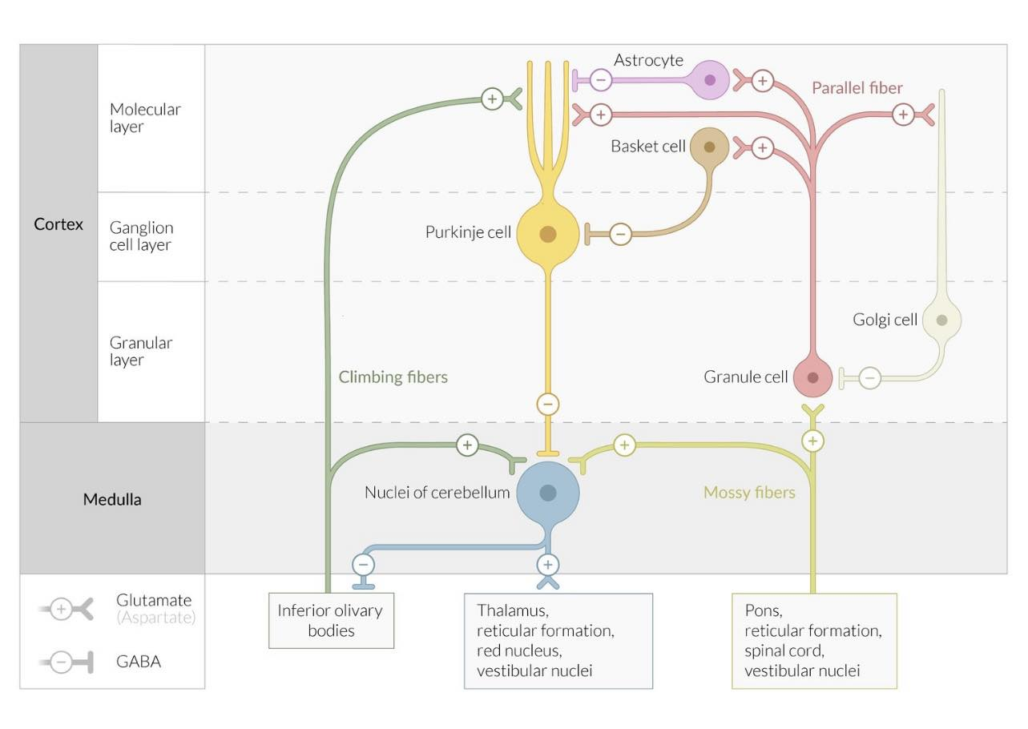
Notes:
Circuitry of the cerebellum
The cerebellar cortex is composed of three layers:
- Molecular layer: contains basket cells, astrocytes (stellate cells), and parallel fibers (axons of granule cells). The astrocytes and basket cells receive excitatory input from parallel fibers and send inhibitory impulses to the Purkinje cells.
- Ganglion cell layer: contains Purkinje cells, which receive excitatory input from climbing fibers and parallel fibers and send inhibitory impulses to the deep cerebellar nuclei
- Granular cell layer: contains golgi cells and granule cells. The golgi cells receive excitatory impulses from the molecular layer and send inhibitory impulses to the granule cells. The granule cells receive excitatory input from mossy fibers and send excitatory efferents to all other cells of the cerebellar cortex. Granule cells are the only excitatory neurons in the cerebellar cortex and use the neurotransmitter glutamate (GABA is the neurotransmitter of the inhibitory cerebellar cells).
The cerebellar medulla contains:
- Mossy fibers: the afferent axons from the cerebral cortex, pons, spinal cord, and vestibular nuclei to the cerebellum. These axons send excitatory stimuli to granule cells and the deep cerebellar nuclei.
- Climbing fibers: are the afferent axons from the inferior olivary nuclei of the medulla. These axons send excitatory stimuli to Purkinje cells and the deep cerebellar nuclei.
- Four deep cerebellar nuclei: send excitatory efferent impulses to the thalamus, red nucleus, and reticular formation (and inhibitory impulses to the inferior olivary nucleus)

Slide 31
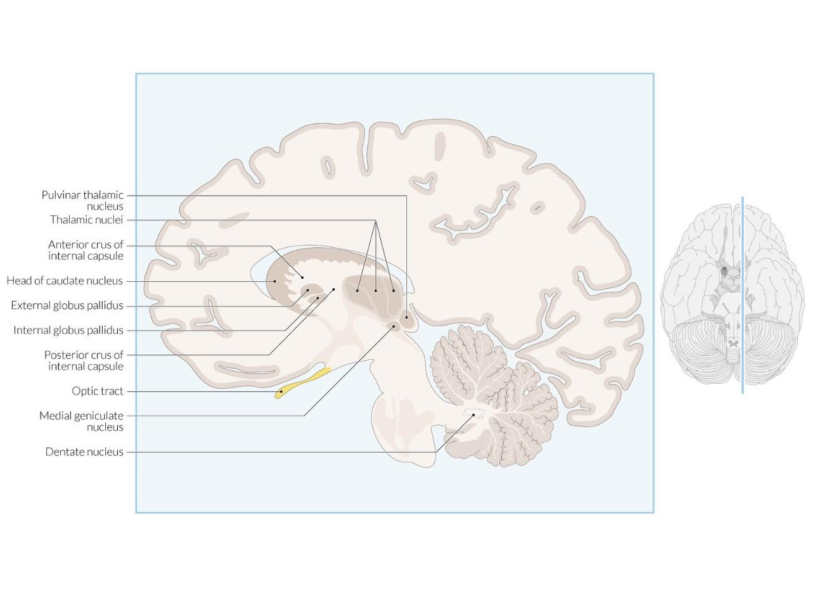

Slide 32
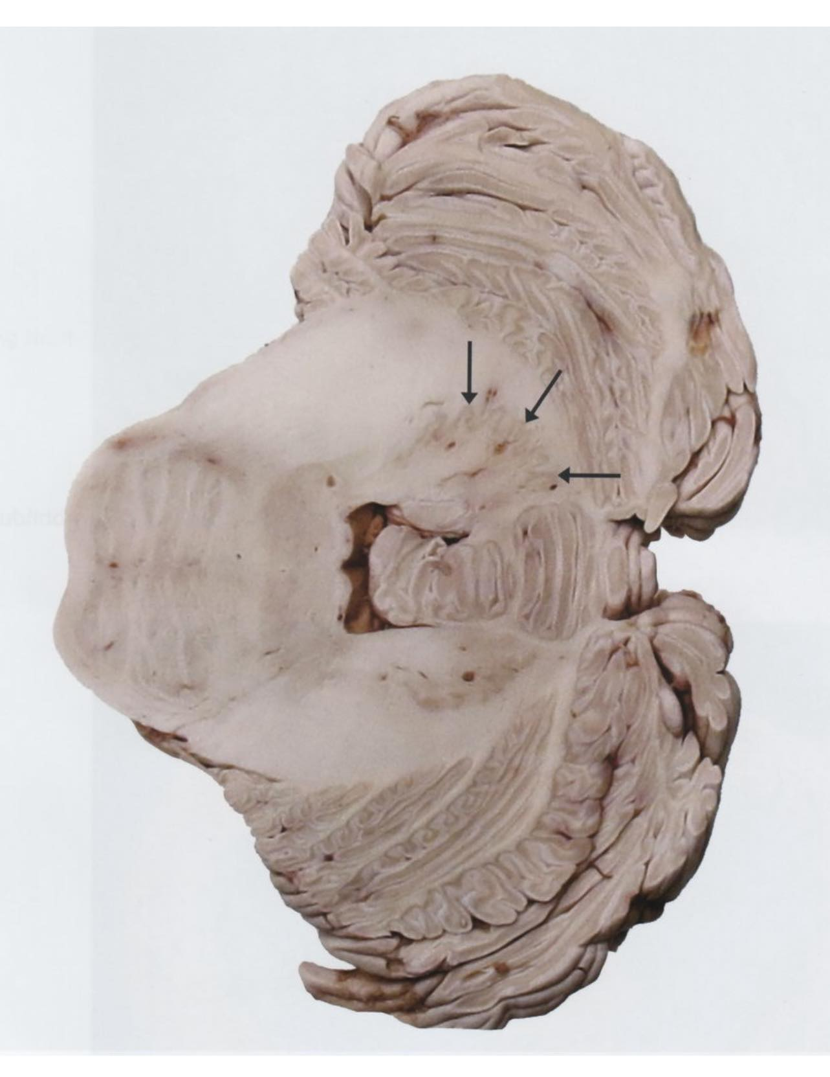
Notes:
Cerebellum
Transverse section
The outer cerebellar cortex is darker than the inner medulla. The dentate nucleus (arrows) is clearly identifiable as a dark wavy line within the medulla, often described as having a “crumpled purse” appearance. The dentate nucleus is functionally a part of the neocerebellum and controls ipsilateral motor coordination by transmitting efferent impulses to the thalamus.

Slide 33
Cerebellar tracts
Afferent cerebellar tracts (input)
Afferent tracts arise from three main sources: the cerebral cortex, the spinal cord, and the vestibular nerve.
Afferent tracts are excitatory and travel to the cerebellum via mossy fibers and climbing fibers.
Afferent tracts travel mainly through the inferior and middle cerebellar peduncles.

Slide 34
Afferent cerebellar tracts
Source | Tracts | Course | Function
Cerebral cortex | Corticopontocerebellar tract | Cerebral cortex → corona radiata → internal capsule → pontine nuclei → mossy fibers → cerebellar hemisphere via middle cerebellar peduncle | Motor planning, motor learning, and cognition
 | Cortico-olivocerebellar tract | Cerebral cortex → corona radiata → internal capsule → inferior olivary nuclei → climbing fibers → cerebellar hemisphere via inferior cerebellar peduncle
 | Corticoreticulocerebellar tract | Cerebral cortex → corona radiata → reticular formation in pons and medulla → mossy fibers → cerebellar hemisphere via the inferior cerebellar peduncle and middle cerebellar peduncle
Spinal cord | Spinocerebellar tract Dorsal spinocerebellar tract Ventral spinocerebellar tract Cuneocerebellar tract Rostral spinocerebellar tract | Golgi tendon organs and muscle spindles → posterior horn of the spinal cord → mossy fibers → cerebellar hemisphere via the inferior cerebellar peduncle and superior cerebellar peduncle | Ipsilateral proprioceptive information
Vestibular nerve | Vestibulocerebellar tract | Vestibular nerve → vestibular nuclei → mossy fibers → ipsilateral flocculonodular lobe via the inferior cerebellar peduncle | Proprioception

Slide 35
Excitatory input to the cerebellar cortex travels through mossy fibers and climbing fibers!
Mossy fibers terminate on granule cells. Climbing fibers terminate on Purkinje cells.

Slide 36
Efferent cerebellar tracts
Efferent tracts originate from the four deep cerebellar nuclei and travel mainly via the superior cerebellar peduncle.
The tracts of the fastigial nucleus travel via the inferior cerebellar peduncle.

Slide 37
Tract | Nucleus | Course | Function
Rubrospinal tract | Dentate nucleus | Dentate nucleus → superior cerebellar peduncle → thalamic nuclei → internal capsule → corona radiata → primary motor cortex | Contralateral motor coordination
 | Emboliform nucleus Globose nucleus | Globose and emboliform nuclei → superior cerebellar peduncle → red nucleus → rubrospinal tract | Tone of contralateral skeletal muscles
Cerebellovestibular tract | Fastigial nucleus | Fastigial nucleus → inferior cerebellar peduncle → bilateral vestibular nuclei → vestibulospinal tract Fastigial nucleus → inferior cerebellar peduncle → bilateral reticular formation → reticulospinal tract → motor neurons from spinal cord | Coordination of balance and saccadic ocular movements Stretch reflex and motor movements

Slide 38
Deep cerebellar nuclei (from lateral to medial): "Don't Eat Greasy Food" (Dentate, Emboliform, Globose, Fastigial).
The deep nuclei are the only output from the cerebellum.

Slide 39
Thank you

