Slide 1
The cerebral cortex, meninges, basal ganglia, and ventricular system

Slide 2
Cerebral cortex
Overview
The cerebral cortex receives its convoluted appearance from a network of gyri (rounded ridges on the surface of the cortex) and sulci (furrows separating the gyri).
The longitudinal fissure divides the brain into two hemispheres.
Deep sulci separate the cerebral cortex into different lobes: frontal, temporal, parietal, and occipital
The main sulci
  Central sulcus (of Rolando): separates the frontal and parietal lobes
  Lateral sulcus (Sylvian fissure): separates the frontal and temporal lobes anteriorly and the parietal and temporal lobes posteriorly
  Cingulate sulcus: separates the cingulate gyrus from the frontal and parietal lobes
  Parieto-occipital sulcus: separates the parietal and occipital lobes
  Calcarine sulcus: divides the occipital lobe horizontally into the cuneus (superior) and lingual (inferior) gyrus

Slide 3
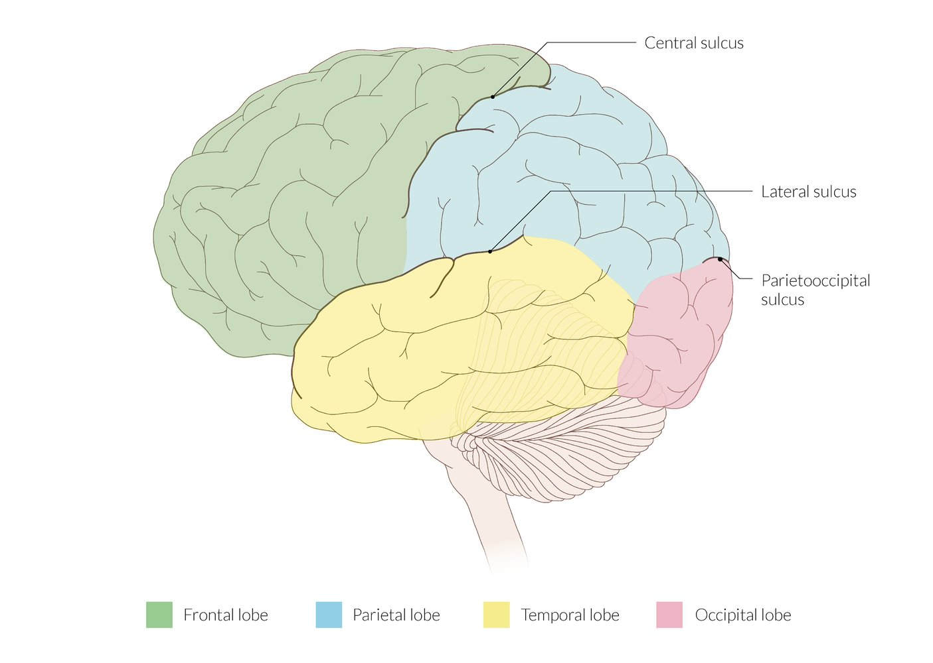
Notes:
Lateral view of the cerebral lobes
The 4 lobes of each cerebral hemisphere are separated by 3 main sulci:
–The central sulcus separates the frontal lobe from the parietal lobe.
–The lateral sulcus separates the temporal lobe from the frontal lobe and the parietal lobe.
–The parieto-occipital sulcus separates the parietal lobe from the occipital lobe.

Slide 4
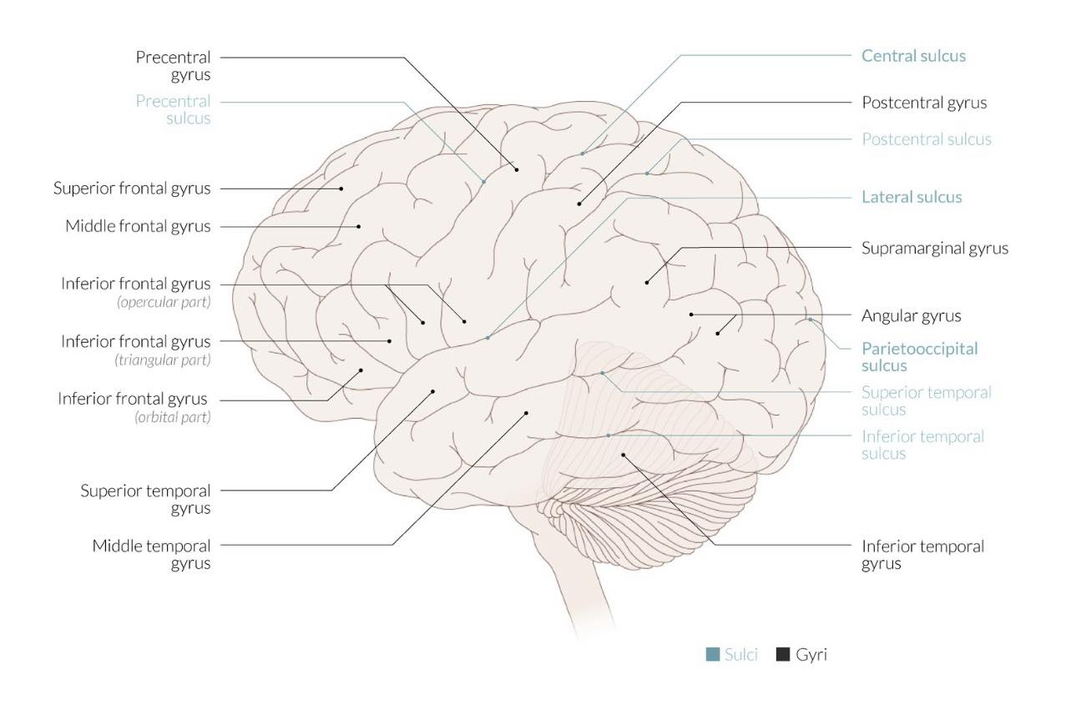

Slide 5
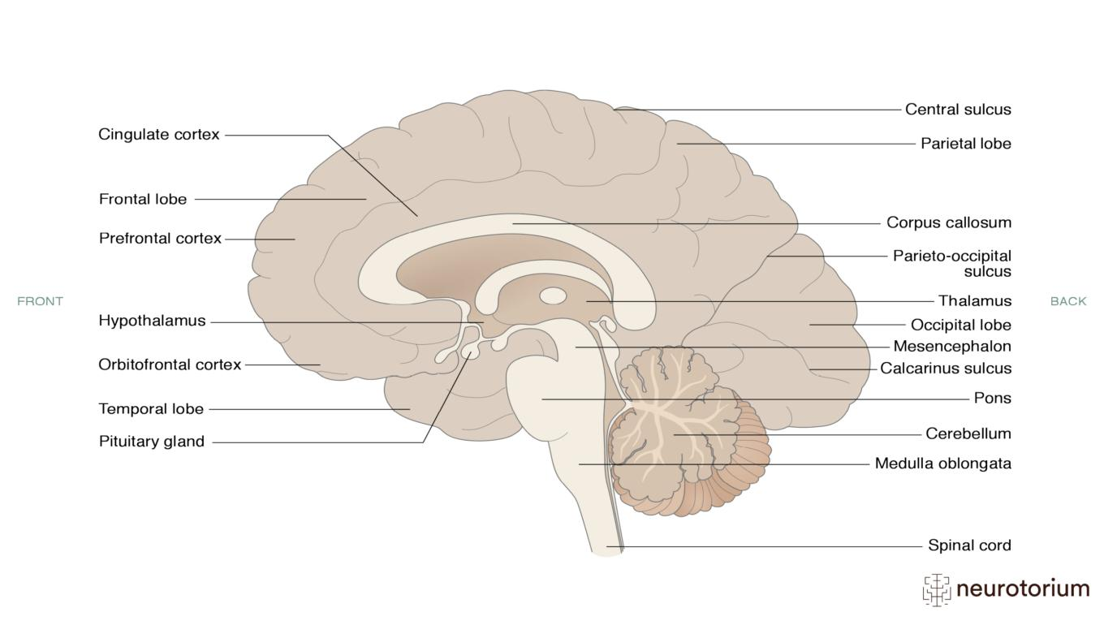

Slide 6
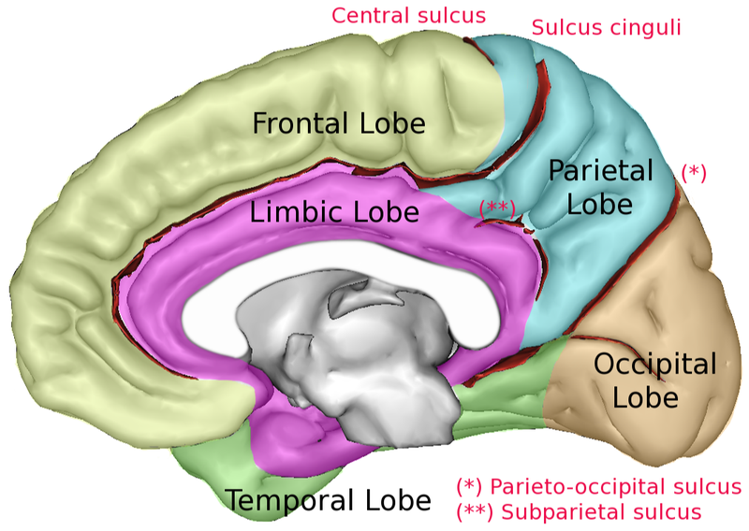

Slide 7
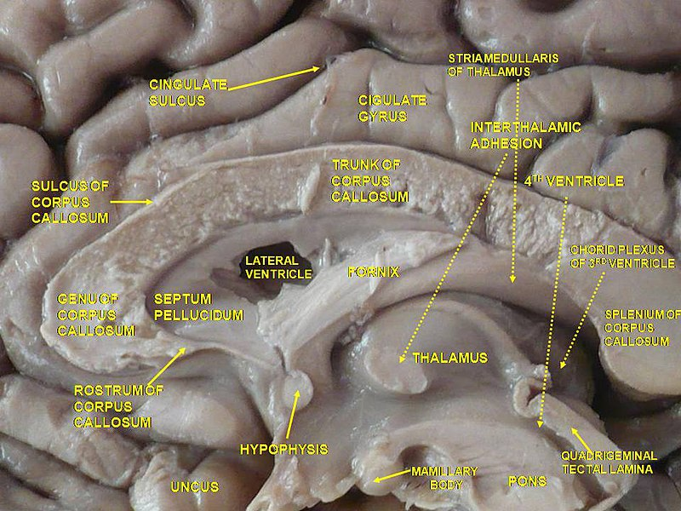

Slide 8
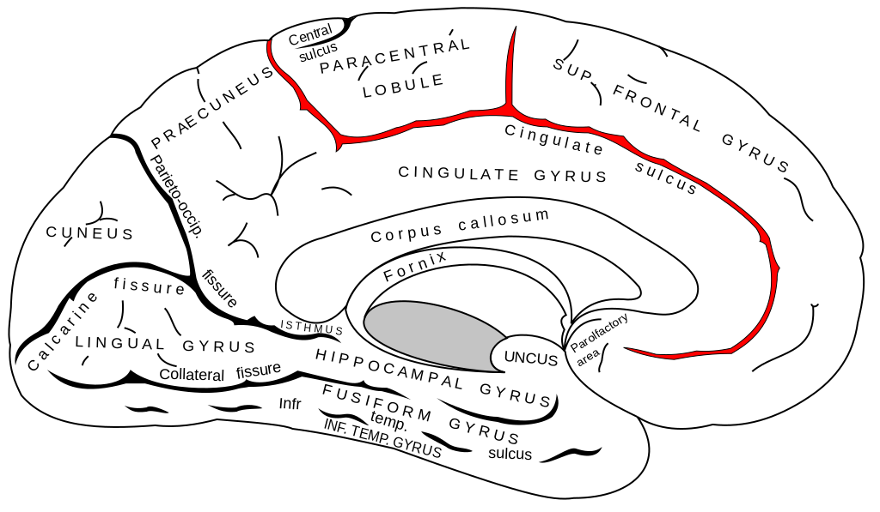

Slide 9
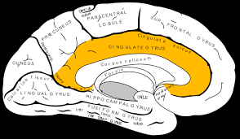

Slide 10
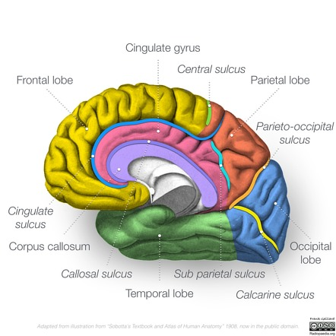

Slide 11
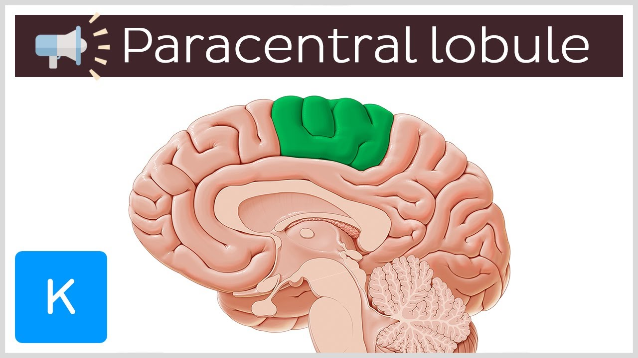

Slide 12
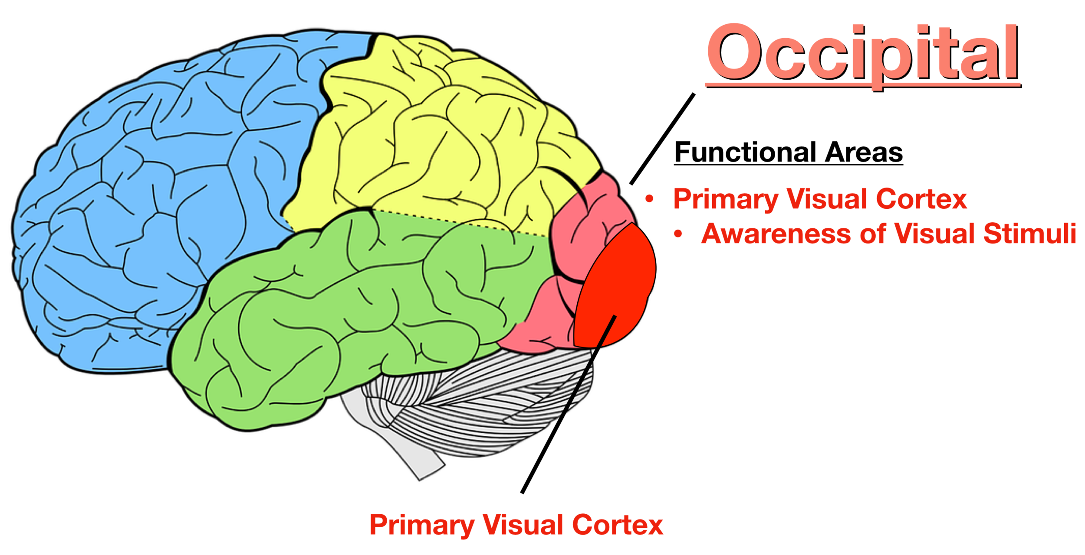

Slide 13
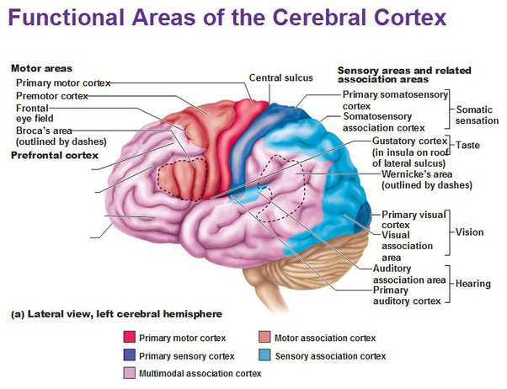

Slide 14
Frontal lobe
Overview of the frontal lobe
Area | Location | Motor and cognitive functions | Effect of lesion
Primary motor cortex (Brodmann area 4) | Precentral gyrus on the frontal lobe | Initiation of voluntary movement Gives rise to axons that form the corticospinal tract The cortical regions responsible for processing the motor functions of the different regions of the body can be mapped using the motor homunculus. The individual parts of the body are arranged against the corresponding cortical regions proportionate in size to their degree of innervation (e.g., the hand is represented disproportionately larger than the foot). Arranged medially to laterally as follows: toes, ankle, knee, hip, trunk, shoulder, elbow, wrist, hand, little finger to thumb, eye, facial expression, mouth, chin, tongue, swallowing. The primary sensory cortex is mapped in the same way using the sensory homunculus. | Contralateral upper motor neuron dysfunction (e.g., contralateral movement paralysis) Lesions in the paracentral lobule can cause urinary incontinence.
Overview of the frontal lobe
Area | Location | Motor and cognitive functions | Effect of lesion
Primary motor cortex (Brodmann area 4) | Precentral gyrus on the frontal lobe | Initiation of voluntary movement Gives rise to axons that form the corticospinal tract The cortical regions responsible for processing the motor functions of the different regions of the body can be mapped using the motor homunculus. The individual parts of the body are arranged against the corresponding cortical regions proportionate in size to their degree of innervation (e.g., the hand is represented disproportionately larger than the foot). Arranged medially to laterally as follows: toes, ankle, knee, hip, trunk, shoulder, elbow, wrist, hand, little finger to thumb, eye, facial expression, mouth, chin, tongue, swallowing. The primary sensory cortex is mapped in the same way using the sensory homunculus. | Contralateral upper motor neuron dysfunction (e.g., contralateral movement paralysis) Lesions in the paracentral lobule can cause urinary incontinence.
Overview of the frontal lobe
Area | Location | Motor and cognitive functions | Effect of lesion
Primary motor cortex (Brodmann area 4) | Precentral gyrus on the frontal lobe | Initiation of voluntary movement Gives rise to axons that form the corticospinal tract The cortical regions responsible for processing the motor functions of the different regions of the body can be mapped using the motor homunculus. The individual parts of the body are arranged against the corresponding cortical regions proportionate in size to their degree of innervation (e.g., the hand is represented disproportionately larger than the foot). Arranged medially to laterally as follows: toes, ankle, knee, hip, trunk, shoulder, elbow, wrist, hand, little finger to thumb, eye, facial expression, mouth, chin, tongue, swallowing. The primary sensory cortex is mapped in the same way using the sensory homunculus. | Contralateral upper motor neuron dysfunction (e.g., contralateral movement paralysis) Lesions in the paracentral lobule can cause urinary incontinence.

Slide 15
Overview of the frontal lobe
Area | Location | Motor and cognitive functions | Effect of lesion
Primary motor cortex (Brodmann area 4) | Precentral gyrus on the frontal lobe | Initiation of voluntary movement Gives rise to axons that form the corticospinal tract The cortical regions responsible for processing the motor functions of the different regions of the body can be mapped using the motor homunculus. The individual parts of the body are arranged against the corresponding cortical regions proportionate in size to their degree of innervation (e.g., the hand is represented disproportionately larger than the foot). Arranged medially to laterally as follows: toes, ankle, knee, hip, trunk, shoulder, elbow, wrist, hand, little finger to thumb, eye, facial expression, mouth, chin, tongue, swallowing. The primary sensory cortex is mapped in the same way using the sensory homunculus. | Contralateral upper motor neuron dysfunction (e.g., contralateral movement paralysis) Lesions in the paracentral lobule can cause urinary incontinence.
Premotor cortex (Brodmann area 6) | Anterior to the precentral gyrus on the frontal lobe | Contributes to the corticospinal tract Involved in control of axial and proximal muscles Informs the primary motor cortex before execution of movements | Apraxia
Overview of the frontal lobe
Area | Location | Motor and cognitive functions | Effect of lesion
Primary motor cortex (Brodmann area 4) | Precentral gyrus on the frontal lobe | Initiation of voluntary movement Gives rise to axons that form the corticospinal tract The cortical regions responsible for processing the motor functions of the different regions of the body can be mapped using the motor homunculus. The individual parts of the body are arranged against the corresponding cortical regions proportionate in size to their degree of innervation (e.g., the hand is represented disproportionately larger than the foot). Arranged medially to laterally as follows: toes, ankle, knee, hip, trunk, shoulder, elbow, wrist, hand, little finger to thumb, eye, facial expression, mouth, chin, tongue, swallowing. The primary sensory cortex is mapped in the same way using the sensory homunculus. | Contralateral upper motor neuron dysfunction (e.g., contralateral movement paralysis) Lesions in the paracentral lobule can cause urinary incontinence.

Slide 16
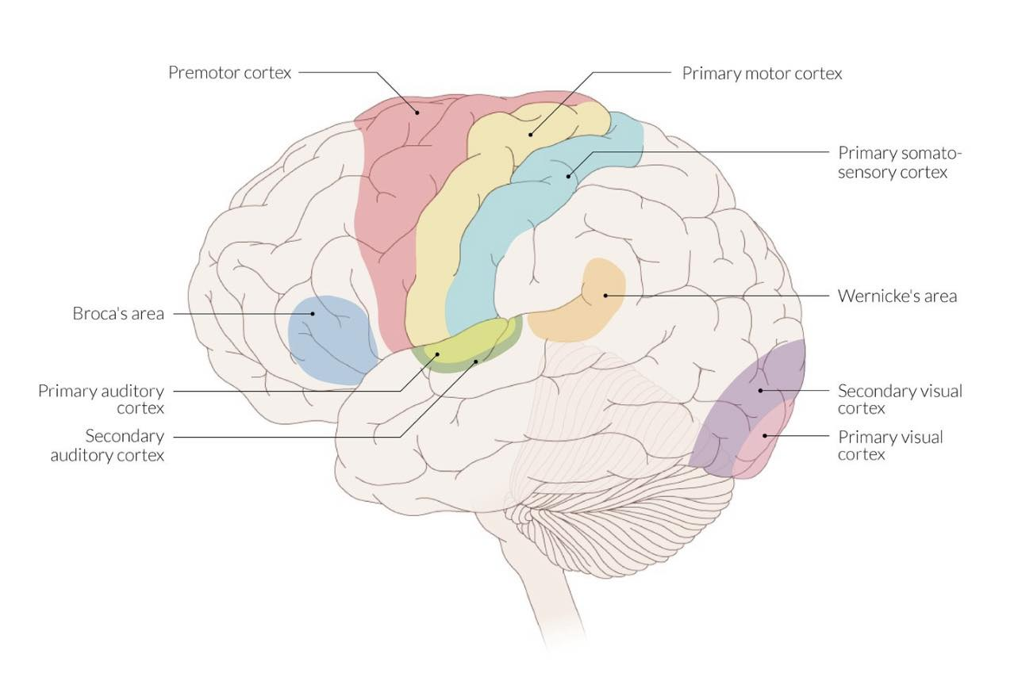
Notes:
Lateral view of important areas of the brain
The primary motor cortex, in the frontal lobe, is the origin of the fibers of the pyramidal tract.
The primary and secondary auditory cortices, where auditory input is processed, are located in the temporal lobe. The primary visual cortex is located at the occipital pole and is surrounded by the secondary visual cortex.
Different functions converge at association areas. The most well-known examples are the motor (Broca) and sensory (Wernicke) areas of speech, which are commonly located in the dominant hemisphere.

Slide 17
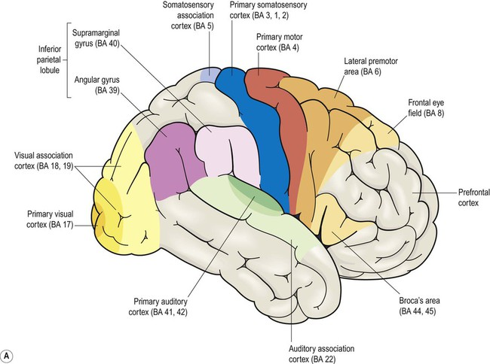

Slide 18
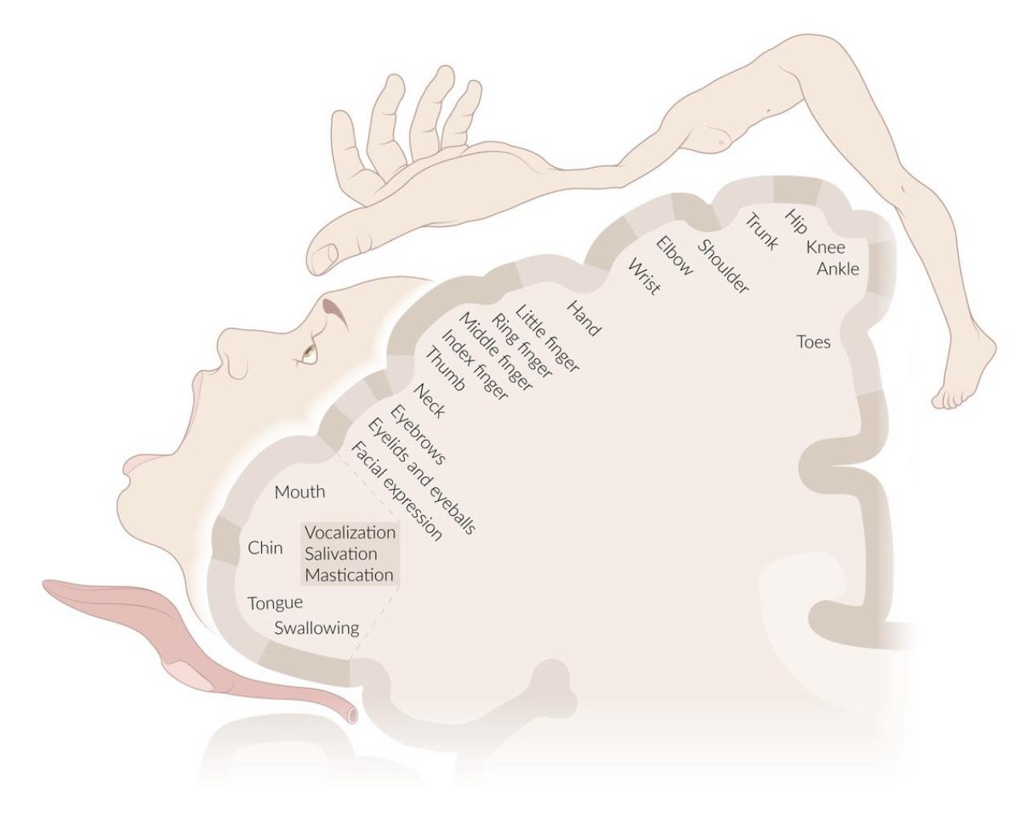
Notes:
Motor homunculus
The motor homunculus is a map of the primary motor cortex (located in the precentral gyrus of the frontal lobes) that illustrates which areas of the brain process the motor output to which part of the body. The distorted representation of the body and the size of the correspondingly labeled cortical areas illustrate the proportional amount of motor output sent to the individual parts of the body. Accordingly, since areas like the tongue, face, and hands receive most motor innervation, these areas are represented as disproportionately large compared to other areas, like the trunk and lower limbs.

Slide 19
Premotor cortex (Brodmann area 6) | Anterior to the precentral gyrus on the frontal lobe | Contributes to the corticospinal tract Involved in control of axial and proximal muscles Informs the primary motor cortex before execution of movements | Apraxia
Frontal eye field (Brodmann area 8) | Posterior part of the middle frontal gyrus | Controls voluntary saccadic eye movements Stimulation causes contralateral conjugate deviation of the eyes | Transient ipsilateral conjugate deviation of the eyes

Slide 20
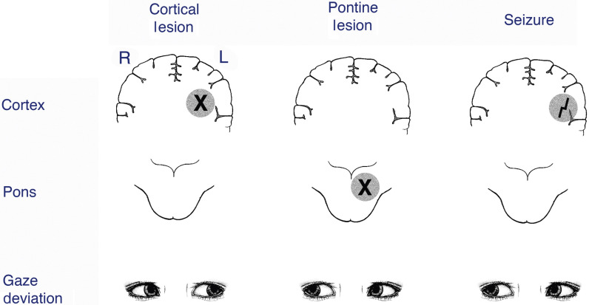

Slide 21
Prefrontal cortex (prefrontal association area) | Connected to the mediodorsal nucleus of the thalamus | Higher cognitive functions (e.g., goal-setting, decision-making) Short term memory Concentration Contains Brodmann areas 8–14, 24, 25, 32, and 45–47 | Frontal lobe syndrome, frontotemporal dementia Personality changes Aggressive behavior Social and sexual disinhibition Tremor Dystonia
Broca area (Brodmann areas 44 and 45) | Posterior part of the inferior frontal gyrus (dominant hemisphere) | Area responsible for processing speech Connected to Wernicke area via the arcuate fasciculus | Broca aphasia Nonfluent, telegraphic, and grammatically incorrect speech Intact comprehension of simple language

Slide 22
Parietal lobe

Slide 23
Overview of the parietal lobe
Area | Location | Characteristics (sensory functions) | Effect of lesion
Primary somatosensory cortex | Postcentral gyrus (parietal lobes) | Receives input from the ventral posterior nuclei of the thalamus Contributes to the corticospinal tract The cortical regions receiving sensory input of the different regions of the body can be mapped using the sensory homunculus. The individual parts of the body are arranged against the corresponding cortical regions proportionate in size to their degree of innervation (e.g., the lips are represented disproportionately larger than the feet). The primary motor cortex is mapped in the same way using the motor homunculus. | Contralateral sensory loss
Somatosensory association cortex | Superior parietal lobule and supramarginal gyrus | Integrates palpatory sensory information for pattern recognition | Contralateral astereognosis (loss of ability to identify an object by tactile input alone) Contralateral astatognosis (loss of ability to recognize the position of one's own body parts) Apraxia (loss of ability to perform coordinated, purposeful, and/or learned movements when asked, even if the request is understood) Most common type: facial apraxia (loss of ability to coordinate and execute facial movements, like whistling or winking) Conduction aphasia (e.g., loss of ability to repeat verbal commands) Due to damage of the arcuate fasciculus (a white matter bundle connecting the frontal, parietal, and temporal lobes that plays a major role in language processing)
Overview of the parietal lobe
Area | Location | Characteristics (sensory functions) | Effect of lesion
Primary somatosensory cortex | Postcentral gyrus (parietal lobes) | Receives input from the ventral posterior nuclei of the thalamus Contributes to the corticospinal tract The cortical regions receiving sensory input of the different regions of the body can be mapped using the sensory homunculus. The individual parts of the body are arranged against the corresponding cortical regions proportionate in size to their degree of innervation (e.g., the lips are represented disproportionately larger than the feet). The primary motor cortex is mapped in the same way using the motor homunculus. | Contralateral sensory loss
Overview of the parietal lobe
Area | Location | Characteristics (sensory functions) | Effect of lesion
Primary somatosensory cortex | Postcentral gyrus (parietal lobes) | Receives input from the ventral posterior nuclei of the thalamus Contributes to the corticospinal tract The cortical regions receiving sensory input of the different regions of the body can be mapped using the sensory homunculus. The individual parts of the body are arranged against the corresponding cortical regions proportionate in size to their degree of innervation (e.g., the lips are represented disproportionately larger than the feet). The primary motor cortex is mapped in the same way using the motor homunculus. | Contralateral sensory loss
Somatosensory association cortex | Superior parietal lobule and supramarginal gyrus | Integrates palpatory sensory information for pattern recognition | Contralateral astereognosis (loss of ability to identify an object by tactile input alone) Contralateral astatognosis (loss of ability to recognize the position of one's own body parts) Apraxia (loss of ability to perform coordinated, purposeful, and/or learned movements when asked, even if the request is understood) Most common type: facial apraxia (loss of ability to coordinate and execute facial movements, like whistling or winking) Conduction aphasia (e.g., loss of ability to repeat verbal commands) Due to damage of the arcuate fasciculus (a white matter bundle connecting the frontal, parietal, and temporal lobes that plays a major role in language processing)
Overview of the parietal lobe
Area | Location | Characteristics (sensory functions) | Effect of lesion
Primary somatosensory cortex | Postcentral gyrus (parietal lobes) | Receives input from the ventral posterior nuclei of the thalamus Contributes to the corticospinal tract The cortical regions receiving sensory input of the different regions of the body can be mapped using the sensory homunculus. The individual parts of the body are arranged against the corresponding cortical regions proportionate in size to their degree of innervation (e.g., the lips are represented disproportionately larger than the feet). The primary motor cortex is mapped in the same way using the motor homunculus. | Contralateral sensory loss

Slide 24
Somatosensory association cortex | Superior parietal lobule and supramarginal gyrus | Integrates palpatory sensory information for pattern recognition | Contralateral astereognosis (loss of ability to identify an object by tactile input alone) Contralateral astatognosis (loss of ability to recognize the position of one's own body parts) Apraxia (loss of ability to perform coordinated, purposeful, and/or learned movements when asked, even if the request is understood) Most common type: facial apraxia (loss of ability to coordinate and execute facial movements, like whistling or winking) Conduction aphasia (e.g., loss of ability to repeat verbal commands) Due to damage of the arcuate fasciculus (a white matter bundle connecting the frontal, parietal, and temporal lobes that plays a major role in language processing)
Visual association cortex | Angular gyrus | Integrates visual sensory information for pattern recognition | Injury to dominant hemisphere: Gerstmann syndrome Inability to recognize right or left Finger agnosia (loss of ability to distinguish or recognize one's own fingers or those of others) Agraphia (loss of ability to write down thoughts) Dyscalculia (loss of ability to do mathematical calculations) Unilateral injury to the nondominant hemisphere: contralateral hemispatial neglect syndrome
Notes:
reduced awareness of stimuli on one side of space, even though there may be no sensory loss

Slide 25
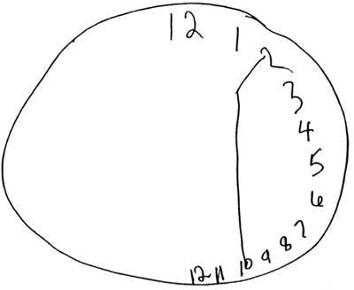
Notes:
Imagine that there’s nothing wrong with your eyes, but you can only see what’s on the right side of your plate. You start writing in the middle of the page, and sentences you read seem to start mid-sentence. You leave your bedroom with only your right arm through your shirt sleeve and only the right side of your hair combed.

Slide 26
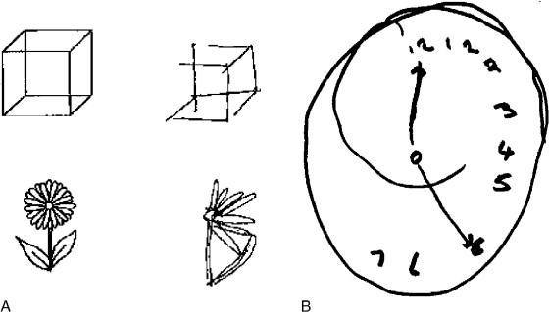

Slide 27
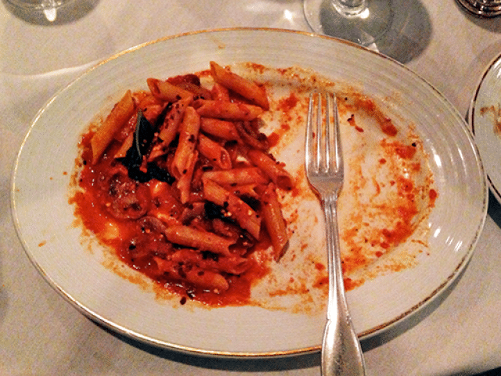

Slide 28
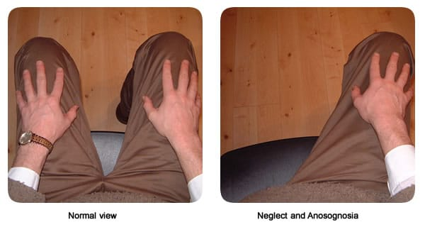

Slide 29
Temporal lobe

Slide 30
Overview of the temporal lobe
Area | Location | Characteristics (hearing) | Effect of lesion
Primary auditory cortex (Brodmann areas 41 and 42) | Transverse gyrus of the temporal lobe | Receives input from the medial geniculate body | One-sided primary auditory cortex lesions do not cause hearing loss because of bilateral representation of hearing on each side. I.e., a primary auditory cortex on the left receives auditory input from both sides, so does the right primary auditory cortex. Therefore, even if the primary auditory cortex on one side is damaged, the cortex on another side will be able to compensate for that. Bilateral primary auditory cortex lesions may lead to cortical deafness. Characterized by an inability to perceive both pure tones and complex sounds The startle reflex is preserved. Bilateral sensorineural hearing loss pattern is confirmed with audiogram.
Wernicke area | Posterior part of the superior temporal gyrus (superior portion of the temporal lobe) | Part of the auditory association cortex (Brodmann area 22) Connected to Broca area via the arcuate fasciculus | Dominant hemisphere: Wernicke aphasia Nondominant hemisphere: aprosodia

Slide 31
Occipital lobe
Overview of the occipital lobe
Area | Location | Characteristics (visual functions) | Effect of lesion
Primary visual cortex | In the region of the calcarine sulcus (cuneus and lingual gyrus) | Receives input from the lateral geniculate body via optic radiations (also known as visual radiations, geniculocalcarine tract) Controls involuntary pursuit and tracking eye movements Stimulation causes contralateral conjugate deviation of the eyes | Difficulty tracking slow movements and/or contralateral homonymous hemianopsia
Secondary visual cortex | Occipital lobe Surrounds the primary visual cortex | Integrates visual properties such as color, position in space, and illusory contours | Visual hallucinations

Slide 32
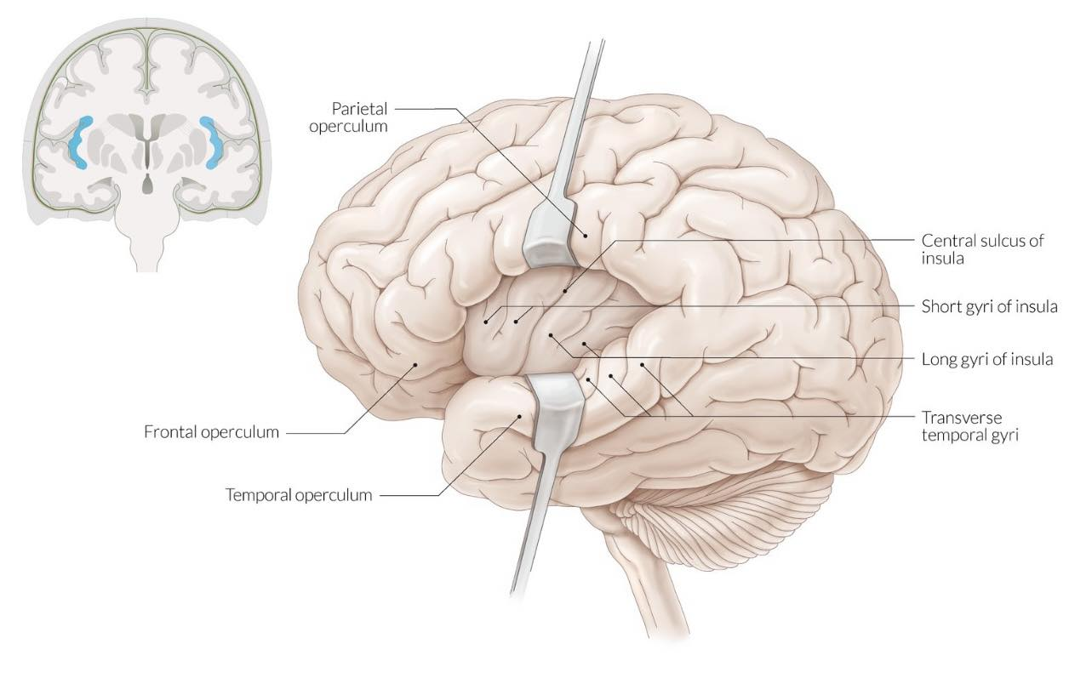
Insular lobe
Notes:
Insula
The insula is a portion of the cerebral cortex that lies deep within the lateral sulcus, covered completely by the frontal, parietal, and temporal opercula. The central sulcus divides the insula into an anterior zone, composed of short gyri, and a posterior zone, composed of long gyri. The anterior insula is mainly involved in processing olfactory, gustatory, autonomic, and limbic information. The posterior insula is principally involved in processing somatic (mainly noxious stimuli), auditory, and motor information. The insula also plays an important role in cognition, emotion, and motivation.

Slide 33
Location
  Small region of the cerebral cortex deep within the Sylvian fissure
  Completely hidden below parts of the frontal, parietal, and temporal lobes
Characteristics
  Receives input from the thalamus (sensory thalamic nuclei) and the cerebral cortex
  Reciprocally connected with the limbic system and frontal brain regions
Function
  Processing of emotions
  Perception of body functions (interoception)
  Integration and perception of somatosensory stimuli
  Perception of gustatory and olfactory stimuli
  Modulation of autonomic functions (e.g., blood pressure, gastrointestinal motility)

Slide 34
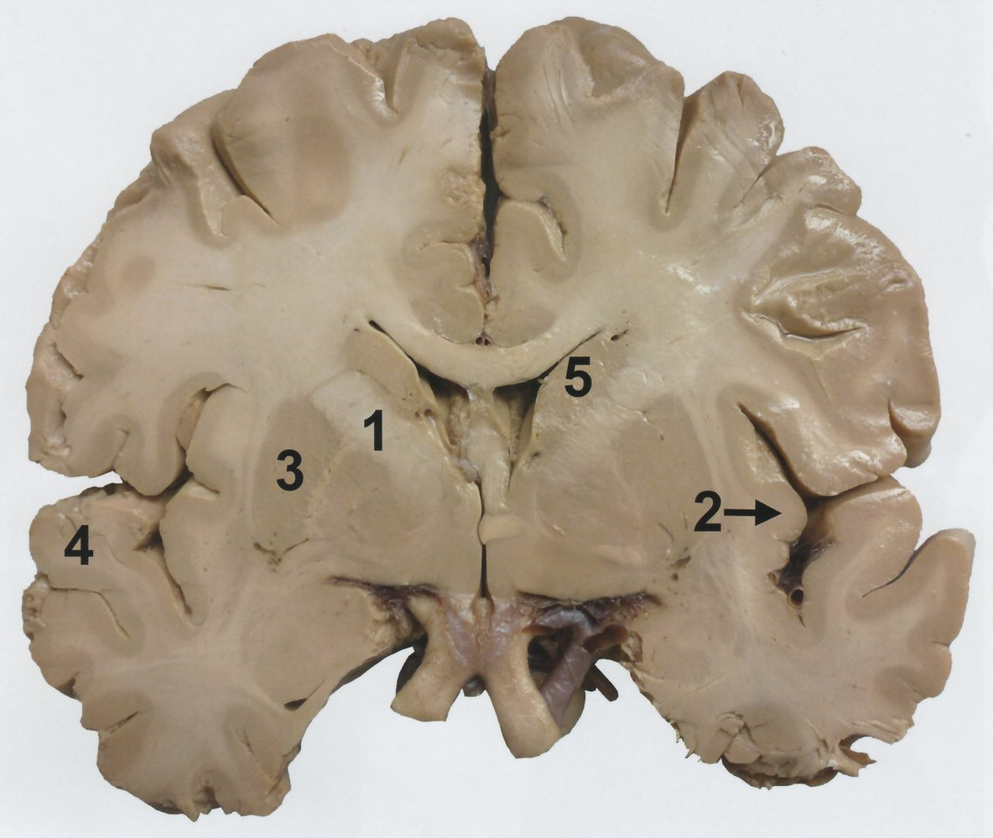
Notes:
Cerebrum with white matter and gray matter
Macroscopic image of the cerebrum:
The brain has been incised at the level of the optic chiasm (marked in green) in the coronal plane (= frontal plane). The brain parenchyma is divided into the neuron-rich gray matter (substantia grisea) and the nerve fiber-rich white matter (substantia alba), which becomes clearly visible in the section image.
Both lateral ventricles (highlighted in white) can be seen below the corpus callosum, which connects the left and right cerebral hemispheres. The third ventricle is marked with a white arrowhead. Lateral to the lateral ventricles, several laterally symmetrical subcortical core areas, that are part of the basal ganglia (extrapyramidal system), become apparent:
- putamen (3)
- pallidum (6)
- caudate nucleus (5)
Most afferent and efferent paths of the cortex run through the bordering internal capsule (1). The insular lobe (insula) for the visceral sensory system is usually not visible from the outside – in a coronal plane, it is represented clearly (2).
Outwardly, the insula is covered by parts of the temporal lobe (“temporal operculum”), in which the superior temporal gyrus (4), that is significantly involved in auditive information processing, is also visible.

Slide 35
Internal capsule
A deep subcortical structure that lies between the basal ganglia
Largest collection of nerve fibers traveling to and from the cerebral cortex, forming the corona radiata (neuroanatomy), a collection of white matter fibers.
Components: anterior limb, genu, and posterior limb
  Anterior limb: contains the thalamocortical tract
  Genu: contains the corticobulbar tract
  Posterior limb: contains the corticospinal tract and thalamocortical and somatosensory fibers

Slide 36
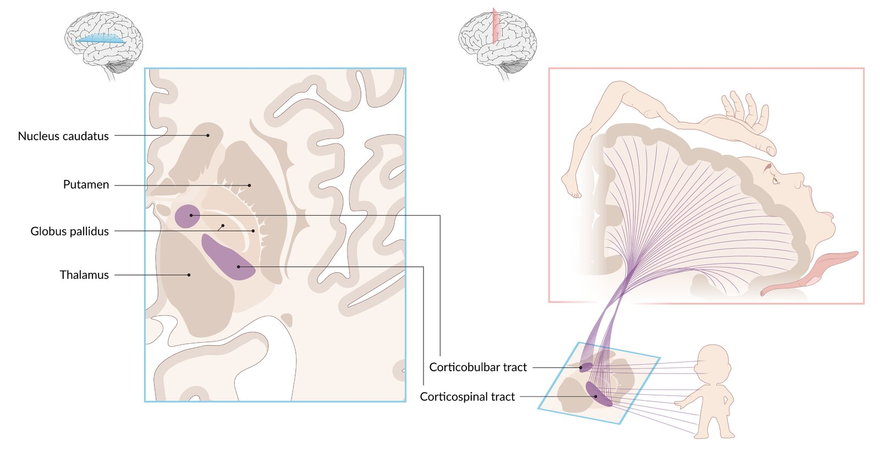
Notes:
nternal capsule: descending pathways
Corticobulbar tract: connects the cerebral cortex to the motor nuclei of the cranial nerves, providing voluntary control of the facial and cervical muscles
Corticospinal tract: conveys voluntary motor input from the cerebral cortex to the anterior horn cells of the spinal cord
Both pathways have a somatotopic organization, as illustrated by the motor homunculus.

Slide 37
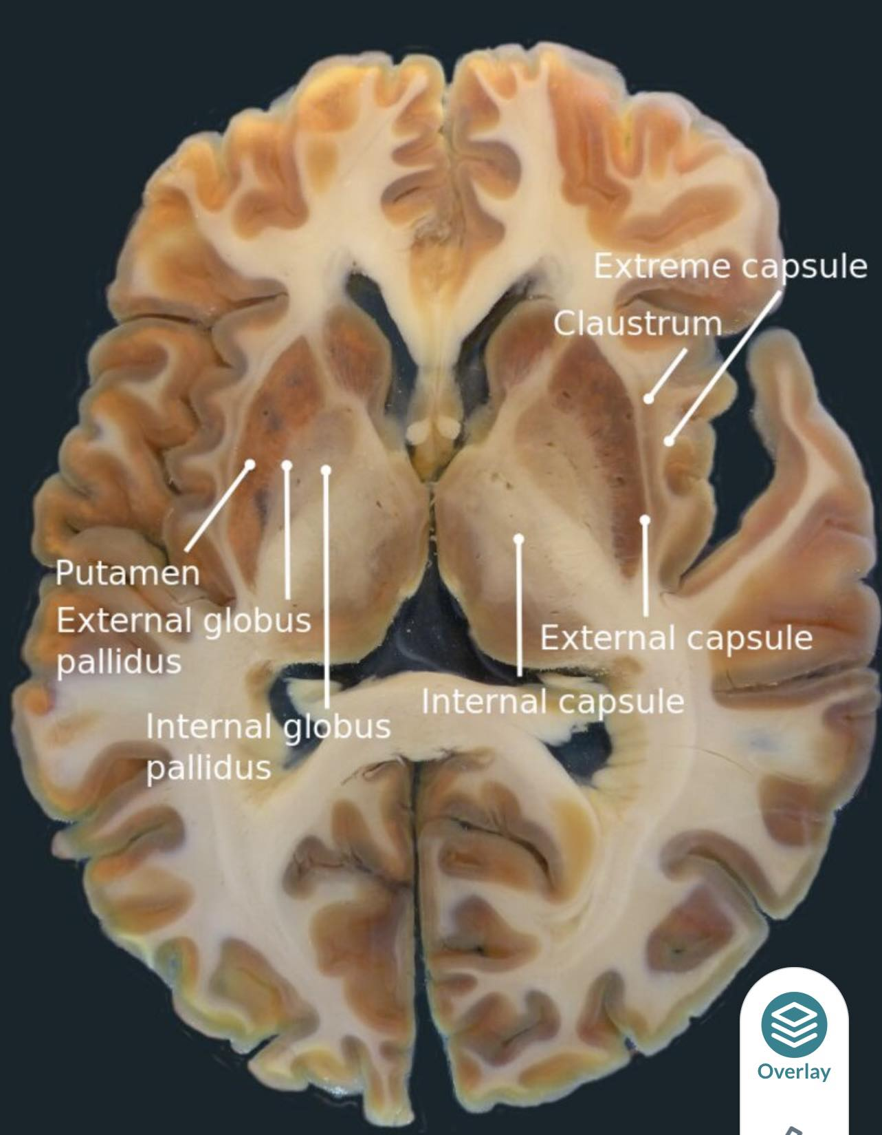

Slide 38
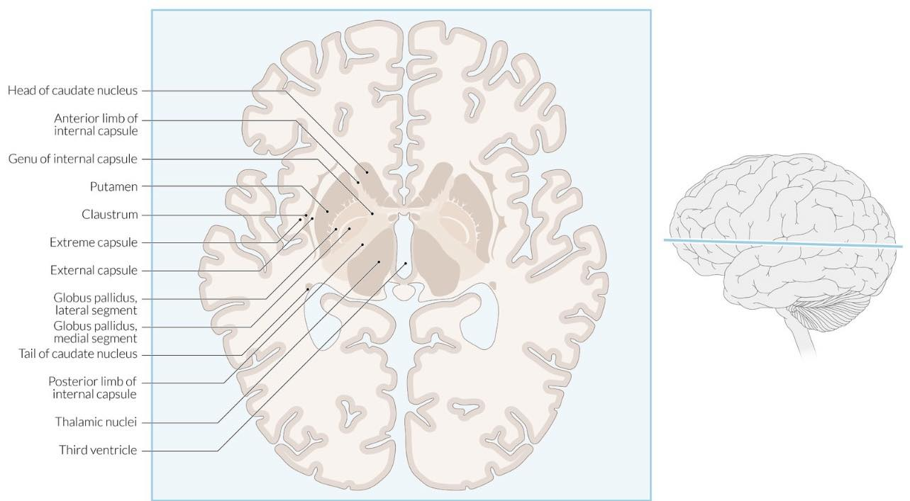

Slide 39
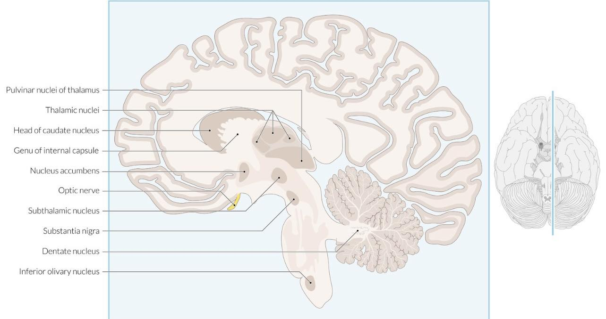

Slide 40
Meninges, falces, and spaces
Meninges
Three layers of connective tissue that cover and protect the brain and the spinal cord
Divided into (from outer to inner layer): dura mater, arachnoid mater, and pia mater

Slide 41
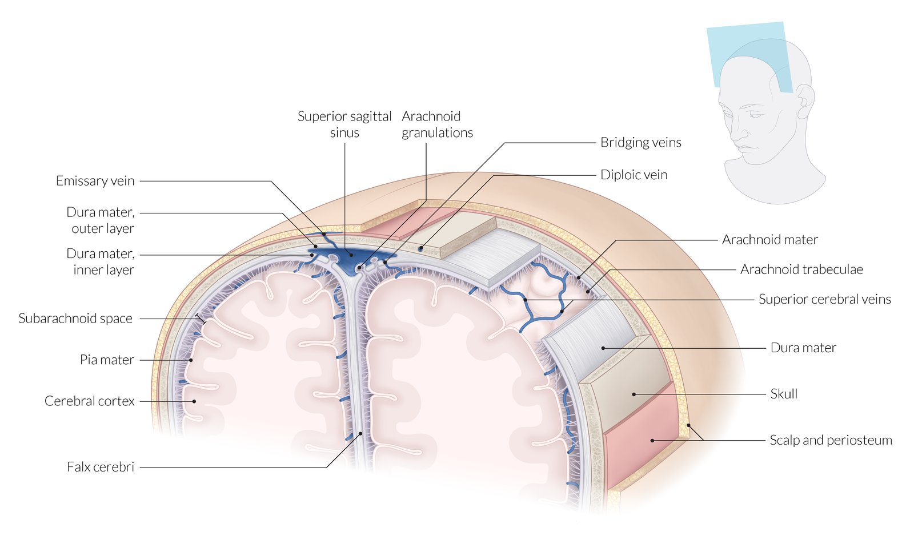
Notes:
Cross-section of skull and meninges
From the outside in:
1. Scalp
2. Periosteum
3. Skull
4. Dura mater
5. Arachnoid mater
6. Pia mater
Diploic veins lie within the inner and outer tables of the skull. Dural venous sinuses lie between the inner and outer layers of the dura mater and are connected to the extracranial veins by emissary veins. Falx cerebri (as well as the falx cerebelli and tentorium cerebelli not shown in this image) are extensions of the dura mater. Arachnoid trabeculae are strands of delicate connective tissue that extend between the arachnoid and pia mater. Arachnoid granulations (villi) are finger-like projections of the arachnoid mater that invaginate into the dural venous sinuses.

Slide 42
Overview of the meningeal layers ^{[1]}
Meningeal layer | Origin | Anatomy | Characteristics
Dura mater | Mesoderm | Outermost and thickest meningeal layer Composed of dense, irregular connective tissue Adheres to the skull | Forms the inner boundary of the epidural space: space between the dura mater and the bones of the cranium/spine Forms the outer boundary of the subdural space Folds to form septae: the falx cerebri, falx cerebelli, and tentorium cerebelli (See “Falces of the brain.”)
Arachnoid mater | Neural crest | Middle layer between the dura mater and the pia mater Composed of loose, translucent connective tissue | Forms the outer boundary of the subarachnoid space
Pia mater |  | Thin and fibrous inner layer Composed of fibrous connective tissue (e.g., reticular fibers, collagen fibers) Adheres to the brain and the spinal cord | Forms the inner boundary of the subarachnoid space

Slide 43
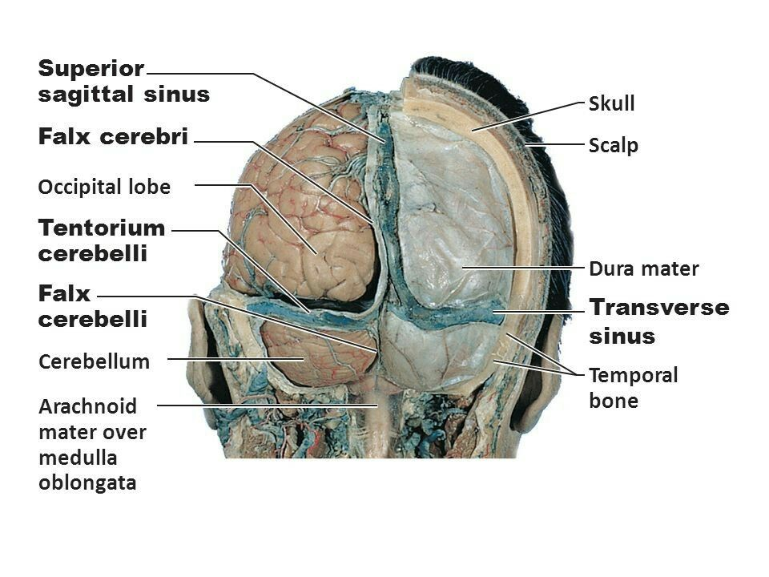
Falces of the brain

Slide 44
Basal ganglia
Overview
The basal ganglia are a group of nuclei that lie beneath the cortex.
Distributed over the telencephalon, diencephalon, and mesencephalon (midbrain)

Slide 45
Overview of the basal ganglia
Basal ganglia |  | Location | Clinical significance
Striatum | Caudate nucleus | Telencephalon | Molecular changes in Huntington disease lead to neuronal loss in the striatum
 | Putamen
Lentiform nucleus | Globus pallidus | Diencephalon . | Wilson disease (hepatolenticular degeneration) leads to an impaired function of the lentiform nucleus due to copper accumulation.
 | Putamen
Subthalamic nucleus |  |  | Effect of lesion: contralateral hemiballismus
Substantia nigra |  | Mesencephalon | Parkinson disease is characterized by neuronal degeneration in the substantia nigra
Notes:
The putamen is located at the base of the forebrain (telencephalon)

Slide 46
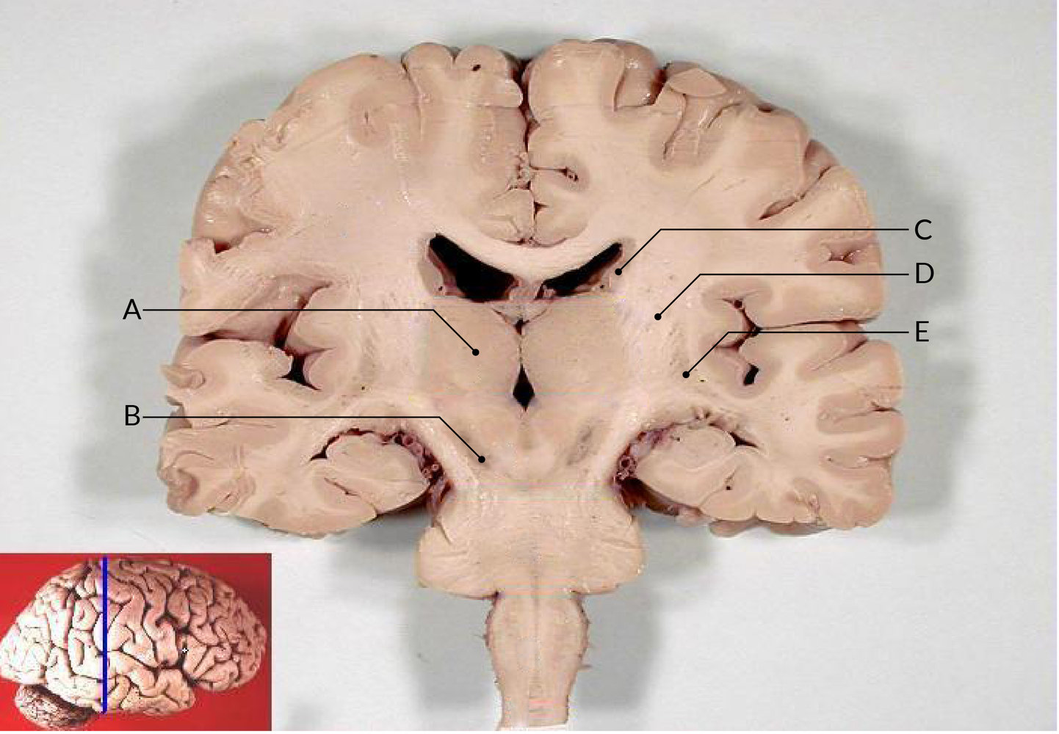
Coronal section of the brain
Notes:
Gross specimen of a brain (coronal section)
A: thalamus
B: substantia nigra
C: caudate nucleus
D: internal capsule
E: putamen

Slide 47
Cortico-basal ganglia-thalamo-cortical loop (CBGTC)
A neuronal circuit between the cortices of the brain, the basal ganglia, and the thalamus
Via this loop, the basal ganglia aid in the initiation of movement, control of skeletal muscles, and adjustment of posture.
Two main pathways: the direct pathway and the indirect pathway.
The balance of activity between the direct and indirect pathways is modulated by dopamine.

Slide 48
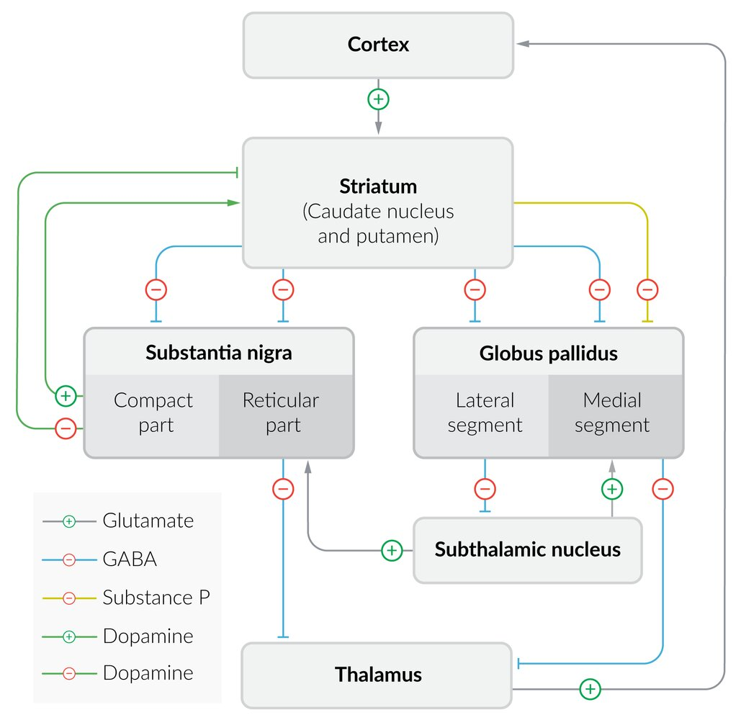

Slide 49
Overview of the functional anatomy of the basal ganglia
Structure |  | Function/Characteristics | Neurotransmitter | Motor activity
Striatum | Motor excitatory part | Inhibition of the Gpi Contains mainly D1 receptors, which are activated by dopamine | GABA Substance P | ↑
 | Motor inhibitory part | Inhibition of the Gpe Contains mainly D2 receptors, which are inhibited by dopamine | GABA | ↓
Pallidum | Globus pallidus internus (Gpi) | Inhibition of the thalamus | GABA | ↓
 | Globus pallidus externus (Gpe) | Inhibition of the subthalamic nucleus | GABA | ↑
Subthalamic nucleus |  | Stimulation of the Gpi Stimulation of the pars reticularis of the substantia nigra | Glutamate | ↓
Substantia nigra | Pars compacta | Stimulation of the motor excitatory part of the striatum Inhibition of the motor inhibitory part of the striatum | Dopamine | ↑
 | Pars reticularis | Inhibition of the thalamus | GABA | ↓

Slide 50
Direct pathway of the basal ganglia (excitatory)
Function: increase in motor activity
Pathway
  Motor cortex activation → glutamate release → striatum stimulation → GABA release → inhibition of Gpi → inhibition of GABA release → thalamus disinhibition → premotor cortex stimulation → muscle activation → ↑ movement
  In addition, the subthalamic nucleus stimulates the substantia nigra (pars compacta) → dopamine release → stimulation of D1 receptor in striatum → further inhibition of Gpi → inhibition of GABA release → thalamus disinhibition → premotor cortex stimulation → muscle activation → ↑ movement

Slide 51
Indirect pathway of the basal ganglia (inhibitory)
Function
  Decrease in motor activity
  Modulation of the disinhibitory effect of the direct pathway
Pathway
  Motor cortex activation → glutamate release → stimulation of striatum → GABA release → inhibition of Gpe → inhibition of GABA release → ↓ inhibition (activation) of subthalamic nucleus → glutamate release → stimulation of substantia nigra (pars reticularis) and Gpi → GABA release → inhibition of thalamus → inhibition of premotor cortex → deactivation of muscles → ↓ movement
  The striatum also stimulates the substantia nigra (pars compacta) → dopamine release → stimulation of D2 receptor in striatum → inhibition of GABA release → disinhibition of Gpe → GABA release → inhibition of subthalamic nucleus → ↓ stimulation of GPi → disinhibition of thalamus → ↑ movement

Slide 52
Dopaminergic pathways
Dopaminergic pathways are collections of neurons that release dopamine.
Dysfunction of dopaminergic pathways is involved in some psychiatric diseases (e.g., schizophrenia) and movement disorders (e.g., Parkinson disease).
Antipsychotic drugs target dopaminergic pathways.

Slide 53
Overview of dopaminergic pathways
Pathway | Location | Characteristics | Defect
Nigrostriatal | From substantia nigra to striatum (putamen and caudate nucleus) | Controls motor function | Altered activity causes extrapyramidal symptoms and movement disorders (parkinsonism in the case of inhibition, chorea in the case of stimulation).
Tuberoinfundibular | From the arcuate nucleus (infundibular nucleus) to the median eminence | Dopamine release inhibits prolactin secretion from the anterior pituitary. | Inhibition causes ↓ dopamine → ↑ prolactin → galactorrhea, sexual dysfunction, ↓ libido
Mesolimbic | From the ventral tegmental area (VTA) to the nucleus accumbens and olfactory tubercle | Controls the reward system of the brain (e.g., pleasure, positive reinforcement) | Stimulation causes positive symptoms (e.g., hallucinations) Primary target for antipsychotic drugs used in the treatment of schizophrenia (e.g., haloperidol)
Mesocortical | From the ventral tegmental area (VTA) to the prefrontal cortex | Controls executive functions | Inhibition causes negative symptoms (e.g., apathy, lack of energy). Antipsychotic drugs have limited efficacy.

Slide 54
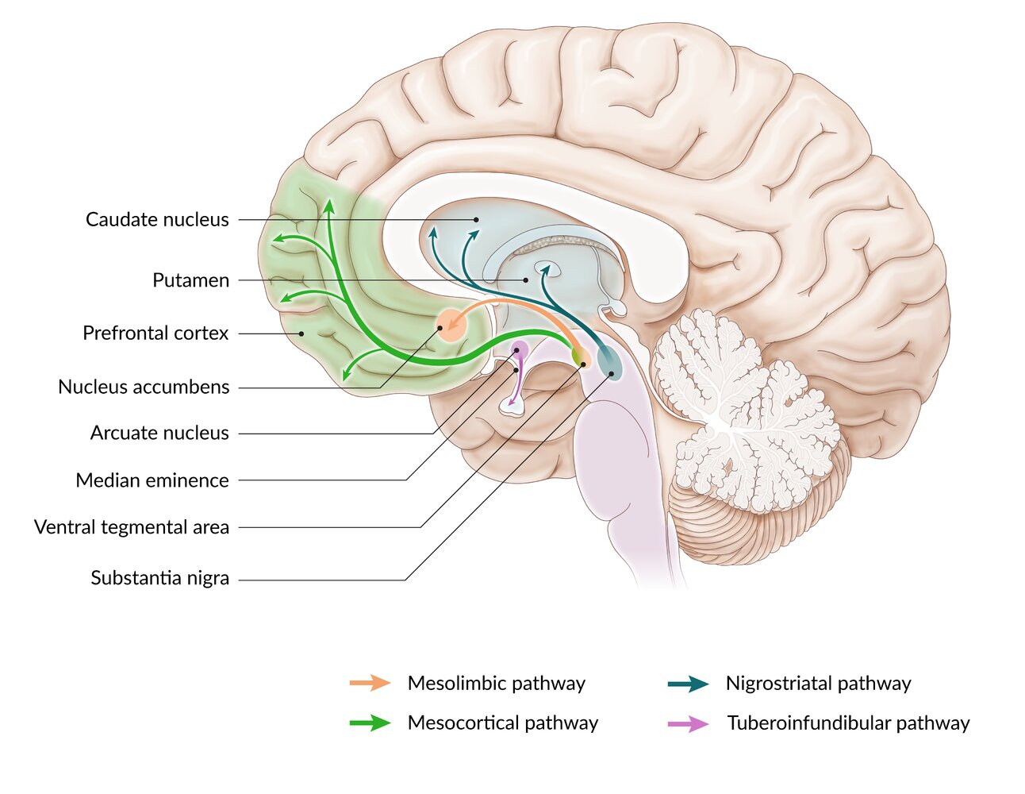
Dopaminergic pathways

Slide 55
Ventricular system
Overview
Consists of four interconnected cavities within the brain: the two lateral ventricles; the third ventricle, located in the diencephalon; and the fourth ventricle, located dorsal to the pons
Involved in the production and circulation of cerebrospinal fluid (CSF)
CSF serves as a fluid cushion and removes waste products from the brain

Slide 56
Overview of the ventricular system
Ventricle | Anatomy | Drainage
Lateral ventricles | Paired (right and left) Located in the cerebral hemispheres | Into the 3rd ventricle via the paired interventricular foramina (of Monro)
Third ventricle | Single midline ventricle Located in the diencephalon | Into the 4th ventricle via the cerebral aqueduct (of Sylvius) Passes through the midbrain Located dorsal to the pons and ventral to the cerebellum
Fourth ventricle | Single midline ventricle Located dorsal to the pons and upper medulla | Into the subarachnoid space Laterally via the paired lateral apertures (foramina of Luschka) Medially via median aperture (foramen of Magendie)

Slide 57
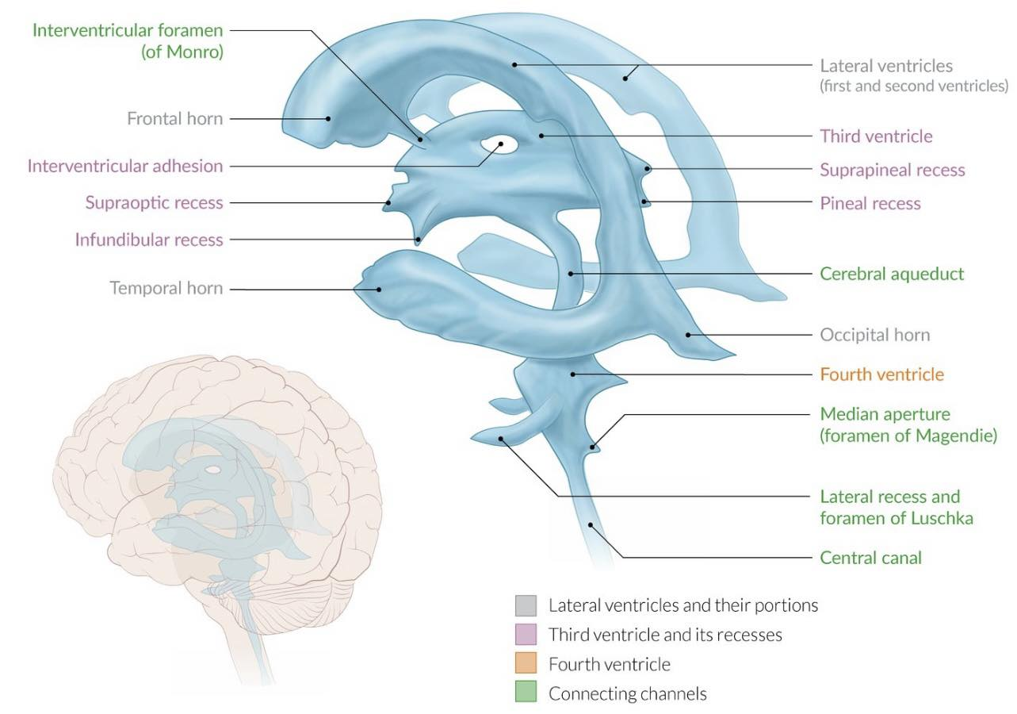
Notes:
Ventricular system of the brain
Within the brain, there are several interconnected CSF-filled spaces (ventricles). The largest of these are the lateral ventricles (first and second ventricles), which are located within the cerebral hemispheres. The third ventricle lies in the diencephalon, between the two thalamic hemispheres, and has several recesses. The fourth ventricle is located in the rhomboid fossa (dorsal to the pons/medulla oblongata). The lateral ventricles are connected to the third ventricle via the interventricular foramina. The third ventricle is connected to the fourth ventricle by the cerebral aqueduct. The fourth ventricle also connects the ventricular system to the subarachnoid space (which is also filled with CSF) via several openings (e.g., the median aperture).

Slide 58
The foramina of Luschka are the Lateral apertures and the foramen of Magendie is the Medial aperture of the fourth ventricle.

Slide 59
Thank You

