Slide 1
Drugs used for regulation of body temperature and food intake
Dr.Samaher Jaber Younis
BCPS

Slide 2
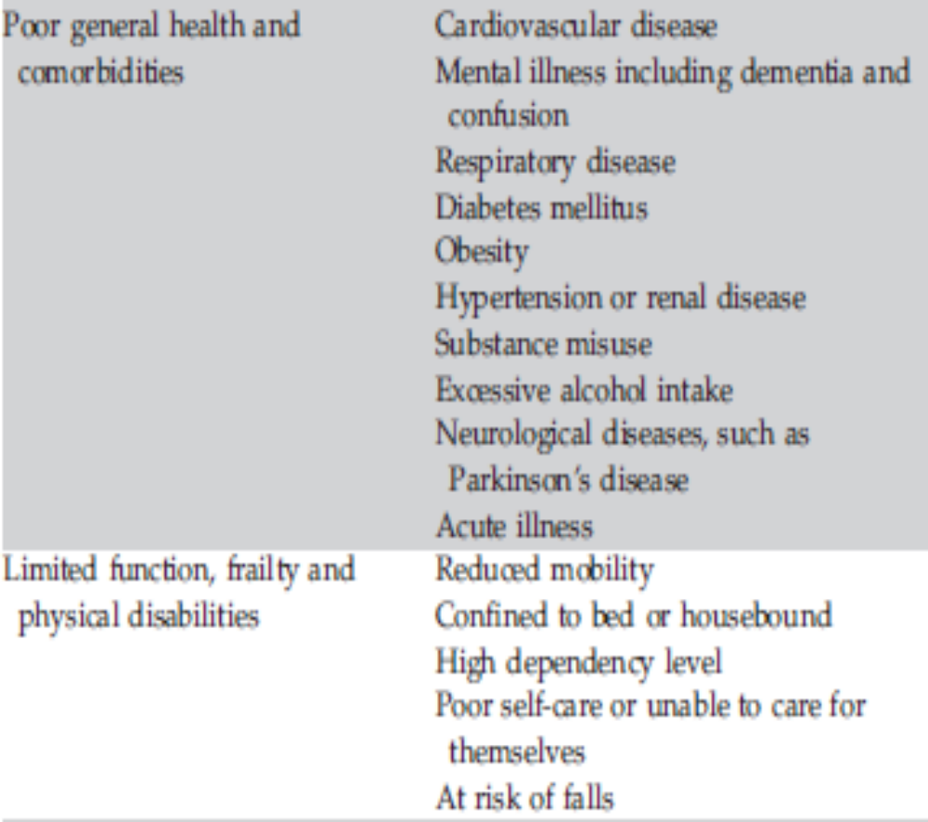
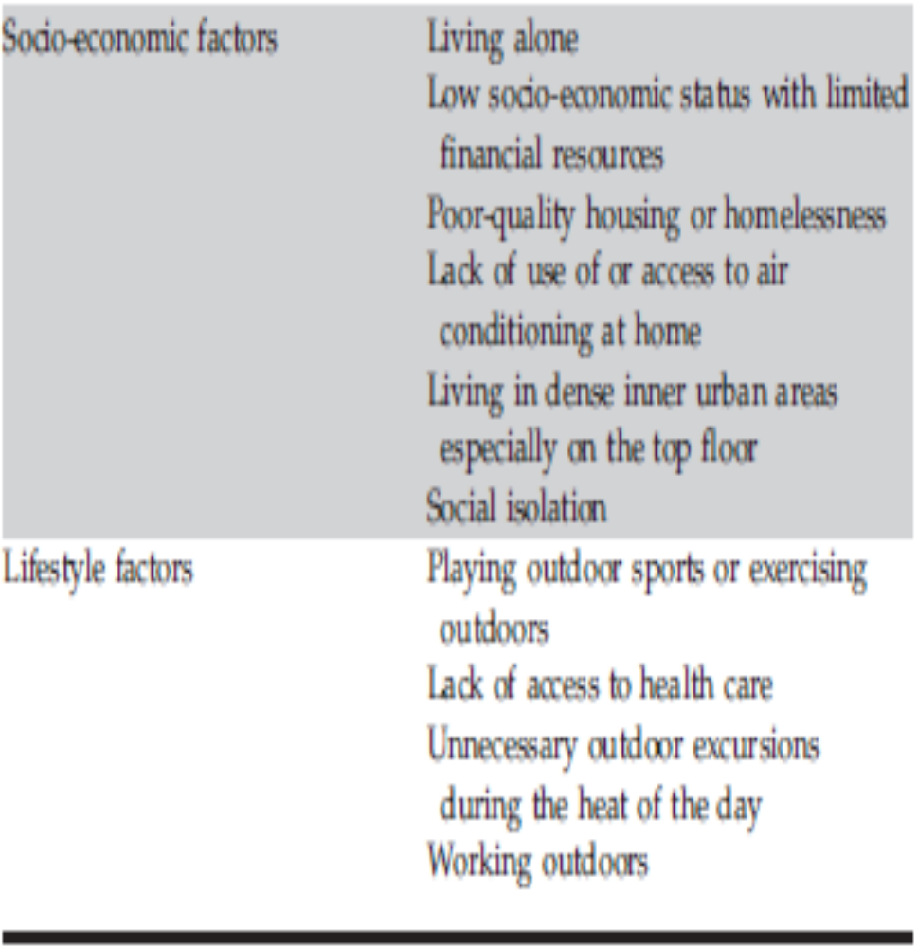
Risk factors for heat-related illness

Slide 3
Which medicines are associated with an increased risk of dehydration or heat-related illness?
Many commonly prescribed medicines can increase the risk of heat-related illness via the following mechanisms:
1 Dehydration and electrolyte imbalance.
2 Impaired sweating.
3 Reduced thirst sensation.
4 Hypotension and reduced cardiac output, which may also increase the risk of fainting and falls.
5 Sedation and cognitive impairment which may reduce alertness, judgement and perception of heat and thirst.
6 Drug toxicity associated with reduced renal clearance of medicines in dehydrated people.
7 Altered central thermoregulation.

Slide 4
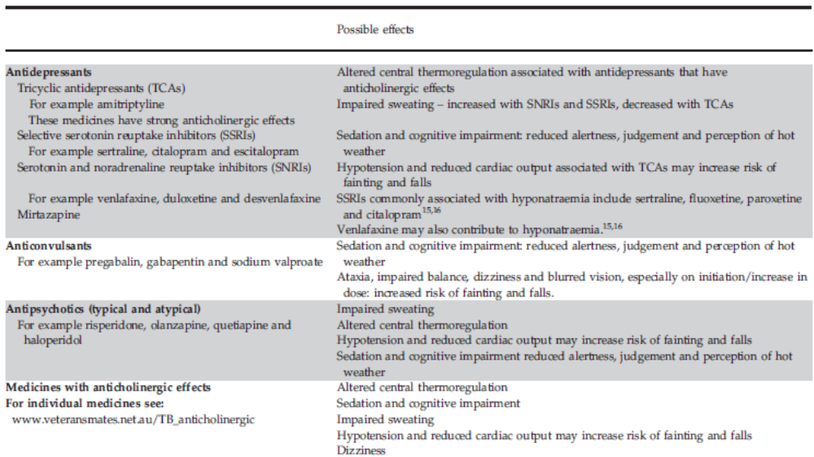

Slide 5
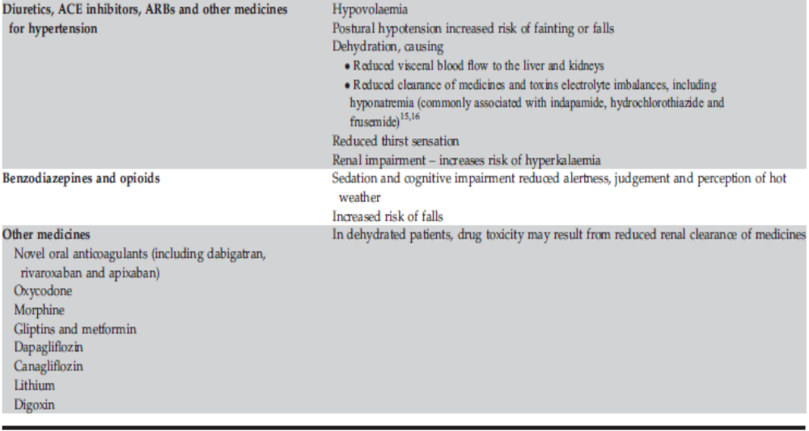

Slide 6
OBESITY
Classification
Based on BMI
Normal: BMI 18.5–24.9 kg/m2
Overweight: BMI 25.0–29.9 kg/m2
Obesity
a. Class I: BMI 30.0–34.9 kg/m2
b. Class II: BMI 35.0–39.9 kg/m2
c. Class III: BMI 40 kg/m2 or greater

Slide 7
Therapy Goals
1. Weight loss: Initial goal: 5%–10% decrease from baseline weight over 6 months
2. Maintain lower weight in the long term
3. Limit weight-induced comorbidities (e.g., T2D, hypertension, cardiovascular disease)
Nonpharmacologic Therapy (aimed at providing an energy deficit)
1. Increased physical activity: 200–300 minutes per week (minimum 150)
2. Dietary options: Any diet that has proven weight reduction data available is appropriate. No specific recommendations of one diet over another. Individualize according to patient preferences.
a. Strive for at least a 500-kcal/day deficit.
b. 1200–1500 kcal/day for women
c. 1500–1800 kcal/day for men
3. Behavioral intervention: According to ACC/AHA/The Obesity Society guidelines: Preferably in-person, high-intensity (at least 14 sessions in 6 months) comprehensive weight-loss intervention through group or individual sessions with a professional (e.g., dietitian, exercise specialist, health counselor)
4. Surgery: Usually reserved for patients with severe obesity (BMI greater than 40 kg/m2) or BMI of at least 35 kg/m2 with at least one obesity-related comorbidity such as diabetes, hypertension, or obstructive sleep apnea
a. Roux-en-Y gastric bypass
b. Sleeve gastrectomy
c. Adjustable gastric banding

Slide 8
Pharmacotherapy
1. Always in conjunction with diet, physical activity, and behavioral therapy
2. Medications should be reserved for those not achieving or sustaining weight reduction with adequate lifestyle modifications, in those with obesity, or in those with a BMI of at least 27 kg/m2 with significant weight-related comorbidities (e.g., diabetes, hypertension, dyslipidemia).
Orlistat
a. Mechanism of action: Reduced absorption of fat by inhibition of gastric and pancreatic lipases
b. Dosing
i. Prescription: 120 mg three times daily during or up to 1 hour after meals
ii. Over the counter: 60 mg three times daily during or up to 1 hour after meals
c. Adverse effects
i. GI tract: Flatulence, oily stools, loose stools, fecal urgency, or incontinence (highly dependent
on fat content of meal)
ii. Reduced absorption of fat-soluble vitamins (A, D, E, and K): Use vitamin supplement before
or well after use.
iii. Hepatotoxicity, kidney stones (FDA warnings)
d. Efficacy: 35%–54% of patients taking a prescription-strength product attained at least a 5% weight
loss after 1 year of therapy, and 16%–25% attained at least a 10% weight loss.

Slide 9
Lorcaserin was removed from the market in early 2020 after increased risk of some cancers was detected
Phentermine/extended-release topiramate (schedule IV)
a. Mechanism of action: Phentermine promotes appetite suppression and decreases food intake secondary to its sympathomimetic activity. Mechanism of topiramate is unknown, but it can cause appetite suppression and satiety through increased γ-aminobutyrate activity.
b. Dosing (phentermine/topiramate): Should be taken in the morning to avoid insomnia
i. Initial: 3.75/23 mg daily for 2 weeks; then increase to 7.5/46 mg daily
ii. If at least a 3% weight loss not achieved after 12 weeks, can discontinue or increase to 11.25/ 69 mg daily for 2 weeks; then increase to 15/92 mg daily, if tolerated
iii. If at least a 5% weight loss not achieved with 15/92 mg daily, discontinue use. Taper when discontinuing to avoid seizures.
iv. Dosing in moderate hepatic or renal impairment: Do not exceed 7.5/46 mg daily.
c. Adverse effects: Dry mouth, paresthesia, constipation, dysgeusia, insomnia, attention and memory disturbances, increased heart rate
d. In women of childbearing age, obtain a negative pregnancy test before initiating and monthly thereafter because of fetal toxicity. Stress the importance of adequate contraception during use.
e. Efficacy: 9%–10% weight loss from baseline; 60%–70% attained at least a 5% weight loss after 1 year of treatment, and 37%–48% attained at least a 10% weight loss

Slide 10
Bupropion/naltrexone
a. Mechanism of action: Reuptake inhibitor of dopamine and norepinephrine (bupropion) and opioid antagonist (naltrexone)
b. Dosing (8 mg naltrexone/90 mg bupropion tablets)
i. Dosage escalation at weekly intervals by 1 tablet daily
ii. Initially, 1 tablet once daily
iii. Target dosage: 2 tablets twice daily
c. Adverse effects: Nausea, constipation, headache, vomiting, dizziness, insomnia, dry mouth.
d. Precautions and contraindications: Uncontrolled hypertension, seizure disorders, anorexia nervosa or bulimia, drug or alcohol withdrawal. Avoid with chronic use of opioids.
e. Efficacy: 5%–6% weight loss from baseline; 40%–55% attained at least a 5% weight loss after 56 weeks of therapy, 20%–25% attained at least a 10% weight loss.
f. Discontinue use if at least a 5% weight loss is not achieved after 12 weeks of use.

Slide 11
Liraglutide
a. Mechanism of action: Glucagon-like peptide-1 (GLP-1) agonist (part of incretin system). Thought to cause satiety and delay gastric emptying. Used in treatment of T2D.
b. Dosing (administered subcutaneously by pen device)
i. Target dosage higher in obesity than in treatment of diabetes. Brand-name product for obesity is not approved for diabetes and vice versa.
ii. Initially, 0.6 mg once daily; increase by 0.6 mg at weekly intervals
iii. Target dosage for obesity: 3 mg daily
c. Adverse effects: Nausea, vomiting, diarrhea, constipation, dyspepsia
Obesity formulation should be avoided in patients receiving insulin (increased risk of hypoglycemia).
Do not use with other GLP-1 agonists used in the treatment of diabetes mellitus (DM).
Discontinue use if the patient does not achieve at least a 4% weight loss after 16 weeks of therapy or if the patient cannot tolerate the target 3-mg daily dosage.

Slide 12
Efficacy
i. Patients without diabetes: 8%–9% weight loss from baseline; 60%–65% attained at least a 5% weight loss after 56 weeks of treatment, and about 33% attained at least a 10% weight loss
ii. Patients with diabetes: 6% weight loss from baseline; 54% attained at least a 5% weight loss after 56 weeks of treatment, and 25% attained at least a 10% weight loss. Only minimally more effective at A1C reduction than standard diabetes dosage f. Discontinue use if the patient does not achieve at least a 4% weight loss after 16 weeks of therapy or if the patient cannot tolerate the target 3-mg daily dosage.
Diethylpropion (schedule IV), phentermine (schedule IV), phendimetrazine (schedule III)
a. Should be used only for a limited time, up to 3 months, and avoid in those with abuse potential
b. Clinical guidelines do not recommend their use.
c. Adverse effects: Increased blood pressure, constipation, increased heart rate, dysrhythmias, abuse
potential (avoid in patients with hypertension or a history of cardiovascular disease)

Slide 13
Semaglutide
a. Mechanism of action similar to liraglutide
b. Dosing (administered subcutaneously by pen device)
i. Target dose, like liraglutide, is higher than in the treatment of diabetes and the brand name is
also different.
ii. Initially, 0.25 mg once weekly, increased at monthly intervals
iii. Target dose for obesity: 2.4 mg once weekly
c. Adverse effects, precautions, contraindications: Similar to liraglutide
d. Discontinue if patient cannot tolerate the target dose.

