Slide 1

Treatment of Parkinson disease
Dr.Samaher Jaber Younis
BCPS

Slide 2
Drugs for Neurodegenerative Diseases
Most drugs that affect the central nervous system (CNS) act by altering some step in the neurotransmission process. Drugs affecting the CNS may act presynaptically by influencing the production, storage, release, or termination of action of neurotransmitters. Other agents may activate or block postsynaptic receptors. These concepts are useful in understanding the etiology and treatment strategies for the neurodegenerative disorders that respond to drug therapy: Parkinson’s disease, Alzheimer’s disease, multiple sclerosis (MS), and amyotrophic lateral sclerosis (ALS)

Slide 3
NEUROTRANSMISSION IN THE CNS
The basic functioning of neurons in the CNS is similar to that of the autonomic nervous system (ANS). For example, transmission of information in both the CNS and in the periphery involves the release of neurotransmitters that diffuse across the synaptic cleft to bind to specific receptors on the postsynaptic neuron. In both systems, the recognition of the neurotransmitter by the membrane receptor of the postsynaptic neuron triggers intracellular changes. However, several major differences exist between neurons in the peripheral ANS and those in the CNS. The circuitry of the CNS is more complex than that of the ANS, and the number of synapses in the CNS is far greater. The CNS, unlike the peripheral ANS, contains networks of inhibitory neurons that are constantly active in modulating the rate of neuronal transmission. In addition, the CNS communicates through the use of multiple neurotransmitters, whereas the ANS uses only two primary neurotransmitters, acetylcholine and norepinephrine.

Slide 4
SYNAPTIC POTENTIALS
In the CNS, receptors in most synapses are coupled to ion channels. Binding of the neurotransmitter to the postsynaptic membrane receptors results in a rapid but transient opening of ion channels. Open channels allow specific ions inside and outside the cell membrane to flow down their concentration gradients. The resulting change in the ionic composition across the membrane of the neuron alters the postsynaptic potential, producing either depolarization or hyperpolarization of the postsynaptic membrane, depending on the specific ions and the direction of their movement.
A. Excitatory pathways
Neurotransmitters can be classified as either excitatory or inhibitory, depending on the nature of the action they elicit. Stimulation of excitatory neurons causes a movement of ions that results in a depolarization of the postsynaptic membrane. These excitatory postsynaptic potentials (EPSP) are generated by the following: 1) Stimulation of an excitatory neuron causes the release of neurotransmitters, such as glutamate or acetylcholine, which bind to receptors on the postsynaptic cell membrane. This causes a transient increase in the permeability of sodium (Na+) ions. 2) The influx of Na+ causes a weak depolarization or EPSP, that moves the postsynaptic potential toward its firing threshold. 3) If the number of stimulated excitatory neurons increases, more excitatory neurotransmitter is released. This ultimately causes the EPSP depolarization of the postsynaptic cell to pass a threshold

Slide 5
B. Inhibitory pathways
Stimulation of inhibitory neurons causes movement of ions that results in a hyperpolarization of the postsynaptic membrane. These inhibitory postsynaptic potentials (IPSP) are generated by the following: 1) Stimulation of inhibitory neurons releases neurotransmitters, such as γ-aminobutyric acid (GABA) or glycine, which bind to receptors on the postsynaptic cell membrane. This causes a transient increase in the permeability of specific ions, such as potassium (K+) and chloride (Cl−). 2) The influx of Cl− and efflux of K+ cause a weak hyperpolarization, or IPSP, that moves the postsynaptic potential away from its firing threshold. This diminishes the generation of action potentials

Slide 6
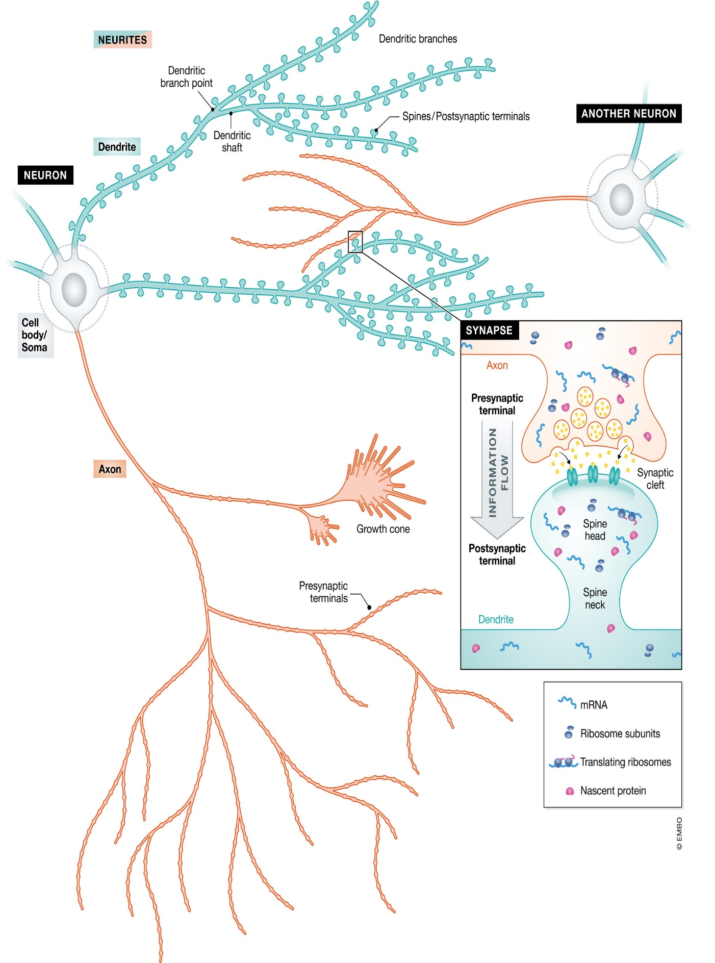
Combined effects of the EPSP and IPSP
Most neurons in the CNS receive both EPSP and IPSP input. Thus, several different types of neurotransmitters may act on the same neuron, but each binds to its own specific receptor. The overall action is the summation of the individual actions of the various neurotransmitters on the neuron. The neurotransmitters are not uniformly distributed in the CNS but are localized in specific clusters of neurons, the axons of which may synapse with specific regions of the brain. Many neuronal tracts, thus, seem to be chemically coded, and this may offer greater opportunity for selective pharmacological modulation of certain neuronal pathways.

Slide 7
Signs and Symptoms
1. Cardinal signs
a. Akinesia or hypokinesia
b. Rigidity
c. Tremor
d. Posture or gait abnormalities
2. Secondary signs
a. Cognitive dysfunction
b. Autonomic dysfunction
c. Speech disturbances
d. Micrographia
e. Masked facies
OVERVIEW OF PARKINSON’S DISEASE
Parkinsonism is a progressive neurological disorder of muscle movement, characterized by tremors, muscular rigidity, bradykinesia, and postural and gait abnormalities. Most cases involve people over the age of 65 years. The exact etiology is unknown. The disease often manifests itself between the ages of 50 and 60 years, among whom the incidence is about 1 in 100 individuals. It was first described by James Parkinson in 1817; therefore, it is named after him.
Etiology
The cause of Parkinson’s disease is unknown for most patients. The disease is correlated with destruction of dopaminergic neurons in the substantia nigra with a consequent reduction of dopamine actions in the corpus striatum, parts of the basal ganglia system that are involved in motor control.

Slide 8
1. Substantia nigra: The substantia nigra, part of the extrapyramidal system, is the source of dopaminergic neurons that terminate in the neostriatum. Each dopaminergic neuron makes thousands of synaptic contacts within the neostriatum and therefore modulates the activity of a large number of cells. These dopaminergic projections from the substantia nigra fire tonically rather than in response to specific muscular movements or sensory input. Thus, the dopaminergic system appears to serve as a tonic, sustaining influence on motor activity, rather than participating in specific movements.
2. Neostriatum: Normally, the neostriatum is connected to the substantia nigra by neurons that secrete the inhibitory transmitter GABA at their termini. In turn, cells of the substantia nigra send neurons back to the neostriatum, secreting the inhibitory transmitter dopamine at their termini. This mutual inhibitory pathway normally maintains a degree of inhibition of both areas. In Parkinson’s disease, destruction of cells in the substantia nigra results in the degeneration of the nerve terminals that secrete dopamine in the neostriatum. Thus, the normal inhibitory influence of dopamine on cholinergic neurons in the neostriatum is significantly diminished, resulting in overproduction, or a relative overactivity, of acetylcholine by the stimulatory neurons. This triggers a chain of abnormal signaling, resulting in loss of the control of muscle movements.

Slide 9
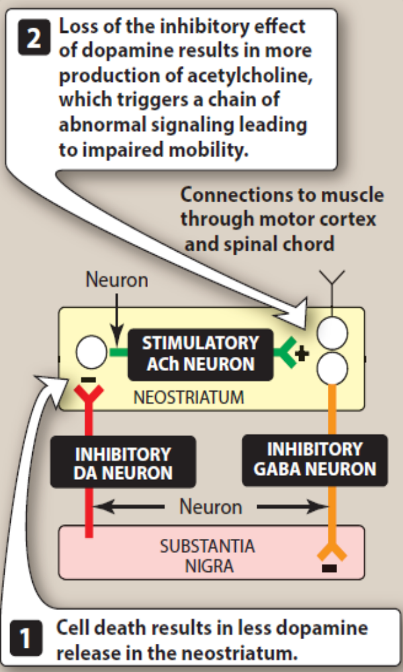
Strategy of treatment
In addition to an abundance of inhibitory dopaminergic neurons, the neostriatum is also rich in excitatory cholinergic neurons that oppose the action of dopamine. Many of the symptoms of parkinsonism reflect an imbalance between the excitatory cholinergic neurons and the greatly diminished number of inhibitory dopaminergic neurons. Therapy is aimed at restoring dopamine in the basal ganglia and antagonizing the excitatory effect of cholinergic neurons, thus reestablishing the correct dopamine/acetylcholine balance.
DRUGS USED IN PARKINSON’S DISEASE
Many currently available drugs aim to maintain CNS dopamine levels, or signaling, as constant as possible. These agents offer temporary relief from the symptoms of the disorder, but they do not arrest or reverse the neuronal degeneration caused by the disease.

Slide 10
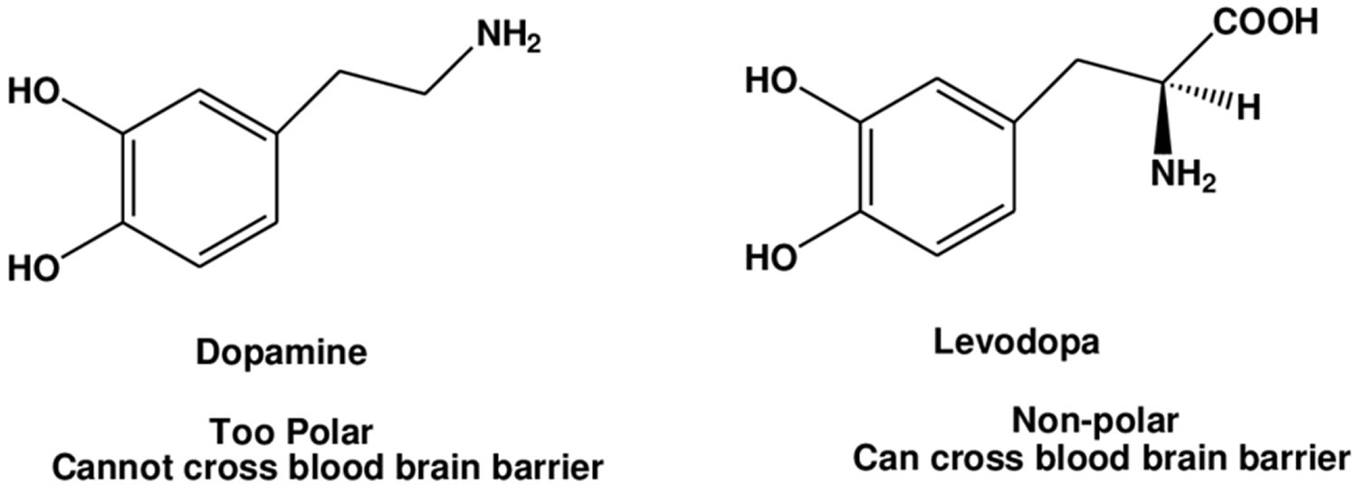
Levodopa and carbidopa
Levodopa is a metabolic precursor of dopamine. It restores dopaminergic neurotransmission in the neostriatum by enhancing the synthesis of dopamine in the surviving neurons of the substantia nigra. In early disease, the number of residual dopaminergic neurons in the substantia nigra (typically about 20% of normal) is adequate for conversion of levodopa to dopamine. Thus, in new patients, the therapeutic response to levodopa is consistent, and the patient rarely complains that the drug effects “wear off.” Unfortunately, with time, the number of neurons decreases, and fewer cells are capable of converting exogenously administered levodopa to dopamine. Consequently, motor control fluctuation develops. Relief provided by levodopa is only symptomatic, and it lasts only while the drug is present in the body.
Mechanism of action:
a. Levodopa: Dopamine does not cross the blood–brain barrier, but its immediate precursor, levodopa, is actively transported into the CNS and converted to dopamine. Levodopa must be administered with carbidopa. Without carbidopa, much of the drug is decarboxylated to dopamine in the periphery, resulting in diminished effect, nausea, vomiting, cardiac arrhythmias, and hypotension.
b. Carbidopa: Carbidopa, a dopamine decarboxylase inhibitor, diminishes the metabolism of levodopa in the periphery thereby increasing the availability of levodopa to the CNS. The addition of carbidopa lowers the dose of levodopa needed by four- to five-fold and, consequently, decreases the severity of adverse effects arising from peripherally formed dopamine

Slide 11
Therapeutic uses: Levodopa in combination with carbidopa is an efficacious drug regimen for the treatment of Parkinson’s disease. It decreases rigidity, tremors, and other symptoms of parkinsonism. In approximately two-thirds of patients with Parkinson’s disease, levodopa–carbidopa substantially reduces the severity of symptoms for the first few years of treatment. Patients typically experience a decline in response during the 3rd to 5th year of therapy. Withdrawal from the drug must be gradual.
3. Absorption and metabolism: The drug is absorbed rapidly from the small intestine (when empty of food). Levodopa has an extremely short half-life (1 to 2 hours), which causes fluctuations in plasma concentration. This may produce fluctuations in motor response, which generally correlate with the plasma concentration of levodopa, or perhaps give rise to the more troublesome “on–off” phenomenon, in which the motor fluctuations are not related to plasma levels in a simple way. Motor fluctuations may cause the patient to suddenly lose normal mobility and experience tremors, cramps, and immobility. Ingestion of meals, particularly if high in protein, interferes with the transport of levodopa into the CNS. Thus, levodopa should be taken on an empty stomach, typically 30 minutes before a meal.

Slide 12
Adverse effects:
a. Peripheral effects: Anorexia, nausea, and vomiting occur because of stimulation of the chemoreceptor trigger zone. Tachycardia and ventricular extrasystole result from dopaminergic action on the heart. Hypotension may also develop. Adrenergic action on the iris causes mydriasis. In some individuals, blood dyscrasias and a positive reaction to the Coombs test are seen. Saliva and urine may turn brownish color because of the melanin pigment produced from catecholamine oxidation.
b. CNS effects: Visual and auditory hallucinations and abnormal involuntary movements (dyskinesias) may occur. These effects are the opposite of parkinsonian symptoms and reflect overactivity of dopamine in the basal ganglia. Levodopa can also cause behavioral effects such as mood changes, depression, psychosis, and anxiety due to exacerbation of pre-existing psychotic symptoms. There are also occasional late-onset dream alterations, visual hallucinations, and drug-induced psychoses characterized by paranoia and confusional states.
Dyskinesias: Dyskinesias are the major limiting factor in therapy with levodopa and may occur in 80% of patients. They are characterized by a variety of repetitive involuntary abnormal movements affecting the face, trunk, and limbs. Dyskinesias may be relieved by decreasing the dose of levodopa, but parkinsonian symptoms may deteriorate. Akinesia paradoxia, a sudden freezing of movement, may follow an episode of dyskinesia and is often precipitated by stress.

Slide 13
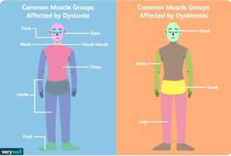
Some patients may experience an end-of-dose akinesia or “wearing-off” (worsening of symptoms) before the next dose is due. Each dose of levodopa improves mobility for a period of time and is followed by the rapid return of muscle rigidity and akinesia before the end of the dosing interval. Increase in dose and frequency of levodopa administration usually relieves these symptoms but may also induce dyskinesia. An “on-off” effect might also occur, in which rapid fluctuation between showing no beneficial effects of levodopa and showing beneficial effects with dyskinesias occurs. Clinical improvement may be seen with sustained release formulation of levodopa/ carbidopa. Hence, levodopa/carbidopa should never be stopped suddenly.

Slide 14
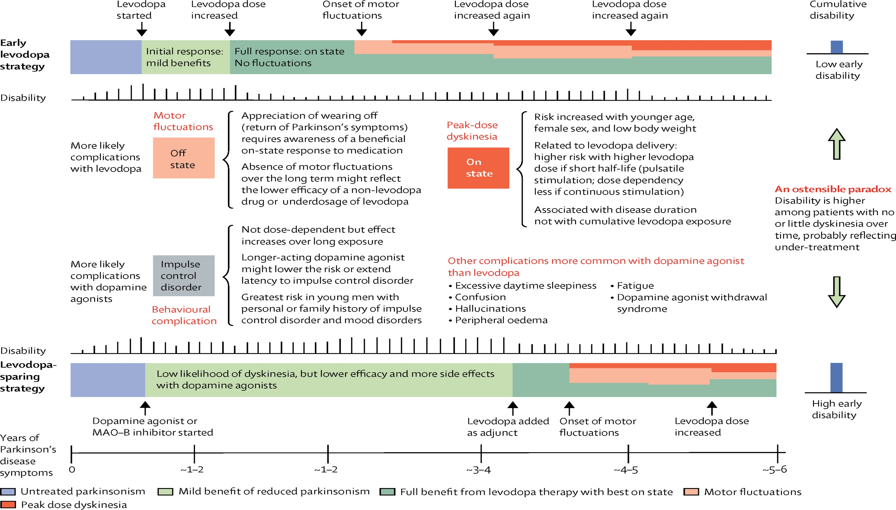

Slide 15
Interactions and contraindications:
The vitamin pyridoxine (B6) increases the peripheral breakdown of levodopa and diminishes its effectiveness. Concomitant administration of levodopa and nonselective monoamine oxidase inhibitors (MAOIs), such as phenelzine, can produce a hypertensive crisis caused by enhanced catecholamine production. Therefore, concomitant administration of these agents is contraindicated. In many psychotic patients, levodopa exacerbates symptoms, possibly through the buildup of central catecholamines. Cardiac patients should be carefully monitored for the possible development of arrhythmias. antipsychotic drugs are generally contraindicated in Parkinson’s disease, because they potently block dopamine receptors and may augment parkinsonian symptoms. However, low doses of atypical antipsychotics, such as quetiapine or clozapine, are sometimes used to treat levodopa-induced psychotic symptoms. The use of levodopa is also contraindicated in patients with narrow-angle glaucoma and peptic ulcer disease.

Slide 16
Selegiline, rasagiline, and safinamide
Selegiline, also called deprenyl, selectively inhibits monoamine oxidase (MAO) type B, the enzyme that metabolizes dopamine. It does not inhibit MAO type A (metabolizes norepinephrine and serotonin) unless given above the recommended doses, where it loses its selectivity. By decreasing the metabolism of dopamine, selegiline increases dopamine levels in the brain. When selegiline is administered with levodopa, it enhances the actions of levodopa and substantially reduces the required dose. Unlike nonselective MAOIs, selegiline at recommended doses has little potential for causing hypertensive crises. However, the drug loses selectivity at high doses, and there is a risk for severe hypertension. Otherwise these drugs are well tolerated. Selegiline is metabolized to methamphetamine and amphetamine, whose stimulating properties may produce insomnia if the drug is administered later than mid-afternoon. Rasagiline, an irreversible and selective inhibitor of brain MAO type B, has five times the potency of selegiline. Unlike selegiline, rasagiline is not metabolized to an amphetamine-like substance. Safinamide is also a selective inhibitor of MAO type B indicated for use as an adjunct to levodopa–carbidopa. These drugs should be avoided in patients taking selective serotonin re-uptake inhibitors (SSRIs), tricyclic antidepressants, and meperidine, as concomitant therapy may precipitate serotonin syndrome

Slide 17
Catechol-O-methyltransferase inhibitors
Normally, the methylation of levodopa by catechol-O-methyltransferase (COMT) to 3-O- methyldopa is a minor pathway for levodopa metabolism. However, when peripheral dopamine decarboxylase activity is inhibited by carbidopa, a significant concentration of 3-O-methyldopa is formed that competes with levodopa for active transport into the CNS. Entacapone and tolcapone selectively and reversibly inhibit COMT. Inhibition of COMT by these agents leads to decreased plasma concentrations of 3-O-methyldopa, increased central uptake of levodopa, and greater concentrations of brain dopamine. Both of these agents reduce the symptoms of “wearing-off” phenomena seen in patients on levodopa–carbidopa. The two drugs differ primarily in their pharmacokinetic and adverse effect profiles. Entacapone acts only in the periphery. It decreases the metabolism of levodopa and makes more levodopa available to the brain. Tolcapone acts in both the periphery and the brain by inhibiting the degradation of dopamine.

Slide 18
Pharmacokinetics:
oral absorption of both drugs occurs readily and is not influenced by food. They are extensively bound to plasma albumin, with a limited volume of distribution. Tolcapone has a relatively long duration of action (probably due to its affinity for the enzyme) compared to entacapone, which requires more frequent dosing. Both drugs are extensively metabolized and eliminated in feces and urine. The dosage may need to be adjusted in patients with moderate or severe cirrhosis.
Adverse effects:
Both drugs exhibit adverse effects that are observed in patients taking levodopa– carbidopa, including diarrhea, postural hypotension, nausea, anorexia, dyskinesias, hallucinations, and sleep disorders. Most seriously, fulminating hepatic necrosis is associated with tolcapone use. Therefore, it should be used, along with appropriate hepatic function monitoring, only in patients in whom other modalities have failed. Entacapone does not exhibit this toxicity and has largely replaced tolcapone in clinical practice

Slide 19
Apomorphine, pramipexole, ropinirole, and rotigotine:
These are nonergot dopamine agonists that are approved for the treatment of Parkinson’s disease. Pramipexole and ropinirole are orally active agents. Apomorphine and rotigotine are available in injectable and transdermal delivery systems, respectively. Apomorphine is used for acute management of the hypomobility “off” phenomenon in advanced Parkinson’s disease. Rotigotine is administered as a once-daily transdermal patch that provides even drug levels over 24 hours. These agents alleviate the motor deficits in patients who have never taken levodopa and also in patients with advanced Parkinson’s disease who are treated with levodopa. Dopamine agonists may delay the need to use levodopa in early Parkinson’s disease and may decrease the dose of levodopa in advanced Parkinson’s disease. Nausea, hallucinations, insomnia, dizziness, constipation, and orthostatic hypotension are adverse effects of these drugs, but dyskinesias are less frequent than with levodopa. Pramipexole is mainly excreted unchanged in the urine, and dosage adjustments are needed in renal dysfunction. The fluoroquinolone antibiotics and other inhibitors of the cytochrome P450 (CYP450) 1A2 isoenzyme (for example, fluvoxamine) may inhibit the metabolism of ropinirole, requiring an adjustment in ropinirole dosage.

Slide 20
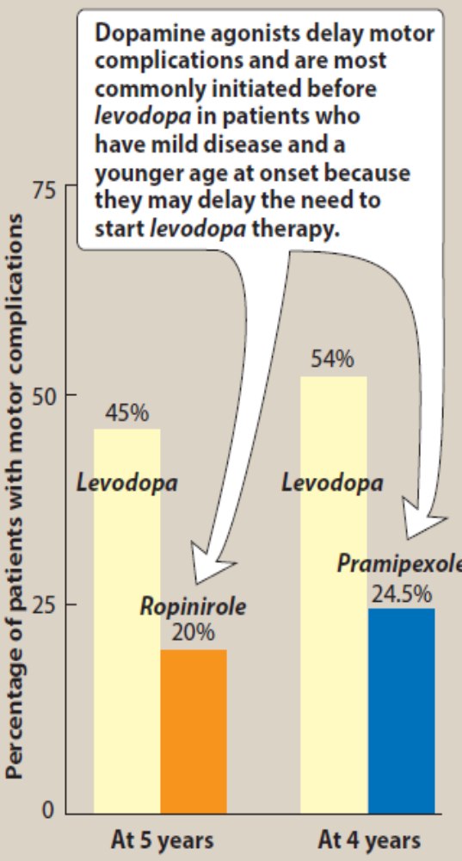
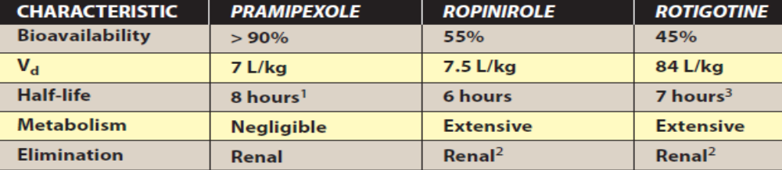
Amantadine
It was accidentally discovered that the antiviral drug amantadine has an antiparkinsonian action. Amantadine has several effects on a number of neurotransmitters implicated in parkinsonism, including increasing the release of dopamine, blocking cholinergic receptors, and inhibiting the N-methyl-d-aspartate (NMDA) type of glutamate receptors. The drug may cause restlessness, agitation, confusion, and hallucinations, and, at high doses, it may induce acute toxic psychosis. Orthostatic hypotension, urinary retention, peripheral edema, and dry mouth also may occur. Amantadine is less efficacious than levodopa, and tolerance develops more readily. However, amantadine has fewer adverse effects

Slide 21

levido reticularis amantadine side effect

Slide 22
Antimuscarinic agents
The antimuscarinic agents are much less efficacious than levodopa and play only an adjuvant role in antiparkinsonism therapy. The actions of benztropine and trihexyphenidyl are similar, although individual patients may respond more favorably to one drug or the other. Blockade of cholinergic transmission produces effects similar to augmentation of dopaminergic transmission, since it helps to correct the imbalance in the dopamine/acetylcholine activity. The antimuscarinic agents have a significant effect on tremors and rigidity but little effect on bradykinesia and postural reflexes. These drugs are often used in the tremor-predominant Parkinson’s disease. These can also be used in combination with levodopa. These agents can induce mood changes and confusion and produce xerostomia, constipation, and visual problems typical of muscarinic blockers. They interfere with gastrointestinal peristalsis and are contraindicated in patients with glaucoma, prostatic hyperplasia, or pyloric stenosis. To avoid precipitating these conditions, these agents should not be administered to patients who are taking other drugs with anticholinergic activity such as tricyclic antidepressants and antihistamines. They can also cause urinary retention in elderly males.

Slide 23
DRUGS USED IN ALZHEIMER’S DISEASE
Dementia of the Alzheimer type has three distinguishing features:
1) Accumulation of senile plaques (β-amyloid accumulations),
2) formation of numerous neurofibrillary tangles, and
3) loss of cortical neurons, particularly cholinergic neurons.
Current therapies aim to either improve cholinergic transmission within the CNS or prevent excitotoxic actions resulting from overstimulation of NMDA-glutamate receptors in selected areas of the brain. Pharmacologic intervention for Alzheimer’s disease is only palliative and provides modest short-term benefit. None of the available therapeutic agents alter the underlying neurodegenerative process.

Slide 24
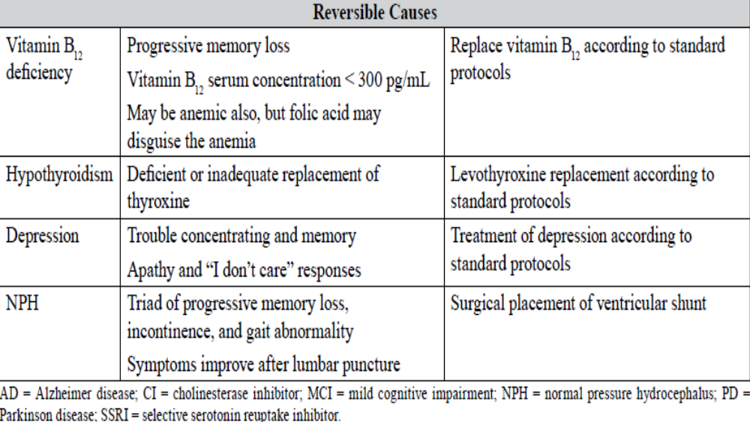

Slide 25
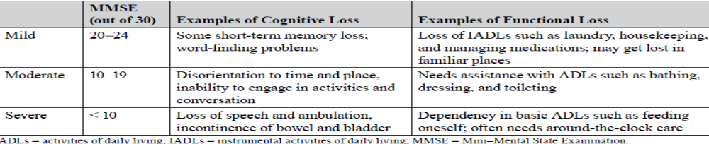
Assessment Tools
1. Folstein MMSE
a. 30-point scale; higher is better function
b. Untreated AD: Score usually decreases 3 or 4 points a year.
c. Heavily relies on verbal and language skills, so less accurate if education is poor
2. SLUMS examination
a. 30-point scale; higher number is better function
b. Includes adjustment of scores for lower educational status
3. Montreal Cognitive Assessment
a. 30-point scale; higher number is better function
b. Less reliant on verbal or language skills
4. Mini-Cog assessment
a. 5-point scale; higher number is better function
b. Easiest to administer; takes 3 minutes
New Diagnostic Guidelines
1. Recognizes three phases
a. Preclinical, asymptomatic phase
b. Symptomatic, predementia phase (MCI)
c. Dementia phase

Slide 26
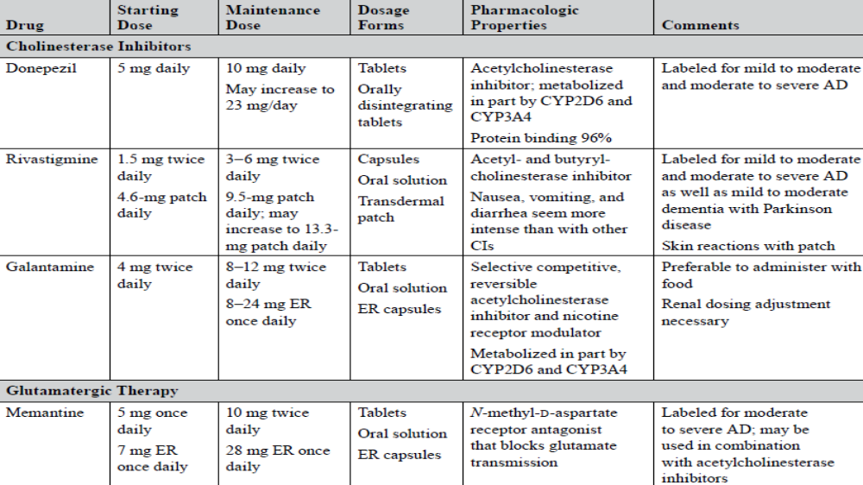

Slide 27
MULTIPLE SCLEROSIS
Definitions
1. Autoimmune disorder with areas of CNS demyelination and axonal transaction
2. Clinical course
a. Clinically isolated syndrome; first clinical presentation for which the criterion of dissemination in time has not been met to diagnose MS
b. Classified as relapsing or progressive disease; subclassified according to disease activity and progression: Relapsing-remitting: 85% of patients at diagnosis, develops into progressive disease in 50% of patients within 10 years
Treatment
1. Acute relapses are treated with corticosteroids.
a. Intravenous methylprednisolone: Usual dose is 1 g/day as one dose or as divided doses for 3–5 days.
b. Oral prednisone: Usual dose is 1250 mg/day given every other day for five doses.
c. Intravenous adrenocorticotropic hormone
d. Neurologic recovery is the same with or without an oral prednisone taper.
2. Disease-modifying therapies

Slide 28
2. Disease-modifying therapies
Interferons b(Avonex, Betaseron, Extavia, Plegridy, Rebif)
i. Mechanism of action: Suppress T-cell activity, down-regulate antigen presentation by major histocompatibility complex class II molecules, decrease adhesion molecules and matrix metalloproteinase 9, increase anti-inflammatory cytokines, and decrease inflammatory cytokines
ii. Adding polyethylene glycol to interferon-β1a decreases the frequency of injections.
iii. Injection site reactions: More common in subcutaneously administered products. May help to bring a drug to room temperature before injection, ice the injection site, and rotate injection sites
iv. Flu-like symptoms: Usually dissipate in 2–3 months. May help to inject the dose in the evening. Begin at the 0.25- to 0.5-mg dose and slowly increase, and use ibuprofen or acetaminophen.
v. Neutralizing antibodies: Develop in some patients 6–18 months after treatment begins; frequency and administration route affect neutralizing antibody development; relapse rates are higher in patients with persistently high antibody titers; antibodies may disappear even during continued treatment; show cross-reactivity with other β-interferons

Slide 29
Dimethyl fumarate
i. Mechanism of action: Antioxidant and cytoprotective; inhibits proinflammatory cytokines, increases anti-inflammatory cytokines
ii. Adverse effects
(a) Skin flushing: Occurs in up to 38% of patients, usually within 30–45 minutes of dosing; involves the face, chest, and neck; dissipates after 15–30 minutes; peaks within first month of therapy and decreases thereafter; aspirin may block flushing, taking with food helps prevent
(b) GI events: Occur in up to 41% of patients; peak within first month of therapy and decrease thereafter
(c) Lymphocytes decrease by 30% in the first year of therapy and then stabilize.
Glatiramer acetate
i. Mechanism of action: Decreases type 1 helper T cells; increases type 2 helper T cells; increases production of nerve growth factors
ii. Injection site reactions: Icing the site before and after injection may help.
iii. Systemic reactions: May involve flushing, chest tightness, palpitations, anxiety, and shortness of breath; this is noncardiac; recurrence is infrequent
Fingolimod
i. Mechanism of action: Binds to the S1P receptor 1 expressed on T cells, prevents activation of T cells
ii. Indicated for patients older than 10 years

Slide 30
iii. Contraindicated in patients with myocardial infarctions, unstable angina, stroke, TIAs, or decompensated heart failure necessitating hospitalization or class III/IV heart failure, history of Mobitz type II second- or third-degree atrioventricular block or sick sinus syndrome unless patient has a pacemaker, baseline QTc interval greater than or equal to 500 milliseconds, or treatment with class Ia or class III antiarrhythmic drugs
iv. Patients must be monitored for bradycardia for 6 hours after the first dose; if therapy is discontinued for more than 2 weeks, patients must be re-monitored.
Adverse effects
(a) Bradycardia: ECG is recommended within 6 months for patients using antiarrhythmics (including β-blockers and calcium channel blockers), those with cardiac risk factors, and those with slow or irregular heartbeat. Heart rate returns to baseline within 1 month of continued dosing.
(b) Atrioventricular conduction delays: First- and second-degree block
(c) Decrease in lymphocytes: A recent CBC should be available before therapy begins. Infections may be more common. discontinue therapy for serious infections; test patients without varicella zoster vaccine or infection history for varicella zoster virus antibodies, and immunize antibody-negative patients (wait 1 month to initiate fingolimod).
(d) Macular edema: Ophthalmologic evaluation at baseline and 3–4 months after fingolimod initiation; a history of uveitis or diabetes mellitus increases risk
(e) Respiratory effects: Decreases in forced expiratory volume over 1 second and diffusion lung capacity for carbon monoxide can occur.
(f) Elevation of liver enzymes
(g) Hypertension: Monitor during treatment.
(h) Extended effects of drug for up to 2 months after discontinuation necessitate extended monitoring for many adverse effects.

Slide 31
Monoclonal antibodies: Alemtuzumab, daclizumab, Ritoximab, natalizumab, and ocrelizumab are monoclonal antibodies indicated for the treatment of MS. Ocrelizumab is the first agent to be approved for primary progressive forms of the disease. These agents can be associated with significant toxicities, such as progressive multifocal leukoencephalopathy with natalizumab, serious infections with daclizumab and alemtuzumab, and autoimmune disorders with alemtuzumab. As such, these agents may be reserved for patients who have failed other therapies. update first line now
On January 20, 2012, an FDA-issued drug safety communication associated positive tests for John Cunningham virus (JCV) antibodies as a risk factor for progressive multifocal leukoencephalopathy. Thus, patients with all three of the following risk factors – presence of anti-JCV antibodies, longer natalizumab treatment duration (especially beyond 2 years), and previous treatment with an immunosuppressant medication (mitoxantrone, azathioprine, methotrexate, cyclophosphamide, mycophenolate mofetil) – have a 1.1% chance of developing progressive multifocal leukoencephalopathy.

Slide 32
DRUGS USED IN AMYOTROPHIC LATERAL SCLEROSIS
Amyotrophic lateral sclerosis (ALS) is characterized by progressive degeneration of motor neurons, resulting in the inability to initiate or control muscle movement. Riluzole and edaravone are indicated for the management of ALS. Riluzole, an oral NMDA receptor antagonist, is believed to act by inhibiting glutamate release and blocking sodium channels. Riluzole may improve survival time in patients suffering from ALS. Edaravone is an intravenous free radical scavenger and antioxidant that may slow the progression of ALS.

