Slide 1
Anxiolytic/Hypnotic
Drugs
DR.Samaher Jaber Younis
BCPS

Slide 2
OVERVIEW
Disorders involving anxiety are among the most common mental disorders. Anxiety is an unpleasant state of tension, apprehension, or uneasiness (a fear that arises from either a known or an unknown source). The physical symptoms of severe anxiety are similar to those of fear (such as tachycardia, sweating, trembling, and palpitations) and involve sympathetic activation. Episodes of mild anxiety are common life experiences and do not warrant treatment. However, severe, chronic, debilitating anxiety may be treated with antianxiety drugs (sometimes called anxiolytics) and/or some form of psychotherapy. Because many antianxiety drugs also cause some sedation, they may be used clinically as both anxiolytic and hypnotic (sleep-inducing) agents. Sedation is characterized by decreased anxiety, motor activity, and cognitive acuity. Hypnosis is characterized by drowsiness and an increased tendency to sleep.

Slide 3
1. Generalized anxiety disorder (GAD) is characterized by 6 months or more of excessive worry or anxiety, generally with an unidentified cause.
2. Panic disorder is characterized by discrete periods of sudden, intense fear or terror, and feelings of impending doom. Usually, the precipitating cause is unknown, but the patient can become conditioned to believe it is attributable to some environmental cause.
3. Agoraphobia: Intense fear in two or more settings (mostly in the open or in public). These settings include using public transportation, being in open spaces, being in enclosed spaces, standing in line or being in a crowd, and being outside the home alone.
4. Social anxiety disorder is characterized by marked and persistent fear and anxiety in social or performance situations that are recognized as excessive or unreasonable. These situations are either avoided or endured with intense anxiety.
5. Specific phobias are characterized by intense fear or anxiety induced by a specific object.
6. OCD, which used to be classified as an anxiety disorder, now has its own designation. OCD is characterized by obsessive or intrusive thoughts that cannot be controlled and that are repetitive. Compulsions are ritualistic behaviors (e.g., washing the hands, combing the hair, cleaning the house).
7. PTSD, which also used to be classified as an anxiety disorder, has been moved to a category titled “Trauma- and Stressor-Related Disorders.” PTSD follows a traumatic event. PTSD is characterized by increased arousal and avoidance of stimuli that approximate the original traumatic event.

Slide 4
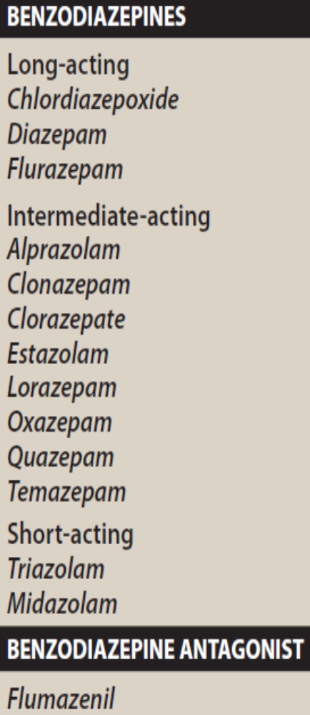
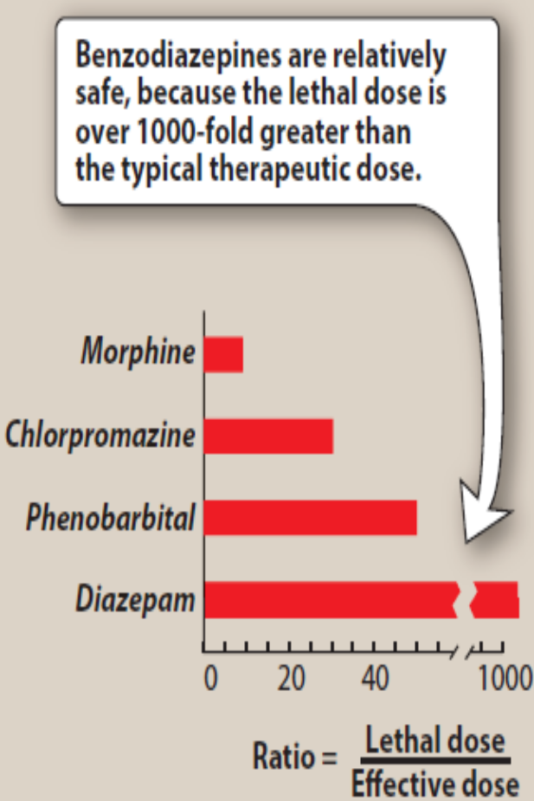
BENZODIAZEPINES
Benzodiazepines are widely used anxiolytic drugs. They have largely replaced barbiturates and meprobamate in the treatment of anxiety and insomnia, because benzodiazepines are generally considered to be safer and more effective. Though benzodiazepines are commonly used, they are not necessarily the best choice for anxiety or insomnia. Certain antidepressants with anxiolytic action, such as the selective serotonin reuptake inhibitors, are preferred in many cases, and nonbenzodiazepine hypnotics and antihistamines may be preferable for insomnia.

Slide 5
Mechanism of action
The targets for benzodiazepine actions are the γ-aminobutyric acid (GABAA) receptors. [Note: GABA is the major inhibitory neurotransmitter in the central nervous system (CNS).] The GABAA receptors are composed of a combination of five α, β, and γ subunits that span the postsynaptic membrane. For each subunit, many subtypes exist (for example, there are six subtypes of the α subunit). Binding of GABA to its receptor triggers an opening of the central ion channel, allowing chloride through the pore. The influx of chloride ions causes hyperpolarization of the neuron and decreases neurotransmission by inhibiting the formation of action potentials. Benzodiazepines modulate GABA effects by binding to a specific, high-affinity site (distinct from the GABA-binding site) located at the interface of the α subunit and the γ subunit on the GABAA receptor. Benzodiazepines increase the frequency of channel openings produced by GABA. The clinical effects of individual benzodiazepines correlate well with the binding affinity of each drug for the GABA receptor–chloride ion channel complex.

Slide 6
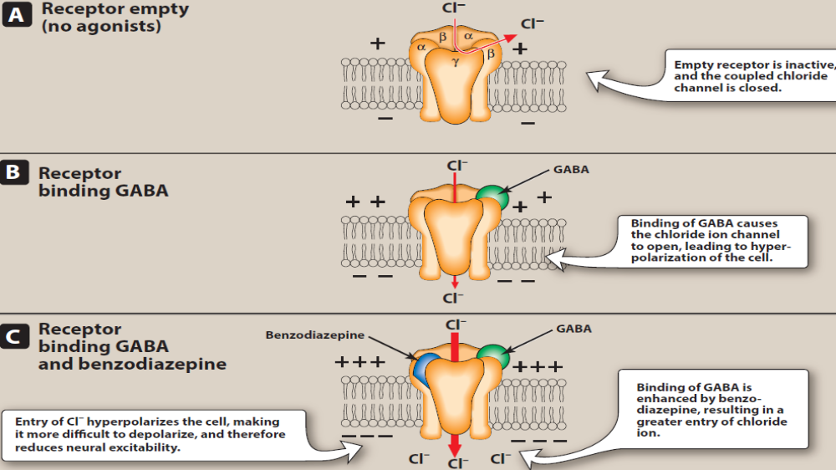

Slide 7
Actions
Most benzodiazepines exhibit qualitatively similar therapeutic actions to some extent but differ in their relative lipid solubility, biotransformation, and elimination half-life.
1. Reduction of anxiety: At low doses, the benzodiazepines are anxiolytic. They reduce anxiety by selectively enhancing GABAergic transmission in neurons having the α2 subunit in their GABAA receptors, thereby inhibiting neuronal circuits in the limbic system of the brain.
2. Sedative/hypnotic: All benzodiazepines have sedative and calming properties, and some can produce hypnosis (artificially produced sleep) at higher doses. The hypnotic effects are mediated by the α1-GABAA receptors.
3. Anterograde amnesia: Temporary impairment of memory with use of the benzodiazepines is also mediated by the α1-GABAA receptors. The ability to learn and form new memories is also impaired.
4. Anticonvulsant: This effect is partially, although not completely, mediated by α1-GABAA receptors.
5. Muscle relaxant: At high doses, the benzodiazepines relax the spasticity of skeletal muscle, probably by increasing presynaptic inhibition in the spinal cord, where the α2-GABAA receptors are largely located. [Note: Baclofen is a muscle relaxant that is believed to affect GABA receptors at the level of the spinal cord.]
6.Physical dependence: Long-acting benzodiazepines (diazepam, chlordiazepoxide) are used to reduce the withdrawal symptoms of physical dependence associated with alcohol and long-term use of short-acting benzodiazepines and barbiturates

Slide 8
Pharmacokinetics
1. Absorption and distribution: The benzodiazepines are lipophilic. They are rapidly and completely absorbed after oral administration, distribute throughout the body, and penetrate into the CNS. The onset of action of benzodiazepines is related to a relative degree of lipid solubility which can vary 50-fold or more. Highly lipid-soluble compounds (midazolam, traiazolam, diazepam) have a rapid onset of action than relatively less lipid-soluble benzodiazepines. Most benzodiazepines are available in oral dosage forms; diazepam and midazolam can be given both parenterally and by the rectal route.
2. Duration of action: The half-lives of the benzodiazepines are important clinically, because the duration of action may determine the therapeutic usefulness. The benzodiazepines can be roughly divided into short-, intermediate-, and long-acting groups. The long-acting agents form active metabolites with long half-lives. However, with some benzodiazepines, the clinical duration of action does not correlate with the actual half-life

Slide 9
(otherwise, a dose of diazepam could conceivably be given only every other day,
given its long half-life and active metabolites). This may be due to receptor dissociation rates in the CNS and subsequent redistribution to fatty tissues and other areas. Short-acting benzodiazepines are more useful as they prevent preanesthetic anxiety and insomnia, without causing hangover on awakening. Long-acting benzodiazepines are generally more useful in managing anxiety, withdrawal states, seizures, and insomnia.

Slide 10
Tolerance, abuse, and dependence
Tolerance develops to the sedative, hypnotic, and anticonvulsant actions of benzodiazepines though to a lesser extent to the anxiolytic action. Cross-tolerance also occurs with other hypnotic and sedative agents, including alcohol and barbiturates. Psychological and physical dependence can develop if high doses of benzodiazepines are given for a prolonged period. All benzodiazepines are controlled substances. Abrupt discontinuation of these agents results in withdrawal symptoms, including confusion, anxiety, agitation, restlessness, insomnia, tension, and (rarely) seizures. Benzodiazepines with a short elimination half-life, such as triazolam, induce more abrupt and severe withdrawal reactions than those seen with drugs that are slowly eliminated such as flurazepam. The withdrawal reaction can be minimized by tapering the dose gradually or by substituting the long-acting benzodiazepines, for example, diazepam and chlordiazepoxide.

Slide 11
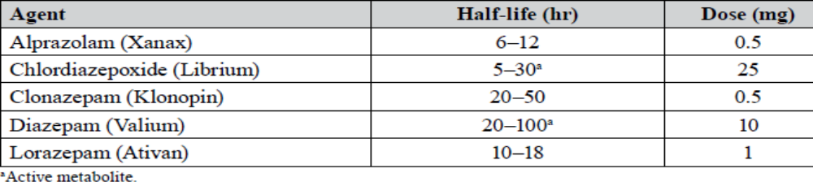
Benzodiazepines are differentiated by their half-life (plus or minus active metabolites) and potency. If they are thought of as short half-life/high-potency versus long half-life/lower-potency drugs, the following distinctions can be made:
i. Short half-life/high potency: These drugs are usually more rapid-acting agents that provide quicker symptom control. However, tolerance of the hypnotic effect develops rapidly, withdrawal problems are common, and interdose breakthrough symptoms can occur. These are often used for acute management and later replaced with longer half-life agents.
ii. Long half-life/low potency: These drugs produce longer-lasting effects throughout the day, and although withdrawal symptoms may be less pronounced, they do occur. Interdose breakthrough symptoms are less likely; however, more “hangover” symptoms occur in the morning. These agents can accumulate in older adult patients.
iii. Table compares the half-lives and potencies of the five main/most commonly prescribed benzodiazepines for anxiety disorders.

Slide 12
Adverse effects
Daytime drowsiness, sedation, and confusion are the most common adverse effects of the benzodiazepines. Ataxia occurs at high doses and precludes activities that require fine motor coordination, such as driving an automobile, or tasks that require skill, particularly in the elderly and with long-acting benzodiazepines. Cognitive impairment (decreased recall and retention of new knowledge) can occur with use of benzodiazepines, especially in the elderly. Benzodiazepines should be used cautiously in patients with liver disease. They may depress respiration at higher doses than hypnotic doses and may be exaggerated in patients with obstructive sleep apnea and chronic obstructive pulmonary disease. Alcohol and other CNS depressants enhance the sedative–hypnotic effects of the benzodiazepines.
BENZODIAZEPINE ANTAGONIST
Flumazenil is a competitive GABA receptor antagonist that rapidly reverses the effects of benzodiazepines. The drug is available for intravenous (IV) administration only. Onset is rapid, but the duration is short, with a half-life of about 1 hour. Administration of flumazenil may precipitate withdrawal in dependent patients or cause seizures if a benzodiazepine is used to control seizure activity. Seizures may also result if the patient has a mixed ingestion with tricyclic antidepressants or antipsychotics.

Slide 13
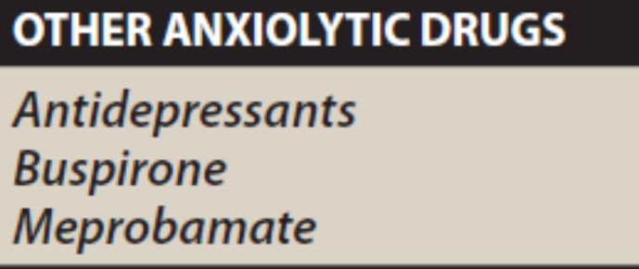
OTHER ANXIOLYTIC AGENTS
Antidepressants
Many antidepressants are effective in the treatment of chronic anxiety disorders and should be considered as first-line agents, especially in patients with concerns for addiction or dependence. Selective serotonin reuptake inhibitors (SSRIs, such as escitalopram or paroxetine) or serotonin/norepinephrine reuptake inhibitors (SNRIs, such as venlafaxine or duloxetine) may be used alone or prescribed in combination with a benzodiazepine during the first weeks of treatment. After 4 to 6 weeks, when the antidepressant begins to produce an anxiolytic effect, the benzodiazepine dose can be tapered. While only certain SSRIs or SNRIs have been approved for the treatment of anxiety disorders such as GAD, the efficacy of these drugs is most likely a class effect. Long-term use of antidepressants and benzodiazepines for anxiety disorders is often required to maintain ongoing benefit and prevent relapse.

Slide 14
Buspirone
Buspirone is a nonbenzodiazepine partial agonist at serotonin receptors. The actions of buspirone appear to be mediated by serotonin (5-HT1A) receptors, although it also displays some affinity for D2 dopamine receptors and 5-HT2A serotonin receptors. Thus, its mode of action differs from that of the benzodiazepines. Buspirone is useful for the chronic treatment of generalized anxiety disorder (GAD) and has an efficacy comparable to that of benzodiazepines as it is devoid of sedation, hypnosis, and general CNS depression or drug abuse liability of benzodiazepines. It has a slow onset of action and is not effective for short-term or “as-needed” treatment of acute anxiety. In addition, buspirone lacks the anticonvulsant and muscle-relaxant properties of the benzodiazepines. Buspirone usually requires therapy of 3 to 6 weeks to demonstrate efficacy. The frequency of adverse effects is low, with the most common effects being headache, dizziness, nervousness, nausea, and light-headedness. Sedation and psychomotor and cognitive dysfunction are minimal, and dependence is unlikely, a benefit that is particularly important in elderly patients. Buspirone does not potentiate the CNS depression of alcohol.

Slide 15
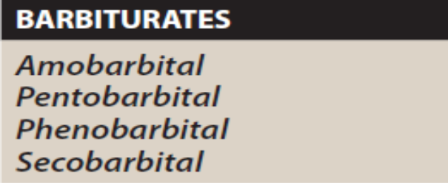
BARBITURATES
The barbiturates were formerly the mainstay of treatment to sedate
patients or to induce and maintain sleep. They have been largely replaced by the benzodiazepines, primarily because barbiturates induce tolerance and physical dependence, are lethal in overdose, and are associated with severe withdrawal symptoms. All barbiturates are controlled substances.
Mechanism of action
The sedative–hypnotic action of the barbiturates is due to their interaction with GABAA receptors, which enhances GABAergic transmission. The binding site of barbiturates on the GABA receptor is distinct from that of the benzodiazepines. Barbiturates potentiate GABA action on chloride entry into the neuron by prolonging the duration of the chloride channel openings. In addition, barbiturates can block excitatory glutamate receptors. These molecular actions lead to decreased neuronal activity.
At low doses, the barbiturates produce sedation (have a calming effect and reduce excitement). At higher doses, the drugs cause hypnosis, followed by anesthesia (loss of feeling or sensation) and, finally, coma and death. Thus, any degree of depression of the CNS is possible, depending on the dose. Barbiturates do not raise the pain threshold and have no analgesic properties. They may even exacerbate pain. Chronic use leads to tolerance.

Slide 16
Adverse effects
Barbiturates cause drowsiness, impaired concentration, and mental and psychomotor impairment. The CNS depressant effects of barbiturates synergize with those of ethanol. Hypnotic doses of barbiturates produce a drug “hangover” that may lead to impaired ability to function normally for many hours after waking. Occasionally, nausea and dizziness occur. Barbiturates induce cytochrome P450 (CYP450) microsomal enzymes in the liver. Therefore, chronic barbiturate administration diminishes the action of many drugs that are metabolized by the CYP450 system. Barbiturates are contraindicated in patients with acute intermittent porphyria. Abrupt withdrawal from barbiturates may cause tremors, anxiety, weakness, restlessness, nausea and vomiting, seizures, delirium, and cardiac arrest. Withdrawal is much more severe than that associated with opioids and can result in death. Death may also result from overdose.

Slide 17
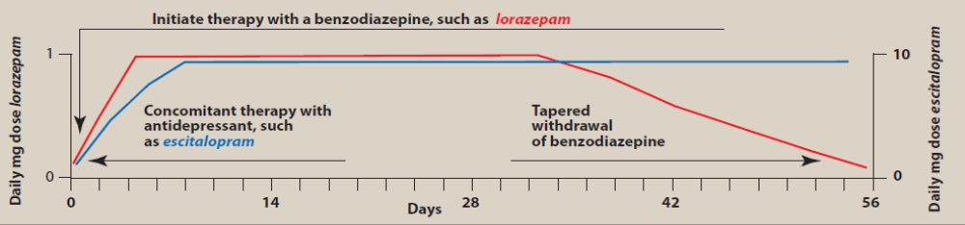
Recommended Therapy for Specific Anxiety and Related Disorders
GAD
a. Antidepressants: These are considered first-line agents. These include the SSRIs (escitalopram, paroxetine, and sertraline) and the SNRIs (duloxetine and venlafaxine).
b. Benzodiazepines: This class of drugs is rapidly effective; if possible, try to discontinue in 3–4 weeks or once the patient has remittance of symptoms. Long-term therapy is common but not recommended. Benzodiazepines can be taken in combination with either antidepressants or buspirone as a bridge until these drugs begin to take effect. Benzodiazepines are more effective against somatic symptoms than against the underlying psychic pathology. Evidence is strongest for alprazolam, diazepam, and lorazepam.

Slide 18
c. Buspirone: Good when benzodiazepines should be avoided (e.g., in patients with a history of substance use disorder); takes 2–4 weeks to be effective. Buspirone is considered a second-line agent.
d. Pregabalin: Depending on the guidelines, it is considered a first- or second-line agent (behind antidepressants). Limited data suggest comparable efficacy with venlafaxine and benzodiazepines. Pregabalin can also be used as an adjunct.
e. Not effective: β-Blockers
f. CBT or another type of psychotherapy should be included with pharmacotherapy.
g. In treatment-refractory patients, augmentation with aripiprazole, quetiapine, olanzapine, or risperidone can be tried.

Slide 19
Cognitive behavioral therapy
Some of the techniques that are most often used with CBT include the following 9 strategies:
Cognitive restructuring or reframing. ...
Guided discovery. ...
Exposure therapy. ...
Journaling and thought records. ...
Activity scheduling and behavior activation. ...
Behavioral experiments. ...
Relaxation and stress reduction techniques. ...
Role playing
Successive approximation

Slide 20
Panic disorder
a. Antidepressants: First-line therapy. These include the SSRIs (citalopram, escitalopram, fluoxetine, fluvoxamine, paroxetine [immediate and CR], sertraline) and venlafaxine XR.
b. Benzodiazepines: High-potency agents; effective; rapid onset; evidence is strongest for alprazolam, clonazepam, diazepam, and lorazepam
c. Not effective: Buspirone, β-blockers, antihistamines, trazodone. Bupropion is considered third line in some guidelines and is not recommended in others.
d. CBT and other psychotherapies are effective.
e. Patients with panic disorder tend to have a higher sensitivity to physical adverse effects. For this reason, these patients should be initiated on low doses of antidepressants – as low as 25 mg of sertraline or 10 mg of paroxetine.
OCD
a. Serotonergic agents are effective – SSRIs (escitalopram, fluoxetine, fluvoxamine, paroxetine, and sertraline). Depending on guidelines, clomipramine is considered a first- or second-line agent. Patients tend to require higher doses of antidepressants.
b. CBT may be effective, but it is secondary to pharmacotherapy.
c. Alone, SSRIs often fail to control OCD completely. Not many other drugs help. Augmentation with haloperidol or an SGA (aripiprazole, olanzapine, quetiapine, or risperidone) may help. In general, high doses need to be used.

Slide 21
PTSD
a. PTSD can be combat or non–combat related, and response to therapy may vary depending on the source of trauma.
b. Psychotherapy is considered the cornerstone of therapy. Effective methods incorporate CBT, including exposure therapy and trauma-based CBT.
c. Medications are considered adjuncts to psychotherapy. They are preferred if psychotherapists are not readily available.
d. SSRIs (fluoxetine, sertraline, and paroxetine) and venlafaxine XR are considered first-line agents.
e. Augment with other agents to treat specific symptoms (e.g., intermittent explosive behavior with β-blockers or mood stabilizers).
i. Prazosin is used for PTSD-associated nightmares, despite recent evidence that it may not reduce distressing dreams or improve sleep quality in combat-related PTSD.
ii. Anticonvulsants for aggression, anger, and depression (carbamazepine, lamotrigine, topiramate). Valproic acid is not considered effective.
iii. Atypical antipsychotics for psychotic symptoms (aripiprazole, quetiapine, risperidone). Some guidelines recommend against the use of olanzapine.
f. Benzodiazepines are sometimes used acutely for sleep disturbances, but use should be very limited. Most data analyses indicate a lack of efficacy. Benzodiazepines have dissociative and disinhibiting properties and may worsen non-hyperarousal symptoms. Benzodiazepines may also interfere with the fear-conditioning aspects of psychotherapy

Slide 22
INSOMNIA
Normal Sleep Patterns and Neurochemistry/Physiology of Sleep
People with sleep problems usually experience one or more of the following: insomnia, daytime sleepiness, or abnormal sleep behaviors.
The neural networks regulating sleep-wake cycles are located in the brain stem, basal forebrain, and hypothalamus, with projections to the cortex and thalamus.
The reticular activating system maintains wakefulness, and when activity here declines, sleep occurs.
Several neurotransmitters are involved in the sleep-wake cycle. Norepinephrine, acetylcholine, histamine, and neuropeptides operate in the hypothalamus during wakefulness. Neuronal systems in the raphe nuclei, solitary tract, ventricular thalamus, anterior hypothalamus, and basal forebrain promote sleep. As the reticular activating system slows down, serotonin neurotransmission in the raphe nuclei reduces sensory input and inhibits motor activity. Norepinephrine is involved in dreaming, whereas serotonin is active during non-dreaming sleep.

Slide 23
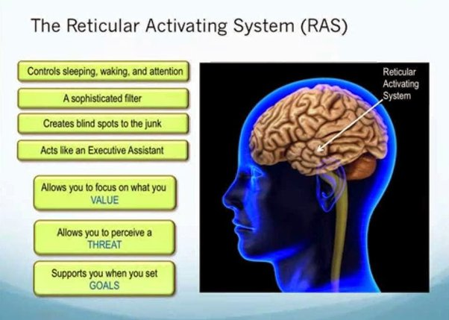

Slide 24
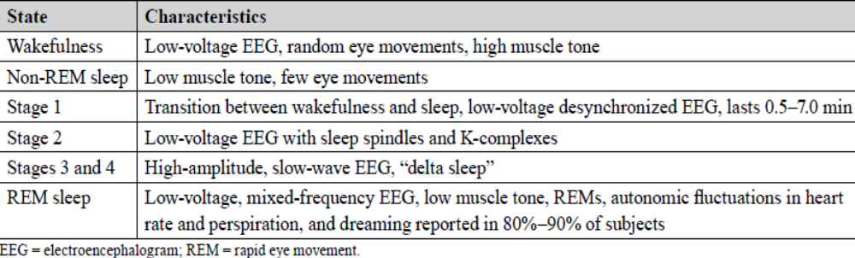
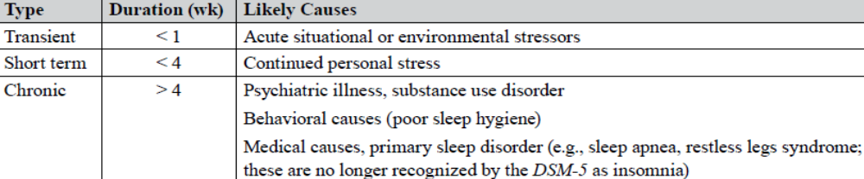
Sleep Stages
Types of Insomnia

Slide 25
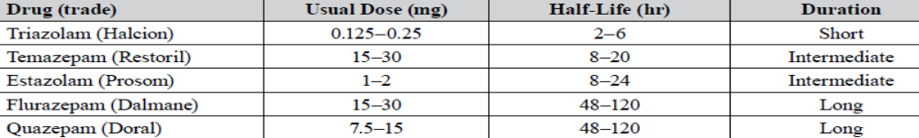
Benzodiazepine hypnotics decrease the latency to sleep onset and increase stage II of non–rapid eye movement (REM) sleep. Both REM sleep and slow-wave sleep are decreased. In the treatment of insomnia, it is important to balance the sedative effect needed at bedtime with the residual sedation (“hangover”) upon awakening. Short-acting triazolam is effective in treating individuals who have problems falling asleep. The risk of withdrawal and rebound insomnia is higher with triazolam than with other agents. Intermediate-acting temazepam is useful for patients who experience frequent awakenings and have difficulty staying asleep. Temazepam should be administered 1 to 2 hours before the desired bedtime Long-acting flurazepam is rarely used, due to its extended half-life, which may result in excessive daytime sedation and accumulation of the drug, especially in the elderly. Estazolam and quazepam are considered intermediate- and long-acting agents, respectively. In general, hypnotics should be used for only a limited time, usually 1 to 3 weeks. Nonbenzodiazepine agents are now preferred due to reduced potential for tolerance, abuse, and physical dependence
Benzodiazepines for Insomnia

Slide 26
Doxepin (Silenor) is a TCA indicated for impaired sleep maintenance. The doses used are lower than those used for depression. Chances for morning effects are high because of the long half-life of both doxepin and its active metabolite, nordoxepin.
Ramelteon (Rozerem): Melatonin agonist (no activity at the GABA or benzodiazepine receptor). Duration is 2–5 hours. To date, there is no evidence that this melatonin agonist is associated with dependence or tolerance, and it may be used long term. This drug can be used long term for chronic insomnia. Ramelteon is primarily metabolized by CYP1A2, but inducers and inhibitors of 2C9 and 3A4 can also affect it.
Suvorexant (Belsomra) is an orexin receptor antagonist. The neuropeptide orexin promotes wakefulness. By blocking the OX1R and OX2R receptors, suvorexant both decreases sleep latency and promotes sleep maintenance. Suvorexant should be taken within 30 minutes of bedtime and with at least 7 hours of sleep time. Suvorexant is metabolized by CYP3A4, and the dose must be decreased in patients taking concomitant 3A4 inhibitors. Suvorexant is contraindicated in patients with narcolepsy.
.

Slide 27
Z- HYPNOTICS
Eszopiclone: This non-benzodiazepine is a g-aminobutyric acid (GABA)A agonist whose half-life is 6 hours; thus, morning effects can result if it is taken late in the night. Eszopiclone can be used for chronic insomnia. Patients should be counseled to use caution when driving or performing activities that require alertness, particularly with the 2- to 3-mg doses. Eszopiclone should be taken immediately before bed and when the patient will be in bed for at least 7–8 hours. Eszopiclone can cause a metallic taste in the mouth.
Zaleplon: This is a non-benzodiazepine with a pharmacology similar to zolpidem and a very short half-life. For patients with sleep maintenance problems, it may not last as long. However, zaleplon has a shorter half-life (about 1 hour) and may cause fewer problems in the morning, especially if given late. Zaleplon shortens onset to sleep but does not prolong sleep time or number of awakenings. Zaleplon is indicated only for short-term treatment of insomnia. Zaleplon has been used in trials for up to 5 weeks.
Zolpidem: This non-benzodiazepine sedative-hypnotic modulates the GABAA receptor complex.
a. Compared with benzodiazepines, zolpidem lacks anticonvulsant action, muscle-relaxant properties, and respiratory depressant effect; it also has a lower risk of tolerance and withdrawal. Zolpidem should still be avoided in obstructive sleep apnea. Zolpidem is a good choice for patients in whom benzodiazepines should be avoided.
b. Zolpidem is available as an immediate-release tablet (IR), controlled-release tablet (CR), sublingual tablet, and sublingual spray. The pharmacokinetics and indications vary depending on the dosing form. The sublingual spray has a shorter onset of action, but that of the sublingual tablet is comparable with both the IR and the CR tablets.
c. Indications vary by dosage form. All are indicated to decrease sleep latency. The CR tablets are indicated to improve sleep maintenance and can be used for longer-term therapy. Intermezzo is indicated as a “as-needed [prn]” treatment for patients who have difficulty falling back to sleep as long as 4 hours or more remain.

Slide 28
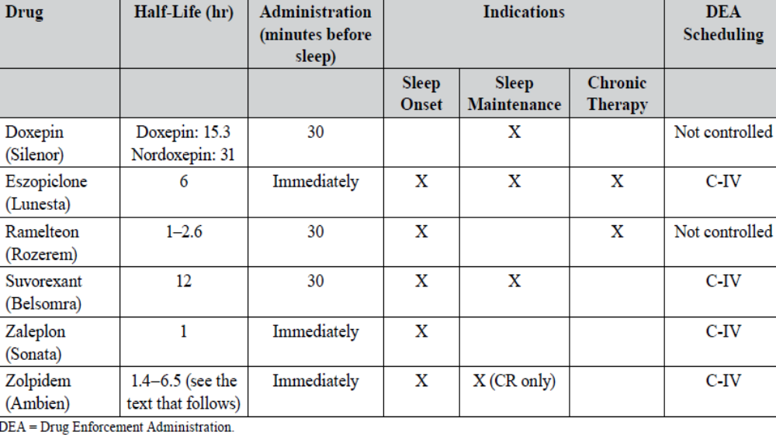

Slide 29
