Slide 1
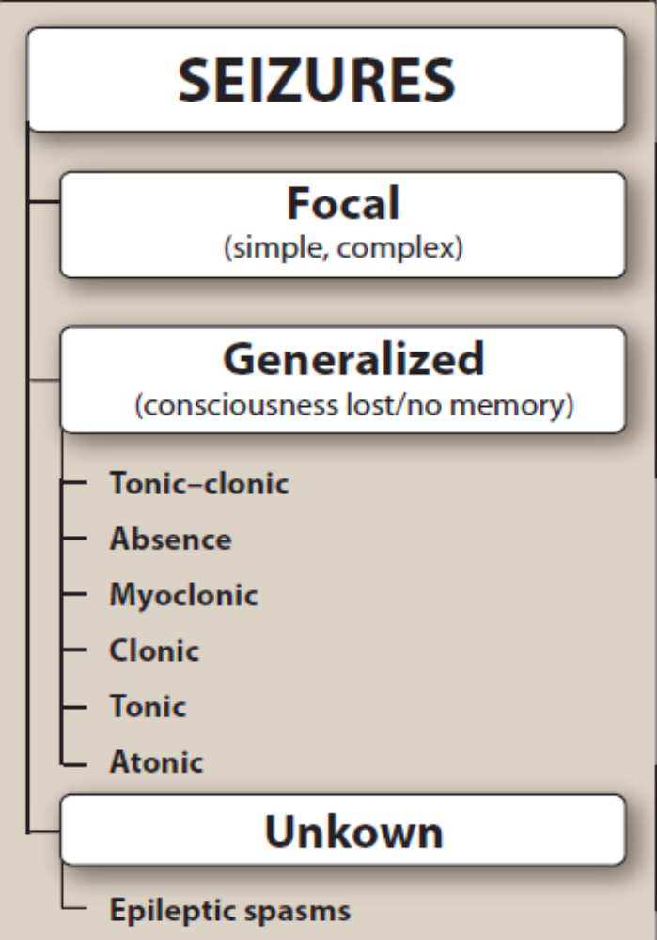
Treatment of epilepsy
Dr.Samaher Jaber Younis
BCPS

Slide 2
Epilepsy
Abnormal electrical activity in brain to abnormal motor, sensory or psychomotor experience. Unprovoked seizure repeatedly spontaneously from recurrent electrical activity in CNS which may clinically manifested as abnormal motor, sensory or psychomotor experience
Classification of Seizures:
1. Focal onset seizures start in an area or network of cells on one side of the brain.
a. Focal seizures can further be classified as with or without loss of awareness, motor or nonmotor, and focal to bilateral tonic-clonic.
b. The terms simple partial seizure, complex partial seizure, and secondarily generalized seizure
2. Generalized onset seizures engage or involve networks on both sides of the brain at the onset.
a. Nonmotor (absence): Typical nonmotor seizures are brief and abrupt, last 10–30 seconds, and occur in clusters. They usually result in a short loss of consciousness, or patients may stare, be motionless, or have a distant expression on their face. Electroencephalograms (EEGs) during seizure activity usually show 3-Hz spike-and-wave complexes. Nonmotor seizures can be further classified as typical, atypical, myoclonic absence, and eyelid myoclonia.

Slide 3
b. Motor-myoclonic: Consist of brief, rapid jerking movements of the entire body or the upper and occasionally lower extremities. Motor-myoclonic seizures can be further classified as myoclonic, myoclonic atonic, or myoclonic tonic.
c. Motor-tonic clonic: Typically, a motor tonic-clonic seizure has five phases: flexion, extension, tremor, clonic, and postictal. During the flexion phase, the patient’s mouth may be held partly open, and the patient may have upward eye movement, involvement of the extremities, and loss of consciousness. In the extension phase, the patient may be noted to extend his or her back and neck; have contraction of thoracic and abdominal muscles; be apneic; and have flexion, extension, and adduction of the extremities. The patient may cry out as air is forced from the lungs in this phase. The tremor phase occurs as the patient goes from tonic rigidity to tremors and then to a clonic state. During the clonic phase, the patient will have rhythmic jerks. The entire seizure usually lasts 1–3 minutes. After the seizure, the patient may be postictal. During this time, the patient can be difficult to arouse or very somnolent. Before the seizure, a patient may have a prodrome but not an aura.
d. Motor-clonic: Only the clonic phase of a motor tonic-clonic seizure; rhythmic, repetitive, jerking muscle movements
e. Motor-tonic: Only the flexion or extension phases of a motor tonic-clonic seizure
f. Motor-atonic: Characterized by a loss of muscle tone. Motor-atonic seizures are often described a drop attacks, in which a patient loses tone and falls to the ground.

Slide 4
Other associated symptoms
Prodrome:
Awareness of an impending seizure before it occurs. The prodrome may consist of headache, insomnia, irritability, or a feeling of impending doom.(objective)
Aura:
A focal seizure, without loss of consciousness, consisting of sensory or autonomic symptoms that may precede evolution to a bilateral, convulsive seizure. Patients may have feelings of fear, embarrassment, or déjà vu. Automatic behavior (automatism) and psychic symptoms may occur. Automatisms may include lip smacking, chewing, swallowing, abnormal tongue movements, scratching, thrashing of the arms or legs, fumbling with clothing, and snapping the fingers. Psychic symptoms include illusions, hallucinations, emotional changes, dysphasia, and cognitive problems.(subjective)

Slide 5
ETIOLOGY OF SEIZURES
Epilepsy can be due to an underlying genetic, structural, or metabolic cause or an unknown cause. In most cases, epilepsy has no identifiable cause. The neuronal discharge in epilepsy results from firing of a small population of neurons in a specific area of the brain referred to as the “primary focus.” Focal areas that are functionally abnormal may be triggered into activity by changes in physiologic factors, such as an alteration in blood gases, pH, electrolytes, and blood glucose and changes in environmental factors, such as sleep deprivation, alcohol intake, and stress. A number of causes, such as illicit drug use, tumor, head injury, hypoglycemia, meningeal infection, and the rapid withdrawal of alcohol from an alcoholic, can precipitate seizures. In cases when the cause of a seizure can be determined and corrected, medication may not be necessary. For example, a seizure that is caused by a drug reaction is not epilepsy and does not require chronic therapy. In other situations, antiseizure medications, also called antiepileptic drugs (AEDs), may be needed when the primary cause of the seizures cannot be corrected.

Slide 6
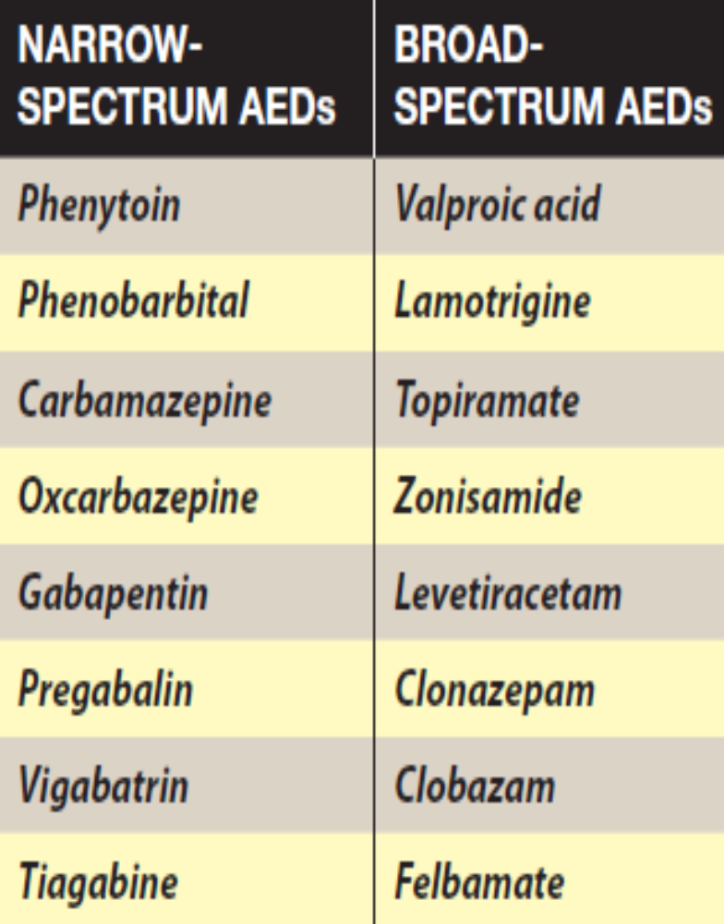
Mechanism of action of antiseizure medications
The AEDs are designed to modify these processes to favor inhibition over excitation in order to stop or prevent seizure activity. Narrow-spectrum AEDs mostly work for specific types of seizures (such as partial, focal, or absence, myoclonic seizures). Broad-spectrum AEDs additionally have some effectiveness for a wide variety of seizures (partial plus absence myoclonic seizures). Drugs reduce seizures through mechanisms such as blocking voltage-gated channels (Na+ or Ca2+), enhancing inhibitory γ-aminobutyric acid (GABA)-ergic impulses, and interfering with excitatory glutamate transmission. Some antiseizure medications appear to have multiple targets within the CNS, whereas the mechanism of action for some agents is poorly defined. Antiseizure medications suppress seizures but do not “cure” or “prevent” epilepsy.

Slide 7
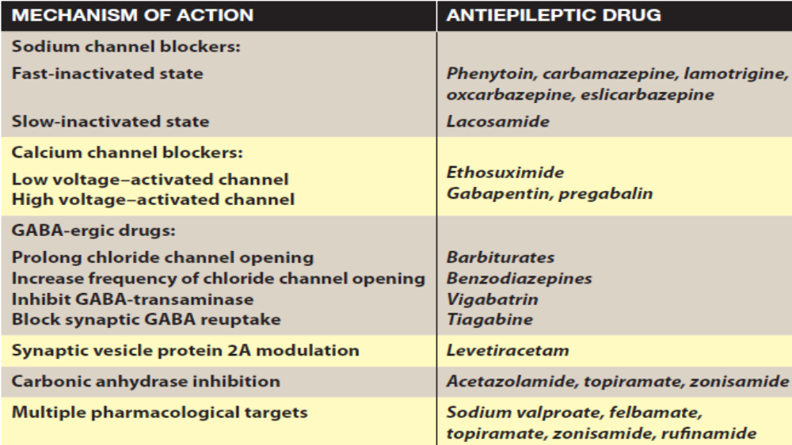
ZONISAMIDE
brivaracetam

Slide 8
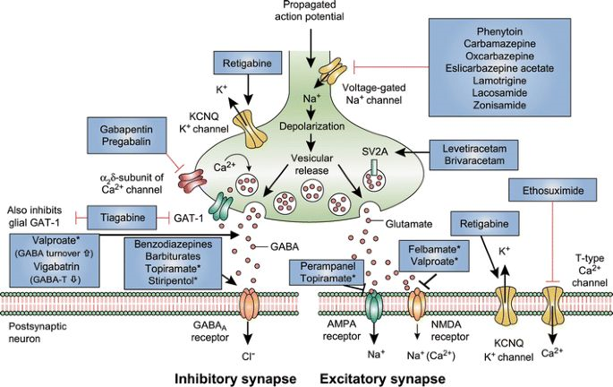
GABA-T GABA aminotransferase, GAT GABA transporter, SV2A synaptic vesicle protein 2A, GABA gamma-aminobutyric acid, NMDA N-methyl-D-aspartate, AMPA α-amino-3-hydroxy-5-methyl-4-isoxazolepropionic acid, KCNQ a family of voltage-gated potassium channels (also known as the Kv7 family)

Slide 9
DRUG SELECTION
Choice of drug treatment is based on the
Classification of the seizures,
Patient-specific variables (for example, age, comorbid medical conditions, lifestyle, and personal preference)
Characteristics of the drug (such as cost and drug interactions).
Awareness of the antiseizure medications available and their mechanisms of action, pharmacokinetics, potential for drug–drug interactions, and adverse effects is essential for successful treatment of the patient.
The toxicity of the agent and characteristics of the patient are major considerations in drug selection.
In newly diagnosed patients, monotherapy is instituted with a single agent and the dose is gradually increased until seizures are controlled or toxicity occurs.
Avoid changing AED as long as seizures are controlled.
Compared with those receiving combination therapy, patients receiving monotherapy exhibit better medication adherence and fewer side effects.
If seizures are not controlled with the first medication, monotherapy with an alternate medication or the addition of medications should be considered

Slide 10
The following prescribing guidelines are to be followed while adding or switching between antiepileptic drugs:
• If the initial drug was partially effective, it should be continued until reasonable levels of the new AED are achieved.
• Attempt tapering the first drug, if seizures are controlled.
• Switch to another AED, if the initial drug is not effective and is not tolerated well.
• Withdraw AEDs gradually that are not effective.
• Arbitrarily never prescribe a patient more than three AEDs at a time.
• Stress on the importance of regular AED usage to avoid loss of seizure control before starting therapy and assess adherence to medication regimens at every visit thereafter.
• Review diagnosis (confirm diagnosis of true seizure) and adherence to treatment in patients not responding to treatment.
The goal of therapy should be complete seizure freedom with a single, first lineAED taken once or twice a day and without significant adverse effects

Slide 11
Therapeutic drug monitoring
Therapeutic drug monitoring (TDM) of antiepileptic drugs seeks to optimize patient outcome by managing their medication regimen with the assistance of information on the concentration of AEDs in serum or plasma. Many a times, identification of the optimal dose for an individual on purely clinical grounds can be difficult; therefore, TDM is required.
Medication discontinuation
a. The following criteria can be used to determine the possibility of withdrawal from therapy:
i. Patient should be seizure free for 2–5 years on seizure medication.
ii. Patient should have a single type of focal or generalized tonic-clonic seizures.
iii. Patient should have a normal neurologic examination and normal IQ.
iv. Patient’s EEG should have become normalized with seizure medication treatment.
b. If a drug is discontinued, it is usually tapered for several months; a typical regimen would reduce the dose by one-third for 1 month, reduce it by another one-third for 1 month, and then discontinue it.

Slide 12
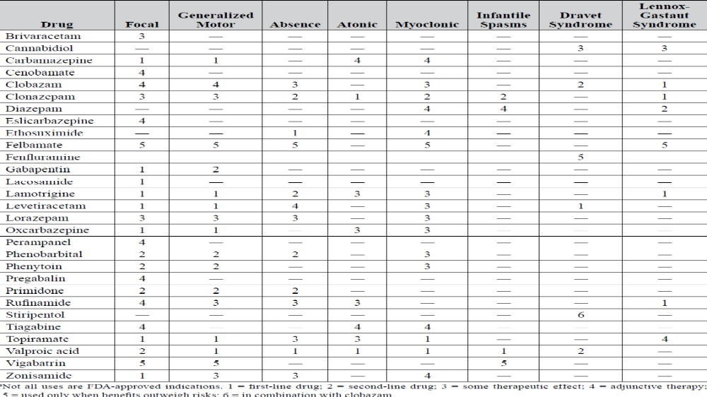

Slide 13
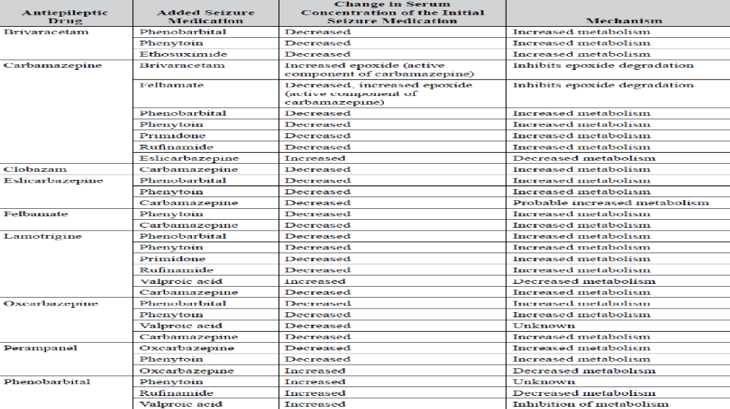

Slide 14
ANTISEIZURE MEDICATIONS
Benzodiazepines
i. Mechanism of action: Augment γ-aminobutyric acid (GABA)-mediated chloride influx
ii. Tolerance may develop: Usually used as adjunctive, short-term therapy
iii. Most commonly used drugs: Chlorazepate, clobazam, clonazepam, diazepam (Valium), midazolam and lorazepam.
iv. All benzodiazepines are controlled substances, scheduled as C-IV.
v. Nonepileptic indications: Chlorazepate (anxiety disorders, anxiety), clonazepam (panic disorder with or without agoraphobia), lorazepam (anxiety disorders, anxiety, alcohol withdrawal)
Most benzodiazepines are reserved for emergency or acute seizure treatment due to tolerance. However, clonazepam and clobazam may be prescribed as adjunctive therapy for particular types of seizures. Diazepam is also available for rectal administration to avoid or interrupt prolonged generalized tonic–clonic seizures or clusters when oral administration is not possible.
Brivaracetam
i. Mechanism of action: Unknown mechanism, but has high affinity for synaptic vesicle protein 2A
ii. Adverse effects: Somnolence, sedation, dizziness, fatigue
iii. Drug interactions: Carbamazepine, phenobarbital, phenytoin

Slide 15
Carbamazepine
i. Mechanism of action: Fast sodium channel blocker
ii. Pharmacokinetics: Enzyme inducer, autoinduction
iii. Adverse effects: Rash (occurs after a delay of 2–8 weeks), syndrome of inappropriate antidiuretic
hormone release, aplastic anemia, thrombocytopenia, anemia, leukopenia
iv. Extended-release tablets (Tegretol XR) 100, 200, and 400 mg; extended-release capsules 100, 200, and 300 mg available. Dosing is still twice daily. Do not crush or chew. Extended-release capsules (Carbatrol) can be opened and sprinkled on food. Ghost tablets can occur in the stool with the extended-release tablets (Tegretol XR).
v. Patients with the HLA-B*1502 allele are at a 10-fold elevated risk of Stevens-Johnson syndrome.
(a) Testing is recommended for Asians (including Indians).
(b) More than 15% of populations in Hong Kong, Malaysia, the Philippines, and Thailand have this allele.
vi. Patients with the HLA-A*3101 allele are also at a 12-fold elevated risk of hypersensitivity syndrome
and a 3-fold elevated risk of maculopapular exanthema.
(a) Prevalence of this allele is 2%–5% in northern European populations and 9.1% in Japanese
populations.
(b) No recommendations have been issued for testing for this allele.
vii. Nonepileptic indication: Trigeminal neuralgia

Slide 16
Oxcarbazepine
i. Mechanism of action: Fast sodium channel blocker
ii. Pharmacokinetics: Active metabolite 10-monohydroxy oxcarbazepine; enzyme inducer, no autoinduction
iii. Adverse effects: Hyponatremia more common than with carbamazepine (increased dose and increased age increase risk of hyponatremia); blood dyscrasias less common than with carbamazepine; 25%–30% of patients with hypersensitivity to carbamazepine will have hypersensitivity to oxcarbazepine; rash
Eslicarbazepine acetate
i. Mechanism of action: Fast sodium channel blocker
ii. Prodrug for eslicarbazepine, with active metabolites; R-licarbazepine 5%, oxcarbazepine 1%
iii. Adjust dose if creatinine clearance (CrCl) is less than 50 mL/minute/1.73 m2.

Slide 17
Phenytoin
i. Mechanism of action: Fast sodium channel blocker
ii. Pharmacokinetics: Enzyme inducer, nonlinear kinetics
iii. Administration considerations
(a) Intravenous formulation: Very basic product. Phlebitis and extravasation are concerns; hypotension; maximal infusion rate of 50 mg/minute. Can prepare only in normal saline Solution
(b) Oral suspension: Must be shaken well; adheres to feeding tubes and is bound by enteral nutrition products
iv. Dose-related adverse effects: Nystagmus, ataxia, drowsiness, cognitive impairment(CNS)
v. Non-dose-related adverse effects: Gingival hyperplasia, hirsutism, acne, rash, hepatotoxicity, coarsening of facial features.

Slide 18
Fosphenytoin
i. Mechanism of action: Prodrug for phenytoin; fast sodium channel blocker
ii. Uses: Parenteral formulation for loading or maintenance dosing in place of phenytoin; status epilepticus
iii. Pharmacokinetics: Enzyme inducer, nonlinear kinetics
iv. Dosing: Phenytoin equivalents (PE) are used. Loading dose: 10–20 mg of phenytoin sodium
equivalents (PE)/kg intravenous or intramuscular dosing is appropriate. Maintenance dosage:
Begin with 4–6 mg PE/kg/day in divided doses after administration of the loading dose.
v. Adverse effects: Hypotension, perianal itching, other adverse effects of phenytoin
vi. Advantages over phenytoin
(a) Intramuscular or intravenous dosing
(b) Phlebitis is minimized.
(c) Infusion can be up to 150 mg PE per minute. In status epilepticus, infusion should be
at 100–150 mg PE per minute. Maximum infusion rate is not to exceed 150 mg PE per minute.
(d) Can deliver in normal saline solution or D5W (5% dextrose [in water] injection)

Slide 19
Valproic acid, divalproex sodium, valproate
i. Mechanism of action: Blocks T-type calcium currents, blocks sodium channels, increases GABA production
ii. Pharmacokinetics: Enzyme inhibitor
ii. Adverse effects: Hepatotoxicity, nausea and vomiting, weight gain, interference with platelet aggregation, pancreatitis, alopecia, tremor, menstrual disturbance, ovarian syndrome and hyper androgenicity.
iii. Nonepileptic indications: Manic episodes associated with bipolar disorder, prophylaxis of
migraine headaches
Ethosuximide
i. Mechanism of action: T-type calcium current blocker
ii. Useful only for absence seizures

Slide 20
Cannabidiol
i. The only U.S. Food and Drug Administration (FDA)-approved cannabis product for epilepsy
ii. Approved for Dravet syndrome and Lennox-Gastaut syndrome
iii. Adverse effects: Sedation, drowsiness, diarrhea, intestinal cramping, increased liver transaminase (11% of patients); 3% of patients discontinued because of increased liver function tests
iv. Metabolized by cytochrome P450 (CYP) 2C19 and 3A4
v. Interaction with clobazam and other antiepileptic drugs (AEDs)
Felbamate
i. Mechanism of action: Blocks glycine site on N-methyl-d-aspartate receptor
ii. Serious adverse effects: Hepatotoxicity, aplastic anemia. Patient or guardian must sign consent form. Used only when seizures are severe and refractory to other medications and when the benefit clearly outweighs the potential adverse effects.

Slide 21
Gabapentin
i. Mechanism of action: Inhibition of α2δ subunit of voltage-dependent calcium channels
ii. Pharmacokinetics: Not metabolized, eliminated renally; adjustments may be necessary for renal dysfunction and hemodialysis
iii. Nonepileptic indication: Postherpetic neuralgia pain
iv. Doses often exceed product information maximum of 3600 mg/day.
v. Extended-release tablets 300 and 600 mg are available. Their indication is for postherpetic neuralgia, not epilepsy and restless leg syndrome.
Lacosamide
i. Mechanism of action: Slow sodium channel blocker
ii. Maximal dose is 300 mg/day with a CrCl of 30 mL/minute/1.73 m2 or less or with mild to moderate hepatic impairment.
iii. Adverse effects: PR interval prolongation or first-degree atrioventricular block; baseline and steady-state electrocardiogram (ECG) recommended in patients with known cardiac conduction problems, taking medications known to induce PR interval prolongation, or with severe cardiac disease
iv. Controlled substance schedule V because of euphoric effects

Slide 22
Lamotrigine
i. Mechanism of action: Decreases glutamate and aspartate release, delays repetitive firing of neurons, blocks fast sodium channels
ii. Rash is a primary concern; lamotrigine must be titrated slowly to avoid a rash.
iii. Valproic acid decreases lamotrigine metabolism (increases the serum concentration of lamotrigine); this interaction requires even slower titration and lower final doses.
iv. Estrogen-containing oral contraceptives increase lamotrigine clearance, so twice the amount of lamotrigine may be necessary.
v. Nonepileptic indications: Maintenance treatment of type I bipolar disorder
Levetiracetam (Keppra)
i. Mechanism of action: May prevent hypersynchronization of epileptiform burst firing and propagation of seizure activity
ii. Pharmacokinetics: Not metabolized extensively; adjust dose in renal dysfunction; no drug interactions with other seizure medications
iii. Parenteral use: Currently FDA indicated only for replacement of oral dosing; however, sometimes used for status epilepticus
iv. Extended-release tablets (500 mg, 750 mg) are available for once-daily dosing.

Slide 23
Perampanel
i. Mechanism of action: Noncompetitive antagonist of the inotropic α-amino-3-hydroxy- 5-methyl-4-isoxazole propionic acid (AMPA) glutamate receptor
ii. Pharmacokinetics: 95%–96% protein bound to albumin and α1-acid glycoprotein; metabolized by CYP 3A4 and 3A5; 105-hour half-life
iii. Adverse effects: Neuropsychiatric effects (irritability, aggression, anger, anxiety), dizziness, gait disturbance, weight gain
iv. Perampanel is a schedule III controlled substance.
Phenobarbital (Luminal)
i. Mechanism of action: Increases GABA-mediated chloride influx
ii. Pharmacokinetics: Enzyme inducer
iii. Adverse effects: Hyperactivity, cognitive impairment
iv. Phenobarbital is a schedule IV controlled substance.
v. Nonepileptic use: Anxiety
Primidone
i. Mechanism of action: Increases GABA-mediated chloride influx
ii. Metabolized to phenobarbital and phenylethylmalonamide
iii. Primidone, phenobarbital, and phenylethylmalonamide all have antiepileptic action.
iv. Pharmacokinetics: Enzyme inducer

Slide 24
Pregabalin (Lyrica)
i. Mechanism of action: Inhibition of α2δ subunit of voltage-dependent calcium channels
ii. Pharmacokinetics: Not metabolized, renally excreted; reduce dose in renal dysfunction
iii. Adverse effects: Drowsiness, blurred vision, weight gain, edema, angioedema, creatine kinase elevations (three reports of rhabdomyolysis), rash
iv. Schedule V controlled substance: Insomnia, nausea, headache, diarrhea reported after abrupt discontinuation
v. Nonepileptic indications: Neuropathic pain associated with diabetic neuropathy, postherpetic neuralgia, and fibromyalgia
Rufinamide
i. Mechanism of action: Fast sodium channel blocker
ii. Pharmacokinetics: Absorption increased by food (should be administered with food); metabolized by hydrolysis rather than through CYP enzymes
iii. Decreases concentrations of ethinyl estradiol and norethindrone
iv. Has an FDA indication only for Lennox-Gastaut syndrome
v. Slightly shortens the QT interval and therefore should not be used in patients with familial short QT syndrome
Stiripentol (Diacomit)
i. Indicated for Dravet syndrome in combination with clobazam
ii. Adverse effects: Somnolence, decreased appetite, agitation, ataxia, weight decrease, hypotonia,
nausea, tremor, dysarthria, insomnia

Slide 25
Tiagabine
i. Mechanism of action: Blocks GABA reuptake in the presynaptic neuron
ii. Associated with new-onset seizures and status epilepticus in patients without epilepsy
Topiramate (Topamax)
i. Mechanism of action: Fast sodium channel blocker, enhances GABA activity and antagonizes AMPA/kainate activity, weak carbonic anhydrase inhibitor
ii. Pharmacokinetics: Not extensively metabolized, eliminated in urine
iii. Adverse effects: Drowsiness, paresthesias, psychomotor slowing (titrate slowly), weight loss, renal stones, acute-angle closure glaucoma, metabolic acidosis, and hyperthermia (associated with decreased perspiration, or oligohidrosis)
iv. Nonepileptic indication: Prophylaxis of migraine headaches
Vigabatrin
i. Mechanism of action: Irreversible inhibition of GABA transaminase
ii. Pharmacokinetics: Induces CYP2C9; renal elimination
iii. Adverse effects: Fatigue, somnolence, nystagmus, tremor, blurred vision, vision impairment, weight gain, arthralgia, abnormal coordination, and confusional state
iv. Serious adverse effect: Vision loss; increased risk with higher total dose and duration; periodic vision testing necessary; restricted distribution program; only used for refractory complex partial seizures and infantile spasms

Slide 26
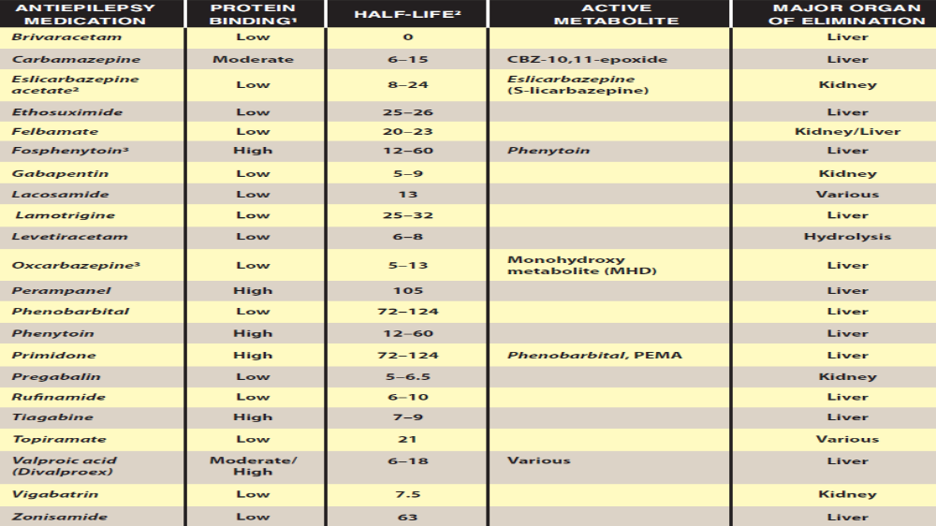

Slide 27
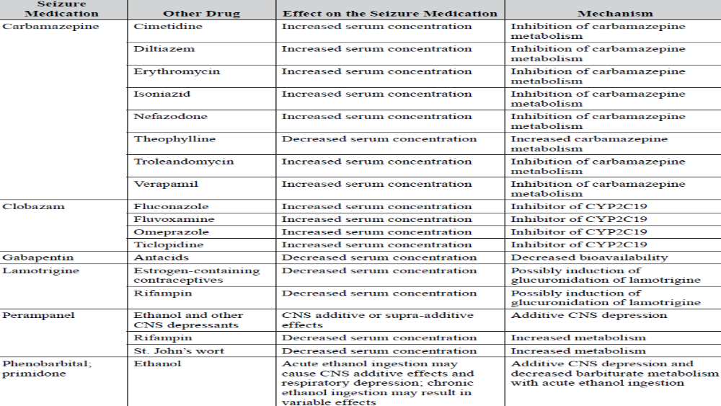

Slide 28
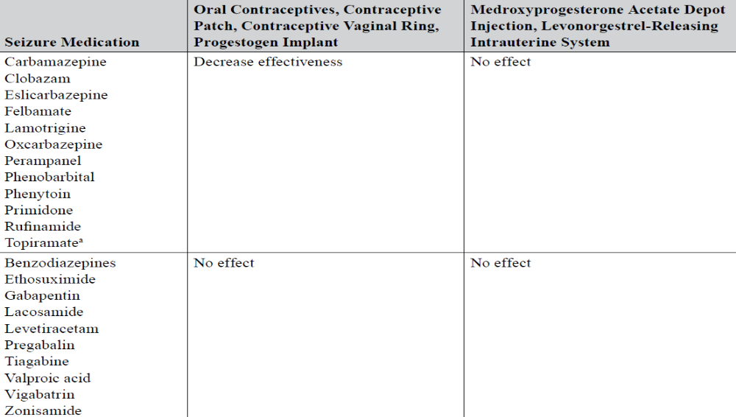

Slide 29
Status epilepticus
Treatment principles
i. Ascertain ABCs (airway, breathing, and circulation).
ii. Laboratory values (fingerstick blood glucose, CBC, basic metabolic panel, calcium, magnesium and seizure medication serum concentrations, if applicable) are sent to determine any reversible causes of status epilepticus.
iii. Give an emergency medication to stop the seizure immediately.
iv. Follow with an urgent medication to prevent the recurrence of seizures.
v. In general, all drugs for status epilepticus should be given parenterally.
vi. Neuromuscular-blocking drugs do not stop seizures; they stop only the muscular response to the brain’s electrical activity.
Emergency medications
i. Lorazepam: Drug of choice
(a) Rapid onset (2–3 minutes)
(b) Dosage 0.1 mg/kg (up to 4 mg/dose) at rate of up to 2 mg/minute; may repeat every 5–10 minutes
ii. Diazepam
(a) Rapid onset, short duration
(b) Dosage 0.15 mg/kg (up to 10 mg/dose) at rate of up to 5 mg/minute. May repeat every 5 minutes
(c) Rectal gel formulation can be given in the absence of intravenous access.
iii. Midazolam: Preferred for intramuscular administration
(a) Rapid onset, short duration
(b) Dosage 0.2 mg/kg (up to 10 mg/dose). Can be given intramuscularly, intranasally, or buccally

Slide 30
Urgent medications
i. Phenytoin: Dosage 20 mg/kg; administration rate less than 50 mg/minute
ii. Fosphenytoin: Administration rate less than 150 mg of phenytoin equivalent per minute
iii. Phenobarbital: Dosage 20 mg/kg at 50–100 mg/minute
iv. Valproic acid: Dosage 20–40 mg/kg at up to 6 mg/kg/minute; does not have FDA-labeled approval for status epilepticus
v. Levetiracetam: 20–30 mg/kg over 15 minutes; does not have FDA-labeled approval for status epilepticus
vi. Lacosamide: 200- to 400-mg bolus over 15 minutes; does not have FDA-labeled approval for status epilepticus
Refractory status epilepticus medications
I Pentobarbital: Load 5–15 mg/kg up to 50 mg/minute; follow with a 0.5- to 5-mg/kg/hour infusion.
Ii Thiopental: Load 2–7 mg/kg up to 50 mg/minute; follow with a 0.5- to 5-mg/kg/hour infusion.
iii. Midazolam: Load 0.2-mg/kg infused up to 2 mg/minute; follow with a 0.05- to 2-mg/kg/hour infusion.
iv. Propofol: Load a 1- to 2-mg/kg intravenous bolus for 30–60 seconds; follow with a 20- to 200-mcg/kg/minute infusion.

Slide 31
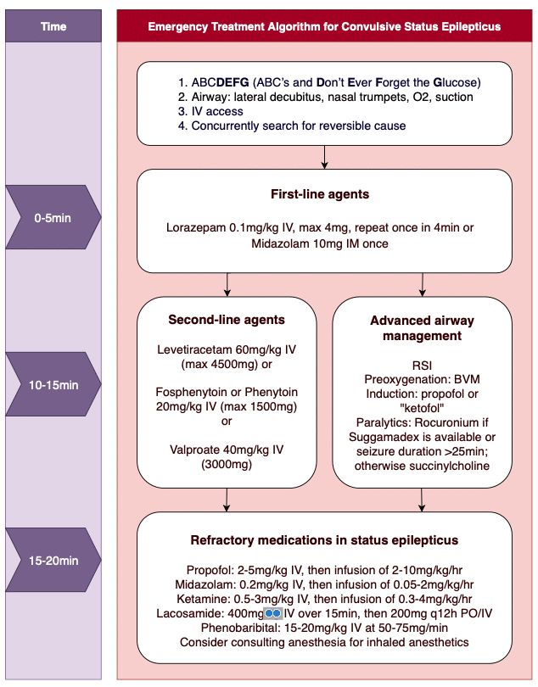

Slide 32
Women’s health
i. During their reproductive years, women with epilepsy should:
(a) Take the best drug for their seizure type. Women of childbearing age should not be given
valproic acid unless other therapies have failed.
(b) Be treated with monotherapy, if possible
(c) Discuss the possible decrease in hormonal contraceptive effectiveness if taking enzyme inducing medications
(d) Use folic acid supplementation with no less than 0.4 mg/day
ii. Three practice guidelines exist regarding epilepsy during pregnancy (relevant material
excerpted in the text that follows).
(a) Avoiding valproic acid monotherapy or polytherapy during the first trimester of pregnancy
should be considered to decrease the risk of major congenital malformations, particularly
neural tube defects, facial clefts, hypospadias, and poor cognitive outcomes. Valproic
acid use has now been associated with lower IQ scores at ages 3 and 4½

