Slide 1
Special metabolism of brain
By
Dr, Faten Allyan

Slide 2
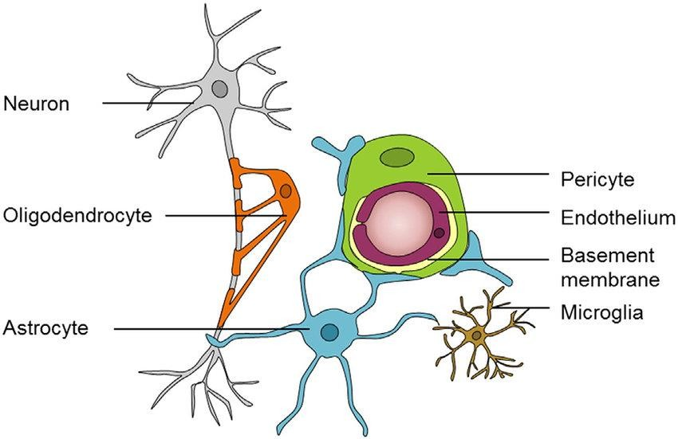
Notes:
Microglial cells specialized population of macrophages that are found in the central nervous system (CNS).

Slide 3
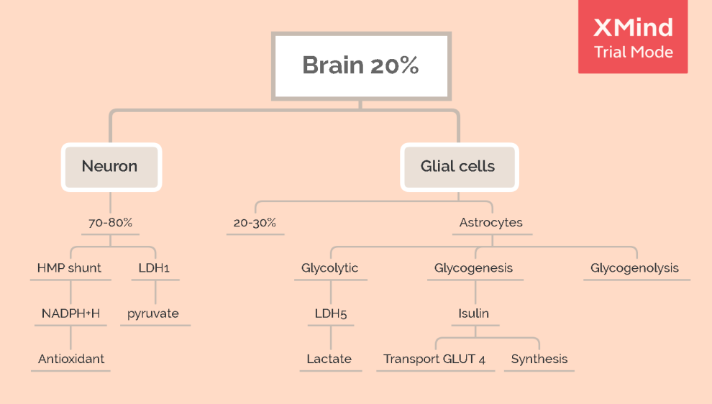

Slide 4
The brain uses 20% of the total energy used in the body at rest :
1. Neurons use 70-80 % of the total energy )used by the brain(:
  To restore neuronal membrane potentials following depolarization
  opening of ion channels in the neuronal membrane and the subsequent influx of sodium ions (Na+) or Ca++ and efflux of potassium ions (K+).
  The response of a neuron to ion channel receptor activation by either the neurotransmitter or a drug is rapid and brief
  b. Other neuronal functions such as vesicle recycling, neurotransmitter synthesis
Notes:
Depolarization: Na and Ca entry to nerve
Hyperpolarization: K out of nerve or Cl entry to nerve

Slide 5
2. The remaining is used by glial cells (astrocytes , oligodendrocytes, microglia). provide support and protection to the neurons (nerve cells), and forming myelin
Decrease glucose and oxygen metabolic rates of brain cells occur during normal aging and are further exacerbated in disorders as Alzheimer’s (AD), Parkinson’s (PD)
Notes:
Myelin is a lipid-rich material that surrounds nerve cell axons (mixture of proteins and phospholipids forming a whitish insulating sheath around many nerve fibers, increasing the speed at which impulses are conducted)

Slide 6

Energy sources of the brain:
1- Neurons in the adult brain dependent mostly on glucose as an energy source.
Glucose
lactate
2- utilization is increased during intense physical activity
Ketone
bodies
3- are utilized during brain development and in the adult during
prolonged fasting periods.

Slide 7
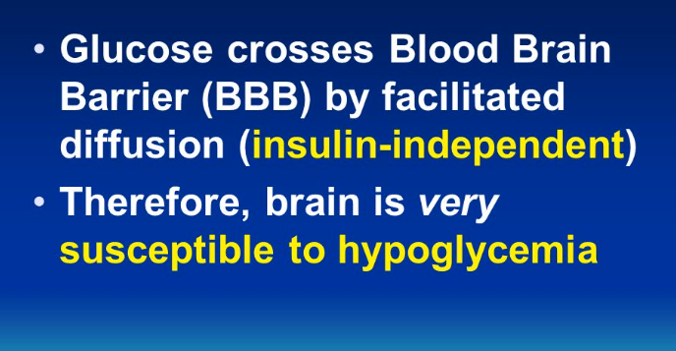
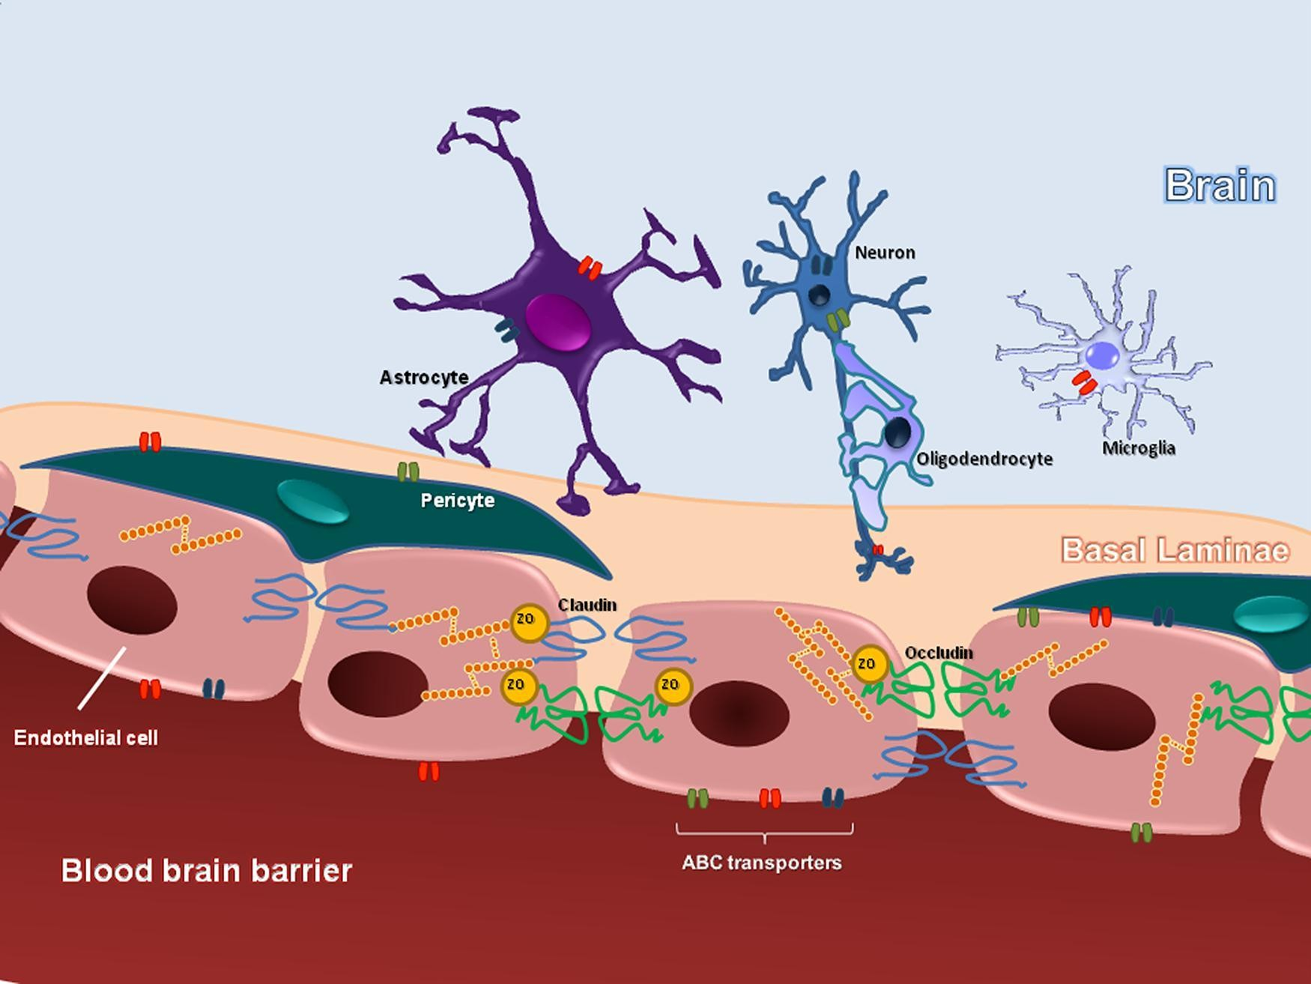
Barriers of Brain
Blood brain barrier
surrounds most of the blood vessels in the brain. It is a structure that is formed primarily due to the establishment of tight junctions between endothelial cells
highly selective semipermeable border of endothelial cells that prevents solutes in the circulating blood from non-selectively crossing into the extracellular fluid of the central nervous system where neurons reside
Notes:
glucose, ions, hormons and other special molecules to cross the blood-brain barrier. Most large molecules and proteins are precluded from entering the barrier.

Slide 8
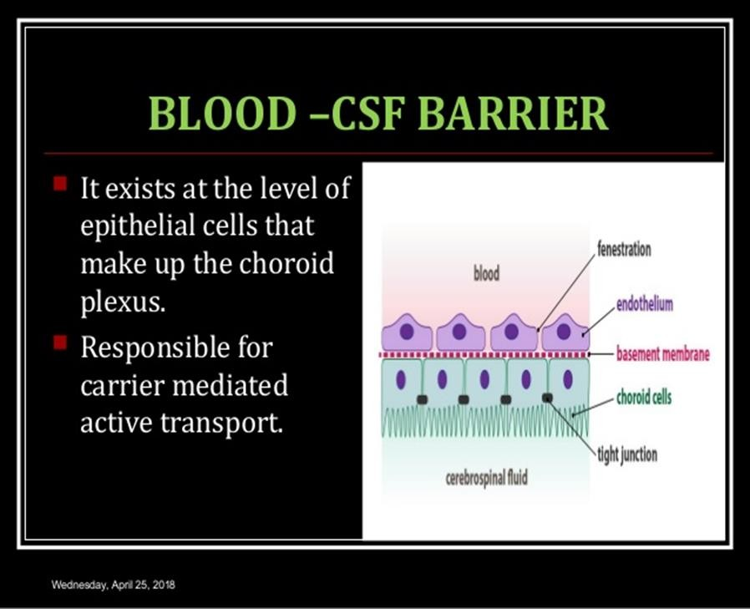
Choriod cell: complex network of capillaries and epithelial cells of the choroid plexuses secrete cerebrospinal fluid (CSF), by a process which involves the transport of Na⁺, Cl⁻ , K⁺ , Ca++, Mg+ from the blood to the of the brain.

Slide 9
Fate of Glucose:
  1- Glycolysis & lactate formation in the astrocytes.
  2- Glycolysis & Krebs' cycle in neurons.
  3- Glycogen synthesis in astrocytes.
  4- HMP shunt.

Slide 10
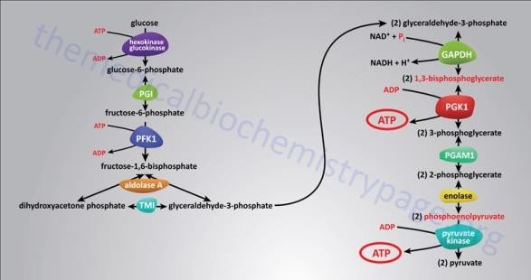
Glycolysis & lactate formation in the astrocytes:

Slide 11
Notes:
Microglial cells specialized population of macrophages that are found in the central nervous system (CNS).

Slide 12
Astrocytes display a very high glycolytic activity. Astrocytic metabolism is glycolytic.
Glucose → G-6-P by glycolysis gives pyruvate. Astrocytes contain lactate dehydrogenase-(LDH-5) which makes lactate from pyruvate.
Most astrocytic lactate is obtained from anaerobic metabolism of glucose and small amounts from G-6-P obtained from glycogenolysis.
Astrocytic lactate is used as a source of energy for neurons.

Slide 13
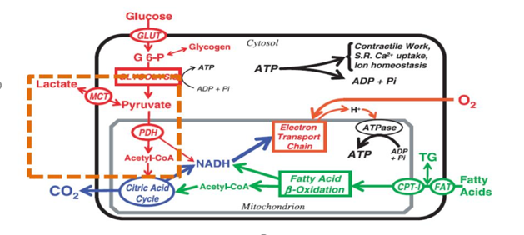

Slide 14
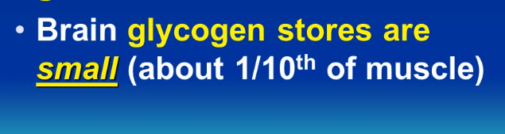
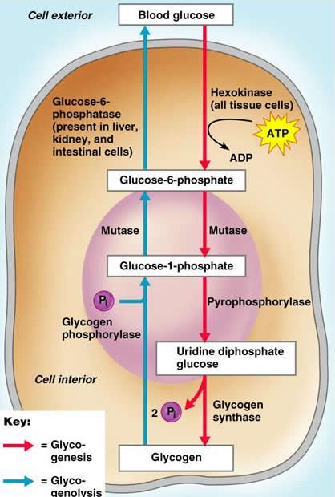
Glycogen synthesis in astrocytes:
Glycogen is a complex glucose polymer found in a variety of tissues, including brain, localized primarily in astrocytes. The small quantity found in brain compared to liver has led to the understanding that brain glycogen is merely used during hypoglycemia or ischemia.

Slide 15
Glucose enters the astrocytes via GLUT1 and. GLUT4( GLUT 4 not entering glucose in the cell with out insulin stimulator)
Glucose is phosphorylated by hexokinase (HK) to G-6-P, which is subsequently converted to G-1-P by phosphoglucomutase (PGM) and then to UDP glucose by UDP glucose pyrophosphate (UDPGPP). The UDP glucose continues on to glycogen synthesis via the actions of glycogen synthase (GYS), which is activated by dephosphorylation (GYSb → active dephosphorylated GYSa) using protein phosphatase-1 (PP-1).
Glycogenolysis: Glycogen is broken down by glycogen phosphorylase (GP) which is activated by phosphorylation (inactive GPb →active phosphorylated form GPa) using phosphorylase kinase (PK).

Slide 16
HMP shunt:
Glucose may be oxidized to lactic acid via HMP shunt, highly important not only for neurons but also for many other brain cells.
This pathway contributes to the production of NADPH and 5-carbon sugar.
NADPH an essential electron donor, and provides the reducing power for anabolic reactions and redox balance
NADPH + H+ is reducing agent important for:
a. Synthesis of lipids and nucleic acids. Therefore, HMP shunt is of great importance in a developing brain compared to a mature brain, e.g in terms of lipogenesis and myelination in the nervous system.
Notes:
Lipogenesis the processes of fatty acid synthesis and subsequent triglyceride synthesis

Slide 17
b. Metabolizing neurotransmitters In this way, NADPH also promotes regeneration of antioxidant glutathione .Therefore, high HMP shunt activity can also be found in the mature brain.
c. Ascorbic acid is taken up by neurons to protect themselves from oxidant species (ascorbic acid is oxidized in neurons). Oxidized ascorbic acid (dehydroascorbic acid) is released from neurons and taken up by astrocytes. Oxidized ascorbic acid is reduced form (ascorbate) via NADPH+H+ to ascorbic acid.
Notes:
the active form of vitamin C is ascorbate (reduced form); it is converted to dehydroascorbate (oxidized form) during enzymatic reaction or antioxidant activity, and then recycled back to ascorbate by dehydroascorbate reductas

Slide 18
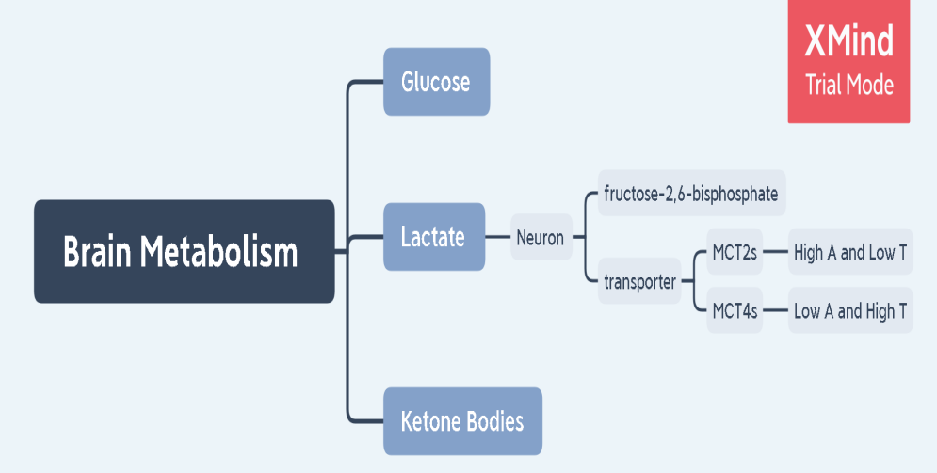

Slide 19
Lactate metabolism by the brain
Neurons exhibit a slower rate of glycolysis than astrocytes due to low production of fructose-2,6-bisphosphat, which is the strongest activator of phosphofructokinase, a key enzyme of glycolysis.
Excessive activation of glycolysis in neurons leads to oxidative stress. ( excess free radicals : not paired electron can build up in cells and have avital role but in increase cause damage to other molecules, such as DNA, lipids, and proteins) and apoptosis of neurons
Notes:
Diabetic ,cancer, heart disease

Slide 20
This suggests that neurons cannot afford to maintain a high rate of glycolysis. ↑glucose concentration
At the same time, it has been shown that starts the HMP shunt in neurons.
The balance between the glycolysis and HMP shunt must be strictly maintained in neurons to meet their energy needs, while retaining their antioxidant status.
The use of lactate as a substrate may be a source of an oxidant to produce large amounts of ATP, apart from the glycolysis, which can save neurons glucose

Slide 21
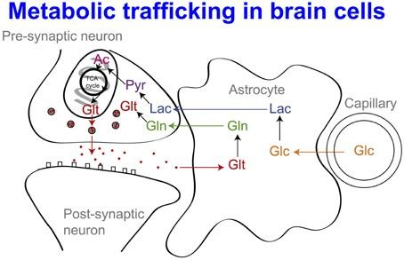
The hypothesis of astrocyte-neuron lactate shuttle:
Glucose is transported from blood to astrocytes.
After entering the astrocyte via GLUT1,4, part of the glucose is metabolized to lactate via pyruvate by the isoenzyme of lactate dehydrogenase (LDH5).
Then lactate is transported outside the astrocyte through the MCT transporter and is captured by neurons, also via the MCT.

Slide 22
Monocarboxylate transporters (MCTs):
- It transport monocarboxylic acids (monocarboxylates) as lactate.
- Different types of MCTs are found in different cells in the brain:
MCT1s: It is found in oligo-dendrocytes, have an intermediate affinity for lactate, and tend to export lactate from a cell.
MCT2s: It is found in neurons, have a high affinity for lactate, allowing neurons to bring in lactate as fuel efficiently even in substrate-poor conditions.
MCT4s : In is found in astrocytes, have a low affinity but high transport rate

Slide 23
Ketone bodies metabolism by the brain:
In the absence of glucose, the brain has alternative energy sources, including ketones derived from fatty acid metabolism taking place mainly in the liver.
These include -β-hydroxybutyrate (BHB), acetoacetate, and acetone.
Ketone bodies are metabolized to acetylCoA, then transferred to the Krebs' cycle (TCA) and oxidized in an amount sufficient to satisfy the high metabolic requirements of the brain.

Slide 24
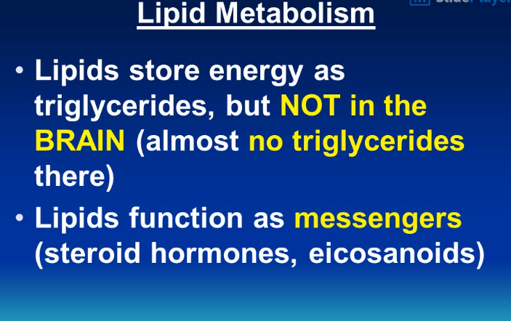
Notes:
Eicosanoids are lipid-based signaling molecules that play a unique role in innate immune responses. The multiple types of eicosanoids, such as prostaglandins (PGs) and leukotrienes (LTs), allow the innate immune cells to respond rapidly to bacterial invaders.

Slide 25
