Slide 1
Learning, understanding and speech
Abdullah Al Jamal
psychiatrist

Slide 2
Speech

Slide 3
Speech
It’s the means of communication between two individuals or group of individuals.
Speech and other intellectual functions are especially well developed in humans
Speech is controlled by three centers:
specific speech nervous control centers in the cerebral cortex
respiratory control centers of the brain
the articulation and resonance structures of the mouth and nasal cavities.

Slide 4
There are two means of communication:
Sensory Communication“Language input”
Auditory communication & Visual communication
Motor Communications “Language output” Talking & Writing

Slide 5
Steps of communication :
Collection of sensory input “Auditory and visual”
Integration “Hearing and articulation mechanism”
Motor execution

Slide 6
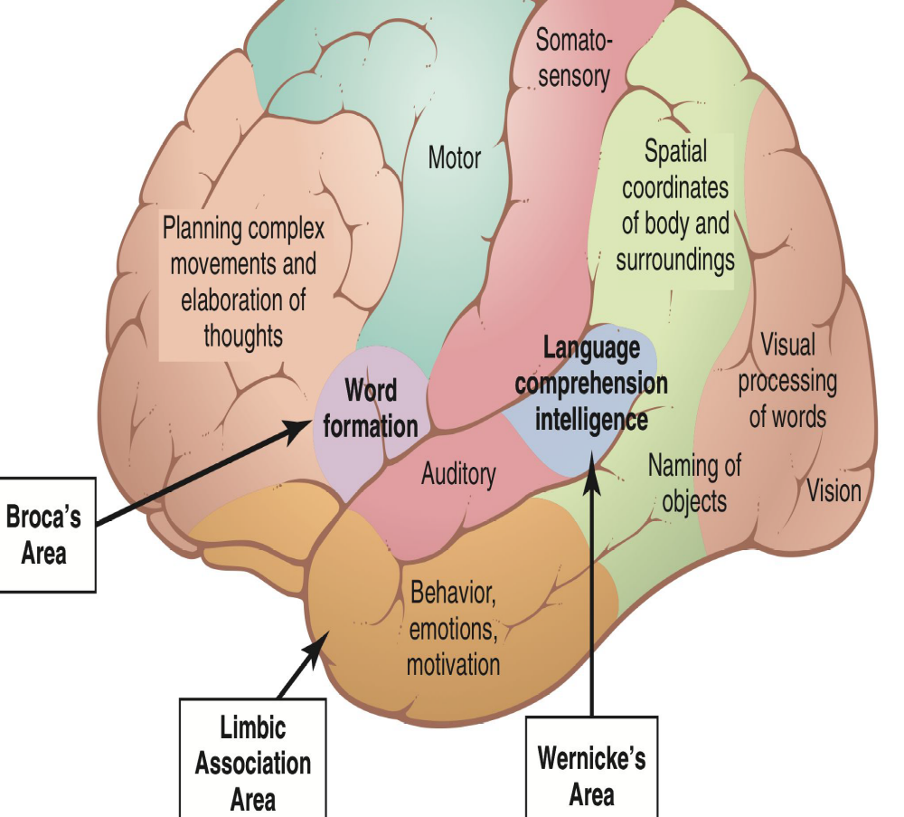
Brain Areas Concerned with Speech and Language:
Wernicke's Area
Broca's Area
Speech articulation
Area in Insula
Motor Cortex
Angular Gyrus
Auditory association
area

Slide 7
Speech structure:
Oral Cavity
Nasal Cavity
Pharynx
Larynx

Slide 8
Speech production
1) Speech Initiation
Action that initiates the flow of air which is achieved by the Lung and glottis and velum.
Initiation will Set the airstream in motion, Creating airstream is an essential process of sound production due to Change in pressure.

Slide 9
there are three mechanisms of initiation:
Pulmonic: Pulmonic airstream mechanism Lungs
95% of human speech sounds are produced in this way
Glottalic: Airstream mechanism via glottis
Velaric: Airstream mechanism via Velum

Slide 10
DIRECTION OF AIR FLOW
Egressive/pressure Sound
Exhalation: Deflation of lungs and consequent compression of the air
Ingressive/suction Sound
Inhalation: Sucking air into the lungs

Slide 11
2) Speech phonation
Action that modulates the quality of sounds which is achieved by the larynx and vocal cords.
Phonation is a process of changing air stream Sound production by passage of air over the vocal cord Produce speech sounds, air stream distorted in one way or another Phonation is mainly achieved at Larynx and Vocal cords

Slide 12
3) Speech articulation
Action that modulates or articulates which is achieved by the structures of the mouth.
A variety of speech sounds can be produced in terms of another way of air stream change Articulation
Articulation is done mainly at vocal cord.
specific part of the vocal apparatus involved in the production of a speech sound Active articulators
Lips, tongue, lower jaw, velum

Slide 13
Muscular movements of the mouth, tongue, larynx, vocal cords are responsible for the intonations, timing, and rapid changes in intensities of the sequential sounds.

Slide 14
Speech centers
1) Wernick’s Area:
Location:
at the posterior end of the superior temporal gyres.
Function:
concerned with comprehension of auditory and visual information.
Interpretations of sensory experience.
Formation of thought in response to sensory experience.

Slide 15
course:
It projects via the arcuate fasciculus to Broca’s area (area 44) in the frontal lobe immediately in front of the inferior end of the motor cortex.
Damage:
Wernicke's Aphasia: “Conduction aphasia”
Unable to interpret the thought.
Meaningless words with loss of comprehension / understanding (fluent aphasia)

Slide 16
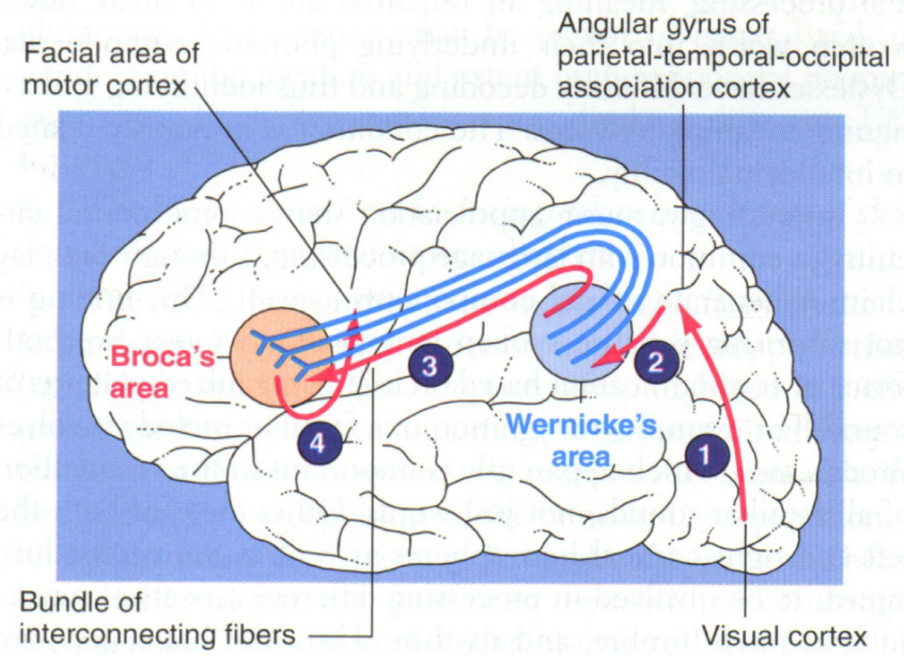

Slide 17
2) Broca's Area
Location:
in the frontal cortex at the lower end of premotor area lying immediately anterior to the primary motor cortex and immediately above the Sylvain fissure. “Motor Speech Area”
course:
Then project it to motor cortex to initiate the appropriate movement of the lips & larynx to produces speech.
Function:
Process information received from Wernicke's Area into detailed & coordinated pattern for vocalization.
provides the neural circuitry for word formation.
It is the area that plan motor patterns for expressing individual words or even short phrases.

Slide 18
course:
Projects to motor cortex to initiate the appropriate movement of the lips & larynx to produces speech.
Damage:
Motor Aphasia:
- Non-Fluent.
- Understanding normal but Voice production defective.

Slide 19
3) Angular Gyrus
Location:
is the most inferior portion of the posterior parietal lobe, lying immediately behind Wernicke's area fused posteriorly into the visual cortex
Function:
interpretation of information obtained from reading from visual cortex

Slide 20
Damage:
Anomic: the patient is unable to name objects.
dyslexia “Word blindness”
the stream of visual experiences passing into Wernicke’s area from the visual cortex is mainly blocked. the person may be able to see words and even know that they are words but not be able to interpret it

Slide 21
4) Insula
Location:
a portion of the cerebral cortex folded deep within the lateral sulcus.
Function:
Contains Speech articulation Area.
Hand and eye motor function.
initiates the appropriate movements of the lips, tongue, and larynx to produce speech.

Slide 22
Speech disorders

Slide 23
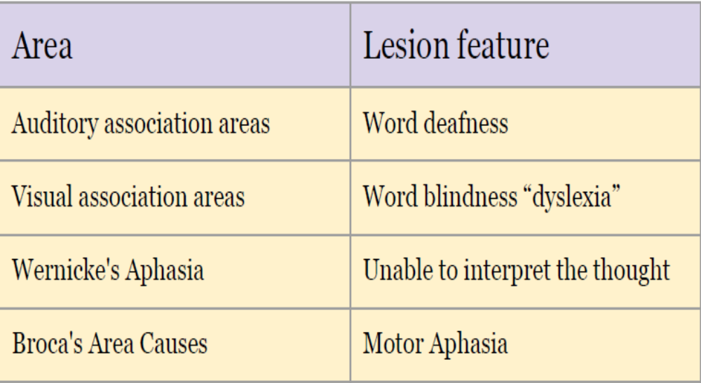
Speech disorders

Slide 24
Dysphasia:
is an acquired loss of production or comprehension of spoken and/or written language
secondary to brain damage.
Dysarthria:
Disorder in articulation. E.g, Slurred Speech
It happens In some individuals who has no abnormality in the speech center or in its pathways.
Language is intact, Paralysis, slowing or in coordination of muscles of articulation or local discomfort causes various different patterns of dysarthria.

Slide 25
“Slurred" speech
Speaking softly or barely able to whisper
Slow rate of speech
Rapid rate of speech with a "mumbling" quality
Limited tongue, lip, and jaw movement
Abnormal intonation (rhythm) when speaking
Changes in vocal quality ("nasal" speech or sounding "stuffy")
Hoarseness

Slide 26
Stuttering
Stuttering affects the fluency of speech.
Talking with involuntary repetition of sounds, especially initial consonants It begins during childhood and, in some cases, lasts throughout life.
The disorder is characterized by disruptions in the production of speech sounds, also called “disfluencies”
Have right cerebral dominance and widespread over activity in the cerebral cortex and cerebellum. This includes increased activity of the supplementary motor area.

Slide 27
Dysphonia:
Abnormal sound production due to problem in vocal cord e.g., paralysis, Stroke “CVS”, other causes
Causes:
Paralysis of both vocal cord e.g whispering sound and inspiratory stridor.
Paralysis of left vocal cord: The voice becomes weak and cough bovine. Mainly due to recurrent laryngeal palsy

Slide 28
Global Aphasia“Central Aphasia”
This means the combination of the expressive problems of Broca's aphasia and the loss of comprehension of Wernicke's.
The patient can neither speak nor understand language.
It is due to widespread damage to speech areas and is the commonest aphasia after a severe left hemisphere infarct.
Writing and reading are also affected.

Slide 29
learning

Slide 30
Learning is the acquisition of knowledge or skill that is not the result of maturation and it can take place through association, understanding or observation.
Associative learning includes classical and operant conditioning.
Cognitive learning involves understanding and uses cognitive strategies to process information.
Observational learning involves modelling.

Slide 31
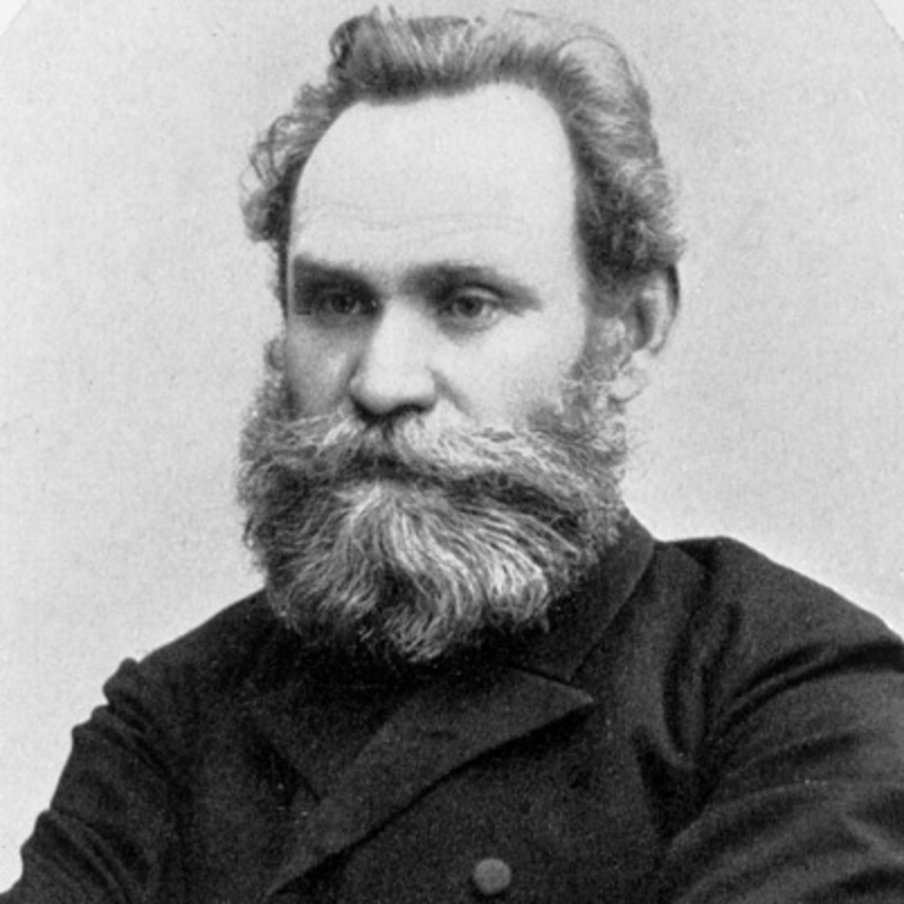
Associative learning classical conditioning
Described by Pavlov (1849–1936) in 1927, who trained dogs to salivate in response to a light or bell by associating it with food.

Slide 32
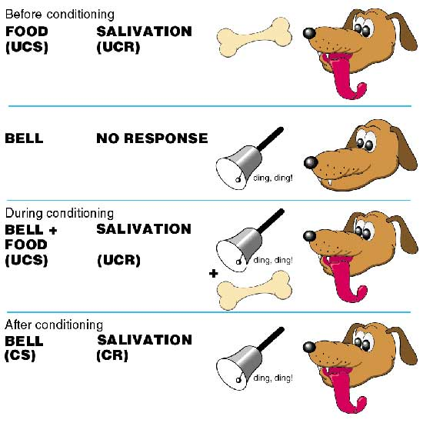

Slide 33
Classical conditioning involves repeated administration of a new stimulus (bell) together with an
unconditioned stimulus (UCS) (food).
The UCS (food) is known to elicit a specific unconditioned response (UCR) (salivation).

Slide 34
This repeated association results in the new stimulus (bell) being able to produce the same response (salivation), eventually without the UCS (food).
The new stimulus (bell) is the conditioned stimulus (CS) and the learned response
it produces (salivation) is now termed the conditioned response (CR), once the association
has been acquired.

Slide 35
The forming of an association is an automatic behavior (passive process) and does not require understanding.
The period of pairing required between an UCS and a CS for the association to be learned and the conditioned response to occur is called the acquisition stage.

Slide 36
delayed conditioning, in which the start of the CS precedes the start of UCS (optimal delay is less than 1 s) is the best method for learning.
If the CS is repeatedly presented without the UCS then the CR gradually disappears,
This is called extinction.

Slide 37
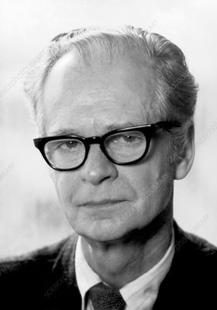
Operant conditioning (OC)
Skinner (1904–1990) proposed an associative learning theory based on
Thorndike’s (1874–1949) law of effect
This states that if a voluntary behavior (operating on trial and error) is rewarded it will be repeated, and vice versa.

Slide 38
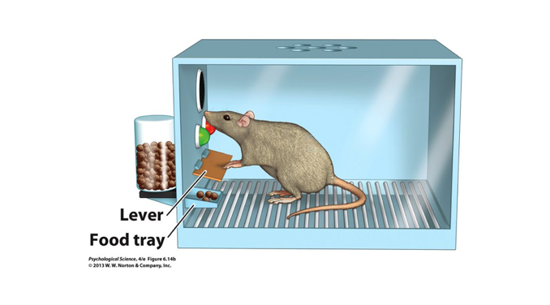
A hungry rat placed in a Skinner box (contains a lever which releases food pellets)
The rat learns to press the lever in order to receive food.

Slide 39
In this way the conditioned response (pressing the lever) is reinforced.
Operant conditioning is thus an active form of learning (the rat must act in order for conditioning to occur).

Slide 40
Primary reinforcement rewards basic drives (e.g. nourishment, sex) and is independent
of prior learning.
Secondary reinforcement rewards learned drives (e.g. money, praise) and is more
subjective.

Slide 41
Reinforcement can be positive, whereby a reward reinforces a response and increases the likelihood of its occurrence
or negative, whereby an unpleasant condition
is removed and again increases the likelihood of the response (e.g. patient-controlled
analgesia).

Slide 42
Punishment is an aversive consequence that is intended to reduce the likelihood of recurrence, and is most effective when given promptly.
The removal of a punitive measure may allow it to act as a negative re enforcer.

Slide 43
continuous reinforcement every positive response is rewarded.
The behavior is quickly acquired and the response rate is at its maximum.
partial reinforcement only a fraction of the responses are reinforced.
Behaviors learned by this method can be very resistant to extinction

Slide 44
Types of partial reinforcement
fixed interval reinforcement (reward follows a fixed amount of time) is relatively
poor at maintaining a CR and the response rate only increases at expected time of reward
fixed ratio reinforcement (reward follows fixed number of responses) is effective in
maintaining rapid response rate

Slide 45
variable interval reinforcement (reward follows a continually varying amount of time regardless of the number of responses) is effective in maintaining a CR
variable ratio reinforcement (reward follows a continually varying number of responses) produces a relatively constant rate of response.

Slide 46
Cognitive learning
This is an active form of learning that involves the creation of cognitive maps and the
development of structure and meaning.
Cognitive learning takes place either as insight learning (spontaneous cognitive remodeling that provides a sudden insight or solution to a problem)
or latent learning (learning occurs but is not immediately apparent).

Slide 47
Observational learning
This is an active form of learning that takes place through observation. there is no direct
reinforcement.
Relevant characteristics of those being observed:
• share features with observer (similarity)
• have a high status
• perceived competence
• their behavior is seen to be rewarded.

Slide 48


