Slide 1
Emotions
Done by
Abdullah Al Jamal
Psychiatrist

Slide 2
Definition
According to the American psychiatric Association (APA), emotion is defined as “a complex reaction pattern, involving experiential, behavioral and physiological elements.”
Emotions are how individuals deal with matters or situations they find personally significant.
Emotional experiences have three components: (a subjective experience, a physiological response and a behavioral or expressive response).

Slide 3
A mood is described by the APA as “any short-lived emotional state, usually of low intensity.” Moods differ from emotions because they lack stimuli and have no clear starting point.
For example, insults can trigger the emotion of anger while an angry mood may arise without apparent cause.

Slide 4
THE PROCESS OF EMOTION

Slide 5
Subjective Experiences
All emotions begin with a subjective experience, also referred to as a stimulus, but what does that mean?
While basic emotions are expressed by all individuals regardless of culture or upbringing, the experience that produces them can he highly subjective.

Slide 6
No matter how intense the experience (stimuli) is, it can provoke many emotions in a single individual and the emotions each individual feel may be different.
For example, one person may feel anger and regret at the loss of a loved one while another may experience intense sadness.

Slide 7
Physiological Responses
We all know how it feels to have our heart beat fast with fear. This physiological response is the result of the autonomic nervous system’s reaction to the emotion we’re experiencing.
The autonomic nervous system controls our involuntary bodily responses and regulates our fight-or-flight response.

Slide 8
Behavioral Responses
The behavioral response aspect of the emotional response is the actual expression of the emotion.
Behavioral responses can include a smile, a grimace, a laugh or a sigh, along with many other reactions depending on societal norms and personality.
For example, how love is expressed is different both from person to person and across cultures.

Slide 9
The physiological and behavioral responses associated with emotions illustrate that emotion is much more than a mental state.
Emotion affects our whole demeanor and our health.
Furthermore, our ability to understand others’ behavioral responses plays a huge role in our emotional intelligence.

Slide 10
Brain mechanisms of emotional recognition and experience

Slide 11
Brain systems important in emotion
Many interrelated brain structures are involved in the recognition and experience of various emotions, often loosely defined as the limbic system

Slide 12
Several subcortical structures are important in emotion.
Damage to the amygdala impairs recognition and expression of fear, anger, and happiness.
Damage to the basal ganglia impairs recognition and expression of disgust.

Slide 13
Several areas of the cortex also are important in emotion, including the prefrontal cortex, posterior cortex, and insula

Slide 14
Lateralized function of cerebral hemispheres
Right hemisphere
High activity is associated with depression and flexion (avoidant) emotions
More active than left hemisphere during displays of many emotions.
Damage often leaves individuals emotionally indifferent and unable to read many emotions.

Slide 15
Left hemisphere
More active than right during smiling, positive emotions, and extension (approach) motions.
Relatively low activity in the left frontal lobe is associated with depression

Slide 16
Neuroendocrine arousal mechanisms
The hypothalamic-pituitary-adrenal system controls stress hormones that facilitate short-term coping with emotional events.
Hypothalamus: Brain region that regulates hormonal functions via the pituitary gland.
Pituitary gland: “Master gland” that receives messages from hypothalamus and relays signals to endocrine glands to regulate hormones.
Adrenal glands: Located atop the kidneys; top part (adrenal cortex) responds to signals from pituitary by releasing stress hormones such as cortisol into the blood.

Slide 17
The Autonomic Nervous System
The sympathetic nervous system releases norepinephrine onto peripheral targets (i.e., organs, glands, or muscles) to prepare the body for vigorous activity (e.g., increased respiration, sweating, and heartbeat).
The parasympathetic nervous system releases acetylcholine onto peripheral targets (i.e., organs, glands, or muscles) to relax the body after the activity is over (e.g., slows heartbeat).

Slide 18
Emotional expressions

Slide 19
Basic emotions are associated with recognizable facial expressions and tend to happen automatically.
Basic emotions are likely to have played a role in our survival throughout human evolution, signaling to those around us to react accordingly.

Slide 20
Emotional psychologist Paul Ekman identified six basic emotions that could be interpreted through facial expressions.
They included (happiness, sadness, fear, anger, surprise and disgust).

Slide 21
psychologist Robert Plutchik identified eight basic emotions which he grouped into pairs of opposites, including (joy and sadness, anger and fear, trust and disgust, and surprise and anticipation).
This classification is known as a wheel of emotions and can be compared to a color wheel in that certain emotions mixed together can create new complex emotions.

Slide 22
The degree of emotion is variable (represented by the arrows), and combining any two adjacent primary emotions gives rise to a secondary emotion (e.g. surprise + sadness = disappointment).

Slide 23
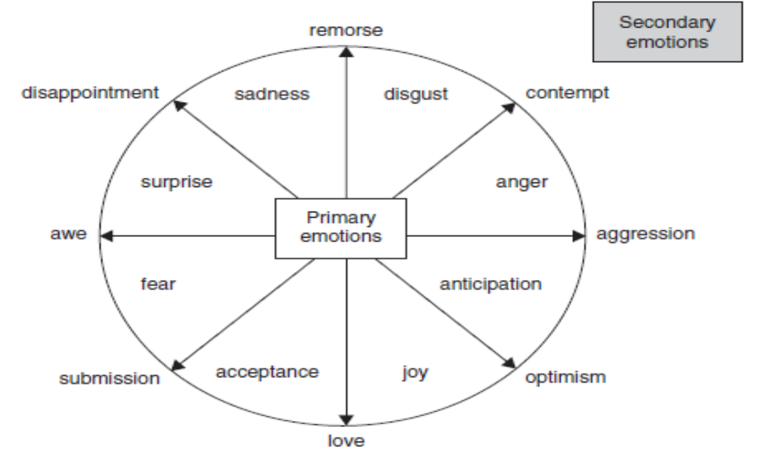

Slide 24
Complex emotions have differing appearances and may not be as easily recognizable, such as grief, jealousy or regret.
Complex emotions are defined as “any emotion that is an aggregate of two or more others.”
The APA uses the example of hate being a fusion of fear, anger and disgust.

Slide 25
Theories of emotions

Slide 26
JAMES–LANGE THEORY (1922)
Perception of an emotion-arousing stimulus causes physiological changes which are then mentally interpreted and experienced as the relevant emotion.
The emotion is therefore secondary to physiological response.

Slide 27
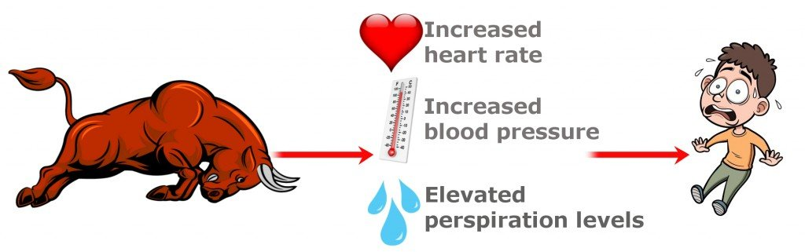

Slide 28
SCHACTER’S COGNITIVE LABELLING THEORY
Schacter also believed emotions were secondary to physical arousal, but that their nature was determined by cognitive appraisal.
In other words, physiology merely generates the ‘energy’ of emotion, which must then be directed (or labelled) by thought.
Studies have shown that similar circumstances and physiological reactions can be variously emotive according to the cognitive appraisal of the situation

Slide 29
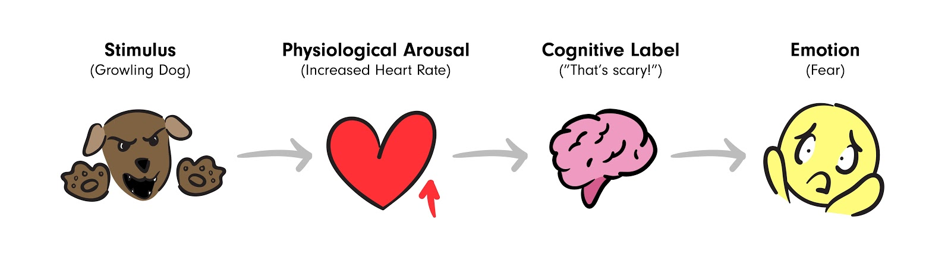

Slide 30
CANNON–BARD (THALAMIC) THEORY
Perception of an emotion-arousing stimulus leads to the concurrent experience of emotion and physiological response.
Thalamus controls processing of sensory information and stimulates both the cortex (to produce the appropriate feeling) and the viscera (via hypothalamus, to produce the relevant physical reaction).

Slide 31
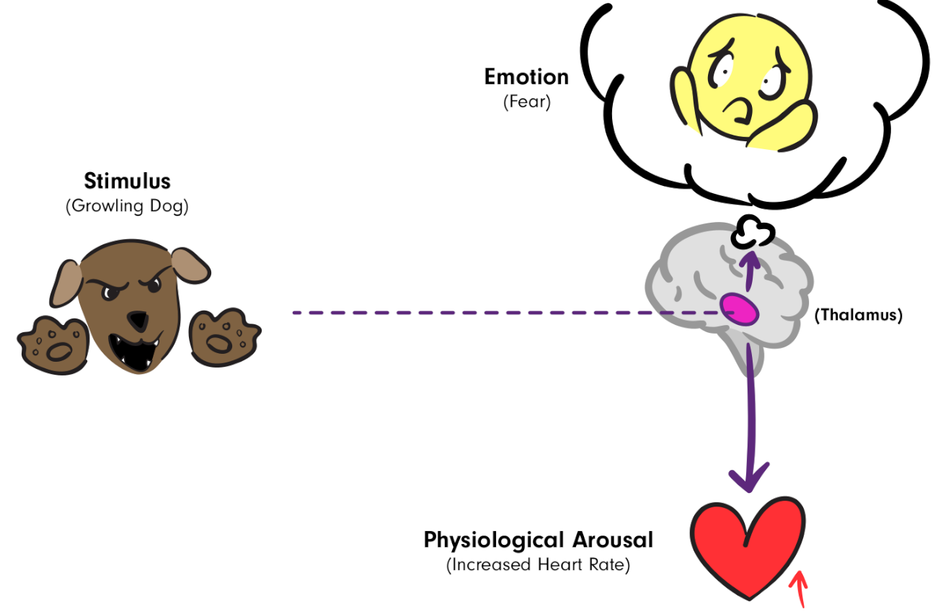

Slide 32


