Slide 1
Motivation

Slide 2
Defining Motivation
Motivation is the process by which activities are started, directed, and continued so that physical or psychological needs or wants are met (Petri, 1996).
The word itself comes from the Latin word movere, which means “to move.”
Motivation is what “moves” people to do the things

Slide 3
Defining Motivation - Examples
For example, when a person is relaxing in front of the television and begins to feel hungry, the physical need for food might cause the person to get up, go into the kitchen, and search for something to eat.
Hunger is here an example.

Slide 4
Defining Motivation - Types
There are different types of motivation.
Sometimes people are driven to do something because of an external reward.
A person performs an action because it leads to an outcome that is separate from the person.
Examples would be:
giving a child a toy for every A received in school,
offering a bonus to an employee for increased performance.
This is called “Extrinsic Motivation”.

Slide 5
Defining Motivation - Types
In contrast, another type of motivation in which a person performs an action because the act itself is fun, rewarding, challenging, or satisfying in some internal manner.
(Moral, non – materialistic gain)
This is called “Intrinsic Motivation”.

Slide 6
Early Approaches to understand Motivation
Instincts Approach:
Early attempts to study motivation shed the light on instincts.
Instinct: is the biologically determined and innate patterns of behavior that exist in both people and animals.
Just as animals are governed by their instincts to perform activities such as migrating, nest building, mating, and protecting their territory.
Theorists proposed that human beings may also be governed by similar instincts.

Slide 7
Instincts Theory to Understand Motivation
For instance, according to these theorists, the human instinct to reproduce is responsible for sexual behavior, and
the human instinct for territorial protection may be related to aggressive behavior.

Slide 8
Theories of motivation

Slide 9
Drive Reduction Theory - Motivation
This approach of understanding motivation includes the concepts of needs and drives.
Need: is a requirement of some material (such as food or water) that is essential for the survival of the organism.
When an organism has a need, it leads to a psychological tension as well as a physical arousal that motivates the organism to act in order to fulfill the need and reduce the tension. This tension is called a Drive (Hull, 1943).

Slide 10
Drive Reduction Theory - Motivation
According to Clark Hull, Drive Reduction Theory suggests that motivation is based on desire to reduce tension within the body that is caused by biological needs as indicated by homeostasis.
Drive-reduction theory: an approach to motivation that assumes behavior arises from physiological needs that cause internal drives to push the organism to satisfy the need and reduce tension and arousal.

Slide 11
Drive Reduction Theory - Motivation
Drive-reduction theory proposes just this connection between internal physiological states and outward behavior.
In this theory, there are two kinds of drives.
Primary drives are those that involve survival needs of the body such as hunger and thirst.
Secondary drives are those that are learned through experience or through conditioning, such as the need for money or social approval.

Slide 12
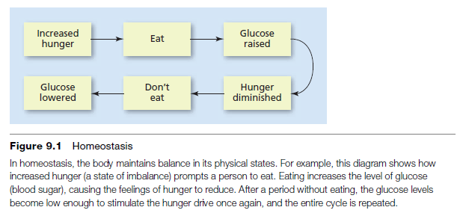
Drive Reduction Theory - Motivation
This theory also includes the concept of homeostasis, which is the tendency of the body to maintain a steady physiological state.

Slide 13
Drive Reduction Theory - Pitfalls
Although drive-reduction theory works well to explain the actions people take to reduce tension created by needs, it does not explain all human motivation.
Why can people eat when they are not really hungry?
People don’t always seek to reduce their inner arousal either—sometimes they seek to increase it.
Why would people do such things if they don’t reduce some need or restore homeostasis?

Slide 14
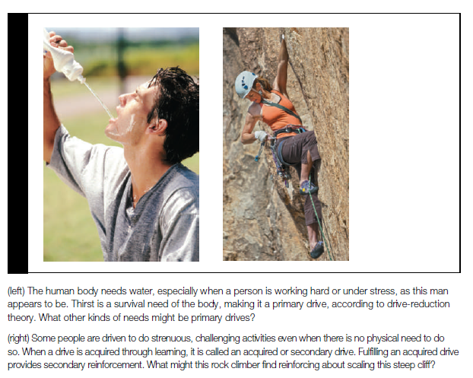
Drive Reduction Theory - Pitfalls

Slide 15
Mcclelland’s Theory: Affiliation, Power, and Achievement Needs
According to McClelland, human beings have a psychological need for friendly social interactions and relationships with others, called the need for affiliation (nAff).
A second psychological need proposed by McClelland is the need for power (nPow).
Power is not about reaching a goal but about having control over other people. People high in this need would want to have influence over others and make an impact on them.
The need for achievement (nAch) involves a strong desire to succeed in attaining goals, not only realistic ones but also challenging ones.

Slide 16
Mcclelland’s Theory: Affiliation, Power, and Achievement Needs
need for affiliation (nAff):
the need for friendly social interactions and relationships with others.
need for power (nPow): the need to have control or influence over others.
need for achievement (nAch): a need that involves a strong desire, to succeed in attaining goals, not only realistic ones but also challenging ones.

Slide 17
Optimum Arousal Theory- Motivation
An explanation for human motivation involves the recognition of yet another type of need, the need for stimulation.
A stimulus motive is one that appears to be unlearned, but causes an increase in stimulation.
Examples would be curiosity, playing, and exploration.
Eating food even when we are not hungry just because it tastes so good—an example of learned behavior.

Slide 18
Optimum Arousal Theory - Motivation
Arousal theory: theory of motivation in which people are said to have an optimal (best or ideal) level of tension that they seek to maintain by increasing or decreasing stimulation.
In arousal theory, people are said to have an optimal level of tension.
Task performances, for example, one may suffer if the level of arousal is too high (such as severe test anxiety) or even if the level of arousal is too low (such as boredom).
For many kinds of tasks, a moderate level of arousal seems to be best.

Slide 19
Incentive Approach - Motivation
Incentives are things that attract or lure people into action.
In incentive approaches, behavior is explained in terms of the external stimulus and its rewarding properties.
Incentive approaches: theories of motivation in which behavior is explained as a response to the external stimulus and its rewarding properties.
Example: ponus for attending the lectures.
Altruism: self-defense mechanism, people do favors to others because it makes them feel good.

Slide 20
Maslow’s hierarchy of needs Theory – Humanistic Approach for Motivation
Maslow proposed that there are several levels of needs that a person must strive to meet before achieving the highest level of personality fulfillment.
According to Maslow, self-actualization is the point that is last reached—at which people have satisfied the lower needs and achieved their full human potential.

Slide 21
Maslow’s hierarchy of needs Theory – Humanistic Approach for Motivation
For a person to achieve self-actualization, which is one of the highest levels of growth needs, the primary fundamental needs must first be fulfilled.
The typical way to represent Maslow’s series of needs as a pyramid with the most basic needs for survival at the bottom and the highest needs at the top.
This type of ranking is called a hierarchy.

Slide 22
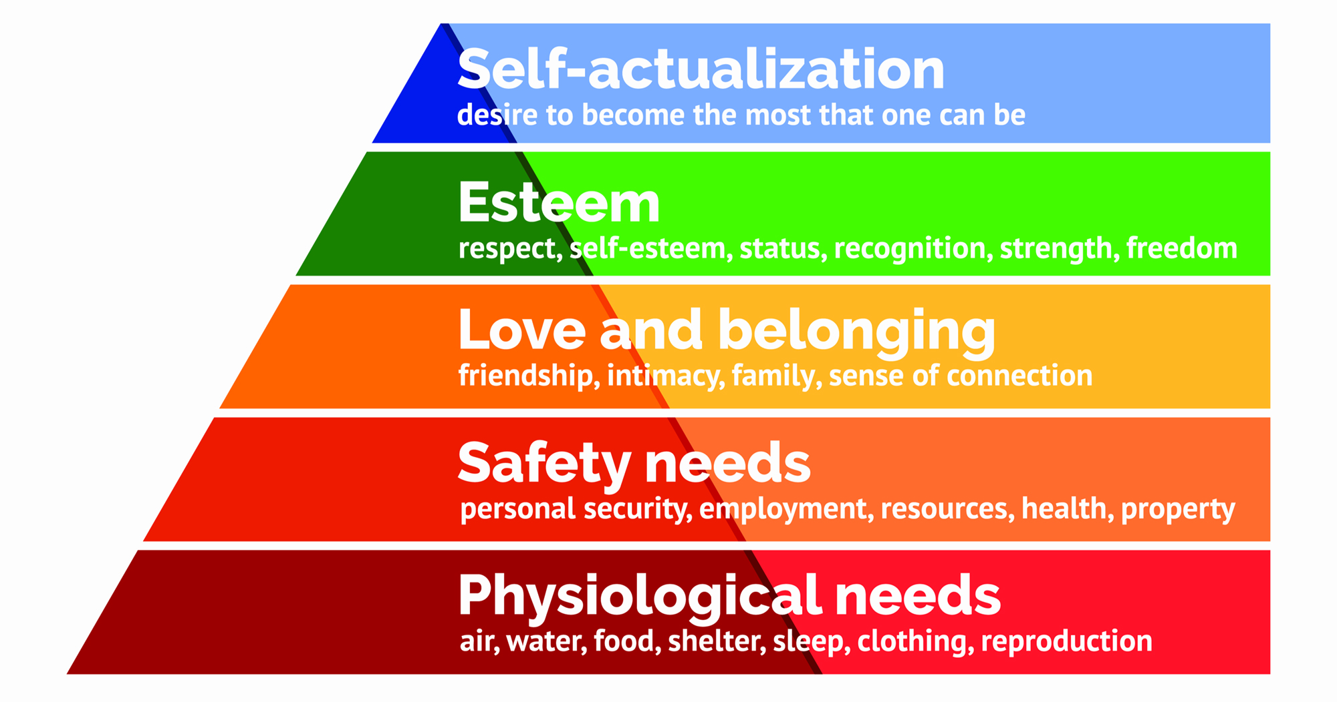
Maslow’s hierarchy of needs Theory – Humanistic Approach for Motivation

Slide 23
Herzberg’s Two Factor Theory
Some variable prevent job dissatisfaction and some variables produce motivation
Hygiene factors-basic needs that will prevent dissatisfaction
  light, temperature, pay, parking
Motivators
  when present cause high levels of motivation
  interesting work, advancement, growth

Slide 24
Herzberg’s Two Factor Theory
14.6
High Motivation
Low Motivation
Low Dissatisfaction
Dissatisfaction
Low
High
Low
High
Hygienes
Motivators

Slide 25
Equity Theory
Individuals try to find a balance between their inputs and outputs relative to a referent other

Slide 26
Results of Inequity
Equity-I am being treated fairly
Under-rewarded-will look to increase rewards, or decrease inputs to match rewards
Over-rewarded-will change referent to match cognitions or increase inputs

Slide 27
Thank You

