Slide 1
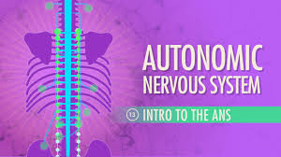
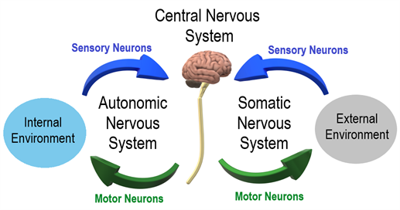
Autonomic Nervous System
Dr.Samaher Jaber Younis
BCPS
hormon

Slide 2
Nervous System
The nervous system is divided into two anatomical divisions: the central nervous system (CNS), which is composed of the brain and spinal cord, and the peripheral nervous system, which includes neurons located outside the brain and spinal cord—that is, any nerves that enter or leave the CNS.
The peripheral nervous system is subdivided into the efferent and afferent divisions. The efferent neurons carry signals away from the brain and spinal cord to the peripheral tissues, and the afferent neurons bring information from the periphery to the CNS. Afferent neurons provide sensory input to modulate the function of the efferent division through reflex arcs or neural pathways that mediate a reflex action.

Slide 3
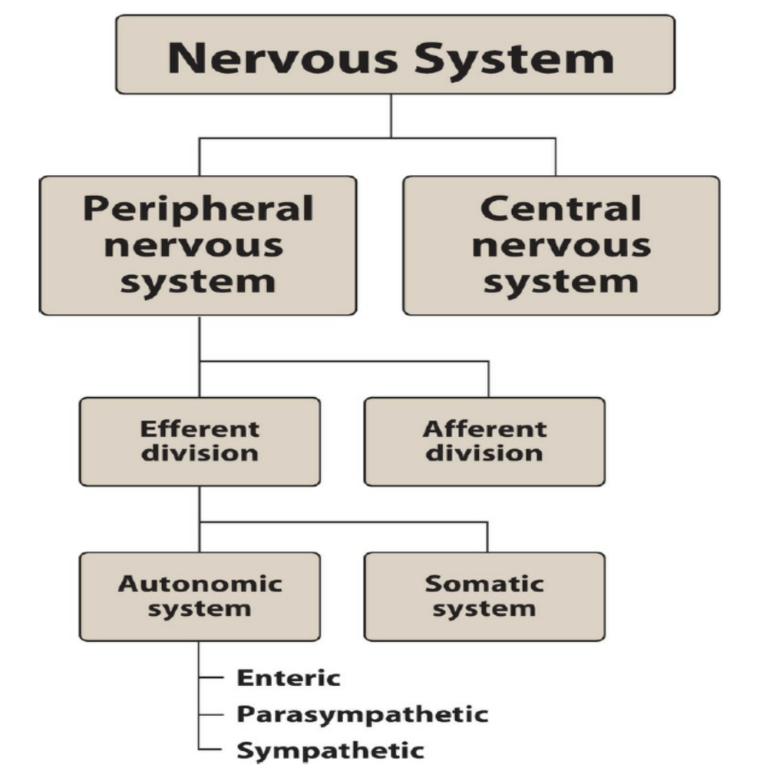

Slide 4
The efferent portion of the peripheral nervous system is further divided into two major functional subdivisions: the somatic nervous system and the ANS. The somatic efferent neurons are involved in the voluntary control of functions such as contraction of the skeletal muscles essential for locomotion.
The ANS, conversely, regulates the everyday requirements of vital bodily functions without the conscious participation of the mind. Because of the involuntary nature of the ANS as well as its functions, it is also known as the visceral, vegetative, or involuntary nervous system. It is composed of efferent neurons that innervate visceral smooth muscle, cardiac muscle, vasculature, and the exocrine glands, thereby controlling digestion, cardiac output, blood flow, and glandular secretions.

Slide 5
1. Efferent neurons
The ANS carries nerve impulses from the CNS to the effector organs through two types of efferent neurons: the preganglionic neurons and the postganglionic neurons. The cell body of the first nerve cell, the preganglionic neuron, is located within the CNS. The preganglionic neurons emerge from the brainstem or spinal cord and make a synaptic connection in ganglia (an aggregation of nerve cell bodies located in the peripheral nervous system). The ganglia function as relay stations between the preganglionic neuron and the second nerve cell, the postganglionic neuron. The cell body of the postganglionic neuron originates in the ganglion. It is generally nonmyelinated and terminates on effector organs, such as visceral smooth muscle, cardiac muscle, and the exocrine glands.
2. Afferent neurons
The afferent neurons (fibers) of the ANS are important in the reflex regulation of this system (for example, by sensing pressure in the carotid sinus and aortic arch) and in signaling the CNS to influence the efferent branch of the system to respond.
3. Sympathetic neurons
The efferent ANS is divided into the sympathetic and the parasympathetic nervous systems, as well as the enteric nervous system. Anatomically, the sympathetic and the parasympathetic neurons originate in the CNS and emerge from two different spinal cord regions. The preganglionic neurons of the sympathetic system come from the thoracic and lumbar regions (T1 to L2) of the spinal cord, ……….

Slide 6
and they synapse in two cord-like chains of ganglia that run close to and in parallel on each side of the spinal cord. The preganglionic neurons are short in comparison to the postganglionic ones. Axons of the postganglionic neuron extend from the ganglia to tissues they innervate and regulate. In most cases, the preganglionic nerve endings of the sympathetic nervous system are highly branched, enabling one preganglionic neuron to interact with many postganglionic neurons. This arrangement enables activation of numerous effector organs at the same time. [Note: The adrenal medulla, like the sympathetic ganglia, receives preganglionic fibers from the sympathetic system. The adrenal medulla, in response to stimulation by the ganglionic neurotransmitter acetylcholine, secretes epinephrine (adrenaline), and lesser amounts of norepinephrine, directly into the blood.]
4. Parasympathetic neurons
The parasympathetic preganglionic fibers arise from cranial nerves III (oculomotor), VII (facial), IX (glossopharyngeal), and X (vagus), as well as from the sacral region (S2 to S4) of the spinal cord and synapse in ganglia near or on the effector organs. [Note: The vagus nerve accounts for 90% of preganglionic parasympathetic fibers. Postganglionic neurons from this nerve innervate most organs in the thoracic and abdominal cavity.] Thus, in contrast to the sympathetic system, the preganglionic fibers are long, and the postganglionic ones are short, with the ganglia close to or within the organ innervated. In most instances, there is a one-to-one connection between the preganglionic and postganglionic neurons, enabling discrete response of this system.
1973

Slide 7
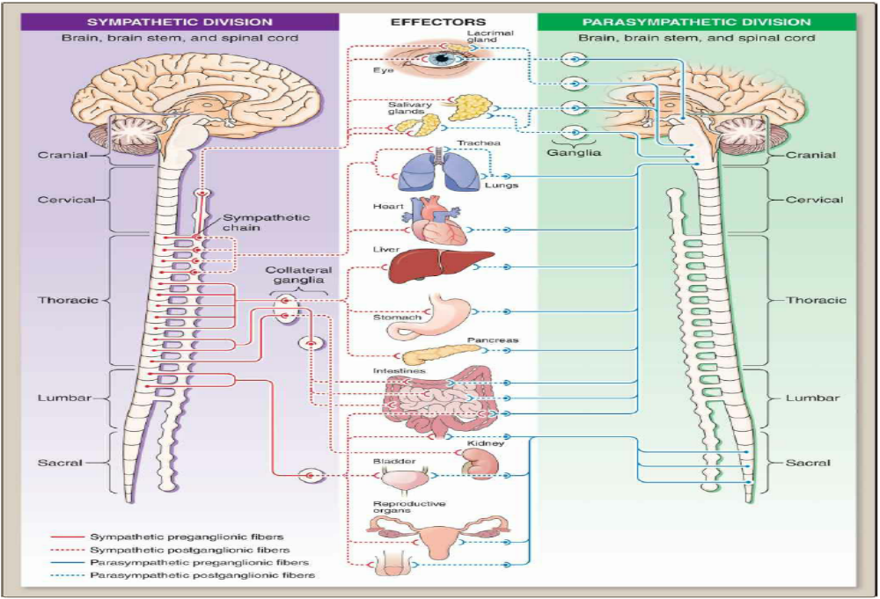

Slide 8
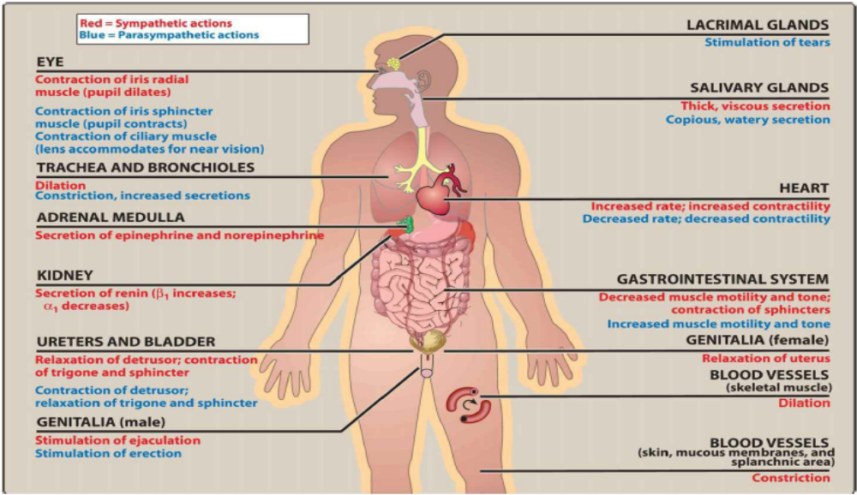

Slide 9
Effects of stimulation of the sympathetic division
The effect of sympathetic stimulation is an increase in heart rate and blood pressure, mobilization of energy stores, and increase in blood flow to skeletal muscles and the heart while diverting flow from the skin and internal organs.
Sympathetic stimulation results in dilation of the pupils and bronchioles. It also reduces GI motility and affects function of the bladder and sexual organs. ( Fight or flight response)
triggered both by direct sympathetic activation of effector organs and by stimulation of the adrenal medulla to release epinephrine and lesser amounts of norepinephrine. Hormones released by the adrenal medulla directly enter the bloodstream and promote responses in effector organs that contain adrenergic receptors. The sympathetic nervous system tends to function as a unit and often discharges as a complete system, for example, during severe exercise or in reactions to fear

Slide 10
The parasympathetic division is involved with maintaining homeostasis within the body. It is required for life, since it maintains essential bodily functions, such as digestion and elimination. The parasympathetic division usually acts to oppose or balance the actions of the sympathetic division and generally predominates the sympathetic system in “rest-and-digest” situations. Unlike the sympathetic system, the parasympathetic system never discharges as a complete system. If it did, it would produce massive, undesirable, and unpleasant symptoms, such as involuntary urination and defecation. Instead, parasympathetic fibers innervating specific organs such as the gut, heart, or eye are activated separately, and the system affects these organs individually.
Innervation by the ANS
1. Dual innervation
Most organs are innervated by both divisions of the ANS. Thus, vagal parasympathetic innervation slows the heart rate, and sympathetic innervation increases heart rate. Despite this dual innervation, one system usually predominates in controlling the activity of a given organ. For example, the vagus nerve is the predominant factor for controlling heart rate. The dual innervation of organs is dynamic, and fine-tuned continually to maintain homeostasis.
2. Sympathetic innervation
Although most tissues receive dual innervation, some effector organs, such as the adrenal medulla, kidney, pilomotor muscles, and sweat glands, receive innervation only from the sympathetic system

Slide 11
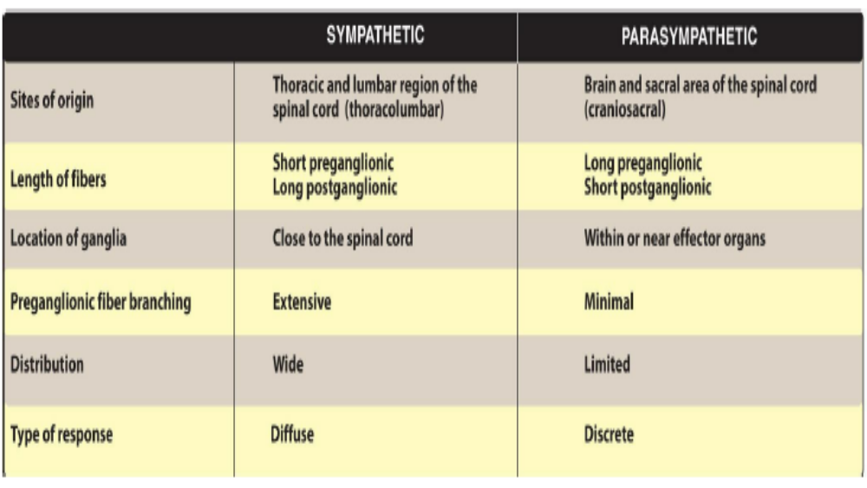

Slide 12
Types of neurotransmitters
Although over 50 signal molecules in the nervous system have been identified, norepinephrine (and the closely related epinephrine), acetylcholine, dopamine, serotonin, histamine, glutamate, and γ-aminobutyric acid are most commonly involved in the actions of therapeutically useful drugs. Each of these chemical signals binds to a specific family of receptors. Acetylcholine and norepinephrine are the primary chemical signals in the ANS, whereas a wide variety of neurotransmitters function in the CNS.
A. Acetylcholine
The autonomic nerve fibers can be divided into two groups based on the type of neurotransmitter released. If transmission is mediated by acetylcholine, the neuron is termed cholinergic. Acetylcholine mediates the transmission of nerve impulses across autonomic ganglia in both the sympathetic and parasympathetic nervous systems. It is the neurotransmitter at the adrenal medulla. Transmission from the autonomic postganglionic nerves to the effector organs in the parasympathetic system, and a few sympathetic system organs, also involves the release of acetylcholine. In the somatic nervous system, transmission at the neuromuscular junction (the junction of nerve fibers and voluntary muscles) is also cholinergic

Slide 13
B. Norepinephrine
When norepinephrine is the neurotransmitter, the fiber is termed adrenergic. In the sympathetic system, norepinephrine mediates the transmission of nerve impulses from autonomic postganglionic nerves to effector organs. Epinephrine secreted by the adrenal medulla (not sympathetic neurons) also acts as a chemical messenger in the effector organs. [Note: A few sympathetic fibers, such as those involved in sweating, are cholinergic].

Slide 14
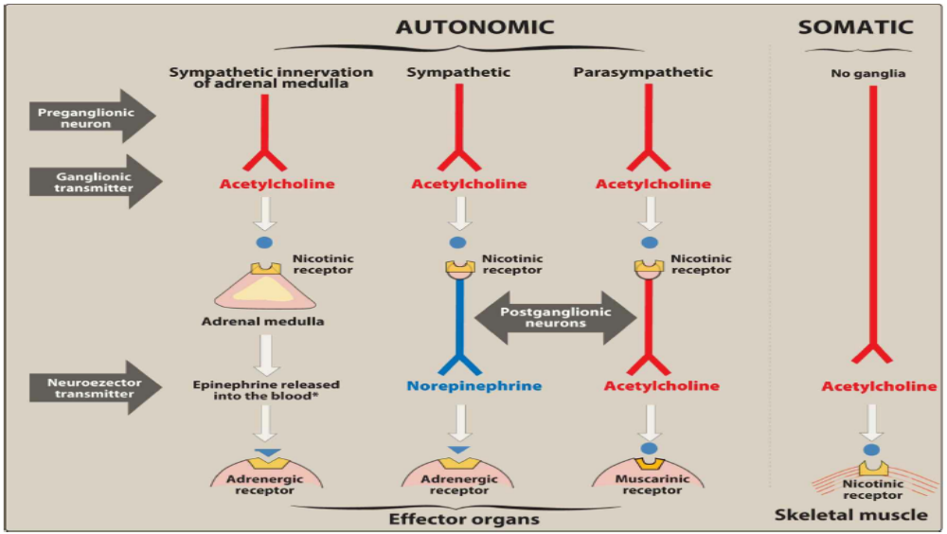

Slide 15
A. Neurotransmission at cholinergic neurons
Neurotransmission in cholinergic neurons involves six sequential steps:
1) synthesis of ACh,
2) storage,
3) release,
4) binding of ACh to the receptor,
5) degradation of ACh in the synaptic cleft
6) recycling of choline

Slide 16
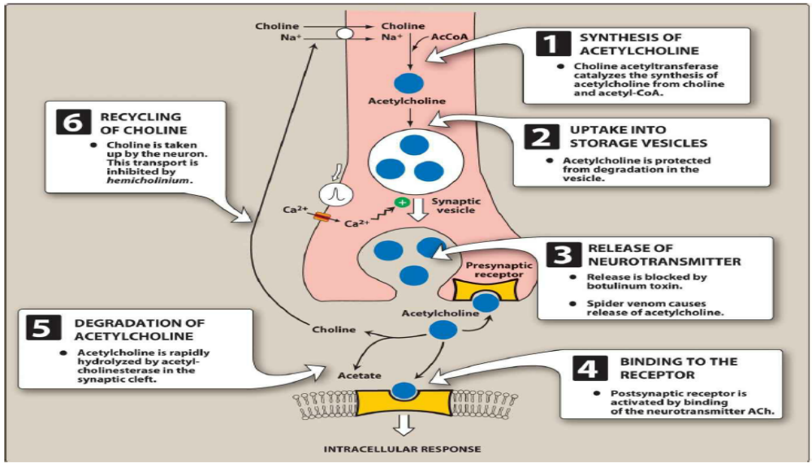

Slide 17
1. Synthesis of acetylcholine
Choline is transported from the extracellular fluid into the cytoplasm of the cholinergic neuron by an energy dependent carrier system that cotransports sodium and can be inhibited by the drug hemicholinium. [Note: Choline has a quaternary nitrogen and carries a permanent positive charge and, thus, cannot diffuse through the membrane.]
The uptake of choline is the rate-limiting step in ACh synthesis. Choline cetyltransferase catalyzes the reaction of choline with acetyl coenzyme A (CoA) to form ACh (an ester) in the cytosol.
2. Storage of acetylcholine in vesicles
ACh is packaged and stored into presynaptic vesicles by an active transport process. The mature vesicle contains not only ACh but also adenosine triphosphate (ATP) and proteoglycan. Cotransmission from autonomic neurons is the rule rather than the exception. This means that most synaptic vesicles contain the primary neurotransmitter (here, ACh) as well as a cotransmitter (here, ATP) that increases or decreases the effect of the primary neurotransmitter.

Slide 18
3. Release of acetylcholine
When an action potential propagated by voltage-sensitive sodium channels arrives at a nerve ending, voltage sensitive calcium channels on the presynaptic membrane open, causing an increase in the concentration of intracellular calcium. Elevated calcium levels promote the fusion of synaptic vesicles with the cell membrane and the release of contents into the synaptic space. This release can be blocked by botulinum toxin. In contrast, the toxin in black widow spider venom causes all the ACh stored in synaptic vesicles to empty into the synaptic gap.
4. Binding to the receptor
ACh released from the synaptic vesicles diffuses across the synaptic space and binds to postsynaptic receptors on the target cell, to presynaptic receptors on the membrane of the neuron that released ACh, or to other targeted presynaptic receptors. The postsynaptic cholinergic receptors on the surface of effector organs are divided into two classes: muscarinic and nicotinic. Binding to a receptor leads to a biologic response within the cell, such as the initiation of a nerve impulse in a postganglionic fiber or activation of specific enzymes in effector cells, as mediated by second messenger molecules.

Slide 19
5. Degradation of acetylcholine
The signal at the postjunctional effector site is rapidly terminated, because acetylcholinesterase (AChE) cleaves Ach to choline and acetate in the synaptic cleft.
6. Recycling of choline
Choline may be recaptured by a sodium-coupled, high-affinity uptake system that transports the molecule back into the neuron. There, it is available to be acetylated into ACh.

Slide 20
Acetylcholine action
Acetylcholine is a quaternary ammonium compound that cannot penetrate membranes. Although it is the neurotransmitter of parasympathetic and somatic nerves as well as autonomic ganglia, it lacks therapeutic importance because of its multiplicity of actions (leading to diffuse effects) and its rapid inactivation by the cholinesterases. ACh has both muscarinic and nicotinic activity. Its actions include the following:
1. Decrease in heart rate and cardiac output
The actions of ACh on the heart mimic the effects of vagal stimulation. For example, if injected intravenously, Ach produces a brief decrease in cardiac rate (bradycardia) and cardiac output, mainly because of a reduction in the rate of firing at the sinoatrial (SA) node. [Note: Normal vagal activity regulates the heart by the release of ACh at the SA node.]
2. Decrease in blood pressure
Injection of ACh causes vasodilation and lowering of blood pressure by an indirect mechanism of action. Ach activates M3 receptors found on endothelial cells lining the smooth muscles of blood vessels. This results in the production of nitric oxide from arginine. Nitric oxide then diffuses to vascular smooth muscle cells to stimulate protein kinase G production, leading to hyperpolarization and smooth muscle relaxation via phosphodiesterase-3 inhibition. In the absence of administered cholinergic agents, the vascular cholinergic receptors have no known function, because ACh is never released into the blood in significant quantities. Atropine blocks these muscarinic receptors and prevents ACh from producing vasodilation.

Slide 21
3. Other actions
In the gastrointestinal (GI) tract, acetylcholine increases salivary secretion, increases gastric acid secretion, and stimulates intestinal secretions and motility. It also enhances bronchiolar secretions and causes bronchoconstriction.
[Note: Methacholine, a direct-acting cholinergic agonist, is used to assist in the diagnosis of asthma due to its bronchoconstricting properties.] In the genitourinary tract, ACh increases the tone of the detrusor muscle, causing urination. In the eye, ACh is involved in stimulation of ciliary muscle contraction for near vision and in the constriction of the pupillae sphincter muscle, causing miosis (marked constriction of the pupil). ACh (1% solution) is instilled into the anterior chamber of the eye to produce miosis during ophthalmic surgery.
Not practical

Slide 22
Cholinergic Receptors (Cholinoreceptors)
Two families of cholinoceptors, designated muscarinic and nicotinic receptors, can be distinguished from each other on the basis of their different affinities for agents that mimic the action of ACh (cholinomimetic agents).
A. Muscarinic receptors
Muscarinic receptors belong to the class of G-protein–coupled receptors (metabotropic receptors). These receptors, in addition to binding ACh, also recognize muscarine, an alkaloid in certain poisonous mushrooms. By contrast, the muscarinic receptors show only a weak affinity for nicotine, an alkaloid found in tobacco and other plants. There are five subclasses of muscarinic receptors; however, only M1, M2, and M3 receptors have been functionally characterized

Slide 23
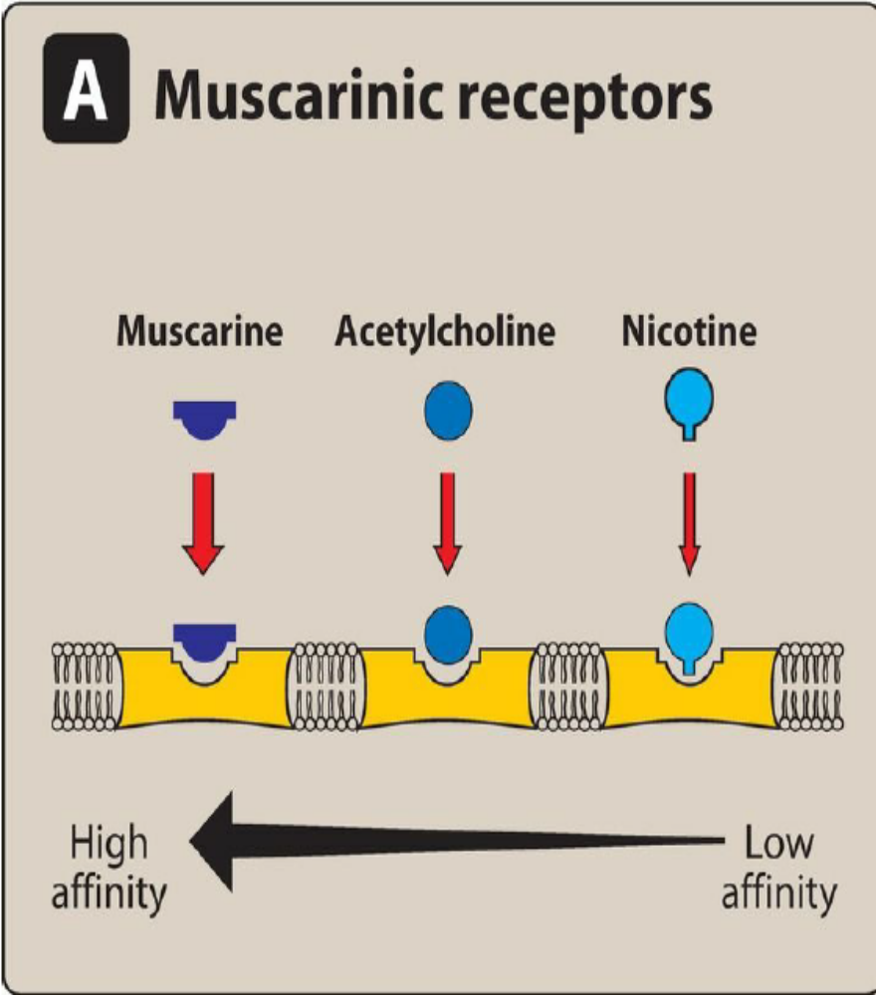
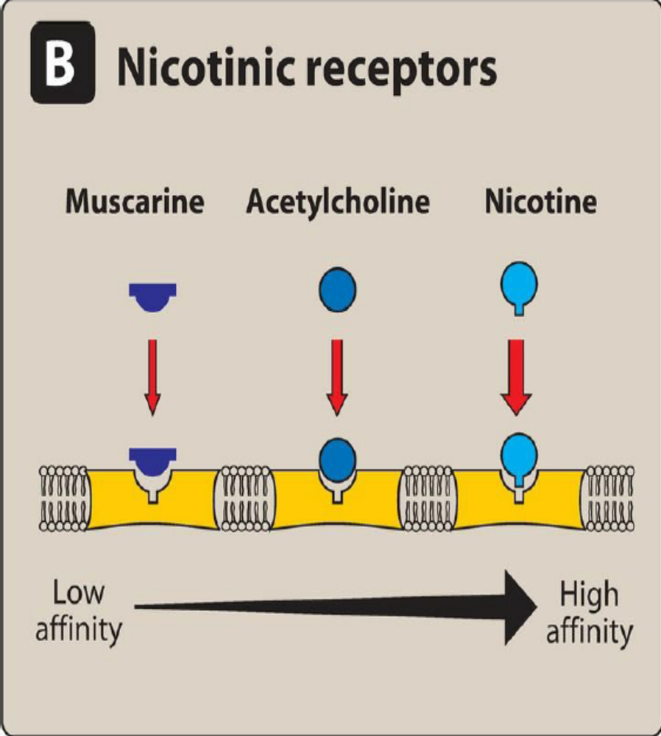

Slide 24
Location of muscarinic receptors
These receptors are found on the autonomic effector organs, such as the heart, smooth muscle, brain, and exocrine glands. Although all five subtypes are found on neurons, M1 receptors are also found on gastric parietal cells, M2 receptors on cardiac cells and smooth muscle, and M3 receptors on the bladder, exocrine glands, and smooth muscle.
[Note: Drugs with muscarinic actions preferentially stimulate muscarinic receptors on these tissues, but at high concentration, they may show some activity at nicotinic receptors.]
Mechanism of acetylcholine signal transduction
A number of different molecular mechanisms transmit the signal generated by ACh occupation of the receptor. For example, when M1 or M3 receptors are activated, the receptor undergoes a conformational change and interacts with a G-protein that activates phospholipase C. This ultimately leads to production of second messengers inositol-1,4,5- trisphosphate (IP3) and diacylglycerol (DAG). IP3 causes an increase in intracellular Ca2+. Calcium can then interact to stimulate or inhibit enzymes or to cause hyperpolarization, secretion, or contraction. DAG activates protein kinase C, an enzyme that phosphorylates numerous proteins within the cell. In contrast, activation of the M2 subtype on the cardiac muscle stimulates a G-protein that inhibits adenylyl cyclase and increases K+ conductance. The heart responds with a decrease in rate and force of contraction.

Slide 25
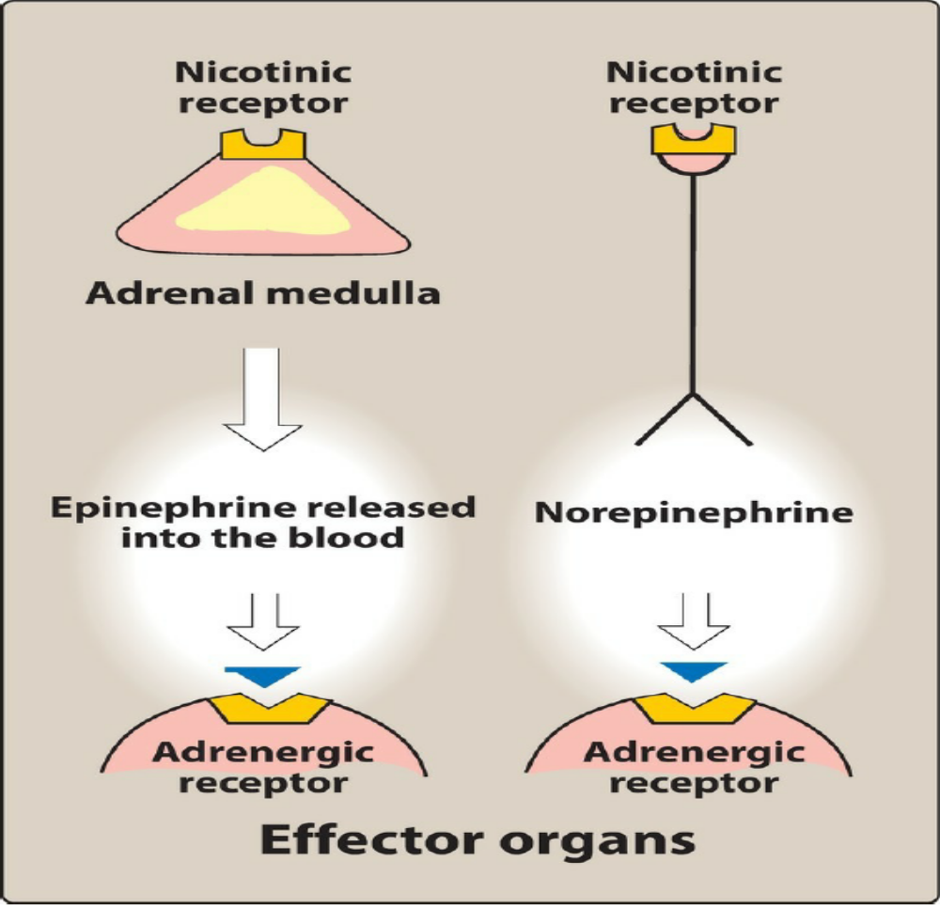
B. Neurotransmission at Adrenergic neurons
Neurotransmission in adrenergic neurons closely resembles that described for the cholinergic neurons, except that norepinephrine is the neurotransmitter instead of acetylcholine. Neurotransmission involves the following steps:
1)synthesis,
2)storage,
3)release, and receptor binding of norepinephrine,
4)removal of the neurotransmitter from the synaptic gap

Slide 26
1. Synthesis of norepinephrine:
Tyrosine is transported by a carrier into the adrenergic neuron, where it is hydroxylated to dihydroxyphenylalanine (DOPA) by tyrosine hydroxylase. This is the rate-limiting step in the formation of norepinephrine. DOPA is then decarboxylated by the enzyme aromatic L-amino acid decarboxylase to form dopamine in the presynaptic neuron.
2. Storage of norepinephrine in vesicles: Dopamine is then transported into synaptic vesicles by an amine transporter system. This carrier system is blocked by reserpine. Next, dopamine is hydroxylated to form norepinephrine by the enzyme dopamine β-hydroxylase.
3. Release of norepinephrine: An action potential arriving at the nerve junction triggers an influx of calcium ions from the extracellular fluid into the cytoplasm of the neuron. The increase in calcium causes synaptic vesicles to fuse with the cell membrane and to undergo exocytosis and expel their contents into the synapse. Drugs such as guanethidine block this release.

Slide 27
4. Binding to receptors:
Binding of norepinephrine to receptors triggers a cascade of events within the cell, resulting in the formation of intracellular second messengers that act as links (transducers) in the communication between the neurotransmitter and the action generated within the effector cell. Adrenergic receptors use both the cyclic adenosine monophosphate (cAMP) second messenger system and the phosphatidylinositol cycle to transduce the signal into an effect. Norepinephrine also binds to presynaptic receptors (mainly α2 subtype) that modulate the release of the neurotransmitter.
5. Removal of norepinephrine:
Norepinephrine may 1) diffuse out of the synaptic space and enter the systemic circulation; 2) be metabolized to inactive metabolites by catechol-O-methyltransferase (COMT) in the synaptic space; or 3) undergo reuptake back into the neuron. The reuptake by the neuronal membrane involves a sodium chloride (Na+/Cl−)-dependent norepinephrine transporter that can be inhibited by tricyclic antidepressants (TCAs) such as imipramine, by serotonin–norepinephrine reuptake inhibitors such as duloxetine, or by cocaine. Reuptake of norepinephrine into the presynaptic neuron is the primary mechanism for termination of its effects.

Slide 28
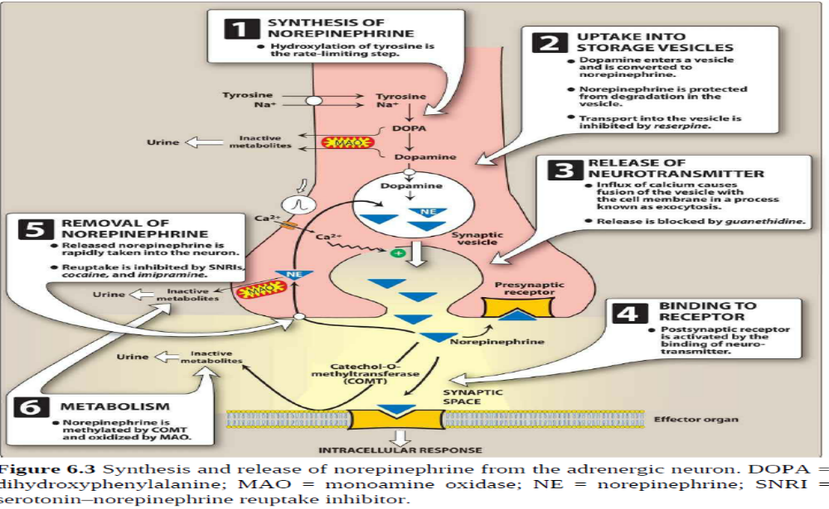

Slide 29
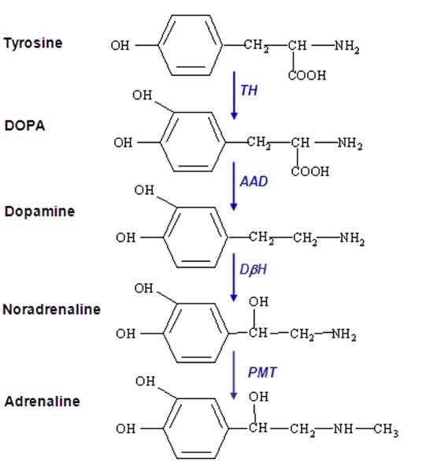

Slide 30
Adrenergic receptors (adrenoceptors)
In the sympathetic nervous system, several classes of adrenoceptors can be distinguished pharmacologically. Two main families of receptors, designated α and β, are classified based on response to the adrenergic agonists epinephrine, norepinephrine, and isoproterenol. Both the α and β receptor types have a number of specific receptor subtypes. Alterations in the primary structure of the receptors influence their affinity for various agents.
1. α-Adrenoceptors
The α-adrenoceptors show a weak response to the synthetic agonist isoproterenol, but they are responsive to the naturally occurring catecholamines epinephrine and norepinephrine. For α receptors, the rank order of potency and affinity is epinephrine ≥ norepinephrine >> isoproterenol. The α-adrenoceptors are divided into two subtypes, α1 and α2, based on their affinities for α agonists and antagonists. For example, α1 receptors have a higher affinity for phenylephrine than α2 receptors. Conversely, the drug clonidine selectively binds to α2 receptors and has less effect on α1 receptors.

Slide 31
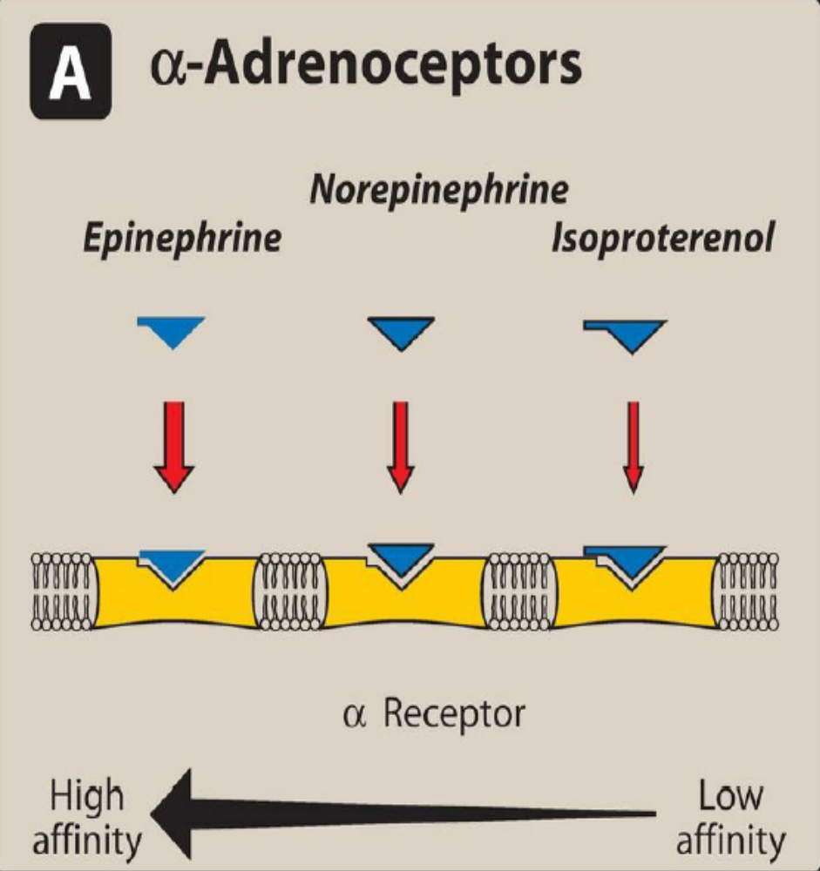
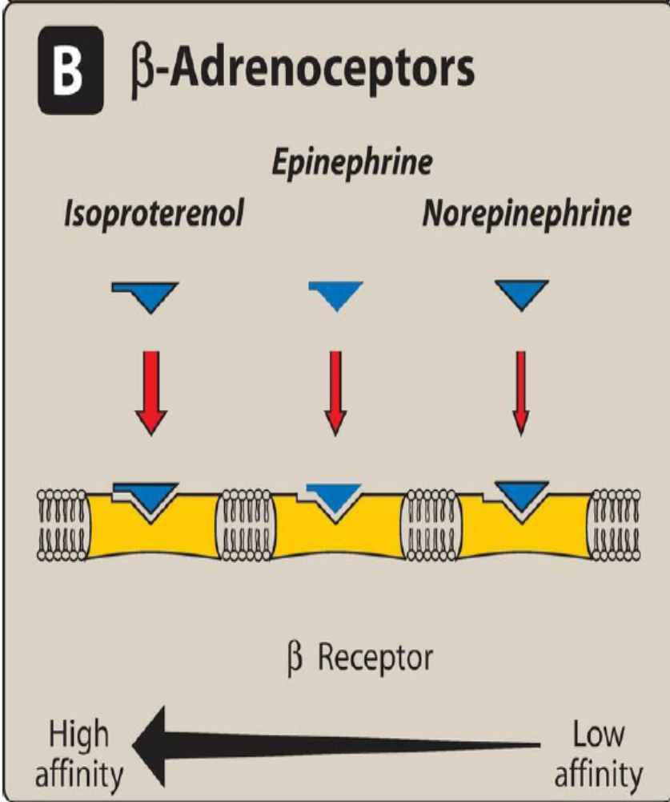

Slide 32
α1 Receptors
These receptors are present on the postsynaptic membrane of the effector organs and mediate many of the classic effects, originally designated as α-adrenergic, involving constriction of smooth muscle. Activation of α1 receptors initiates a series of reactions through the G-protein activation of phospholipase C, ultimately resulting in the generation of second messengers inositol-1,4,5-trisphosphate (IP3) and diacylglycerol (DAG). IP3 initiates the release of Ca2+ from the endoplasmic reticulum into the cytosol, and DAG turns on other proteins within the cell
α2 Receptors
These receptors are located primarily on sympathetic presynaptic nerve endings and control the release of norepinephrine. When a sympathetic adrenergic nerve is stimulated, a portion of the released norepinephrine “circles back” and reacts with α2 receptors on the presynaptic membrane. Stimulation of α2 receptors causes feedback inhibition and inhibits further release of norepinephrine from the stimulated adrenergic neuron. This inhibitory action serves as a local mechanism for modulating norepinephrine output when there is high sympathetic

Slide 33
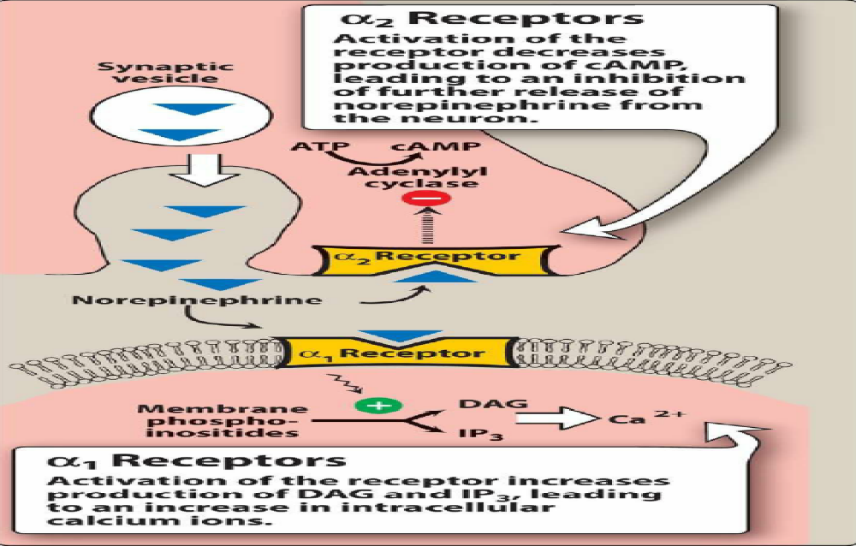

Slide 34
activity. [Note: In this instance, by inhibiting further output of norepinephrine from the adrenergic neuron, these receptors are acting as inhibitory autoreceptors.] α2 Receptors are also found on presynaptic parasympathetic neurons. Norepinephrine released from a presynaptic sympathetic neuron can diffuse to and interact with these receptors, inhibiting acetylcholine release. [Note: In these instances, these receptors are behaving as inhibitory heteroreceptors.] This is another mechanism to modulate autonomic activity in a given area. In contrast to α1 receptors, the effects of binding at α2 receptors are mediated by inhibition of adenylyl cyclase and by a fall in the levels of intracellular cAMP.

Slide 35
β-Adrenoceptors
Responses of β receptors differ from those of α receptors and are characterized by a strong response to isoproterenol, with less sensitivity to epinephrine and norepinephrine. For β receptors, the rank order of potency is isoproterenol > epinephrine > norepinephrine. The β-adrenoceptors can be subdivided into three major subgroups, β1, β2, and β3, based on their affinities for adrenergic agonists and antagonists.
β1 receptors have approximately equal affinities for epinephrine and norepinephrine, whereas
β2 receptors have a higher affinity for epinephrine than for norepinephrine. Thus, tissues with a predominance of β2 receptors (such as the vasculature of skeletal muscle) are particularly responsive to the effects of circulating epinephrine released by the adrenal medulla.
Binding of a neurotransmitter at any of the three types of β receptors results in activation of adenylyl cyclase and increased concentrations of cAMP within the cell

Slide 36
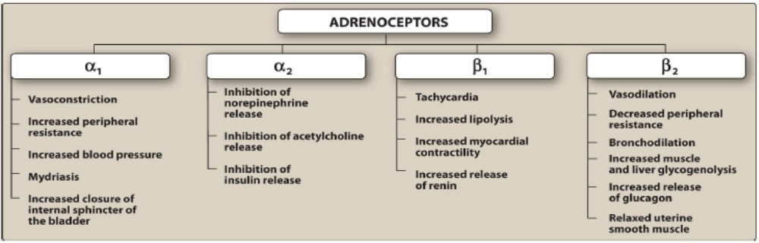
stimulation of α1 receptors characteristically produces vasoconstriction (particularly in skin and abdominal viscera) and an increase in total peripheral resistance and blood pressure. Stimulation of β1 receptors characteristically causes cardiac stimulation (increase in heart rate and contractility), whereas stimulation of β2 receptors produces vasodilation (in skeletal muscle vascular beds) and smooth muscle relaxation. β3 Receptors are involved in lipolysis (along with β1), and also have effects on the detrusor muscle of the bladder.

