Slide 1
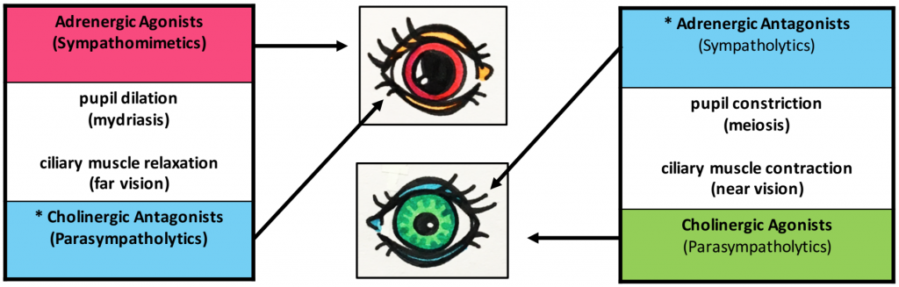
Autonomic drugs parasympathomimetics & parasympatholytics sympathomimetics & sympatholytics
Dr.Samaher Jaber Younis
BCPS
mimetic

Slide 2
Cholinergic Agonists
Drugs affecting the autonomic nervous system (ANS) are divided into two groups according to the type of neuron involved in the mechanism of action:
1. The cholinergic drugs act on receptors activated by acetylcholine (ACh)
2. Adrenergic drugs act on receptors stimulated by norepinephrine or epinephrine.
Cholinergic and adrenergic drugs act by either stimulating( mimetics) or blocking receptors(lytics) of the ANS.

Slide 3
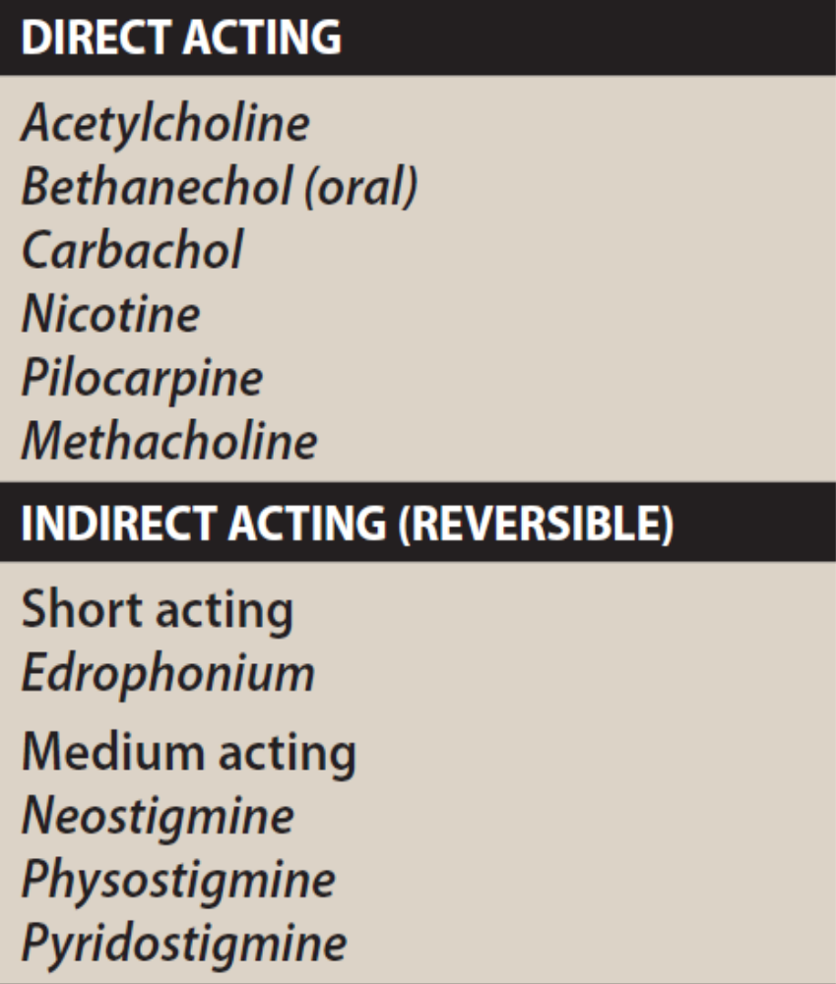
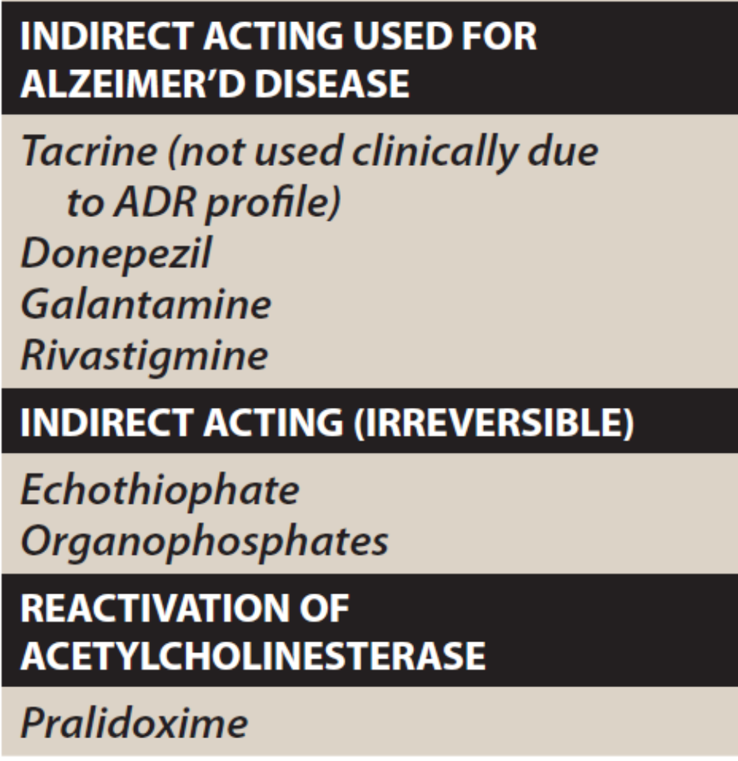

Slide 4
1.Direct-Acting Cholinergic Agonists
Cholinergic agonists mimic the effects of ACh by binding directly to cholinoceptors (muscarinic or nicotinic). These agents may be broadly classified into two groups: 1) choline esters, which include endogenous ACh and synthetic esters of choline, such as carbachol and bethanechol, and 2) naturally occurring alkaloids, such as nicotine and pilocarpine. All direct-acting cholinergic drugs have a longer duration of action than ACh. The more therapeutically useful drugs (pilocarpine and bethanechol) preferentially bind to muscarinic receptors and are sometimes referred to as muscarinic agents. However, as a group, the direct-acting agonists show little specificity in their actions, which limits clinical usefulness.

Slide 5
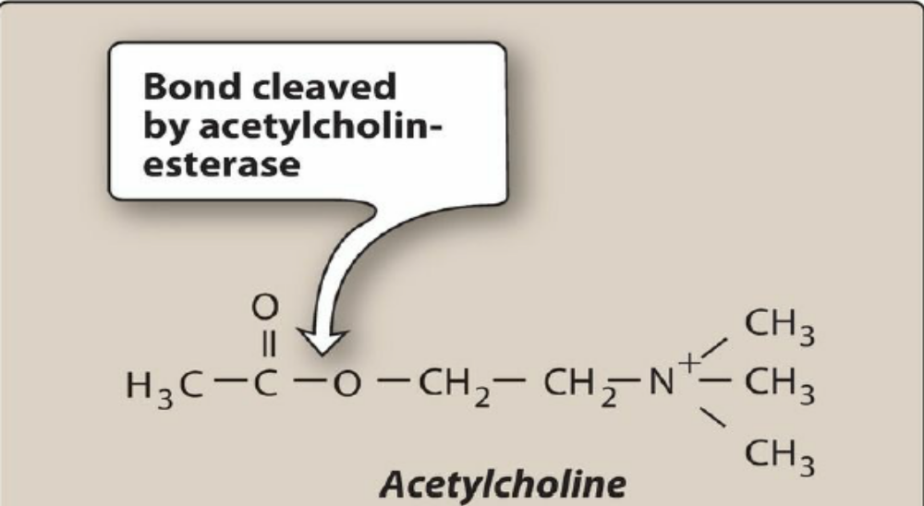
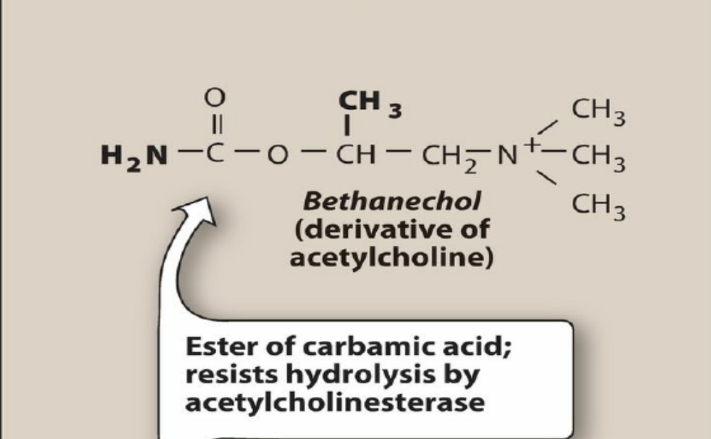
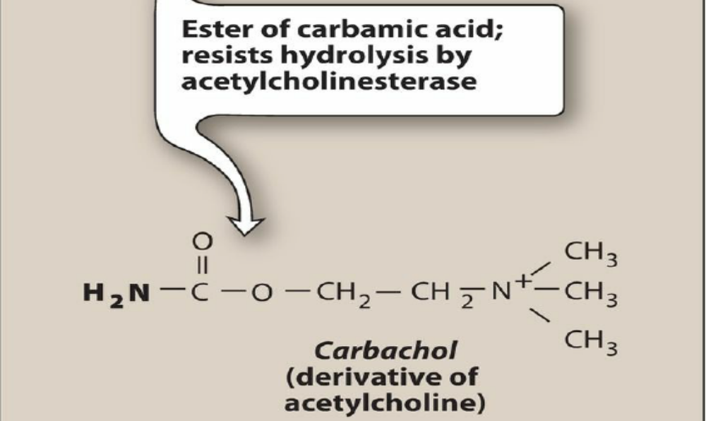
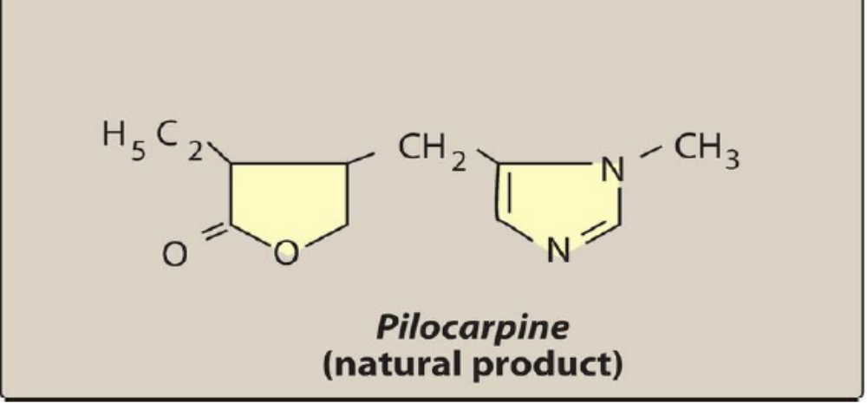

Slide 6
Bethanechol
Bethanechol is an unsubstituted carbamoyl ester, structurally related to ACh . It is not hydrolyzed by AChE due to the esterification of carbamic acid, although it is inactivated through hydrolysis by other esterases. It lacks nicotinic actions (due to addition of the methyl group), but does have strong muscarinic activity. Its major actions are on the smooth musculature of the bladder and GI tract. It has about a 1-hour duration of action.
1. Actions
Bethanechol directly stimulates muscarinic receptors, causing increased intestinal motility and tone. It also stimulates the detrusor muscle of the bladder, whereas the trigone and sphincter muscles are relaxed. These effects stimulate urination.
2. Therapeutic uses
In urologic treatment, bethanechol is used to stimulate the atonic bladder, particularly in postpartum or postoperative, nonobstructive urinary retention. Bethanechol may also be used to treat neurogenic atony as well as megacolon.
3. Adverse effects
Bethanechol can cause generalized cholinergic stimulation, with sweating, salivation, flushing, decreased blood pressure (with reflex tachycardia), nausea, abdominal pain, diarrhea, and bronchospasm. Atropine sulfate may be administered to overcome severe cardiovascular or bronchoconstrictor responses to this agent

Slide 7
Carbachol (carbamylcholine)
Carbachol has both muscarinic and nicotinic actions. Like bethanechol, carbachol is an ester of carbamic acid and a poor substrate for AChE. It is biotransformed by other esterases, but at a much slower rate.
1. Actions
Carbachol has profound effects on both the cardiovascular and GI systems because of its ganglion-stimulating activity, and it may first stimulate and then depress these systems. It can cause release of epinephrine from the adrenal medulla by its nicotinic action. Locally instilled into the eye, it mimics the effects of ACh, causing miosis and a spasm of accommodation in which the ciliary muscle of the eye remains in a constant state of contraction. The vision becomes fixed at some particular distance, making it impossible to focus. [Note the opposing effects of atropine, a muscarinic blocker, on the eye.]
2. Therapeutic uses
Because of its high potency, receptor nonselectivity, and relatively long duration of action, carbachol is rarely used. Intraocular use provides miosis for eye surgery and lowers intraocular pressure in the treatment of glaucoma.
3. Adverse effects
With ophthalmologic use, few adverse effects occur due to lack of systemic penetration (quaternary amine).

Slide 8
Pilocarpine
The alkaloid pilocarpine is a tertiary amine and is stable to hydrolysis by AChE . Can penetrate the CNS at therapeutic doses. Pilocarpine exhibits muscarinic activity and is used primarily in ophthalmology.
1. Actions
Applied topically to the eye, pilocarpine produces rapid miosis, contraction of the ciliary muscle, and spasm of accommodation. Pilocarpine is one of the most potent stimulators of secretions such as sweat, tears, and saliva, but its use for producing these effects has been limited due to its lack of selectivity.
2. Therapeutic uses
Pilocarpine is used to treat glaucoma and is the drug of choice for emergency lowering of intraocular pressure of both open-angle and angle-closure glaucoma. Pilocarpine is extremely effective in opening the trabecular meshwork around the Schlemm canal, causing an immediate drop in intraocular pressure because of the increased drainage of aqueous humor. This action occurs within a few minutes, lasts 4 to 8 hours, and can be repeated. [Note: Topical carbonic anhydrase inhibitors, such as dorzolamide and β-adrenergic blockers such as timolol, are effective in treating glaucoma but are not used for emergency lowering of intraocular pressure.] The miotic action of pilocarpine is also useful in reversing mydriasis due to atropine. The drug is beneficial in promoting salivation in patients with xerostomia resulting from irradiation of the head and neck. Sjögren syndrome, which is characterized by dry mouth and lack of tears, is treated with oral pilocarpine tablets and cevimeline, a cholinergic drug that also has the drawback of being nonspecific.
3. Adverse effects
Pilocarpine can cause blurred vision, night blindness, and brow ache. Poisoning with this agent is characterized by exaggeration of various parasympathetic effects, including profuse sweating (diaphoresis) and salivation. The effects are similar to those produced by consumption of muscharine. Parenteral atropine, at doses that can cross the blood–brain barrier, is administered to counteract the toxicity of pilocarpine.

Slide 9
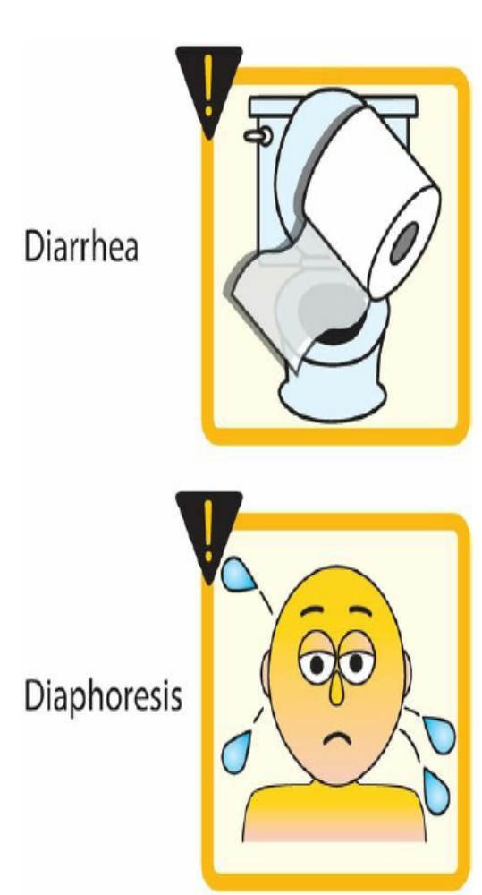
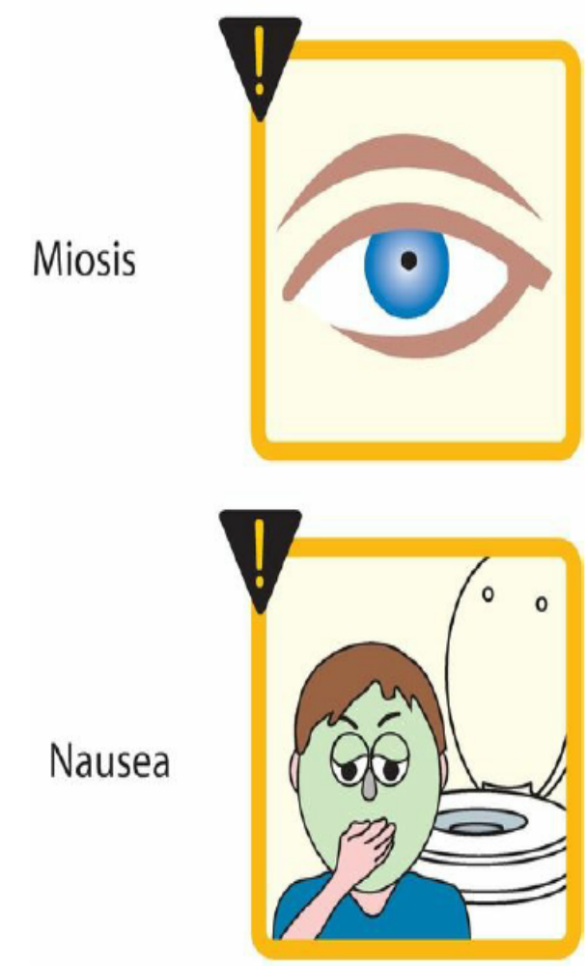
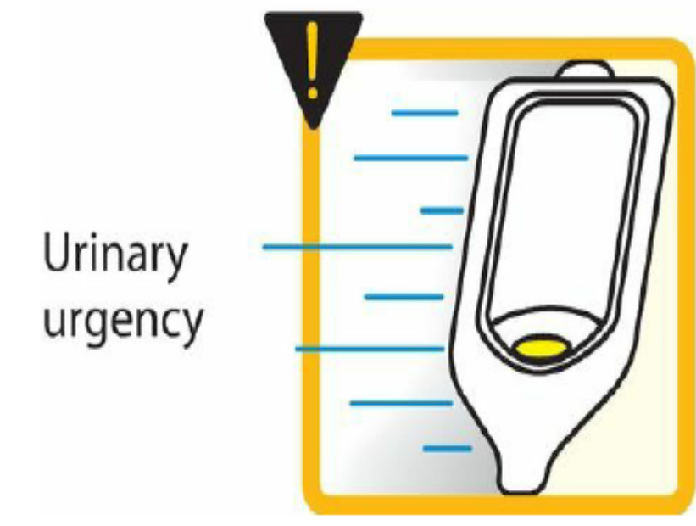

Slide 10
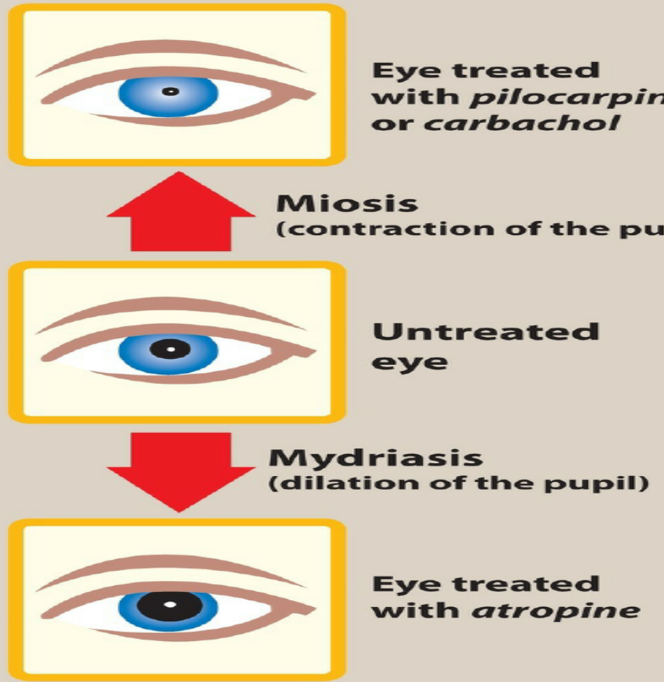

Slide 11
2. Indirect-Acting Cholinergic Agonists: Anticholinesterase Agents (Reversible)
Inhibitors of AChE (anticholinesterase agents or cholinesterase inhibitors) indirectly provide cholinergic action by preventing the degradation of ACh. This results in an accumulation of ACh in the synaptic space. Therefore, these drugs can provoke a response at all cholinoceptors, including both muscarinic and nicotinic receptors of the ANS, as well as at the NMJ and in the brain. The reversible AChE inhibitors can be broadly classified as short-acting or intermediate-acting agents.

Slide 12
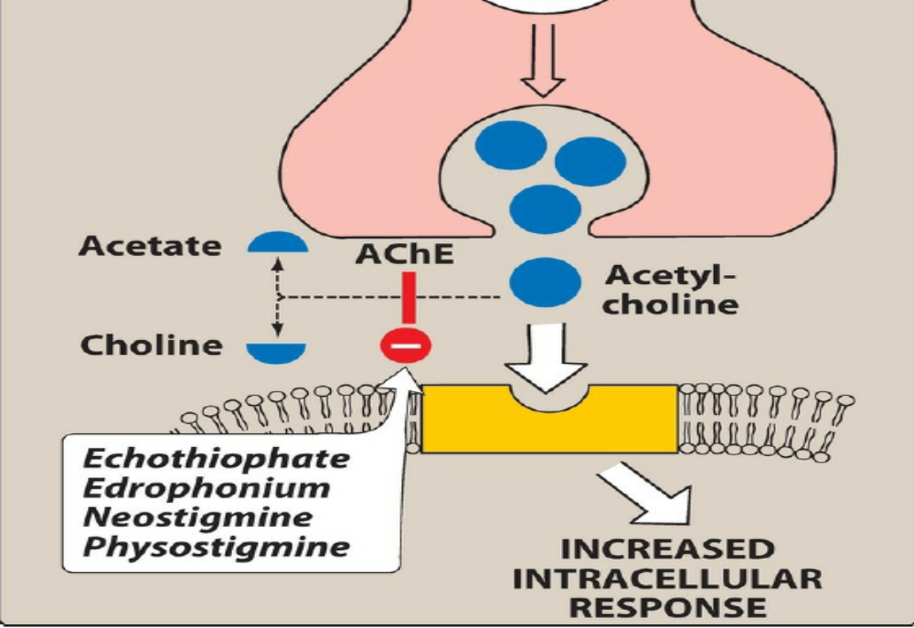

Slide 13
Edrophonium
Edrophonium is the prototype short-acting AChE inhibitor. Edrophonium binds reversibly to the active center of AChE, preventing hydrolysis of ACh. It has a short duration of action of 10 to 20 minutes due to rapid renal elimination. Edrophonium is a quaternary amine, and its actions are limited to the periphery. It is used in the diagnosis of myasthenia gravis( historical), an autoimmune disease caused by antibodies to the nicotinic receptor at the NMJ. This causes the degradation of the nicotinic receptors, making fewer receptors available for interaction with ACh. Intravenous injection of edrophonium leads to a rapid increase in muscle strength in patients with myasthenia gravis. Care must be taken, because excess drug may provoke a cholinergic crisis (atropine is the antidote). For reversing the effects of nondepolarizing neuromuscular blockers (NMBs) after surgery. Due to the availability of other agents, edrophonium use has become limited.

Slide 14
Physostigmine
Physostigmine is a substrate for AChE, and it forms a relatively stable carbamoylated intermediate with the enzyme, which then becomes reversibly inactivated. The result is potentiation of cholinergic activity throughout the body.
1. Actions
Physostigmine has a wide range of effects and stimulates not only the muscarinic and nicotinic sites of the ANS, but also the nicotinic receptors of the NMJ. Muscarinic stimulation can cause contraction of GI smooth muscles, miosis, bradycardia, and hypotension. Nicotinic stimulation can cause skeletal muscle twitches, fasciculations, and skeletal muscle paralysis (at higher doses). Its duration of action is about 30 minutes to 2 hours, and it is considered an intermediate-acting agent. Physostigmine can enter and stimulate the cholinergic sites in the CNS.
2. Therapeutic uses
Physostigmine is used in the treatment of overdoses of drugs with anticholinergic actions, such as atropine, and to reverse the effects of NMBs.
3. Adverse effects
High doses of physostigmine may lead to convulsions. Bradycardia and a fall in cardiac output may also occur. Inhibition of AChE at the NMJ causes the accumulation of ACh and, ultimately through continuous depolarization, results in paralysis of skeletal muscle. However, these effects are rarely seen with therapeutic doses

Slide 15
Neostigmine
Neostigmine is a synthetic compound that reversibly inhibits AChE in a manner similar to physostigmine.
1. Actions
Unlike physostigmine, neostigmine has a quaternary nitrogen. Therefore, it is more polar, is absorbed poorly from the GI tract, and does not enter the CNS. Its effect on skeletal muscle is greater than physostigmine, and it can stimulate contractility before it paralyzes. Neostigmine has an intermediate duration of action, usually 30 minutes to 2 hours.
2. Therapeutic uses
It is used to stimulate the bladder and GI tract and as an antidote for competitive neuromuscular-blocking agents. Neostigmine is also used to manage symptoms of myasthenia gravis.
3. Adverse effects
Adverse effects of neostigmine include those of generalized cholinergic stimulation, such as salivation, flushing, decreased blood pressure, nausea, abdominal pain, diarrhea, and bronchospasm. Neostigmine does not cause CNS side effects and is not used to overcome toxicity of central-acting antimuscarinic agents such as atropine. Neostigmine is contraindicated when intestinal or urinary bladder obstruction is present

Slide 16
Pyridostigmine
Pyridostigmine is another cholinesterase inhibitor used in the chronic management of myasthenia gravis. Its duration of action is intermediate (3 to 6 hours) but longer than that of neostigmine. Adverse effects are similar to those of neostigmine
Tacrine, donepezil, rivastigmine, and galantamine
Patients with Alzheimer disease have a deficiency of cholinergic neurons and therefore lower levels of ACh in the CNS. This observation led to the development of anticholinesterases as possible remedies for the loss of cognitive function. Tacrine, the first agent in this category, has been replaced by others because of its hepatotoxicity. Despite the ability of donepezil, rivastigmine, and galantamine to delay the progression of Alzheimer disease, none can stop its progression. GI distress is their primary adverse effect.

Slide 17
Indirect-Acting Cholinergic Agonists: Anticholinesterase Agents (Irreversible)
A number of synthetic organophosphate compounds have the ability to bind covalently to AChE. The result is a long-lasting increase in ACh at all sites where it is released. Many of these drugs are extremely toxic and were developed by the military as nerve agents. Related compounds, such as parathion and malathion, are used as insecticides.
Echothiophate
1. Mechanism of action
Echothiophate is an organophosphate that covalently binds via its phosphate group at the active site of AChE. Once this occurs, the enzyme is permanently inactivated, and restoration of AChE activity requires the synthesis of new enzyme molecules. Following covalent modification of AChE, the phosphorylated enzyme slowly releases one of its ethyl groups. The loss of an alkyl group, which is called aging, makes it impossible for chemical reactivators, such as pralidoxime, to break the bond between the remaining drug and the enzyme.

Slide 18
2. Actions
Actions include generalized cholinergic stimulation, paralysis of motor function (causing breathing difficulties), and convulsions. Echothiophate produces intense miosis and, thus, has found therapeutic use. Intraocular pressure falls from the facilitation of outflow of aqueous humor. Atropine in high dosages can reverse many of the peripheral and some of the central muscarinic effects of echothiophate.
3. Therapeutic uses (no use)
A topical ophthalmic solution of the drug is available for the treatment of open-angle glaucoma. However, echothiophate is rarely used due to its side effect profile, which includes the risk of cataracts.
Reactivation of acetylcholinesterase
Pralidoxime (2-PAM) can reactivate inhibited AChE. However, it is unable to penetrate into the CNS and therefore is not useful in treating the CNS effects of organophosphates. The presence of a charged group allows it to approach an anionic site on the enzyme, where it essentially displaces the phosphate group of the organophosphate and regenerates the enzyme. If given before aging of the alkylated enzyme occurs, it can reverse both muscarinic and nicotinic peripheral effects of organophosphates, but not the CNS effects. With the newer nerve agents that produce aging of the enzyme complex within seconds, pralidoxime is less effective.

Slide 19
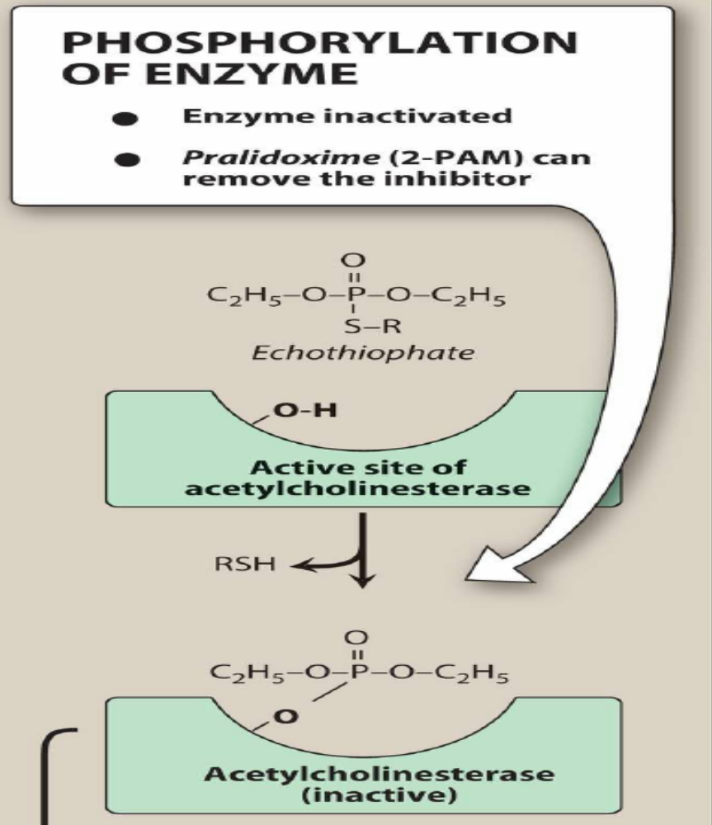
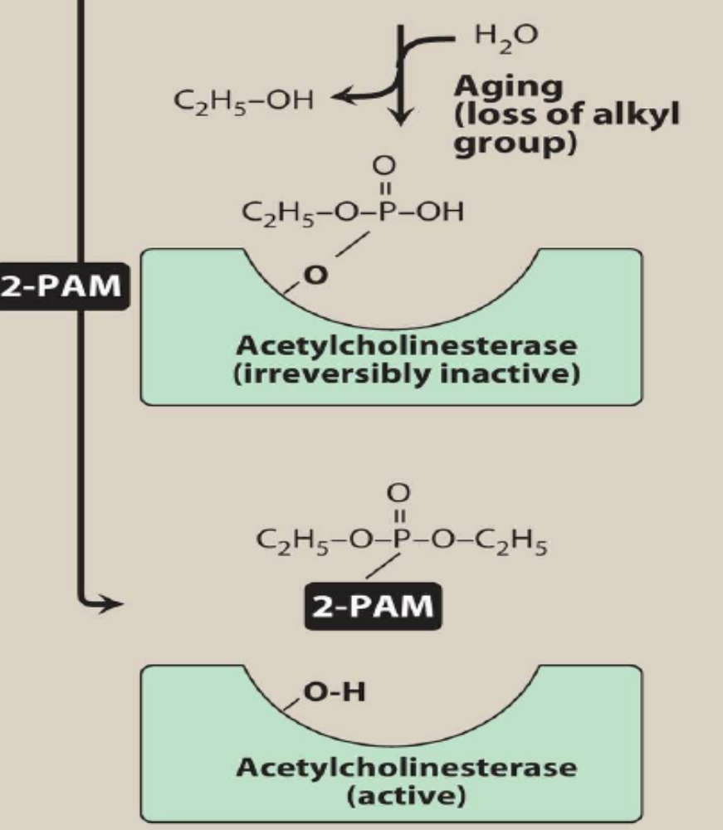
2-PAM NOT EFECTIVE
AGING
2-PAM

Slide 20
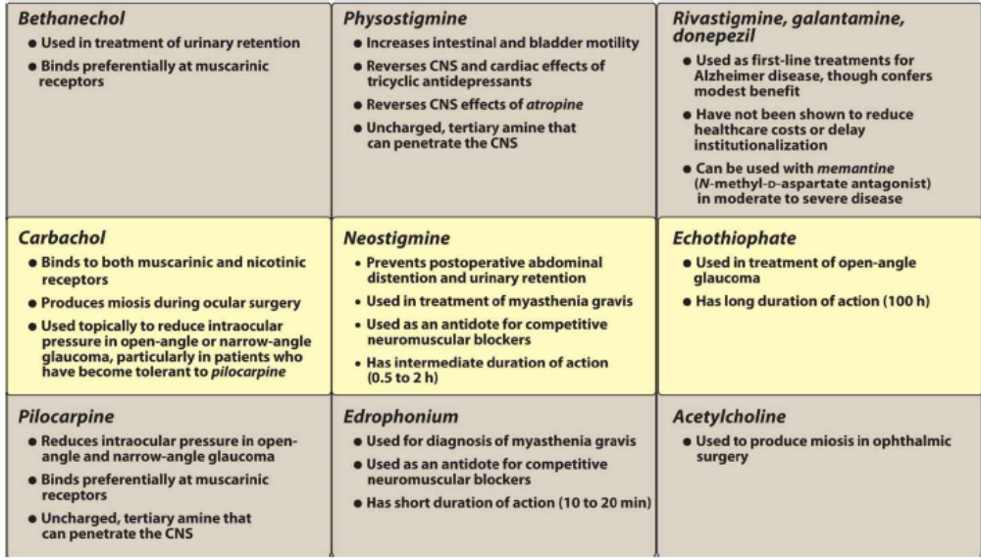

Slide 21
Cholinergic Antagonists
Cholinergic antagonist is a general term for agents that bind to cholinoceptors (muscarinic or nicotinic) and prevent the effects of acetylcholine (ACh) and other cholinergic agonists. The most clinically useful of these agents are selective blockers of muscarinic receptors. They are commonly known as anticholinergic agents (a misnomer, as they antagonize only muscarinic receptors), antimuscarinic agents (more accurate terminology), or parasympatholytics. The effects of parasympathetic innervation are thus, interrupted by these agents, and the actions of sympathetic innervation are left unopposed. A second group of drugs, the ganglionic blockers, shows a preference for nicotinic receptors of the sympathetic and parasympathetic ganglia. Clinically, they are the least important cholinergic antagonists. A third family of compounds, the neuromuscular blocking agents (mostly nicotinic antagonists), interfere with transmission of efferent impulses to skeletal muscles. These drugs are used as skeletal muscle relaxants in surgical anesthesia and as agents to facilitate intubation in surgical and critical care patients.

Slide 22
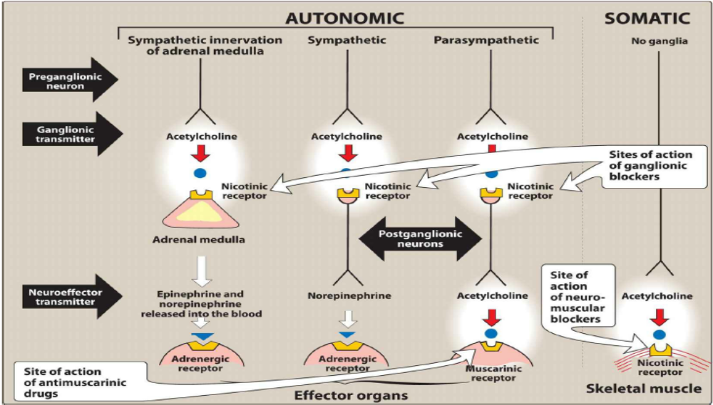

Slide 23
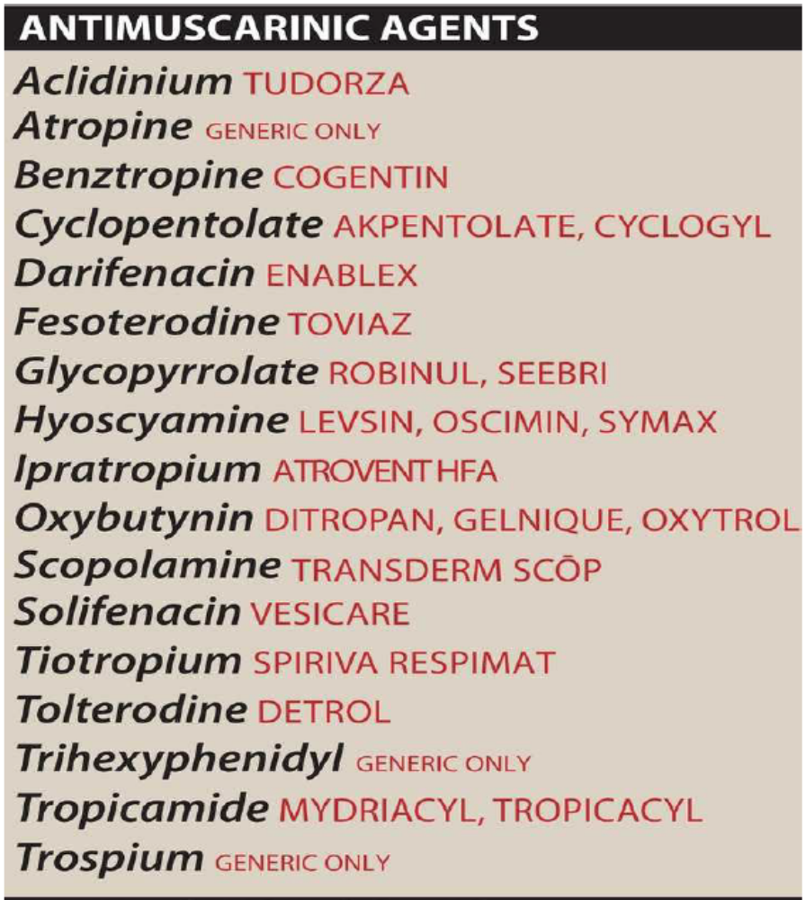
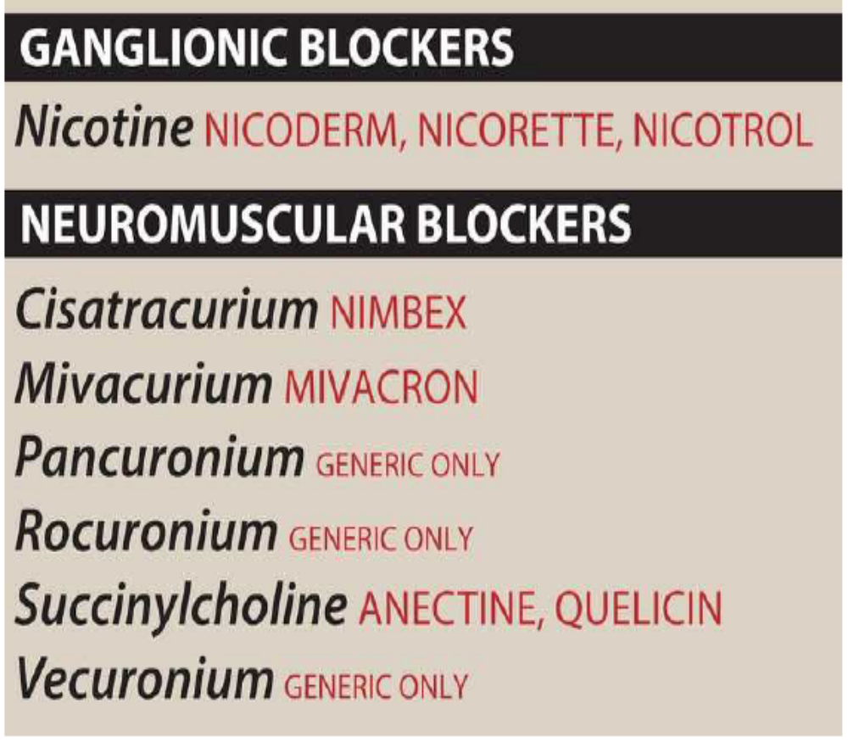

Slide 24
Antimuscarinic Agents
Commonly known as anticholinergic drugs, these agents (for example, atropine and scopolamine) block muscarinic receptors, causing inhibition of muscarinic functions. In addition, these drugs block the few exceptional sympathetic neurons that are cholinergic, such as those innervating the salivary and sweat glands. Because they do not block nicotinic receptors, the anticholinergic drugs (more precisely, antimuscarinic drugs) have little or no action at skeletal neuromuscular junctions (NMJs) or autonomic ganglia. The anticholinergic drugs are beneficial in a variety of clinical situations. [Note: A number of antihistamines and antidepressants (mainly tricyclic antidepressants) also have antimuscarinic activity.]

Slide 25
Atropine
Atropine is a tertiary amine extracted from belladonna alkaloid. It has a high affinity for muscarinic receptors and binds competitively to prevent ACh from binding. Atropine acts both centrally and peripherally. General actions last about 4 hours; however, effects of topical administration in the eye may persist for days. Neuroeffector organs have varying sensitivity to atropine. The greatest inhibitory effects are seen in bronchial tissue, salivary and sweat glands, and the heart.
1. Actions
a. Eye
Atropine blocks muscarinic activity in the eye, resulting in mydriasis (dilation of the pupil), unresponsiveness to light, and cycloplegia (inability to focus for near vision). In patients with angle-closure glaucoma, intraocular pressure may rise dangerously.
b. Gastrointestinal (GI)
Atropine (as the active isomer, L-hyoscyamine can be used as an antispasmodic to reduce activity of the GI tract. Atropine and scopolamine are probably the most potent antispasmodic drugs available. Although gastric motility is reduced, hydrochloric acid production is not significantly affected. Thus, atropine is not effective for the treatment of ulcers. Doses of atropine that reduce spasms also reduce saliva secretion, ocular accommodation, and urination. These effects decrease compliance with atropine.
c. Cardiovascular
Atropine produces divergent effects on the cardiovascular system, depending on the dose. At low doses, the predominant effect is a slight decrease in heart rate. This effect results from blockade of M1 receptors on the inhibitory prejunctional (or presynaptic) neurons, thus permitting increased ACh release. Higher doses of atropine cause a progressive increase in heart rate by blocking M2 receptors on the sinoatrial node.

Slide 26
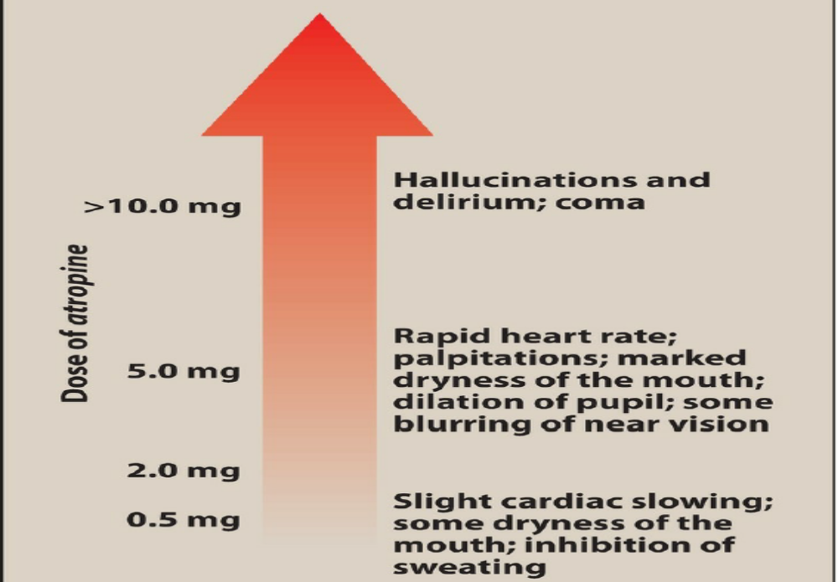

Slide 27
d. Secretions
Atropine blocks muscarinic receptors in the salivary glands, producing dryness of the mouth (xerostomia). The salivary glands are exquisitely sensitive to atropine. Sweat and lacrimal glands are similarly affected. [Note: Inhibition of secretions of sweat glands can cause elevated body temperature, which can be dangerous in children and the elderly.]
2. Therapeutic uses
a. Ophthalmic
Topical atropine exerts both mydriatic and cycloplegic effects, and it permits the measurement of refractive errors without interference by the accommodative capacity of the eye. Shorter-acting antimuscarinics (cyclopentolate and tropicamide) have largely replaced atropine due to prolonged mydriasis observed with atropine (7 to 14 days vs. 6 to 24 hours with other agents).
b. Antispasmodic
Atropine is used as an antispasmodic agent to relax the GI tract.
c. Cardiovascular
Injectable atropine is used to treat bradycardia of varying etiologies.
d. Antisecretory
Atropine is sometimes used as an antisecretory agent to block secretions in the respiratory tract prior to surgery.
e. Antidote for cholinergic agonists
Atropine is used for the treatment of organophosphate (insecticides, nerve gases) poisoning, of overdose of clinically used anticholinesterases such as physostigmine, and in some types of mushroom poisoning (certain mushrooms contain cholinergic substances that block cholinesterases). Massive doses of injectable atropine may be required over a long period to counteract the poisons. The ability of atropine to enter the central nervous system (CNS) is of particular importance in treating central toxic effects of anticholinesterases.

Slide 28
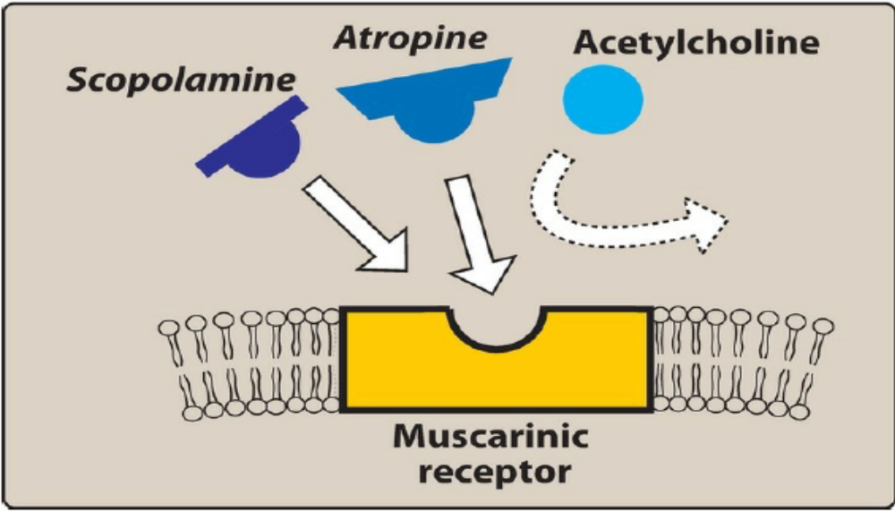

Slide 29
Scopolamine
Scopolamine, another tertiary amine plant alkaloid, produces peripheral effects similar to those of atropine. However, scopolamine has greater action on the CNS (unlike atropine, CNS effects are observed at therapeutic doses) and a longer duration of action as compared to atropine. It has some special actions as indicated below.
1. Actions
Scopolamine is one of the most effective drugs available for motion sickness. It also has the unusual effect of blocking short-term memory. In contrast to atropine, scopolamine produces sedation, but at higher doses, it can produce excitement. Scopolamine may produce euphoria and is susceptible to abuse.

Slide 30
Aclidinium, glycopyrrolate, ipratropium, and tiotropium
Ipratropium and tiotropium are quaternary derivatives of tropine, and glycopyrrolate and aclidinium are synthetic quaternary compounds.
Ipratropium is classified as a short-acting muscarinic antagonist (SAMA), while glycopyrrolate, tiotropium, and aclidinium are classified as long-acting muscarinic antagonists (LAMAs) based on the duration of action.
These agents are approved as bronchodilators for maintenance treatment of bronchospasm associated with chronic obstructive pulmonary disease (COPD). Ipratropium and tiotropium are also used in the acute management of bronchospasm in asthma and chronic management of asthma, respectively. All of these agents are delivered via inhalation. Because of the positive charge, these drugs do not enter the systemic circulation or the CNS, restricting effects to the pulmonary system.

Slide 31
Tropicamide and cyclopentolate
These agents are used as ophthalmic solutions for mydriasis and cycloplegia. Their duration of action is shorter than that of atropine. Tropicamide produces mydriasis for 6 hours and cyclopentolate for 24 hours.
Benztropine and trihexyphenidyl
Benztropine and trihexyphenidyl are useful as adjuncts with other antiparkinson agents to treat Parkinson disease and other types of parkinsonian syndromes, including antipsychotic-induced extrapyramidal symptoms.

Slide 32
Oxybutynin and other antimuscarinic agents for overactive bladder
Oxybutynin, darifenacin, fesoterodine, solifenacin, tolterodine, and trospium are synthetic atropine-like drugs with antimuscarinic actions.
1. Actions
By competitively blocking muscarinic (M3) receptors in the bladder, intravesical pressure is lowered, bladder capacity is increased, and the frequency of bladder contractions is reduced. Antimuscarinic actions at M3 receptors in the GI tract, salivary glands, CNS, and eye may cause adverse effects. Darifenacin and solifenacin are relatively more selective M3 muscarinic receptor antagonists; however, the other drugs are mainly nonselective muscarinic antagonists, and binding to other muscarinic receptor subtypes may contribute to adverse effects.
2. Therapeutic uses
These agents are used for management of overactive bladder and urinary incontinence. Oxybutynin is also used in patients with neurogenic bladder.
4. Adverse effects
Side effects include dry mouth, constipation, and blurred vision, which limit tolerability of these agents. Extended release formulations and the transdermal patch have a lower incidence of adverse effects and may be better tolerated. Trospium is a quaternary compound that minimally crosses the blood–brain barrier and has fewer CNS effects than do other agents, making it a preferred choice in treating overactive bladder in patients with dementia.

Slide 33
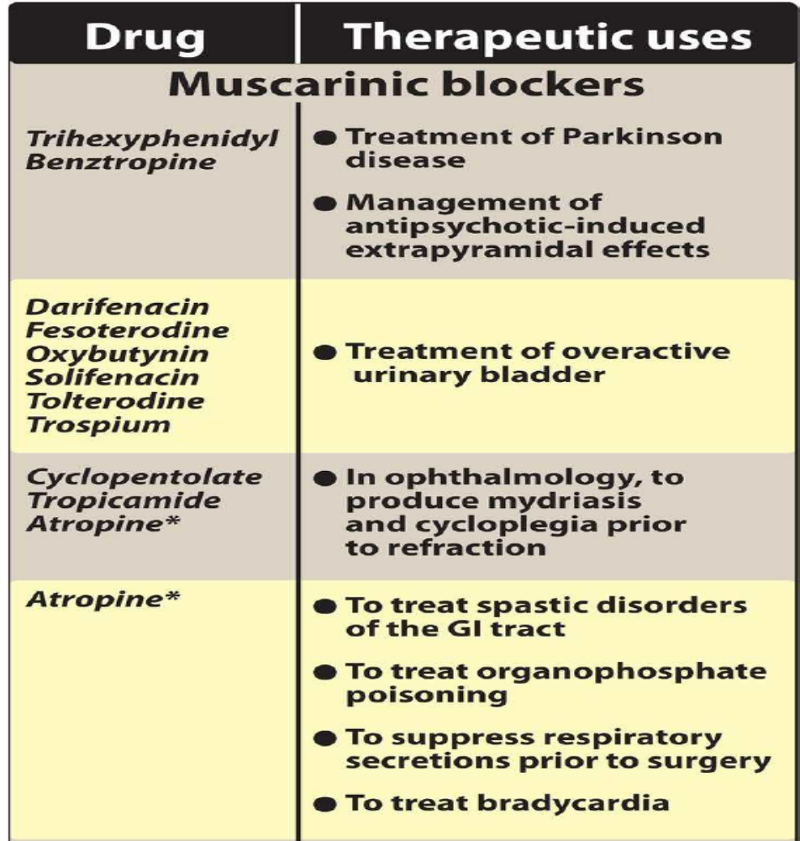
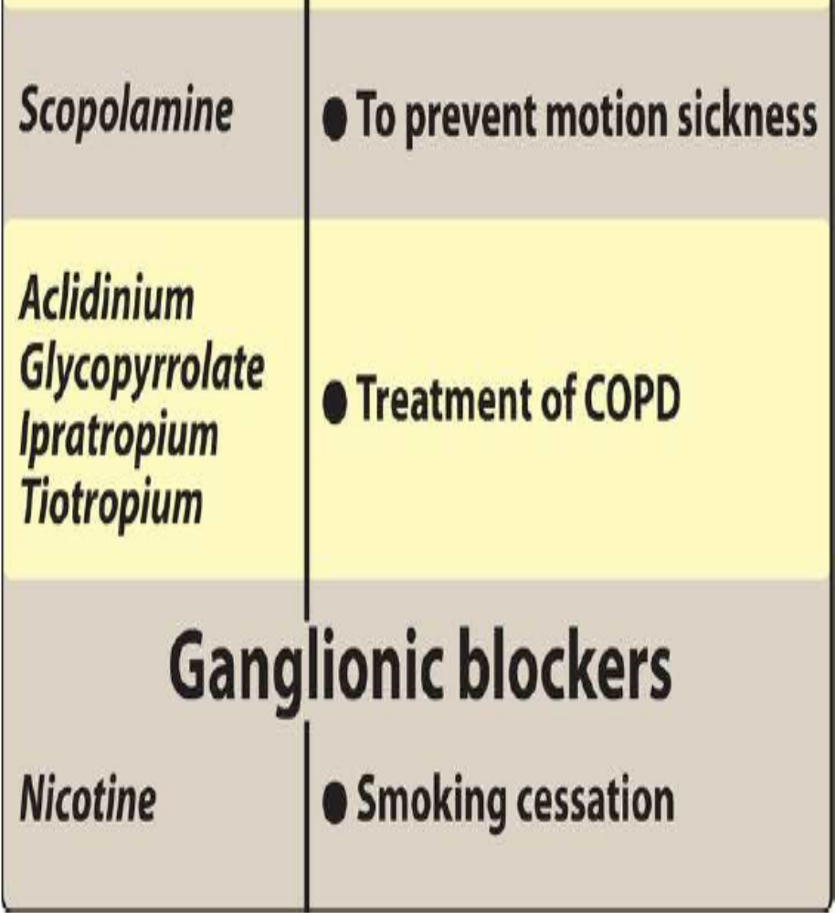

Slide 34
Neuromuscular Blocking Agents
REVIEW PLZ
These drugs block cholinergic transmission between motor nerve endings and the nicotinic receptors on skeletal muscle. They possess some chemical similarities to ACh and act either as antagonists (nondepolarizing) or as agonists (depolarizing) at the receptors on the endplate of the NMJ. Neuromuscular blockers (NMBs) are clinically useful to facilitate rapid intubation when needed due to respiratory failure (rapid sequence intubation).
During surgery, they are used to facilitate endotracheal intubation and provide complete muscle relaxation at lower anesthetic doses. This increases the safety of anesthesia by allowing patients to recover quickly and completely.
NMBs should not substitute for inadequate anesthesia. NMBs are also used in the intensive care unit (ICU) as adjuvant therapy to facilitate intubation and mechanical ventilation in critically ill patients.

Slide 35
Adrenergic Agonists
The adrenergic drugs affect receptors that are stimulated by norepinephrine (noradrenaline) or epinephrine (adrenaline).
These receptors are known as adrenergic receptors or adrenoceptors. Drugs that activate adrenergic receptors are termed Sympathomimetics, and drugs that block activation of adrenergic receptors are termed sympatholytics.
Some sympathomimetics directly activate adrenergic receptors (direct-acting agonists),
while others act indirectly by enhancing release or blocking reuptake of norepinephrine (indirect-acting agonists).

Slide 36
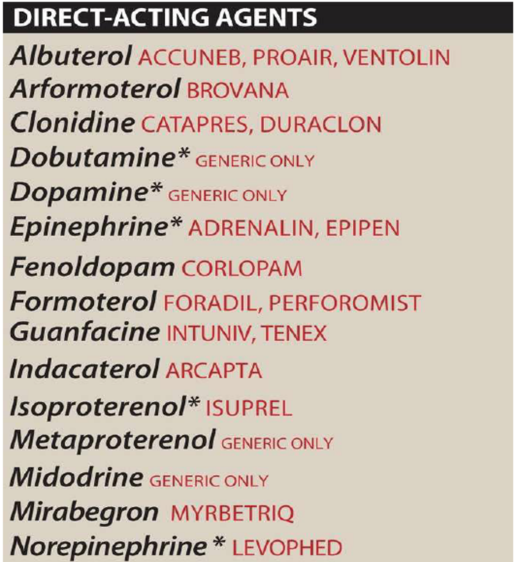
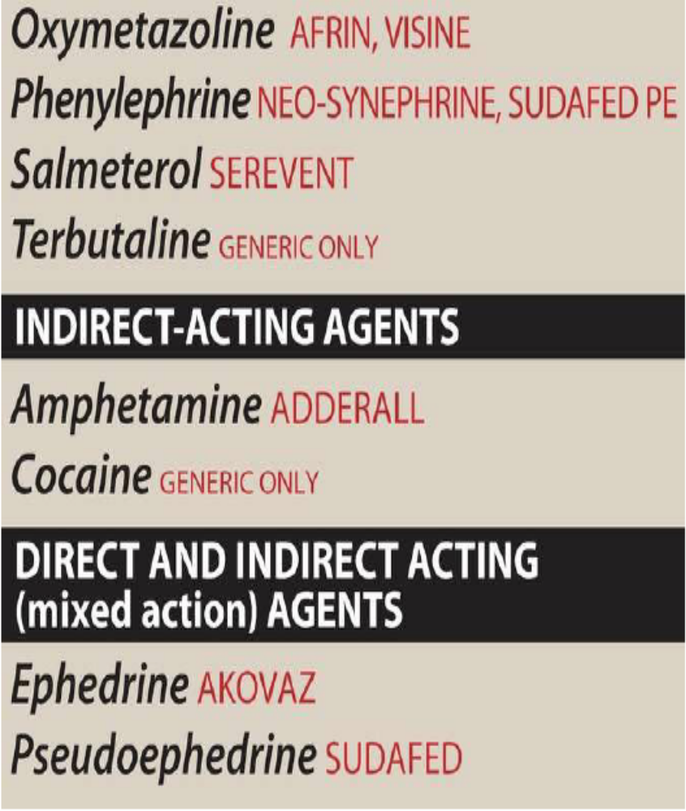

Slide 37
Mechanism of action of adrenergic agonists
1. Direct-acting agonists
These drugs act directly on α or β receptors, producing effects similar to those that occur following stimulation of sympathetic nerves or release of epinephrine from the adrenal medulla. Examples of direct-acting agonists include epinephrine, norepinephrine, isoproterenol, dopamine, and phenylephrine
2. Indirect-acting agonists
These agents may block the reuptake of norepinephrine or cause the release of norepinephrine from the cytoplasmic pools or vesicles of the adrenergic neuron. The norepinephrine then traverses the synapse and binds to α or β receptors. Examples of reuptake inhibitors and agents that cause norepinephrine release include cocaine and amphetamine, respectively
3. Mixed-action agonists
Ephedrine and its stereoisomer, pseudoephedrine, both stimulate adrenoceptors directly and enhance release of norepinephrine from the adrenergic neuron

Slide 38
Epinephrine
Epinephrine is one of the four catecholamines (epinephrine, norepinephrine, dopamine, and dobutamine) commonly used in therapy. The first three are naturally occurring neurotransmitters, and the latter is a synthetic compound. In the adrenal medulla, norepinephrine is methylated to yield epinephrine, which is stored in chromaffin cells along with norepinephrine. On stimulation, the adrenal medulla releases about 80% epinephrine and 20% norepinephrine directly into the circulation. Epinephrine interacts with both α and β receptors. At low doses, β effects (vasodilation) on the vascular system predominate, whereas at high doses, α effects (vasoconstriction) are the strongest.
1. Actions
a. Cardiovascular
The major actions of epinephrine are on the cardiovascular system. Epinephrine strengthens the contractility of the myocardium (positive inotrope: β1 action) and increases its rate of contraction (positive chronotrope: β1 Action). Therefore, cardiac output increases. These effects increase oxygen demands on the myocardium. Epinephrine activates β1 receptors on the kidney to cause renin release. Renin is an enzyme involved in the production of angiotensin II, a potent vasoconstrictor. Epinephrine constricts arterioles in the skin, mucous membranes, and viscera (α effects), and it dilates vessels going to the liver and skeletal muscle (β2 effects). These combined effects result in a decrease in renal blood flow. Therefore, the cumulative effect is an increase in systolic blood pressure, coupled with a slight decrease in diastolic pressure due to β2 receptor–mediated vasodilation in the skeletal muscle vascular bed

Slide 39
b. Respiratory
Epinephrine causes powerful bronchodilation by acting directly on bronchial smooth muscle (β2 action). It also inhibits the release of allergy mediators such as histamine from mast cells
c. Hyperglycemia
Epinephrine has a significant hyperglycemic effect because of increased glycogenolysis in the liver (β2 effect), increased release of glucagon (β2 effect), and a decreased release of insulin (α2 effect).
d. Lipolysis
Epinephrine initiates lipolysis through agonist activity on the β receptors of adipose tissue. Increased levels of cAMP stimulate a hormone-sensitive lipase, which hydrolyzes triglycerides to free fatty acids and glycerol.
2. Therapeutic uses
a. Bronchospasm
Epinephrine is the primary drug used in the emergency treatment of respiratory conditions when bronchoconstriction has resulted in diminished respiratory function. Thus, in treatment of anaphylactic shock, epinephrine is the drug of choice and can be lifesaving in this setting. Within a few minutes after subcutaneous administration, respiratory function greatly improves.
a. Anaphylactic shock
Epinephrine is the drug of choice for the treatment of type I hypersensitivity reactions (including anaphylaxis) in response to allergens.
a. Cardiac arrest
Epinephrine may be used to restore cardiac rhythm in patients with cardiac arrest.
d. Local anesthesia
Local anesthetic solutions may contain low concentrations (for example, 1:100,000 parts) of epinephrine. Epinephrine greatly increases the duration of local anesthesia by producing vasoconstriction at the site of injection. Epinephrine also reduces systemic absorption of the local anesthetic and promotes local hemostasis.
e. Intraocular surgery
Epinephrine is used in the induction and maintenance of mydriasis during intraocular surgery.

Slide 40
Pharmacokinetics
Epinephrine has a rapid onset but a brief duration of action (due to rapid degradation). The preferred route for anaphylaxis in the outpatient setting is intramuscular (anterior thigh) due to rapid absorption. In emergencies, epinephrine is given intravenously (IV) for the most rapid onset of action. It may also be given subcutaneously, by endotracheal tube, or by inhalation. It is rapidly metabolized by MAO and COMT, and the metabolites metanephrine and vanillylmandelic acid are excreted in urine.
Adverse effects
Epinephrine can produce adverse CNS effects that include anxiety, fear, tension, headache, and tremor. It can trigger cardiac arrhythmias, particularly if the patient is receiving digoxin. Epinephrine can also induce pulmonary edema due to increased afterload caused by vasoconstrictive properties of the drug. Patients with hyperthyroidism may have an increased production of adrenergic receptors in the vasculature, leading to an enhanced response to epinephrine, and the dose must be reduced in these individuals. Inhalation anesthetics also sensitize the heart to the effects of epinephrine, which may lead to tachycardia. Epinephrine increases the release of endogenous stores of glucose. In diabetic patients, dosages of insulin may have to be increased. Nonselective β-blockers prevent vasodilatory effects of epinephrine on β2 receptors, leaving α receptor stimulation unopposed. This may lead to increased peripheral resistance and increased blood pressure.

Slide 41
Norepinephrine
Because norepinephrine is the neurotransmitter in the adrenergic neurons, it should, theoretically, stimulate all types of adrenergic receptors. However, when administered in therapeutic doses, the α- adrenergic receptor is most affected.
1. Cardiovascular actions
a. Vasoconstriction
Norepinephrine causes a rise in peripheral resistance due to intense vasoconstriction of most vascular beds, including the kidney (α1 effect). Both systolic and diastolic blood pressures increase. [Note: Norepinephrine causes greater vasoconstriction than epinephrine, because it does not induce compensatory vasodilation via β2 receptors on blood vessels supplying skeletal muscles. The weak β2 activity of norepinephrine also explains why it is not useful in the treatment of bronchospasm or anaphylaxis.]

Slide 42
Dopamine
Dopamine, the immediate metabolic precursor of norepinephrine, occurs naturally in the CNS in the basal ganglia, where it functions as a neurotransmitter, as well as in the adrenal medulla. Dopamine can activate α- and β-adrenergic receptors. For example, at higher doses, it causes vasoconstriction by activating α1 receptors, whereas at lower doses, it stimulates β1 cardiac receptors. In addition, D1 and D2 dopaminergic receptors, distinct from the α- and β-adrenergic receptors, occur in the peripheral mesenteric and renal vascular beds, where binding of dopamine produces vasodilation. D2 receptors are also found on presynaptic adrenergic neurons, where their activation interferes with norepinephrine release.
1. Actions
Cardiovascular
Dopamine exerts a stimulatory effect on the β1 receptors of the heart, having both positive inotropic and chronotropic effects . At very high doses, dopamine activates α1 receptors on the vasculature, resulting in vasoconstriction.
Dose:
1-5 mcg/kg/min iv(renal dose, low dose)
5-15 mcg/kg/min iv (cardiac dose, medium dose)
>20 mcg/kg/min iv (vascular dose, high dose)

Slide 43
Fenoldopam
Fenoldopam is an agonist of peripheral dopamine D1 receptors. It is used as a rapid-acting vasodilator to treat severe hypertension in hospitalized patients, acting on coronary arteries, kidney arterioles, and mesenteric arteries. Fenoldopam is a racemic mixture, and the R-isomer is the active component. It undergoes extensive first-pass metabolism and has a 10-minute elimination half-life after IV infusion. Headache, flushing, dizziness, nausea, vomiting, and tachycardia (due to vasodilation) may occur with this agent.
Dobutamine
Dobutamine is a synthetic, direct-acting catecholamine that is primarily a β1 receptor agonist with minor β2 and α1 effects. It increases heart rate and cardiac output with few vascular effects. Dobutamine is used to increase cardiac output in acute heart failure, as well as for inotropic support after cardiac surgery. The drug increases cardiac output and does not elevate oxygen demands of the myocardium as much as other sympathomimetic drugs. Dobutamine should be used with caution in atrial fibrillation, because it increases atrioventricular (AV) conduction. Other adverse effects are similar to epinephrine. Tolerance may develop with prolonged use.

Slide 44
Phenylephrine
Phenylephrine is a direct-acting, synthetic adrenergic drug that binds primarily to α1 receptors. Phenylephrine is a vasoconstrictor that raises both systolic and diastolic blood pressures. It has no effect on the heart itself but, rather, induces reflex bradycardia when given parenterally, making it useful in the treatment of paroxysmal supraventricular tachycardia. The drug is used to treat hypotension in hospitalized or surgical patients (especially those with a rapid heart rate). Large doses can cause hypertensive headache and cardiac irregularities. Phenylephrine acts as a nasal decongestant when applied topically or taken orally. Although data suggest it may not be as effective, phenylephrine has replaced pseudoephedrine in many oral decongestants, since pseudoephedrine has been misused to make methamphetamine. Phenylephrine is also used in ophthalmic solutions for mydriasis.
Midodrine
Midodrine, a prodrug, is metabolized to the pharmacologically active desglymidodrine. It is a selective α1 agonist, which acts in the periphery to increase arterial and venous tone. Midodrine is indicated for the treatment of orthostatic hypotension. The drug should be given three times daily, with doses at 3- or 4-hour intervals. To avoid supine hypertension, doses within 4 hours of bedtime are not recommended.

Slide 45
Clonidine
Clonidine is an α2 agonist used for the treatment of hypertension. It can also be used to minimize symptoms of withdrawal from opiates, tobacco smoking, and benzodiazepines. Both clonidine and the α2 agonist guanfacine may be used in the management of attention deficit hyperactivity disorder. Clonidine acts centrally on presynaptic α2 receptors to produce inhibition of sympathetic vasomotor centers, decreasing sympathetic outflow to the periphery. The most common side effects of clonidine are lethargy, sedation, constipation, and xerostomia. Abrupt discontinuation must be avoided to prevent rebound hypertension
Albuterol, metaproterenol, and terbutaline
Albuterol, metaproterenol, and terbutaline are short-acting β2 agonists (SABAs) used primarily as bronchodilators and administered by a metered-dose inhaler . Albuterol is the SABA of choice for the management of acute asthma symptoms, because it is more selective for β2 receptors than metaproterenol. Inhaled terbutaline is no longer available in the United States, but is still used in other countries. Injectable terbutaline is used off-label as a uterine relaxant to suppress premature labor, and use for this indication should not exceed 72 hours. One of the most common side effects of these agents is tremor, but patients tend to develop tolerance to this effect. Other side effects include restlessness, apprehension, and anxiety. When these drugs are administered orally, they may cause tachycardia or arrhythmia (due to β1 receptor activation), especially in patients with underlying cardiac disease. Monoamine oxidase inhibitors (MAOIs) also increase the risk of adverse cardiovascular effects, and concomitant use should be avoided

Slide 46
Salmeterol, formoterol, and indacaterol
Salmeterol, formoterol, arformoterol (the [R,R]-enantiomer of formoterol), and indacaterol are long-acting β2 selective agonists (LABAs) used for the management of respiratory disorders such as asthma and chronic obstructive pulmonary disease. A single dose by a metered-dose inhalation device, such as a dry powder inhaler, provides sustained bronchodilation over 12 hours, compared with less than 3 hours for albuterol. Unlike formoterol, however, salmeterol has a somewhat delayed onset of action. LABAs are not recommended as monotherapy for the treatment of asthma, because they have been shown to increase the risk of asthma-related deaths; however, these agents are highly efficacious when combined with an asthma controller medication such as an inhaled corticosteroid.
Mirabegron
Mirabegron is a β3 agonist that relaxes the detrusor smooth muscle and increases bladder capacity. It is used for patients with overactive bladder. Mirabegron may increase blood pressure and should not be used in patients with uncontrolled hypertension. It increases levels of digoxin and inhibits the CYP2D6 isozyme, which may enhance the effects of other medications metabolized by this pathway (for example, metoprolol).
Tyramine
Tyramine is not a clinically useful drug, but it is important because it is found in fermented foods, such as aged cheese and Chianti wine. It is a normal by-product of tyrosine metabolism. Normally, it is oxidized by MAO in the gastrointestinal tract, but if the patient is taking MAOIs, it can precipitate serious vasopressor episodes. Like amphetamines, tyramine can enter the nerve terminal and displace stored norepinephrine. The released catecholamine then acts on adrenoreceptors.

Slide 47
Adrenergic Antagonists
The adrenergic antagonists (also called adrenergic blockers or sympatholytics) bind to adrenoceptors but do not trigger the usual receptor-mediated intracellular effects. These drugs act by either reversibly or irreversibly attaching to the adrenoceptors, thus preventing activation by endogenous or exogenous agonists. Like the agonists, the adrenergic antagonists are classified according to their relative affinities for α or β receptors in the sympathetic nervous system. Numerous adrenergic antagonists have important roles in clinical medicine, primarily to treat diseases associated with the cardiovascular system.

Slide 48
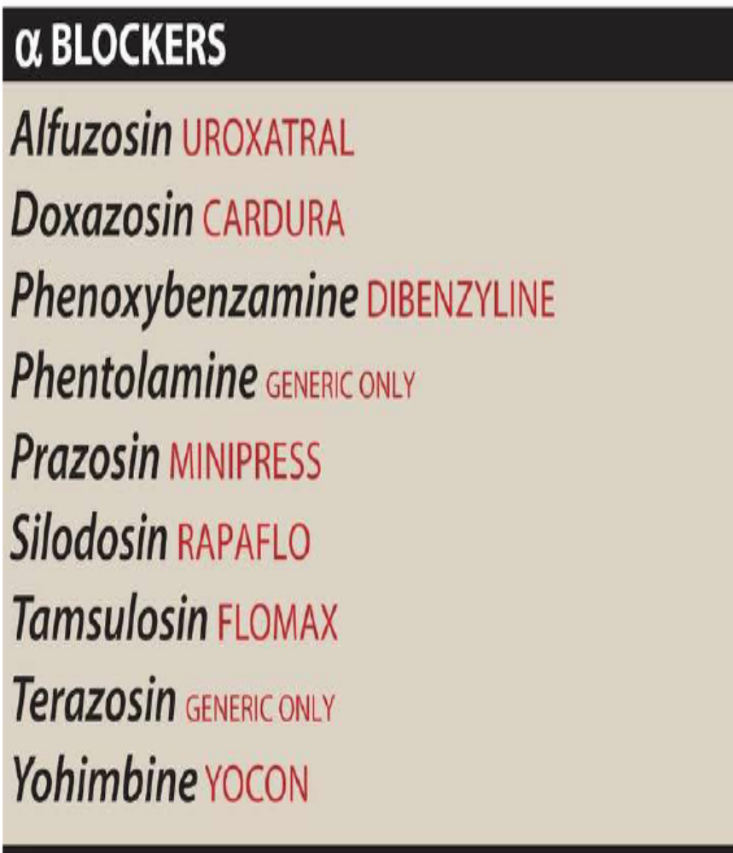
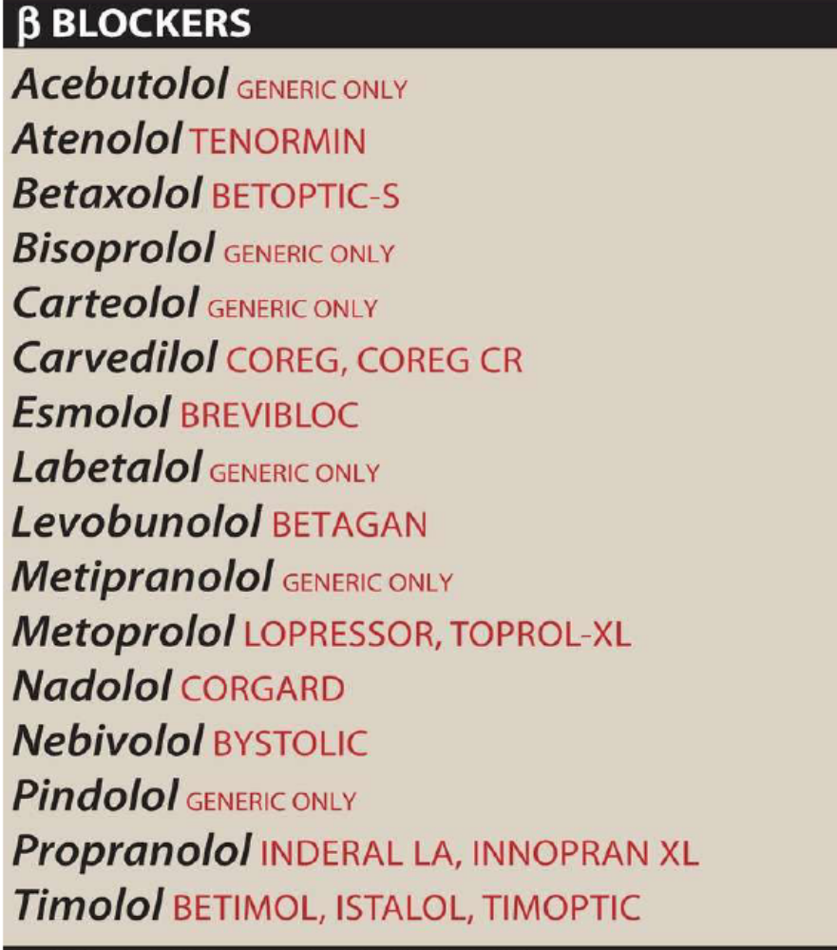

Slide 49
α-Adrenergic Blocking Agents
α-Adrenergic blocking agents antagonize the subtype(s) of α-adrenergic receptors (α1 or α2), depending on the specificity of the agent for the receptor subtype(s). Drugs that block α1-adrenoceptors profoundly affect blood pressure. Because normal sympathetic control of the vasculature occurs in large part through agonist actions on α1- adrenergic receptors, blockade of these receptors reduces the sympathetic tone of the blood vessels, resulting in decreased peripheral vascular resistance. This lowered blood pressure induces reflex tachycardia. The magnitude of the response depends on the sympathetic tone of the individual when the agent is given. Selective α2-adrenergic blockers have limited clinical utility.

Slide 50
Phenoxybenzamine (α) | Vasodilation, ↓peripheral Resistance, Reflex tachycardia, ↓BP, Epinephrine Reversal. Used in Pheochromocytoma, Ranaud's Desease. Adverse: postural hypotension, nasal stuffiness, nausea, and vomiting, Sexual dysfunction
Phentolamine (α) | Vasodilation, ↓peripheral Resistance, Reflex tachycardia, ↓BP, Epinephrine Reversal.Used in Pheochromocytoma, Impotense, Ranaud's Desease. Adverse:Postural hypotension, nasal stuffiness, nausea, and vomiting, Sexual dysfunction, arythmias, anginal pain
Doxazocin, Prazocin, Trazocin, Alfuzocin, Tamsulosin(α1) | Vasodilation, ↓peripheral Resistance, ↓BP1st three are used in Hypertension, 1st dose effect.other 2 are used in benign prostatic hyperplasia or BPH Adverse: dizziness, a lack of energy, nasal congestion, headache, drowsiness, and orthostatic hypotension

Slide 51
the first dose of these drugs may produce an exaggerated orthostatic hypotensive response that can result in syncope (fainting). This action, termed a “first-dose” effect, may be minimized by adjusting the first dose to one-third or one-fourth of the normal dose and by giving the drug at bedtime.
α1-Blockers such as prazosin and doxazosin may cause dizziness, a lack of energy, nasal congestion, headache, drowsiness, and orthostatic hypotension (although to a lesser degree than that observed with phenoxybenzamine and phentolamine). An additive antihypertensive effect occurs when α1 antagonists are given with vasodilators such as nitrates or PDE-5 inhibitors (for example, sildenafil), thereby necessitating cautious dose titration and use at the lowest possible doses. These agents may cause “floppy iris syndrome,” a condition in which the iris billows in response to intraoperative eye surgery

Slide 52
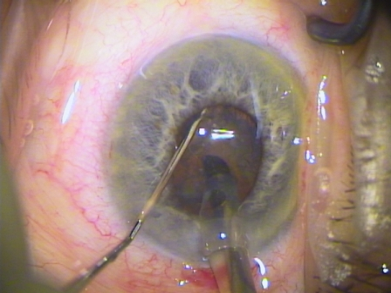
a triad of intraoperative signs beyond poor pupil dilation: iris billowing and floppiness; iris prolapse to the main and side incisions; and progressive miosis. Particularly if such iris behavior is unexpected, the rate of complications such as posterior capsule rupture, vitreous loss, and iris trauma is increased.

Slide 53
β-Adrenergic Blocking Agents
All of the clinically available β-blockers are competitive antagonists. Nonselective β-blockers act at both β1 and β2 receptors, whereas cardioselective β antagonists primarily block β1 receptors. These drugs also differ in intrinsic sympathomimetic activity (ISA), CNS effects, blockade of sympathetic receptors, vasodilation, and pharmacokinetics. Although all β-blockers lower blood pressure, they do not induce postural hypotension, because the α- drenoceptors remain functional. Therefore, normal sympathetic control of the vasculature is maintained. β-Blockers are effective in treating systemic as well as portal hypertension, angina, cardiac arrhythmias, myocardial infarction, heart failure, hyperthyroidism, and glaucoma.
They are also used for the prophylaxis of migraine headaches. [Note: The names of all β-blockers end in “-olol”except for labetalol and carvedilol.]

Slide 54
Propranolol(β) | Actions: ↓HR, ↓HT, ↓Heart O2 Demand, ↓BP, no Postural Hypotensin due to Peripheral Vasoconstriction, Bronchoconstriction, ↓Renel Flow due to ↓BP results in Na Retention, disturbances in glucose metabolism, blocks action of Isoproterinol.Uses: Hypertension, glaucoma, angina, hyperthyroidism, Myocardial Infarction, Migrain prophylaxisAdverse: Bronchoconstriction, Arrhythmias, Sexual impairment, Disturbances in metabolism.
Timolol, Nadolol (β) | more potent than propranolol, with longer duration of action.Used in Glaucoma, & occasionally, for systemic treatment of hypertension
Acebutolol, Atenolol, Esmolol, Metoprolol(β1) | antagonize β1 receptors at doses 50- to 100-fold less than those required to block β2 receptors. ↓BP in hypertension and increase exercise tolerance in angina. Esmolol has a very short lifetime. little effect on pulmonary function, peripheral resistance, and carbohydrate metabolismuseful in hypertensive patients with impaired pulmonary function, & Diabetes. Atenolol (Glaucoma) Adverse:dizziness, drowsiness, fatigue, bradycardia

Slide 55
Acebutolol, Pindolol(β1-ISA) | intrinsic sympathomimetic activity, i.e, stimulate β1,2.effective in hypertensive patients with moderate bradycardia
Labetolol, Carvedilol(α, β) | Peripheral vasodilation, ↓BP, useful in treating hypertensive patients for whom increased peripheral vascular resistance is undesirable.Labetalol may be employed as an alternative to methyldopa in the treatment of pregnancy-induced hypertension.Adverse:Orthostatic hypotension and dizziness

