Slide 1
Opioid Analgesics
Dr.Samaher Jaber Younis
BCPS

Slide 2
Pain
Pain is defined as an unpleasant sensation that can be either acute or chronic and is a consequence of complex neurochemical processes in the peripheral and central nervous systems associated with actual or potential tissue damage. The clinician must rely on the patient’s perception and description of pain. Alleviation of pain depends on the specific type of pain (nociceptive or neuropathic pain). For example, with mild-to-moderate arthritic pain (nociceptive pain), non opioid analgesics such as nonsteroidal anti-inflammatory drugs are often effective. Neuropathic pain responds best to anticonvulsants, tricyclic antidepressants, or serotonin/norepinephrine reuptake inhibitors. However, for severe acute pain or chronic malignant or nonmalignant pain, opioids can be considered as part of the treatment plan in select patients.
Opioids are natural, semisynthetic, or synthetic compounds that produce morphine-like effects. All opioids act by binding to specific opioid receptors in the CNS to produce effects that mimic the action of endogenous peptide neurotransmitters (for example, endorphins, enkephalins, and dynorphins). Their primary use is to relieve intense pain that results from surgery, injury, or chronic disease. Unfortunately, widespread availability of opioids has led to abuse of agents with euphoric properties. Antagonists that reverse the actions of opioids are also clinically important for use in cases of overdose

Slide 3
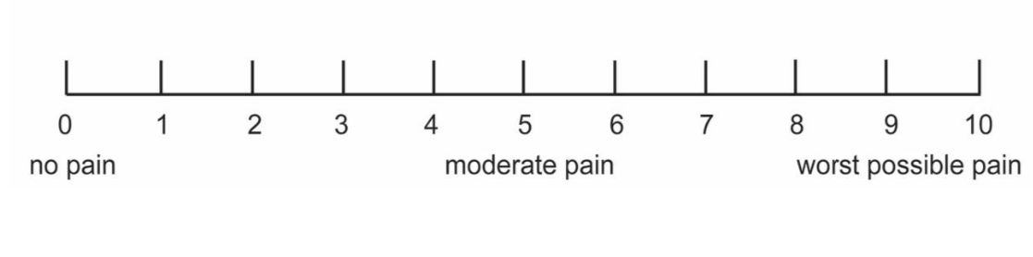
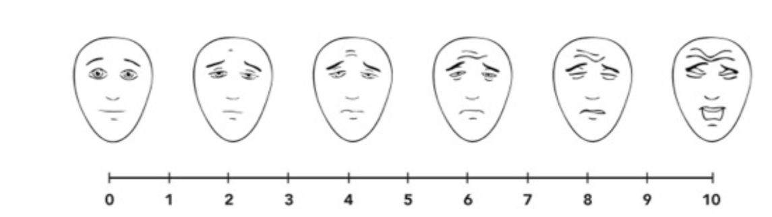
Assessment of Severity
Visual Analogue Scale Ask the patient to show what his/her pain is on a scale of 0 to 10.
Faces Pain Scale

Slide 4
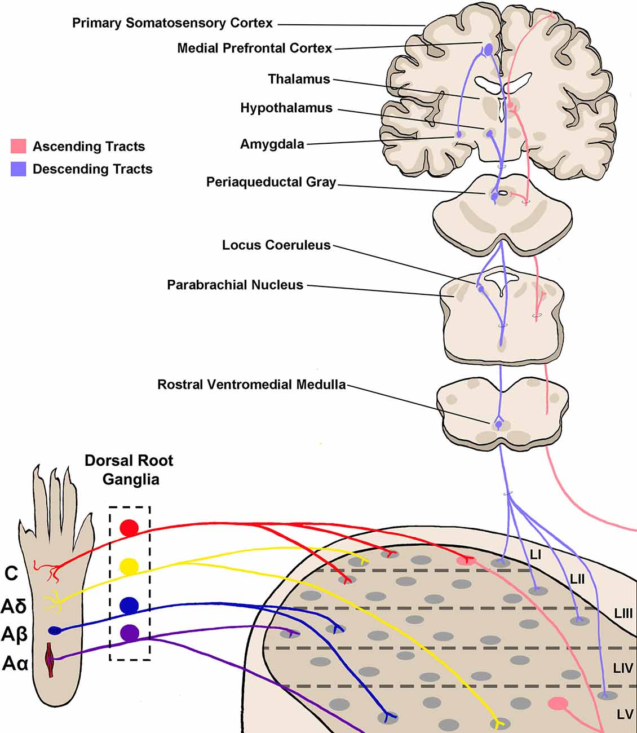
PAIN PHYSIOLOGY
4steps:
– Periphery (Transduction)
– Spinal cord (transmission)
– Brain (perception)
– Modulation

Slide 5
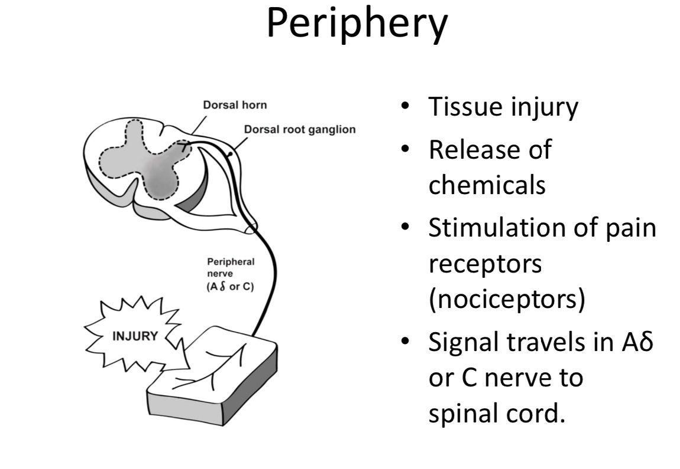

Slide 6
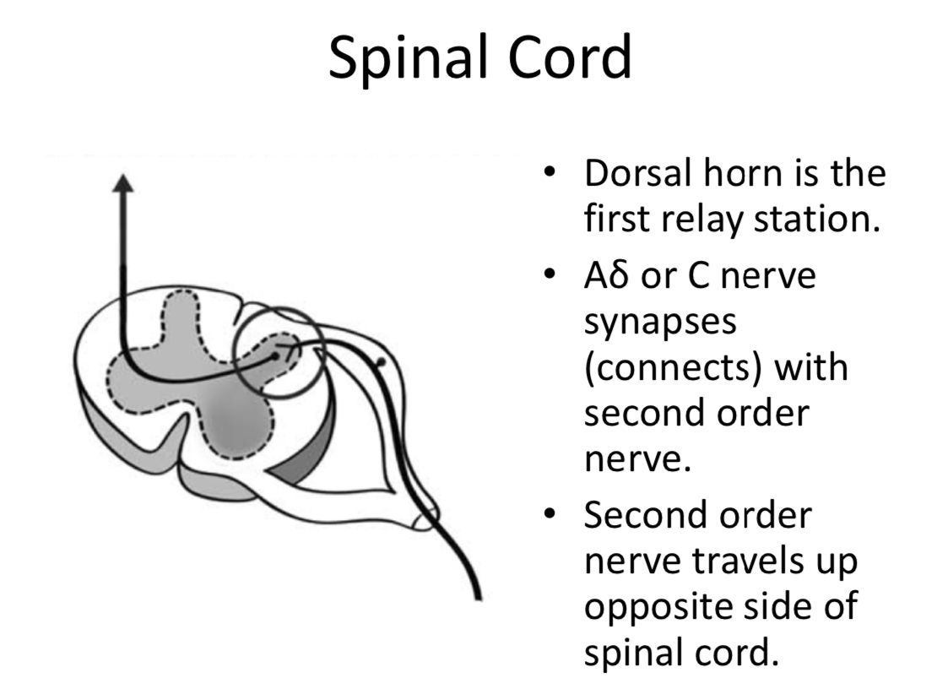

Slide 7
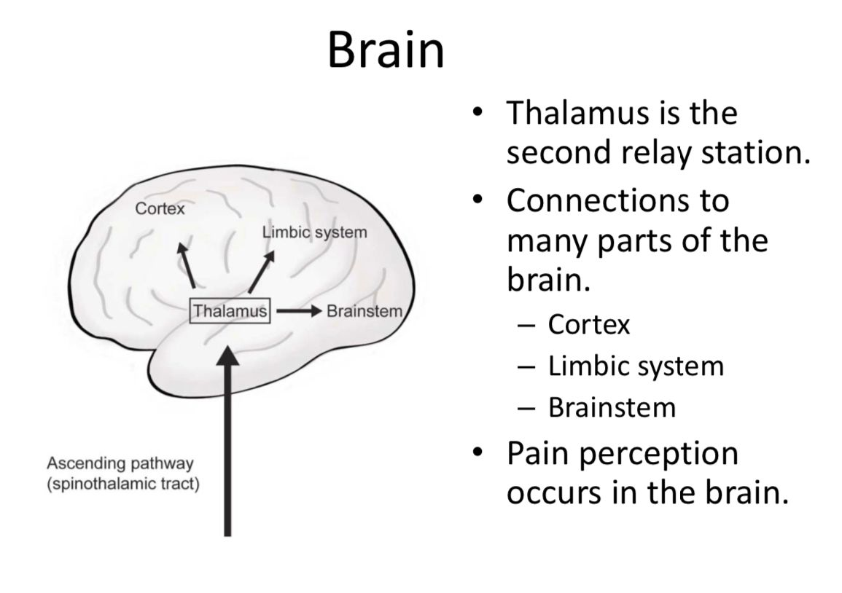

Slide 8
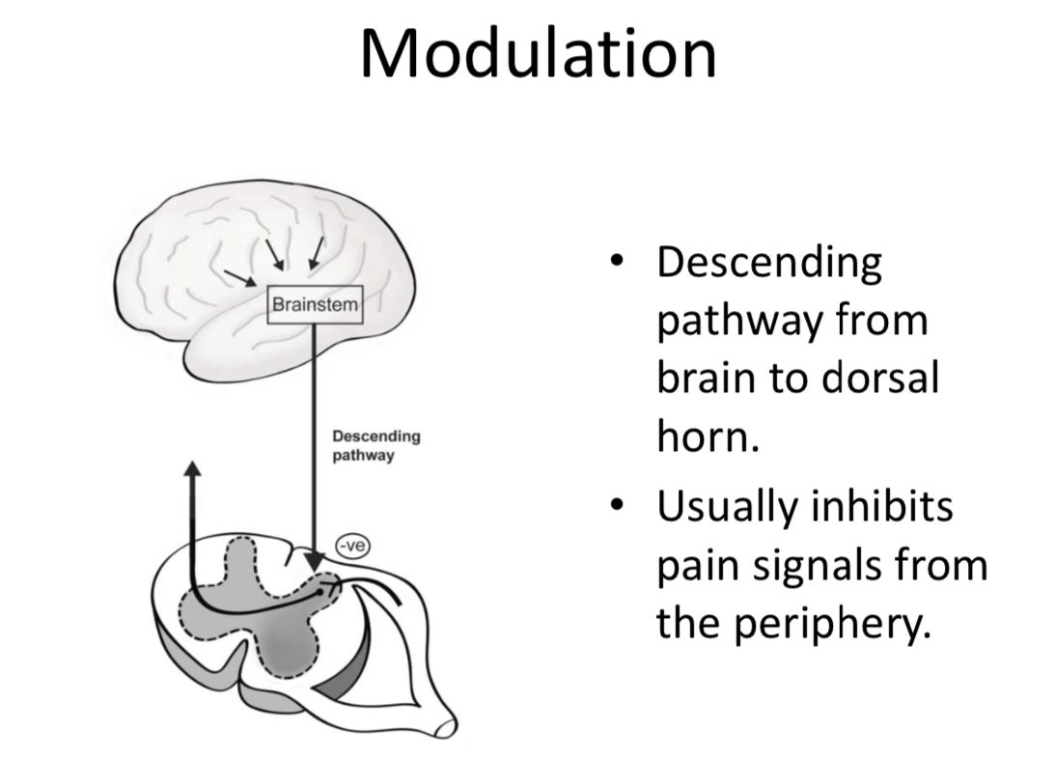
proenkephalin peptides are present in areas of the CNS that are presumed to be related to the perception of pain (e.g., laminae I and II of the spinal cord, the spinal trigeminal nucleus, and the periaqueductal gray), to the modulation of affective behavior (e.g., amygdala, hippocampus, locus ceruleus, and the frontal cerebral cortex), to the modulation of motor control (e.g.,caudate nucleus and globus pallidus), to the regulation of the autonomic nervous system (e.g., medulla oblongata),

Slide 9
OPIOID RECEPTORS
The major effects of the opioids are mediated by three main receptor families, commonly designated as μ (mu, MOR), κ (kappa, KOR), and δ (delta, DOR). Each receptor family exhibits a different specificity for the drug(s) it binds. The analgesic properties of the opioids are primarily mediated by the μ receptors that modulate responses to thermal, mechanical, and chemical nociception. The κ receptors in the dorsal horn also contribute to analgesia by modulating the response to chemical and thermal nociception. The enkephalins interact more selectively with δ receptors in the periphery. All three opioid receptors are members of the G protein–coupled receptor family and inhibit adenylyl cyclase. They are also associated with ion channels, increasing postsynaptic K+ efflux (hyperpolarization) or reducing presynaptic Ca2+ influx, thus impeding neuronal firing and transmitter release in the spinal dorsal horn

Slide 10
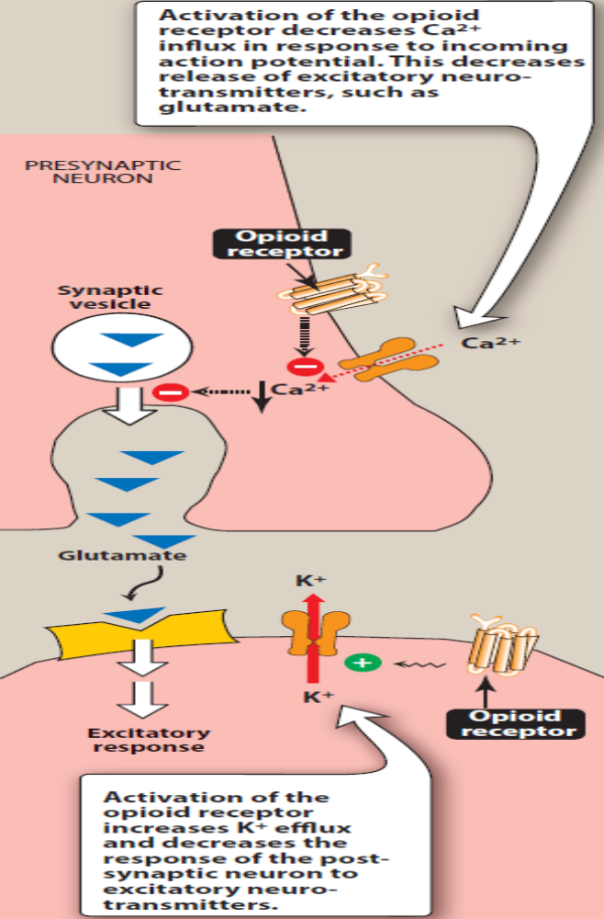
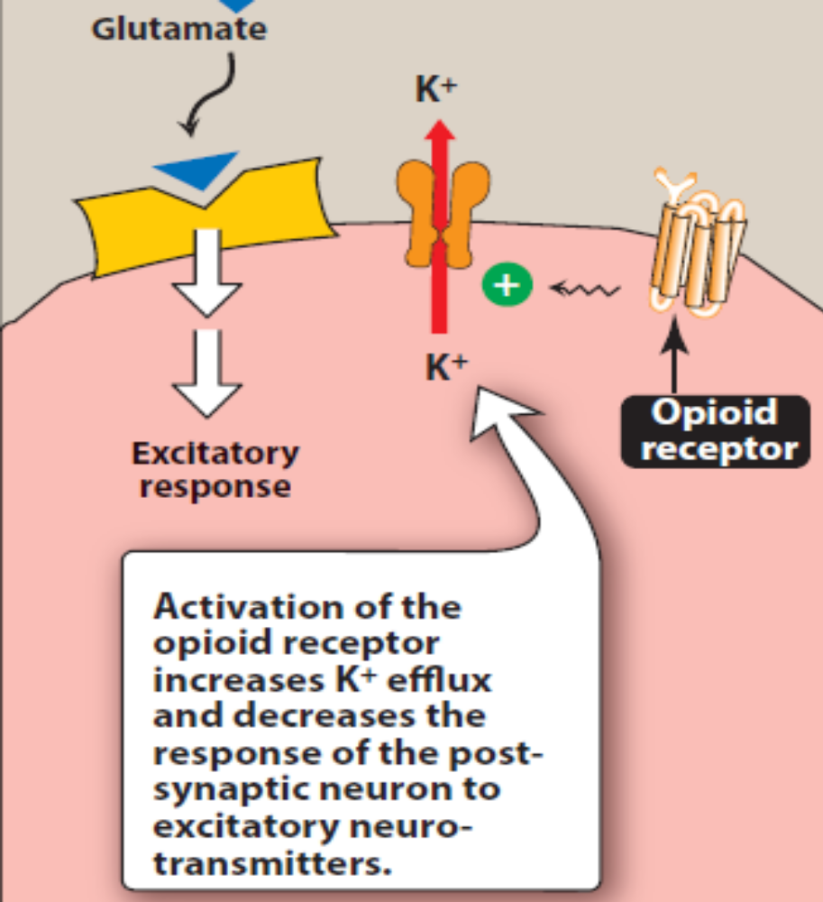

Slide 11
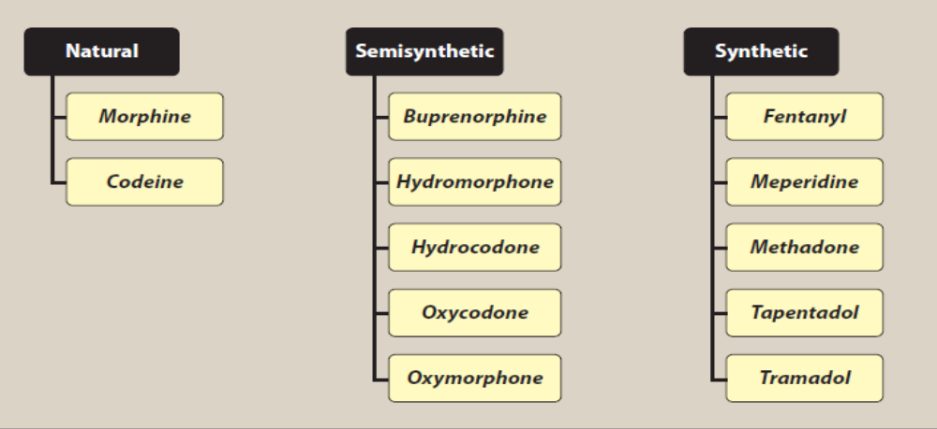
OPIOID AGONISTS

Slide 12
Morphine
Morphine is a plant alkaloid isolated from the latex of opium poppy (Papaver somiferum). Morphine was isolated from opium and named representing the Greek God of Dreams “Morpheus.” The name “opium” was derived from the Greek word “opos,” which means juice. The compounds derived from morphine are generalized as “opiates.” The receptor on which morphine acts is called opioid receptors. Endorphins are the endogenous peptide ligands found in the brain for opioid receptors. The addictive liability of compounds associated with opioids and other compounds are generally called narcotics. In the legal context, the Greek word “narkotikos” which means “benumbing” or the “state of stupor” refers to substances of abuse or substances with addictive liabilities.

Slide 13
Mechanism of action:
Morphine and other opioids exert analgesic effects by interacting stereospecifically with opioid receptors on the membranes of neuronal cells in the CNS and other anatomic structures, such as the smooth muscles of the gastrointestinal (GI) tract and the urinary bladder. Morphine is somewhat selective to the μ opioid receptor, but has some affinity for the κ and δ receptors. Morphine also inhibits the release of many excitatory transmitters from nerve terminals carrying nociceptive (painful) stimuli.
Actions:
a. Analgesia: Morphine and other opioids relieve pain by raising the pain threshold at the spinal cord level and by altering the brain’s perception of pain.
b. Euphoria: Morphine produces a powerful sense of contentment and well-being. Euphoria may be caused by disinhibition of the dopamine-containing neurons of the ventral tegmental area. In normal pain-free individuals, analgesic doses of morphine can cause dysphoria.
c. Respiration: Morphine causes respiratory depression by reduction of the responsiveness of medullary respiratory center neurons to carbon dioxide. This can occur with ordinary doses of morphine in patients who are opioid-naive and can be accentuated as the dose is increased, until ultimately respiration ceases. Respiratory depression is the most common cause of death in acute opioid overdoses. Tolerance to this effect develops with repeated dosing, which allows for the safer use of morphine for the treatment of pain when the dose is correctly titrated.

Slide 14
d. Depression of cough reflex: Both morphine and codeine have antitussive properties. In general, cough suppression does not correlate closely with analgesic and respiratory depressant properties of opioid drugs. The receptors involved in the antitussive action appear to be different from those involved in analgesia.
e. Miosis: The pinpoint pupil characteristic of morphine uses results from stimulation of μ and κ receptors at the Edinger–Westphal nucleus. There is little tolerance to this effect. [Note: This is important diagnostically, because many other causes of coma and respiratory depression produce dilation of the pupil.]
f. Emesis: Morphine directly stimulates the chemoreceptor trigger zone in the area postrema that causes vomiting.

Slide 15
g. GI tract: Morphine relieves diarrhea by decreasing the motility and increasing the tone of the intestinal circular smooth muscle. Morphine also increases the tone of the anal sphincter. Morphine and other opioids produce constipation, with little tolerance developing. Morphine can also increase biliary tract pressure due to contraction of the gallbladder and constriction of the biliary sphincter (sphincter of Oddi). It can aggravate biliary colic pain to multiple folds. This morphine-induced biliary pain is relieved partially by the administration of atropine and completely by opioid antagonists such as naloxone and other smooth muscle relaxants such as papaverine.
h. Cardiovascular: Morphine has no major effects on blood pressure or heart rate at lower dosages, but hypotension and bradycardia may occur at higher doses. Because of respiratory depression and carbon dioxide retention, cerebral vessels dilate and increase cerebrospinal fluid pressure. Morphine is usually contraindicated in individuals with head trauma or severe brain injury

Slide 16
i. Histamine release: Morphine releases histamine from mast cells causing urticaria, sweating, and vasodilation. Because it can cause bronchoconstriction, morphine should be used with caution in patients with asthma.
j. Hormonal actions: Prolonged use of morphine may lead to opioid-induced androgen deficiency due to suppression of the hypothalamic-pituitary-gonadal axis (HPA).This results in decreased production of sex hormones, especially testosterone, resulting in many clinical symptoms. Decrease prolactin and growth hormone secretions.
k. Labor: Morphine may prolong the second stage of labor by transiently decreasing the strength, duration, and frequency of uterine contractions.
l. Thermoregulation: Morphine decreases the body temperature slightly due to its effect on hypothalamus heat-regulating mechanisms. In opioid withdrawal, elevated body temperature has been observed.
m. Immune system: Morphine shows both direct and indirect effects (through centrally mediated neuronal mechanisms) on the immune system. Opioids in general cause moderate immunosuppression which makes the recipient susceptible for infections and tumor metastasis.

Slide 17
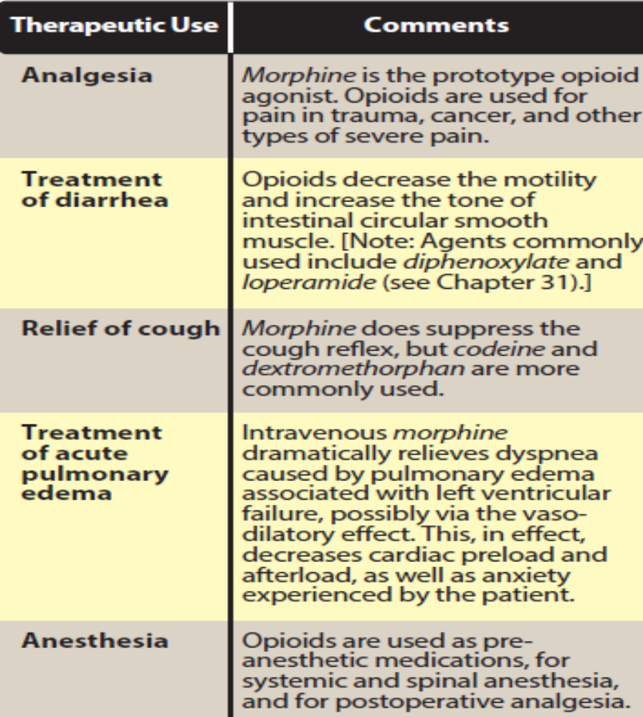
Tolerance and Physical Dependence
The development of tolerance and physical dependence
with repeated use is a characteristic feature of all the opioid drugs.
Tolerance to the effect of opioids or other
drugs simply means that, over time, the drug loses its
effectiveness and an increased dose is required to produce
the same physiological response.
Dependence refers to a complex and poorly understood set of changes in the homeostasis of an organism that causes a disturbance of the homeostatic set point of the organism if the drug is stopped. This disturbance often is revealed when administration of an opioid is stopped abruptly, resulting in withdrawal.
Addiction is a behavioral pattern characterized by
compulsive use of a drug and overwhelming involvement
with its procurement and use. Tolerance and dependence
are physiological responses seen in all patients and are not predictors of addiction

Slide 18
Pharmacokinetics:
Administration: Morphine has a linear pharmacokinetic profile; however, absorption of morphine after oral administration is slow and erratic. Extended-release oral preparations provide more consistent plasma levels. Because significant first-pass metabolism of morphine occurs in the liver, subcutaneous and IV injections produce the most reliable response.
b. Distribution: Morphine rapidly enters all body tissues, including the fetuses of pregnant women. It should not be used for analgesia during labor. Infants born to addicted mothers show physical dependence on opioids and exhibit withdrawal symptoms if opioids are not administered. Only a small percentage of morphine crosses the blood–brain barrier, because morphine is the least lipophilic of the common opioids. By contrast, the more lipid-soluble opioids, such as fentanyl and methadone, readily penetrate the CNS.

Slide 19
c. Fate: Morphine is conjugated with glucuronic acid in the liver to two active metabolites (morphine-6-glucuronide [M6G] and morphine-3-glucuronide [M3G]) which are renally excreted. M6G is a very potent analgesic, and morphine glucuronide metabolites undergo enterohepatic circulation. M3G does not have analgesic activity, but is believed to cause neuroexcitatory effects. The duration of action of morphine is 4 to 5 hours when administered systemically to opioid-naive individuals, but considerably longer when injected epidurally because the low lipophilicity prevents redistribution from the epidural space.
Adverse effects:
Many adverse effects are common across the entire opioid class. With most μ agonists, severe respiratory depression can occur and may result in death from acute opioid overdose. Respiratory drive may be suppressed in patients with respiratory disorders such as obstructive sleep apnea, emphysema, or cor- pulmonale, so close monitoring is necessary when using opioids. Opioid-induced constipation (OIC) is a common adverse effect.

Slide 20
Initial management includes a nonprescription stimulant laxative such as senna. Peripherally acting μ-opioid receptor antagonists such as methylnaltrexone, naloxegol, and naldemedine are prescription drugs available for the treatment of OIC. [Note: Lubiprostone is a chloride channel activator that is indicated for OIC and irritable bowel syndrome. Morphine should be used with caution in patients with liver disease and renal dysfunction.
Tolerance and physical dependence:
Repeated use produces tolerance to the respiratory depressant, analgesic, euphoric, emetic, and sedative effects of morphine. Tolerance usually does not develop to miosis (constriction of the pupils) or constipation. Physical and psychological dependence can occur with morphine and other agonists. Withdrawal produces a series of autonomic, motor, and psychological responses such as goosebumps, muscle spasms, hyperalgesia, lacrimation, rhinorrhea, yawning, sweating, restlessness, dilated pupils, anorexia, irritability, tremors, diarrhea, and flushing that can be severe The abstinence withdrawal peaks at 48 to 72 hours, though generally it is not life threatening except in neonates and the severely debilitated. Administration of an opioid antagonist may precipitate a severe withdrawal reaction.

Slide 21
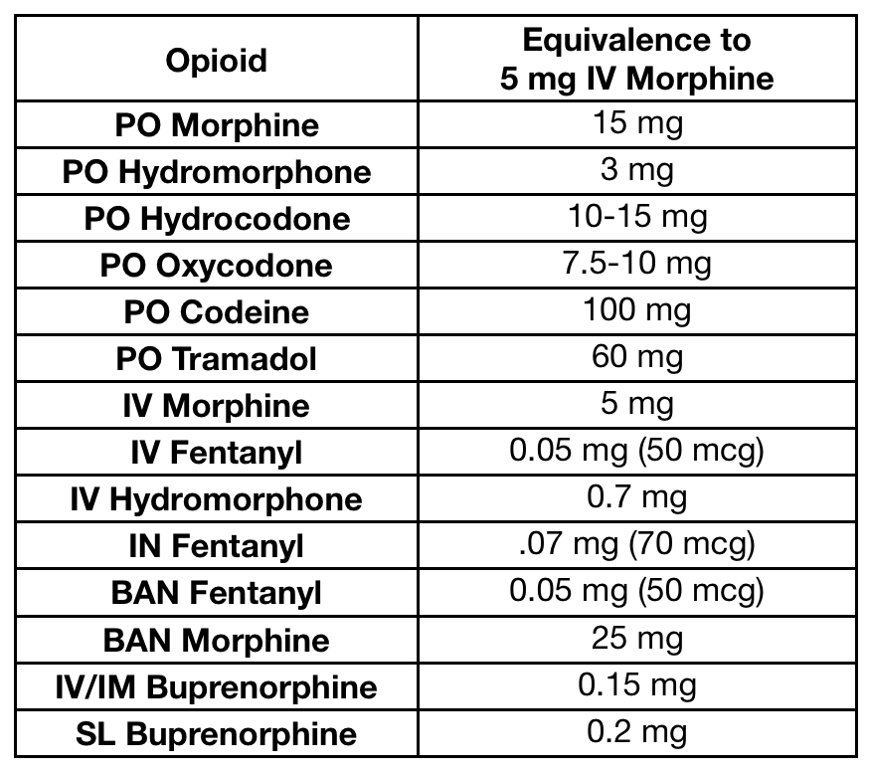
Drug interactions: Drug interactions with morphine are possible. The depressant actions of morphine are enhanced by coadministration with CNS depressant medications such as phenothiazines, monoamine oxidase inhibitors (MAOIs), and benzodiazepines. Guidelines for opioid prescribing urge clinicians to avoid simultaneous prescribing of opioids and benzodiazepines. A black box warning also has been included on the labeling of both opioids and benzodiazepines to alert prescribers of this dangerous combination.

Slide 22
Codeine
Codeine is a naturally occurring opioid and a weak analgesic compared to morphine. It is used for mild-to-moderate pain. The analgesic actions of codeine are derived from its conversion to morphine by the CYP2D6 enzyme. CYP2D6 activity varies among patients, and ultra-rapid metabolizers may experience higher levels of morphine, leading to possible overdose and toxicity. Life threatening respiratory depression and death have been reported in children who received codeine, mostly following tonsillectomy and/or adenoidectomy. Codeine is commonly used in combination with acetaminophen for management of pain. The drug exhibits good antitussive activity at doses that do not cause analgesia. Dextromethorphan is a synthetic cough depressant that has relatively no analgesic action and much lower potential for abuse in usual antitussive doses. It is preferred over codeine in most situations where cough suppression is needed. Noscapine is an opium alkaloid obtained from the plant Papaver somniferum exerts its antitussive effects through the activation of sigma opioid receptors without narcotic, analgesic, or dependence-inducing properties. Noscapine is registered for the treatment of a dry nonproductive cough and is available as a syrup and a tablet.

Slide 23
Oxycodone and oxymorphone
Oxymorphone and oxycodone are orally active, semisynthetic analogs of morphine and codeine, respectively. Oxymorphone given parenterally is approximately 10 times more potent than morphine, but when administered orally the potency drops to about three times that of morphine. Oxymorphone is available in both immediate-release and extended-release oral formulations. This agent has no clinically relevant drug interactions associated with the CYP450 enzyme system. Oxycodone is approximately two times more potent than morphine and is available in an immediate-release formulation, alone or in combination with acetaminophen, aspirin, or ibuprofen. An extended-release formulation is also available. Oxycodone is mainly metabolized via the CYP2D6 and CYP3A4 enzymes.

Slide 24
Hydromorphone and hydrocodone
Hydromorphone and hydrocodone are orally active, semisynthetic analogs of morphine and codeine, respectively. Oral hydromorphone is approximately four to seven times more potent than oral morphine. It is preferred over morphine in patients with renal dysfunction due to less accumulation of active metabolites. Hydrocodone is the methyl ether derivative of hydromorphone, but is a weaker analgesic than hydromorphone, with oral analgesic efficacy comparable to that of morphine. This agent is often combined with acetaminophen or ibuprofen to treat moderate- to-severe pain. It is also used as an antitussive. Hydrocodone is metabolized in the liver to several metabolites, one of which is hydromorphone via the actions of CYP2D6.

Slide 25
Fentanyl
Fentanyl is a synthetic opioid chemically related to pethidine. Fentanyl has 100-folds the analgesic potency of morphine and is used for anesthesia and acute pain management. The drug is highly lipophilic and has a rapid onset and short duration of action (15 to 30 minutes). It is usually administered IV, epidurally, or intrathecally.
Fentanyl is combined with local anesthetics to provide epidural analgesia for labor and postoperative pain. IV fentanyl is used in anesthesia for its analgesic and sedative effects. Many fast-acting transmucosal and nasal fentanyl products are available for cancer-related breakthrough pain in opioid-tolerant patients. The transdermal patch creates a reservoir of the drug in the skin and has a delayed onset of at least 12 hours and a prolonged offset. The patch is used for the management of chronic severe pain. It is contraindicated in opioid-naive patients and should not be used in management of acute or postoperative pain. Fentanyl is metabolized to inactive metabolites by CYP 3A4 and drugs that inhibit this isoenzyme can potentiate the effect of fentanyl.

Slide 26
Sufentanil, alfentanil, remifentanil, and carfentanil
Sufentanil, alfentanil , remifentanil, and carfentanil are synthetic opioid
agonists related to fentanyl. These agents differ in potency and metabolic
disposition. Sufentanil and carfentanil are even more potent than
fentanyl, whereas the other two are less potent and shorter acting.
Sufentanil, alfentanil, and remifentanil are mainly used for their analgesic
and sedative properties during surgical procedures requiring
anesthesia. Carfentanil is about 100 times more potent than fentanyl.
The drug is not used in clinical practice; however, it is of toxicological
interest as it is used to lace heroin and has contributed to several
opioid-related deaths.

Slide 27
Methadone
Methadone is a synthetic, orally effective opioid that has variable equianalgesic potency compared to that of morphine, and the conversion between the two products is not linear. Methadone is a μ agonist, an antagonist of the N-methyl-d-aspartate (NMDA) receptor, and a norepinephrine and serotonin reuptake inhibitor. Therefore, it is useful in the treatment of both nociceptive and neuropathic pain. Methadone may also be used for opioid withdrawal and maintenance therapy in the setting of prescription opioid and heroin abuse. The withdrawal syndrome with methadone is milder but more protracted (days to weeks) than that with other opioids. Methadone induces less euphoria and has a longer duration of action than morphine. Unlike morphine, methadone is well absorbed after oral administration. Methadone is also constipating, but less so than morphine. Methadone can produce physical dependence like that of morphine, but it has less neurotoxicity than morphine due to lack of active metabolites. Methadone can prolong the QTc interval and cause torsades de pointes, possibly by interacting with cardiac potassium channels. Baseline and routine ECG monitoring is recommended

Slide 28
Tramadol
Tramadol is a centrally acting analgesic that binds to the μ opioid receptor. It undergoes extensive metabolism via CYP2D6, leading to an active metabolite which has a much higher affinity for the μ receptor than the parent compound. In addition, it weakly inhibits reuptake of norepinephrine and serotonin. It is used to manage moderate-to-severe pain. Of note, tramadol has less respiratory-depressant activity compared to morphine. Administration of naloxone can only partially reverse tramadol toxicity and has been associated with an increased risk of seizures. Anaphylactoid reactions have been reported. Overdose or drug–drug interactions with SSRIs, MAOIs, and tricyclic antidepressants can lead to toxicity manifested by CNS excitation and seizures. Tramadol should be used with caution in patients with a history of seizures. As with other agents that bind the μ opioid receptor, tramadol has been associated with misuse and abuse.

Slide 29
Diphenoxylate and loperamide
Diphenoxylate and loperamide are used for the treatment of diarrhea.
At a much higher dose, diphenoxylate shows opioid activity including
euphoria. Therefore, diphenoxylate is combined with atropine to
reduce the chance of abusing liability. Definoxin is a metabolite of
diphenoxylate which is also being marketed along with atropine as a
fixed-dose combination. Loperamide shows action similar to that of
diphenoxylate. It exerts its action by interacting with the opioid receptors
in the intestine. Abdominal cramps and constipation are the common
side effects observed with these agents.

Slide 30
Propoxyphene
Propoxyphene is a congener of methadone. However, it has the analgesic activity and side effects similar to those of codeine but less antitussive action. It can be combined with NSAIDs such as paracetamol and aspirin. Its dextro form is found to be analgesic; therefore, it is used as dextropropoxyphene. The levo form is found to have antitussive activity.
PARTIAL AGONISTS AND MIXED AGONIST–ANTAGONISTS
Partial agonists bind to the opioid receptor, but they have less intrinsic activity than full agonists. There is a ceiling to the pharmacologic effects of these agents. Drugs that stimulate one receptor but block another are termed mixed agonist–antagonists. The effects of these drugs depend on previous exposure to opioids. In individuals who are opioid-naive, mixed agonist–antagonists show agonist activity and are used to relieve pain. In the presence of a full agonist, the agonist–antagonist drugs may precipitate opioid withdrawal symptoms.
Pentazocine, Nalbuphine and butorphanol(Mixed)

Slide 31
Buprenorphine
Buprenorphine acts as a potent partial agonist at the μ receptor and an antagonist at the κ receptors. Buprenorphine is very lipophilic and has a longer duration of action due to its high affinity for the opioid receptors when compared to morphine. Due to high affinity for the μ receptor, buprenorphine can displace full μ agonists, leading to withdrawal symptoms in an opioid-dependent patient. Because of the partial μ agonist activity, buprenorphine provides a “ceiling effect,” causing less euphoric effects and a lower abuse potential than that of full agonists. Additionally, the risk of opioid-induced respiratory depression may be lower when compared with full agonists, except when combined with CNS depressants such as benzodiazepines. Buprenorphine is available in sublingual, transmucosal, buccal, parenteral, subdermal, and transdermal formulations.

Slide 32
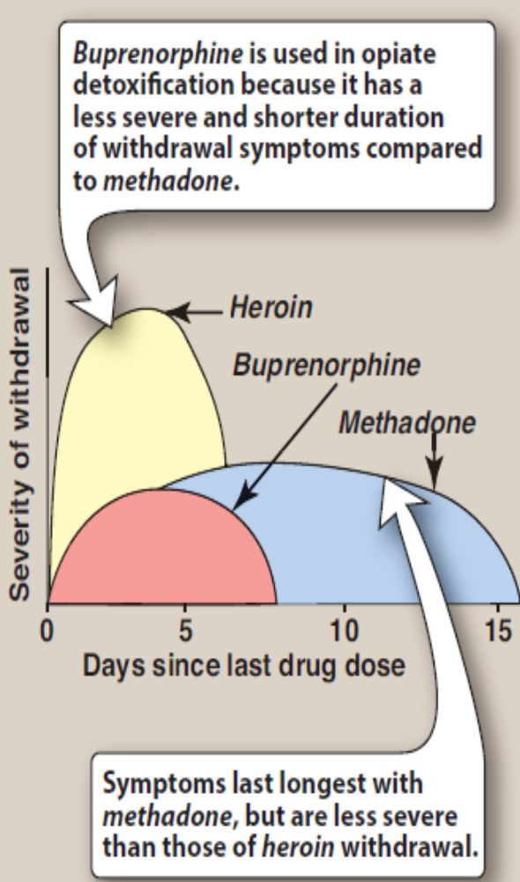
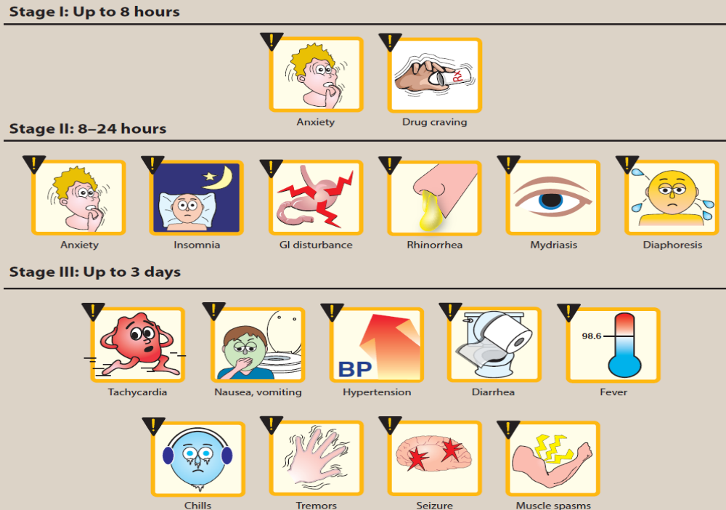
Severity of opioid withdrawal
symptoms after abrupt withdrawal of
equivalent doses of heroin, buprenorphine, and methadone.

Slide 33
Naloxone
Naloxone is a competitive antagonist at μ, κ, and δ receptors, with a 10-fold higher affinity for μ than for κ receptors. It rapidly displaces all receptor-bound opioid molecules and, therefore, can reverse the effects of morphine overdose, such as respiratory depression and coma within 1 to 2 minutes of IV administration. It is also used to diagnose opioid dependence. Naloxone can also be administered intramuscularly, subcutaneously, and intranasally, with a slightly longer onset of 2 to 5 minutes; however, little to no clinical effect is seen with oral naloxone due to extensive first-pass metabolism. Since naloxone has a half-life of 30 to 81 minutes, a patient who has been treated for an overdose and recovered may lapse back into respiratory depression, depending on the opioid ingested and dosage form of that opioid. Therefore, multiple doses should be administered. [Note: Much higher doses and continuous administration of naloxone are needed to reverse the effects of buprenorphine due to its high affinity for the μ receptor.] The duration of action of naloxone lasts for up to 48 hours; it is used to decrease the craving for alcohol.

Slide 34
Naltrexone
Naltrexone has actions similar to those of naloxone,
but it has a longer duration of action and can be given orally. For
example, a single oral dose of naltrexone blocks the effect of injected
heroin for up to 24 hours, and the intramuscular formulation blocks
the effect for 30 days. Naltrexone in combination with clonidine (and,
sometimes, with buprenorphine) is used for rapid opioid detoxification.
Naltrexone has been reported to cause hepatotoxicity, and monitoring
of hepatic function is recommended.

Slide 35
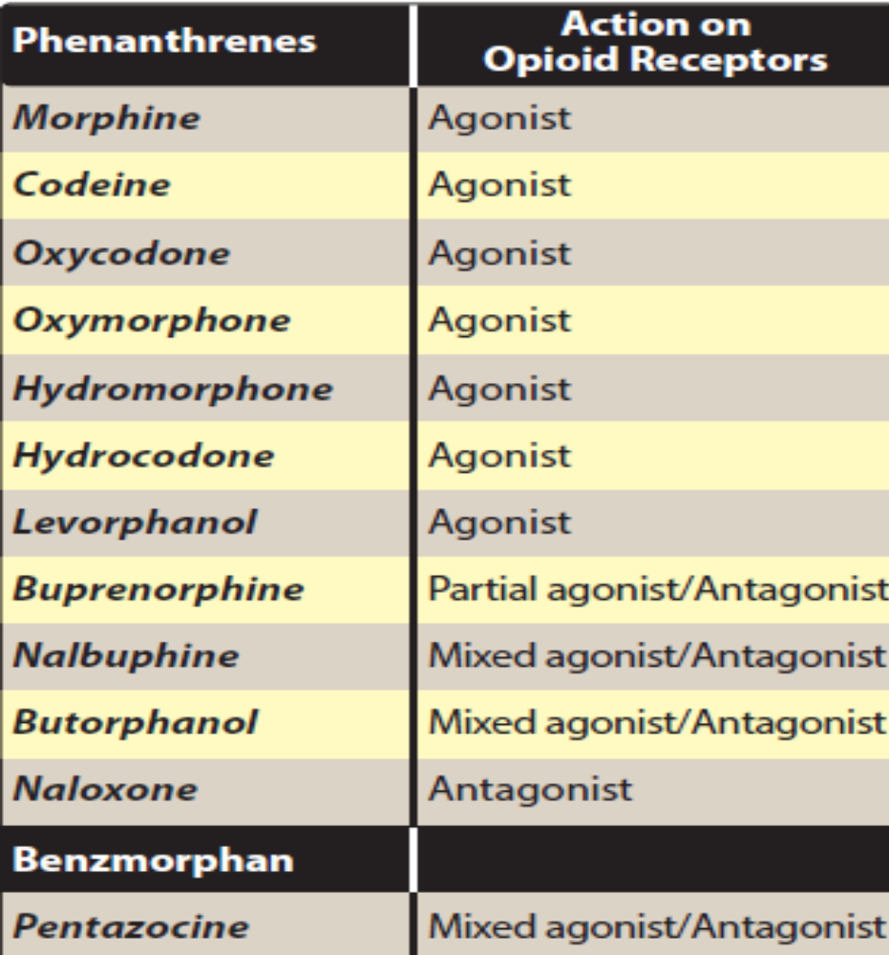
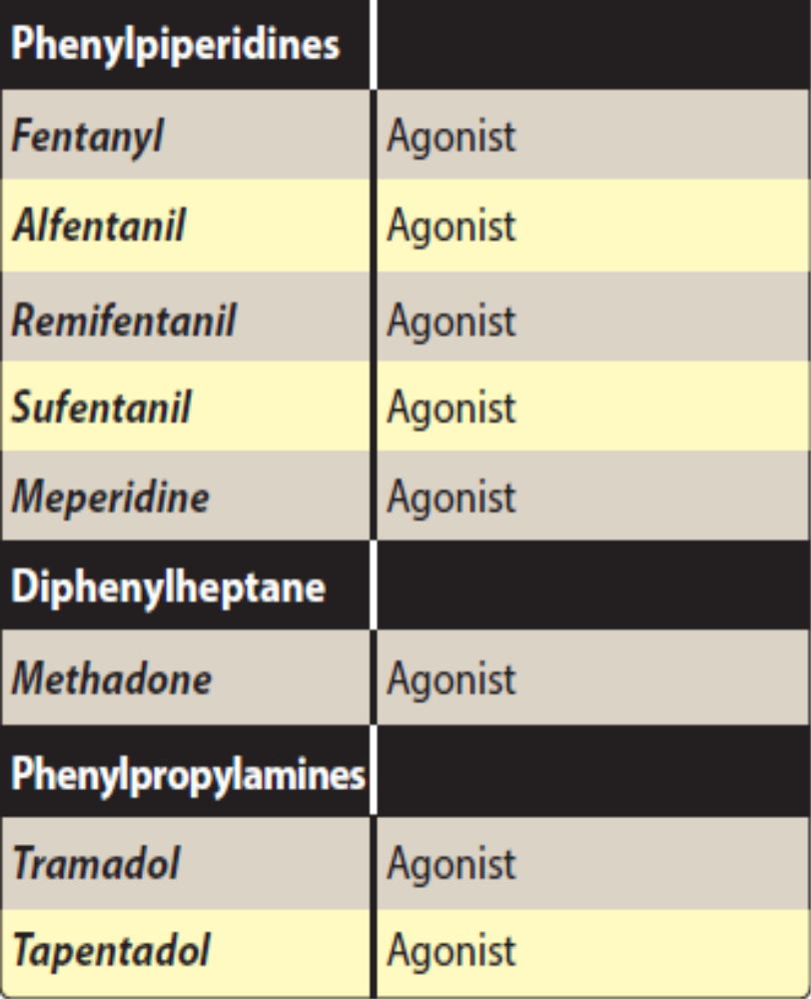

Slide 36
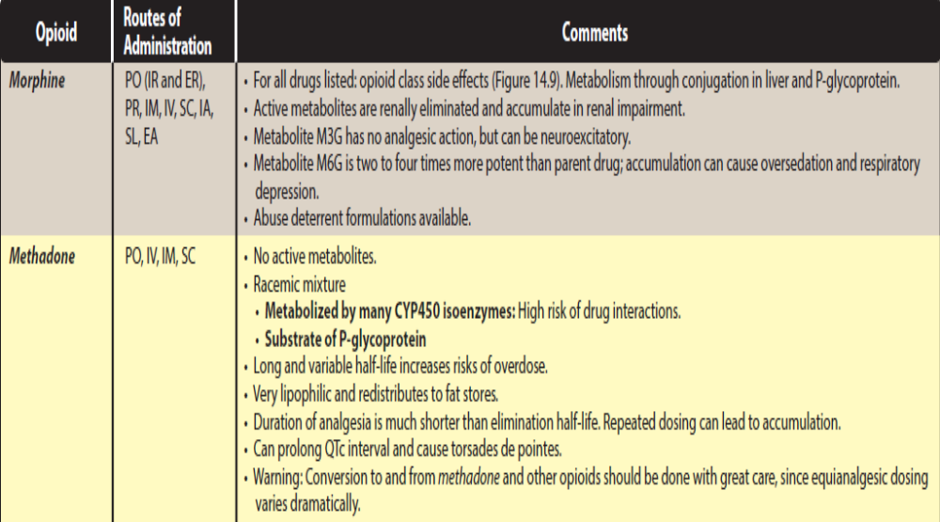

Slide 37
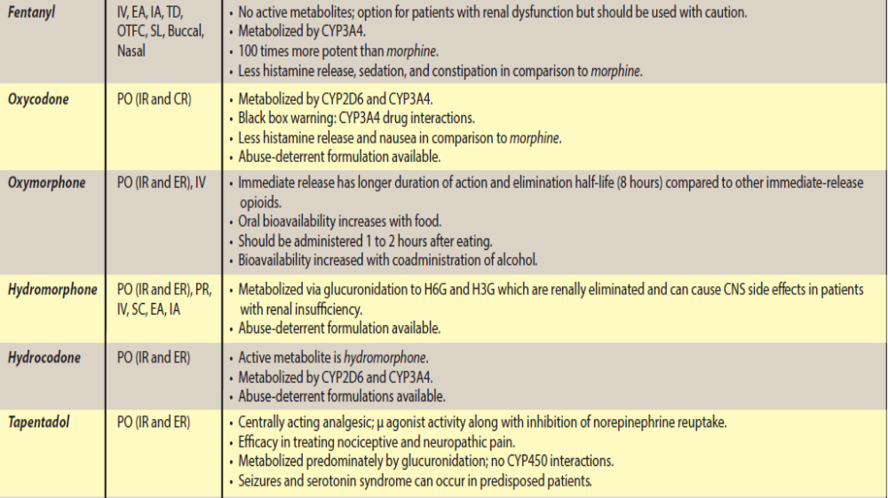

Slide 38
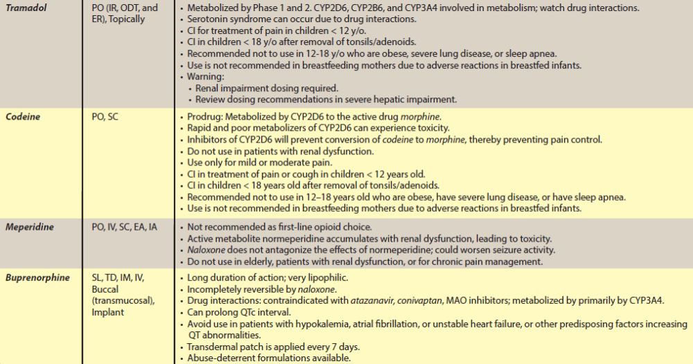
CI = contraindicated; CR = controlled-release; EA = epidural anesthesia; IA = intrathecal anesthesia; IM = intramuscular; IR = immediate release; IV = intravenous; OTFC = oral transmucosal fentanyl citrate; PO = orally PR = rectally; SC = subcutaneous; SL = sublingual; TD = transdermal; M3G = morphine-3-glucuronide; M6G = morphine-6-glucuronide; NMDA = N-methyl-D-aspartate; H6G = hydromorphone-6-glucuronide; H3G = hydromorphone-3-glucuronide Note: Many dierent acronyms may be used to indicate a medication is extended-release. Examples include CR (controlled-release), LA (long-acting), ER (extended-release

