Slide 1
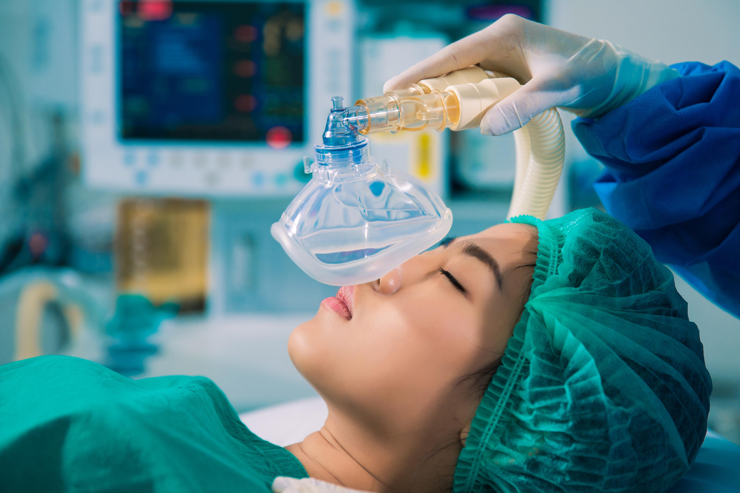
Anesthetics
Dr.Samaher Jaber Younis
BCPS

Slide 2
Anesthetics are agents that bring about reversible loss of sensation and consciousness. They are divided into two main groups: general anesthetics and local anesthetics. Drugs are chosen to provide safe and efficient sedation based on the type and duration of the procedure and patient characteristics, such as organ function, medical conditions, and concurrent medications.
Preoperative medications provide anxiolysis and analgesia, and mitigate unwanted side effects of the anesthetic or the procedure itself. Neuromuscular blockers enable endotracheal intubation and muscle relaxation to facilitate surgery. Potent general anesthetic medications are delivered via inhalation and/or intravenously. Except for nitrous oxide, inhaled anesthetics are volatile, halogenated hydrocarbons, while intravenous (IV) anesthetics consist of several chemically unrelated drug classes commonly used to rapidly induce and/ or maintain a state of general anesthesia.
ETHER-CHLOROFORM-CYCLOPROPANE
FIRST AGENTS USED

Slide 3
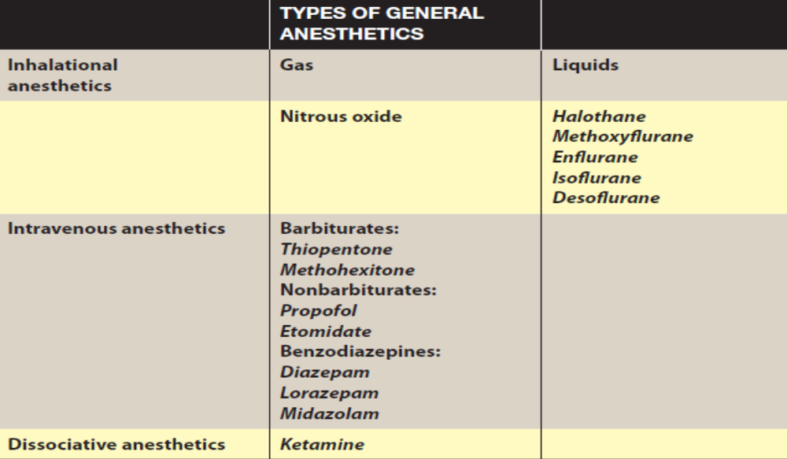

Slide 4
PATIENT FACTORS IN SELECTION OF ANESTHESIA
Drugs are chosen to provide safe and efficient anesthesia based on the type of procedure and patient characteristics such as organ function, medical conditions, and concurrent medications.
A. Status of organ systems
1. Cardiovascular system: Anesthetic agents suppress cardiovascular function to varying degrees. This is an important consideration in patients with coronary artery disease, heart failure, dysrhythmias, valvular disease, and other cardiovascular disorders. Hypotension may develop during anesthesia, resulting in reduced perfusion pressure and ischemic injury to tissues Treatment with vasoactive agents may be necessary. Some anesthetics, such as halothane, sensitize the heart to arrhythmogenic effects of sympathomimetic agents

Slide 5
Respiratory system: Respiratory function must considered for all anesthetics. Asthma and ventilation or perfusion abnormalities complicate control of inhalation anesthetics. Inhaled agents depress respiration but also act as bronchodilators. IV anesthetics and opioids suppress respiration. These effects may influence the ability to provide adequate ventilation and oxygenation during and after surgery.
Liver and kidney: The liver and kidneys influence long-term distribution and clearance of drugs and are also target organs for toxic effects. Release of fluoride, bromide, and other metabolities of halogenated hydrocarbons can affect these organs, especially if they accumulate with frequently repeated administration of anesthetics.

Slide 6
Nervous system: The presence of neurologic disorders (for example, epilepsy, myasthenia gravis, neuromuscular disease, compromised cerebral circulation) influences the selection of anesthetic.
Pregnancy: Special precautions should be observed when anesthetics and adjunctive agents are administered during pregnancy. Effects of fetal organogenesis are a major concern in early pregnancy. Transient use of nitrous oxide may cause aplastic anemia in the fetus. Oral clefts have occurred in fetuses when mothers received benzodiazepines in early pregnancy. Benzodiazepines should not be used during labor because of resultant temporary hypotonia and altered thermoregulation in the new born

Slide 7
Hemodynamic Effects of General Anesthesia. The most prominent physiological effect of anesthesia induction,
associated with the majority of both intravenous and inhalational agents, is a decrease in systemic arterial blood pressure. The causes include direct vasodilation, myocardial depression or both, a blunting of baroreceptor control, and a generalized decrease in central sympathetic tone. Agents vary in the magnitude of their specific effects, but in all cases the hypotensive response is enhanced by underlying volume depletion or preexisting myocardial dysfunction. Even anesthetics that show minimal hypotensive tendencies under normal conditions (e.g.ketamine)anesthetics must be used with caution in trauma victims, in whom intravascular volume depletion is being compensated by intense sympathetic discharge. Smaller-than-normal anesthetic dosages are employed in patients presumed to be sensitive to hemodynamic effects of anesthetics.
Respiratory Effects of General Anesthesia. Airway maintenance is essential following induction of anesthesia, as nearly all general anesthetics reduce or eliminate both ventilatory drive and the reflexes that maintain airway patency. Therefore, ventilation generally must be assisted or controlled for at least some period during surgery. The gag reflex is lost, and the stimulus to cough is blunted. Lower esophageal sphincter tone also is reduced, so both passive and active regurgitation may occur. Endotracheal intubation was introduced by Kuhn in the early 1900s and has been a major reason for a decline in
the number of aspiration deaths during general anesthesia. Muscle relaxation is valuable during the induction of general anesthesia where it facilitates management of the airway, including endotracheal intubation(NMJB).
Hypothermia. Patients commonly develop hypothermia (body temperature <36˚C) during surgery. The reasons for the hypothermia include low ambient temperature, exposed body cavities, cold intravenous fluids, altered thermoregulatory control, and reduced metabolic rate. General anesthetics lower the core temperature set point at which thermoregulatory vasoconstriction is activated to defend against heat loss. Furthermore, vasodilation produced by both general and regional anesthesia offsets cold-induced peripheral vasoconstriction, thereby redistributing heat from central to peripheral body compartments, leading to a decline in core temperature. Metabolic rate and total body oxygen consumption decrease with general anesthesia by about 30%, reducing heat generation. Even small drops in body temperatures may lead to an increase in perioperative morbidity, including cardiac complications, and impaired coagulation. Prevention of hypothermia has emerged as a major goal of anesthetic care. Modalities to maintain normothermia include using warm intravenous fluids.

Slide 8
Mechanisms of Anesthesia
Cellular Mechanisms of Anesthesia. General anesthetics produce two important physiologic effects at the cellular level. First, the inhalational anesthetics can hyperpolarize neurons. This may be an important effect on neurons serving a pacemaker role and on pattern-generating circuits. Second, at anesthetizing concentrations, both inhalational and intravenous anesthetics have substantial effects on synaptic transmission and much smaller effects on action-potential generation or propagation. The inhalational anesthetics inhibit excitatory synapses and enhance inhibitory synapses in various preparations.
Molecular Actions of General Anesthetics. The electrophysiological effects of general anesthetics at the cellular level suggest several potential molecular targets for anesthetic action. There is strong evidence that ligand-gated ion channels are important targets for anesthetic action. Chloride channels gated by the inhibitory GABAA receptors are sensitive to clinical concentrations of a wide variety of anesthetics, including the halogenated inhalational agents and many intravenous agents (propofol, barbiturates, etomidate, and neurosteroids) Structurally closely related to the GABAA receptors are other ligand-gated ion channels including glycine receptors and neuronal nicotinic acetylcholine receptors. Glycine receptors may play a role in mediating inhibition by anesthetics of responses to noxious stimuli. Clinical concentrations of inhalational anesthetics enhance the capacity of glycine to activate glycine-gated chloride channels (glycine receptors), which play an important role in inhibitory neurotransmission in the spinal cord and brainstem. Propofol, neurosteroids, and barbiturates also potentiate. The only general anesthetics that do not have significant effects on GABAA or glycine receptors are ketamine, nitrous oxide, These agents inhibit a different type of ligand gated ion channel, the N-methyl-D-aspartate (NMDA). NMDA receptors are glutamate-gated cation channels that are somewhat selective for calcium and are involved in longterm modulation of synaptic responses.

Slide 9
Concomitant use of drugs
1. Multiple adjunct agents: Commonly, patients receive one or more of these preanesthetic medications: H2 blockers (famotidine, ranitidine) to reduce gastric acidity, benzodiazepines (midazolam, diazepam) to allay anxiety and facilitate amnesia; nonopioids (acetaminophen, celecoxib) or opioids (fentanyl) for analgesia; antihistamines (diphenhydramine) to prevent allergic reactions; antiemetics (ondansetron) to prevent nausea; and/or anticholinergics (glycopyrrolate) to prevent bradycardia and secretion of fluids in to the respiratory tract. Premedications facilitate smooth induction of anesthesia and lower required anesthetic doses. However, they can also enhance undesirable anesthetic effects (hypoventilation) and, when coadministered, may produce negative effects not observed when given individually.

Slide 10
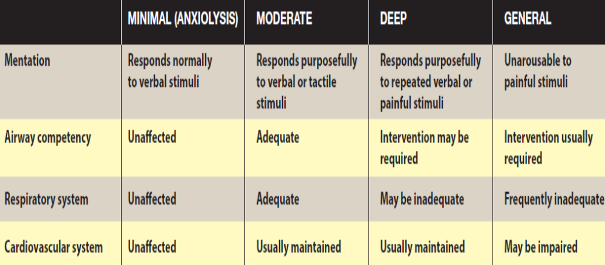
LEVELS OF SEDATION

Slide 11
Depth of anesthesia
The depth of anesthesia has four sequential stages characterized by increasing CNS depression as the anesthetic accumulates in the brain . [Note: These stages were defined for the original anesthetic ether, which produces a slow onset of anesthesia. With modern anesthetics, the stages merge because of the rapid onset of stage III.]
1. Stage I—Analgesia: Loss of pain sensation results from interference with sensory transmission in the spinothalamic tract. The patient progresses from conscious and conversational to drowsy. Amnesia and reduced awareness of pain occur as stage II is approached.
2. Stage II—Excitement: The patient displays delirium and possibly combative behavior. A rise and irregularity in blood pressure and respiration occur, as well as a risk of laryngospasm. To shorten or eliminate this stage, rapid-acting IV agents are given before inhalation anesthesia is administered.
3. Stage III—Surgical anesthesia: There is gradual loss of muscle tone and reflexes as the CNS is further depressed. Regular respiration and relaxation of skeletal muscles with eventual loss of spontaneous movement occur. This is the ideal stage of surgery. Careful monitoring is needed to prevent undesired progression to stage IV.
4. Stage IV—Medullary paralysis: Severe depression of the respiratory and vasomotor centers occurs. Ventilation and/or circulation must be supported to prevent death.

Slide 12
STAGES OF GENERAL ANESTHESIA
General anesthesia is a reversible state of central nervous system (CNS) depression, causing loss of response to and perception of stimuli. The state of general anesthesia can be divided into three stages: induction, maintenance, and recovery. Induction is the time from administration of a potent anesthetic to development of unconsciousness, while maintenance is the sustained period of general anesthesia. Recovery starts with the discontinuation of the anesthetic and continues until the return of consciousness and protective reflexes. Induction of anesthesia depends on how fast effective concentrations of anesthetic reach the brain. Recovery is essentially the reverse of induction and depends on how fast the anesthetic diffuses from the brain. The depth of general anesthesia is the degree to which the CNS is depressed, as evident in electroencephalograms.

Slide 13
A. Induction
General anesthesia in adults is normally induced with an IV agent such as propofol, producing unconsciousness in 30 to 40 seconds. Often an IV neuromuscular blocker such as rocuronium, vecuronium, or succinylcholine is administered to facilitate endotracheal intubation by eliciting muscle relaxation. For children without IV access, nonpungent volatile agents, such as sevoflurane, are administered via inhalation to induce general anesthesia.
B. Maintenance of anesthesia
After administering the induction drug, vital signs and response to stimuli are vigilantly monitored to balance the amount of drug continuously inhaled or infused to maintain general anesthesia. Maintenance is commonly provided with volatile anesthetics, although total intravenous anesthesia (TIVA) with drugs such as propofol can be used to maintain general anesthesia. Opioids such as fentanyl are used for analgesia along with inhalation agents, because the latter alter consciousness but not perception of pain.

Slide 14
C. Recovery
After cessation of the maintenance anesthetic drug, the patient is
evaluated for return of consciousness. For most anesthetic agents,
redistribution from the site of action (rather than metabolism of the
drug) underlies recovery. Neuromuscular blocking drugs are typically
reversed after completion of surgery, unless enough time has elapsed
for their metabolism. The patient is monitored to assure full recovery
of all normal physiologic functions (spontaneous respiration, blood
pressure, heart rate, and all protective reflexes).

Slide 15
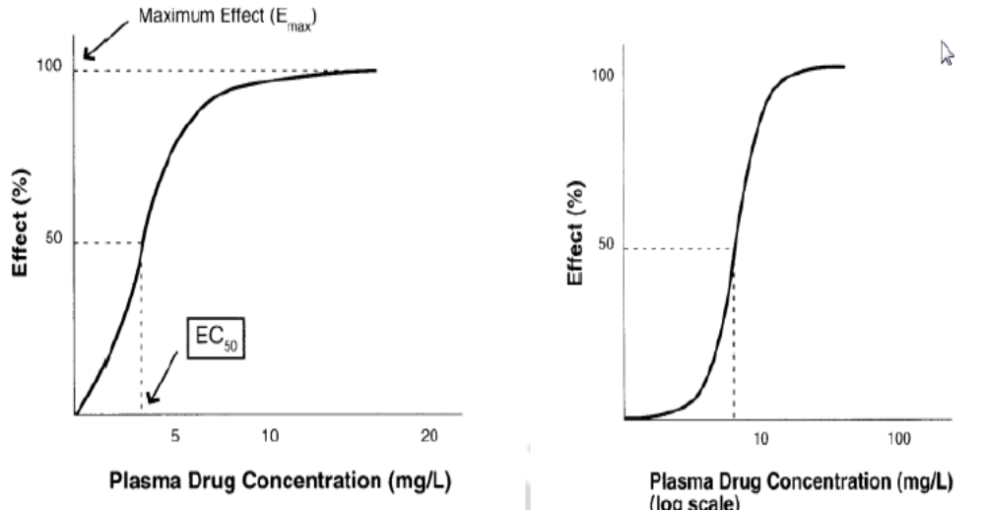
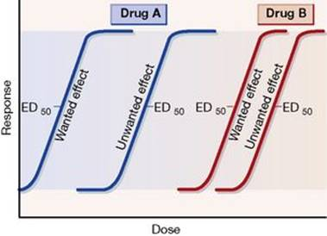
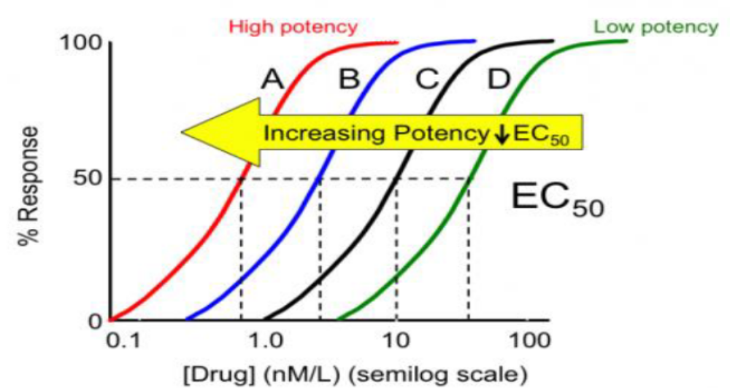
Potency refers to the amount of drug required to produce a certain response. A drug which produces a certain effect at 5 mg dosage is ten times more potent than a drug which produces the same effect at 50 mg dosage. In other words, potency defines as the dose (ED50) or concentration (EC50) of a drug required to produce 50% of the drugs maximum effect.

Slide 16
INHALATION ANESTHETICS
Inhaled gases are used primarily for maintenance of anesthesia after administration of an IV drug. Depth of anesthesia can be rapidly altered by changing the inhaled gas concentration. Inhalational agents have steep dose–response curves with very narrow therapeutic indices, so the difference in concentrations from eliciting general anesthesia to cardiopulmonary collapse is small. No antagonists exist. To minimize waste, inhaled gases are delivered in a recirculation system that contains absorbents to remove carbon dioxide and allow rebreathing of the gas.
Potency
Potency is defined quantitatively as the minimum alveolar concentration (MAC), which is the end-tidal concentration of inhaled anesthetic needed to eliminate movement in 50% of patients exposed to a noxious stimulus. MAC is the median effective dose (ED50) of the anesthetic, expressed as the percentage of gas in a mixture required to achieve that effect. Numerically, MAC is small for potent anesthetics

Slide 17
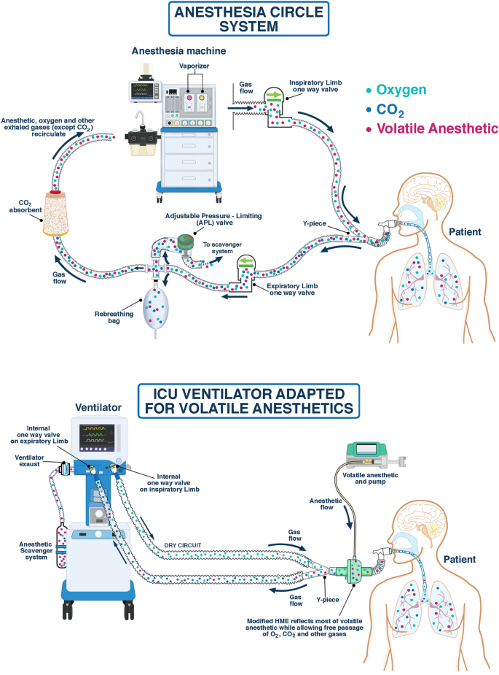

Slide 18
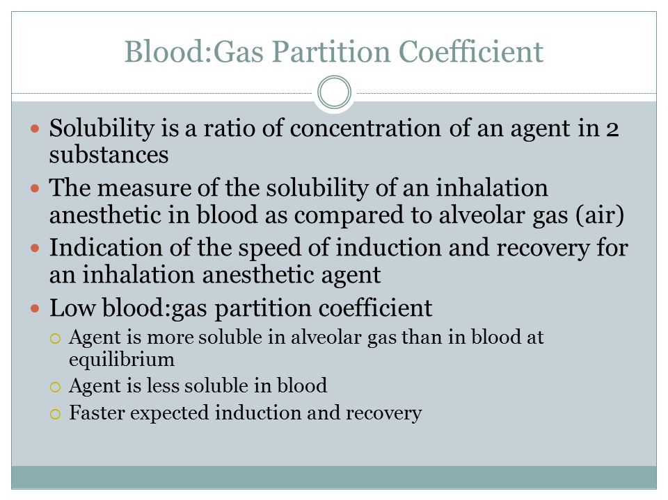

Slide 19
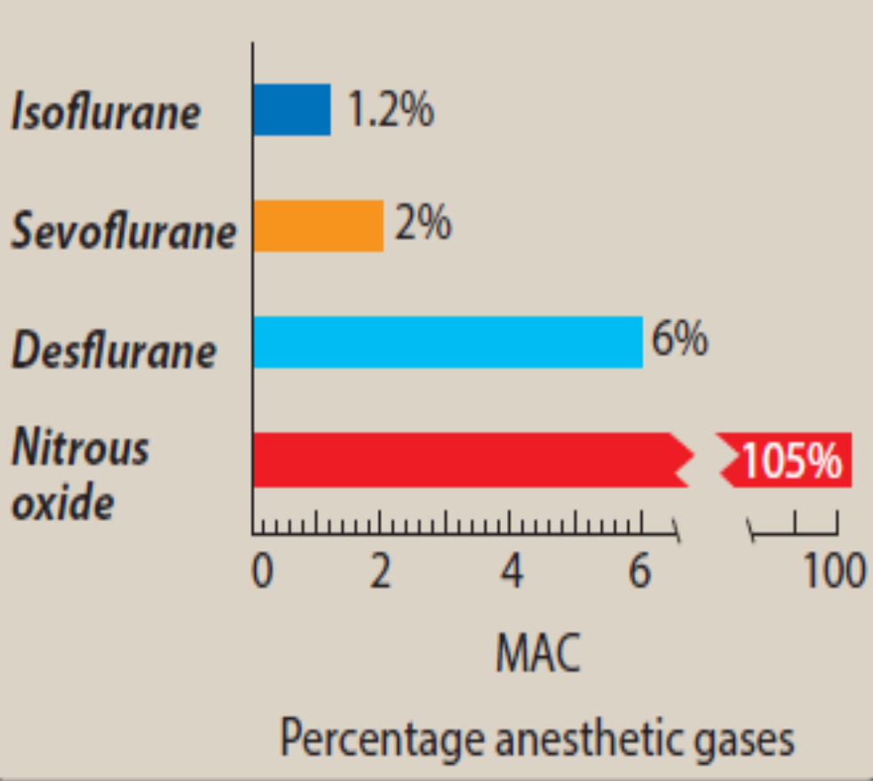
Uptake and distribution of inhalation anesthetics
The principal objective of inhalation anesthesia is a constant and optimal brain partial pressure (Pbr) of inhaled anesthetic (to create a partial pressure equilibrium between alveoli [Palv] and brain [Pbr]). Measuring the Palv is the most practical and feasible way to ascertain the Pbr for the inhaled anesthetic concentration, but this necessitates adequate time for the two compartments to reach equilibrium. The partial pressure of an anesthetic gas that originates by pulmonary entry is the driving force moving the gas from the alveolar space into the bloodstream (Pa), which transports the drug to the brain and other body compartments. Because gases move from one body compartment to another according to partial pressure gradients, a steady state is achieved when the partial pressure in each of these compartments is equivalent to that in the inspired mixture. [Note: At equilibrium, Palv = Pa = Pbr.] The time course for attaining this steady state is determined by the following factors:

Slide 20
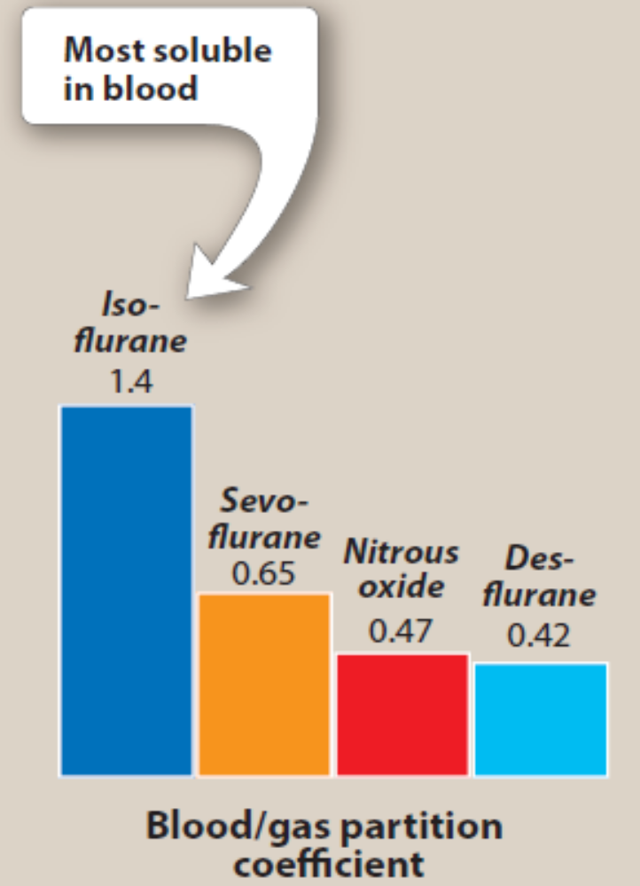
a. Solubility in blood: This is determined by a physical property of the anesthetic called the blood:gas partition coefficient (the ratio of the concentration of anesthetic in the liquid [blood] phase to the concentration of anesthetic in the gas phase when the anesthetic is in equilibrium between the two phases. For inhaled anesthetics, think of the blood as a pharmacologically inactive reservoir. Drugs with low versus high blood solubility differ in their rate of induction of anesthesia. When an anesthetic gas with low blood solubility such as nitrous oxide diffuses from the alveoli into the circulation, little anesthetic dissolves in the blood. Therefore, equilibrium between the inspired anesthetic and arterial blood occurs rapidly with relatively few additional molecules of anesthetic required to raise …..
Blood/gas partition coefficients for some inhalation anesthetics

Slide 21
…..the arterial anesthetic partial pressure. By contrast, anesthetic gases with high blood solubility, such as isoflurane, dissolve more fully in the blood; therefore, greater amounts of gas and longer periods of time are required to raise blood partial pressure. This results in longer periods for induction, recovery, and slower changes in depth of anesthesia in response to changes in the drug concentration. The solubility in blood is ranked as follows: isoflurane > sevoflurane > nitrous oxide > desflurane.
b. Cardiac output: CO is inversely correlated with induction time for inhaled anesthetics. This counterintuitive phenomenon is explained by the threshold of drug concentration required to alter neuronal activity and the time neurons are exposed to the drug in the passing blood. During low CO, a longer period of time permits a larger concentration of gas to dissolve in the slowly moving bloodstream. Furthermore, this large bolus of drug has longer contact time to diffuse into neuronal tissue when it traverses the blood–brain barrier. Although a high CO will quickly transport the drug to the brain, a lower concentration of the drug with a shorter exposure time slows down the rate of induction.

Slide 22
c. Alveolar-to-venous partial pressure gradient:
This gradient between the alveolar and returning venous gas partial pressure results from the tissue uptake from the arterial delivery. The arterial circulation distributes the anesthetic to various tissues, and tissue uptake is dependent on the tissue blood flow, blood to tissue partial pressure difference, and blood:tissue solubility coefficient. As venous circulation returns to the lung blood with low or no dissolved anesthetic gas, this high gradient causes gas to move from the alveoli into the blood. If a large alveolar-to-venous partial pressure gradient persists, the peripheral tissue gas uptake must be high, and, therefore, the induction time is longer. Over time, as the partial pressure of gas in venous blood approximates the inspired mixture and subsequent alveolar concentration, no further uptake from the lung occurs.

Slide 23
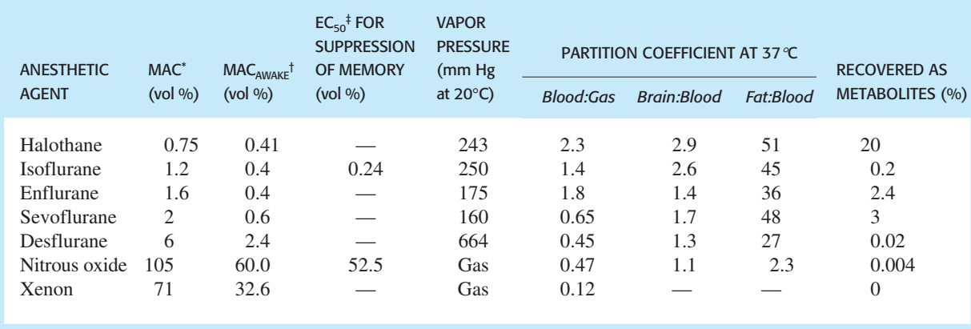
1. Alveolar wash-in: This refers to replacement of normal lung gases with the inspired anesthetic mixture. The time required for this process is directly proportional to the functional residual capacity of the lung (volume of gas remaining in the lungs at the end of a normal expiration) and inversely proportional to the ventilator rate. It is independent of the physical properties of the gas. As the partial pressure builds within the lung, anesthetic gas transfer from the lung begins.
2. Anesthetic uptake (removal to peripheral tissues other than the brain): Uptake is the product of the gas solubility in the blood, cardiac output (CO), and gradient between alveolar and blood anesthetic partial pressures.
MACawake is the concentration at which appropriate responses to commands are lost. ‡EC50 is the concentration that produces memory suppression in 50% of patients

Slide 24
Isoflurane (1.4 Par. Co)(MAC 1.2)
Isoflurane, like other halogenated gases, produces dose-dependent hypotension predominantly from relaxation of systemic vasculature. Hypotension can be treated with a direct-acting vasoconstrictor, such as phenylephrine. Because it undergoes little metabolism, isoflurane is considered nontoxic to the liver and kidney. Its pungent odor stimulates respiratory reflexes (breath holding, salivation, coughing, laryngospasm), so it is not used for inhalation induction. With a higher blood solubility than desflurane and sevoflurane, isoflurane takes longer to reach equilibrium, making it less ideal for short procedures; however, its low cost makes it a good option for longer surgeries
Desflurane (0.45 Pa. Co)(MAC 6)
Desflurane provides very rapid onset and recovery due to low blood solubility. This makes it a popular anesthetic for short procedures. It has a low volatility, which requires administration via a special heated vaporizer. Desflurane has significant respiratory irritation like isoflurane so it should not be used for inhalation induction

Slide 25
Sevoflurane (0.65 Pa.co)(MAC 2)
Sevoflurane has low pungency or respiratory irritation. This makes it useful for inhalation induction, especially with pediatric patients who do not tolerate IV placement. It has a rapid onset and recovery due to low blood solubility. Sevoflurane has low hepatotoxic potential, but compounds formed from reactions in the anesthesia circuit (soda lime) may be nephrotoxic with very low fresh gas flow that allows longer chemical reaction time.
Halothane (2.3 Pa.co)(MAC 0.75)
Halothane is a noninflammable, nonirritant, photosensitive volatile agent with a sweet smell. It is a liquid at room temperature and it is administered with a special vaporizer. A precise control of the concentration of halothane is essential as it can cause direct effect on heart by interfering with calcium, thus causing depression of myocardial contractility. Dose-dependent fall in blood pressure is known during halothane anesthesia. It directly suppresses respiratory centers, thereby reducing ventilatory response to blood carbon dioxide levels. Decreased alveolar ventilation can cause increase in arterial CO2 levels without compensatory increase in ventilation. Therefore, continuous arterial gas monitoring is essential during its usage.

Slide 26
Halothane dilates cerebral blood vessels and increases cerebral blood flow which in turn causes increased intracranial pressure, especially in patients with other susceptible comorbid conditions in the brain. It causes relaxation of skeletal muscle and potentiates the actions of competitive neuromuscular blockers. Halothane causes uterine smooth muscle relaxation. Although it is useful for the manipulation of fetus orientation, it is not used due to its action of inhibiting uterine contraction during parturition. Therefore, it is not used for vaginal delivery. More than 60% of the inhalationally administered halothane is eliminated through lungs on recovery within 24 hours. The rest of halothane is metabolized by liver. Trifluoroacetic acid is a major metabolite which can cause hepatic injury (halothane-induced hepatic necrosis). This syndrome of hepatic necrosis is reported in 1 in 10,000 patients and it is referred to as “halothane hepatitis.”

Slide 27
Nitrous oxide (0.47Pa.co)(MAC 105)
Nitrous oxide (“laughing gas”) is a nonirritating potent sedative that is unable to create a state of general anesthesia. It is frequently used at concentrations of 30% to 50% in combination with oxygen to create moderate sedation, particularly in dentistry. Nitrous oxide does not depress respiration and maintains cardiovascular hemodynamics as well as muscular strength. Nitrous oxide can be combined with other inhalational agents to establish general anesthesia, which lowers the required concentration of the combined volatile agent. This gas admixture further reduces many unwanted side effects of the other volatile agent that impact cardiovascular output and cerebral blood flow. Nitrous oxide is poorly soluble in blood and other tissues, allowing it to move very rapidly in and out of the body. This can be problematic in closed body compartments because nitrous oxide can increase the volume (exacerbating a pneumothorax) or pressure (sinus or middle ear pressure); it replaces nitrogen in various air spaces faster than the nitrogen leaves. Its speed of movement allows nitrous oxide to retard oxygen uptake during recovery, thereby causing “diffusion hypoxia.” This can be overcome by delivering high concentrations of inspired oxygen during recovery.

Slide 28
Malignant hyperthermia
In a very small percentage of susceptible patients, exposure to halogenated hydrocarbon anesthetics (or succinylcholine) may induce malignant hyperthermia (MH), a rare life-threatening condition. MH causes a drastic and uncontrolled increase in skeletal muscle oxidative metabolism, overwhelming the body’s capacity to supply oxygen, remove carbon dioxide, and regulate temperature, eventually leading to circulatory collapse and death if not treated immediately. Strong evidence indicates that MH is due to an excitation–contraction coupling defect. Burn victims and individuals with muscular dystrophy, myopathy, myotonia, and osteogenesis imperfecta are susceptible to MH-like events and caution should be taken. Susceptibility to MH is often inherited as an autosomal dominant disorder. Should a patient exhibit symptoms of MH, dantrolene is given as the anesthetic mixture is withdrawn, and measures are taken to rapidly cool the patient. Dantrolene blocks release of Ca2+ from the sarcoplasmic reticulum of muscle cells, reducing heat production and relaxing muscle tone. It should be available whenever triggering agents are administered. In addition, the patient must be monitored and supported for respiratory, circulatory, and renal problems.

Slide 29
INTRAVENOUS ANESTHETICS
IV anesthetics cause rapid induction of anesthesia often occurring in 1 minute or less. It is the most common way to induce anesthesia before maintenance of anesthesia with an inhalation agent. IV anesthetics may be used as single agents for short procedures or administered as infusions (TIVA) to help maintain anesthesia during longer surgeries. In lower doses, they may be used solely for sedation.
A. Induction
After entering the blood, a percentage of drug binds to plasma proteins, and the rest remains unbound or “free.” The degree of protein binding depends upon the physical characteristics of the drug, such as the degree of ionization and lipid solubility. The majority of CO flows to the brain, liver, and kidney (“vessel-rich organs”). Thus, a high proportion of initial drug bolus is delivered to the cerebral circulation and then passes along a concentration gradient from blood into the brain. The rate of this transfer is dependent on the arterial concentration of the unbound free drug, the lipid solubility of the drug, and the degree of ionization. Unbound, lipid-soluble, nonionized molecules cross into the brain most quickly. Like inhalational anesthetics, the exact mode of action of IV anesthetics is unknown; however, GABA likely plays a large role.

Slide 30
B. Recovery
The recovery phase is short as these drugs are rapidly redistributed from the CNS into the various compartments of the body. After initial flooding of the CNS and other vessel-rich tissues with nonionized molecules, the drug diffuses into other tissues with less blood supply. With secondary tissue uptake, predominantly skeletal muscle, plasma concentration of the drug falls. This allows the drug to diffuse out of the CNS, down the resulting reverse concentration gradient. This initial redistribution of drug into other tissues leads to the rapid recovery seen after a single IV dose of the induction agent. The final elimination occurs via kidneys or liver. Metabolism and plasma clearance become important only following infusions and repeat doses of a drug. Adipose tissue makes little contribution to the early redistribution of free drug following a bolus, due to its poor blood supply. However, following repeat doses or infusions, equilibration with fat tissue forms a drug reservoir, often leading to delayed recovery

Slide 31
Propofol
Propofol is an IV sedative/hypnotic used for induction and/or maintenance of anesthesia. It is widely used and has replaced thiopental as the first choice for induction of general anesthesia and sedation. Because propofol is poorly water soluble, it is supplied as an emulsion containing soybean oil and egg phospholipid, giving it a milk-like appearance.
Onset: Induction is smooth and occurs 30 to 40 seconds after administration. Plasma levels decline rapidly as a result of redistribution, followed by a more prolonged period of hepatic metabolism and renal clearance. The initial redistribution half-life is 2 to 4 minutes. The pharmacokinetics of propofol are not altered by moderate hepatic or renal failure.

Slide 32
Actions: Although propofol depresses the CNS, it occasionally contributes to excitatory phenomena, such as muscle twitching, spontaneous movement, yawning, and hiccups. Transient pain at the injection site is common. Propofol decreases blood pressure without significantly depressing the myocardium. It also reduces intracranial pressure, mainly due to decreased cerebral blood flow and oxygen consumption. It has less of a depressant effect than volatile anesthetics on CNS-evoked potentials, making it useful for surgeries in which spinal cord function is monitored. It does not provide analgesia, so supplementation with narcotics is required. Propofol is commonly infused in lower doses to provide sedation. The incidence of postoperative nausea and vomiting is very low secondary to its antiemetic properties.

Slide 33
Barbiturates
Thiopental is an ultra short–acting barbiturate with high lipid solubility. It is a potent anesthetic but a weak analgesic. Barbiturates require supplementary analgesic administration during anesthesia. When given IV, agents such as thiopental and methohexital quickly enter the CNS and depress function, often in less than 1 minute. However, diffusion out of the brain can also occur very rapidly because of redistribution to other tissues. These drugs may remain in the body for relatively long periods, because only about 15% of a dose entering the circulation is metabolized by the liver per hour. Thus, metabolism of thiopental is much slower than its redistribution. Barbiturates tend to decrease blood pressure, which may cause a reflex tachycardia. They decrease intracranial pressure through reductions in cerebral blood flow and oxygen consumption. Methohexital is still commonly used for electroconvulsive therapy.

Slide 34
Benzodiazepines
The benzodiazepines are used in conjunction with anesthetics for sedation and amnesia. The most commonly used is midazolam. Diazepam and lorazepam are alternatives. All three facilitate amnesia while causing sedation, enhancing the inhibitory effects of various neurotransmitters, particularly GABA. Minimal cardiovascular depressant effects are seen, but all are potential respiratory depressants (especially when administered IV). They are metabolized by the liver with variable elimination half-lives, and erythromycin may prolong effects of midazolam. Benzodiazepines can induce a temporary form of anterograde amnesia in which the patient retains memory of past events, but new information is not transferred into long-term memory. Therefore, important treatment information should be repeated to the patient after the effects of the drug have worn off.

Slide 35
Opioids
Because of their analgesic property, opioids are commonly combined with other anesthetics. The choice of opioid is based primarily on the duration of action needed. The most commonly used opioids are fentanyl and its congeners, sufentanil and remifentanil, because they induce analgesia more rapidly than morphine. They may be administered intravenously, epidurally, or intrathecally (into the cerebrospinal fluid). Opioids are not good amnestics, and they can all cause hypotension and respiratory depression, as well as nausea and vomiting. Opioid effects can be antagonized by naloxone.

Slide 36
Etomidate
Etomidate is a hypnotic agent used to induce anesthesia, but it lacks analgesic activity. Its water solubility is poor, so it is formulated in a propylene glycol solution. Induction is rapid, and the drug is short-acting. Among its benefits are little to no effect on the heart and systemic vascular resistance. Etomidate is usually only used for patients with cardiovascular dysfunction or patients who are acutely critically ill. It inhibits 11-β hydroxylase involved in steroidogenesis, and adverse effects may include decreased plasma cortisol and aldosterone levels. Etomidate should not be infused for an extended time, because prolonged suppression of these hormones is dangerous. Injection site pain, involuntary skeletal muscle movements, and nausea and vomiting are common

Slide 37
Ketamine
Ketamine a short-acting anti-NMDA receptor anesthetic and analgesic, induces a dissociated state in which the patient is unconscious (but may appear to be awake) with profound analgesia. Ketamine stimulates central sympathetic outflow, causing stimulation of the heart with increased blood pressure and CO. It is also a potent bronchodilator. Therefore, it is beneficial in patients with hypovolemic or cardiogenic shock as well as asthmatics. Conversely, it is contraindicated in hypertensive or stroke patients. The drug is lipophilic and enters the brain very quickly. Like the barbiturates, it redistributes to other organs and tissues. Ketamine has become popular as an adjunct to reduce opioid consumption during surgery. Of note, it may induce hallucinations, particularly in young adults, but pretreatment with benzodiazepines may help. Ketamine may be used illicitly, since it causes a dream-like state and hallucinations similar to phencyclidine (PCP).

Slide 38
Dexmedetomidine
Dexmedetomidine is a sedative used in intensive care settings and surgery. Like clonidine, it is an α2 receptor agonist in certain parts of the brain. Dexmedetomidine has sedative, analgesic, sympatholytic, and anxiolytic effects that blunt many cardiovascular responses. It reduces volatile anesthetic, sedative, and analgesic requirements without causing significant respiratory depression. It has gained popularity for its ability to blunt emergence delirium in the pediatric population.

Slide 39
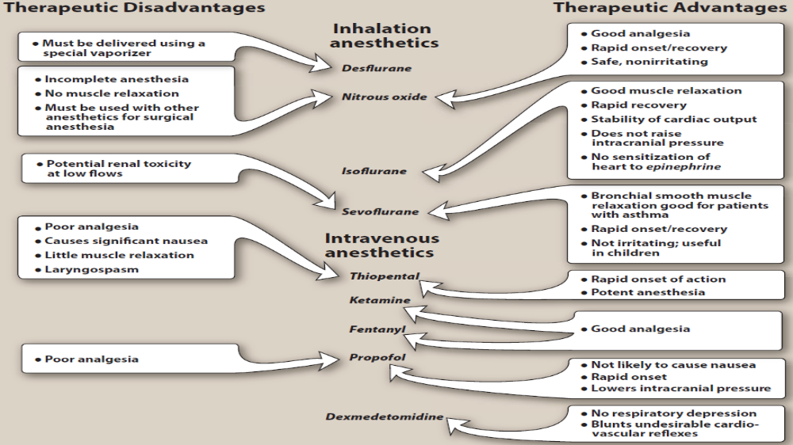

Slide 40
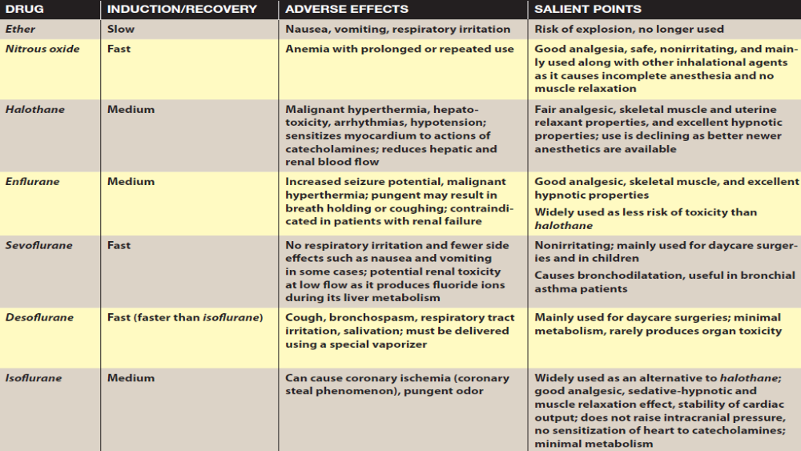

Slide 41
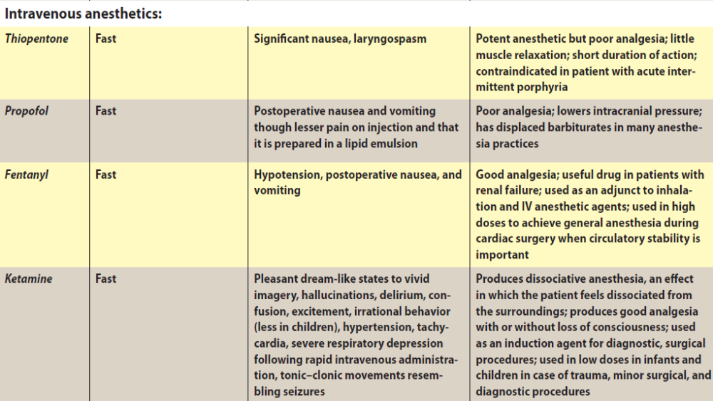

Slide 42
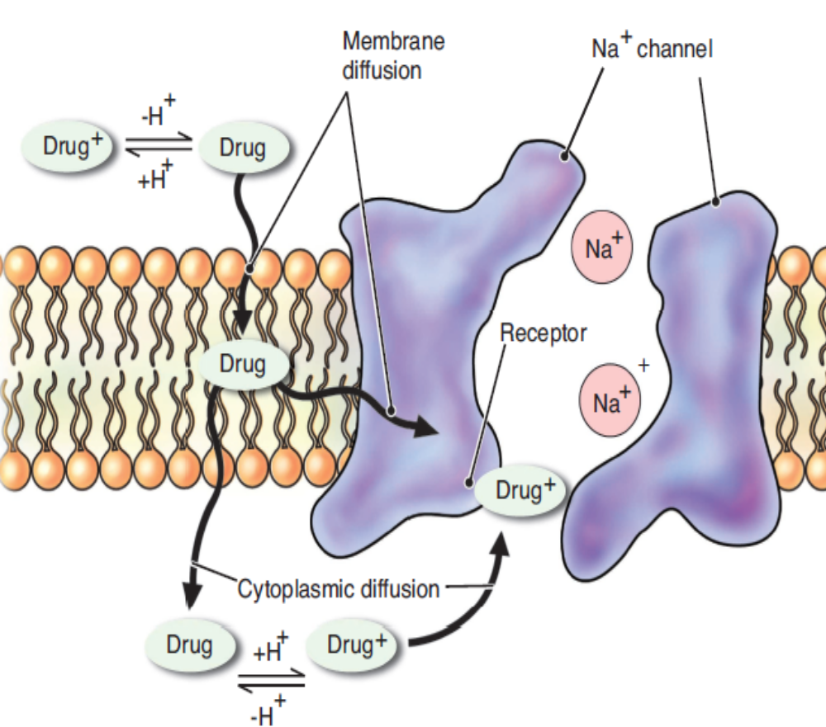
Local Anesthetics
Dr.Samaher Jaber Younis
BCPS

Slide 43
LOCAL ANESTHETICS
Local anesthetics provide a reversible regional loss of sensation. They reduce pain and thereby facilitate surgical procedures. Local anesthetics block nerve conduction of sensory impulses and in higher concentrations block motor impulses from the periphery to the CNS. Sodium ion channels are blocked to prevent the transient increase in permeability of the nerve membrane to Na+ that is required for an action potential. When propagation of action potentials is prevented, sensation cannot be transmitted from the source of stimulation to the brain. Cocaine is a naturally occurring compound indigenous to the Andes Mountains, West Indies, and Java. It was the first anesthetic to be discovered and is the only naturally occurring local anesthetic; however, it is not used clinically because of its adverse effects and abuse potential. All other anesthetics are synthetically derived. Procaine, the first synthetic derivative of cocaine, was developed in 1904

Slide 44
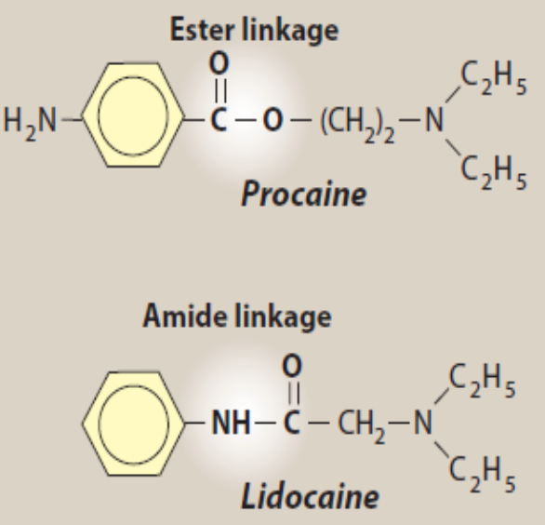
All local anesthetics have a similar chemical structure,
The degree of lipid solubility of each anesthetic is an important property because the lipid solubility enables its diffusion through the highly lipophilic nerve membrane. The extent of an anesthetic’s lipophilicity is directly related to its potency. All local anesthetics are weak bases that require the addition of hydrochloride salt in order to be water soluble and therefore injectable. Salt equilibrates between an ionized form and a nonionized form in aqueous solution. Equilibration is crucial because, although the ionized form is injectable, it is the nonionized base which has the lipophilic properties and is responsible for their diffusion into the nerve cell membrane. The duration of action of an anesthetic is determined by their protein-binding capacity to anesthetic receptors along the nerve cell membrane. The most widely used local anesthetics are bupivacaine, lidocaine, mepivacaine, ropivacaine and tetracaine.

Slide 45
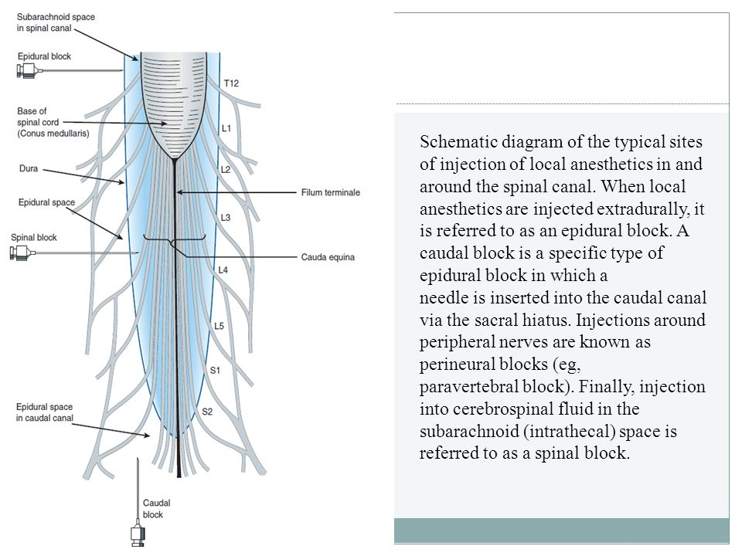
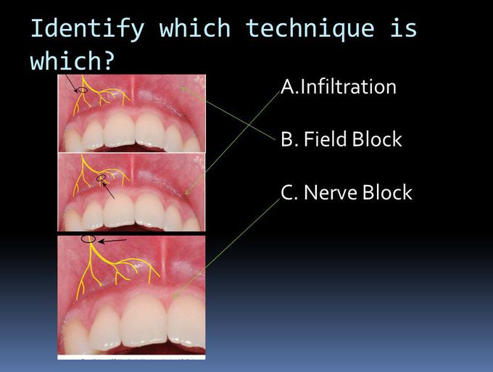

Slide 46
Delivery techniques of local anesthetics
Various delivery techniques broaden the clinical applicability of local anesthetics. These techniques include topical administration, infiltration, perineural, and neuraxial (spinal, epidural, or caudal) blocks. Small, unmyelinated nerve fibers for pain, temperature, and autonomic activity are most sensitive. These are as follows.
1. Regional anesthesia: It makes a specific part of the body numb to relieve pain or allow surgical procedures to be done. Local anesthetics are safer than general or systemic anesthetics; therefore, they are preferred whenever possible.
2. Surface anesthesia: It is used during ocular tonometry, intubation, and endoscopic procedures. Tetracaine 2% and lidocaine 2% to 4% are used. The anesthetic effect is superficial and does not last long.
3. Infiltration anesthesia: The local anesthetic is injected directly into the skin or deeper structures to carry out incision, excision, hydrocoele, herniorraphy, incision and drainage of an abscess, etc. Lignocaine and bupivacaine are generally used for infiltration anesthesia.

Slide 47
4. Field block: The local anesthetic is injected subcutaneously proximal to the site where anesthesia is desired. All nerves distal to the site of injection are blocked. Lidocaine (1% to 2%) is used for intermediate duration of anesthesia in dental extraction, operation on forearms, legs, herrniorraphy, etc.
5. Nerve block: The local anesthetic is injected around a nerve plexus or a nerve trunk. This results in a large area of anesthesia. Thus even with a small amount of drug, a large area of anesthesia can be produced. Lidocaine is most commonly used apart from bupivacaine. Intercostal, sciatic, brachial plexus, facial, and phrenic are commonly performed nerve blocks.
6. Spinal anesthesia: A single dose of the local anesthetic is injected into the subarachnoid space in the lower end of the spinal cord (lumbar region). The site of action is nerve roots, resulting in loss of pain sensation and paralysis of the lower abdomen and hind limbs. Lidocaine, bupivacaine, and tetracaine are most commonly used for spinal anesthesia. The duration of anesthesia depends on the concentration and the drug used. Spinal anesthesia is associated with various complications such as respiratory paralysis, hypotension, headache, nausea, vomiting, bradycardia, and septic meningitis. It is used during operations on lower limbs, pelvis, lower abdomen, etc.

Slide 48
7. Epidural anesthesia: The local anesthetic is injected into the epidural space where it acts upon the nerve roots and relieves pain from large areas of the body by stopping pain signals traveling along the nerves in the spine. Epidural anesthesia is similar to but not the same as spinal anesthesia. In epidural anesthesia, local anesthetic is administered continuously through an epidural catheter that does not reach the CSF and provides long-term anesthesia and pain relief. The local anesthetics most commonly used for this procedure are lidocaine and bupivacaine. Epidural anesthesia is used during labor to relieve pain or during a cesarean section. It can also be used to reduce the amount of general anesthesia needed during some operations and can provide pain relief postoperatively. In knee and hip replacement surgery, epidural anesthesia can be used in place of a general anesthetic.

Slide 49
Actions
All local anesthetics cause vasodilation, which leads to a rapid diffusion away from the site of action and short duration when these drugs are administered alone. By adding the vasoconstrictor epinephrine, the rate of local anesthetic absorption and diffusion is decreased. This minimizes systemic toxicity and increases the duration of action. However, epinephrine should not be coadministered for nerve block in extremities such as fingers and toes as vasoconstriction of end arteries may lead to ischemia and necrosis. It should be used with caution in patients with thyrotoxicosis or cardiovascular disease and in labor. Hepatic function does not affect the duration of action of local anesthesia because that is determined by redistribution rather than biotransformation. Some local anesthetics have other therapeutic uses (for example, lidocaine is an IV antiarrhythmic).

Slide 50
Onset, potency, and duration of action
The onset of action of local anesthetics is influenced by several factors including tissue pH, nerve morphology, concentration, pKa, and lipid solubility of the drug. Of these, the pKa is most important. Local anesthetics with a lower pKa have a quicker onset, since more drug exists in the unionized form at physiologic pH, thereby allowing penetration of the nerve cell membrane. Once at the nerve membrane, the ionized form interacts with the protein receptor of the Na+ channel to inhibit its function and achieve local anesthesia. The pH may drop in infected sites, causing onset to be delayed or even prevented. Potency and duration of these agents depend mainly on lipid solubility, with higher solubility correlating with increased potency and duration of action.

Slide 51
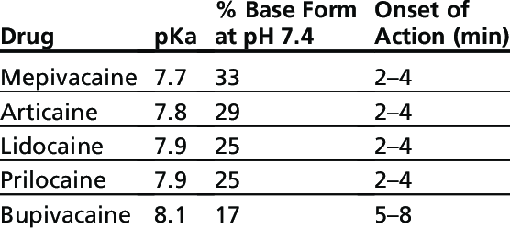
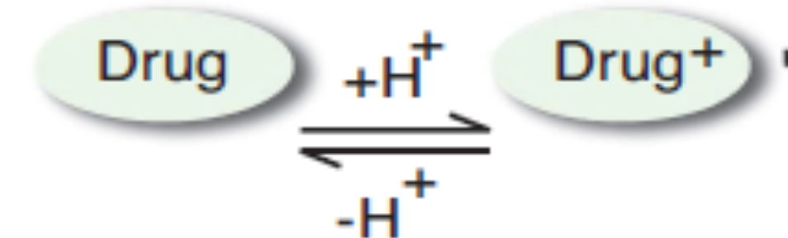

Slide 52
Metabolism
Biotransformation of amides occurs primarily in the liver. Prilocaine, a dental anesthetic, is also metabolized in the plasma and kidney, and one of its metabolites may lead to methemoglobinemia. Esters are biotransformed by plasma cholinesterase (pseudocholinesterase). Patients with pseudocholinesterase deficiency may metabolize ester local anesthetics more slowly. At normal doses, this has little clinical effect. Reduced hepatic function predisposes patients to toxic effects, but should not significantly increase the duration of action of local anesthetics.
Allergic reactions
Patient reports of allergic reactions to local anesthetics are fairly common, but often times reported “allergies” are actually side effects from the coadministered epinephrine.
Local anesthetic systemic toxicity
Treatment for LAST may include seizure suppression, airway management, and cardiopulmonary support. Administering a 20% lipid emulsion infusion (lipid rescue therapy) is a valuable asset.

Slide 53
