Slide 1
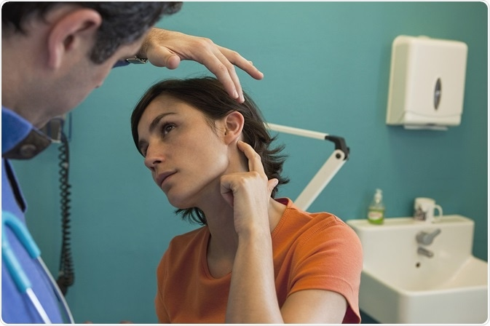
ANATOMY OF THE EAR
DR: KHALIL M. ABU NADA

Slide 2
General Principals
_ The ear is a sensory organ responsible for the sense of hearing and balance.
_ Anatomically, the ear can be divided into 3 parts: the outer ear, the middle ear, and the inner ear.
_ The outer ear consists of the auricle and ear canal.
_ The middle ear houses the tympanic structures and ossicles, which are responsible for the detection and initial transmission of sound.
_ Finally, the inner ear contains the bony labyrinth, along with other structures essential for spatial orientation, hearing, and balance.

Slide 3
Outer Ear Anatomy
Auricle
_ The auricle is composed of musculocutaneous tissue and elastic cartilage covered by skin
_ This structure is responsible for collecting and redirecting sound waves into the external auditory meatus.
Helix: curved outer rim
Antihelix: inner curved rim
Tragus
and antitragus: protrusions that partially obstruct external auditory meatus
Concha: hollow region in front of external auditory meatus
Lobule: inferior, fleshy portion of ear
Triangular fossa: concave surface of anterosuperior ear
Scaphoid fossa: concave surface of posterosuperior ear

Slide 4
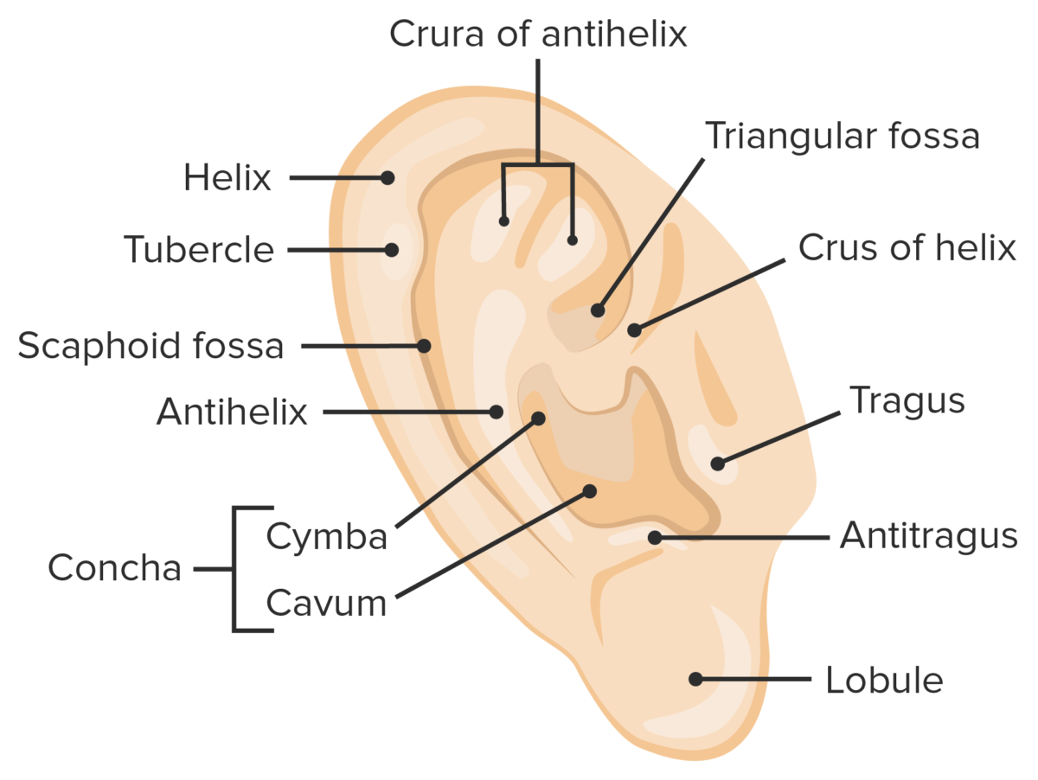

Slide 5
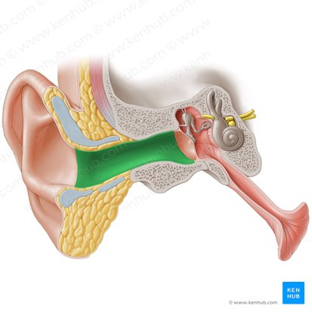
External auditory meatus
_ The external auditory meatus is typically 1 in. (2.5 cm) in length and is S-shaped.
Lateral ⅓ surrounded by cartilage (posterosuperior trajectory)
Medial ⅔ surrounded by temporal bone (anteroinferior trajectory)
Surrounding skin contains ceruminous and sebaceous glands → ear wax

Slide 6
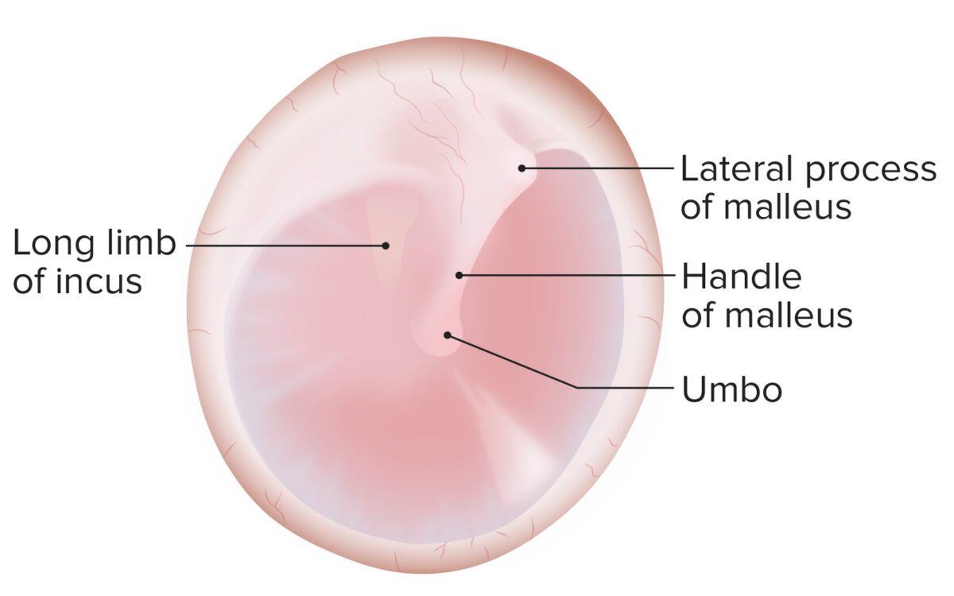
Tympanic membrane
Transmits sound waves from the air to the ossicles → mechanical vibrations
Located between outer and middle ear
Attached to fibrocartilaginous ring of temporal bone
3 layers: cutaneous, fibrous, and mucous
Ossicles attach to the tympanic membrane at the umbo.

Slide 7
Middle Ear
Tympanic cavity
Bony membranous cavity shaped like a 6-sided prism and filled with air
Contains the ossicles, muscles, and nerves
The roof consists of the tegmental wall, which separates the middle ear from the middle cranial fossa
Labyrinthine or medial wall contents:
  Oval window (connects to vestibule of the internal ear)
  Round window (secondary tympanic membrane)
  Promontory
  Prominence of the facial canal
Relations:
  Lateral wall: tympanic membrane
  Posterior wall:
    Mastoid antrum
    Communicates with mastoid air cells
  Anterior wall (carotid wall):
    Thin layer of bone
    separating the cavity from the carotid artery
    Pierced by the tympanic branch of the internal carotid artery and deep petrosal nerve
    Contains the auditory tube
  Floor (jugular wall): separates the cavity from the internal jugular vein

Slide 8
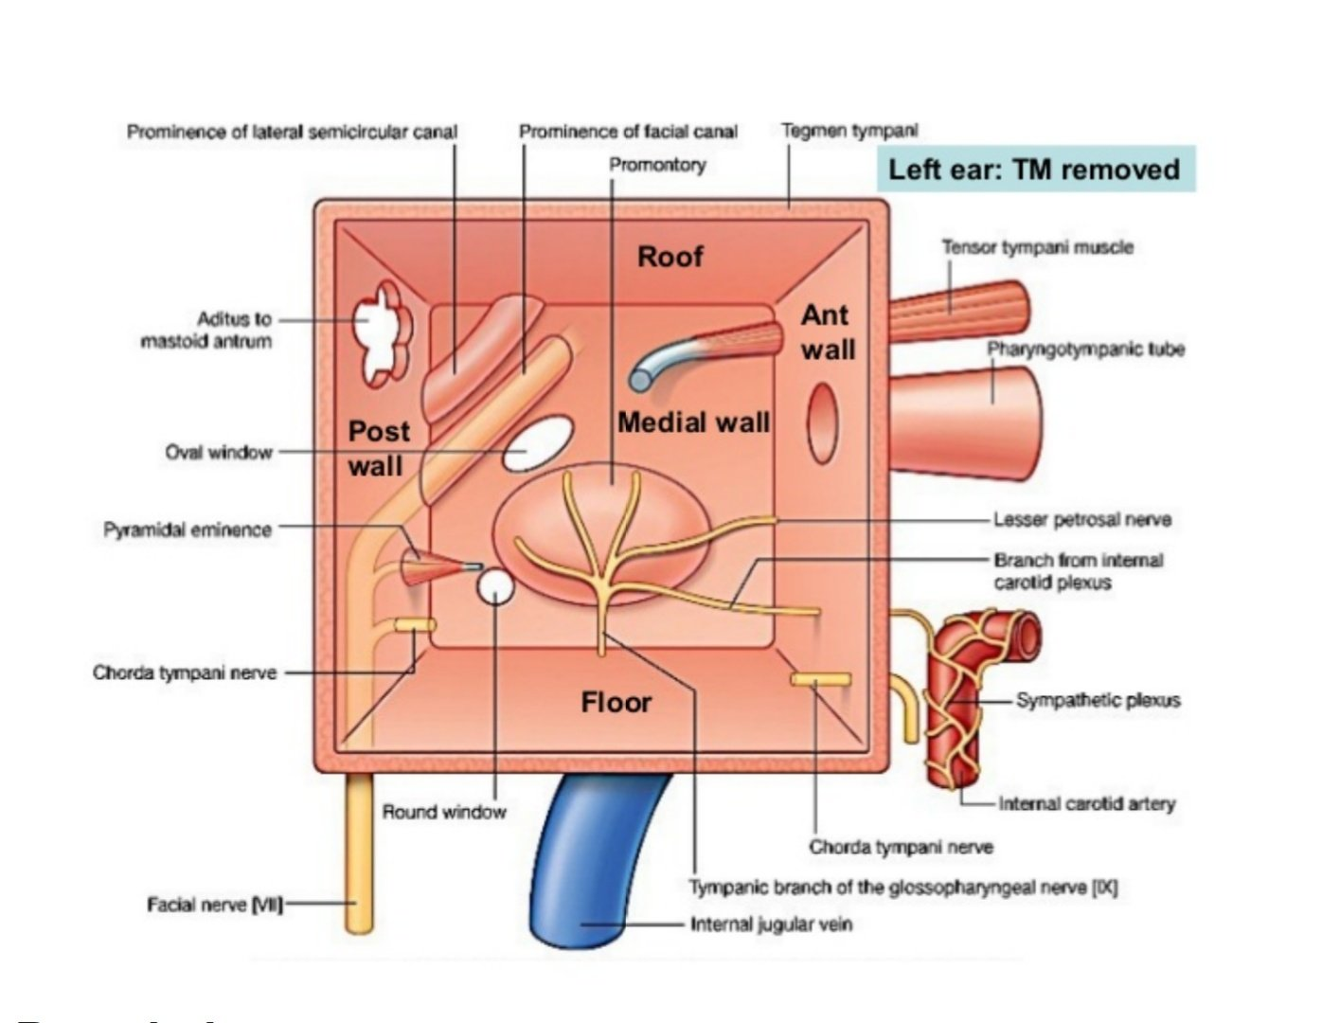

Slide 9
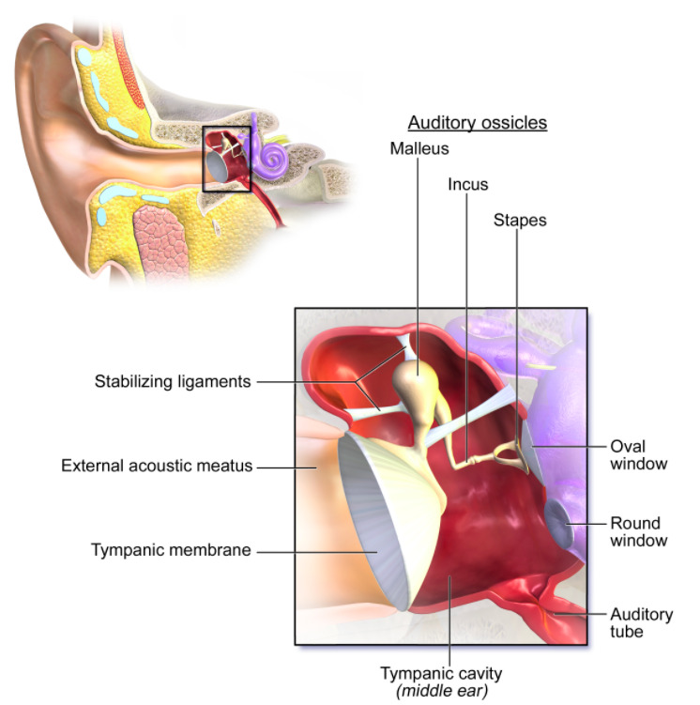
Auditory ossicles:
  Amplify sound waves and transmit them to the labyrinth of the inner ear
  Connect the tympanic membrane to the oval window
  Smallest bones in the human body
  Lateral → medial: malleus, incus, stapes

Slide 10
Muscles of the middle ear
Middle ear muscles are responsible for movement of the tympanic membrane.
Tensor tympani muscle:
  Origin:
    Cartilaginous part of eustachian tube
    Greater wing of the sphenoid
    Semicanal for tensor tympani (petrous part of temporal bone)
  Insertion: superior part of the handle of the malleus
  Innervation: mandibular branch of the trigeminal nerve (CN V3)
  Function:
    Pulls the handle of the malleus medially
    Tenses the tympanic membrane
Stapedius muscle:
  Origin: cartilaginous/bony margins of eustachian tube
  Insertion: neck of stapes
  Innervation: facial nerve (CN VII)
  Function:
    Pulls stapes posteriorly
    Prevents excessive oscillation of the ossicles

Slide 11
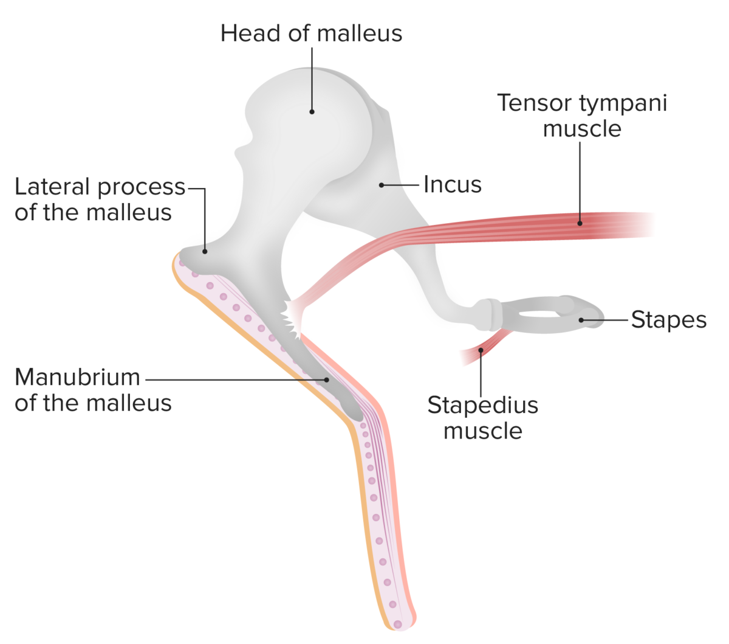

Slide 12
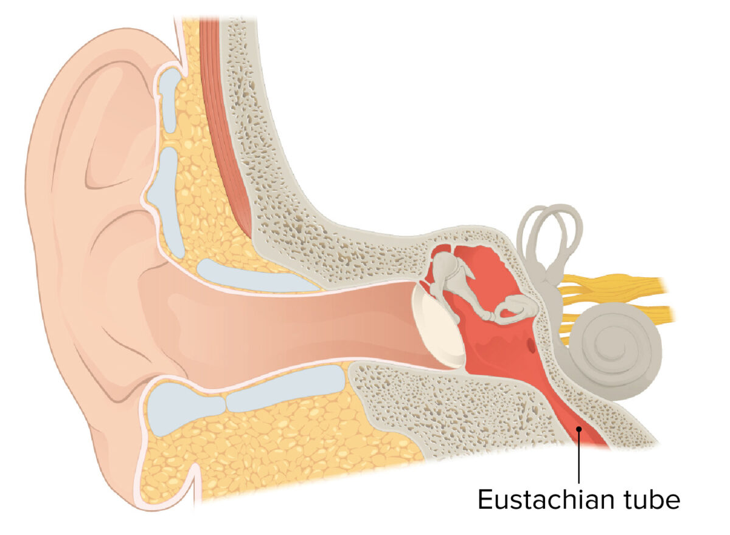
Eustachian tube (auditory tube)
Controls pressure within the middle ear and on both sides of the tympanic membrane
Located anterior to the tympanic cavity
Connects the middle ear to the nasopharynx

Slide 13
Inner Ear
The inner ear is located within the petrous part of the temporal bone and contains the organs of hearing and equilibrium
Bony labyrinth
The bony labyrinth is filled with perilymph and is separated from the middle ear by the medial wall of the tympanic cavity.
Vestibule: central bony cavity:
  Contains the utricle and saccule
  Communicates with the middle ear in 3 directions:
    Laterally through the oval window
    Anteriorly with the cochlea
    Posteriorly with the semicircular canals
Semicircular canals: 3 canals at 90-degree angles to each other:
  Anterior canal = sagittal plane
  Posterior canal = frontal plane
  Lateral canal = transverse plane
Cochlea: spiral-shaped bony cavity:
  Spiral lamina: superior scala vestibuli and inferior scala tympani
  Central bony column = modiolus

Slide 14
Membranous labyrinth :
The membranous labyrinth is filled with endolymph and is composed of the vestibular and cochlear labyrinths.
Vestibular labyrinth:
  Comprised of the utricle, saccule , and 3 membranous semicircular ducts
  Contains sensory organs for balance
Cochlear labyrinth:
  Sensory organ for hearing
  Scala vestibuli:
    Contains perilymph
    Anterior chamber up which sound travels
  Scala tympani:
    Contains perilymph
    Posterior chamber down which sound travels
  Scala media (cochlear duct):
    Contains endolymph
    Located between scala vestibuli and scala tympani
    Houses organ of Corti

Slide 15
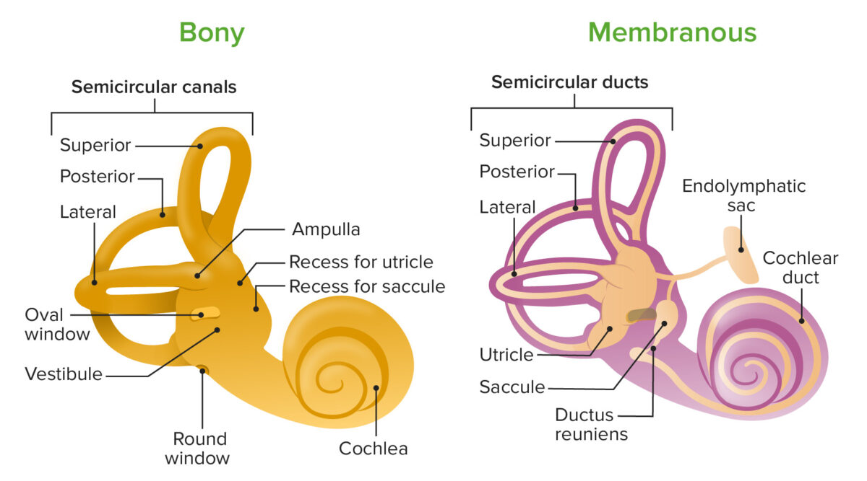

Slide 16
Organ of Corti:
  Spiral organ within cochlear labyrinth
  Contains mechanoreceptors called hair cells
  Hair cells determine the movement and position of the head in space.
  Types I (bulbous) and II (elongated) hair cells
    Both types have stereocilia of varying lengths at the apex.
    Stereocilia respond to movement of endolymph.
    Kinocilium: single cilium at lateral portion of hair cell, defines polarity of the cell

Slide 17
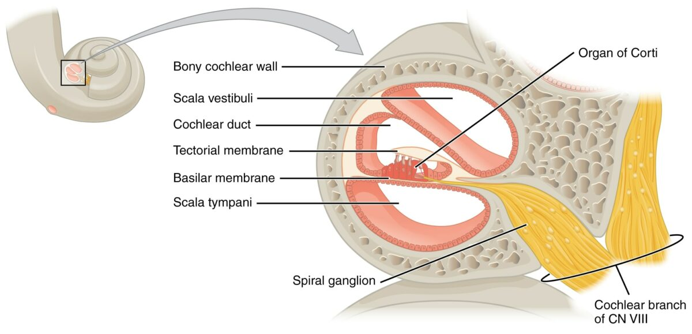

Slide 18
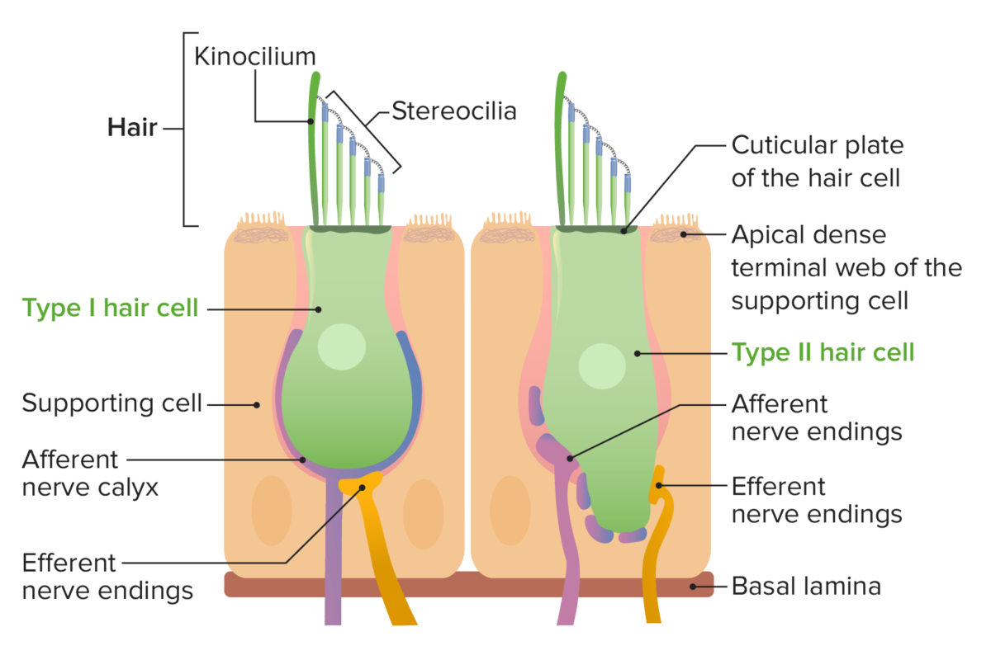

Slide 19
vestibulocochlear nerve
_ The vestibulocochlear nerve is the eighth paired cranial nerve. It is comprised of two parts – vestibular fibres and cochlear fibres. Both have a purely sensory function.
_ The vestibular and cochlear portions of the vestibulocochlear nerve are functionally discrete, and so originate from different nuclei in the brain:
Vestibular component – arises from the vestibular nuclei complex in the pons and medulla.
Cochlear component – arises from the ventral and dorsal cochlear nuclei, situated in the inferior cerebellar peduncle.
_ Both sets of fibres combine in the pons to form the vestibulocochlear nerve. The nerve emerges from the brain at the cerebellopontine angle and exits the cranium via the internal acoustic meatus of the temporal bone.
_ Within the distal aspect of the internal acoustic meatus, the vestibulocochlear nerve splits, forming the vestibular nerve and the cochlear nerve. The vestibular nerve innervates the vestibular system of the inner ear, which is responsible for detecting balance. The cochlear nerve travels to cochlea of the inner ear, forming the spiral ganglia which serve the sense of hearing.

Slide 20
