Slide 1
Cerebellum & Basal Nuclei
Anatomy & physiology
Dr. Mahmoud Abumettleq

Slide 2
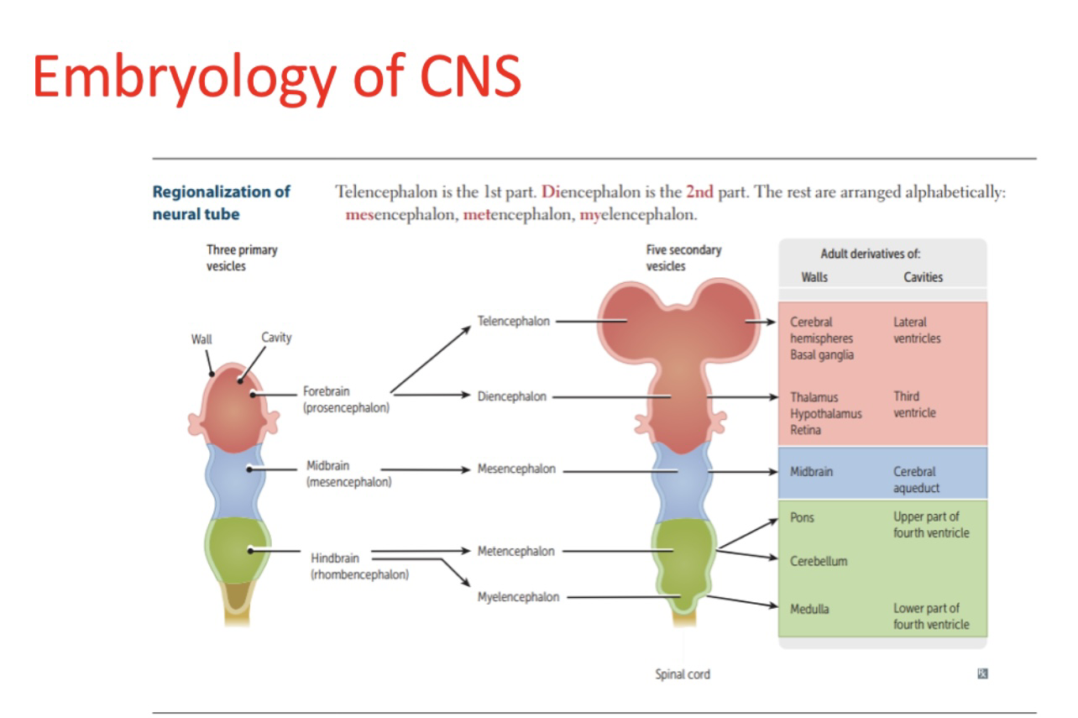

Slide 3
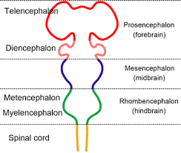
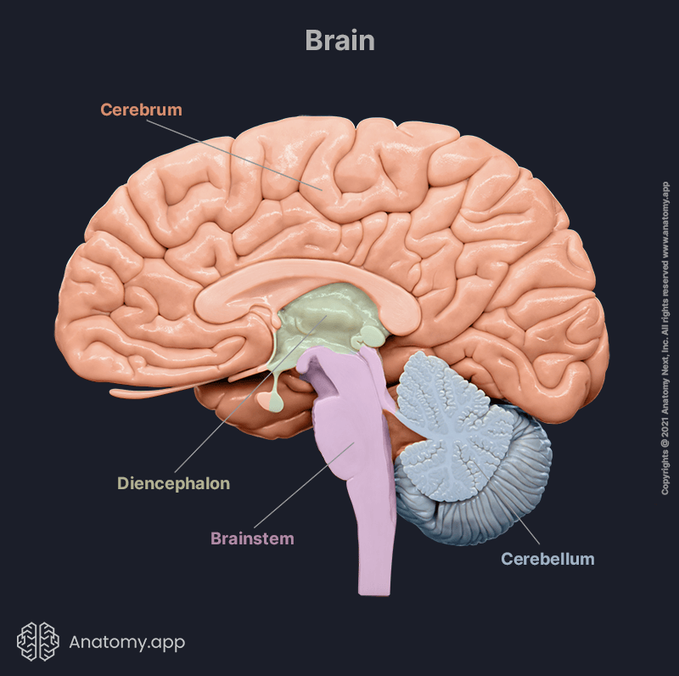

Slide 4
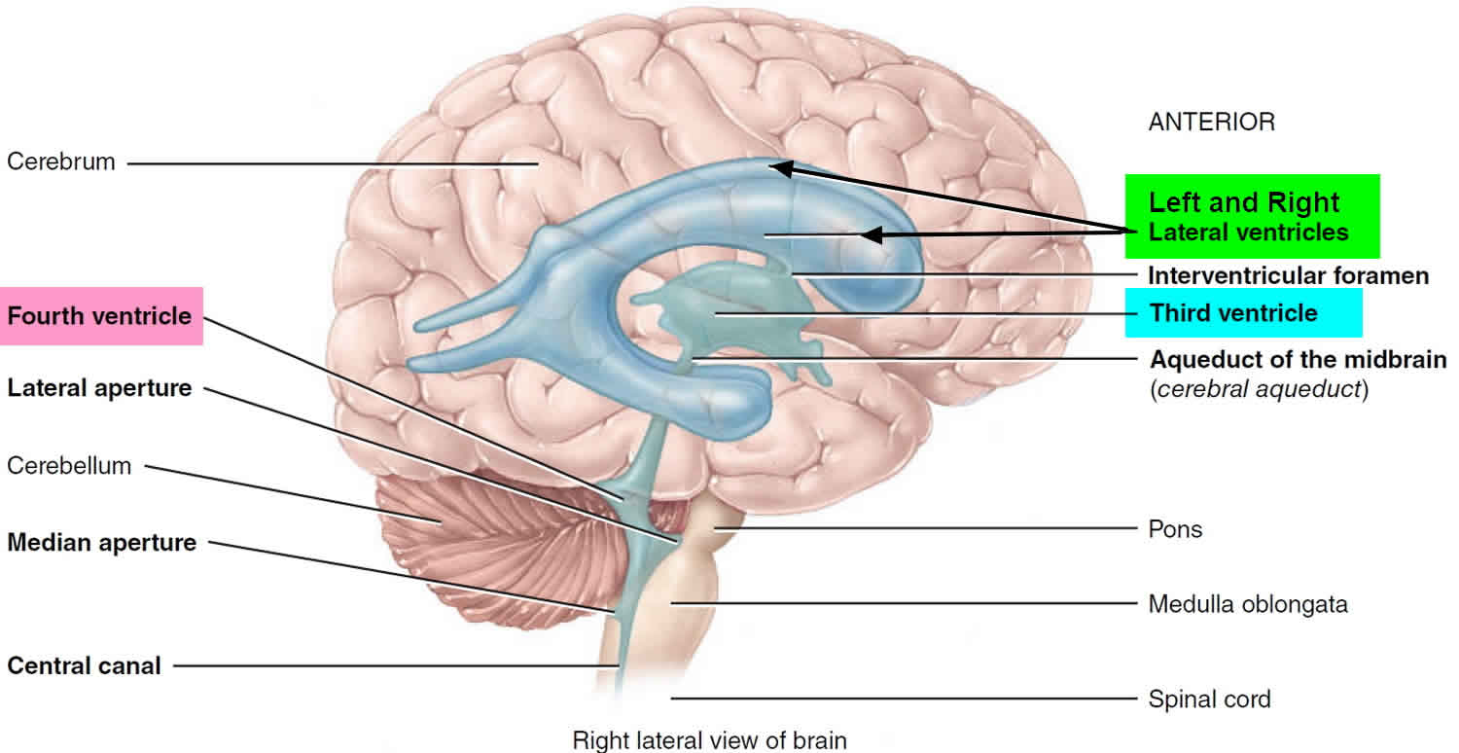

Slide 5
Introduction
Cerebellum is the dorsal part of hindbrain (rhombencephalon).
Among the three components of hindbrain with pons and medulla oblongata,Cerebellum is the largest in volume.
Cerebellum is considered as motor component of brain. Though it does not initiate voluntary movement, but it exerts a control on it in a subconscious state.
In contrast to cerebrum, cerebellum is known as little brain'.
Cerebellum exerts ipsilateral control on body.

Slide 6
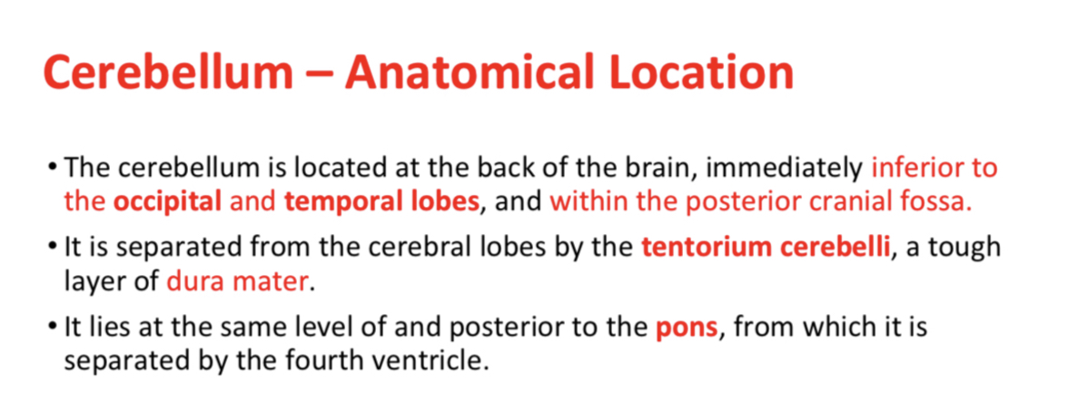
Three components of brainstem, midbrain, pons and medulla oblongata are connected to cerebellum by paired superior, middle and inferior cerebellar peduncles respectively

Slide 7
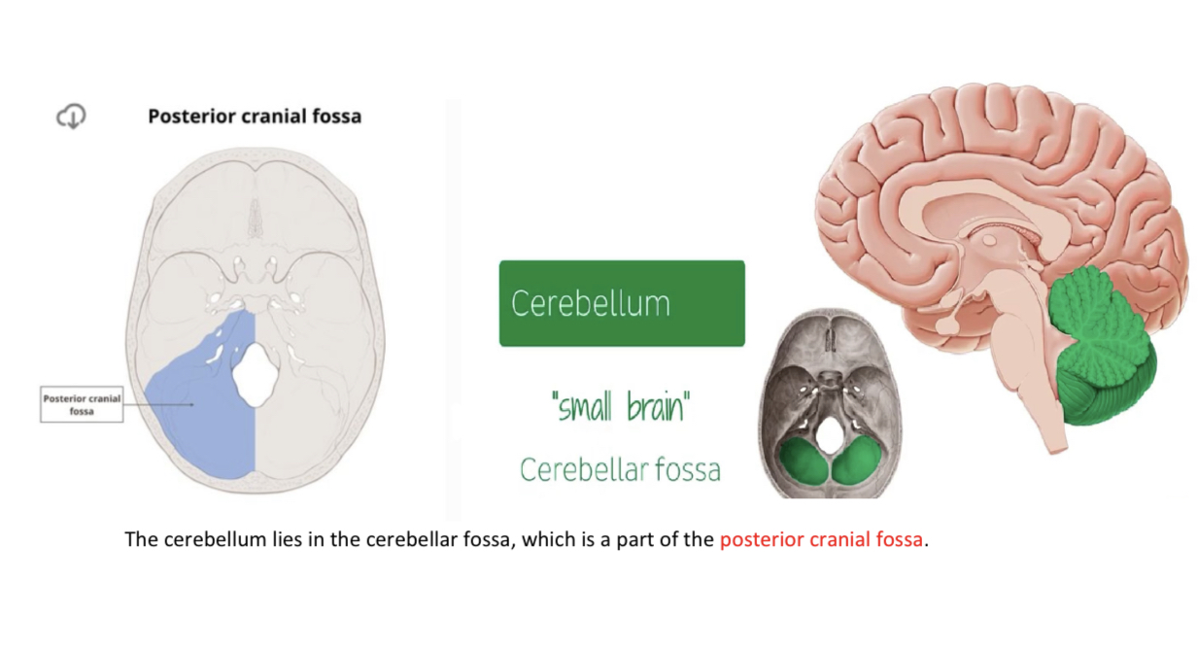

Slide 8
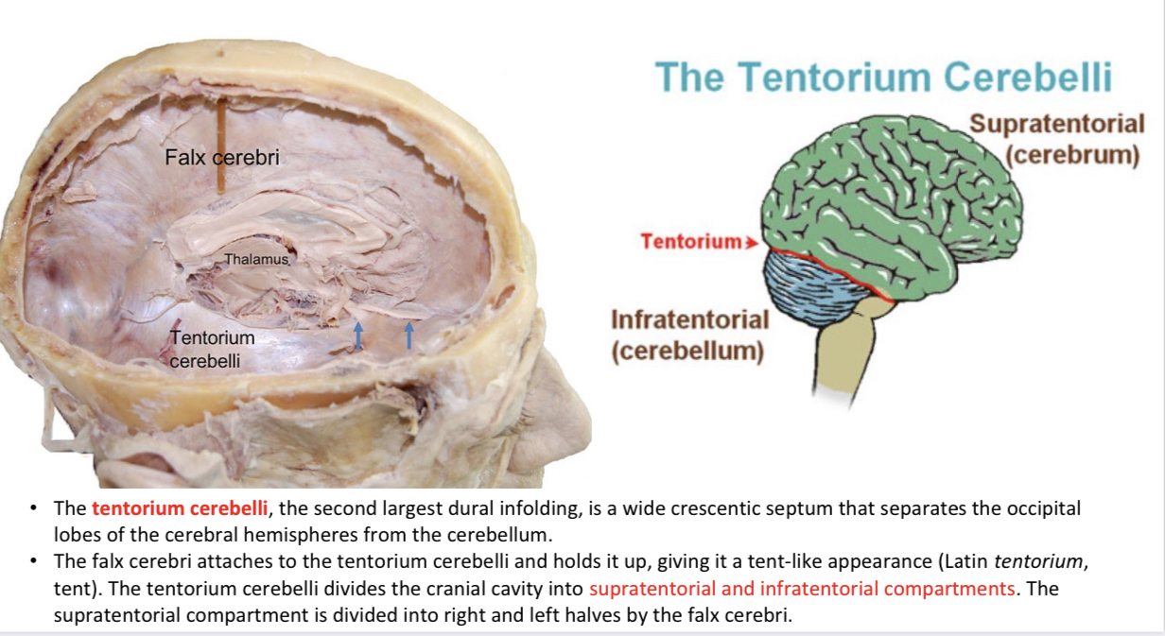

Slide 9
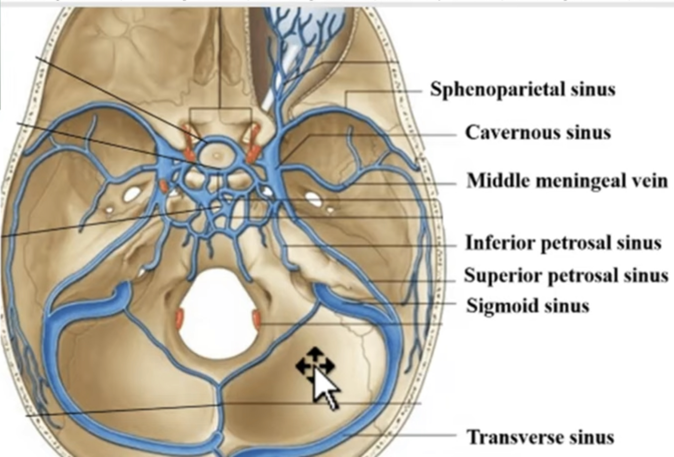

Slide 10
Cerebellum – Cerebellar Peduncles
• There are three foot processes that not only anchor the cerebellum to the brainstem, but also provide a pathway for neuronal tracts to travel to and from the cerebellum.
These structures are the superior, middle and inferior cerebellar peduncles.
The connections between the cerebellum and the respective parts of the brainstem (Medulla, pons, midbrain) are as follows:
to midbrain: superior cerebellar peduncles
- to pons: middle cerebellar peduncles
to medulla: inferior cerebellar peduncles

Slide 11
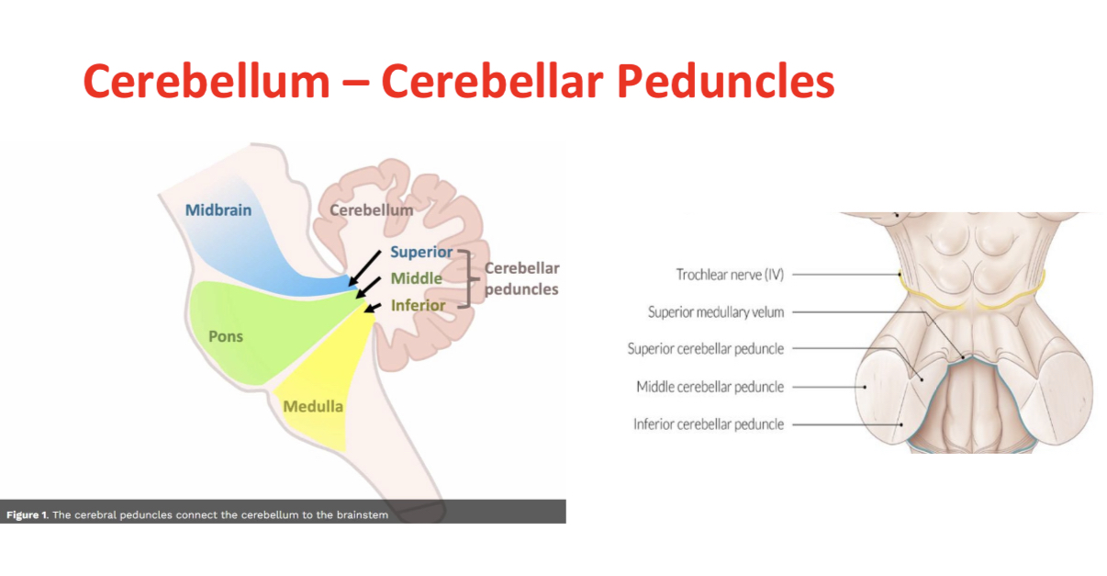

Slide 12
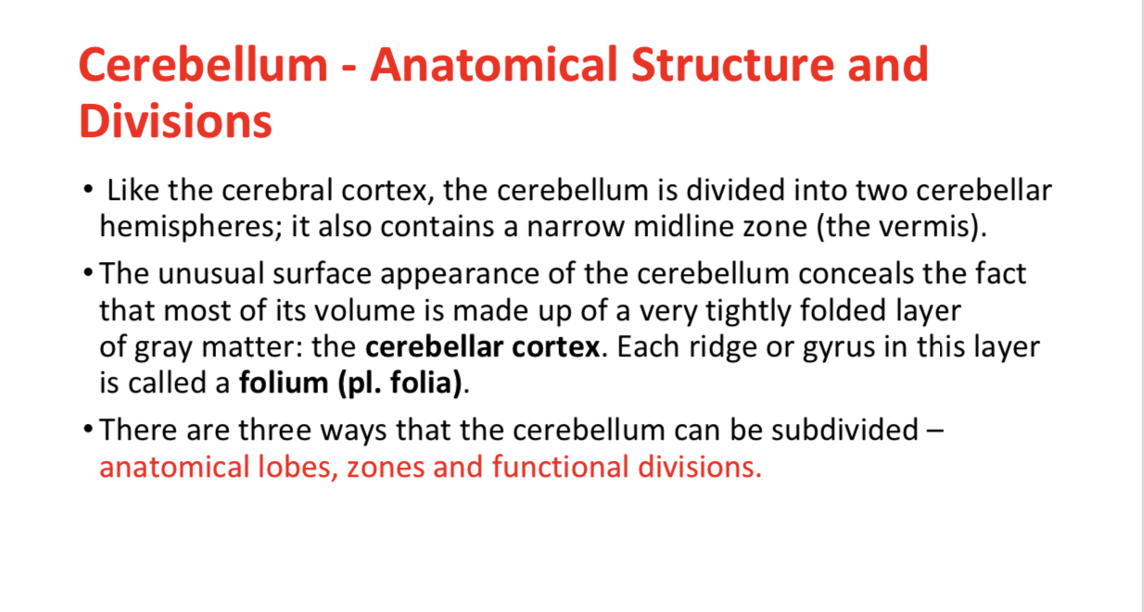

Slide 13
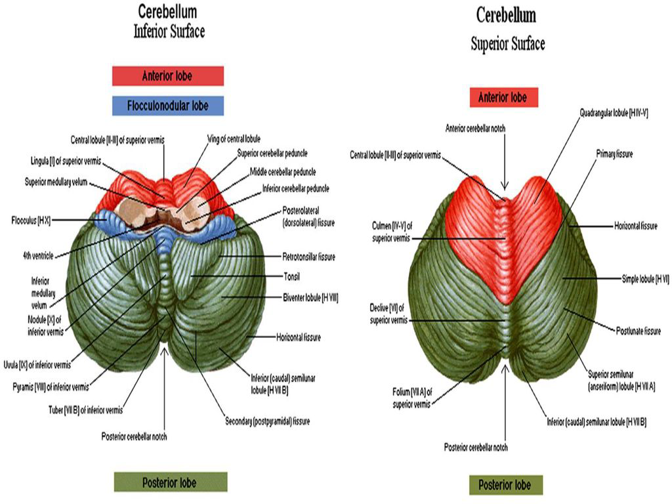

Slide 14
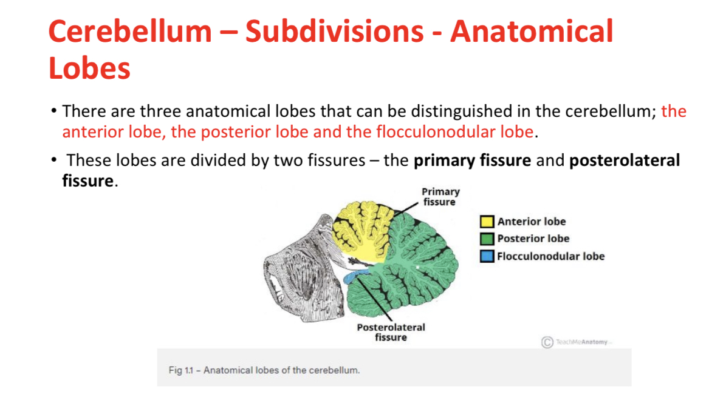

Slide 15
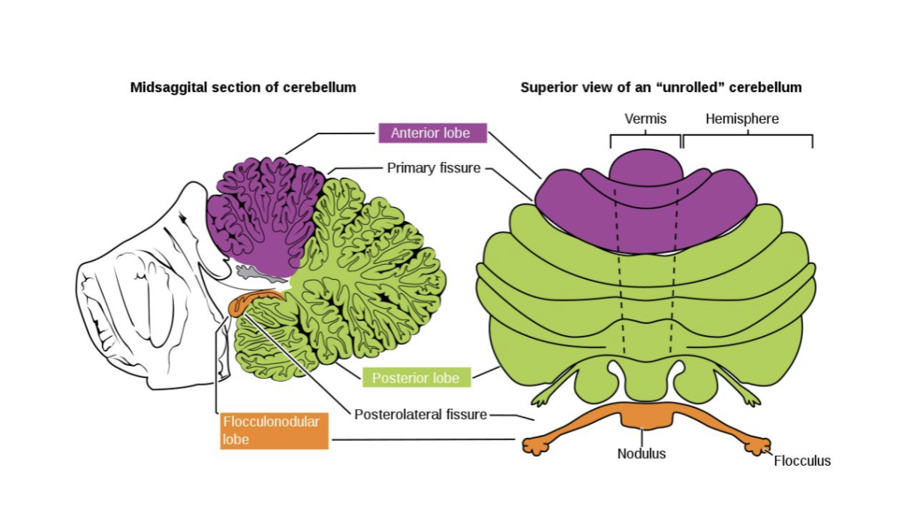

Slide 16
Lobes of the cerebellum:
1) Anterior lobe
It lies anterior to the primary fissure on the superior surface . It is associated functionally with the spinal cord.
2) Middle lobe (the largest lobe)
It lies between primary fissure and posterolateral fissure . It is associated functionally with the cerebral cortex.
3) Flocculonodular lobe
It lies anterior to the posterolateral fissure on thr inferior surface . It consist of the nodule in the median plane and the two flocculi. It is associated functionally with the vestibular nuclei.

Slide 17
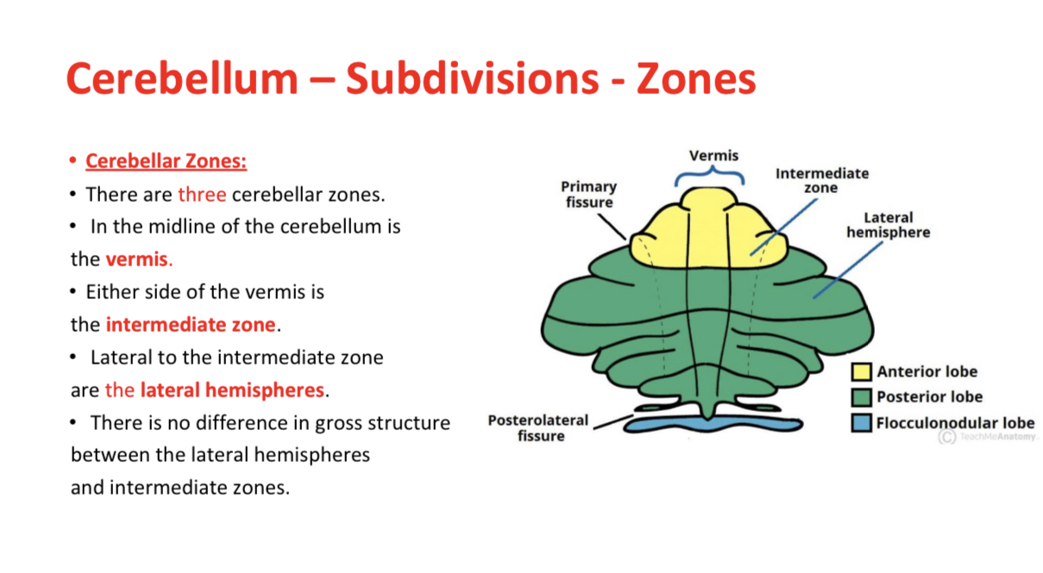

Slide 18
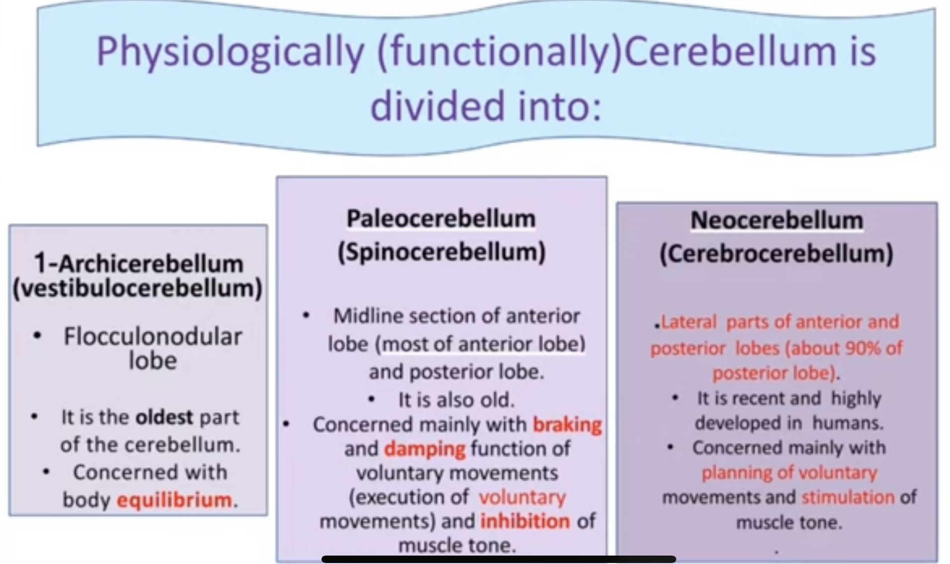

Slide 19
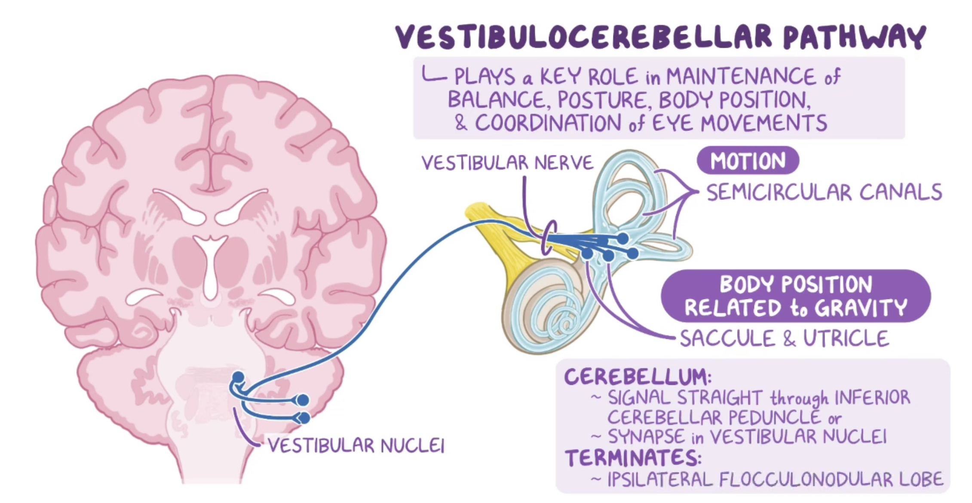
Functional classification of cerebellum
1-Vestibulo-cerebellum (Archicerebellum):
.Flocculonodular lobe
.It receives information from the vestibular nuclei and visual cortex and is responsible for balance and ocular movements

Slide 20
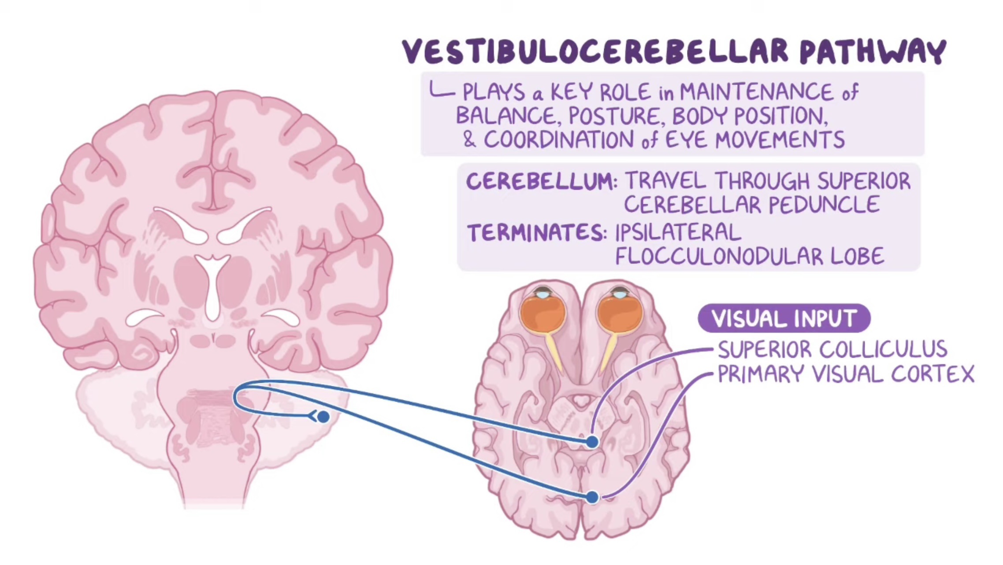

Slide 21
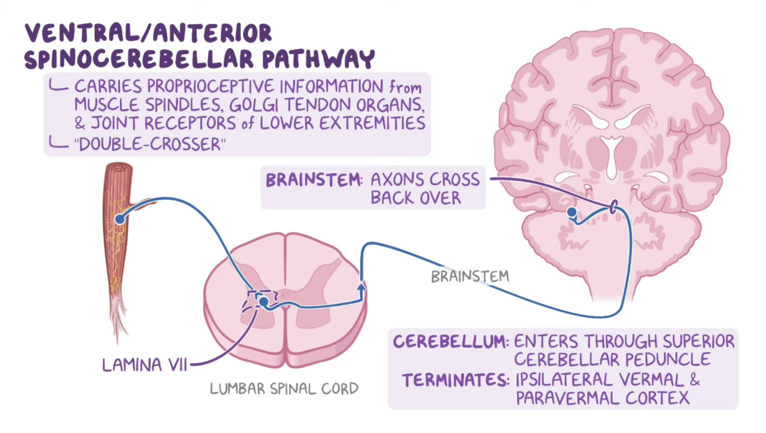
2-spino-cerebellum (the vermis and intermediate zones), which receives proprioceptive information from the spinal cord and is responsible for the coordination of movements (motor execution)

Slide 22
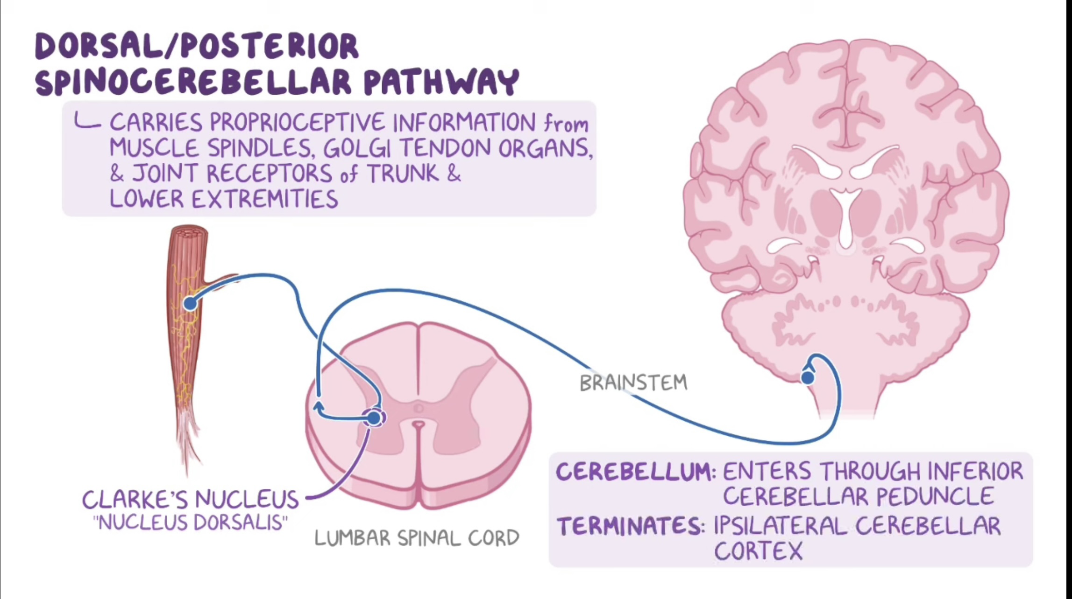

Slide 23
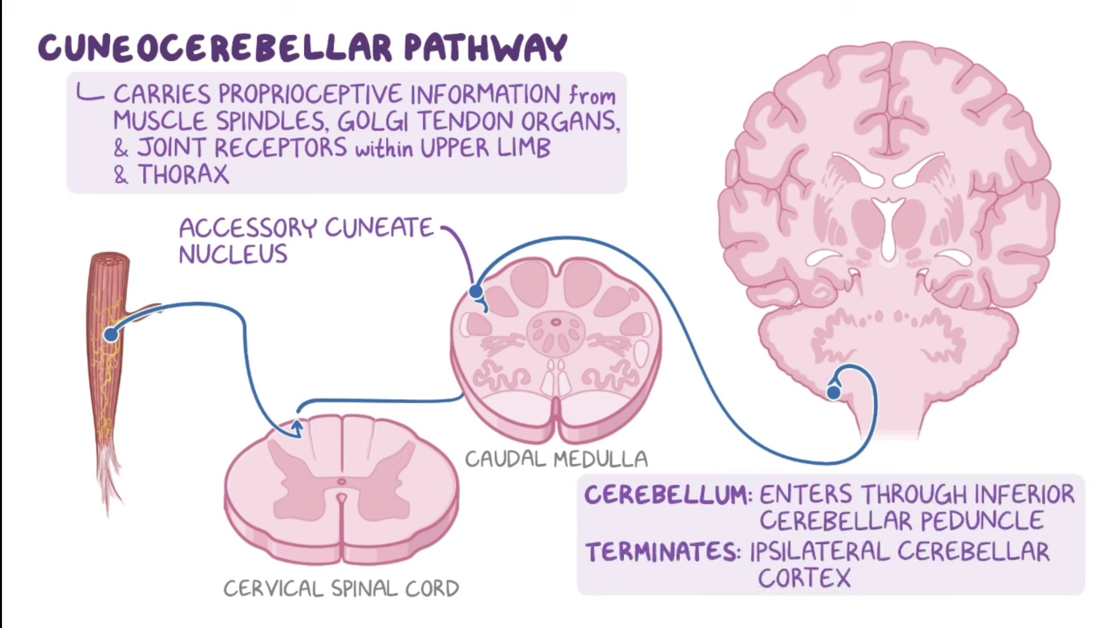

Slide 24
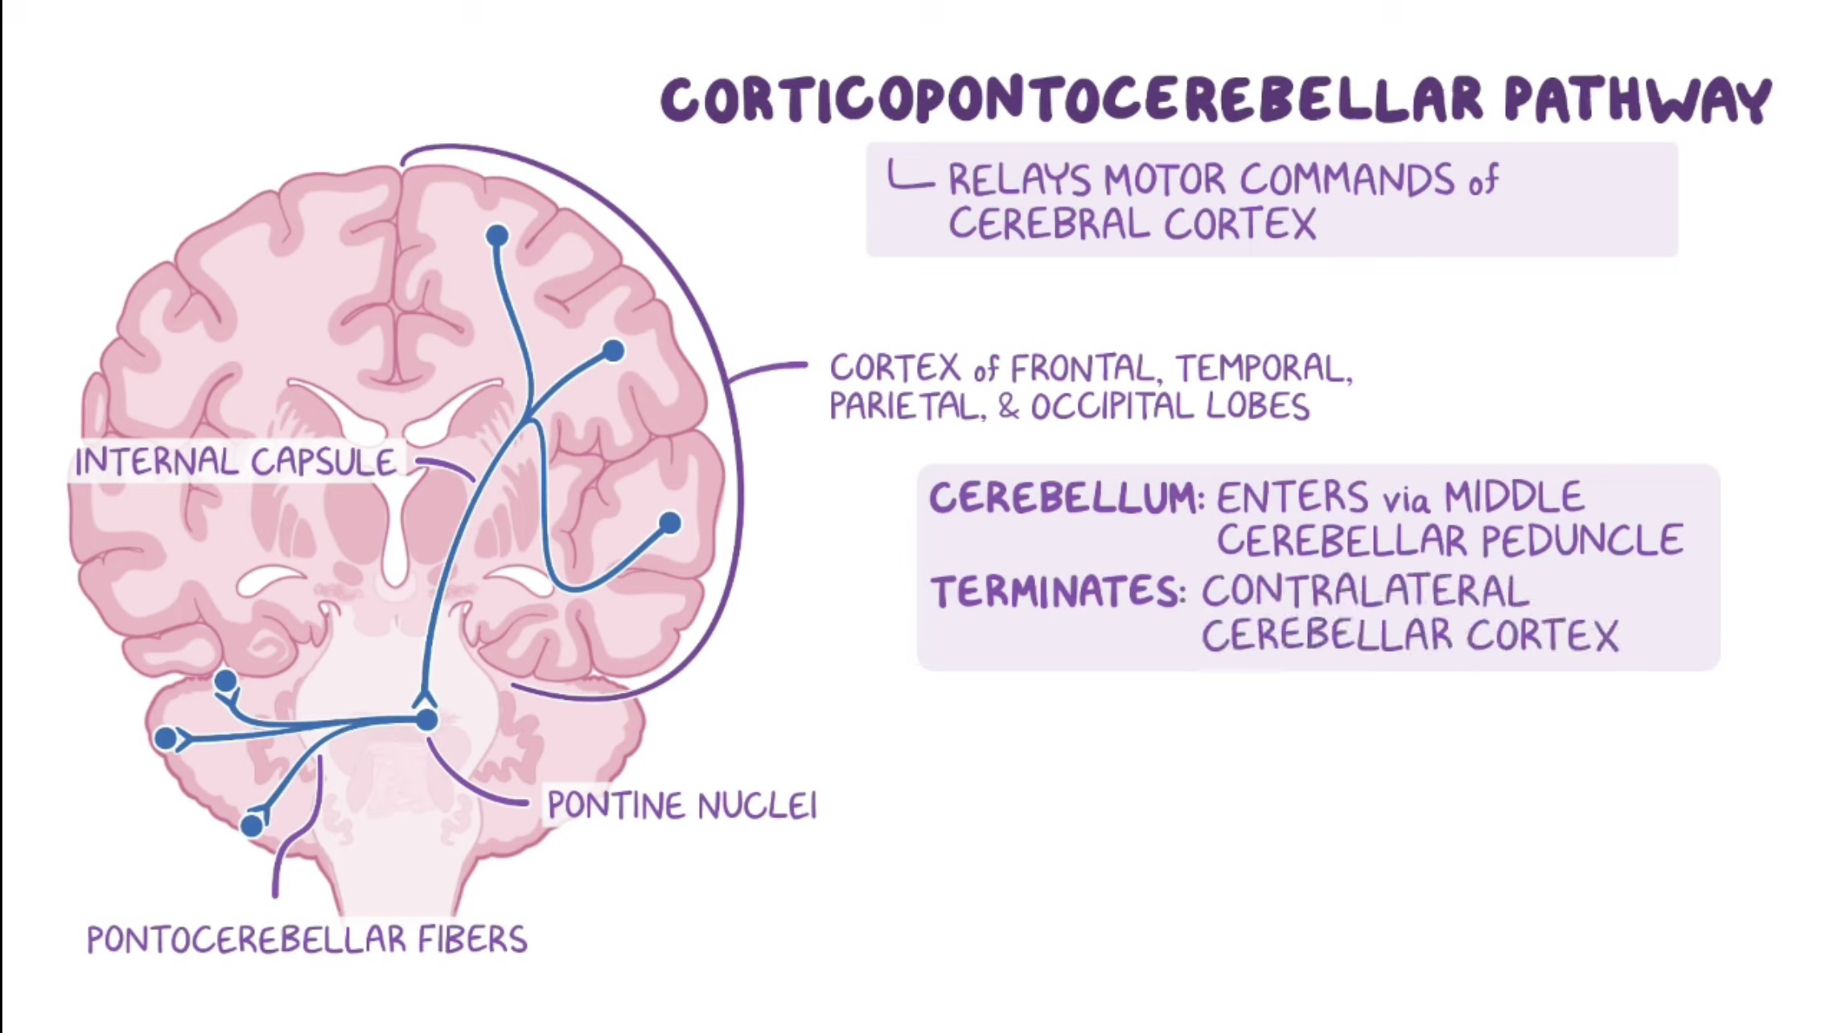
3-cerebro-cerebellum (the lateral zones), which receives sensory information from the cerebral cortex and is responsible for the planning of movements that are just about to occur (motor planning)

Slide 25
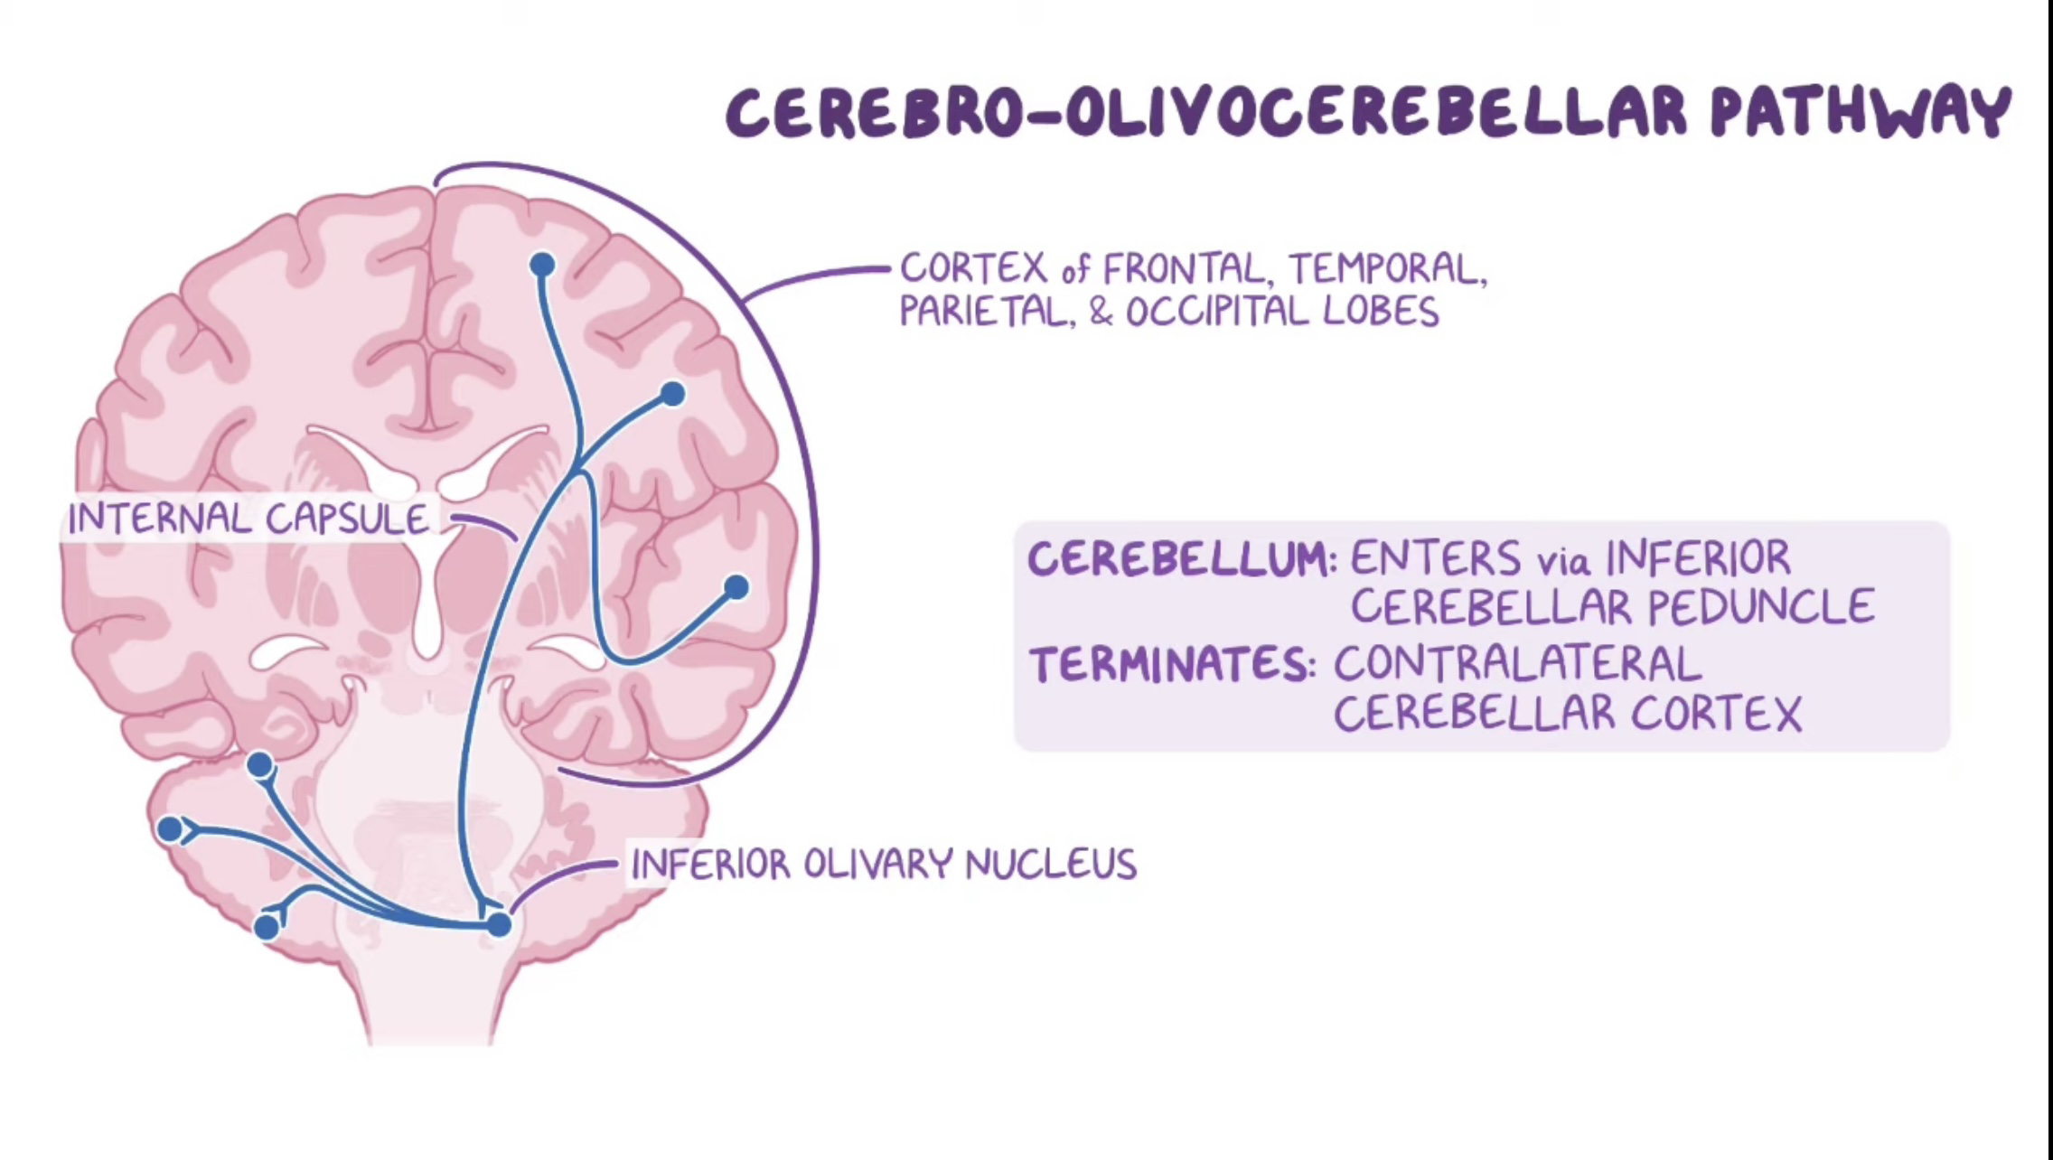

Slide 26
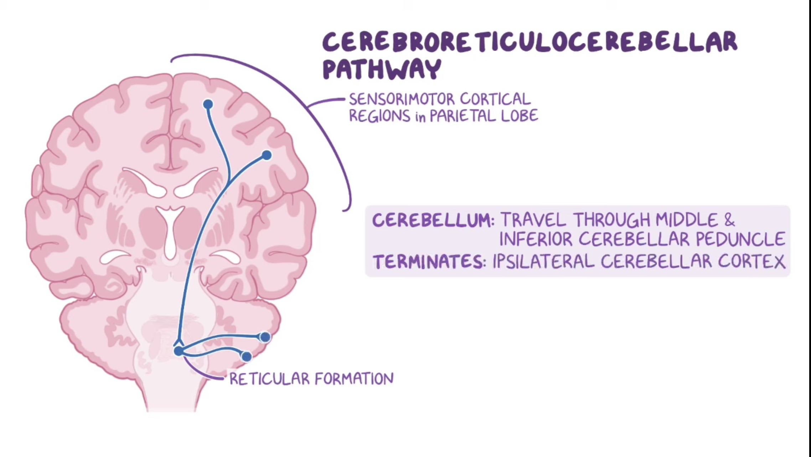

Slide 27
INTERNAL STRUCTURE OF CEREBELLUM
Cerebellum is structurally made up of following two fundamental zones.
1-Outer layer of gray matter called cerebellar cortex.
2-Inner central core of white matter which presents a pattern like branching of a tree projecting superficially beneath the cortex of each and every folium, called arbor vitae cerebelli.
Inside the substance of white matter are embedded mass of gray matter called cerebellar nuclei.

Slide 28
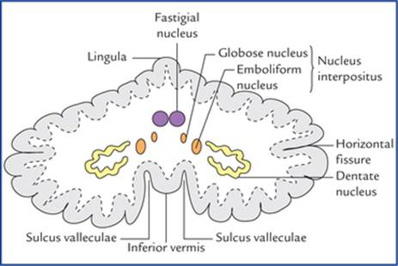
Cerebellar nuclei
From lateral to medial the nuclei are -
1.Dentate nucleus -D
2.Emboliform nucleus -E
3.Globose nucleus -G
4.Fastigial nucleus -F
Nucleus emboliformis and nucleus globossus are together known as nucleus interpositus.

Slide 29
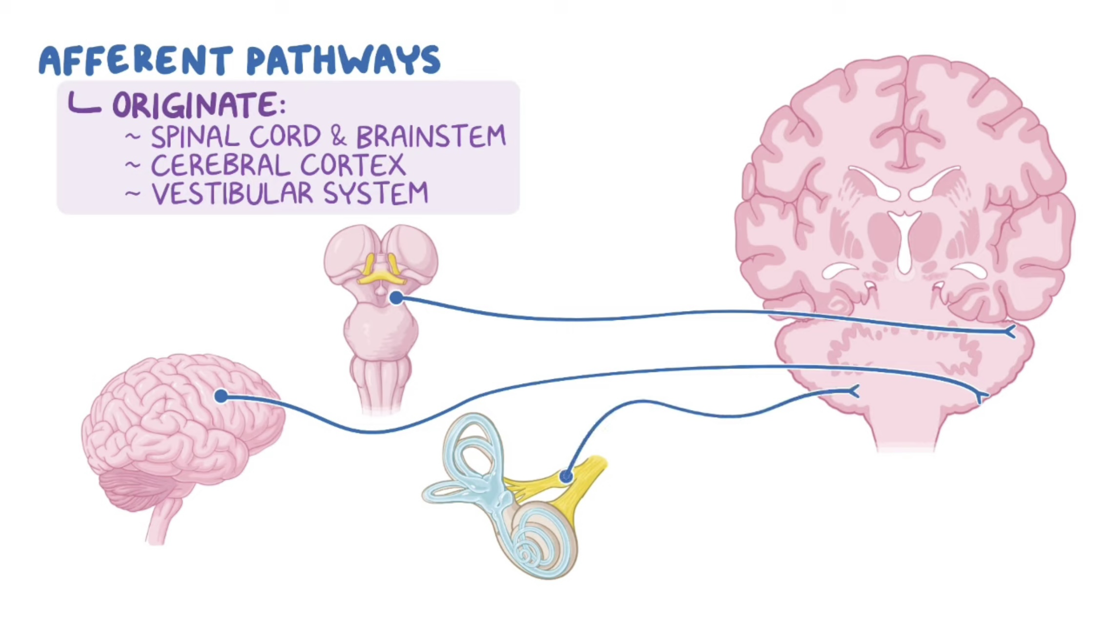
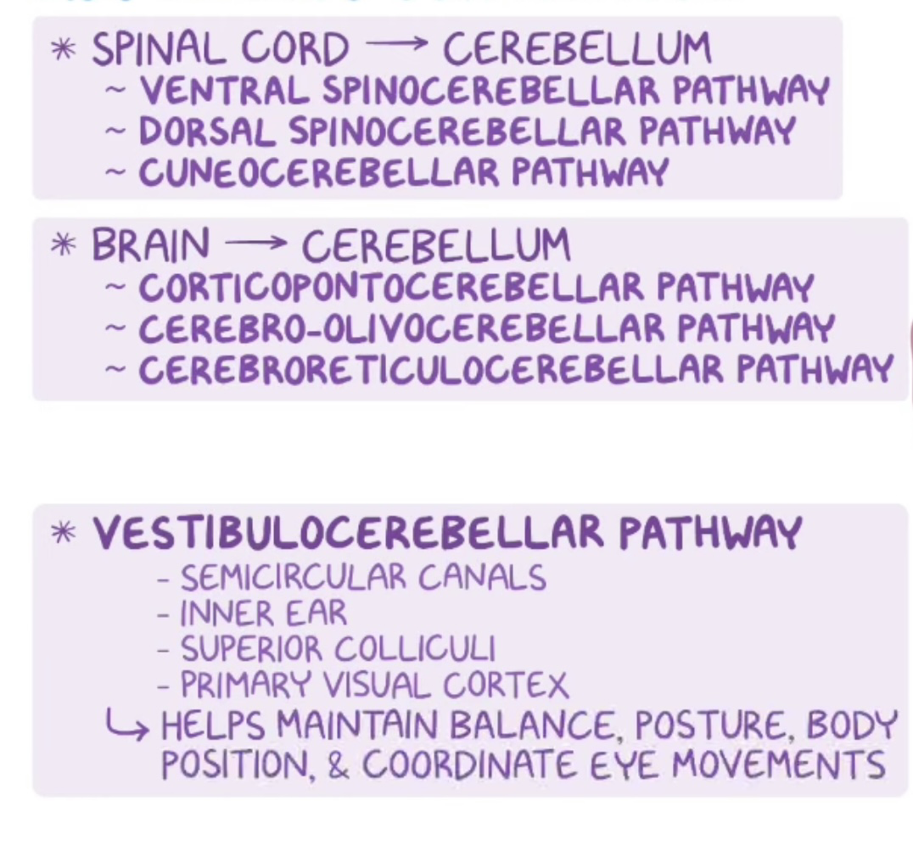

Slide 30
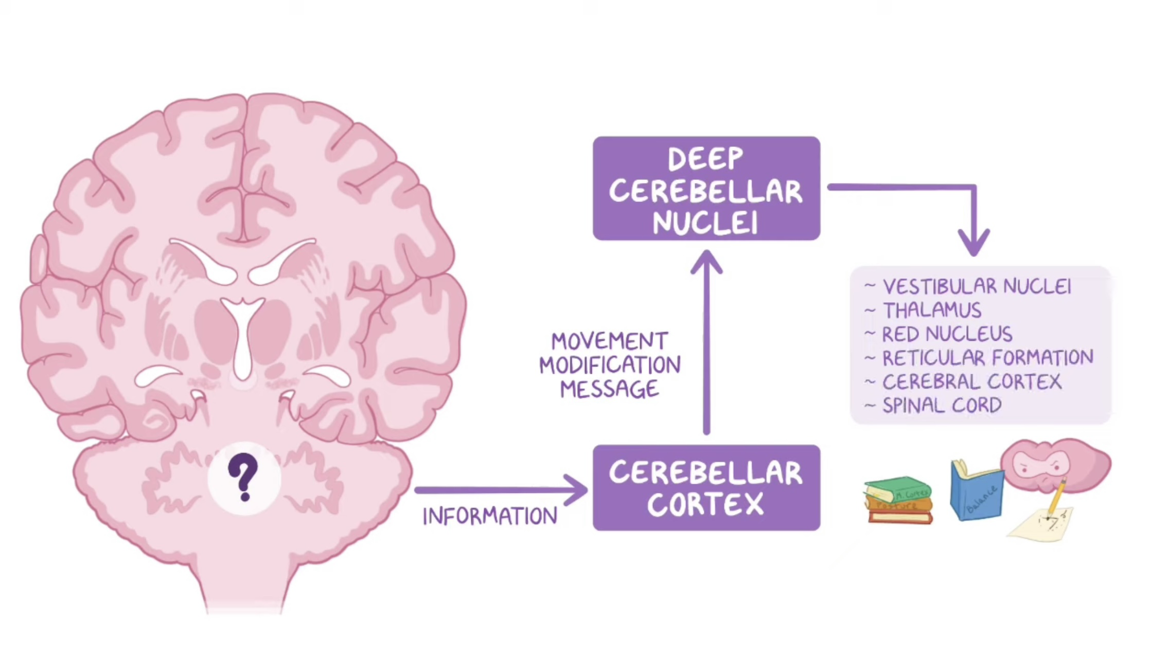
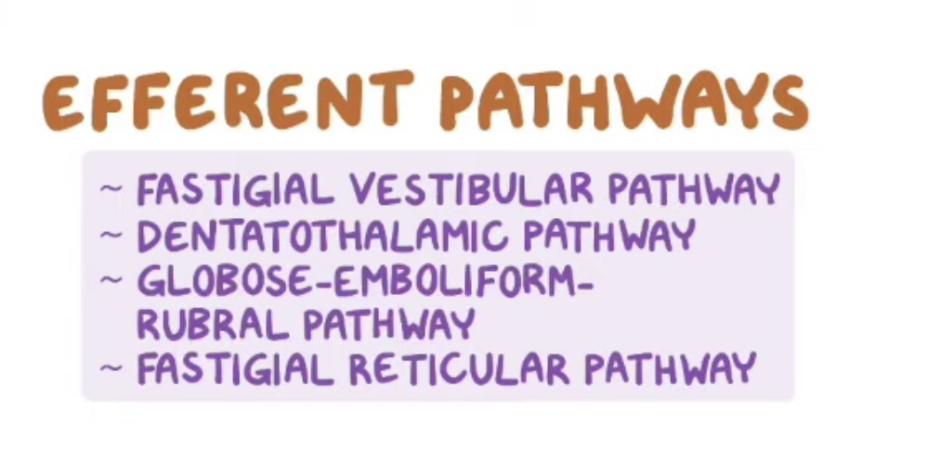

Slide 31
PRINCIPLE OF FUNCTIONS
Stage |
Cerebellum receives various kinds of sensory informations either through direct pathway like spinocerebellar or indirect pathway like spinothalamocortical and corticopontocerebellar tracts.
Sources of informations are as follows
-Proprioceptive general somatic sensation: From end organs of muscles, tendons, joints.
-Exteroceptive general somatic sensations: Mainly from end organs for touch and pressure.
-Proprioceptive special somatic sensation: From end organ for balance, i.e. vestibular apparatus.
-Exteroceptive special somatic sensation: From end organs for sight (photoreceptors) and end organs for hearing (cochlear apparatus).
Stage II
All sensor informations are analysed and coordinated or integrated.

Slide 32
Stage III
After integration of all sensory inputs. a regulatory effect is exerted by cerebellum, in a subconscious or unconscious state. on brainstem. spinal cord and cerebral cortex for
1. Maintenance of equilibrium or balance of body through postural adjustment.
2. Maintenance of muscle tone for desired sense of position and movements.
3. Coordinated and smooth muscular activities to proper range, extent and direction.

Slide 33
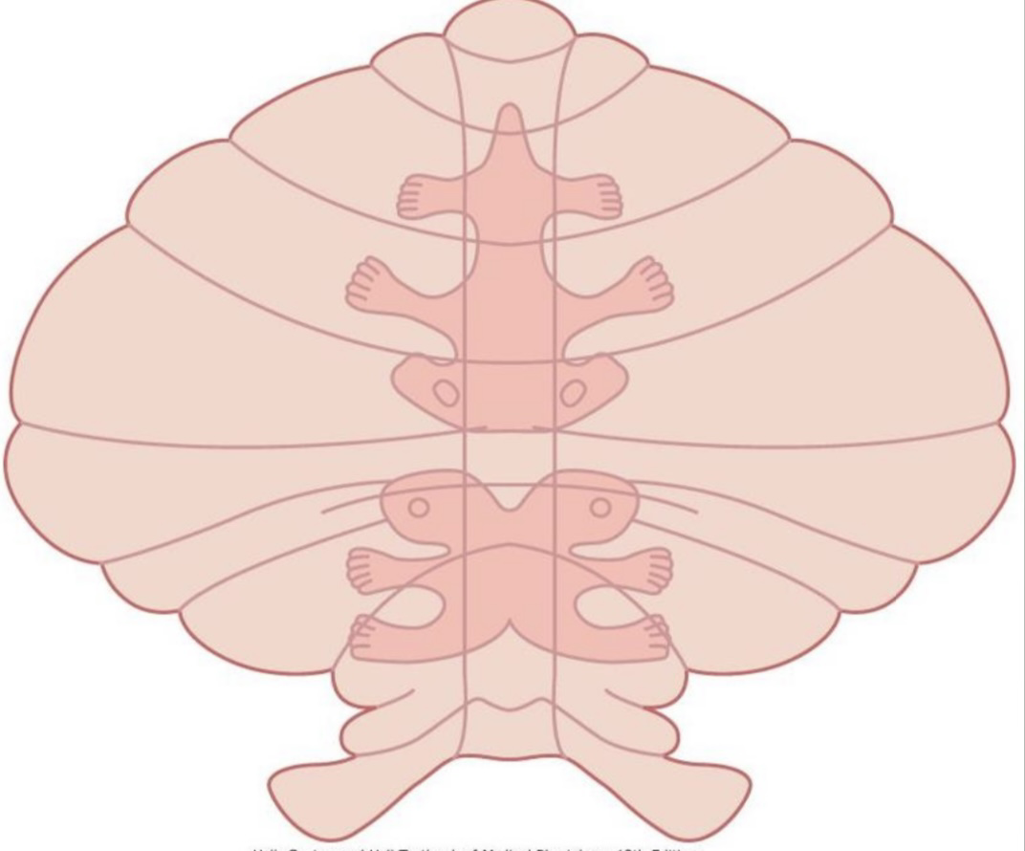
Body representation in cerebellum:
﻿-In the anterior lobe and upper parts of posterior lobe the body is represented in an inverted manner.
﻿-In the posterior lobe the representation is split in two halves.

Slide 34
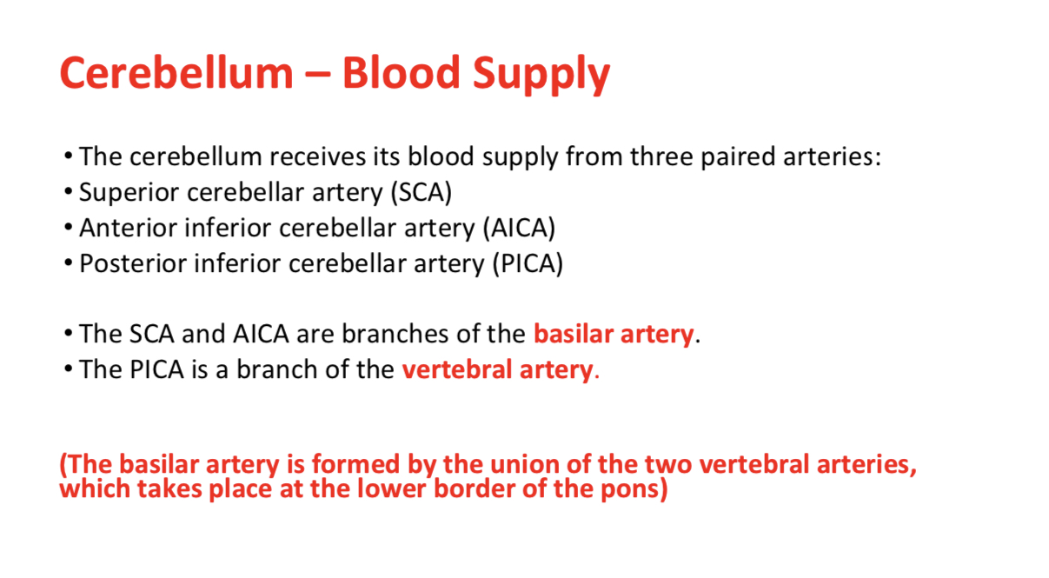

Slide 35
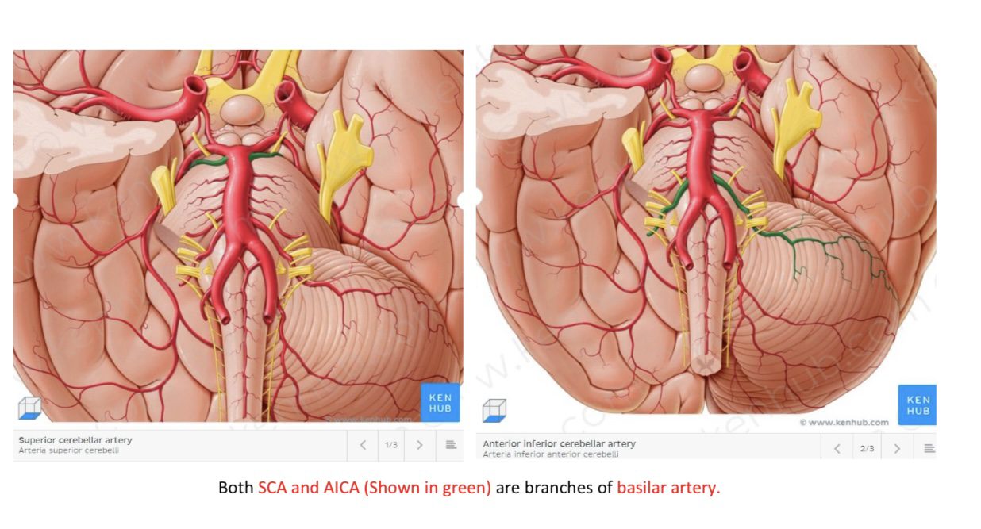

Slide 36
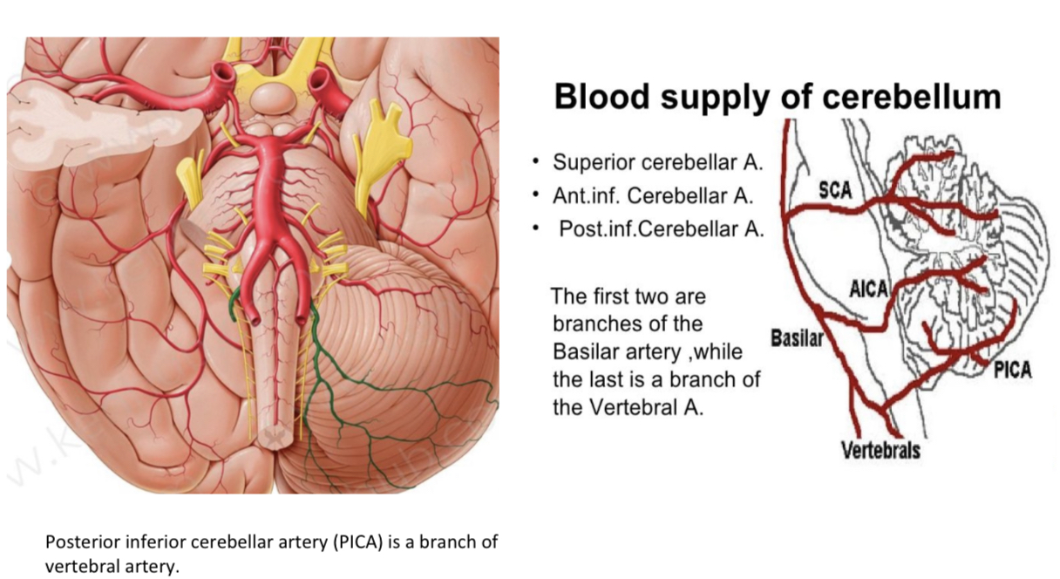

Slide 37
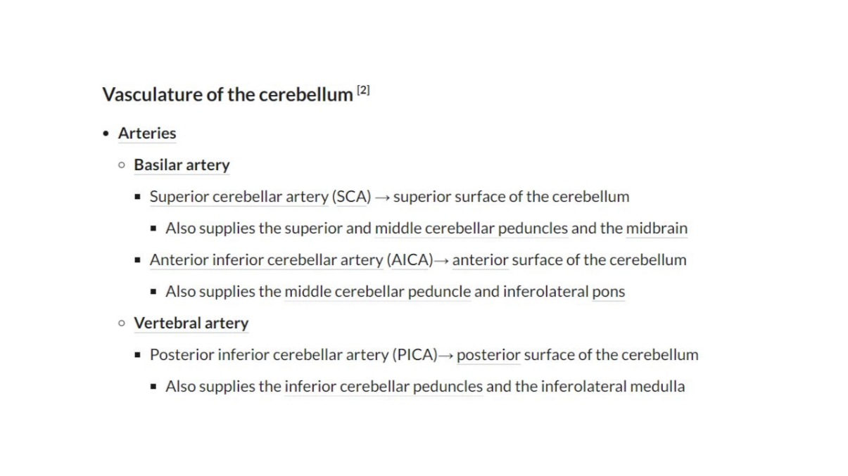

Slide 38
Cerebellar Dysfunction
Dysfunction of the cerebellum can produce a wide range of symptoms and signs. The aetiology is varied causes include stroke, physical trauma, tumours and chronic alcohol excess.
• The clinical picture is dependent on the functional area of the cerebellum that is affected. Damage to the cerebrocerebellum and spinocerebellum presents with problems in carrying out skilled and planned movements and in motor learning.
Damage to the vestibulocerebellum can manifest with loss of balance, abnormal gait with a wide stance.

Slide 39
Cerebellar Dysfunction
A wide variety of manifestations are possible. These can be remembered using the acronym ‘DANISH‘:
Dysdiadochokinesia (difficulty in carrying out rapid, alternating movements)
Ataxia
• Nystagmus (coarse):is an involuntary rhythmic side-to-side, up and down or
circular motion of the eyes
• Intention tremor:increases with activity, but relieved by rest
• Scanning speech
• Hypotonia

Slide 40
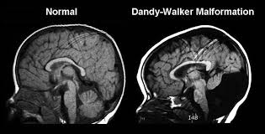
Dandy Walker syndrome
This is a congenital malformation and there is a partial or complete absence of the cerebellar vermis. Symptoms include:
slow motor development
convulsions
vomiting
an enlarged fourth ventricle, leading to raised intracranial pressure

Slide 41
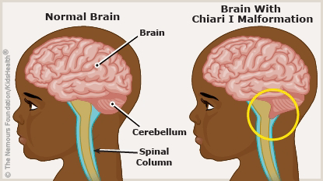
Arnold-Chiari malformation
This is a congenital malformation that results in an inferior displacement of the cerebellar tonsils through the foramen magnum. This obstructs the flow of cerebrospinal fluid and affects the blood flow to the structures inside the skull.
Symptoms include:
headaches
neck pain
tingling of the hands and feet
vomiting
fatigue

Slide 42


Slide 43
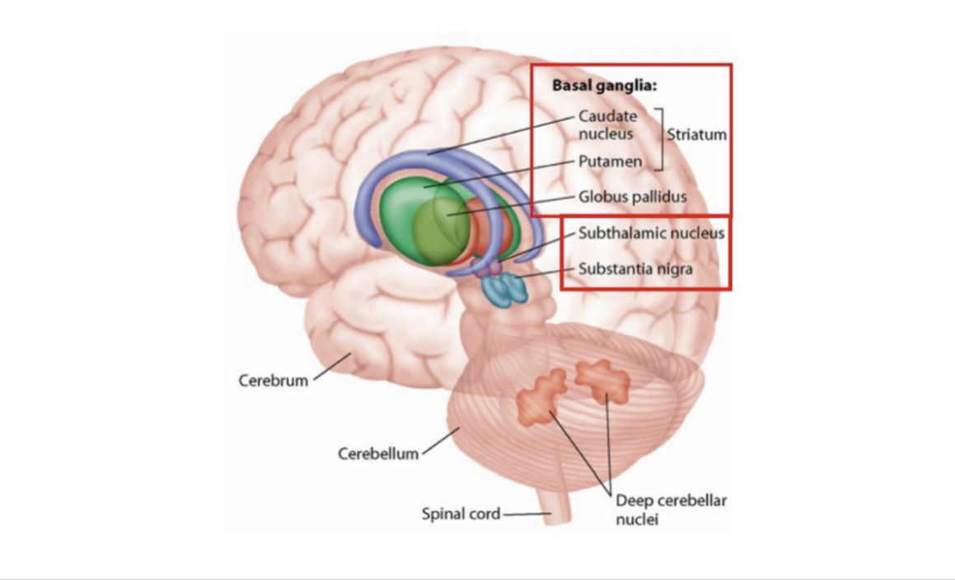

Slide 44
Basal ganglia are subcortical masses of gray matter inside cerebral hemisphere.
They are also known as basal nuclei.
Basal ganglia or basal nuclei are embedded in the central white core of cerebral hemisphere (telencephalon) at the level of diencephalon.
Though basal ganglia are concerned with control of posture and voluntary movements, they do not have any direct input or output connections with spinal cord.
Basal ganglia are the important components of extrapyramidal system.

Slide 45
Principle of Functions
Its main function is related to motor refinement, acting as a tonically active break, preventing unwanted movements to start. Much of this involves reducing the excitatory input to the cerebral cortex. This prevents excessive and exaggerated movements.
The basal ganglia also plays an important role in modulating cognitive and emotional responses.
Basal ganglia also influence stereotyped associated voluntary movements, e.g. swinging of arms while walking.

Slide 46
Components of Basal Ganglia
Caudate nucleus
Lentiform nucleus
Amygdaloid nucleus
Claustrum.
Subthalamic nuclei, substantia nigra are correlated and colisted with the components of basal ganglia clinically only because all these masses of gray matter are the centers for extrapyramidal system.

Slide 47
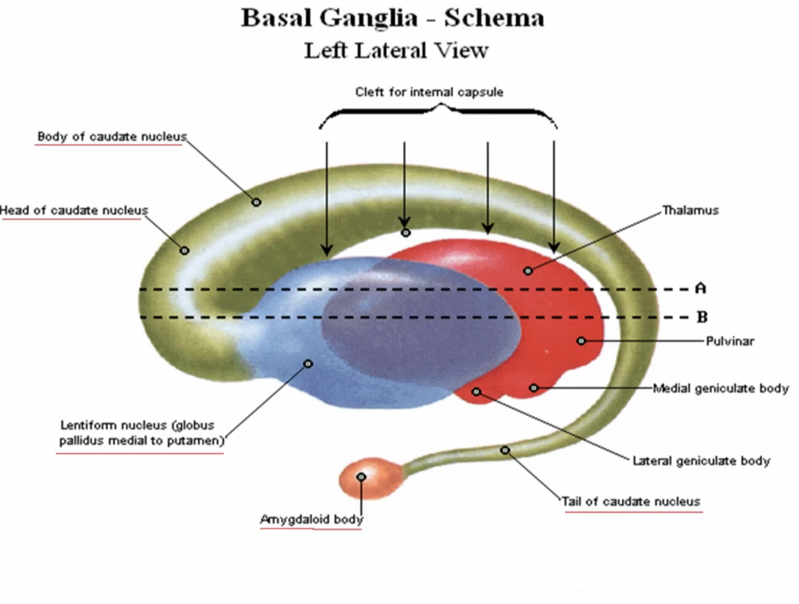

Slide 48
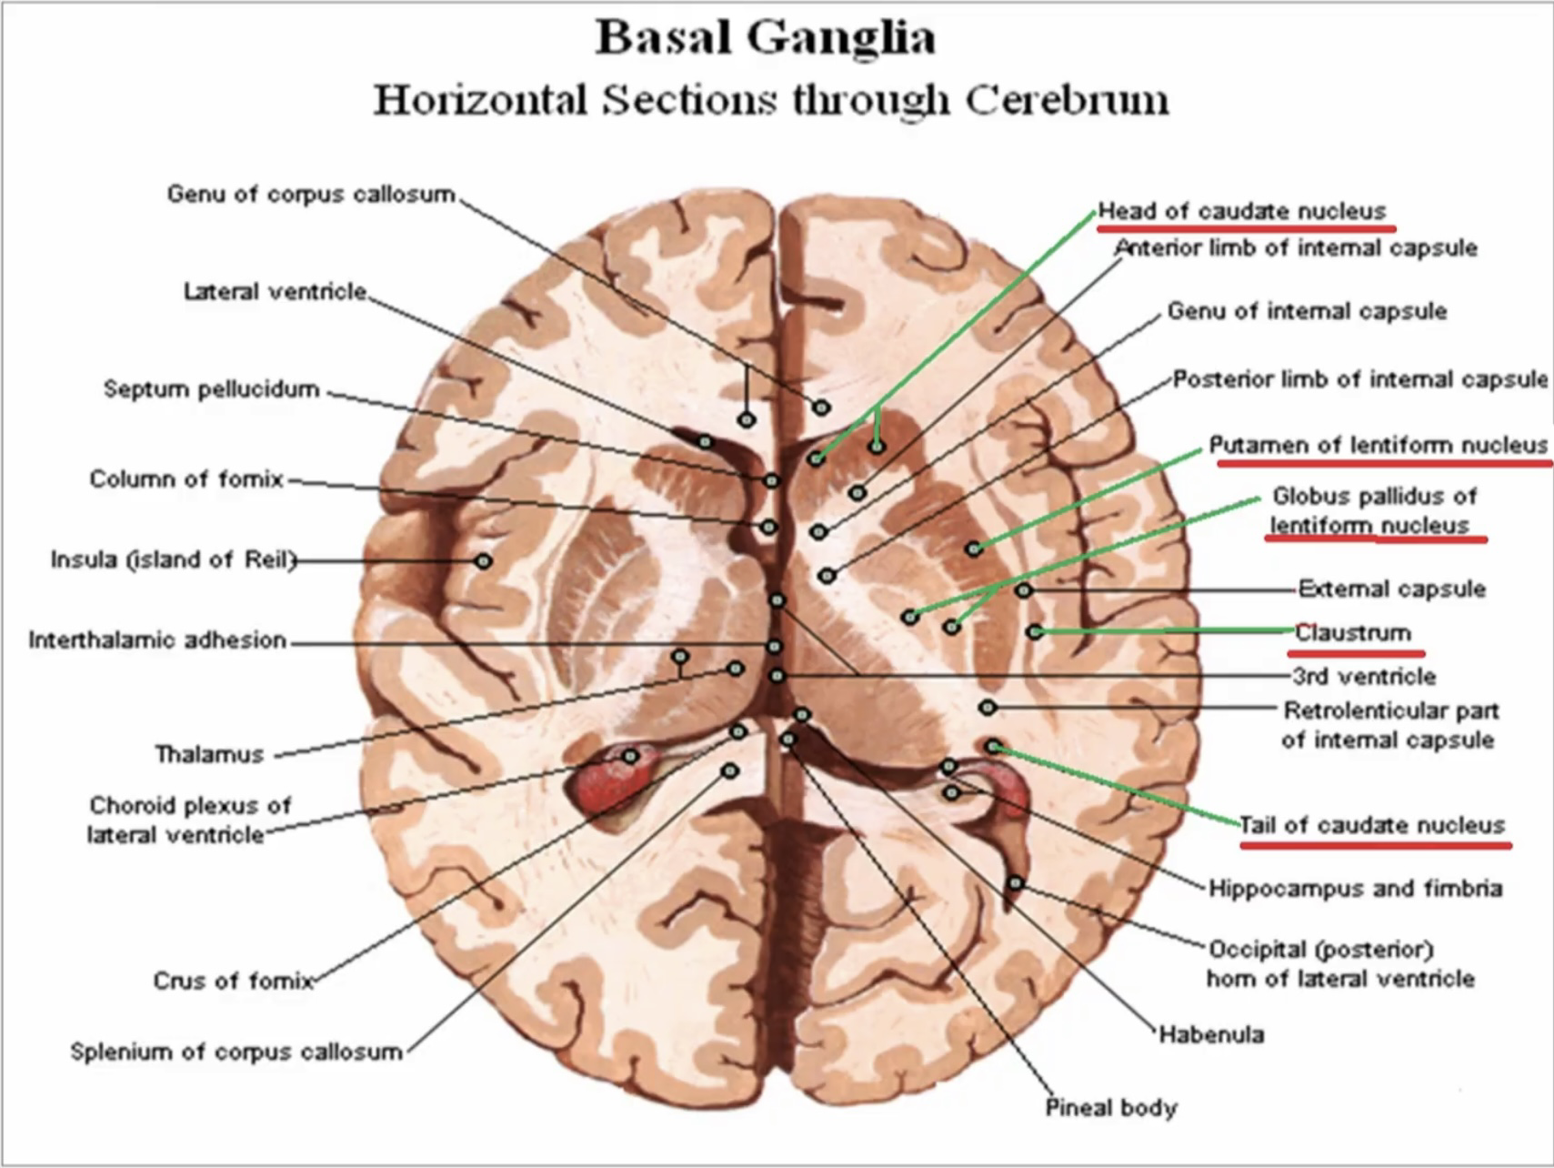

Slide 49
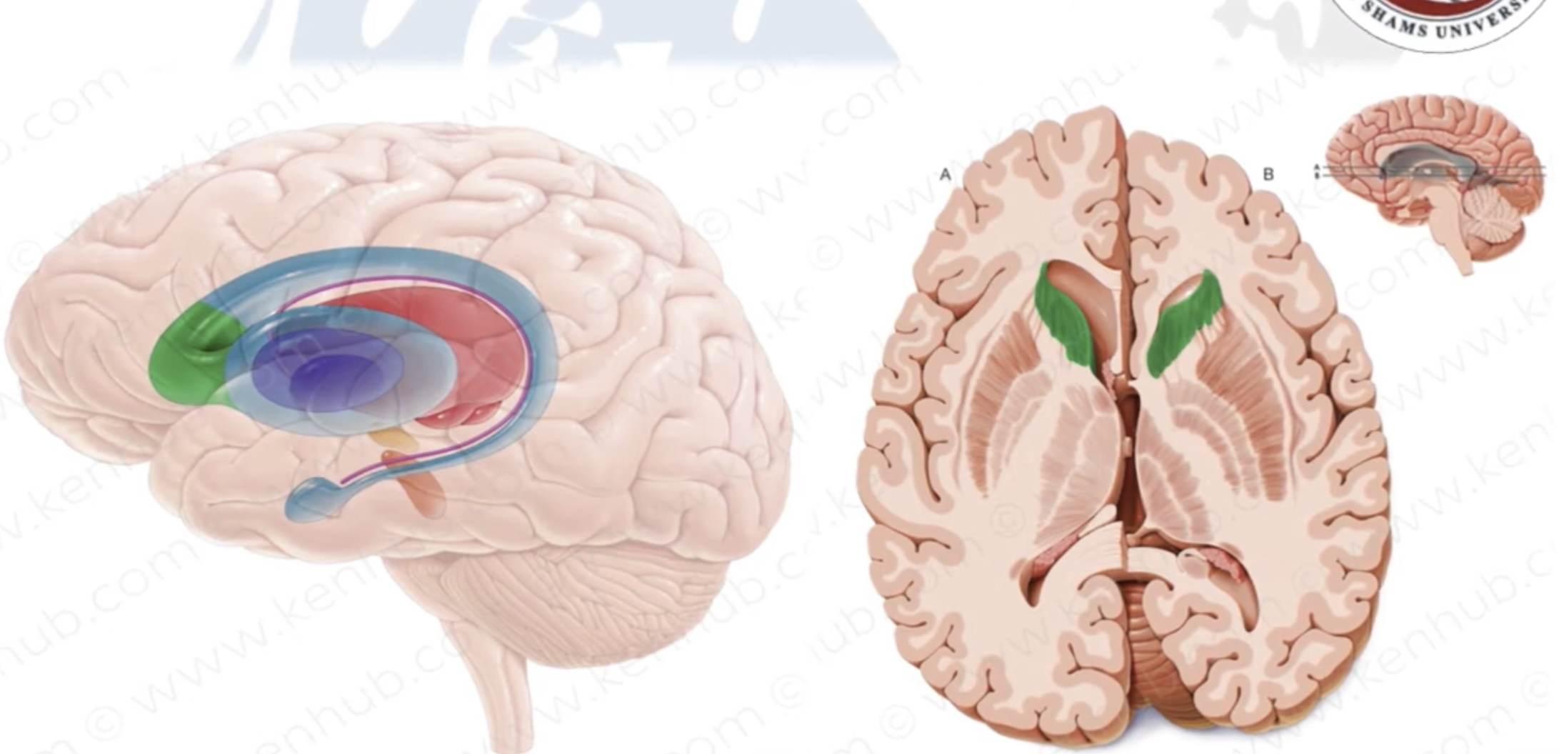
Caudate nucleus:
Is a comma-shaped mass of grey matter, consisting of 3 parts, head, body, and tail.
1) Head :
* The large anterior part of the caudate nucleus.
* It lies in the floor and lateral wall of the anterior horn of lateral vent.
* The lower aspect of its posterior part is fused with the anterior end of lentitorm nucleus .
.

Slide 50
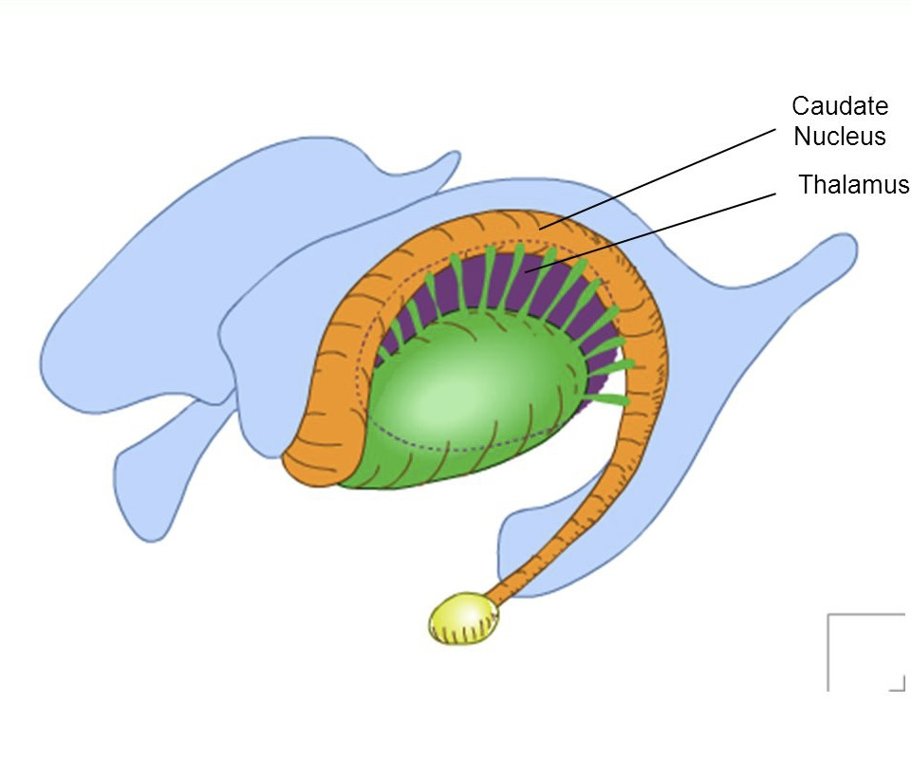
Lateral Ventricle

Slide 51
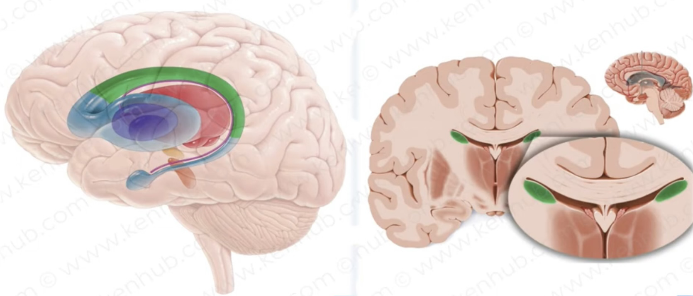
2) Body :
The tapering part next to the head .
* It runs posteriorly in the floor of the body of lateral vent., just lateral to the thalamus.

Slide 52
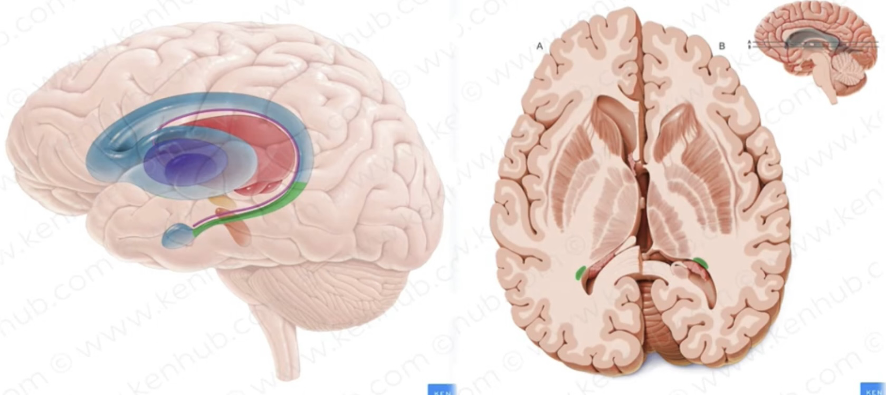
3-Tail:
The narrowest part next to the body.
It curves ventrally then forwards in the roof of the inferior horn of the lateral vent. (lateral to stria terminalis) to end in the amygdaloid nucleus.

Slide 53
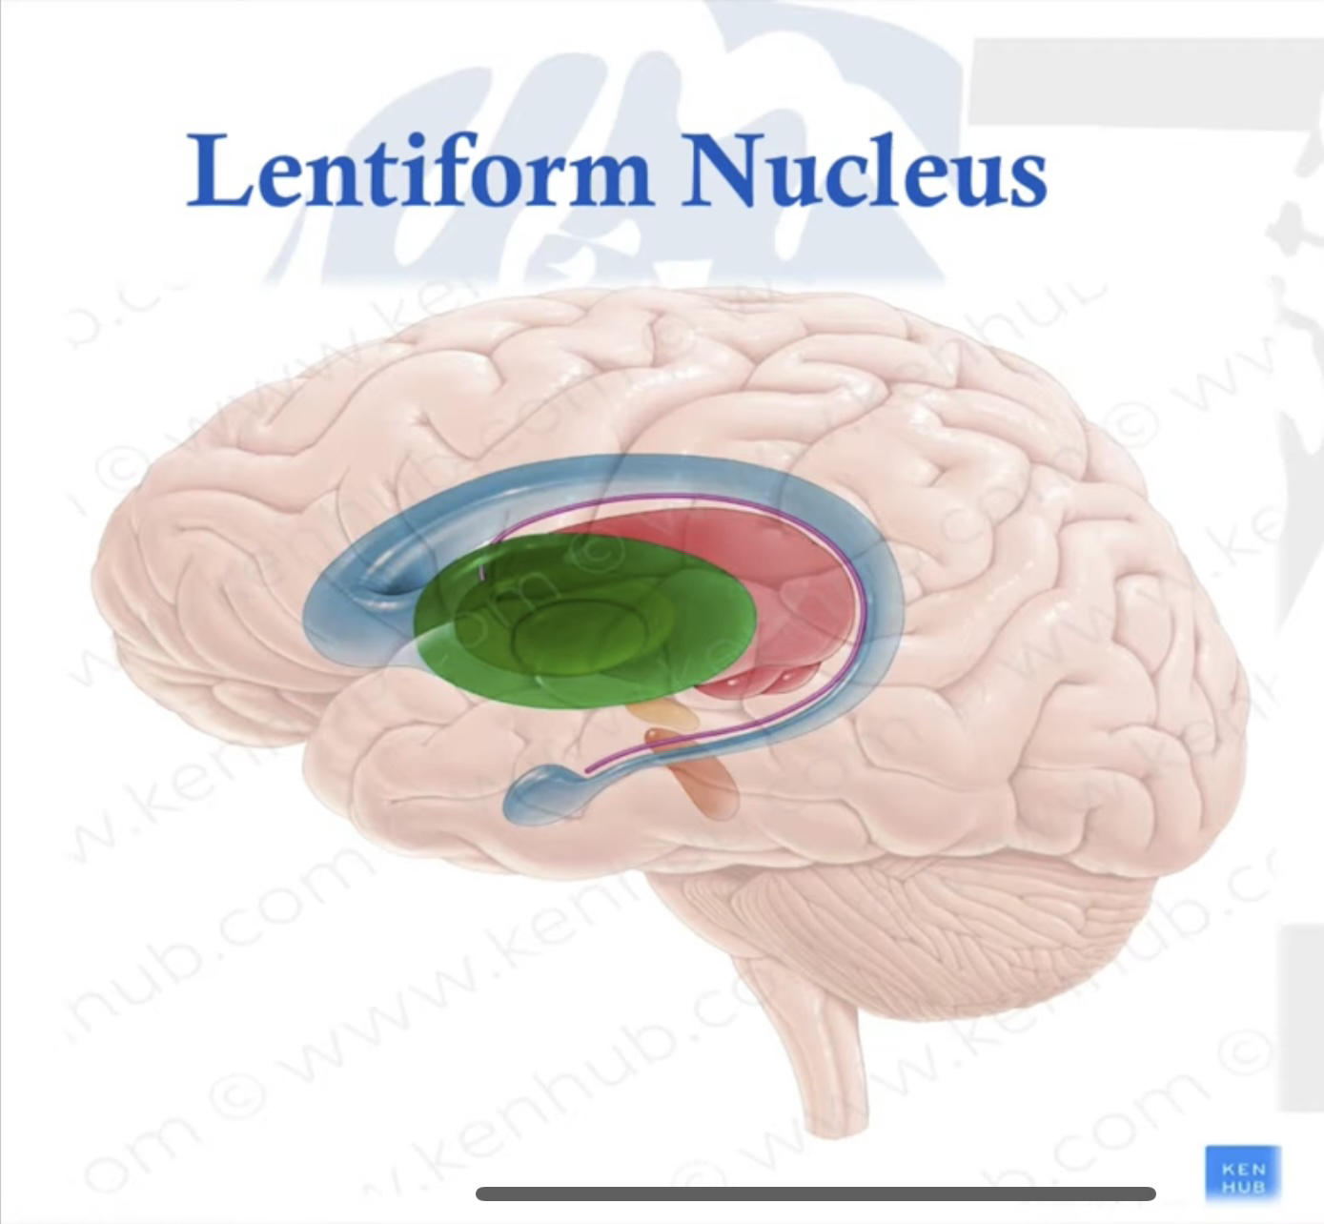
Lentiform nucleus:.
Is a large biconvex lens shaped mass of grey matter. It Lies between the internal capsule (medially) and the external capsule (laterally).
It consists of two parts:
A) Putamen:
The outer ,larger, dark part (large number of neurons).
Is the part which is fused with the head of caudate nucleus.

Slide 54
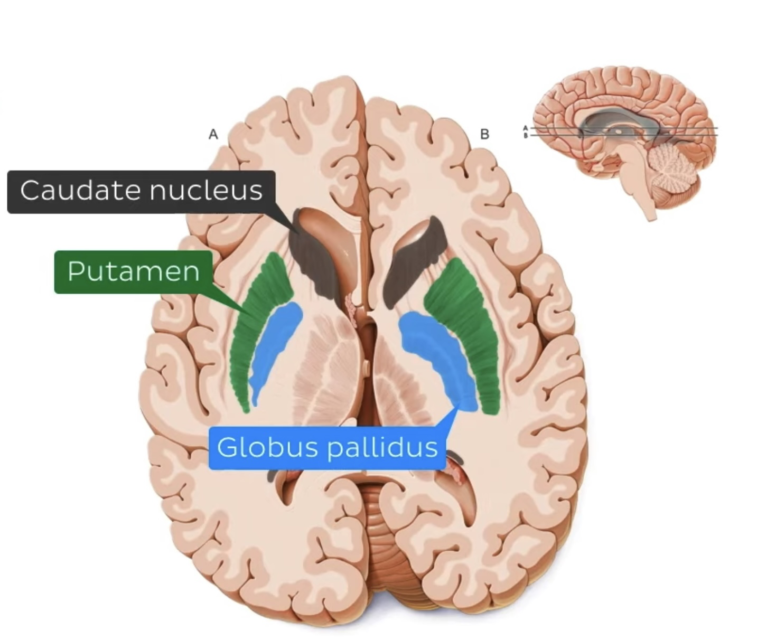

Slide 55
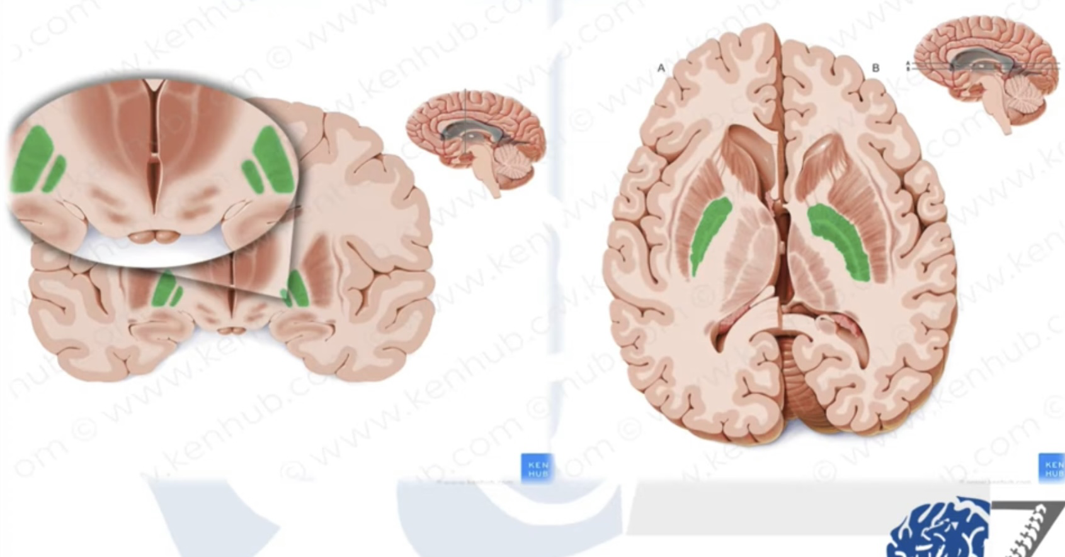
B) Globus pallidus:
The inner, smaller, pale part.
The globus pallidus is medial to the putamen and lateral to the thalamus.
can be subdivided into an external part and internal part.
The globus pallidus is the output nucleus of the basal ganglia, sending inhibitory projections to the thalamus

Slide 56
Connections of corpus striatum:
Putamen and caudate nucleus: Receives most of the afferent fibers to corpus striatum (afferent part) and sends it to globus palliduas. These afterents are:
-From cerebral cortex “Corticostriatal fibers”.
-From Substantia Nigra”Nigrostriatal fibers”.
The globus pallidus is the output nucleus of the basal ganglia, sending inhibitory projections to the thalamus

Slide 57
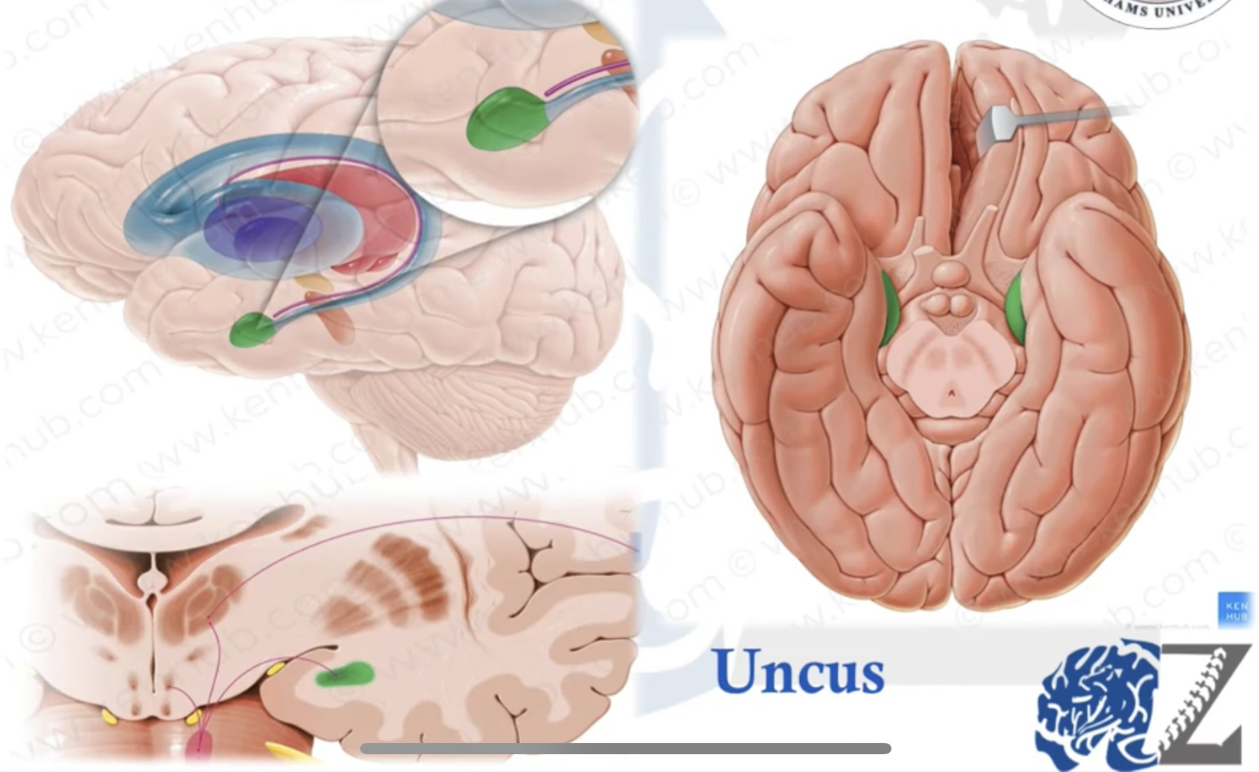
amygdaloid nucleus
is an almond-shaped mass of gray matter attached to the tip of tail of caudate nucleus. It is located deep to uncus of temporal lobe and related to anterior most end of roof of inferior horn of lateral ventricle

Slide 58
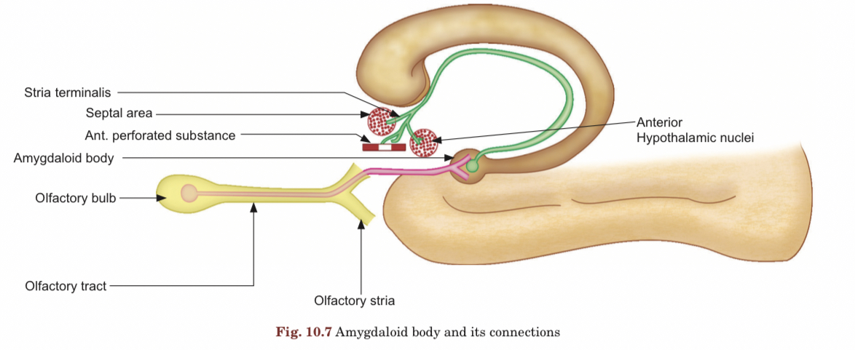
Functions
-It can influence the body's response to environmental changes. In the sense of fear, for example, it can change the heart rate, blood pressure, skin color, and the rate of respiration.
-Smell function.

Slide 59
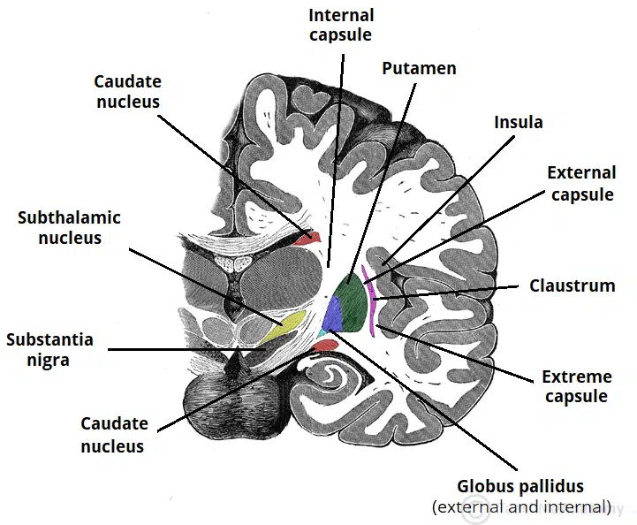
Claustrum
Is a thin, curved and wavy sheet of gray matter.
It is situated lateral to lentiform nucleus from which it is separated by external capsule.
Laterally claustrum is related to insular cortex, but separated by extreme capsule
Connections and functions of claustrum are not known.

Slide 60
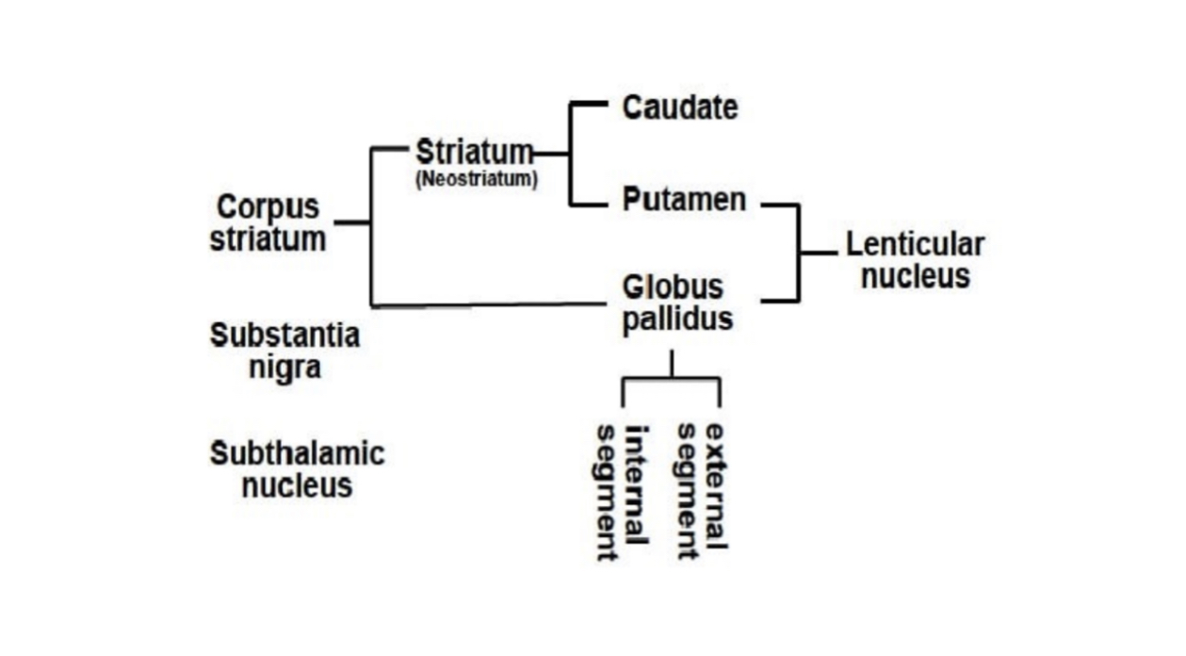
Archistriatum: Amygdaloid nucleus and claustrum

Slide 61
Subthalamic Nucleus
The subthalamic nucleus is a biconvex nucleus that lies inferior to the thalamus and superior to the tegmentum of the midbrain.
Its primary afferents originate in the substantia nigra (SN) and the external part of the globus pallidus.
The ST is under tonic inhibition, and its output is excitatory through glutamatergic projections to the internal segment of the globus pallidus as well as a reciprocal connection with the SN.
It plays a central role in basal ganglia connectivity and can be described as the "pacemaker" of the basal ganglia, defining the output rhythm.

Slide 62
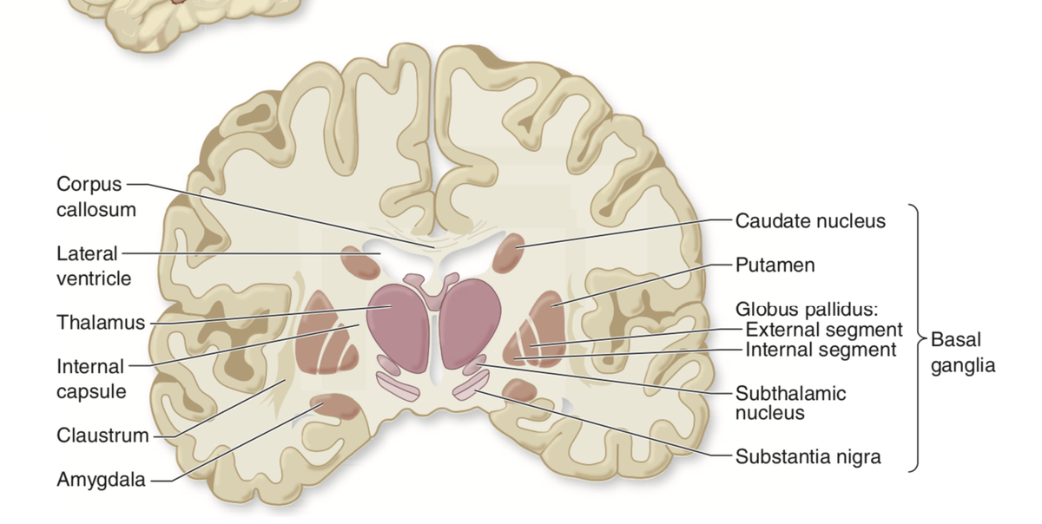

Slide 63

Substantia Nigra
The substantia nigra is located in the midbrain, just posterior to the descending motor fibers.
SN has two different sections:
SN pars reticulata: This section has connections relating to the movement of your eyes and your ability to learn and think.
SN pars compacta: The neurons here hold a chemical called dopamine. That’s why this section has connections that involve your emotions, ability to learn, how you judge risks and rewards, your motivations and more.
It contains dopaminergic neurons that project to the putamen and caudate nucleus as well as the STN

Slide 64

Blood supply of BN
-is primarily supplied by the medial and lateral lenticulostriate arteries, which are branches of the anterior and middle cerebral artery respectively .

Slide 65


Slide 66


Slide 67

⬆️Motor activity

Slide 68

⬇️unwanted”undesired” movements

Slide 69

3-Nigrostriatal pathway
-Modulation of D & ID pathways

Slide 70
CLINICAL ANATOMY
Disorder of function of basal ganglia results from lesion in basal ganglia. Lesion of basal ganglia may be vascular in orgin or due to genetic disorder, less commonly may be infective or degenerative.Lesion of basal ganglia is clinically characterized by two general types of disorders.
Hyperkinetic disorder: Showing excessive abnormal involuntary movements as seen in chorea, athetosis and ballism (ballismus).
Hypokinetic disorder: Presenting slow and sluggish abnormal involuntary movements.
Parkinson disease is characterized of course, by both types of disorders

Slide 71
Chorea: is nonrepetitive irregular, quick and jerky movements.
Athetosis: is characterized by slow, sinuous writhing movements of distal part of limbs affecting muscles of fingers and toes.
Ballismus: is spontaneous involuntary movements, muscular weakness and incoordination of movements of the proximal extremities

Slide 72
Parkinson disease is also known as Parkinsonism.
It is a progressive degenerative disease of unknown cause. It is the result of degeneration of neurons of dopaminergic substantia nigra.
Dopamine exerts inhibitory effect on striatal neurons. So, reduction of dopamine due to lesion of neurons of substantia nigra causes loss of inhibitory effect on function of neurons of corpus striatum.
Early symptoms are tremor, rigidity, slowness of movement, and difficulty with walking.

Slide 73


Slide 74


Slide 75
Thank you

