Slide 1

Lipids in Brain
By
Dr. Faten Allyan

Slide 2
General properties of Lipid
Lipids are organic compounds of biologic origin.
Properties of lipid:
    Insoluble in water
    Soluble in non polar organic solvents such as ¹ether (R-O-R), ²acetone (CH₃COCH₃), and ³carbon tetrachloride (CCl₄).
    Contains C, H, O and sometimes N and P.
    Mostly yield fatty acids on hydrolysis or combine with fatty acids to form esters (R-COO-R).

Slide 3
Uses of fats in the body
Serve as fuel producing 9 Kcal/gram of lipid
Act as protector for the vital organs and act as shock absorbers
Serve as a reserve supply of food and energy.
Heat insulators in the outer layers to keep the body warm in cold weather.
Electrical insulators and allow rapid spread of nerve impulses.
Constituent of lipoproteins.
  Lipoprotein found in cell membranes and in the mitochondria and transport lipids in the blood.

Slide 4
Classification of Lipids
Lipids are divided into three main categories:
    Simple lipids
    Complex lipids
    Precursor and Derived lipids

Slide 5
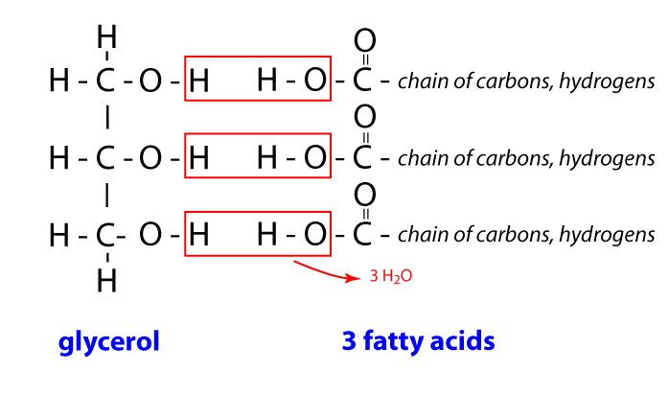
1. Simple lipids
Fats and oils
Fats are esters of fatty acids and alcohol.
  For example glycerol contains 3-OH group so it can form three ester bonds through the binding of 3 fatty acids molecules.
Fatty acid + glycerol→→→ fat or oil

Slide 6
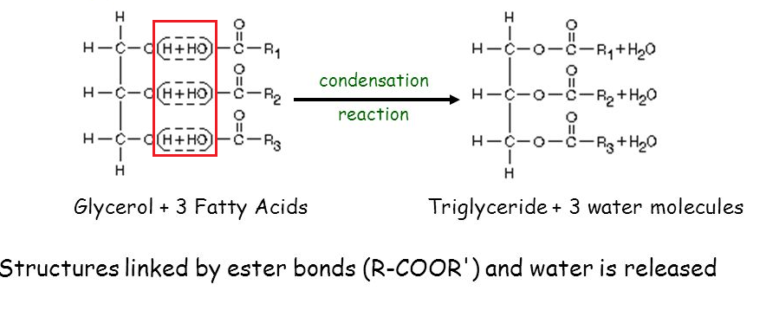
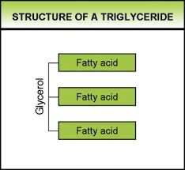
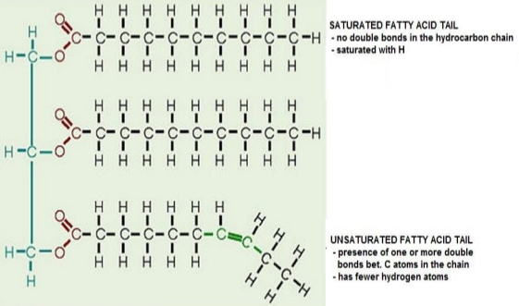

Slide 7
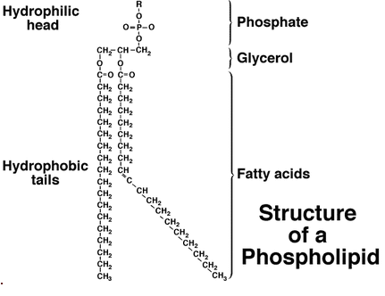
2. Complex Lipids
1. Phospholipids:

Slide 8
Complex Lipids
Phospholipids:
Phospholipids are phosphate esters and can be divided into two categories depending on type of alcohol:
    Phosphoglycerides (glycerol).
    Phosphosphingosides (sphingosine).
Phospholipids are found in all tissues in the human body, particularly in the brain, spinal tissue and cell membranes.
Phospholipids are amphipathic compounds by means it contain :
*hydrophobic tail (fatty acid)
*and a hydrophilic head (Phosphate and glycerol) .

Slide 9
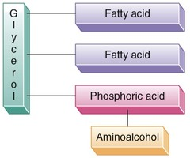
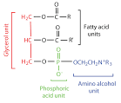
1. Phosphoglycerides
One category of phospholipid is the phosphoglycerides.
General formula:
Phosphoglycerides subdivided into several types, depending into nitrogen compound present.
Types / lecithins and cephalins

Slide 10
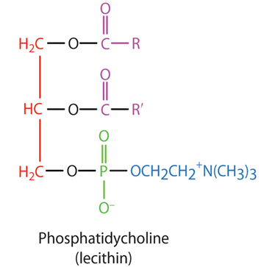
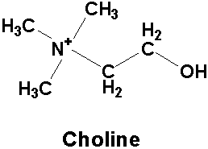
Lecithins (phosphatidylcholines)
In lecithins, the nitrogen compound is choline.
choline is an essential nutrient that is required for optimal health. It may play a key role in healthy brain function
Lecithin functions as a precursor for choline, which in turn creates the neurotransmitter acetylcholine.
lecithin, may improve the brain's functional pathways
Maintaining these neurotransmitter levels helps support healthy cognitive function

Slide 11
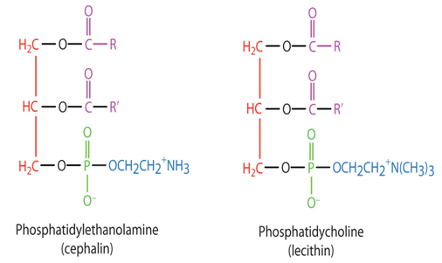
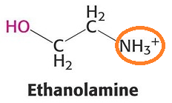
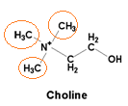
Cephalins (Phosphatidyl ethanolamine)
Cephalin is similar to lecithins except that nitrogen compound (ethanolamine) is present instead of choline.
Cephalins are found in most cell membranes, particularly in brain tissues
Significant constituent of nervous tissue and brain substance
Cephaline is crucial for the transmission of nerve signals in the brain
Cephalins are important in blood clotting and sources of phosphoric acid constituent in bone and teeth .
Phosphorus is present both in DNA and RNA

Slide 12
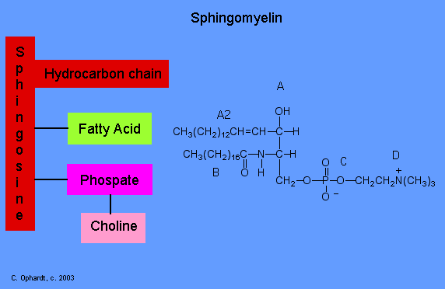
2. Phosphosphingosides
Are also called sphingolipids, differ from phosphoglycerides in that they contain the alcohol sphingosine in place of glycerol,
One type of sphingolipid, called sphingomyelin, is present in brain and nerve tissue.
phosphoglycerides

Slide 13
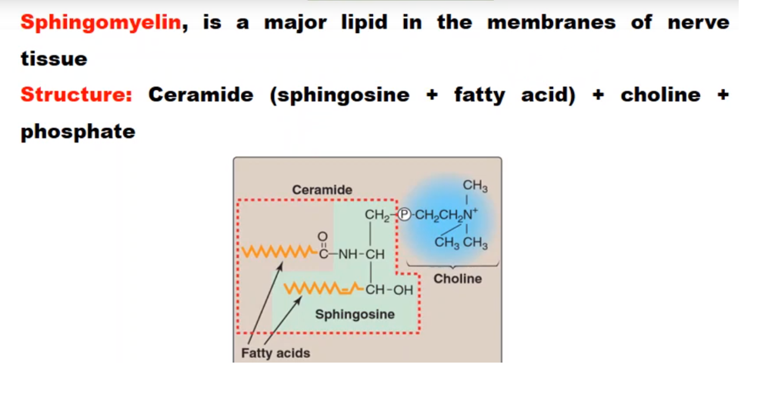

Slide 14
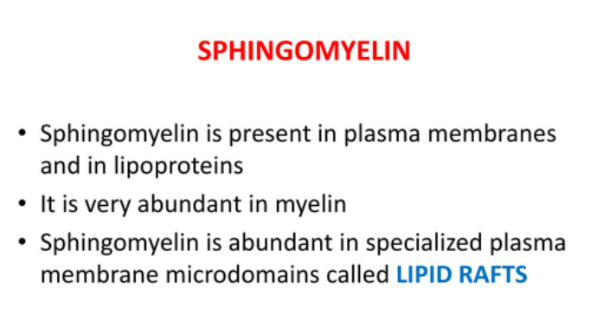

Slide 15
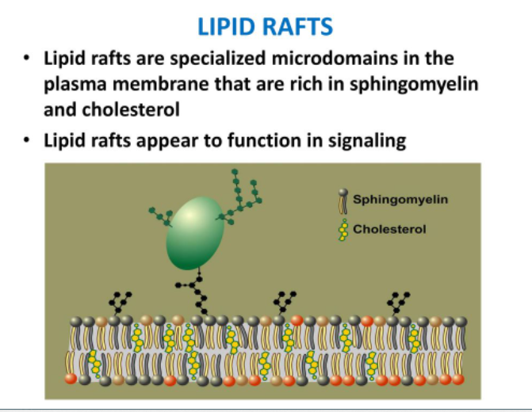

Slide 16
Brain is a vital organ performs very important functions such as analysis, processing, coordination, and execution of electrical signals
Lipids account for 50–60% of dry weight
Substantial amount of lipids in the nervous system is present in the myelin sheath
Myelin is a fatty substance wraps around nerve fibers and serves to increase the speed of electrical communication between neurons.
Myelin sheath is fatty sleeve (sheath) that’s wrapped around neuron as protective layer
Important function in cellular physiology involved in cellular signaling, including regulation of numerous ion pumps, channels, and transporters all vital events responsible for the development

Slide 17
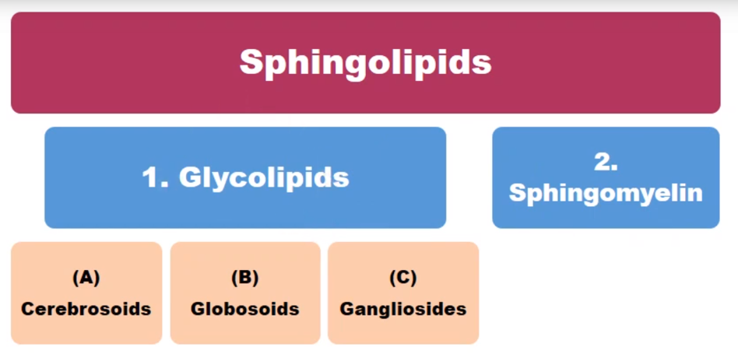

Slide 18
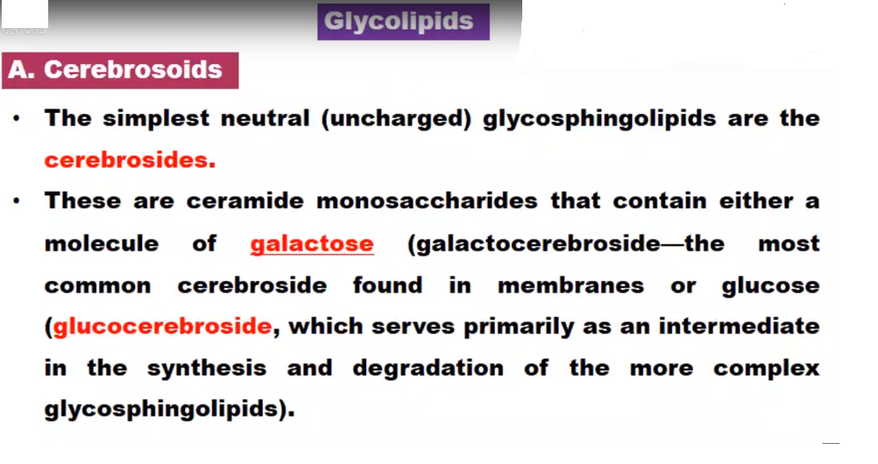

Slide 19
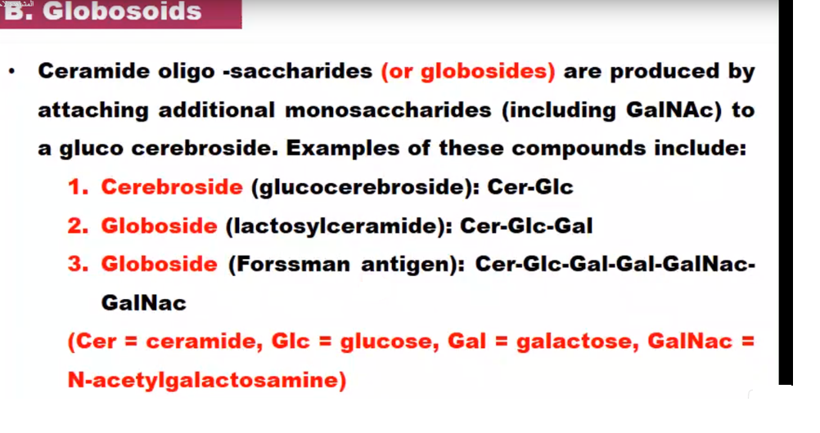

Slide 20
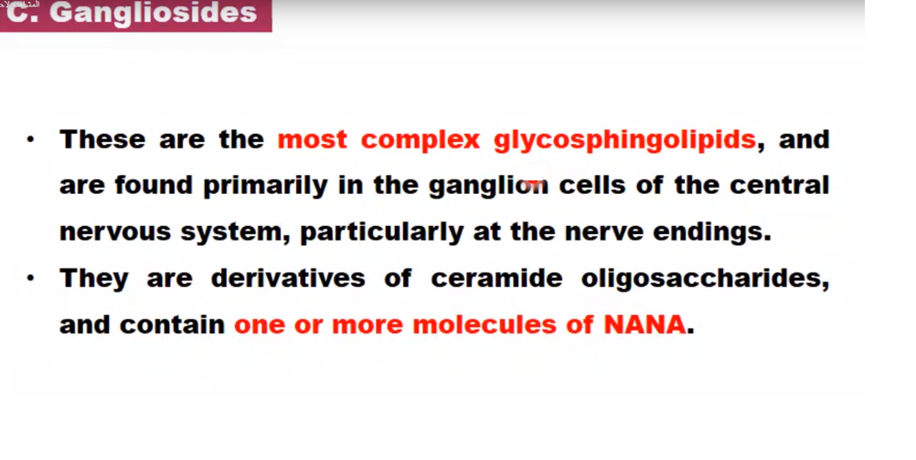
N-acetylneuraminic acid
Ganglioside :ceramide and oligosaccharide

Slide 21
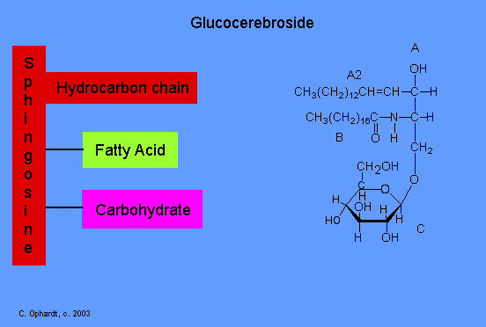
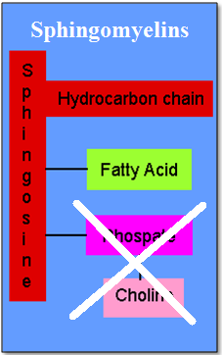
Complex Lipids
Glycolipids:
Similar to sphingomyelins except it contain a carbohydrate, often galactose in place of choline and phosphoric acid.
Glycolipids

Slide 22
Glycolipids
Glycolipids produce no phosphoric acid on hydrolysis because they do not contain this compound.
Glycolipids are called cerebrosided because they found in large amounts in the brain tissue.
Among glycolipids are kerasin, cerebron, nervon, oxynervon and gangliosides.
These compounds differ in the fatty acid attached to sphingosine.

Slide 23
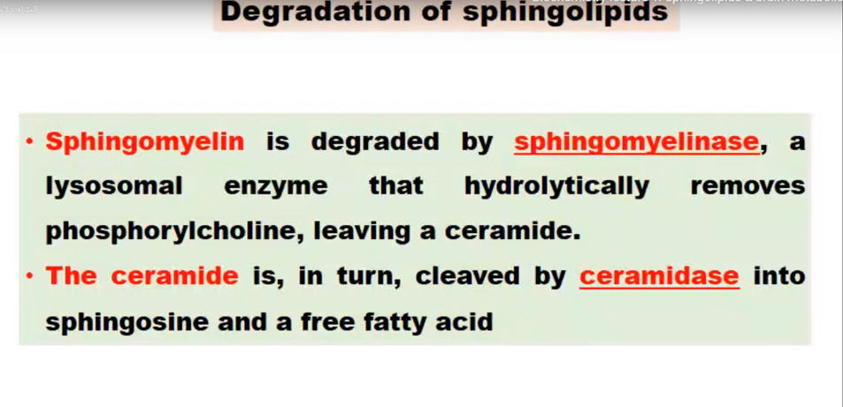

Slide 24
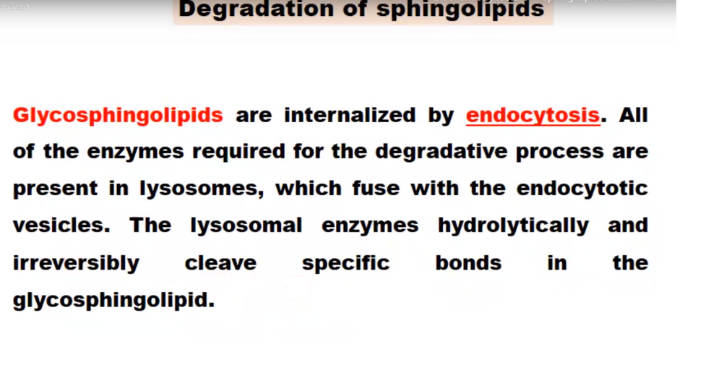

Slide 25
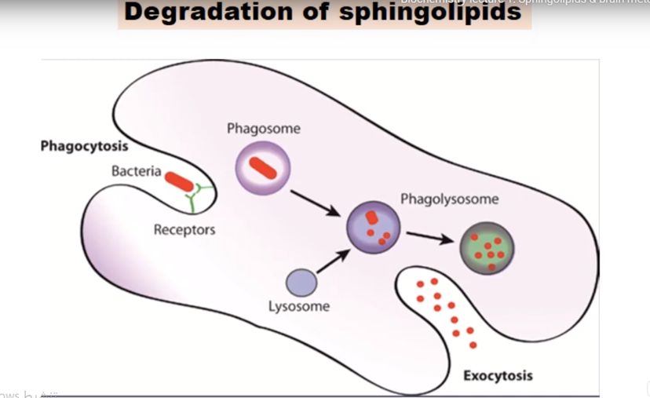

Slide 26
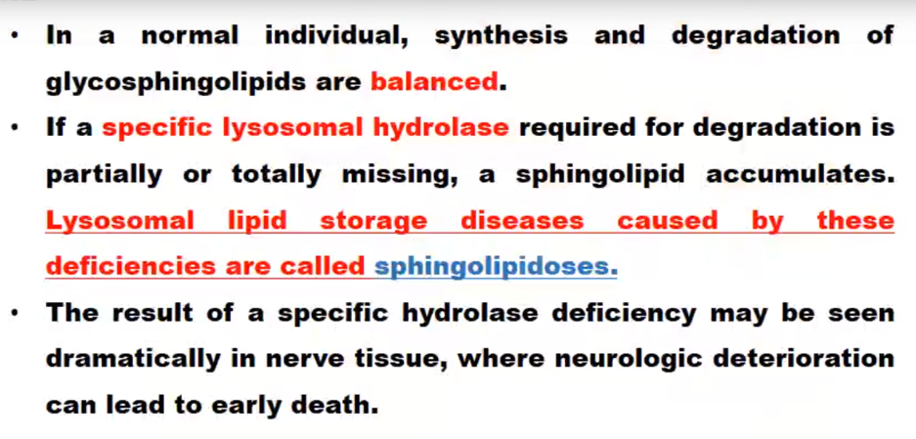

Slide 27
Niemann-Pick disease
Niemann-Pick disease (disease of infancy or early childhood)
  Niemann-Pick disease caused by the lack of sphingomyelinase enzyme.
  Sphingomyelins accumulate in the brain, liver and spleen leading to mental retardation and early death.

Slide 28
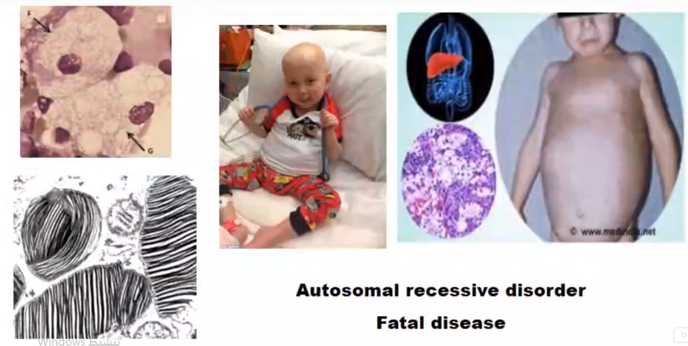
Niemann-Pick disease

Slide 29
Gaucher's disease
Gaucher's disease:
  Gaucher's disease is due to the lack of β-glucosidase enzyme
  So, glycolipids accumulate in the brain and causing severe mental retardation and death by age 3.
  Adult forms of this disease are characterized by enlarged spleen and kidneys, hemorrhaging, mild anemia and fragile bones.

Slide 30
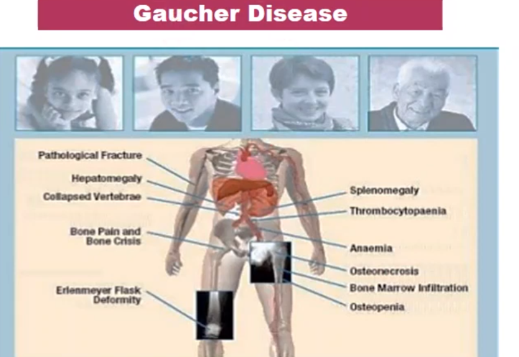

Slide 31
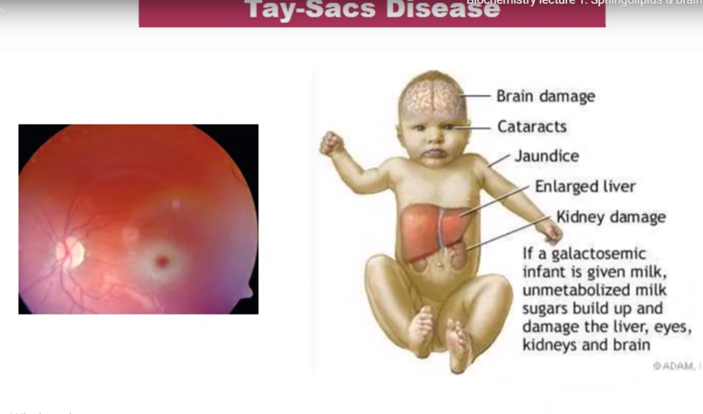
Tay-Sachs disease :
  Tay-Sachs disease is a rare, neurodegenerative disorder
  Tay-Sachs disease due to absence of hexosaminidase A enzyme,
  So, glycolipids gangliosides accumulate
  in the brain, nerves cell and eyes
  fatal to infants before they reach age 2.

Slide 32
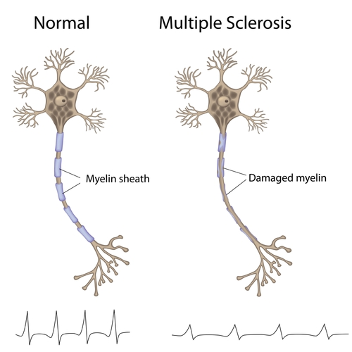
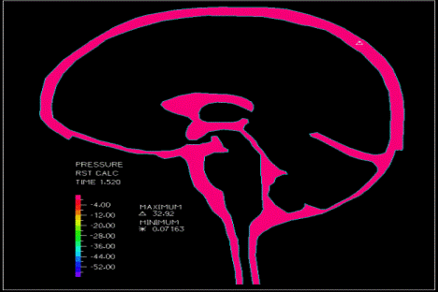
Multiple sclerosis (demyelinating process)
  There is a loss of phospholipids and sphingolipids.
  An increased phosphate level occurs in the cerebrospinal fluid.
  The cause of multiple sclerosis is unknown. It's considered an immune mediated disease this immune system malfunction destroys the fatty substance that coats and protects nerve fibers in the brain and spinal cord (myelin)

Slide 33
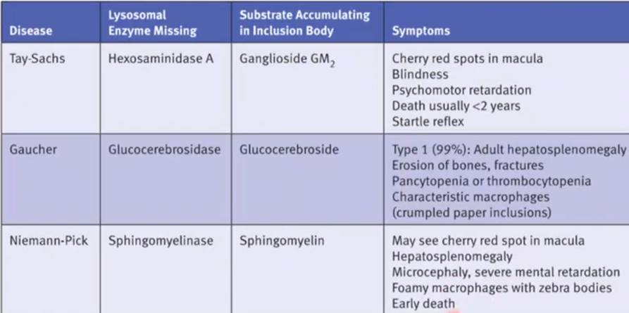
Genetic disease resulting of sphingolipid catabolism

Slide 34
Derived lipids
1. Eicosanoids are biologically an active group of compounds derived from arachidonic acid.
Some types:
      Prostaglandins
      Prostacyclins
      Thromboxanes
      Leukotrienes

Slide 35
