Slide 1
Anatomy of the Nervous System
Osama Jarada MD,
T.A. at AUG

Slide 2
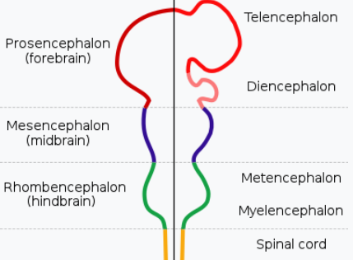
Central Nervous System
Fundamental Subdivisions of Brain
Forebrain (prosencephalon)
Telencephalon: Two lateral extensions, each of which looks like half of a sphere, known as cerebral hemisphere. They overhang the diencephalon (thalamus) form both sides and together form a sphere known as cerebrum.
Diencephalon: Central midline part, it forms different components of thalamus.
Midbrain (mesencephalon)
It is shortest and simplest out of the three components of brain.
Hindbrain (rhombencephalon)
It is subdivided into:
Proximal (Metencephalon): Which is further subdivided
into two parts: 1. Ventral: Pons 2. Dorsal: Cerebellum
Distal (Myelencephalon): 3. Medulla oblongata

Slide 3
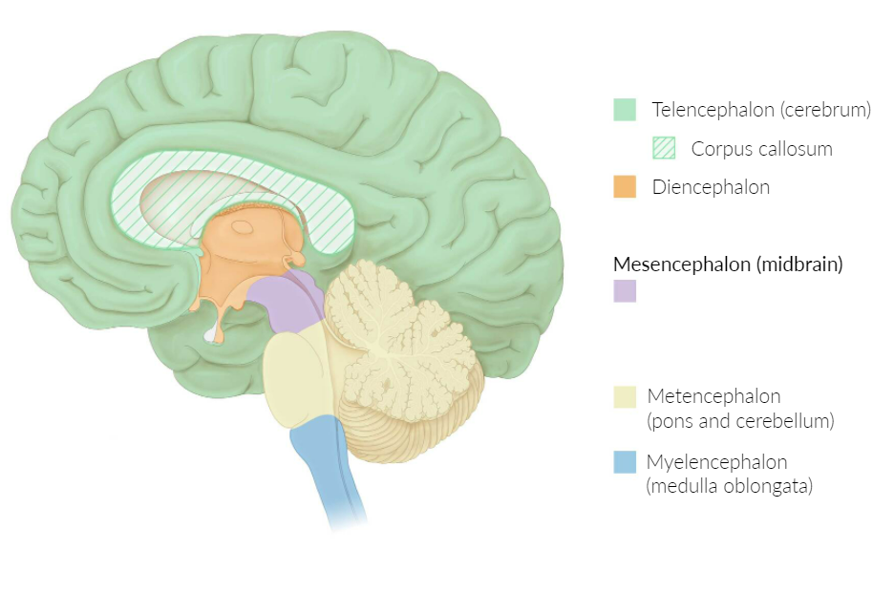

Slide 4
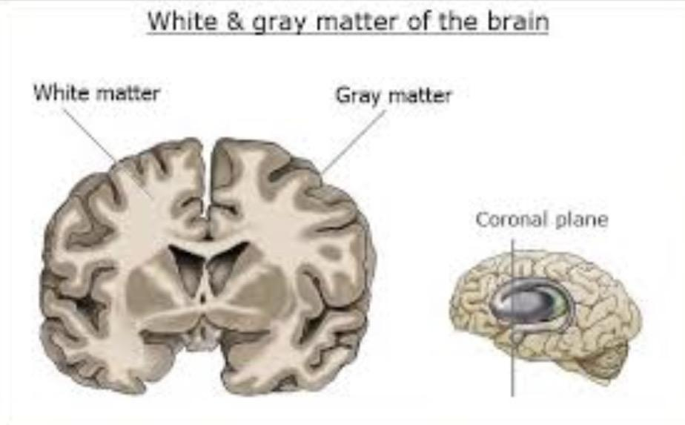
Cerebrum
Outer gray matter and inner white matter:
superficial part of cerebrum is made up of grayish colored neuronal cell bodies which forms gray matter. This constitutes cerebral cortex. Deep inner or central core is made up of process of neurons which are whitish myelinated nerve fibers. This component of cerebrum is called white matter or medullary substance
The cerebral cortex receives its convoluted appearance from a network of gyri (rounded ridges on the surface of the cortex) and sulci (furrows separating the gyri).
The longitudinal fissure divides the brain into two hemispheres.
Deep sulci divide each hemisphere further into a frontal, temporal, parietal, and occipital lobe.

Slide 5
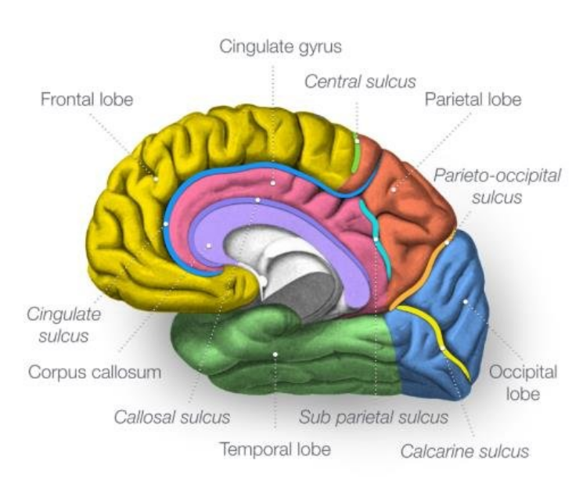
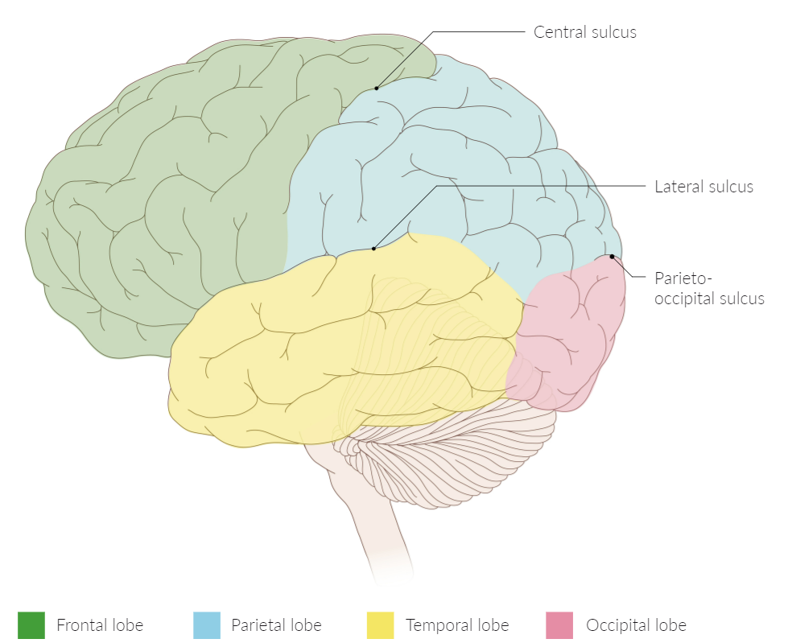
The 4 lobes of each cerebral hemisphere are separated by 3 main sulci:
–The central sulcus separates the frontal lobe from the parietal lobe.
–The lateral sulcus separates the temporal lobe from the frontal lobe and the parietal lobe.
–The parieto-occipital sulcus separates the parietal lobe from the occipital lobe.

Slide 6
The main sulci
  Central sulcus (of Rolando): separates the frontal and parietal lobes
  Lateral sulcus (Sylvian fissure): separates the frontal and temporal lobes anteriorly and the parietal and temporal lobes posteriorly
  Cingulate sulcus: separates the cingulate gyrus from the frontal and parietal lobes
  Parieto-occipital sulcus: separates the parietal and occipital lobes
  Calcarine sulcus: divides the occipital lobe horizontally into the cuneus (superior) and lingual (inferior) gyrus

Slide 7
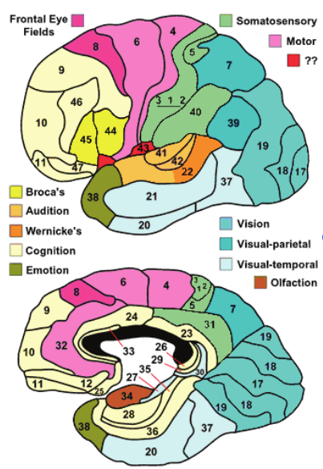
Brodmann’s functional classification

Slide 8
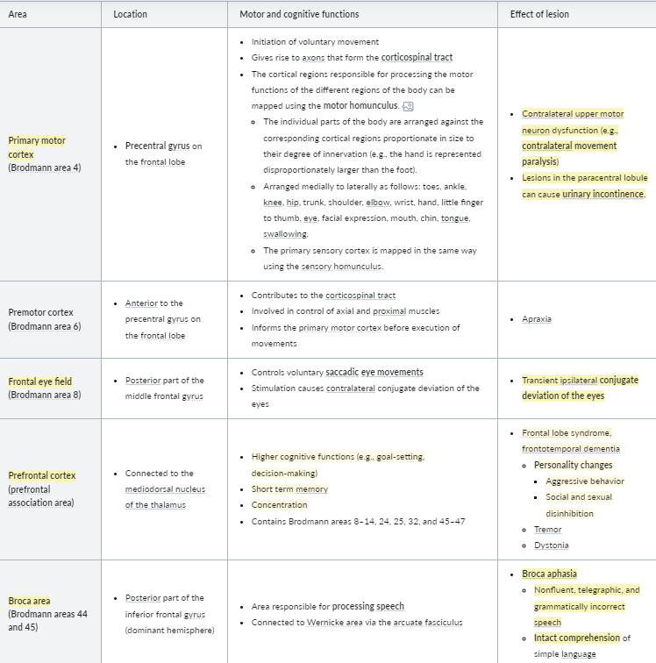
Areas of Frontal Lobe

Slide 9
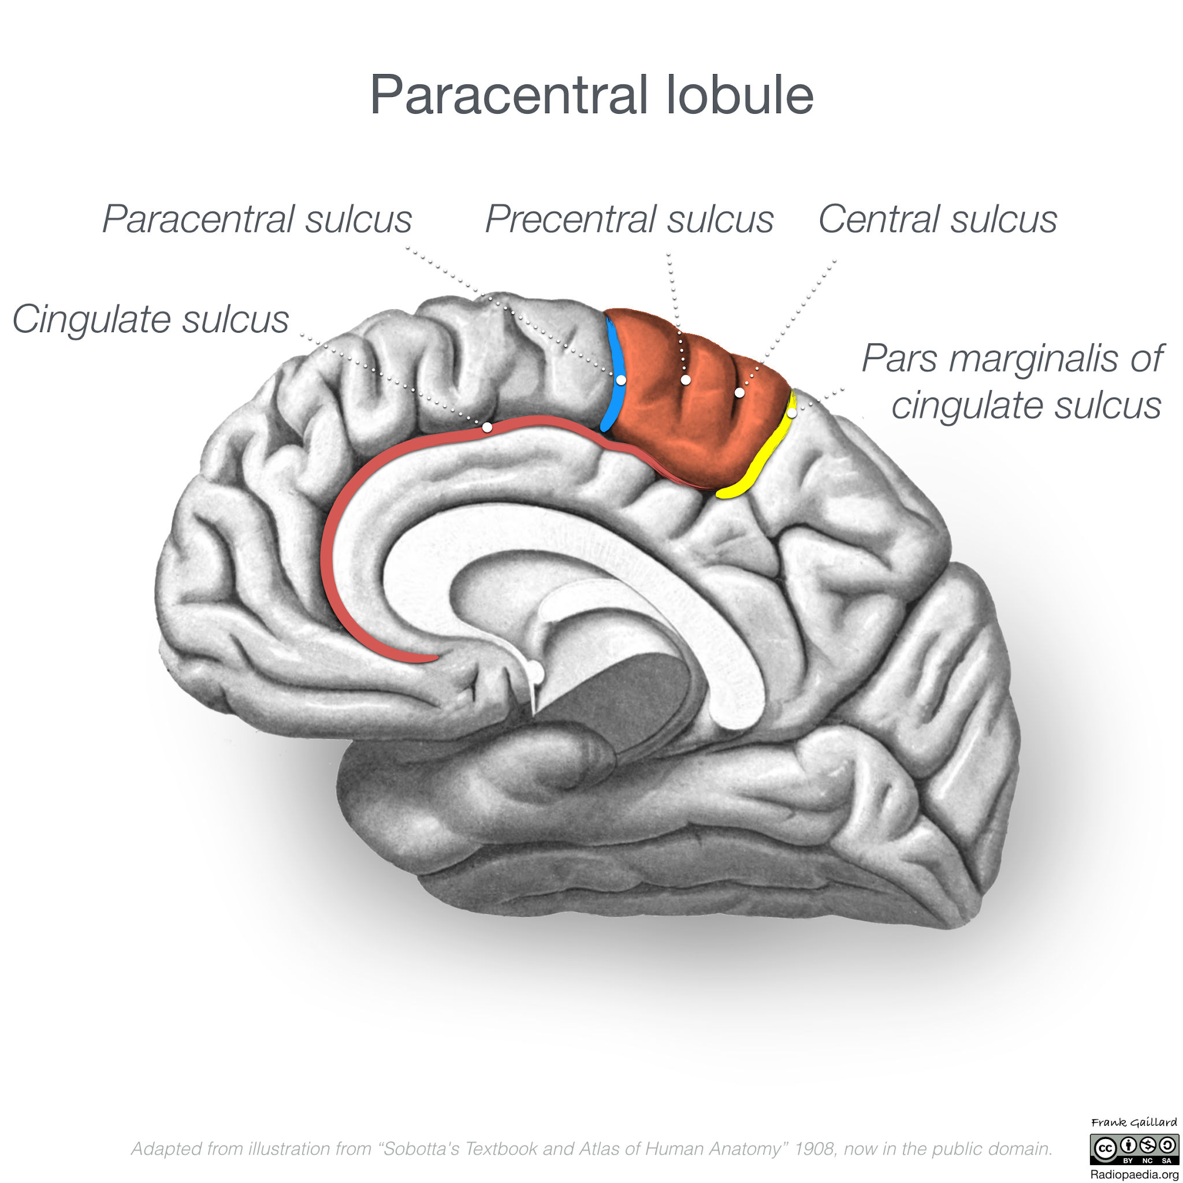
Paracentral lobule is on the medial surface of the hemisphere and is the continuation of the precentral and postcentral gyri.
The paracentral lobule controls motor and sensory innervations of the contralateral lower extremity.
It is also responsible for control of defecation and urination.

Slide 10
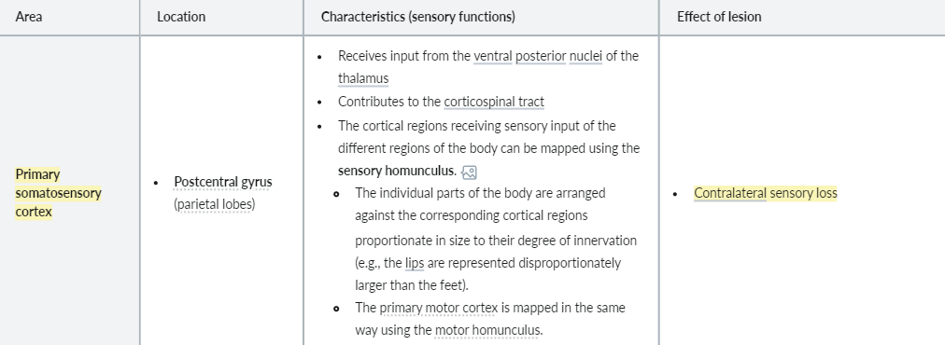
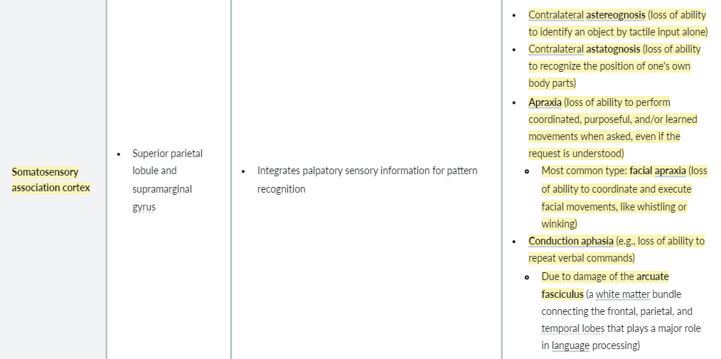
Parietal lobe

Slide 11
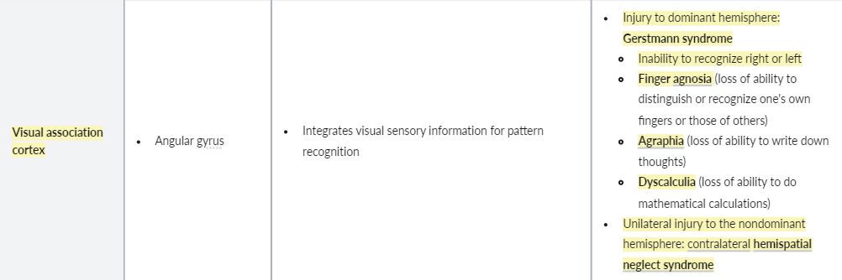
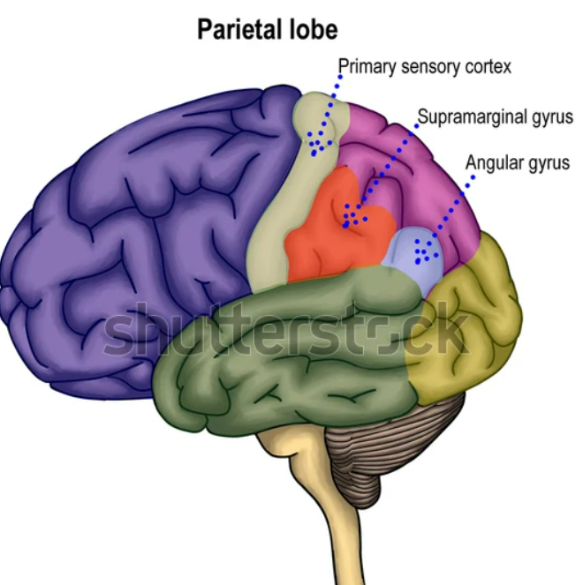
Parietal lobe

Slide 12
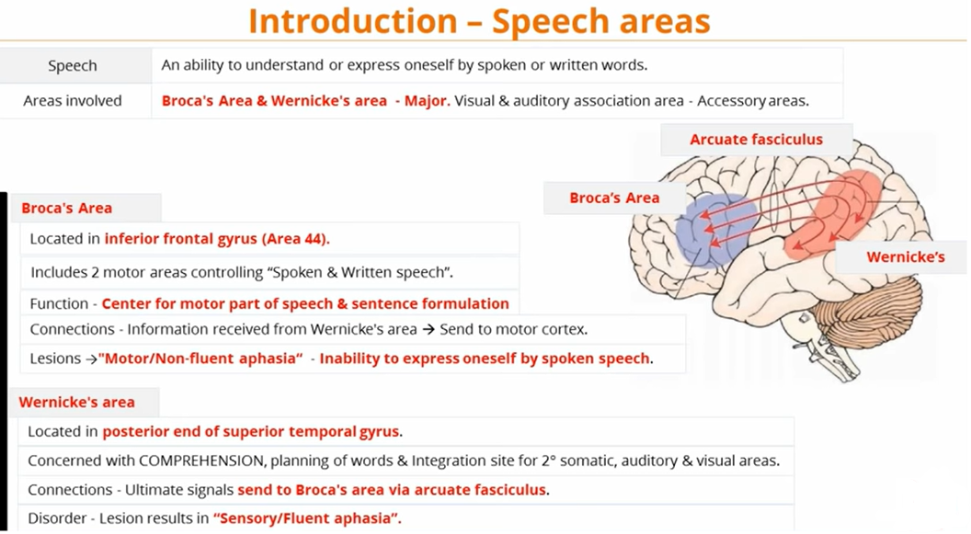
+45

Slide 13
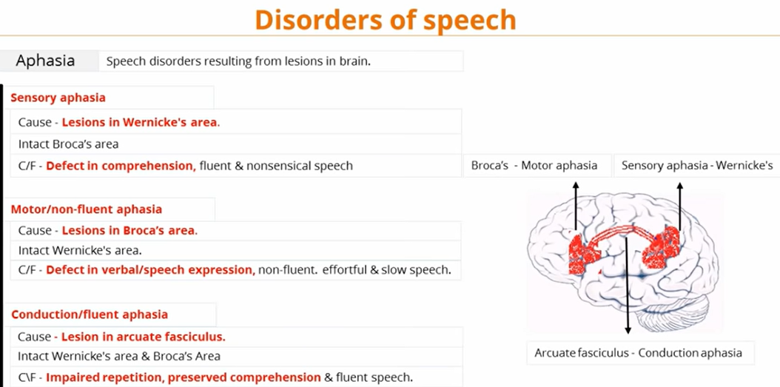

Slide 14
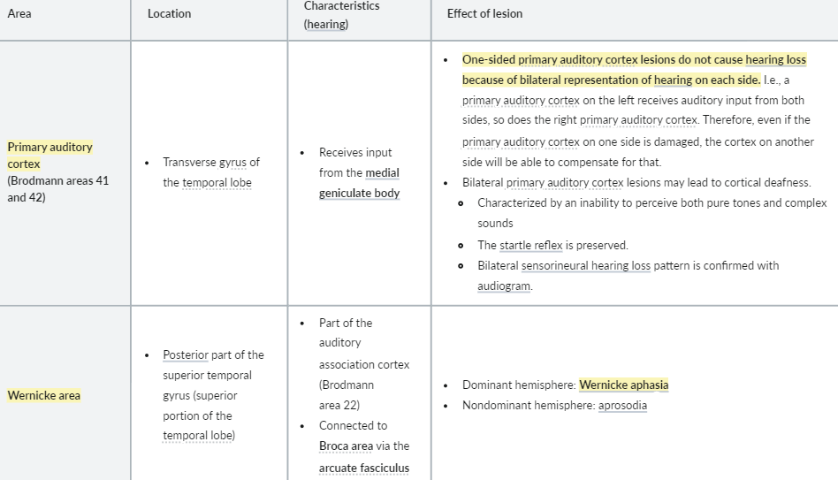
Temporal lobe

Slide 15
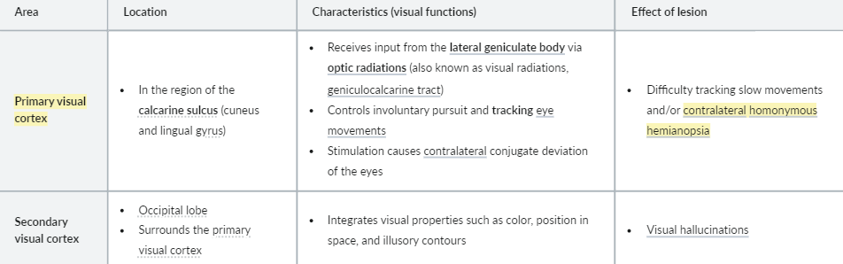
Occipital lobe

Slide 16
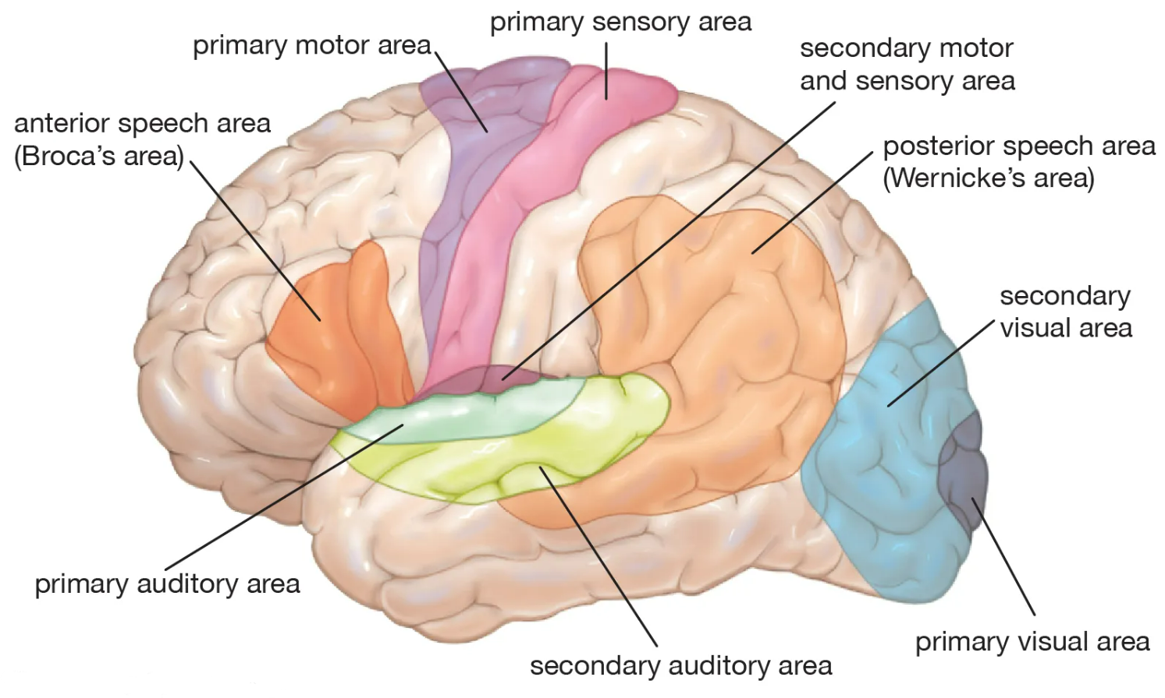

Slide 17
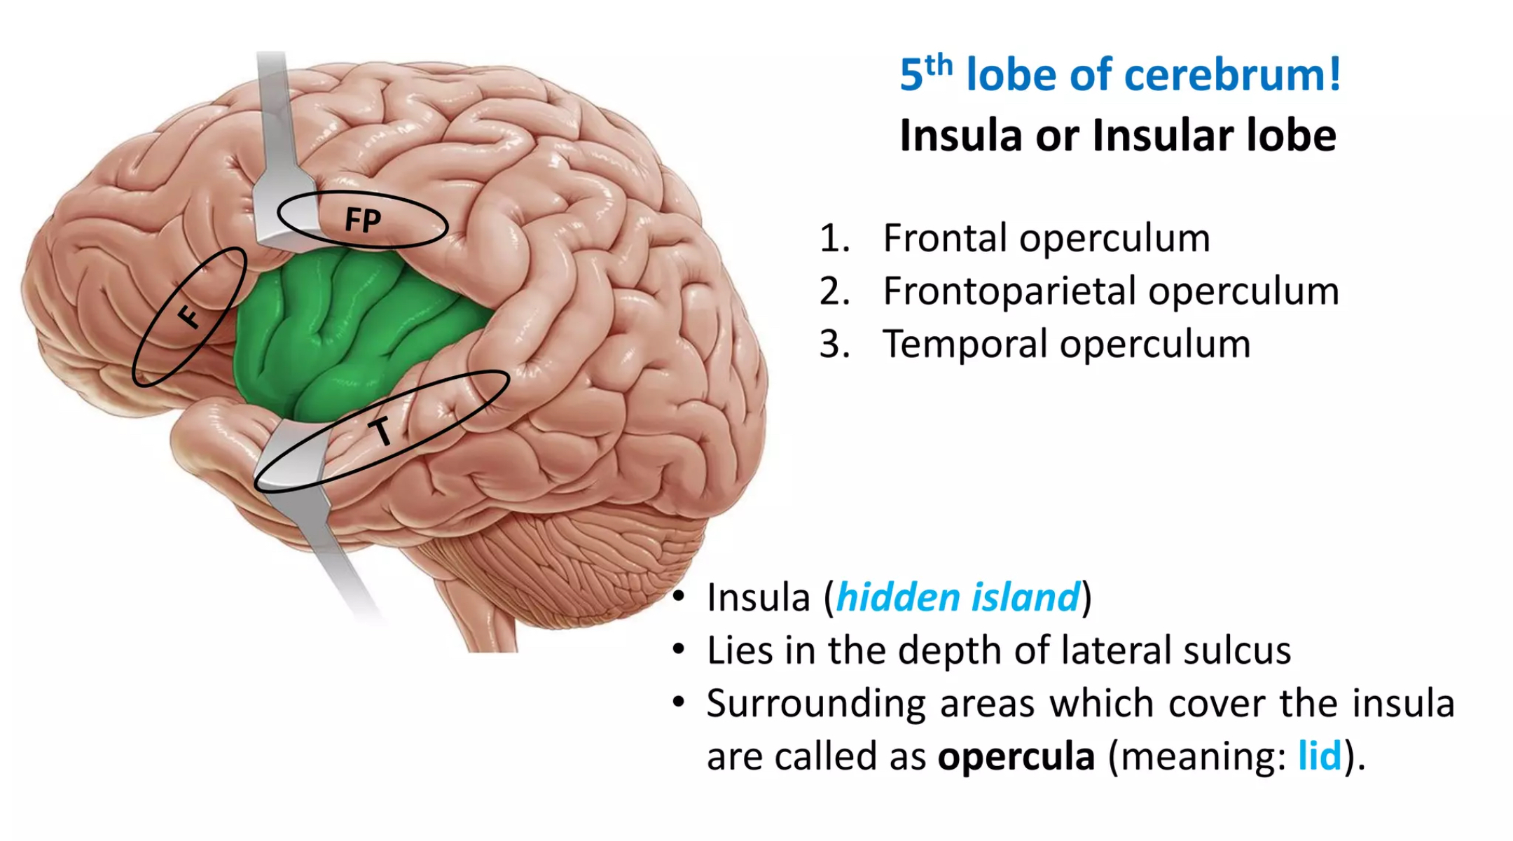

Slide 18
Function of the insula lobe:
The insula is important for gustatory and sensorimotor processing, risk-reward behavior, autonomics, pain pathways, and auditory and vestibular functioning. It is because of insula that people are able to perceive pain and have the awareness about their body and self.

Slide 19
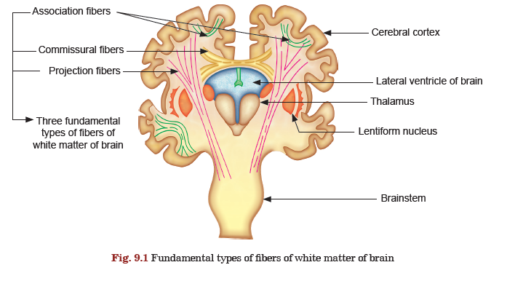
Cerebrum – White matter
Bundles of white matter are classified into following three groups:
1. Association fibers are the fiber bundles which interconnect different areas of same cerebral hemisphere. But these may be restricted in one lobe or may extend from one lobe to another. So, these fibers do not cross midline and do not go to any subcortical centers. They interconnect adjacent gyri.
2. Commissural fibers interconnect identical areas of two cerebral hemispheres. So these fibers cross the midline but do not extend to any center below cerebral cortex.
3. Projection fibers, as the name suggests, project from one cerebral hemisphere to subcortical centers of same side or opposite side. So these fibers extend beyond cerebral cortex and may or may not cross the midline.

Slide 20
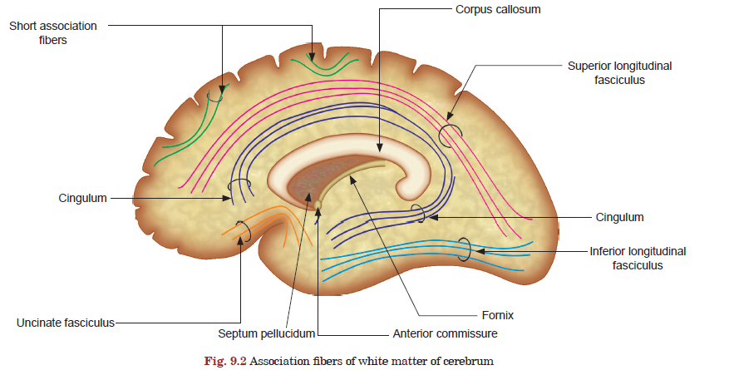

Slide 21
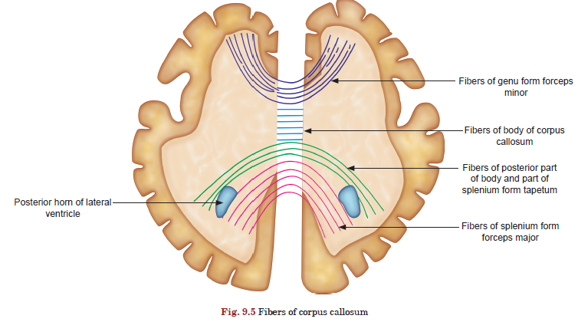
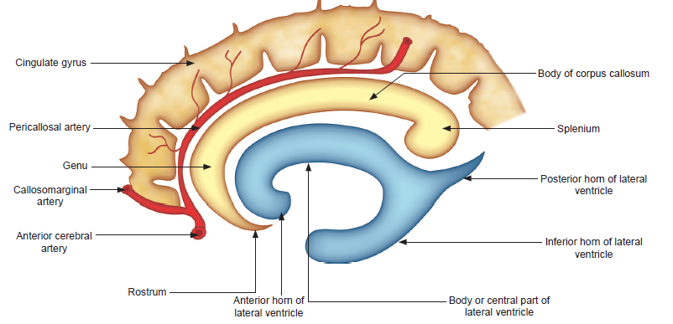
Commissure fibers
Corpse Callosum

Slide 22
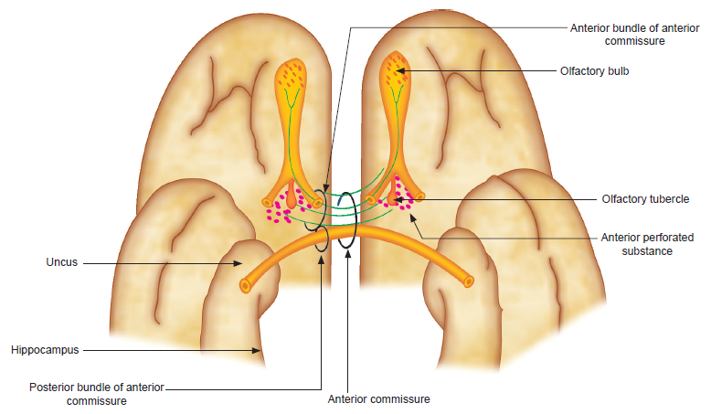
Commissure fibers
2. Anterior Commissure (anterior limb & posterior limb)
Other commissures: posterior commissure, Habenular commissure, hippocampal commissure

Slide 23
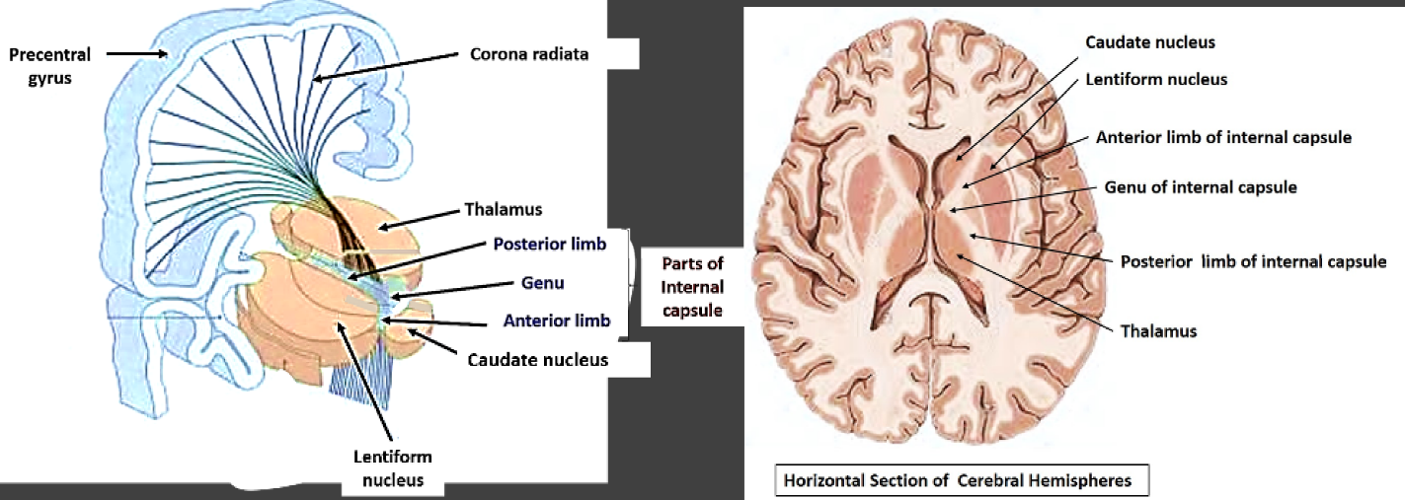
Internal Capsule - Projection fibers
a broad and compact band of white matter in horizontal section of cerebral hemisphere
Components:
anterior limb, genu, and posterior limb
  Anterior limb: contains the thalamocortical tract
  Genu: contains the corticobulbar tract
  Posterior limb: contains the corticospinal tract and thalamocortical and somatosensory fibers

Slide 24
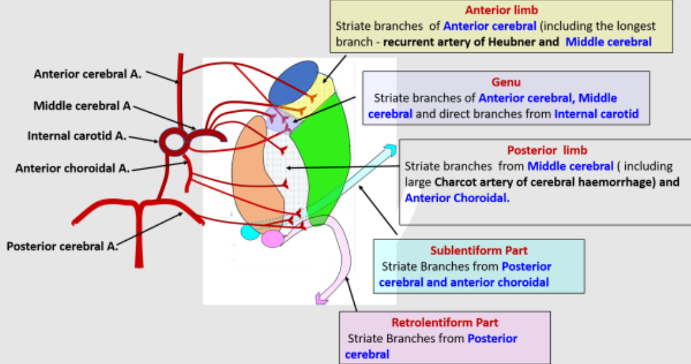
Blood supply of the internal capsule

Slide 25
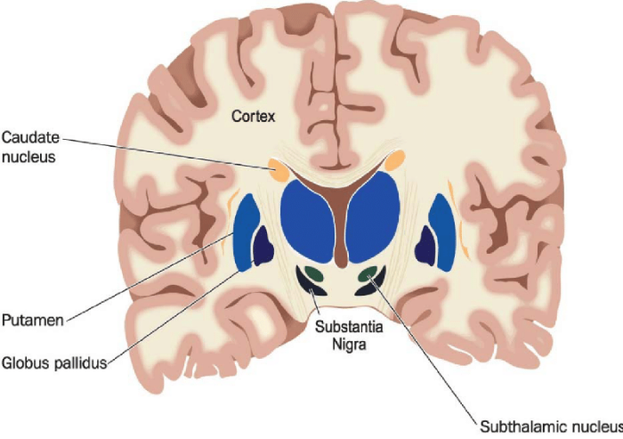
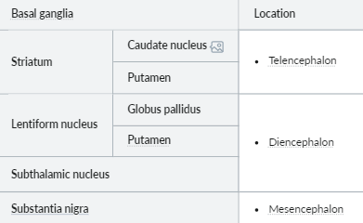
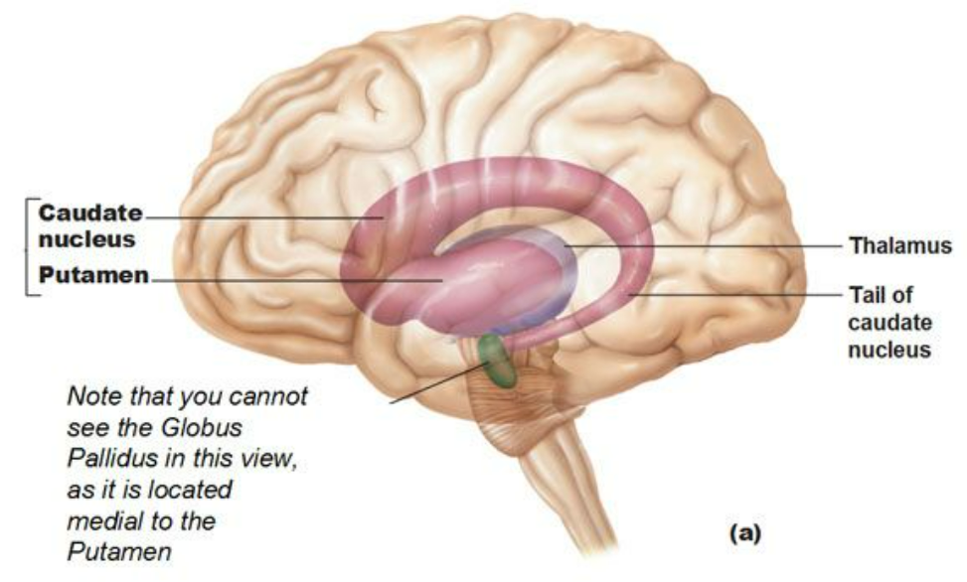
Basal Ganglia
Function: Motor Control
person with basal ganglia dysfunction may have trouble starting, stopping, or sustaining movement + problems controlling speech, movement, and posture. This combination of symptoms is called parkinsonism.

Slide 26
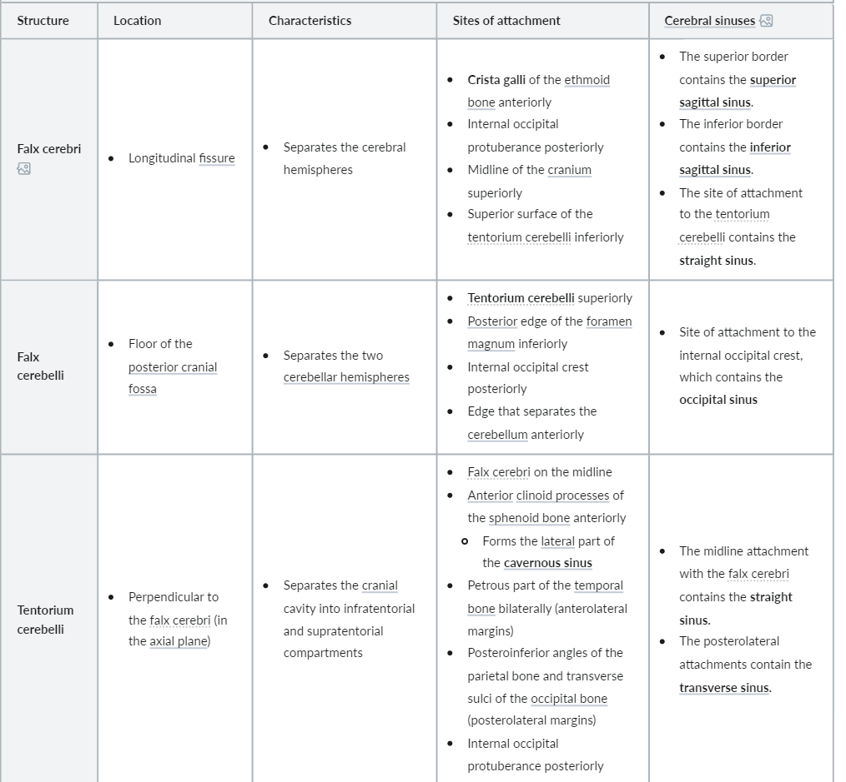
Falces of the brain

Slide 27
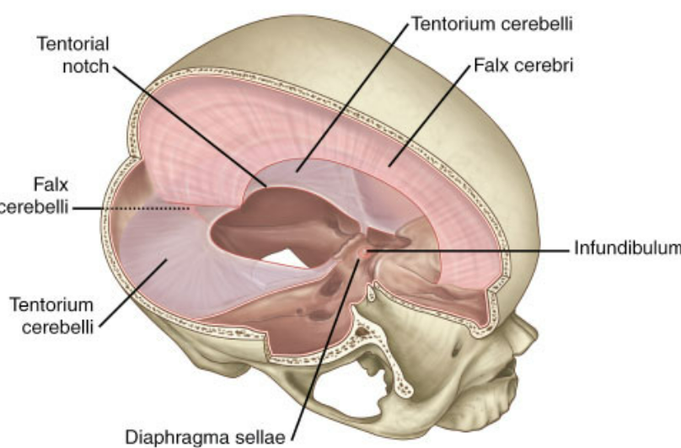
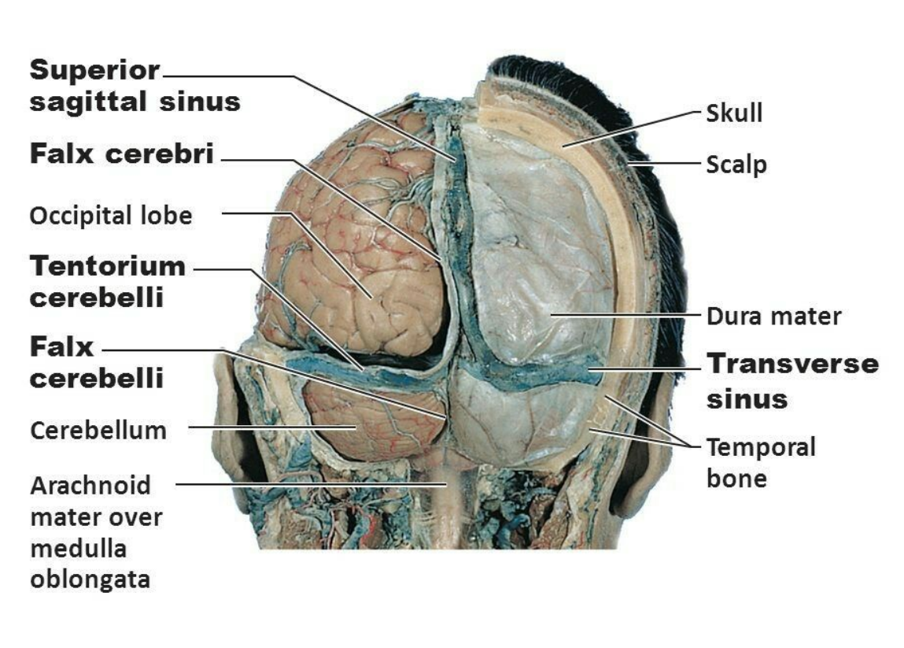
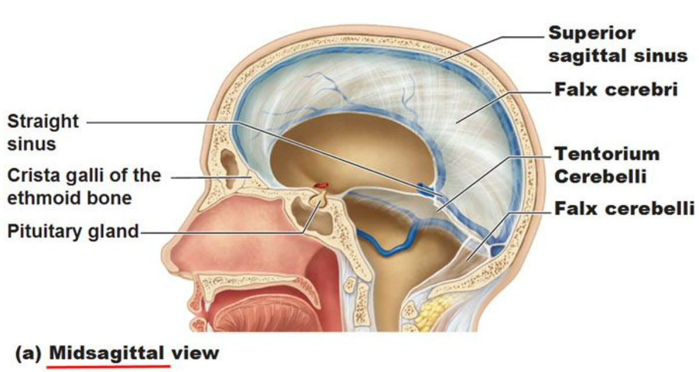

Slide 28
The Diencephalon
Location: caudal portion of the forebrain, situated between the cerebrum and midbrain
Embryogenesis: arises from prosencephalon
Parts of diencephalon: five in number separated by hypothalamic sulcus
Dorsal diencephalon (above hypothalamic sulcus)
1. The thalamus: relay center of sensory information between subcortical and cortical structures
2. Meta-thalamus: made up od medial & lateral geniculate bodies
3. Epithalamus: (pineal gland) involved in the regulation of the sleep-wake cycle
Ventral diencephalon (below hypothalamic sulcus)
4. Subthalamus: contains the subthalamic nucleus, a part of the basal ganglia
5. Hypothalamus: main center of autonomic function and endocrine system function

Slide 29
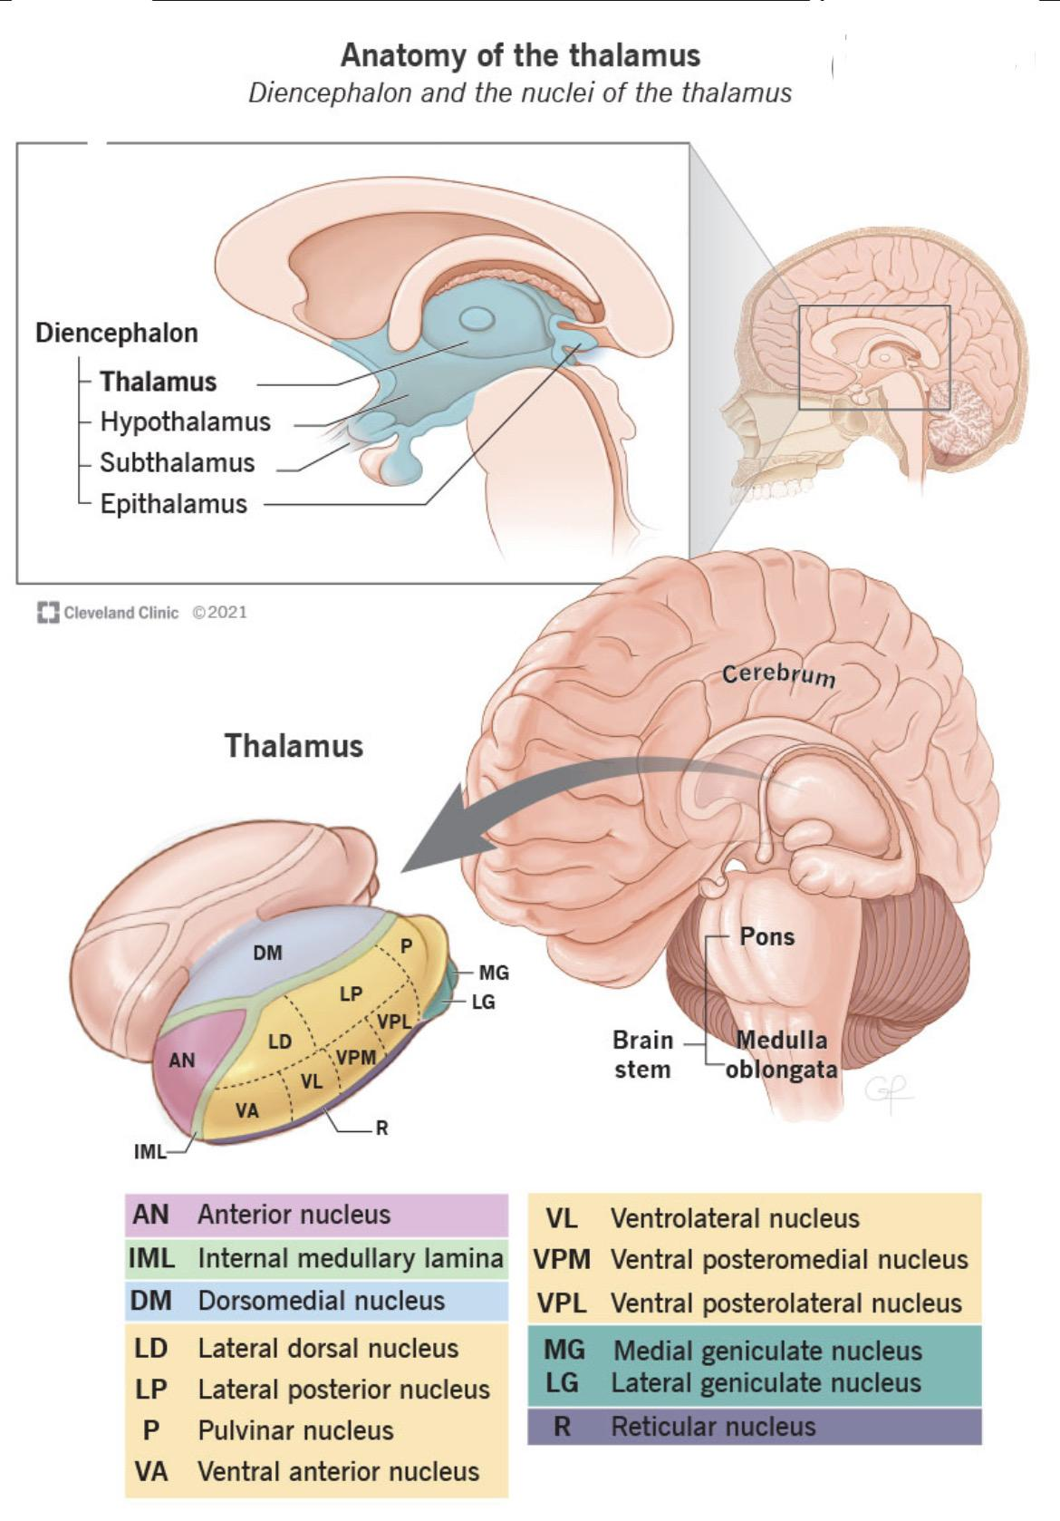

Slide 30
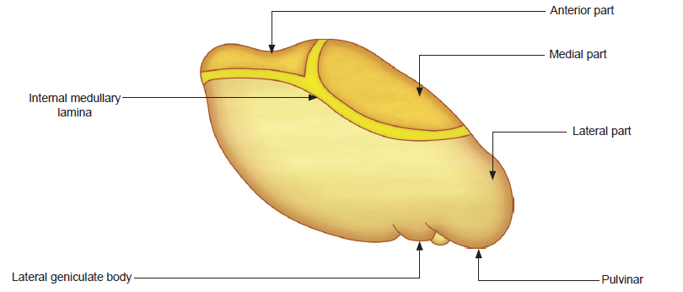
Thalamus
a group of nuclei constituting the main relay center of ascending sensory information between subcortical and cortical centers (except for the sense of smell)
The Two thalami are interconnected by a compact band of white matter crossing midline, called inter-thalamic adhesion
Composition
  Lateral, anterior, medial, and intralaminar nuclear groups and the metathalamic region
  Lateral, ant., and medial nuclear groups are separated by Y-shaped internal medullary lamina
  The lateral group can be subdivided into posterior, dorsal, and ventral subgroups
Blood supply
Mainly derived from branches of
the posterior cerebral artery

Slide 31
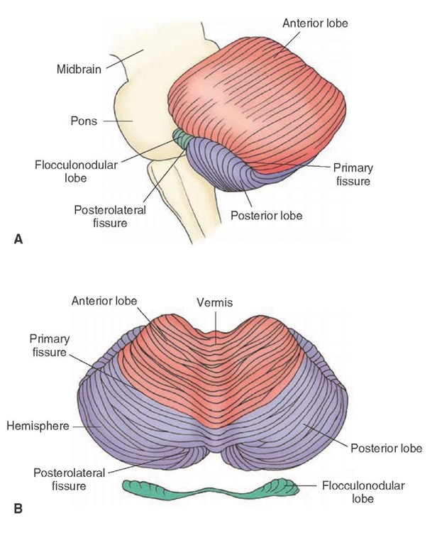
Gross Anatomy of cerebellum
Lobes and fissures
Three lobes
  Anterior lobe
  Posterior lobe
  Flocculonodular lobe
Main fissures
  The primary fissure separates the anterior and posterior lobes.
  The posterolateral fissure separates the posterior lobe from the flocculonodular lobe.

Slide 32
Cerebellum
Lies in the posterior cranial fossa
Covered by the tentorium cerebelli (dura mater)
Connected to brainstem via three paired cerebellar peduncles (sup, mid, inf)
Separated from the medulla and pons by the fourth ventricle
Functionally, it is divided into three zones. These are the:
cerebro-cerebellum (the lateral zones), which receives sensory information from the cerebral cortex and is responsible for the planning of movements that are just about to occur (motor planning);
spino-cerebellum (the vermis and intermediate zones), which receives proprioceptive information from the dorsal columns of the spinal cord and is responsible for the coordination of movements (motor execution);
Vestibulo-cerebellum (the flocculonodular lobe), which receives information from the vestibular nuclei and visual cortex and is responsible for balance and ocular movements

Slide 33
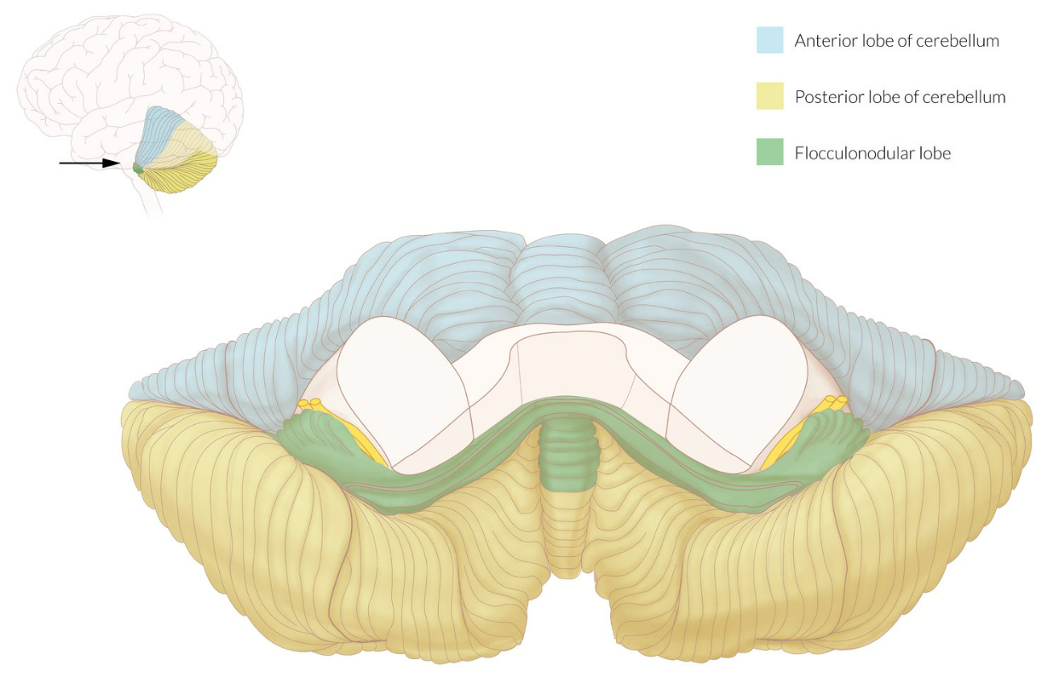
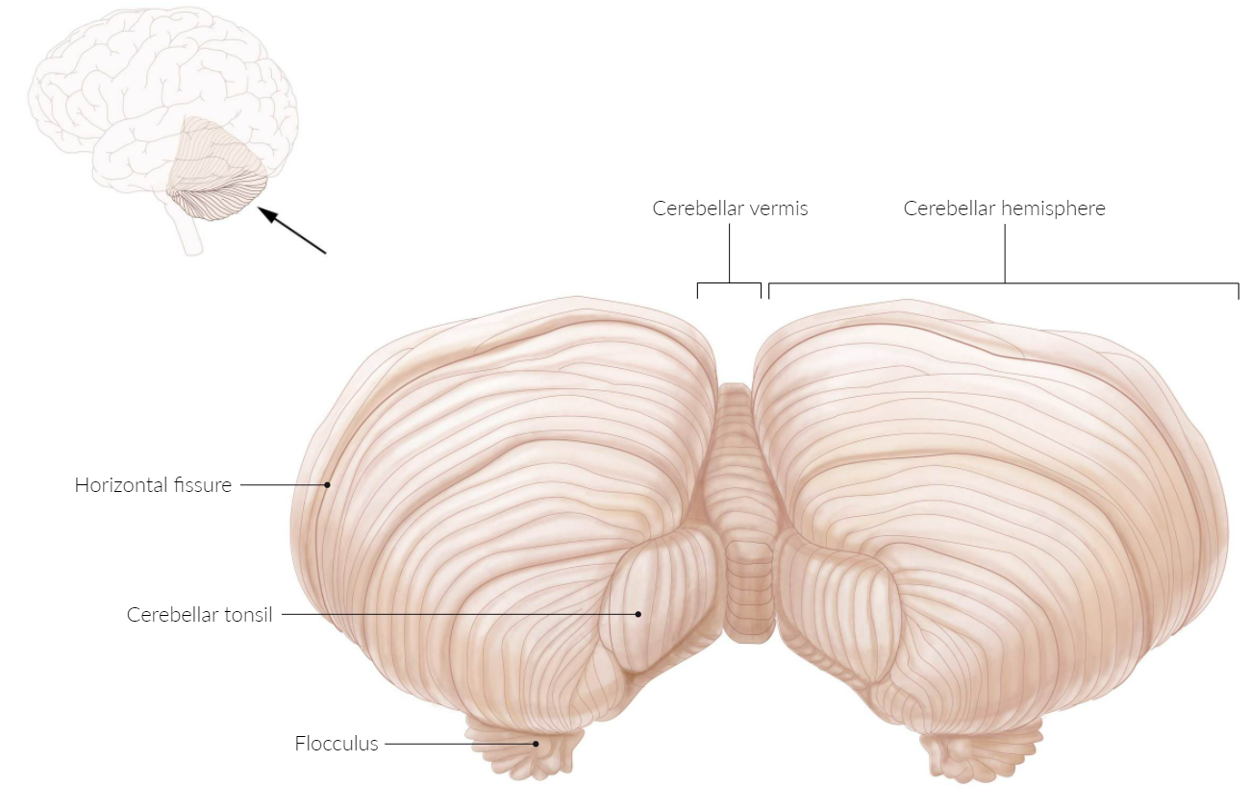
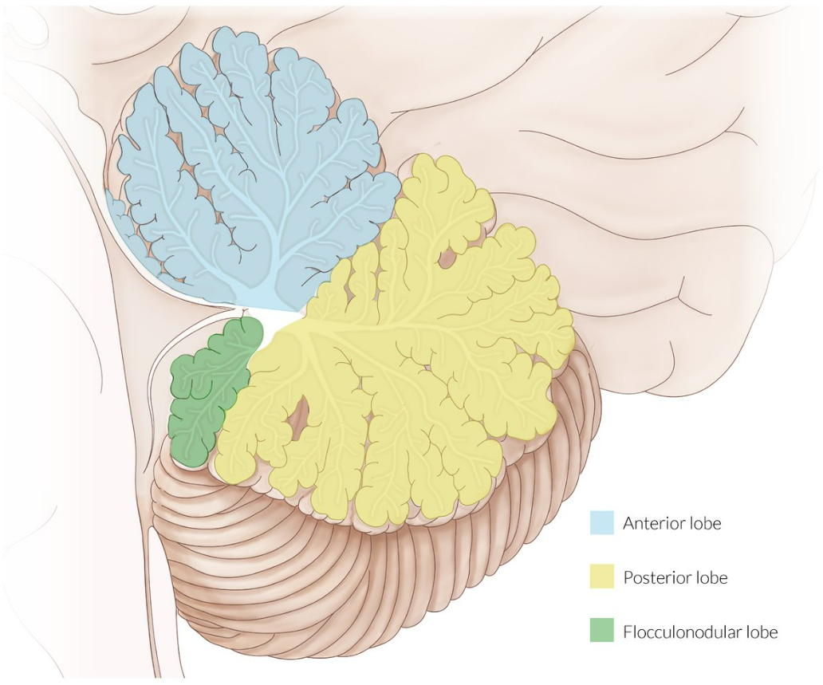

Slide 34
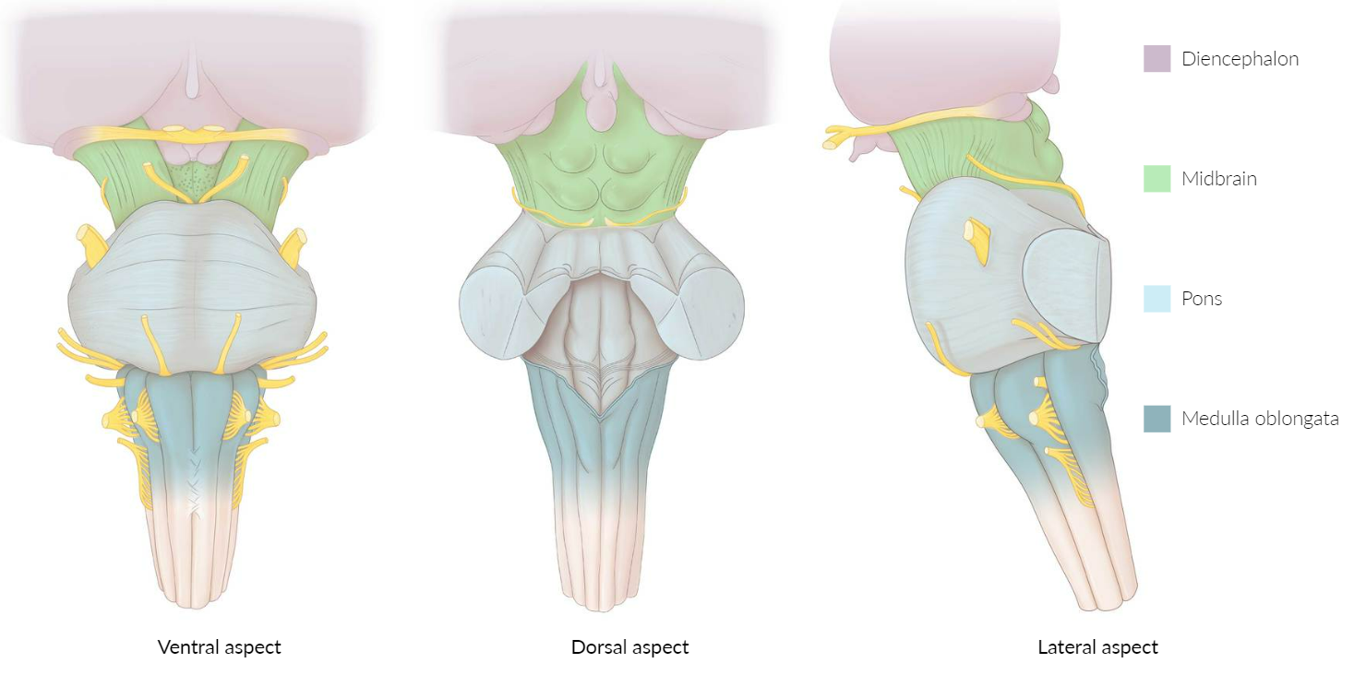
The Brainstem
1- Midbrain is the smallest - 2cm in length
As it ascends, the midbrain travels through the opening in the tentorium cerebelli.
It can be divided into two main parts:
Tectum – located posterior to the cerebral aqueduct
Paired cerebral peduncles – located anteriorly and laterally.

Slide 35
Tectum
The tectum houses four rounded prominences named colliculi (collectively the corpora quadrigemina) which sit directly inferior to the pineal gland. The colliculi are separated by the cruciform sulcus; there are two superior and two inferior colliculi.
Extending laterally from each colliculi are the quadrigeminal brachium:
Superior quadrigeminal brachium forms a pathway between the superior colliculus and the retina of the eye.
Inferior quadrigeminal brachium conveys fibres from the lateral lemniscus and inferior colliculus to the medial geniculate body.
Inferior to the colliculi, the trochlear nerve (CN IV) emerges before sweeping across to the anterior surface.
Cerebral Peduncles
The paired cerebral peduncles extend from the cerebral hemispheres to converge as they meet the pons. They are separated anteriorly in the midline by the interpeduncular fossa, the floor of which is termed the posterior perforated substance (as many perforating blood vessels can be identified).

Slide 36
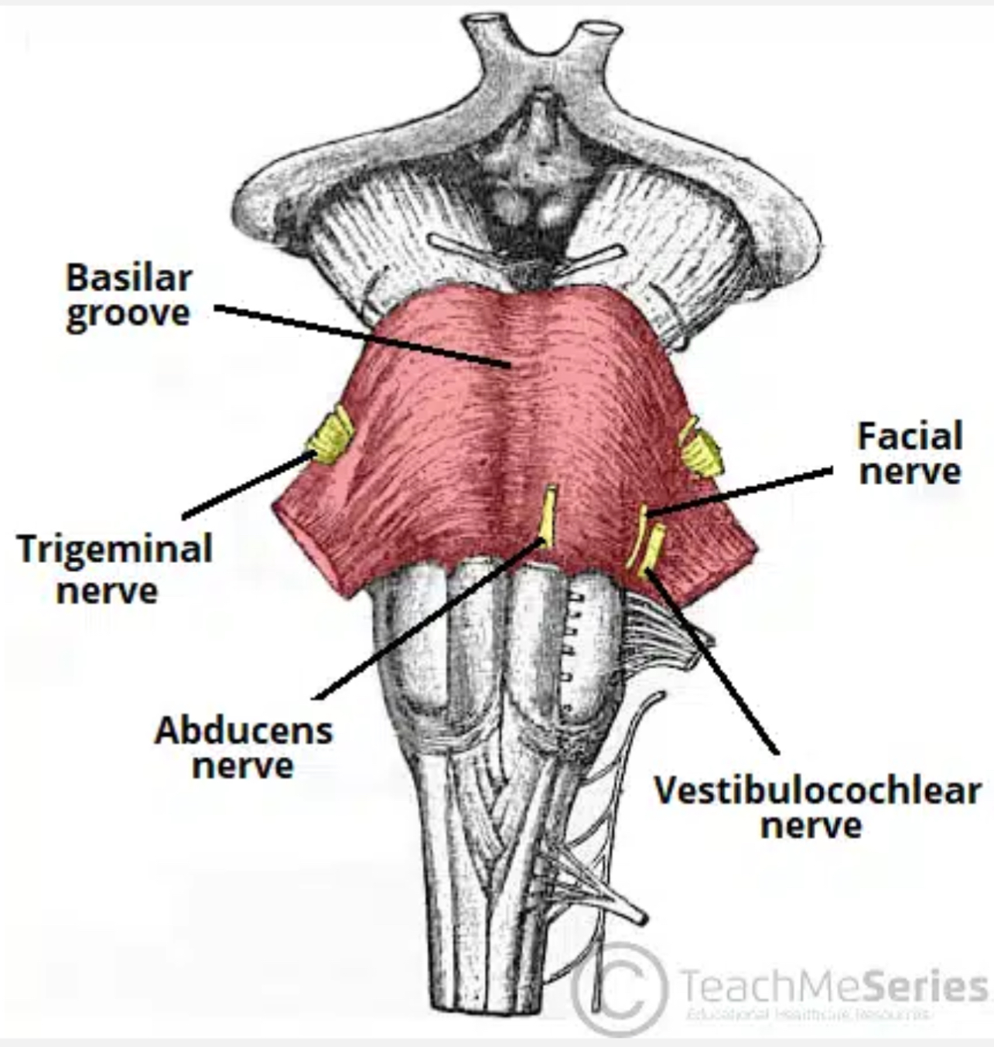
2) Pons is a group of nerves that function as a connection between the cerebrum and cerebellum (pons is Latin for bridge).
Anteriorly: the pons is marked by a bulging formed by the transverse pontocerebellar fibres. These fibres wrap around the otherwise vertically oriented brainstem. It measures around 2.5 cm in adults.
The basilar groove demarcates the midline of the ventral surface and is where the basilar artery is located.
The pontomedullary junction is an important anatomical landmark

Slide 37
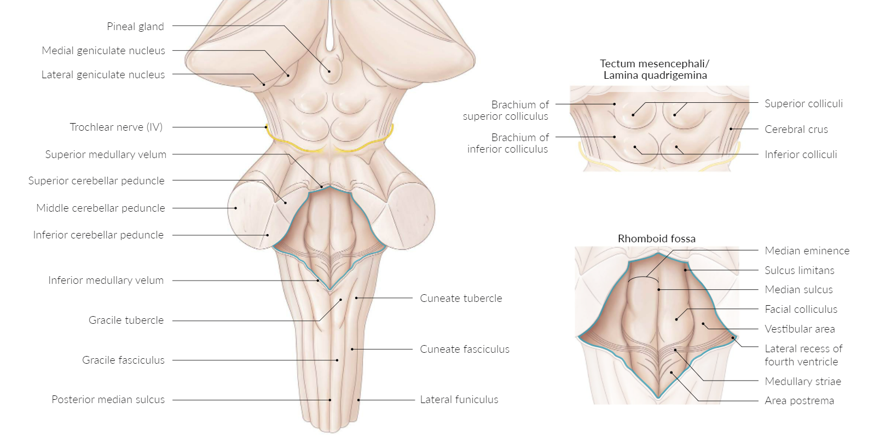
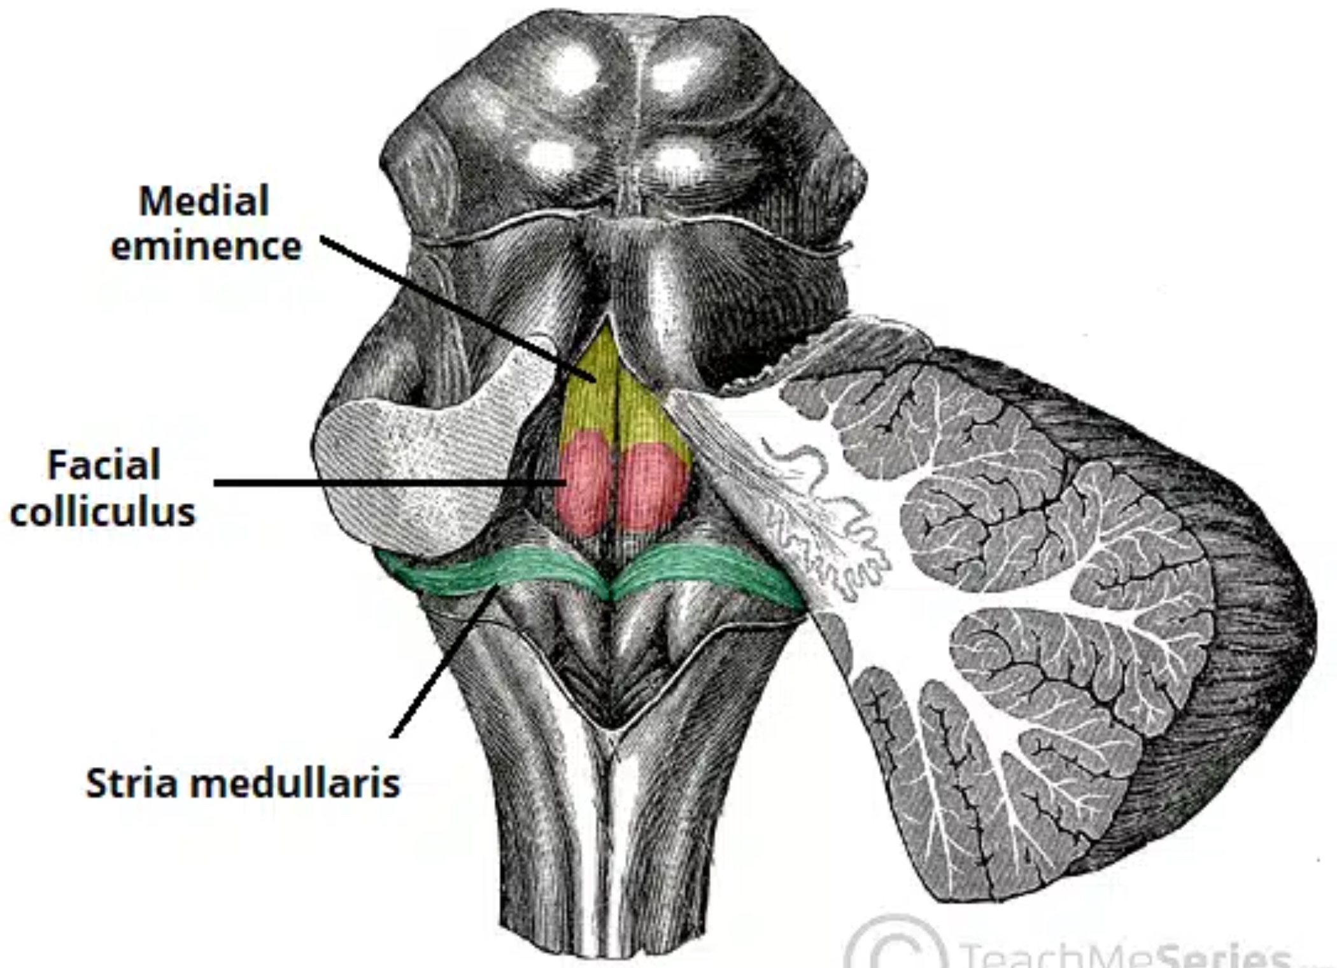
Posteriorly: The pons is intimately related to the cerebellum and is connected to it by the middle cerebellar peduncles. Removal of the cerebellum will reveal the underlying fourth ventricle.
The floor of the fourth ventricle is composed of the dorsal surface of the pons and the medulla. There are some important anatomical landmarks here:
The medial eminence marks the midline of the floor.
The facial colliculus is a bulging formed by the fibres of the facial nerve looping around the abducens nucleus.
The stria medullaris of the fourth ventricle is a bundle of nerve fibres crossing transversely from the lateral aspect into the midline. They mark the posterior border between the pons and the medulla.
The angle formed at the junction of the pons, medulla, and cerebellum is another anatomical landmark and is named cerebellopontine angle. Here, the cerebellar flocculus, the ventricular choroid plexus and the emerging CNs VII and VIII surround the lateral apertures of the fourth ventricle (the foramen of Luschka).

Slide 38
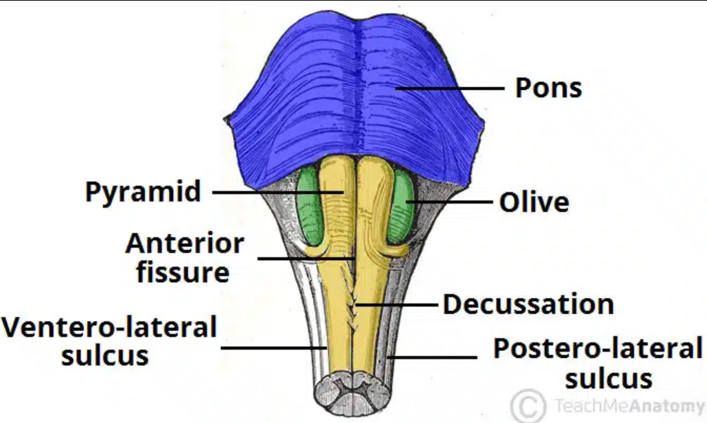
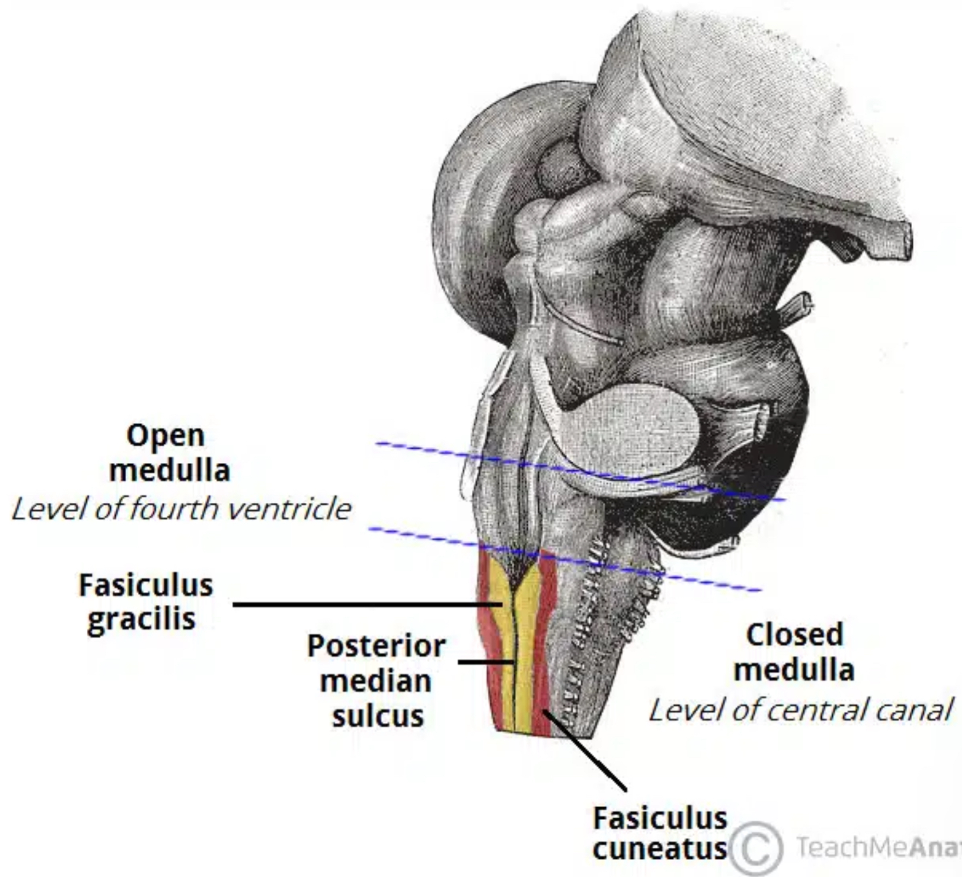
3) medulla The superior margin of the medulla is located at the junction between the medulla and pons, while the inferior margin is marked by the origin of the first pair of cervical spinal nerves. This occurs just as the medulla exits the skull through the foramen magnum.
Anterior Surface: There are several structures visible on the anterior surface of the medulla – namely the three fissures/sulci, the pyramids, the olives, and five cranial nerves.
In the midline of the medulla is the anterior median fissure, which is continuous along the length of the spinal cord. However, it is interrupted temporarily by the decussation of the pyramids (see below). As we move away from the midline, two sulci are visible – the ventrolateral sulcus and the posterolateral sulcus.
The pyramids are paired swellings found between the anterior median fissure and the ventrolateral sulcus. The olives are another pair of swellings located laterally to the pyramids – between the ventrolateral and posterolateral sulci.
Posterior Surface: Unlike the anterior surface of the medulla, the posterior surface is largely obstructed from view and is relatively devoid of features. In order to appreciate the posterior surface, the cerebellum must be removed.
Similar to the anterior surface, the posterior surface has a midline structure – the posterior median sulcus – which is continuous below as the posterior median sulcus of the spinal cord. Above, the sulcus ends at the point in which the fourth ventricle develops.
As we move lateral from the midline, the fasciculus gracilis and fasciculus cuneatus are seen, separated by the posterior intermediate sulcus.

Slide 39
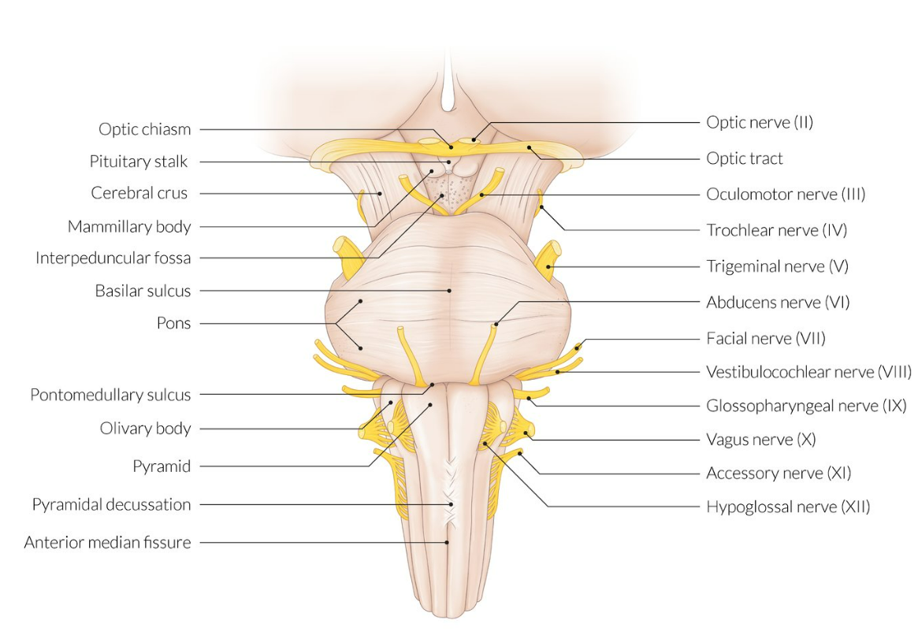
Origin of the Cranial Nerves
There are 12 cranial nerves in total.
The olfactory nerve (CN I) and optic nerve (CN II) originate from the cerebrum. Cranial nerves III – XII arise from the brainstem.
They can arise from a specific part of the brainstem (midbrain, pons or medulla), or from a junction between two parts:
Midbrain – the trochlear nerve (IV) comes from the posterior side of the midbrain. It has the longest intracranial length of all the cranial nerves.
Midbrain-pontine junction – oculomotor (III).
Pons – trigeminal (V).
Pontine-medulla junction – abducens, facial, vestibulocochlear (VI-VIII).
Medulla oblongata
Posterior to the olive: glossopharyngeal, vagus, accessory (IX-XI).
Anterior to the olive: hypoglossal (XII).
The cranial nerves are numbered by their location on the brainstem (superior to inferior, then medial to lateral) and the order of their exit from the cranium (anterior to posterior)

Slide 40
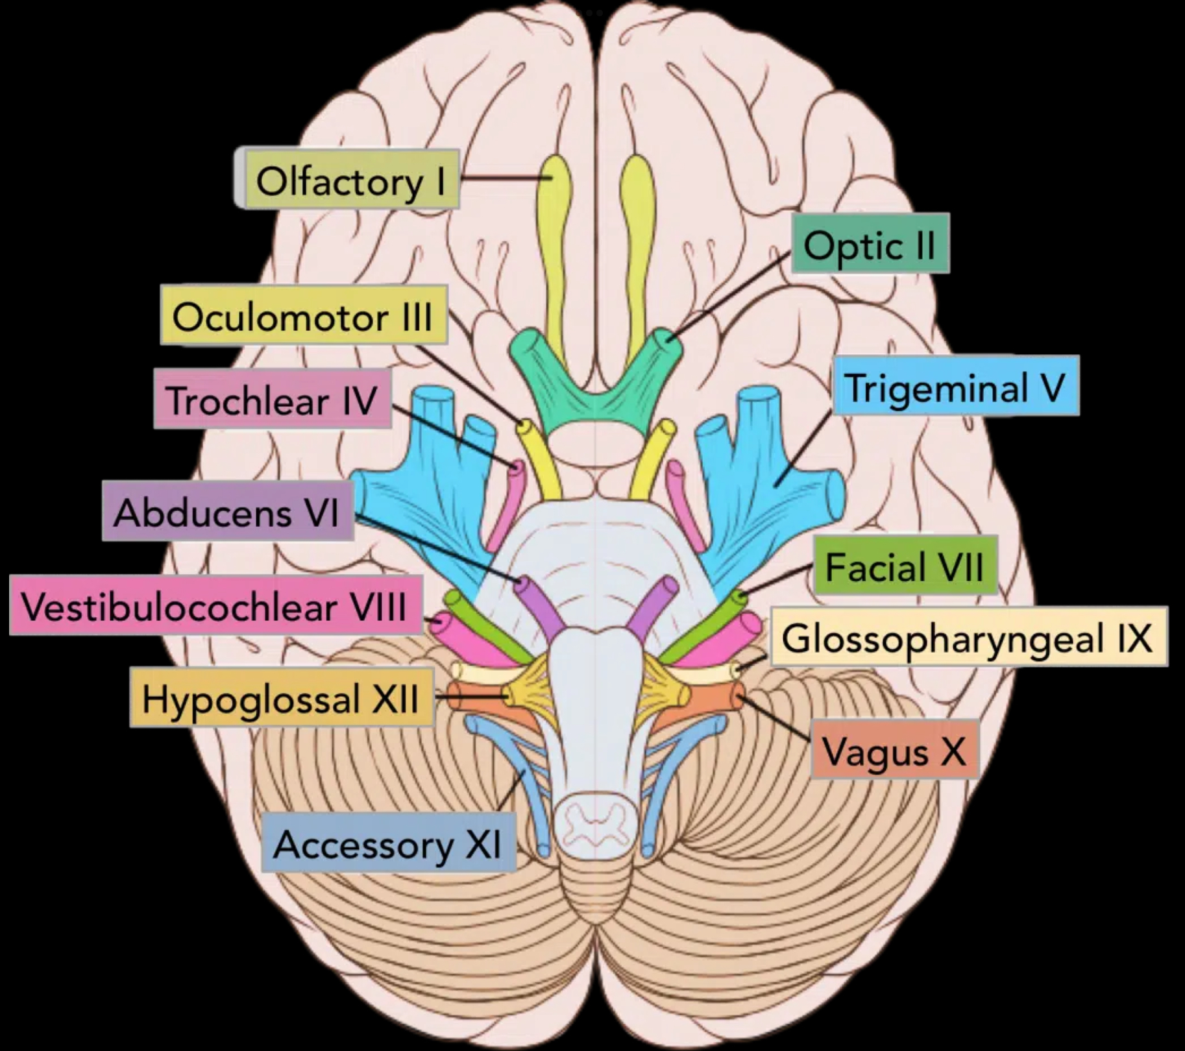
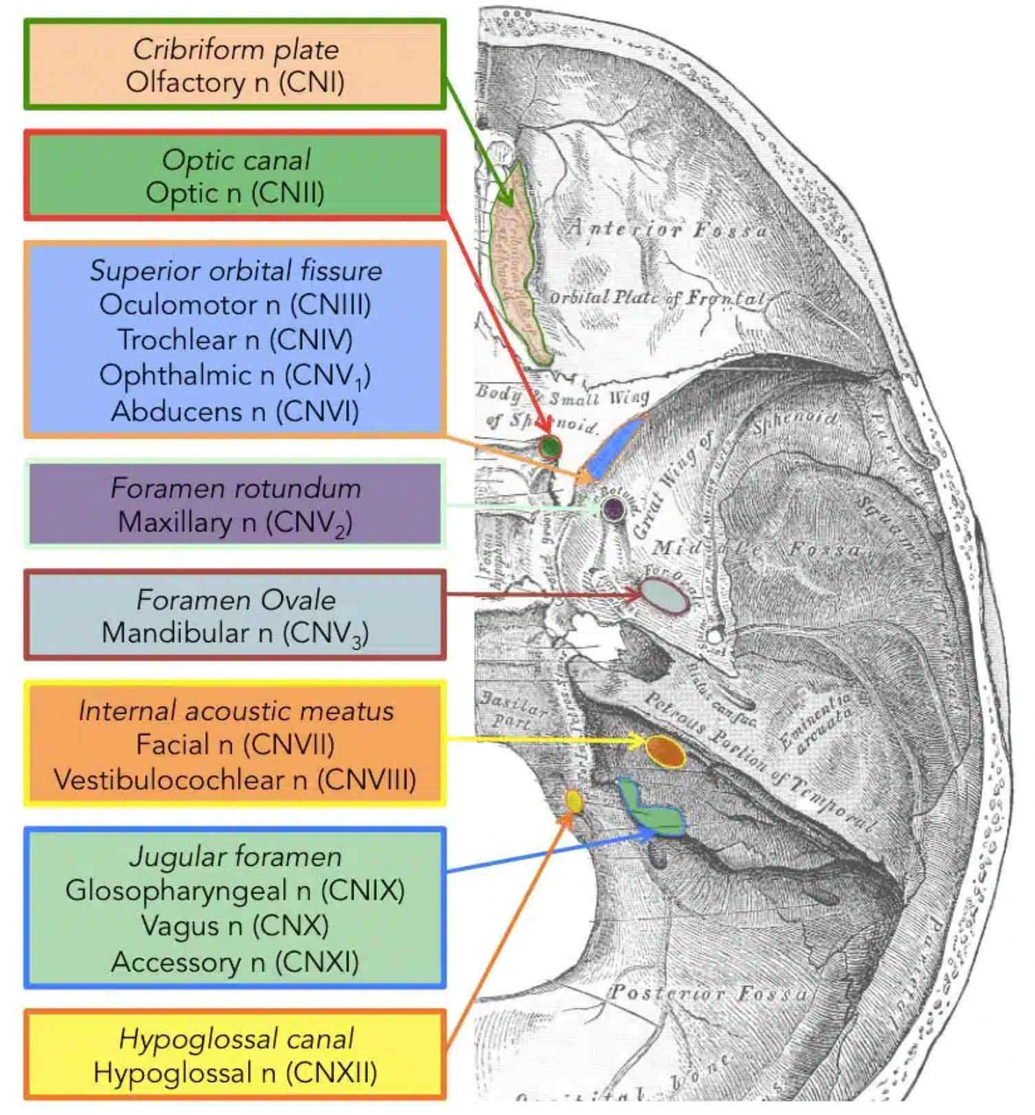

Slide 41
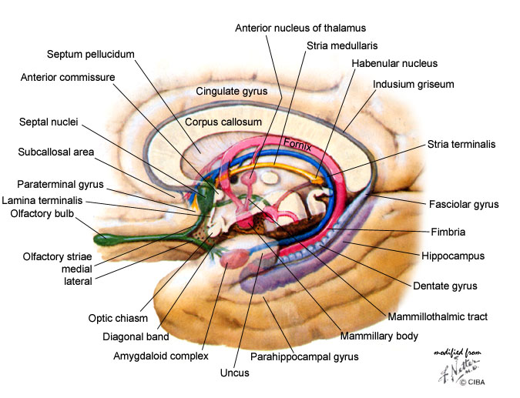
The limbic systemic
involved in emotional and behavioral responses, motivation, memory, olfaction, and autonomic nervous system function.
Components
  Areas of the cerebral cortex: hippocampal formation (hippocampus, dentate gyrus, entorhinal cortex), cingulate gyrus
  Nuclei: mammillary bodies, amygdala, anterior thalamic nuclei
  Nerve fiber tracts
    Cerebral fornix: C-shaped nerve fiber bundle that represents the major output tract of the hippocampus
    Cingulum: nerve fiber bundle connecting cingulate gyrus and entorhinal cortex
    Mammillothalamic tract
    Stria terminalis: efferent of the amygdala

Slide 42
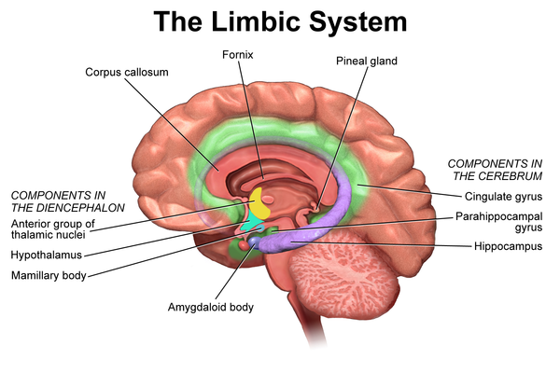
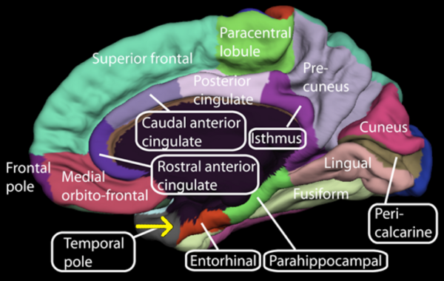

Slide 43


Ventricular system
Ventricles are structures that produce CSF, and transport it around the cranial cavity. They are lined by ependymal cells, which form a structure called the choroid plexus. It is within the choroid plexus that CSF is produced.
Lateral Ventricles:
The left and right lateral ventricles are located within their respective hemispheres of the cerebrum. They have ‘horns’ which project into the frontal, occipital and temporal lobes. The volume of the lateral ventricles increases with age.

Slide 44

Third Ventricle
The lateral ventricles are connected to the third ventricle by the foramen of Monro. The third ventricle is situated in between the right and the left thalamus. The anterior surface of the ventricle contains two protrusions:
Supra-optic recess – located above the optic chiasm.
Infundibular recess – located above the optic stalk.
Fourth Ventricle
The fourth ventricle is the last in the system – it receives CSF from the third ventricle via the cerebral aqueduct. It lies within the brainstem, at the junction between the pons and medulla oblongata.
From the 4th ventricle, the fluid drains into two places:
Spinal canal – bathes the spinal cord
Subarachnoid cisterns – bathes the brain, between arachnoid mater and pia mater. Here it’s reabsorbed by the arachnoid villi into the dural venous system.
The median aperture (foramen of Magendie) opens on midline into a subarachnoid space inferior to the cerebellum called the cisterna magna and into the quadrigeminal cistern in the region of the tectum of the midbrain. Two lateral apertures (foramen of Luschka) also open into the cisterna magna.

Slide 45

Spinal cord
The spinal cord arises cranially as a continuation of the medulla oblongata.
It then travels inferiorly within the vertebral canal, surrounded by the spinal meninges containing cerebrospinal fluid.
At the L2 vertebral level the spinal cord tapers off, forming the conus medullaris (L3 vertebra in neonates).
As a result of the termination of the spinal cord at L2, it occupies around two thirds of the vertebral canal. The spinal nerves that arise from the end of the spinal cord are bundled together, forming a structure known as the cauda equina "horse tail” (it’s comprised of L2-S5 nerves + the coccygeal nerve - 10 nerve pairs ).
During the course of the spinal cord, there are two points of enlargement. The cervical enlargement is located proximally, at the C4-T1 level. It represents the origin of the brachial plexus. Between T11 and L1 is the lumbar enlargement, representing the origin of the lumbar and sacral plexi.
The spinal cord is marked by two depressions on its surface. The anterior median fissure is a deep groove extending the length of the anterior surface of the spinal cord. On the posterior aspect there is a slightly shallower depression – the posterior median sulcus.
The pia mater that surrounds the spinal cord continues downwards all the way to the coccyx as a thin filament known as the filum terminale. This provides for a tight connection between the medullary cone and the back of the coccyx and, thereby, stabilizing the entire spinal cord

Slide 46

Inside, the spinal cord consists of grey matter and white matter.
The grey matter takes on the shape of a butterfly, with four 'wings' called horns: The horns in the front contain motor neurons; the horns in the back contain sensory neurons which carry sensory information.
The spinal cord grey matter is surrounded by a column of white matter, containing axons that allow different parts of the spinal cord to communicate smoothly, with signals passing upwards and downwards conveying eg sensation and motor signals.
Entry and Exit
Sensory Nerve Fibres enter the Spinal Cord via the Posterior (Dorsal) Root. The cell bodies for these neurons are situated in the Dorsal Root Ganglia.
Motor and Preganglionic Autonomic Fibres exit via the Anterior (Ventral) Root.

Slide 47

Formation of the Spinal Nerves (31 pairs through the 33 vertebrae)
The spinal nerves are mixed nerves that originate from the spinal cord, forming the peripheral nervous system.
Each spinal nerve begins as an anterior (motor) and a posterior (sensory) nerve root. These roots arise from the spinal cord, and unite at the intervertebral foramina, forming a single spinal nerve.
The spinal nerve then leaves the vertebral canal via the intervertebral foramina, and then divides into two:
Posterior rami – supplies nerve fibres to the synovial joints of the vertebral column, deep muscles of the back, and the overlying skin.
Anterior rami – supplies nerve fibres to much of the remaining area of the body, both motor and sensory.

Slide 48





Slide 49
Brain Blood Supply
The brain receives blood from two sources: the internal carotid arteries 80%, which arise at the point in the neck where the common carotid arteries bifurcate, and the vertebral arteries 20%. The internal carotid arteries branch to form two major cerebral arteries, the anterior and middle cerebral arteries. The right and left vertebral arteries come together at the level of the pons on the ventral surface of the brainstem to form the midline basilar artery. The basilar artery joins the blood supply from the internal carotids in an arterial ring at the base of the brain (in the vicinity of the hypothalamus and cerebral peduncles) called the circle of Willis. The posterior cerebral arteries arise at this confluence, as do two small bridging arteries, the anterior and posterior communicating arteries. Conjoining the two major sources of cerebral vascular supply via the circle of Willis presumably improves the chances of any region of the brain continuing to receive blood if one of the major arteries becomes occluded

Slide 50


Slide 51
The major branches that arise from the internal carotid artery—the anterior and middle cerebral arteries—form the anterior circulation that supplies the forebrain. These arteries also originate from the circle of Willis. Each gives rise to branches that supply the cortex and branches that penetrate the basal surface of the brain, supplying deep structures such as the basal ganglia, thalamus, and internal capsule. Particularly prominent are the lenticulostriate arteries that branch from the middle cerebral artery. These arteries supply the basal ganglia and thalamus. The posterior circulation of the brain supplies the posterior cortex, the midbrain, and the brainstem; it comprises arterial branches arising from the posterior cerebral, basilar, and vertebral arteries. The pattern of arterial distribution is similar for all the subdivisions of the brainstem: Midline arteries supply medial structures, lateral arteries supply the lateral brainstem, and dorsal-lateral arteries supply dorsal-lateral brainstem structures and the cerebellum. Among the most important dorsal-lateral arteries (also called long circumferential arteries) are the posterior inferior cerebellar artery (PICA) and the anterior inferior cerebellar artery (AICA), which supply distinct regions of the medulla and pons. These arteries, as well as branches of the basilar artery that penetrate the brainstem from its ventral and lateral surfaces (called paramedian and short circumferential arteries), are especially common sites of occlusion and result in specific functional deficits of cranial nerve, somatic sensory, and motor function

Slide 52


Slide 53
The physiological demands served by the blood supply of the brain are particularly significant because neurons are more sensitive to oxygen deprivation than other kinds of cells with lower rates of metabolism. In addition, the brain is at risk from circulating toxins, and is specifically protected in this respect by the blood-brain barrier. As a result of the high metabolic rate of neurons, brain tissue deprived of oxygen and glucose as a result of compromised blood supply is likely to sustain transient or permanent damage. Brief loss of blood supply (referred to as ischemia) can cause cellular changes, which, if not quickly reversed, can lead to cell death. Sustained loss of blood supply leads much more directly to death and degeneration of the deprived cells. Strokes—a term that refers to the death or dysfunction of brain tissue due to vascular disease—often follow the occlusion of (or hemorrhage from) the brain's arteries. Historically, studies of the functional consequences of strokes, and their relation to vascular territories in the brain and spinal cord, provided information about the location of various brain functions. The location of the major language functions in the left hemisphere, for instance, was discovered in this way in the latter part of the nineteenth century. Now, noninvasive functional imaging techniques based on blood flow have largely supplanted the correlation of clinical signs and symptoms with the location of tissue damage observed at autopsy.

Slide 54


Vertebral Artery
There are four segments of the vertebral artery, following its way through the neck; preforaminal, foraminal, extradural (atlantic), and intradural (intracranial) parts.

Slide 55

Cerebellum blood supply
The cerebellum is supplied by three bilateral arteries from the vertebrobasilar system: superior cerebellar artery (SCA): branch of the distal basilar artery. anterior inferior cerebellar (AICA): branch of the proximal basilar artery. posterior inferior cerebellar (PICA): branch of the distal vertebral arteries.

Slide 56

Blood supply of the spinal cord. (A) View of the ventral (anterior) surface of the spinal cord. At the level of the medulla, the vertebral arteries give off branches that merge to form the anterior spinal artery. Approximately 10 to 12 segmental arteries (which arise from various branches of the aorta) join the anterior spinal artery along its course. These segmental arteries are known as medullary arteries. (B) The vertebral arteries (or the posterior inferior cerebellar artery) give rise to paired posterior spinal arteries that run along the dorsal (posterior) surface of the spinal cord. (C) Cross section through the spinal cord, illustrating the distribution of the anterior and posterior spinal arteries. The anterior spinal arteries give rise to numerous sulcal branches that supply the anterior two-thirds of the spinal cord. The posterior spinal arteries supply much of the dorsal horn and the dorsal columns. A network of vessels known as the vasocorona connects these two sources of supply and sends branches into the white matter around the margin of the spinal cord.

Slide 57
Cerebral venous drainage
Dural Venous Sinuses
The dural venous sinuses lie between the periosteal and meningeal layers of the dura mater. They are best thought of as collecting pools of blood, which drain the central nervous system, the face, and the scalp. All the dural venous sinuses ultimately drain into the internal jugular vein. Unlike most veins of the body, the dural venous sinuses do not have valves.
There are 11 venous sinuses in total. The straight, superior, and inferior sagittal sinuses are found in the falx cerebri of the dura mater. They converge at the confluence of sinuses (overlying the internal occipital protuberance). The straight sinus is a continuation of the great cerebral vein and the inferior sagittal sinus.
From the confluence, the transverse sinus continues bi-laterally and curves into the sigmoid sinus to meet the opening of the internal jugular vein.
The cavernous sinus drains the ophthalmic veins and can be found on either side of the sella turcica. From here, the blood returns to the internal jugular vein via the superior or inferior petrosal sinuses.

Slide 59
Veins of the Cerebrum
The veins of cerebrum are responsible for carrying blood from the brain tissue, and depositing it in the dural venous sinuses.
They can be divided into superficial and deep groups, which are arranged around the gyri and sulci of the brain. Upon exiting the cerebral parenchyma, the veins run in the subarachnoid space and pierce the meninges to drain into the dural venous sinuses.
Superficial System
The superficial system of veins is largely responsible for draining the cerebral cortex:
Superior cerebral veins: Drain the superior surface, carrying blood to the superior sagittal sinus.
Superficial middle cerebral vein: Drains the lateral surface of each hemisphere, carrying blood to the cavernous or sphenoparietal sinuses.
Inferior cerebral veins: Drain the inferior aspect of each cerebral hemisphere, depositing blood into cavernous and transverse sinuses.
Superior anastamotic vein (Trolard): Connects the superficial middle cerebral vein to the superior sagittal sinus.
Inferior anastamotic vein (Labbé): Connects the superficial middle cerebral vein to the transverse sinus.
Deep System
Subependymal veins – There are numerous subependymal veins. These receive blood from the medullary veins and carry it to the dural venous sinuses. The great cerebral vein (vein of Galen) is worthy of a mention; it is formed by the union of two of the deep veins, and drains into the straight sinus.
Medullary veins: Originate 1-2cm below the cortical grey matter, and drain into subependymal veins. These drain the deep areas of the brain.

Slide 60




Slide 61

Cerebellum
There are two main veins responsible for the venous drainage of the cerebellum – the superior and inferior cerebellar veins. They empty into the superior petrosal, transverse and straight dural venous sinuses.
Brainstem
Venous drainage of the brainstem is carried out by numerous vessels. Examples include the transverse pontine vein, anteromedian medullary vein, and the anterior and posterior spinal veins.
Spinal Cord
The spinal cord is supplied by three anterior and three posterior spinal veins. These veins are valveless, and form an anastamotic network along the surface of the spinal cord. They drain into the anterior and posterior radiculomedullary veins, which in turn drain into the paravertebral and intervertebral plexuses.
Then into the internal and external vertebral plexuses, which in turn empty into the systemic segmental veins. Finally, the venous plexuses drain into the segmental veins, draining into the ascending lumbar veins, azygos system, and pelvic venous plexuses.
The internal vertebral plexus also empties into the dural venous sinuses superiorly.

