Slide 1
Cerebrovascular Accidents Pathology
Osama Jarada MD,
T.A. at AUG

Slide 2
Two groups which are:
1. Superficial (cortical): Which have two characteristics:
a) They supply superficial cortical part of brain.
b) They form anastomosis on the surface of the brain which will help in collateral circulation.
2. Deep (central, ganglionic or nuclear): Which have two characteristics:
a) They supply deeper part of brain, e.g. white matter (fiber bundles) and deep-seated mass of gray matter like basal nuclei.
b) These branches are end arteries which do not have any anastomosis before capillary level.
Sources of arteries: Sources of arteries to the brain are from two bilateral arterial systems which are–
1. Vertebrobasilar arterial system (posterior circulation)
2. Carotid arterial system (anterior circulation)

Slide 3
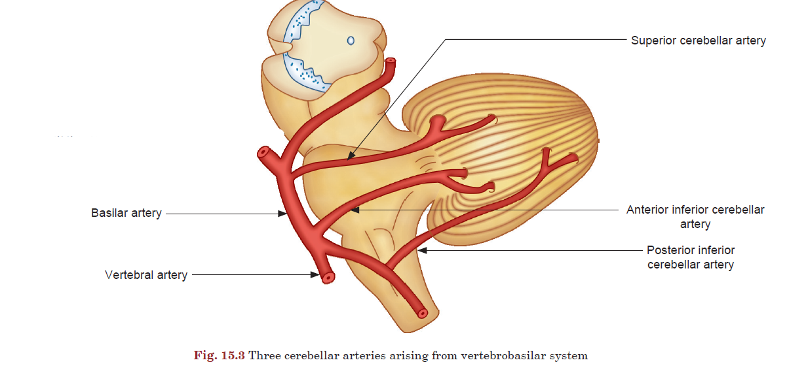
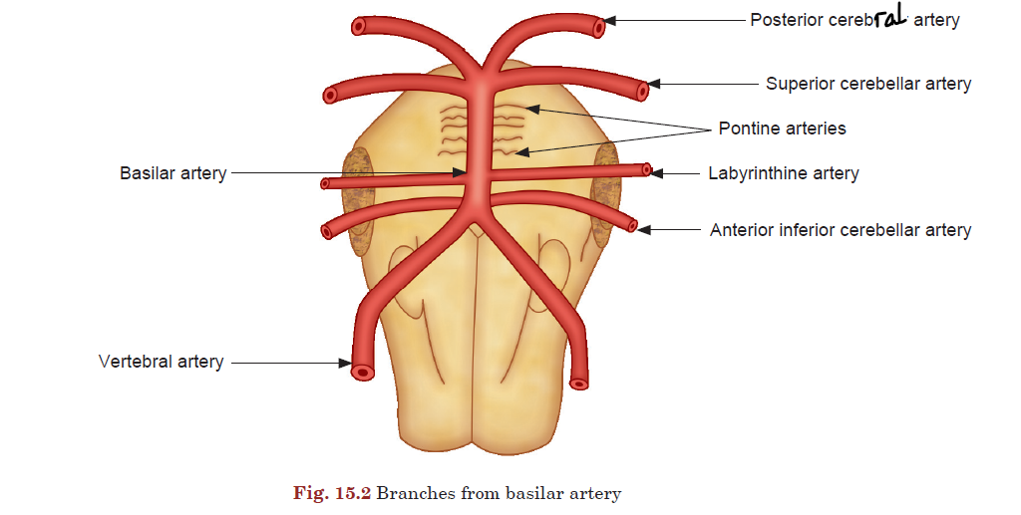
Branches
  Anterior inferior cerebellar artery (AICA): supplies anteroinferior cerebellum, middle cerebellar peduncle, and inferolateral pons
    Labyrinthine artery: supplies the inner ear
  Pontine arteries: supply the pons
  Superior cerebellar artery (SCA): supplies the superior surface of the cerebellum, superior and middle cerebellar peduncles, and lower midbrain
  Posterior cerebral artery: These are two terminal branches (right and left) of basilar artery supply occipital cortex, inferior and medial temporal cortices, thalamus, and rostral midbrain

Slide 4
Carotid arterial system
Internal Carotid Artery: terminal branches of the common carotid artery
Course
  Neck: lie within the carotid sheath and enter the cranium through the carotid canal
  Cranium: lie on the roof of the cavernous sinus, in close proximity to CN VI
Branches: only have intracranial branches, 5 sets
  Carotico-tympanic artery (the first intracranial branch of the ICA that enters the middle ear cavity and anastomoses with the inferior tympanic artery)
  Artery of the pterygoid canal (Vidian artery)
  Meningo-hypophyseal trunk
  Inferolateral trunk
  Ophthalmic artery
  Superior pituitary artery
  Anterior choroidal artery
  Posterior communicating artery: anastomosis in Circle of Willis
  Terminal branches
    Middle cerebral artery: supplies lateral cerebrum
    Anterior cerebral artery: supplies anterior cerebrum

Slide 5
Stroke
A stroke is an acute neurologic condition resulting from a disruption in cerebral perfusion, either due to ischemia (ischemic strokes) or hemorrhage (hemorrhagic strokes). Hemorrhagic strokes are further classified as intracerebral or subarachnoid.
Transient Ischemic attack (TIA)
sudden onset of a focal neurologic symptom and/or sign (neurologic deficits) without acute infarction or permanent loss of function (Previously defined as lasting less than 24 hours), brought on by a transient decrease in blood flow, which renders the brain ischemic in the area producing the symptom

Slide 6
Causes of stroke
Ischemic stroke: Cerebral infarction due to insufficient cerebral blood flow (hypoperfusion), which results in ischemia and neuronal injury
Ischemic strokes account for ∼ 85% of all strokes
“The principal mechanisms by which stroke occurs are:
Large & Small artery thrombosis (lacunar), Embolic (cardiogenic or artery-to-artery), Vascular dissection, & Bleeding”
Risk factors for ischemic stroke
  Nonmodifiable risk factors
    Age ≥ 65 years
    Sex ♂ > ♀
    Family history of cardiovascular or cerebrovascular disease
    Genetic disorders (e.g., sickle cell disease)
    History of TIA
    Migraine with aura
  Modifiable risk factors
    Systemic hypertension
    Hyperlipidemia
    Diabetes mellitus
    Atherosclerosis
    Cardiovascular disease: Carotid artery stenosis, Atrial fibrillation
    Obesity
    Coagulopathy
    Tobacco use
    Recreational drug use (e.g., cocaine can cause cerebral vasospasm)
    Oral contraceptive use & Hormone replacement therapy

Slide 7
Etiology of Ischemic stroke
Embolic strokes (∼ 20% of all strokes)
  Most commonly affect the middle cerebral artery, Can affect multiple cerebral vascular territories
  Cardiac emboli
    Atrial fibrillation, Rheumatic heart disease, Ventricular aneurysms
  Athero-emboli
    Internal carotid artery
  Infectious emboli: bacterial endocarditis
  Paradoxical embolism: venous thromboembolism (especially due to deep vein thrombosis) in patients with right-to-left cardiac shunt (e.g., persistent foramen ovale or atrial septal defect)
Thrombotic strokes (∼ 40%)
  Large vessel atherosclerosis (∼ 20%)
    Rupture of an atherosclerotic plaque and exposure of subendothelial collagen → formation of a thrombus
    Thrombus formation most commonly occurs at branch points in arteries (e.g., internal carotid artery bifurcation or where the MCA branches from the circle of Willis).
  Small vessel occlusion (e.g., lacunar infarct).
Global cerebral ischemia
  Systemic hypoperfusion
    Shock → decreased effective oxygen delivery to the whole brain
    Can result in watershed infarct
  Hypoglycemia: Repeated episodes of hypoglycemia (e.g., due to insulinoma) increase the risk of cerebral ischemia.
  Severe and/or chronic hypoxia: hypoxemia (e.g., due to respiratory arrest) → global tissue hypoxia in the brain

Slide 8
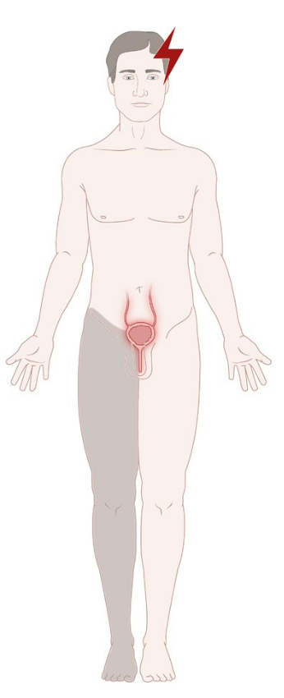
Anterior cerebral artery infarct
ACA SUPPLIES: the medial and superior parts of the frontal lobe, and the anterior parietal lobe
typically leads to the following clinical features:
– Contralateral lower extremity weakness & sensory loss (supplementary motor cortex, parts of the primary motor and primary sensory cortex)
– Urinary incontinence
– Apathy and personality change & confusion (frontal, pre-frontal areas)
“Lower extremity weakness exceeds upper extremity weakness.” (paracentral lobule, medial paracentral gyrus)

Slide 9
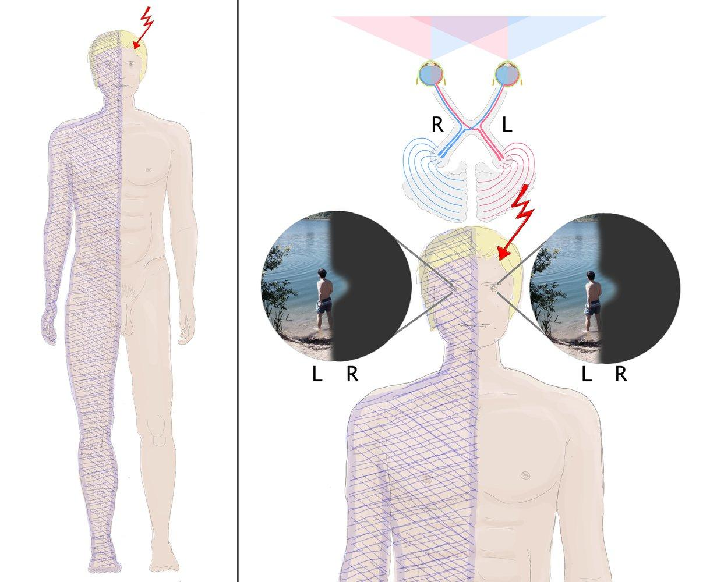
posterior cerebral artery infarct
“The posterior circulation provides blood supply to the cerebellum, brain stem, occipital lobe of the cortex. The major blood vessels that comprise the posterior circulation are the (PCA),(BA), and vertebral arteries.”
PCA supplies: occipital lobe, posteromedial temporal lobes, midbrain, thalamus, choroid plexus, and part of the lateral and third ventricles.
typically leads to the following clinical features:
– Contralateral sensory loss (lateral thalamic nuclei)
– Contralateral homonymous hemianopia with macular sparing (occipital lobe), (macula receives collateral vascular supply from the middle cerebral)
PCA territory of the dominant hemisphere (usually left):
  Alexia without agraphia (inability to read with preserved writing capacity and classically localizes to the dominant occipital cortex and splenium of the corpus callosum)
  Anomic aphasia(retrieval failures, amnesic aphasia) (posteromedial temporal)
  Agnosia: impairment of recognition of sensory stimulus (mostly visual)(occipitotemporal)
PCA territory of the non Dominant hemisphere (usually right): prosopagnosia (difficulty in recognition of persons by their face)

Slide 10
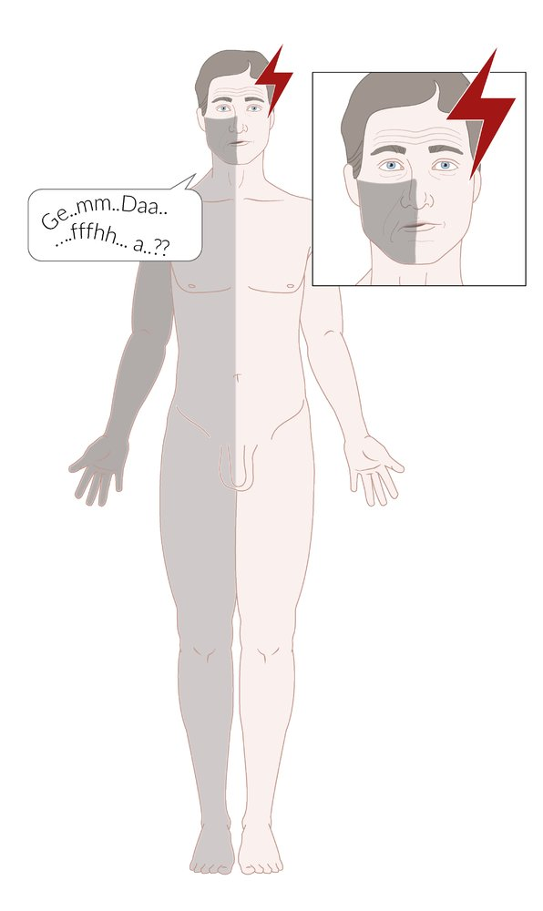
Stroke symptoms by affected vessel
“The major blood vessels comprising the anterior circulation include the (ACA) and (MCA).”
MCA supplies: deep brain structures, the majority of the lateral surface of the cerebral hemispheres, and the temporal pole of the brain.
Middle cerebral artery infarct
Thrombosis is most common in MCA or its branches, because it is the direct continuation of internal carotid artery.
typically leads to the following clinical features:
– Contralateral hemiparesis & hemisensory loss (primary motor and somatosensory cortical areas)
more marked in the upper limbs and lower half of the face than in lower limbs
– Aphasia, if the dominant hemisphere is affected (Broca's & Wernicke's areas)
– Contralateral central facial nerve palsy (upper motor neuron: The patient can raise both eyebrows & close his eyes because the forehead receives bilateral facial nerve innervation)
- Contralateral homonymous hemianopia /quadrantanopia (due to lesion of optic radiation which receives branches from middle cerebral artery).
- Auditory area (area 41 and 42) of superior temporal gyrus also suffers from ischemia. But in case of unilateral vascular lesion, there is little impairment of hearing due to bilateral cortical influence.
“Nondominant hemisphere involvement results in preserved speech, comprehension with confusion, and apraxia with spatial and constructional deficits.”

Slide 11
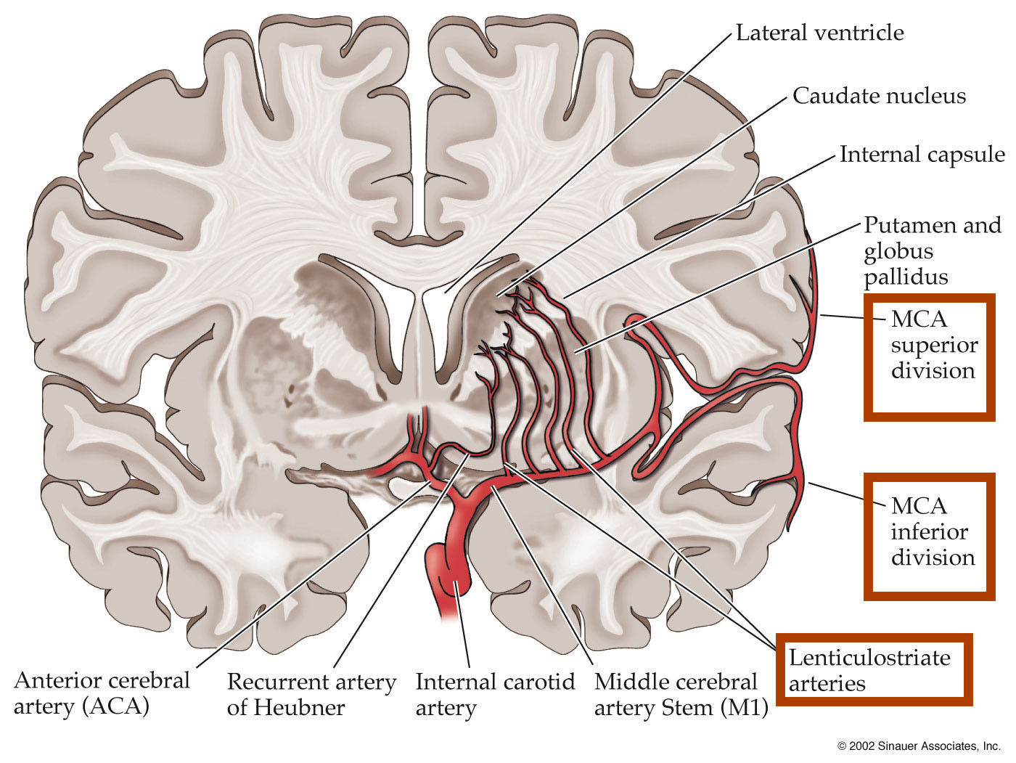

Slide 12
Occlusion of the penetrating branches of PCA can result in ipsilateral CN III palsy with contralateral hemiplegia (Weber syndrome) or ipsilateral CN III palsy with contralateral ataxia or athetosis (Benedikt syndrome).”
Specific syndromes associated with occlusion of basilar artery branches include the “locked-in syndrome” (paramedian branches), presenting as quadriparesis with intact vertical eye movements;
and Wallenberg syndrome (posterior inferior cerebellar artery), which presents as ipsilateral facial sensory loss, contralateral body sensory loss, vertigo, ataxia, dysarthria, dysphagia, and Horner syndrome.
“Occlusion of the major cerebellar arteries produces vertigo, vomiting, nystagmus, and ipsilateral limb ataxia.”

Slide 13
Anterior choroidal Artery infarct
AChA Supplies: anterior medial temporal lobe, the optic tract, the geniculate body, the medial globus pallidus, the medial third of the cerebral peduncle, portions of the ventral and pulvinar thalamus, and the posterior limb of the internal capsule, Uncus, Hippocampus.
typically leads to the following clinical features:
facial diplegia or hemiparesis (internal capsule, cerebral peduncle)
hemisensory loss (Thalamus)
lethargy, neglect, and affect changes (Uncus, Hippocampus)
Homonymous hemianopia (optic tract, lateral geniculate body)

Slide 14
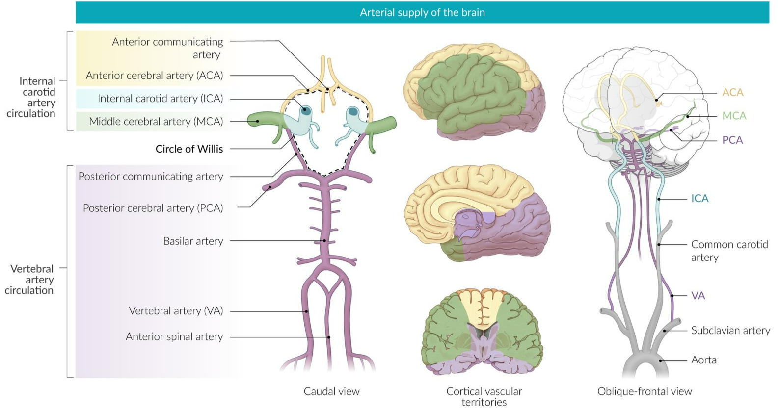
Cerebral arterial territories

Slide 15
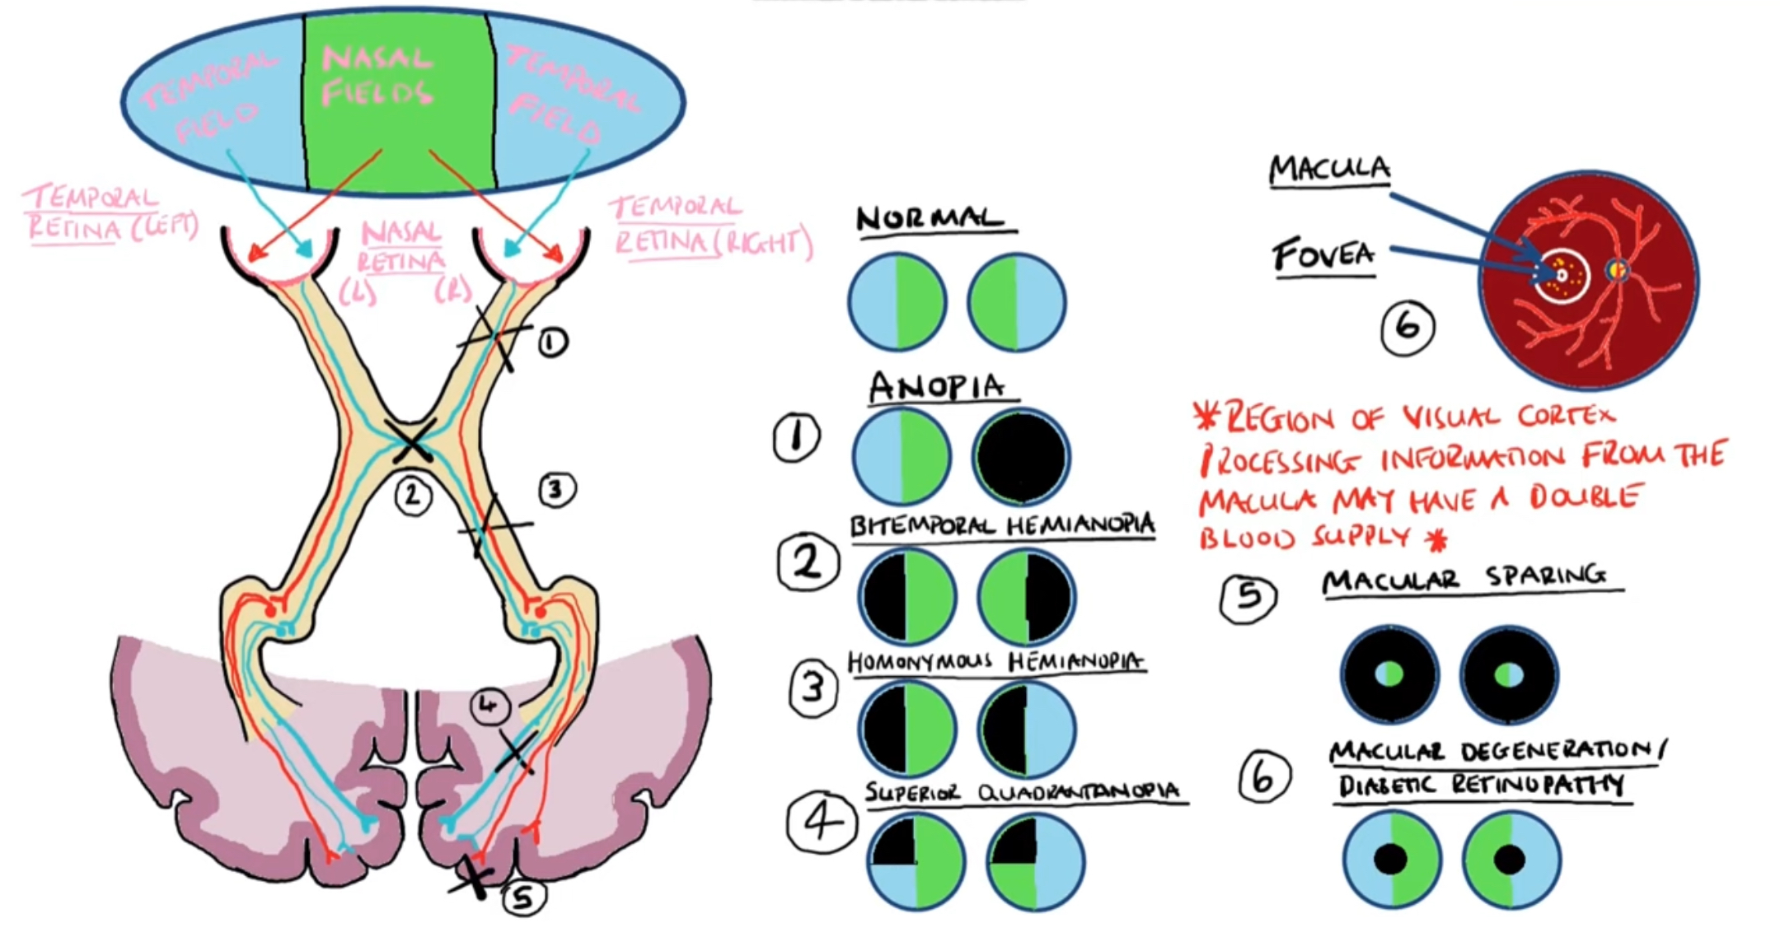

Slide 16
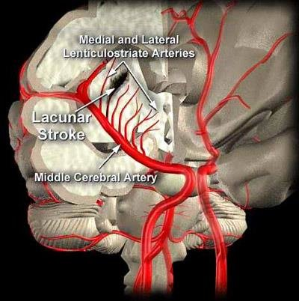
Lacunar stroke
It’s a type of ischemic stroke that occurs when blood flow to one of the small arteries deep within the brain becomes blocked.
They represent anywhere from 15% to 25% of strokes.

Slide 17
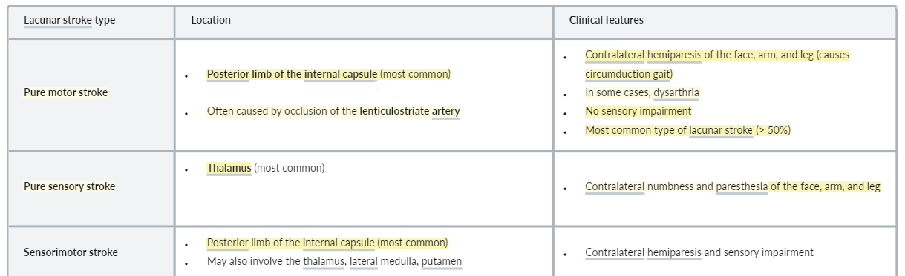
Lacunar syndromes
There are no cortical signs (e.g., neglect, aphasia, visual field loss) in any of the types of lacunar stroke.

Slide 18
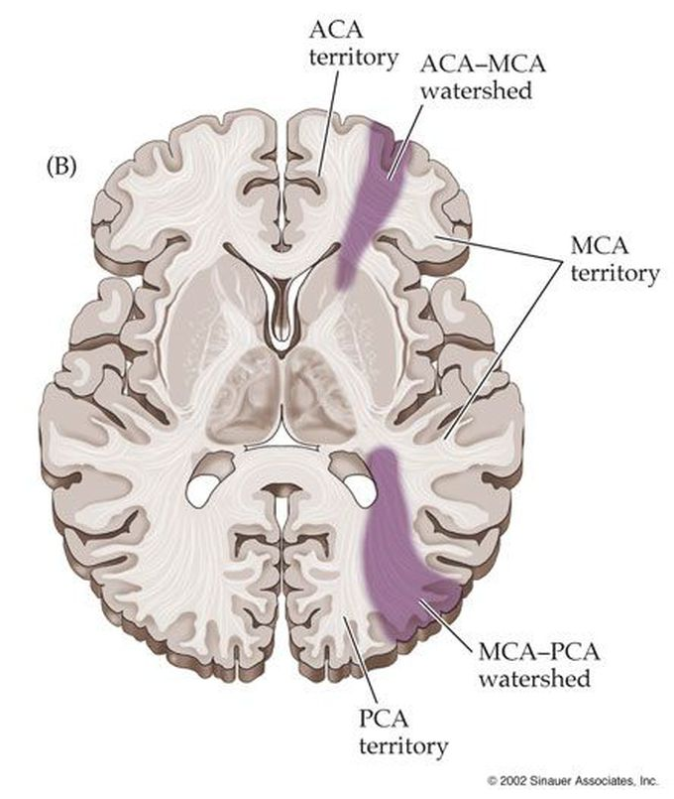
Watershed infarction

Slide 19
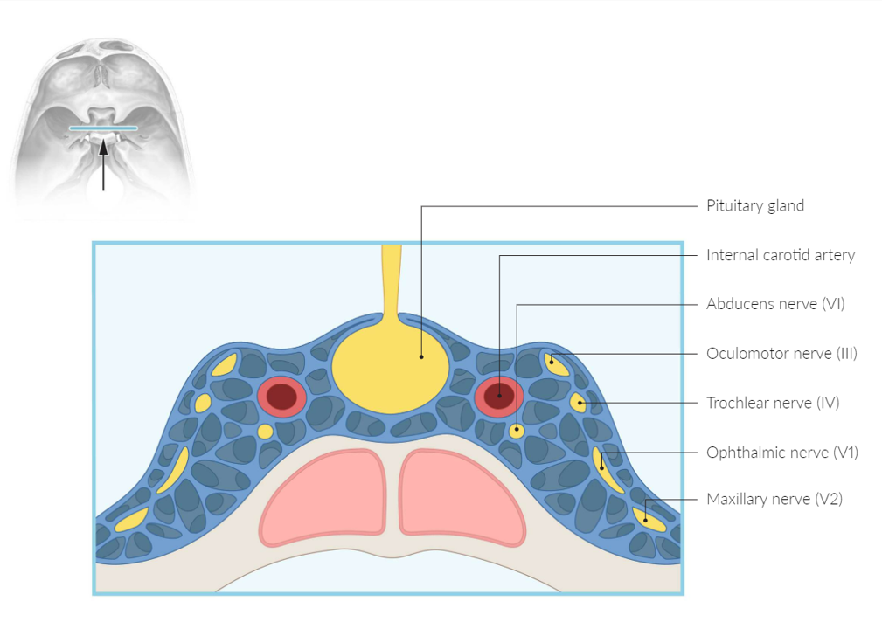
Each cavernous sinus receives venous drainage from:
Superior & inferior Ophthalmic veins, Central vein of the retina, Spheno-parietal sinus, Superficial middle cerebral vein, Pterygoid plexus.
It is important to note that the superior ophthalmic vein forms an anastomosis with the facial vein. Therefore, the ophthalmic veins represent a potential route by which infection can spread from an extracranial to an intracranial site.
The cavernous sinuses empty into the superior and inferior petrosal sinuses, and ultimately, into the internal jugular vein.
The left and right cavernous sinuses are connected in the midline by the anterior and posterior
inter-cavernous sinuses.

Slide 20
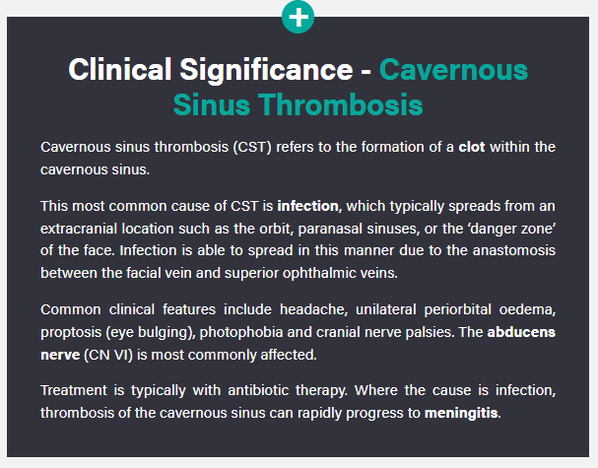
Venous sinus thrombosis Pathophysiology
Occlusion of dural sinuses leads to decreased venous flow, increased venous pressure, decreased relative cerebral perfusion pressure, and physical dilation of cerebral veins. Some combination of these forces can lead to local areas of hypoperfusion of brain tissue and resulting in hypoxic tissue damage. Additionally, the thrombosis itself can damage the vessel wall and predispose to vessel rupture and subarachnoid hemorrhage. The decreased cerebral venous outflow decreases cerebrospinal fluid (CSF) outflow. This leads to elevated intracranial pressure and associated signs and symptoms, e.g., headaches, papilledema.

Slide 21
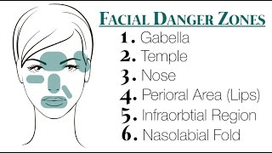
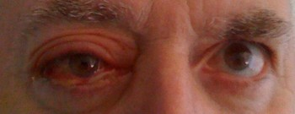
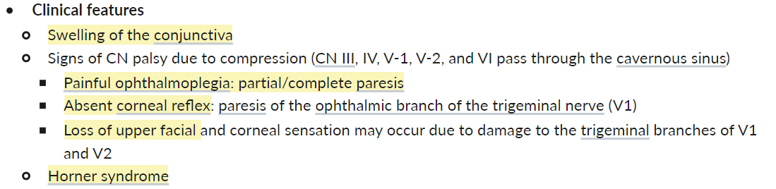

Slide 22
Assessment
It`s important to recognise the stroke symptoms and to immediately seek medical assistance. FAST (Face, Arm, Speech, Time) has a Sensitivity of 82% and a Specifity of 83%. Assess for Facial Palsy, Arm Weakness and Speech Impairment & time to call emergency service. The test is positive if ≥ 1 is present.

Slide 23
Diagnosis
The initial test of choice will always be noncontrast CT of the head, done to distinguish between hemorrhagic and ischemic stroke. Noncontrast CT is the most sensitive test for detecting blood in the brain. CT is often negative for ischemia within the first 48 hours after symptom onset; diffusion-weighted MRI is the most accurate test for detecting cerebral ischemia.
Diagnostic workup for acute ischemic stroke involves searching for embolic sources (echocardiogram, carotid duplex, and 24-hour Holter monitor). Also consider a workup for inherited hypercoagulability. A “bubble study” is done on the echocardiogram to detect the presence of a patent foramen ovale or other cardiac defect.

Slide 24
Treatment
Tissue plasminogen activator is given if the patient presents within 3 hours of symptom onset. Contraindications for use of tissue plasminogen activator include:
Stroke or serious head trauma within 3 months
Hemorrhage (GI or GU) within 21 days
Surgery within 14 days
History of intracranial hemorrhage
BP >185/110 mm Hg
Current use of anticoagulants
Platelets <100,000/mm3
Coagulopathy (PT >15 seconds
“Patients who receive tissue plasminogen activator in an appropriate manner have better neurologic function 3 months after CVA as compared with those who do not receive it.”

Slide 25
Antiplatelet therapy is most useful in secondary prevention of ischemic stroke. Aspirin is considered first-line treatment (start 24 hours after TPA).
When there is a known allergy to aspirin or recurrent cerebrovascular events on aspirin alone, add dipyridamole or switch to clopidogrel to enhance antiplatelet therapy.
Do not combine aspirin and clopidogrel for a stroke. Combination of anti-platelet agents is used on coronary disease but not cerebral disease.
Ticlopidine is no longer used because the rates of thrombotic thrombocytopenic purpura and leukopenia are unacceptably high.
“There is no clear benefit to the use of heparin with stroke. That is because of the increased risk of bleeding. Any benefit is offset by adverse events associated with treatment. For every stroke prevented, one intracranial hemorrhage is caused.”

Slide 26
“Carotid endarterectomy is recommended when an occlusion exceeds 70% of the arterial lumen and the lesion is symptomatic. Endarterectomy may benefit those who are asymptomatic if there is >60% stenosis in men age <60. The benefit of endarterectomy is less certain in women because they have a lower risk of stroke. The more severe the disease, the greater the benefit. Carotid stenting is an alternative to endarterectomy.
“Endarterectomy is simply not clear in asymptomatic carotid stenosis.”
Carotid angioplasty and stenting are not as good as endarterectomy for symptomatic patients with >70% stenosis. Angioplasty and stenting should be considered only for those who cannot undergo surgical endarterectomy.”

