Slide 1
Pathology of peripheral nervous tissue tumer
Dr . Dina Haboush

Slide 2
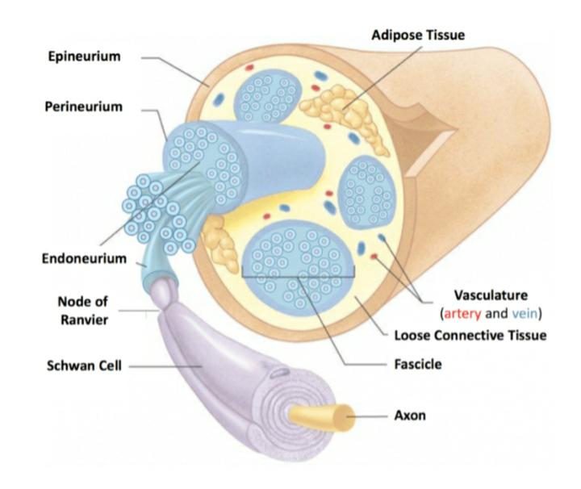

Slide 3
Majority of tumors of PNS are derived from Schwann cells and their peripheral nerve elements.
Majority are benign and the malignant neoplasms generally have a propensity for local invasion rather than regional or distant metastasis.

Slide 4
Classification of PNT
Benign Tumours:
1. Traumatic Neuroma
2. Palisaded encapsulated neuroma
3. Hamartomas
4. Neurofibroma/ Neurofibromatosis
5. Schwannoma
6. Granular cell tumor
7. Nerve Sheath Myxoma
8. Pigmented Neuroectodermal Tumor of Infancy
Malignant Tumours:
Malignant peripheral nerve sheath tumor
Olfactory Neuroblastoma
Malignant granular cell tumor
Peripheral neuroectodermal tumour

Slide 5
Schwannoma
Also known as neurilemoma/ perineural fibroblastoma/neurinoma.
Benign tumor of Schwann sheath Defined as - Encapsulated biphasic nerve sheath tumor derived from Schwann cells with highly ordered cellular component (Antoni A) that palisades (Verocay bodies) and a myxoid component (Antoni B)

Slide 6
Schwannomatosis - familial tendency for formation of multiple peripheral + vestibular schwannomas
Schwannomatosis - predisposition for malignant change

Slide 7
Clinical features
Ages 20-50; M=F
Head, neck, flexor upper and lower extremities, retroperitoneum, Intra oral region- slowly enlarging, painless submucosal nodule that is somewhat movable beneath the surface and rarely becomes larger than 2 cm in greatest diameter
Pain or rapid enlargement of preexisting lesion are suggestive of malignant

Slide 8
Gross description
Usually solitary
well, circumscribed, encapsulated mass attached to nerve
Gelatinous appearance, periphery may show fibrosis
Nerve of origin present in periphery - does not penetrate substance of tumor

Slide 9
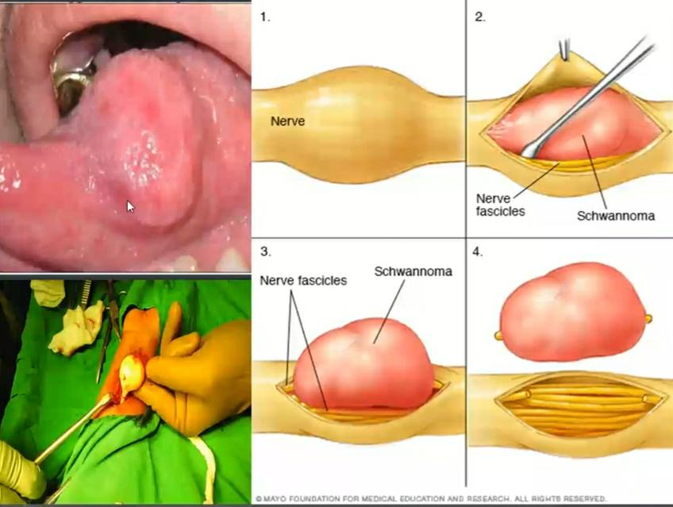

Slide 10
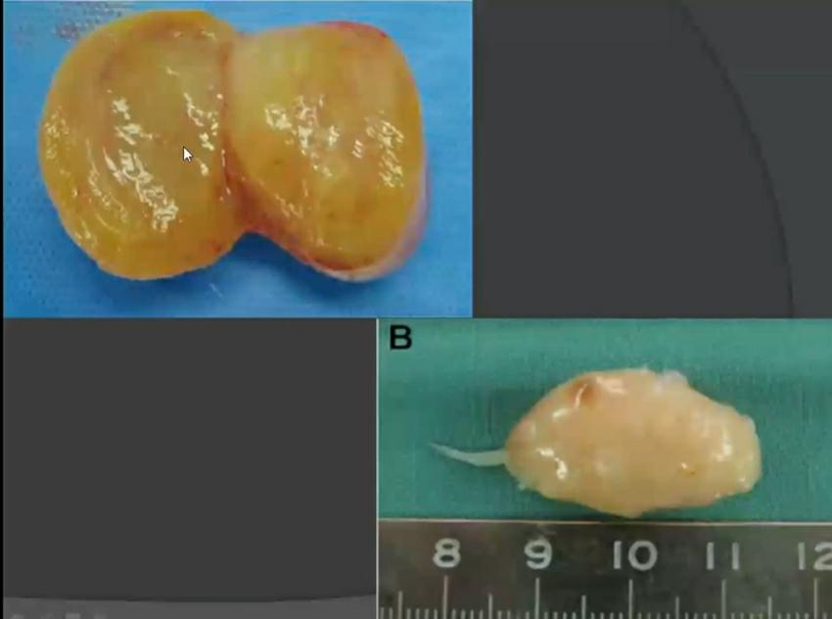

Slide 11
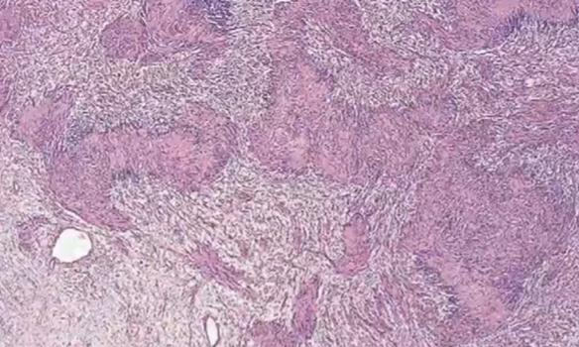
Microscopic features:
Encapsulated Biphasic tumor with compact hypercellular Antoni A areas and myxoid hypocellular Antoni B areas

Slide 12
Antoni A type tissue
Fascicles of monomorphic spindle-shaped Schwann cells with poorly defined eosinophilic cytoplasm and pointed basophilic nuclei in variably collagenous stroma
These cells show nuclear palisading, and parallel arrays of such palisades with intervening eosinophilic cytoplasm (cell processes) are known as Verocay bodies 'Soldiers across battle lines' appearance

Slide 13
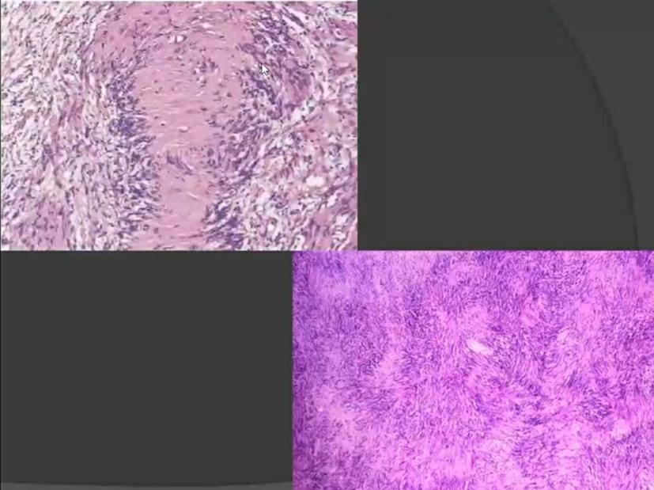

Slide 14
Antoni B type tissue
Antoni B areas are also composed of Schwann cells, but their cytoplasm is unclear , and the nuclei appear suspended in a copious myxoid, often microcystic, matrix.These areas are probably degenerative in nature
A common feature, most prominent in Antoni B areas, is the presence of blood vessels with thick hyaline walls and gaping tortuous lumina with occasional thrombi

Slide 15
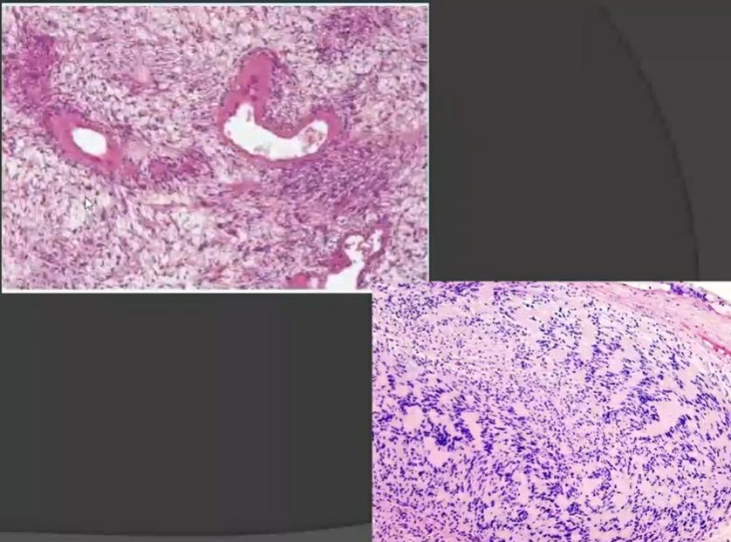

Slide 16
Variants
Ancient schwannoma
Cellular schwannoma
Pigmented schwannoma
Plexiform schwannoma
Epitheloid Schwannoma
Hybrid Schwannoma/Perineurioma
Glandular Schwannoma

Slide 17
Cellular Schwannoma
.The presence of predominantly Antoni A tissue and the nuclear zones of Verocay bodies yields a hypercellular appearance to this variant.
.They are more common in paravertebral locations in the pelvis, retroperitoneum, and mediastinum, although cranial nerves may be involved.

Slide 18
Plexiform Schwannoma
.These are most frequently encountered as a skin or subcutaneous tumor of an extremity, heads and neck, or trunk. They have a low association with NF2, and have also been noted in non-NF2 patients with multiple schwannomas (schwannomatosis).

Slide 19
Neurofibroma/Neurofibromatosis
May be solitary or associated with NF
Benign tumor derived from endoneural fibroblasts
Multiple lesions- Neurofibromatosis
Autosomal Dominant/spontaneous mutations
2 subtypes
■NF1- mutation of genes coding for neurofibromin on chromosome 17 (1 in 2500-3300 live births)
■ NF2- mutation of genes coding for Schwannomin on chromosome 22 ( 1 in 33,000-40,000 live births)
Syndrome associated neurofibromas- malignant transformation rate - 15%, NF2>NF1

Slide 20
Diagnostic Criteria for NF1 (3 or more)
(1)six or more café au lait macules
(2) two or more neurofibromas of any type,
(3) One plexiform neurofibroma
(4) axillary or inguinal freckling
(5) optic glioma,
(6) two or more iris hamartomas (Lisc nodules)
(7) sphenoid dysplasia or thinning of long bone cortex
(8) a first-degree relative with known NF1.

Slide 21
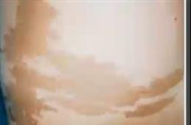
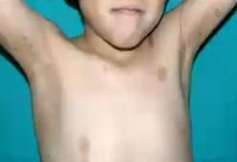
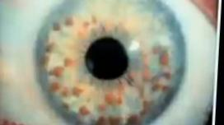

Slide 22
Diagnostic criteria for NF2 (any 1)
1.Bilateral acoustic neuroma, family history of NF2
2. Unilateral acoustic neuroma+any 2 of meningioma, neurofibroma, schwannoma,corneal opacities
3. 2 or more meningiomas + unilateral acoustic neuroma/any 2 of glioma,schwannoma or cataract

Slide 23
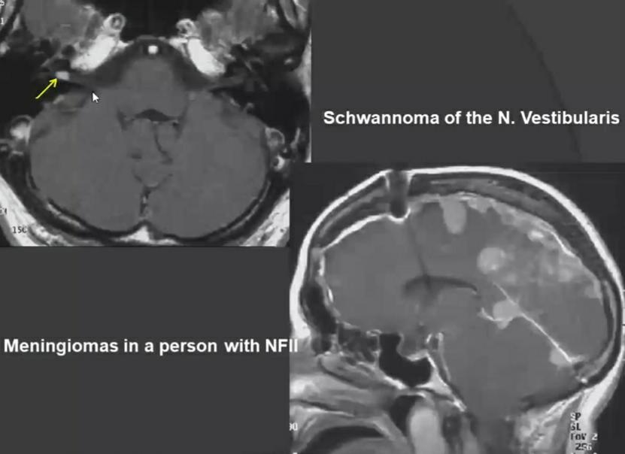

Slide 24
Types of neurofibroma:
1- Localized cutaneous neurofibromas:arise as superficial nodular or polypoid tumors.These occur either as solitary sporadic lesions or as often multiple lesions in the context of neurofibromatosis type 1 (NF1)

Slide 25
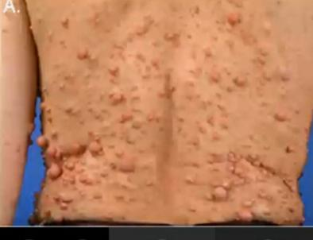
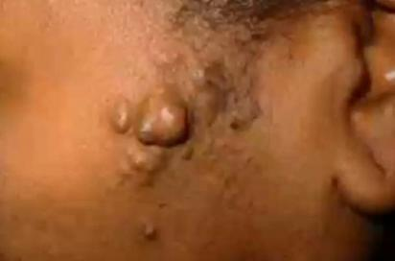

Slide 26
2- Plexiform neurofibromas:
grow diffusely within the confines of a nerve or nerve plexus.
Surgical enucleation of such lesions is therefore difficult and is often associated with lasting neurologic deficits.
Plexiform neurofibromas are virtually pathognomonic for NF1

Slide 27
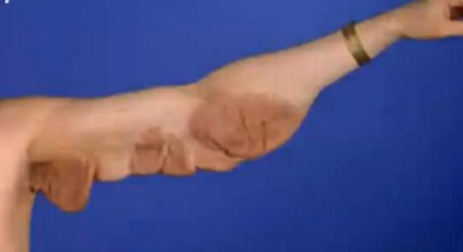
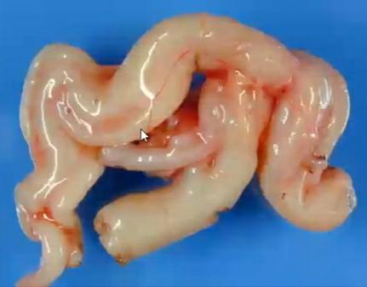

Slide 28
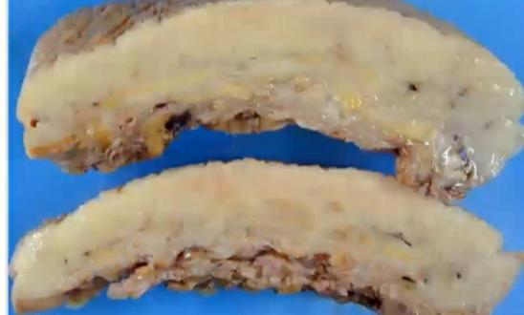
3_Diffuse neurofibromas:
are infiltrative proliferations that can take the form of large, disfiguring subcutaneous masses.
These also are often associated with NF1

Slide 29
Clinical Features
Neurofibroma- Present in young adults as a relatively small, soft, dermal or subcutaneous nodule.
Discrete non ulcerated nodules with normal overlying skin
Oral lesions in 7-20% patients, site- buccal mucosa, palate….
Multiple conventional neurofibromas, prompt consideration of possible NF1
Diffuse neurofibromas, associated with NF1 in approximately 10% of cases, are usually deeply situated.
Pain/paresthesia may present

Slide 30
Gross description
Not encapsulated, softer (more gelatinous) than schwannoma Superficial tumors are small, pedunculated nodules
Deeper tumors are larger, may cause tortuous enlargement of peripheral nerves- 'tuber root' app
Plexiform neurofibromas, grossly visible, large masse with a characteristic "bag of worms" appearance

Slide 31
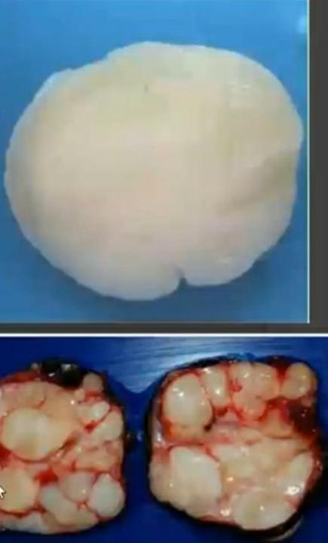

Slide 32
Pathologic Features.
Well circumscribed, unencapsulated
Elongated spindle cells with poorly defined pale eosinophilic cytoplasm and tapering wavy or buckled nuclei admixed with intermediate short spindle cells, numerous small nerve fibres and mast cells.

Slide 33
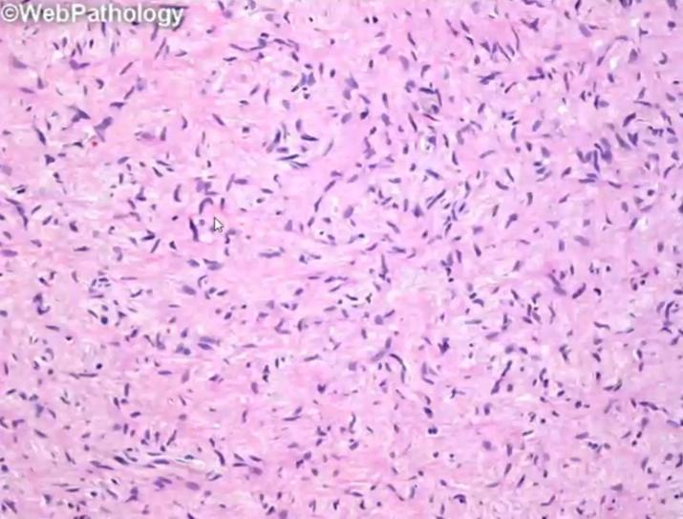

Slide 34
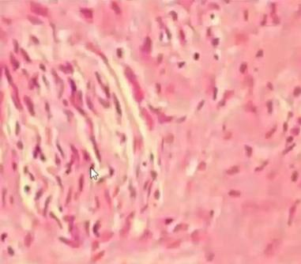
There may be a variable matrix of collagen, sometimes showing a fragmented appearance reminiscent of "shredded carrots"

Slide 35
MPNST
Formerly known as malignant schwannoma /neurofibrosarcoma
Affect young and middle-aged adults with a slight female predominance
Pediatric examples account for 13% of cases in one series
NF1 is associated with between 50% and 60% of MPNSTS.

Slide 36
Ionizing radiation, either therapeutic or through occupational exposure, may contribute to the development of a MPNST.
MPNSTS are usually found in large- and medium-sized nervous of the buttock with the sciatic nerve being the most frequently affected, and in addition the thigh, brachial plexus, upper arm, and paraspinal nerves

Slide 37
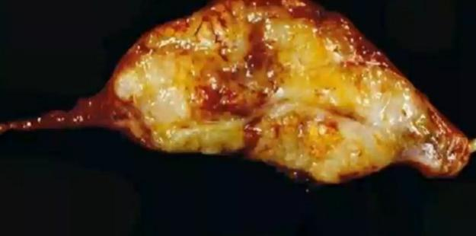
They are globoid or fusiform and surrounded by a fibrous pseudocapsule of varying thickness.
They display a firm opaque consistency on cut section with areas of necrosis grossly recognizable in the majority of cases

Slide 38
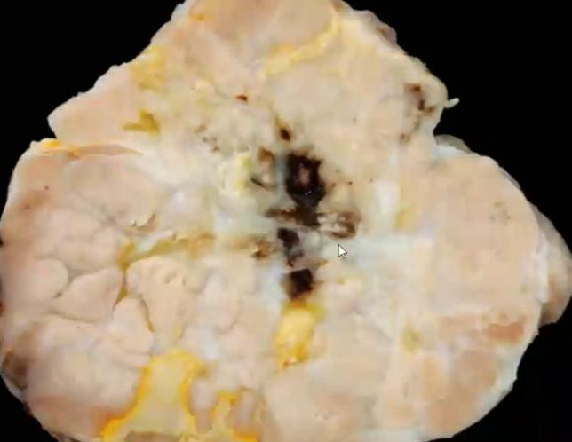

Slide 39
features of a malignant spindle cell tumor composed of tightly packed cells with variable amounts of eosinophilic cytoplasm. Nuclei are elongated but in contrast to "benign" nerve sheath tumors, the nuclei are enlarged, hyperchromatic, and crowded
MPNSTS exhibit a high mitotic index.

Slide 40
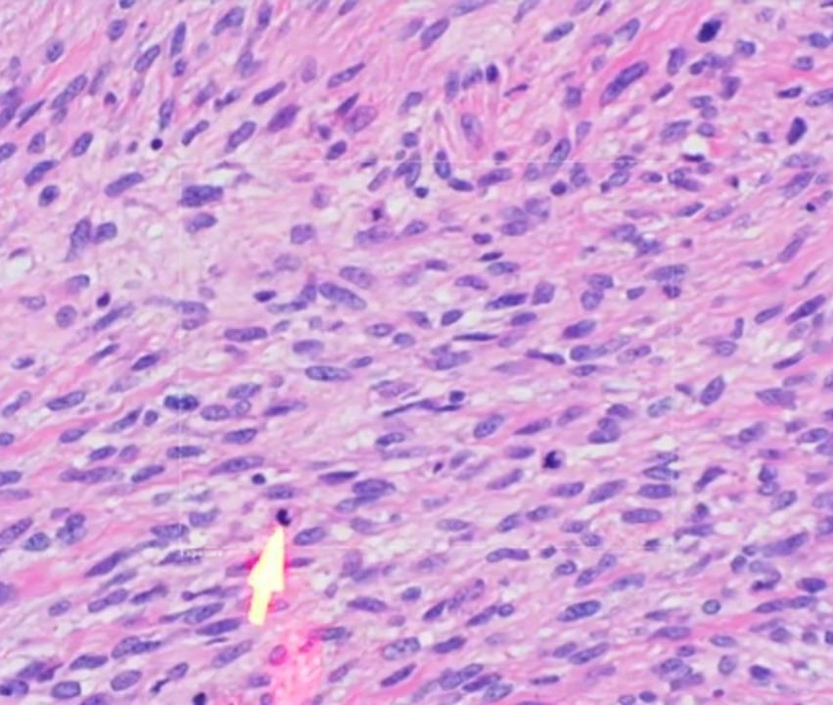

Slide 41
Wide resection is the treatment of choice with postoperative radiation therapy.
Recurrence depends upon the extent of surgical resection.

Slide 42
Thank you

