Slide 1

Prepared By :
Dr.Aya M.F. Almzayyen
MD, T.A

Slide 2
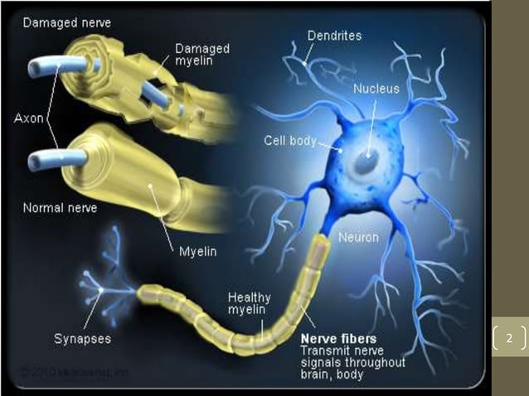

Slide 3
General Considerations in Multiple Sclerosis
1- Myelin:
Myelin consists of multiple layers of the specialized plasma membrane of oligodendrocytes (in the CNS) around the axon, with most of the cytoplasm excluded.
Although myelinated axons are present in all areas of the brain, they are the dominant component in the white matter; therefore, most diseases of myelin are primarily white matter disorders.

Slide 4
The myelin in peripheral nerves is similar to the myelin in the CNS but:
-Peripheral myelin is made by Schwann cells, not oligodendrocytes.
- Each cell in the peripheral nerve contributes to only one internode, while in the CNS, many internodes comes from a single oligodendrocyte.
- The specialized proteins and lipids are also different. Because of these differences, most diseases of CNS myelin do not significantly involve the peripheral nerves, and vice versa

Slide 5
REMEMBER:
Oligodendrocyte: gives myelin in CNS to many axon.
Schwann cell: gives myelin in PNS to one axons (because of its small size it won't be able to give myelin sheath to the axon which is much bigger).
Function of Myelin is: Insulation & speeds up the transmission of impulses along axons.”

Slide 6
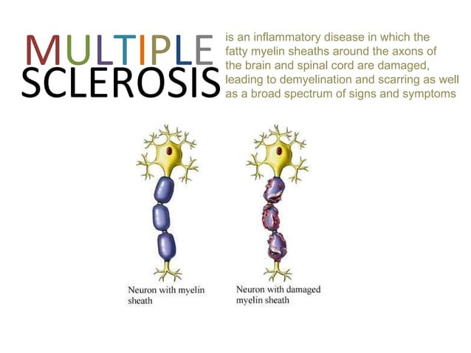

Slide 7
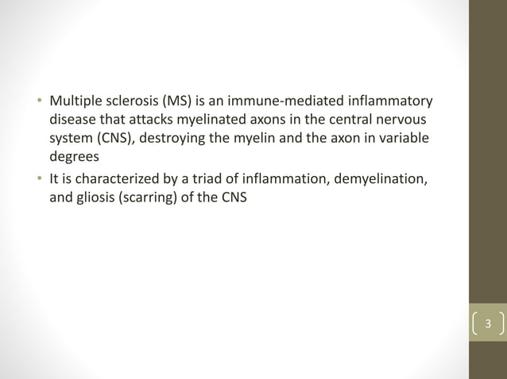

Slide 8
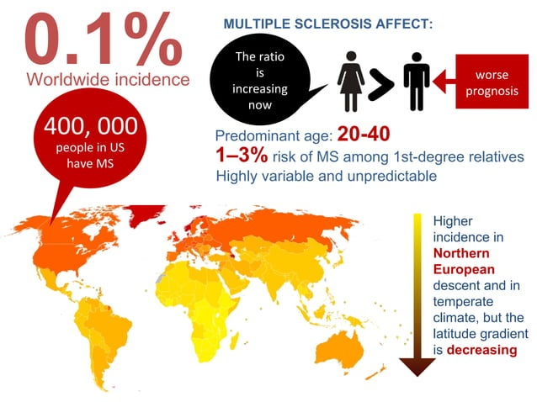

Slide 9
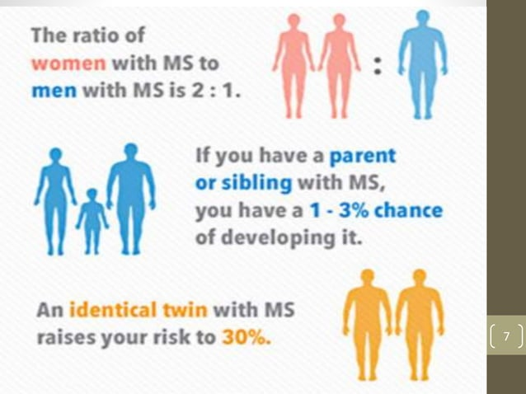

Slide 10
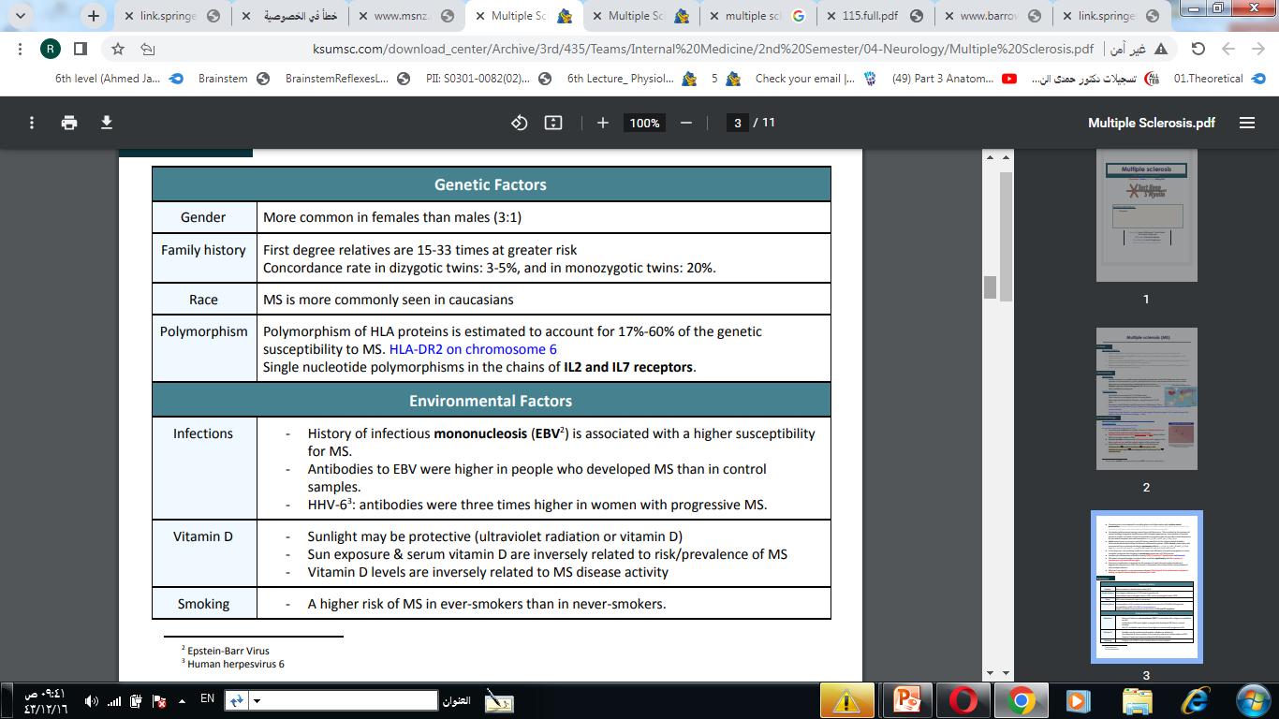

Slide 11
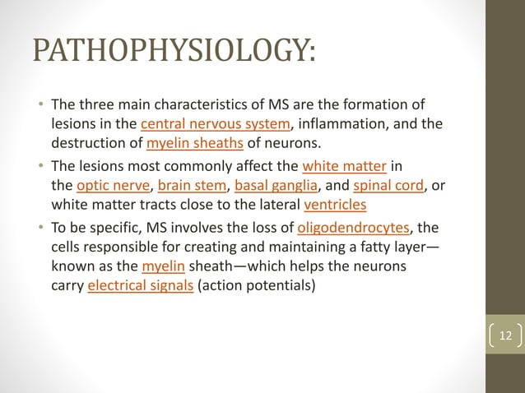

Slide 12
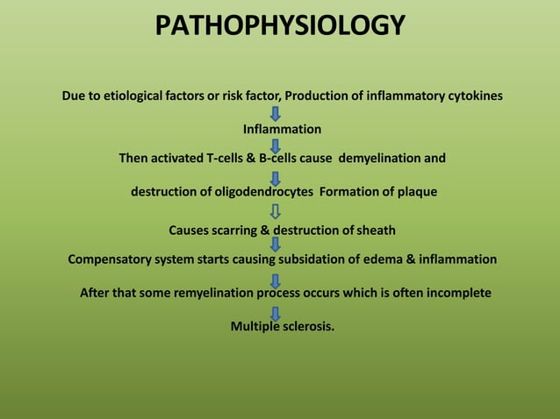

Slide 13
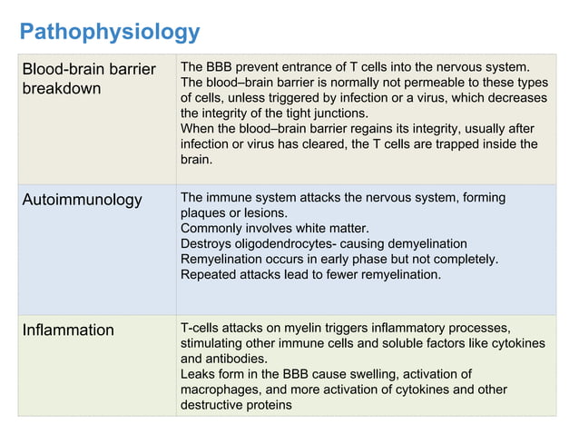

Slide 14
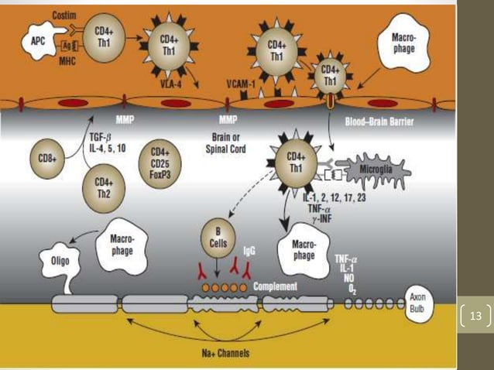

Slide 15
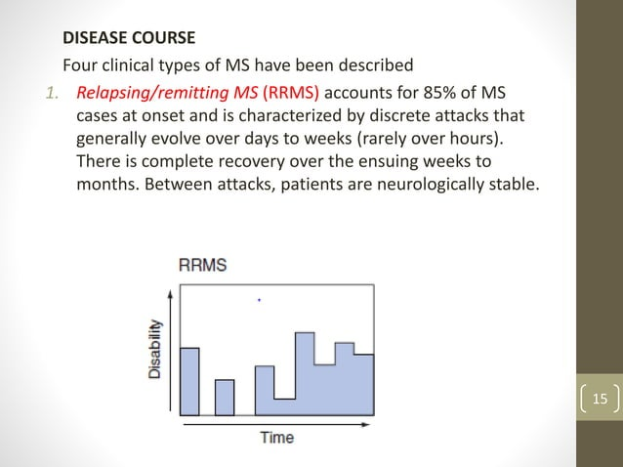

Slide 16
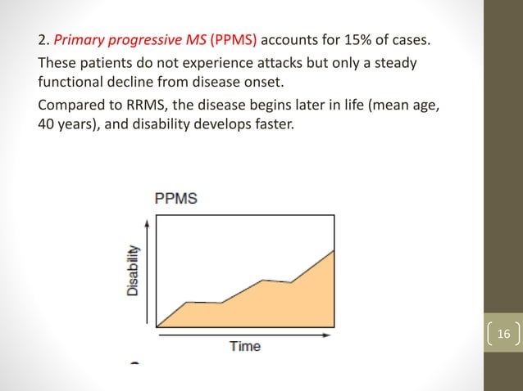

Slide 17
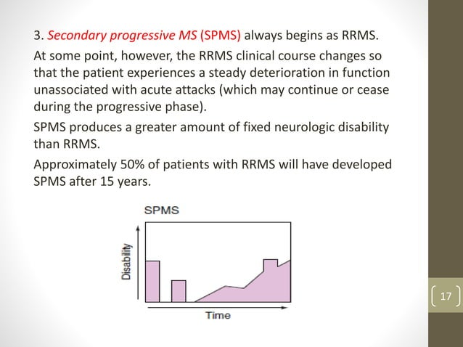

Slide 18
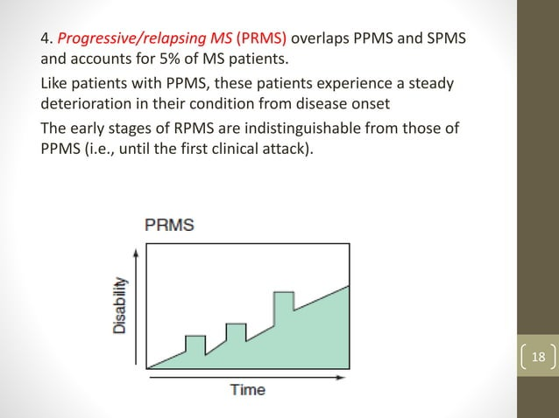

Slide 19
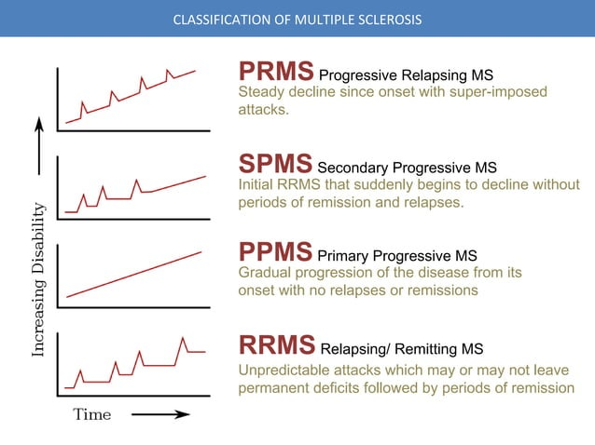

Slide 20
Clinically Isolated Syndrome
اللفظ الطبي اللي نقوله ّ لما یجي شخص لأول مرة مع أعراض تتناسب مع التصلب اللویحي لكن لسا ما
تأكدنا
A monophasic clinical episode with patient-reported symptoms and objective findings developing acutely or subacutely, with a duration of at least 24 h, with or without recovery, and in the absence of fever or infection; similar to a typical multiple sclerosis relapse (attack and exacerbation) but in a patient not known to have multiple sclerosis.
● can be monofocal (reflecting pathology in a single location) or multifocal; the specific manifestations of a clinically isolated syndrome depend on the anatomical location (or locations) of the pathology.

Slide 21
Clinical attack (relapse or exacerbation):
A clinical attack is considered if the symptoms are present for at least 24 hours and is preceded by more than 30 days of clinical stability.
There has to be no better explanation (other than MS) for the attack and we must rule out psuedorelapse.
Examples of psuedorelapse: metabolic stress, infections that worsens the symptoms. or if the symptoms last for LESS than 24 hours. (in a relapse the symptoms have to occur for MORE than 24 hours.)
-Patient-reported symptoms or objectively observed signs.
-Typical of CNS acute inflammatory demyelinating lesion.
- No fever or infection

Slide 22
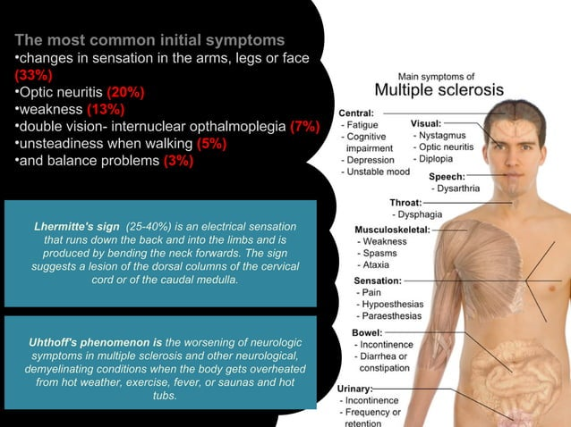

Slide 23
Optic neuritis:
Pain. Most people who develop optic neuritis have eye pain that's worsened by eye movement
Vision loss in one eye. Most people have at least some temporary reduction in vision, but the extent of loss varies. Noticeable vision loss usually develops over hours or days and improves over several weeks to months.
Loss of color vision. Optic neuritis often affects color perception. You might notice that colors appear less vivid than normal.

Slide 24
Diagnosis:
History & Exam MS is mainly a clinical diagnosis.
Suspect MS if the patient is for example a young adult with relapsing and remitting neurologic signs and symptoms that are difficult to explain.

Slide 25
MRI
The most sensitive test and is considered diagnostic in the majority of the cases.
However, the number of lesions on the MRI is not necessarily proportional to disease severity or speed of the progression.
MRI is abnormal in 90% of MS patients.

Slide 26
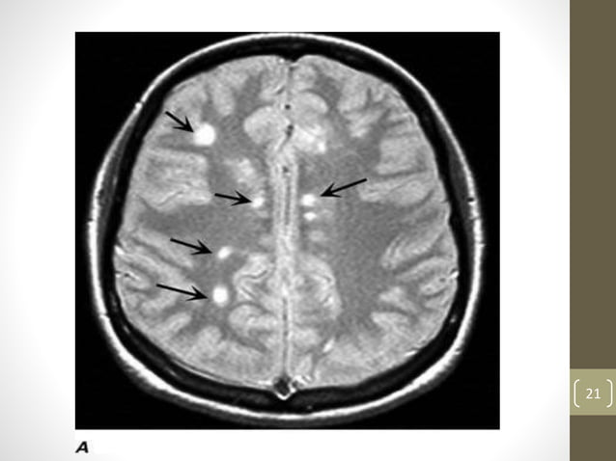

Slide 27
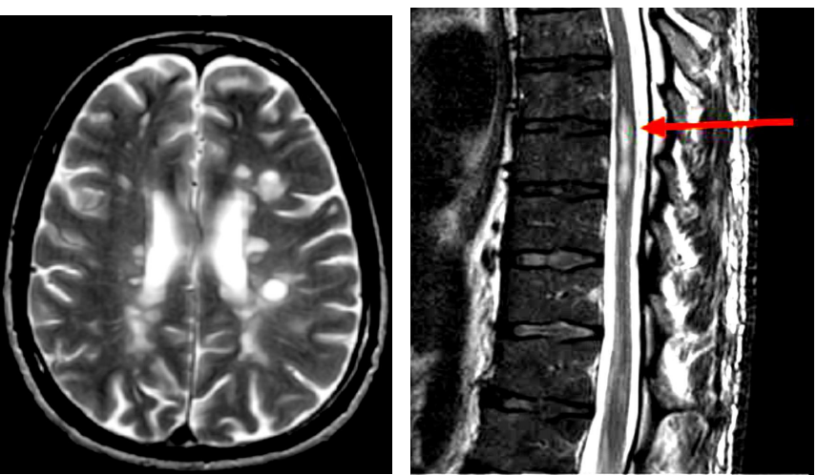

Slide 28
CSF findings
-It shows mildly elevated protein level with an increased proportion of γ-globulin
- In one-third of cases there is moderate pleocytosis (different cell in CSF)
-When the immunoglobulin is examined further, most MS patients show oligoclonal bands, representing antibodies directed against a variety of antigenic targets
- These antibodies constitute a marker for disease activity

Slide 29
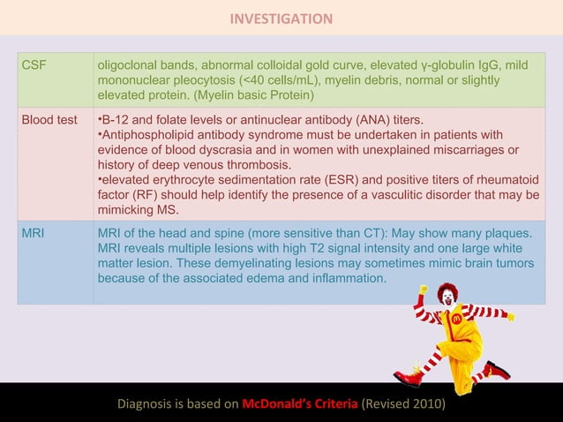

Slide 30
Prognosis:
Fifty percent of patients will require a cane 28 years after disease onset.
● Twenty five percent will require a wheelchair 44 years after disease onset.
Features of a better prognosis in MS include:
1-Onset below 25 years of age
2. Optic neuritis or sensory before cerebellar symptoms on first presentation
3. A long interval (over 1 year) between relapses
4. Fewer lesions on MRI
5. Full recovery from relapses
6. Being a female (MS is more severe in males) Progressive MS carries a worse prognosis than RR-MS.

Slide 31
. A woman with MS who wants to have children should be aware that her disease may affect her pregnancy in what way?
A. A miscarriage is more likely
B. Labor and delivery may be more risky
C. Her baby may develop birth defects
D. MS symptoms may ease or fade away late in pregnancy but may get worse after childbirth

Slide 32
CASE
A 25-year-old woman presents to the emergency department for poor vision on the left eye. She reports that her symptoms began approximately 1 week ago and it has progressively worsened. Her visual deficit is associated with eye pain with movement. She denies having these symptoms in the past but recalls having urinary incontinence that self-resolved. Physical examination is only remarkable for a significant visual deficit affecting the left eye. The rest of the neurological examination is normal. An MRI of the brain and spinal cord enhanced with gadolinium demonstrate a hyperintense lesion affecting her left optic nerve. There is also enhancing and nonenhancing hyperintense lesions in the spinal cord, suggestive of demyelinating lesions of different ages.

Slide 33


