Slide 1
CNS II PATHOLOGY
Dr : Khalil Mazen Abu Nada

Slide 2
Guillain-Barré syndrome (GBS)
Guillain-Barré syndrome (GBS) is an acute postinfectious polyneuropathy characterized by symmetric and ascending flaccid paralysis.
Etiology
_ About ⅔ of GBS patients experience symptoms of an upper respiratory or gastrointestinal tract infection 1–4 weeks prior to onset of GBS.
_ Campylobacter jejuni: campylobacter enteritis is the most common disease associated with GBS.
_ Cytomegalovirus: most common virus associated with GBS
_ HIV

Slide 3
Pathophysiology
_ Infection triggers humoral response → formation of autoantibodies against gangliosides (e.g., GM1, GD1a) or other unknown antigens of peripheral Schwann cells → immune-mediated segmental demyelination → axonal degeneration of motor and sensory fibers in peripheral and cranial nerves (CN III–XII)

Slide 4
Clinical features
_ Initial symptoms
_ Back and limb pain
_ Paresthesias affecting distal extremities
_ Advanced symptoms
_ Ascending paralysis
_ Bilateral flaccid paralysis
_ Spreads from the lower to the upper limbs in a “stocking‑glove” distribution
_ Landry paralysis: involvement of the respiratory muscles → respiratory failure
_ Muscle reflexes
_ Reduced or absent
_ Paresthesias
_ Peripheral, symmetric
_ Usually affecting hands and feet
_ Neuropathic pain: develops in about ⅔ of affected individuals

Slide 5
_ Autonomic dysfunction
_ Cardiovascular
_ Arrhythmia
_ Blood pressure dysregulation: ↑ or ↓
_ Voiding dysfunction
_ Intestinal dysfunction
_ Cranial nerve involvement
_ Facial diplegia due to frequent bilateral facial nerve involvement

Slide 6
Overview of subtypes and variants of Guillain-Barré syndrome
 | Description | Etiology | Clinical features | Treatment
Acute inflammatory demyelinating polyneuropathy (AIDP) | Acute variant of Guillain‑Barré syndrome Predominant sub-type affecting 60–80% of GBS patients in North America and Europe | Associated with Campylobacter and CMV Autoantibodies against various antigens | Ascending paralysis Autonomic neuropathy CN defects and pain Peak at ∼ 4 weeks | Intravenous immunoglobulin Plasmapheresis
Chronic inflammatory demyelinating polyneuropathy (CIDP) | A chronic autoimmune polyneuropathy | CIDP has not been linked to any pathogen in particular. Macrophage-induced demyelination Autoantibodies (e.g., anti‑GM1 ganglioside autoantibodies) | Symmetric distal and/or proximal weakness Sensory involvement Autonomic dysfunction and cranial nerve involvement is rare Developing symptoms for > 8 weeks | Intravenous immunoglobulin or corticosteroids Plasmapheresis Immunomodulatory drugs (e.g., azathioprine, cyclophospha

Slide 7
Miller-Fisher syndrome | A limited variant of GBS characterized by cranial nerve involvement | Autoantibodies directed against ganglioside GQ1b, GT1a | Ophthalmoplegia Ataxia Areflexia | Intravenous immunoglobulin
Multifocal motor neuropathy (MMN) | A variant of GBS solely affecting the motor neurons. Differential diagnosis for amyotrophic lateral sclerosis | Multifocal motor conduction block Anti‑GM1 ganglioside autoantibodies Usually normal protein levels in CSF ^{[10]} | Asymmetric paralysis and areflexia Initially involves the distal upper limbs | Immunes

Slide 8
Diagnostics
_Cerebrospinal fluid: albuminocytologic dissociation
_ ↑ Protein levels and normal white blood cell count in cerebrospinal fluid
_ Electroneurography
_ ↓ Nerve conduction velocity (NCV) due to demyelination
_ Respiratory function
_ Assess for respiratory muscle exhaustion.
_ Regularly monitor vital capacity, maximal inspiratory pressure, and maximal expiratory pressure.

Slide 9
Treatment
_ Supportive management
_ Monitor cardiac and respiratory function: in some cases, intensive care unit (ICU) treatment and intubation may be indicated
_ Intravenous immunoglobulins
_ Plasmapheresis

Slide 10
Myasthenia gravis (MG)
_ Myasthenia gravis (MG) is an autoimmune disease of the neuromuscular junction (NMJ) characterized by muscle weakness that worsens with activity and improves with rest.
_ Most common neuromuscular junction disorder.
_ Etiology
_ Autoimmune
_ Autoantibodies directed against postsynaptic acetylcholine receptors or receptor-associated proteins
_ Association with other autoimmune diseases
_ Associated conditions
_ Thymoma
_ Thymic hyperplasia

Slide 11
Pathophysiology
_ Thymus involvement
Muscle-like (myoid) cells in the thymus express AChR → autoreactive targeting by T cells → production of acetylcholine receptor antibodies (AChR antibodies)
_ Acetylcholine receptor antibodies
_ Antibodies target postsynaptic AChRs of normal muscle cells → competitive inhibition of acetylcholine (ACh) → AChR decay through receptor internalization (↓ receptor density at the postsynaptic membrane) and activation of complement (→ muscle cell lysis) → impaired signal transduction at the NMJ → skeletal muscle weakness and fatigue
_ Seropositive MG (80–90% of cases): positive assays for antibodies (in blood) against the acetylcholine receptor (AChR-Ab)
_ Seronegative MG (10–20% of cases): negative for AChR antibodies, but may be positive for muscle-specific tyrosine kinase antibodies (MuSK antibodies)

Slide 12
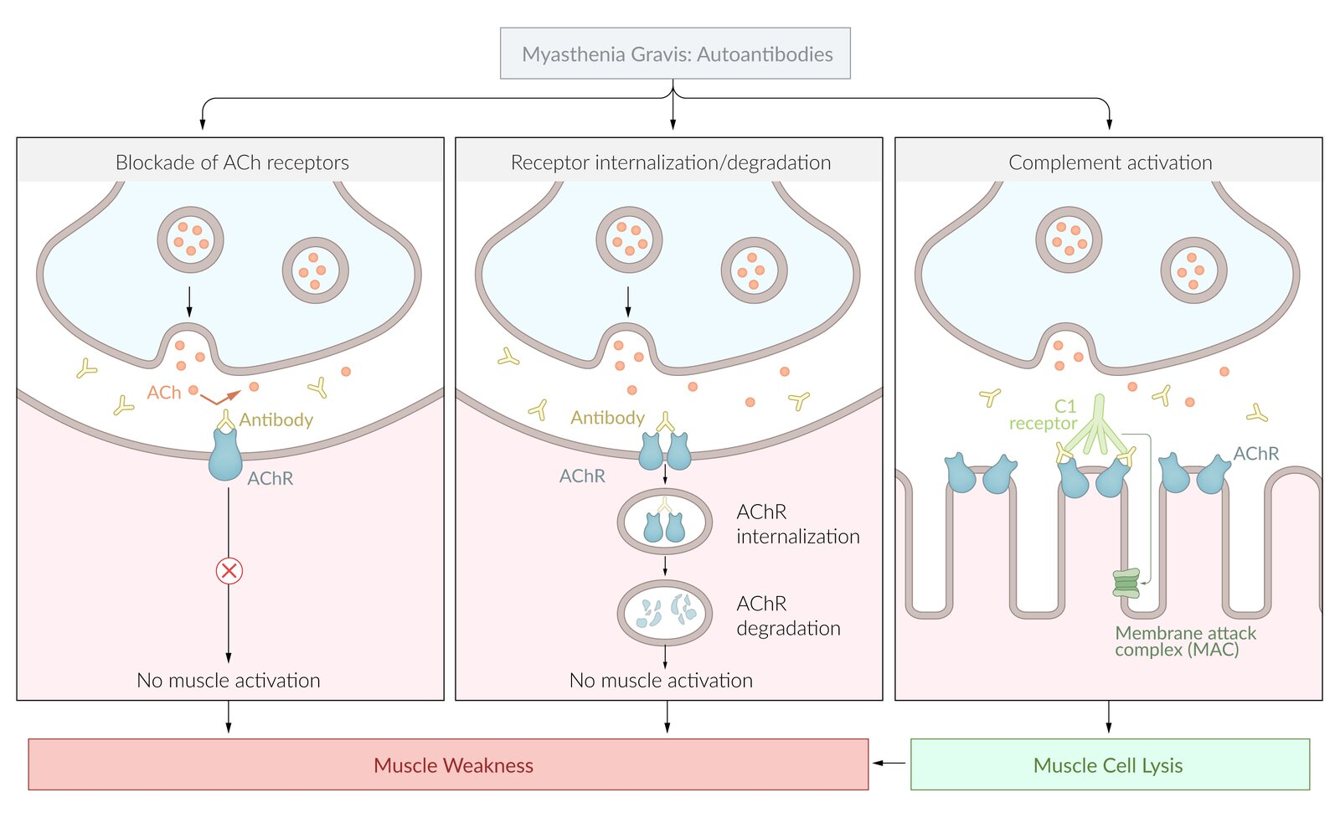
Receptor internalization/degradation (middle): Binding of ACh antibody results in accelerated receptor degradation. The receptor is internalized and degraded by the muscle cell.
Complement activation (right): Binding of ACh autoantibodies results in complement activation and membrane attack complex formation, leading to the destruction of the neuromuscular junction and muscle cell lysis.
Blockade of ACh receptors (Left): ACh antibodies bind to postsynaptic ACh receptors and inhibit muscle activation.

Slide 13
Clinical features
_ Symptoms
_ Fatigable weakness of skeletal muscles that worsens with increased muscle use and improves with rest.
_ Generalized disease can involve all skeletal muscles, especially:
_ Eye muscles: diplopia, blurred vision
_ Bulbar muscles: dysarthria, difficulty chewing and/or swallowing
_ Proximal muscles: difficulty standing from a chair , climbing stairs, brushing hair
_ Respiratory muscles: dyspnea
_ Localized disease most commonly affects the eye muscles
Eye muscle involvement is the most common initial symptom in generalized disease.

Slide 14
Physical examination findings
_ Normal deep tendon reflexes
_ ptosis
Exacerbating factors of myasthenia gravis
_ Infection
_ Surgery, anesthesia
_ Pregnancy
_ Medications
_ Antibiotics (e.g., fluoroquinolones, aminoglycosides, macrolides
_ Cardiovascular drugs (e.g., procainamide, quinidine, beta-blockers)
_ Psychiatric drugs (e.g., chlorpromazine, risperidone, lithium)

Slide 15
Diagnostics
confirm the diagnosis with serum auto-antibodies or; electromyography (EMG).
_ Laboratory studies
_ Initial test: anti-AChR antibodies (highly specific for MG)
_ Additional studies
_ EMG of affected muscles ;
_ Findings: decremental response to repetitive nerve stimulation
_ Chest CT: indicated in all patients with confirmed myasthenia gravis to assess for a thymoma

Slide 16
Treatment
_ Pharmacotherapy
_ Cholinesterase inhibitor: first-line agent is pyridostigmine
_ Immunosuppressants (off-label)
_ glucocorticoids
_ Thymectomy
_ Consider for:
_ Most patients with thymoma,
_ Select patients without thymoma

