Slide 1
Hydatid disease
Rabies
Dr. Essa allahham
MD

Slide 2
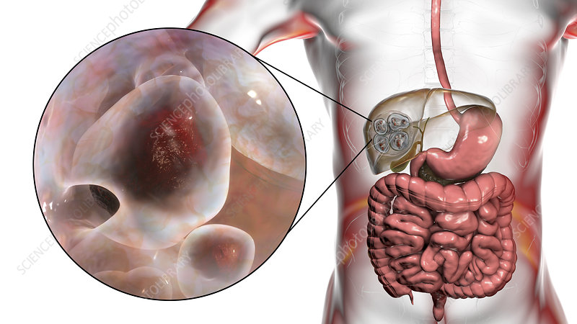
Hydatid disease

Slide 3
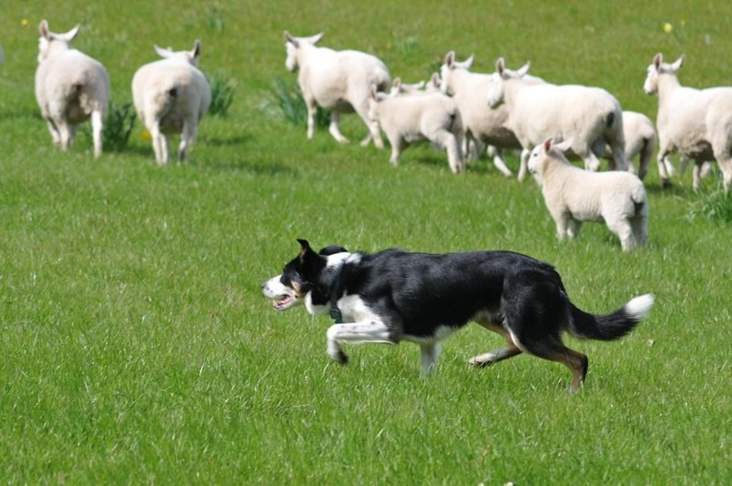
Hydatid disease, also known as echinococcosis, is a potentially serious parasitic infection that affects both humans and various mammalian species.This disease is considered zoonotic, meaning it can be transmitted between animals and humans, posing a significant public health concern worldwide.

Slide 4
Etiology
Pathogens:
  Echinococcus granulosus
  causes Cystic Echinococcosis
  Echinococcus multilocularis
  causes Alveolar Echinococcosis

Slide 5
Pathophysiology
Hosts
  Definitive hosts: foxes, dogs, and cats
  Intermediate hosts: hoofed animals (e.g., sheep, goats, camels, horses, cattle, and pigs)
  Humans are accidental hosts (e.g., sheep farmers)

Slide 6
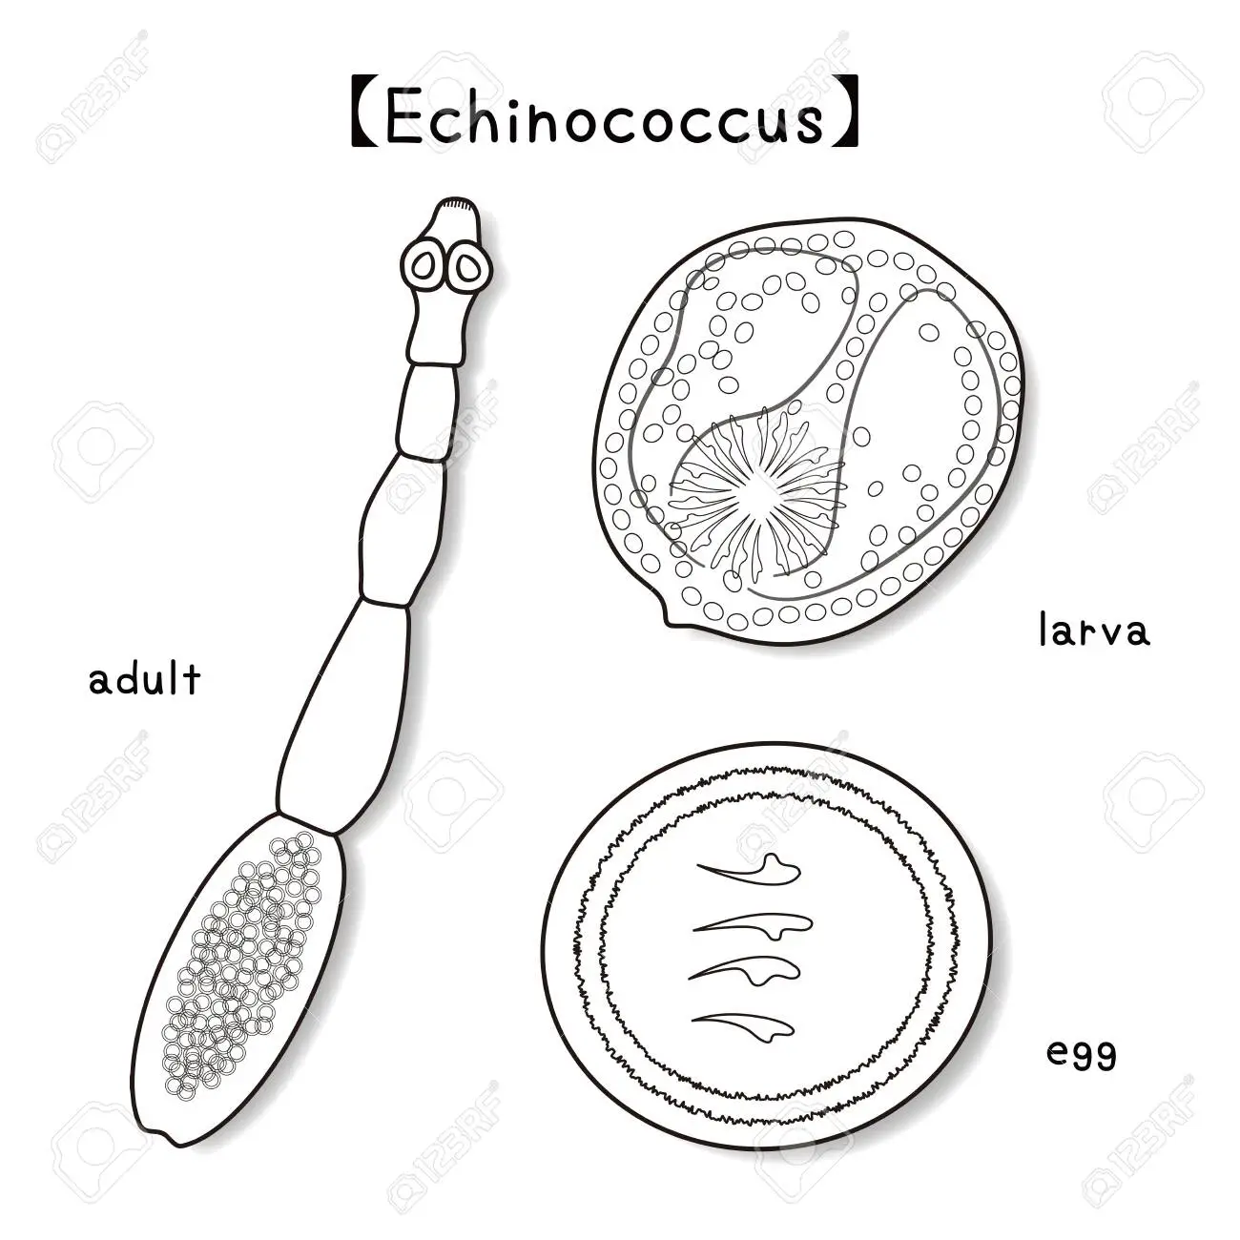
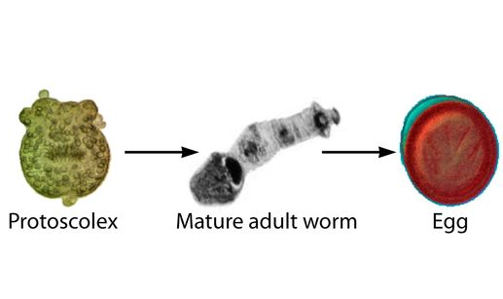

Slide 7
Life cycle
The definitive host consumes hydatid cysts from an intermediate host → adult tapeworms develop and inhabit the small intestine →tapeworms produce eggs that are shed through stool, contaminating the ground → eggs are ingested by intermediate hosts → eggs hatch within the intestine and penetrate the intestinal wall → travel through the bloodstream and lymphatic system →liver or other organs → hydatid cysts

Slide 8
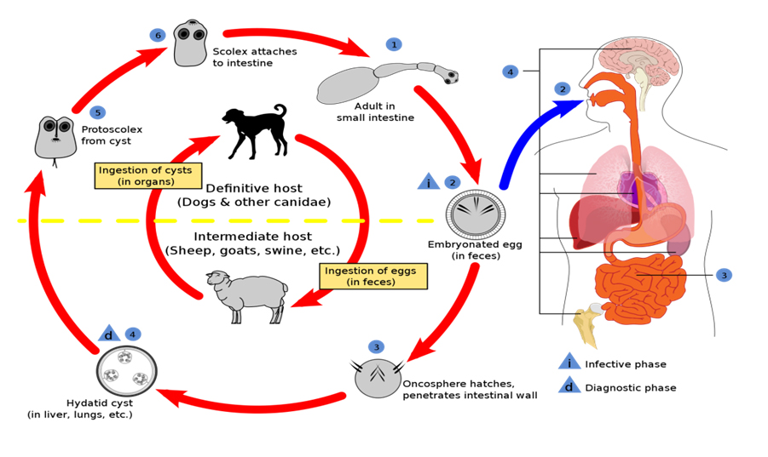

Slide 9
Transmission
  Hand-to-mouth
    From the fur of definitive hosts (e.g., petting a dog or cat)
    Contaminated dirt (e.g., dog feces)
  Fecal-contaminated food or water (e.g., wild berries, mushrooms)

Slide 10
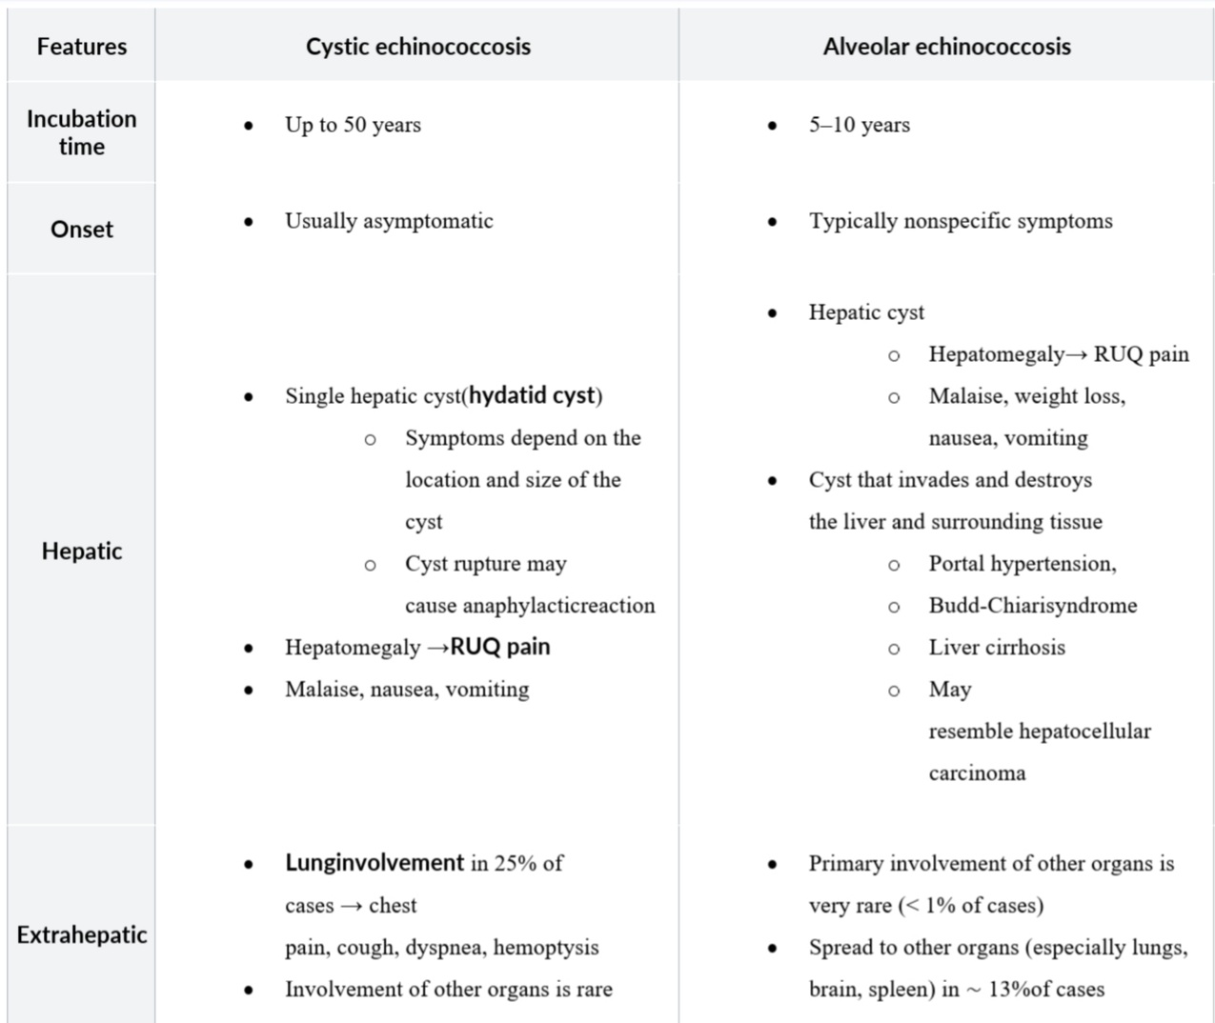
Clinical features
Features | Cystic echinococcosis | Alveolar echinococcosis
Incubation time | Up to 50 years | 5–10 years
Onset | Usually asymptomatic | Typically nonspecific symptoms
Hepatic | Single hepatic cyst(hydatid cyst) Symptoms depend on the location and size of the cyst Cyst rupture may cause anaphylacticreaction Hepatomegaly →RUQ pain Malaise, nausea, vomiting | Hepatic cyst Hepatomegaly→ RUQ pain Malaise, weight loss, nausea, vomiting Cyst that invades and destroys the liver and surrounding tissue Portal hypertension, Budd-Chiarisyndrome Liver cirrhosis May resemble hepatocellular carcinoma
Extrahepatic | Lunginvolvement in 25% of cases → chest pain, cough, dyspnea, hemoptysis Involvement of other organs is rare | Primary involvement of other organs is very rare (< 1% of cases) Spread to other organs (especially lungs, brain, spleen) in ∼ 13%of cases

Slide 11
Cyst rupture may lead to a severe allergic reaction ( anaphylactic shock ) and even death.
Echinococcus granulosus (cystic echinococcus):
singular hydatid cyst
Echinococcus multilocularis (alveolar echinococcosis): infiltrative growth.

Slide 12
Diagnosis
Suspected echinococcosis is generally confirmed via ELISA and ultrasonography.
Laboratory tests
(nonspecific; low diagnostic value) : mild eosinophilia, leukopenia or thrombocytopenia, liver function abnormalities
Serology: positive ELISA (false negatives are common)

Slide 13
Imaging
  Ultrasonography
    Cystic echinococcosis: unilocular, smooth, well-defined hepatic cyst with or without daughter cysts
      Possibly daughter cysts and hyperdense internal septa
      Eggshell calcifications within the wall of a hydatid cyst may be visible
    Alveolar echinococcosis: lesions with irregular, poorly defined margins, central necrosis, and irregular calcifications within the cyst and cyst wall
  CT scan: indicated for further evaluation of cysts
    Best test for evaluating extrahepatic cysts

Slide 14
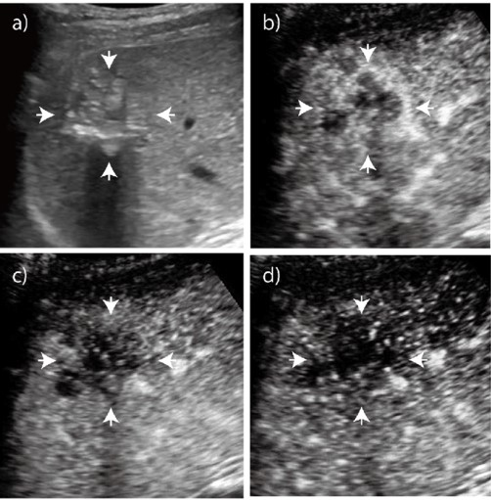
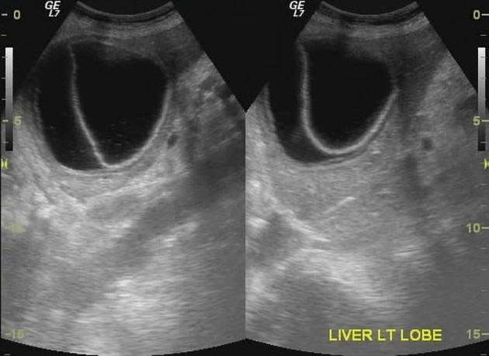

Slide 15
Treatment
Cystic echinococcosis
Medical therapy: may be considered as the sole treatment for cysts < 5 cm
  Drug of choice: albendazole
  Alternative drugs: mebendazole, praziquantel
Ultrasonography/CT-guided percutaneous drainage
  Commonly conducted using the PAIR (puncture, aspiration, injection , reaspiration) procedure
  Should only be done in combination with medical therapy (albendazole)
  Indications: > 5 cm and/or septations
Surgery
  Goal: resect the whole cyst to prevent spillage of its content
  Indications: > 10 cm, complicated cysts
Follow-up: Because relapse is common, patients should be closely monitored via imaging for up to five years.

Slide 16
Alveolar echinococcosis
Curative resection followed by at least 2 years of treatment with albendazole to prevent a potential relapse
Follow-up for at least 10 years

Slide 17
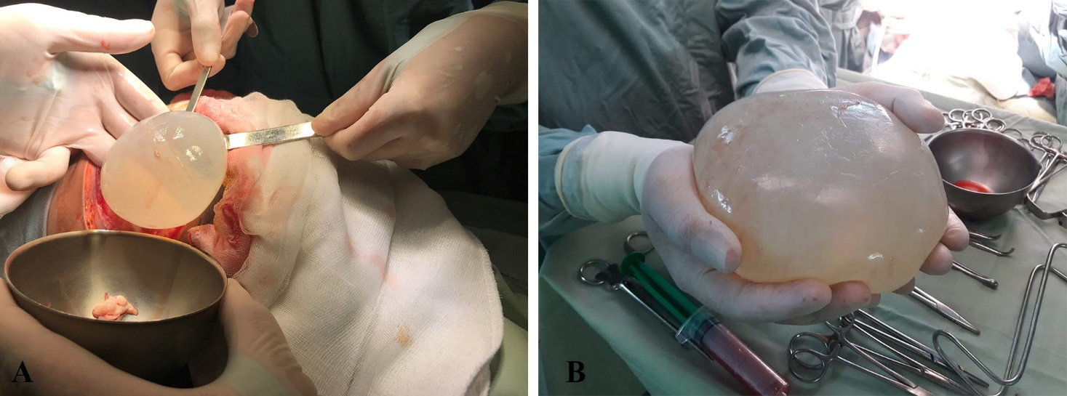

Slide 18
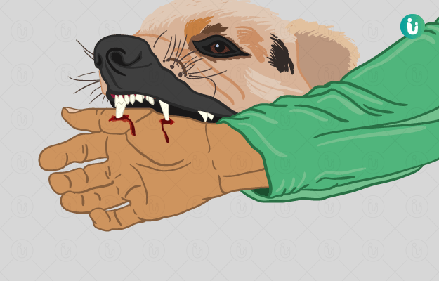
Rabies

Slide 19
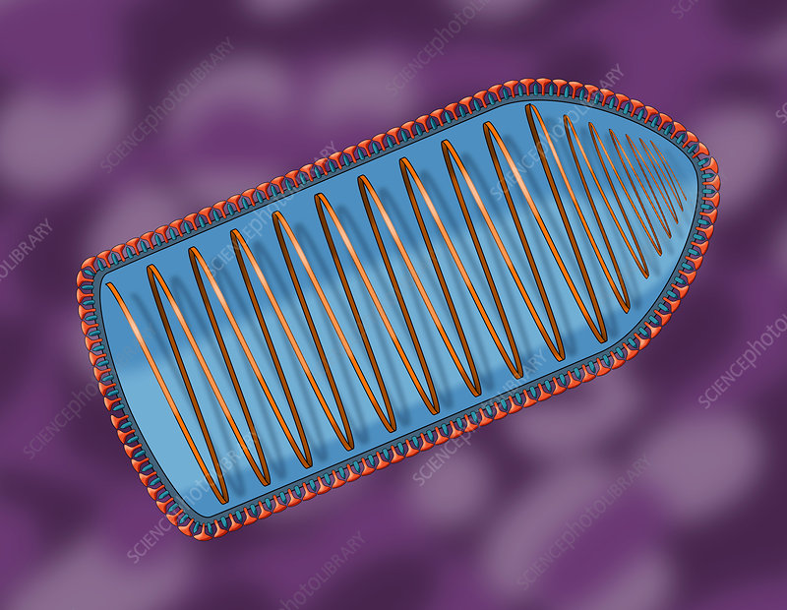
Etiology
Pathogen
  Rabies is caused by several different members of the Rhabdoviridae family.
  Rhabdoviruses are bullet shaped
  Genus: Lyssavirus
  ssRNA

Slide 20
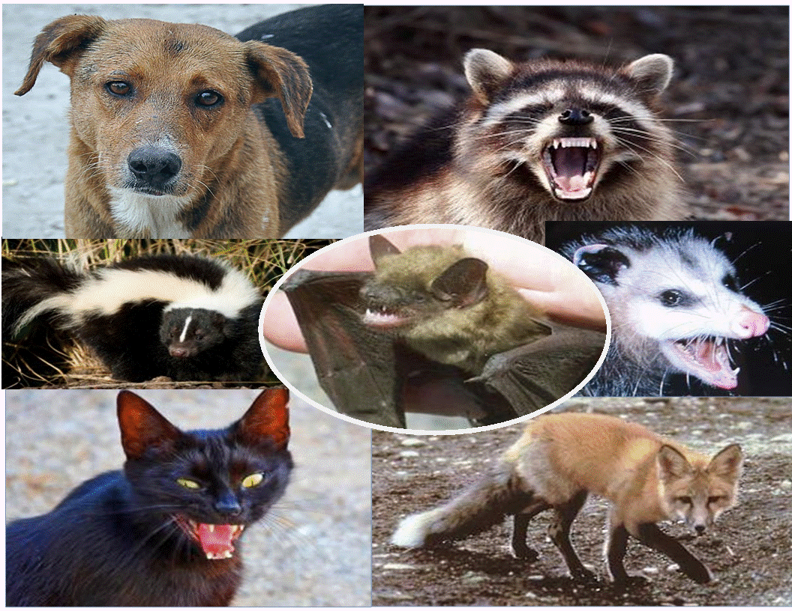
Transmission
  Most common animal reservoir worldwide: dogs
  Most common animal reservoirs in the US: bats, raccoons and foxes
  Spread through saliva of rabid animal after bite injury

Slide 21
Pathophysiology
Rabies virus binds the ACh receptor of peripheral nerves in the bite wound → migrates retrogradely along the axonal microtubules → enters the CNS → infects the brain
  Diencephalon, hippocampus, and brainstem are involved first
  Causes acute, progressive, and fatal encephalitis→ encephalitic rabies
  In < 20% of cases, causes ascending flaccid paralysis → paralytic rabies

Slide 22
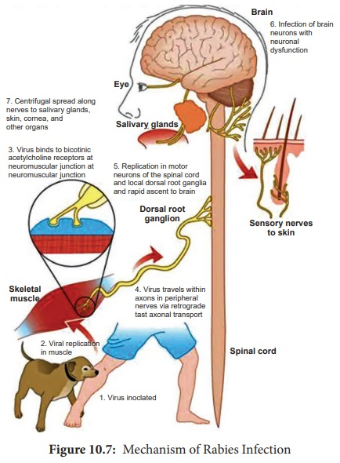

Slide 23
Clinical features
General
Incubation period: 4–12 weeks average
Prodromal symptoms
  Flu-like symptoms (e.g., fever, malaise)
  Locally: pain, paresthesia, and pruritus near the bite site

Slide 24
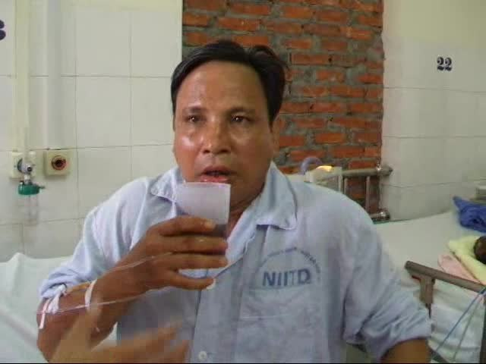
Hydrophobia:
Rabies patients experience involuntary, painful pharyngeal muscle spasms when trying to drink; later on in the disease, the sight of water alone may provoke nausea or vomiting.

Slide 25
Encephalitic rabies
CNS symptoms
  Anxiety, agitation, and combativeness alternating with calm periods
  Confusion and hallucinations
  Photophobia
  Fasciculations
  Seizures
  ↑ Muscle tone and reflexes with nuchal rigidity
Autonomic symptoms (e.g., hypersalivation, hyperhidrosis)
Coma and death within days to weeks of the development of neurological symptoms

Slide 26
Paralytic rabies (< 20% of cases)
Flaccid paralysis, gradually ascending and spreading from bite wound
Paraplegia and loss of sphincter tone
Respiratory failure and death
The pathognomonic feature of rabies is hydrophobia due to pharyngeal muscle spasm. This may present along with agitation, strange behaviour, mental status changes, and possibly foaming at the mouth.

Slide 27
Diagnostics
Antemortem diagnosis
Several tests using multiple specimens must be performed to diagnose rabies
because individual tests have limited sensitivity.
Evidence of the virus can only be obtained after disease onset.
Four specimens are required for testing:
serum
saliva
CSF
skin

Slide 28
Laboratory tests
  PCR to detect rabies RNA
  Cell culture to isolate the virus
  Fluorescent antibody testing (FAT) to detect viral antigen in a smear or frozen section of a biopsy
  Antibody testing (indirect fluorescent antibody test)
    Serum antibodies detected in individuals who are not immunized and did not receive postexposure prophylactic immunoglobulins indicate the diagnosis
    Rising serum antibody levels over several days in immunized patients are suggestive of rabies infection
    Antibodies in the CSF regardless of the immunization history are indicative of rabies infection

Slide 29
Postmortem diagnosis
Postmortem brain tissue autopsy
  Immunofluorescent staining of viral antigen in infected CNS tissue
  Histopathological findings: Negri bodies (eosinophilic cytoplasmic inclusion bodies typically found in the cerebellum and hippocampus)

Slide 30
Treatment
Rabies risk assessment
Administer PEP
  Bite by a known wild reservoir for rabies (e.g., bats, raccoons, foxes), if the animal is not available for testing or if the test comes back positive
Observe/test animal and possibly administer PEP
  Attack by an unvaccinated domestic carnivore without symptoms of rabies (e.g., dog) → observe animal for a 10-day period
    Animal remains normal: PEP is not necessary
    Animal starts to display symptoms of rabies
      Administer PEP to patient
      study brain samples of the animal
      PEP is stopped if test results of the animal are negative

Slide 31
PEP is not required
  Bite by a vaccinated domestic carnivore
  Bite by an indoor domestic herbivore

Slide 32
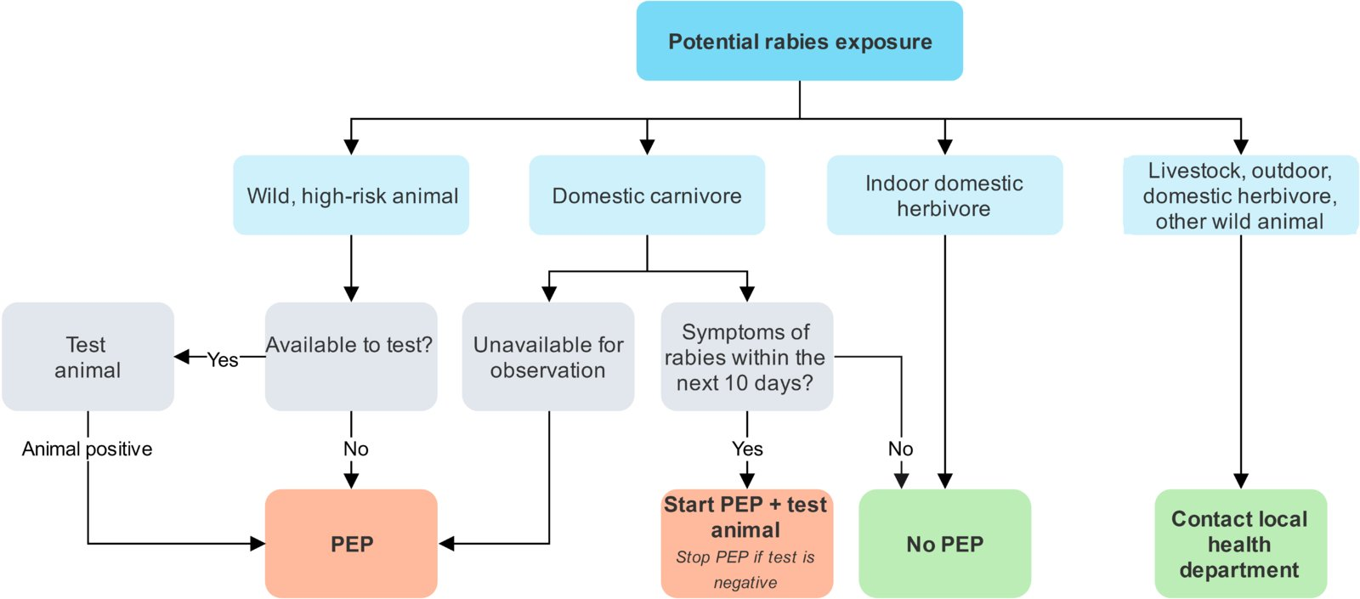

Slide 33
Rabies post-exposure prophylaxis
Cleaning and debridement, as with all bite wounds
Tetanus shot and antibiotic prophylaxis may be indicated
Non-immunized patient: postexposure prophylaxis (passive-active immunization)
  Rabies immunoglobulin is given into the site of the wound by injection (passive immunization)
  PLUS inactivated rabies vaccine is given IM on days 0, 3, 7, and 14 (active immunization)
Prior immunization
Even patients who have been vaccinated against rabies should be treated after exposure!
  Rabies vaccine IM on days 0 and 3.
  No immunoglobulin
  Check antibody titers on day 14.
  Treatment with PEP in suspected cases of a bite by a rabid animal should take place urgently, as the disease is fatal once it becomes symptomatic. Suspicion of rabies is sufficient indication for PEP!

Slide 34
Prognosis
Mortality: Symptomatic rabies is almost always fatal.
Rabies is preventable following exposure to a rabid animal with adequate PEP

Slide 35
Prevention
Vaccination (pre-exposure prophylaxis)
Rabies vaccine: inactivated (killed) vaccine
Indications
  People with frequent occupational contact with potentially rabid animals
  Travelers to regions in which rabies is widespread (especially if PEP may not be readily available).

Slide 36
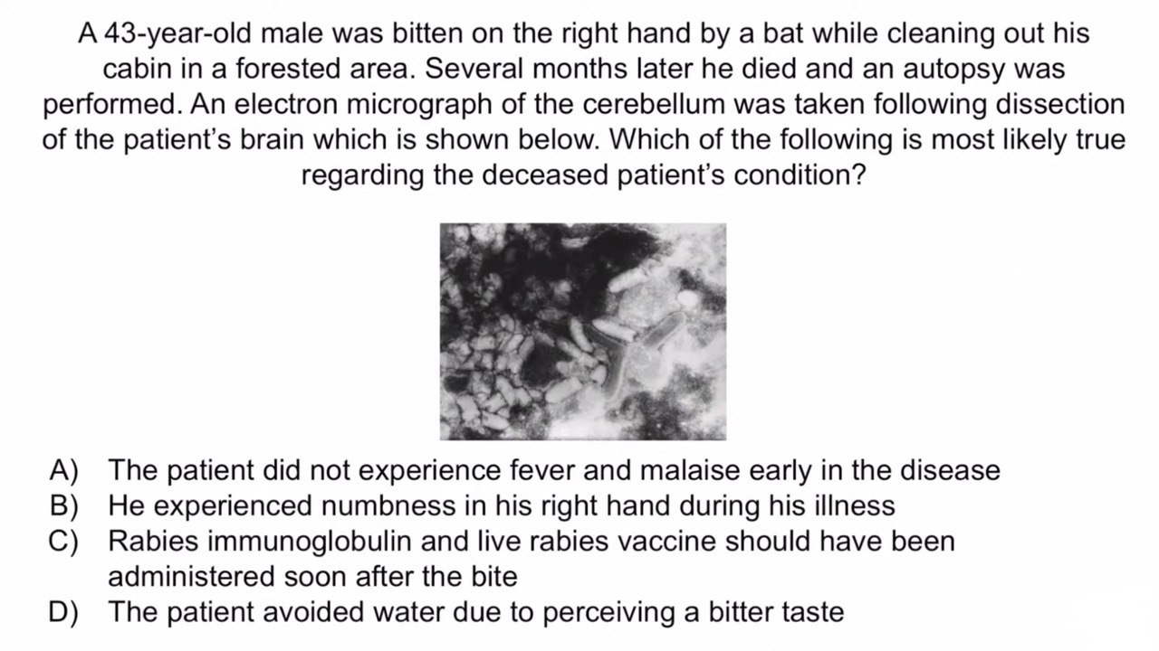

Slide 37
Thank you

