Slide 1
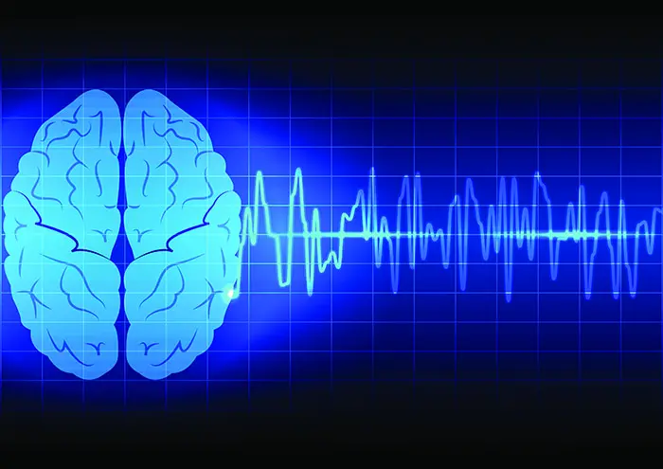
Seizures and Epilepsy
Prepared by :
Dr. Asmaa Alaa Abed

Slide 2
Seizures , convulsions and epilepsy
Seizures transient occurrence of signs or symptoms due to abnormal excessive electrical neuronal activity in the brain. Depending on the distribution of discharges, this abnormal brain activity can have various manifestations (3-10%of population)
Convulsions - motor seizures ( it doesn't always have to be during seizures )
Epilepsy - is a history of recurrent >=2 unprovoked seizures occurring at least 24 hrs apart (0.3-0.5%)
Epilepsy refers to a clinical phenomenon rather than a single disease entity, because there are many forms and causes of epilepsy. However, among the many causes of epilepsy there are various epilepsy syndromes in which the clinical and pathologic characteristics are distinctive and suggest a specific underlying etiology.
Status epilepticus - condition of prolonged or repetitive convulsive seizures . it is a medical emergency and can be life threatening as it can lead to neuronal cell death and long-term consequences
** AGE

Slide 3
Provoked seizures : seizures with an acute process or curable avoidable process such as
  Infections - Meningitis encephalitis
  Poising toxins medications
  Electrolyte disturbances – hypo/hypernatremia hypocalcemia
  Metabolic – hypoglycemia uremia acidosis
  Fever –febrile convulsion
  Head trauma
Provoked seizures are not epileptic
Unprovoked seizures : seizures due to chronic non curable process, genetic or idiopathic cause
  Idiopathic
  Genetic (positive family history)
  Neurodegenerative disease( eg Alzheimer )
  Brain tumors
  Cerebral stroke
Provoked vs unprovoked seizures

Slide 4
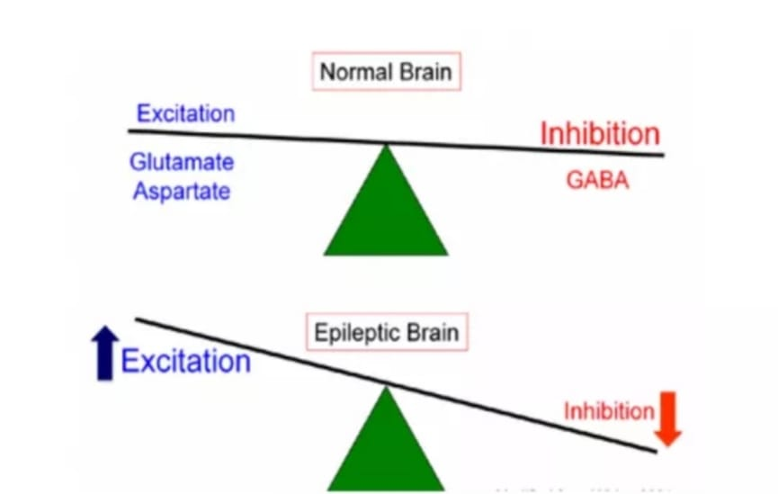
THE CAUSES OF SEIZURES AND EPILEPSY
Seizures are a result of a shift in the normal balance of excitation and inhibition within the CNS.

Slide 5
Classifications of seizures
Determining the type of seizure that has occurred is essential for focusing the diagnostic approach on particular etiologies, selecting the appropriate therapy, and providing potentially vital information regarding prognosis.
The International League Against Epilepsy (ILAE) provided an updated approach to classification of seizures in 2017 ,which is based on the clinical features of seizures and associated EEG - electroencephalographic findings.
Other potentially distinctive features such as etiology or cellular substrate are not considered in this classification system.
Focal seizures are usually associated with structural abnormalities of the brain. In contrast, generalized seizures may result from cellular, biochemical, or structural abnormalities that
have a more widespread distribution. There are clear exceptions in both cases, however.

Slide 6
Jerky contractions - very sudden , sharp, quick spasmodic movement
Clonic - periods of shaking or rhythmical regular jerky twitching of muscles
Myoclonic - nonrhythmic (i.e., jerks occur at different intervals) and irregular (i.e., jerks are
asymmetric and may change laterality)
Tonic - sustained muscles tension or stiffness
Atonic - loss of muscle tone

Slide 7
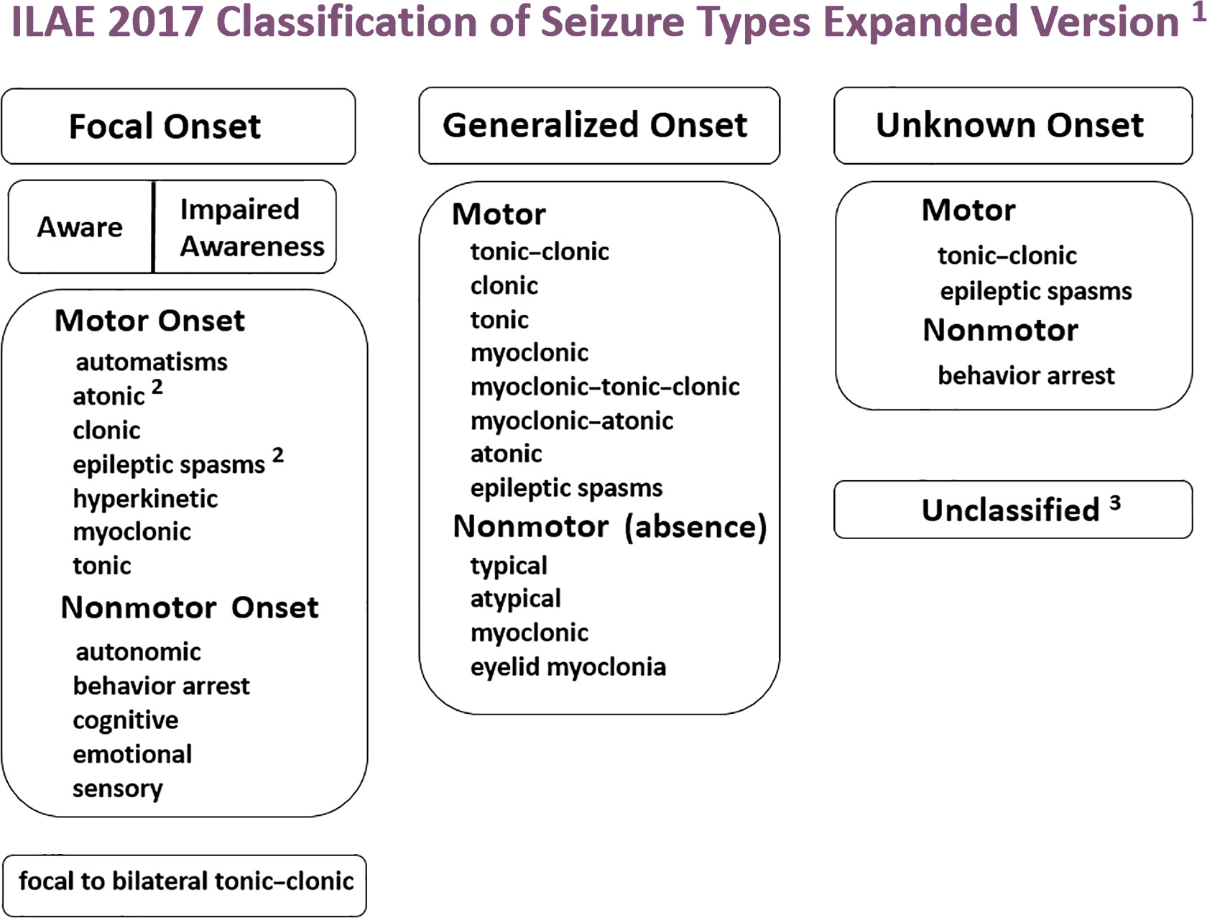
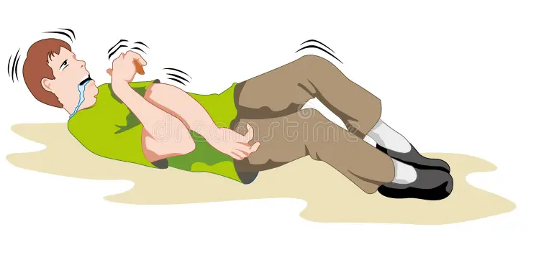

Slide 8
FOCAL ONSET SEIZURES
Focal seizures arise from a neuronal network either discretely localized within one brain region or more broadly distributed but still within a cerebral hemisphere.
With the new classification system, the subcategories of “simple focal seizures” and “complex focal seizures” have been eliminated. Instead, the classification emphasizes the effect on awareness (intact or impaired) and nature of the onset (motor or nonmotor).
Focal seizures can also evolve into generalized seizures. In the past this was referred to as focal seizures with secondary generalization, but the new system relies on descriptions of the type of generalized seizures that
evolve from the focal seizure. ( Focal to bilateral tonic clonic seizure )
The routine interictal (i.e., between seizures) electroencephalogram (EEG) in patients with focal seizures is often normal or may show brief discharges termed epileptiform spikes, or sharp waves.
Because focal seizures can arise from the medial temporal lobe or inferior frontal lobe (i.e., regions distant from the scalp), the EEG recorded during the seizure may be nonlocalizing. However, the region of seizure onset may
be detected using surgically placed intracranial electrodes.

Slide 9
Focal Seizures with Intact Awareness
Focal seizures can have motor manifestations (such as tonic, clonic, or myoclonic movements) or nonmotor manifestations (such as sensory, autonomic, or emotional symptoms) without impairment of awareness. For example, a patient having a focal motor seizure arising from the right primary motor
cortex near the area controlling hand movement will note the onset of involuntary movements of the contralateral, left hand. Since the cortical region controlling hand movement is immediately adjacent to
the region for facial expression, the seizure may also cause abnormal movements of the face synchronous with the movements of the hand.
The EEG recorded with scalp electrodes during the seizure (i.e., an ictal EEG) may show abnormal discharges in a very limited region over the appropriate area of cerebral cortex if the seizure focus involves the cerebral convexity.

Slide 10
Focal Seizures with Intact Awareness
Focal seizureswithout impairment of awareness. can be
motor manifestations (such as tonic, clonic, or myoclonic movements)
nonmotor manifestations (such as sensory, autonomic, or emotional symptoms)
Focal seizures may also manifest as changes in somatic sensation (e.g., paresthesias), vision (flashing lights or formed hallucinations), equilibrium (sensation of falling or vertigo), or autonomic function(flushing, sweating, piloerection). Focal seizures arising from the temporal cortex may also cause alterations in hearing, olfaction, or emotional state. This includes the sensation of unusual, intense odors (e.g., burning rubber or kerosene) or sounds (crude or highly complex sounds), or an epigastric sensation that rises from the stomach or chest to the head (epigastric uprising sensation). Some patients describe odd, internal feelings such as fear, a sense of impending change, detachment, depersonalization or déjá vu.
These subjective, “internal” events that are not directly observable by someone else are referred to as auras

Slide 11
Focal Seizures with Intact Awareness
Simple Focal Seizures (Auras)Simple focal seizures, also known as auras, occur in one area on one side of the brain, but may spread from there. The person does not lose consciousness during a simple focal seizure. Physicians typically break simple focal seizures down into the following four areas, depending on the location in the brain and parts of the body affected:
Motor: A simple focal seizure with motor symptoms will affect muscle activity, causing jerking movements of a foot, the face, an arm or another part of the body. Physicians can diagnose which side of the brain is affected by observing which side of the body experiences symptoms, since the left brain controls the right side of the body and the right brain controls the left.
Sensory: A simple focal seizure may cause sensory symptoms affecting the senses, such as: hearing problems, hallucinations and olfactory or other distortions.
Autonomic: A simple focal seizure with autonomic symptoms affects the part of the brain responsible for involuntary functions. These seizures may cause changes in blood pressure, heart rhythm, or bowel or bladder function.
Psychic: Some simple focal seizures strike parts of the brain that trigger emotions or memories of previous experiences, causing feelings of fear, anxiety, or déjà vu (the illusory feeling that something has been experienced before).

Slide 12
Focal Seizures with Intact Awareness
Focal seizures are seizures arising from a focal area within one hemisphere of the brain🧠
Frontal lobe focal seizures may show signs including head or limb movement, abnormal posturing and Jacksonian march 🦵
Parietal lobe focal seizures often consist of sensory symptoms like tingling, pain and paresthesia🌡
Occipital lobe focal seizures involve visual phenomena such as colours, flashes of light and scotoma 👁🌈💥
Temporal lobe seizures are the most common of the focal seizures. Its signs can be remembered by “HEAD”’
- Hallucinations (which can be auditory, olfactory or gustatory)👂👅
- Emotions or an epigastric rising sensation ⬆
- Automatisms (non-purposeful repetitive behaviours e.g. lip smacking) 👄
- Déjà vu

Slide 13
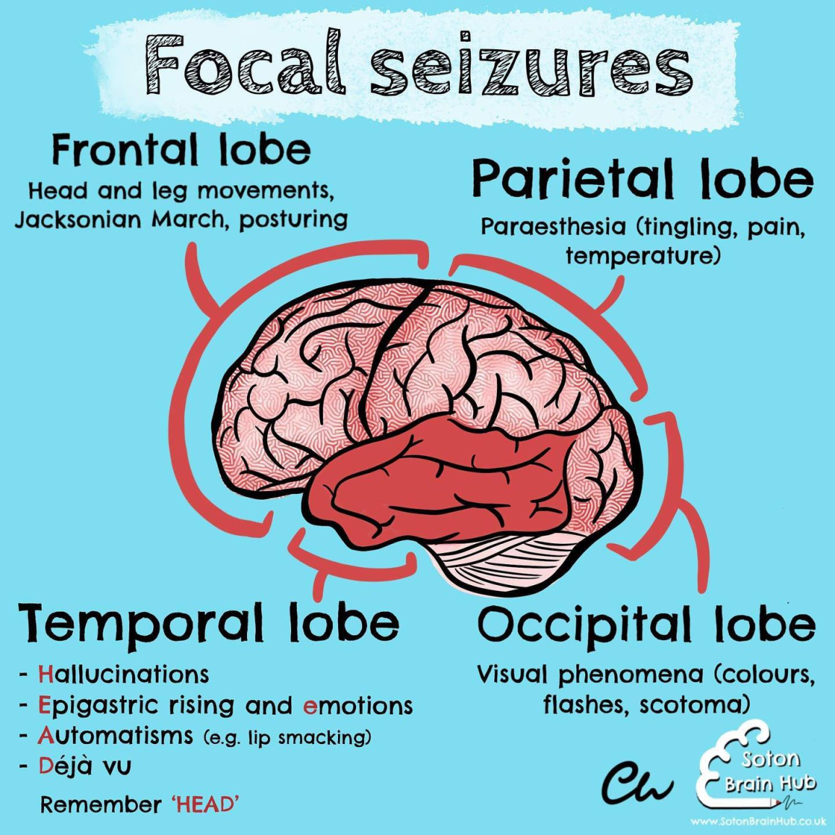
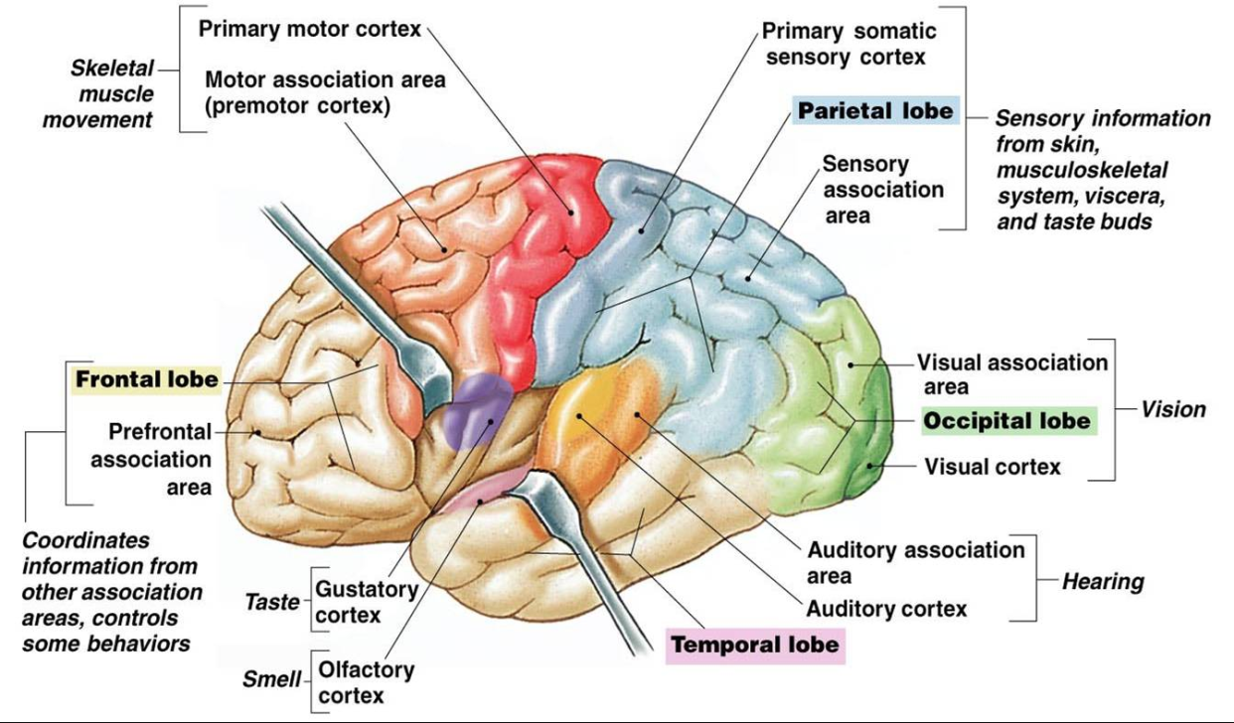

Slide 14
Focal Seizures with Intact Awareness
Three additional features of focal motor seizures are worth noting.
First, in some patients, the abnormal motor movements may begin in a very restricted region such as the fingers and gradually progress (over seconds to minutes) to include a larger portion of the extremity. This phenomenon, described by Hughlings Jackson and known as a “Jacksonian march,” represents the spread of seizure activity over a progressively larger region of motor cortex.
Second, patients may experience a localized paresis (Todd’s paralysis) for minutes to many hours
in the involved region following the seizure.
Third, in rare instances, the seizure may continue for hours or days. This condition, termed epilepsia partialis continua, is often refractory to medical therapy.

Slide 15
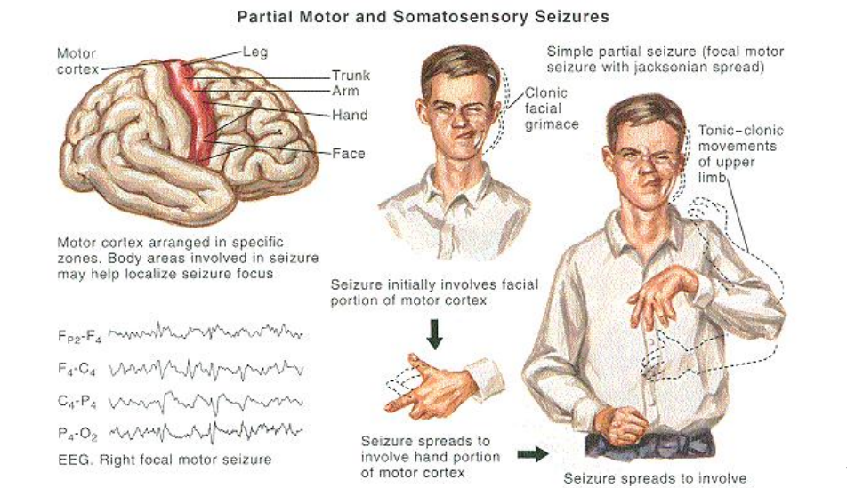
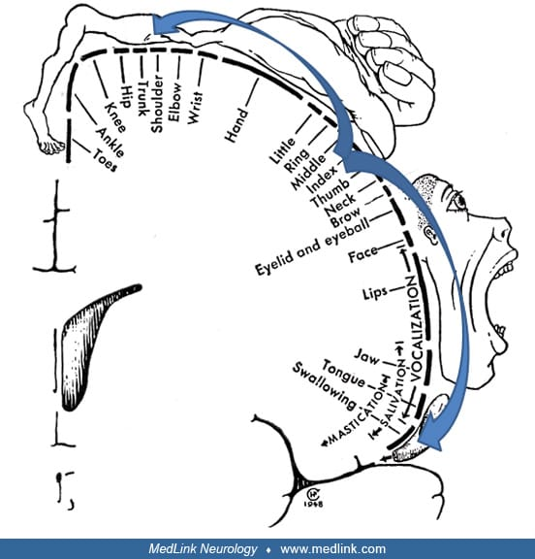

Slide 16
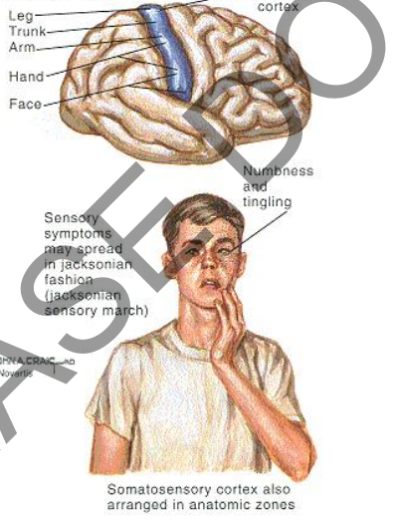

Slide 17
. Focal Seizures with Impaired Awareness Focal seizures
may also be accompanied by a transient impairment of the patient’s
ability to maintain normal contact with the environment. The patient
is unable to respond appropriately to visual or verbal commands
during the seizure and has impaired recollection or awareness of the
ictal phase. The seizures frequently begin with an aura (i.e., a focal seizure without cognitive disturbance) that is stereotypic for the patient.
The start of the ictal phase is often a motionless stare, which marks the
onset of the period of impaired awareness. The impaired awareness is
usually accompanied by automatisms, which are involuntary, automatic
behaviors that have a wide range of manifestations. Automatisms
may consist of very basic behaviors such as chewing, lip smacking,
swallowing, or “picking” movements of the hands, or more elaborate behaviors such as a display of emotion or running. The patient
is typically confused following the seizure, and the transition to full
recovery of consciousness may range from seconds up to an hour or
longer. Examination immediately following the seizure may show an
anterograde amnesia or transient neurological deficits (such as aphasia,
hemi-neglect, or visual loss) caused by postictal inhibition of the cortical regions most involved in the seizure itself.
The range of potential clinical behaviors linked to focal seizures is
so broad that extreme caution is advised before concluding that stereotypic episodes of bizarre or atypical behavior are not due to seizure
activity. In such cases additional, detailed EEG studies may be helpful
Symptoms and Signs ( Autonomic changes during epilepsy)
Cardiac/thoracic
Palpitations, chest pain, tachycardia, bradycardia, arrhythmia, hypotension, hypertension
More common in right temporal mesial foci; potential SUDEP with arrhythmia
Respiratory
Apnea, hyperventilation, hypoxia, cough
Particularly in temporal foci, hippocampal, and insular involvement; potential SUDEP with apnea
Gastrointestinal/abdominal
Ascending sensation (dyspepsia), pain, hunger, borborygmi, nausea, vomiting, belching, urge to defecate, fecal incontinence
Particularly in temporal mesial foci; vomiting in occipital and opercular foci; pain especially in children
Urinary
Incontinence, urgency
Detrusor muscle contraction in absence seizures and external sphincter relaxation in GTC
Genital
Genital sensations, erection, orgasm
Genital sensation in sensory cortex; sexual arousal in limbic and temporal cortex
Cutaneous
Flushing, erythema, cyanosis, blanching, pallor, piloerection
Pupillary
Mydriasis, miosis, hippus
Secretory
Perspiration, salivation, lacrimationFrequent in GTC

Slide 18
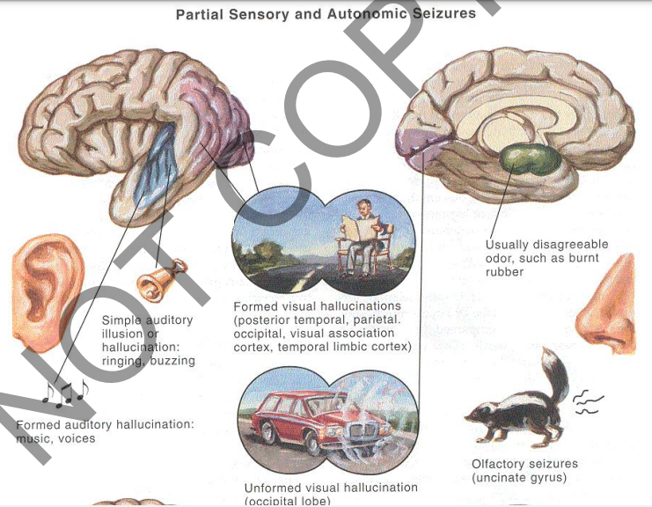

Slide 19
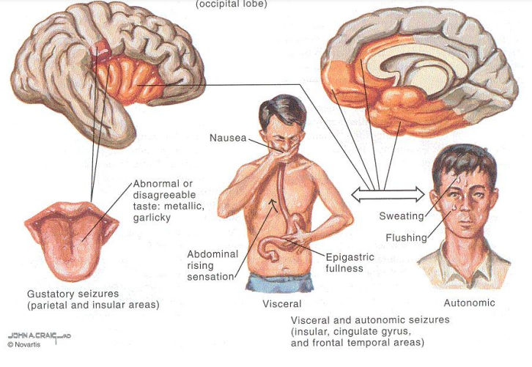

Slide 20
Todd’s paralysis-paresis
Todd's paralysis is a neurological condition experienced by individuals with epilepsy, in which a seizure is followed by a brief period of temporary paralysis.The paralysis may be partial or complete
It is commonly observed after partial seizures or generalized tonic-clonic seizures (GTCS)
Incidence :0.5-13% ( more in structural cause )
The paralysis may be confined to one hand, arm, or leg, but it can affect the whole body
Todd's paralysis can also affect sight and speech. A person experiencing Todd's paralysis may be unable to speak or have slurred speech.
It can last from 30 minutes to 36 hours, with an average of 15 hours, before it resolves completely.
The clinical manifestation occurring during the period following the seizure and lasting until the brain recovers all its functions is known as the postictal syndrome.
current and most accepted understanding eitology of the condition is theorized to be the exhaustion of the primary motor cortex (or any other area of the brain) after neuronal hyperexcitation in a seizure state, or due to hypoperfusion to the affected area of the brain through vasoconstriction mechanisms, thus limiting the function of that area through relative oxygen starvation.

Slide 21
Focal seizures with impaired awareness
Focal seizures may also be accompanied by a transient impairment of the patient’s ability to maintain normal contact with the environment. The patient is unable to respond appropriately to visual or verbal commands during the seizure and has impaired recollection or awareness of the ictal phase. The seizures frequently begin with an aura (i.e., a focal seizure without cognitive disturbance) that is stereotypic for the patient. The start of the ictal phase is often a motionless stare, which marks the onset of the period of impaired awareness. The impaired awareness is usually accompanied by automatisms, which are involuntary, repetitive, purposeless and automatic behaviors that have a wide range of manifestations. Automatisms may consist of very basic behaviors such as mouth (chewing, lip smacking, swallowing) or hands “picking, fiddling with cloths , pill rolling ” movements of the hands, or more elaborate behaviors such as a display of emotion or running. The patient is typically confused following the seizure, and the transition to full recovery of consciousness may range from seconds up to an hour or longer. Examination immediately following the seizure may show an anterograde amnesia or transient neurological deficits (such as aphasia, hemi-neglect, or visual loss) caused by postictal inhibition of the cortical regions most involved in the seizure itself.
Usually it lasts from 30 to 120 sec

Slide 22
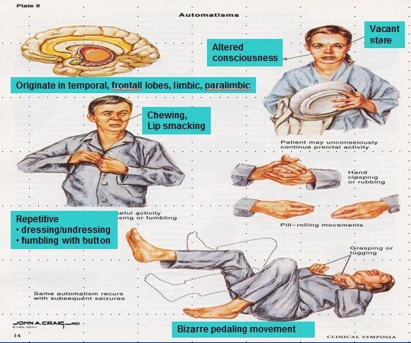

Slide 23
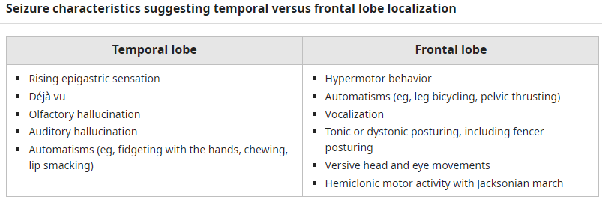

Slide 24
Temporal lobe epilepsy (TLE)
Temporal lobe epilepsy (TLE) is the most common of the focal epilepsies. Most cases of TLE can be further localized to the mesial temporal lobe (hippocampus, amygdala, and parahippocampal gyrus).
Hippocampal sclerosis (HS) is the most common underlying cause of TLE and the most common pathologic finding in patients undergoing surgery for temporal lobe epilepsy.
What Is Mesial Temporal Sclerosis (hippocampal sclerosis) ?
Pathologic examination reveals neuronal loss and gliosis in the hippocampus
The pathogenesis of HS is not completely understood. While birth and developmental histories are usually normal, a history of febrile seizures in early childhood is common. A long duration of febrile seizures, in particular, appears to be associated with the an increased risk of TLE. In some patients and families, genetic factors appear to influence both the development of febrile seizures and the later development of TLE.

Slide 25
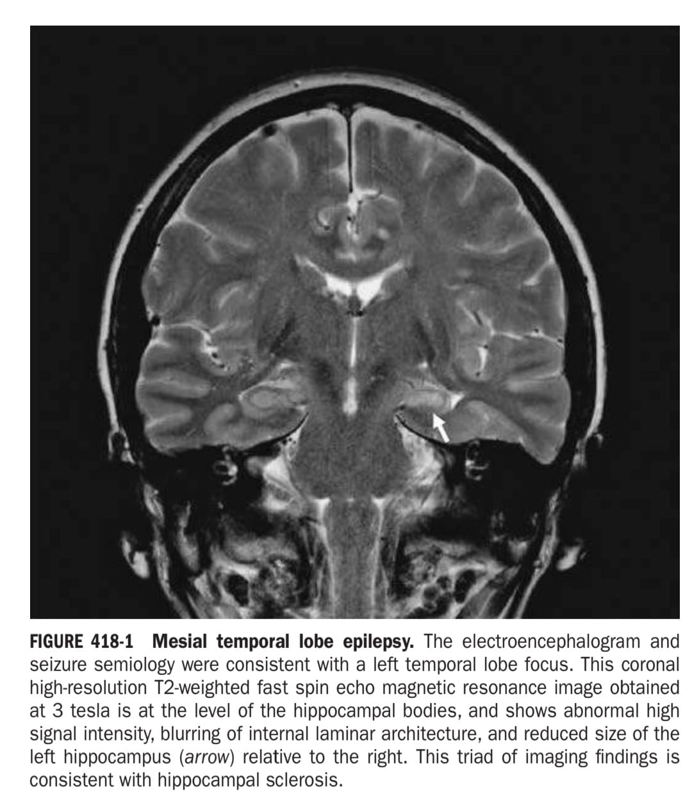

Slide 26
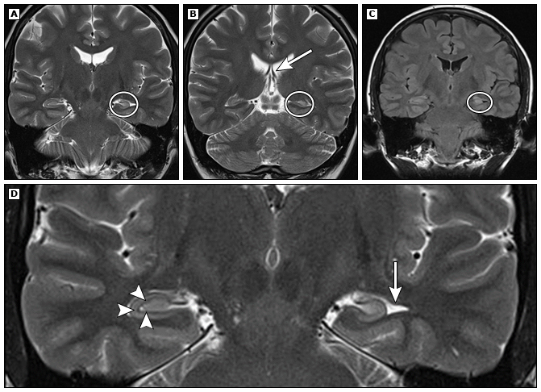

Slide 27
SEIZURE AURA
An aura is a perceptual disturbance that may precede a focal seizure. Auras do not occur with primary general- ized seizures. Note that auras do occur with migraine, but all discussion here is in reference only to seizures.
Auras have various manifestations affecting the senses. They can be somatosensory perceptions, such as pain, numbness or tingling, or related to other senses. They can be also motor, ranging from tremors or shaking to gross motor movement.
They can also be:
• Visual with lights, patterns, or seeing objects Auditory with voices, noises, tones, and other sounds
• Olfactory, typically with a burnt rubber smell
• Gustatory with the perception of strange tastes
Know: Auras are used as a warning manifestation of seizure and allow the patient to take precautions. These auras are thought to be produced by early seizure activity.
A focal seizure can evolve into a focal seizure with diminished consciousness, and either of these can evolve secondarily into a generalized seizure. In any of these situations, the preceding seizure is also called an aura by some.

Slide 28
EVOLUTION OF FOCAL SEIZURES TO GENERALIZED SEIZURES
Focal seizures can spread to involve both cerebral hemispheres and produce a generalized seizure, usually of the tonic-clonic variety (discussed below). This evolution is observed frequently following focal seizures arising from a region in the frontal lobe, but may also be associated with focal seizures occurring elsewhere in the brain. A focal seizure that evolves into a generalized seizure is often difficult to distinguish from a primary generalized onset tonic-clonic seizure, because bystanders tend to emphasize the more dramatic, generalized convulsive phase of the seizure and overlook the more subtle, focal symptoms present at onset. In some cases, the focal onset of the seizure becomes apparent only when a careful history identifies a preceding aura. Often, however, the focal onset is not clinically evident and may be established only through careful EEG analysis. Nonetheless, distinguishing between these two entities is extremely important, because there may be substantial differences in the evaluation and treatment of epilepsies characterized by focal versus generalized onset seizures

Slide 29
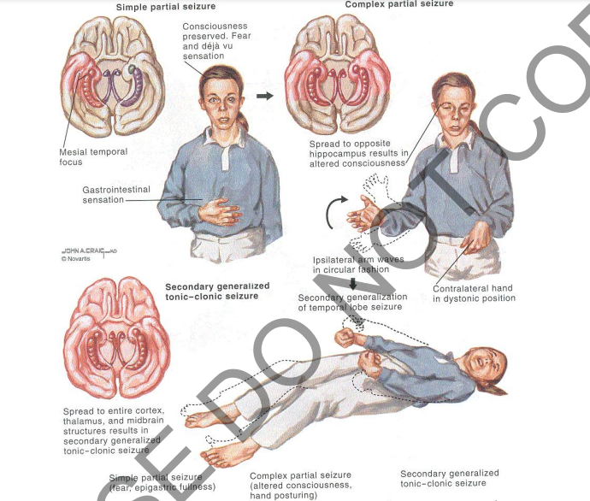

Slide 30
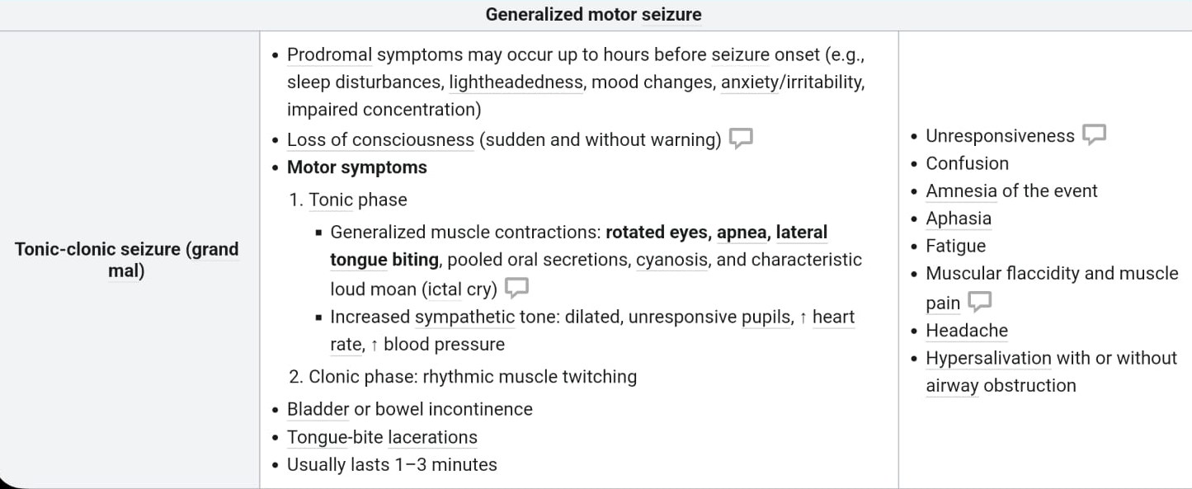
GENERALIZED SEIZURES

Slide 31
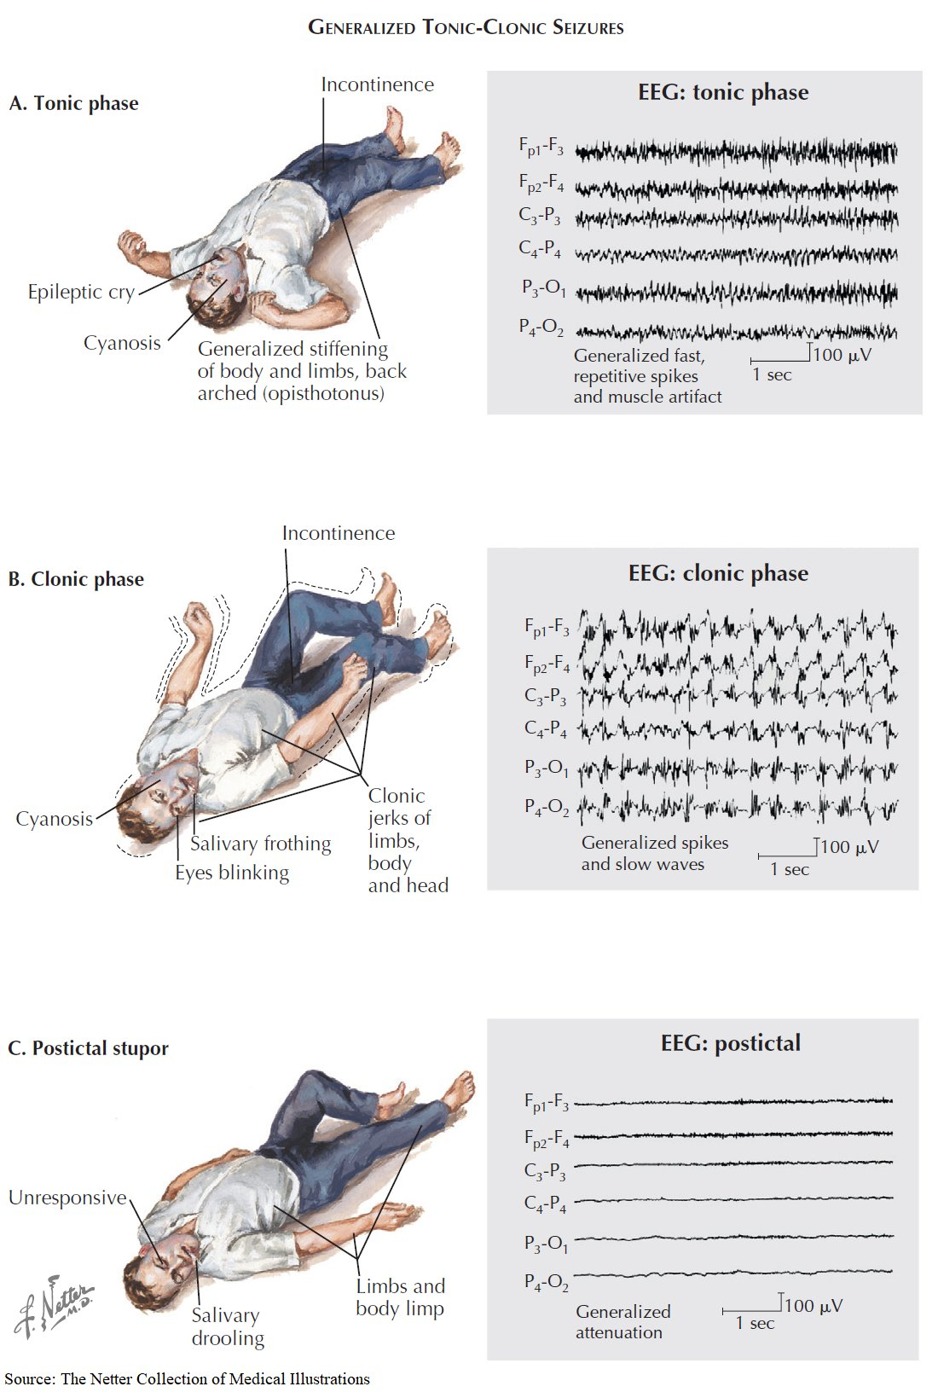

Slide 34
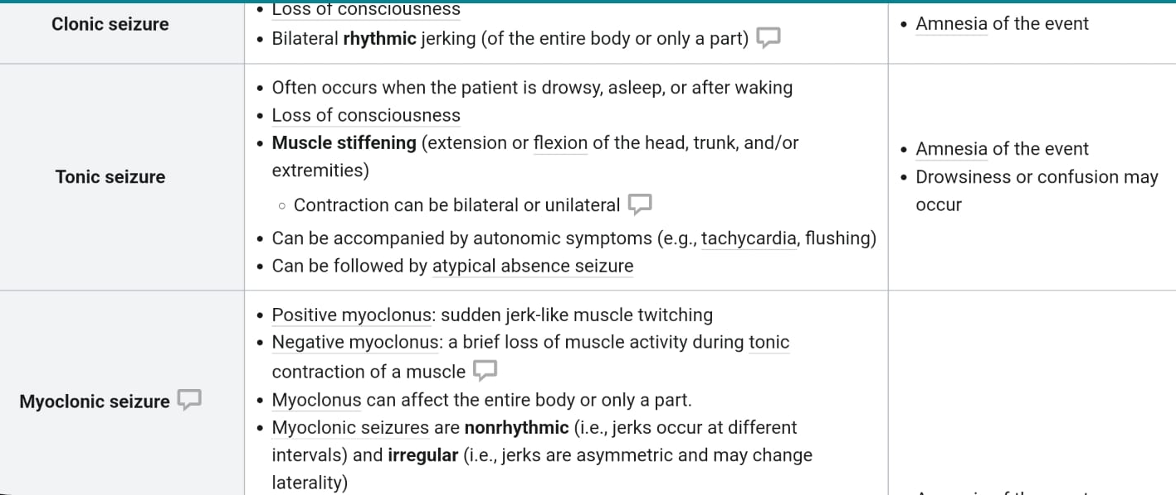
GENERALIZED SEIZURES

Slide 35
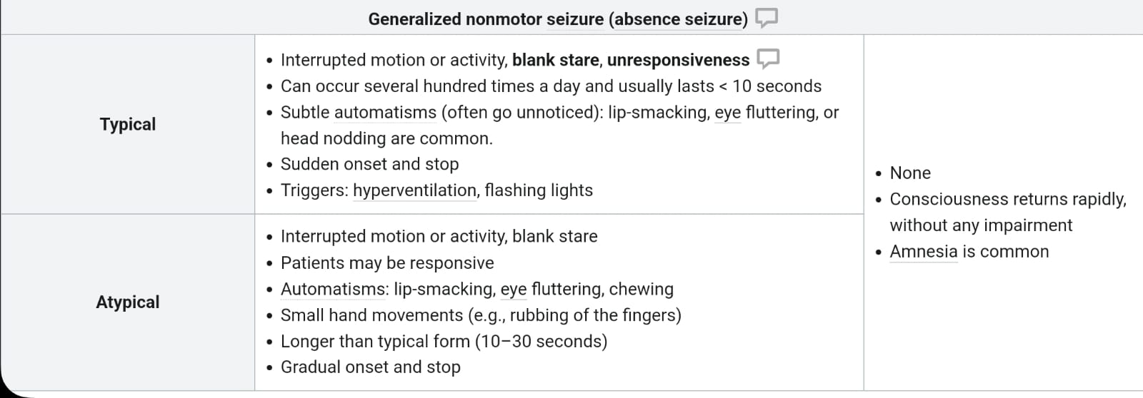
GENERALIZED SEIZURES

Slide 36
EPILEPSY SYNDROMES
Epilepsy syndromes are disorders in which epilepsy is a predominant feature, and there is sufficient evidence (e.g., through clinical, EEG, radiologic, or genetic observations) to suggest a common underlying mechanism

Slide 37
JUVENILE MYOCLONIC EPILEPSY
is the most common generalized epilepsy syndromes of childhood.
It typically occurs in otherwise healthy adolescents and is characterized by the triad of myoclonic jerks (all pts typically occurs at the 1st hour after awakining) , generalized tonic-clonic seizures (GTCS) ( 80- 100% of pts ) , and absence seizures ( 1/3 of pts and typically precedes myoclonus and GTCS by up to 5 yrs – suspected if family Hx +ve for epilepsy ). NO cognitive abnormality
Seizures characteristically occur upon awakening or in association with sleep deprivation
Although complete remission is relatively uncommon, patients generally respond quickly and completely to standard antiseizure medications. Seizure frequency often lessens in adulthood but many patients require long-term antiseizure medication therapy.
There is often a family history of epilepsy( in about 50%) , and genetic linkage studies suggest a complex underlying polygenic defects. (chromosome 6)
Diagnosis :
History
EEG abnormal in 75% interictal and 100% during sleep
MRI normal in JME – no need for it

Slide 38
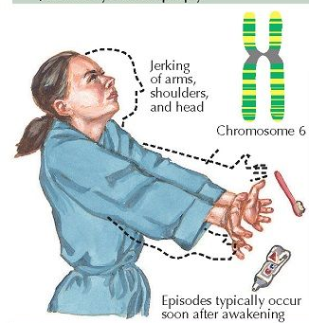

Slide 39
The Lennox-Gastaut syndrome (LGS)
The most common cause of intractable (difficult to treat) childhood epilepsy.
The most common time for it to start is between three and five years of age.
is a lifelong condition associated with the onset of severe seizures in childhood, treatment-resistant epilepsy, and intellectual disabilityand is defined by the following triad:
(1) multiple seizure types (usually including generalized tonic-clonic, atonic, and atypical absence seizures);
(2) an EEG showing characteristic abnormalities; and
(3) impaired cognitive function in most but not all cases.
LGS has many causes, including genetic disorders, cortical malformations, tumors, neurocutaneous syndromes (eg, tuberous sclerosis complex), encephalopathies following hypoxic-ischemic insults, meningitis, and head injuries . Approximately 40 percent of patients have an unknown etiology, although these children are increasingly found to have genetic disorders, particularly chromosomal syndromes or de novo pathogenic variants

Slide 40
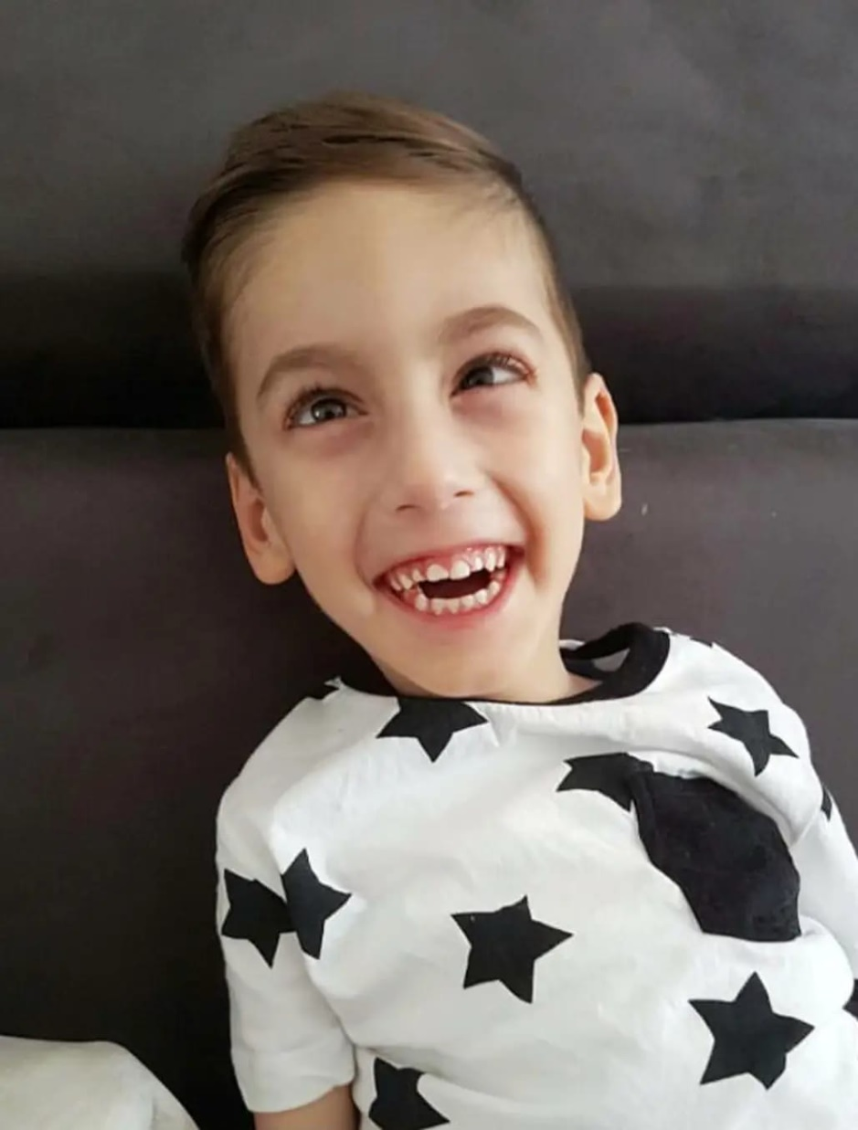
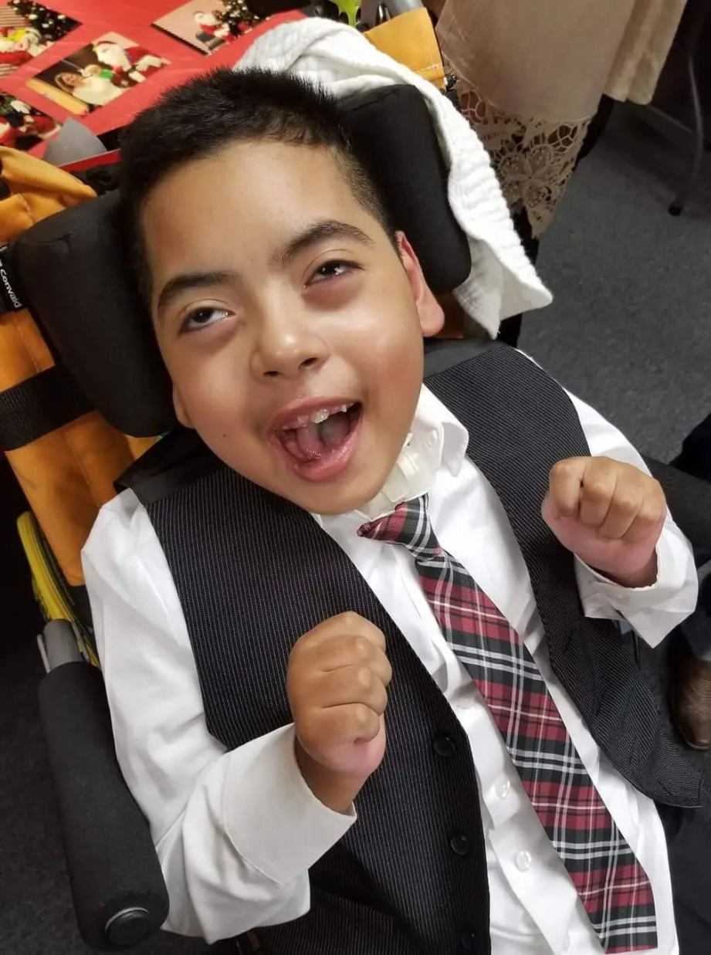

Slide 41
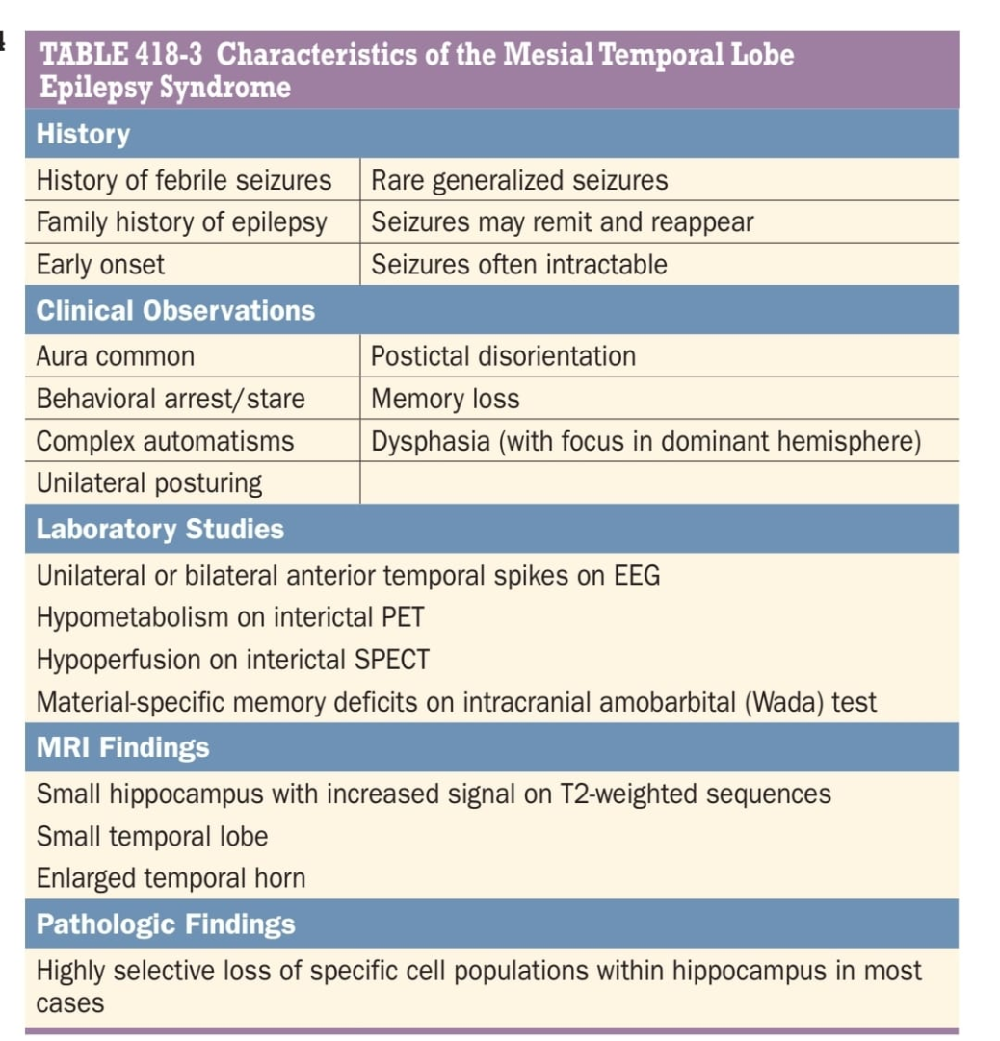
MESIAL TEMPORAL LOBE EPILEPSY SYNDROME
Mesial temporal lobe epilepsy (MTLE) is the most common syndrome associated with focal seizures with impairment of consciousness and is an example of an epilepsy syndrome with distinctive clinical, electroencephalographic, and pathologic features
High-resolution magnetic resonance imaging (MRI) can detect the characteristic hippocampal sclerosis that appears to be essential in the pathophysiology of
MTLE for many patients
Recognition of this syndrome is especially important because it tends to be refractory to treatment with anticonvulsants but responds well to surgical intervention.

Slide 42
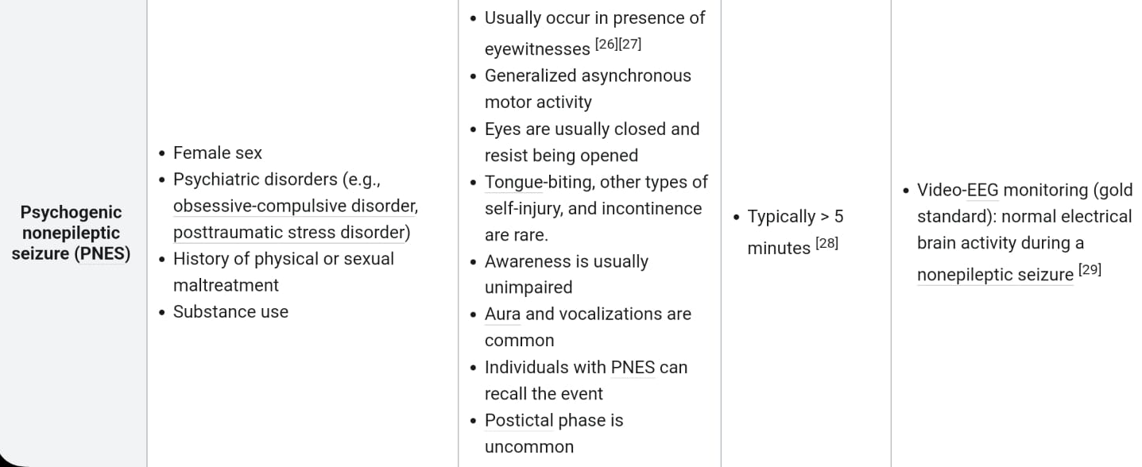
Psychogenic nonepileptic seizures PNES

Slide 43


