Slide 1
Diencephalon

Slide 2
Summary
The diencephalon is the caudal part of the forebrain (prosencephalon), located between the midbrain (mesencephalon) and the cerebrum (telencephalon). It consists of the thalamus, hypothalamus, epithalamus, and subthalamus. The thalamus is the relay center for sensory information. The hypothalamus regulates autonomic function and the endocrine system. The epithalamus, which comprises the pineal gland, habenula, habenular commissure, and stria medullaris, regulates the sleep-wake cycle. The subthalamus, which contains the subthalamic nucleus, is part of the indirect basal ganglia circuit and is involved in the inhibition of involuntary movements. The limbic system consists of the amygdala, hypothalamus, anterior thalamus, hippocampus, mammillary bodies, cingulate cortex, and entorhinal cortex. These structures are involved in memory formation, regulation of appetite and satiety, attention, emotional responses, and sexual arousal.

Slide 3
Overview
Location: caudal portion of the forebrain, situated between the cerebrum and midbrain
Composition and function:
Thalamus: relay center of sensory information between subcortical and cortical structures
Hypothalamus: main center of autonomic function and endocrine system function
Epithalamus: involved in the regulation of the sleep-wake cycle
Subthalamus: contains the subthalamic nucleus, a part of the basal ganglia

Slide 4
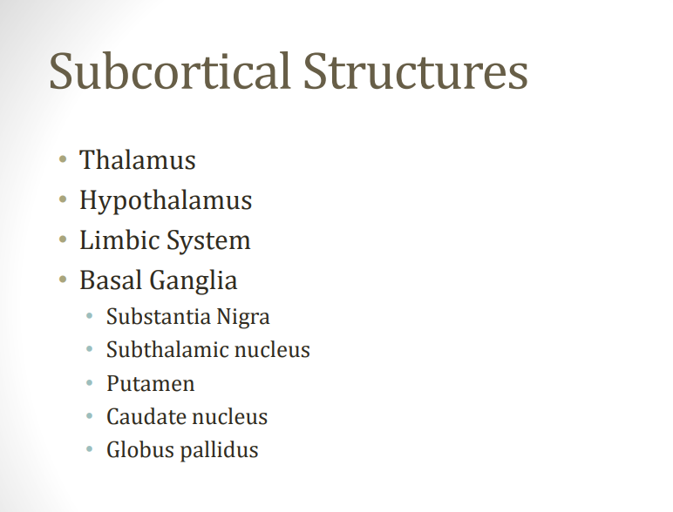

Slide 5
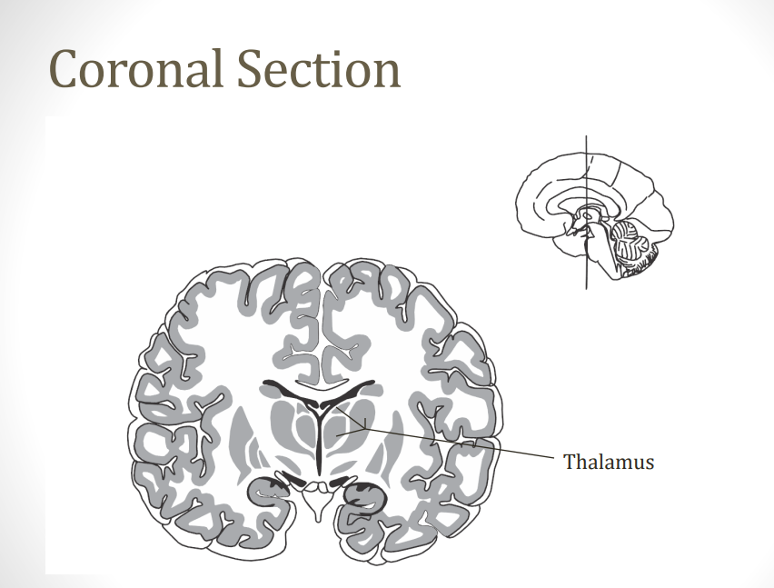

Slide 6
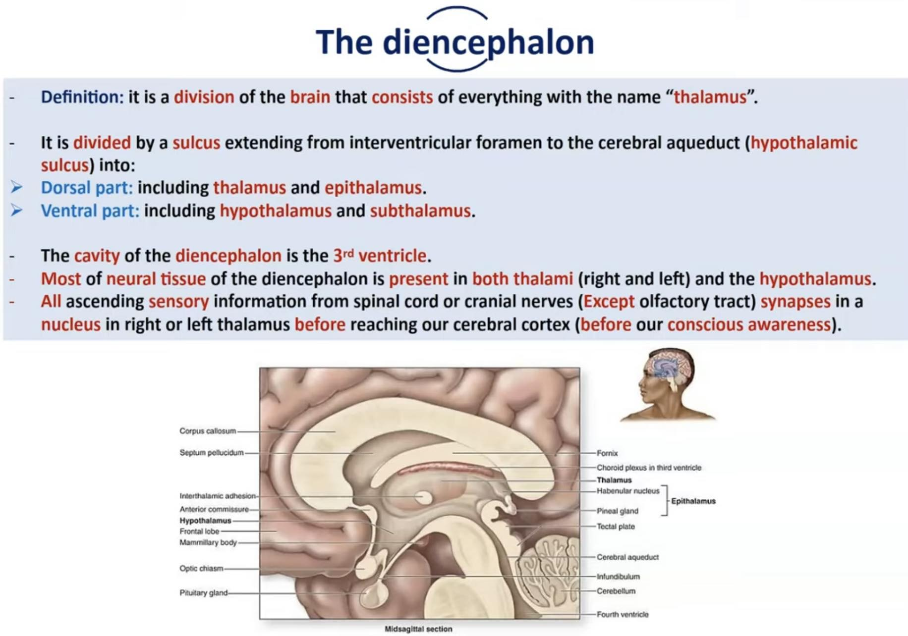

Slide 7
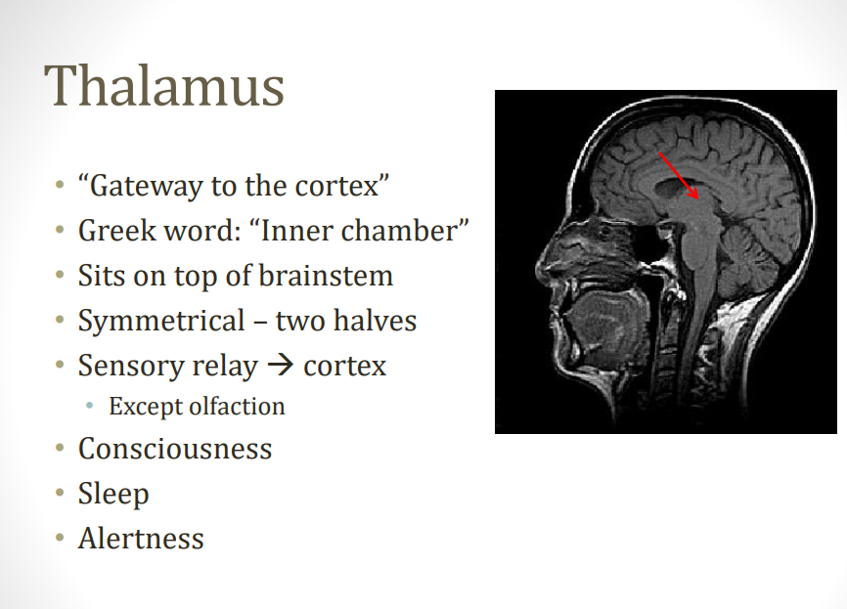

Slide 8
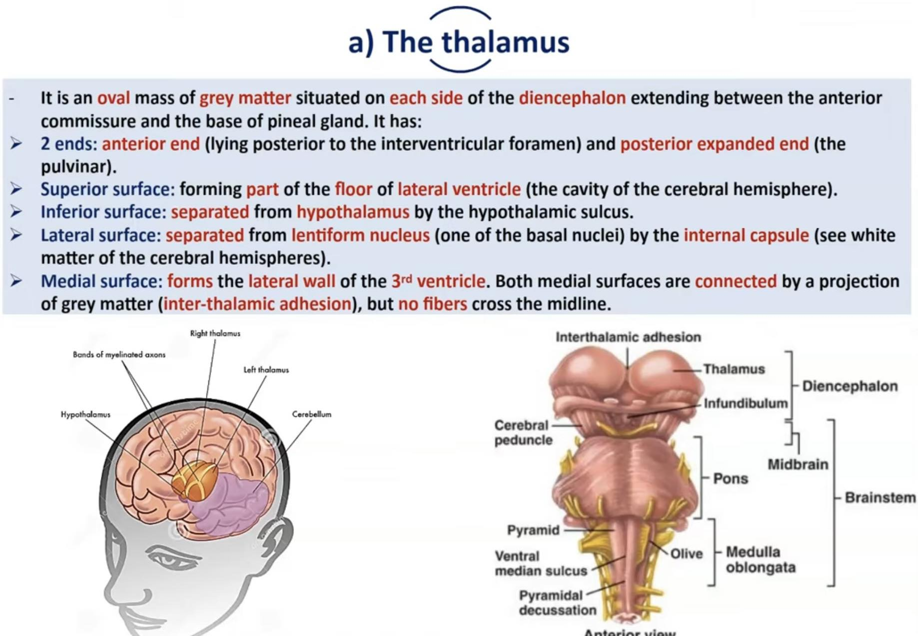

Slide 9
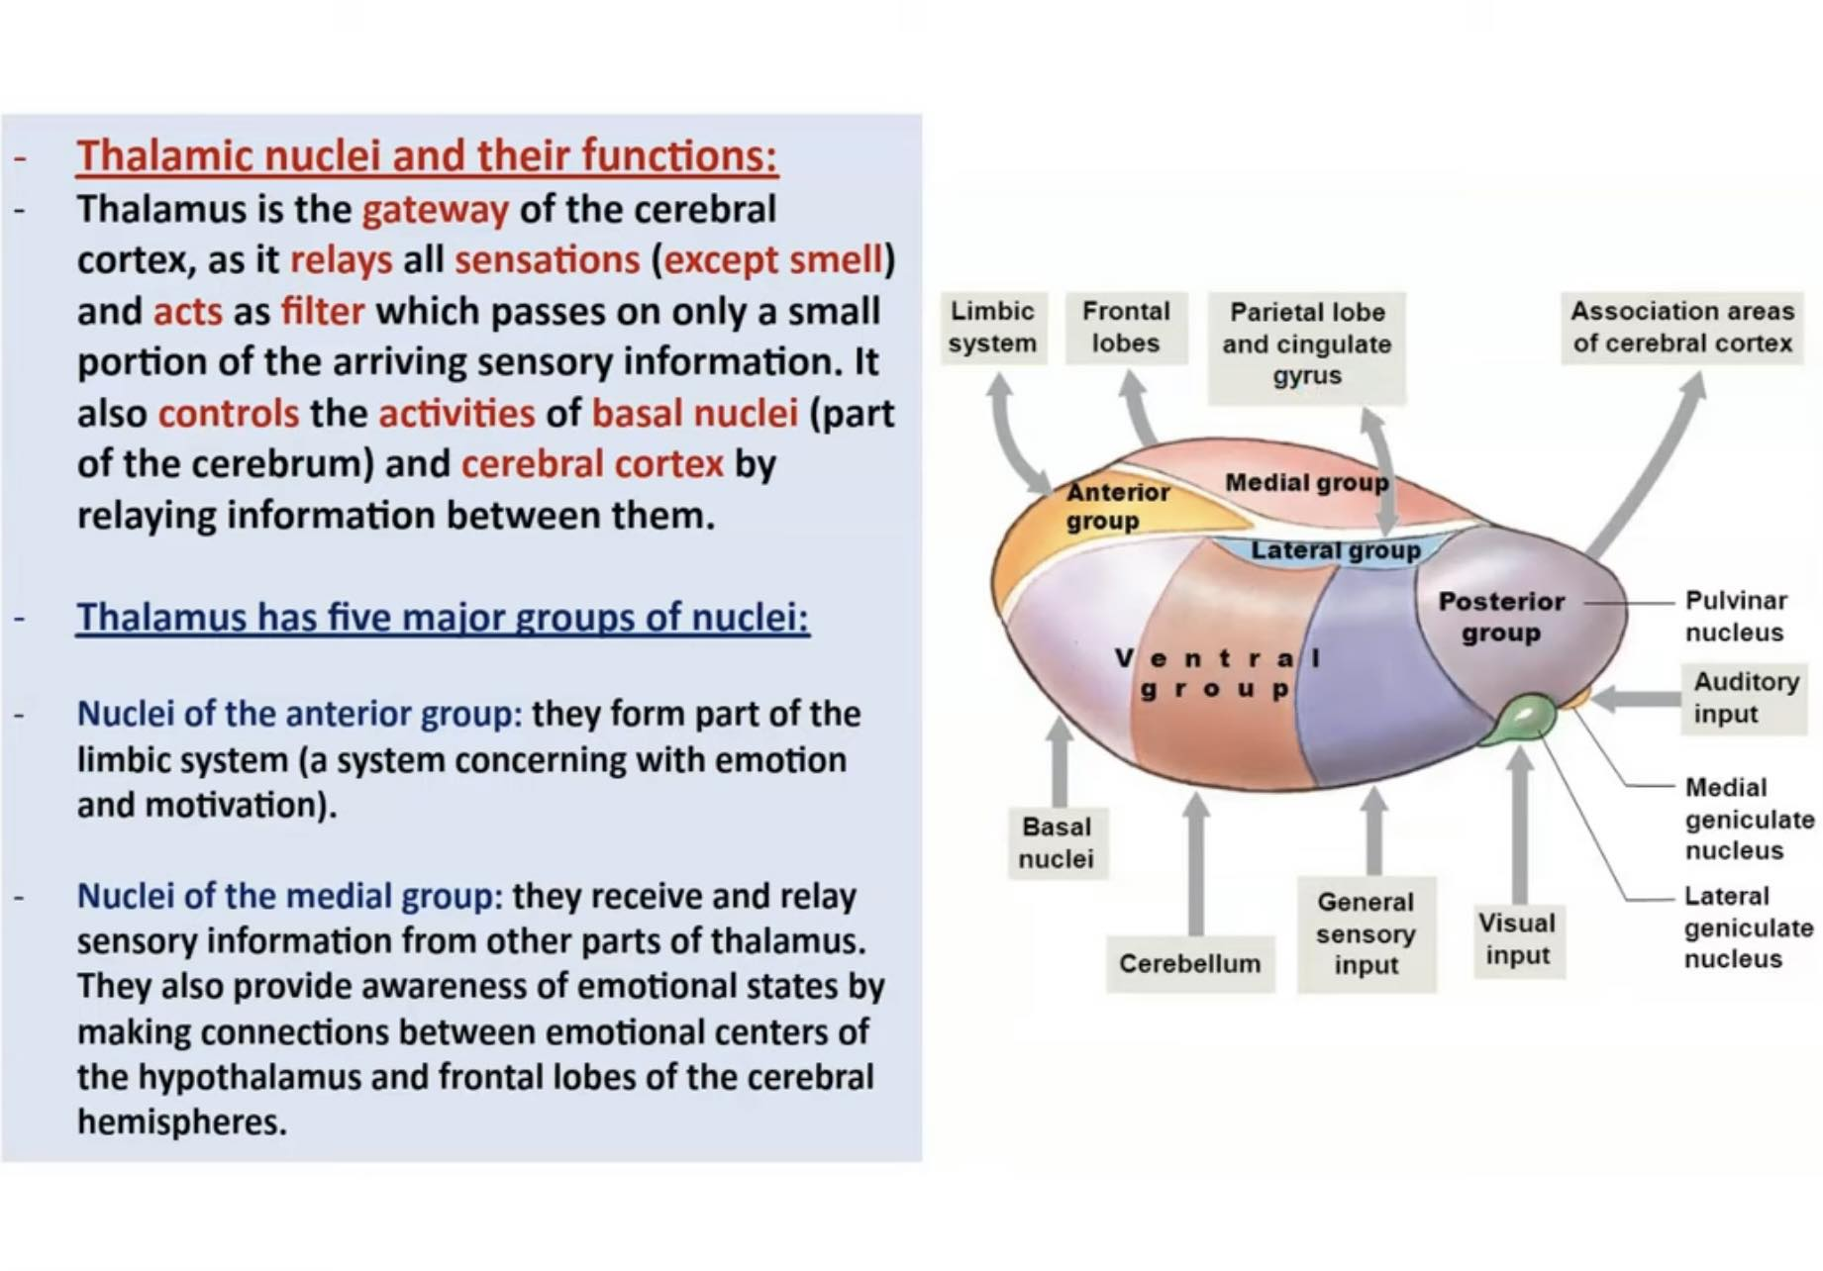

Slide 10
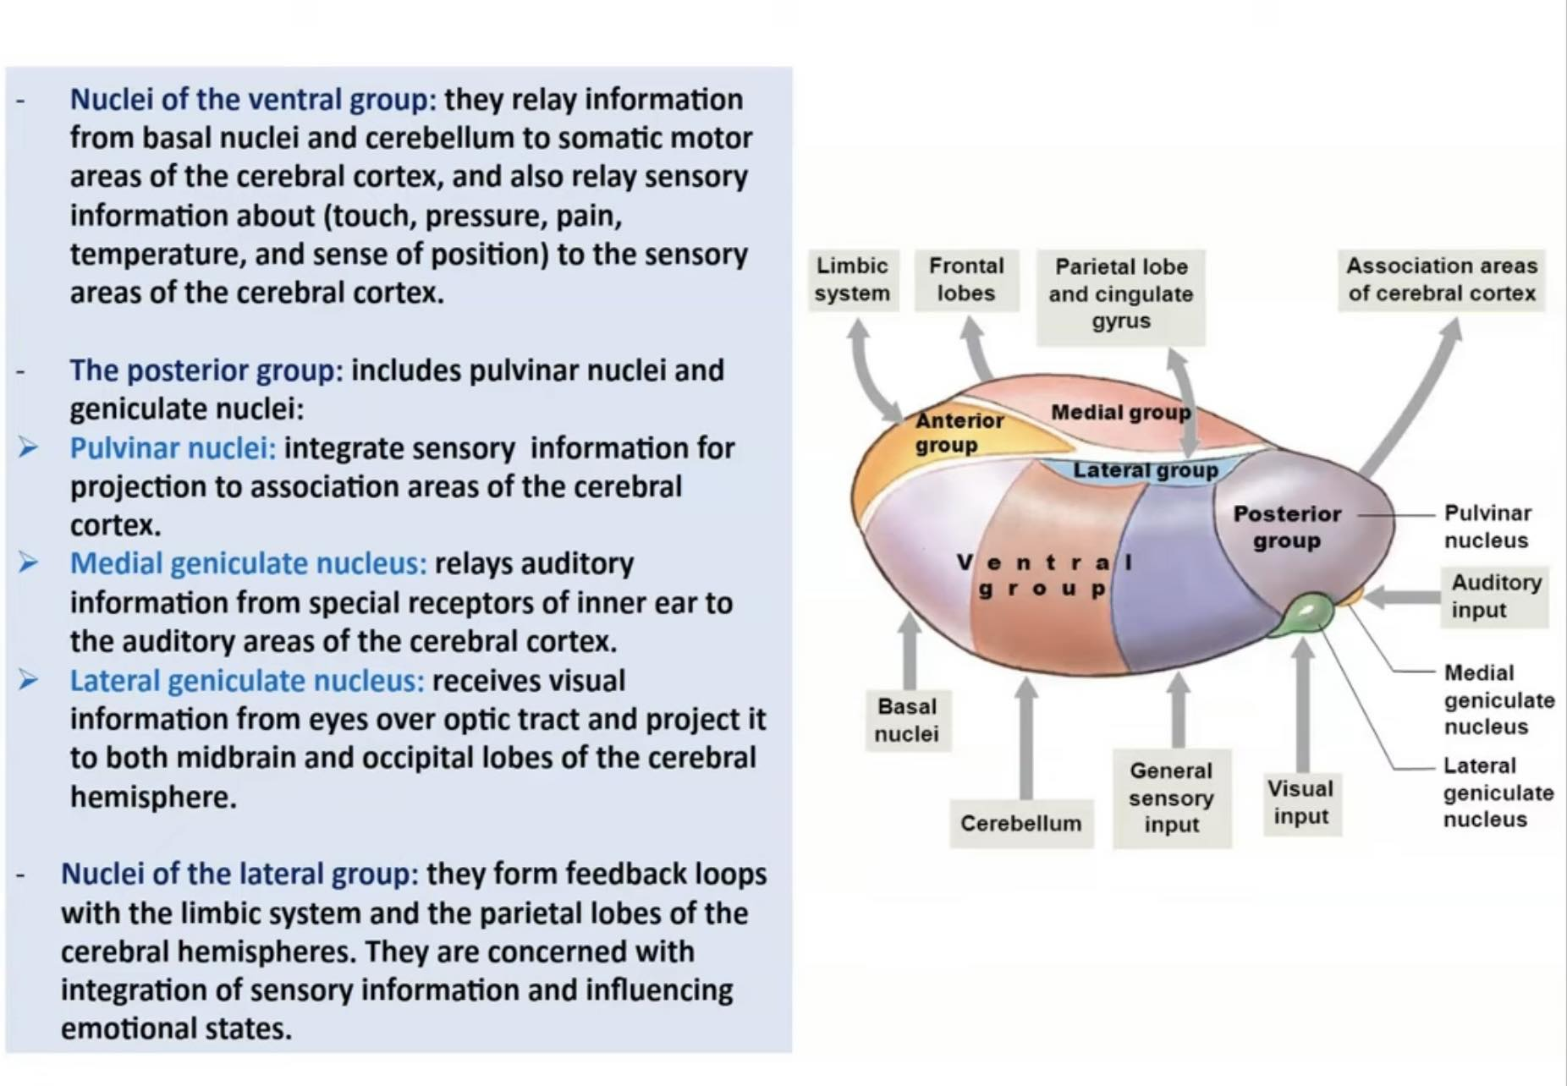

Slide 11
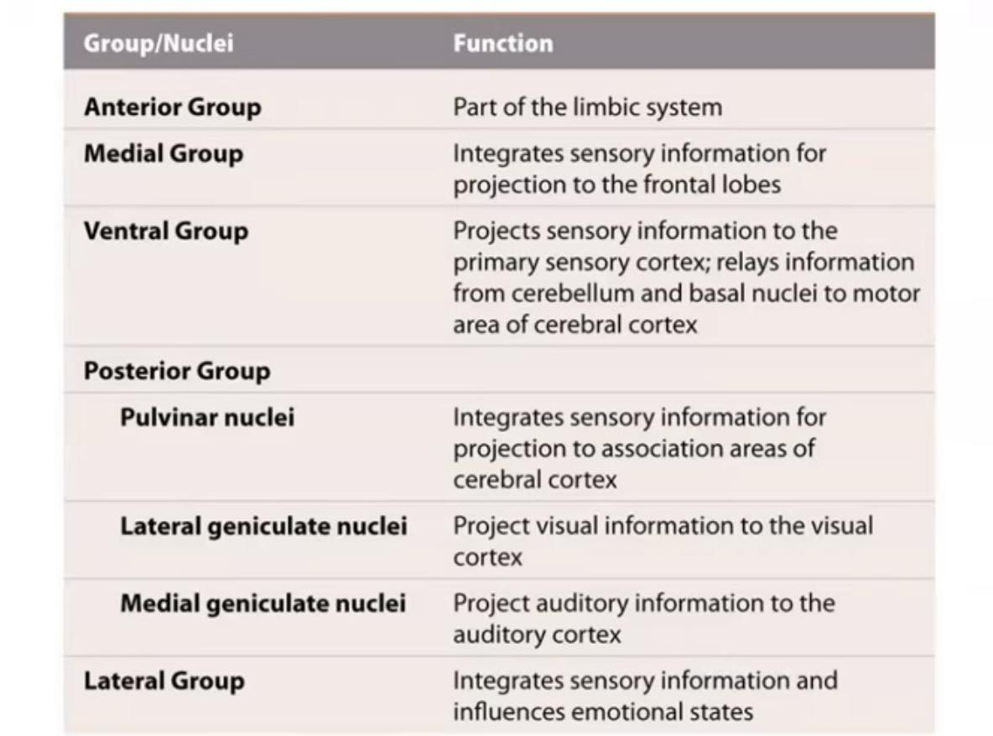

Slide 12
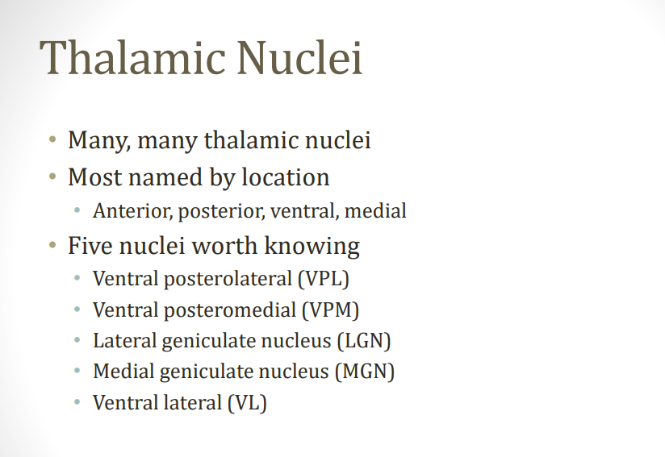

Slide 13
Olfaction is the only sensory modality that is not relayed through the thalamus.
VPL: receives sensory information from the Limbs. VPM: receives sensory information from your Mug (face).
The Lateral geniculate body processes Light (part of the visual pathway); the Medial geniculate body processes Music (part of the hearing pathway).

Slide 14
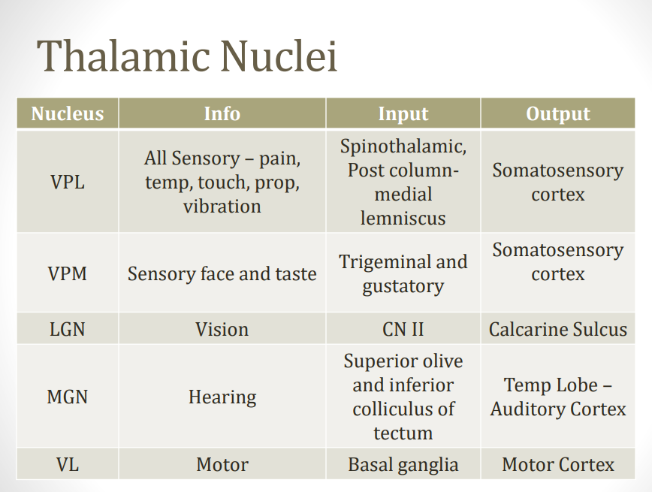
Notes:
VL nucleus also receives input from the cerebellum

Slide 15
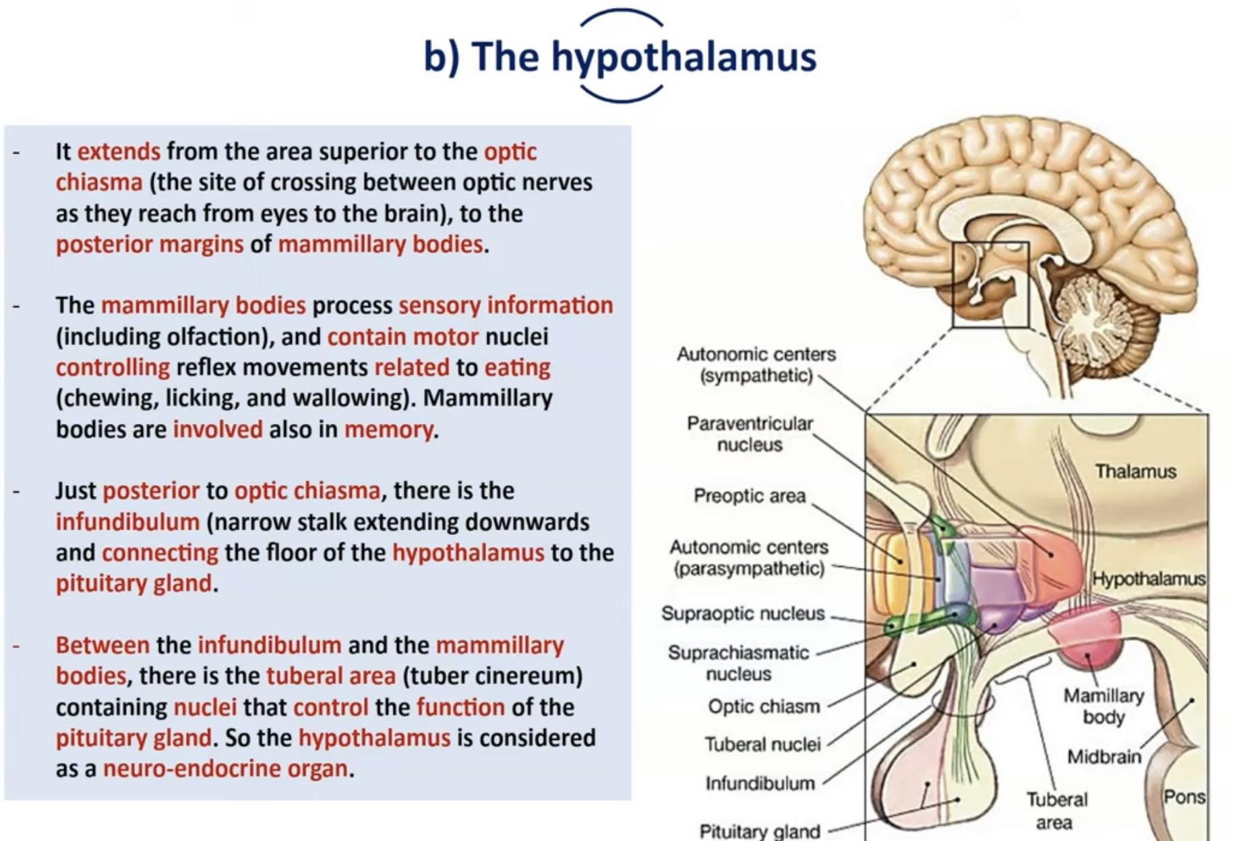

Slide 16
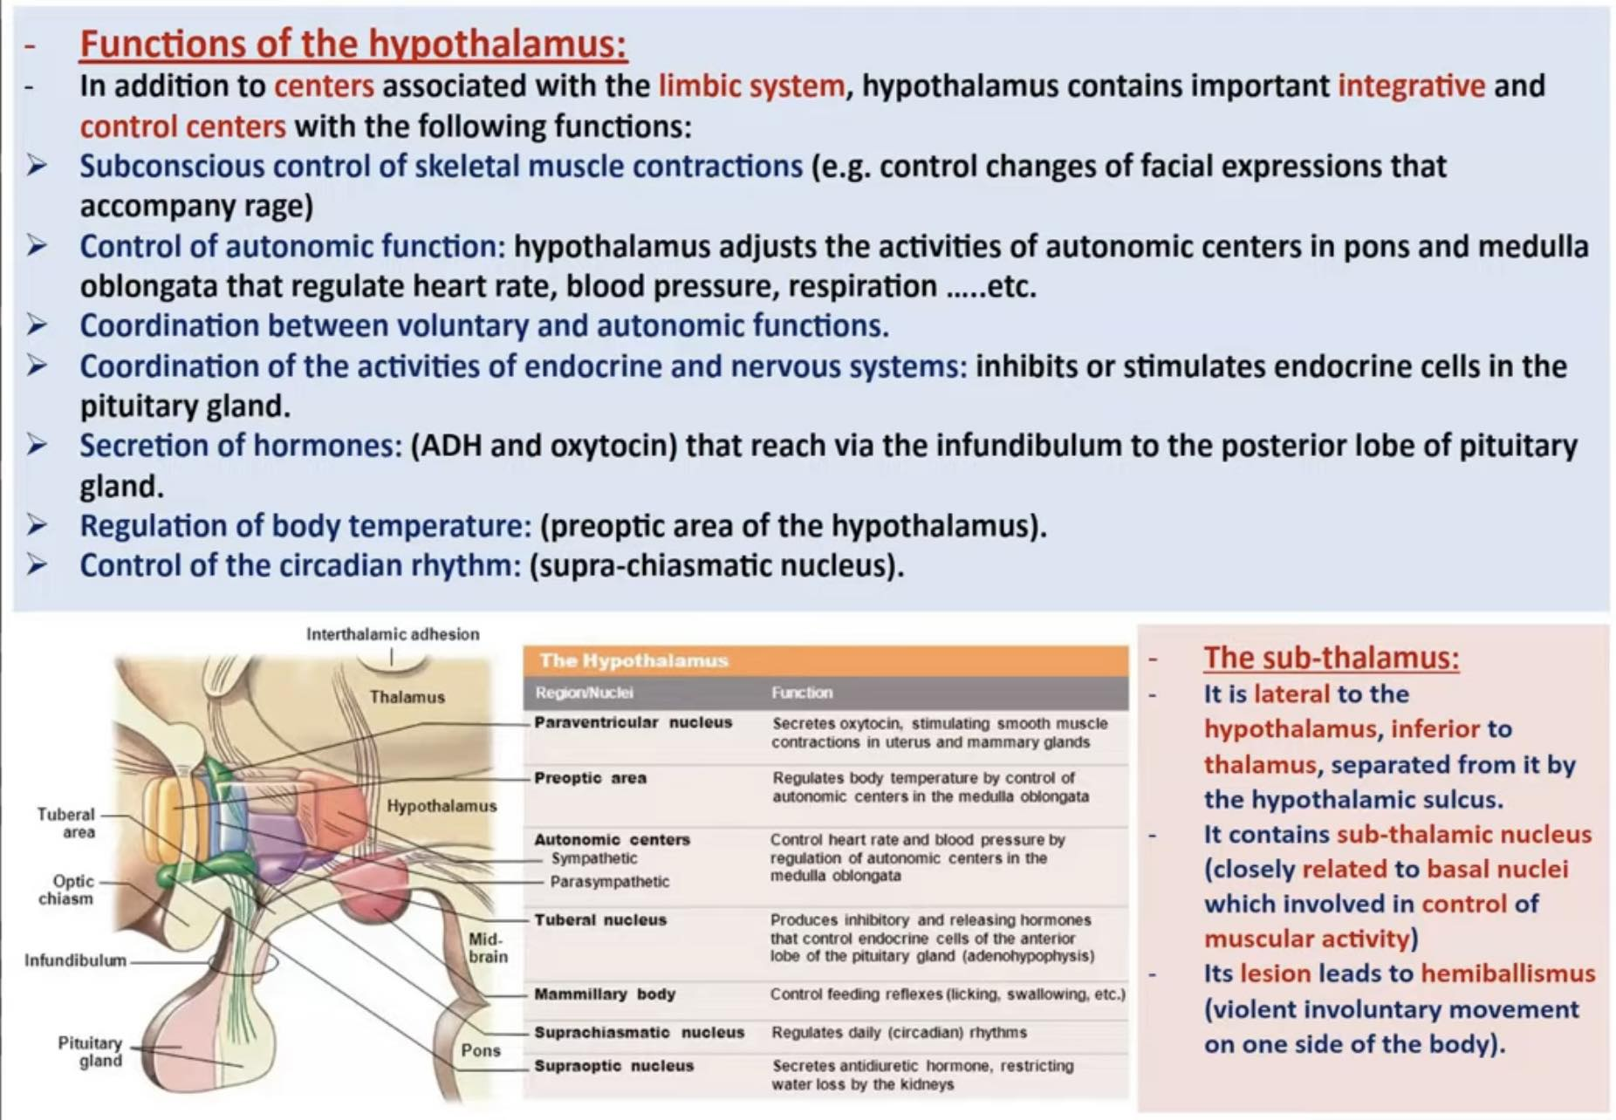

Slide 17
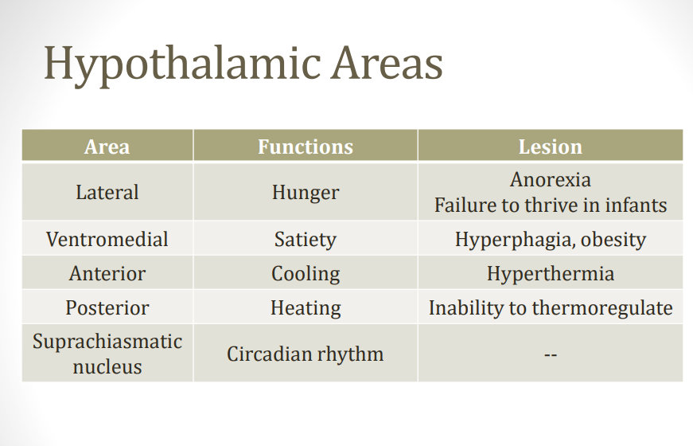

Slide 18
A wide variety of neurotransmitters have been identified in the cell bodies and afferent synaptic terminals in the basal ganglia. A deficiency of which of the following transmitters is typically associated with Parkinson disease?
A) Norepinephrine
B) Dopamine
C) Serotonin
D) GABA
E) Substance P
Notes:
B

Slide 19
Hemiballismus, the sudden flailing movements of an entire limb, results when damage occurs to which area of the brain?
A) The subthalamic nucleus
B) The ventral basal complex of the thalamus
C) The globus pallidus
D) The red nucleus
E) The lateral hypothalamus
Notes:
A

Slide 20
Bilateral lesions involving the ventromedial hypothalamus will lead to which of the following deficits?
A) Decreased eating and drinking
B) Loss of sexual drive
C) Excessive eating, rage and aggression, hyperactivity
D) Uterine contractility, mammary gland enlargement
E) Obsessive compulsive disorder
Notes:
C

Slide 21
An 83-year-old man is brought to the emergency department by his daughter, who explains that her father started having "fits." The examination reveals an alert, otherwise healthy, man who frequently has uncontrollable flailing movements of his left arm. Which of the following structures is most likely involved in this lesion?
A. Cerebellar cortex plus nuclei
B. Lenticular nucleus
C. Subthalamic nucleus
D. Ventral lateral nucleus
E. Ventral posterolateral nucleus
Notes:
C

Slide 22
Which of the following thalamic nuclei has a motor function?
A- lateral dorsal nucleus
B- mediodorsal nucleus
C- ventral lateral nucleus
D- ventral posterior nucleus
E- lateral posterior nucleus
Notes:
C

Slide 23
Spinothalamic fibers project to which one of the following thalamic nuclei
A- ventral posteromedial (VPM) nucleus
B- pulvinar
C- ventral anterior nucleus
D- ventral posterolateral (VPL) nucleus
E- anterior nucleus
Notes:
D

Slide 24
Cerebellar fibers project to which one of the following nuclei
A- ventral posteromedial (VPM) nucleus
B- lateral dorsal nucleus
C- lateral posterior nucleus
D- ventral lateral nucleus
E- anterior nucleus
Notes:
D

Slide 25
The thalamus receives precortical sensory input from all of the following modalities except
A- general somatic sense
B- gustation
C- vision
D- audition
E- olfaction
Notes:
E

Slide 26
Thank you

