Slide 1
ANATOMY LAB 1
Pelvis
Prepared By:
Dr. Ayah Mahmoud Almzayyen
MD , T.A in AUG

Slide 2
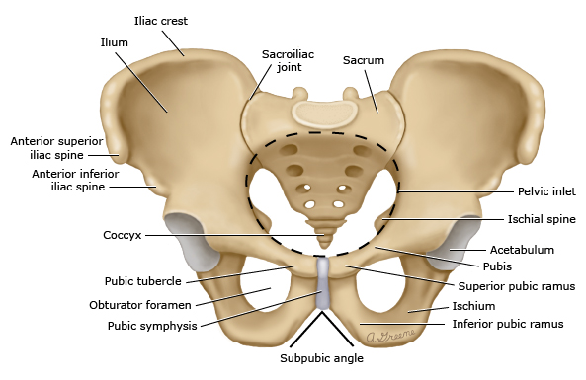
Pelvis
is the region of the trunk that lies inferior to the abdomen.
is the region where the trunk and lower limbs meet.
The word pelvis means “basin” and is more correctly applied to the skeleton of the region, that is, the pelvic girdle or bony pelvis. Thus, the pelvis is a bowl-shaped bony structure.
The main function of the bony pelvis is :
to transmit the weight of the body from the vertebral column to the femurs especially during movement.
it contains, supports, and protects the lower parts of the gastrointestinal and urinary tracts and the male and female internal organs of reproduction.
It also contains important nerves, blood vessels, and lymphatic tissues.
provides attachment for trunk and lower limb muscles.

Slide 3
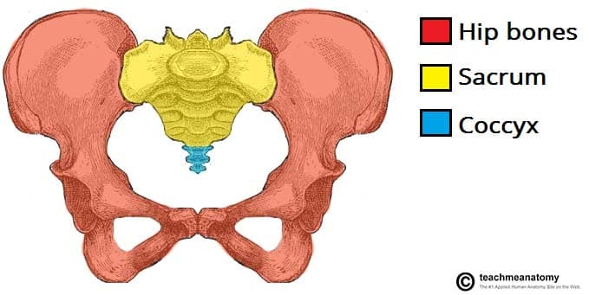
Four bones make up the bony pelvis:
* the two hip bones (innominate or pelvic bones ) , which form the anterolateral walls , they articulate with each other anteriorly at the symphysis pubis and posteriorly with the sacrum at the sacroiliac joints.
* the sacrum and the coccyx , which are part of the vertebral column and form the posterior wall

Slide 5
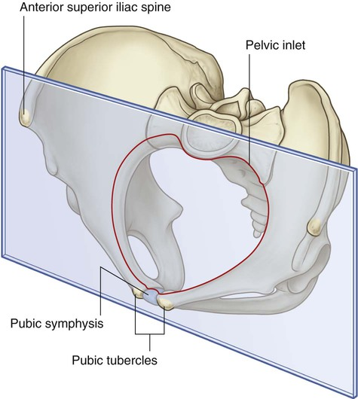
Orientation of pelvic bone

Slide 6
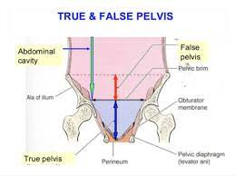
False pelvis
It is of little clinical importance.
It is bounded:
Behind by the lumber vertebrae.
Laterally by the iliac fossa and the iliacus muscles.
In Front by the lower part of the anterior abdominal wall.
The false pelvis supports the abdominal contents and after the third month of pregnancy helps support the gravid uterus.

Slide 7
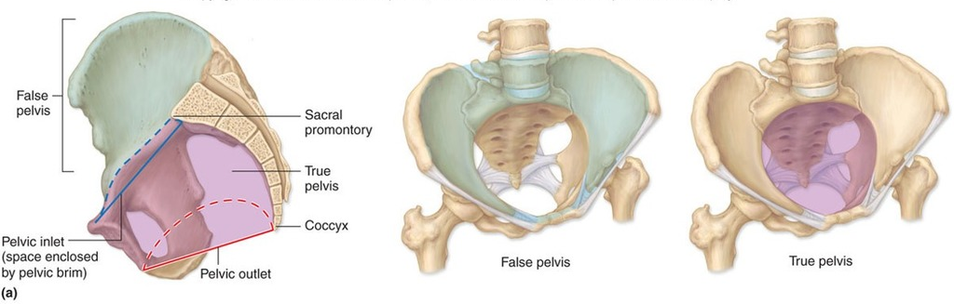
True and false pelvis

Slide 8
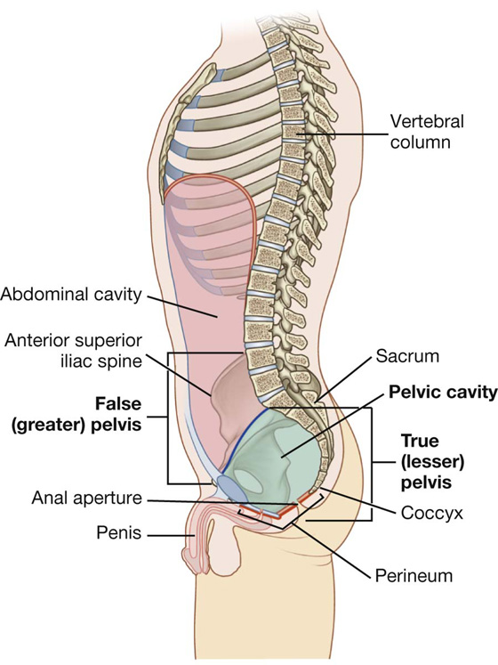

Slide 9
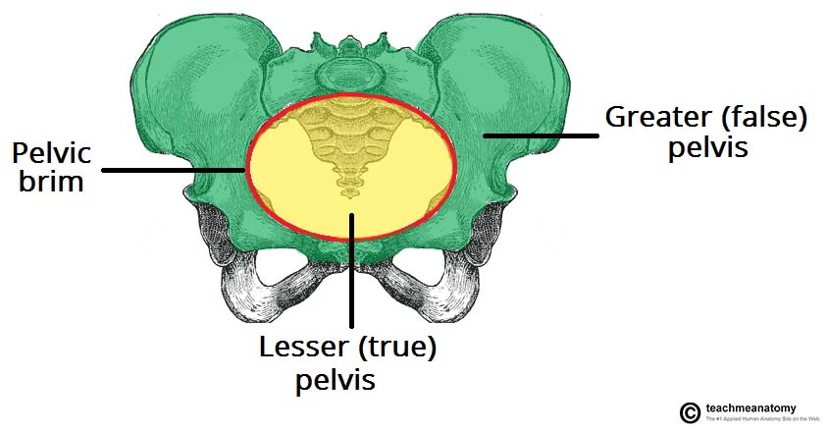
The pelvic brim / inlet
The pelvic brim divides the pelvis into two parts :
The false / greater pelvis , which bounds the lower part of the abdominal cavity and support lower abdominal viscera as ileum and sigmoid colon , is above the brim
* The true / lesser pelvis, which
contains the pelvic cavity and pelvic viscera , is below the brim

Slide 10
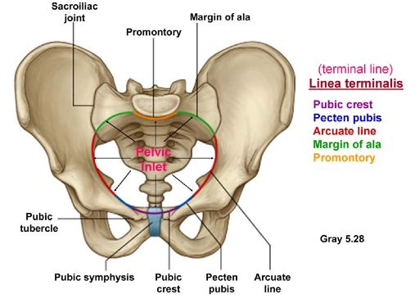
Pelvic brim

Slide 11
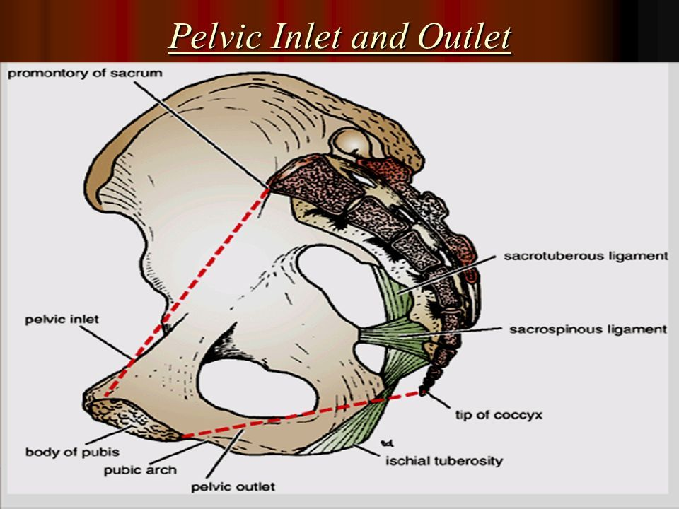
True Pelvis(lesser)
True Pelvis has an inlet, an outlet, and a cavity
Pelvic inlet (pelvic brim)
Its boundaries are :
Posteriorly by the sacral promontory.
Laterally by the iliopectineal lines.
Anteriorly by the symphysis pubis.
Pelvic outlet:
its boundaries are :
Posteriorly by the tip of coccyx .
Laterally by ischial tuberosities .
Anteriorly by the pubic arch .
Pelvic cavity:
lies between the inlet and the outlet

Slide 12
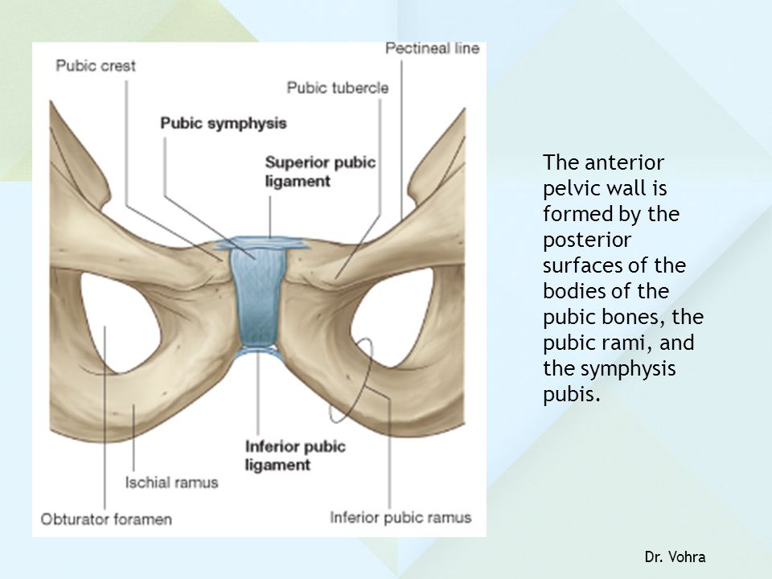
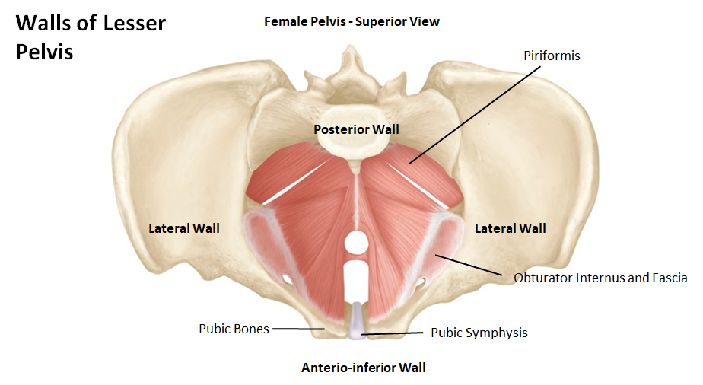
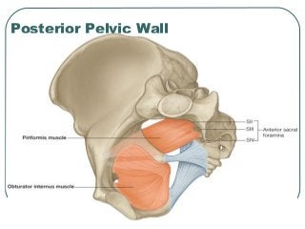
Pelvic Walls
Bones and ligaments that are partly lined with muscles covered with fascia and parietal peritoneum form the walls of the pelvis.
The pelvis has anterior, posterior, and lateral walls and an inferior wall or floor
Anterior Pelvic Wall
the shallowest wall
is formed by the symphysis pubis , the bodies of pubic bones , and the pubic rami (superior and inferior )
Posterior Pelvic Wall
is formed by the sacrum and coccyx and by the piriformis muscles and their covering of parietal pelvic fascia

Slide 13
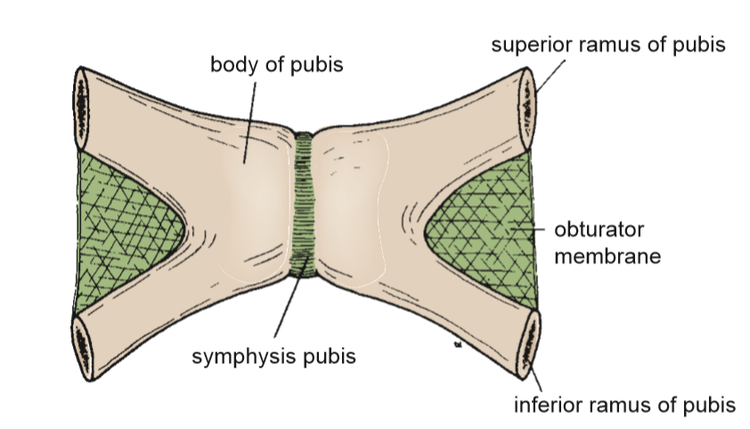
Anterior pelvic wall

Slide 14
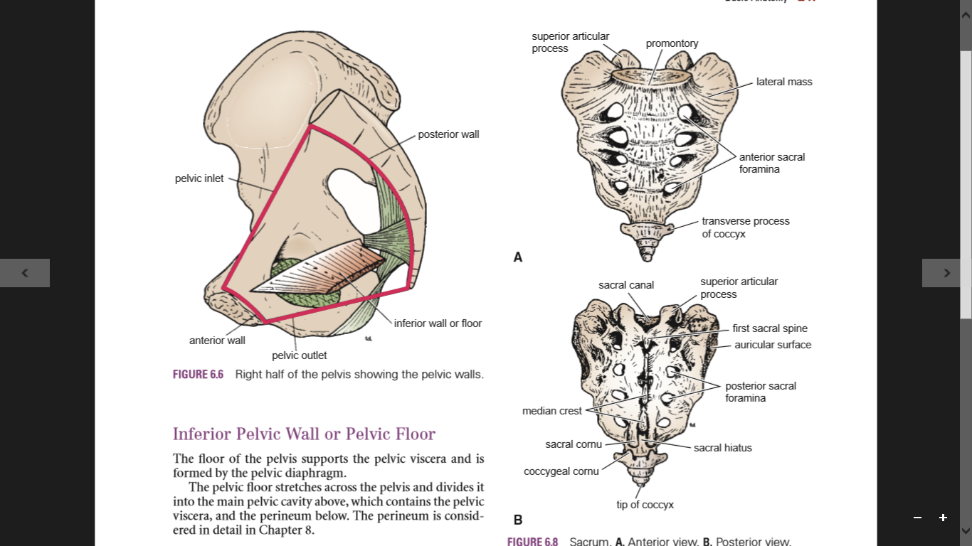
Posterior pelvic wall-sacrum & coccyx

Slide 15
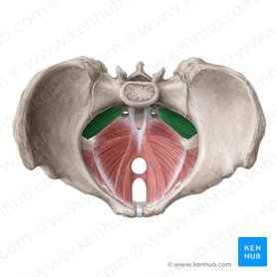
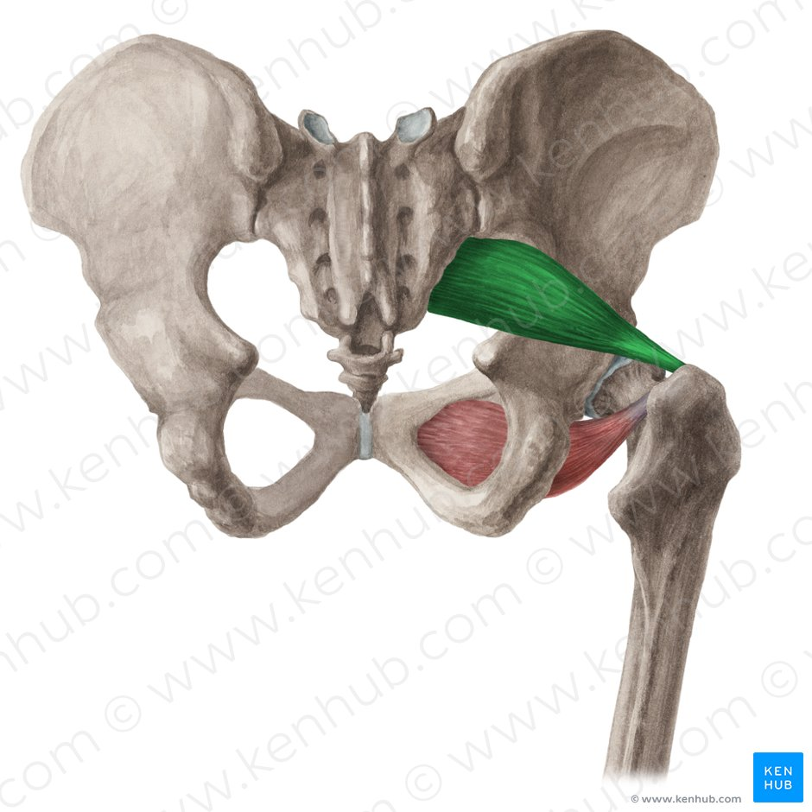
Posterior pelvic wall – piriformis muscle

Slide 16
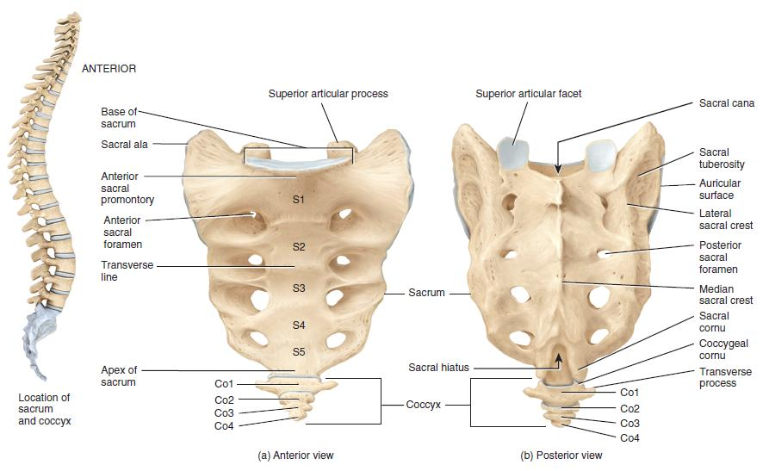
Sacrum
The sacrum consists of five rudimentary vertebrae fused together to form a single wedge-shaped bone (fusion of the sacral vertebrae begins at age 20) , (inverted triangular , concave shape)
The upper border or base of the bone articulates with the fifth lumbar vertebra (lumbosacral angle )
The narrow inferior border or apex articulates with the coccyx.
Laterally , the sacrum articulates with the two iliac bones to form the sacroiliac joints .
The anterior and upper margins of the first sacral vertebra bulge forward to form the sacral promontory
( This is the posterior margin of the pelvic inlet and is an important obstetric landmark used when measuring the size of the pelvis)
The anterior and posterior surfaces of the sacrum possess four pairs of anterior and posterior sacral foramina, respectively, for the passage of the anterior and posterior rami of the upper four sacral nerves .
The sacral vertebral foramina together form the sacral
canal

Slide 17
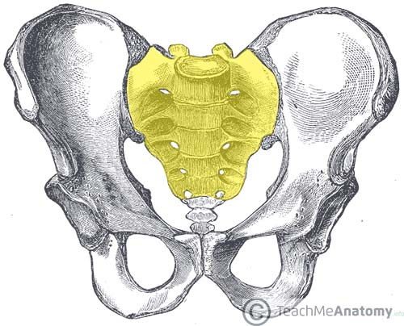
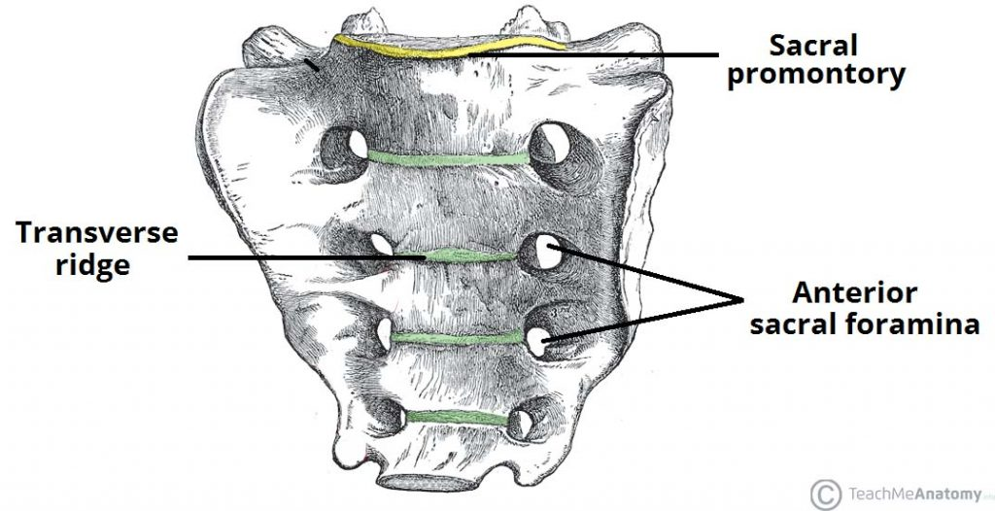
The sacrum consists of a base, apex and four surfaces:
Base , articulates superiorly with the fifth lumbar vertebra and its associated intervertebral disc .
Apex , articulates inferiorly with the coccyx .
Two auricular surfaces (lateral ) , shaped like the outer ear – hence the name. Each articulates with the auricular surface of the ilium to form the sacroiliac joint .
Anterior and posterior surfaces , provide attachment to pelvic ligaments and muscles.
Pelvic / Anterior Surface
The pelvic surface of the sacrum is less remarkable than the dorsal surface . In the adult, the surface is marked by four transverse lines(the remnants of the fused four sacral intervertebral discs )
Superiorly, there is an anterior projection of bone, known as the sacral promontory . It forms the posterior margin of the pelvic inlet .

Slide 18
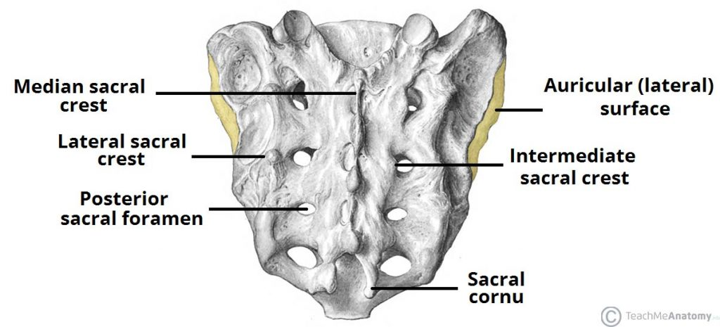
Dorsal / Posterior Surface
is coarse and rugged. This can be attributed to the fusion of the sacral vertebrae, which give rise to three bony ridges (or crests).
the median sacral crest ,
* Central bony ridge located in the midline of the dorsal surface
* It is formed by the fusion of the spinous processes of S1-S3
* It gives attachment to the supraspinous ligament.
the intermediate sacral crests ,
* are formed by the fusion of the articular processes of S2-S4
*The posterior sacroiliac ligaments are attached along this crest.
the lateral sacral crests ,
* are formed by the fusion of the transverse processes of the S1-S5
* a point of attachment to the posterior sacroiliac ligaments as well as the sacrotuberous ligament.
* The fusion of these processes is not complete, allowing the sacral nerve fibres to enter and leave the central canal by way of the four pairs of posterior sacral foramina

Slide 19
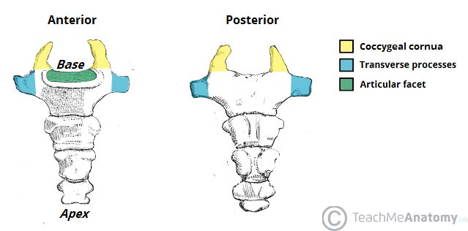
Coccyx
The coccyx consists of four vertebrae fused together throughout life to form a small triangular bone .
The coccyx consists of an apex, base, anterior surface, posterior surface and two lateral surfaces.
* Base , located most superiorly , articulates with the inferior border / apex of the sacrum .
* Apex , is situated inferiorly, at the terminus of the vertebral column .
* Lateral surfaces , are marked by a small transverse process, which projects from Co1 .
**The coccygeal vertebrae consist of bodies only, but the first vertebra possesses rudimentary transverse processes and cornua .

Slide 20
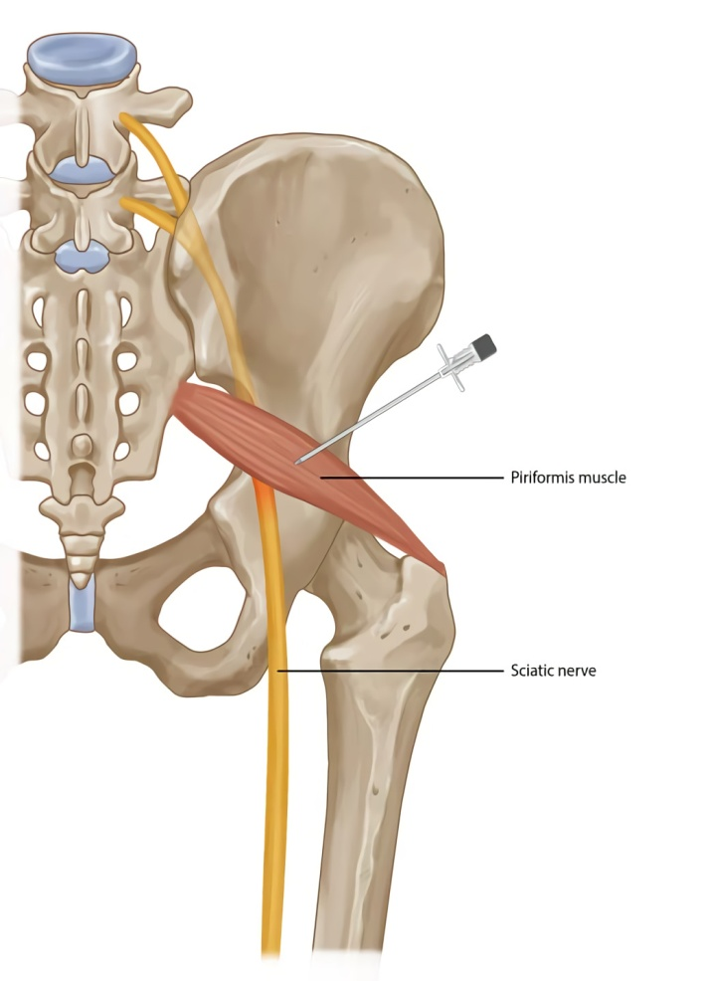
Piriformis muscle
It is the most superior of the deep gluteal muscles.
Attachments:
Origin: the anterior surface of the sacrum(S2-S4) , then travels infero-laterally, through the greater sciatic foramen.
Insertion: into the greater trochanter of the femur.
Actions: Lateral / external rotation and abduction of the lower limb
Innervation: Nerve to piriformis from sacral plexus .

Slide 21
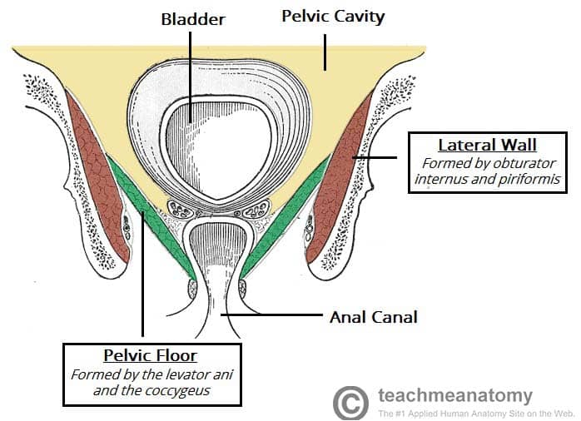
Lateral pelvic wall
Is formed by part of hip bone below the pelvic inlet, obturator membrane , sacrotuberous and sacrospinous ligaments, and the obturator internus muscle and its covering fascia.

Slide 22
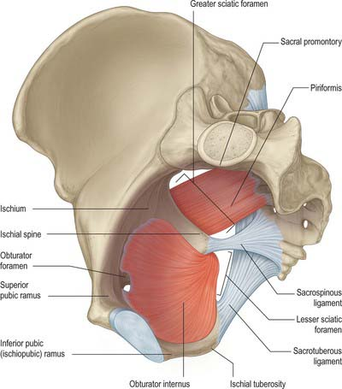
Lateral pelvic wall

Slide 23
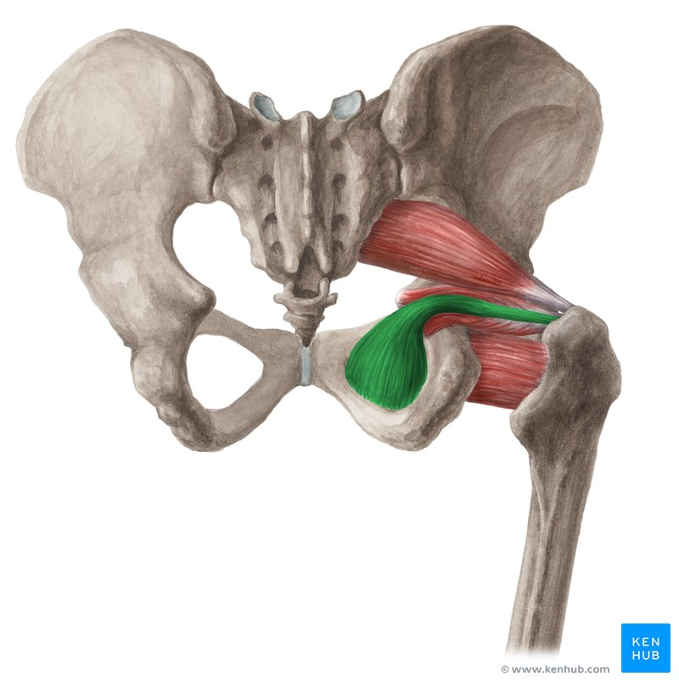
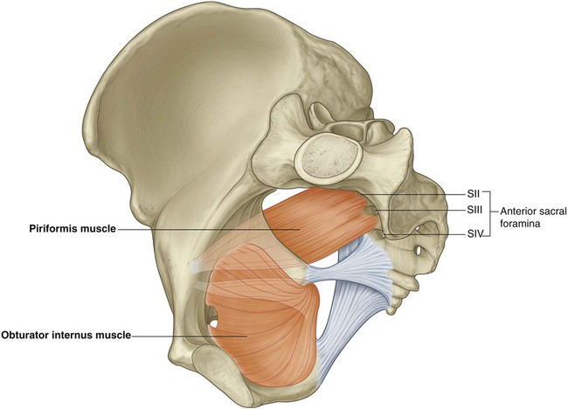
Lateral pelvic wall-obturator internus muscle

Slide 24
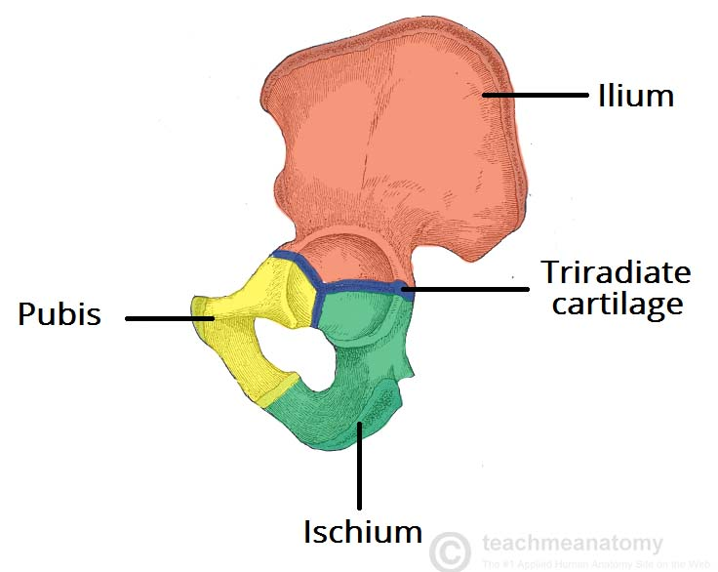
Hip Bone /Innominate/Pelvic bones
In children , each hip bone consists of 3 separate parts :
* the ilium, which lies superiorly
* the ischium, which lies posteriorly and inferiorly
the pubis, which lies anteriorly and inferiorly
A triradiate cartilage joins the three separate bones at the acetabulum (cup – shaped socket where head of femur articulates to form the hip joint )
At puberty , these three bones fuse together to form one large, irregular bone.
The hip bones articulate with the sacrum at the sacroiliac joints and form the anterolateral walls of the pelvis. They also articulate with one another anteriorly at the symphysis pubis.

Slide 25
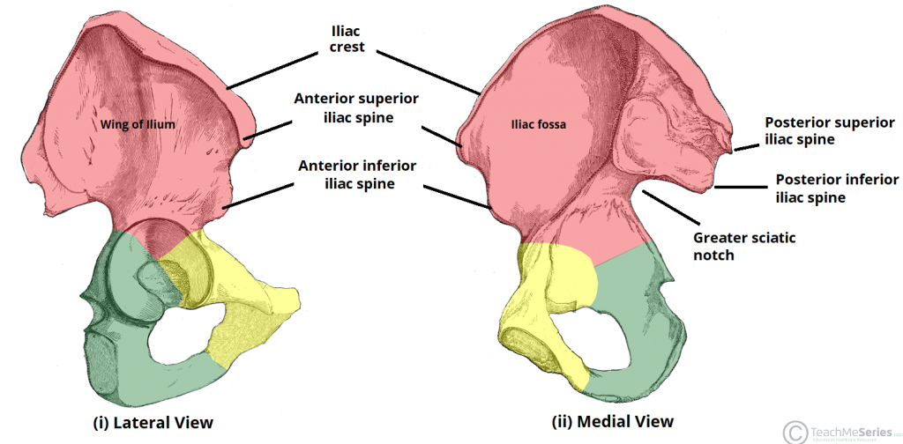
The Ilium
is the widest and largest of the three parts of the hip bone, and is located superiorly.
The body of the ilium forms the superior part of the acetabulum (acetabular roof).
Immediately above the acetabulum, the ilium expands to form the wing (or ala).
The wing of the ilium has two surfaces:
Inner surface (iliac fossa) – has a concave shape, which the site of origin of the iliacus muscle.
External surface (gluteal surface) – has a convex shape and provides attachments to the gluteal muscles.
Anterior border of Ala: ASIS to AIIS
Posterior border of Ala: PSIS to PIIS
The superior margin is thickened forming iliac crest. It extends from the anterior superior iliac spine (ASIS) to the posterior superior iliac spine (PSIS).

Slide 26
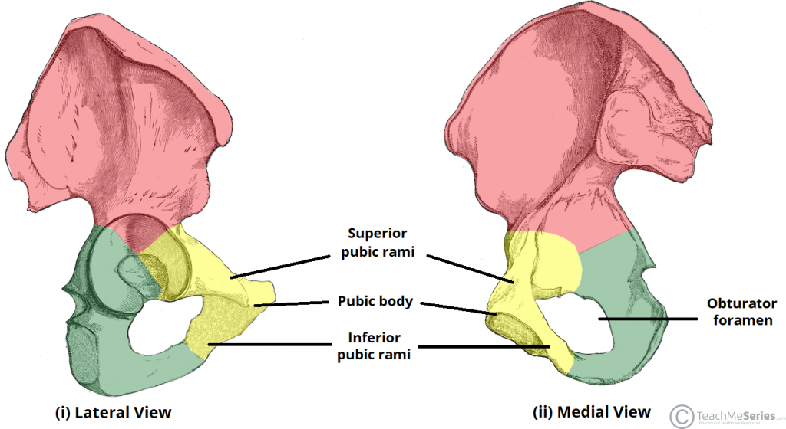
The Pubis
The pubis is the most anterior portion of the hip bone.
It consists of a body, superior ramus and inferior ramus (ramus = branch).
Pubic body ,
* located medially, it articulates with the opposite pubic body at the pubic symphysis.
Its superior aspect is marked by a rounded thickening (the pubic crest), which extends laterally as the pubic tubercle.
Superior pubic ramus , extends laterally from the body to form part of the acetabulum.
It has 3 surfaces : upper pectineal surface, pelvic surface, obturator surface.
Inferior pubic ramus , projects towards the ischium.
Together, the superior and inferior rami enclose part of the obturator foramen – through which the obturator nerve, artery and vein pass through to reach the lower limb.

Slide 27
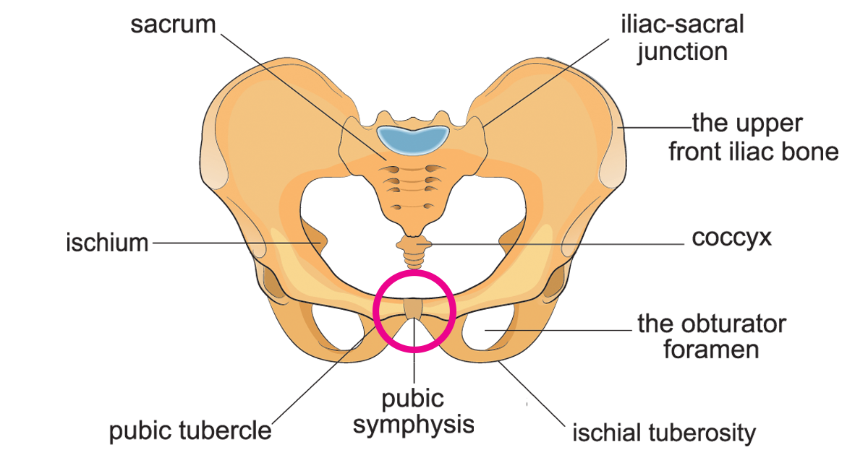
Symphysis Pubis
Is a cartilaginous joint between the two pubic bones.
The articular surfaces are covered by a layer of hyalin cartilage and are connected together by a fibrocartilaginous disc.
Almost no movement is possible at this joint.

Slide 28
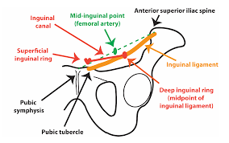
Pubic tubercle
It can be felt on the upper border of the pubis.
The medial end of inguinal ligament is attached to it.
The tubercle can be palpated easily in the male by invagination the scrotum from below with the examining finger.
In the female, the pubic tubercle can be palpated through the lateral margin of the labium majus.

Slide 29
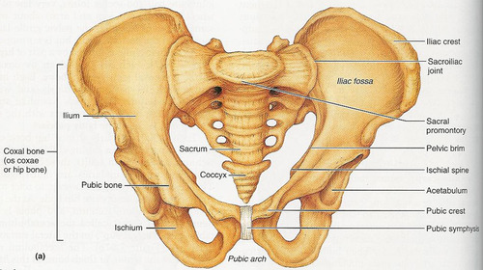
Pubic crest is the ridge of the bone on the superior surface of pubic bone, medial to pubic tubercule.

Slide 30
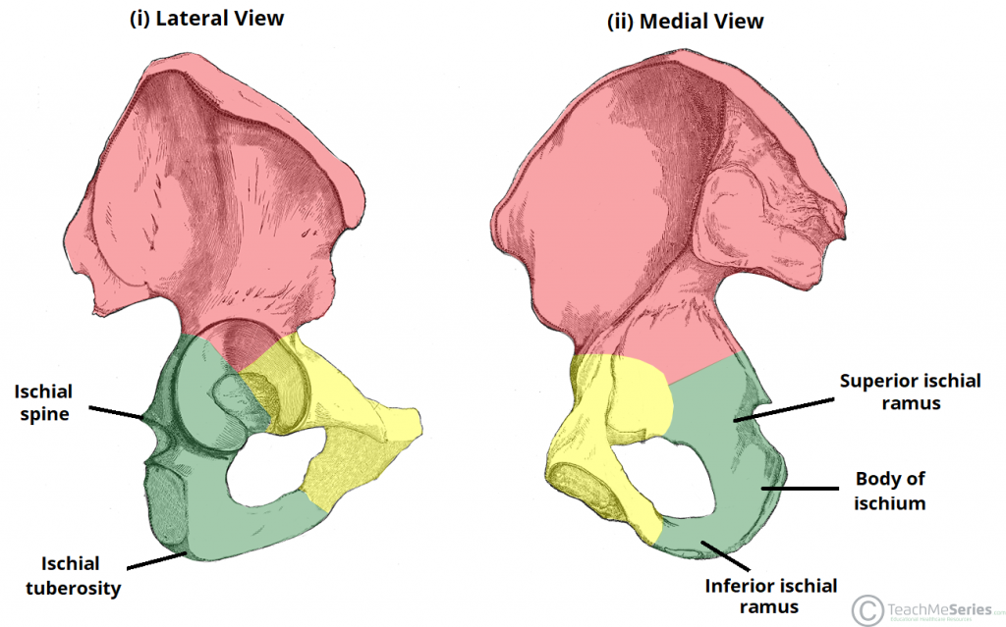
The Ischium
it forms the posteroinferior part of the hip bone.
it is composed of a body, an inferior ramus and superior ramus (ramus=branch) .
The inferior ischial ramus
it combines with the inferior pubic ramus forming the ischiopubic ramus, which encloses part of the obturator foramen.
The ischial tuberosities,
* the posteroinferior aspect of the ischium
* when sitting, it is these tuberosities on which our body weight falls.
the ischial spine,
* is formed near the junction of the superior ramus and body
* is a posteromedial projection of bone
*it separates the greater sciatic notch from the lesser sciatic notch.
The sciatic notches are converted into the greater and lesser sciatic foramina by the sacrotuberous and sacrospinous ligaments

Slide 31
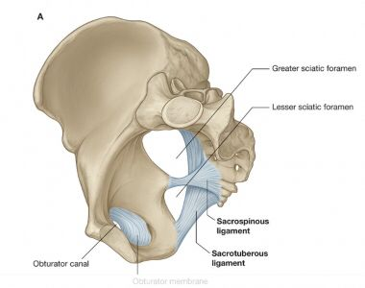
Two important ligaments attach to the ischium:
Sacrospinous ligament – runs from the ischial spine to the lateral part of the sacrum and coccyx , thus creating the greater sciatic foramen through which lower limb neurovasculature (including the sciatic nerve) transcends.
Sacrotuberous ligament – runs from the lateral part of the sacrum and coccyx and the posterior inferior iliac spine to the ischial tuberosity, forming the lesser sciatic foramen.
** These ligaments prevent the lower end of the sacrum and the coccyx from being rotated upward at the sacroiliac joint by the weight of the body . Also, convert the greater and lesser sciatic notches into the greater and lesser sciatic foramina. Also , stabilize the sacrum in between the two iliac bones .

Slide 32
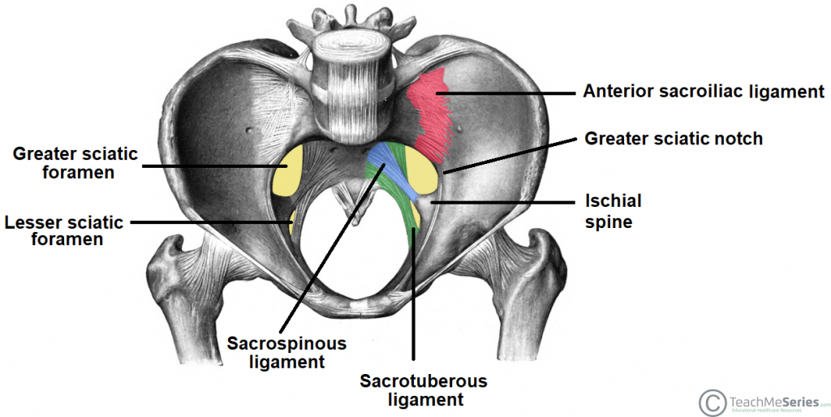
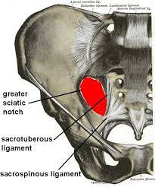
Sciatic Foramina
The greater and lesser sciatic foramina are two openings in the posterior aspect of the pelvis.
The greater sciatic foramen is larger and is separated from the lesser sciatic foramen by the sacrospinous ligament.
Greater Sciatic Foramen
The greater sciatic foramen provides a passageway for structures to pass from the pelvis into the gluteal region
Borders
* Superior – anterior sacroiliac ligament
*Posteromedial – sacrotuberous ligament
*Anterolateral – greater sciatic notch of the ilium
*Inferior – sacrospinous ligament and ischial spine

Slide 33
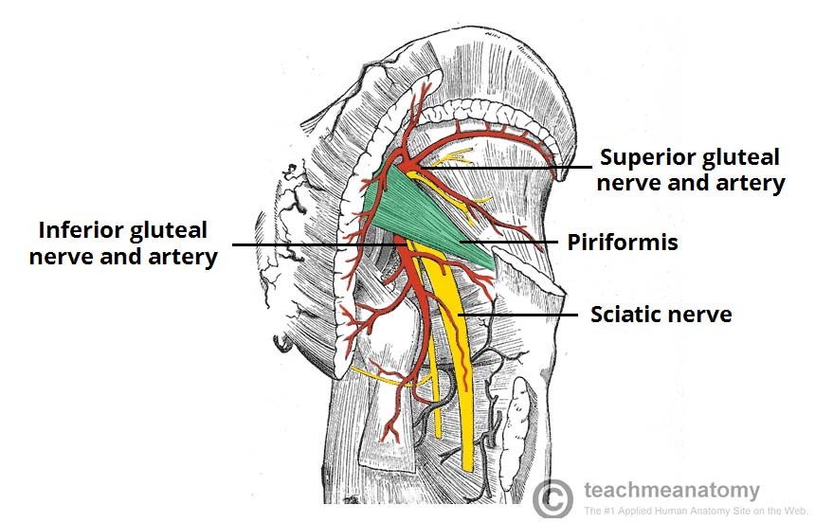
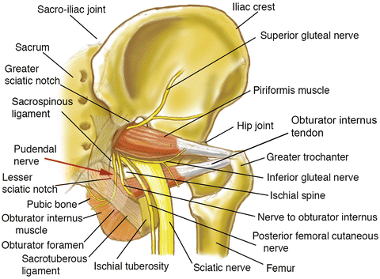
Contents
The greater sciatic foramen is divided into two parts by the presence of the piriformis muscle – the suprapiriform and infrapiriform foramina.
Suprapiriform foramen:
  Superior gluteal artery and vein
  Superior gluteal nerve
Infrapiriform foramen:
  Sciatic nerve
  Pudendal nerve
  Inferior gluteal artery and vein
  Inferior gluteal nerve
  Posterior femoral cutaneous nerve
  Nerve to obturator internus
  Nerve to quadratus femoris

Slide 34
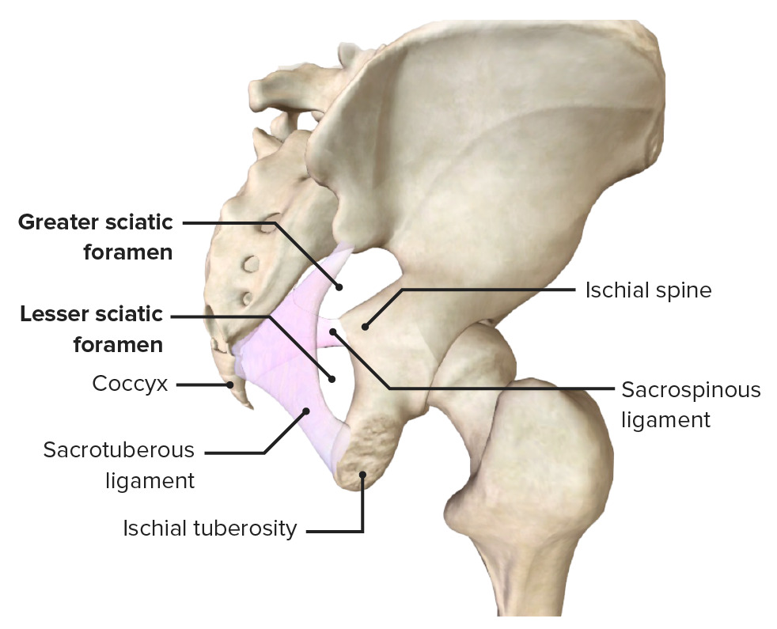
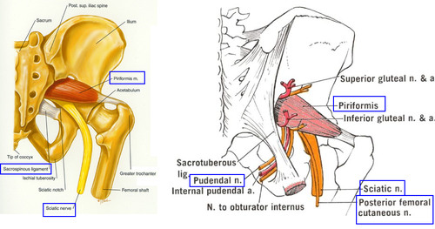
lesser sciatic foramen
The lesser sciatic foramen provides a communication between the perineum of the pelvis and the gluteal region.
It lies inferiorly to the pelvic floor
Borders
Superior – sacrospinous ligament and ischial spine
Anterior – ischial spine, lesser sciatic notch and ischial tuberosity
Posterior – sacrotuberous ligament
Contents
Internal pudendal artery and vein
Pudendal nerve (note the pudendal nerve first leaves the pelvis via the greater sciatic foramen, and then re-enters via the lesser sciatic foramen)
Obturator internus tendon
Nerve to obturator internus

Slide 35
Obturator Internus Muscle
It is one of the deep gluteal muscles
Attachments :
Origin: from the pubis and ischium at the obturator foramen and obturator membrane . It leaves pelvis through the lesser sciatic foramen.
Insertion: to the greater trochanter of the femur.
Actions : Lateral / external rotation and abduction of the lower limb.
Innervation : Nerve to obturator internus from sacral plexus.

Slide 36
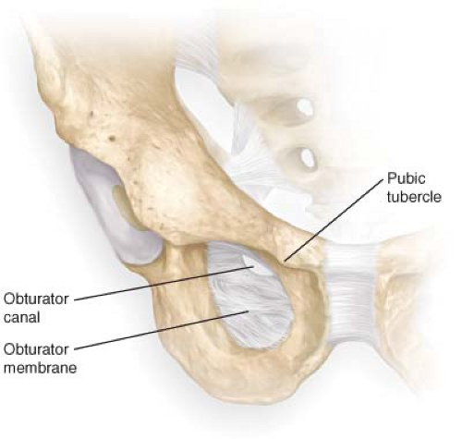
Obturator Membrane:
is a fibrous sheet that almost completely closes the obturator foramen, leaving a small gap, the obturator canal, for the passage of the obturator nerve and vessels as they leave the pelvis to enter the thigh .
v

Slide 37
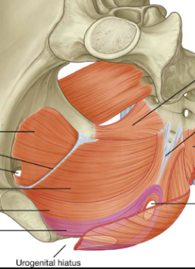
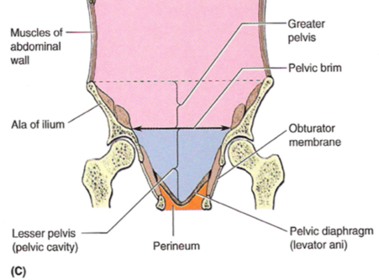
Floor of the pelvic- pelvic diaphragm

Slide 38
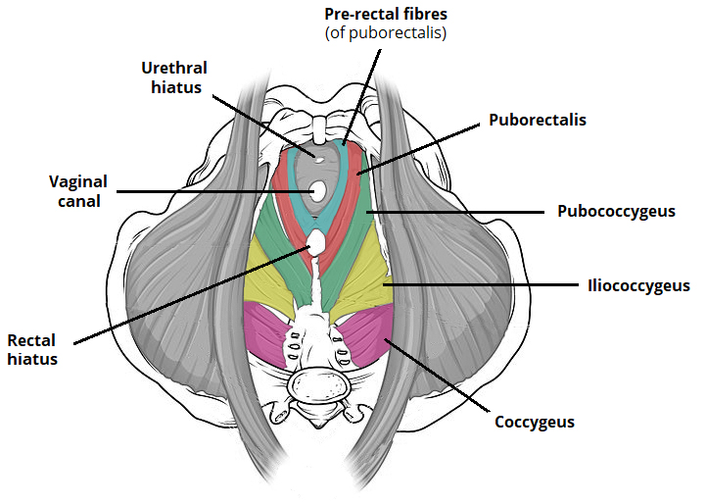
Inferior Pelvic Wall / Pelvic Floor/Pelvic Diaphragm
is a funnel-shaped structure, It attaches to the walls of the lesser pelvis below pelvic brim and supports the pelvic viscera
it divides pelvis into the main pelvic cavity above , which contains the pelvic viscera , and the perineum below.
The paired levator ani and coccygeus muscles and their covering fasciae form the pelvic diaphragm
It is incomplete anteriorly to allow passage of the urethra in males and the urethra and the vagina in females

Slide 39
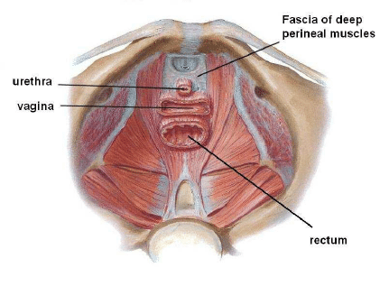
There are two ‘holes’ that have significance in order to allow for urination and defecation :
* Urogenital hiatus – an anteriorly situated gap, which allows passage of the urethra (and the vagina in females).
* Rectal hiatus – a centrally positioned gap, which allows passage of the anal canal.
** Between the urogenital hiatus and the anal canal lies a fibrous node known as the perineal body, which joins the pelvic floor to the perineum

Slide 40
Levator Ani Muscle
is a wide, thin sheet forming the larger, more anterior part of the pelvic diaphragm
Origin :
Course of fibers:
Downwards, backwards and medially.
Anterior fibers: pubic bodies of the hip bones.
Middle fibers: white line of the thickened fascia of the obturator internus muscle, known as the tendinous arch.
Posterior fibers: ischial spines of the hip bones.

Slide 41
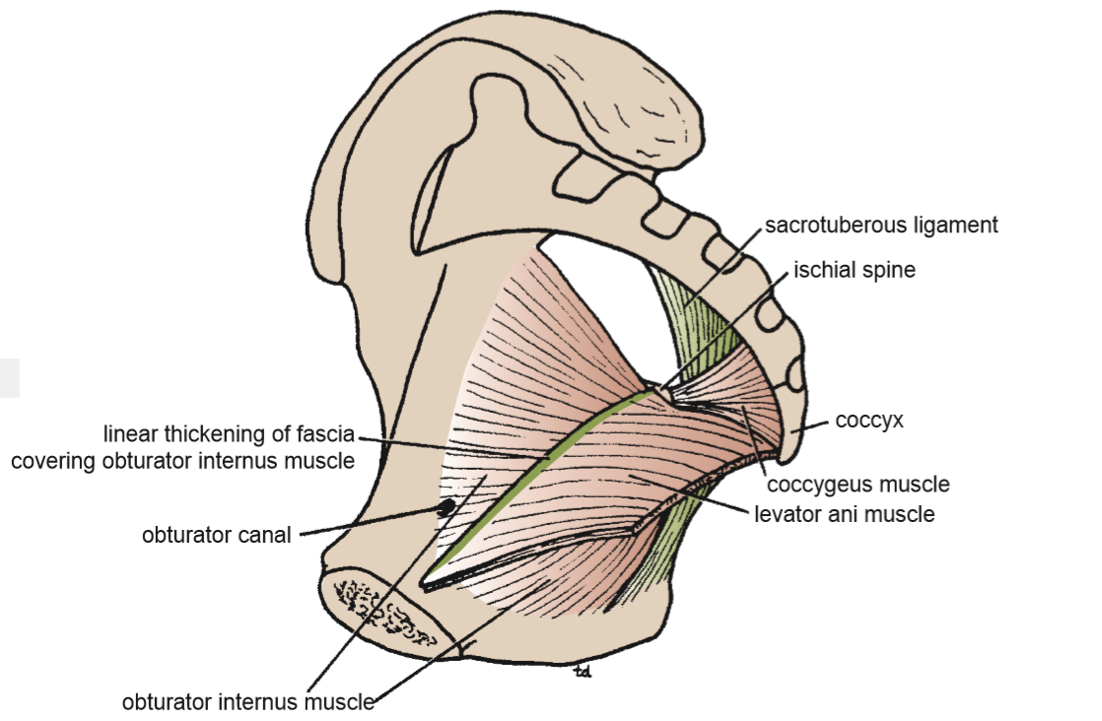
Lavator ani - origin

Slide 42
Insertion:
The muscle consists of three parts:
Anterior fibers of pubococcygeus: Runs below and lateral to prostate in male (levator prostatae ) and around vagina in female (sphincter vagina). It is inserted in the perineal body .
Middle fibers (puborectalis),encircles rectum at recto-anal junction. It is inserted in anococcygeal body.
Posterior fibers ( iliococcygeus), are inserted in last 2 coccygeal segments and anococcygeal raphe.

Slide 43
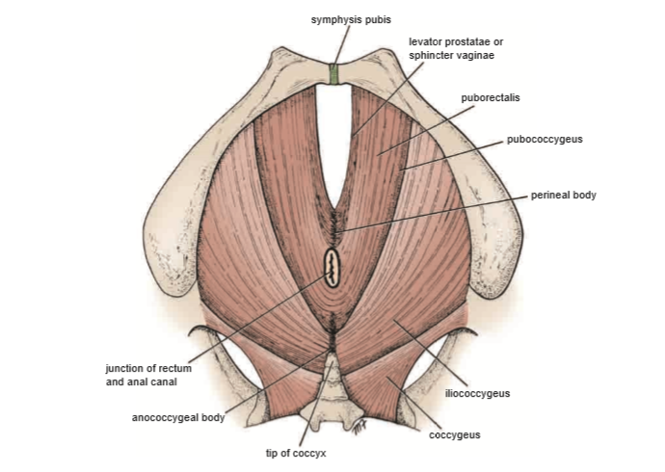

Slide 44
Nerve Supply :
Upper (pelvic) surface : the anterior ramus of S4 and branches of the pudendal nerve (roots S2, S3 and S4).
Lower (perineal) surface : Inferior rectal N.
Action :
supports and maintains the pelvic viscera in position.
It increases the intra abdominal pressure, so its used in defecation , micturition and labor.
They also have an important sphincter action on the anorectal junction, and, in the female, they serve also as a sphincter of the vagina.

Slide 45
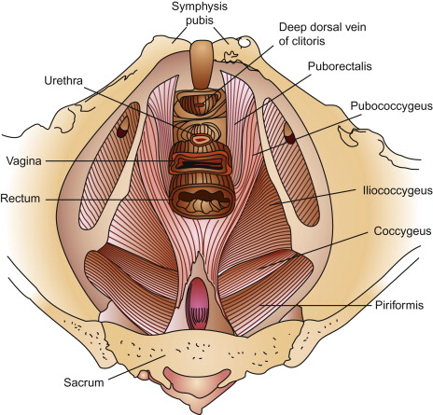
Puborectalis
is a U-shaped sling, extending from the bodies of the pubic bones, past the urogenital hiatus, around the anal canal producing U – shape .
Its tonic contraction bends the anal canal anteriorly, creating the anorectal angle (90 degrees) at the anorectal junction (where the rectum meets the anus) and so maintain fecal continence .
during defecation this muscle relaxes .
Some fibers of the puborectalis muscle (pre-rectal fibers) form another U-shaped sling that flank the urethra in the male and the urethra and vagina in the female (pubovaginalis or sphincter urethrae / vaginae). These fibers are very important in preserving urinary continence, especially during abrupt increase of the intra-abdominal pressure i.e. during sneezing

Slide 46
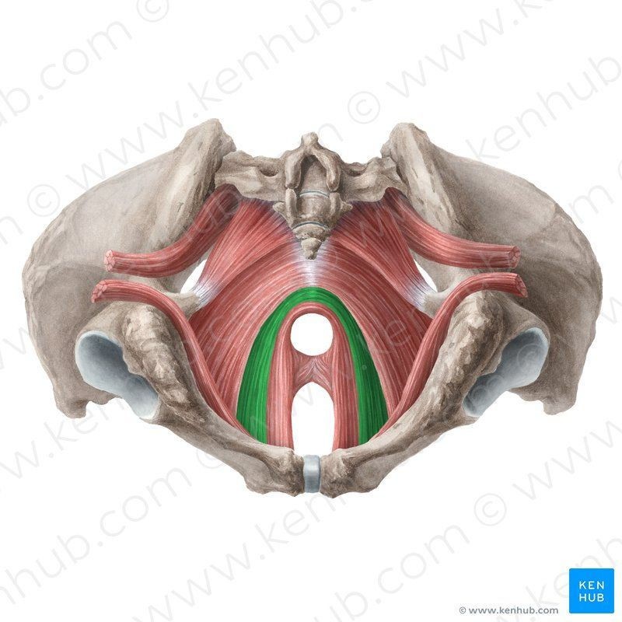
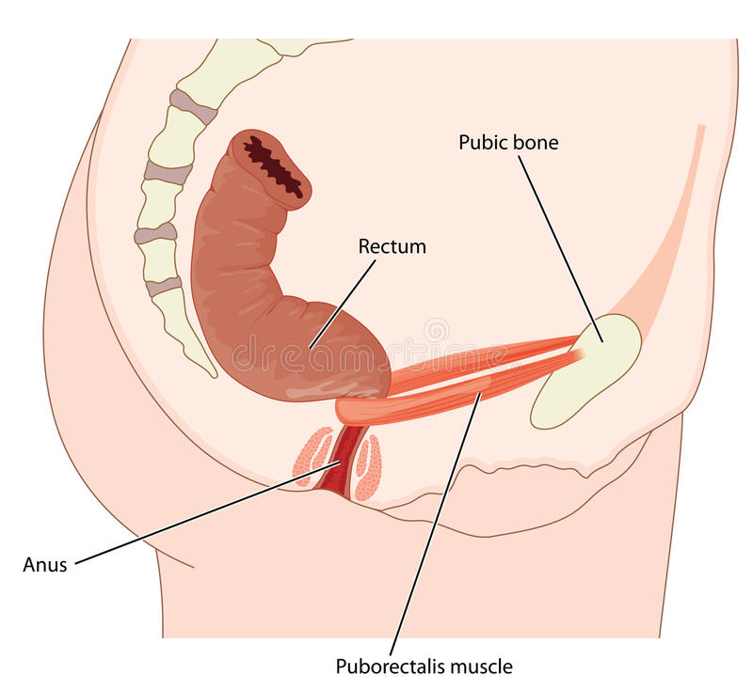

Slide 47
Pubococcygeus
The muscle fibres of the pubococcygeus are the main constituent of the levator ani.
They arise from the body of the pubic bone and the anterior aspect of the tendinous arch(thickened fascia covering obturator internus ), then fibres travel around the margin of the urogenital hiatus and run posteromedially , attaching at the coccyx and anococcygeal ligament/body (between the tip of coccyx and the anal canal ) .
Iliococcygeus
The iliococcygeus has thin muscle fibres, which arise from ischial spines and posterior aspect of the tendinous arch , attach posteriorly to the coccyx and the anococcygeal ligament.
This part of the levator ani is the actual “levator” of the three: its action elevates the pelvic floor and the anorectal canal.

Slide 48
The coccygeus (or ischiococcygeus )
is the smaller, and most posterior pelvic floor component
It originates from the ischial spines and travels to the lateral aspect of the sacrum and coccyx, along the sacrospinous ligament.
Innervated by the anterior rami of S4 and S5
The roles of the pelvic floor muscles are:
Support of abdominopelvic viscera (bladder, intestines, uterus etc.) through their tonic contraction.
Resistance to increases in intra-pelvic/abdominal pressure during activities such as coughing or lifting heavy objects.
Urinary and fecal continence . The muscle fibres have a sphincter action on the rectum and urethra. They relax to allow urination and defecation.

Slide 49

Thank You

