Slide 1
ANATOMY LAB 2
Pelvis
Prepared By:
Dr. Ayah Mahmoud Almzayyen
MD , T.A in AUG

Slide 2
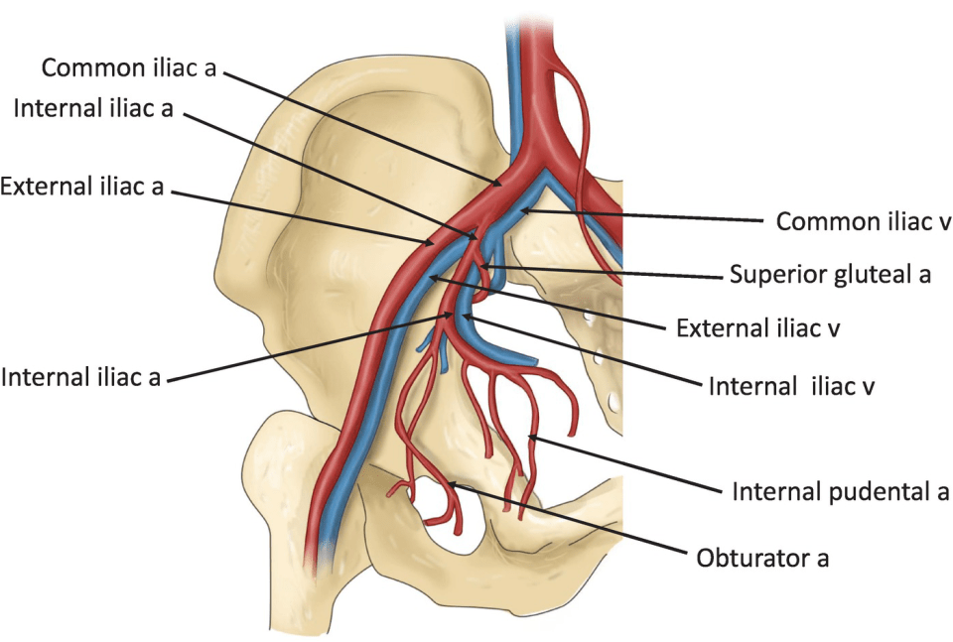
PELVIC ARTERIES
Common Iliac Artery
Each common iliac artery ends at the pelvic inlet in front of the sacroiliac joint by dividing into the external and internal iliac arteries (usually occurs at vertebral level L5-S1)
External Iliac Artery
The external iliac artery runs along the medial border of the psoas muscle, following the pelvic brim
gives off the inferior epigastric and deep circumflex iliac branches. It leaves the false pelvis by passing under the inguinal ligament to become the femoral artery.
True Pelvis Arteries
The following arteries enter the pelvic cavity(true pelvis) : * * *Internal iliac artery
* Superior rectal artery
* Ovarian artery
* Median sacral artery

Slide 3
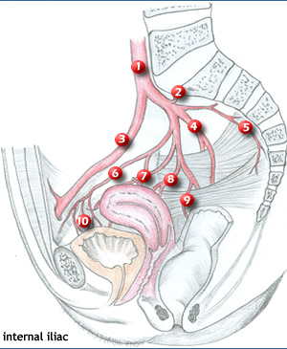
Common iliac artery bifurcation at vertebral level L5-S1)

Slide 4
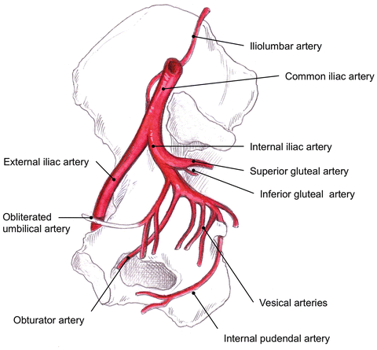
The internal iliac artery courses posteromedially towards the greater sciatic foramen. It is approximately 4 cm in length.
At the superior margin of the greater sciatic foramen it divides into an anterior division and posterior division.
The anterior division continues down to the ischial spine anterior to piriformis giving off visceral and parietal branches. The posterior division only gives rise to parietal branches.

Slide 5
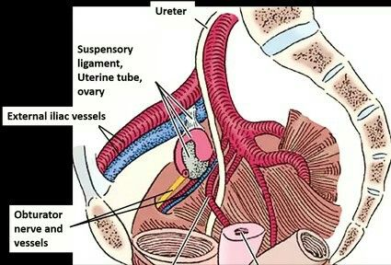
Relations
Anteriorly: ureter, ovary, uterine tube
Posteriorly: lumbosacral trunk, sacroiliac joint,IIV
Medially: peritoneum
Laterally: external iliac vein, obturator nerve

Slide 6
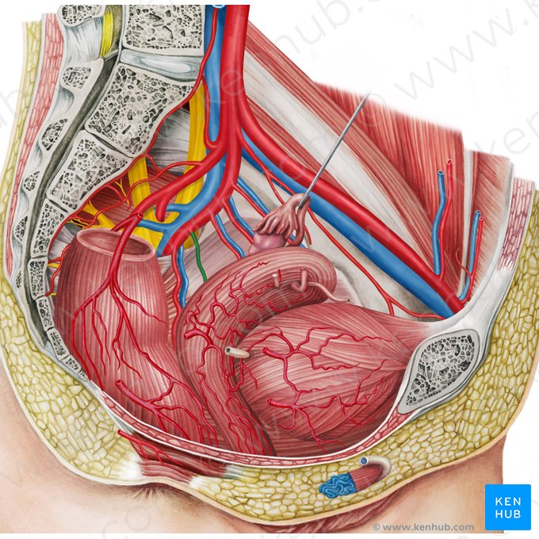

Slide 7
Posterior Division Branches
( I Love Surgery )
Iliolumbar artery – Ascends to exit the lesser pelvis, dividing into a lumbar and iliac branch. The lumbar branch supplies psoas major, quadratus lumborum and the posterior abdominal wall. The iliac branch supplies the muscles and bone around the iliac fossa.
Lateral sacral arteries (superior and inferior) – Travel infero-medially along the posterior pelvic wall to supply structures in the sacral canal, and the skin and muscle posterior to the sacrum.
Superior gluteal artery – The main branch of Internal iliac artery .
The terminal branch of the posterior trunk. It exits the pelvic cavity via the greater sciatic foramen, entering the gluteal region superiorly to the piriformis muscle. It is the major blood supply to the muscles and skin of the gluteal region.

Slide 8
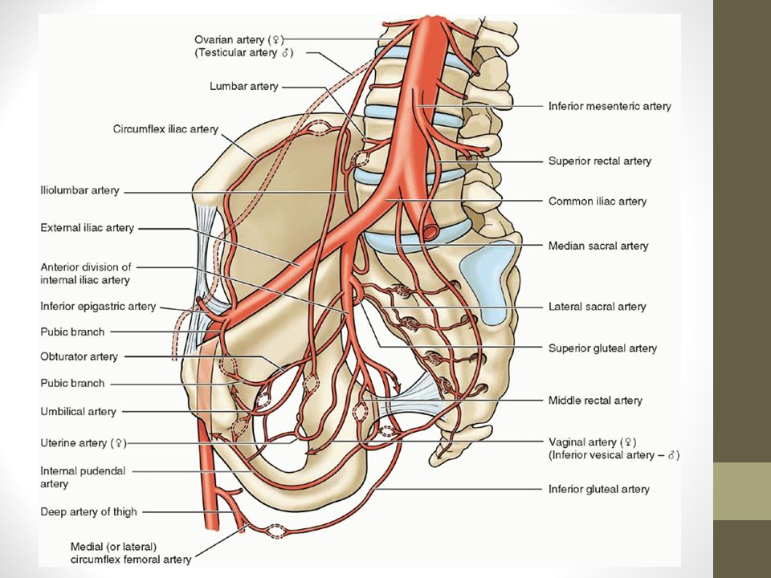

Slide 9
Anterior Division Branches
(So I'm Under Very Good )
S : Superior vesical artery
O : Obturator artery
I : Inferior vesical artery, Internal pudendal artery, Inferior gluteal artery
M : Middle rectal arteries
U : Uterine artery, Umbilical artery
V : Vaginal artery
G : Inferior gluteal artery

Slide 12
The parietal branches of anterior division:
Obturator artery – Leaves the pelvis through the obturator canal, accompanied by the obturator nerve and vein. It supplies the muscles of the thigh’s adductor region.
Inferior gluteal artery – The terminal branch of the anterior trunk. It leaves the pelvic cavity via the greater sciatic foramen, emerging inferiorly to the piriformis muscle in the gluteal region. It contributes to the blood supply of the gluteal muscles and hip joint
Internal pudendal artery – Moves inferiorly to exit the pelvis via the greater sciatic foramen. Accompanied by the pudendal nerve, it then enters the perineum via the lesser sciatic foramen. It is the main artery responsible for the blood supply to the perineum.

Slide 13
The visceral branches of anterior division:
Umbilical artery – Gives rise to the superior vesical artery, which supplies the superior aspect of the urinary bladder. In utero, the umbilical artery transports deoxygenated blood from the fetus to the placenta.
Middle rectal artery – Travels medially to supply the distal part of the rectum. It also forms anastomoses with the superior rectal artery (derived from the inferior mesenteric) and the inferior rectal artery (derived from the internal pudendal)
Inferior vesical artery(Male) – Supplies the lower aspect of the bladder. In males, it also supplies the prostate gland and seminal vesicles.
Vaginal artery (female) – Descends to the vagina, supplying additional branches to the inferior bladder and rectum.

Slide 14
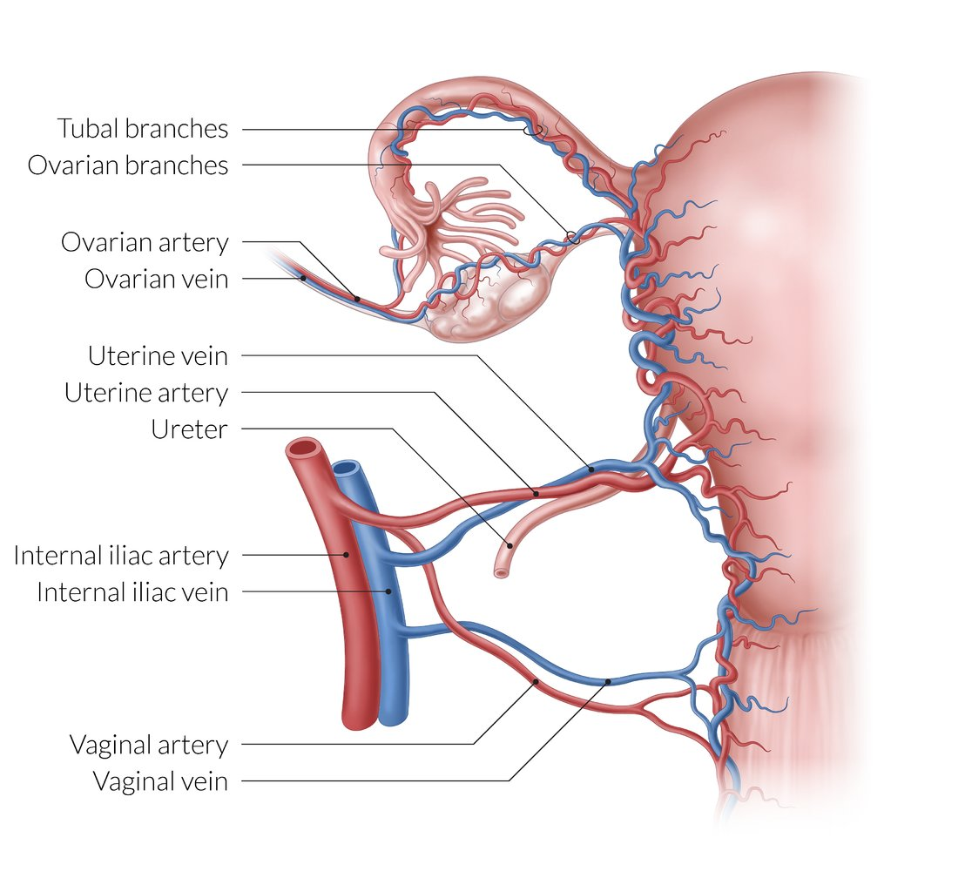
Uterine artery (female) – Travels within the Broad ligament to reach the cervix, where it ascends along the lateral aspect of the uterus. At origin of the fallopian tubes, it anastomoses with the ovarian artery. During its course, it crosses the ureters superiorly.

Slide 15
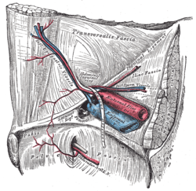
Obturator artery (IVP)
(25% will branch off the inferior epigastric artery)

Slide 16
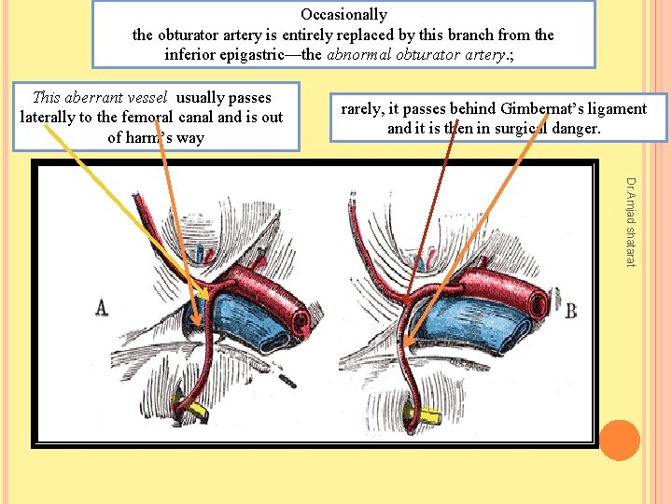

Slide 18
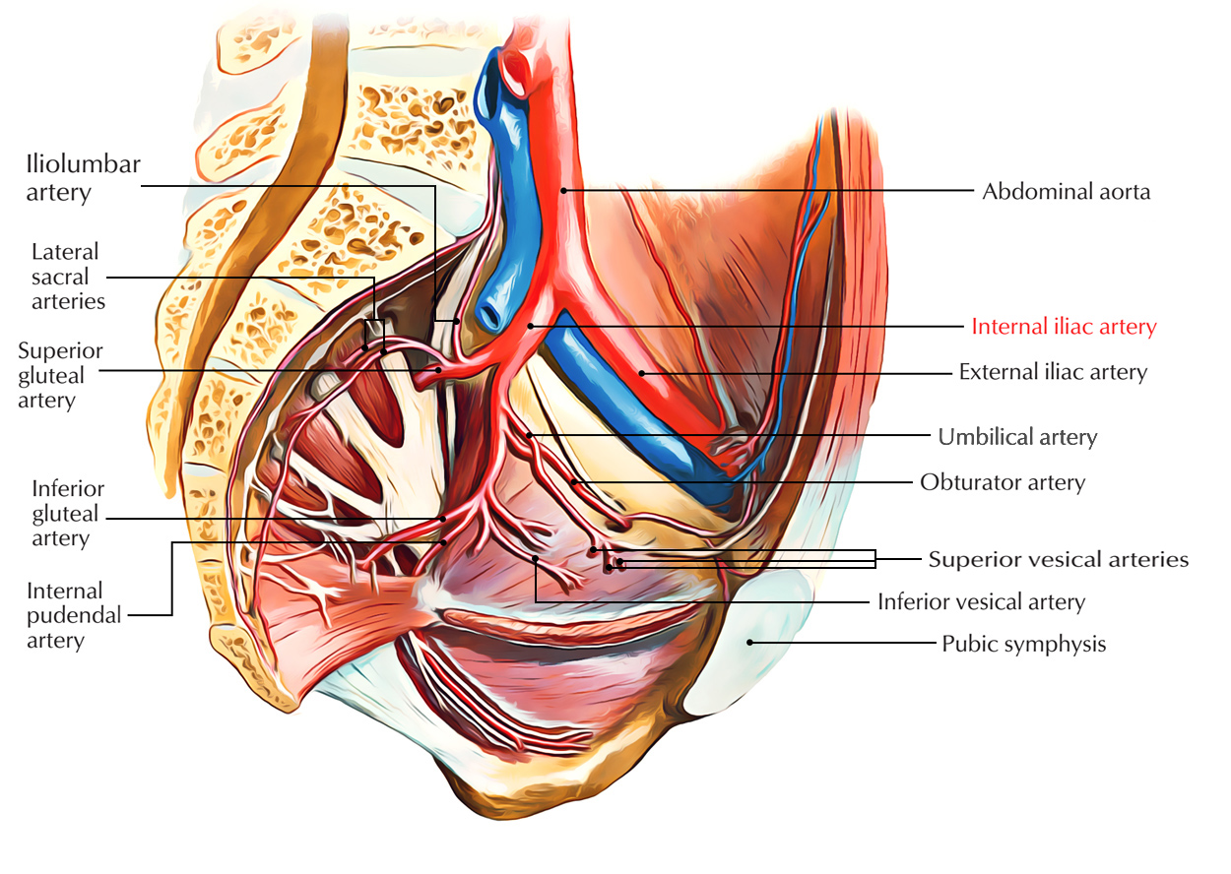

Slide 19
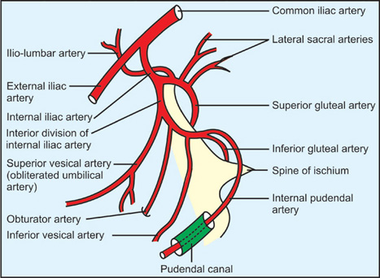

Slide 20
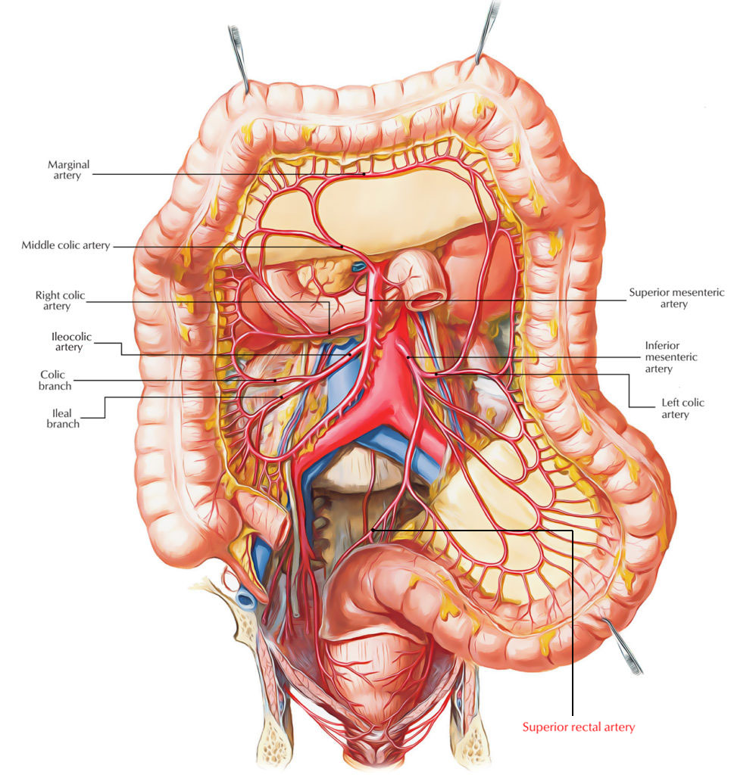
Minor Arteries of the Pelvis
Superior Rectal Artery
Is the terminal continuation of the inferior mesenteric artery.
It crosses the left common iliac artery and descends in the mesentery of the sigmoid colon.
It gives rise to branches that supply the rectum and upper half of anal canal.

Slide 21
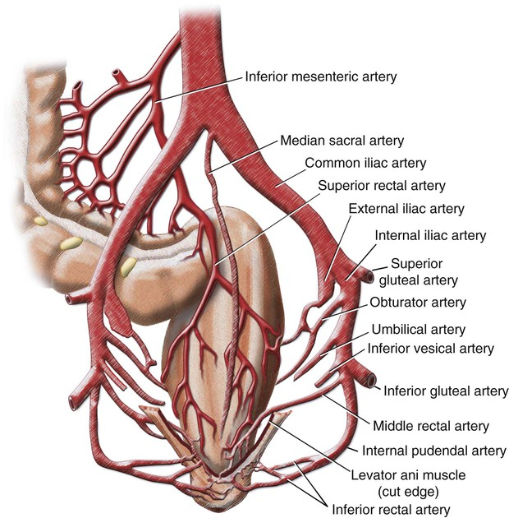
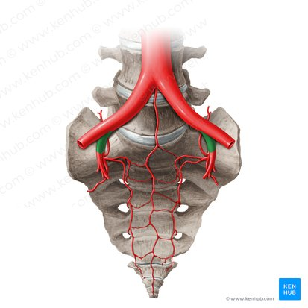
Median Sacral Artery
It originates from the posterior aspect of abdominal aorta, at its bifurcation into the common iliac arteries.
It descends anteriorly to the L4 and L5 vertebrae, the sacrum and the coccyx, contributing to the arterial supply of these regions.

Slide 22
Gonadal Arteries
The ovarian artery , is the major gonadal artery in females. It arises from the abdominal aorta, distal to the origin of the renal arteries.
The artery descends towards the pelvis, crossing the pelvic brim and the origin of the external iliac vessels.
It moves medially, dividing into an ovarian branch and tubal branches, which supply their respective structures

Slide 23
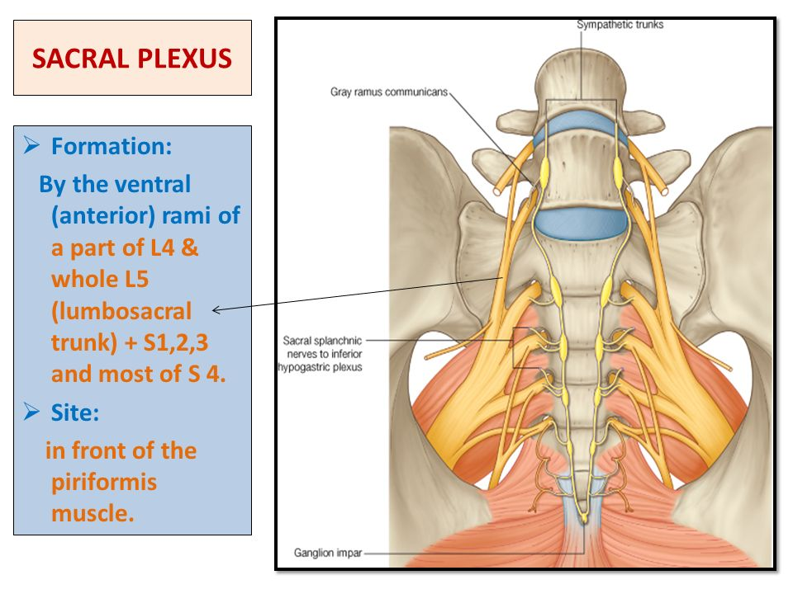
PELVIC NERVES
Sacral Plexus
is a network of nerve fibers that supplies the skin and muscles of the pelvis and lower limb.
It is located on the surface of the posterior pelvic wall, anterior to the piriformis muscle.
is formed by the anterior rami (divisions) of the sacral spinal nerves S1, S2, S3 and S4. It also receives contributions from the anterior rami of lumbar spinal nerves L4 and L5( lumbosacral trunk).
Relations
Anteriorly: the internal iliac vessels and their branches and the rectum
Posteriorly: the piriformis muscle

Slide 24
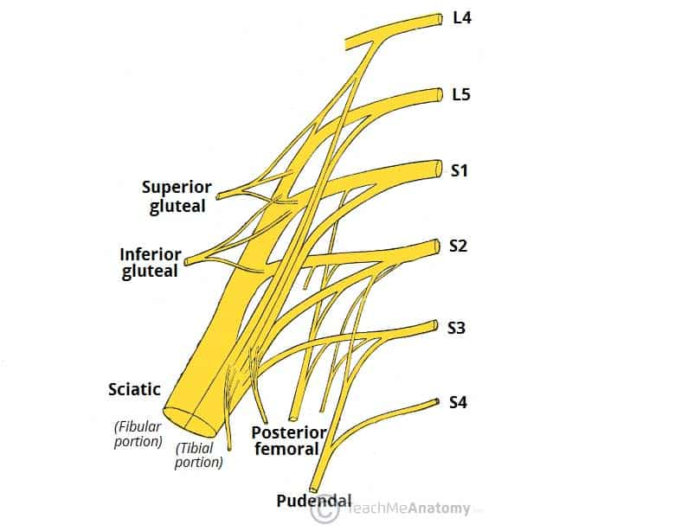
The Branches
The anterior rami of the S1-S4 spinal roots and the lumbosacral trunk divide into several cords. These cords then combine together to form the five major peripheral nerves of the sacral plexus
These nerves then descend down the posterior pelvic wall. They have two main destinations:
Remain in the pelvis – these nerves innervate the pelvic muscles, organs and perineum.
Leave the pelvis via the greater sciatic foramen – these nerves enter the gluteal region of the lower limb, innervating the structures there.

Slide 25
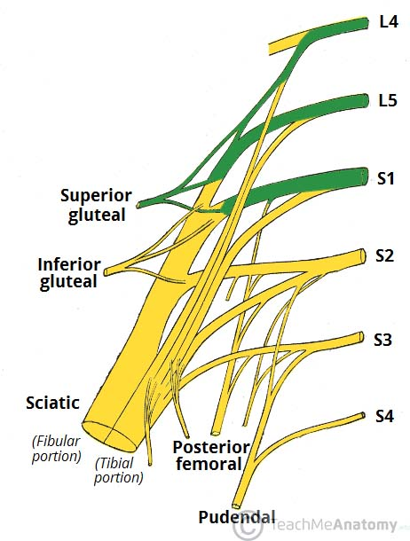
Superior Gluteal Nerve
leaves the pelvis via the greater sciatic foramen, entering the gluteal region superiorly to the piriformis muscle. It is accompanied by the superior gluteal artery and vein for much of its course.
Roots: L4, L5, S1.
Motor Functions: Innervates the gluteus minimus, gluteus medius and tensor fascia lata.
Sensory Functions: None

Slide 26
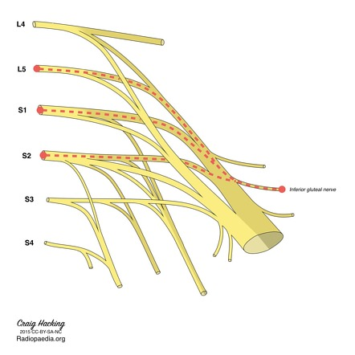
Inferior Gluteal Nerve
leaves the pelvis via the greater sciatic foramen, entering the gluteal region inferiorly to the piriformis muscle.
It is accompanied by the inferior gluteal artery and vein for much of its course.
Roots: L5, S1, S2.
Motor Functions: Innervates gluteus maximus.
Sensory Functions: None.

Slide 27
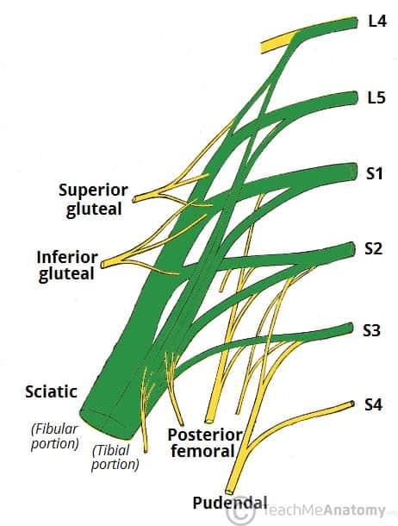
Sciatic Nerve
is the largest branch of the plexus and the largest nerve in the body
Roots: L4, L5, S1, S2, S3
Motor Functions:
  Tibial portion – Innervates the muscles in the posterior compartment of the thigh except apart from the short head of the biceps femoris , and the hamstring component of adductor magnus. Innervates all the muscles in the posterior compartment of the leg and sole of the foot.
  Common fibular portion – Short head of biceps femoris, all muscles in the anterior and lateral compartments of the leg and extensor digitorum brevis.

Slide 28
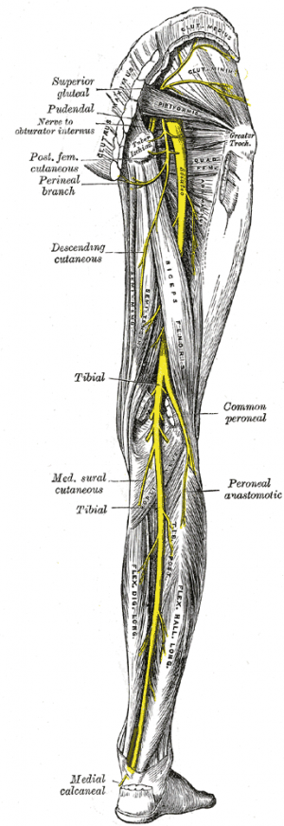
Sensory Functions:
  Tibial portion: supplies the skin of the posterolateral leg, lateral foot and the sole of the foot.
  Common fibular portion: supplies the skin of the lateral leg and the dorsum of the foot

Slide 29
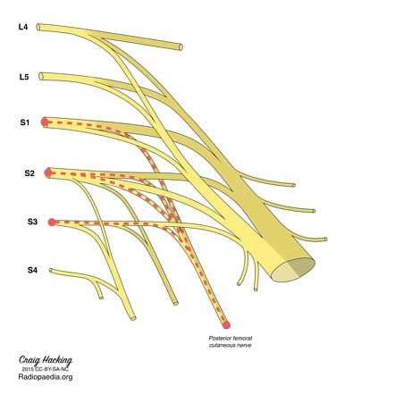
Posterior Femoral Cutaneous
leaves the pelvis via the greater sciatic foramen, entering the gluteal region inferiorly to the piriformis muscle. It descends deep to the gluteus maximus and runs down the back of the thigh to the knee.
Roots: S1, S2, S3
Motor Functions: None
Sensory Functions:(cutaneous) Innervates the skin on the posterior surface of the thigh and leg. Also innervates the skin of the perineum

Slide 30
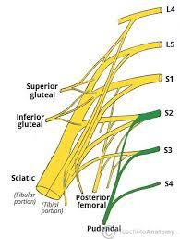
Pudendal Nerve
leaves the pelvis via the greater sciatic foramen, then re-enters via the lesser sciatic foramen. It moves anterosuperiorly along the lateral wall of the ischiorectal fossa, and terminates by dividing into several branches.
Roots: S2, S3, S4
Motor Functions: Innervates the skeletal muscles in the perineum , levator ani , the external urethral sphincter, the external anal sphincter .
Sensory Functions: Innervates the penis and the clitoris and most of the skin of the perineum.

Slide 31
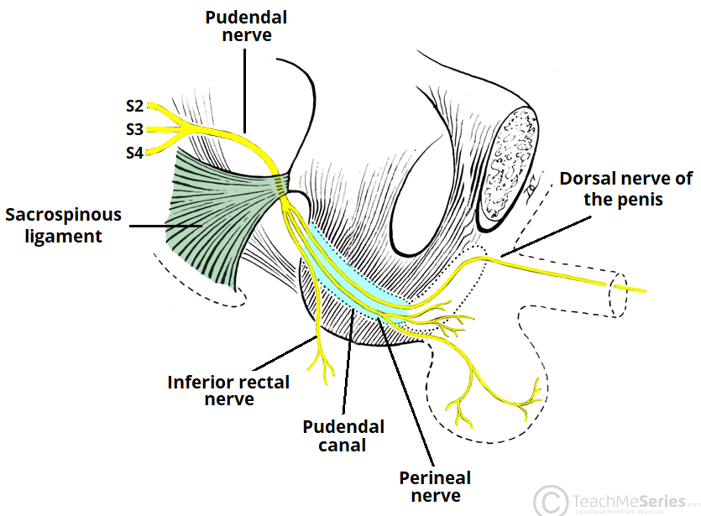
Branches of Pudendal Nerve:
Inferior rectal nerve – innervates the perianal skin and lower third of the anal canal.
Perineal nerve – innervates the skin of the perineum, labia minora and majora or posterior scrotum.
Dorsal nerve of the penis or clitoris – innervates the skin of the penis or clitoris. Thus, responsible for the afferent component of penile and clitoral erection.
(main sensory supply of penis)

Slide 32
Other Nerves in Pelvis:
perforating cutaneous nerve, which supplies the skin over the lower medial aspect of the buttock
Nerve to piriformis (piriformis muscle )
Nerve to obturator internus
(obturator internus and inferior gemellus muscles)
Nerve to quadratus femoris (quadratus femoris and inferior gemellus muscles)

Slide 33
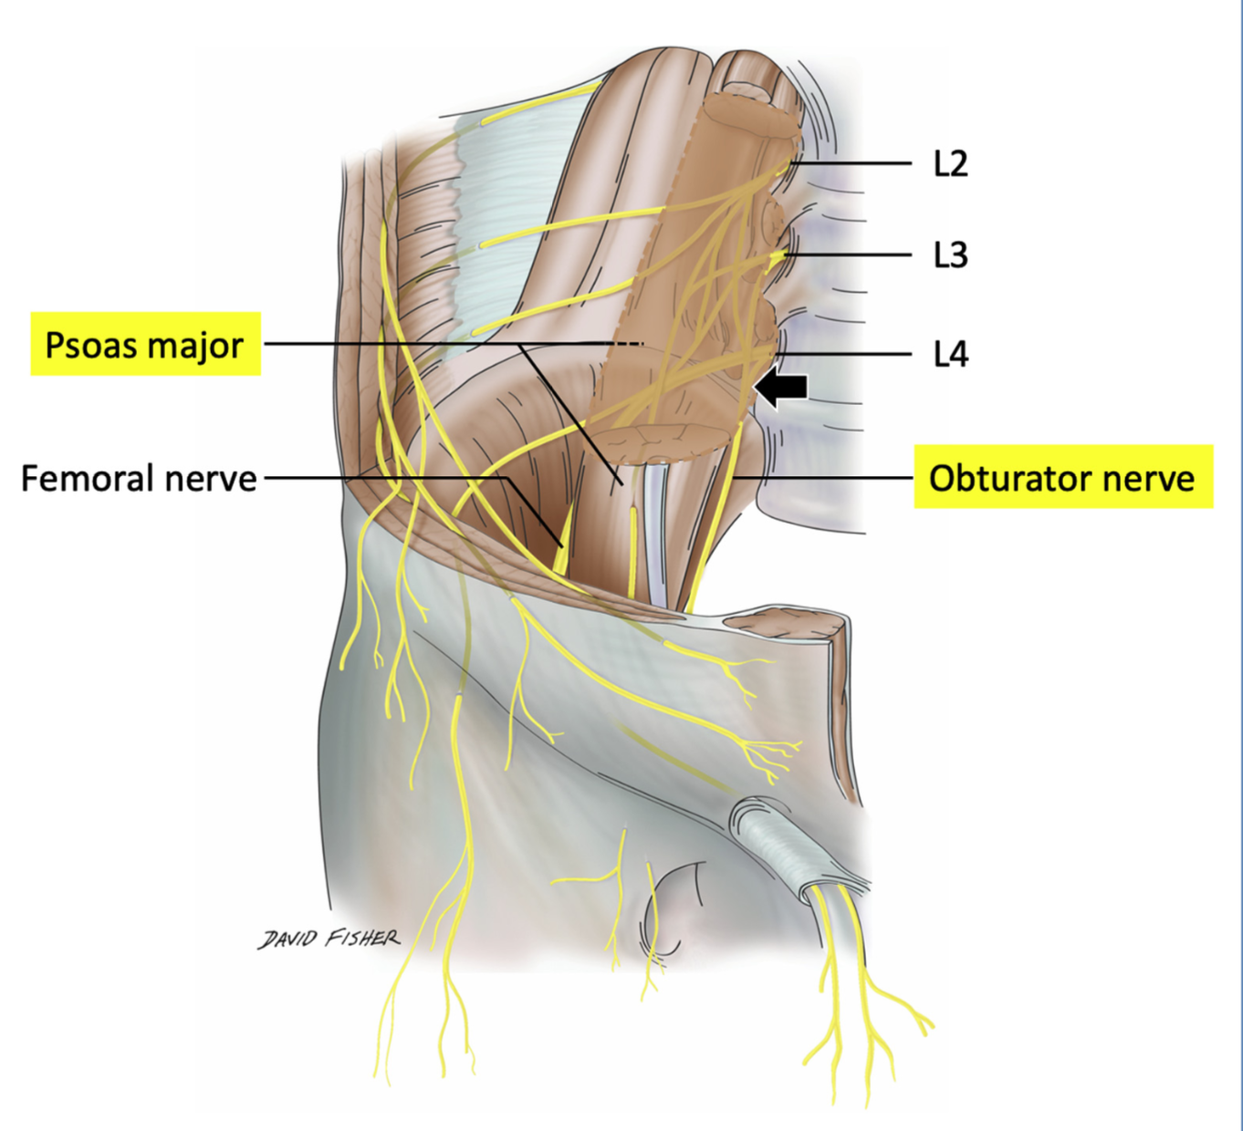
Obturator Nerve
is a branch of the lumbar plexus (L2, 3, and 4).
It emerges from the medial border of the psoas muscle in the abdomen and accompanies the lumbosacral trunk down into the pelvis.
It crosses the front of the sacroiliac joint and runs forward on the lateral pelvic wall in the angle between the internal and external iliac vessels .
On reaching the obturator canal (i.e., the upper part of the obturator foramen, which is devoid of the obturator membrane), it splits into anterior and posterior divisions that pass through the canal to enter the adductor region of the thigh.

Slide 34
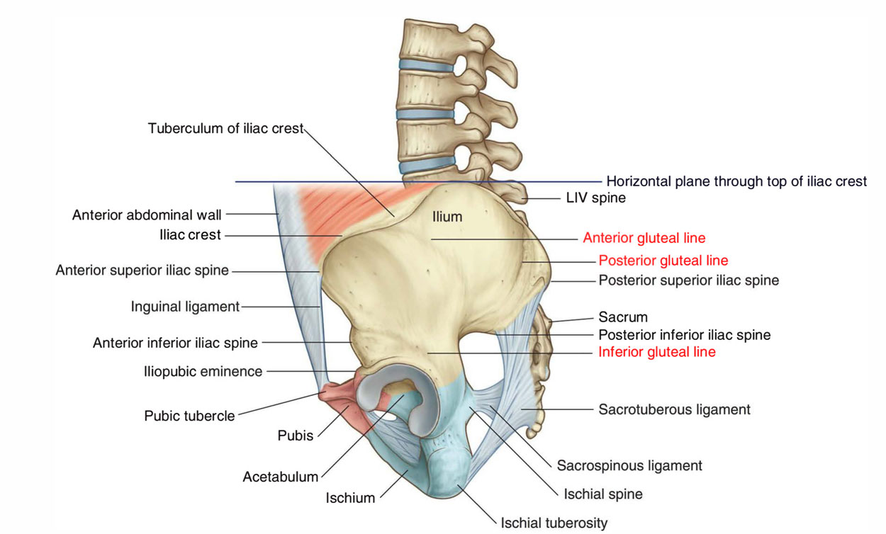
SURFACE ANATOMY
Several bony features of the pelvic walls are palpable in an adult of average body build. Additionally, significant parts of the underlying urogenital tracts are palpable with proper manipulation. Collectively, these form notable surface landmarks that help orient the clinician conducting a physical examination or procedure.
Iliac Crest
It can be felt through the skin along its entire length
It extends from the anterior superior iliac spine (ASIS) to the posterior superior iliac spine (PSIS).
The anterior superior iliac spine is situated at the anterior end of the iliac crest and lies at the upper lateral end of the fold of the groin
The posterior superior iliac spine is situated at the posterior end of the iliac crest . It lies at the bottom of a small skin dimple and on a level with the second sacral spine

Slide 35
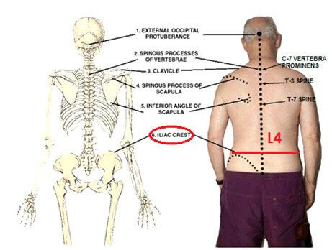
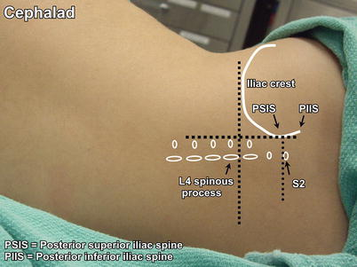

Slide 36
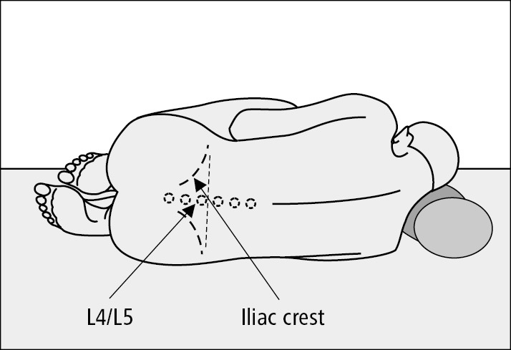
iliac crest
is used as a landmark to find the L4-L5 vertebrae as this is the space through which the needle is commonly inserted during a lumbar puncture.
A lumbar puncture (also called a spinal tap) is a minimally invasive procedure in which a needle is introduced into the spinal canal. Also , It can be used to administer spinal anesthesia (e.g. epidural) or other medications (e.g. chemotherapeutic drugs) into the spinal canal. It can also be done to collect cerebrospinal fluid in order to aid in diagnosing numerous illnesses (e.g. meningitis, demyelinating disorders)

Slide 37
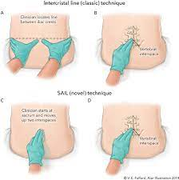

Slide 38
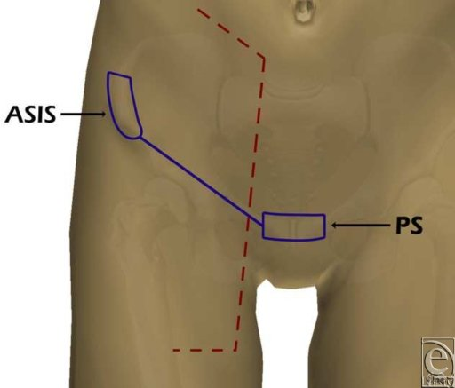
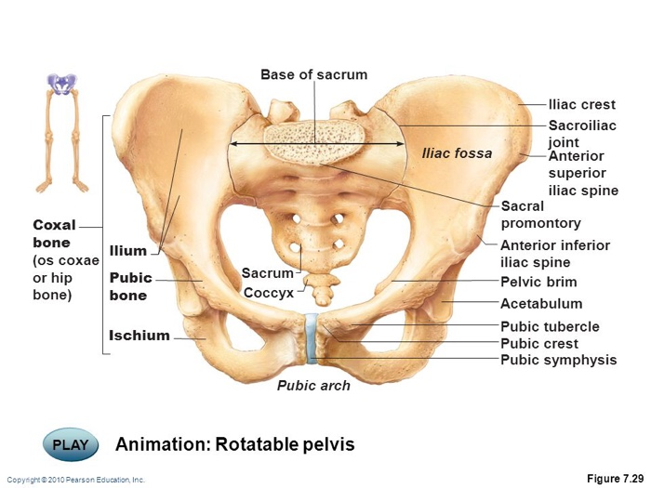
Symphysis Pubis
lies in the midline between the bodies of the pubic bones
it can be palpated as a solid structure through the fat that is present in this region.
Pubic Tubercle and Crest
The pubic tubercle can be felt on the upper border of the pubis .
The medial end of the inguinal ligament is attached to it.
The tubercle can be palpated easily in the male by invaginating the scrotum from below with the examining finger. In the female, the pubic tubercle can be palpated through the lateral margin of the labium majus.
The pubic crest is the ridge of the bone on the superior surface of the pubic bone, medial to the pubic tubercle

Slide 39
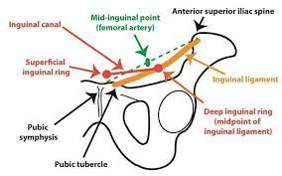
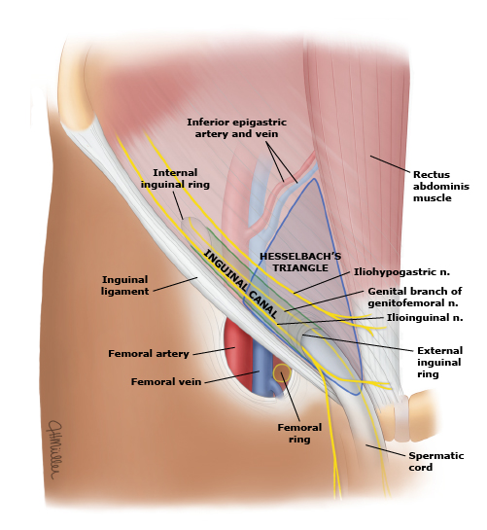
Clinical Notes
Anterior Superior Iliac Spine/ ASIS
The anterior superior iliac spine (ASIS) is an important anatomical landmark:
Mid-inguinal point – halfway between the ASIS and the center of the pubic symphysis. The femoral artery can be palpated here.
Mid-point of the inguinal ligament – halfway between the ASIS and the pubic tubercle. The deep inguinal ring can be found 0.5 inch above it.
Pubic tubercle
0.5 inch above and medial to pubic tubercle , superficial inguinal ring can be found.
0.5 inch below and lateral to pubic tubercle , femoral ring can be found.

Slide 40
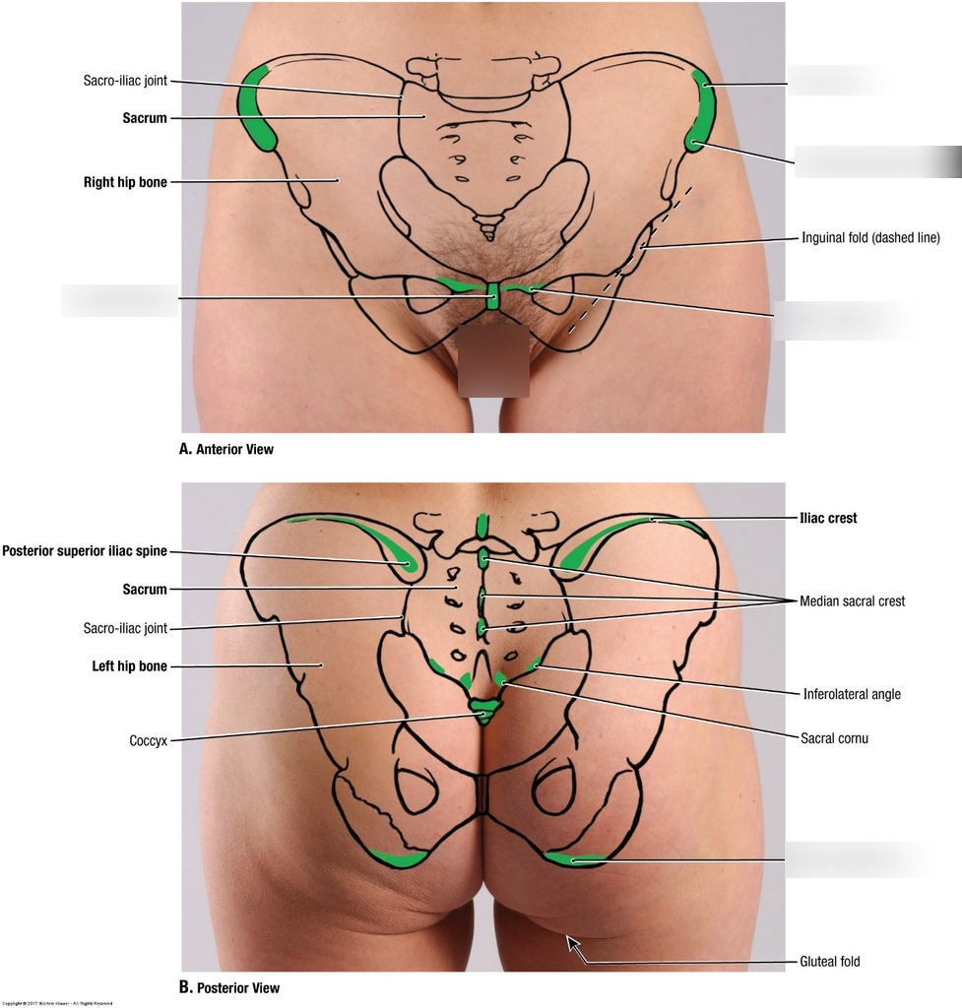
Sacrum and Coccyx
The spinous processes of the sacrum S1-S3 are fused with each other in the midline to form the median sacral crest. The crest can be felt beneath the skin in the uppermost part of the cleft between the buttocks.
The sacral hiatus is situated on the posterior aspect of the lower end of the sacrum, where the extradural space terminates. The hiatus lies about 2 in. (5 cm) above the tip of the coccyx and beneath the skin of the cleft between the buttocks.
The inferior surface and tip of the coccyx can be palpated in the cleft between the buttocks about 1 in. (2.5 cm) behind the anus. The anterior surface of the coccyx can be palpated with the gloved finger in the anal canal.

Slide 41

Urinary Bladder
In adults, the empty bladder is a pelvic organ and lies posterior to the symphysis pubis.
As the bladder fills, it rises up out of the pelvis into the abdomen, where it can be palpated through the anterior abdominal wall above the symphysis pubis

Slide 42
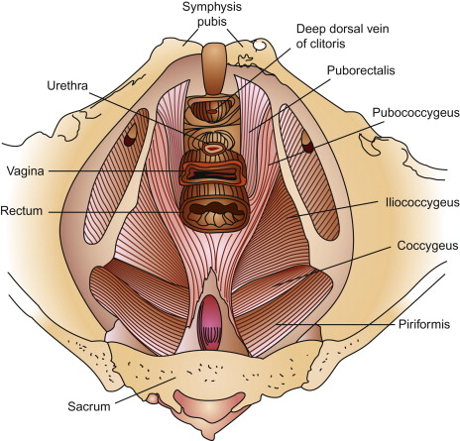
Pelvic Floor Injury :
( injury to the levator ani or local nerves , especially the pudendal nerve , during childbirth )
can result in the loss of support for the pelvic viscera (Pelvic Organ Prolapse POP ) leading to uterine and vaginal prolapse, herniation of the bladder (cystocele), and alteration in the position of the bladder neck and urethra, leading to stress incontinence. Prolapse of the rectum may also occur.

Slide 43
Clinical Notes
Assessment of the Female Bony Pelvis
The true / lesser pelvis is the bony canal through which the fetus has to pass during childbirth.
The female pelvis is well adapted for the process of childbirth.
*The female pelvis is shallower and the bones are smoother than in the male.
*The size of the pelvic inlet is similar in the two sexes, but in the female, the cavity is larger and cylindrical, and the pelvic outlet is wider in both the anteroposterior and the transverse diameters.
The pelvis can be classified into four general morphological groups:
Gynecoid
Anthropoid
Android
platypelloid

Slide 44
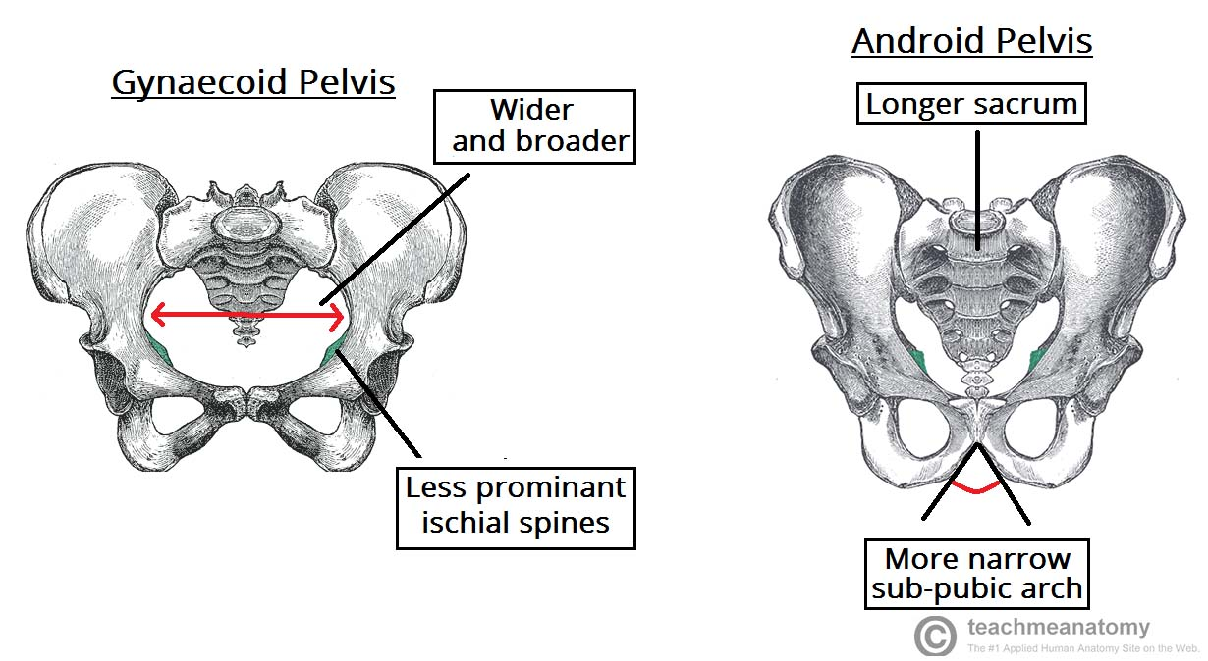
The majority of women have a gynaecoid pelvis, as opposed to the male android pelvis. The slight differences in their structures creates a greater pelvic outlet, adapted to aid the process of childbirth.
When comparing the two, the gynaecoid pelvis has:
A wider and broader structure yet it is lighter in weight
An oval-shaped inlet compared with the heart-shaped android pelvis.
Less prominent ischial spines, allowing for a greater bispinous diameter
A greater angled sub-pubic arch, more than 80-90 degrees.
A sacrum which is shorter, more curved and with a less pronounced sacral promontory.
**In addition to the bony adaptations, the sacrotuberous and sacrospinous ligaments can stretch under the influence of progesterone and increase the size of the outlet further

Slide 45
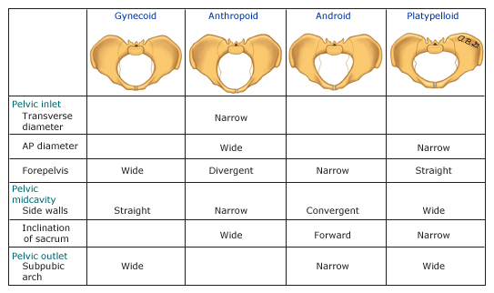

Slide 46
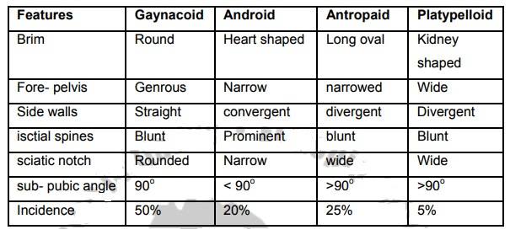

Slide 47

Thank You

