Slide 1
Musculoskeletal System -Pathology Lab

Slide 2
CONGENITAL DISORDERS OF BONE
AND CARTILAGE
A. Osteogenesis imperfecta (brittle bone disease)
1. Definition: Inherited generalized disorder of connective tissue characterized by defective synthesis of type I collagen
2. Epidemiology
a. MC type is autosomal dominant (AD) disease 90%
b. Increase in perinatal death. Families with severe postmenopausal osteoporosis should be evaluated for possible osteogenesis imperfecta.(Most common genetic cause of osteoporosis.)
3. Clinical findings
a. Pathologic fractures occur at birth with minimal trauma.
b. Patients have blue sclera . Reflection of the underlying choroidal veins through the thin sclera. Sclera is thin because of the lack of type I collagen.
c. Presenile deafness occurs in patients in their 20s and 30s.
d. Other findings: short stature, scoliosis, brittle teeth, short limbs

Slide 3
Etiology: various genetic defects; most commonly autosomal dominant mutations in COL1A1 or COL1A2 genes
Collagen, type I, alpha COL1A1
Genes that encodes collagen Type I alpha chain including (COL1A1 and COL1A2). Mutations in these genes are associated with osteogenesis imperfecta, Ehlers-Danlos syndrome, and osteoporosis.
Severe forms (types II and III) are usually due to a new (sporadic) mutation in one of these genes. Mild forms (types I, IV) are typically hereditary.

Slide 4
Pathophysiology: ↓ formation of hydrogen and disulfide bonds between type I preprocollagen molecules → ↓ triple helix formation → ↓ synthesis of normal type I collagen → impaired bone matrix formation (osteogenesis)
triple helix structure
two alpha-1 chains coded by genes COL1A1
one alpha-2 chain coded by gene COL1A2
Type I collagen is the most abundant scleroprotein and the main constituent of connective tissue in the human body. It occurs in bones, skin, tendons, dentin, fascia, as well as the sclera.
Triad of Fragile bone , blue sclera, and earlydeafness.

Slide 5
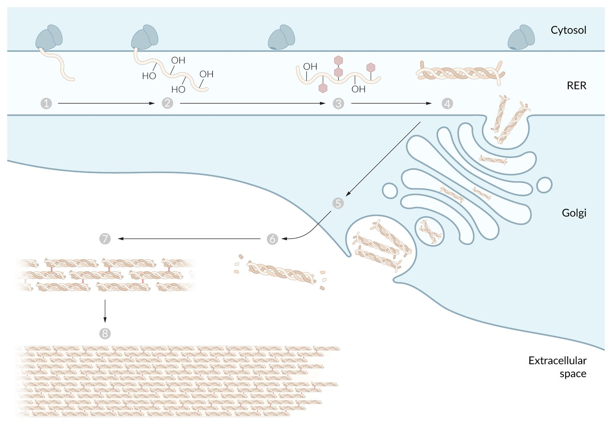

Slide 6
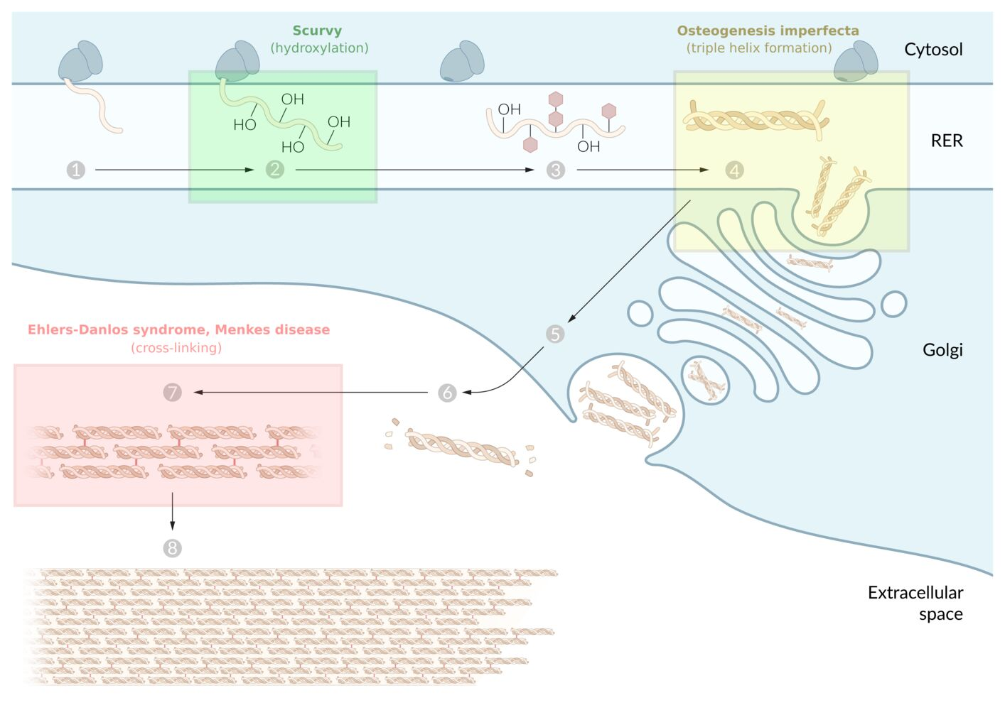
Notes:
Collagen synthesis
Collagen biosynthesis starts with the translation (1) at the rough ER, during which the polypeptide chain of the collagens is modified (Hydroxylation, 2). For attaching the OH groups, vitamin C is necessary as a cofactor for lysyl hydroxylase and prolyl hydroxylase. Next, by attaching sugar molecules, hydroxylysine residues are glycosylated (3). Three procollagen chains form a triple helix (4). These very large molecules are enclosed in vesicles, transported to the cell membrane via the Golgi apparatus and secreted via exocytosis in the extracellular space (5). At this stage, the collagen triple helix is further processed: The propeptides at the end of the collagen propeptide chains are split off (6). Next, the formed tropocollagens are cross-linked to fibrils (fibrillogenesis, 7). In the extracellular space, several of these fibrils form collagen fibers (8).
Various conditions are the result of defective collagen synthesis.
Examples can be found in the overlay.

Slide 7
Clinical features-The severity of symptoms depends on the type of osteogenesis imperfecta (types I–VIII).
  Osteogenesis imperfecta type I (the mildest and most common form)
    Growth delay
    Skeletal deformities, brittle bones
    Bowing of bones
    Fractures during childbirth and recurrently from minimal trauma thereafter
    Blue sclerae (choroidal veins show through the thin, translucent sclera)
    Progressive hearing loss due to deformation, fracture, and/or atrophy of the ossicles
    Brittle, opalescent teeth (dentinogenesis imperfecta; due to a lack of dentin)
    Ligamentous laxity and joint hypermobility

Slide 8
  Osteogenesis imperfecta type II
    Most severe form; usually fatal within the first year of life
    Multiple intrauterine and/or perinatal fractures
    Micromelia, hypoplastic thorax
    Underdeveloped lungs leading to respiratory problems
    Other findings: micrognathia, large fontanelle, hypotonia

Slide 9
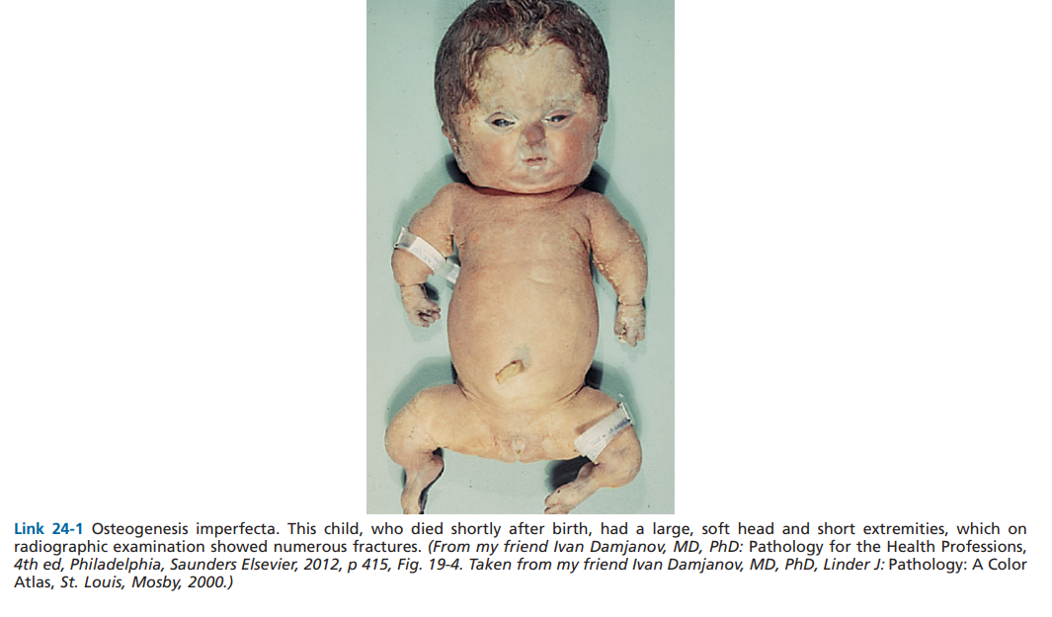

Slide 10
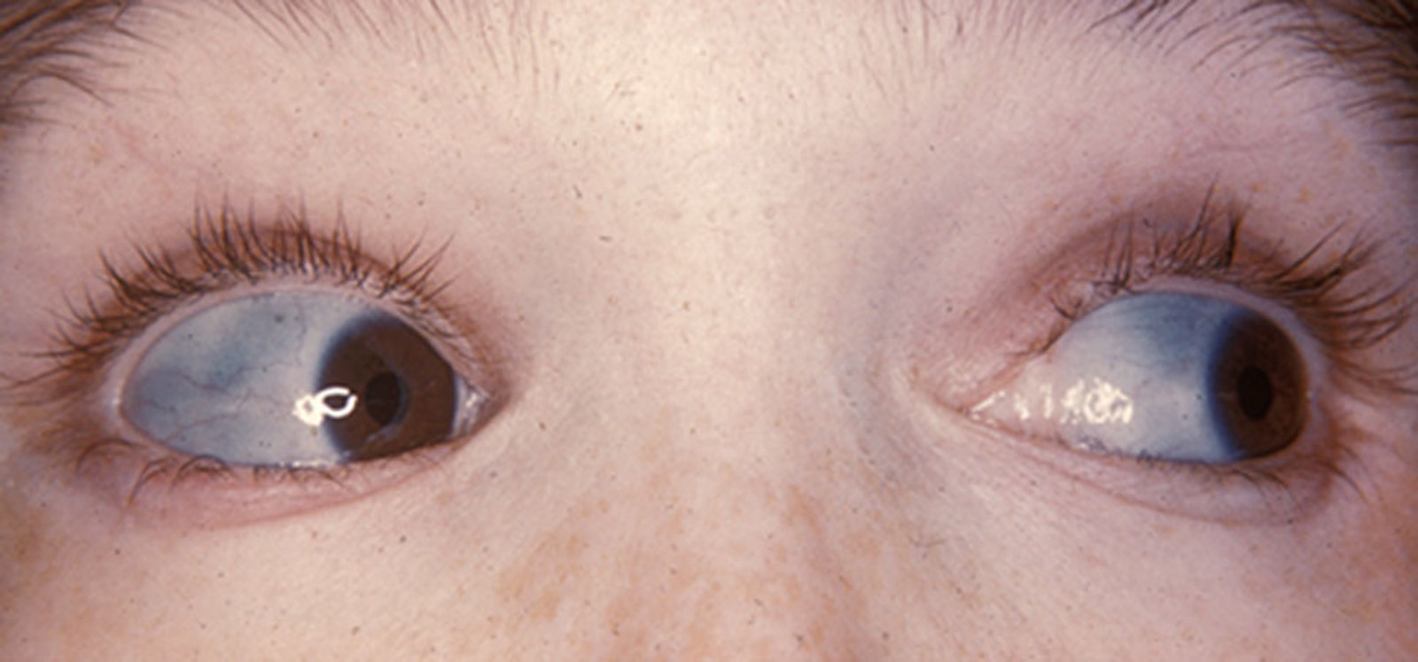

Slide 11
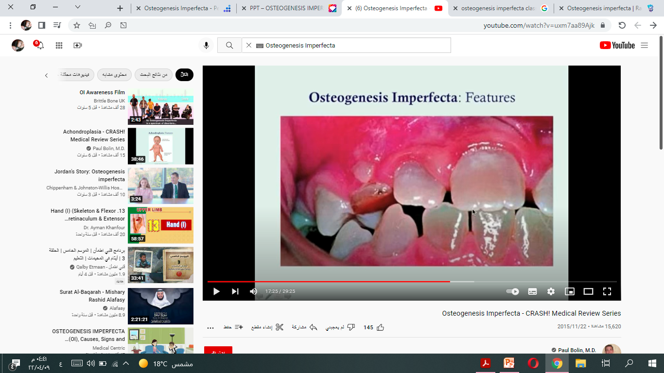

Slide 12
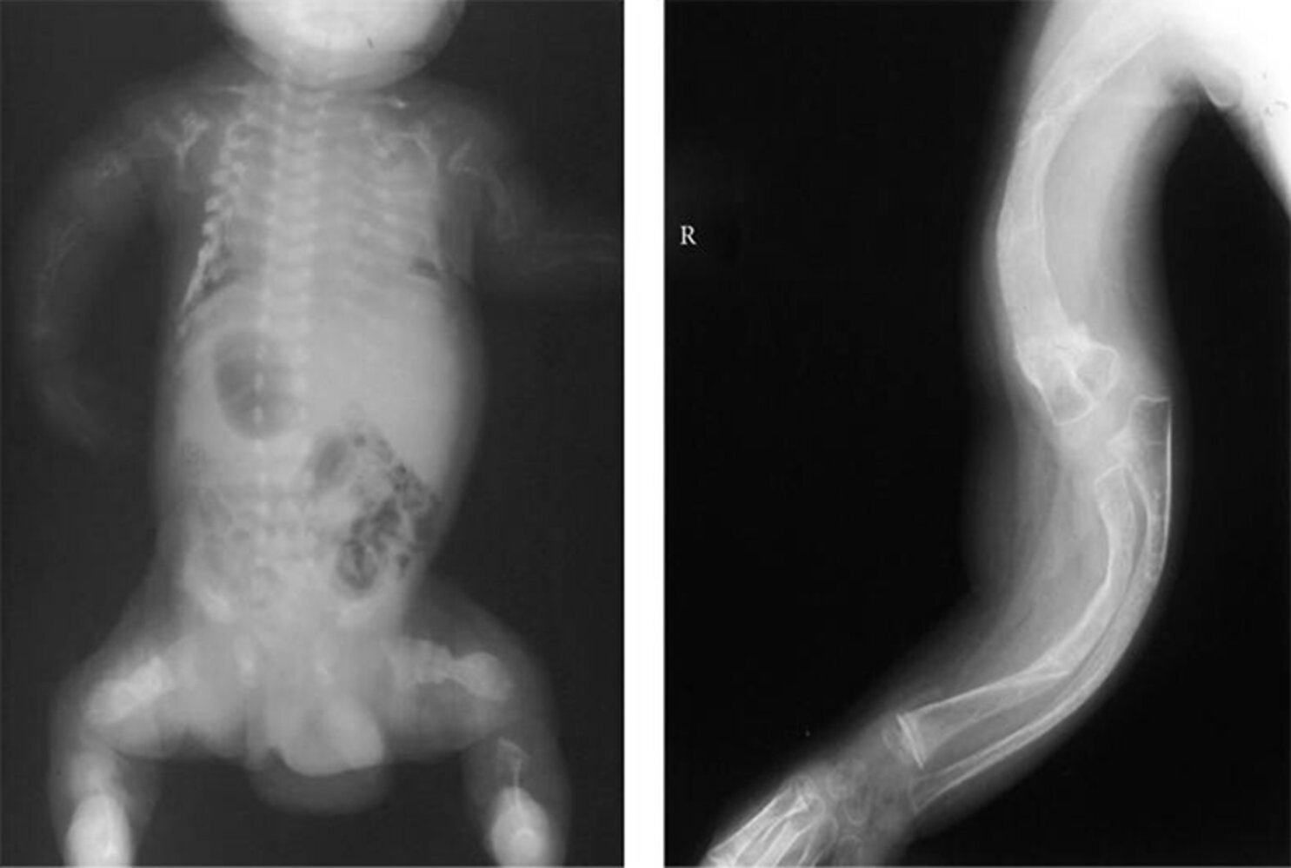

Slide 13
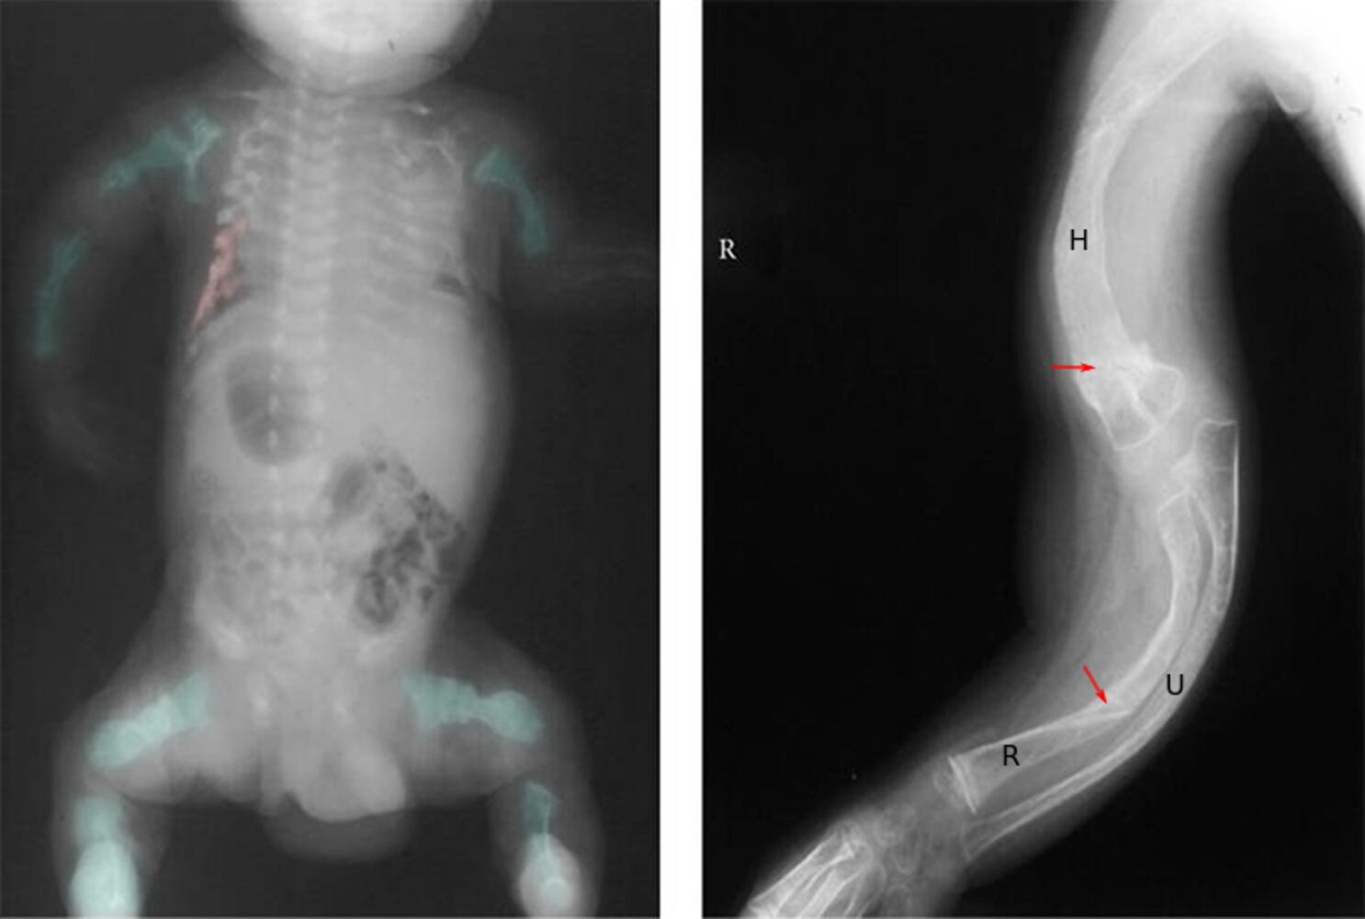
Notes:
Skeletal deformities in osteogenesis imperfecta
Left: X-ray whole body (AP view); right: X-ray right arm (AP view) of a 3-year-old boy
Osteoporosis is accompanied by severe deformities of the appendicular (examples indicated by green overlay) and axial skeleton (examples indicated by red overlay on left image). Multiple old fractures (red arrows) are associated with callus formation and sclerosis. There is severe limb bowing and foreshortening.
The findings are consistent with osteogenesis imperfecta.
H: humerus; R: radius; U: ulna

Slide 14
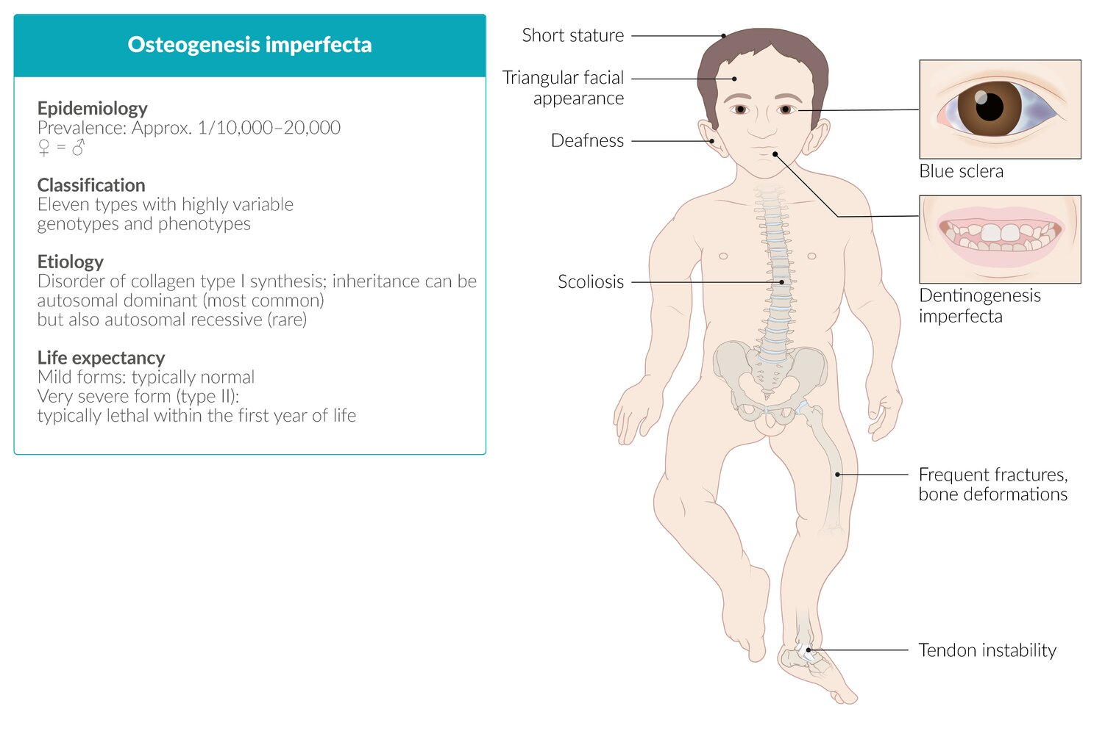

Slide 15
B. Achondroplasia
1. Definition: Hereditary condition associated with impaired proliferation of cartilage at the growth plate; results in very short limbs and sometimes a face that is small in relation to the (normal-sized) skull
2. Epidemiology
a. AD disease
b. Mutation in the fibroblast growth factor receptor 3 (FGFR3) gene. Gene mutations increase with paternal age.
3. Clinical and laboratory findings
a. Macrocephaly, depressed nasal bridge
b. Shortened arms and legs, redundant skin folds in arms and legs
c. Normal serum growth hormone (GH) and insulin-like growth factor 1 (IGF-1) levels

Slide 16
Definition: a genetic disorder characterized by impaired longitudinal bone growth that results in disproportionate short stature
Epidemiology
  Most common type of skeletal dysplasia
  Most common cause of disproportionate short stature
  1:15,000–40,000 children affected in the US
Etiology
  Gain of function mutation in fibroblast growth factor receptor 3 gene (FGFR3) on chromosome 4
  New (sporadic) mutations in ∼ 80% of cases
  The probability of new mutations increases with the father's age at the time of conception.
  Autosomal dominant inheritance in ∼ 20% of cases (homozygosity is lethal perinatally)
Notes:
Gain-of-function mutation
Activating mutation
A mutation in a gene that results in increased function of that gene. Converts proto-oncogenes into oncogenes.

Slide 17
Pathophysiology
  Defective FGFR3 → continuous receptor stimulation by FGF → inhibited chondrocyte proliferation → ↓ endochondral ossification → impaired longitudinal bone growth
  Normal intramembranous ossification of the craniofacial bones → disproportionately large head in relation to the limbs
Clinical features The characteristic skeletal abnormalities are apparent at birth.
Stature
  Disproportionate short stature
  Normal-sized torso
  Short, plump extremities
Craniofacial abnormalities
  Macrocephaly
  Prominent brows
  Midface retrusion
  Flattening of the nose
  Middle ear deformation: recurrent otitis media

Slide 18
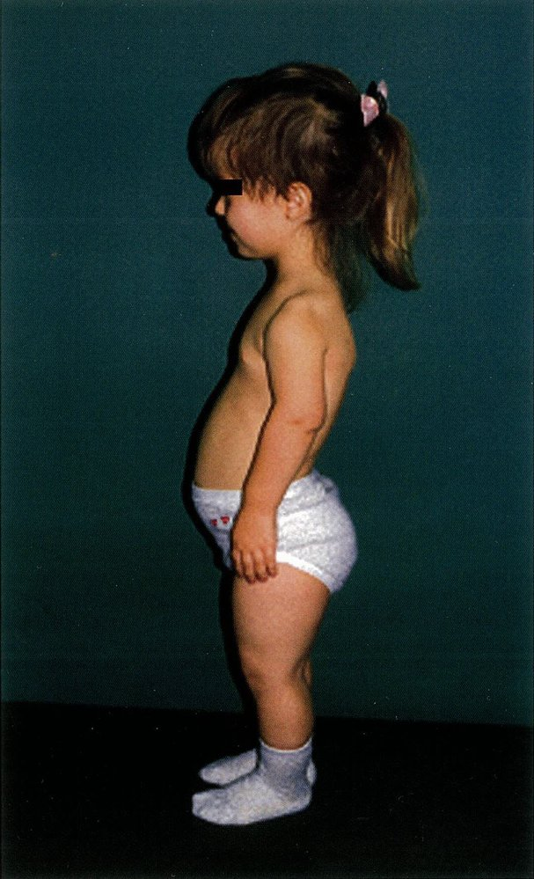
Achondroplasia
Notes:
Short stature and prominent lumbar lordosis can be seen in this 11-year-old patient.
This is the characteristic appearance of achondroplasia.

Slide 19
Other skeletal abnormalities
-Small foramen magnum
-Lumbar lordosis and kyphoscoliosis
-Trident hand: a deformity of the hand that is characterized by short stubby fingers of equal size and increased separation between the middle finger and ring finger, which gives the hand the three-pronged appearance of a trident
Normal intellectual development

Slide 20
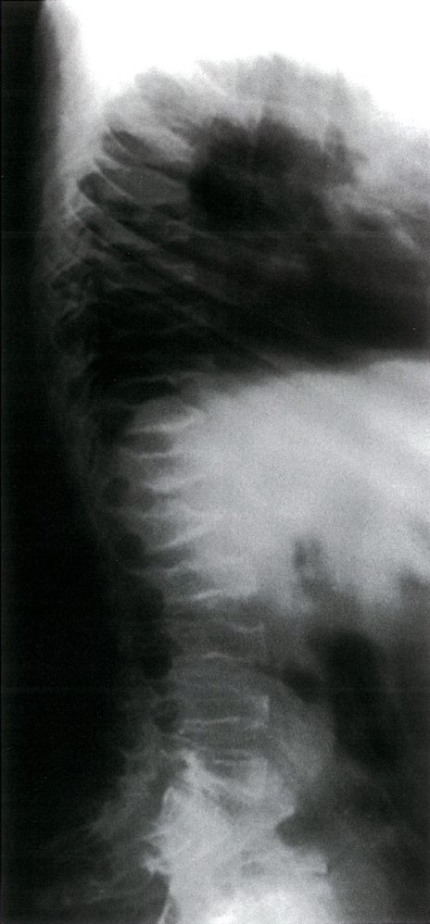
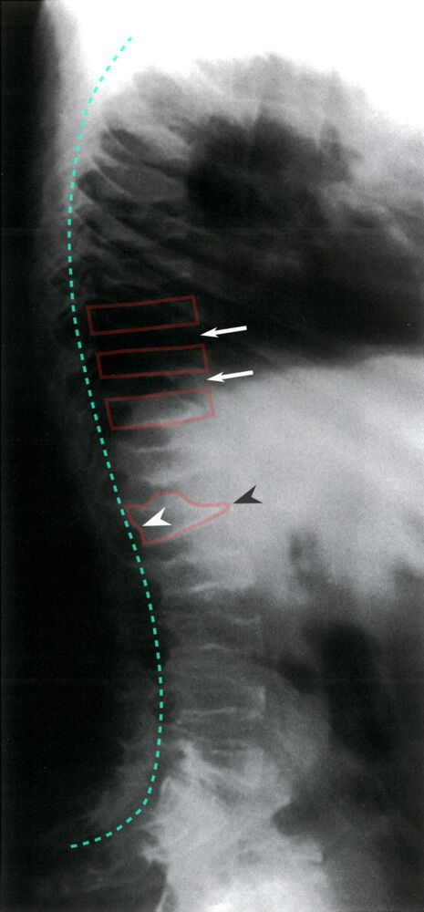
Notes:
Achondroplasia
X-ray thoracic and lumbar spine (lateral view)
There is accentuation of thoracic kyphosis and lumbar lordosis (green line). Vertebral body heights are reduced (examples indicated by red outlines), and intervertebral disc spaces are widened (examples indicated by arrows). Several vertebrae show anterior wedging (example indicated by black arrowhead) and posterior scalloping (example indicated by white arrowhead).

Slide 21
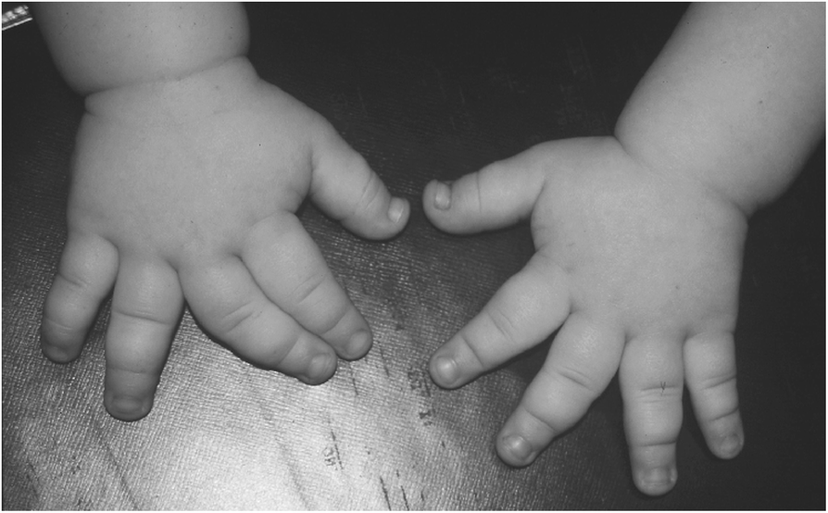
Notes:
Trident Hand

Slide 22
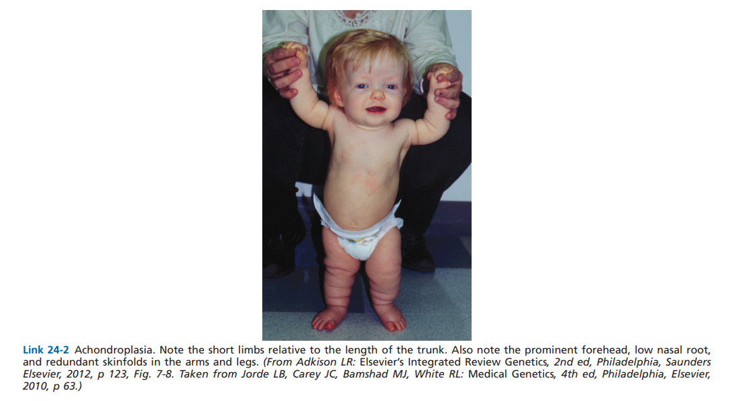

Slide 23
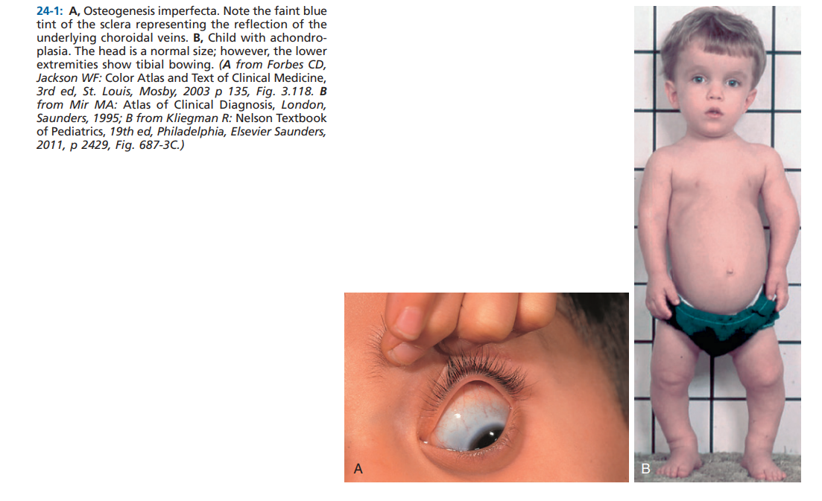

Slide 24
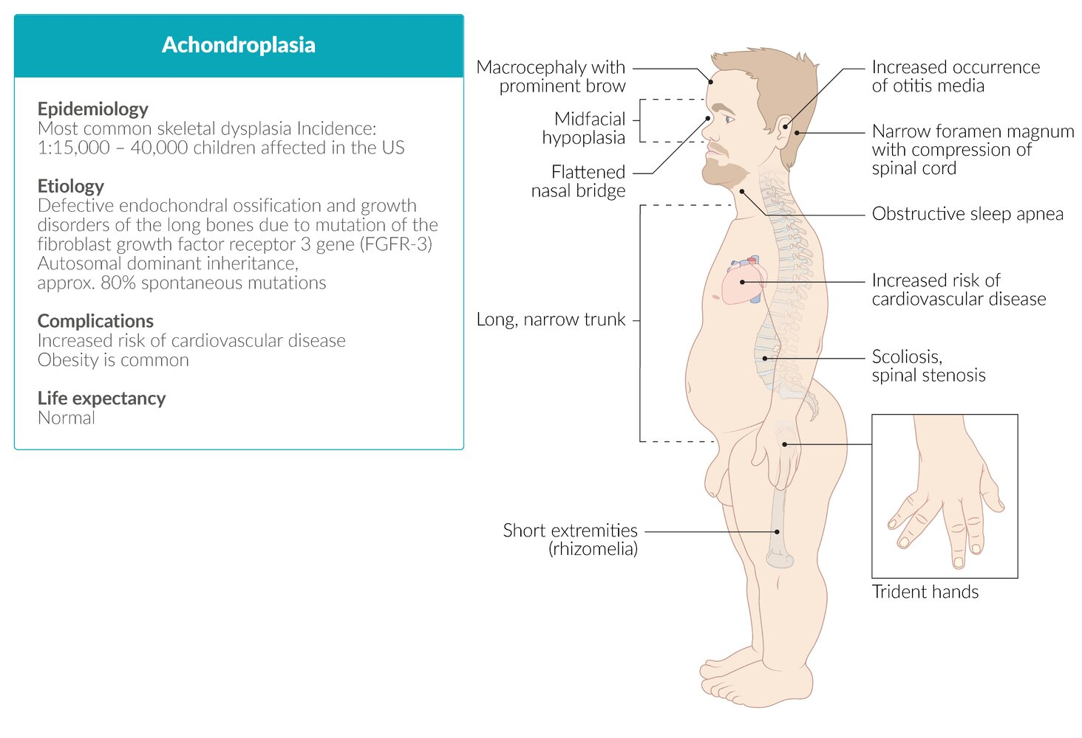

Slide 25
C. Osteopetrosis (marble bone disease)
1-Definition: Rare inherited disease caused by a failure of the osteoclasts to reabsorb bone; net result is the formation of dense but disorganized bone, resulting in bone fractures
(an inherited, diffuse bone disease that results in sclerotic thickening of the skeleton on radiological examination)
2. Epidemiology
a. The three distinct clinical forms of the disease are infantile-malignant (autosomal recessive [AR]), intermediate(AR), and adult onset(MC)-benign (AD) AKA Albers-Schonberg disease.
b. Adult form has a good prognosis; the other types have a poor prognosis.
c. Overgrowth and sclerosis of the cortical bone (“too much bone”)
3. Clinical findings
a. Pathologic fractures
b. Anemia caused by replacement of marrow cavity by bone
c. Cranial nerve compression causing visual and hearing loss

Slide 26
Pathophysiology: gene mutations → inability of osteoclasts to generate acidic environment in the bone matrix → bone resorption with preserved osteoblastic function → overgrowth of bone with pathological bone composition
Most of the mutations underlying osteopetrosis interfere with the process of acidification of the osteoclast resorption pit, which is required for the dissolution of calcium hydroxyapatite within the matrix. These include autosomal recessive mutations in the enzyme carbonic anhydrase 2 (CA2), or mutations in the TCIRG1(T Cell Immune Regulator 1) gene, which encodes a component of a vacuolar ATPase that helps to maintain acidic pH in osteoclasts, which is essential for breaking down bone

Slide 27
Clinical features
  Recurring pathological fractures (osteopetrotic bone tissue is very dense but brittle)
  Cranial nerve disorders (e.g., palsies) due to hyperostosis and stenosis of the cranial nerve foramina
  Pancytopenia due to reduced marrow space
  Hepatosplenomegaly due to extramedullary hematopoiesis
X-ray: symmetrical, homogenous, sclerotic thickening of both cortical and trabecular bone (stone bone)
-Ends of long bones are bulbous (Erlenmeyer flask deformity)
Histology shows defective osteoclasts
-Lack of ruffled border

Slide 28
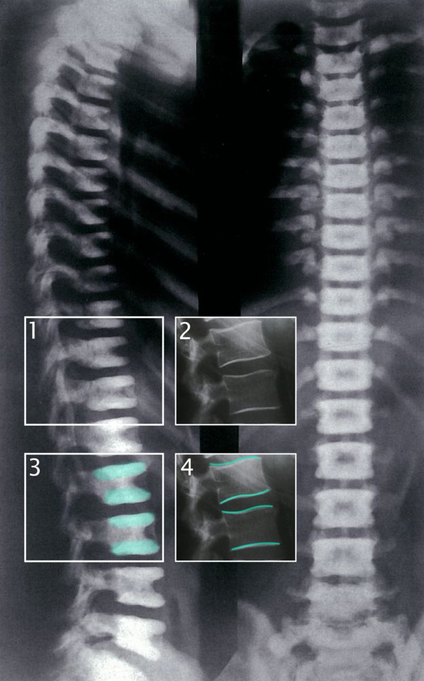
Notes:
Osteopetrosis
X-ray of the thoracic and lumbar spine (AP and lateral view)
Broad, linear sclerotic lesions of the inferior and superior endplates (box 1, highlighted with green overlay in box 3). Normal findings are shown in boxes 2 and 4. This finding is sometimes referred to as “sandwich vertebral body.”
Diagnosis: autosomal-dominant osteopetrosis

Slide 29
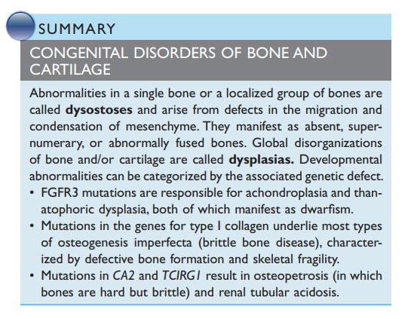

Slide 30
METABOLIC DISORDERS OF BONE
Osteopenia and Osteoporosis
The term osteopenia refers to decreased bone mass, while osteoporosis is defined as osteopenia that is severe enough to significantly increase the risk of fracture.
The disorder may be localized or generalized (involving the entire skeleton). Although osteoporosis can be secondary to endocrine disorders (e.g., hyperthyroidism), gastrointestinal disorders (e.g., malnutrition), or drugs (e.g., corticosteroids), most osteoporosis is primary.

Slide 31
Osteoporosis
1-Definition: The progressive loss of both organic bone matrix (osteoid) and mineralized bone
2-Epidemiology
a. MC metabolic abnormality of bone
b. Risk factors
(1) Family history of osteoporosis; currently smoking cigarettes
(2) Thin body habitus; current use of corticosteroids (MC secondary cause)
(3) Sedentary lifestyle, premature menopause, heavy alcohol intake
c. Bone mass peaks at age 30 years and is slightly greater in men than women.
d. During the fourth and fifth decades of life, both sexes start losing bone.
e. Loss of both organic bone matrix (osteoid) and mineralized bone produces decreased bone mass and density.
(1) Decreased thickness of the cortical and trabecular bone
(2) Radiographs of osteoporotic bone show osteopenia (a washed-out appearance).

Slide 32
f. Osteoporosis is more common in women than men. Men have greater bone mass to begin with; therefore, it takes longer for them to develop osteoporosis.
g. Primary osteoporosis
(1) Affects 80% of women and 60% of men
(2) Subdivided into idiopathic (not discussed), type I (postmenopausal women), and type II (involutional involving men and women)
h. Secondary osteoporosis
(1) Accounts for 20% to 40% of osteoporosis in both men and women
(2) Refers to osteoporosis that exists in other disease processes, inherited disease, or as a result of a medication side effect

Slide 33
3. Type I osteoporosis
a. Definition: Type of osteoporosis typically seen in postmenopausal women caused by a deficiency of estrogen (E); commonly results in vertebral and distal forearm fractures
b. Role of E in maintaining bone mass
(1) E normally enhances osteoblastic activity and inhibits osteoclastic activity in bone.
(2) Effect on bone mass is mediated through the inhibition of cytokines (cks; e.g., interleukin [IL]-1, IL-6, tumor necrosis factor [TNF]) that modulate osteoclastogenesis (osteoclast differentiation, activation, life span, and function).
c. In E deficiency, there is an increase in secretion of the previously mentioned cks by monocytes and cells in the bone marrow.
(1) These cks have the following normal effects.
(a) Enhance expression of RANKL (receptor activator of nuclear factor κB ligand) and RANK genes (receptor activator of nuclear factor κB), which increase osteoclastogenesis (increase in recruitment and activity of osteoclasts)
(b) Inhibit the expression of osteoprotegerin (OPG), a receptor produced by osteoblasts that inhibits RANKL/RANK interaction
(2) In postmenopausal osteoporosis, osteoclastic activity is greater than osteoblastic activity, so there is a loss of bone mass.

Slide 34
d. Clinical findings
(1) Compression fractures of the vertebral bodies
(a) MC fracture in postmenopausal osteoporosis
(b) Patients lose stature (height).
(2) Dowager’s hump
(a) Kyphosis (forward bending of the spine) is caused by advanced osteoporosis.
(b) Interferes with respiration, if severe

Slide 35
4. Type II osteoporosis
Definition: Senile type of osteoporosis that is caused by defective differentiation of bone marrow stromal cells into adipocytes rather than osteoblasts. This type of osteoporosis is especially associated with fractures of the wrist, proximal humerus, vertebrae, pelvis, femoral neck, and tibia.
b. Epidemiology
(1) Occurs in women and men who are >70 years old
(2) Progressive decline in osteoblasts and increased activity of osteoclasts (bone resorption exceeds bone formation). Decreased physical activity puts less stress on bone, resulting in decreased bone formation (decreased osteoblastic activity).
(3) In addition, there is decreased production of 1,25(OH)2D3, the active form of vitamin D that is derived from the kidneys. Results in decreased calcium absorption and increased secretion of parathyroid hormone (PTH; increases bone resorption).
(4) Fractures commonly occur in the wrist, hip, and vertebrae.

Slide 36
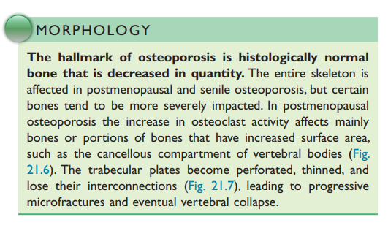

Slide 37
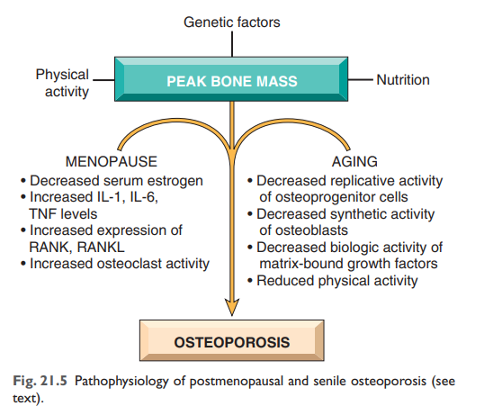

Slide 38
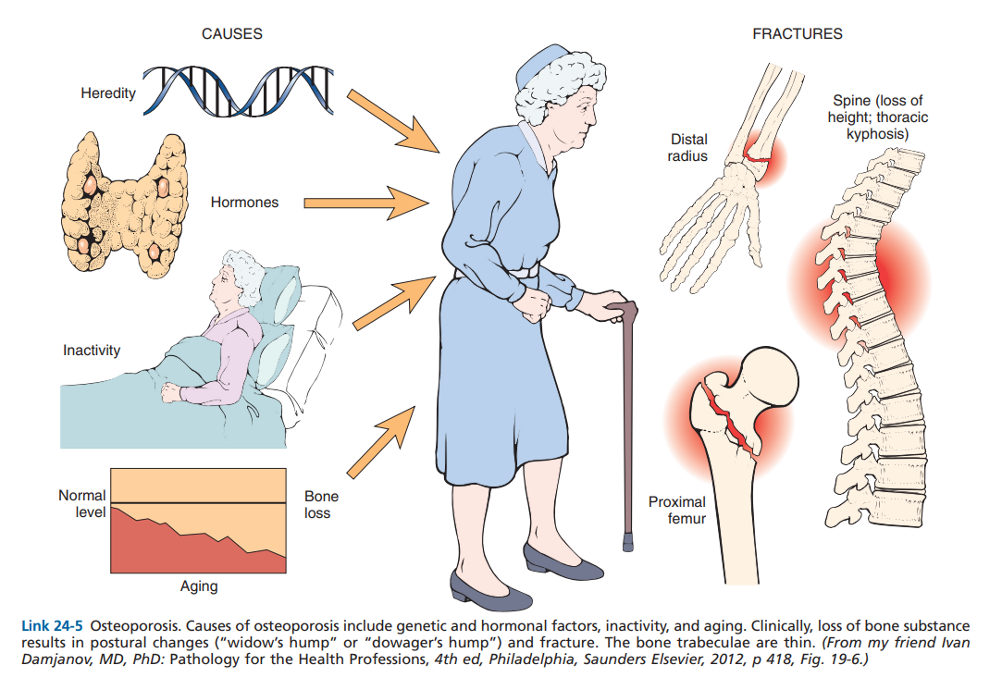

Slide 39
5. Secondary osteoporosis
a. Definition: Osteoporosis that is caused by medical conditions or treatments that interfere with the formation of the organic bone matrix (osteoid) or mineralized bone
b. Epidemiology and causes
(1) Underlying disease: endocrine (hypercortisolism), bone marrow (multiple myeloma, leukemia), connective tissue (Ehlers-Danlos syndrome, Marfan syndrome), or gastrointestinal (GI; malabsorption syndromes)
(2) Drugs (e.g., prolonged heparin use, corticosteroids, cyclosporine)
(3) Hypogonadism (e.g., in hypopituitarism, there is a decrease in GH and IGF-1; decrease in E in women and testosterone in men)
(4) Malnutrition (e.g., anorexia nervosa is associated with hypoestrinism)
(5) Space travel (lack of gravity reduces bone stress)

Slide 40
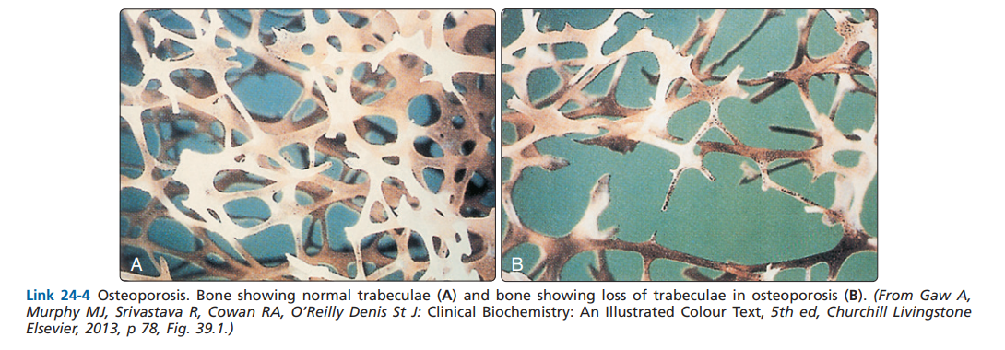

Slide 41
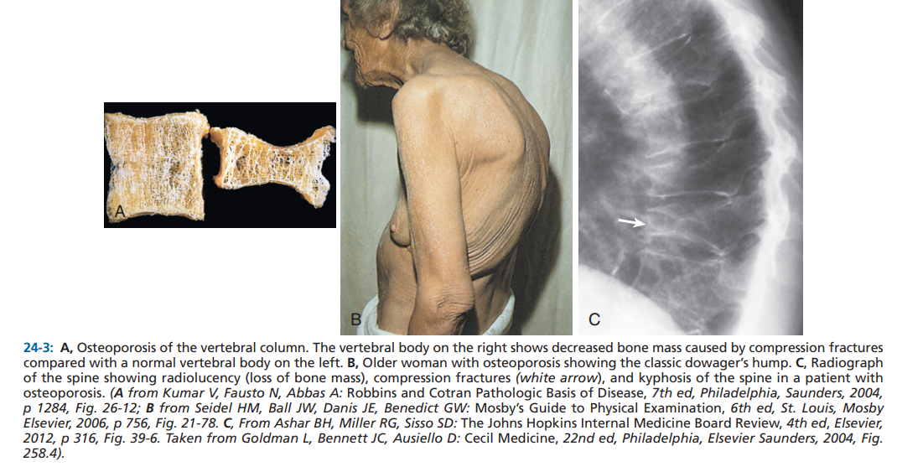

Slide 42
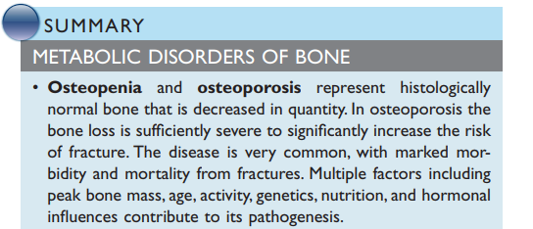

Slide 43
Osteomalacia and rickets
Osteomalacia is a disorder of impaired mineralization of the osteoid; rickets is a disorder of impaired mineralization of cartilaginous growth plates. Adults have fused growth plates so they are only affected by osteomalacia. In children, whose growth plates are open, the disorders can occur simultaneously. The most common cause of both osteomalacia and rickets is vitamin D deficiency resulting from inadequate intake, malabsorption, or lack of exposure to sunlight. Patients with osteomalacia usually present with bone pain and tenderness, while patients with rickets exhibit bone deformities and impaired growth. Over time, both conditions may lead to bending of the long bones or even pathologic fractures. Treatment consists of administering vitamin D and ensuring sufficient calcium intake.

Slide 44
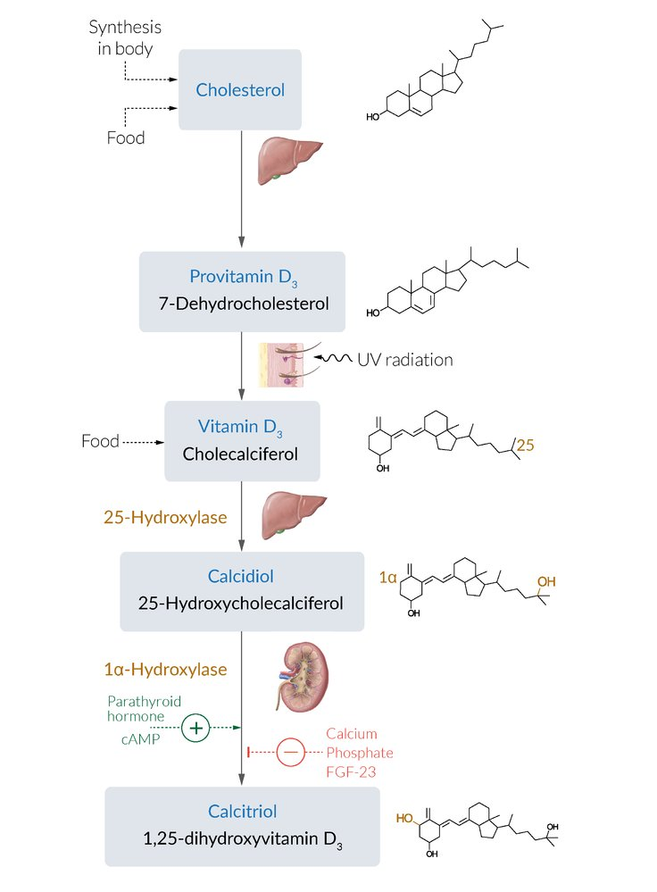
Notes:
Biosynthesis of vitamin D
Vitamin D₃ (cholecalciferol) is mainly synthesized in the body, but it can also be taken up with food and supplements.
Endogenous vitamin D synthesis involves a series of steps:
1. provitamin D₃ (7-dehydrocholesterol) is synthesized from cholesterol in the liver and the skin.
2. provitamin D₃ is converted in the skin with the help of UV radiation to vitamin D₃.
3. Vitamin D₃ is hydroxylated to calcidiol (25-hydroxycholecalciferol) in the liver (by the enzyme 25-hydroxylase)
4. Vitamin D₃ is hydroxylated to calcitriol (1,25-dihydroxyvitamin D₃, which is biologically active) in the kidneys (by the enzyme 1α-hydroxylase). Parathyroid hormone and cAMP promote this last step by stimulating 1α-hydroxylase. Calcium, phosphate, and FGF-23 inhibit 1α-hydroxylase.

Slide 45
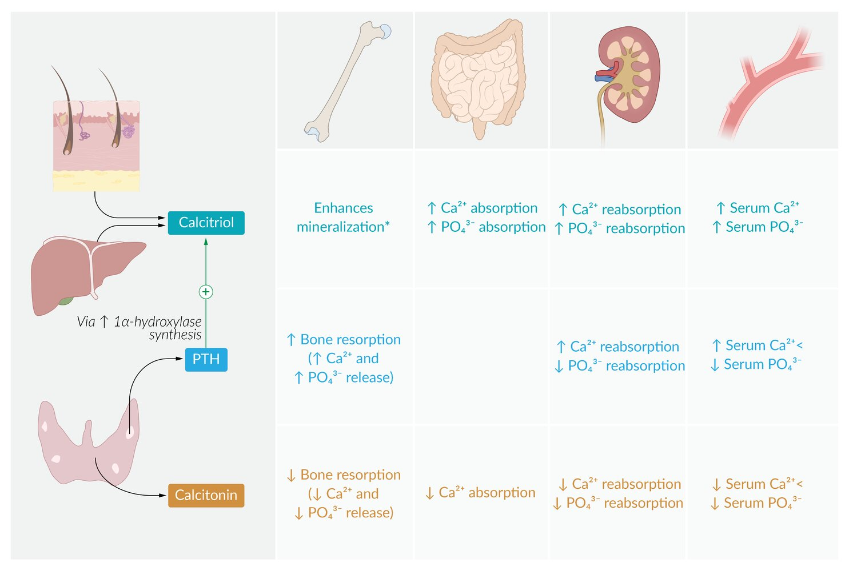
Notes:
Regulation of calcium and phosphate metabolism
When serum calcium levels decrease, parathyroid chief cells secrete parathyroid hormone (PTH), which regulates calcium levels via the following mechanisms:
1. PTH activates osteoclasts, which degrade bone, thereby releasing calcium and phosphate.
2. In the kidneys, PTH stimulates calcium resorption in the distal tubule and decreases phosphate reabsorption in the proximal tubule.
3. PTH increases the expression of 1α-hydroxylase, an enzyme required to synthesize calcitriol. Calcitriol, in turn, stimulates renal and intestinal resorption of both calcium and phosphate. In contrast to PTH, calcitriol promotes the mineralization of bone using calcium and phosphate.

Slide 46
Etiology
Vitamin D‑dependent forms (most common)
Vitamin D deficiency
UV radiation
  Reduced exposure
  Dark skin
Oral intake
  Low dietary intake
  Infants younger than 1 year: breast milk has low amounts of vitamin D
Intestinal absorption can be reduced due to a number of factors, including:
  Cystic fibrosis, chronic pancreatitis
  Premature birth
  Celiac disease
  Gastrectomy

Slide 47
Defective vitamin D metabolism
Impaired organ function
  Liver cirrhosis
  Renal disease (e.g., chronic renal failure) → ↓ production of vitamin D and metabolic acidosis → impaired calcification
Drugs: cytochrome P450 inducers increase the metabolism of vitamin D
  Anticonvulsants (e.g., phenytoin, carbamazepine, phenobarbital)
  Antimicrobial agents (e.g., rifampin, hydroxychloroquine)
Rare vitamin D-dependent hereditary forms
  Vitamin D-dependent rickets type 1
    Mutation in the 25-hydroxyvitamin-D-1α-hydroxylase gene
    Leads to impaired conversion of inactive vitamin D to the active form, 1,25‑dihydroxyvitamin D3 (calcitriol).
    Characterized by early onset of rickets, muscle weakness, failure to thrive, hypotonia, and pathological fractures
  Vitamin D-dependent rickets type 2
    Mutation in the vitamin D receptor gene causes end-organ resistance to vitamin D.
    Characterized by early onset of rickets, failure to thrive, and alopecia

Slide 48
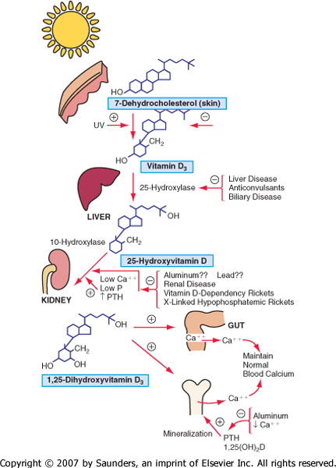

Slide 49
Vitamin D‑independent forms (rare)
Renal tubular defects
  Renal tubular acidosis
  Fanconi syndrome
Phosphate deficiency
Drugs
  Aluminium
  Fluoride

Slide 50
Pathophysiology
Vitamin D deficiency and defective vitamin D metabolism
Hypocalcemia → defective bone matrix mineralization (osteomalacia) or cartilaginous growth plate mineralization (rickets).
Hypocalcemia → ↑ PTH levels → ↓ phosphate levels → impaired mineralization.
Vitamin D-independent forms
Phosphate deficiency → ↓ phosphate blood levels → defective bone matrix mineralization (osteomalacia) or growth plate mineralization (rickets).

Slide 51
Clinical features
Osteomalacia
Occurs in adults and children
Bone pain and tenderness
Pathologic fractures
Waddling gait and difficulty walking
Myopathy
  Muscle weakness
  Spasms
  Cramps
Bone deformity only in very severe cases of osteomalacia
Symptoms of hypocalcemia

Slide 52
Rickets
Only occurs in children (growth plates have not fused)
Bone deformities
  Bending of primarily the long bones
  Distention of the bone-cartilage junctions
    Rachitic rosary: bead-like distention of the bone-cartilage junctions in the ribs
    Marfan sign: distention of the epiphyseal plate of the distal tibia with widening and cupping of the metaphysis gives the impression of a double medial malleolus on inspection and palpation of the ankle
  Craniotabes: softening of the skull
  Deformities of the knee, especially genu varum
Increased risk of fracture
Harrison groove: depression of the thoracic outlet due to muscle pulling along the costal insertion of the diaphragm
Late closing of fontanelles
Impaired growth
Symptoms of hypocalcemia

Slide 53
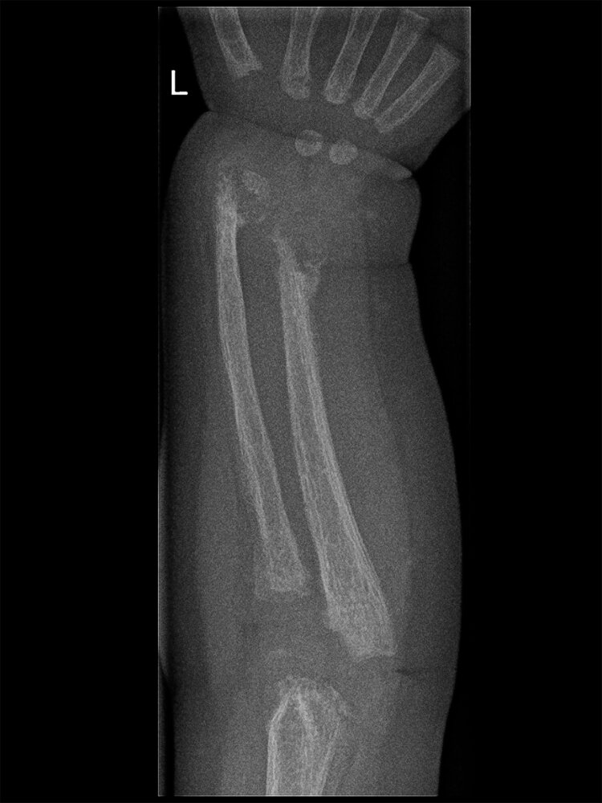
Notes:
Rickets
X-ray of the left forearm (PA view) of a 2-year-old child with rickets from vitamin D deficiency
There is generalized osteopenia as a result of deficient mineralization. Growth plate widening and metaphyseal cupping and flaring seen earlier in the disease have progressed to an irregular disorganized appearance of the distal radius and ulna. The radius and ulna are shortened and bowed.

Slide 54
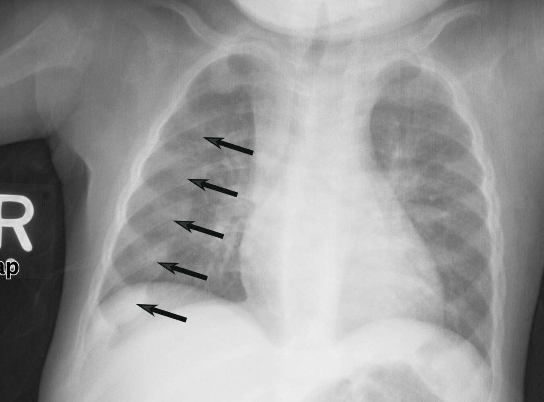
Notes:
Rickets
X-ray chest (AP view) of a child.
There are prominent nodular costochondral junctions (black arrows) on the right side of the chest due to the expansion of the anterior ribs.
These findings are referred to as rachitic rosary because of their resemblance to beads on a rosary.

Slide 55
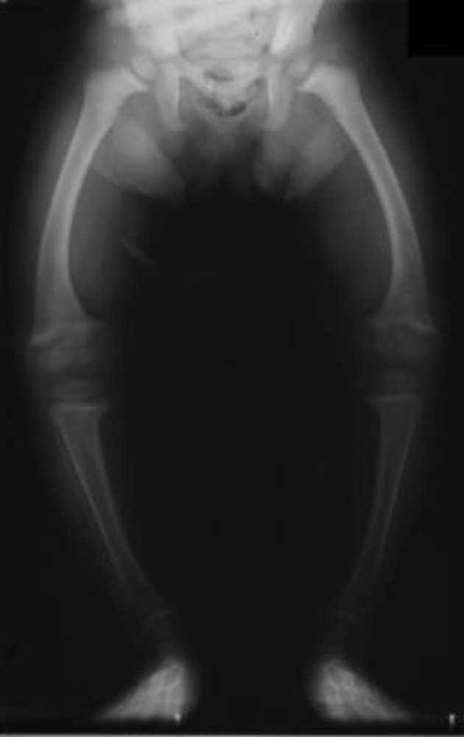
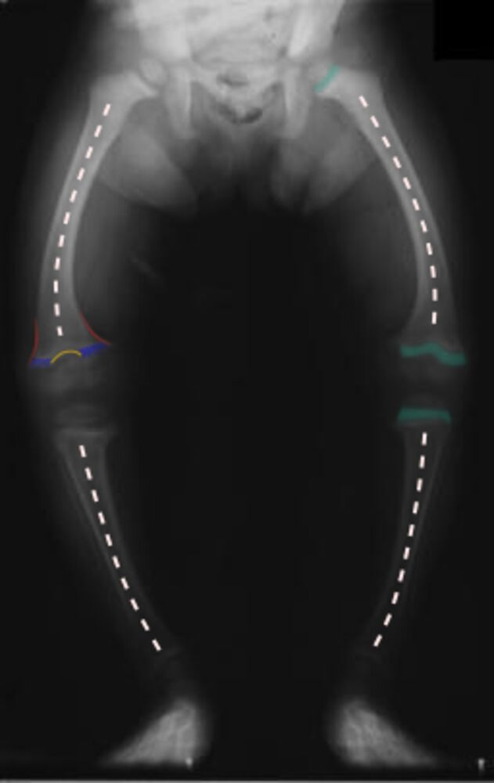
Notes:
Rickets of the lower extremities
X-ray legs (AP view) of a 2-year-old child with rickets
Deficiency in mineralization has resulted in bowing of the legs (genu varum; indicated by dashed lines). Excess nonmineralized osteoid at the metaphyseal zones of provisional calcification has produced widening of the epiphyseal growth plate (examples indicated by green overlay) along with metaphyseal splaying (examples indicated by red lines), cupping (yellow line), and fraying (examples indicated by blue overlay).

Slide 56
Diagnostics
Laboratory tests
↓ Calcium and ↓ phosphate
↑ Alkaline phosphatase and ↑ PTH
Vitamin D-dependent rickets type 1: ↓ calcitriol concentration
Vitamin D-dependent rickets type 2: ↑ calcitriol concentration

Slide 57
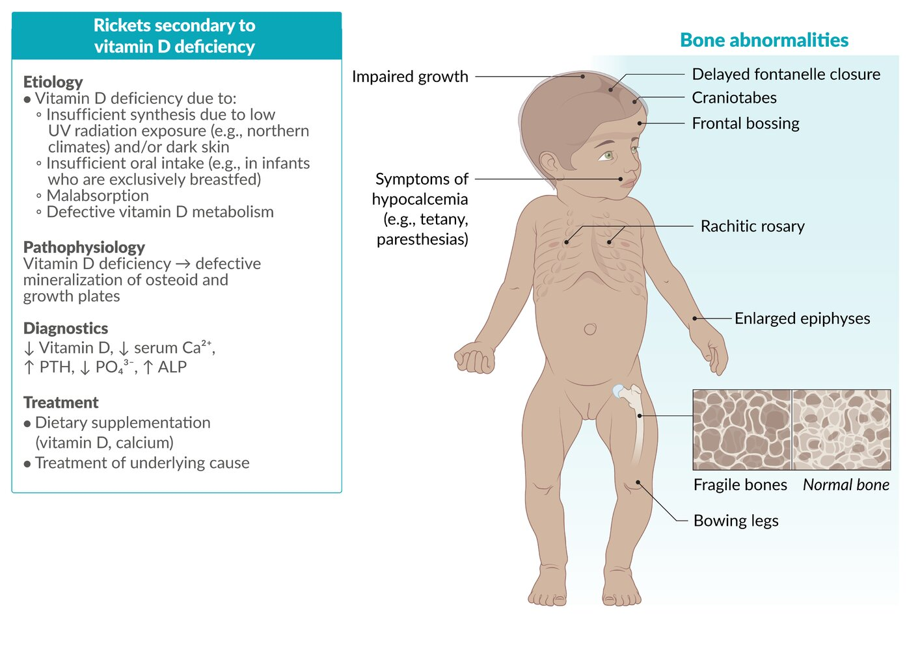

Slide 58
Hyperparathyroidism
Excess production and activity of PTH result in increased osteoclast activity, bone resorption, and osteopenia. Although the entire skeleton is affected, the osteopenia in some bones (e.g., phalanges) is more conspicuous radiographically. Isolated hyperparathyroidism peaks in middle adulthood and slightly earlier if presenting as a component of multiple endocrine neoplasia (MEN, types I and IIA).

Slide 59
Pathogenesis
PTH plays a central role in calcium homeostasis through the following effects:
• Osteoclast activation, increasing bone resorption, and calcium mobilization. PTH mediates the effect indirectly by increased RANKL expression on osteoblasts.
• Increased resorption of calcium by the renal tubules.
• Increased urinary excretion of phosphates.
• Increased synthesis of active vitamin D, 1,25(OH)2-D, by the kidneys, which in turn enhances calcium absorption from the gut and mobilizes bone calcium by inducing RANKL on osteoblasts

Slide 60
The net result of the actions of PTH is an elevation in serum calcium, which, under normal circumstances, inhibits further PTH production. However, excessive or inappropriate levels of PTH can result from autonomous parathyroid secretion (primary hyperparathyroidism) or can occur in the setting of underlying renal disease (secondary hyperparathyroidism). PTH is directly responsible for the bone changes seen in primary hyperparathyroidism. Abnormalities stemming from chronic renal insufficiency that contribute to bone disease in secondary hyperparathyroidism include inadequate 1,25-(OH)2-D synthesis, hyperphosphatemia, metabolic acidosis, and aluminum deposition in bone (in those undergoing renal dialysis).

Slide 61
Clinical Course
As bone mass decreases, affected patients are increasingly susceptible to fractures, bone deformation, and joint problems. Osteitis fibrosa cystica is now rarely encountered because hyperparathyroidism is usually diagnosed on routine blood tests and treated at an early stage. Restoration of PTH levels to normal can completely reverse the bone changes. Secondary hyperparathyroidism is usually not as severe or as prolonged as primary hyperparathyroidism, hence the skeletal abnormalities tend to be milder

Slide 62
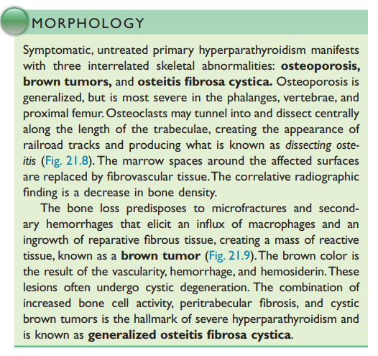
Notes:
A membrane protein ligand on osteoblasts that binds to RANK on osteoclasts. Induces differentiation and activation of osteoclasts.

Slide 63
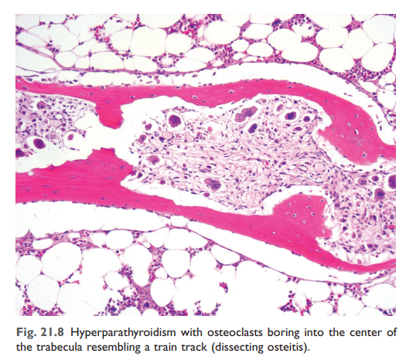

Slide 64
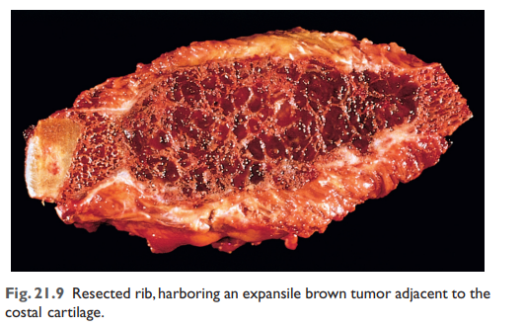

Slide 65
Osteitis fibrosa cystica (OFC): a rare skeletal disorder seen in advanced hyperparathyroidism characterized by replacement of calcified bone with fibrous tissue
  Most commonly seen in primary hyperparathyroidism but can also occur in secondary hyperparathyroidism
  ↑ PTH → ↑ RANK ligand expression → activation of osteoclasts → bone resorption, cortical bone destruction, and fibrous tissue deposition
  Features include bone pain, subperiosteal thinning, and bone cysts
  In advanced OFC, large, cystic, vascular cavities with a tumor-like appearance on x-ray and a brown color due to hemosiderin deposition (brown tumors) can form in long bones.

Slide 66
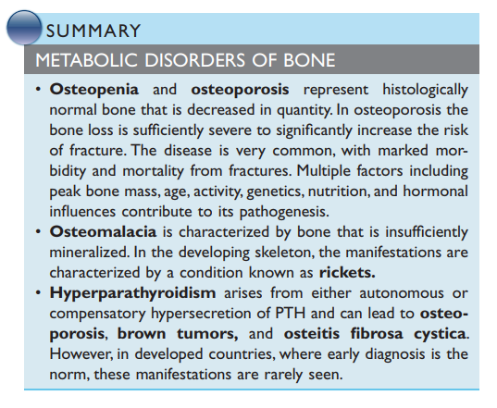

Slide 67
Paget disease (osteitis deformans)
Definition: Focal disorder of chaotic bone remodeling (both formation and resorption) that results in thick, weak bone at risk for pathologic fractures
Paget disease of bone (PDB, or osteitis deformans) is a slowly progressive monostotic or polyostotic skeletal disease. It is characterized by increased bone turnover, which causes normal lamellar bone to be replaced by weak woven bone. The cause of this common yet underdiagnosed skeletal disease is not known. It predominantly affects individuals over the age of 55 and is characterized by localized pain and bony deformities (such as bowing of long bones). Skeletal x-ray, bone scans, and serum alkaline phosphatase are important tests for diagnosing and monitoring the progression of PDB. Treatment is mainly supportive and involves the use of bisphosphonates to inhibit osteoclastic function.

Slide 68
Epidemiology
Prevalence: second most prevalent skeletal disease after osteoporosis in individuals > 50 years of age
Sex: ♂ > ♀ (1.2:1)
Age of onset: > 55 years

Slide 69
Pathophysiology
Overview
Idiopathic disease
Associated with a high rate of bone remodeling: ↑ RANKL-RANK activity → ↑ NF-κB signaling → ↑ osteoclast activity → ↑ osteoblast activity → formation of disorganized (woven) bone
Notes:
In the case of Paget disease, the rate of bone remodeling is 20 times the normal rate. The result is that newly remodeled bone is more vascular, and lacks the strength and shape of normal bone. This weak bone can be easily deformed by stress (e.g., weight bearing) and is highly susceptible to fractures. Furthermore, bone remodeling in Paget disease can result in enlargement of bone, which can result in entrapment neuropathies in regions where nerves pass through bony tunnels (e.g., cranial nerve canals, skull base foramina, spinal canal).

Slide 70
Stages of Paget disease
Bone remodeling in Paget disease occurs in three phases, followed by a quiescent stage:
Lytic phase: ↑ number of osteoclasts appear in bone → ↑ osteoclastic activity → ↑ rate of bone resorption
Mixed lytic and blastic phase: ↑ osteoclastic activity is accompanied by an ↑ number of osteoblasts, which infiltrate the lacunae → ↑ rate of bone formation with haphazardly laid collagen fibers → formation of abnormal hypervascular woven bone
Sclerotic phase: Osteoblastic activity overtakes osteoclastic activity, which leads to formation of dense, sclerotic bone.
Quiescent stage: Both osteoclastic and osteoblastic activity cease (“quiet phase” of the disease).
Disease localization
The pelvis, skull, vertebral column, and long bones of the lower extremities are the most commonly affected sites.
Monostotic PDB: affects only one bone (∼ ⅓ of cases)
Polyostotic PDB: affects two or more bones (∼ ⅔ of cases)

Slide 71
Clinical features
Approximately 70–90% of cases are asymptomatic.
Bone pain, which may be associated with erythema and elevated skin temperature over the affected bones
Pathological fractures: chalk-stick fractures of long bones
Bony deformities, e.g., bowing of legs
Skull involvement (in ∼ 40% of cases)
  Skull enlargement (increasing hat size)
  Cranial nerve deficits
  Impaired hearing: due to ankylosis of the ossicles and narrowing of the internal auditory meatus
  Headache
  Leonine facies
Cauda equina syndrome, nerve root compression

Slide 72
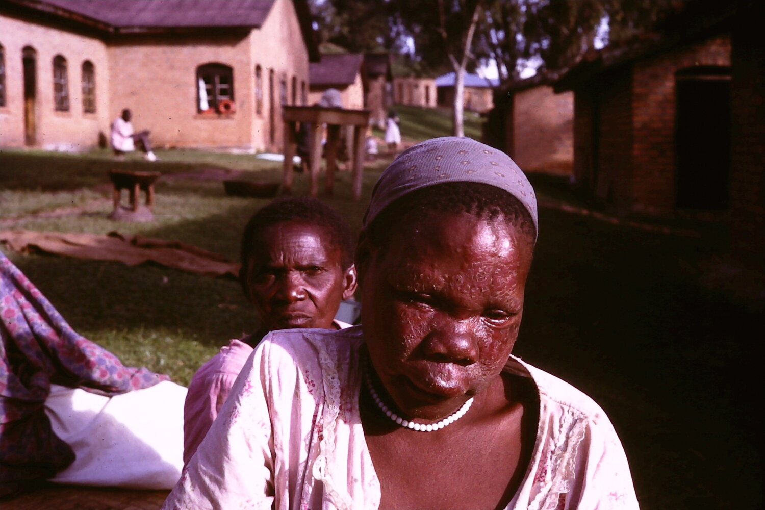
Notes:
Leonine facies
This woman's face appears deeply furrowed and swollen, large coalescent nodules are visible.
Leonine facies (so termed after the ostensible resemblance to a lion's face) is characteristic of lepromatous leprosy. It can, however, also occur in conditions such as Paget disease of bone, fibrous dysplasia, or renal osteodystrophy.

Slide 73
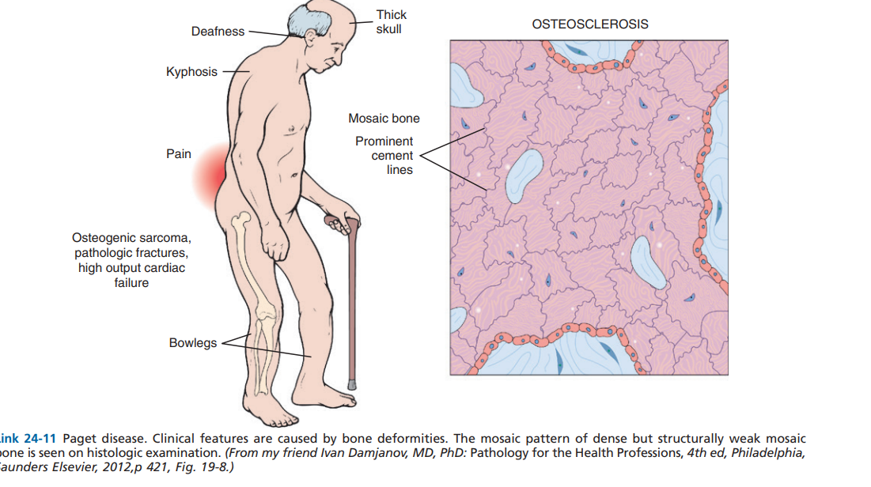

Slide 74
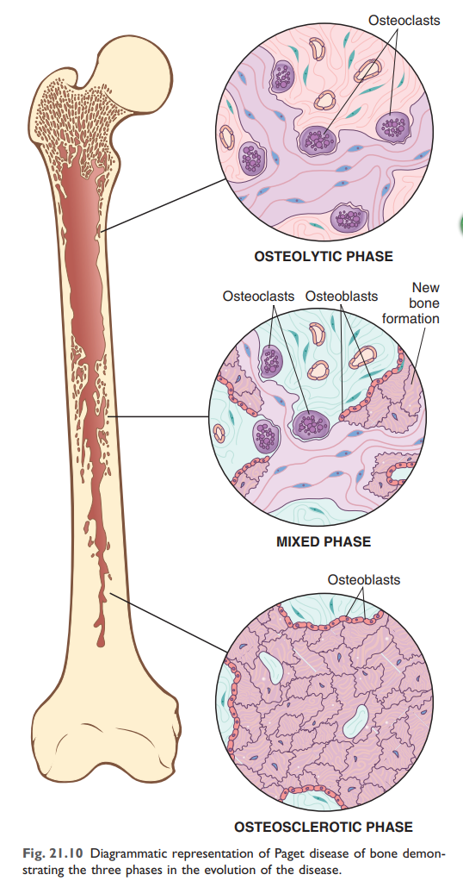

Slide 75
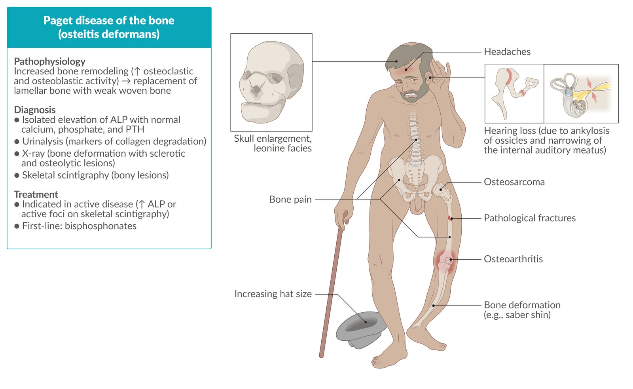

Slide 76
Osteomyelitis
1. Definition: Acute or chronic infection of bone; most commonly caused by a bacterium and less commonly by fungi and viruses
2. Acute osteomyelitis
a. Staphylococcus aureus is the overall MC pathogen causing acute osteomyelitis (70% to 89%) followed by Streptococcus (Streptococcus pyogenes, viridans Streptococcus, Streptococcus pneumoniae).
b. Sources of infection include contiguous, hematogenous, and direct implantation (trauma or surgery).
c. Contiguous source
(1) MCC of osteomyelitis
(2) Refers to extension of infection into bone from adjacent soft tissue (diabetic foot ulcers, decubitus ulcers), injury, or surgery
(3) Most of these infections are polymicrobial, with S. aureus commonly present as well

Slide 77
d. Hematogenous source (bloodstream infection) is a common cause of osteomyelitis in both children and adults; commonly monomicrobial.
(1) Metaphysis in bone is a common site of infection. Vascular supply is best in the metaphysis (nutrient artery), which favors hematogenous spread of the infection to that area of the bone.
(2) Tibia and fibula are the MC sites for osteomyelitis in children. These are rapidly growing tubular bones that receive a lot of blood, hence the predisposition to osteomyelitis
(3) Calcaneus bone in the foot is a nontubular bone that develops osteomyelitis.
(4) Vertebrae are a common site for osteomyelitis in adults. Pathogens include Mycobacterium spp., S. aureus, gram-negative bacteria (e.g., Pseudomonas aeruginosa, Serratia spp.), and Candida spp.
(5) Infection is most often caused by S. aureus in adults (90% of cases). Other pathogens include S. pyogenes, Klebsiella kingae (children <3 years old; 32% of cases), S. pneumoniae (children <3 years old; 18%), P. aeruginosa (intravenous drug abusers [IVDAs]; second MCC in adults), Serratia spp. (IV drug abusers), Eikenella (IVDAs), Enterobacteriaceae (third MCC in adults), Salmonella paratyphi (sickle cell disease [SCD]), Mycobacteria spp., and fungi.

Slide 78
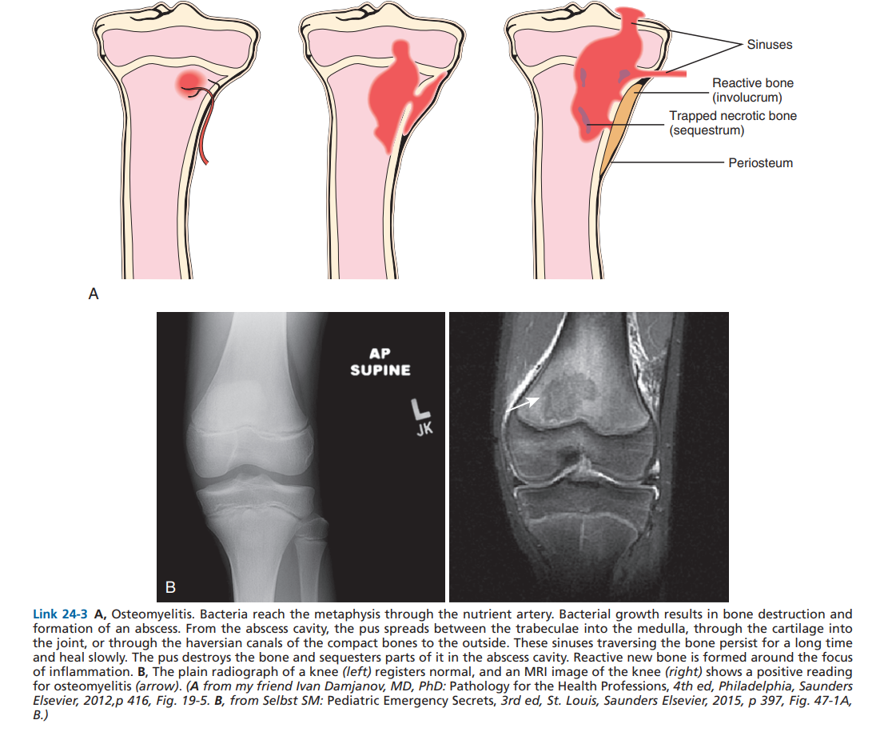

Slide 79
(6) Osteomyelitis in SCD
(a) S. paratyphi is the usual causative agent (50%–70% of cases). S. aureus is the next MCC.
(b) Sickling of blood vessels in the spleen results in repeated infarctions, rendering it dysfunctional, small, and fibrotic. Net result is impaired removal of opsonized encapsulated organisms (e.g., Salmonella spp.).
(7) Tuberculous osteomyelitis
(a) Hematogenous spread of tuberculosis from a primary lung focus.
(b) Targets vertebral column (Pott disease)
(8) IVDAs
(a) Bones involved include the vertebrae and sternoclavicular and pelvic bones.
(b) Common organisms include P. aeruginosa and Serratia marcescens. Other pathogens include S. aureus and Eikenella spp.
e. Direct implantation
(1) Direct implantation of P. aeruginosa caused by puncture of a foot through rubber footwear produces a localized osteomyelitis.
(2) Prosthetic joints: microorganisms typically grow in biofilm, which protects bacteria from antimicrobial treatment and the host immune response.

Slide 80
3. Chronic osteomyelitis; epidemiology
a. Treatment of refractory acute osteomyelitis is the most frequent cause.
b. Approximately 10% to 30% of acute osteomyelitis progresses into chronic osteomyelitis.
c. In elective trauma surgery, chronic osteomyelitis occurs in 1% to 5% after closed fractures and, depending on severity, 3% to 50% after open fractures.
d. Neutrophils enzymatically destroy the bone in chronic osteomyelitis.
(1) Devitalized bone is called sequestra.
(2) Reactive bone formation occurs in the periosteum (called involucrum).
e. Draining sinus tracts to the skin surface often occur; increased risk of squamous cell carcinoma (SCC) developing at the orifice of the sinus tracts.

Slide 81
4. Clinical findings of osteomyelitis include abrupt fever, bone pain (usually back in 86% of cases), and swelling. If chronic, a draining sinus tract(s) may also be present.
5. Diagnosis
a. Increased erythrocyte sedimentation rate (ESR; ~90% of cases) and C-reactive protein.
b. Peripheral white blood cell (WBC) count is increased in 20% of cases.
c. Bone aspiration and blood for culture: Together, they are diagnostic in 50% to 80% of cases.
d. Imaging studies: plain radiography, magnetic resonance imaging is the most accurate (test of choice for vertebral osteomyelitis).

Slide 82
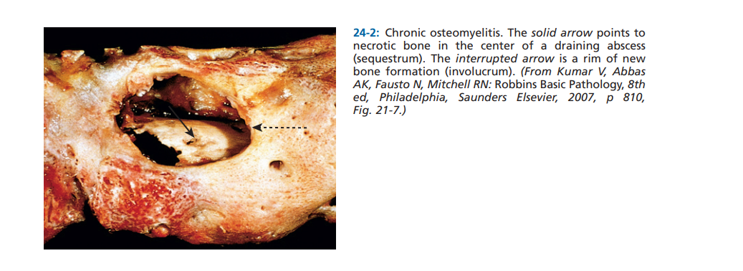

Slide 83
Avascular necrosis (AVN)
1. Definition: Cellular death of bone components caused by interruption of the blood supply
Osteonecrosis refers to infarction (ischemic necrosis) of bone and marrow cells. A diverse set of conditions predisposes to bone ischemia, including vascular injury (e.g., trauma, vasculitis), drugs (e.g., corticosteroids), systemic disease (sickle cell crisis), and radiation. In about 25% of cases, the cause is unknown. The three suspected mechanisms causing osteonecrosis are mechanical disruption of vessels, thrombotic occlusion, and extravascular compression. Osteonecrosis has a wide age range but peaks in the 30s to 50s and accounts for about 10% of hip replacements in the United States

Slide 84
Clinical Course
The symptoms depend on the location and extent of infarct. Typically, subchondral infarcts cause pain that is initially associated only with activity but then becomes constant. Subchondral infarcts often collapse and may lead to severe, secondary osteoarthritis. Treatment ranges from conservative measures (limited weight bearing, immobilization) to surgery.

Slide 85
K. Neoplastic disorders of bone; epidemiology
Metastasis is the MC malignancy of bone
Breast cancer is the MC primary tumor that metastasizes to bone.
2. Primary malignant tumors of bone, in descending order of frequency
-Multiple myeloma, osteosarcoma, chondrosarcoma, and Ewing sarcoma

Slide 86
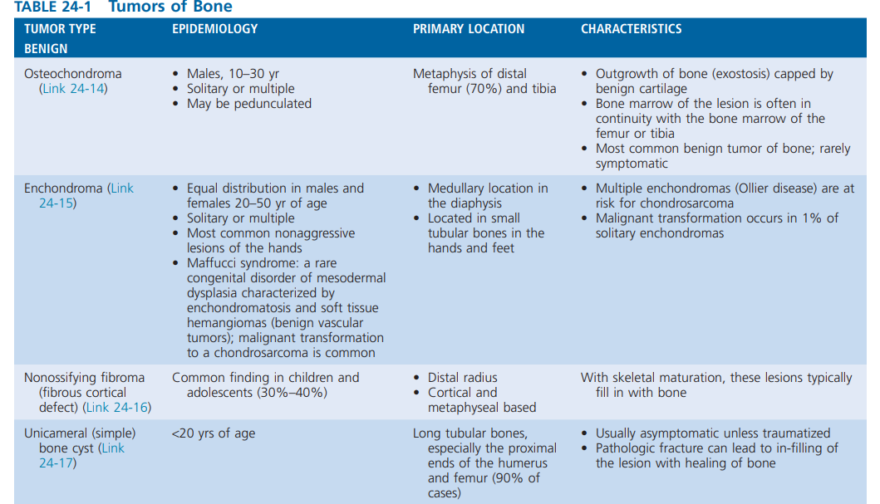

Slide 87
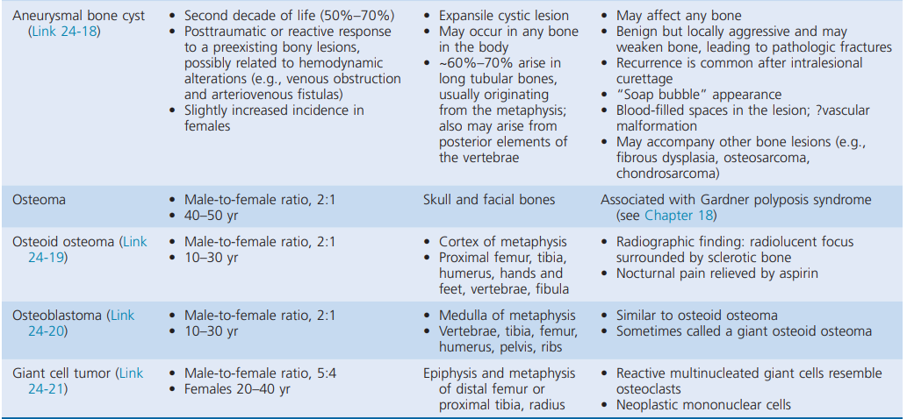

Slide 88
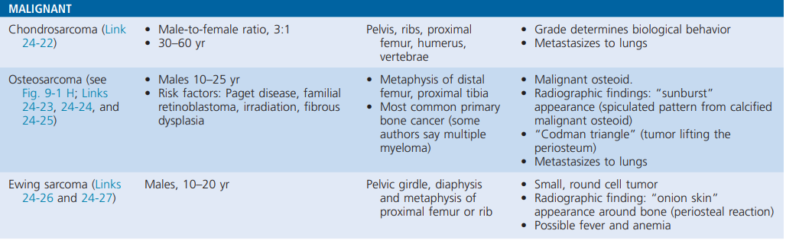

Slide 89
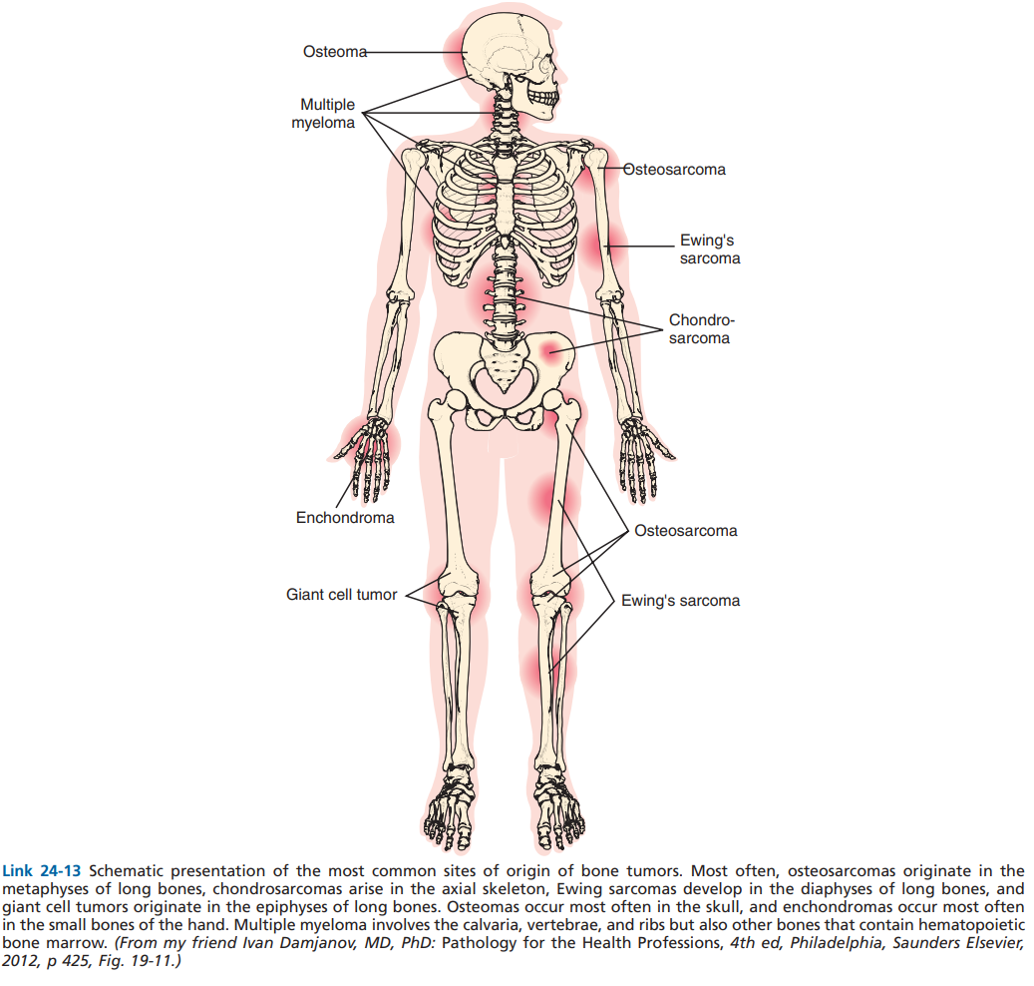

Slide 90
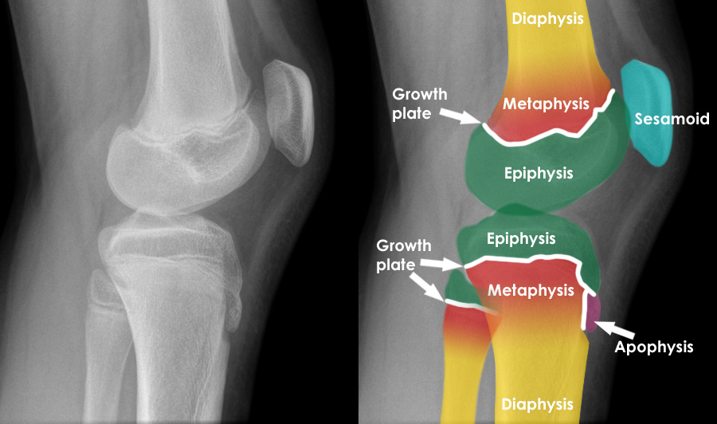

Slide 91
II. Joint Disorders
A. Classification of joint disorders
1. Group I
a. Noninflammatory joint disease
b. Examples: OA, neuropathic joint
2. Group II
a. Inflammatory joint disease
b. Examples: rheumatoid arthritis (RA), gout
3. Group III
a. Septic joint disease
b. Examples: Lyme disease (LD), disseminated gonococcemia (GC)
4. Group IV
a. Hemorrhagic joint disease
b. Examples: trauma, hemophilia A and B

Slide 92
B. Signs and symptoms of joint disease
1. Arthralgia is a general term for joint pain.
2. Arthritis connotes inflammation of the joint associated with pain, swelling, tenderness, and warmth.
3. Morning stiffness
a. Definition: Pain or stiffness in the joints that lasts >30 minutes
b. Examples: RA, systemic lupus erythematosus (SLE), polymyalgia rheumatica
4. Abnormal joint mobility
a. Caused by damage to ligaments and the joint capsule
b. Example: a tear of the anterior cruciate ligament (ACL) in the joint

Slide 93
5. Swelling of the joint (effusion)
• Caused by increased joint fluid. Examples: exudate (protein- and neutrophil-rich fluid),blood
6. Redness (rubor) and warmth (calor; “hot joint”) of the joint
• Signs of acute inflammation. Examples: septic arthritis, RA
7. Joint crepitus with motion; refers to a crackling feeling when moving a joint.

Slide 94
Osteoarthritis (OA)
1. Definition: Progressive degeneration of articular cartilage that mainly targets weight-bearing joints or joints that are used very frequently (e.g., joints in the hands and feet)
2. Epidemiology
Noninflammatory joint disease; no sex predilection
Incidence: increases with age (Approx. 80% of the population have radiographic evidence of OA by age 65.)
Sex: ♀ > ♂, especially in patients older than 50 years (Relative risk of OA in hands and knees is higher for females. Prevalence of hip OA is almost equal for both sexes.)
Incidence rates in specific joints: knee > hip > hand

Slide 95
Etiology
Modifiable risk factors
  Obesity
  Excessive joint loading or overuse (mechanical stress)
Nonmodifiable risk factors
  Age (> 55 years)
  Family history
  History of joint injury or trauma
  Anatomic factors causing asymmetrical joint stress
  Hemophilic hemarthroses and deposition diseases that stiffen cartilage
  Sex

Slide 96
3. Pathogenesis
a. Components of normal articular cartilage
(1) Proteoglycans (provide elasticity)
(2) Type II collagen (provides tensile strength)
b. In OA, cks activate metalloproteinases that degrade proteoglycans and collagen.
Pathophysiology
Chronic mechanical stress on the joints and age-related decrease in proteoglycans → cartilage loses elasticity and becomes friable → degeneration and inflammation of cartilage → joint space narrowing and thickening and sclerosis of the subchondral bone
c. Joint findings

Slide 97
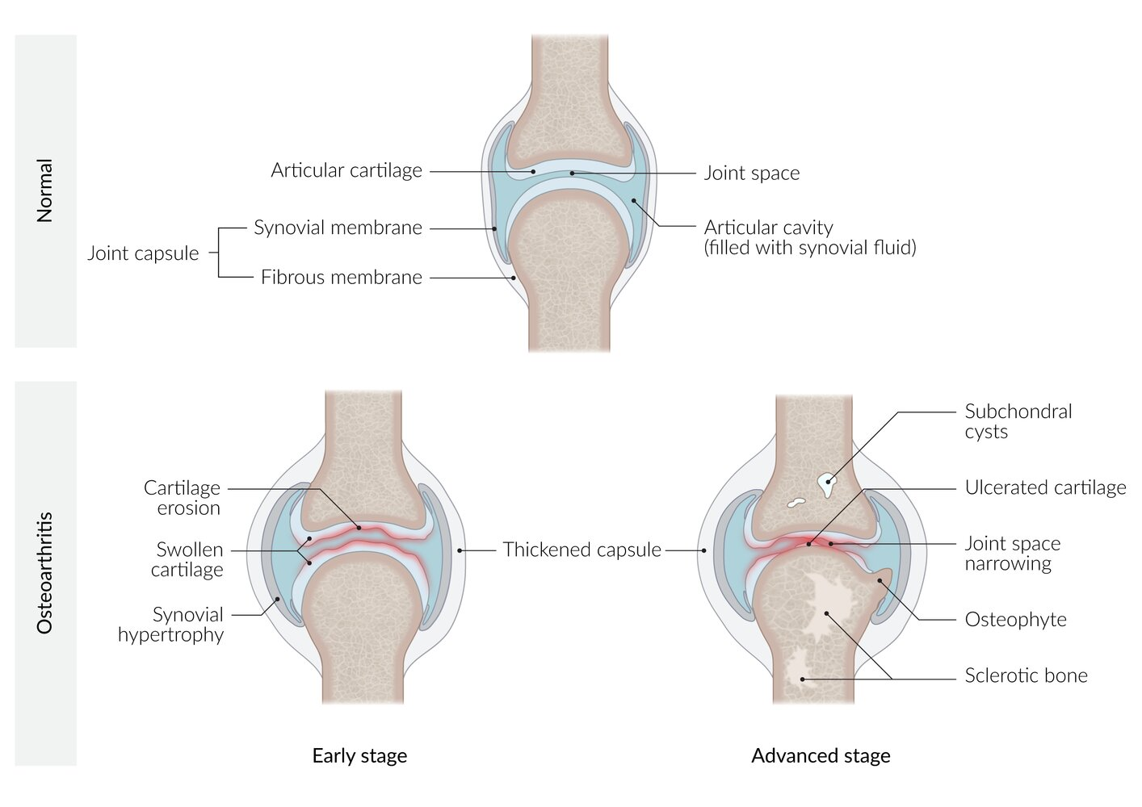

Slide 98
(1) Erosion and clefts in articular cartilage
(2) Reactive bone formation at the joint margins
(a) Reactive bone formation refers to bone that is produced as a reaction to injury
(b) Reactive bone contains bone and a cartilage matrix
(c) Osteophytes are responsible for the slight increase in serum ALP that is present in older adults.
(3) Subchondral cysts. Degradative enzymes of the cartilage leaves the underlying bone exposed, allowing synovial fluid to be forced by the pressure of weight into the bone.
(4) Bone eventually rubs on bone, producing dense, sclerotic bone.
(5) No ankylosis (fusion) of the joint
(6) Joint mice: fragments of articular cartilage that break free into the joint space

Slide 99
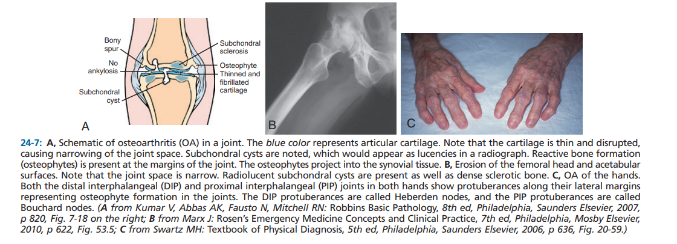

Slide 100
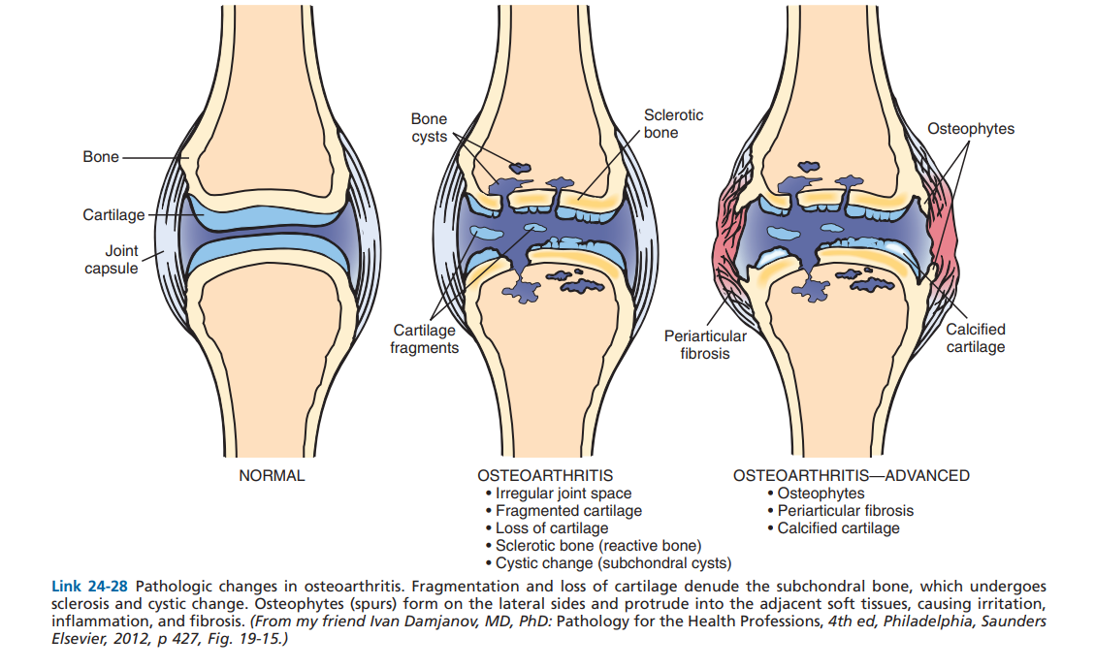

Slide 101
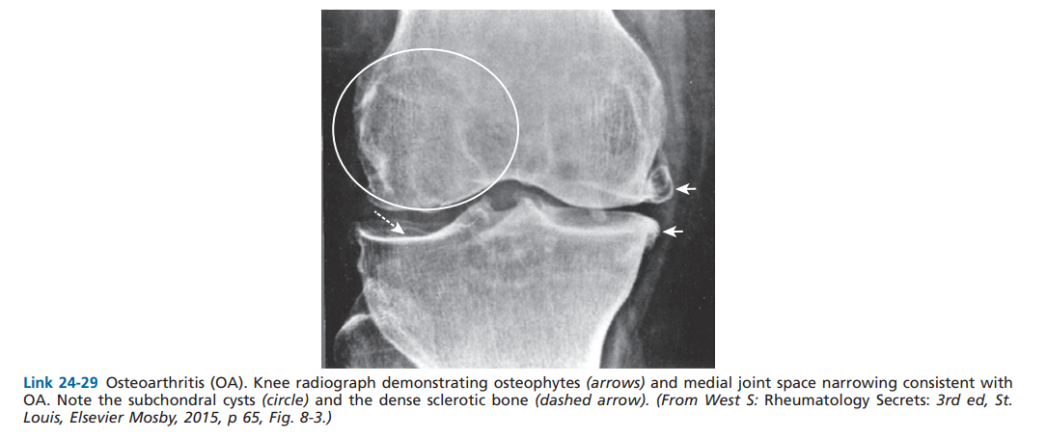

Slide 102


Slide 103
4. Clinical findings
a. Pain is the MC complaint.
(1) Osteophytes irritate the synovial lining.
(2) Bone rubs on bone.
(3) Hip OA may refer pain to the groin.
(4) Pain is aggravated with movement of the joint. Pain is caused by a secondary synovitis from osteophytes.
b. Joint stiffness occurs after inactivity, waking up in the morning, and after sitting.
c. Crepitus of the joint with movement (crackling sound) and decreased range of motion (ROM)
d. Hand involvement in OA
Enlargement of the distal interphalangeal (DIP) joints caused by osteophytes. Osteophytes are called Heberden nodes.
Enlargement of the proximal interphalangeal (PIP) joints caused by osteophytes. Osteophytes are called Bouchard nodes.

Slide 104


Slide 105


Slide 106
6. Diagnosis of OA
Plain radiographs
b. MRI is good for synovial tissue abnormalities and effusions.
c. ESR and CRP are usually normal.
d. Synovial fluid is noninflammatory

Slide 107
Rheumatoid arthritis (RA)
Epidemiology
Sex: ♀ > ♂ (3:1)
Peak incidence: > 65 years
Etiology
Idiopathic inflammatory autoimmune disorder of unknown etiology
Risk factors include:
  Genetic disposition: associated with HLA-DR4 and HLA-DR1
  Environmental factors (e.g., smoking)
  Hormonal factors (premenopausal women are at the highest risk, suggesting a predisposing role of female sex hormones)
  Infection
  Obesity
  Family history of RA

Slide 108
Pathophysiology
Certain interstitial tissue proteins (e.g. intracellular filament protein type II collagen) undergo a posttranslational modification that involves the conversion of arginine to citrulline (citrullination).
Citrullinated proteins are recognized as foreign by the antigen-presenting cells that present them to CD4⁺ T cells.
Activation of CD4⁺ T cells leads to the following sequences of events:
  IL-4 production → B-cell proliferation and differentiation → production of anticitrullinated peptide antibodies → type II hypersensitivity reaction and type III hypersensitivity reaction
  Migration of CD4⁺ T cells to synovial joints → secretion of cytokines (IFN-γ, IL-17) → recruitment of macrophages → secretion of cytokines (TNF-α, IL-1, IL-6) → inflammation and proliferation
Bouts of inflammation, angiogenesis, and proliferation → proliferative granulation tissue with mononuclear inflammatory cells → pannus and synovial hypertrophy → invasion, progressive destruction, and deterioration of cartilage and bone
Antibodies against Fc portion of IgG (rheumatoid factor, RF) are produced to aid in removing autoantibodies and immune complexes.
  RF excess triggers formation of new immune complexes and type III HSR
  Individuals with positive RF are more likely to develop extraarticular manifestations.

Slide 109

Notes:
Schematic representation of the pathophysiology of rheumatoid arthritis
At the initial stage of the disease, there is non-specific inflammation of the synovial tissue, joint swelling, and erosion. Over the course of the disease, a progressive destruction and deterioration of cartilage and bone occurr, followed by a complete joint destruction with malpositioning, loss of mobility, and osteoporosis of the surrounding bones in the end stage of the disease.

Slide 110


Slide 111
Pathology
Synovial pannus formation and bone invasion: pathological layer of proliferative granulation tissue, mononuclear inflammatory cells, and fibroblast-like mesenchymal cells, releasing cytokines and enzymes, which, in turn, damage and invade the surrounding connective tissue
Synovial lining hyperplasia with mononuclear cell infiltrate
Perivascular inflammatory infiltrates
Angiogenesis
Fibrin deposition on synovial surfaces
Rheumatoid nodules: central fibrinoid necrosis with palisading histiocytes (epithelioid cells)

Slide 112


Slide 113

Notes:
Rheumatoid nodule
Photomicrograph of a rheumatoid nodule (H&E stain; high magnification)
Fibrinoid necrosis is visible as an accumulation of fibrin (green overlay). Histiocytes (epithelioid cells) surround the necrotic area (white overlay). The outermost granuloma layer shows fibrosis (gray overlay) and an abundance of lymphocytes (blue overlay).
Rheumatoid nodules are a typical finding in patients with rheumatoid arthritis.

Slide 114
4. Clinical findings
a. Symmetric involvement of the metacarpophalangeal (MCP) and PIP joints, notable sparing of DIP joints
b. Causes bilateral ulnar deviation at MCP joints and morning stiffness >1 hour; radial deviation at the wrists
Swan neck deformity
(a) Flexion of the DIP joint
(b) Extension of the PIP joint
Boutonnière deformity
(a) Extension of the DIP joint
(b) Flexion of the PIP joint. Note that this is the reverse of a swan neck deformity.
(3) Radiographs of the hands show bony erosions around involved joints and periarticular osteopenia (decrease bone density).
(4) Other joints commonly involved in RA include the cervical spine, shoulders, elbows, hips, knees, and feet.

Slide 115


Slide 116


Slide 117


Slide 118
c. Lung disease: chronic pleuritis with effusions (characteristic low glucose), interstitial fibrosis, and bronchiolitis obliterans
d. Hematologic disease
Anemia of chronic disease
Felty syndrome (RA, splenomegaly, autoimmune neutropenia, leg ulcers)
Autoimmune hemolytic anemia
e. Carpal tunnel syndrome: entrapment of the median nerve under the transverse carpal ligament
f. Cervical spine
(1) Entire cervical spine is frequently involved.
(2) Subluxation of the atlantoaxial joint is particularly dangerous.
(a) Risk for compression of the spinal cord

Slide 119
g. Rheumatoid nodules
(1) Nodules occur on the extensor surface of the fingers, forearms, and pressure points (Achilles tendon, olecranon process) and in the lungs
A). They are present in 20% of patients.
•Caplan syndrome: rheumatoid nodules in the lung plus a pneumoconiosis caused by silica, asbestos, or coal dust
(2) Fibrinoid necrosis is present in the center of the nodules with palisading of fibroblasts
(3) Presence of rheumatoid nodules correlates with very high titers of RF.

Slide 120
h. Cardiovascular disease
(1) Fibrinous pericarditis, constrictive pericarditis
(2) Aortitis
(3) Immunocomplex small-vessel vasculitis
(a) Vasculitis is usually located around the ankles.
(b) Vasculitis correlates with high RF titers.
I. Popliteal (Baker) cyst behind the knee joint
(1) Extension of the semimembranous bursa into the posterior joint space because of increased intraarticular pressure
(2) Sometimes ruptures and dissects into the calf and is frequently misdiagnosed as deep venous thrombosis (DVT)
(3) Not pulsatile; a key to differentiating from a popliteal artery aneurysm (pulsatile mass). Differentiation is confirmed with ultrasonography.
j. Ocular changes include episcleritis and scleritis

Slide 121
5. Laboratory findings
a. Positive serum antinuclear antibody (ANA) test is present in 30% of cases.
b. Positive serum RF is present in 70% to 90% of cases; IgM-RF, 60% to 80% sensitivity; IgG-RF, 80% to 90% specificity.
c. Anticyclic citrullinated peptide (anti-CCP)
d. Normal to increased serum complement C3 and a decreased synovial fluid complement C3
e. ESR and CRP are both increased.

Slide 122


Slide 123


Slide 124


Slide 125
Gouty arthritis
Gout is an inflammatory crystal arthropathy caused by the precipitation and deposition of uric acid crystals in synovial fluid and tissues. Decreased renal excretion and/or increased production of uric acid leads to hyperuricemia, which is commonly asymptomatic but also predisposes to gout.

Slide 126
Epidemiology
Sex: ♂ > ♀ (3:1)
Age of onset: 2 peaks of incidence (at 30–39 years and at 60 years of age)

Slide 127
Etiology
Hyperuricemia
Can be idiopathic (primary hyperuricemia) or secondary to insufficient excretion or increased production of purines
Predisposes to gout and acute gout attacks
Not obligatory for developing gout
Primary hyperuricemia
Idiopathic extracellular supersaturation of uric acid
No history of comorbidities or medications that affect uric acid formation or excretion

Slide 128
Secondary hyperuricemia
Decreased uric acid excretion: most common cause
  Medications (e.g., pyrazinamide, aspirin, loop diuretics, thiazides, niacin)
  Chronic renal insufficiency, lead nephropathy
  Ketoacidosis (due to, e.g., starvation, diabetes mellitus) and lactic acidosis
  Postmenopause (Estrogen promotes renal uric acid excretion. Postmenopausal women have decreased estrogen levels and are therefore more likely to develop gout.)
Increased uric acid production
  High cell turnover, e.g.:
    Tumor lysis syndrome
    Hemolytic anemia
    Psoriasis
    Myeloproliferative neoplasms
    Chemotherapy, radiation

Slide 129
Diet rich in protein and especially purine (e.g., red meat, seafood)
Obesity
Combined decreased excretion and overproduction: high alcohol consumption
  Organic acids from alcohol metabolism compete with uric acid to be excreted by the kidneys.
  Many alcoholic beverages contain a high level of purines.

Slide 130
Pathophysiology
Gout
  An inflammatory crystal arthropathy that is caused by the precipitation and deposition of uric acid crystals in synovial fluid and tissues.
  It is typically associated with hyperuricemia, but can also occur if uric acid levels are normal.
Uric acid
  An end-product of purine metabolism that is excreted by the kidneys
  Has somewhat poor water solubility
  Predisposes to gout
Triggers of urate crystal deposition
  ↑ Uric acid levels (due to insufficient excretion or increased production of purines)
  Acidosis
  Low temperature (e.g., cool peripheral joints)

Slide 131
Crystalline arthritis: supersaturation of uric acid in extracellular fluid → intraarticular uric crystal precipitation (coated by IgGs) → phagocytosis by polymorphonuclear cells → release of inflammatory mediators and enzymes → local joint inflammation
Chronic effects: repeated attacks → aggregations of urate crystals and giant cells (tophi) → deformities and arthritis

Slide 132
Clinical features- Acute gouty arthritis
Most common manifestation
  Acute severe pain with overlying erythema, decreased range of motion, swelling, warmth
  Possibly fever
  Symptoms are more likely to occur at night, typically waking the patient.
  Symptoms peak after 12–24 hours and regress over days to weeks.
  Desquamation of the skin overlying the joint may be seen during the recovery from an acute gout flare.
Location
  Usually monoarthritis during first attacks
    In < 20% of cases, patients present with polyarthritis during first attacks.
    Asymmetrical distribution is common if more than one joint is affected
  Peripheral small joints in the lower extremities are especially affected.
  Podagra: metatarsophalangeal joint (MTP joint) inflammation of the big toe (the most common site)

Slide 133


Slide 134


Slide 135


Slide 136


Slide 137


Slide 138
Chronic gouty arthritis
Progressive joint destruction
Tophi formation
  Multiple painless hard nodules with possible joint deformities
    May appear yellow or white because of overlying attenuated skin
    Ulceration and discharge (chalky white substance) may occur
  Bone tophi: urate crystal deposition in bones (e.g., elbows, knees, extensor surfaces of forearms)
  Soft tissue tophi: urate crystal deposition in the pinna of the external ear, subcutis, tendon sheaths (e.g., at the Achilles tendon), or synovial bursae (e.g., olecranon bursa)
Renal manifestations with uric acid nephrolithiasis and uric acid nephropathy

Slide 139


Slide 140


Slide 141

Notes:
Gouty tophi
Tophi (monosodium urate crystal deposition in bones and soft tissues) are visible distributed irregularly in the fingers and metacarpus of this patient's left hand.

Slide 142


Slide 143
Pathology
Foreign body granuloma
Caused by urate crystal deposition in cutis and subcutis
Findings include:
  Clusters of crystal deposits
  Macrophages in the shape of epithelioid cells or polynuclear giant cells

Slide 144


Slide 145

Notes:
Gout tophus with foreign body granulomas
Photomicrograph of subcutaneous tissue (H&E stain, 200x magnification)
Two foreign body granulomas can be seen (outlined in black) and each with centrally located, urate crystal deposits (green areas) as well as macrophages in the form of epithelioid cells (black arrows) and multinucleated giant cells (green arrowheads).

Slide 146

Notes:
Podagra
X-ray of a left foot (AP and lateral views)
Joint space narrowing of the first metatarsophalangeal joint with multiple spiky periosteal appositions (green overlay). Both the first metatarsal bone and the first proximal phalanx also show the characteristic “punched-out” lesions (green arrowheads). There is marked soft tissue swelling on the lateral border of the foot (red overlay).

Slide 147
Septic arthritis
1. Definition: Painful infection of a joint; may occur via the bloodstream or direct inoculation (e.g., a penetrating injury of the joint)
2. Epidemiology
a. S. aureus is the MC nongonococcal cause of septic arthritis. Predisposing factors include rheumatoid arthritis (RA), diabetes mellitus, corticosteroid therapy, and after surgical procedures.
b. Neisseria gonorrhoeae is the MCC of septic arthritis in urban populations.
(1) Usually occurs in adults <30 years old
(2) May produce disseminated GC
(a) Disseminated GC most commonly occurs in young women.
(b) May also occur if there is a deficiency of complement components C6 to C9
• These components are required to kill the bacteria.
(3) Other clinical findings
(a) Septic arthritis (knee)
(b) Tenosynovitis (wrists and ankles)
(c) Dermatitis (pustules on the wrists or ankles

Slide 148
c. Other bacterial causes
(1) S. pneumoniae: risk factors: sickle cell anemia, HIV, alcoholism
(2) Mycoplasma pneumoniae: risk factor: primary immunoglobulin deficiency
d. Viral arthritis: causes
(1) Direct synovial invasion or via an immune reaction
(2) Parvovirus B19
(a) Usually involves the hands
(b) Adult infections can occur without rash (see Chapter 25) or fever.
(c) Usually self-limited, with resolution within 8 to 10 weeks
(3) Hepatitis B virus (HBV)
(a) Symmetrical arthritis or arthralgias (pain; no inflammation)
(b) Often occurs before jaundice and resolves as jaundice develops

Slide 149

Miscellaneous joint disease
Bunion: Deformity of the joint that connects the great toe to the foot

Slide 150
Thank You

