Slide 1

Dementia and Alzheimer

Slide 2
Dementia
Dementia is defined as a chronic progrssive decline of cognitive function with or without behavioral impairment that is interfering with normal daily functioning and is not due to delerium or an underlying psychiatric disorder.

Slide 3
Dementia
Dementia is diagnosed when theres impairment in more than of the following 6 domains
Learning and memory
Executive function
Perception and motor function
Language
Social cognition
Complex attention

Slide 4
Mild cognitive impairment
When ≥ 1 of the domains is declinig but does not significantly impact daily functioning
Could either be amnestic ( more common ) Or nonamnestic
Not all MCI deteriorate to dementia
Peolple with amnestic MCI are more likely to deteriorate to Alzheimer disease

Slide 5
Alzheimer disease
Alzheimer disease (AD) is a neurodegenerative disorder marked by cognitive and behavioral impairment that significantly interferes with social and occupational functioning
it's the most common cause of dementia the age of 60
accounting for 70% of dementia cases

Slide 6
Pathophysiology
The fundamental abnormality in AD is the accumulation of two proteins (Aβ and tau) in specific brain regions, in the forms of plaques and tangles, respectively.
In AD, plaques develop in the hippocampus, a structure deep in the brain that helps to encode memories, and in other areas of the cerebral cortex that are involved in thinking and making decisions

Slide 7
Aβ is created when the transmembrane protein amyloid precursor protein (APP) is sequentially cleaved by the enzymes β-amyloid–converting enzyme (BACE) and γ-secretase
Once generated, Aβ is highly prone to aggregation; it first forms small oligomers, and these eventually propagate into large aggregates and fibrils, that deposit in the brain and are visible as plaques.
There is evidence that these oligomers decrease the number of synapses present and alter the function of those that remain so that the cellular processes felt to underlie learning and memory are disrupted

Slide 8
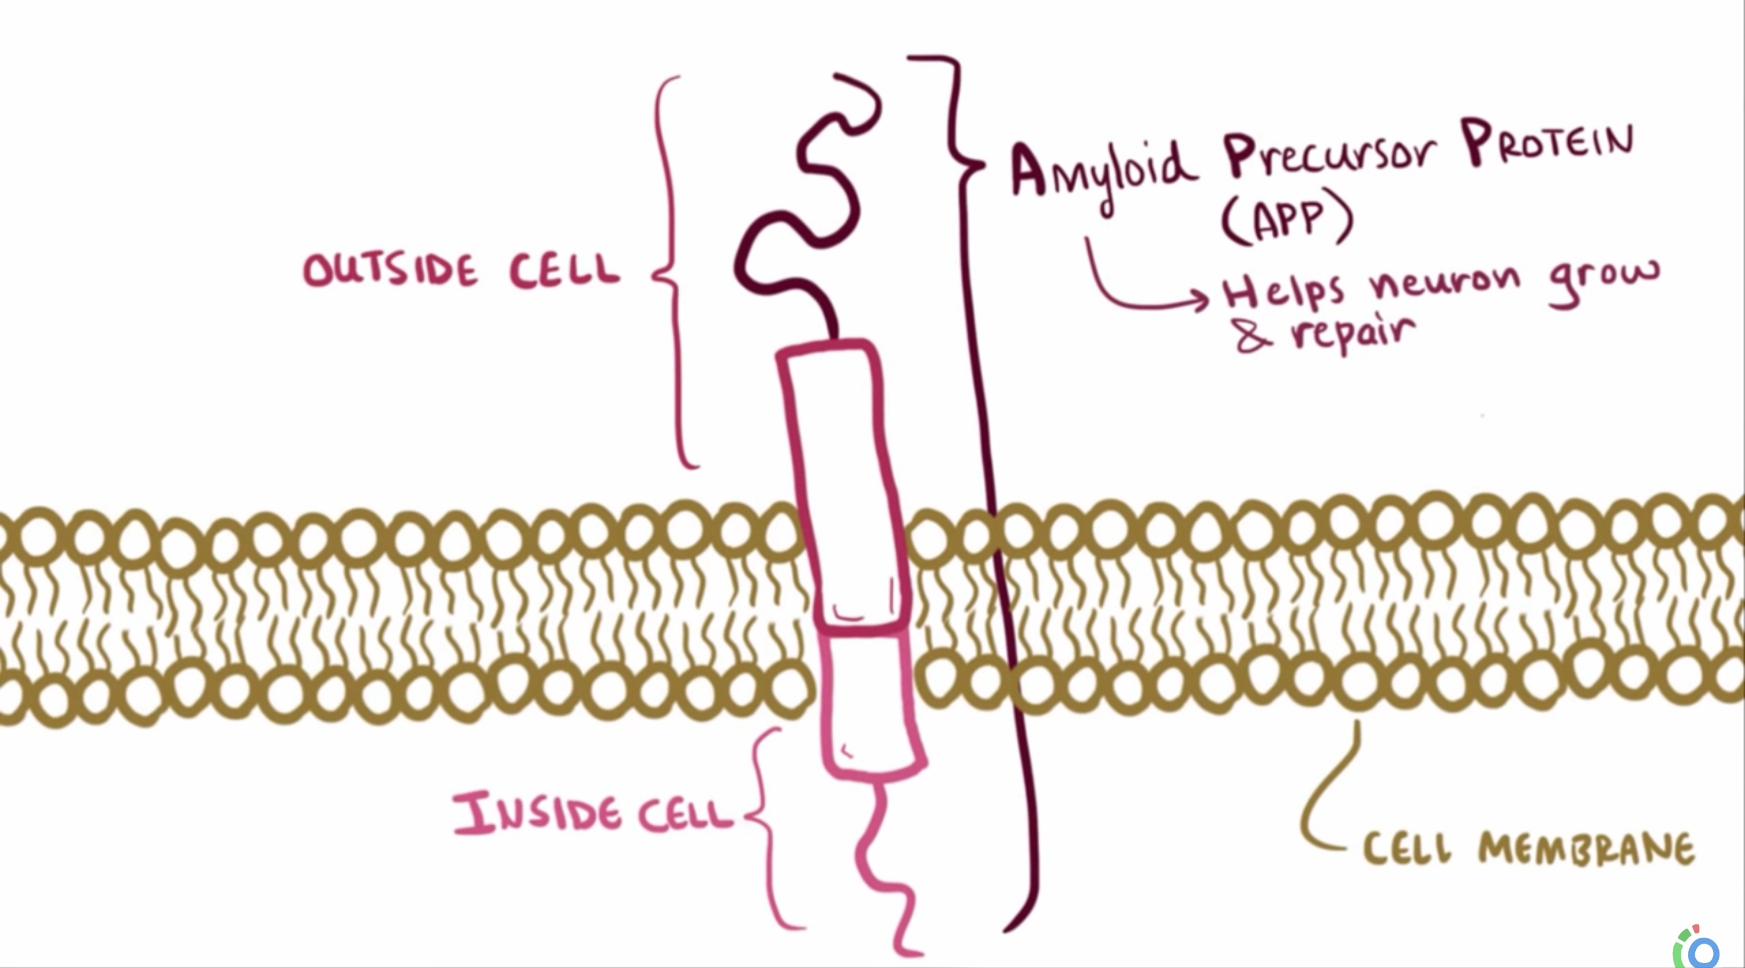

Slide 9
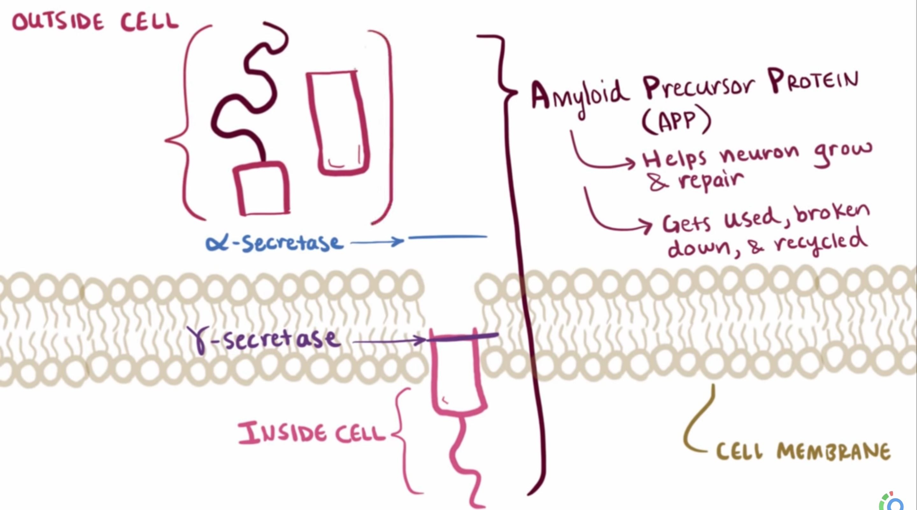

Slide 10
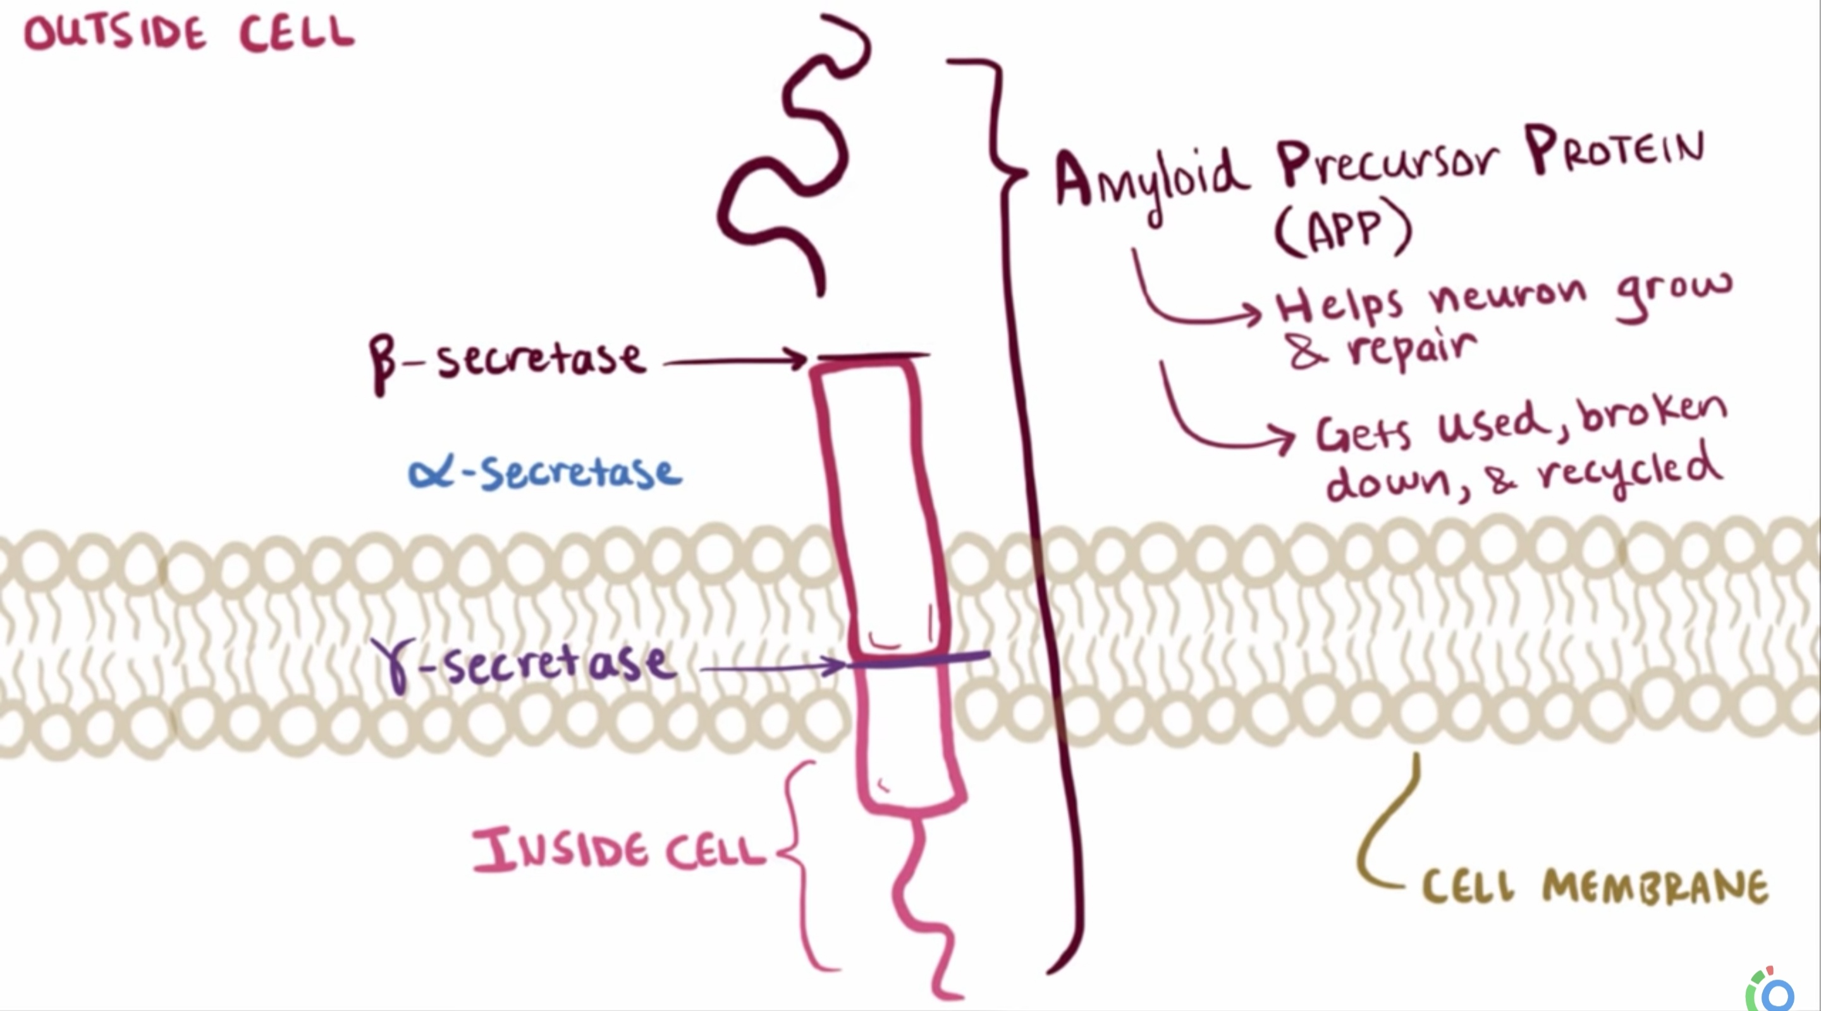

Slide 11
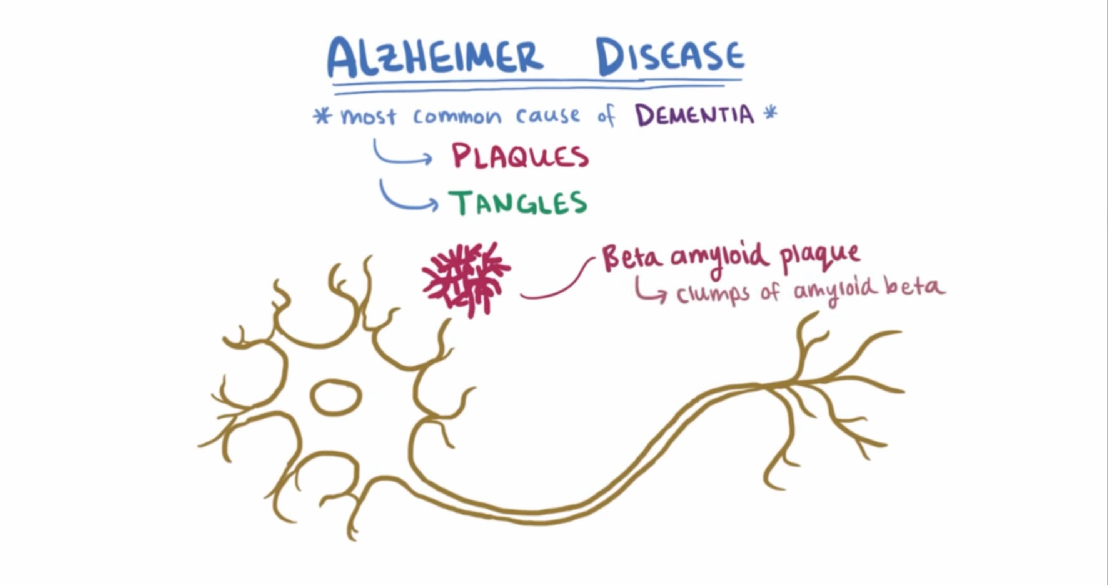

Slide 12
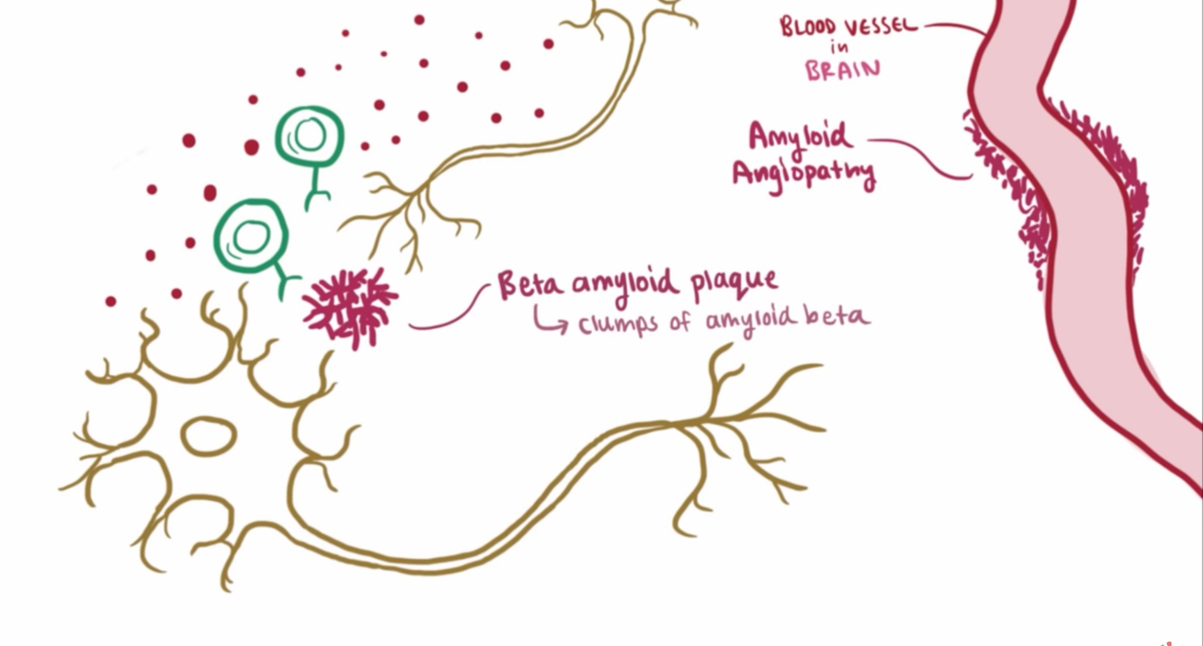

Slide 13
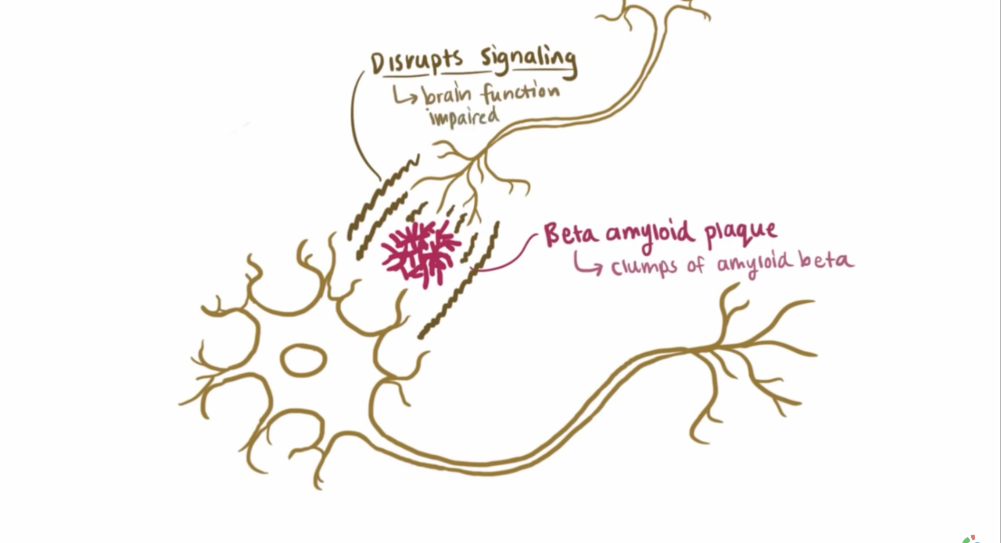

Slide 14
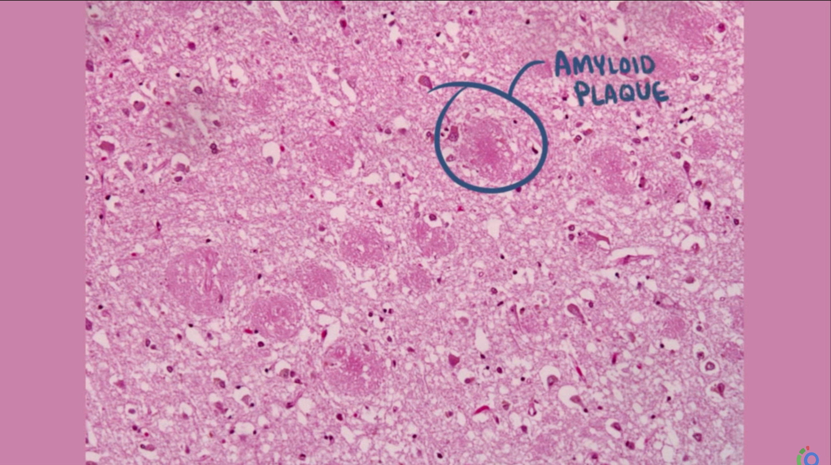

Slide 15
Role of tau
Tau is a microtubule-associated protein present in axons in association with the microtubular network.
It is though that AB outside the cell initiates pathways inside the neurons activating kinase enzyme which transports phosphate to tau protien
tau shifts to a somatic-dendritic distribution, becomes hyperphosphorylated, and loses the ability to bind to microtubules
Tau clumps together with other tau protiens forming neurofibrillatory tangles

Slide 16
Pathophysiology
1) aggregates of tau protein elicit a stress response, which persists and eventually leads to cell death
2), the microtubule stabilizing function of tau protein is lost, leading to neuronal toxicity and death.

Slide 17
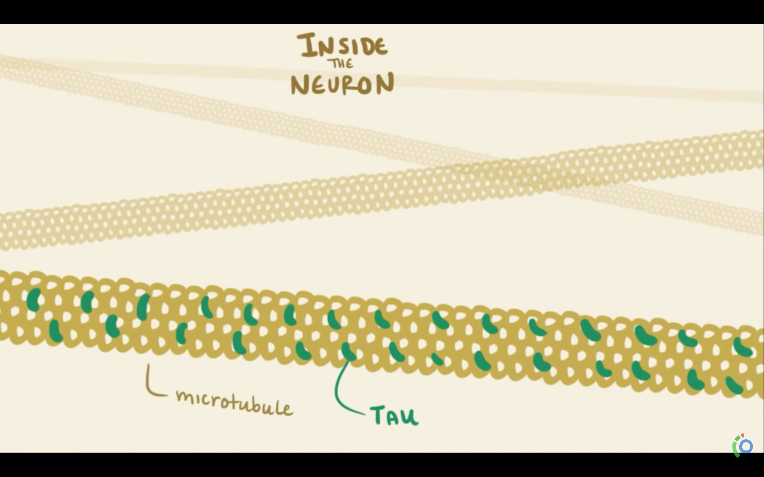

Slide 18
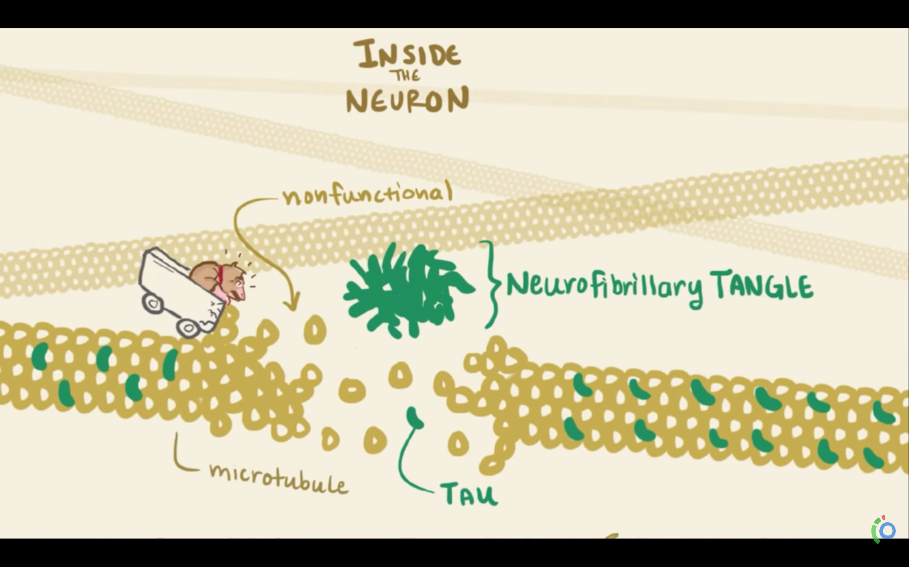

Slide 19
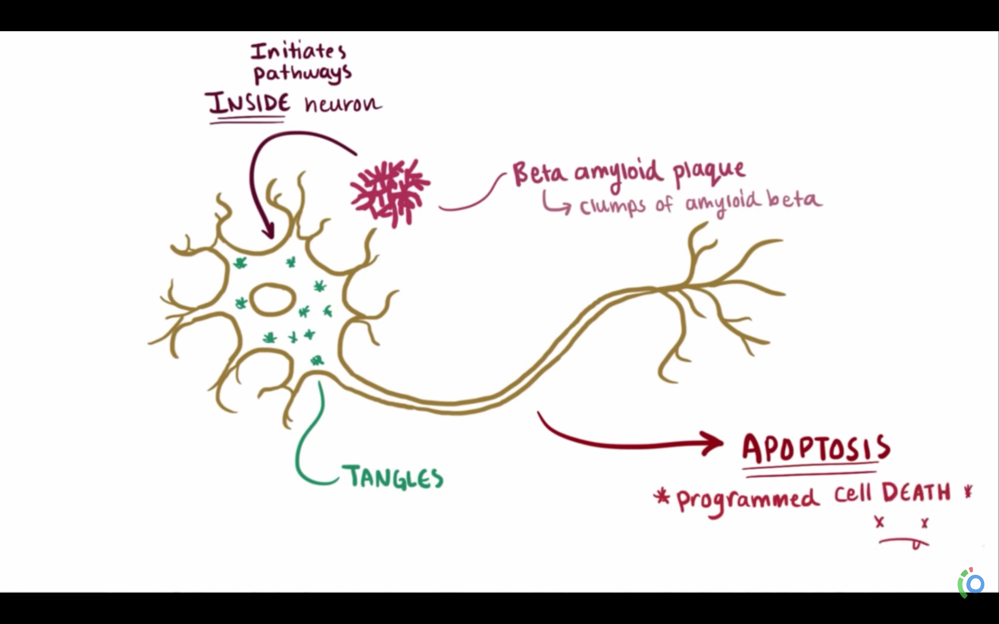

Slide 20
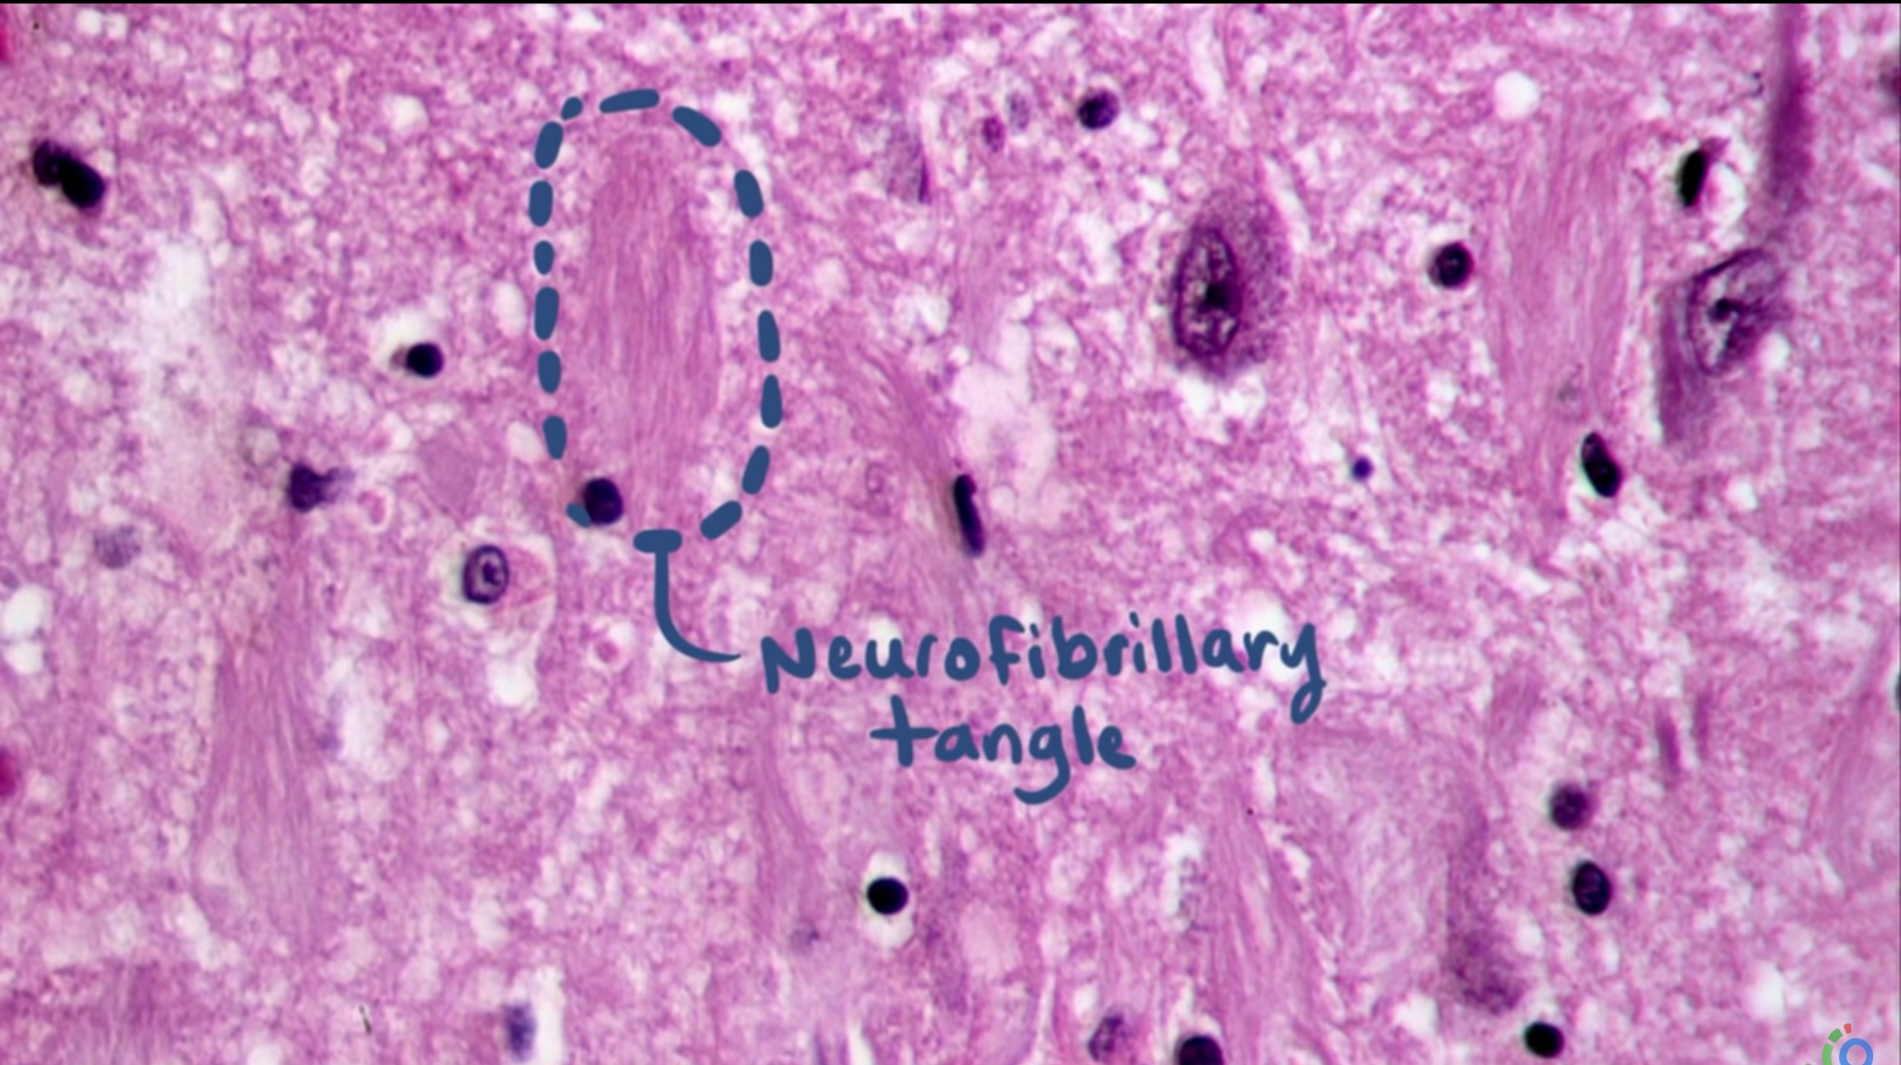

Slide 21
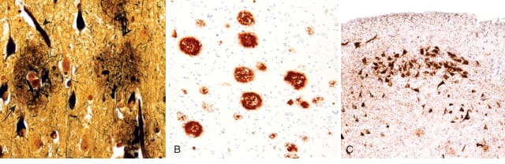
Notes:
Fig. 23.25 Alzheimer disease. (A) Plaques (arrow) contain a central core of amyloid and a surrounding region of dystrophic neurites (Bielschowsky stain). (B) Immunohistochemical stain for Aβ. Peptide is present in the core of the plaques as well as in the surrounding region. (C) Neurons containing tangles stained with an antibody specific for tau.

Slide 22
Brains involved by AD show a variable degree of cortical atrophy, resulting in a widening of the cerebral sulci that is most pronounced in the frontal, temporal, and parietal lobes.
The atrophy produces a compensatory ventricular enlargement (hydrocephalus )

Slide 23
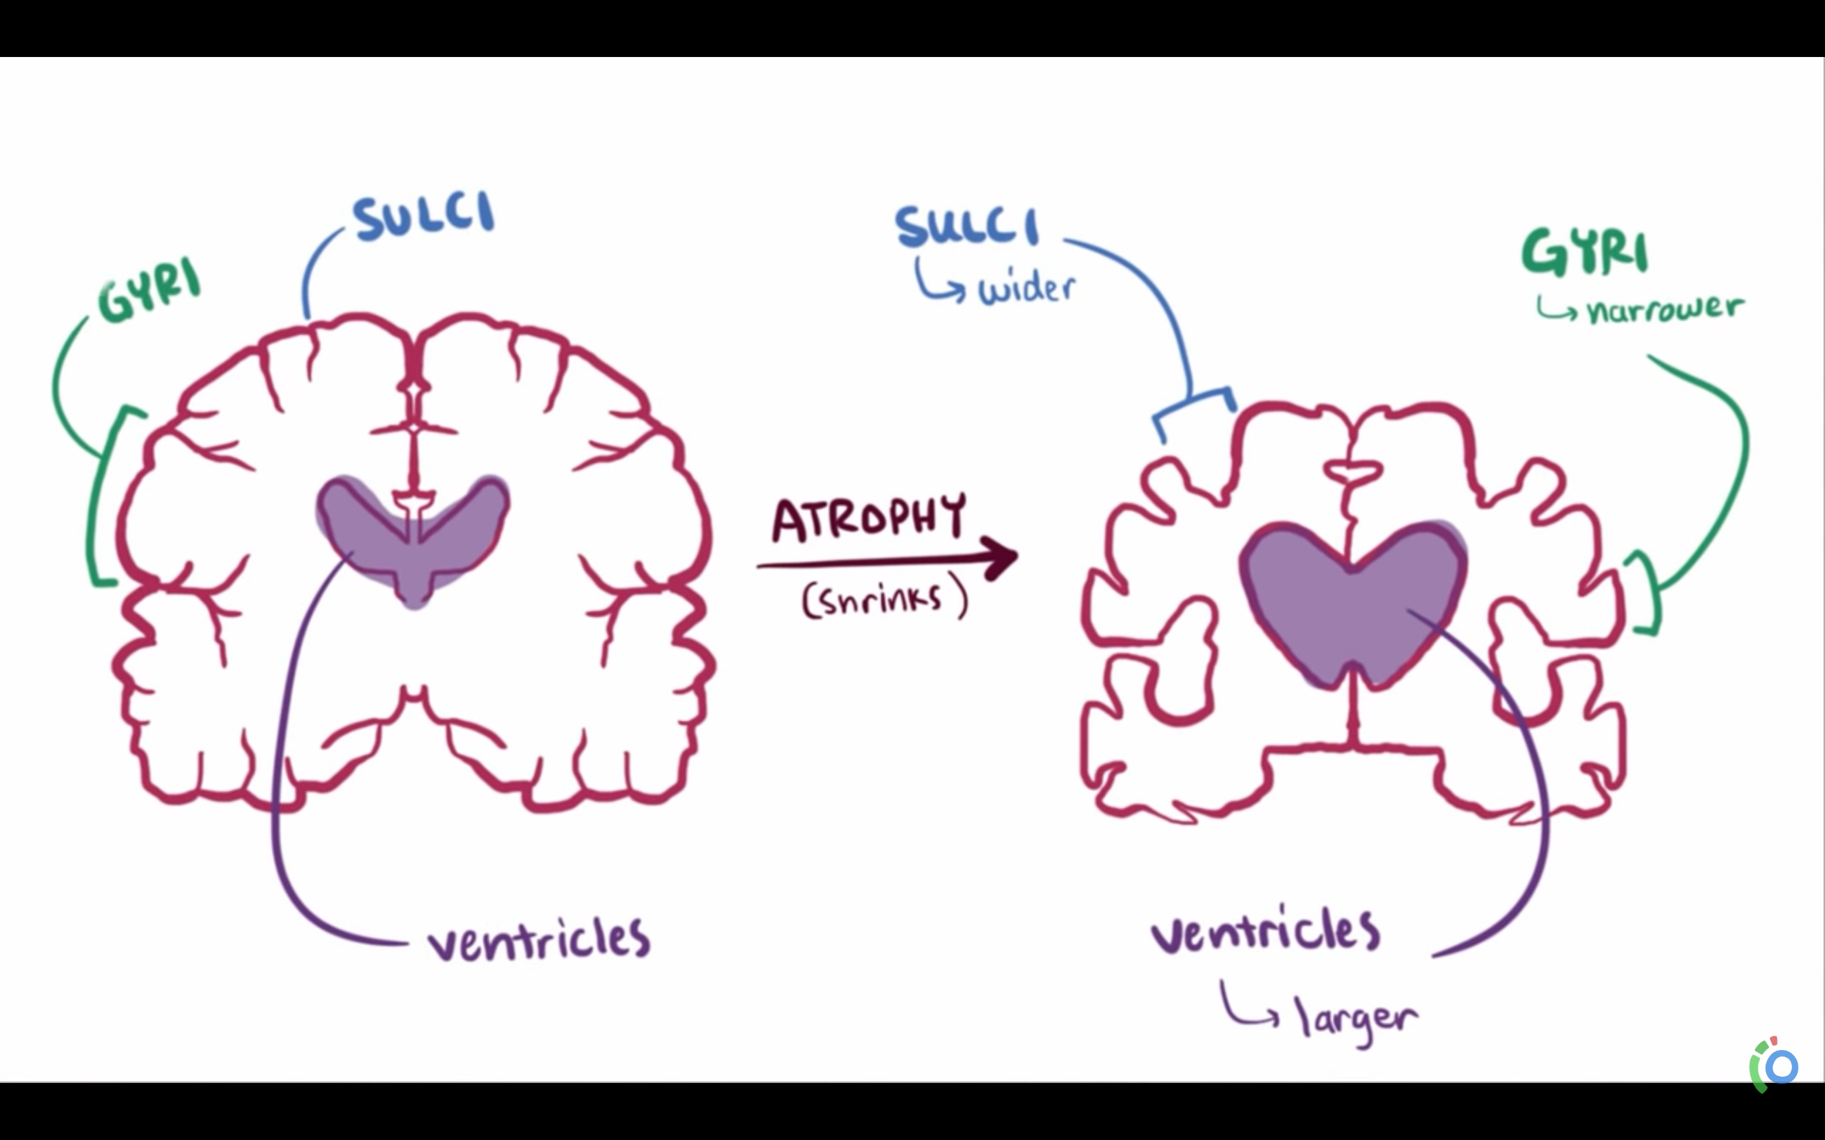

Slide 24
Risk of Alzheimer's
1- Most cases are sporadic 90_95%( late onset alzheimer’s)
Age
Genetic: e4 allel of apolipoprotein E gene (APOE e4)
2- familial ( early onset Alzheimer's)
Several gene muations with domenent inheritance have been found including PSEN1 (ch4) AND PSEN2 (ch1) gen mutations which codes for γ-secretase enzyme
trisomy 21 (down syndrome ) > app gene is carried on chromosome 21

Slide 25
Signs and symptoms
the disease typically has an insedious , progressive onset with marked imapirment of ≥ 2 of the domains ( Learning and memory, Executive function, perception and motor function, Language, Social cognition and Complex attention) and significant impairment of daily functioning
amnestic presentation is most typical

Slide 26
initial signs reflects hippocampal dysfunction :
poor immendiate recall and short term memory
impairment of naming
as the disease progresses frontal and parietal dysfunction immerges like
impairment of perception, social complex, and executive domains
In later stages, many patients develop extrapyramidal dysfunction including akathisia, parkinsonism, dystonia, bradykinesia, tremor, and tardive dyskinesia.

Slide 27
Many patients with AD lack insight into impairments and may even deny deficits.
It is important to characterize the onset and early symptoms to differentiate other pathologies that are more abrupt, such as vascular dementia.

Slide 28
stages of the disease
Preclinical Alzheimer disease:
The pathologic changes begin in the entorhinal cortex, then proceeds to the hippocampus(reponsible for formation of short-term and long-term memories) and Affected regions begin to atrophy
Memory loss, the first visible sign, is the main feature of amnestic mild cognitive impairment (MCI).
patients at this stage may appear completely normal .
there is normally no alteration in judgment or the ability to perform activities of daily living.

Slide 29
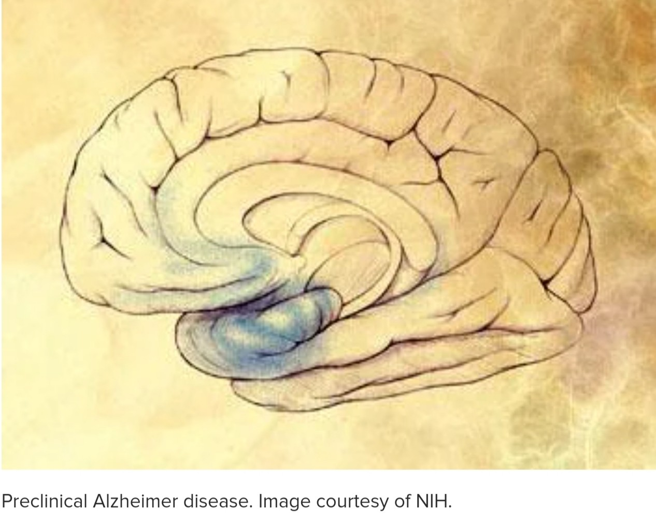
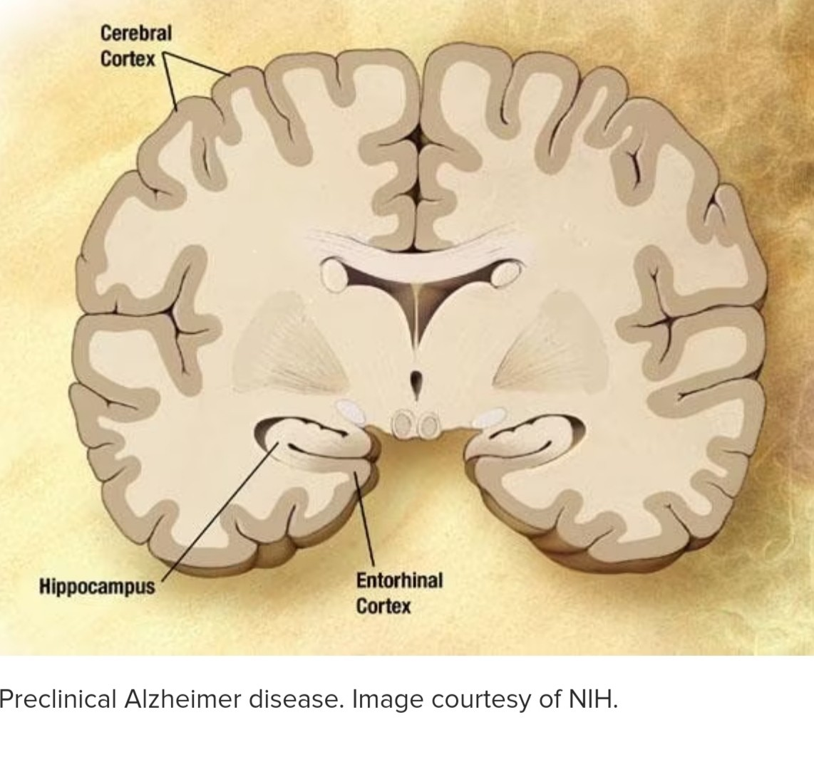
https://youtu.be/K_3t5-jV_sY

Slide 30
2. mild Alzheimer disease
As AD begins to affect the cerebral cortex, memory loss continues and impairment of other cognitive abilities emerges.
Signs include the following:
Memory loss
Confusion about the location of familiar places (getting lost begins to occur)
Taking longer to accomplish normal daily tasks
Trouble handling money and paying bills
Compromised judgment often leading to bad decisions
Mood and personality changes; increased anxiety

Slide 31
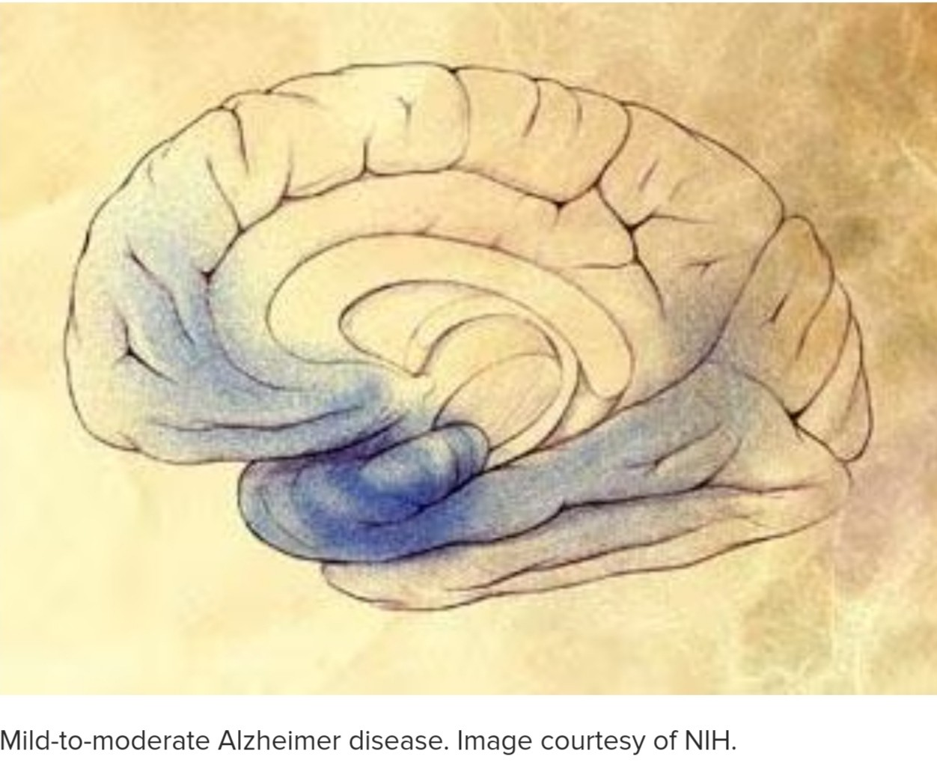

Slide 32
The growing number of plaques and tangles first damage areas of the brain that control memory, language, and reasoning.
Later in the disease, physical abilities decline.
This leads to a situation in mild AD in which a person seems to be healthy but is actually having more and more trouble making sense of the world around him or her.
The realization that something is wrong often comes gradually because the early signs can be confused with changes that can happen normally with aging.

Slide 33
3- Moderate Alzheimer disease
damage spreads further to the areas of the cerebral cortex that control language, reasoning, sensory processing, and conscious thought. Behavior problems, such as wandering and agitation, can occur.
The symptoms of this stage can include the following:
Increasing memory loss and confusion, with Shortened attention span.
Problems recognizing friends and family member
Difficulty with language; problems with reading, writing, working with numbers
Difficulty organizing thoughts and thinking logically
Restlessness, agitation, anxiety, tearfulness, wandering, especially in the late afternoon or at night
Repetitive statements or movement; occasional muscle twitches
Hallucinations, delusions, suspiciousness or paranoia, irritability
Perceptual-motor problems (such as trouble getting out of a chair or setting the table)

Slide 34
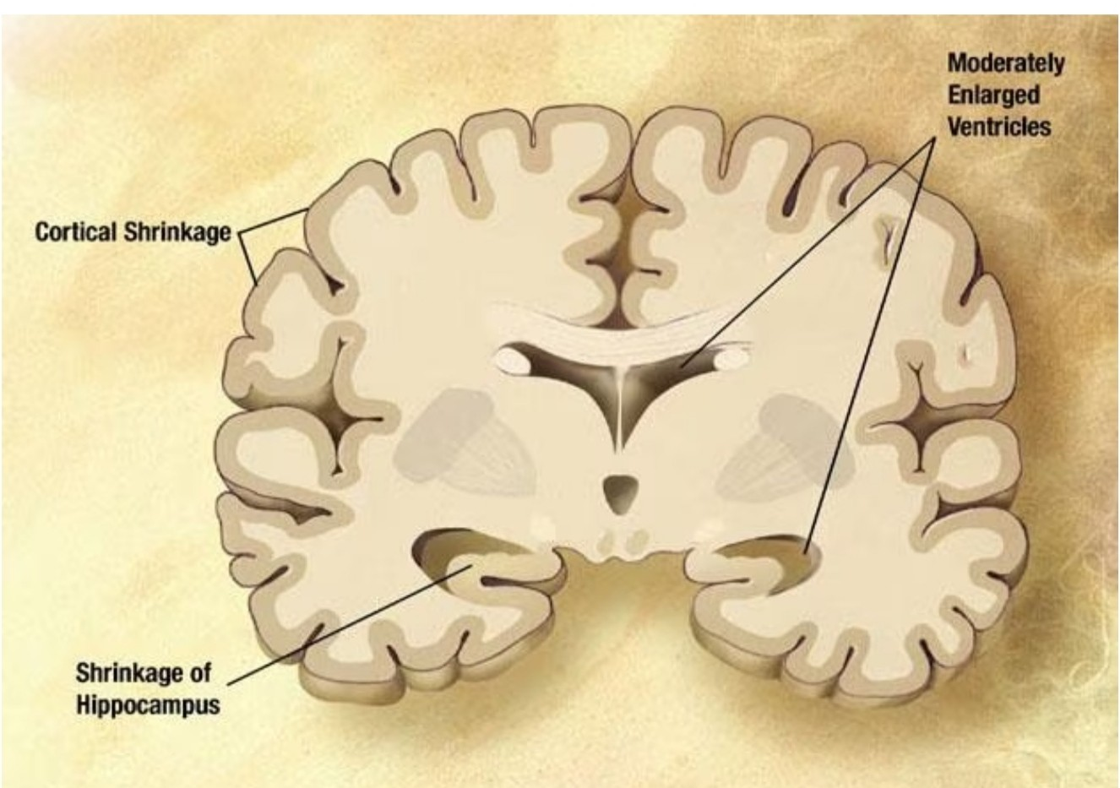

Slide 35
4. Severe Alzheimer disease
plaques and tangles are widespread throughout the brain, and areas of the brain have atrophied further. Patients cannot recognize family and loved ones or communicate in any way. They are completely dependent on others for care.
Other symptoms can include the following:
Weight loss
Seizures, skin infections, difficulty swallowing
Groaning, moaning, or grunting
Increased sleeping
Lack of bladder and bowel control
In end-stage AD, patients may be in bed much or all of the time. Death is often the result of other illnesses, frequently aspiration pneumonia.

Slide 36
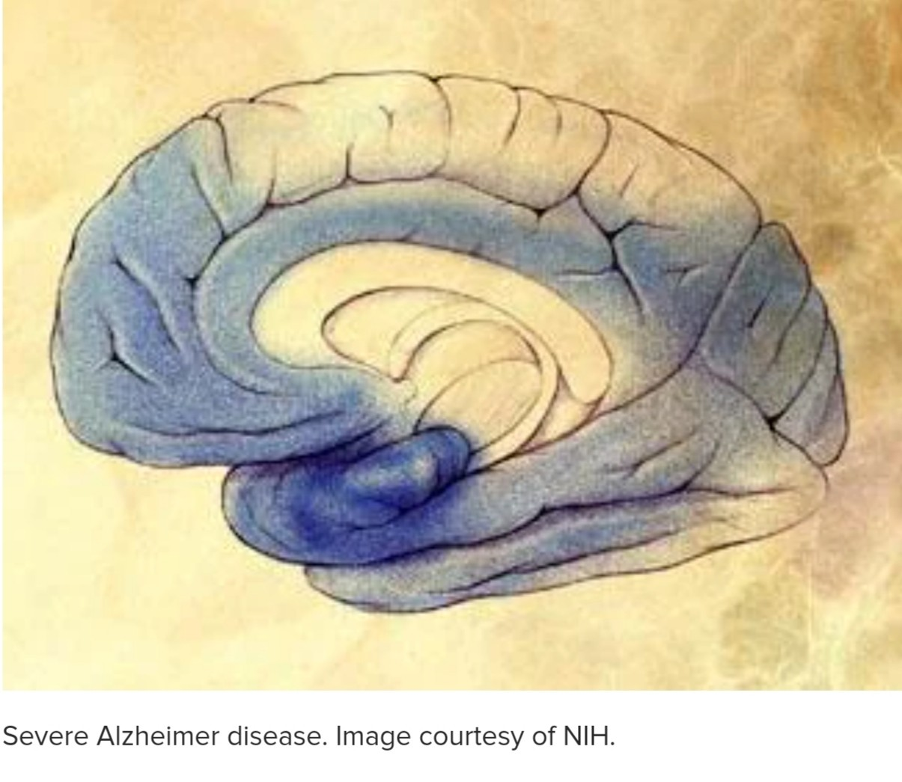
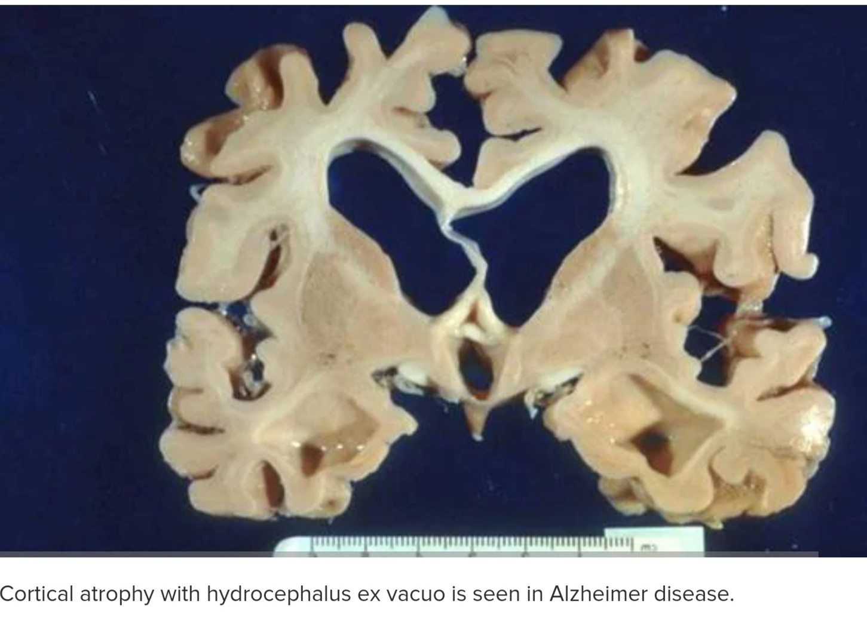

Slide 37
Diagnosis
Alzheimer disease (AD) is a clinical diagnosis .
tests are done mainly to exclude other causes of dementia
MRIshowing disproportionate atrophy
PET scan demonistrating amyloid depostion
CSF tau and amyloid measurement
these biomarkers are not specific enough and abnormalities might be seen in people with normal cognition or MCI only
Do not diagnose alzheimer in patient with history of significant cvd, have evidence of pshyciatric disorder or neurological illness or taking medication that can cause cognitive impairment

Slide 38
reversable causes of dementia
medications
vit b12 diffeciency
hypothyroidism
chronic subdural hematoma
normal pressure hydroencephalus
tumers espicially frontal lobe
infection/inflamation > hiv/ads , chronic menengitis nesurosyphilis, vasculitis
autoimmune encephalitis
heavy metal poisoning

Slide 39
Treatment
only symptomatic therapies for Alzheimer disease (AD) are available and thus do not act on the evolution of the disease
first line treament is chlinesterase inhibitors (ChEIs)
Donepezil
Rivastigmine
Galantamine
Patients on ChEIs have shown slower declines on cognitive and functional measures

Slide 40
2- Anti-amyloid beta monoclonal antibodies
aducanumab>>targets beta amyloid and binds to aggregated forms of beta amyloid
Lecanemab>> targets soluble aggregated amyloid beta species (protofibrils) to disrupt plaque formation

Slide 41
manging neurophsychiatric symptoms (eg, depression, agitation, aggression, hallucinations, delusions, sleep disorders)
Antidepressants SSRIS , trazodone, avloid TCAs )
Anxiolytics
Neuroleptics(olanzapine , quitiapine , repiridone, clozapine )
antiepiliptics

