Slide 1
Larynx (voice box)
Anatomy of the larynx vocal cord paralysis
Presented BY:
Dr. Kamal Al-Saba’a

Slide 2
The larynx is the organ of:
Respiration.
Phonation.
Protection.
Coughing.

Slide 3
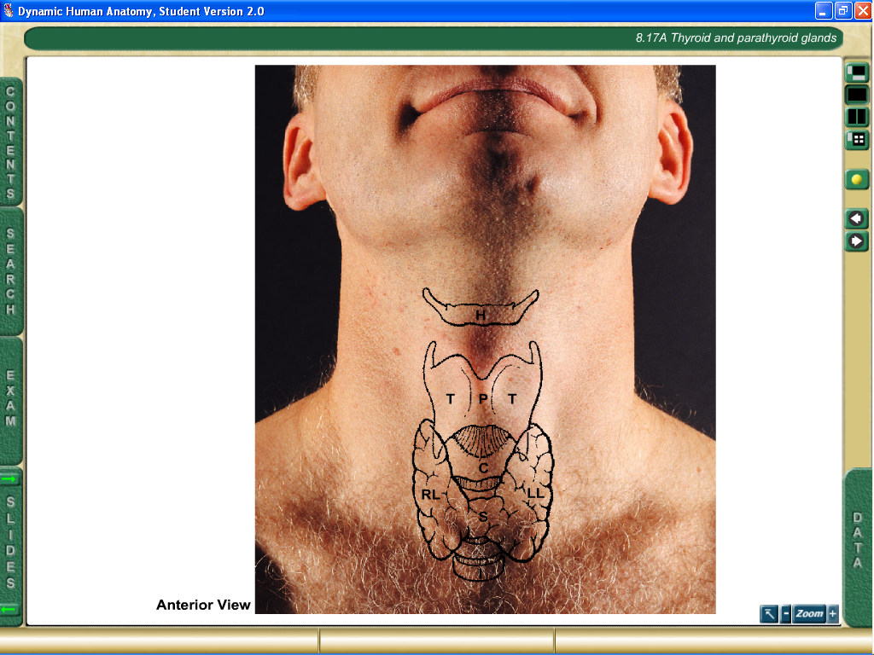
The Larynx
It lies in the median part of the front of the neck, below the hyoid bone.
Infront of the lower part of pharynx and tongue opposite the 3rd, 4th, 5th and 6th cervical vertebrae.
It extends from the upper border of epiglottis to the lower border of cricoid cartilage.

Slide 4
Its extend from lower border third cervical vertebra to lower border sixth cervical vertebra.
Its upper end opens into the Laryngopharynx by the laryngeal inlet.
Its lower end is continuous with the trachea at the level of the lower border sixth cervical vertebra.

Slide 5
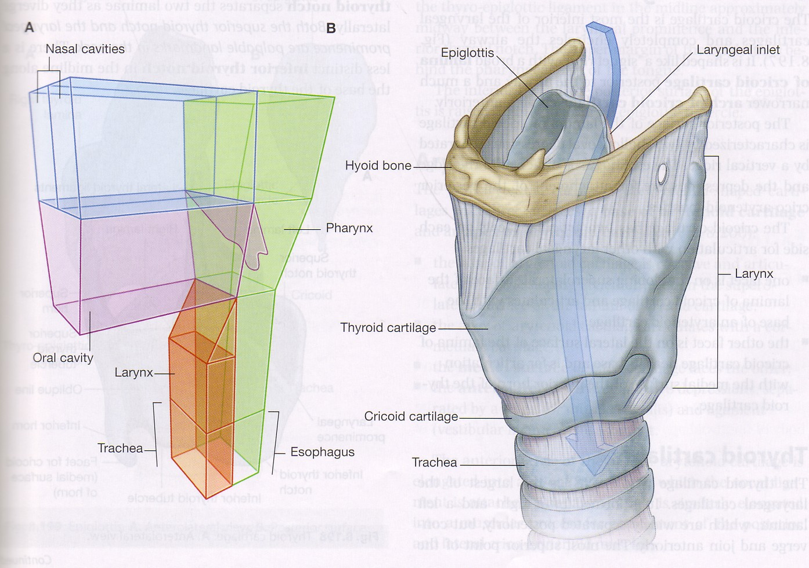

Slide 6
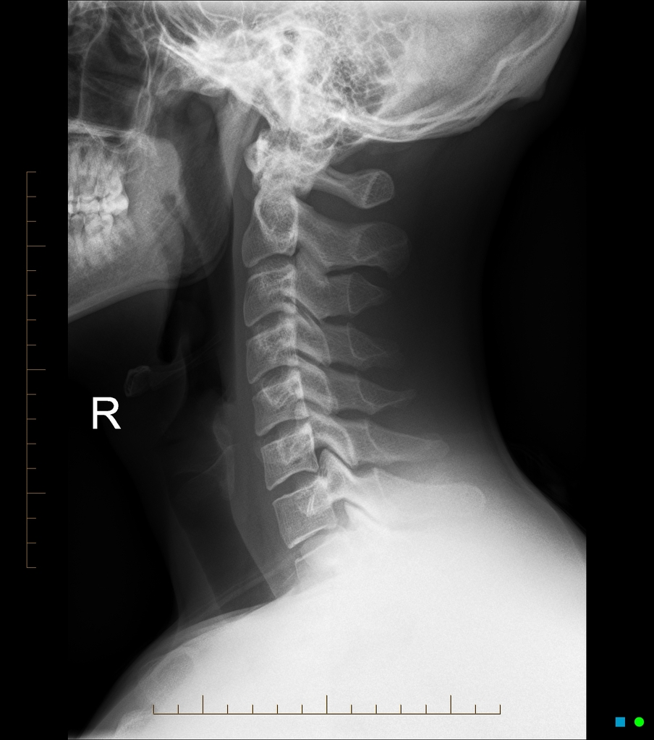

Normal cervical spine radiographs
Help us to know:
Position of larynx
Position of F. body
A. A. I (instability)
Trachiovertebral Space
Eagle syndrome

Slide 7
Trachea
The trachea is a mobile cartilaginous and membranous tube, has a diameter of fore finger (1.5-2 ) cm.
4.5 inch 11-12 cm long up to 15cm.
In newborn, diameter about 3 mm- length about 4cm.
Start at lower border of C6 At lower border of cricoid cartilage.
It end at angle of Lewis Sternal angle by dividing into 2 Bronchi.
Half trachea in neck half in chest.

Slide 8
Trachea is kept open by 16-20 C shapes cartilage open posteriorly.
In the thorax it ends by dividing into two main bronchi at the level of the disc between the 4th & 5th up to 7 thoracic vertebrae .
The distance between the incison teeth and the inlet of esophagus ( pharyngoesophagal junction) and first trachial ring about 15 cm.

Slide 9
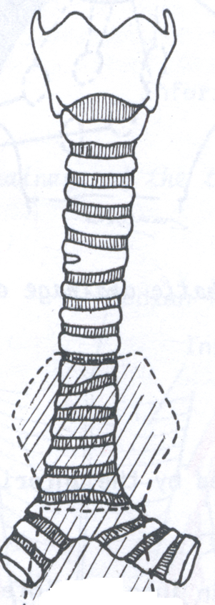
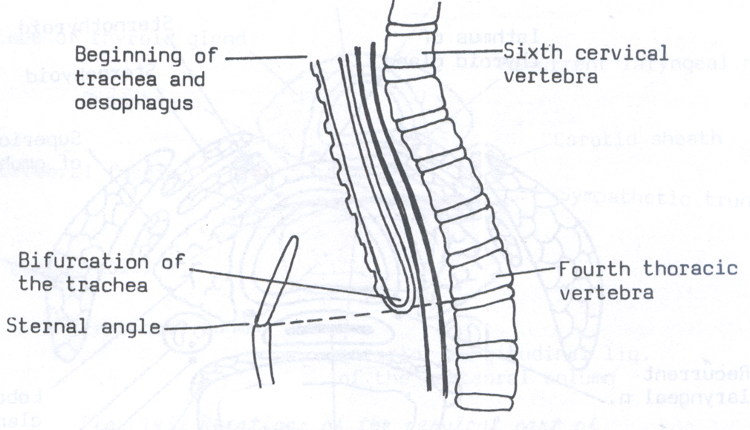

Slide 10
Esophagus:
It’s a muscular tube about 10 inch (25-28 cm)
Begins at level of the cricoid cartilage, opposite the 6 cervical vertebra.
Upper esophageal sphincter (UES) under voluntary control.
Lower esophageal sphincter (LES) not under voluntary control, 2 cm in diameter.
Start: 6 cervical vertebra – End: 11 thoracic vertebra.
5 cm of esophagus in the neck (cervical part).
17-18 cm thoracic part, 1-1.5 cm in diaphragm.
2-3 cm in abdomen (abdominal part).

Slide 11
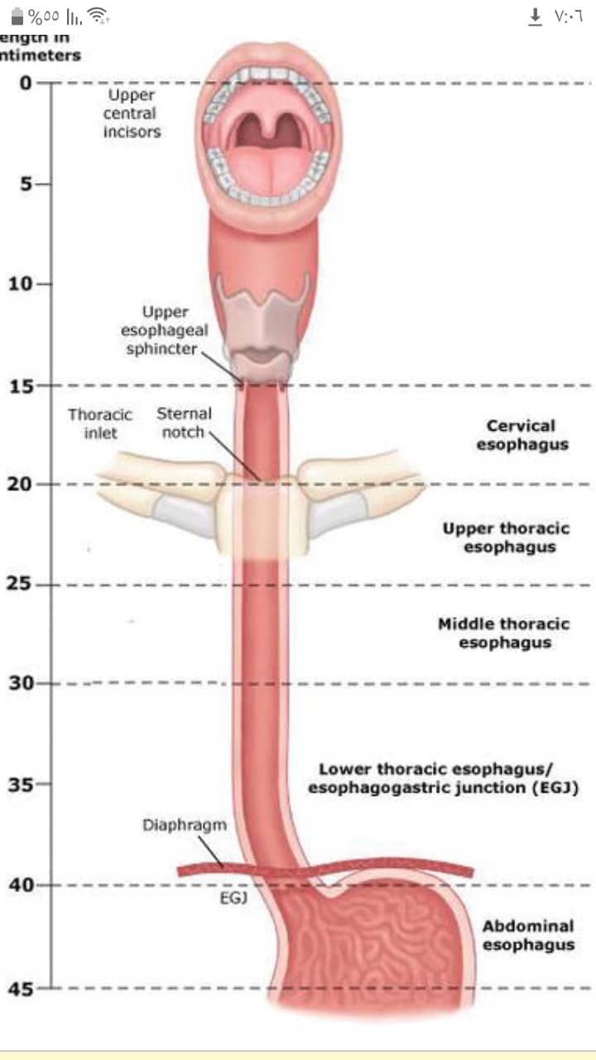
Lower esophageal sphincter

Slide 12
Newborn: 18 cm. 3years old: 22 cm. 10 years old: 25cm.
Some esophagus condition related to ENT
* Gastroesophageal reflex disease.
In short: GERD occur when the sphincter becomes weak or opens when it should not.
GERD occurs commonly in people who are overweighed or obese, pregnant, drugs: sedatives, antihistamine, calcium channel block.
Hiatal hernia: upper part of the stomach move up in the chest.
where acid from the stomach comes up into the esophagus.
( more than twice a week)

Slide 13
Symptoms: heartburn, burning sensation in chest, coughing, hoarseness of voice, dysphagia.
Complications:
Esophagitis.
Esophageal stricture.
Esophageal ulcer
Barrett's esophagus ( Barrett's syndrome): change of the cells of the esophagus which become similar to the cells of intestine ( mucosal dysplasia). It can develop to cancer.

Slide 14
The larynx consists of
Cartilages.
Muscles.
Ligaments and mucus membranes.
Joints.

Slide 15
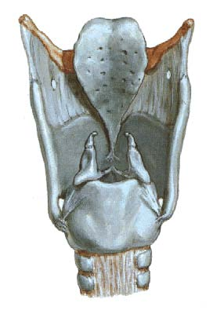
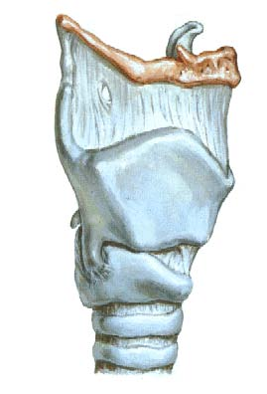

Slide 16
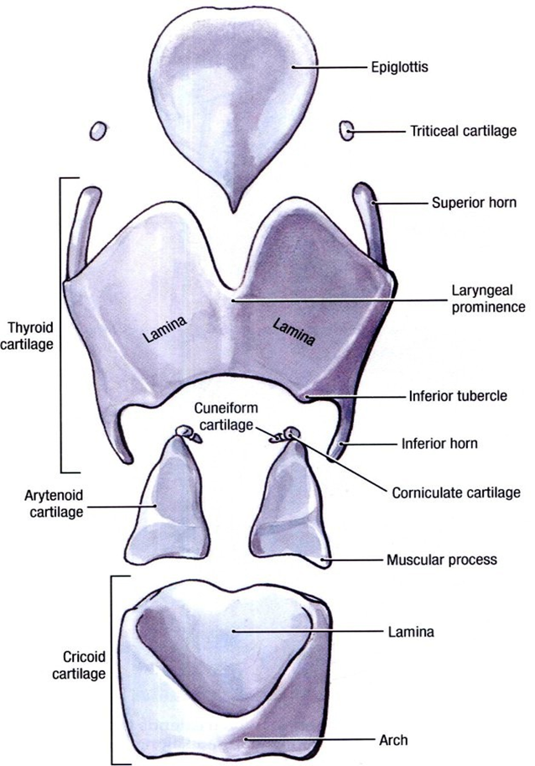
The Larynx
Laryngeal cartilages:
  Single:
    Thyroid cartilage.
    Cricoid cartilage.
    Epiglottis cartilage.
  Paired:
    Arytenoid cartilages.
    Corniculate cartilages.
    Cuneiform cartilages.

Slide 17
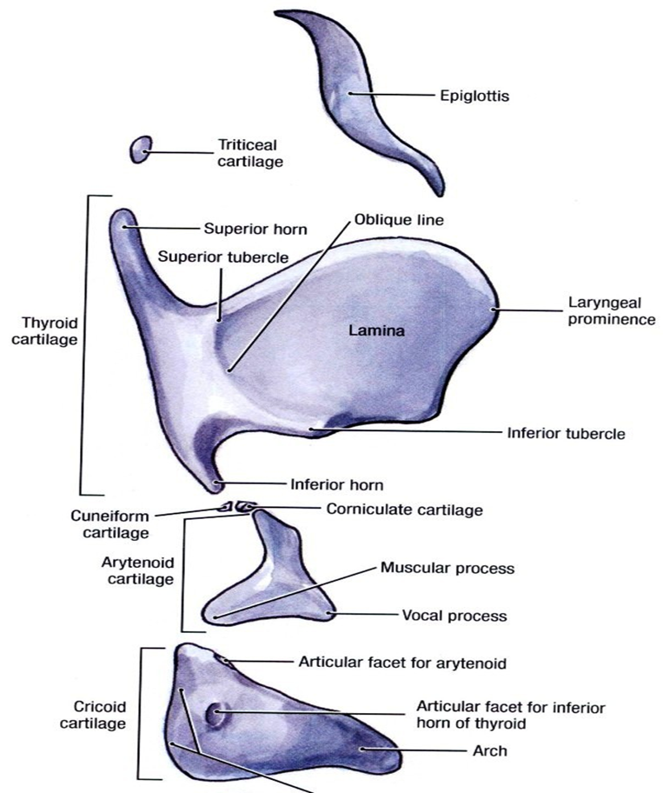

Slide 18
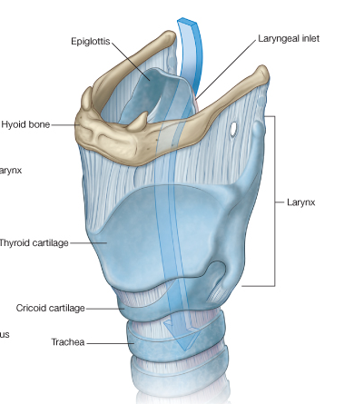
The Hyoid bone
A supportive structure for the larynx and the root of the tongue.
The larynx is suspended to the hyoid bone.
An attachment point to some extrinsic muscles of the larynx.
U-shaped and located in the anterior part of the neck.
Consists of : Body- lesser cornua- greater cornua.

Slide 19
What is Eagle syndrome ( stylohyoid syndrome) ?
It is a condition that causes:
Pain in the throat and face.
Dysphagia
Shooting pain from the throat to the ear or jaw.
Pain at the base of the tounge.
Tinnitus
Eagle syndrome occurs due to elongation of styloid process or calcification of the stylohyoid ligament.
Normal stylohyoid process is 2.5-3 cm in length. If the length is longer than 3 cm, it is Eagle syndrome.

Slide 20
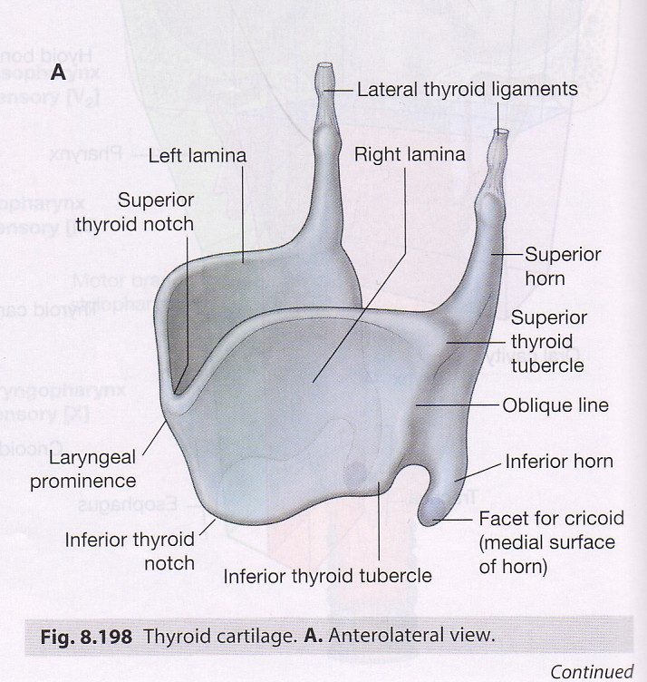
Thyroid cartilage
The largest cartilage of the larynx, related to the thyroid G.
Look like a hard cover of an open book.
Two laminae ,widely separated behind,
The superior corn is attached by ligaments to the hyoid bone.
The inferior corn articulates with the cricoid cartilage (Cricothyroid joint).

Slide 21

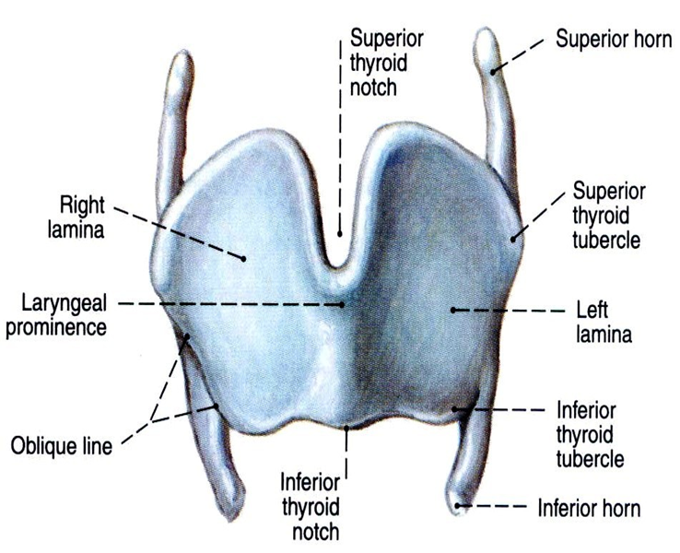
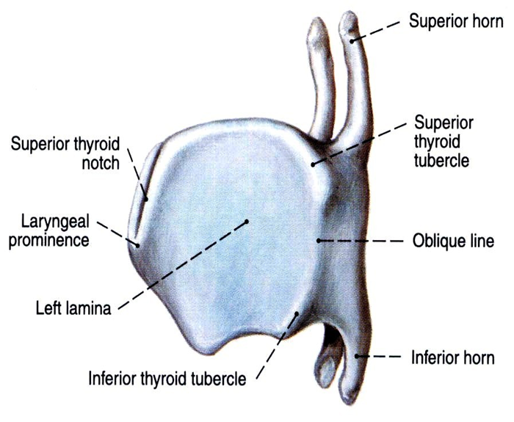

Slide 22
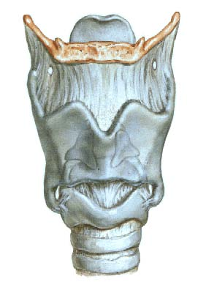
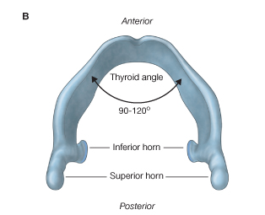
Thyroid cartilage
Thyroid notch superiorly
The angle between the two laminae is called the thyroid angle and is 90 degree in males and 120 degree in females (ADAM’S APPLE).
This means that VC are longer 2.5 cm in male 1.6 in female

Slide 23
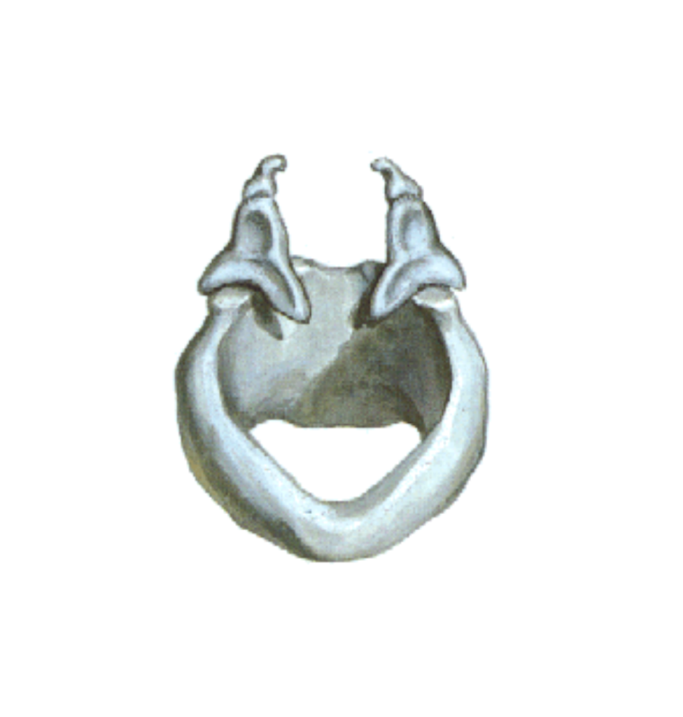
Cricoid cartilage
A ring, the only ring in the respiratory passages.
Anterior: Arch
Posterior: Lamina

Slide 24
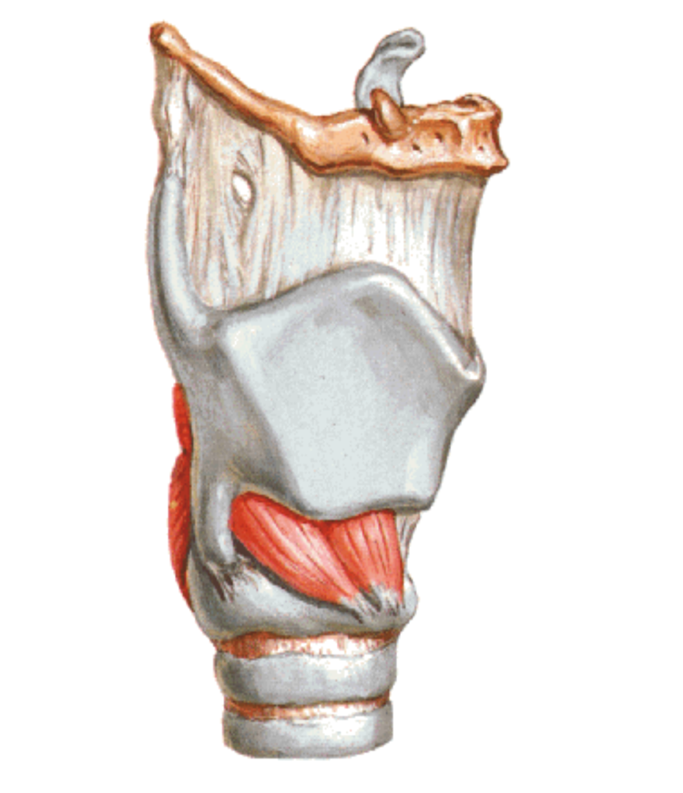
Laterally the arch of the cricoid articulates with the inferior horns of the thyroid cartilage (Cricothyroid joint).

Slide 25
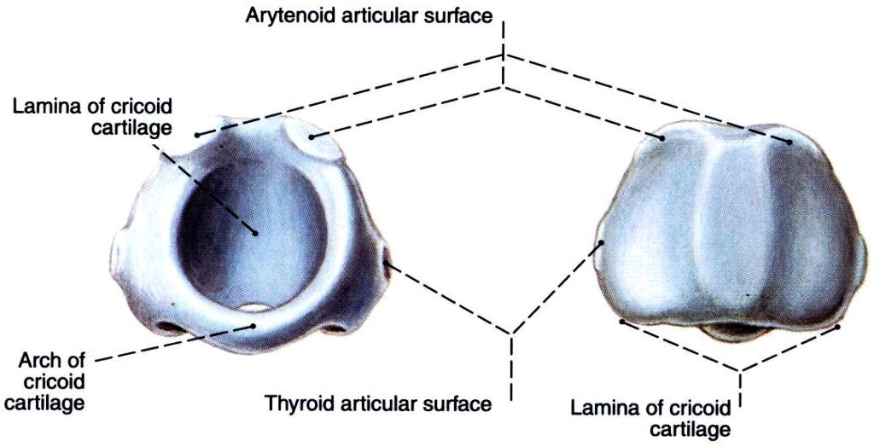

Slide 26

Arytenoid Cartilage
A pyramidal-shaped cartilage, with an apex, base and 3 surfaces
The apex is directed upwards and articulates with the corniculate cartilage.
The base is directed downwards and articulates with the upper border of the lamina of cricoid cartilage.

Slide 27
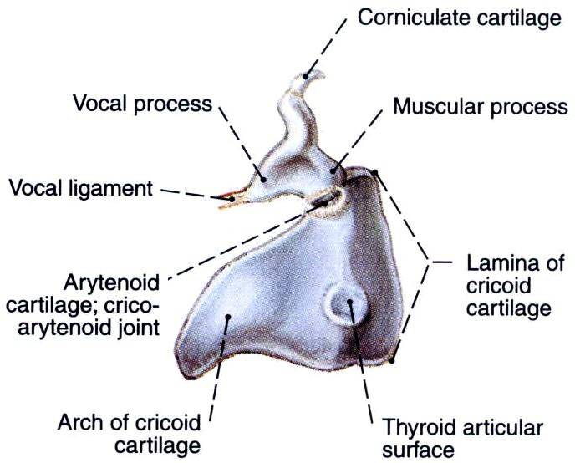

Slide 28
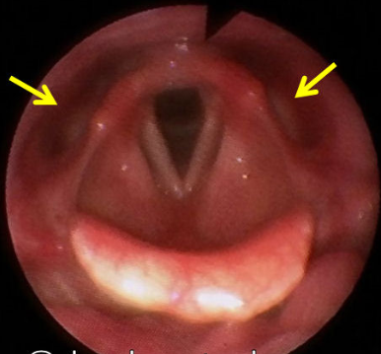
Corniculate Cartilage
A small cartilage on the apex of the arytenoids cartilage.
Enclosed in the aryepiglottic fold forming the corniculate tubercle.

Slide 29
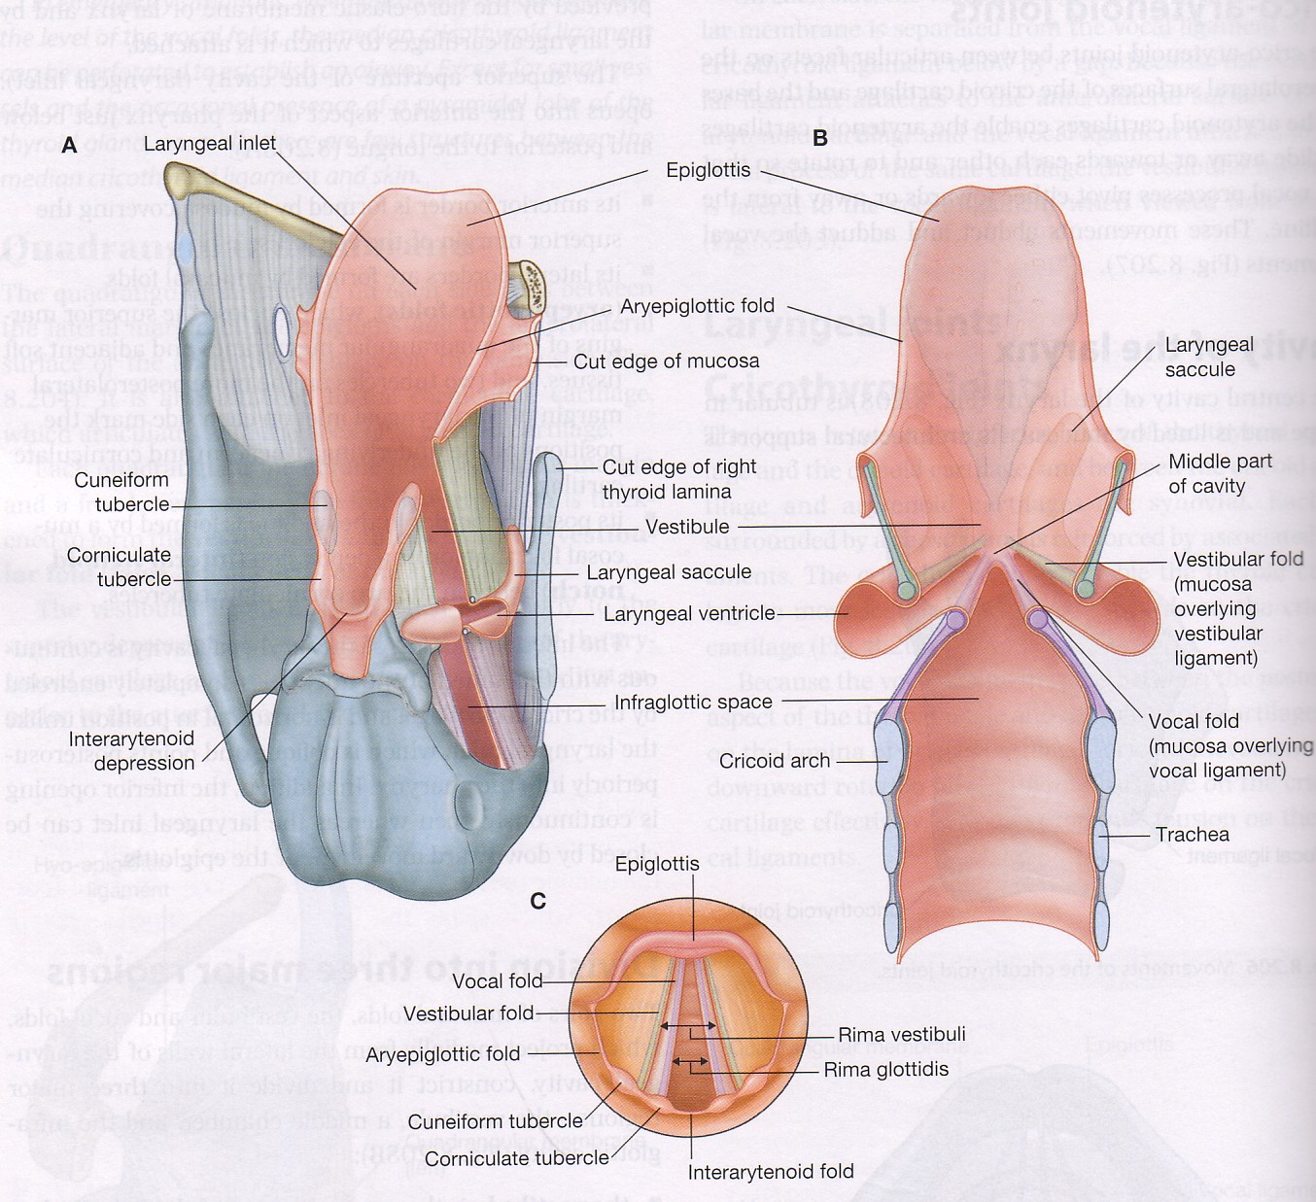

Cuneiform Cartilage
A small nodule enclosed in the aryepiglottic fold forming the cuneiform tubercle.

Slide 30
Epiglottis Cartilage
A leaf-shaped elastic cartilage.
It projects upwards behind the tongue and hyoid bone.
Has an upper broad free end and a lower tapering end.

Slide 31
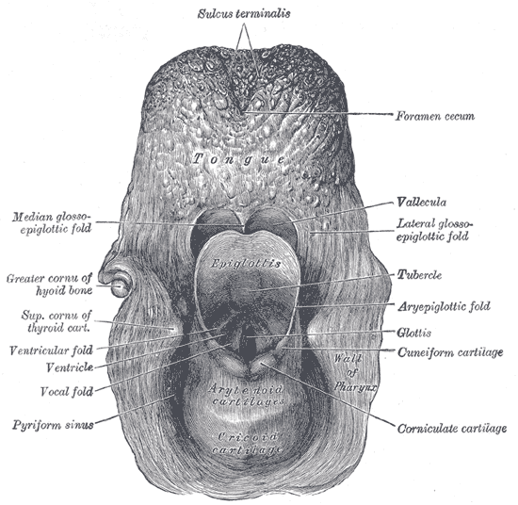
Anteriorly, it is connected to:
The root of the tongue, by the median and lateral glosso-epiglottic folds.
The hyoid bone, by the hyoepiglottic ligament.
The inner surface of the thyroid cartilage by the thyroepiglottic ligament.

Slide 32
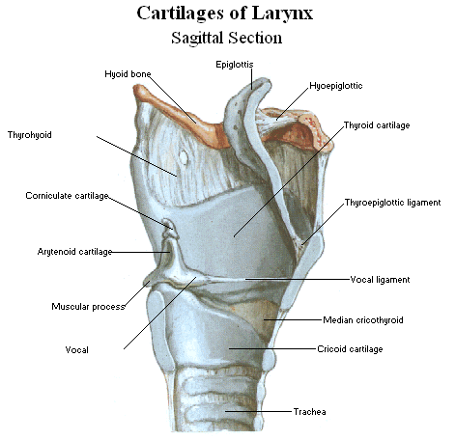

Slide 33
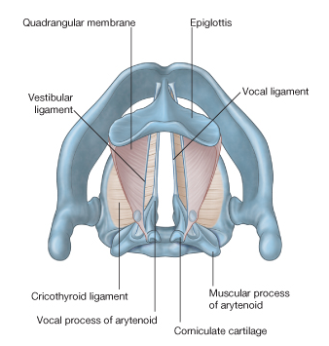
Joints of the larynx
The Cricothyroid joints
Cricoarytenoid joints

Slide 34

The Cricothyroid joints
The inferior horn of the thyroid cartilage articulates with the lateral side of the lamina of the cricoid cartilage.

Slide 35
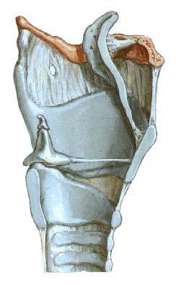
Cricoarytenoid joints
Between the base of the arytenoids and the cricoid lamina.
Ankylosis
Rheumatoid arthritis
Endotracial intubation

Slide 36
Membranes and ligaments of the larynx

Slide 37
Thyrohyoid membrane:
In the space between the hyoid bone and the thyroid cartilage.

Slide 38
Hyo-epiglottic ligament:
Connects the epiglottis to the body of the hyoid bone in the midline.

Slide 39
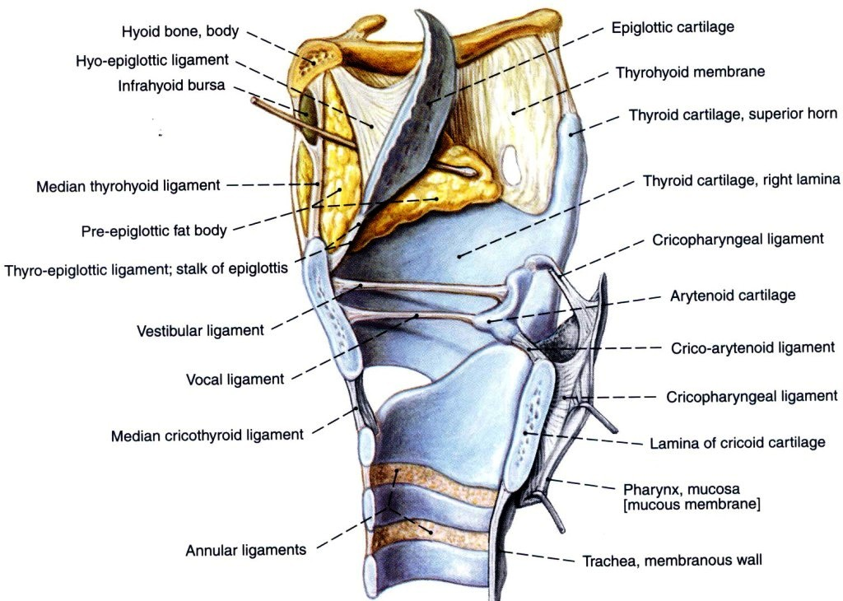
Larynx Ligaments and membranes

Slide 41
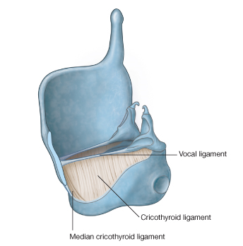
The cricothyroid ligament
  An elastic band which lies below and on the inner aspect of the thyroid cartilage.
  It is connected to thyroid cartilage, cricoid cartilage and arytenoids cartilage.
  Two parts of the ligament can be recognized:

Slide 42
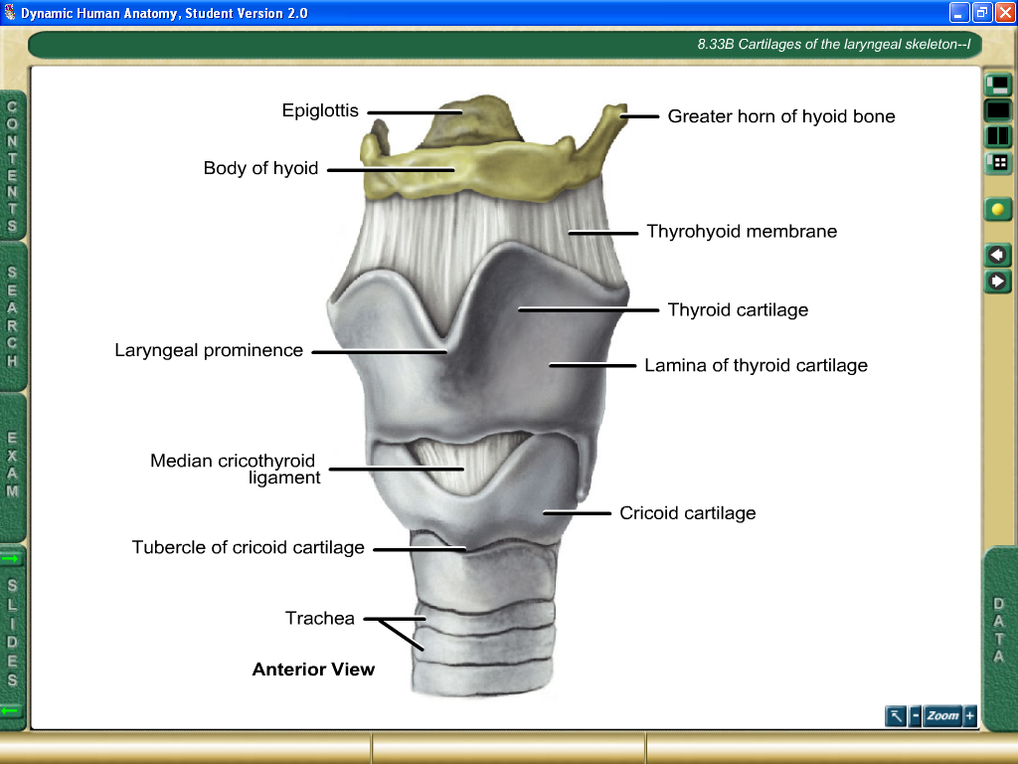
Median cricothyroid ligament:
  The anterior thickened part of the ligament which connects the adjacent borders of the cricoid and thyroid cartilages.
  The ligament is overlapped by the cricothyroid muscle.

Slide 43
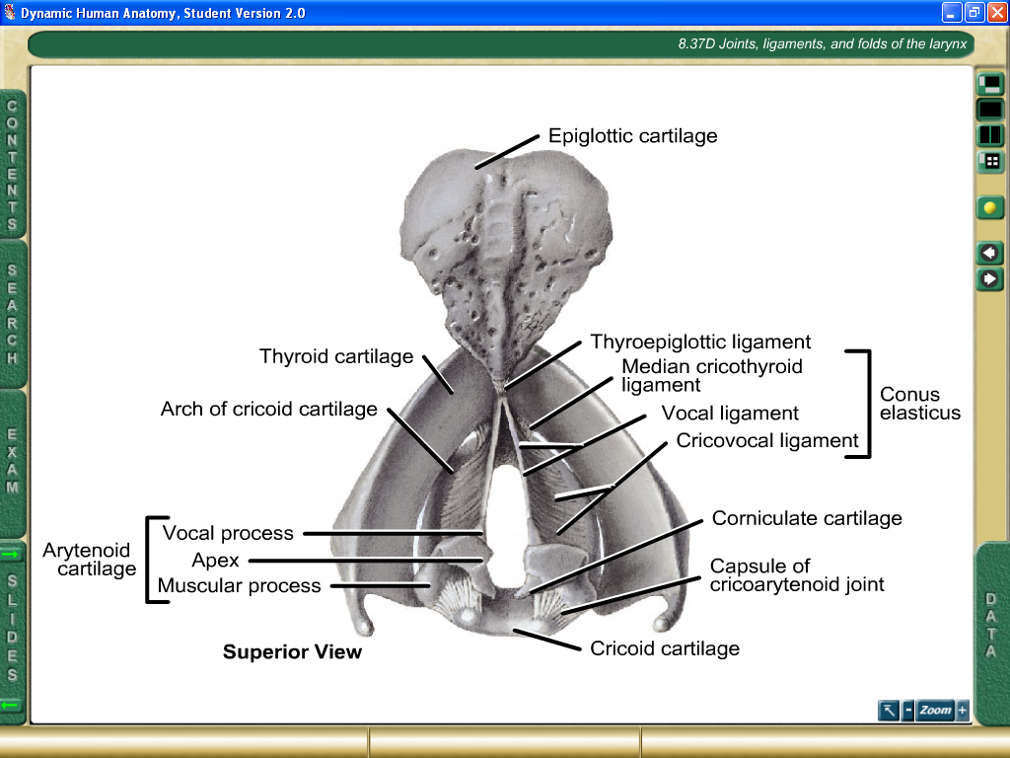
Lateral cricothyroid ligament (crico-vocal membrane)
This ligament is attached inferiorly to the upper border of cricoid cartilage
superiorly, it has 2 attachments:
to the inner surface of thyroid cartilage, anteriorly.
to the vocal process of arytenoid cartilage, posteriorly.

Slide 44
The free upper border of the crico-vocal membrane is called the Vocal Ligament.
So, the vocal ligament is attached to the inner surface of thyroid cartilage (anteriorly) and to the vocal process of the arytenoid cartilage (posteriorly).

Slide 45
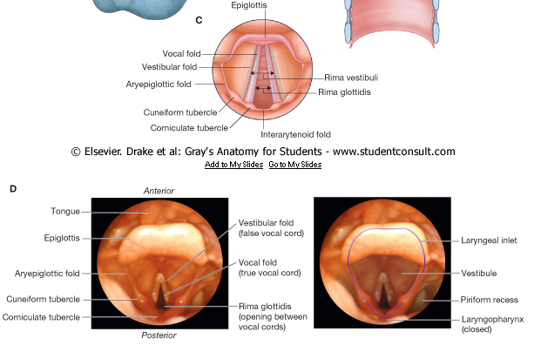
Laryngeal Inlet
The opening of communication between the pharynx and larynx.
It is directed upwards and backwards.

Slide 46

Boundaries:
Upper border of epiglottis anteriorly.
Aryepiglottic folds on both sides.
MM between the arytenoids cartilages posteriorly.

Slide 47
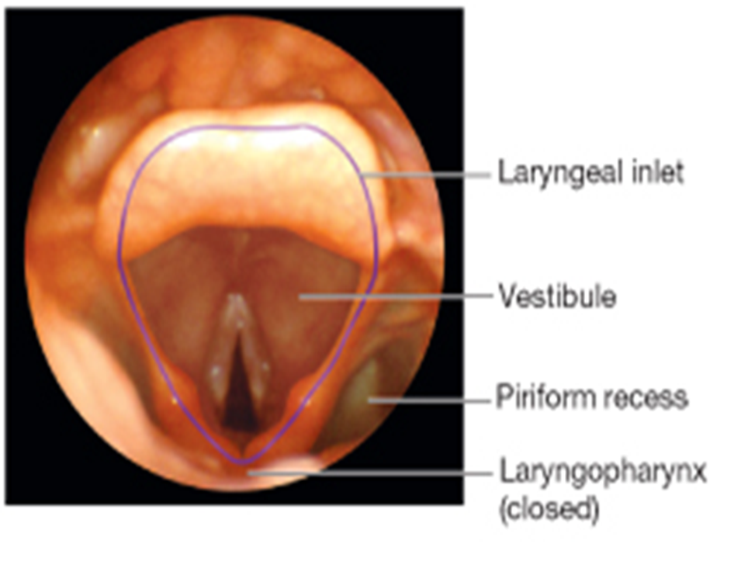
Aryepiglottic fold:
Is a fold of mucosa extending between the apex of arytenoids cartilage and the side of epiglottis.
It encloses the
aryepiglottic muscle, cuneiform and corniculate cartilages.

Slide 48
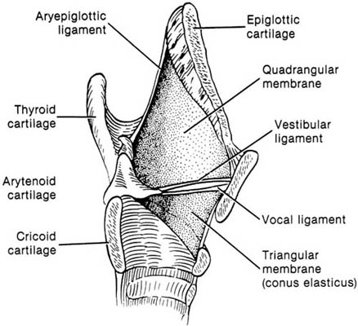
Vestibular folds (False vocal cords):
vestibular ligaments + mucosa
Thickening of the quadrangular membrane.
Between the thyroid cartilage and the arytenoids.
Rima vestibuli.

Slide 49
Vestibule of the larynx:
  The part of the cavity between the inlet and the vestibular folds

Slide 50
Vocal fold:
A fold of mucous membrane extending from the inner surface of thyroid cartilage to the vocal process of arytenoid cartilage.
The folds enclose the vocal ligaments (upper border of lateral cricothyroid ligaments).
The fissure between the 2 vocal folds is called
Rima glottidis.

Slide 51
The Subglottic region
Extends from below the vocal folds till the lower margin of the cricoid cartilage.

Slide 52
Muscles of the larynx
Extrinsic muscles
Intrinsic muscles

Slide 53
The extrinsic muscles of the larynx
The muscles that have only one attachment or origin in the larynx.
They divided into elevators and depressors of the larynx.
They have functions supporting the position and movements of the larynx and in deglutition.
The larynx moves up during swallowing and down after swallowing
The hyoid moves with the larynx.

Slide 54
The intrinsic muscles of the larynx
Muscles controlling the movements of the vocal cords:
Tensors
Cricothyroid
Relaxors
Thyroarytenoid
Abductors (open)
Posterior Cricoarytenoid
Adductors (close)
Lateral Cricoarytenoid, Transverse arytenoids

Slide 55
The intrinsic muscles of the larynx
2. Muscles controlling the laryngeal inlet:
Narrowers
Oblique arytenoids
Wideners
Thyroepiglottic

Slide 56
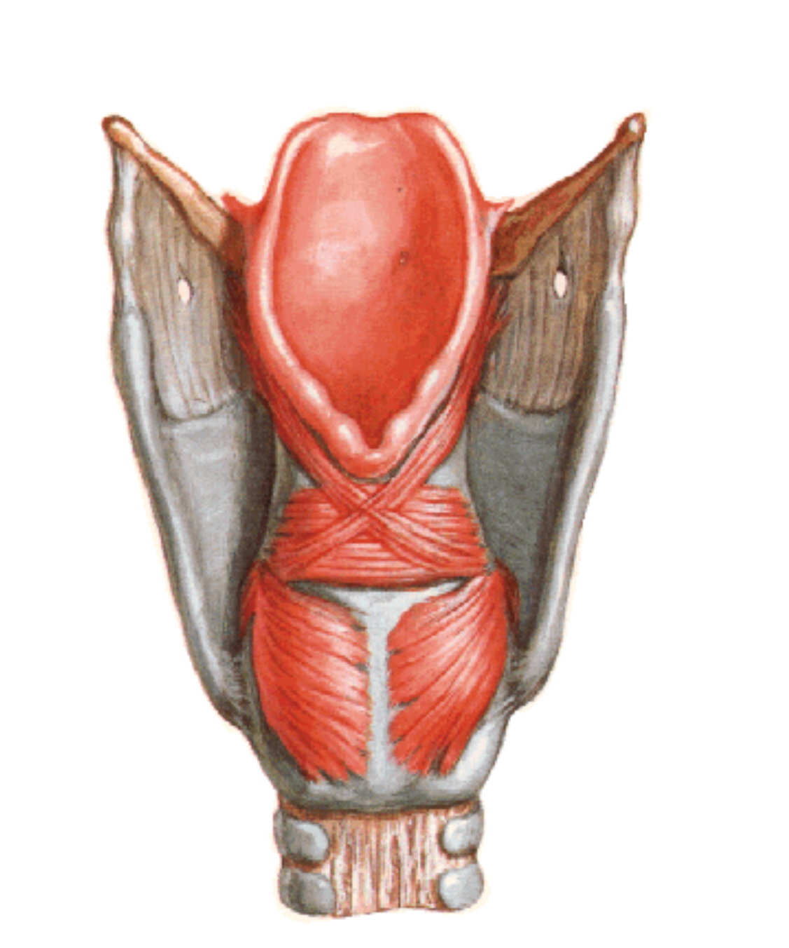
Posterior Cricoarytenoid Muscle
Origin: from the posterior surface of the lamina of the cricoid cartilage.
Insertion: into the muscular process of the arytenoid cartilage.
Nerve supply: recurrent laryngeal nerve
Action: Abduction of the vocal cords by rotating the arytenoid cartilage.

Slide 57
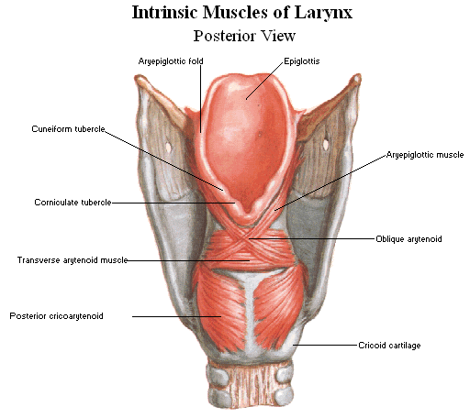

Slide 58
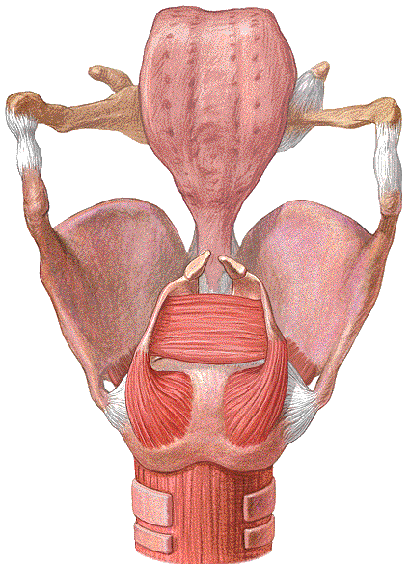
Posterior
cricoarytenoid muscle

Slide 59
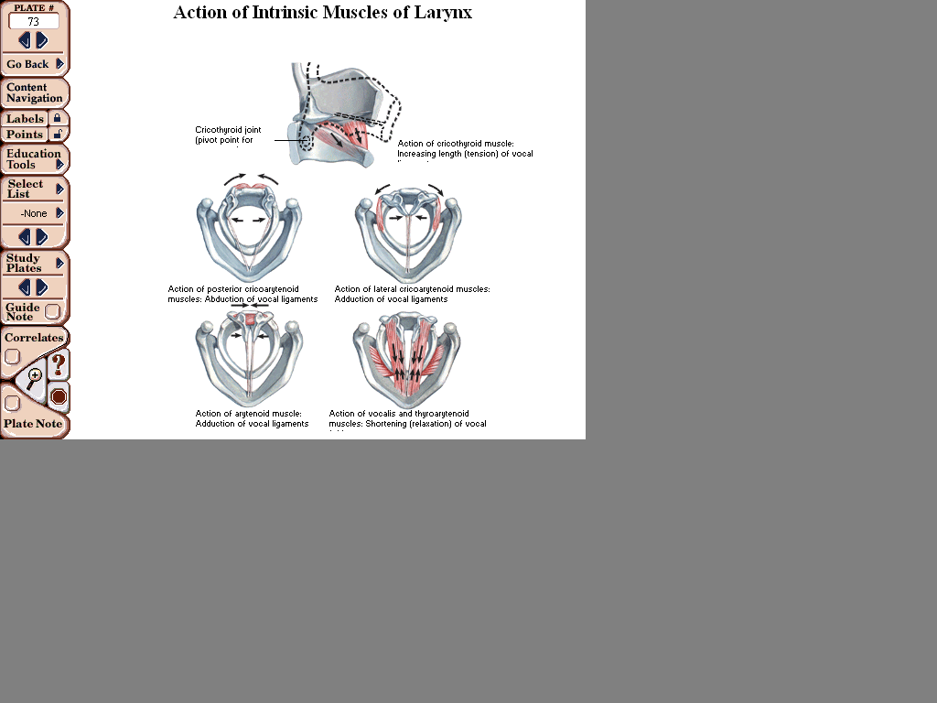

Slide 60
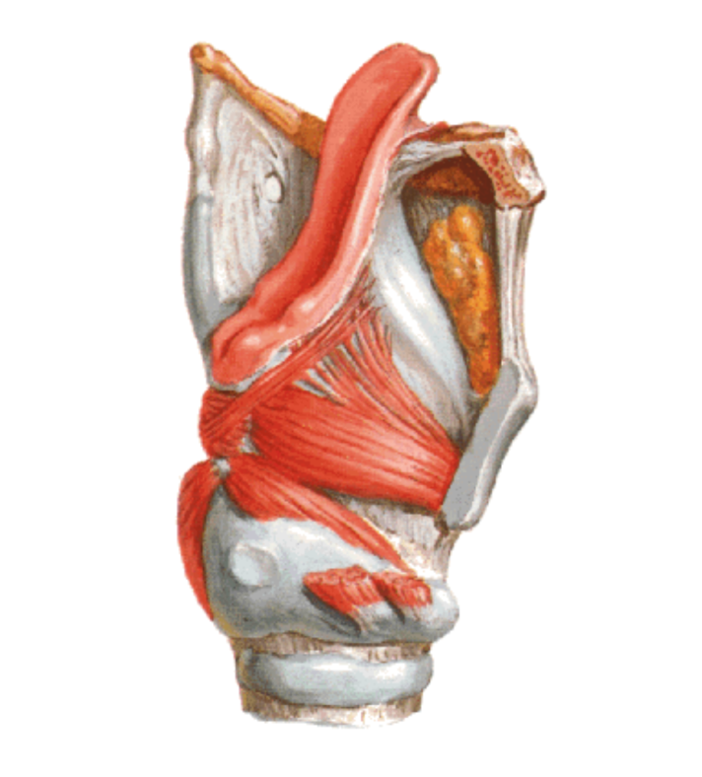
Lateral Cricoarytenoid Muscle
Origin: from the upper border of the arch of cricoid cartilage.
Insertion: into the muscular process of the arytenoid cartilage.
Nerve supply: recurrent laryngeal nerve
Action: Adduction of the vocal cords by rotation of the arytenoid cartilage.

Slide 61
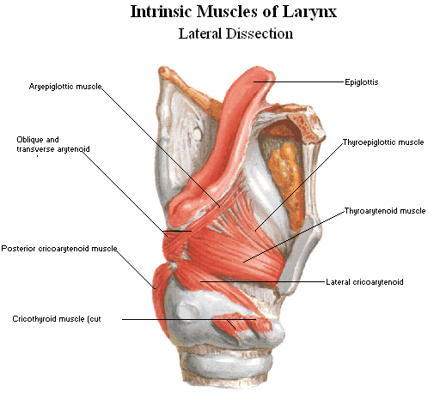

Slide 63
Transverse Arytenoid Muscle
Origin: from the back and medial surface of the arytenoid cartilage.
Insertion: into the back and medial surface of the opposite arytenoid cartilage.
Nerve supply: recurrent laryngeal nerve
Action: Adduction of the vocal cords by approximating the arytenoid cartilages.

Slide 65
Transverse arytenoid muscle

Slide 67
Cricothyroid Muscle
The only intrinsic muscle seen on the outside of the larynx.
The only muscle of the larynx supplied by the external laryngeal nerve.
Origin: from the outer aspect of the arch of cricoid cartilage.
Insertion: into the inferior horn and lower border of the thyroid cartilage.
Nerve supply: external laryngeal nerve
Action: elongation and tension of the vocal cords.

Slide 68
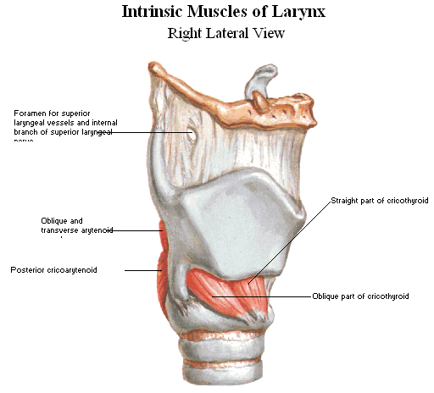
Cricothyroid muscle

Slide 69
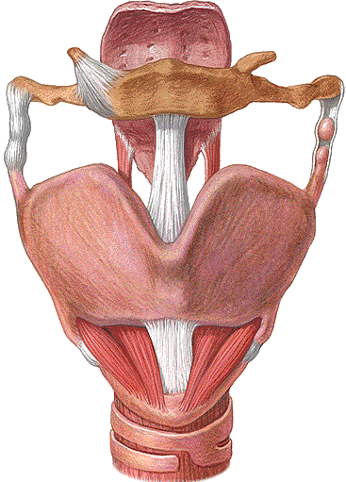
Cricothyroid muscle

Slide 70
Cricothyroid Muscle
The only intrinsic muscle seen on the outside of the larynx.
The only muscle of the larynx supplied by the external laryngeal nerve.
Origin: from the outer aspect of the arch of cricoid cartilage.
Insertion: into the inferior horn and lower border of the thyroid cartilage.
Nerve supply: external laryngeal nerve
Action: elongation and tension of the vocal cords.

Slide 71
Cricothyroid muscle

Slide 72
Cricothyroid muscle

Slide 73
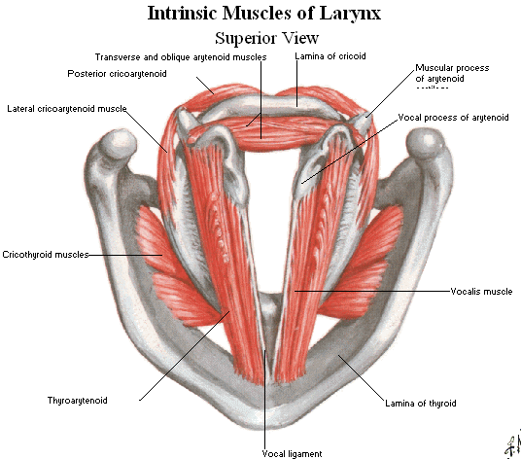

Slide 75

Thyroarytenoid Muscle
Origin: from the inner surface of thyroid cartilage
Insertion: into the antero-lateral surface of arytenoid cartilage.
Nerve supply: recurrent laryngeal nerve
Action: shortening and relaxation of the vocal fold.

Slide 79
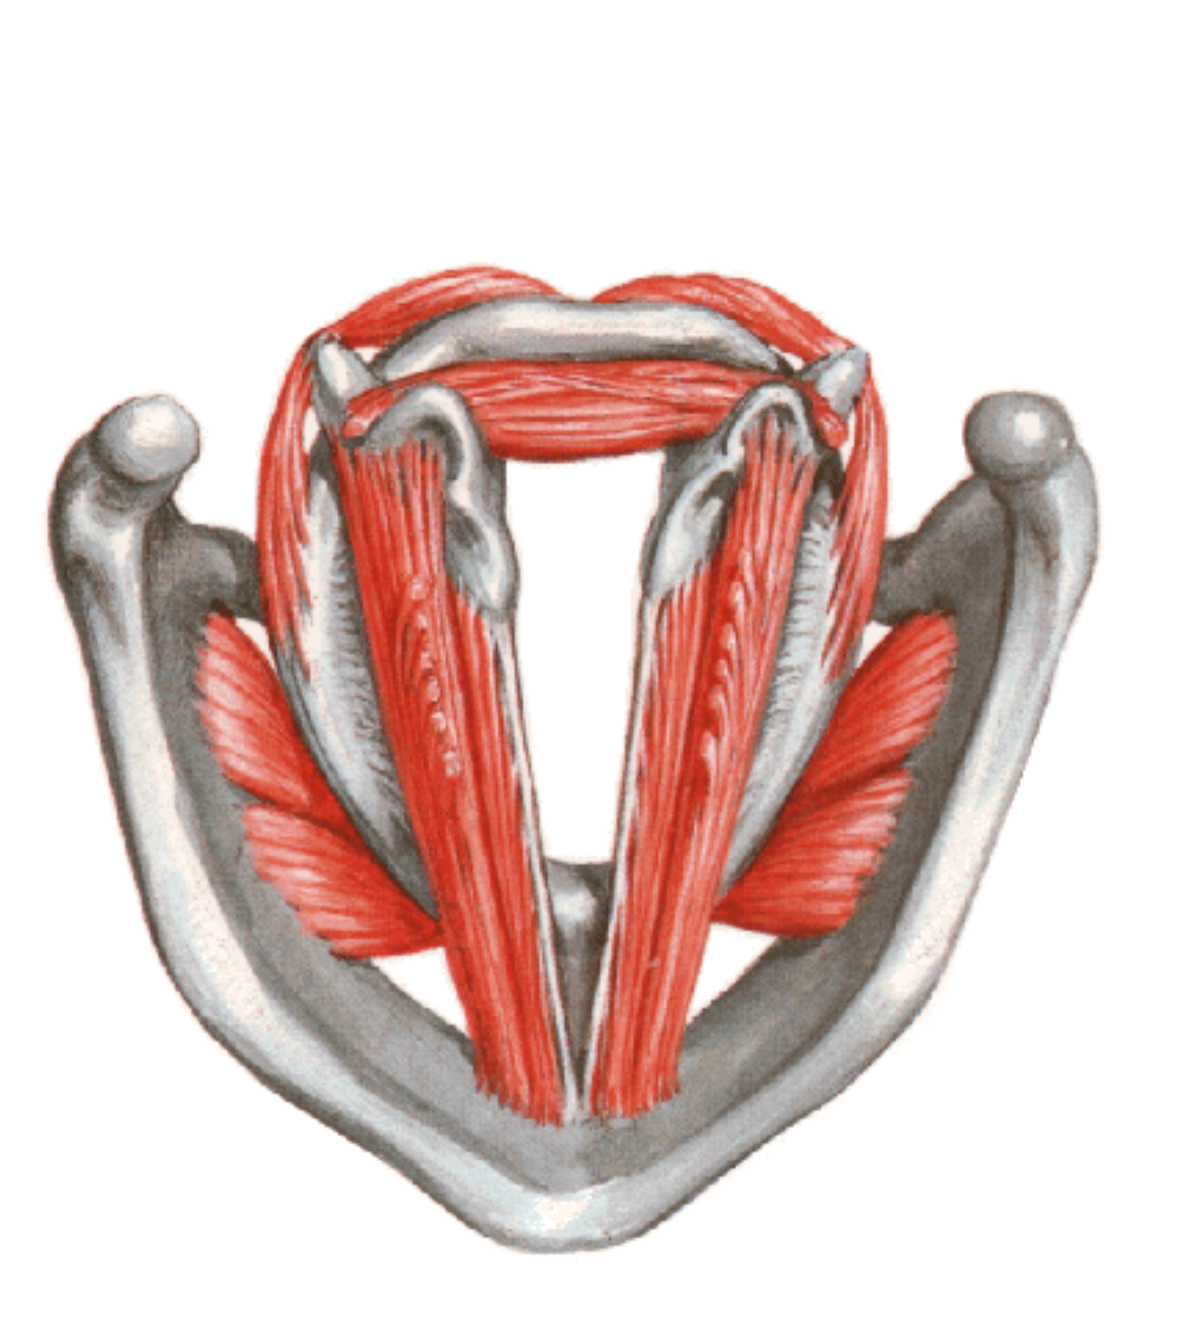
Vocalis Muscle
Origin: deep fibers of thyroarytenoid.
Insertion: into the vocal process of arytenoid cartilage and vocal ligament.
Nerve supply: recurrent laryngeal nerve
Action: shortening and relaxation of the vocal fold.

Slide 82
Oblique arytenoid Muscle
Origin: from the back of the muscular process of the arytenoid cartilage.
Insertion: into the apex of the opposite arytenoid cartilage.
Nerve supply: recurrent laryngeal nerve
Action: narrowing of the laryngeal inlet by bringing the two aryepiglottic folds together.

Slide 84
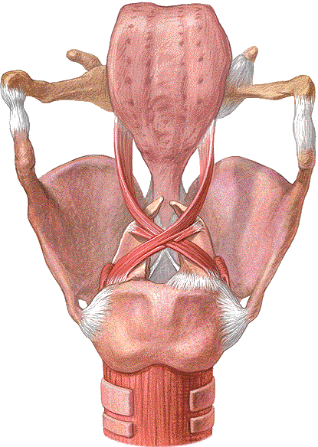
Oblique arytenoid muscle

Slide 85
Thyroepiglottic Muscle
Origin: from the inner surface of the thyroid cartilage.
Insertion: into the side of the epiglottis cartilage.
Nerve supply: recurrent laryngeal nerve
Action: widening of the laryngeal inlet.

Slide 87
Aryepiglottic Muscle
Origin: from the apex of the arytenoid cartilage as a continuation of the oblique arytenoid muscle.
Insertion: into the side of the epiglottis cartilage.
Nerve supply: recurrent laryngeal nerve
Action: narrowing of the laryngeal inlet by shortening the aryepiglottic fold.

Slide 89
Aryepiglottic muscle

Slide 90
Nerve supply of the larynx:
To understand vocal cord paralysis must be understand nerve supply of the larynx:
Vagus nerve
Superior laryngeal nerve
Inferior (recurrent) laryngeal nerve.

Slide 91
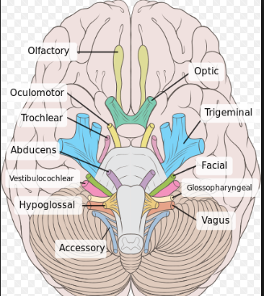

Slide 92
What is the Vagus Nerve (X)
The vagus nerve is the longest cranial nerve. Its mixed , Motor, Parasympathetic ,Sensory fibers, more important as motor nerve.
It pass through the neck and thorax to the abdomen has the widest distribution in the body.
Extends widely into Thorax & abdomen
(hence the name)
Mainly parasympathetic to thorax & heart, abdominal viscera
Exist: from the medulla oblongata leave the skull through the jugular foramen, where has upper and lower ganglionic swelling which are the sensory ganglion of the nerve.
The vagus nerve is join by the accessory nerve below the inferior ganglion.

Slide 93
The vagus nerve pass through carotid sheath with common carotid artery and internal jugular vein in the neck. Then pass the thorax and reach to the esophagus through opening in the diaphragm to form eophageal plexuses ( left vagus join with right vagus)
Esophageal plexus gives anterior and posterior gastric nerve which supply all abdominal organ and gastrointestinal tract.

Slide 94
Branches in jugular foramen (Superior ganglion):
Meningeal branches: supply the posterior fossa dura.
Auricular branch: supply sensation the pinna and posterior part of the external auditory canal.
Branches in the neck (inferior ganglion):
Pharyngeal branch: contains sensory and motor fibers, supply the pharyngeal muscles and mucosal membrane and palatal muscles expect.
tensor palatal muscle, muscle of soft palate, which innervated from mandibular nerve (trigeminal nerve)
Stylopharyngeus : muscle of pharynx which innervated from glossopharyngeal nerve.

Slide 95
2. Superior laryngeal nerve.
3. Inferior (recurrent) laryngeal nerve.
both innervate all laryngeal muscle+ laryngeal mucosa.
4. Superior cardiac nerve: End in the deep part of cardiac plexuses.
Branches in the thorax:
Inferior cardiac branch: End in the deep part of cardiac plexuses.
Anterior and posterior bronchial braches: form Anterior and posterior pulmonary plexuses.

Slide 96
Motor fibers supply:
All muscles of larynx
All muscles of pharynx, except Stylopharyngeus
All muscles of palate except Tensor palati

Slide 97
Parasympathatic effects of vagus:
Decrease alerteness, blood pressure, breathing rate and heart rate.
Helps with calmness, relaxtion and digestion.
Helps with defection, urination and sexual arousal.

Slide 98
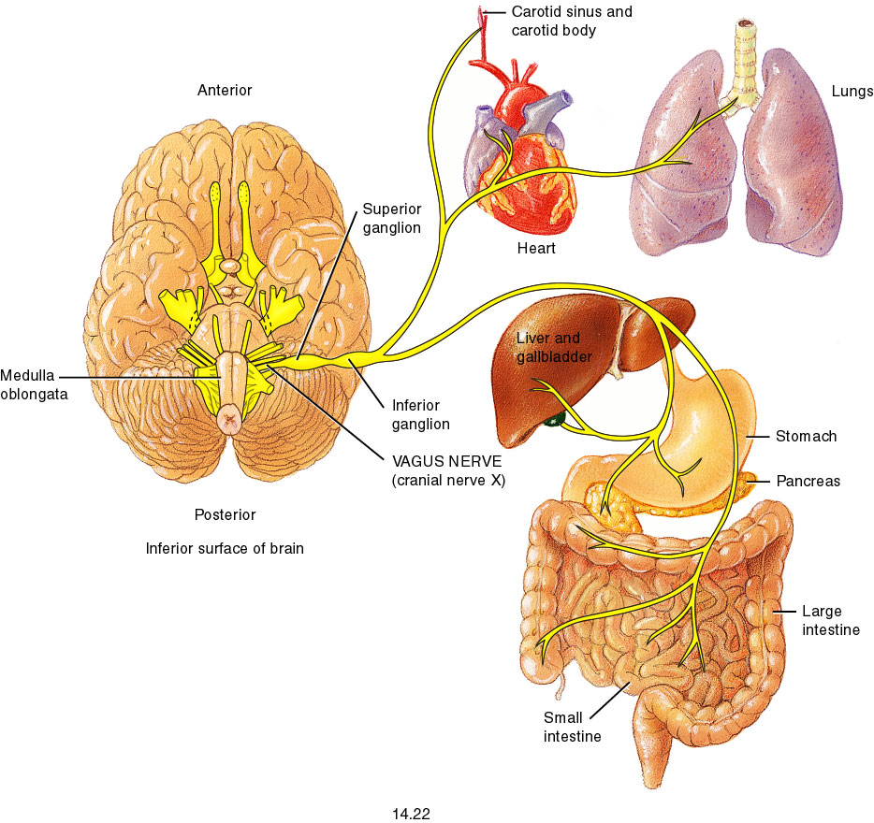
Fig. 14.22

Slide 99
Nerve Supply of the Larynx
Superior laryngeal nerve (from Vagus nerve) divides into:
  External laryngeal nerve (motor): supplies the cricothyroid muscle.
  Internal laryngeal nerve (sensory): supplies the mucous membrane above the level of the vocal folds.

Slide 100
Nerve Supply of the Larynx
Recurrent laryngeal nerve (from Vagus nerve) divides into motor and sensory branches:
  The motor branch supplies ALL intrinsic muscles of the larynx (except cricothyroid muscle).
  The sensory branch supplies the mucous membrane below the level of the vocal folds.

Slide 101
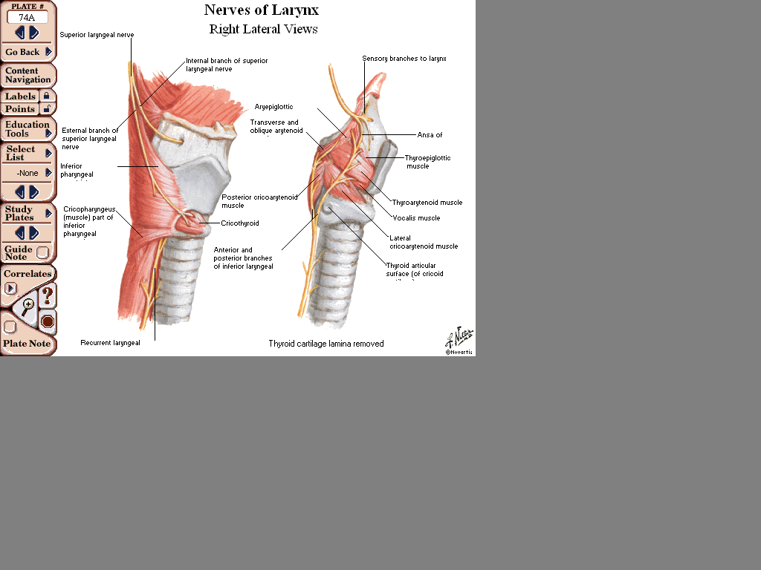

Slide 102
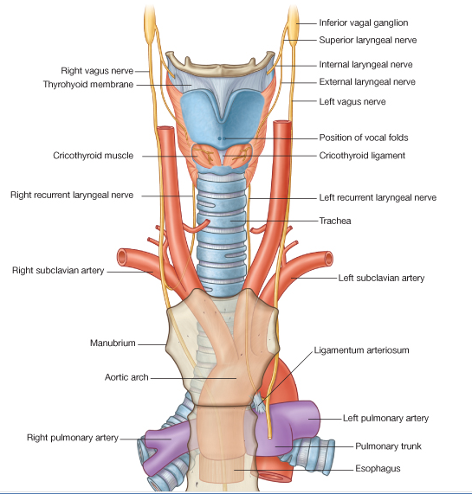

Slide 103
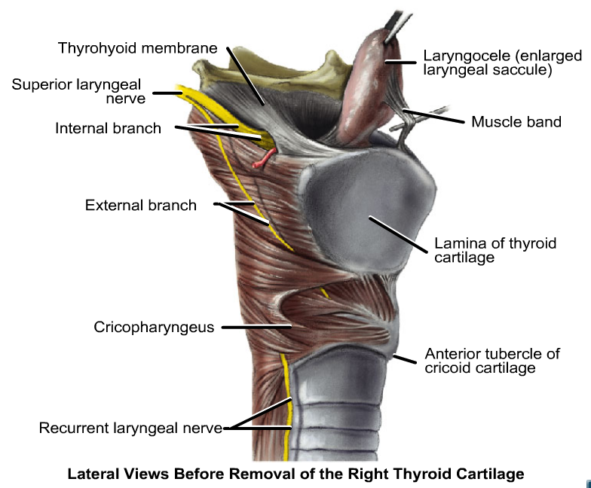

Slide 104
Glossopharyngeal (IX)
It emerges from the anterior surface from medulla oblongata and leave the skull through the jugular foramen, then pass through upper part of the neck to the back of the tongue.
Mixed : Sensory , Motor and Parasympathetic effects
Motor; innervates the stylopharngeaus muscle of pharynx ( elevate the larynx during swallowing)

Slide 105
Parasympathecs: innervates the parotid gland.
( by tympanic nerve)
Sensory: innervates the mucosa of oropharynx
Softpalate, posterior third of the tongue + taste sensation.
Palatine tonsill
Carotid body and sinus.
Middle ear + tympanic membrane + Eustachian tube
( by tympanic nerve )

Slide 106
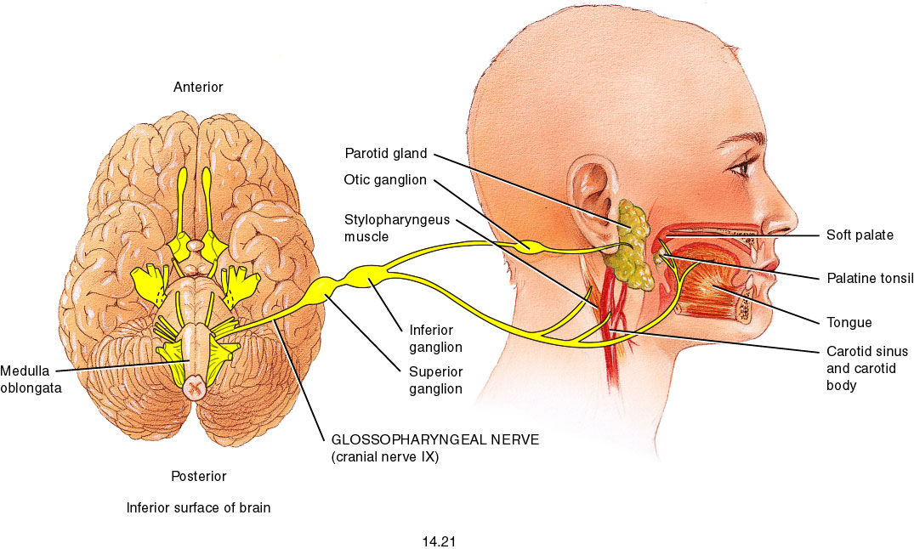
Fig. 14.21
(Parasympathetic)
(Oropharynx)
(motor)
Tympanic nerve
(Parasympathetic and sensory)

Slide 107
Accessory Nerve (XI)
Purely Motor
*Has 2 part:
Cranial part : arise from medulla oblongata and join with vagus nerve.
Spinal part : arsie from neurons of upper spinal cord level C1-C5 and innervates:
Sternocleidomastoid m.
Trapezius.
Accessory nerve Leaves skull through Jugular foramen.
Notes:
Posterior triangle

Slide 108

Fig. 14.23
Cranial part
Spinal part

Slide 109
Blood supply of the larynx
Arterial supply of the larynx:
Superior laryngeal artery (from superior thyroid artery from external carotid artery).
Inferior laryngeal artery (from inferior thyroid artery from thyrocervical trunk from 1st part of subclavian artery).

