Slide 1
Locomotor physiology
Mahmoud A.Matar
Orthopedic surgeon

Slide 2
Locomotor system
Organ system that gives human the ability to move.
Muscle ,bone ,nerve.
Interaction between these structure movement happen.
40%of body weight is skeletal muscle.
Up to 10% is cardiac and smooth muscle.

Slide 3
Function of locomotor system.
Protection of vital organs
ex.thoracic cage and heart ,lung.
Source of mineral ,calcium.
Blood production bone marrow.
Cosmotic appearance.

Slide 4
Function of muscles
Body movement.
Stabilize body position.
Stores and move substances within body.
Generate heat

Slide 5
Properties of muscle tissue
Electrical excitability.
Contractility.
extensibility,.
Elasticity.

Slide 6
Electrical excitability.
Both muscle ,nerve cells respond to certain stimuli by producing electrical signal called action potentials

Slide 7
Properties of muscle tissue
Electrical excitability.
contractility
Both muscle ,nerve cells respond to certain stimuli by producing electrical signal called action potentials
Ability of the muscle to contract forcefully when stimulated by action potential.
When muscle contracts,it generate tension while pulling on its attachment point.

Slide 8
Properties of muscles
Extensibility.
Elasticity.
Ability of muscular tissue to stretch without being damaged.
Allow muscle to contract forcefully even it is already stretched.
Ability of muscle tissue to return to its original lengthand shape after contraction

Slide 9
Classification of muscles
Presence or absence of striation.
striated ,non stiated
Depend upon control.
voluntary,involuntary
Depend upon situation.

Slide 10
Upon striation
Striated
Non striated
Has large no, of cross striation(transverse line).
Skeletal muscles and cardiac muscle
No cross striation.
Plain or smooth muscle.
Wall of visceral organs

Slide 11
Upon control
voluntary
involuntary
Controlled by our own will.
Skeletal muscles
Somatic nerve
We cannot control it.
Cardiac and smooth muscle

Slide 12
Upon situation
Skeletal .
Cardiac.
Smooth muscles

Slide 13
Skeletal muscles
In association with bone forming skeletal system.
40% of body mass,voluntary and striated.
Somatic nerve.
Fibers arranged in parallel.
Anchored to the bone by tendons

Slide 14
Description.
long,cylindrical,many peripherally located nuclei,voluntary .
Location.
with bone via tendon.
Function.
motion,posture,heat protection

Slide 15
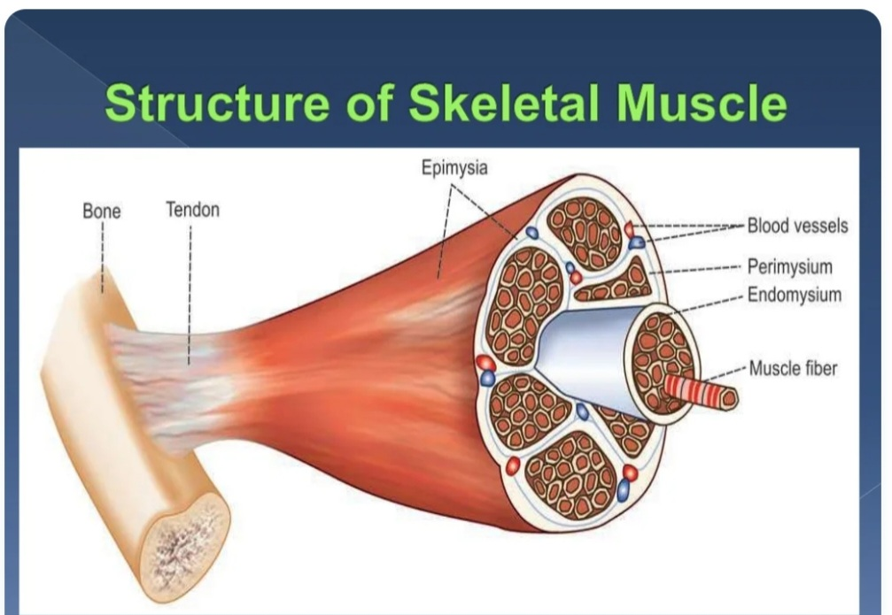
Structure of skeletal muscle

Slide 16
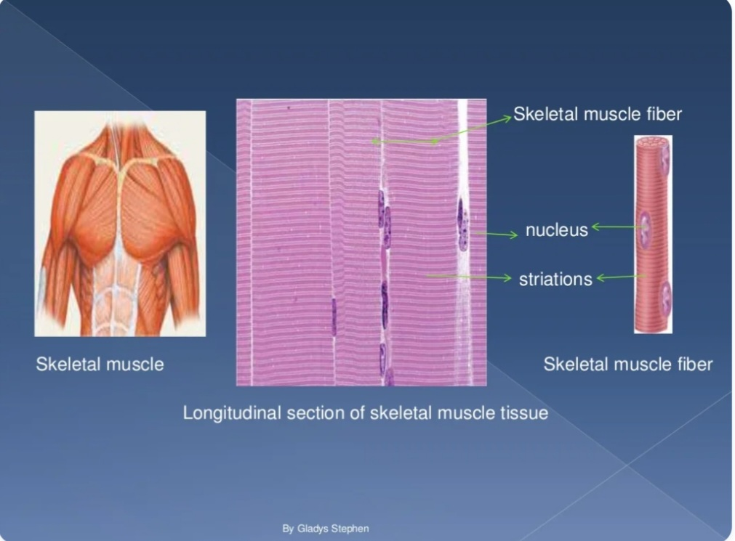

Slide 17
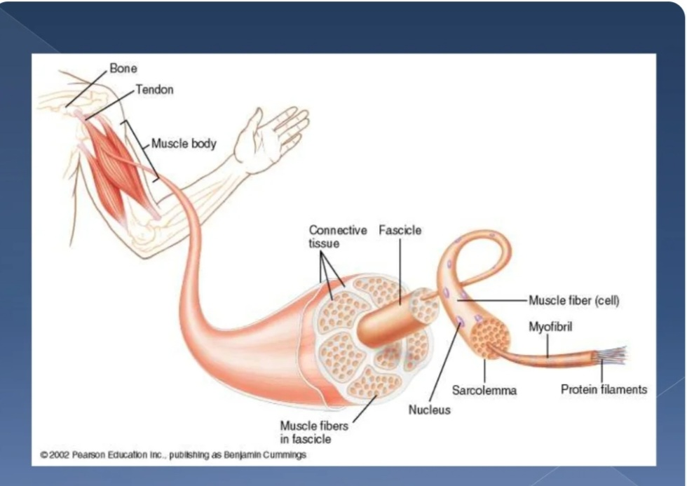

Slide 18
Muscle mass or tissue
Made up of large no. of individual muscle cell or myocytes.
Muscle cell called muscle fiber as they are long and slender in shape.
Muscle fiber are multinucleated and arranged parallel to one another with some connective tissue in between.
Muscle mass is separated from adjucent tissue by athick fibrous tissue layer known as fascia

Slide 19
Beneath the fascia muscle coverd by connective tissue sheath called epimysium.
Muscle fibers arranged in various groups called fasciculi.
Fasciculi coverd by connective tissue sheath called perimysium.
Each mucle fiber is coverd by connective tissue layer called endomysium

Slide 20
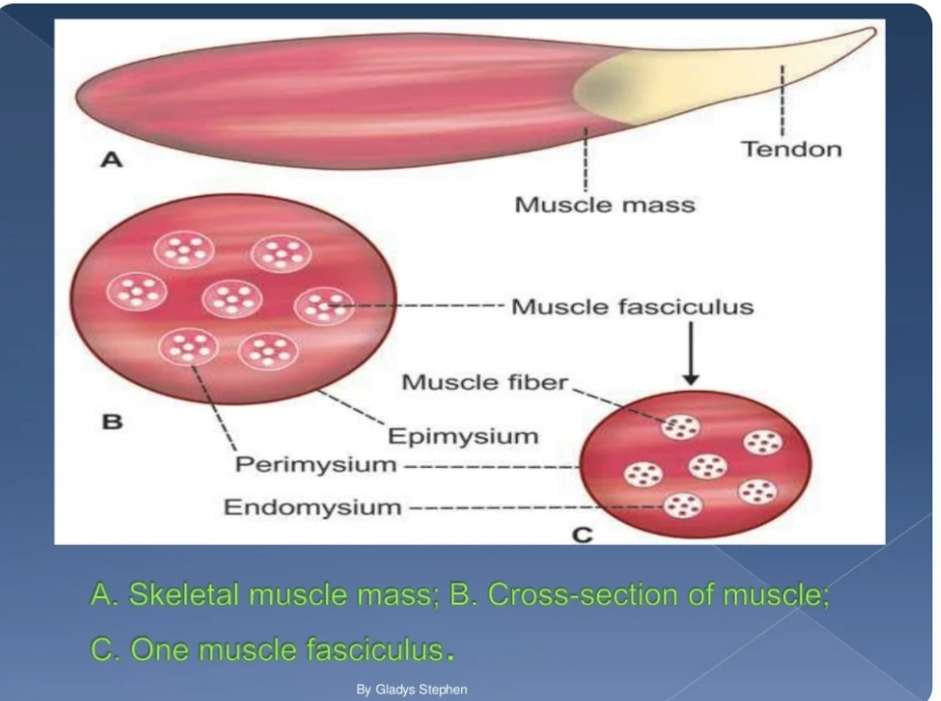

Slide 21
Muscle fiber
Each muscle cell is cylindrical in shape
Average length is 3 cm depend on muscle length.
Diameter varies from 10-100 micron,and varies in single muscle.
Attached to bone by tough cord called tendon.
Tendon of some muscle are flat ,thin and tought called aponeurosis

Slide 22
Each muscle fiber is enclosed by cell membrane called plasma membrane or sarcolemma lies beneath the endomysium.
Cytoplasm of the muscle called sarcoplasm.

Slide 23
Structures embedded within sarcoplasm are
Nuclei.
Myofibril.
Golgi apparatus.
Mitochondria.
Sarcoplasmic reticulum.
Ribosomes.
Glycogen droplets.
Occasional lipid droplets.

Slide 24
sarcolemma
It is the cell membrane of muscle fiber.
Consist of true cell membrane called plasma membrane,and outer coat made up of thin layer of poly saccharides material that contain thin numerous collagen fibril.

Slide 25
myofibril
Each muscle fiber contains several hundred to several thousand myofibrils.
Are fine parallel filaments present in sarcoplasm of the muscle cell.
Some arranged in groups called cohnheims area.
1500myosin and 3000 actin filaments.
They are large polymerized protein molecules responsible for actual muscle contraction.

Slide 26
Thick filaments myosin.
Thin filaments actin,troponin and tropomyosin

Slide 27
General mechanism of muscle contraction
Action potential travels along the motor nerve to muscle fiber.
Release of neurotransmitter acetylcholine.
Open Acetylcholine gated channels through protein molecules in the membrane.
Sodium iones diffuse to intracellular area.lead to action potential at the membrane.
Action potential travell along muscle fiber.
Action potential depolarized muscle membrane,sacroplasmic reticulum release calcium ions .
Calcium ions initiate attractive force between actin and myocin causing them to slide along each others(contractile process)
After fraction of second calcium ions pumped back into sarcoplasmic reticulum and muscle contraction cease.

Slide 28
Fenn effect
ATP is the energy source for contraction.
when muscle contract ,large amount of ATP is cleaved to form ADP.
The more muscle wark the more ATP is cleaved

Slide 29
Source of energy for muscle contraction
Phosphocreatine.
Glycolysis: is the breakdown of glycogen which stored in the muscle,to pyruvic acid and lactic acid help to convert ADP TO ATP. This process can happen without oxygen.ATP formed about 2.5 fold than ATP formed in response to cellular foodstuff reactiong with oxygen.
Oxidative metabolism;- more than 95%of all energy used by the muscle for long term contraction is drived from oxidative metabolism.oxygen is combining with the end product of glycolysis

Slide 30
Food stuffs are consumed are carbohydrates,fat,protein.
Fat provide greatest proportion of energy come from fat for many hrs.then carbohydrates for 2-4hrs

Slide 31
Characteristics of muscle contraction.
Isometric contraction
Donot shorten muscle.
Muscle contracts against force transducers.(pushing against nonmovable wall)
Isotonic contraction
Shorten muscle.
Tension on the muscle remain constant.
Bicepes lifting object

Slide 32
Fast versus slow muscle fiber
Slow fiber(red muscle)type1
Fast fiber(white muscle)type
Smaller .
Innervated by smaller nerve fiber.
More vascular.
Higher amount of mitochondria.
Higher amount of myoglobin iron binding protein.
Soleus muscle
Larger.
Extensive sarcoplasmic reticulum for rapid release of calcium.
Large amount of glycolytic enzyme for rapid release of energy.
Less blood supply.
Less mitochondria.
Less myoglobin
Tibialis anterior

Slide 33
Mechanics of muscle contraction
Motor unit:-all the muscle fiber innervated by single nerve.
Summation:-the adding togother of individual twitch contraction to increase the intensity of overall contraction
Multiple fiber summation.
Frequency summation and tetanization

Slide 34
Multiple fiber summation
Frequency summation
Increase no. of motor unit contracting simultaneously.
Smaller motor unit stimulated in preference to large one
Increase the signals strength larger and larger motor unit exited.(size principle)
Smaller motor unit is driven by small motor nerve fiber.
Increase the frequency of contraction.
Individual contraction occurring one after another.
Once the frequency increase ,new contraction happen before the previous one is over.
If frequency reach critical level ,the contraction fuse togother (tetanization).
No futher increase in frequency can cause more contraction.
Enough calcium remain in the sarcoplasm.

Slide 35
Staircase effect(treppe)
When muscle begin to contract after prolong rest the initial strength of contraction may be as little as one half of its strength
Strength of the contraction increase to plateaue
Unknown cause.
Calcium remain increase .
Muscle tone:despite muscle being at rest certain amount of tautness remain,low rate of impulse come from spinal cord

Slide 36
Muscle fatique
Prolong strong contraction of muscle lead to muscle fatique.
Releated to depletion of muscle glycogen,and loss of oxygen.

Slide 37
Muscle remodling
Muscles are in continuos remodel to match the function required from them.
Diameter ,length, strength and vascular supply
Could happen in 2weeks

Slide 38
Muscle hypertrophy
Increase of the total mass of the muscle.
Increase the no. of actin and myocin in muscle fiber.
More hypertrophy happen if muscle loadd during contraction
Muscle hyperplasia:-
Increase in no. of muscle fiber,in addition to hypertrophy.
Linear splitting of previously enlarged fiber.

Slide 39
Muscle denervation
When muscle loses its nerve supply,atrophy begins almost immedialtly.
Degeneration and fibrosis develop within 2 months.
When nerve function return the muscle return its function within 3 months.
No return of function develop after 2 years.
Finally permanent contracture develop.

Slide 40
Muscle pathology
Recovery from polimylitis:-
some of nerve fiber destroyed,the remaining nerve fiber branch off to form new axons to innervates the paralysed muscle fiber.
this process called macromotor unit.
Rigor mortis:-
several hours after death all body muscles goes into contracture,due to lack of ATP which required to separate the crossbridges of actin filaments.later on all muscle protein deteriorate within 15-25hr due to autolysis from lysosomal enzymes.this happen more rapid in hot tempreture.

Slide 41
Muscle dystrophy:-
inherited disorder cause progressive weakness and degeneration of muscle fiber which replaced by fatty tissue and collagen.
Duchenne muscle dystrophy:- x-liked recessive (male),mutation of gene that encodes for protein dystrophin .
Becker muscular dystrophy later onset and longer survival

