Slide 1
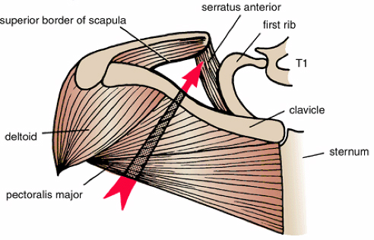
The Axilla
A pyramidal space between upper part of the arm & the upper part of side of chest wall, just inferior to shoulder joint.
Importance:
Passageway for vessels & nerves between the neck & upper limb which pass through its apex.
Contain a group of important lymph nodes embedded in soft fat (Axillary L.N.)
Its made up of:
Apex, base & 4 walls

Slide 2
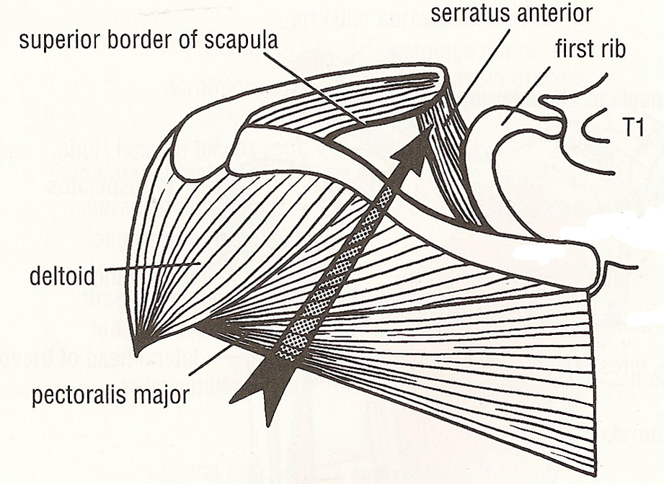
Apex:
The entrance from the root of the neck (cervico-axillary canal)
Lies at medial side of coracoid process.
Main nerves and vessels
of UL pass through apex
Boundaries:
Ant.: clavicle
Post.: upper border of scapula
Med.: 1st rib
Base:
Formed by the skin concavity extending from the arm to
thoracic wall.

Slide 3
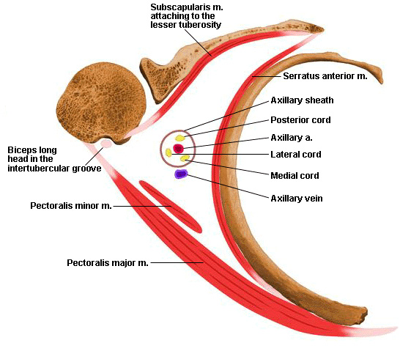
Anterior Wall:
Pect. Major (superficial layer)
Pect. Minor(deep layer)Subclavius
, clavipectoral fascia suspensory
lig of axilla.
Clavipectoral Fascia: Is the fascia
of anterior wall of axilla
Thickened membrane of Deep
facial layer that extends from
clavicle to floor of axilla, pierced by 2 in 2 out
Cephalic vein
Infraclavicular lymph node
Acromothoracic artery
Lateral pectoral nerve
Fibers run from medial to lateral

Slide 4
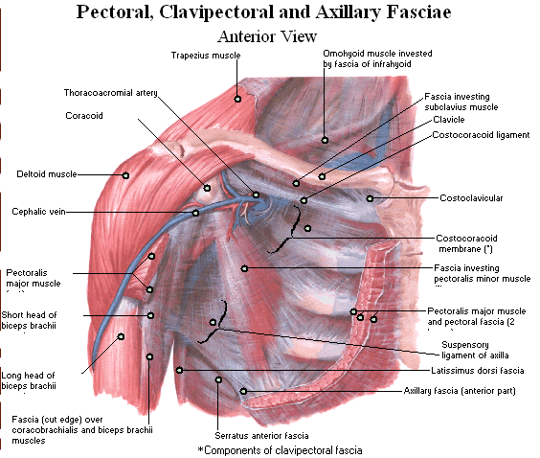

Slide 5
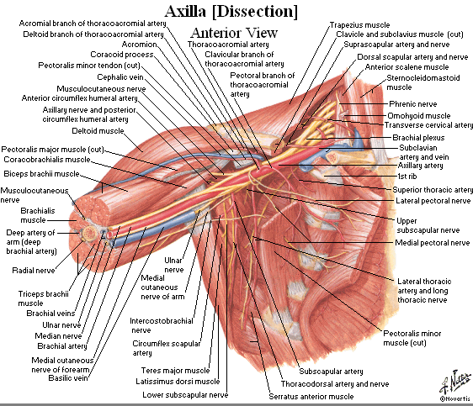

Slide 6
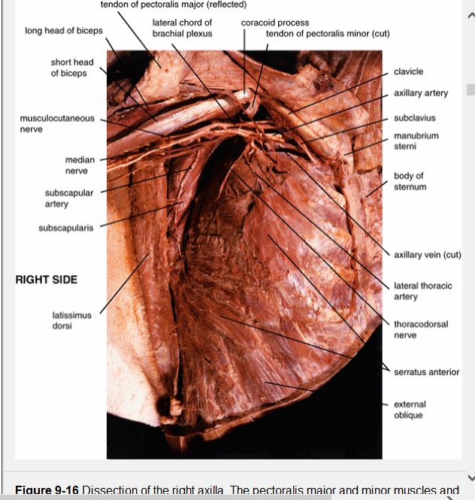

Slide 7
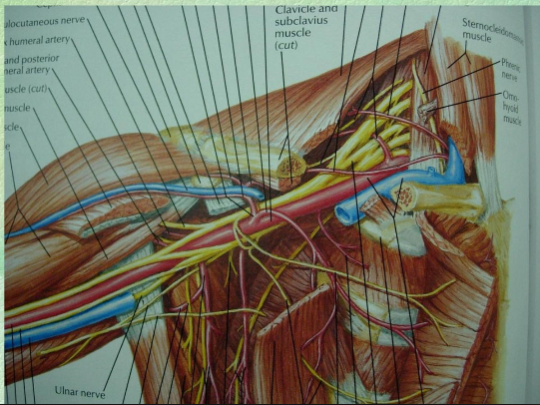

Slide 8
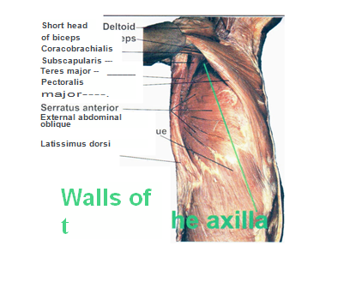

Slide 9
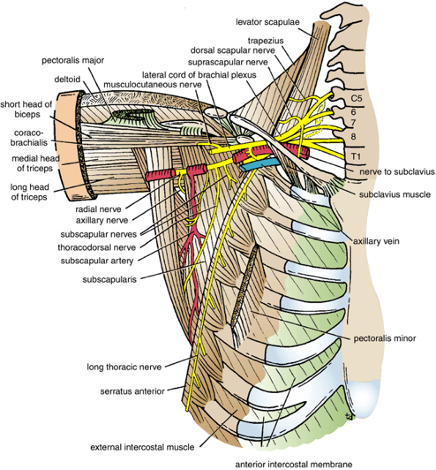
Posterior Wall:
Is longer than anterior wall
Formed by
Subscapularis (medially)
Teres major
Latissimus dorsi (laterally)

Slide 10
Medial Wall:
1st 🡲 4th ribs
& intercostal muscles in
Between overlying serratus ant. m.
Lateral Wall:
Intertubercular groove
of the humerus hidden from view by short head of biceps and coracobrachialis

Slide 11
Contents of The Axilla
Axillary artery
Axillary vein
Axillary lymph nodes
Brachial plexus

Slide 12
Axillary Artery
Starts:
At outer border of 1st rib.
As a continuation of Subclavian a.
Ends:
At lower border of teres major m.
To become Brachial a.
Divided by pect. Minor in to 3 parts

Slide 13
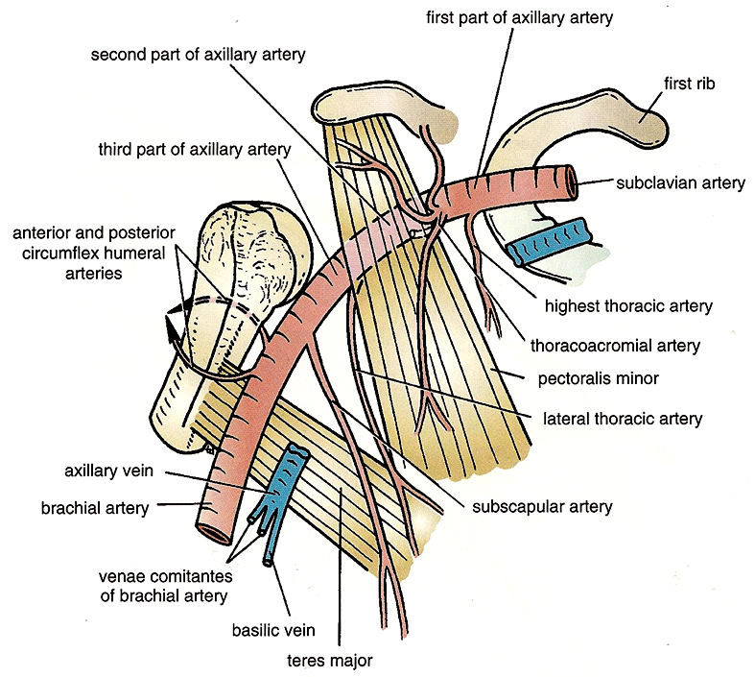
Axillary Artery

Slide 14
1st part:
Outer border of 1st rib
🡳
Medial border of pect. Minor
One branch:
Sup. (highest) thoracic a.
2nd part:
Post. to pec. Minor
2 branches:
Thoracoacromial a.
Lateral thoracic a.
3rd part:
Lat. border of pec. minor
🡳
lower border of teres major
3 branch:
Subscapular a.
(largest branch of axillary)
Ant. circumflex humeral a.
(in front of surgical neck)
Post. circumflex humeral a.
(behind the surgical neck)

Slide 15
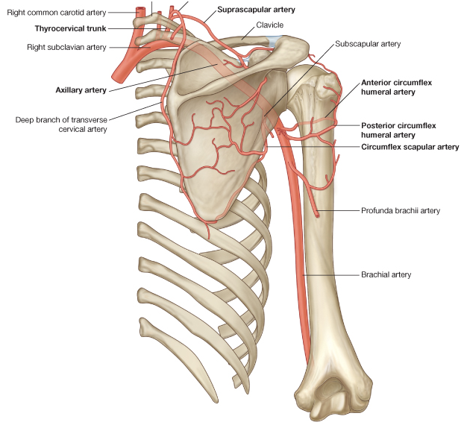
Scapular Anastomosis
An arterial Anastomoses
between branches of
1st part Subclavian a.
& 3rd part of Axillary a.
Branches of subclavian:
Suprascapular a.
Dorsal scapular a.
Branches of axillary:
Subscapular a.
Circumflex scapular a.

Slide 16
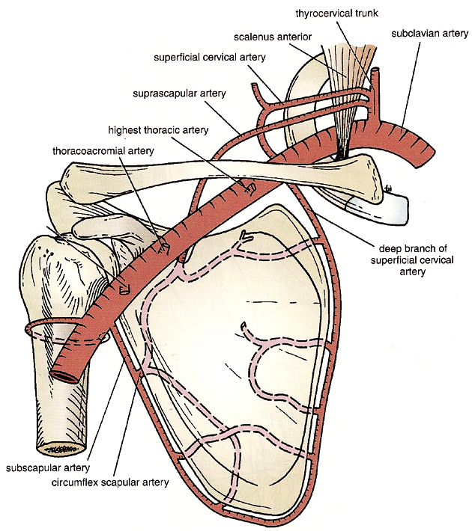
Scapular Anastomoses

Slide 17
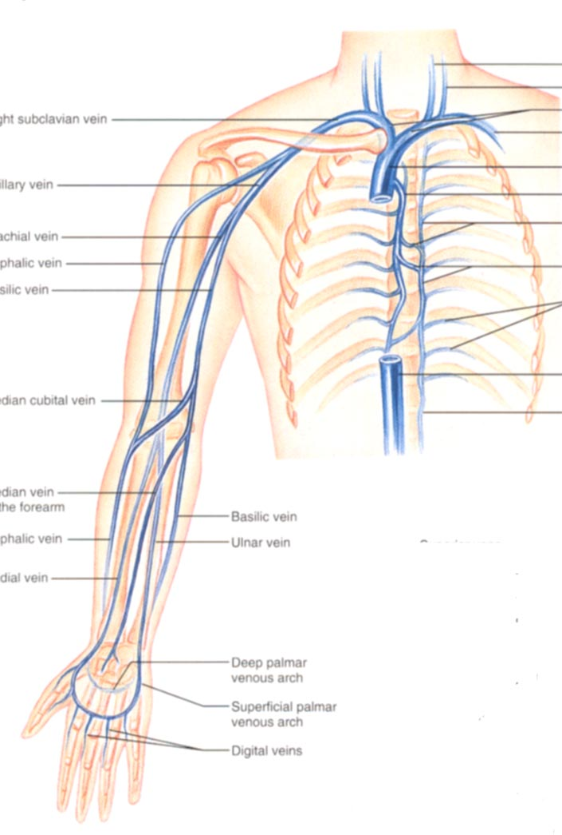
Axillary Vein
Medial to Axillary a.
Starts:
At lower border of teres major
By union of:
brachial veins + basilic vein
Ends:
Lat. Border of 1st rib
To become subclavian v.
Tributiry
Cephalic vein above pec minor m

Slide 18
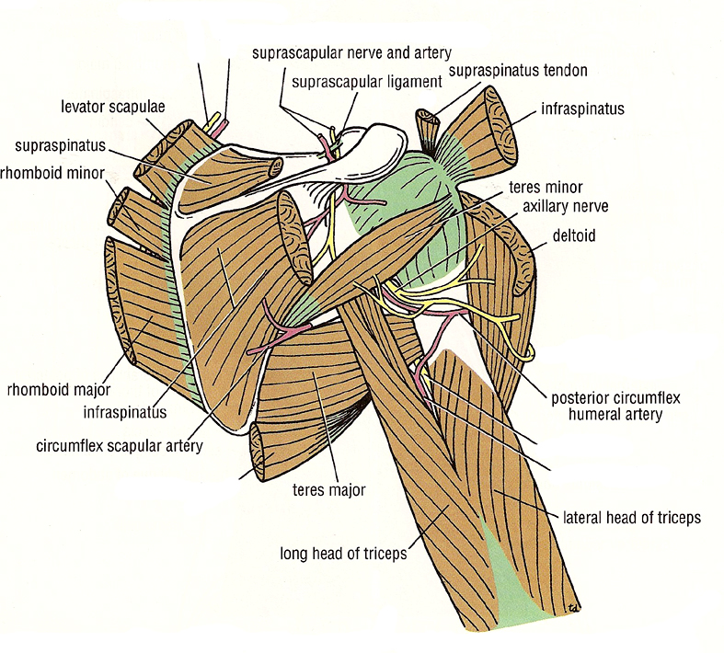
Triangular Space
Boundaries:
Sup.: teres minor
Inf.: teres major
Lat.: long head of triceps
Contents:
Circumflex scapular artery

Slide 19
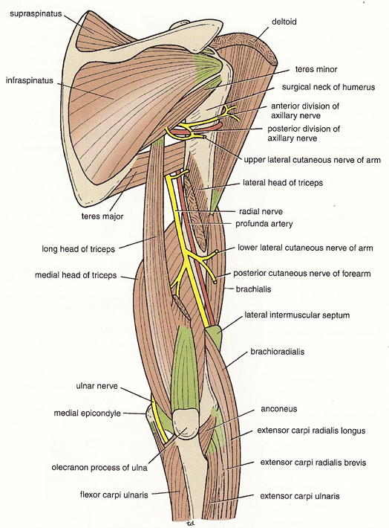
Quadrangular Space
Lateral to triangular space
Boundaries:
Sup.: teres minor
Inf.: teres major
Med.: long head of triceps
Lat.: surgical neck of humerus
Contents:
Axillary n. (which muscles??)
Post. circumflex humeral vessels

Slide 21
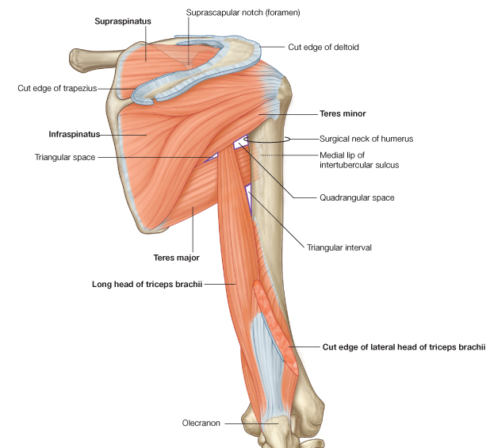

Slide 22
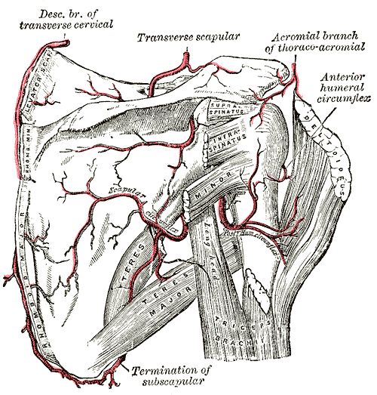

Slide 23
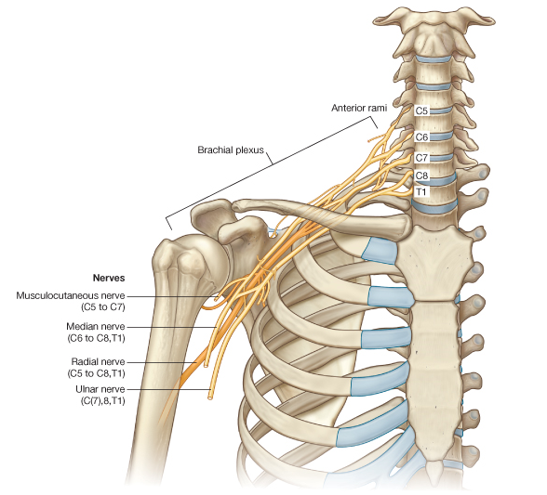
Brachial Plexus
A major network of nerves that supply the upper limb
Formed by Anterior primary rami of
C5- C6- C7- C8-T1 spinal nerves
Composed of:
Roots (root of neck)
Trunks (in post. triangle of the neck).
Divisions (post. To middle third the clavicle).
Cords (within the axilla).

Slide 24
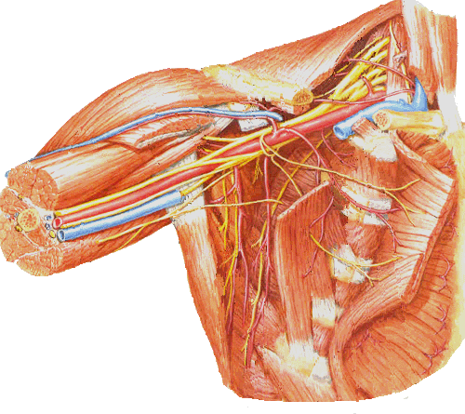
Brachial plexus
B.P. is covered with Axillary sheath
Axillary Sheath: a facial covering that derived from prevertebral layer of deep cervical fascia & covers:
Brachial plexus, Axillary artery
& Axillary vein

Slide 25
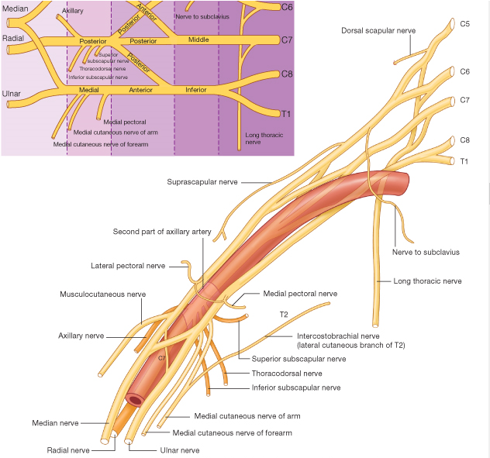
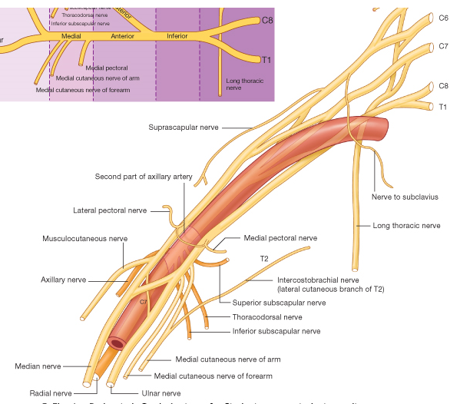
Brachial plexus

Slide 26
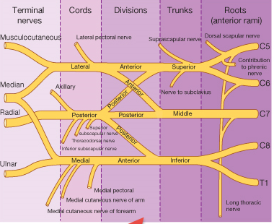

Slide 27
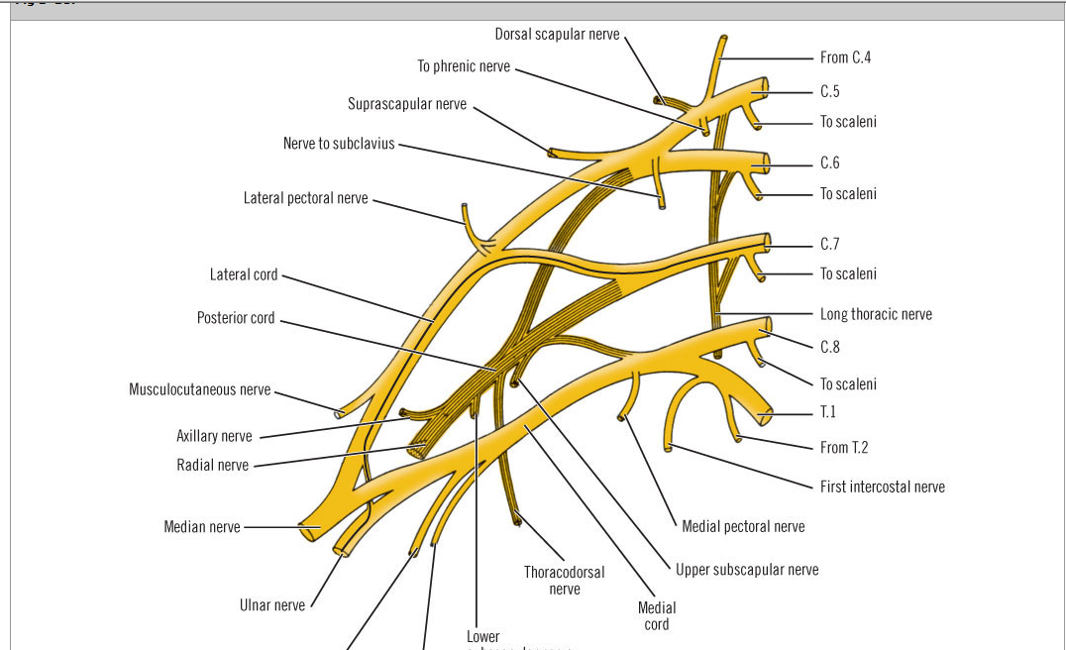

Slide 28
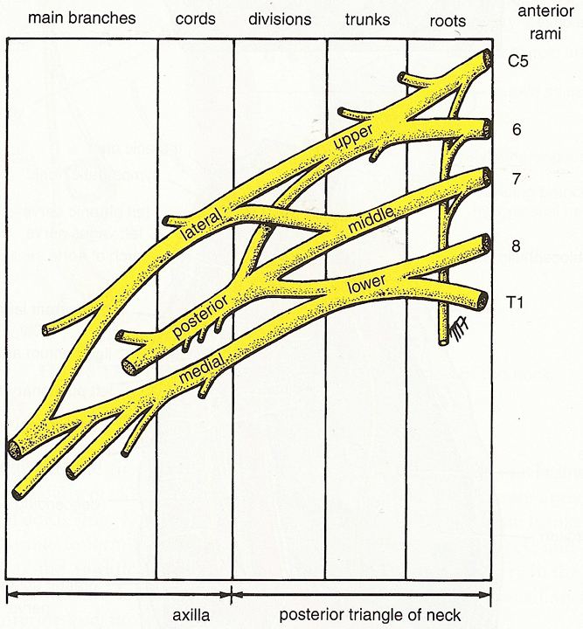
Brachial plexus

Slide 29
Roots & Trunks
Roots: C5, 6, 7, 8 & T1
Trunks:
upper: C5 & C6
middle: C7
Lower: C8 & T1

Slide 30
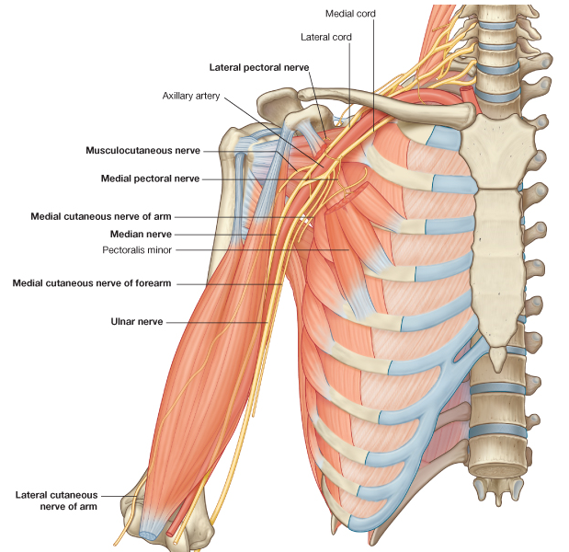
Branches of Brachial Plexus
Branches from the roots: 2
Branches from upper trunk: 2
Branches from the cords
No branches from the divisions

Slide 31
Divisions & Cords
Divisions:
Ant. & Post. from each trunk
Located behind the clavicle
Cords:
lateral: Ant. divisions of upper & middle trunks
medial: ant. division of lower trunk
posterior: by all 3 post. divisions
*the cords are named according to their position around the axillary artery

Slide 32
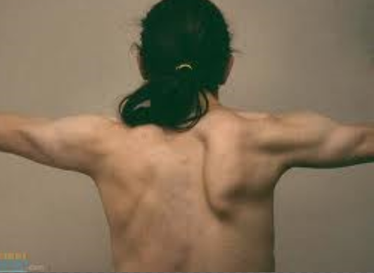
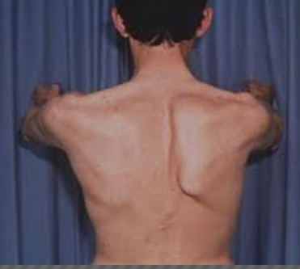
Branches From The Roots
Dorsal Scapular nerve :from C5
Supply the rhomboids & levator scapulae muscles
Long Thoracic nerve of Bell:
From C5, 6, 7
Descends in the thorax at lat. Surface of serratus m.
Supply the serratus anterior m.

Slide 34
Branches From Trunks
From upper trunk only
1. Nerve to subclavius:
From C5 & C6
2. Suprascapular nerve:
Pass lat. & then post. through suprascapular notch in the scapula
Supply the supraspinatus & infraspinatus m.
Branches from roots & trunks are considered:
Supraclavicular branches

Slide 35
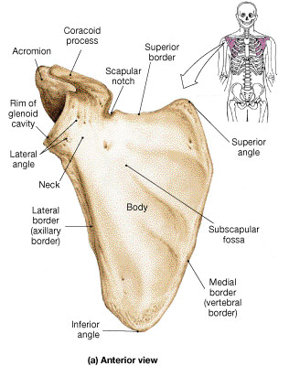
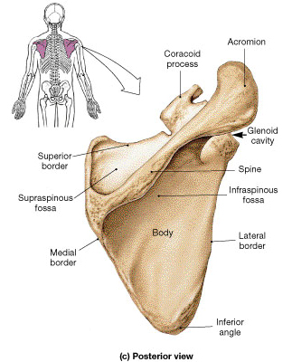

Slide 36
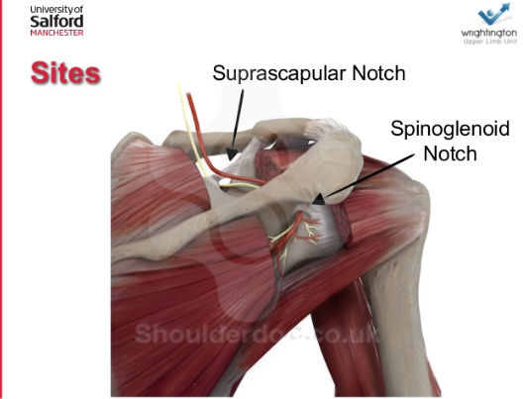

Slide 37
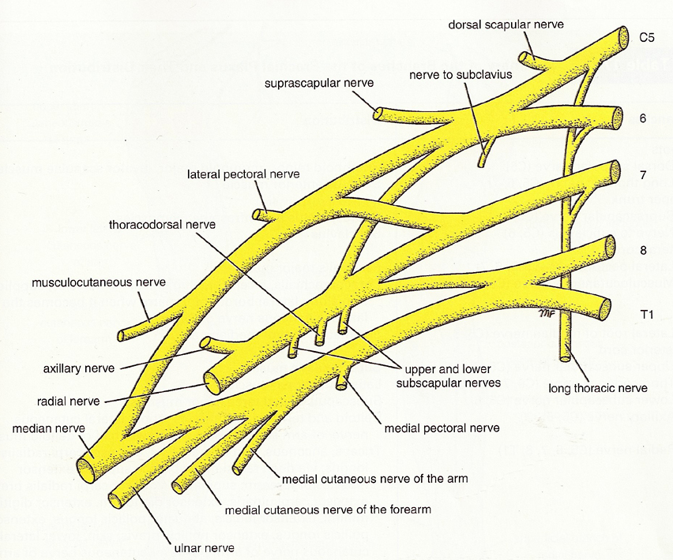

Slide 38
Suprascapular Nerve

Slide 39
Lateral Cord Branches
1. Lat. Pectoral nerve:
Supply pect. Major
2. Musculocutaneous nerve:
Muscle + skin
3. Lat. ½ of median nerve

Slide 40
Musculocutaneous Nerve
From lateral cord of B.P. (C5, 6, 7)
Pierces coracobrachialis muscle &
Pass in ant. compartment of the arm
(between biceps brachii & brachialis m.)
Branches
Motor: to Ant. arm muscles (3)
Sensory: Elbow joint
lateral side of forearm and ball of thumb
(lat. Cutaneous nerve of forearm)

Slide 41
Injury of musculocutaneous nerve
How it commonly occurs: An injury to the MCN is relatively uncommon, as it is well protected within the axilla. The most common cause is a stab wound to the axilla region.
Motor functions: The coracobrachialis, biceps brachii and brachialis muscles are paralyzed. Flexion at the shoulder is weakened, but can still occur due to the pectoralis major. Flexion at the elbow is also affected, but can still be performed because of the brachioradialis muscle. Also, supination of the affected limb is greatly weakened, but is produced by the supinator muscle.
Sensory functions: Loss of sensation over the lateral side of the forearm.

Slide 42
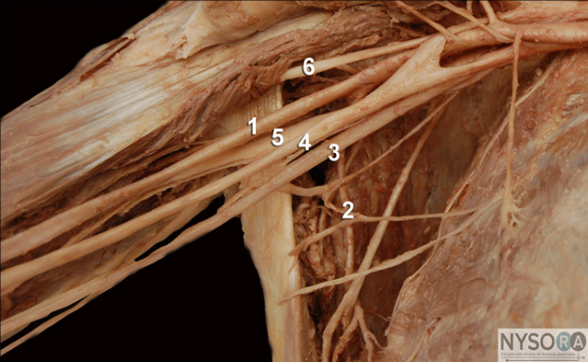

Slide 43
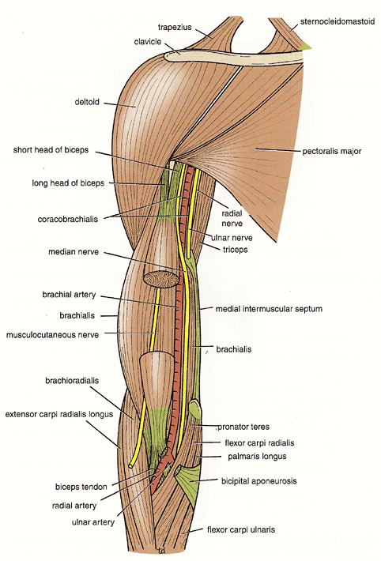

Slide 44
Medial Cord Branches
1. Medial pectoral n.
Pass through pec. Minor m.
Innervates: pec. Minor & major
2. Medial cutaneous nerve of the arm
Sensory to skin of the medial side of arm
3. Medial cutaneous nerve of forearm
Sensory to the skin of the medial side of forearm
4. Ulnar n.
Terminal branch
5. Medial ½ of median n.
Terminal branch
Notes:
It has previously been shown that in 62% of patients the medial pectoral nerve courses through the pectoralis minor muscle to innervate the lower half or two thirds of the pectoralis major muscle. In the other 38% of patients, the medial pectoral nerve exits around the lateral aspect of the pectoralis minor muscle. The lateral pectoral nerve courses on the undersurface of the pectoralis major muscle, innervating the proximal one third or more of the muscle. Consequently, when the pectoralis minor muscle is removed in a modified radical mastectomy, or dissection between the two muscles is performed, there is partial deinnervation of the pectoralis major muscle with partial atrophy and a decrease in size. Further, if the lateral pectoral nerve also is injured or removed, it can result in total deinnervation of the pectoralis major muscle with more severe atrophy and fibrosis of the muscle. In cosmetic augmentations, when the breast implant is placed behind the pectoralis major muscle, that muscle is partially deinnervated. In this clinical situation, this is believed to be advantageous because it allows the breast to project better. This paper details the anatomy of the pectoral nerves and discusses the clinical implications of surgery in this region as it relates to the size and function of the pectoral muscles.

Slide 45
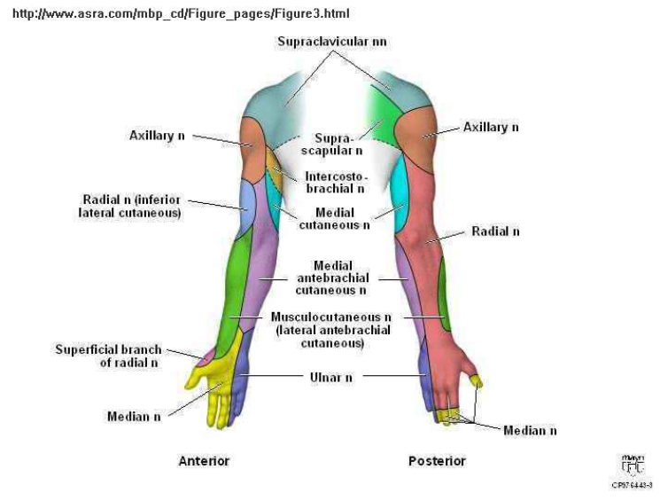

Slide 47
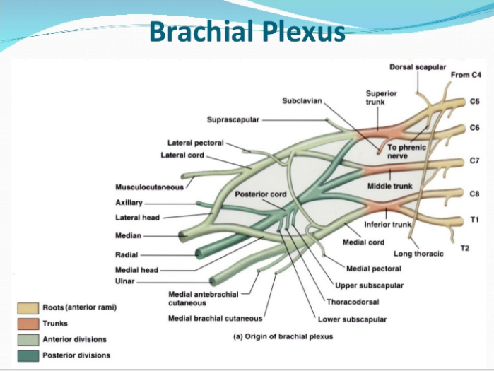

Slide 48
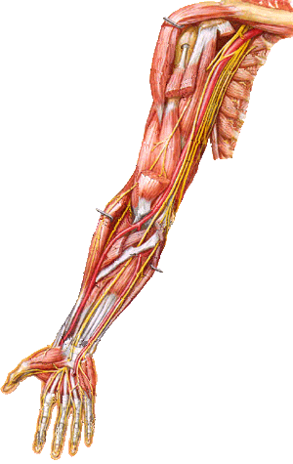
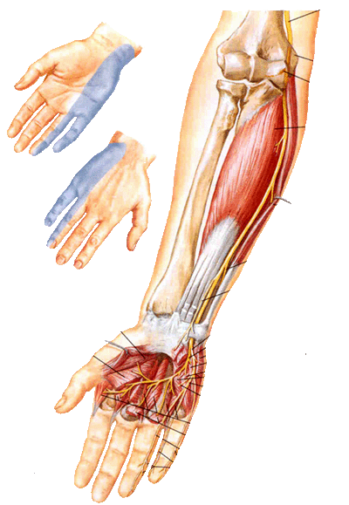
Ulnar Nerve
From medial cord of B.P. (C8 & T1)
End on FR by dividing into superficial and deep branches
In the arm:
No branches
Medial to axillary & brachial a.
At elbow:
Pass post. to medial epicondyle of the humerus
(subcutaneous)
Innervates medial muscles in the forearm & hand

Slide 49
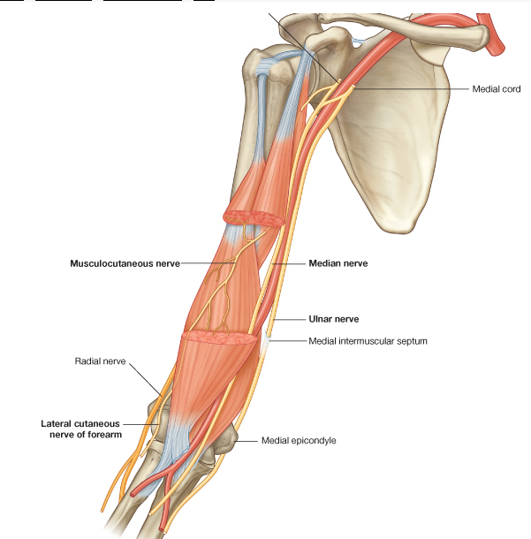
Ulnar nerve

Slide 50
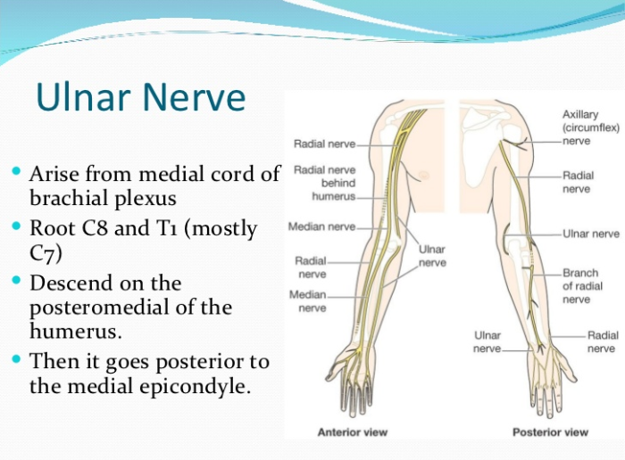

Slide 51
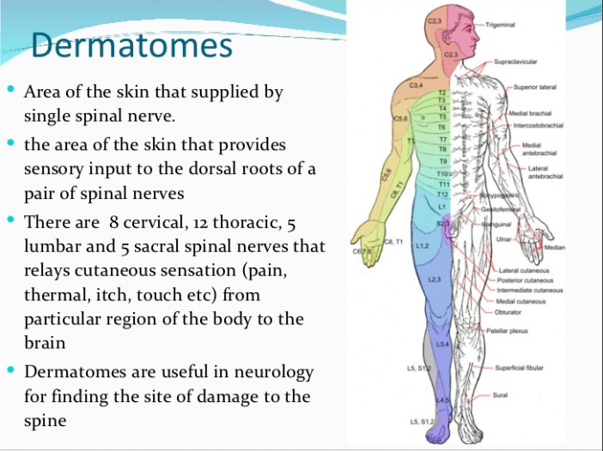

Slide 52
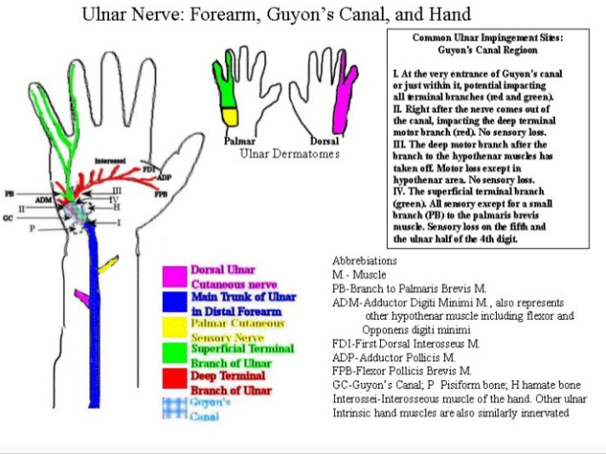

Slide 53
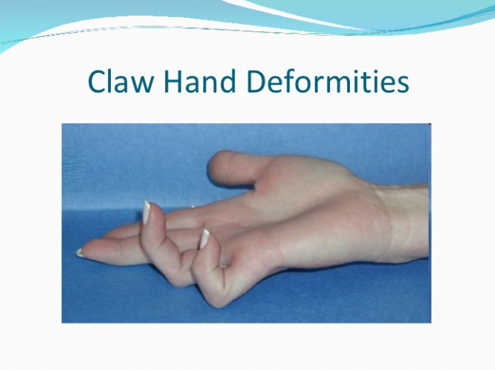
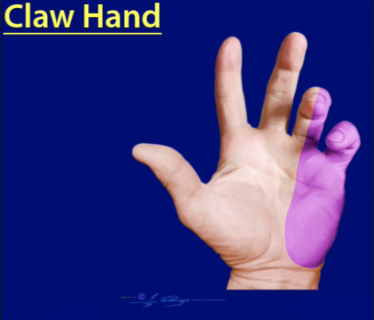

Slide 54
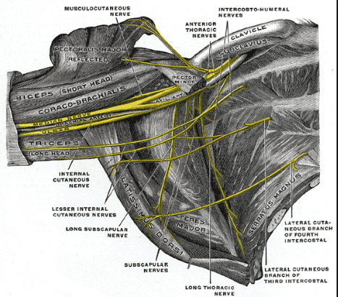
Median Nerve
From medial & lateral cords of B.P.,unite in front third part of axillary artery
(C5, 6, 7, 8 & T1)
Within Axilla:
Lat. To axillary a.
In the arm:
Upper ½: lat. To brachial a.
Lower ½: crosses in front then medial to brachial a.
Enter fore arm between two heads
of pronator teres muscle
No branches in the arm
Innervates most of flexor (ant.) muscles in forearm & hand

Slide 55
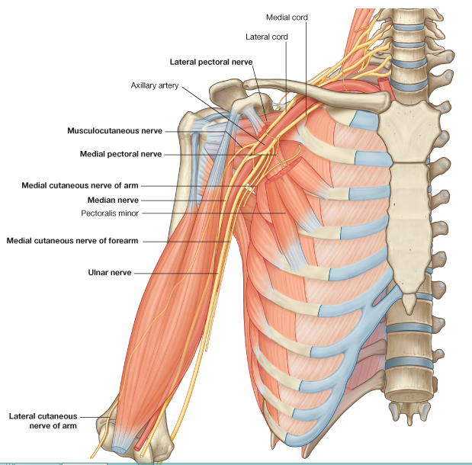
Median nerve

Slide 56
Median nerve

Slide 57
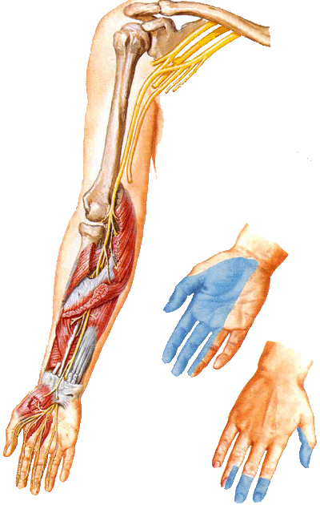

Slide 58
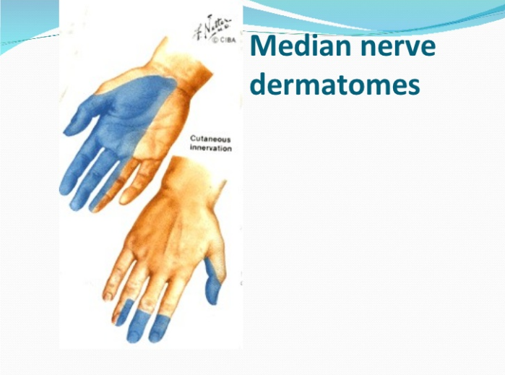

Slide 59
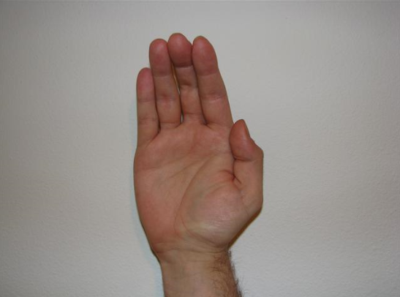
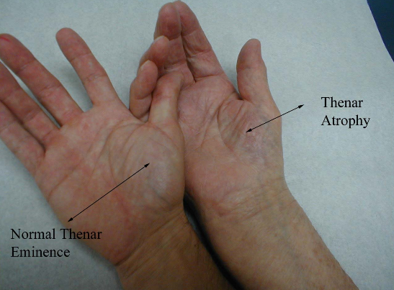
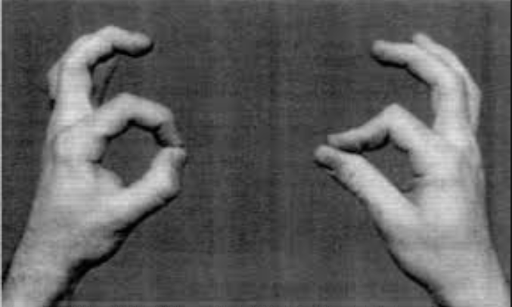

Slide 60
‘M’ Shape Terminal Branches
Ant. terminal branches form the shape of letter “M”:
Musculocutaneous n.:
lateral border
Median n.:
2 middle lines
Ulnar n.:
medial border

Slide 61
Posterior Cord Branches
1. Upper subscapular n.
supply subscapularis m.
2. Lower subscapular n.
3. Thoracodorsal n C6-C7-C8
Between upper & lower subscapular n.
Supply the latissimus dorsi m.
4. Axillary n.
Terminal branch, supply deltoid & teres minor m.
5. Radial n.
Terminal branch, largest branch of B. P.

Slide 63

Axillary Nerve
From post. cord of B. P.
(C5, 6, 7)
Pass posteriorly around surgical neck of humerus.
Then through the quadrangular space with PCHV
Innervations:
Motor: Deltoid & teres minor m.
And long head of triceps muscle
Sensory: upper lateral cutaneous n. of the arm

Slide 64


Slide 65
Clinical significance of axillary nerve injury
Causes of axillary nerve injury
Anterior-inferior dislocations of the shoulder joint.
Compression of the axilla with a crutch.
Fracture of the surgical neck of the humerus.
Injury to the nerve results in:
Paralysis of the teres minor muscle and deltoid muscle, resulting in loss of abduction of arm (from 15-90 degrees).
Weak flexion, extension, and rotation of shoulder.
Paralysis of deltoid and teres minor muscles results in flat shoulder deformity.
Loss of sensation in the skin over a small part of the lateral upper arm (an area known as the regimental badge/patch).

Slide 66


Axillary nerve injury

Slide 67


Slide 68




Radial Nerve
From post. cord of B.P. (C5, 6, 7, 8, T1)
In axilla: Pass post. to axillary a.
In arm: winds around the back of humerous in spiral groove between medial and lateral heads of triceps
to reach back compartment.
In lower third of arm
It enter anterior compartment and lie between brachialis and brachioradialis m

Slide 69


Slide 70


Slide 71

Continue radial nerve
At elbow: pass Ant. to lateral epicondyle of humerous were it give posterior interosseous nerve, then continue as superficial radial nerve, and lies lateral to radial artery.
Innervations.
Motor : post. muscles
of arm & forearm.
Sensory: lower lat.
Cutaneous n. of arm.
post. cutaneous n. of arm
& forearm.

Slide 72



Slide 73

Injuries of Radial Nerve
Can be injured by:
Pressure of badly fitting crutches
Drunkard falling asleep with one arm over the back of a chair
Fractures or dislocation of the proximal end of the humerus

Slide 74


Slide 75


Slide 76
Findings in Radial N. Injury
Triceps, ancones and long extensors of the wrist are paralyzed
Unable to extend the elbow joint, wrist joint and fingers.
Wrist drop or flexion of wrist occurs.
Unable to flex the fingers firmly for gripping.
Brachioradialis & supinator are paralyzed.

Slide 77


Sensory Findings
Little loss of skin sensation over posterior surface of lower part of the arm.
Sensory loss on the lateral part of dorsum of the hand.
Sensory loss on the dorsal surface of the roots of the lateral 3 & ½ fingers .

Slide 78
In the Spiral Groove
Radial nerve can be injured in the spiral groove at the time of fracture of shaft of the humerus
Wrist drop occurs
Sensory loss on the dorsal surface of the roots of the lateral 3 & ½ fingers

Slide 79
Review: B. P. Branches
Medial cord branches (5)
Lateral cord branches (3)
Post. cord branches (5)
Terminal branches:
Ant.: “3 = M”
Post.: 2

Slide 80
Deep Branch of Radial Nerve
Can be damaged in the fracture of the proximal end of radius or during dislocation of the radial head.
No wrist drop as extensor carpi radialis longus is undamaged.
No sensory loss as this is a motor nerve.

Slide 81

Injuries to Brachial Plexus
Affect movements (muscles) & sensations in upper limb
2 types:
Superior part injuries: C5 & C6
Inferior part injuries: C8 & T1

Slide 82


Superior Injuries
Causes:
1. Falling down on the shoulder (as falling from a horse)
2. In newborns due to excessive stretching of the neck
during delivery
The angle between the neck & shoulder is increased
Stretch & tears in upper part of B. P. (C5 &6)
suprascapular nerve, Musculocutaneous nerve, and the axillary nerve are most nerves affected.
“Waiter’s tip position”

Slide 83



Injury to muscles of shoulder region supra,infraspinatus teres major subscapularis, deltoid
Injury to biceps and brachialis which flex and supinate elbow joint
Loss of sensation lateral aspect of arm and forearm
Notes:
Deltoid teres minor axillary ,subscapular and teres major upper and lower subscapular nerves.supraspinatus,infraspinatus suprascapular nerve,biceps and brachialis musculo cutaneous nerve

Slide 84



Slide 85


Inferior Injuries
Less common
Causes:
1. Sudden pull of upper limb superiorly.
(as getting kids in school bus)
2. In newborns due to upper limb is pulled excessively
during delivery.
Stretch & tears in lower part of B. P. (C8 & T1).
“Claw hand”

Slide 86



Klumpke’s palsy
Injury of all intrinsic muscles of hand interosseus and lumbricals

Slide 87

Brachial Plexus Injuries
(Lower lesions)
Are usually a traction injuries caused by excessive abduction of the arm
The first thoracic nerve is usually torn.
The hand has a clawed appearance caused by hyperextension of metacarpophalangeal joints & flexion of interphalangeal joints

Slide 88
Brachial Plexus Injuries
(Lower lesions)
Loss of sensation will occur along the medial side of the arm.
Lower lesions can also be produced by a presence of a cervical rib or malignant metastases from the lungs in the lower deep cervical lymph nodes.

Slide 89

Transient Paralysis
From pressure on the axilla
(as heavy sleep on the armpit)
Radial & ulnar are most frequently involved
It can stay up to 24 hrs sometimes
Released by it self

Slide 90


Slide 91


Slide 92


Slide 93


Slide 94

Clavicle
Anterior bone of shoulder girdle
Long bone but has no medullary cavity
Ossify from membrane not cartilage.
The first bone to appear in fetus 5th,6th intrauterine week.
Is only attachment between trunk and upper limb.
Medial 2/3 is convex forward,lateral1/3 is concave
Commonest bone to be fractured by fall on out stretched hand, at junction of medial 2/3,lateral 1/3.
Notes:
Site of junction of two curvature, different cross section,weakend by subclavius groove, and nutrient artery

Slide 95
Scapula
Posterior bone of shoulder girdle.
Lie on postero-lateral aspect of chest wall.
Extend from 2nd,to 7th rib when arm is adducted
Flat triangular bone, has two surfaces.
Anterior (costal surface):concave forming subscapular fossa.
Posterior (dorsal surface):shows the spine and smaller supraspinous fossa, larger infraspinous fossa
Three borders
Upper border: sharpest and shortest border.
Has suprasternal notch, and coracoid process
Medial vertebral border: Lies 5 cm away from thoracic spine.
Lateral border: thickest border: for stability

Slide 97
Scapula
Three angles
Superior angle:Rt angle opposite 2nd rib and 2nd thoracic spine
Inferior angle: acute angle opposite 7th rib
Lateral angle: Forms head and neck of scapula
Directed Fowrward,laterally,and upward
Form supra,and infra glenoid tubercle
Head carry glenoid cavity , its margins, give attachment to labrum glenoidale.
Coracoid process: Project forward and laterally, above glenoid cavity, tip can be felt below junction of m2/3,lat 1/3
Spine: Apex lies opposite 3rd rib.
Acromiom:Lies at Rt angle to spine.

Slide 98


Slide 99
Shoulder region
Is the junction of upper limb with neck and chest, formed of two halves
The bones of shoulder region is scapula behind and clavicle in front, articulate with each other at acromio-clavicular joint and upper end of humerus.
In front two halves are connected together by upper end of sternum, where medial end of clavicle articulate with sternum at sternoclavicular joint
Behind the two scapulae are separated widely by muscles
They form the pectoral girdle

Slide 100

Muscles of shoulder region
Two superficial muscles of shoulder region are deltoid and trapezius muscles.
Trapezius attach scapula and clavicle to trunk.
Deltoid attach scapula and clavicle to humerus.
Both muscles are attached to opposing surface and margins
of acromiom,spine of scapula and clavicle .

Slide 101



Slide 102

Posterior muscles
Trapezius: most superficial muscle of the back of the neck, and upper trunk.
Origin: occipital bone of skull, back of neck back of chest.
Insertion: scapular spine
acromion, and clavicle.
N S: Spinal accessory,C3-C4 proprioception
Action: extend the head, elevate, and depress the shoulder adduct arm.

Slide 103
Deep muscles of the back of shoulder
Levator scapulae.
Rhomboids major.
Rhomboid minor.
All are elevators of scapula, rhomboids retract scapula
as well

Slide 104

Latissimus dorsi:
large, flat muscle.
Important muscle in swimming
Origin: lower6 thoracic spines, and ilium.
Insertion: upper humerus(floor of bicipital groove)
NS: C6-C7-C8 thoraco dorsal n
Action: Extend and adduct and medially rotate the arm.
Pulls the trunk upwards in climbing.

Slide 105

Bone of Arm: Humerus
Long bone that articulates:
Sup.:
To scapula at shoulder joint
Inf.:
To radius & ulna at elbow joint

Slide 106

Humerus
Upper part
Head ( less than1/2 of sphere)
Anatomical Neck
Lesser Tubercle
Intertubercular Groove
Greater Tubercle
Surgical Neck
Deltoid Tuberosity
Rough elevation half way on lateral surface for insertion of deltoid muscle.

Slide 107


Right Humerus, Lower part
1. Radial Fossa
2. Lateral Epicondyle
3. Capitulum
4. Trochlea
5. Medial Epicondyle
6. Coronoid Fossa
7. Olecranon Fossa

Slide 108

Humerus Fractures
1. Fracture of the surgical neck:
Common in elderly (osteoporosis)
due to falls down
injury to circumflex arteries
&/or axillary n.

Slide 109
2. Transverse fracture of
humerus shaft:
Direct blow to the arm
injury to radial n.
displacement depends on relation to deltoid insertion
below deltoid tuberosity:
upper → laterally (deltoid)
lower → superiorly (biceps)

Slide 110
3. Supracondylar fracture:
Fractures of the distal part of humerus
Injury to median n, and brachial artery.
4. Fracture of medial epicondyle:
Pulls the epicondyle inferiorly
Weakness in fingers/hand flexion
injury to ulnar n.

Slide 111

Fascial Covering of The Arm
Skin
Superficial fascia
(subcutaneous fat)
Deep fascia:
(Brachial fascia)
From brachial fascia:
Med. & Lat. intermuscular septa
🡳
shaft of humerus
⇒ Divide the arm into:
Ant. & Post. compartments

Slide 112

Muscles of The Arm
Anterior:
Biceps Brachii
Brachialis m.
Coracobrachialis
Posterior:
Triceps m.:
Long
Lat.
Med.

Slide 113


Biceps Brachii Muscle
Origin (2 heads)
Short: coracoid process
Long: supraglenoid tubercle of scapula
Insertion
Radial tuberosity
Bicipital aponeurosis (to deep fascia)
Innervation
Musculocutaneous n C5-C6-C7.
Action
Flexion of forearm,
Supination of forearm
Flexion of shoulder
Tendon of long head keep head of humerus in place in shoulder movements

Slide 114


Slide 115

Brachialis Muscle
Arises from the anterior aspect of the shaft of the humerus below the deltoid tuberosity
It is inserted into the anterior aspect of the coronoid process of the ulna and the capsule of the elbow joint
It lies directly anterior to the elbow joint and is only a flexor of the elbow
The musculocutaneous nerve
C5,6,7 supplies it

Slide 116


Triceps Muscle
Origin (3 heads)
Long: infraglenoid tubercle of scapula
Stretch over two joints
Lat.:sup.½ of post. aspect of humerus shaft
Med: inf. ½ of post. aspect of humerus shaft
Insertion
Olecranon process of ulna
Innervation
Radial n.
Action
Extension of forearm
Extension of shoulder long head

Slide 117


Bicipital Groove

Slide 118


Radial nerve in spiral groove

Slide 119
Brachial Artery
Starts:
At lower border of teres major m.
As a continuation of axillary a.
Ends
In cubital fossa, 1 cm below elbow joint, opposite to radial neck
By dividing into:
Radial & Ulnar a.
It is a superficial artery lie below deep fascia in all its course
Basilic vein lie on its medial side

Slide 120


Slide 121
Pass in bicipital groove
Upper ½ of arm:
Between median & ulnar n.
Medial to humerus bone
At middle of arm:
Crossed by median n. from
lat. to med. Side
Lie over humerus bone
At elbow:
Enters cubital fossa,
Medial to biceps tendon
Notes:
Separated from humerus bone by brachialis m

Slide 122
Branches of Brachial Artery
Muscular branches
To muscles of ant. compartment
Profanda brachii (Deep a. of the arm)
Pass post. largest branch
Follows radial n. into spiral groove
Supply triceps m.
Nutrient a.
To humerus
Sup. & Inf. ulnar collateral a.
Contribute to elbow anastomoses

Slide 123

Veins of The Arm
Superficial Veins:
Cephalic v.
Basilic v.
Median cubital vein
Deep Veins:
Brachial v.
(vena comitans: (accompanying vein)
pair of veins on the sides of brachial a.

Slide 124


Slide 125
Cephalic Vein
From lat. Side of venous network on the back of the hand
Ascends in the anterolateral aspect of forearm
Lat. to biceps m. in the arm
At delto-pectoral triangle:
drains to axillary v.

Slide 126
Basilic Vein
From medial side of venous network on the back of the hand
Ascends in posteromedial aspect of forearm
Medial side of biceps m. in the arm
At middle of arm:
Pierces deep fascia & join brachial vein.
To form: axillary vein

Slide 127

Median cubital vein
Is a branch of cephalic vein
Lies in cubital fossa
Joins Basilic vein
Crosses in front of brachial
artery and median nerve
Separated from them by bicipital aponeurosis.

Slide 128
Scapulo-humeral Muscles
Deltoid
Teres Major
Teres Minor
Supraspinatus
Infraspinatus
subscapularis

Slide 129


Slide 130
Rotator Cuff Muscles
4 Muscles that inserted around shoulder joint & and fuse with underlying capsule of shoulder joint form a musculotendinous cuff
Cover the joint from 3 directions:
Superior: Supraspinatus
Anterior: Subscapularis
Posterior: Infraspinatus & teres minor
Fxn.
Stabilize shoulder joint
Deficit inferiorly that is weak area

Slide 131




Anterior
Superior
Posterior

Slide 132
Cubital Fossa

Slide 133

Shallow triangular depression
on the anterior surface of the elbow joint, and upper 1/3 of forearm
base above
apex extend a short distance
in fore arm, overlapping of
BR over PT muscle
Boundaries
Superiorly: imaginary line connecting the epicondyles
Laterally: brachioradialis
Medially: Pronator teres

Slide 134
Contents of the cubital fossa
From medial to lateral:
Median n.
⇓
Brachial a.
⇓
Biceps tendon
⇓
Radial nerve

Slide 135
Floor:
Brachialis m. (med and above)
Supinator m. (lat and below)
Roof:
Skin, superficial and deep fascia,
and bicipital aponeurosis
Sup Fascia contains 3 Sup veins, Supratrochlear LN , lat , med Cutaneous ns of FA
Fascia:
Superficial (median cubital vein)
Deep (bicipital aponeurosis)

Slide 136


Slide 137
Skin
Superf. Fascia
(med. Cubital v.)
Deep fascia
Bicipital aponeuro.
Median n.
Brachial a
Biceps t.
Radial nerve
Brachialis
supinator

Slide 138

How do these structures leave the cubital fossa?
Median nerve disappear between two heads of pronator teres
Ulnar artrey deep to pronator teres
Radial artery overlaped by brachioradialis muscle
Biceps tendon to tuberosity of radius
Supratrochlear LN are present in upper medial part of fossa

Slide 139
Nerves of Arm
4 main nerves:
Musculocutaneous n.
Median n.
Ulnar n.
Radial n.

Slide 140


Gleno-Humeral (Shoulder) Joint
Type: Synovial (ball & socket)
Multiaxial joint, wide range of movement
Articulations:
Head of humerus
Glenoid cavity of scapula
Ligaments:
1. Fibrous Capsule
2. Gleno-humeral lig.(3) thickening of fibrous capsule
3. Coraco-humeral lig.
4. Transverse humeral lig.

Slide 141


Stability of joint is due to
Rotator cuff muscles
Long head of biceps muscle
Related bony processes
Extra capsular Lig.

Slide 142


Slide 143


Slide 144


Slide 145
Movement of shoulder region
Flexion :Anterior fibers of deltoid,pectoralis major, long head of biceps
Extension: Posterior fibers of deltoid ,teres major, latissmus dorsi M
Abduction: 0-15⁰ supraspinatus
15⁰-90⁰ middle fibers of deltoid
above 90⁰ rotation of scapula
Adduction :Pectoralis major muscles,latismus dorsi and teres major and minor
Median rotation: Subscapularis ,latissmus dorsi, anterior fibers of deltoid teres major
Lateral rotation: Teres minor, infraspinatus Posterior fibers of deltoid

Slide 146
Movements:
Circumduction
Includes all movements together
Characteristics:
The fibrous capsule is Weak inferiorly
due to:
1. Penetrated inferiorly by tendon of long head of triceps
2. Joint is surrounded (stabilized) by group of muscles called: Rotator Cuff muscles
*except inferiorly

Slide 147
Rotator Cuff Muscles
4 muscles that inserted around shoulder joint & and fuse with underlying capsule of shoulder joint form a musculotendinous cuff
Cover the joint from 3 directions:
Superior: supraspinatus
Anterior: subscapularis
Posterior: infraspinatus & teres minor
Fxn.
Stabilize shoulder joint
Deficit inferiorly that is weak area

Slide 148


Slide 149
Relation of shoulder joint
Anteriorly: subscapularis muscle, axillary vessels and brachial plexus
Posteriorly: Infraspinatus muscle, and teres minor
Superiorly : supraspinatus muscle,subacromial bursa,coraco acromial lig,deltoid muscle
Inferiorly: long head of triceps muscle, axillary nerve, posterior circumflex humeral vessels

Slide 150

Pectoralis major muscle
Origin: V shaped M
Clavicular end :Anterior surface of medial1/2 of clavicle
Sternocostal head:
Anterior surface of sternum, first 7 costal cartilages,EOA
Insertion: lateral lip of bicipital aponeurosis
NS: med,lat pectoral nerves
Action: All muscle, adduction of shoulder.
Medial rotation of arm
Ant fiber flex shou, pos fiber extend it.

Slide 151


Deltopectoral groove

Slide 152


Structures in Deltopectoral groove
Cephalic vein
Deltoid branch of thoracoacromial
artery
Coracoid process is most easy
Palpable
Detopectoral Ln

Slide 153


Slide 154

Acromio clavicular joint
Small synovial plane joint between medial surface of acromion, and lateral end of clavicle.
None axial
Joint is surrounded by joint capsule reinforced by
Acromio-clavicular lig
Coraco-clavicular Lig:
which Is an accessory lig for transmission of BW.
Notes:
which is not directly related to the joint, but is an important strong accessory ligament, providing much of the weightbearing support for the upper limb on the clavicle and maintaining the position of the clavicle on the acromion-it spans the distance between the coracoid process of the scapula and the inferior surface of the acromial end of the clavicle and comprises an anterior trapezoid ligament

Slide 155

Sterno-clavicular lig
Synovial joint double plane.
Absorb forces transmitted
from shoulder region along
clavicle
Medial end of clavicle, and
clavicular notch of manubrium,
and small part of 1st costal cartilage.
Joint is surrounded by joint
capsule and 4 lig
Ant, pos sternoclavicular lig
Inter clavicular lig
Costo-clavicular lig
Is responsible for protraction,retraction,rotation Elevation , depression of scapula
Notes:
joint, as joint is divided into 2 separate spaces by circular articular disc

Slide 156

Bones of The Forearm
Radius Bone:
- Lateral bone of the forearm
- Articulations:
Humerus & Ulna
🢃
Scaphoid & Lunate
- Shaft is convex lat. & wider below than above

Slide 157


Right radius
Head of Radius
Neck of Radius
Radial Tuberosity
Radius (Shaft)
Styloid Process
Ulnar Notch

Slide 158
Bones of The Forearm
Ulna:
- Medial bone of the forearm
- Articulations:
Humerus & Radius
🢃
Radius
- Longer than Radius
Stabilizing bone of forearm

Slide 159


Right Ulna
Olecranon Process
Trochlear notch
Coronoid Process
Tuberosity
Radial Notch
Ulna (Shaft)
Head of Ulna
Styloid Process

Slide 160

Fractures of Distal End of Radius
Colles’ Fracture:
Fracture of distal end of the radius, where the distal fragment moves posteriorly & superiorly
Most common fracture of the forearm
due to falls on outstretched hand
“dinner-fork deformity”

Slide 161

Smith’s Fracture:
Fracture of distal end of radius, where the distal fragment displaced Anteriorly
Reversed Colles’ fracture
Falls on the back of the hand

Slide 162


Cole's and smith fractures

Slide 163




Cole's and smith fractures

Slide 164


Lunate dislocation

Slide 165


Elbow Joint
Type:
Synovial Hinge joint.
Articular Surfaces:
Capitulum & Trochlea of humerus.
Trochlear notch of ulna (med.)
Head of radius (lat.)
(continuous with proximal radio-ulnar joint)

Slide 166

Elbow joint
When the elbow is extended,
  Medial epicondyle,
  Olecranon and
  lateral epicondyle
  are in a straight line
When flexed, they form a triangle

Slide 167

Capsule of Elbow Joint
Capsule surrounds the joint
Anteriorly to the margins of the Coronoid and radial fossae of the humerus
Medially and laterally just beyond the articular margin
Excluding the medial and lateral epicondyle to which the common flexor and extensor origins are attached
As in any hinge joint the capsule is thin in front to allow flexion and extension, thick at sides to prevent abduction and adduction

Slide 168

Ulnar Collateral Ligament:
medial thickening of fibrous capsule
medial epicondyle
🢃
coronoid & olecranon
3 bands:
Ant.: cordlike (strongest)
Post.: fanlike (weakest)
oblique: slender band
Movements:
Flexion & Extension
Prevent abduction of elbow joint

Slide 169

Medial or Ulnar Collateral Ligament
Thick triangular ligament attached superiorly to the medial epicondyle
The ulnar nerve lies on the medial ligament
The anterior band may be ruptured in throwing events

Slide 170


Supporting Ligaments
Radial Collateral Ligament:
lateral thickening of the capsule
Prevent adduction of the elbow joint
from: Lateral epicondyle of humerus
🢃
blends to:
Annular ligament of radius

Slide 172

Lateral or Radial Collateral Ligament
The ligament is attached to the lateral epicondyle
Fans out to be attached to the upper border of the annular ligament
The annular ligament is attached to the margins of the radial notch of the ulna
It is part of the articulation of the superior radioulnar joint
Covered with articular cartilage

Slide 173

Synovial Membrane
Lines the capsule and non- articular structures inside the capsule
Continuous inferiorly with synovial membrane of superior radio-ulnar joints
Annular ligament covered with articular cartilage

Slide 174
Movements
Flexion:
brachialis > biceps brachii > brachioradialis
(chief flexors)
Extension:
triceps brachii (medial head) > anconeus
(chief extensors)

Slide 175


Superior raido- ulnar joint
Close association with elbow joint
Both have one capsule
Joint space continuous with each other
Pivot joint
Head of radius rotate against radial notch of ulna
Less than 1/4 of head of radius articulate with ulna, rest articulate with annular ligament

Slide 176

Important relations to elbow joint
Anterior:
Median n. & Brachial a.
brachialis m. & biceps tendon
Posterior:
Triceps muscle
Medial:
Ulnar n. posterior to medial epicondyle
Lateral:
Radial n. anterior to lateral epicondyle

Slide 177
Muscles of Forearm

Slide 178
Muscles of Forearm
(Main action & Innervation, unless mentioned in slides)
    3 groups:
Anterior (flexors & pronators)
Lateral (2 muscles)
Posterior (extensors & supinator)
Ant. flexor group is separated from post. extensor group by:
Radius, ulna & interosseous membrane connecting these bones

Slide 179
Naming The Forearm Muscles
Action:
Flexor or Extensor, Pronator or Supinator
Attachment:
Carpi or Digitorum, or Pollicis
Length of the tendon:
Longus or Brevis

Slide 180
Anterior Muscles of Forearm
Anteriomedial compartment
Include flexors of hand & pronators of hand & forearm
Originate from front Medial epicondyle of humerus by a common tendon: Common Flexors Origin
Front of Radius and Ulna and inter osseous membrane
8 muscles 5 superficial 3 deep
Innervated by:
median & ulnar n.
Action
Flex elbow
Flex and pronate wrist

Slide 181

Common Flexor Origin
Pronator teres
Flexor carpi radialis
Flexor digitorum superficialis
Palmaris longus
Median nerve (C6,7)
Flexor carpi ulnaris
Ulnar nerve (C6,7)

Slide 182



3 layers:
Superficial: 4
Intermediate: 1
Deep: 3
* Distinguish these muscles in the lab

Slide 183

Lateral Muscles of Forearm
1. Brachioradialis m.:
Humerus (?) 🡲 base of Styloid process of radius
Flexes forearm at elbow
Help start Pronation
2. Extensor carpi radialis longus:
From Humerus (?) 🡲 base of 2nd metacarpal
3. Extensor carpi radialis brevis
From CET 🡲 base of 3rd metacarpal

Slide 184
Posterior Muscles of Forearm
Originate from back of lateral epicondyle of humerus:
Common Extensors Origin
All are innervated by Radial n.
Fxn. In extending the hand at wrist joint
* Distinguish these muscles in the lab.

Slide 185

Extensor Tendons
Superficial group 7 muscles
Brachioradialis
Extensor carpi radialis longus
Extensor carpi radialis brevis*
Extensor digitorum communis
Extensor digiti minimi
Extensor carpi ulnaris
Anconeus

Slide 186
Continue
Deep group 5 muscles
Supinator
Three for thumb
Abductor Pollicis longus
Extensor Pollicis brevis
Extensor Pollicis longus
Extensor indicis

Slide 187



Slide 188
Extensors of the wrist 3 muscles
Extensor carpi radialis longus
Extensor carpi radialis brevis
Extensor carpi ulnaris
Extensors of fingers
Extensor digitorum communis
Extensor digiti minimi
Extensor indicies
Extensors of the thumb
Abductor Pollicis longus
Extensor Pollicis brevis
Extensor Pollicis longus

Slide 189
Flexor retinaculum
Flexor Retinaculum:
A thick band of deep fascia that stretch across anterior surface of carpus Ant. to wrist joint that holds the tendons of flexor muscles.
Attachments
Laterally split in to 2 laminae
Superficial lamina to tubercle of scaphoid crest of trapezium.
Deep lamina to groove of trapezium
Tendon of FCR pass between the 2 laminae in a special compartment
Medially to pisiform bone hook of hamate.
Distally continue with palmar aponeurosis

Slide 190


Flexor Retinaculum
A
Attached medially hook of hamate pisiform bone
Laterally crest of trapezium,tubercle of Scaphoid

Slide 191


Carpal tunnel

Slide 192
Structures on the surface of FR
From medial to lateral
Ulnar nerve close to pisiform bone
Ulnar vessels lateral to ulnar nerve
Palmar cutaneous branch of ulnar nerve
Tendon of palmaris longus
Palmar cutaneous branch of median nerve

Slide 194
Structure which pass through carpal tunnel
The tendons of FDS
The tendons of FDP
The tendon of FPL.
Median nerve

Slide 195


Slide 196


CARPAL TUNNEL SYNDROME

Slide 197



Slide 198



Slide 199

Clinical Features
Pain
Numbness
Tingling
Symptoms are usually worse at night and can awaken patients from sleep.
To relieve the symptoms, patients often “flick” their wrist as if shaking down a thermometer (flick sign).

Slide 200


Extensor Retinaculum

Slide 201

Extensor Retinaculum
A band of deep fascia less strong and thick Post. to wrist joint that holds the tendons of extensor muscles.
Run obliquely
Medially attached to Triquetral and pisiform bone
Laterally attached to sharp edge between lateral and anterior surface of lower end of radius
Divided into six compartments

Slide 202
Nerves in The Forearm
3 main nerves:
Median n.
Ulnar n.
Radial n.

Slide 203
The Median nerve
The Median nerve : is formed by 2 roots from median and lateral cords of brachial plexus, unite in front third part of Axillary artery.
  Course:
  In upper arm lie lateral to Axillary artrey,and upper half of brachial artery, till insertion of brachioradialis
  Here it crosses in front of brachial artery from lateral to medial
  It leaves cubital fossa between two heads of pronator teres muscle

Slide 204
Median Nerve
Pass in the middle of forearm Anteriorly
Beneath FDS & ant. to FDP
At wrist:
beneath flexor retinaculum (in carpal tunnel)
Innervates all ant. muscles except:
FCU & medial ½ of FDP

Slide 205
Median nerve
  Motor supply to: ALL muscles of anterior forearm flexors, except FCU,medial half of FDP
  3 thenar eminence muscles (thumb), lat.2 Lumbricals
  Sensory : skin of lateral 2/3 of palm ,lat. Three & half fingers to back of middle phalanges
  Nerve Damage = “Ape” Hand
    Inability to Oppose Thumb

Slide 206


The median nerve

Slide 207
Branches Of Median Nerve
No branches in axilla, or upper arm
In cubital fossa 4 muscles ,PT,FCR,FDS,PL.
As it emerge between two heads of pronator teres it give Anterior interosseus nerve
3 cm above wrist it give palmar cutaneous branch of median nerve which pass on surface of FR
Anterior interosseus nerve supply two and half muscles ,PQ, FPL, lateral half of FDP
Digital branches three and half fingers

Slide 209


Slide 210
Ulnar Nerve
Post. to medial epicondyle of humerus
Between: FCU & FDP
Medial to ulnar artery.
At wrist:
Pass superficial to flexor retinaculum
Innervate: FCU & medial ½ of FDP

Slide 211


The Ulnar nerve C7,8,T1

Slide 212


Radial Nerve
Pass ant. to lat. Epicondyle of humerus
Divides into: Deep & superficial branches
Deep branch:
Pierces supinator m.
Winds around radial neck (lat.)
& enters post. compartment of forearm
To become: Post. interosseous Nerve
*innervates all post. muscles of forearm
Superficial branch (sensory):
Pass beneath brachioradialis m.

Slide 213
Anterior
posterior

Slide 214
Arteries in Forearm
Radial Artery
Arises from brachial a.
Opposite to neck of radius (anteriorly)
End in the palm by becoming deep Palmar arch
Proximally:
Pass on lat. Aspect of forearm,
Beneath brachioradialis m.
Distally: Pass lat. To tendon of FCR, medial to tendon of BR
(site for pulsation)
Radial nerve lie lateral to artery
At wrist:
Wind backward to enter the
anatomical snuff box over scaphoid,trapezium bones

Slide 215

It pass between two heads of first dorsal interosseus muscle, to enter palm of hand
It give two branches
Princeps pollicis to thumb
Radialis indicis to radial part of index finger.
It pass through adductor pollicis muscle to become deep Palmar arch.
Finger breadth nearer to wrist ,its concave course lie deep branch of ulnar nerve

Slide 216



Slide 217
Ulnar Artery
Larger than radial a.
Arises from brachial a.
opposite to neck of radius
End in palm by becoming superficial palmar arch
Proximally:
Pass between FDS & FDP
Distally:
Pass between FDS &
tendon of FCU
Ulnar nerve lie on medial side of artery.

Slide 218

Wrist Joint (Radiocarpal Joint)
Type:
Condyloid (ellipsoid) synovial joint
Biaxial joint
Articulations:
- Distal end of radius (lat.)
Articular disc below head of ulna (med.) 🡳🡳
- Scaphoid, Lunate & Triquetral bones
Movements:
Flexion,extension,abduction,adduction

Slide 219

Supporting Ligaments
Anterior Radiocarpal ligament
(Palmar)
2. Posterior Radiocarpal ligament
(Dorsal)
Anterior ulno capral lig
3. Ulnar (medial) collateral lig.:
Attachments?
4. Radial (lateral) collateral lig.:
Attachments?

Slide 220


Slide 221

The Hand
2 surfaces: Palm & Dorsum
3 Regions:
The Wrist
Proximal part
Carpal bones
The Hand Proper main part
Metacarpals (5)
The Fingers
Distal part
Phalanges
(prox., mid., dist.)

Slide 222
Bones of The Hand
Carpal bones (8):
Proximal row (4) & distal row (4)
Metacarpals (5):
Base, shaft & head
Phalanges:
Proximal, middle & distal
Thumb (two)

Slide 223

Carpals of proximal row:
Scaphoid (boat) 2. Lunate (moon)
3. Triquetral (3 cornered) 4. Pisiform (pea)

Slide 224
Carpals of distal row:
Trapezium (4-sided)
Trapezoid (wedge)
3. Capitate (large, with rounded head)
4. Hamate (hummer, hook process)

Slide 225

Fracture of Scaphoid
Most common fracture of the wrist, due to fall on outstretched hand
Symptoms- Pain on lateral side of the wrist
Deep tenderness in anatomical snuff box
Any pain in wrist which does
not disappear in 24 hour
think of fracture Scaphoid
Complications:
Non union
Avascular necrosis of proximal fragment
In 10% of people blood supply to distal segment only from radial artery
Arthritis of the wrist joint
Rx.: Cast for fracture near the thumb, may include the thumb
Surgical treatment for fracture near the fore arm

Slide 226

Skin of The Palm
Thick, hairless with many
Flexure creases
Nerve supply:
Palmar cutaneous nerves
From median and ulnar nerves

Slide 227
Deep Fascia of The Palm
At wrist:
flexor Retinaculum
At hand proper:
Palmar Aponeurosis
At fingers:
Fibrous Digital Sheaths
(ligamentous tubes enclosing the flexor tendons & phalanges)

Slide 228
Palmar Aponeurosis
In central palm is strong fibrous sheath, under superficial
fascia, which protect nerves vessels and tendons, improve grip.
Triangular in shape:
Apex (prox.) 🡺fuse with FR
Base (distal) 🡺divides into
4 processes, each to root of finger, which divide into two
and pass backward
Two margins lateral and medial fuse with deep fascia over TE,HE
Fibrous septa,separate flexor tendons of fingers from T,H eminence

Slide 229


Slide 230


Dupuytren’s contraction
Progressive shortening, of medial part of PA
Lead to flexion deformity and unable
to extend the fingers
Ring finger, and pinkie finger are
the most affected.
More common in men, north Europe above 40y
Painless,progerssive,?hereditary.
Early lump,noudule in palm, later deformity
Causes unknown manual trauma, smoking, alcohol , epilepsy DM.
Treatment
Radiation.
Surgical.
needle apponeurotomy.
Collagenase Injection.

Slide 231
Muscle Groups in The Hand
5 Groups
Thenar group
4 muscles related
to thumb
Hypothenar group Adductor group
3 m., related to little finger Adductor pollicis
Lumbricals
4 muscles.
Interosseii:
3 palmar & 4 dorsal

Slide 232

Thenar Group
3 thumb muscles:
Abductor pollicis brevis
Flexor pollicis brevis
Opponens pollicis
Nerve supply:
Median nerve

Slide 233

Adductor Pollicis
Not part of thenar group
2 Heads: Origin
Oblique: bases of 2nd & 3rd metacarpals
Transverse: shaft of 3rd metacarpal
⇒ prox. phalanx of thumb
Nerve supply:
Ulnar nerve

Slide 234
Hypothenar Group
3 Muscles of little finger:
Abductor digiti minimi
Flexor digiti minimi
Opponens digiti minimi
Nerve supply:
Ulnar nerve

Slide 235

Lumbrical muscles
4 slender muscles
Origin from lateral margin of
lateral 2 tendon of FDP one head.
From adjacent margin of medial
three tendons of FDP two heads.
Insertion Through the E Expansion
in base of terminal phalanx of all
fingers except the thumb
Nerve supply
Lateral 2 digital branch of
median nerve
Medial 2 deep branch of ulnar nerve
Action Flex metacarpo-phalangeal,extend
interphalangeal joint.

Slide 236


Slide 237

Interosseous muscles
7 muscles,3palmar,4 dorsal muscles lie in space between metacarpal bones.
Origin palmar I single head, from the palmar surface of MB of finger in which it acts
Dorsal I by two heads, from
metacarpal bones between which it lie
Insertion join EE
Nerve supply ulnar nerve
Action
putting finger in writing position
PI adduct ring index and little finger
DI abduct the middle three fingers

Slide 238


Slide 239


Palmar and dorsal interosseus muscles

Slide 240
Extensor expansion
Each extensor tendon expand over the whole of the back proximal phalanx to form what is known as extensor expansion.
It receive insertion of one Lumbrical muscle, and one or two interosseus muscles, extensor digitorum muscle.
Each extensor expansion divide into three slips.
Middle main inserted in base of middle phalanx.
The lateral two slips converge over middle phalanx and unite to be inserted in distal phalanx.
The lateral slip receive insertion of Lumbrical and interosseous muscle.

Slide 241


Slide 242


1

Slide 243



Extensor expansion

Slide 244

Arrangement of tendons of FDS,FDP in the fingers
Each medial 4 fingers receive
2 flexor tendons FDS,FDP
They run along flexor surface
of finger kept in place by FFS
On first phalanx the tendon of
FDS become flat, fold around
tendon of FDP,then split in to
2 parts, which pass behind
tendon of FDP,then they fuse
and leave each other and inserted
in base of middle phalanx
Tendon of FDP pass through short tubular pathway and inserted in base of distal phalanx

Slide 245


Slide 246
Fibrous flexor sheath
Anterior surface of each finger from Head of metacarpal bone, to Base of distal phalanx has a strong fibrous sheath derived from deep fascia.
It s edges is attached to sides of phalanges,MP,IP joints
Hold flexor tendons in contact with anterior surface of phalanges and joints.
The proximal end is open, continuous wit PA ,distal end is closed and attached to base of distal phalanx.
Flexor tendons lie inside the FFS to change it to tunnel.
In the tunnel lie tendon of FDS,FDP,in thumb FPL.
At crease skin is adherent to FFS.
FFS is loose over joints to allow mobility of fingers.

Slide 247
Synovial sheath
Flexor tendons are enclosed in synovial sheath SS
It has two layers one cover tendon.
2nd cover the canal made by FFS,the two layers are separated by narrow space contain synovial fluid.
The SS of the thumb radial bursa, extend above the wrist for one inch.
SS of little finger ulnar bursa, is continuous with common flexor synovial sheath extend above the wrist for one inch.
The SS of index ring ,and middle finger extend to middle of palm, at level of proximal transverse crease.
The distal end of flexor tendons of middle three fingers have digital synovial sheath, which end at base of distal phalanx.
Radial and ulnar bursa are connected to each other at wrist in 50% of cases

Slide 248


Slide 249


Slide 250


Tenosynovitis
Is infection of synovial sheath
Due to small penetrating wound(needle- thorn).
Result in distension of tendon sheath with pus.
Finger is semiflexed,and swollen ,extension cause severe pain
Infection of thumb and little finger spread to palm
Kanavel’s sign
Notes:
Kanavel S swollen ,tender, Semi flexed, passive extension cause severe pain

Slide 251




Slide 252

Fascial space of the palm
Lateral space contain thenar muscles
Medial space contain Hypothenar muscles
Superficial intermediate space, contains
Superficial palmar arch
Branches from median n
Branches from ulnar nerve
Deep intermediate space contain tendon of flexor muscles
Adductor space contain adductor muscle

Slide 253


Slide 254


Pulp space infection
Definition of pulp space
Spaces at tip of fingers and thumb are very tightly packed with fat lobules, that lie between many fibrous septa, extend between skin and periosteum
The blood supply to the shaft and not the base pass through it
Base has dual blood supply

Slide 255


Pulp space

Slide 256

Arterial Blood Supply To The Hand
2 main arterial arches
Superficial palmar arch
from ulnar artery
Deep palmar arch
from radial artery

Slide 257

Superficial Palmar Arch
Direct continuation of ulnar artery
Between:
Palmar aponeurosis
&
Long flexor tendons
Anastomose lat. With radial a.

Slide 258

Deep Palmar Arch
Direct continuation of radial
Between:
Long flexor tendons
&
Metacarpal bones
Anastomose med. With ulnar a.

Slide 259

Radial and ulnar arteries in hand

Slide 260

Radial artery in hand

Slide 261

Anatomical Snuff Box
Triangular depression on lat. Side of the wrist.
Base proximal apex distal
Boundaries
Medial: Tendon of EPL
Lateral: Tendons of EPB & ABPL
Floor: scaphoid & trapezium
Content
Radial artery, SC end of superficial radial nerve, cephalic v.
Scaphoid bone can be felt in floor if hand is ulnary deviated

Slide 263
Nerves in the hand
Ulnar nerve
Deep branch of ulnar nerve
It begins on surface of FR.
lie deep to flexor tendons, lying in concavity of deep palmar arch
It supply 13 muscles
7 Interosseous muscles
2 Medial lumbricals
3 Hypothenar muscles
Adductor pollicis
Superficial branch of ulnar nerve supply little and medial side of ring finger
Dorsal branch of ulnar nerve medial third of dorsum of palm and medial one and half fingers
Palmar cutaneous nerve median third of palm

Slide 264


Slide 265
MEDIAN NERVE
The median nerve end in carpal tunnel by dividing to lateral and medial divisions.
Lateral division smaller
Supply 3 thenar muscles
3 Digital branches to thumb and lateral index
First Lumbrical
Median division larger
Supply digital nerves by two branches ,medial side of index, middle and lateral part of ring,2nd Lumbrical

Slide 266


Slide 267
Radial nerve
Cutaneous branch of radial nerve pierce deep fascia two cm above wrist
Descend towards anatomical snuff box
It give 5 dorsal digital nerves, to supply 2/3 of dorsum of hand and three and half fingers.

