Slide 1
The Lower Limb:
Gluteal Region

Slide 2
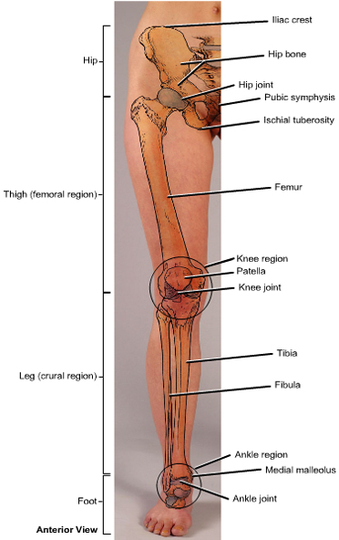
Lower Limb
Divided into 4 regions:
Gluteal Region: hip bone
Thigh: femur
Leg: tibia & fibula
Foot: tarsals, metatarsals
& phalanges

Slide 3
Hip Bone
Made up of 3 bones:
Ilium (flat) ischium (L) pubis (V)
Meet at the Acetabulum:
a socket where the femur head articulates to form the hip joint.
Beneath the Acetabulum is an opening:
“Obturator Foramen
Posterior:
2 notches (greater & lesser sciatic notches)

Slide 4
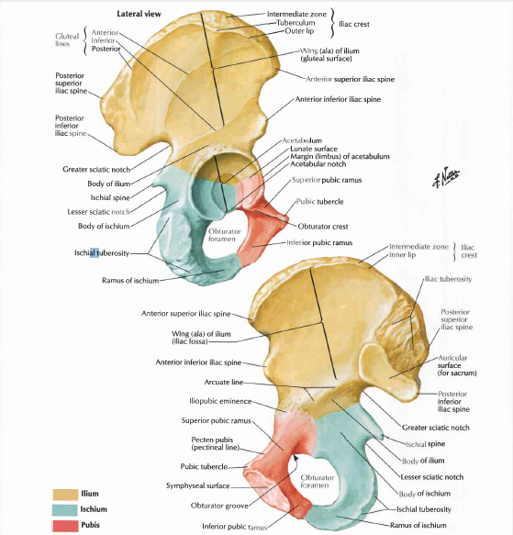
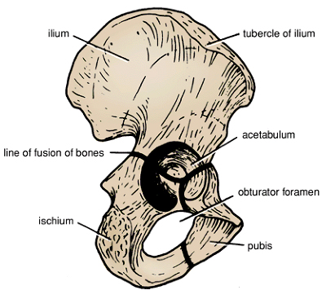

Slide 5
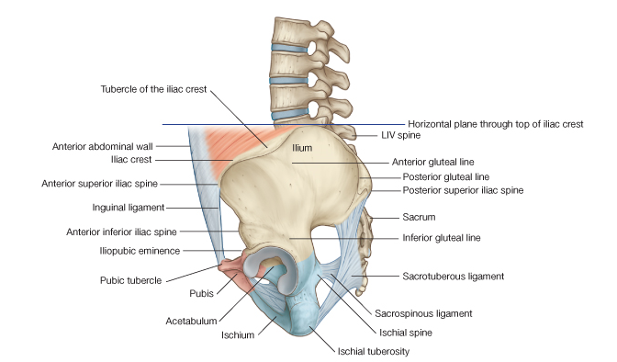

Slide 6
Ischium (L-shaped)
Forms infero posterior part of hip bone 2/5.
Consists of:
Body upper thicker part.
Ramus lower thinner part
Spine between greater and lesser sciatic notches.
Tuberosity posterior of inferior part of body

Slide 7
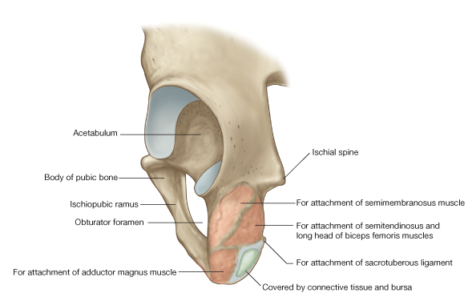
Ischium

Slide 8
ilium
The largest part of hip bone 2/5
Consist of: body & wing (ala)
Has 4 spines
The sup. Border of the wing:
Iliac crest (palpable)
Iliac tubercle lies 5cm behind ASIS
Iliac crest from ASIS TO PSIS
Greater sciatic notch above and behind Acetabulum

Slide 9
Pubis (V-shaped)
Forms the ant. part of hip bone 1/5
Consists of:
Body each side form
symphysis pubis
Sup. & Inf. rami
Pubic crest from upper border of body of pubis end laterally at pubic tubercle

Slide 10
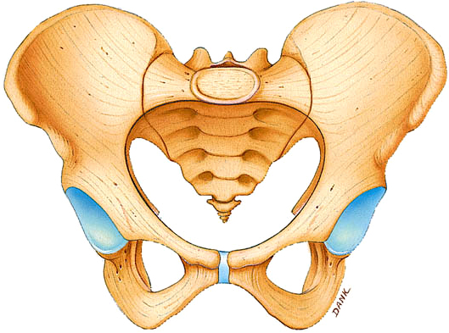

Slide 11
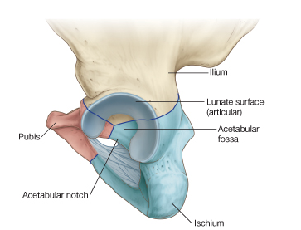
Acetabulum
The socket (deep depression) on outer surface of hip bone, where the head of femur articulates to form the hip joint.
Made up by the 3 bones of the hip Inf. margin is deficient (not continuous):
“acetabular notch”
Consists of 2 parts:
Articular: horseshoe-shaped area
covered with hyaline cartilage.
Non-articular: forms the floor of Acetabulum
“acetabular fossa”

Slide 12
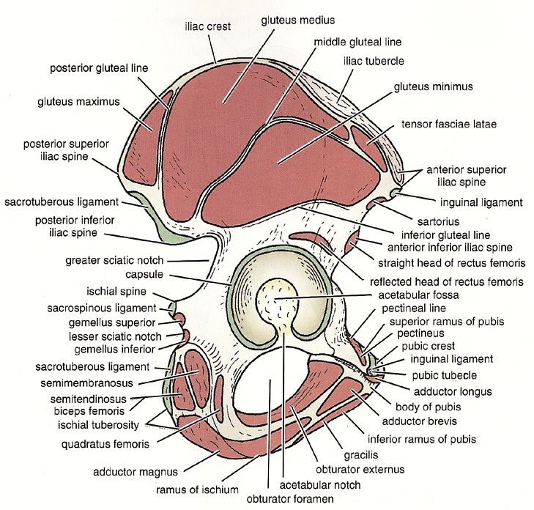

Slide 13
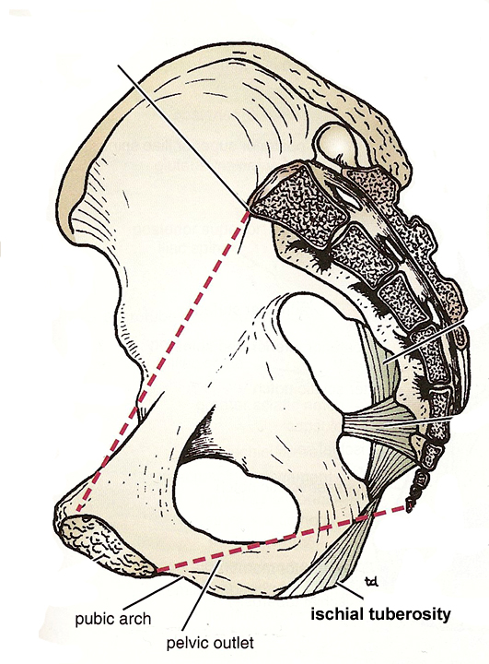
Ligaments of Gluteal Region
1. Sacrotuberous Lig.:
Back of sacrum &coccyx
➲
Ischial tuberosity
Medial to greater & lesser sciatic notches.
Fxn.: stabilizes the sacrum, prevent rotation of posterior part of Ilium over sacrum, especially when getting out of chair .
Convert greater, lesser sciatic curvature to foramen.

Slide 14
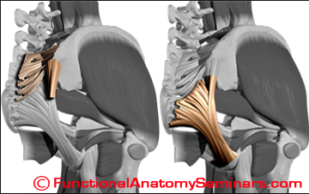
Sacrotuberous ligament is triangular in shape narrow in middle part

Slide 15
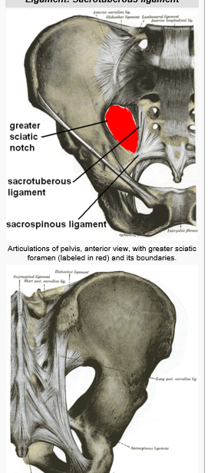
2. Sacrospinous Lig.:
Back of sacrum & coccyx
➲
Ischial spine
Separates between sciatic notches
Fxn.:
stabilizes the sacrum

Slide 16
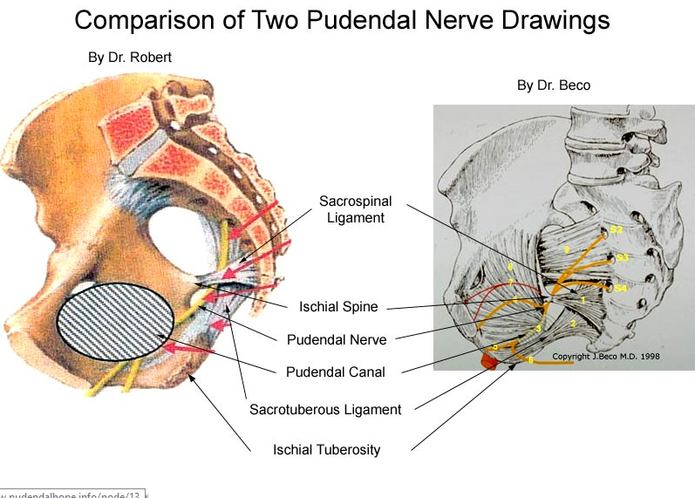

Slide 17
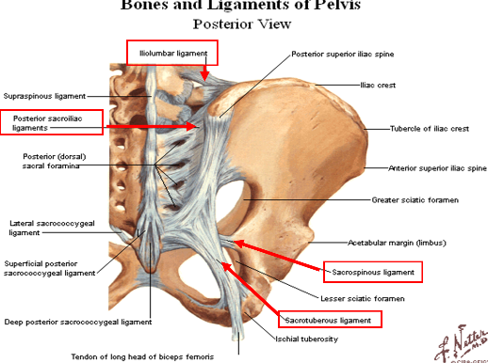

Slide 18
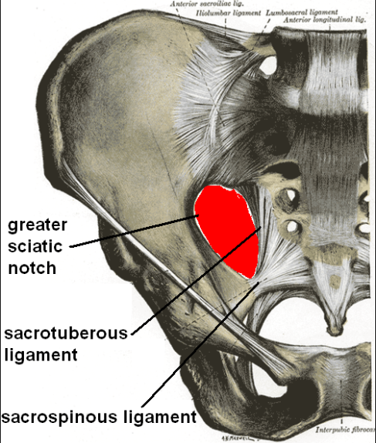

Slide 19
Foramina of Gluteal Region
2 foramina:
Greater & Lesser sciatic foramina
Consist of bony & ligamentum parts:
Bony part: sciatic notches
Ligaments part:
Sacrotuberous & Sacrospinous
ligaments
It is an exit from pelvis to gluteal region

Slide 20
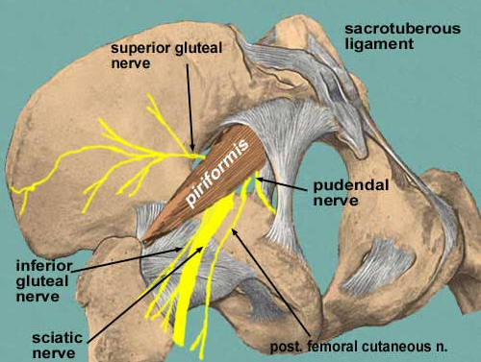
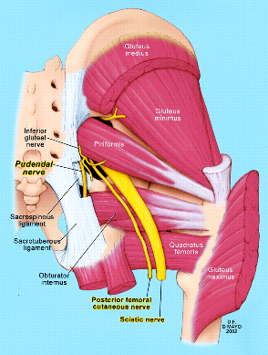
Structures

Slide 21
Greater sciatic foramen
It contain piriformis muscle and structure above and below muscle
Above muscle
Superior gluteal nerve and vessels
Below muscle
Sciatic nerve
Posterior cutaneous nerve of thigh superficial to Sciatic
Inferior gluteal nerves, and vessels.
Nerve to quadratus femoris, and obturator internus.
Pudendal nerve, internal pudendal vessels.

Slide 22
Lesser sciatic foramen
Lie between lesser sciatic notch, and Sacrotuberous and Sacrospinous ligaments,
It transmit
Tendon of obturator internus
Nerve to obturator internus
Pudendal nerve and internal pudendal vessels

Slide 23
Muscles of The Gluteal Region
Most powerful muscles
Back of hip
Front of thigh
Back of leg
ANTIGRAVITY MUSCLES

Slide 24
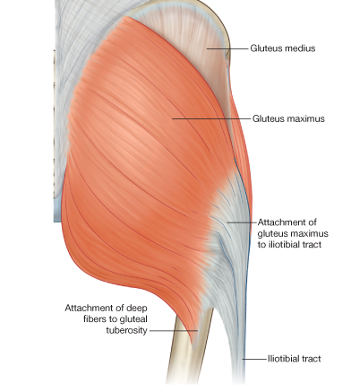
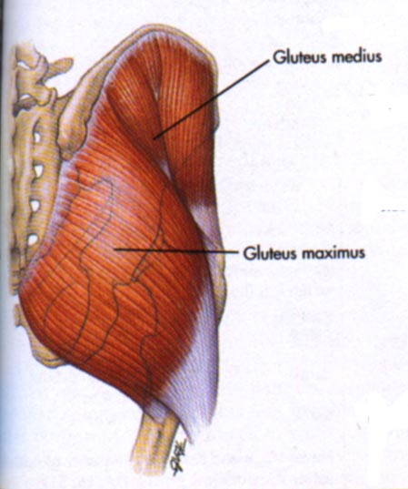
Gluteus Maximus
The largest m. in the body Lies
superficial in glut. Region.
Origin: outer surf of Ilium
Sacrotuberous lig. back sacrum & coccyx
Insertion:
Upper ¾ iliotibial tract
Deep 1/4th fibers gluteal tuberosity of femur.
Innervation: Inf. Gluteal n. L5-S1-S2
Action:
Main extension of hip.
lat Rotation of hip.
Extensor of trunk.
Help to maintain knee joint in extension,throuh ilio tibial tract rigid column.

Slide 25
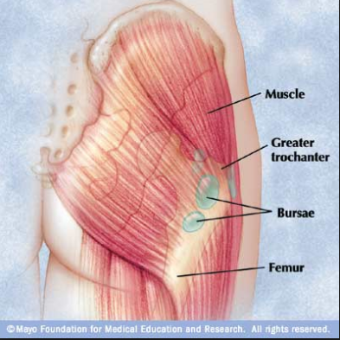
Continue
Three bursae lie under gluteal region
Bursa separate lower part of muscle from Ischial tuberosity.
A large bursa separate muscle from greater trochanter of femur.
Large bursa separate muscle from Vastus lateralis muscle
Natal fold( fold of buttocks) is made by binding superficial to deep fascia not by muscle.

Slide 26
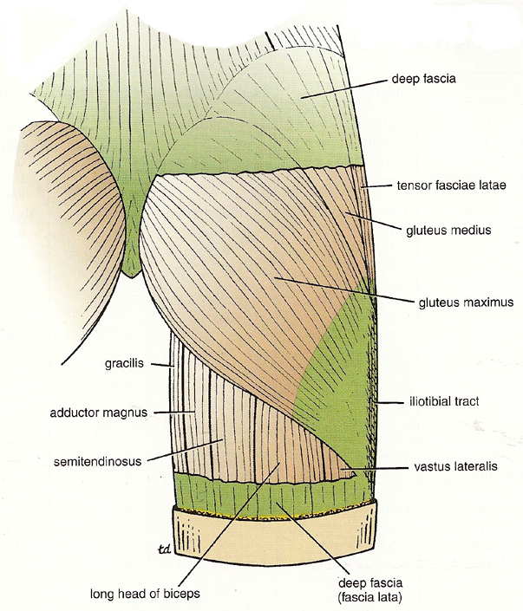
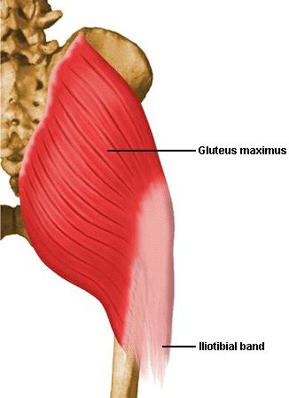

Slide 27
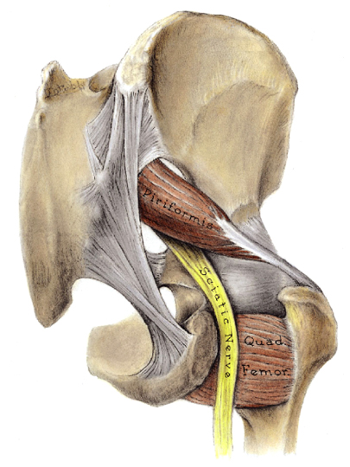
Pyriformis Muscle
Pass through greater sciatic foramen to glut. Region.
Separates gluteal region into sup. & inf. Parts.
Neurovascular bundles are divided by piriformis into:
Sup. & inf. Bundles.
Sciatic n. most commonly (∼80%) lies inferior to it.

Slide 28
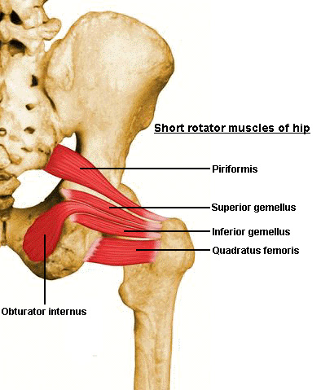
Piriformis Muscle
Origin:
Ant. surface of sacrum.
Insertion:
Greater trochanter of femur.
Innervation:
N. to Piriformis (S1 & S2)
Action:
lat. rotation

Slide 29
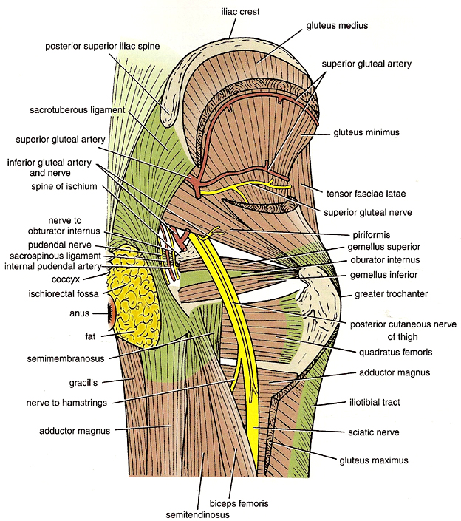
Muscles of Sup. Gluteal Region
1. Gluteus Medius
Origin Outer surface of ilium,between iliac crest and middle gluteal line.
Insertion:
Greater trochanter
Innervations:
Sup. Gluteal n. L4-L5-S1
Action:
Main abductor of thigh
Anterior part thicker medial rotation of thigh

Slide 30
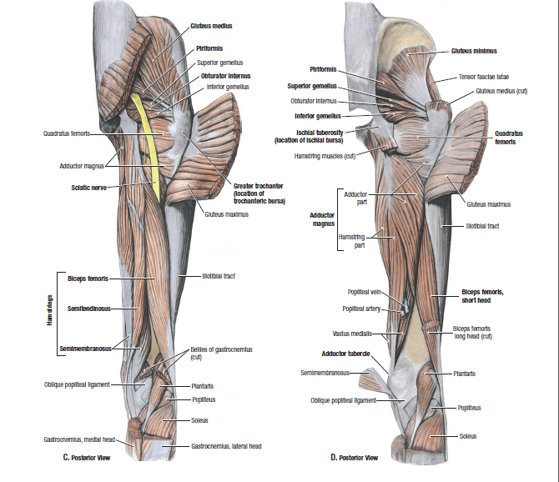

Slide 31
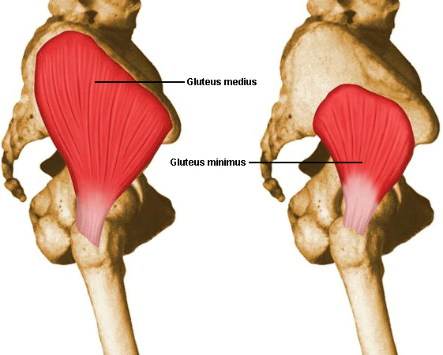
2. Gluteus Minimus
Deep to gluteus medius ,between middle and inferior gluteal lines
Outer surface of Ilium
➲
Greater trochanter
Innervation:
Sup. Gluteal n.
Action:
Abduction & medial rotation
of thigh

Slide 32
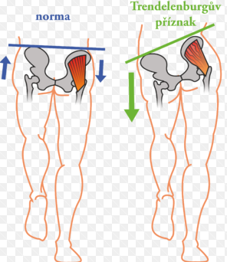
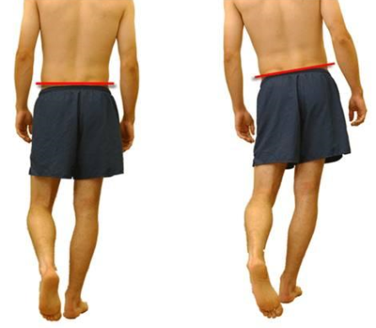
Clinical: Trendelenburg Sign
Sagging (tilting) of the pelvis downward after lifting the lower limb.
Due to injury or paralysis in gluteus medius & minimus of the other side
Congenital dislocation of hip
Waddling gate

Slide 33
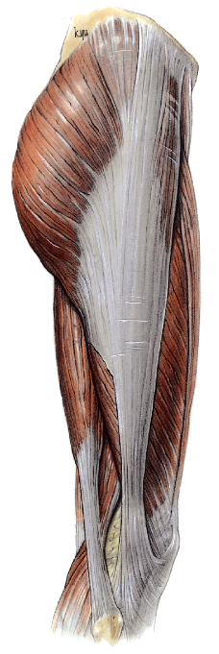
TENSOR FACIAE LATAE
Origin : Outer border of iliac crest
Insertion: Iliotibial tract
Nerve supply :Superior gluteal nerve
Action :Traction on ilio tibial tract, make lower limb a rigid column
Keeping knee extended
Iliotibial tract :Thickened lateral part of deep fascia of the thigh, attached above to iliac tubercle, below to lateral condyle of tibia, 5 cm wide above, thin below.
It receive insertion of greater part 3/4 gluteus max. and TFL muscles.

Slide 34
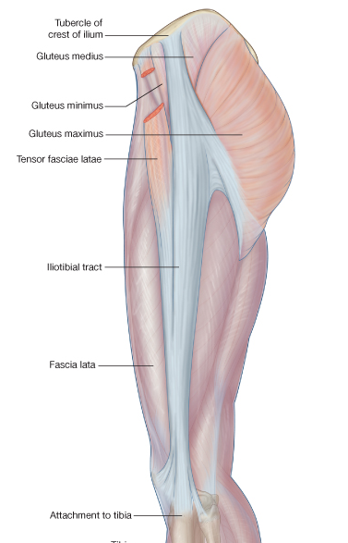
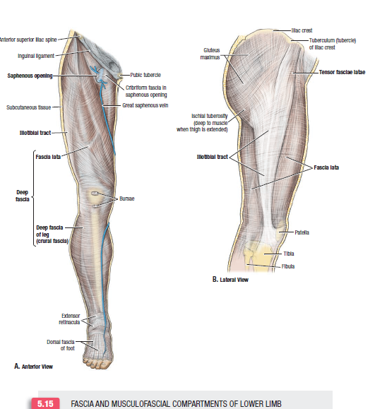

Slide 35
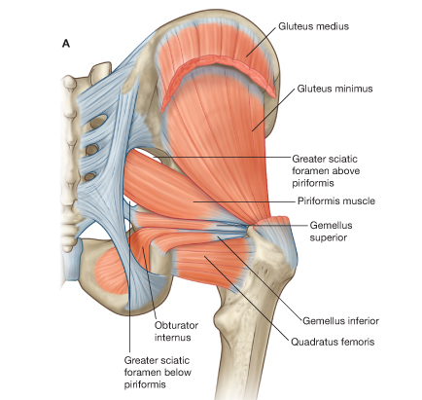
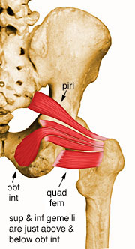
Muscles of Inf. Gluteal Region
Six lateral rotator of hip
Piriformis
Gemellus Superior
Obturator Internus
Obturator externus
Gemellus Inferior
Quadratus Femoris
Origins? Insertions? Innervation? Action?

Slide 36
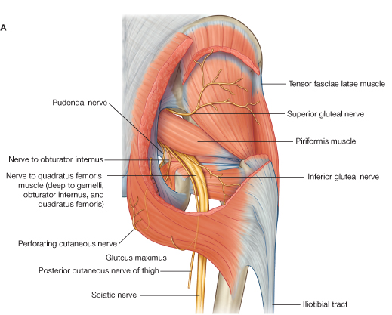
Nerves of Gluteal Region
1. Sciatic nerve
2. Post. cutaneous n. of thigh
3. Sup. Gluteal n.
4. Inf. gluteal n.
5. Pudendal n.
6. n. To obturator internus m.
7. n. To quadratus femoris m.

Slide 37
Sacral plexus
Formed by lumbosacral trunk L4-L5.
Anterior primary rami of the upper four sacral nerves.
L4 is a link between lumbar and sacral plexuses, with L5 forming a thick LS trunk.
LS trunk emerges from the medial border of psoas major
Anterior primary rami of the upper four sacral nerves, leave the sacral canal through the anterior sacral foramina, and unit in front of the piriformis muscle, here they are joined by LST.
End at GSF by dividing into two terminal branches.

Slide 38
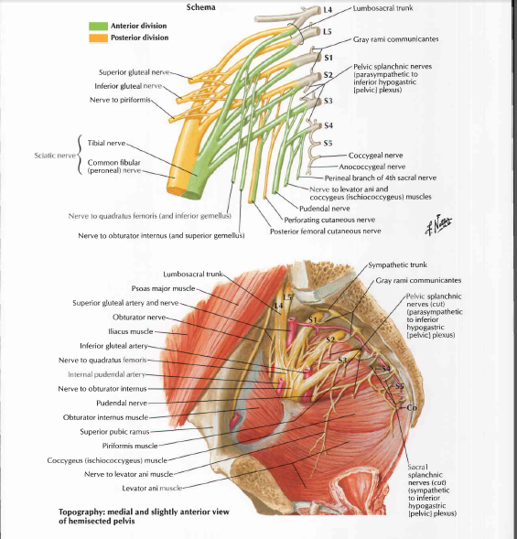

Slide 39
Branches of sacral plexus
Superior gluteal nerve L4-L5-S1
Inferior gluteal nerve L5-S1-S2
Nerve to quadratus femoris
Nerve to obturator internus
Perforating cutaneous nerve
Posterior cutaneous nerve of thigh S2-S3
Branch to piriformis
Pelvic splanchnic nerve S2-S3-S4
Sciatic nerve (L4, L5; S1, S2, S3)
Pudendal nerve (S2-S3-S4)

Slide 40
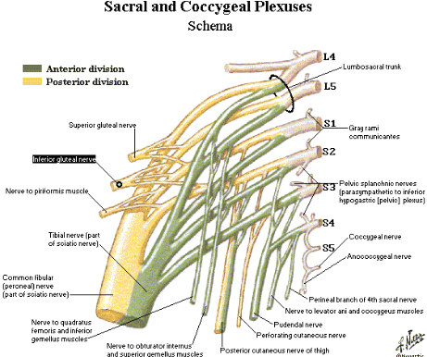

Slide 41
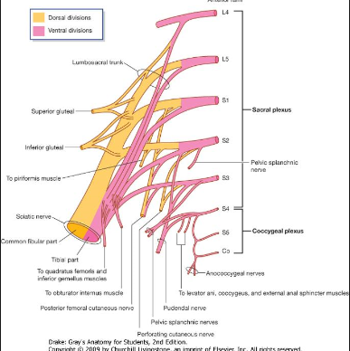
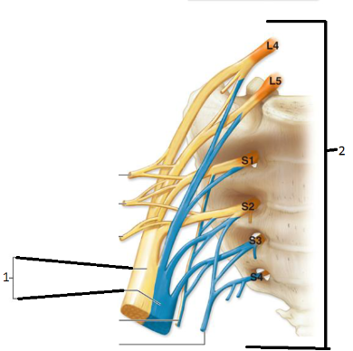

Slide 42
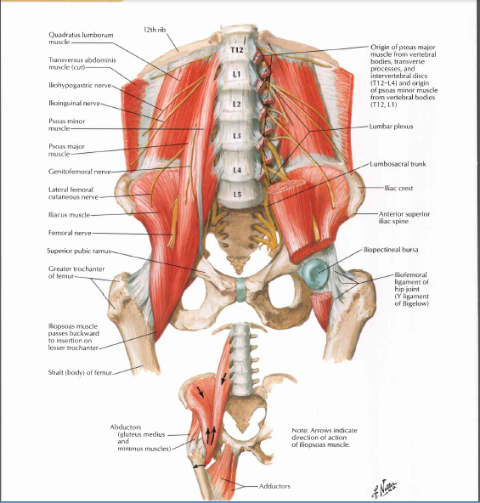

Slide 43
Sciatic Nerve
The largest nerve in the body
(L4, L5; S1, S2, S3)
Arise from sacral plexus.
Ends at level of middle of back of thigh by dividing in to
Tibial n.
Common peroneal n.
Largest of two terminal branches of sacral plexus.
Flat at its origin ,rounded at it is end.
Leaves pelvis through lower part of GSF,below piriformis muscle.
Innervates all muscles in post. aspect of thigh, and leg and foot.

Slide 44
Sciatic Nerve
Pass through greater sciatic foramen Beneath (inf.) piriformis .
(most common scenario)
Post. Posterior surface of ischium,
OI,2G ,QF which separate it from hip
joint& ant. to gluteus maximus.
It leave buttock passing deep to long head of biceps muscle, to reach back of thigh.
All branches come out from
medial part of nerve except nerve
short head of biceps.
Small artery from inferior gluteal
artery accompanies the nerve
bleed excessively in AKA.

Slide 45
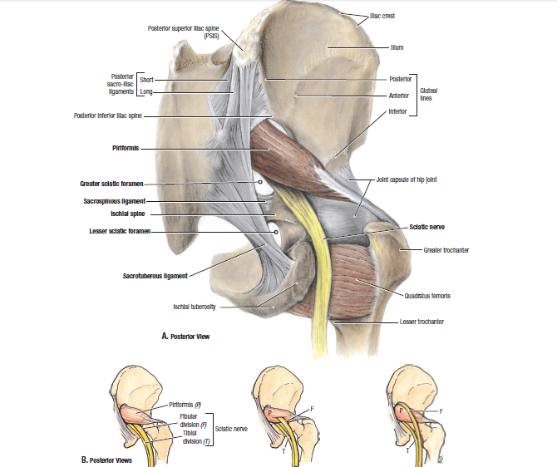

Slide 46
Superior Gluteal Nerve
From lumbosacral plexus
(L4, L5, S1)
Pass through greater sciatic F.
& above piriformis m.
Lies between gluteus medius &Gluteus minimus
Innervates both muscles. and
tensor fascia lata

Slide 47
Inferior Gluteal Nerve
From lumbosacral plexus
(L5, S1, S2)
Pass through greater sciatic F.
& below piriformis m.
Lies close to post. cutaneous n.
of thigh & sciatic
Innervates
Gluteus Maximus m.

Slide 48
Posterior cutaneous nerve of thigh S2-S3
Enter gluteal region below piriformis.
It pass on posterior surface of sciatic nerve.
Below buttock pass vertically in mid line.
Ends in popliteal fossa.

Slide 49
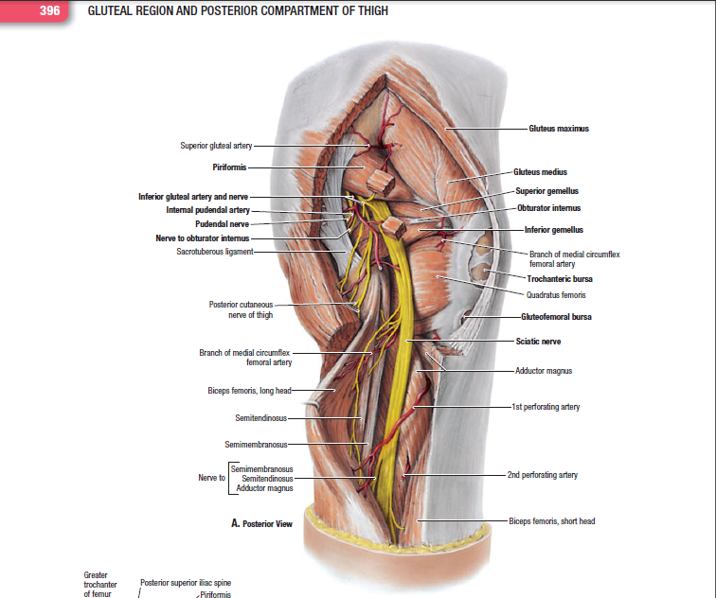

Slide 50
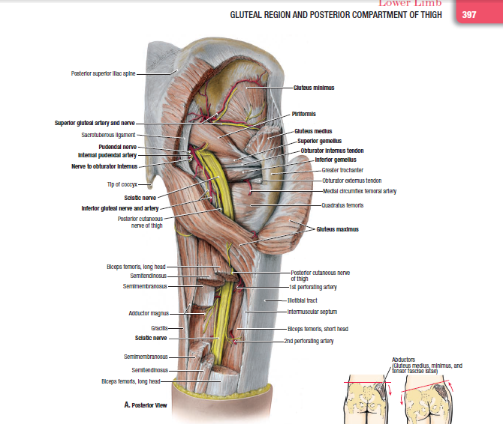

Slide 51
Pudendal Nerve
The main nerve of the perineum.
Supplies most of perineum structures.:
skin, muscles, organs
Involved in:
Micturation, Defecation, Erection & ejaculation, orgasm.
Originate from lumbosacral plexus.
(S2, S3, S4)

Slide 52
Pudendal Nerve
Enters through greater sciatic F.
& inf. to piriformis
Pass post. to Sacrospinous lig.
Leaves to perineum through
lesser sciatic F.
No branches in G.R.

Slide 53
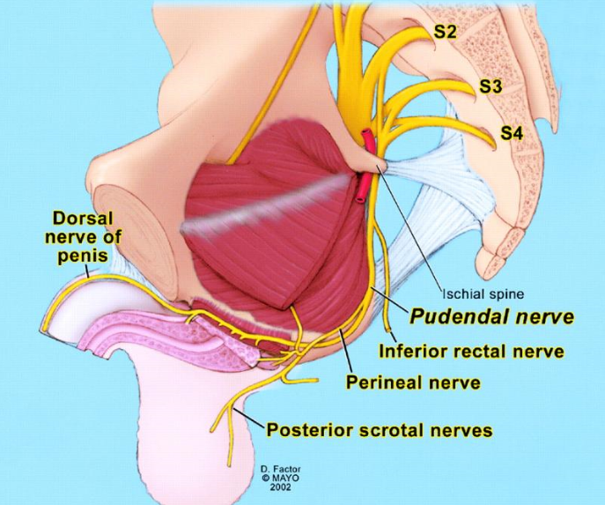

Slide 54
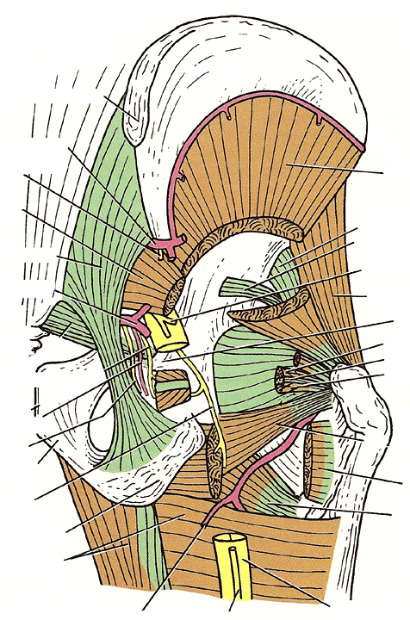
N. to obturator internus
Enters thorough greater Sci. F.
Leaves through lesser sci. F.
Supply:
Sup. Gemellus & obturator int.
N. To quadratus femoris
Enters through greater sciatic F.
Supply:
Inf. gemellus & quadratus

Slide 55
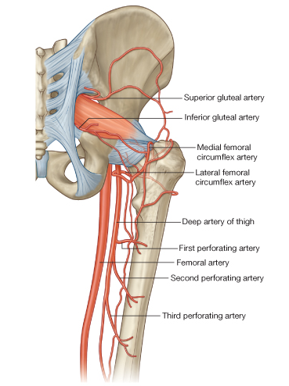
Arteries of Gluteal Region
3 arteries:
Sup. gluteal a. from internal iliac artery.
Inf. gluteal a. ILA
internal pudendal a.
2 anastomosis:
trochanteric anastomosis
Main supply of head of femur
SGA, IGA , medial ,lateral circumflex arteries
cruciate anastomosis
Connection between , ILA, Femoral artery

Slide 56
The Thigh

Slide 57
The Thigh
The region that extends from hip joint to knee joint
Inguinal lig. & gluteal fold
➲
Patella & popliteal fossa
Coverings of thigh:
Skin
Superficial fascia (great saphenous v.)
Deep fascia (fascia lata)

Slide 58
Fascia Lata
The deep fascia of the thigh
Laterally thickened to become:
“Iliotibial tract”
Extension & muscle attachments
Medially: small opening
“Saphenous opening”
Sends 3 intermuscular septa that divides thigh into 3 compartments:
anterior, medial & posterior

Slide 59
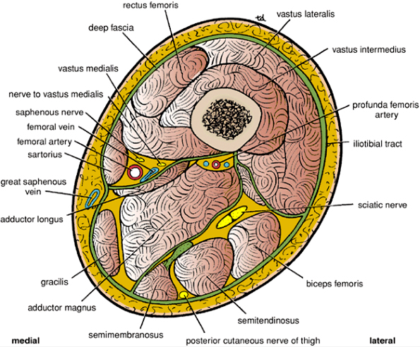
Ant. Compartment:(Quadriceps)
muscles (hip flexors/ knee extensors)
femoral VAN
Medial Compartment:
muscles (hip adductors)
obturator n.
Post. compartment:
muscles (hamstring)
(hip extensors/
knee flexors)
sciatic n.

Slide 60
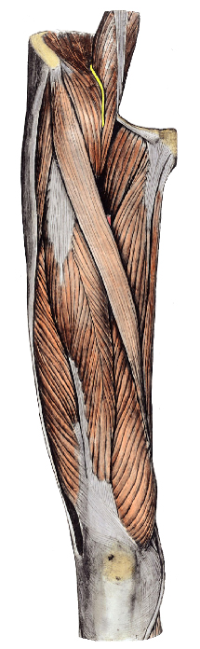
Anterior Thigh Muscles
1. Quadriceps Femoris:
Rectus femoris
Vastus medialis
Vastus intermedius (deep to rectus femoris)
Vastus lateralis
chief extensor of knee
2. Sartorius: (L, tailor)
Longest m. in the body
Most superficial m. in thigh
ant. sup. iliac spine
➲
Medial surface of tibia

Slide 61
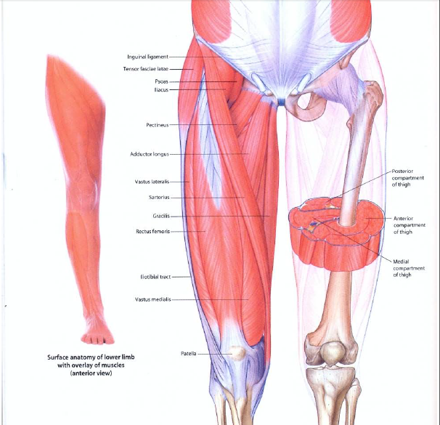

Slide 62
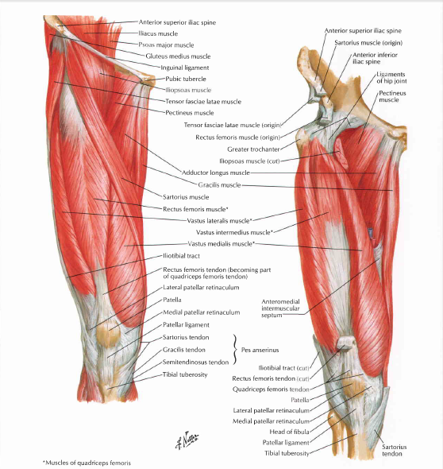
. Quadriceps Femoris

Slide 63
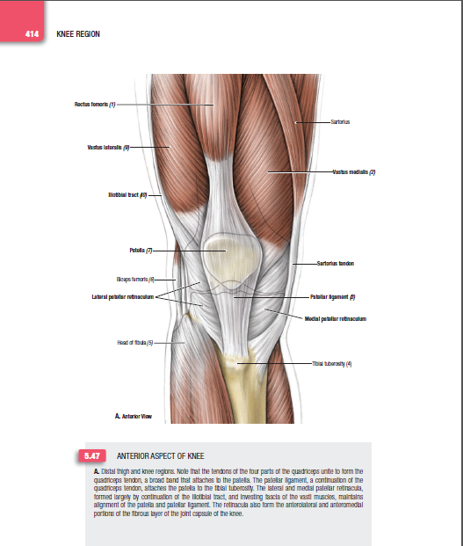

Slide 64


Slide 65


Slide 66
3. Tensor fascia lata:
Ant. iliac crest  iliotibial tract
Tenses iliotibial tract.
4. Pectineus:
Flat m. at super medial aspect of thigh
Origin pectineal line of pubis
Insertion Upper part of line from lesser trochanter to linea aspera
Nerve supply femoral nerve
Considered detached medial part of psoas major
Action Adduct , Flex thigh.

Slide 67

Psoas major m.
Iliacus m.
Pectineus m.
Inguinal ligament
Adductor longus m.
Sartorius m.
Gracilis m.
Adductor magnus m.

Slide 68

5. Iliopsoas:
Both Arise in abdomen, enter thigh behind IL
Psoas is elongated fleshy, iliacus is lateral fan shaped
Origin sides of lumbar vertebrae and discs, iliac fossa
Insertion Strong tendon in lesser trochanter of femur
Iliacus by fleshy fibers in tendon of psoas
Femoral nerve pass in groove between the two Fused muscle pass in front of capsule of hip joint, in front head of femur, then back under the hip.
Nerve supply Direct from lumbar plexus femoral nerve.
Action Main flexor of hip , Flex the trunk.

Slide 69


Medial Thigh Muscles (5)
Adductor group (3 m.)
1. Adductor longus:
Most ant.
2. Adductor brevis:
Deep to pectineus
& longus
3. Adductor magnus:
Largest
½ in post. thigh
2 nerves

Slide 70


Slide 71

4. Gracilis: (L, slender)
Long, strap-like m,descend vertically, from symphysis to medial part of upper tibia
Form with shaft of femur V shaped interval occupied by other adductor muscles
All adductor muscles are triangular except Gracilis, only muscle to cross knee joint
Inserted with sartorius into medial surface of tibia
The adductor muscles are arranged in three layers
First layer pectineus and adductor longus
Second layer adductor brevis
Third layer adductor magnus
Anterior and posterior division of obturator nerve descend in front and behind adductor brevis

Slide 72

5. Obturator externus:
Fan shaped, deep m.
Outer surface of
obturator membrane

Slide 73

Origin of Adductor Muscles
Pectineus m.
Adductor longus m.
Adductor brevis m.
Gracilis m.
Obturator externus m.
Adductor magnus m.

Slide 74

Pectineus m.
Adductor brevis m.
Adductor longus m.
Pubic part of adductor magnus m.
Insertion of Adductor Muscles
Ischial part of adductor magnus m.

Slide 75


Femoral Triangle
Inverted Triangular space in the upper 1/3 of front of thigh
Prominent when thigh is
: flexed, abducted &
lat. Rotated
Boundaries:
Base above.: inguinal lig.
Med.: Adductor longus m.
Lat.: Sartorius m.
Apex: meeting of medial and lateral boundaries
Floor: iliopsoas & pectineus
Roof: skin superficial and
deep fascia

Slide 76


Slide 77


Slide 78
Contents of Femoral Triangle
Femoral artery+5 branches
Femoral vein+ profanda femoris v+ lateral and medial circumflex f v
Femoral nerve (most lat.)
LCN of thigh
Genital branch of GF nerve
Femoral Sheath Contents:
Femoral artery +femoral branch of Genito femoral nerve
Femoral vein
Femoral canal
(containing L.N.& L.V.)
From lat. To med:
n. a.  v.  LN (in the canal)

Slide 79
Femoral Sheath
Funnel shaped fascial tube deep & inferior to inguinal lig.
Surrounds upper 3-4 cm of femoral vessels
Formed by fascial extensions:
Ant.: Transversalis fascia
Post.: Iliopsoas fascia
Ends inf. by merging with walls of femoral vessels

Slide 80

Femoral nerve
Femoral canal
Femoral a.
Femoral vein
Saphenous opening

Slide 81


Slide 82


Slide 83

Contents of Femoral Sheath
Funnel shape 4cm long ,medial part is shorter than lateral part
Divided into 3 parts by two antro-posterior septa
Femoral Artery: lateral comp continuation of ext. iliac A, femoral branch of GFN
Femoral Vein intermediate comp
Femoral canal: medial comp
vertically placed contains deep inguinal L.N. & vessels

Slide 84
Femoral Canal
Most medial part of femoral sheath
Short (∼1.5 cm) & conical in shape
Contains:
Part of deep ing. L.N. & vessels
Sup. Opening of the canal is called: “Femoral Ring” closed by femoral septum
i.e condensation of extraperitoneal fat

Slide 85
Boundaries of femoral canal
Ant: Inguinal lig
Pos : Pectineal line and fascia over pectineus muscle
Lat: Femoral vein
Med: Crescentic sharp border of lacunar lig
N.B In 30% abnormal obturator artery run in medial boundary.

Slide 86
FEMORAL HERNIA
Below and lateral to pubic tubercle.
7% of all hernias, strangulation 20%.
33% of female groin hernias.
5% in male hernias, Bilateral in 20%.
Always acquired hernia.
Anatomy of femoral canal
1.2cm gap, in most medial compartment of femoral sheath
Contain fat , lymphatic's, and lymph node of Cloquet , loose areolar CT

Slide 87


Slide 88


Slide 89


Anatomy of femoral canal

Slide 90


FEMORAL HERNIA

Slide 91
Inguinal lymph nodes
Superficial inguinal lymph nodes 10 nodes
Lie in superficial fascia below IL divided into
Horizontal group below and parallel to IL.
All lie in femoral triangle
Medial half drain
Anterior abdominal wall below umbilicus.
Perineum,urethra,scrotum,labia,lower anal canal.
Lateral half drain posterior abdominal wall below iliac crest.
Vertical group along termination of GSV,drain lower limb
Deep inguinal lymph nodes 3-5 nodes.
Beneath cribriform fascia, medial to FV.
The most superior LN is cloquet’s LN in femoral canal.
lymph pass through femoral canal to lymph nodes in abdomen around external iliac artery, then pelvic LN,PA LN

Slide 92


Slide 93


Slide 94

Femoral Artery
Chief artery of the lower limb
Starts: As it enters the thigh behind mid inguinal point.
Runs vertically downward ,and slightly backward in Ft,AC
Ends at junction of middle and lower third of the thigh, by passing through an opening in adductor magnus, to reach popliteal fossa and become popliteal artery.
In femoral triangle it is superficial covered by skin and fascia
It lie from above downward on ,psoas major, pectenius ,adductor longus.
.

Slide 95
Femoral artery
Psoas muscle separate artery from head of femur in hip joint
Pectineus muscle has two relation to artery.
Profunda femoris arise from FA as it pass over it.
Nerve to pectineus pass medially behind artery.
Femoral vein lies medial to artery at base of triangle, but behind it at apex.
Lateral to it is femoral nerve and its branches

Slide 96
Branches of femoral artery
Superficial branches
Superficial epigastric
Superficial circumflex iliac
Superficial external pudendal
Deep branches
Deep external pudendal
Descending genicular artery
Profunda femoris

Slide 97
Profunda femoris
Profunda femoris is the main supply of blood to thigh.
Largest branch of femoral artery.
Arise from poster lateral part of femoral artery 4cm below inguinal ligament, then curve downward and medially, behind FA,FV
Ends by becoming the 4th perforating artery
Lateral circumflex femoral artery
Medial circumflex femoral artery
Four perforating arteries

Slide 98


Slide 99


Slide 100


Slide 101


Slide 102


Slide 103



Slide 104


Slide 105

1-Superficial circumflex iliac a
2-Superficial epigastric
Femoral a.
Sartorius (cut)
3-Superficial external pudendal
4-Deep external pudendal
Rectus femoris
Pectineus
6-Profunda femoris
Vastus lateralis
Adductor longus
Vastus medialis
Adductor magnus
End of femoral a. at adductor hiatus
5-Descending genicular a.

Slide 106


Slide 107
Adductor (Hunter’s) Canal
Intermuscular space extends from the apex of fem triangle to popliteal fossa & beneath sartorius m. (subsartorial)
Lie in middle 1/3 of the thigh.
Contains lower 1/2 of femoral artery.
Fxn.: Provides a passage for femoral vessels to popliteal fossa.
Boundaries:
Post.: Adductor longus upper 2/3 & Magnus lower 1/3
Antero-lat.: Vastus medialis m.
Antero-med. (Roof): sartorius m.

Slide 109


Slide 110
Contents of Adductor Canal
Femoral artery
Femoral vein
Saphenous nerve terminal branch of femoral n.
N. To Vastus medialis in the upper part
Descending genicular artery
Subsartorial plexus of nerves

Slide 111
Saphenous opening
Is a gap in the deep fascia of the thigh below IL
1 inch long 1/2 inch wide
It lie1 1/2 inch below and lateral to pubic tubercle.
The falciform margin is the upper, lower, lateral border of the opening form sharp Crescentic edge.
Medial margin is at more posterior plane ,formed by deep fascia over pectineus m.
Is covered by ML of superficial fascia(cribriform F)
Pierced by
GSV
Lymph vessels from superficial-to deep LN
Superficial branches of femoral artery

Slide 112


Slide 113
Great Saphenous Vein (Long saphenous v.)
Formed by medial end dorsal venous plexus(Dorsum of foot)
Pass ant,infront of medial malleolus, with saphenous , superficial to it in superficial fascia.
Ascends in med. Side of leg and thigh, pass through lower part of saphenous opening to deep fascia to end in femoral vein,4 cm below and lateral to pubic tubercle.
It has many valves 10-20 more in leg than thigh, one valve is present at sap –fem junction and is connected to short saphenous vein behind the knee
Perforating veins connect the saphenous with deep veins.
Has three tributaries
Superficial circumflex
,superficial epigastric
Superficial external pudendal

Slide 114


Slide 115


Slide 116


Slide 117


Slide 118
Small Saphenous Vein Short saphenous v
Formed at dorsum of foot (Lat.)
Pass post. to lat. Malleolus with sural nerve.
Extends in middle of post. aspect of leg
Pierce deep fascia between two heads of gastrocemius muscle
Drains to popliteal v. at the popliteal fossa
May end in saphenous vein or
In both veins

Slide 119
Femoral vein
It begins at the opening of adductor magnus as a continuation of popliteal vein
End by passing behind the inguinal ligament to become external iliac vein
Femoral vein is medial to femoral artery at base of FT,and behind at apex of FT.
Tributaries
Deep external pudendal vein
Profunda femoris vein
Medial and lateral circumflex femoral veins
GSV Muscular veins

Slide 120


Slide 121


Slide 122


Slide 123



Slide 124


Varicose vein

Slide 125



Slide 126



Perforator veins

Slide 127


Slide 128
Lumbar plexus
Is formed in substance of psoas major muscle,infront of lower lumbar transverse processes
Anterior primary rami of upper four lumbar nerves
Gives six nerves four small two main nerves
Iliohypogastric L1
Ilioinguinal L1
Genitofemoral nerve L1-L2
Lateral cutaneous nerve of thigh L2-L3
Femoral nerve L2-L3-L4 dorsal division
Obturator nerve L2-L3-L4 ventral division
L4 is a link between lumbar, sacral plexus

Slide 129

Lumbar plexus

Slide 130

i

Slide 131

How do branches leave psoas muscle?

Slide 132
Femoral Nerve
Largest branch of lumbar plexus (L2, L3, L4)
Before it pass deep to IL it give branch to iliacus m,after that branch to pectineus m
Most lat. Str. In the triangle
(out of the sheath)
Divides within the triangle 1 ½ inch below IL to anterior and posterior parts
Anterior part
Intermediate, medial cutaneous n of thigh, sartorius m
Posterior part
Saphenous n, Branches to QM ,branch to knee joint.

Slide 133


Slide 134
Saphenous Nerve
Terminal branch of femoral n.
Arise from Pos division
In FT lies Lat to FA
Accompany femoral a. & v.
in the adductor canal, lies first lat
then cross the FA from lat to med
Then, pass superficially between
Sartorius & Gracilis m.
In leg lies on medial side accompanied
by GSV
Sensory to skin of
medial leg & foot

Slide 135


Slide 136
Femoral nerve injury
Rare
Motor loss: paralysis of quads muscles
Loss of knee extension
Sensory loss: loss of sensation in front medial side of thigh ,leg and foot

Slide 137
Obturator nerve
Arise from ventral division of L2-L3-L4
Is the nerve of medial adductor compartment of the thigh, emerge from medial side of psoas m.
It reach thigh by passing through obturator canal to lie
behind adductor longus and divide into two divisions
Anterior division anterior to adductor brevis
Adductor brevis, adductor longus,gracilis
Hip joint, medial side of thigh
Posterior division posterior to adductor brevis
Obturator externus, pubic branch of adductor magnus
Knee joint
Hip pain radiate to knee joint, knee pain radiate to hip joint
Accessory obturator nerve L3-4 30% of population,does not enter obturator mem,

Slide 138


Slide 139

Psoas major m.
Obturator nerve
Obturator foramen

Slide 140


Slide 141
Femur bone
The longest and strongest bone in body 45cm long
The head is 2/3 of sphere, face upward forward and medially.
Neck is 5cm long connect the head with shaft, it form an angle 125⁰ with shaft, less in females more in children.
Greater trochanter at lateral upper part of junction of neck with shaft.
Lesser trochanter small pyramidal projection
Junction between neck and shaft is marked by
Greater trochanter lateral
Lesser trochanter medial and posterior
Trochanteric line in front
Trochanteric crest behind

Slide 142

Femur

Slide 143



Slide 144
SHAFT OF FEMUR
Cylindrical in middle part flattened at upper and lower parts
Smooth and rounded on anterior surface
Posterior surface has a ridge linea aspera,to which is attached many muscles, and intermuscular septum
Margins of linea aspera diverge from each other to form medial and lateral supracondylar ridges, popliteal surface of femur between
MSCR end in adductor tubercle
Below the greater trochanter there is gluteal tuberosity

Slide 145


Slide 146
Lower end
Two large condyles and two epicondyles, to articulate with tibia
Condyles look like wheels 2.5cm thick
Joints of femur
Head articulate with Acetabulum in hip joint
Two femoral condyles with tibial condyles with knee joint
Anterior surface of its lower end articulate with upper 2/3 of posterior surface of patella
Outer condyle is stronger receive most of body weight

Slide 147


Blood supply of head of femur
Blood ascending from shaft.
Blood from capsule of hip joint.
Blood from ligamentum teres.
Types of fracture neck femur
Sub capital Transcervical
Basal Intertrochanteric

Slide 148
Trochanteric anastomosis
Main blood supply of head of femur
Pass below the capsule of joint
Superior gluteal artery
Inferior gluteal artery
Medial femoral circumflex artery
Lateral femoral circumflex artery

Slide 149
Fracture neck femur
Immediately below head Subcapital
Near middle of neck Transcervical
Near trochanter is Basal
Between the trochanter Inter trochanteric
Leg is shortened and laterally rotated
Fracture shaft of femur result in shortening of femur
Upper end is flexed by iliopsoas
Abducted by gluteus medius and minimus
Lower end is adducted by adductor muscles
Lower end fractures get injury of popliteal vessels

Slide 150


Slide 151


Slide 152


Slide 153
HIP JOINT
Ball and socket joint multi axial
Head of femur, Acetabulum of hip bone.
Articular surface is hoarse shoe, deficient inferiorly at acetabular notch, through it nerves and vessels enter the hip joint.
The cavity of the joint is deepened by labrum acetabular.
Capsule enclose the joint, attached infront and laterally to interrochanteric line, base of greater and lesser trochanter, behind to neck of femur.
Anterior neck of femur is completely inside capsule
Posterior only part of neck is inside capsule.
Notes:
Par t of capsule called retinacula is reflected to neck of femur and very adherent to bone, carry blood vessels to head of femur

Slide 154


Slide 155


Slide 156
Ligaments of hip joint
Three ligaments strengthen the capsule from outside
Iliofemoral ligament very strong inverted y shape, support front of capsule
Attached above to AIIS
Below to upper and lower ends of interrochanteric line
Prevent over extension
Pubofemoral ligament triangular lig, support inferiomedial part of capsule
Prevent over extension and abduction
Ischiofemoral lig spiral shape, support upper posterior part of capsule, limit extension, and excessive medial rotation
Transverse acetabular lig

Slide 157


Slide 158


Slide 159


Slide 160
Synovial membrane
Lines the inner aspect of capsule ,and attached to margins of articular surface
Covers part of neck of femur within joint capsule
All parts of hip except the articular surface is covered SM.
Round ligament of head of femur is covered by SM
SM protrude from a gap in anterior wall of capsule,betwwen pubofemoral and ileofemoral lig form psoas bursa.

Slide 161


Slide 162
Movement of hip joint
Flexion by Iliopsoas, rectus femoris ,sartorius, adductor muscles
Extension Gluteus maximus and hamstring muscles
Abduction Gluteus medius and minimus
Adduction Adductor longus, brevis and pubic branches of adductor magnus,gracilis
Lateral rotation GM ,6 lateral rotators
Medial rotation Gluteus medius and minimus TFL

Slide 163
Muscles of back of leg
Hamstring muscles
Biceps femoris
Semitendinosus
Semimembranosus

Slide 164

Gluteus maximus
Semi-tendinosus
Adductor magnus
Long head of biceps
Gracilis
Short head of biceps
Semi-membranosus
Semi-membranosus

Slide 165

Long head of biceps
Semi-membranosus
Short head of biceps
Semi-tendinosus
Oblique popliteal lig.
Fascia covering popliteus

Slide 166

Sciatic nerve
Long head of biceps
Semi-tendinosus
Semi-membranosus
Short head
of biceps

Slide 167


Slide 168


Slide 169


Slide 170


Slide 171
Popliteal Fossa

Slide 172

Popliteal fossa
Normally closed space ,become rhomboid shape by dissection
Partly natural ,partly artificial space , behind the knee joint
Boundaries upper part natural bounded by
Biceps femoris laterally
Semitendinosus
&Semimembranosus medially
Lower part is artificial space formed by separation of two heads of gastrocnemius muscle
Lateral head plantaris muscle as well

Slide 173

Popliteal fossa

Slide 174
Popliteal fossa
Roof
Skin, Superficial fascia, SSV , Branches of PCNT
Deep fascia of roof, pierced by SSV
Floor
Popliteal surface of femur.
Back of capsule of knee joint.
Popliteus muscle and fascia.

Slide 175

Content of Popliteal fossa
Popliteal artery deepest structure of fossa
Popliteal vein crosses the back of
artery from medial to lateral Intermediate
Structure +end of SSV
Lateral popliteal nerve:
Enter fossa at upper angle
Pass downward, laterally close to
biceps, leave fossa at lateral angle
Medial popliteal nerve: bisect the
whole length of fossa
In upper part lateral to vessels more superficial
In middle part crosses superficial to vessels, lateral to medial
In lower part nerve medial to VS
Popliteal LNS 6-7.

Slide 176


Slide 177


Slide 178


Slide 179
Popliteal vein
Begins at lower border of Popliteus muscle by union of vena comitantes of A&P tibial arteries
Ends by entering adductor canal to become femoral vein
Popliteal vein lie between PA,MPN
Lower is medial, crosses superficial,postro lateral to A
Tributaries SSV,veins correspond to branches of PA
Popliteal LNs 6 in number
Lie in fatty CT of popliteal fossa
Receiving lymphatic's from
Lateral foot, and leg, knee joint
Deep lymph vessels with A&PO tibial arteries

Slide 180
Knee Joint
The largest & most complicated joint in the body
Three joints
Lateral and medial femora tibial
Femoropatellar joints
Modified hinge synovial Joint
“modified = rotation”

Slide 181

Articular Surfaces
Femoral condyles
Tibial condyles
Patella (plane gliding)
(Fibula is NOT contributing to knee joint)

Slide 182


Slide 183
Supporting
Structures
Capsule:
Extracapsular
ligaments:
Intracapsular
ligaments
2 parts
5 ligaments
ACL
PCL
Menisci

Slide 184

Extracapsular Ligaments
1. Patellar ligament:
Distal part of quadriceps tendon
Extends from:
Patellar apex

Tibial tuberosity

Slide 185

2. Fibular Collateral Lig.
Rounded, cord-like lig.
lateral Epicondyle of femur

Head of fibula (Lat)
Popliteus tendon pass deep to it
Separates it from lat. Meniscus by pad of fat
Injured in violent abduction of knee

Slide 186

3. Tibial Collateral Lig.
Flat band
Medial epicondyle of femur

Medial condyle & surface of tibia
Superficial and deep part
Merges with medial meniscus firmly attached to it
Liable to injury in full extension
Violent adduction

Slide 187

4. Oblique Popliteal Lig.
Reflected expansion of
Semimembranosus tendon
Passes upwards and laterally to lateral condyle of femur.
5. Arcuate Popliteal Lig.
Covers the popliteus tendon &
strengthens the capsule
From Post. aspect of fibular
head
Both lig. blend into fibrous capsule

Slide 188


Slide 189
Extracapsular Ligaments

Slide 190

Intra Capsular Ligaments
Cruciate Ligaments
Join the femur to intercondylar region of the tibia
Named according to their tibial attachment
Pass in criss-cross direction (X)
They are NOT included within the synovial cavity

Slide 191


Slide 192

1. Ant. Cruciate Lig.
Ant. intercondylar area behind
anterior horn of medial semilunar cartilage
 Postero-laterally 
Posterior surface Lateral condyle
of femur
Relaxed when knee is flexed, tense in extension prevent hyper extension
Relatively weak ligament with poor bld. Supply
More susceptible to injuries
Prevent posterior displacement of femur,or anterior displacement of tibia

Slide 193


Slide 194

2. Post. Cruciate Lig.
Strong ligament
Most posterior part of Post. intercondylar area
 up antero-medially 
anterior part of lateral surface of Medial condyle of femur
Stronger than ant. Cruciate
Relaxed in extension, tense in flexion
Prevent forward dislocation of femur,or tibia backward

Slide 195


Slide 196
Structures attached to inter condylar area
Anterior intercondylar area
Anterior horn of medial semilunar cartilage
Anterior Cruciate lig
Anterior horn of lateral semilunar cartilage
Posterior intercondylar area
Posterior horn of lateral semilunar cartilage
Posterior horn of medial semilunar cartilage
Posterior cruciate lig

Slide 197

3. Menisci:
C-shaped sheets of fibro cartilage
Lie on upper condyle of tibia
Thick convex peripheral borders
Attached to the capsule
Thin concave inner borders attached by anterior and posterior horn to ICA with free edge
Significance: 1. Reduce friction & shock absorption
2. Deepen the tibial condyles

Slide 198
Medial semilunar cartilage
C shape, border behind than in front.
Form a small part of large circle.
Anterior horn is connected to lateral semilunar cartilage by transverse lig of knee.
Fixed cartilage outer border is firmly adherent to capsule of knee joint, and MCL
It increase concavity of upper surface of medial epicondyle

Slide 200


Slide 201


Slide 202
Lateral semilunar cartilage
Anterior and posterior horn attached just infront and behind intercondylar eminence.
Large part of small circle
Outer border is thick ,inner border is thin
Less fixed more mobile than medial, as it is separated from capsule and LCL by popliteus muscle
Less liable to injury

Slide 203
Injury to Cruciate ligaments
ACL is injured violent hyperextension or
Anterior dislocation of tibia.
PCL is injured in posterior dislocation.
Semilunar cartilage meniscus injury
Only injured in flexed and rotated knee.
Medial SLC more liable to injury more fixed.
Lateral SLC is mobile less injured.

Slide 204


Slide 205

Movements of Knee Joint
Flexion:
hamstrings, gracilis & sartorius,
popliteus
Extension:
quadriceps femoris
Rotational Movement
limited when knee is flexed
Lateral rotator biceps
Medial rotator popliteus unlock joint
SGS +semimembranosus

Slide 206
Bursae of Knee Joint
Fluid filled sacs to reduce friction
Usually beneath ligaments & tendons
Some are Continuation of synovial capsule
Usually around ~ 12 bursae
Main ones:
Anterior (4), medial (1), & posterior (2)

Slide 207


Slide 208

Anterior
1. Suprapatellar bursa:
Beneath quadriceps tendon, communicate with joint cavity
Extend 5cm above patella in a hole in capsule
2. Prepatellar
Subcutaneous, infront of the patella
3. Superficial infrapatellar
Ant. to patellar ligament
4. Deep infrapatellar
Post. (beneath) the patellar lig.

Slide 209


Slide 210

Medial
Anserine bursa:
(L, goose)
between Semitendinosus, & tibial collateral lig.
Posterior
1. Popliteal bursa:
Beneath popliteus tendon communicate with joint cavity
2. Semimembranosus bursa:
Between medial head of gastrocnemius muscle and medial femoral condyle
Beneath semimemb. Tendon, may communicate.

Slide 211


Slide 212


Slide 213


Slide 214
Tibia
Receive weight from the femur ,Long bone .
Upper end the strongest part of tibia.
Form flat plateau, two articular surfaces, articulate with two femoral condyles
Intercondylar area in between
Medial condyle has two features
Articular surface is oval
Has a transverse groove on its posterior aspect for insertion of Semimembranosus muscle
Lateral condyle has two features
Articular surface is circular
Has a small circular facet for head of fibula

Slide 215


Slide 216


Slide 217

Continue
Intercondylar eminence ICE is found in the middle of intercondylar area ,and consist of medial and lateral tubercle, infront and behind ICE
The tibial tuberosity large prominence in anterior aspect of upper end of tibia
Structures attached to inter condylar area

Slide 218
Shaft of tibia
Thick above ,gradually become thinner below.
Junction of middle and lower third of tibia is narrowest part, common site for fracture
Medial surface is subcutaneous, can be felt under the skin.
Upper end of tibia is one of the commonest site for osteomyelitis,upper end of shaft of tibia is extra capsular, so infection does not spread to joint.

Slide 219
Lower end of tibia
Thick has 5 surfaces
Lateral surface fibular notch for lower end of fibula
Medial surface medial malleolus.
Inferior surface has concave four sided articular area for talus and ankle joint
Joints of tibia
Knee joint
Ankle joint
Upper and lower tibiofibular joints

Slide 220
Fibula
Very thin long bone, on lateral side of tibia.
Has head neck, shaft lower limb.
Head has two features .
Upward projection,styloid process, for insertion of biceps.
Circular articular facet with tibia
Common peroneal nerve can be rolled against posteriolateral part of neck
Give origin to 8 muscles
Form part of ankle joint
Lower end form a pulley for peroneal muscles

Slide 221


Slide 222


Slide 223


Slide 224


Slide 225
The Leg Coverings
Skin
Superficial fascia:
Small & Great saphenous veins
Deep (Crural) fascia:
divided by intermuscular septa into
3 compartments:
Ant., Lat., Post.

Slide 226


Slide 227


Slide 228


Slide 229


Anterior Compartment of Leg
Contains 4 extensor muscles:
Tendon pass infront of ankle
Tibialis Ant.
Extensor digitorum longus
Extensor hallucis longus
Peroneus (Fibularis) tertius
Fxn.:
Dorsiflexion of ankle joint &
Extention of toes
Innervation: Anterior tibial nerve.

Slide 230


Slide 231


Slide 232


Slide 233


Slide 234


Slide 235

Extensor Retinacula
Thickening of deep fascia that covers the tendons of ant. leg m.
2 ext. retinacula:
Superior extensor retinaculum:
Rectangular band
Attaches to anterior border of
tibia and fibula
Medially it split to enclose tendon Tibialis anterior muscle
Inf. extensor retinaculum:
More important
Y-shaped band
Attaches to Calcaneous split to
be attached to medial malleolus,
and planter fascia of medial foot.

Slide 236


Deep Peroneal Nerve
One of two terminal branch of
common peroneal (fibular) n.,
Arise in substance of Peroneus longus m,lateral side of neck of fibula
Joins ant. tibial a. in ant. compartment of leg
Innervates m. of ant. Leg
Ankle joint
Relations:
between EHL & EDL

Slide 237


Slide 238


Slide 239


Slide 240

Common peroneal n.
Anterior tibial n.
Superficial peroneal n.
Anterior tibial art.
Medial division of anterior tibial n.
Lateral division of anterior tibial n.
Dorsalis pedis a

Slide 241


Slide 242

Anterior Tibial Artery
Ant. Interosseous a.
The smaller branch of popliteal a.
In lower leg:
Located between EHL & EDL
In foot it becomes:
Dorsalis Pedis a.
Pulsation Half way between medial and lateral malleolus lateral to tendon of EHL one third the way down.

Slide 243


Dorsalis pedis pulse PT pulse

Slide 245


Slide 246
Lateral Compartment of Leg
Contains 2 muscles in lateral comp,tendons pass behind lateral malleolus
Peroneus (fibularis) longus
Peroneus (fibularis) brevis
Originate from lat. Fibula
PL is inserted in Base of first metatarsal bone
PB is inserted in Tuberosity of Base of 5th MB
Involved in Eversion
PL maintain lateral arch of foot
Tendon can be felt behind LM,held down by Superior F Reti
Innervation superficial peroneal n

Slide 247


Slide 248
Superficial peroneal nerve
One of two terminal branches of CPN
Arise in substance of peroneus longus muscle, on lateral side of neck of fibula.
Descends between PL,and PB muscles
Lower in leg it become SC
Branches
Muscular branches: PL.PB muscles
Sensory: lower part of front of leg and back of foot, except first web (deep P), and lateral side of little toe (sural n)

Slide 249

Tibialis anterior m.
Peroneus longus m.
Extensor digitorum longus m
Peroneus brevis m.

Slide 250

Peroneus longus m
Peroneus brevis m.

Slide 251


Slide 252
Peroneal Retinacula
(Superior & Inferior)
Superior peroneal retinaculum
Lie over Peroneus longus and brevis
Lie on back of lateral malleolus, lateral surface of Calcaneus
Inferior peroneal retinaculum
Continuous with stem of inferior Exten Retinaculum
Attached to Calcaneous bone

Slide 254



Slide 255

Superior peroneal retinaculum
Inferior peroneal retinaculum

Slide 256

Posterior Compartment
2 groups of m.
I- Superficial muscles:
1. Gastrocnemius:
2 Heads; med. & lat. From condyles of femur
2. Soleus:
Beneath gastrocnemius
Arise from soleal line of tibia and p surface of fibula
Both m. inserted into
calcaneus bone via:
calcaneal tendon = Achilles tendon

Slide 257


Slide 258


Slide 259
Action of both muscles
Powerful planter flexion of ankle
Soleus is the strongest PF of ankle.
Gastrocnemius flex the knee as well.
GC m cannot do both action as fibers are short.
GC flex the ankle in extended knee only ;standing on tip of toes.

Slide 260
3. plantaris:
Lat. Supracondylar ridge of femur
➲
Post. calcaneus
(med. To Achilles tendon)
NOT of that significant importance

Slide 261

II- Deep m. group:
Tibialis posterior
Flexor digitorum longus
Flexor hallusis longus

Slide 262
Popliteus:
Thin triangular m. in popliteal fossa
Origin Lat. Femoral condyle & lat. Meniscus
➲
Pierces knee joint capsule Posteriorly
➲
Post. Tibia
Action
Unlockling of knee joint
Lateral rotation of femoral condyle to begin
Flexion of the knee is made by popliteus m UN locking
Locking of knee joint is medial rotation of femoral condyle in full extension

Slide 263

Tibial Nerve
Descends behind knee joint in
popliteal fossa.
Lies superficial to poplit. Vessels.
Then deep to gastrocnemius & soleus m.
N lies on medial side of TA,then crosses superf,then lies lateral to it.
At ankle:
Pass post. to med. Malleolus
Between FDL & FHL
Divides into:
Med. & lat. Plantar n.

Slide 264
Posterior Tibial Artery
The larger terminal branch of popliteal a.
Main bld. Supply to the foot
It start at lower border of popliteus M
Accompany tibial n. between FDP,FHL
At ankle:
Post. to med. Malleolus & Divide into
Med. & lat. Plantar a.
*Post. Tibial pulse Half way
between MM
And heel bone always present
Its largest branch is: fibular (peroneal) a. arise close to origin of PTA
Is artery of lateral comp of leg

Slide 265



Slide 266


Slide 267

Review
3 leg compartments:
Ant.: 3 + 1 m.
Lat.: 2 m.
Post.: 3 superficial m. & 4 deep

Slide 268


Slide 269


Slide 270
Flexor retinaculum
Is present between tubercle of calcaneous,and medial malleolus attached to both bones
It hold and protect the tendons which enter the foot
These structures are
Tendon of Tibialis posterior
Tendon of flexor digitorum longus
Posterior tibial vessels
Posterior tibial nerve
Tendon of flexor hallucis longus

Slide 271


Slide 272
Compartment syndrome
Increase in hydrostatic pressure in closed osteofascial space resulting in decreased perfusion of muscle and nerves within compartment
Causes
Fractures
Burns
Soft tissue injury
Reperfusion
Tight plaster

Slide 273

Symptoms and signs
Pain out of proportion
Pain on passive stretch, not relieved by elevation
Not relieved by rest, worsening
Parathesia,pins and needles
Paralysis
Pallor
Pulseless
Treatment is decompression by Fasciotomy

Slide 274


continue

Slide 275

Compartment syndrome

Slide 276



Slide 277
Ankle joint
Hinge joint
Trochlear surface of body of talus
Two malleoli,lower end of tibia
Both bones are firmly connected by inferior tibiofibular fibrous joint
Capsule fits closely around articular surface
Deltoid ligaments: is medial ligament of ankle, is very strong lig attached by apex to medial malleolus.
Lower part is attached from front to back
Navicular bone, spring lig, neck and body of talus, calcaneus bone
Lateral lig of ankle 3 separate bands
Weaker than medial lig,ant, pos talo fibular, calcaneo-fibular.

Slide 278


Slide 279


Slide 280


Slide 281


Slide 282


Slide 283

Relation of ankle joint
Anteriorly from M to L
TA
EHL
ATV
ATN
EDL
Posteriorly from M to L
TP
FDL
PTV
PTN
FHL

Slide 285

Bones of the foot
Root of the foot tarsus
Middle of the foot metatarsus
Toes

Slide 286
Tarsus
Tarsus forms ½ of skeleton of the foot
7 Bones 2 large calcaneus talus
5 Small Navicular ,cuboid,3 cuneiform bones
Calcaneous ,the largest,longest,most posterior
Talus lie on top of calcaneus
Navicular lie between head of talus and 3 cuneiform bones
Cuboid lie between calcaneus lateral 2 metatarsal

Slide 287

287
Notes:
287

Slide 288


Slide 289

Arches of the foot
2 longitudinal arches medial and lateral
1 Transverse arch at base of MT bones,cuboid 3 C bones
Arches of the feet are the bones which don't come in contact with ground during standing.
Each LA has an anterior and posterior pillar.
Common posterior pillar is calcaneus.
Anterior pillar of MLA IS pad under 1st MT head.

Slide 290

Arches of the foot:-
Notes:
290

Slide 291


Slide 292


Arches of the foot:-
MLA is formed of 9 bones,calcaneus,talus,navicular,3 cuneiform,3MT, higher than lateral arch.
LLA is formed of 4 bones calcaneus cuboid,2 lateral MT
LA support weight of body
MA is concerned with elastic propulsion during walking
Pes planus flat foot
Medial LA is collapsed may be congenital or acquired
Pes cavus high arch

Slide 293

Medial longitudinal arch

Slide 294
Lateral longitudinal arch

Slide 295

Transverse arch
Made by Bases of
Metatarsal bone ,
Cuboid
And 3 cuneiform bones

Slide 296
Factors which maintain longitudinal arches
Shape of bones.
Ligaments of foot, plantar aponeurosis.
Action of certain muscles.
Transmission of body weight
VC ,SIJ,Hip joint, Lateral FC,tibia,talus,1/2 back to calcaneous,1/2 anterior 6 bones lateral 4 MTB,2 sesamoid bones below first MTB

Slide 297
Planter aponeurosis
Triangular in shape ,is part of deep fascia of sole of foot.
Narrow behind attached to medial and lateral tubercles of calcaneus.
Near heads of MT bone it split to 5 processes.
Digital slips bifurcate for passage of flexor tendons .
Medial and lateral border of PA is continuous with deep fascia covering abductors of 1st,5th toe
Functions
Firm attachment of skin of sole.
Protection .
Support arches.

Slide 298

Digital branches of
medial planter nerve

Slide 299
Muscles of sole of foot
There are 4 layers of muscles and tendons, separated by layers of fascia, where vessels and nerves lie.
First layer 3 muscles Abductors hallucis,minimi,FDB
2nd layer 2 tendons FHL,FDL,5 muscles 4 lumbricals
3rd layer 3 muscles adductor,FHB,FDMB
4th layer 2 tendons Peroneus longus, Tibialis posterior, 7 Interosseii

Slide 300


Slide 301


Slide 302

2nd layer

Slide 303


Slide 304


Slide 305


Slide 306

Notes:
306

Slide 307


Slide 308


Slide 309

Arteries of sole of foot
Medial planter artery
Smaller of two terminal branches of posterior tibial A
Lateral planter artery
Larger of two terminal branches of posterior tibial artery
Form the planter arch at the base of 5th MT bone
Dorsalis pedis artery
Enter the sole between 2 heads of dorsal interosseus muscle, join lateral planter artery

Slide 311
Fig. 10-56
Quadratus
plantae

Slide 312
Fig. 10-58

Slide 313
Fig. 10-59

Slide 314
Nerves of sole of foot
Medial planter nerve
Terminal branch of tibial nerve, accompany medial planter artery
Lateral planter nerve
Terminal branch of tibial nerve, accompany lateral planter artery
At base of 5th MT bone divide into superficial and deep branches

Slide 315

Summary of the sensory supply of the foot:-
315
Notes:
315

Slide 316


Slide 317


Slide 318


Slide 319


Slide 320


