Slide 1
Bones & joints of shoulder girdle

Slide 2
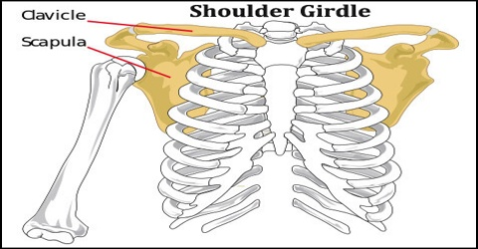
these are the bones which connect the limb to the trunk and include :
(a) the Clavicle: anteriorly
(b) the scapula posteriorly
NB ~
(1)the Shoulder girdle is Completed anteriorly by the upper end of the sternum which articulates with the med ends of the 2 clavicles
(2) posteriorly, the 2 scapulae are widely separated from each other & are connected to the axial skeleton by muscles only

Slide 3
(1) THE SCAPULA

Slide 4
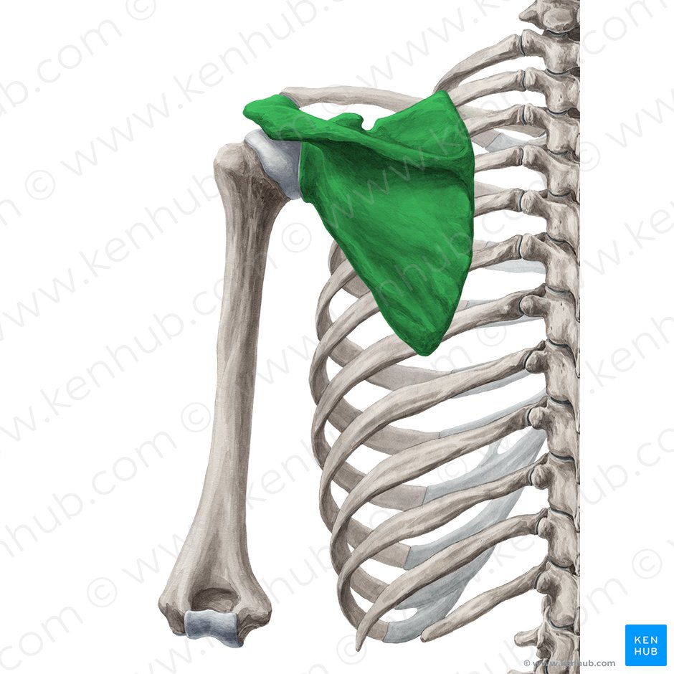
It is the posterior bone of the shoulder girdle
it lies on the posterolateral aspect of the chest Wall Covering the backs of the ribs 2-7

Slide 5
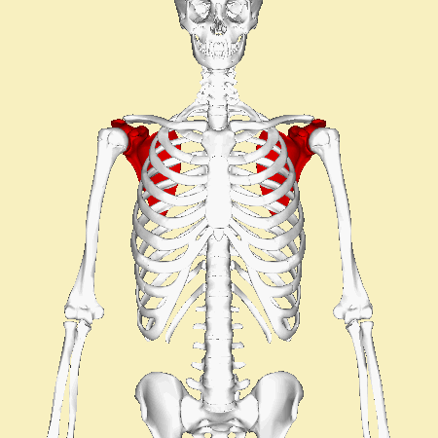
the scapula has:
(a) 2 surfaces : ant & post
(b) 3 borders : sup , med & lateral.
(c)3 angles ; sup , inf- & lateral.
(d)3 fossae : subscapular/ supraspinous & infraspinous
(e) 3processes: spine , acromion &coracoid process •
(f) 3 notches: suprascapular , spinoglenoid & circumflex scapular
(g)3 tubercles : supraglenoid , infraglenoid & tubercle of spine

Slide 6
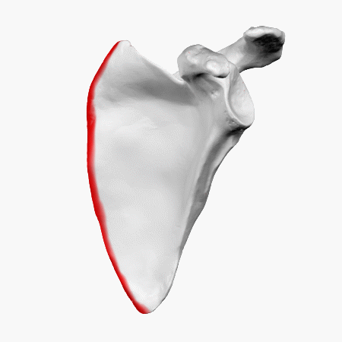
surfaces
(1) Costal Surface ( anterior or ventral)
*. it is Concave forming the subscapular fossa
(2) Dorsal (Posterior)surface :
divided by the attachment of the spine into a small supraspinous fossa above the spine &a large infraspinous fossa below

Slide 7
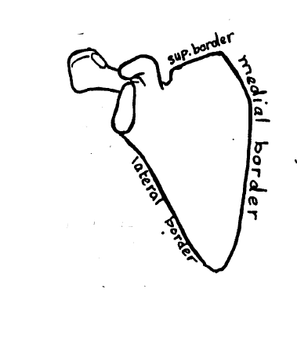
(B) BORDERS OF THE SCAPULA
Superior border : it presents a suprascapular notch near the notch of the coaracoid process
medial border : it is the longest border & parallel to the vertebral spines..
lateral border : thickest border because it gives attachments to muscles.

Slide 8
(C) ANGLES OF THE SCAPULA
Sup angle;
* it is nearly a right angle
* it lies opposite the 2nd rib
Inferior angle;
* it is an acute angle
* it lies opposite the 7th rib
lateral angle :
it is enlarged to form the head and neck of scapula •
* the head Carries a pear-shaped Concavity called the glenoid cavity For articulation with the head oF humerus

Slide 9
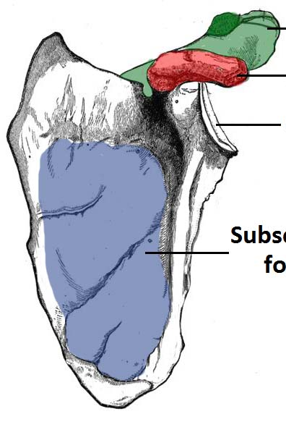
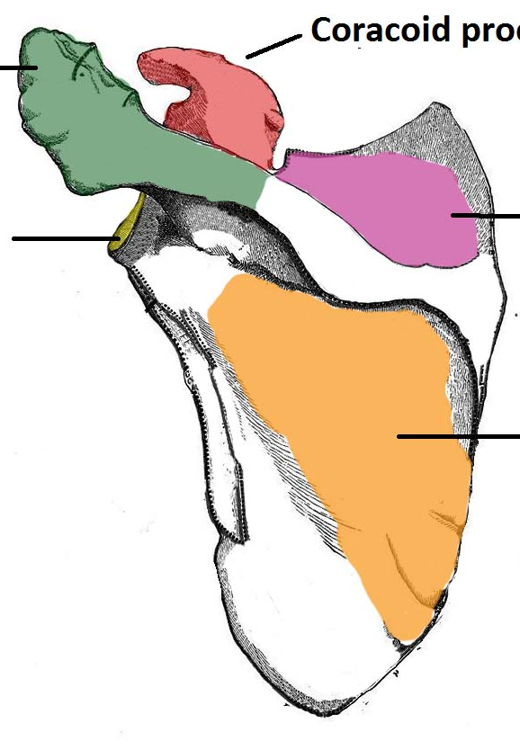
(D) FOSSAE OF THE SCAPULA
Subscapular fassa
(1)Subscapular fassa
it is the concave and anterior
(2)Supraspinous fossa
On the dorsal surface lying above the spine
it also includes the upper surface of the spine •
(3)Infra-spinous fossa :
On the dorsal surface lying below the spine
*it also includes the lower surface ofthe spine .
Supraspinous fossa
Infra-spinous fossa

Slide 10
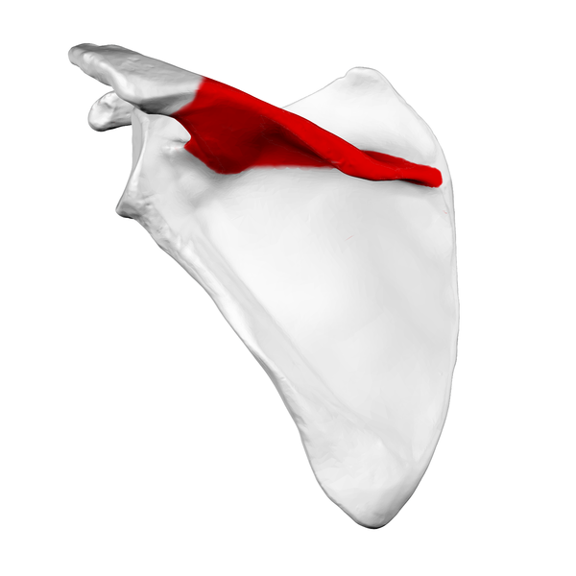
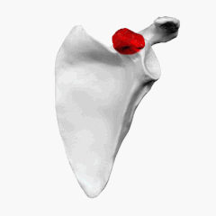
(E) PROCESSES OF THE SCAPULA
1. Spine of the Scapula
■ continues laterally as the acromion.
■ Divides the posterior scapula into the upper supraspinous and lower infraspinous fossae,
and also provides an origin for the deltoid and an insertion for the trapezius.
2. Acromion
■ Is the lateral end of the spine and articulates with the clavicle.
■ Provides an origin for the deltoid and an insertion for the trapezius.
3. Coracoid Process
■ Provides the origin of the coracobrachialis and short head of biceps brachii, the insertion of
the pectoralis minor

Slide 11
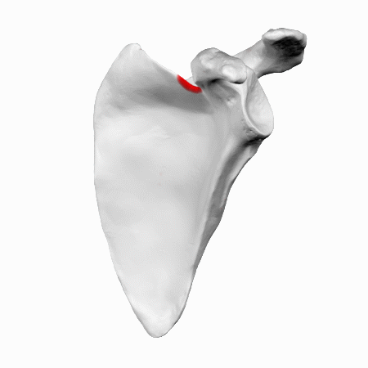
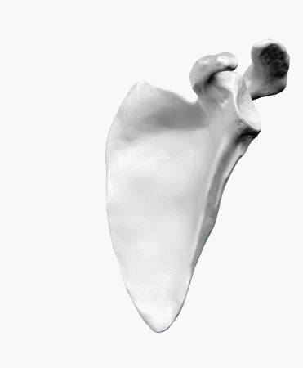
F) NOTCHES OF THE SCAPULA
Suprascapular notch
On the Sup border .
it is transformed into Foramen by the suprascapular ligament
+through the foramen passes the suprascapularn Nerve
and above the ligament passes the suprascapular vessels
Spinoglenoid Tubercle
* lies between the lat free border.ofthe spine and the glenoid Cavity •
* transmits the suprascapular vessles and nerve from the supraspinous to the infraspinous fossa

Slide 12
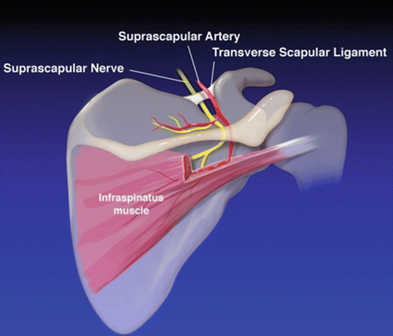
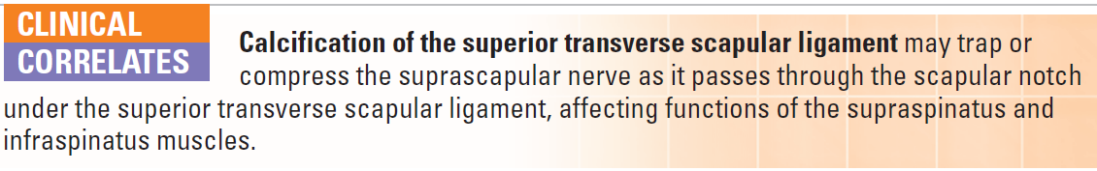

Slide 13
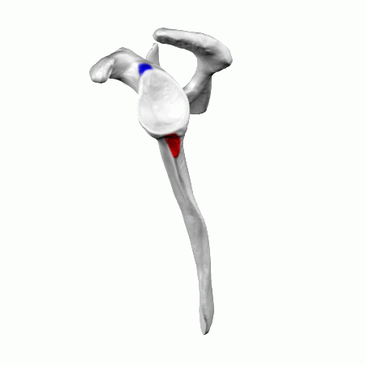
(G) TUBERCLES OF THE SCAPULA
1-supra-glenoid tubercle:
A small rough projection above the glenoidCavity
2-Infraglenoid tubercle :
A rough triangular area just below the glenoid Cavity
3-tubercle of the crest of spine
triangular rough projection from the lower lip of spine

Slide 14
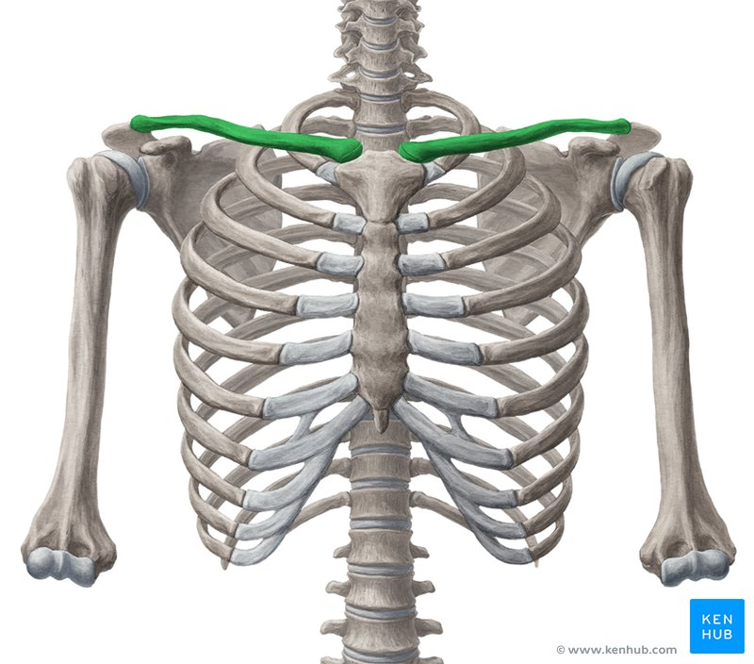
The clavicle

Slide 15
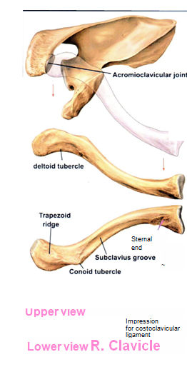
Clavicle
Anterior bone of shoulder girdle
Long bone but has no medullary cavity (atypical long bone)
Ossify from membrane not cartilage.
The first bone to appear in fetus 5th,6th intrauterine week , but it is the last one to complete ossification, at approximately 21 years of age.
Notes:
Site of junction of two curvature, different cross section,weakend by subclavius groove, and nutrient artery

Slide 16
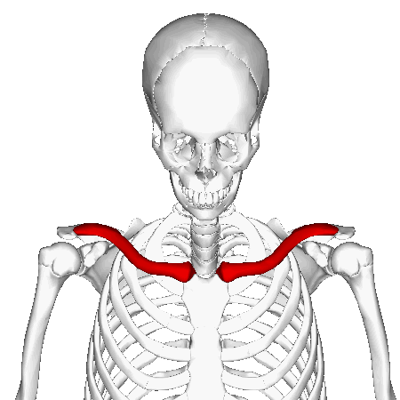
Is only attachment between trunk and upper limb.

Slide 17
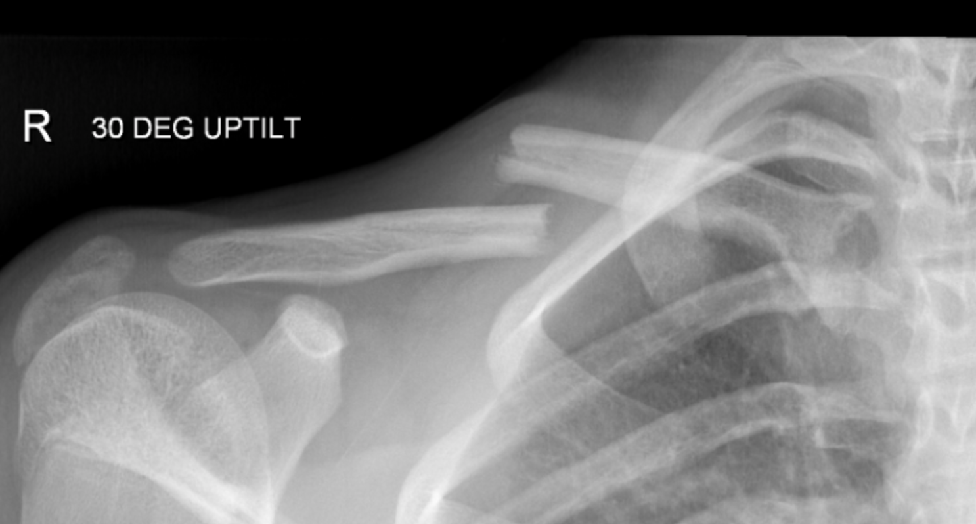
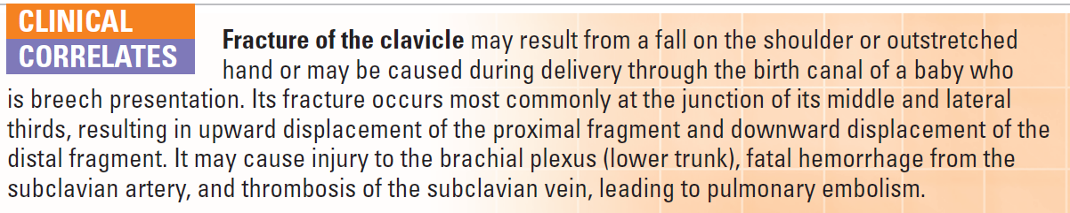
Medial 2/3 is convex forward,lateral1/3 is concave
Commonest bone to be fractured by fall on out stretched hand, at junction of medial 2/3,lateral 1/3.

Slide 18
Joints of shoulder girdle

Slide 19
Sternoclavicular Joint
Articulation: This occurs between the sternal end of the clavicle, the manubrium sterni, and the 1st costal cartilage
Type: Synovial double-plane joint
■■ Capsule: This surrounds the joint and is attached to the margins of the articular surfaces.
■■ Ligaments: The capsule is reinforced in front of and behind the joint by the strong sternoclavicular ligaments.

Slide 20
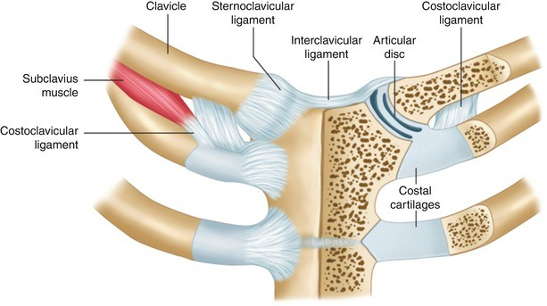
Sternoclavicular Joint
■■ Articular disc: This flat fibrocartilaginous disc lies within the joint and divides the joint’s interior into two compartments (double plane) .
Its circumference is attached to the interior of the capsule, but it is also strongly attached to the superior margin of the articular surface of the clavicle above and to the first costal cartilage below.

Slide 21
Sternoclavicular Joint
■■ Accessory ligament: The costoclavicular ligament is a strong ligament that runs from the junction of the 1st rib with the 1st costal cartilage to the inferior surface of the sternal end of the clavicle
■■ Synovial membrane: This lines
the capsule and is attached to the
margins of the cartilage covering
the articular surfaces.
■■ Nerve supply:
The supraclavicular nerve and the
nerve to the subclavius muscle.

Slide 22
Sternoclavicular Joint
Movements
Forward and backward movement of the clavicle takes (medial compartment).
Elevation and depression of the clavicle (lateral compartment.)

Slide 23
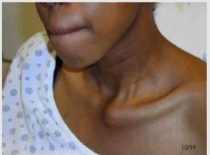
Sternoclavicular Joint
Sternoclavicular Joint Injuries : Violent forces directed along the long axis of the clavicle usually result in fracture of that bone, but dislocation of the sternoclavicular joint takes place occasionally.
Anterior dislocation | Posterior dislocation
medial end of the clavicle projecting forward beneath the skin | Clavicle derived backward more serious : because the displaced clavicle may press on the trachea, the esophagus, and major blood vessels in the root of the neck.

Slide 24
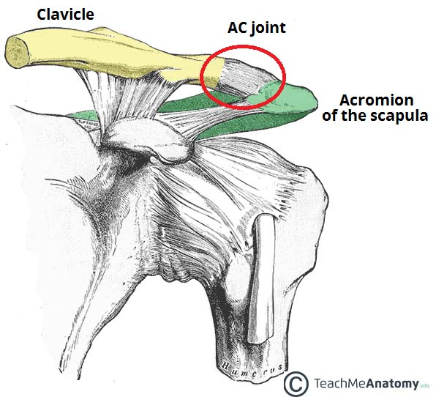
Acromioclavicular Joint
Articulation: This occurs between the acromion of the scapula and the lateral end of the clavicle
Type: Synovial plane joint
■■ Capsule: This surrounds the joint and is attached to the margins of the articular surfaces.

Slide 25
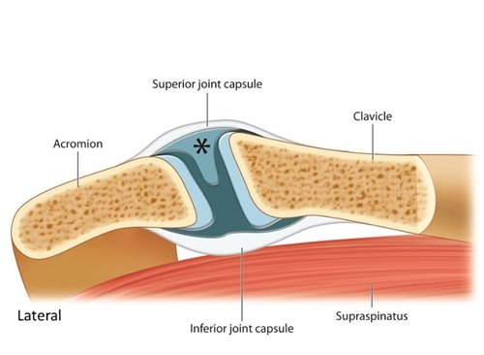
Acromioclavicular Joint
■■ Ligaments: Superior and inferior acromioclavicular ligaments reinforce the capsule;
from the capsule, a wedge-shaped fibrocartilaginous disc projects into the joint cavity from above

Slide 26
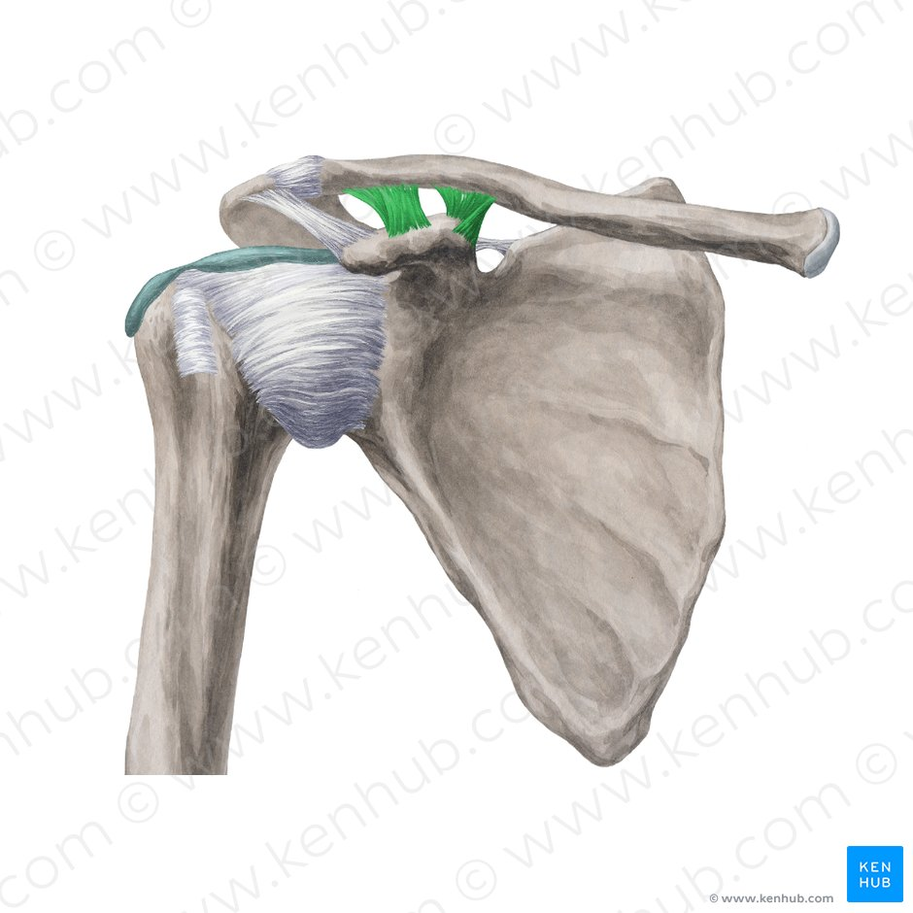
Acromioclavicular Joint
■■ Accessory ligament: The very strong coracoclavicular ligament extends from the coracoid process to the undersurface of the clavicle . It is largely responsible for suspending the weight of the scapula and the upper limb from the clavicle.
■■ Synovial membrane: This lines the capsule and is attached to the margins of the cartilage covering the articular surfaces.
■■ Nerve supply: The suprascapular nerve

Slide 27
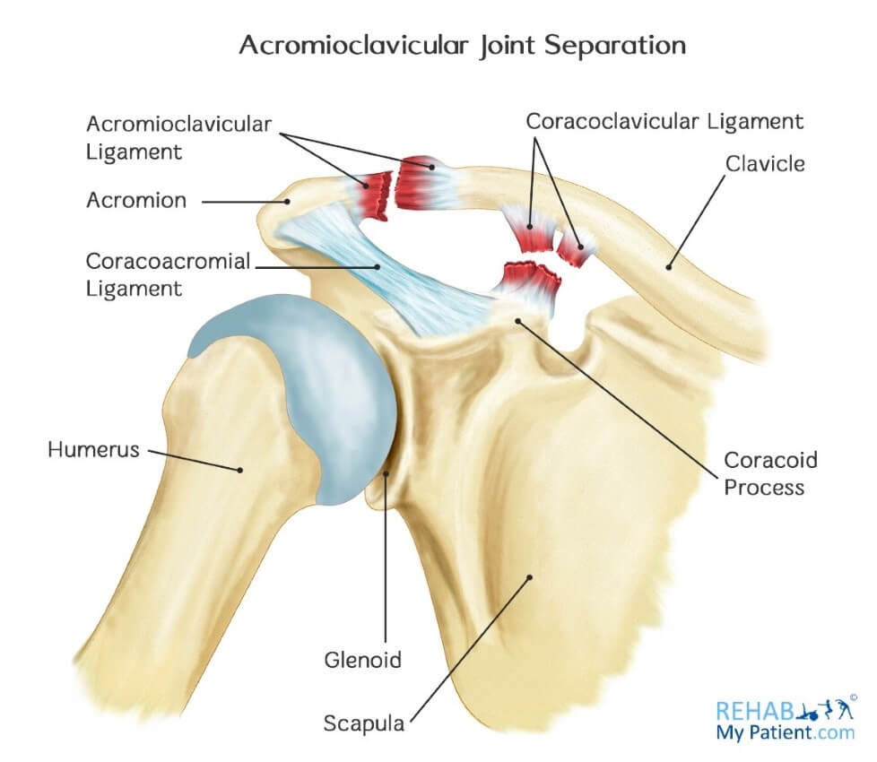
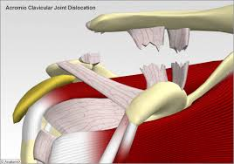
Acromioclavicular Joint
Acromioclavicular Dislocation
A severe blow on the point of the shoulder, as is severe fall, can result in the acromion being thrust beneath the lateral end of the clavicle, tearing the coracoclavicular ligament. This condition is known as shoulder separation. The displaced outer end of the clavicle is easily palpable.

Slide 28
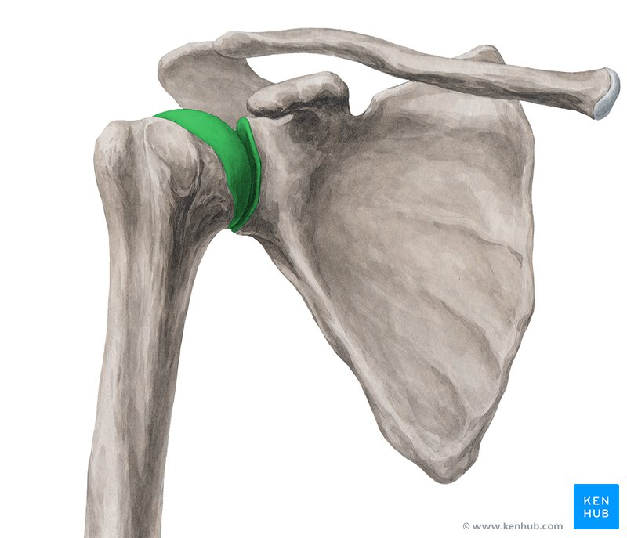
Shoulder Joint
Articulation: This occurs between the rounded head of the humerus and the shallow, pear-shaped glenoid cavity of the scapula. The articular surfaces are covered by hyaline articular cartilage, and the glenoid cavity is deepened by the presence of a fibrocartilaginous rim called the glenoid labrum
Type: Synovial ball-and-socket joint

Slide 29
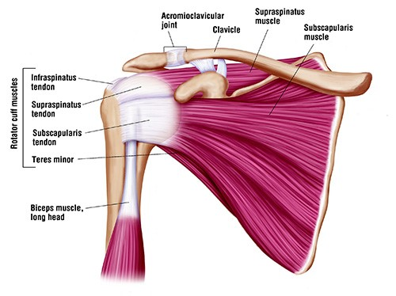
■■ Capsule: This surrounds the joint and is attached medially to the margin of the glenoid cavity outside the labrum; .
The capsule is thin and lax, allowing a wide range of movement.
It is strengthened by fibrous slips from the tendons of the subscapularis, supraspinatus, infraspinatus, and teres minor muscles (the rotator cuff muscles).

Slide 30
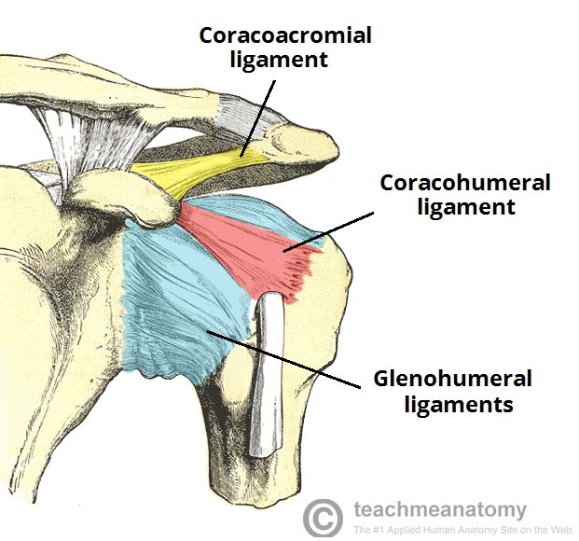
Ligaments:
The glenohumeral ligaments are three weak bands of fibrous tissue that strengthen the front of the capsule.
The transverse humeral ligament strengthens the capsule and bridges the gap between the two tuberosities .
The coracohumeral ligament strengthens the capsule above and stretches from the root of the coracoid process to the greater tuberosity of the humerus
Accessory ligaments: The coracoacromial ligament
Its function is to protect the superior aspect of the joint

Slide 31
■■ Synovial membrane: This lines the capsule and is attached to the margins of the cartilage covering the articular surfaces
■■ Nerve supply: The axillary and suprascapular nerves
Movements
Movements increased at the expense of stability (the opposite of hip joint)
The following movements are possible :
■■ Flexion: Normal flexion is about 90° and is performed by the anterior fibers of the deltoid, pectoralis major, biceps, and coracobrachialis muscles.
■■ Extension: Normal extension is about 45° and is performed by the posterior fibers of the deltoid, latissimus dorsi, and teres major muscles.

Slide 32
■■ Abduction: Abduction of the upper limb occurs both at the shoulder joint and between the scapula and the thoracic wall. The middle fibers of the deltoid, assisted by the supraspinatus, are involved. The supraspinatus muscle initiates the movement of abduction and holds the head of the humerus against the glenoid fossa of the scapula; this latter function allows the deltoid muscle to contract and abduct the humerus at the shoulder joint.
■■ Adduction: Normally, the upper limb can be swung 45° across the front of the chest. This is performed by the pectoralis major, latissimus dorsi, teres major, and teres minor muscles.

Slide 33
■■ Lateral rotation: Normal lateral rotation is 40° to 45°. This is performed by the infraspinatus, the teres minor, and the posterior fibers of the deltoid muscle.
■■ Medial rotation: Normal medial rotation is about 55°. This is performed by the subscapularis, the latissimus dorsi, the teres major, and the anterior fibers of the deltoid muscle.
■■ Circumduction: This is a combination of the above movements.

Slide 34
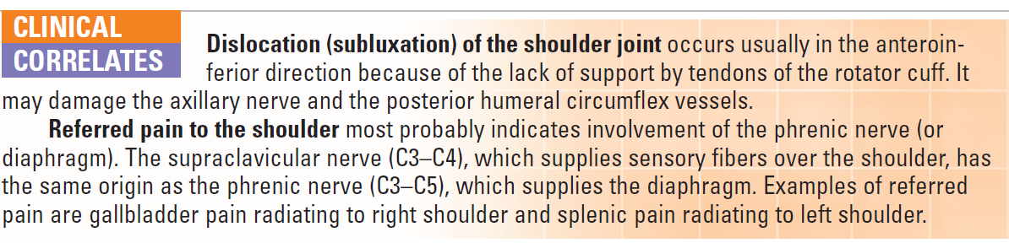

Slide 35
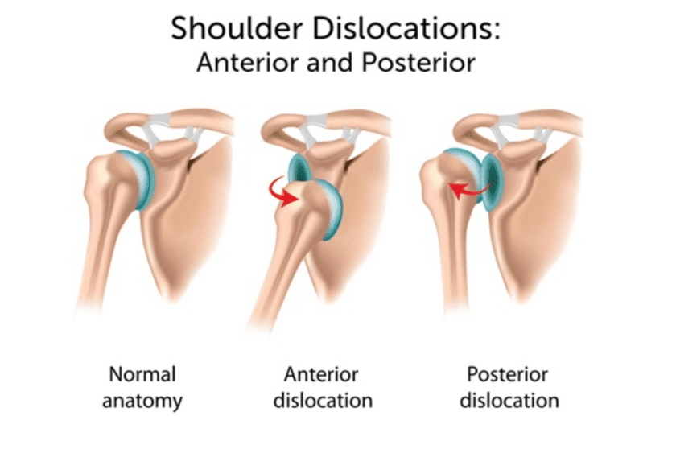
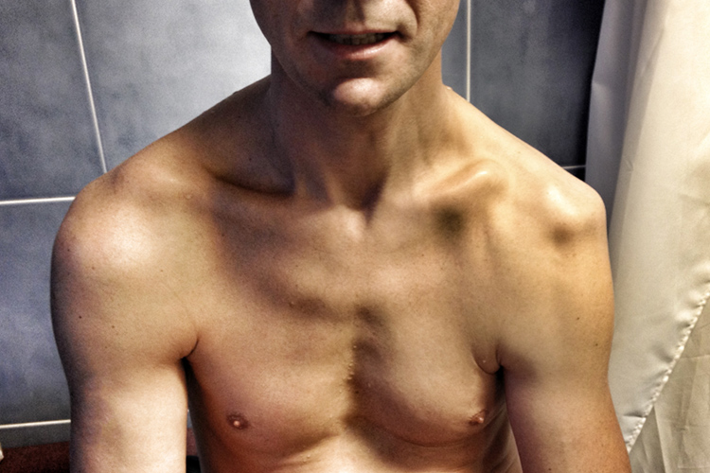

Slide 36
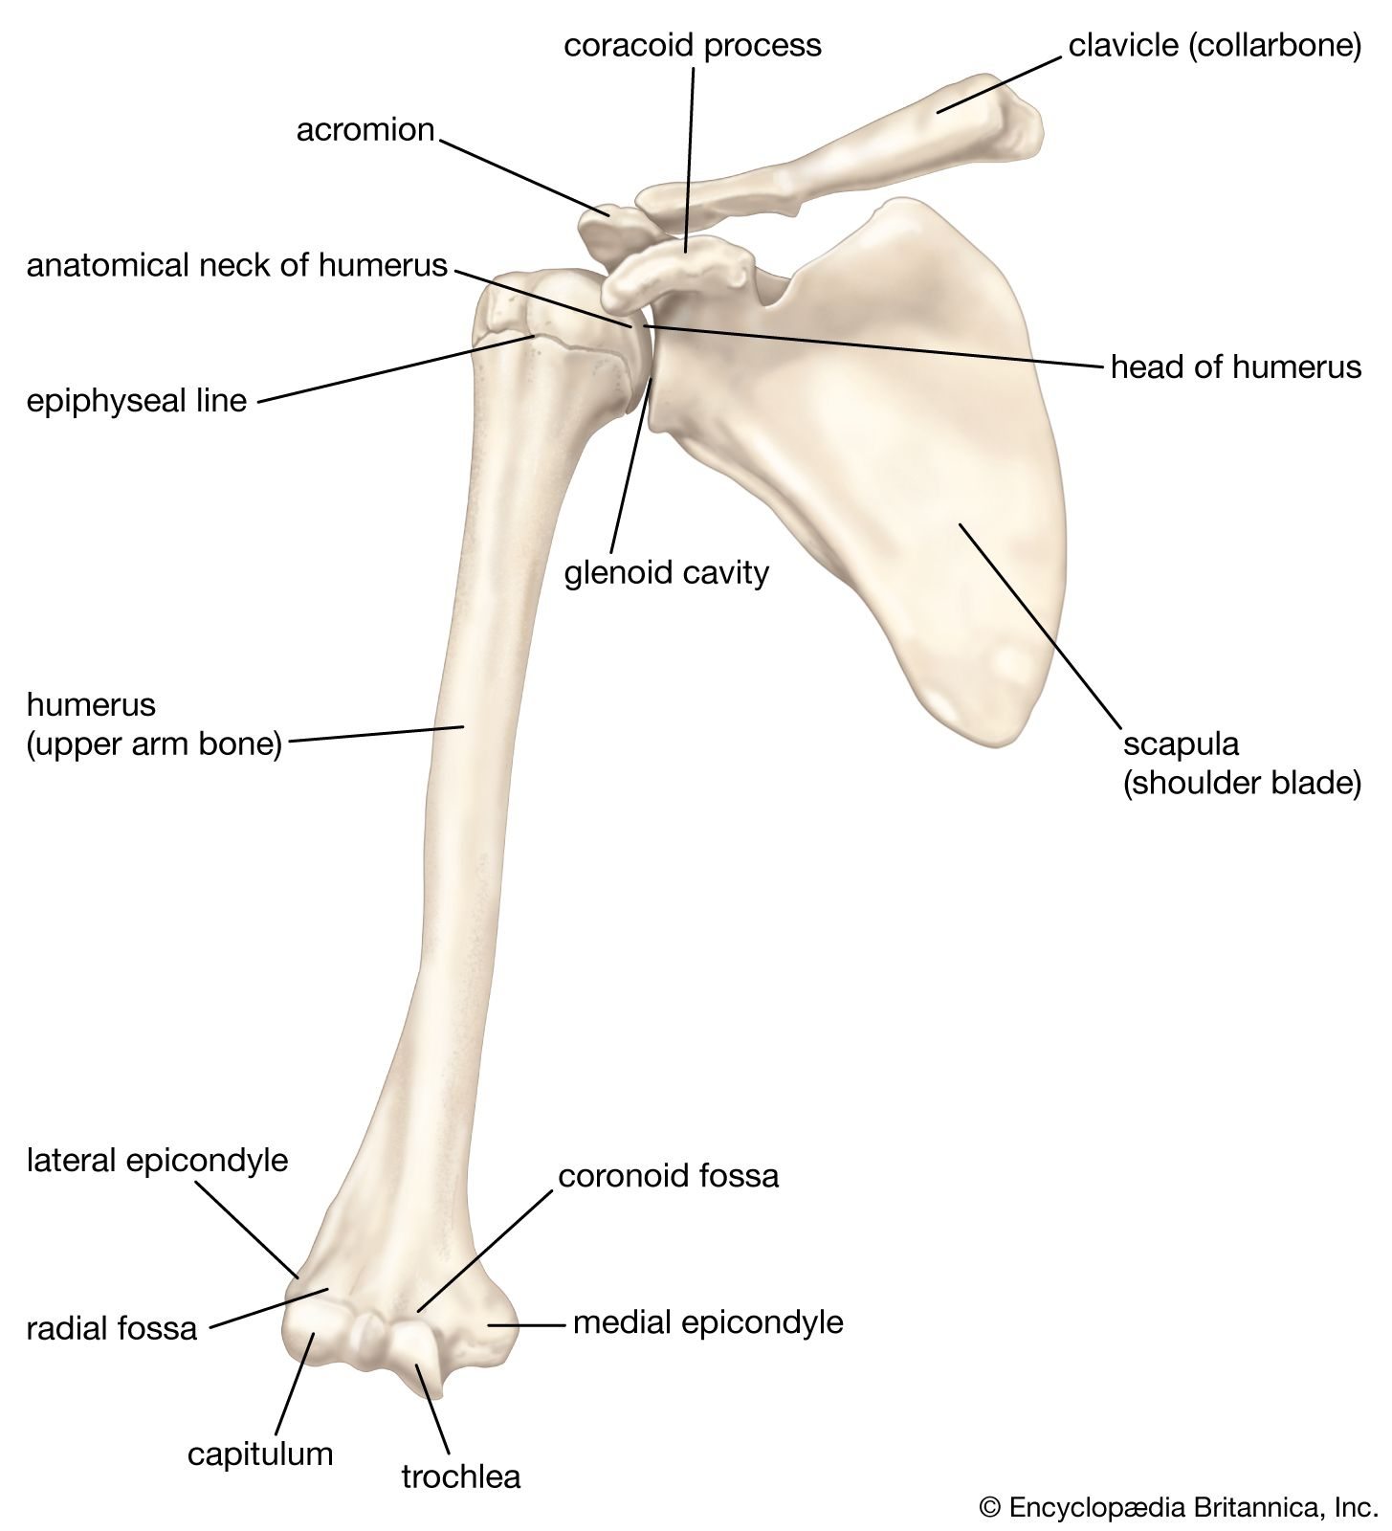
Humerus

Slide 37
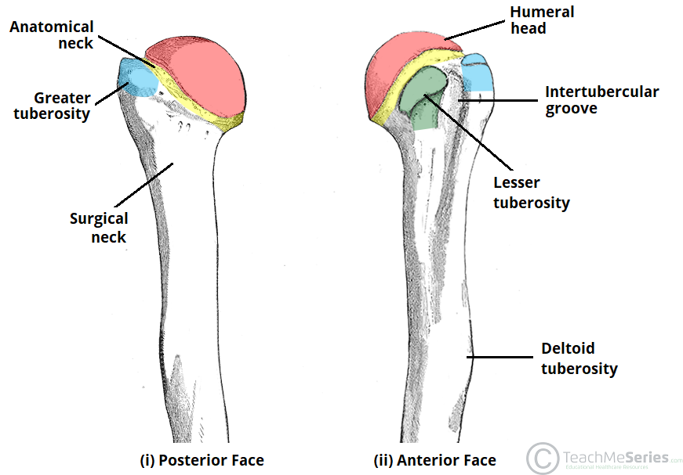

Slide 38
1. Head
■ Articulates with the scapula at the glenohumeral joint.
2. Anatomic Neck
■ Is an indentation distal to the head and provides an attachment for the fibrous joint capsule.
3. Greater Tubercle
■ Lies just lateral and distal to the anatomic neck and provides attachments for the
supraspinatus, infraspinatus, and teres minor muscles.
4. Lesser Tubercle
■ Lies on the anterior medial side of the humerus, just distal to the anatomic neck, and
provides an insertion for the subscapularis muscle.

Slide 39

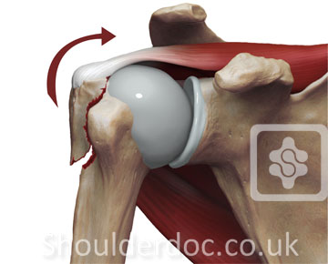
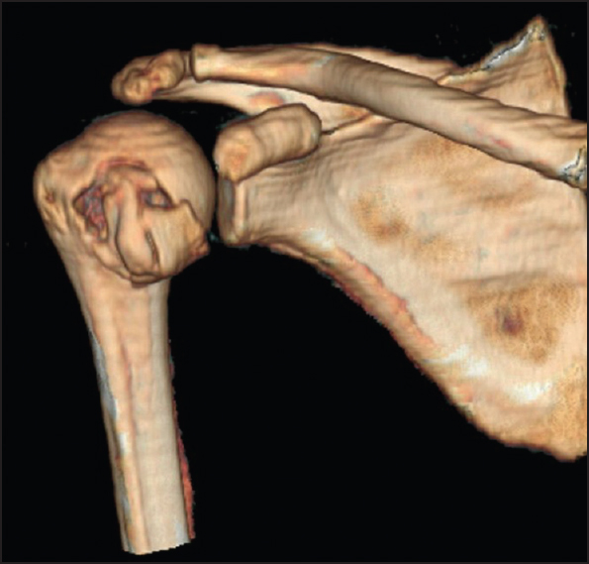
Fracture of the greater tuberosity commonly occurs by direct trauma or by violent contractions of the supraspinatus muscle. The bone fragment has the attachments of the supraspinatus, infraspinatus, and teres minor muscles, whose tendons form parts of the rotator cuff.
Fracture of the lesser tuberosity accompanies posterior dislocation of the shoulder joint, and the bone fragment has the insertion of the subscapularis tendon.

Slide 40
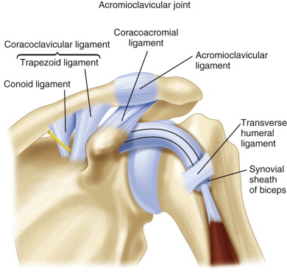
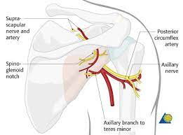
5. Intertubercular (Bicipital) Groove
■ Lies between the greater and lesser tubercles, lodges the tendon of the
long head of the
biceps brachii muscle, and is bridged by the transverse humeral ligament.
■ Provides insertions for the pectoralis major on its lateral lip, the teres major on its medial
lip, and the latissimus dorsi on its floor.
6. Surgical Neck
■ Is a narrow area distal to the tubercles that is a common site of
fracture and is in contact with the axillary nerve and the posterior
humeral circumflex artery.(may be injured )

Slide 41
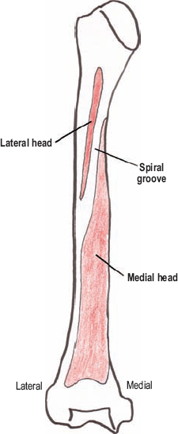
7. Deltoid Tuberosity
■ Is a rough triangular elevation on the lateral aspect
of the midshaft that marks the insertion of the deltoid
muscle.
8. Spiral Groove
■ Contains the radial nerve, separating the origin of the
lateral head of the triceps above and
the origin of the medial head below.

Slide 42

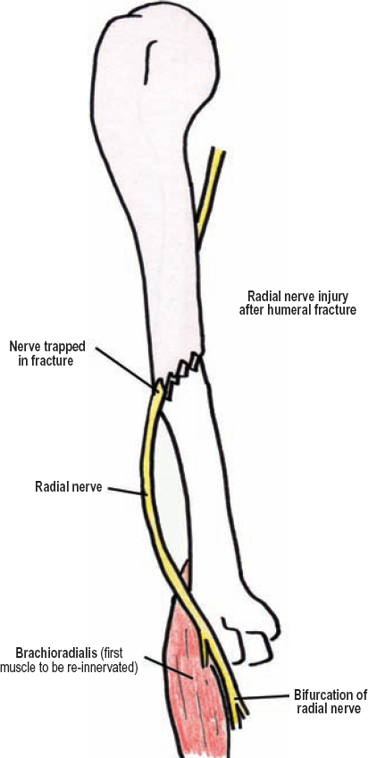
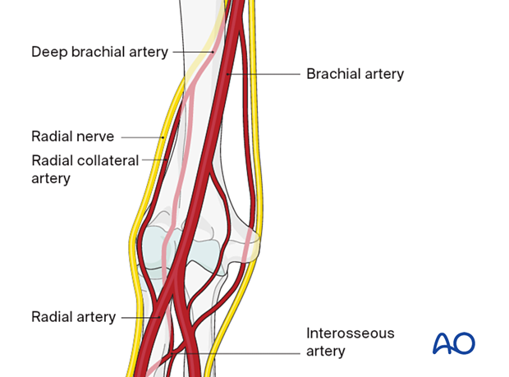
Fracture of the shaft of the humerus may injure the radial nerve and deep Brachial artery in the spiral groove.

Slide 43
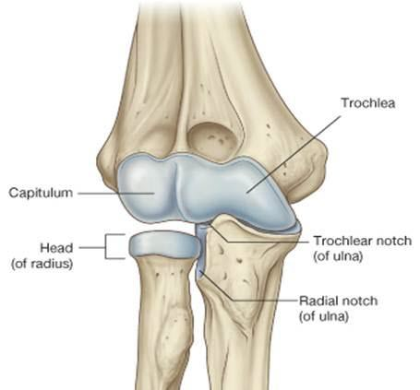
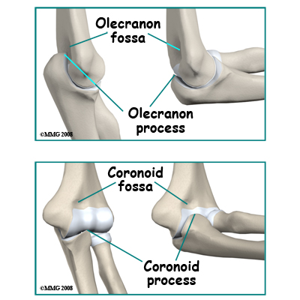
9. Trochlea
■ Is a spool-shaped medial articular surface and articulates with the trochlear notch of the ulna.
10. Capitulum
■ Is the lateral articular surface, globular in shape, and articulates with the head of the radius.
11. Olecranon Fossa
■ Is a posterior depression above the trochlea of the humerus that houses the olecranon of the ulna on full extension of the forearm.

Slide 44
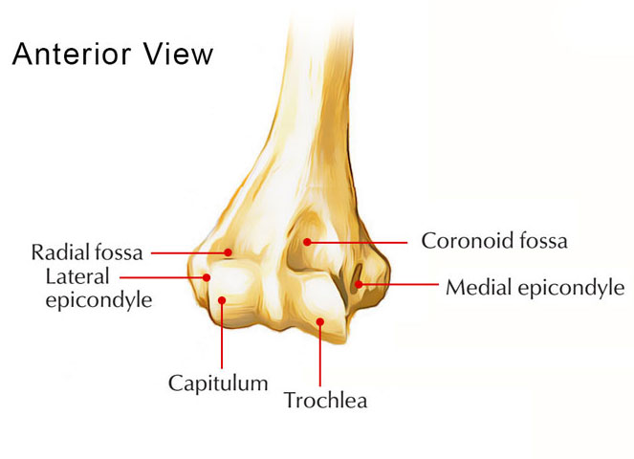
12. Coronoid Fossa
■ Is an anterior depression above the trochlea of the humerus that accommodates the
coronoid process of the ulna on flexion of the elbow.
13. Radial Fossa
■ Is an anterior depression above the capitulum that is occupied by the head of the radius during full flexion of the elbow joint.
14. Lateral Epicondyle
■ Projects from the capitulum and provides the origin of the supinator and extensor muscles of the forearm. It is an attachment site for the radial collateral ligament.

Slide 45
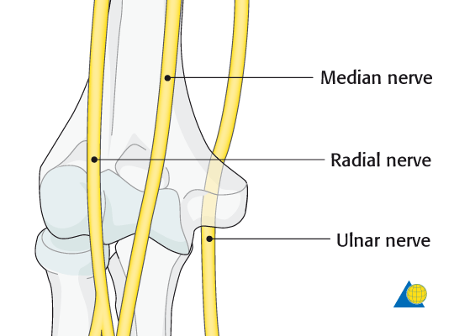
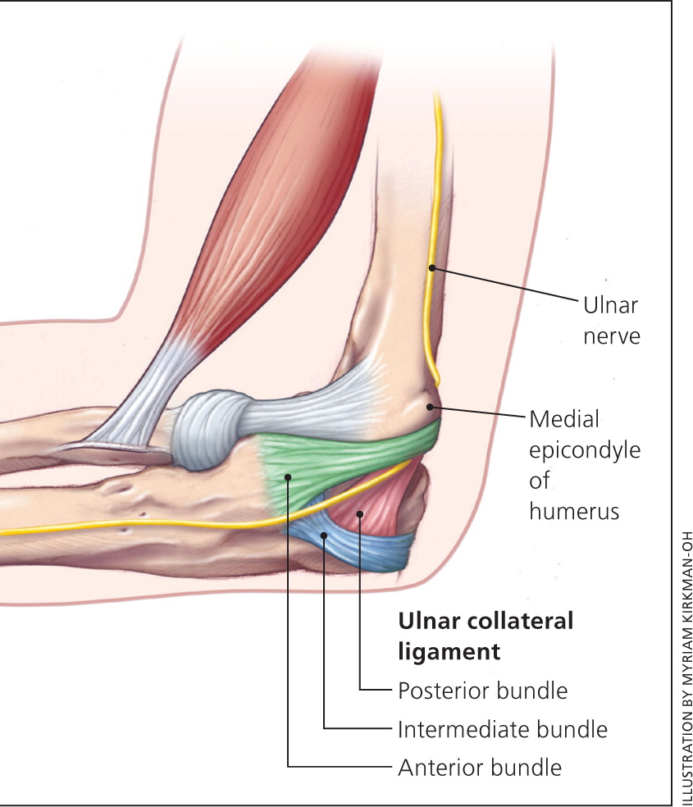
15. Medial Epicondyle
■ Projects from the trochlea and has a groove on the back for the ulnar nerve and superior ulnar collateral artery.
■ Provides attachment sites for the ulnar collateral ligament, the pronator teres, and the common tendon of the forearm flexor muscles.

Slide 46
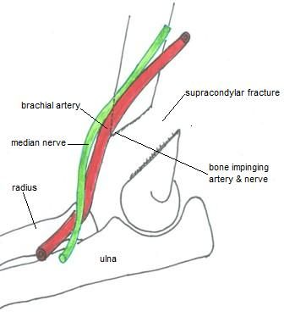
Supracondylar fracture is a fracture of the distal end of the humerus; it is common in children
and occurs when the child falls on the outstretched hand with the elbow partially flexed and may injure the median nerve.
Fracture of the medial epicondyle may damage the ulnar nerve. This nerve may be compressed
in a groove behind the medial epicondyle “funny bone,” causing numbness.

Slide 47
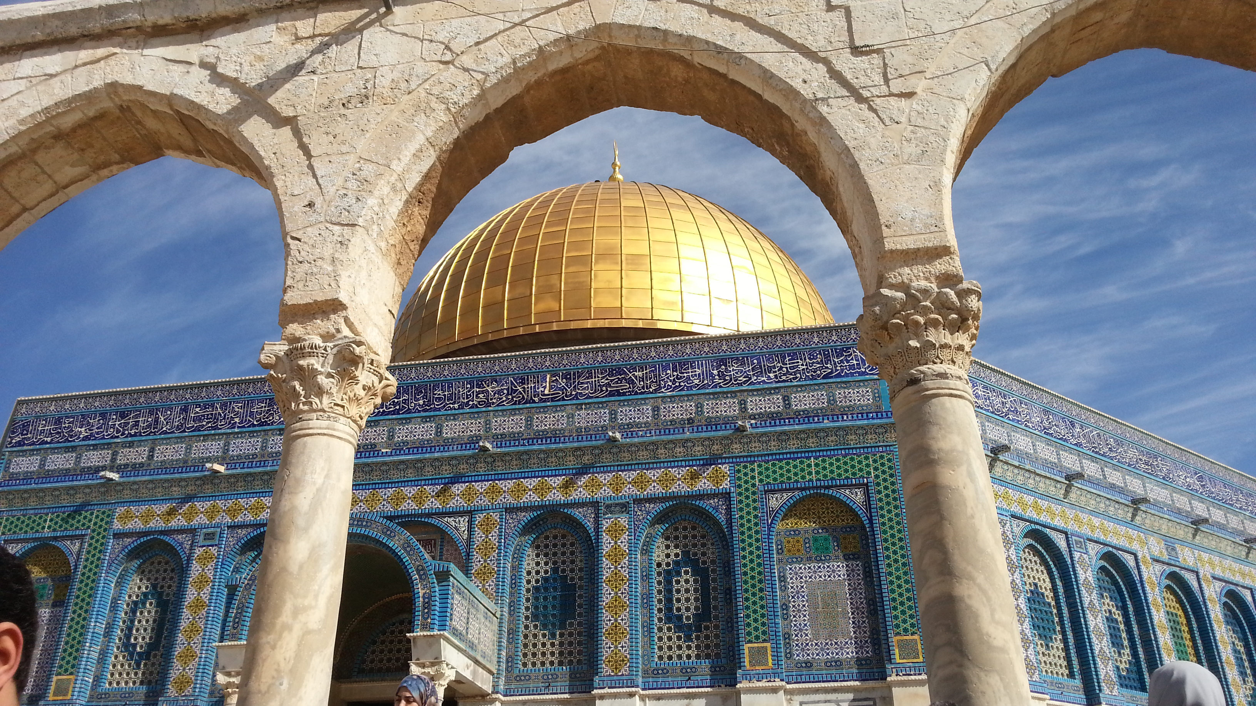

Slide 48
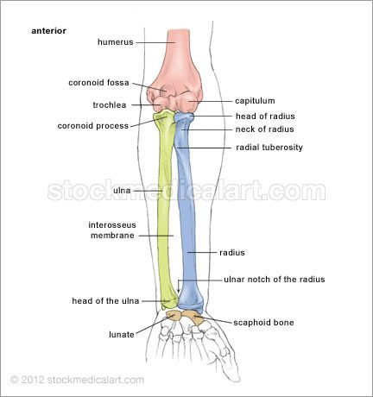
Radius

Slide 49
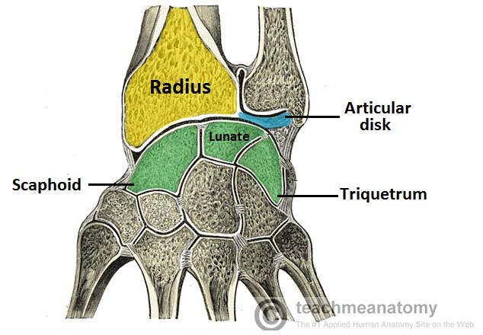
The radius is the lateral bone of the forearm
proximal end : articulates with the humerus at the elbow joint and with the ulna at the proximal radioulnar joint
distal end articulates with the scaphoid and lunate bones of the hand at the wrist joint and with the ulna at the distal radioulnar joint.

Slide 50


Head of radius :
proximal end
upper surface of the head is concave and articulates with the convex capitulum of the humerus
The circumference of the head articulates with the radial notch of the ulna.
Neck : Below the head, the bone is constricted to form the neck

Slide 51

bicipital tuberosity : for the insertion of the biceps muscle.
It has a sharp interosseous border medially for the attachment of the interosseous membrane that binds the radius and ulna together.
The pronator tubercle, for the insertion of the pronator teres muscle, lies halfway down on its lateral side.

Slide 52

styloid process :
projects distally from its lateral margin
On the medial surface is the ulnar notch, which articulates with the round head of the ulna
The inferior articular surface articulates with the scaphoid and lunate bones
On the posterior aspect of the distal end is a small tubercle, the dorsal tubercle, which is grooved on its medial side by the tendon of the extensor pollicis longus

Slide 53



Colles fracture of the wrist is a distal radius fracture in which the distal fragment
is displaced (tilted) posteriorly, dinner (silver) fork deformity
reverse Colles fracture (Smith fracture) : distal fragment is displaced anteriorly

Slide 54
Ulna

Slide 55
The ulna is the medial bone of the forearm
proximal end articulates with the humerus at the elbow joint and with the head of the radius at the proximal Radioulnar joint.
Its distal end articulates with the radius at the distal radioulnar joint, but it is excluded from the wrist joint by the articular disc.

Slide 56


olecranon process : Is the curved projection on the back of the elbow that provides an attachment site for the triceps tendon.
trochlear notch, Receives the trochlea of the humerus.

Slide 57
coronoid process :
Is located below the trochlear notch and provides an attachment site for the brachialis.
has on its lateral surface the radial notch for articulation with the head of the radius.

Slide 58

The shaft of the ulna tapers from above down
sharp interosseous border laterally for the attachment of the interosseous membrane
supinator crest : gives origin to the supinator muscle.
head, :Articulates with the articular disk of the distal radioulnar joint and has a styloid process

Slide 59
Bones of the Hand

Slide 60
A. Carpal Bones
Are arranged in two rows of four (lateral to medial): scaphoid, lunate, triquetrum, pisiform, trapezium, trapezoid, capitate, and hamate (mnemonic device: Sandra Likes To Pat Tom’s Two Cold Hands).
سلمى لما تلعب بوكر ، تكسب تخسر كله هم

Slide 61

1. Proximal Row (Lateral to Medial): Scaphoid, Lunate, Triquetrum, and Pisiform
■ Except for the pisiform, articulates with the radius and the articular disk (the ulna has no contact with the carpal bones). The pisiform is said to be a sesamoid bone contained in the flexor carpi ulnaris tendon.
2. Distal Row (Lateral to Medial): Trapezium, Trapezoid, Capitate, and Hamate

Slide 62

B. Metacarpals
■ Are miniature long bones consisting of
bases (proximal ends),
shafts (bodies), and
heads (distal ends). Heads form the knuckles of the fist.
■ The first metacarpal bone of the thumb is the shortest and most mobile.

Slide 63


C. Phalanges
■ Are miniature long bones consisting of bases, shafts, and heads.
The heads of the proximal and middle phalanges form the knuckles.
■ Occur in fingers (three each) and thumb (two).

Slide 64



Fracture of the scaphoid : Fall on FOOSH , tenderness over the snuff box , retrograde blood supply , if non unite it leads to avascular necrosis of the bone and degenerative joint disease of the wrist

Slide 65

Bennett fracture is a fracture of the base of the metacarpal of the thumb.

Slide 66

Boxer’s fracture is a fracture of the necks of the second and third metacarpals, seen in professional boxers, and typically of the fifth metacarpal in unskilled boxers.

Slide 67

Dislocation of the lunate bone occasionally occurs in young adults who fall on the outstretched hand in a way that causes hyperextension of the wrist joint. Involvement of the median nerve is common.

Slide 68
shoulder girdle related muscles

Slide 69

Shoulder Girdle ?
these are the bones which connect the limb to the trunk and include :
(a) the Clavicle: anteriorly
(b) the scapula posteriorly
NB ~
(1)the Shoulder girdle is Completed anteriorly by the
upper end of the sternum which articulates with the
med ends of the 2 clavicles
(2) posteriorly, the 2 scapulae are widely separated
from each other & are connected to the axial
skeleton by muscles only

Slide 70
five muscles that attach to the clavicle and scapula and allow for the motion of the sternoclavicular joint (connection between sternum and clavicle) and acromioclavicular joint (connection between clavicle and scapula)
trapezius muscle (upper, middle, and lower),
levator scapulae muscle,
rhomboid muscles (major and minor),
serratus anterior muscle, and
pectoralis minor muscle.

Slide 71


Trapezius
Origin : External occipital protuberance, superior
nuchal line, ligamentum nuchae, and spines of
C7–T12
Insertion :
Spine of scapula,
acromion, and lateral third of clavicle

Slide 72



Slide 73

Nerve supply :
Spinal accessory nerve; C3–C4
NB : this is the only muscle in Upper limb
NOT supplied by Brachial plexus
Action :
Adducts, (middle fibers)
rotates,
Elevates (upper fibers )
depresses scapula (lower fibers)

Slide 74

levator scapulae muscle
Origin :
Transverse processes of C1–C4
Insertion :
Medial border of scapula

Slide 75

levator scapulae muscle
Nerve supply :
Dorsal scapular nerve (C5); C3–C4
Action :
Elevates scapula and rotates glenoid cavity

Slide 76

rhomboid muscles (minor)
Origin
Spines of C7–T1
Insertion
Root of spine of scapula

Slide 77

Nerve
Dorsal scapular nerve (C5)
Action
Adducts scapula

Slide 78

rhomboid muscles (major)
Origin
Spines of T2–T5
Insertion
Medial border of scapula

Slide 79

Nerve
Dorsal scapular nerve (C5)
Action
Adducts scapula

Slide 80

serratus anterior muscle
Origin
Upper eight ribs
Insertion
Medial border of scapula

Slide 81


Nerve
Long thoracic
Action
Rotates scapula upward;
Abducts (protraction) scapula with arm and
elevates it above the horizontal

Slide 82


Winging of scapula

Slide 83

pectoralis minor muscle
Origin
Third, fourth, and fifth ribs
Insertion
Coracoid process of scapula

Slide 84


Nerve
Medial (and lateral)
Pectoral N
Action
Depresses scapula;
elevates ribs (as in forced inspiration)

Slide 85

Sunset in Jaffa

