Slide 1
Muscles of the Arm
Mahmoud Abuaita
Orthopedic specialist
Palestinian board / Makassed hospital

Slide 2
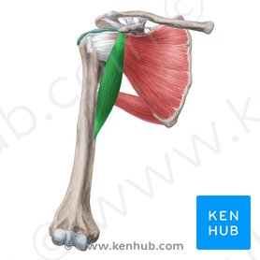
Coracobrachialis
Origin
Coracoid process
Insertion
Middle third of medial
surface of humerus

Slide 3
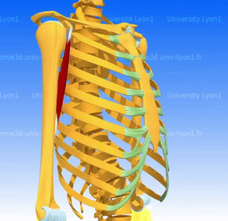
Coracobrachialis
Nerve
Musculocutaneous
Action
Flexes and adducts
Arm

Slide 4
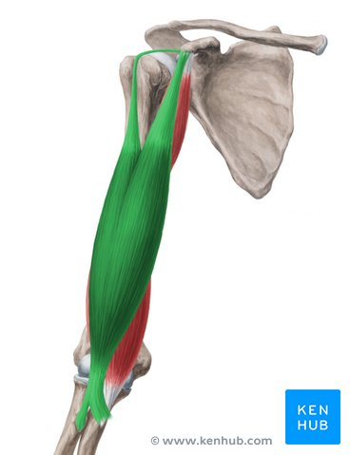
Biceps brachii
Origin
Long head, supraglenoid tubercle;
short head, coracoid process
Insertion
Radial tuberosity of
radius

Slide 5
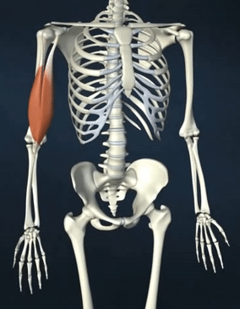
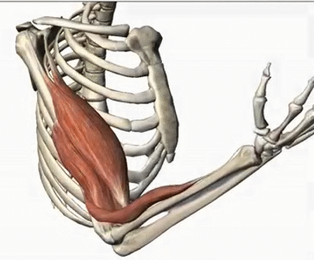
Biceps brachii
Nerve
Musculocutaneous
Action
Flexes arm and
forearm, supinates
forearm

Slide 6
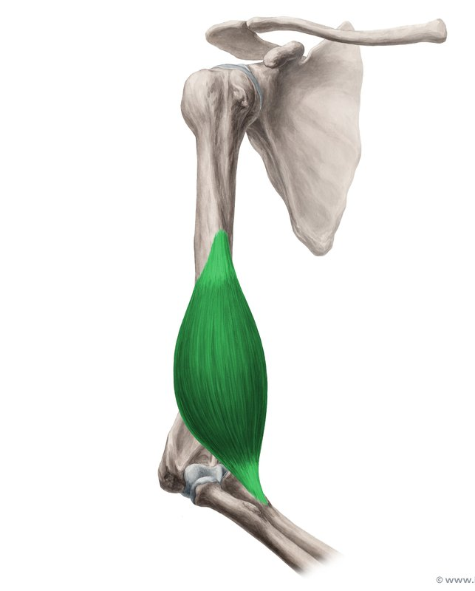
Brachialis
Origin
Lower anterior surface of
humerus
Insertion
Coronoid process
of ulna and ulnar
tuberosity

Slide 7
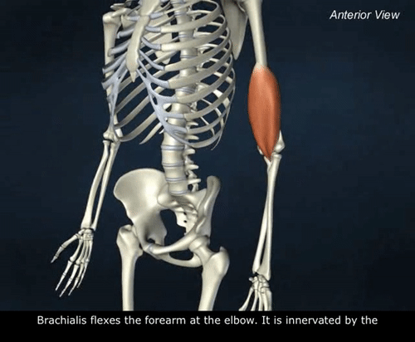
Brachialis
Nerve
Musculocutaneous
Action
Flexes forearm

Slide 8
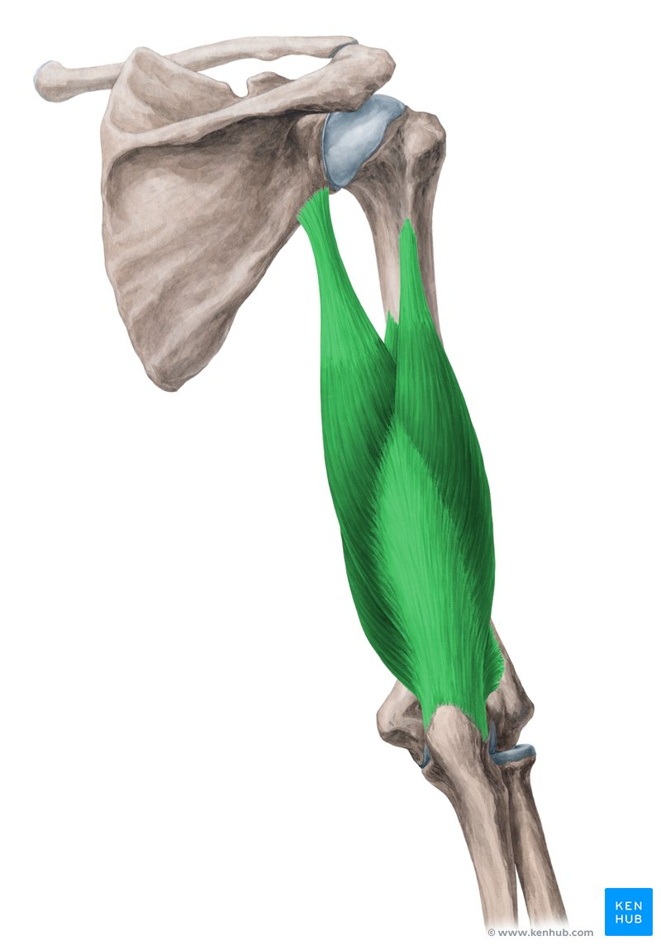
Triceps
Origin
Long head, infraglenoid tubercle;
lateral head, superior to radial groove of humerus;
medial head, inferior to radial groove
Insertion
Posterior surface of
olecranon process of
ulna

Slide 9
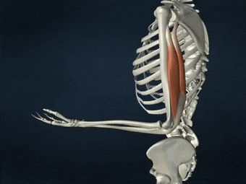
Triceps
Nerve
Radial
Action
Extends forearm

Slide 10
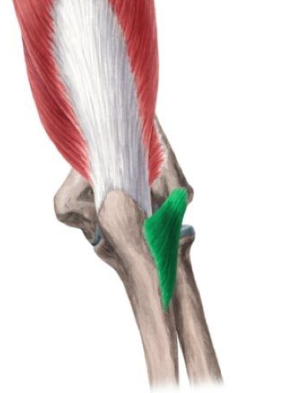
Anconeus
Origin
Lateral epicondyle of
humerus
Insertion
Olecranon and upper
posterior surface of ulna

Slide 11
Anconeus
Nerve
Radial
Action
Extends forearm

Slide 12
Muscles of the Anterior Forearm

Slide 13
superficial group : consisting of the
pronator teres, the flexor carpi radialis, the palmaris longus, and the flexor carpi ulnaris
intermediate group : consistin of the flexor digitorum superficialis;
Deep group : consisting of the
flexor pollicis longus, the flexor digitorum profundus, and the pronator quadratus

Slide 14
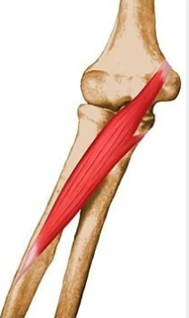
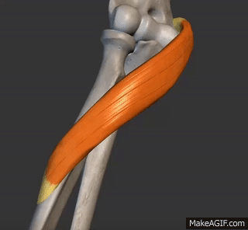
Pronator teres
Origin
Medial epicondyle and
coronoid process of ulna
Insertion
Middle of lateral side of
radius

Slide 15
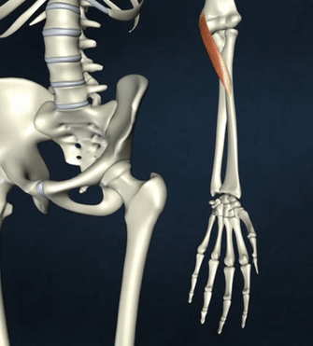
Nerve
Median
Action
Pronates and flexes
forearm

Slide 16
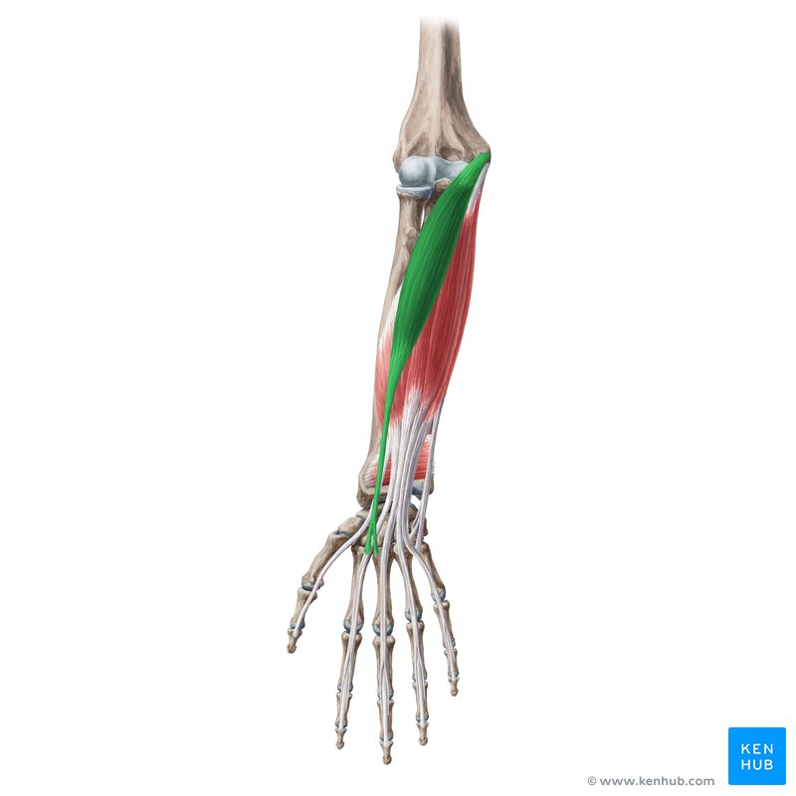
Flexor carpi radialis
Origin
Medial epicondyle of
humerus
Insertion
Bases of second and third
metacarpals

Slide 17
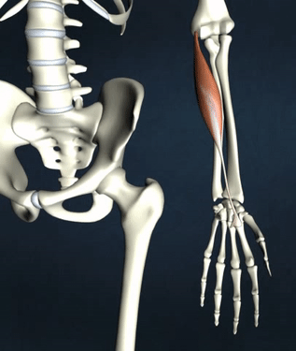
Nerve
Median
Action
Flexes forearm, flexes
and abducts hand

Slide 18
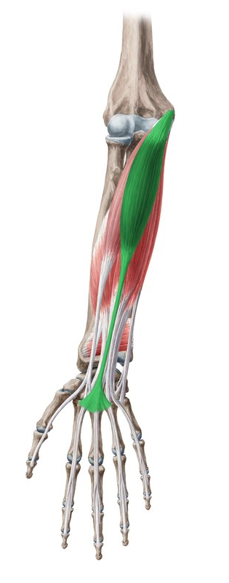
Palmaris longus
Origin
Medial epicondyle of
humerus
Insertion
Flexor retinaculum, palmar
aponeurosis

Slide 19
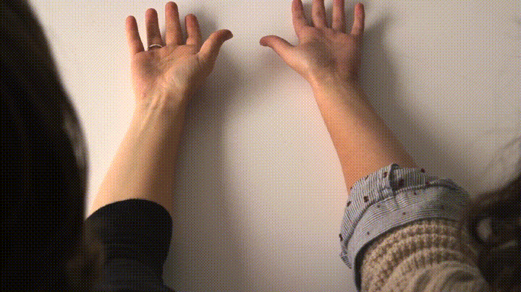
Nerve
Median
Action
Flexes forearm and
hand
Absent Palmaris Longus
The palmaris longus muscle may be absent on one or both sides of the forearm in about 10% of persons (NO DISABILITY)

Slide 20
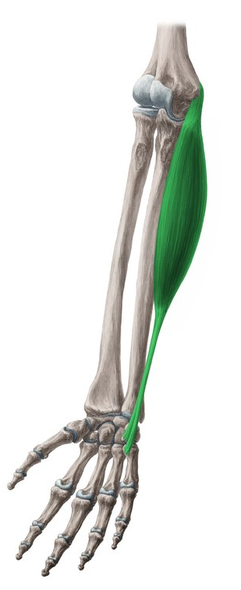
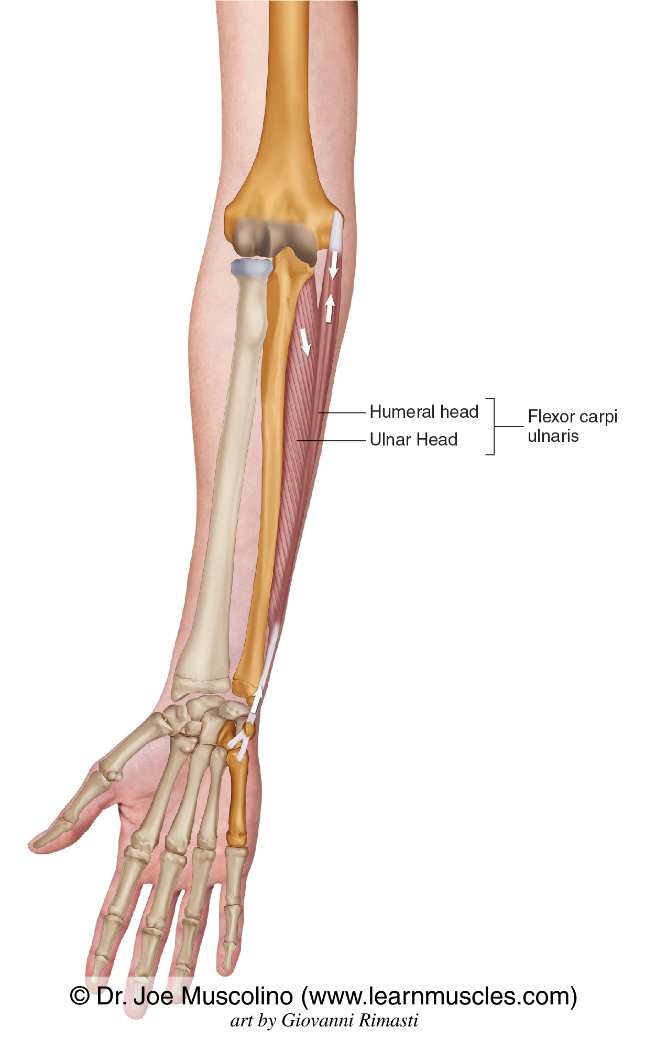
Flexor carpi ulnaris
Origin
(humeral head) :Medial epicondyle;
(ulnar head) :medial olecranon, and
posterior border of ulna
Insertion
Pisiform, hook of hamate,
and base of fifth metacarpal

Slide 21
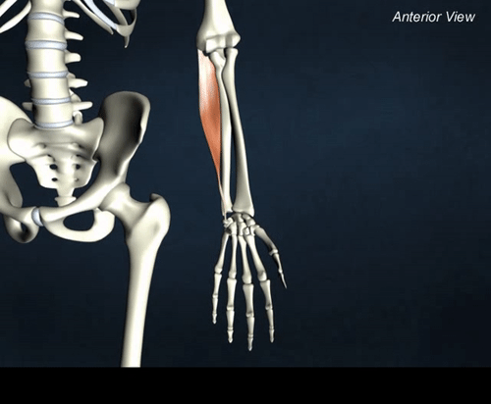
Nerve
Ulnar
Action
Flexes forearm; flexes
and adducts hand

Slide 22
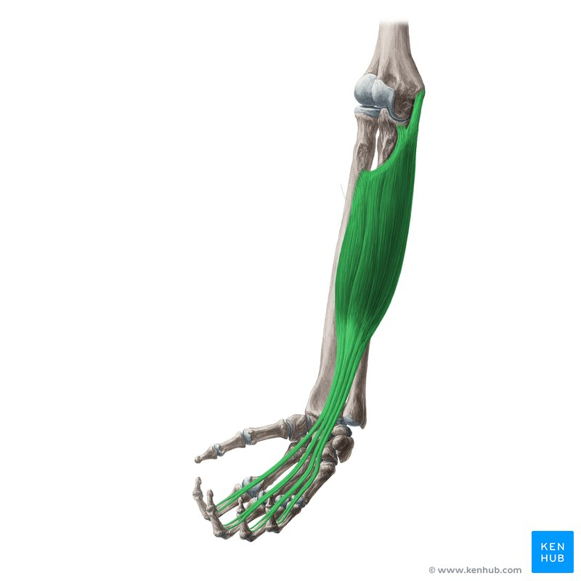
Flexor digitorum superficialis
Origin
Medial epicondyle, coronoid
process, oblique line of
radius
Insertion
Middle phalanges of finger

Slide 23
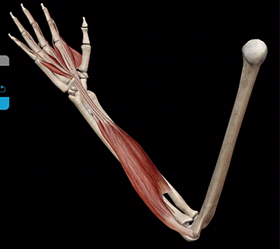
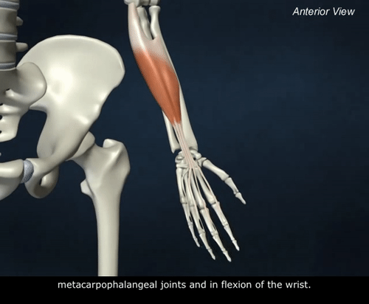
Nerve
Median
Action
Flexes proximal
interphalangeal joints,
flexes hand and
forearm

Slide 24
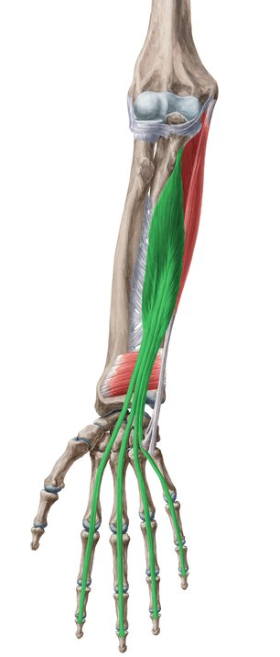
Flexor digitorum profundus
Origin
Anteromedial surface
of ulna, interosseous
membrane
Insertion
Bases of distal phalanges
of fingers

Slide 25
Nerve
Ulnar and
Median(AIN)
Action
Flexes distal
interphalangeal joints
and hand

Slide 26
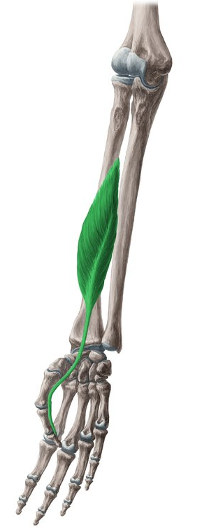
Flexor pollicis longus
Origin
Anterior surface of shaft
of radius
Insertion
Base of distal phalanx of
thumb

Slide 27
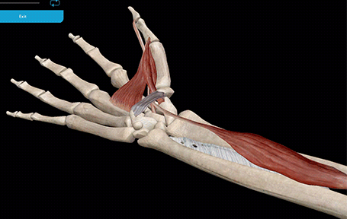
Nerve
Anterior interosseous branch of median nerve
Action
Flexes thumb

Slide 28
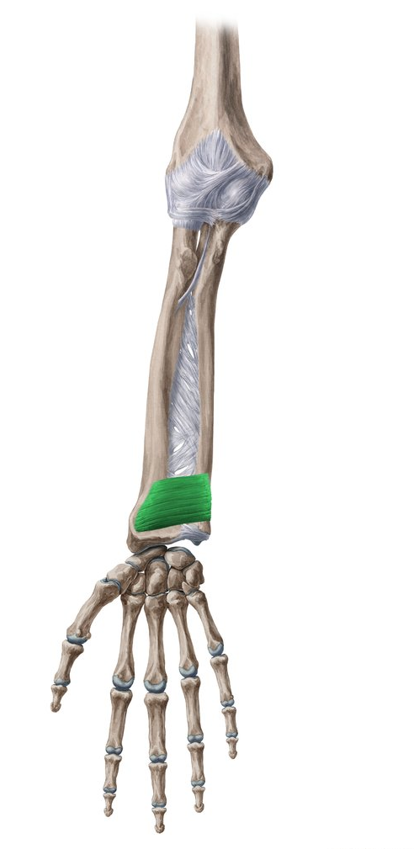
Pronator quadratus
Origin
Anterior surface of distal
ulna
Insertion
Anterior surface of distal
radius

Slide 29
Nerve
Anterior interosseous branch of median nerve
Action
Pronates forearm

Slide 30
Muscles of the Posterior Forearm

Slide 31
Lateral Fascial Compartment of the Forearm :
Brachioradialis and extensor carpi radialis longus
Posterior Fascial Compartment of the Forearm
superficial group extensor carpi radialis brevis, extensor digitorum, extensor digiti minimi, extensor carpi ulnaris, and anconeus. These muscles possess a common tendon of origin, which is attached to the lateral epicondyle of the humerus.
deep group includes the supinator, abductor pollicis longus, extensor pollicis brevis, extensor pollicis longus, and extensor indicis.

Slide 32
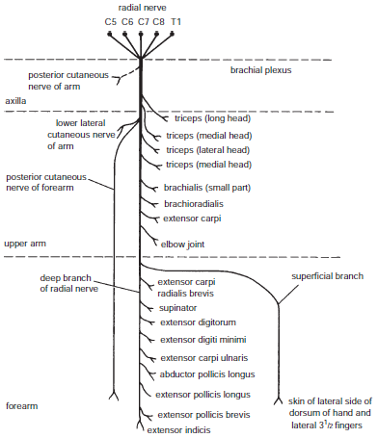
Radial Nerve :TABEB
Triceps
Anconeus
Brachioradialis
ECRL
Brachialis (small part)

Slide 33
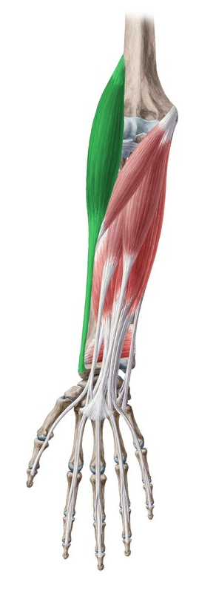
Brachioradialis
Origin
Lateral supracondylar ridge of
humerus
Insertion
Base of radial styloid
process

Slide 34
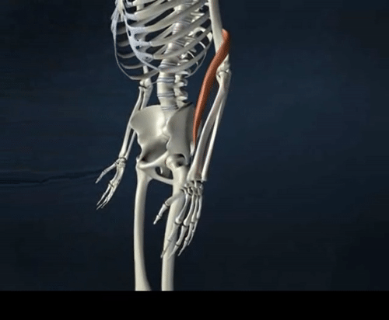
Nerve
Radial
Action
Flexes forearm

Slide 35
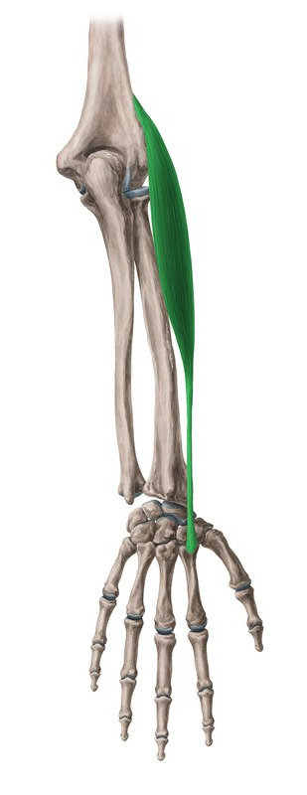
Extensor carpi radialis longus
Origin
Lateral supracondylar ridge of
humerus
Insertion
Dorsum of base of second
metacarpal

Slide 36
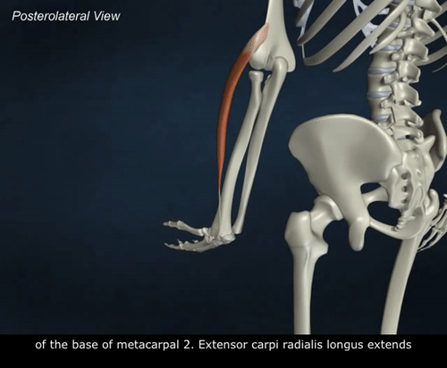
Nerve
Radial
Action
Extends and abducts hand

Slide 37
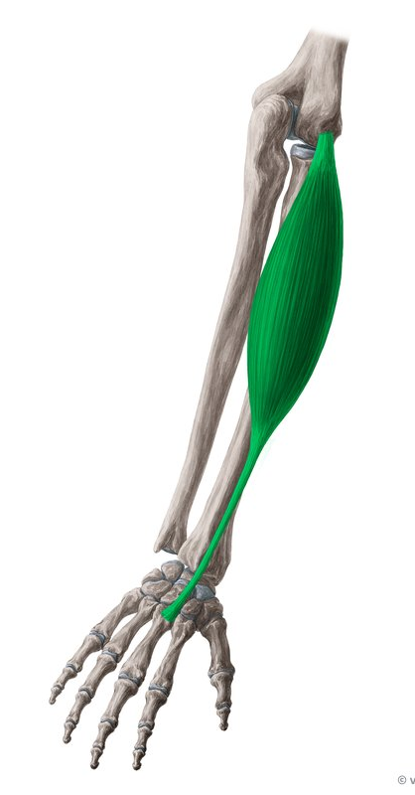
Extensor carpi radialis brevis
Origin
Lateral epicondyle of humerus Posterior
Insertion
base of third
metacarpal

Slide 38
Nerve
Radial / Deep branch of
radial nerve
Action
Extends and abducts
hands

Slide 39
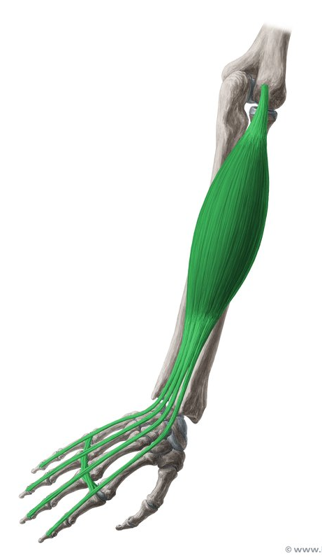
Extensor digitorum
Origin
Lateral epicondyle of humerus
Insertion
Extensor expansion, base
of middle and digital
phalanges

Slide 40
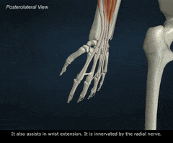
Nerve
Deep branch of
radial nerve
Action
Extends fingers and hand

Slide 41
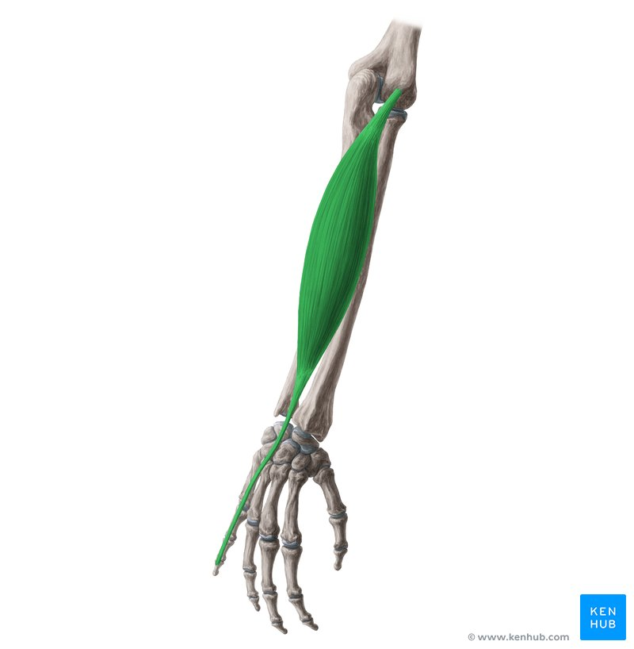
Extensor digiti minimi
Origin
Common extensor tendon and
interosseous membrane
Insertion
Extensor expansion, base of
middle and distal phalanges

Slide 42
Nerve
Deep branch of
radial nerve
Action
Extends little finger

Slide 43
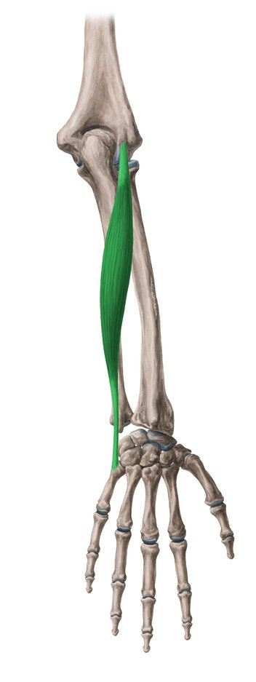
Extensor carpi ulnaris
Origin
Lateral epicondyle and
posterior surface of ulna
Insertion
Base of fifth metacarpal

Slide 44
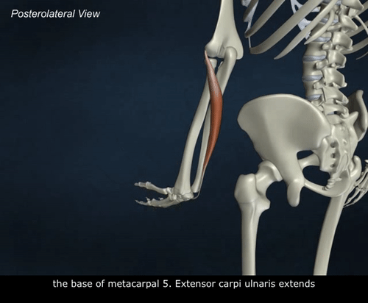
Nerve
Deep branch of
radial nerve
Action
Extends and adducts hand

Slide 45
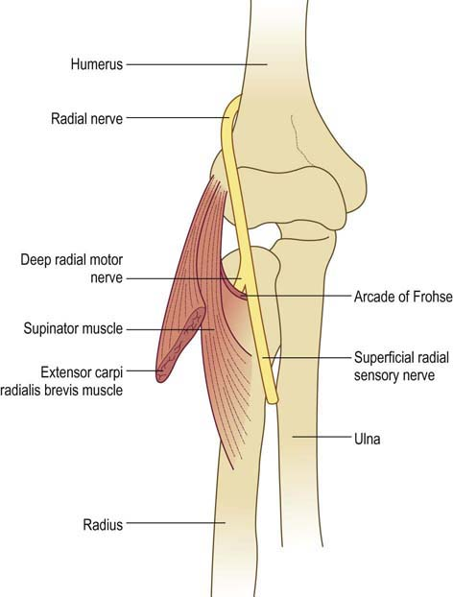
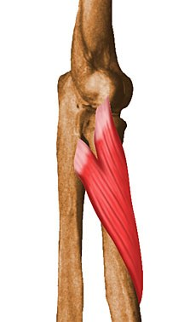
Supinator
Origin
Lateral epicondyle, radial
collateral and annular
ligaments, supinator fossa and
crest of ulna
Insertion
Lateral side of upper part
of radius

Slide 46
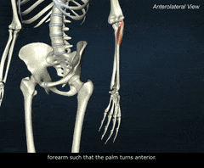
Nerve
Deep branch of
radial nerve
Action
Supinates forearm

Slide 47
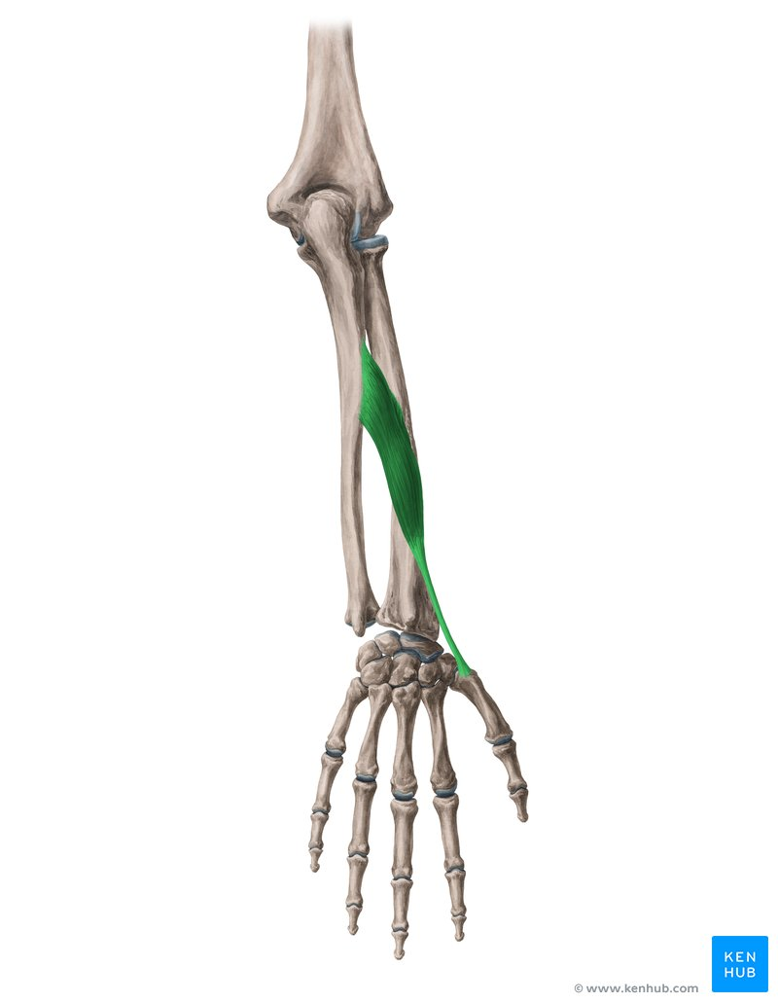
Abductor pollicis longus
Origin
Interosseous membrane,
middle third of posterior
surfaces of radius and ulna
Insertion
Lateral surface of base of
first metacarpal

Slide 48
Nerve
Deep branch of
radial nerve
Action
Abducts thumb and hand

Slide 49
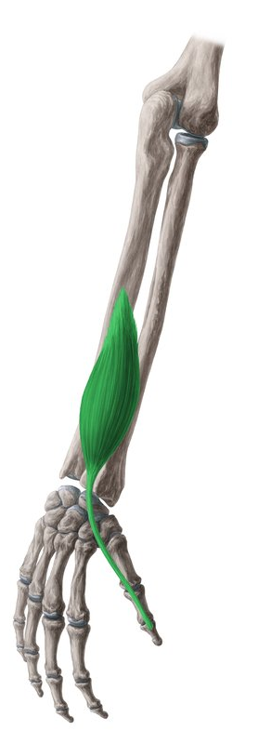
Extensor pollicis longus
Origin
Interosseous membrane
and middle third of posterior
surface of ulna
Insertion
Base of distal phalanx of
thumb

Slide 50
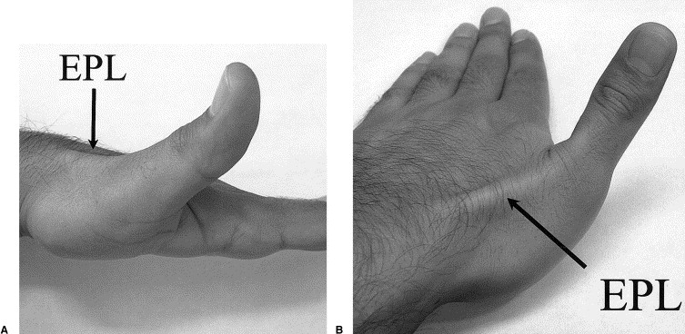
Nerve
Deep branch of
radial nerve
Action
Extends distal phalanx of
thumb and abducts hand

Slide 51
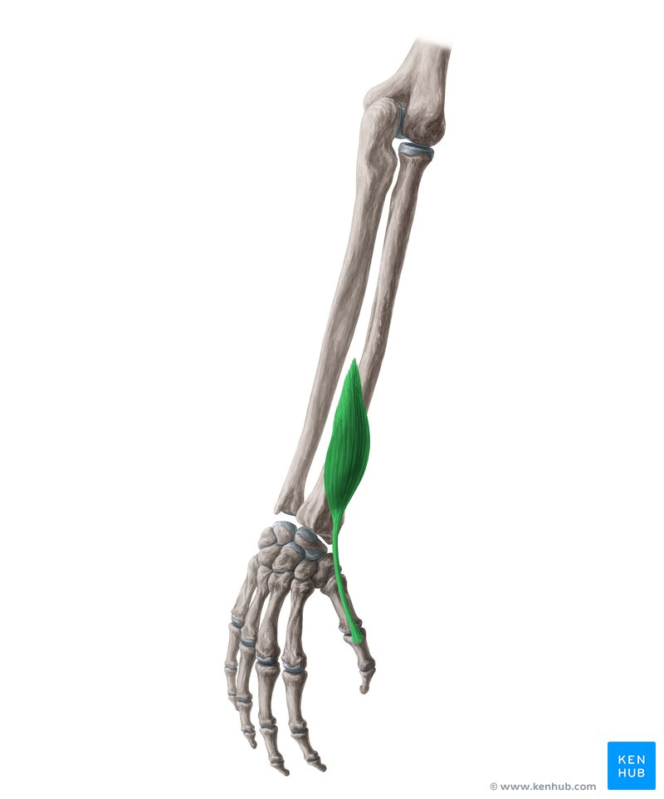
Extensor pollicis brevis
Origin
Interosseous membrane and
posterior surface of middle
third of radius
Insertion
Base of proximal phalanx
of thumb

Slide 52
Nerve
Deep branch of
radial nerve
Action
Extends proximal phalanx
of thumb and abducts
hand

Slide 53
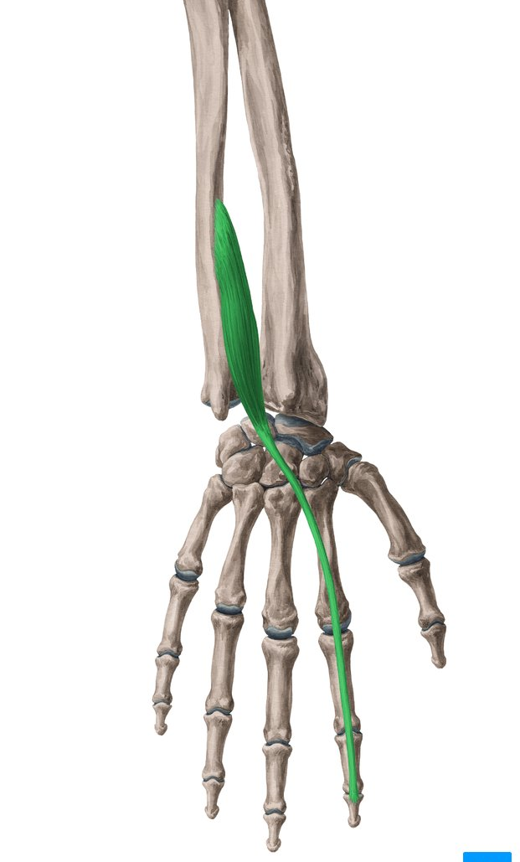
Extensor indicis
Origin
Posterior surface of ulna and
interosseous membrane
Insertion
Extensor expansion of index
finger

Slide 54
Nerve
Deep branch of
radial nerve
Action
Extends index finger

Slide 55
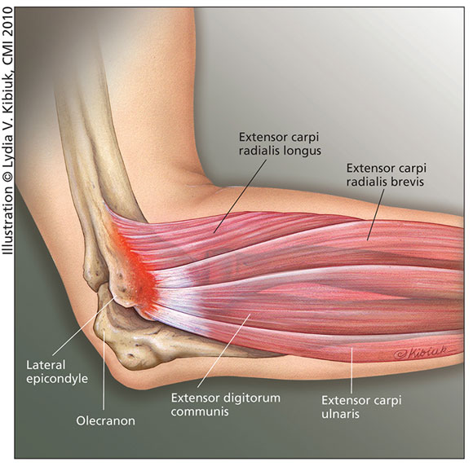
Tennis elbow (lateral epicondylitis)
chronic inflammation or irritation of the origin (tendon) of the extensor muscles of the forearm , painful , treated with NSAIDs , bracing, injections , surgery

Slide 56
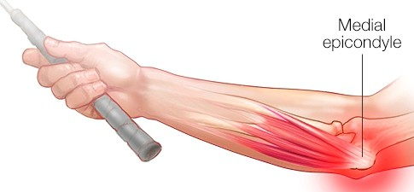
Golfer’s elbow (medial epicondylitis)
small tear or an inflammation or irritation in the origin of the flexor muscles of the forearm from the medial epicondyle.

Slide 57
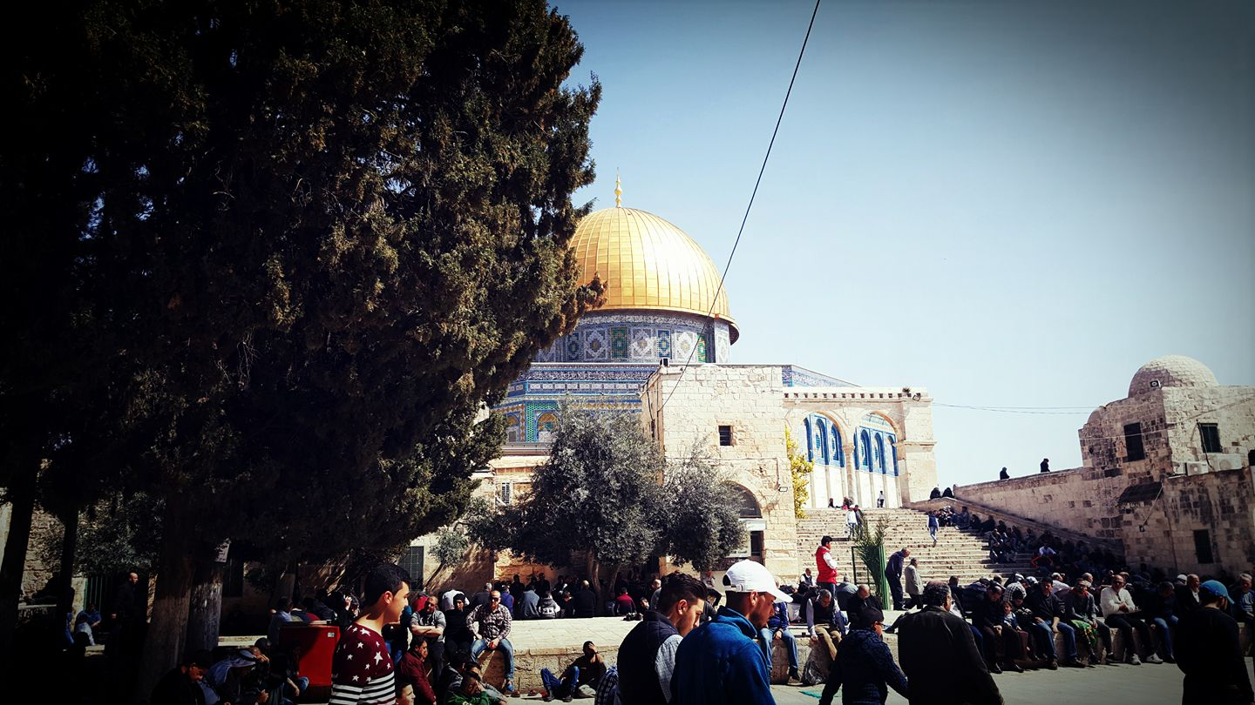

Slide 58
Cubital fossa

Slide 59
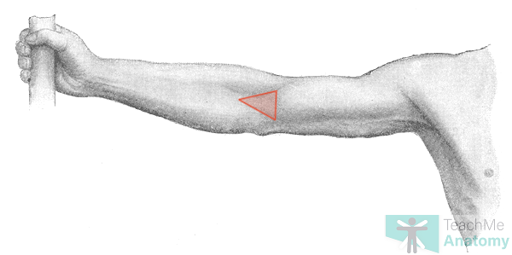
The cubital fossa is a triangular depression that lies in front of the elbow

Slide 60

Boundaries
■■ Laterally: The brachioradialis muscle
■■ Medially: The pronator teres muscle
■■ base : an imaginary line drawn between the two epicondyles
■■ Floor : supinator + brachialis muscle
■■ Roof : skin + fascia

Slide 61

Contents
From medial to lateral :
median nerve→ brachial artery (bifurcation) →
biceps tendon→ radial nerve and its deep branch.

Slide 62
Vessels of upper limb

Slide 63


Slide 64

Axillary Artery
Starts:
At outer border of 1st rib.
As a continuation of Subclavian a.
Ends:
At lower border of teres major m.
To become Brachial a.
Divided by pect. Minor in to 3 parts

Slide 65
1st part:
Outer border of 1st rib
➲
Medial border of pect. Minor
One branch:
Sup. (highest) thoracic a.
2nd part:
Post. to pec. Minor
2 branches:
Thoracoacromial a.
Lateral thoracic a.
3rd part:
Lat. border of pec. minor
➲
lower border of teres major
3 branch:
Subscapular a.
(largest branch of axillary)
Ant. circumflex humeral a.
(in front of surgical neck)
Post. circumflex humeral a.
(behind the surgical neck)

Slide 66

Scapular Anastomosis
An arterial Anastomoses
between branches of
1st part Subclavian a.
& 3rd part of Axillary a.
Branches of subclavian:
■ Suprascapular a.
■ superficial cervical artery, which gives off a deep branch
Branches of axillary:
■ Subscapular a. →Circumflex scapular a.
■ The anterior circumflex humeral artery
■ The posterior circumflex humeral artery

Slide 67

Scapular Anastomoses

Slide 68
Brachial Artery
Starts:
At lower border of teres major m.
As a continuation of axillary a.
Ends
In cubital fossa, 1 cm below elbow joint, opposite to radial neck
By dividing into:
Radial & Ulnar a.
Basilic vein lie on its medial side

Slide 69


Slide 70

Upper ½ of arm:
Between median & ulnar n.
Medial to humerus bone
At middle of arm:
Crossed by median n. from
lat. to med. Side
Lie over humerus bone
At elbow:
Enters cubital fossa,
Medial to biceps tendon , lateral to the median nerve
Notes:
Separated from humerus bone by brachialis m

Slide 71
Branches of Brachial Artery
Muscular branches
To muscles of ant. compartment
Profanda brachii (Deep a. of the arm)
Pass post. largest branch
Follows radial n. into spiral groove
Supply triceps m.
Nutrient a.
To humerus
Sup. & Inf. ulnar collateral a.
Contribute to elbow anastomoses

Slide 72

Arteries in Forearm
Radial Artery
Arises from brachial a.(smaller branch)
Opposite to neck of radius (anteriorly)
End in the palm by becoming deep Palmar arch
Proximally:
Pass on lat. Aspect of forearm,
Beneath brachioradialis m.
Distally: Pass lat. To tendon of FCR, medial to tendon of BR
(site for pulsation)
Radial nerve lie lateral to artery
At wrist:
Wind backward to enter the
anatomical snuff box over scaphoid,trapezium bones

Slide 73

At hand : to be discussed at hand session

Slide 74

Ulnar Artery
Larger than radial a.
Arises from brachial a.
opposite to neck of radius
End in palm by becoming superficial palmar arch
Proximally:
Pass between FDS & FDP
Distally:
Pass between FDS &
tendon of FCU
Ulnar nerve lie on medial side of artery.

Slide 75

Veins of The Arm
Superficial Veins:
Cephalic v.
Basilic v.
Median cubital vein
Deep Veins:
Brachial v. (radial + ulnar veins)
(vena comitans: (accompanying vein)
pair of veins on the sides of brachial a.

Slide 76


Cephalic Vein
From lat. Side of venous network on the back of the hand
Ascends in the anterolateral aspect of forearm
Lat. to biceps m. in the arm
At delto-pectoral triangle:
drains to axillary v.

Slide 77
Basilic Vein
From medial side of venous network on the back of the hand
Ascends in posteromedial aspect of forearm
Medial side of biceps m. in the arm
At middle of arm:
Pierces deep fascia & join brachial vein.
To form: axillary vein

Slide 78


Median cubital vein
Is a branch of cephalic vein
Lies in cubital fossa
Joins Basilic vein
Crosses in front of brachial
artery and median nerve
Separated from them by bicipital aponeurosis.
(be carful during Venipuncture)

Slide 79
Axillary Vein
Medial to Axillary a.
Starts:
At lower border of teres major
By union of:
brachial veins + basilic vein
Ends:
Lat. Border of 1st rib
To become subclavian v.
Tributary
Cephalic vein above pec minor m

Slide 80


Slide 81
One of the following not attached to medial border of the scapula ?
Levator scapulae
Teres minor
serratus anterior
Rhomboides minor
Rhomboides major

Slide 82
One of the following not attached to medial border of the scapula ?
Levator scapulae
Teres minor
serratus anterior
Rhomboides minor
Rhomboides major

Slide 83
The glenoid cavity articulates with head of humerus By
Fibrous articulation
Cartligenous articulation
Plane synovial articulation
Ball and socket articulation
Hinge synovial articulation

Slide 84
The glenoid cavity articulates with head of humerus By
Fibrous articulation
Cartligenous articulation
Plane synovial articulation
Ball and socket articulation
Hinge synovial articulation

Slide 85
The surgical neck of humerus is related to ?
Radial nerve
Ulnar nerve
Median nerve
Axillary nerve
Non of above

Slide 86
The surgical neck of humerus is related to ?
Radial nerve
Ulnar nerve
Median nerve
Axillary nerve
Non of above

Slide 87
The bicipital groove contains :
Axillary artery
Long head of triceps
Coracobrachialis
Long head of biceps
Non of above

Slide 88
The bicipital groove contains :
Axillary artery
Long head of triceps
Coracobrachialis
Long head of biceps
Non of above

Slide 89
In klumpke palsy , deformity called ?
Winging of scapula
Claw hand
Ape hand
Wrist drop
Policeman’s tip position

Slide 90
In klumpke palsy , deformity called ?
Winging of scapula
Claw hand
Ape hand
Wrist drop
Policeman’s tip position

Slide 91
Root value of long thoracic nerve is ?
C5
C6
C7
C5+C6+C7
C5+C6+C7+C8

Slide 92
Root value of long thoracic nerve is ?
C5
C6
C7
C5+C6+C7
C5+C6+C7+C8

Slide 93

GOOD LUCK
Dr

