Slide 1
Bone Disorders
Jason Ryan, MD, MPH

Slide 2
Bone Disorders
Osteoporosis (thin bones)
Osteopetrosis (thick bones)
Rickets/Osteomalacia (nutritional bone disorders)
Paget’s disease (↑ bone turnover)

Slide 3
Osteopetrosis
Defective osteoclast activity
Osteoblastic activity >> osteoclastic activity
Increased bone density

Slide 4
Osteopetrosis
Autosomal recessive (infantile) form
  Most severe form
  Presents in infancy
  Mutations in carbonic anhydrase type II gene
  Also may have renal tubular acidosis
  Children may have seizures, intellectual disability
Autosomal dominant form
  Albers-Schönberg disease
  Presents in adolescence
  Milder form of disease
  May be asymptomatic – identified by x-ray

Slide 5
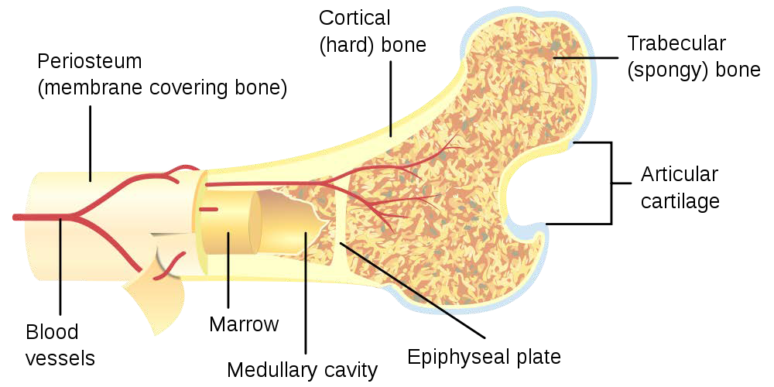
Osteopetrosis
Bones prone to fracture
Excess bone → loss of bone marrow
  Pancytopenia
  Enlarged liver and spleen (extramedullary hematopoiesis)
Excess bone in skull → cranial nerve compression
  Vision loss
  Deafness
  Facial paralysis
Hydrocephalus
Pbroks13 /Wikipedia

Slide 6
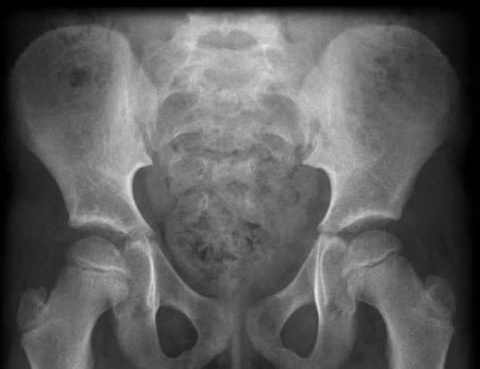
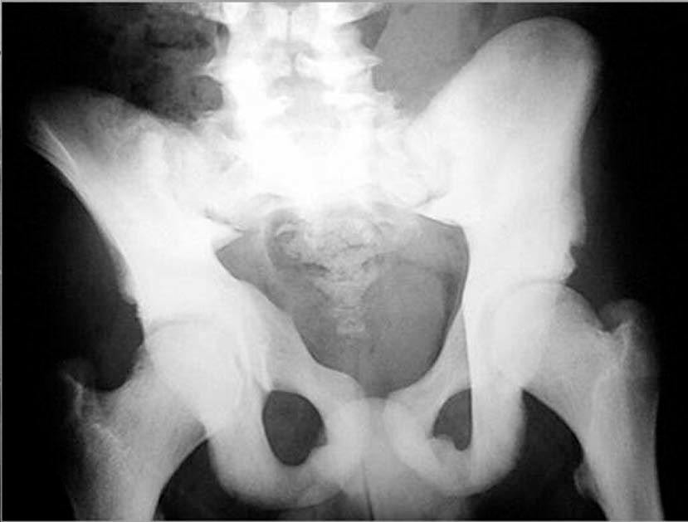
Osteopetrosis
Konstantinos et al. Rare causes of scoliosis and spine deformity, 10.1186/1748-7161-2-15

Slide 7
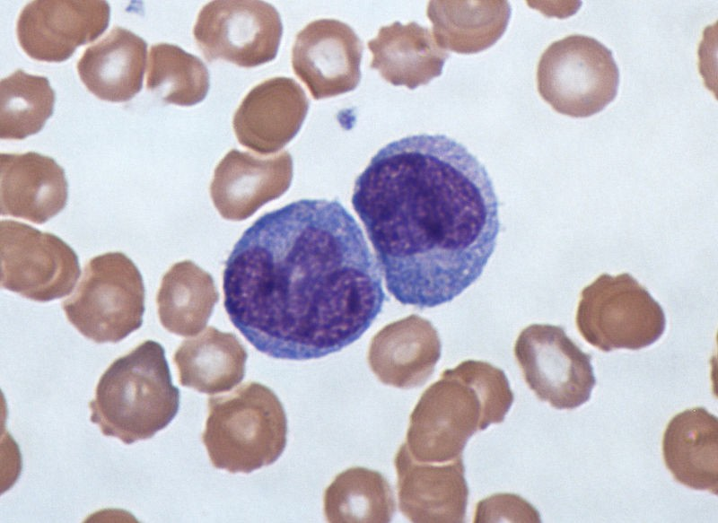
Osteopetrosis
Potentially curable with bone marrow transplant
Used for infantile form
Osteoclasts derived from monocytes/macrophages
Dr Graham Beards/Wikipedia

Slide 8
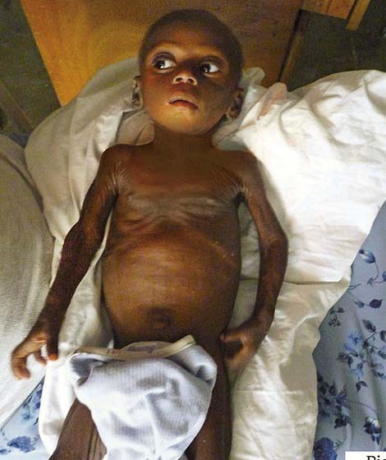
Rickets and Osteomalacia
Nutritional bone disorders
Low calcium or vitamin D intake
Feedmystarvingchildren/Flikr

Slide 9
Rickets and Osteomalacia
Poor mineralization of osteoid
  Non-mineralized bone matrix
  Mostly proteins
  Laid down by osteoblasts
  Later mineralized with calcium and phosphate
Sites of osteoid and new bone growth:
  Children: Growth plates
  Children and adults: Bone turnover

Slide 10
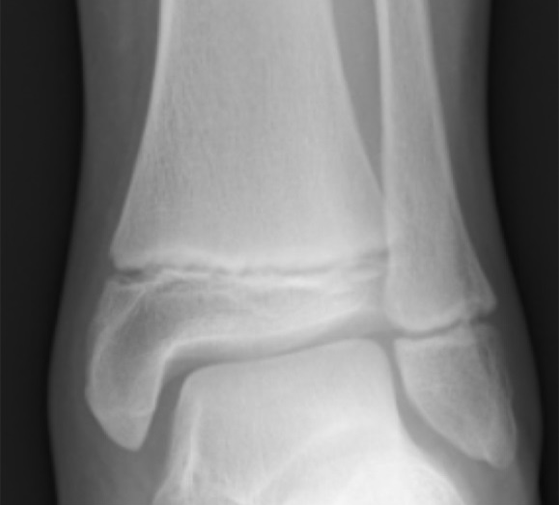
Growth Plates
Found at ends of long bones in children
Contains hyaline cartilage
Chondrocytes grow toward epiphysis
Osteoblasts lay down matrix toward diaphysis
Gilo1969/Wikipedia

Slide 11
Rickets
Growth plate thickens
  Chondrocytes expand (disorganized growth)
  Osteoblasts lay down osteoid only
Bone thickening from osteoid accumulation
Distorted bone growth

Slide 12
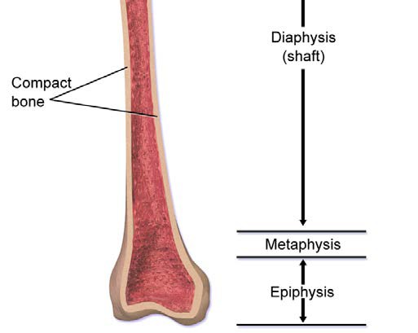
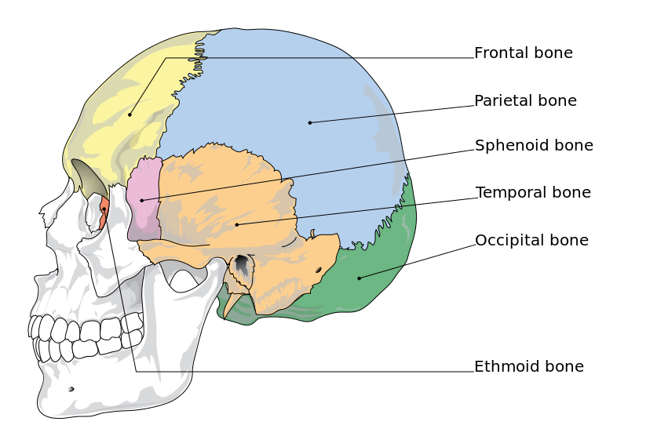
Rickets
Epiphyseal widening
Bowed legs (genu varum)
Swelling at costochondral junctions
  Rachitic rosary
Craniotabes (soft skull)
  Occipital/parietal bones
  Collapse with pressure
BruceBlaus /Wikipedia

Slide 13
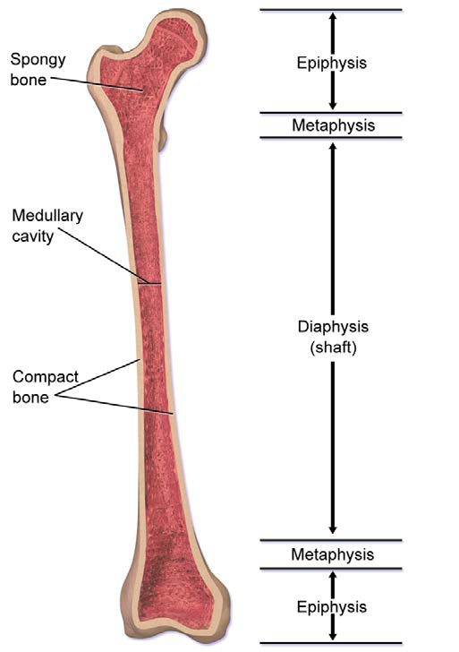
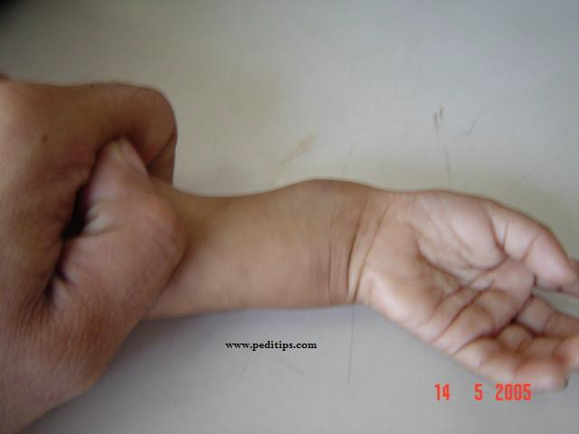
Epiphyseal Widening
Wikipedia/Public Domain
BruceBlaus /Wikipedia

Slide 14
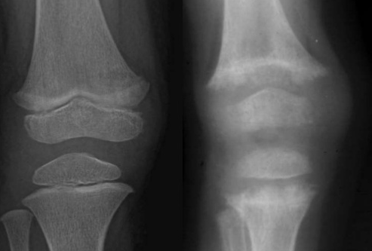
Growth Plate Fraying
Normal
Rickets
Pro Faather/Slideshare

Slide 15
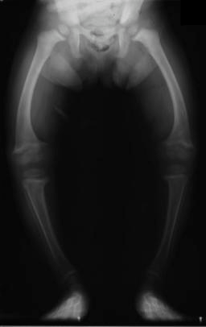
Genu Varum
Michael L. Richardson, M.D./Wikipedia

Slide 16
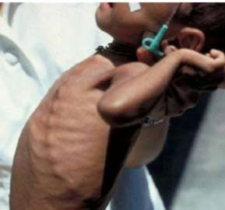
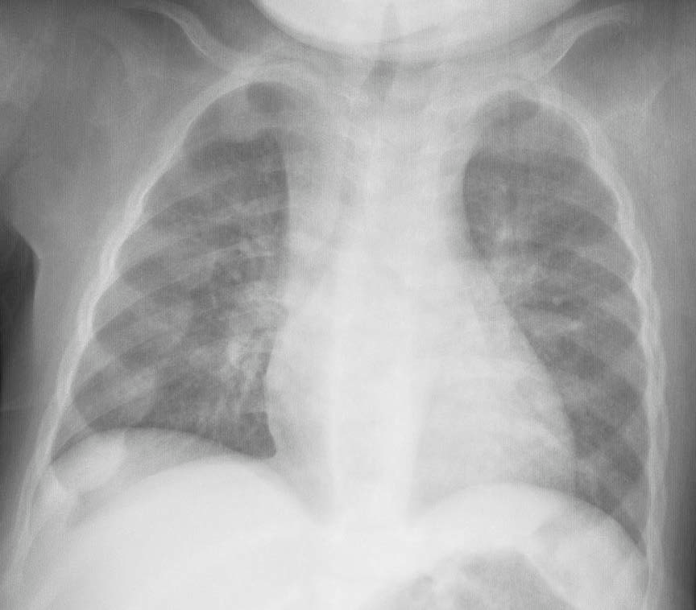
Rachitic Rosary
Ma Wady/Public Domain
Frank Gaillard/Wikipedia

Slide 17
Osteomalacia
Children and adults
Occurs in areas of bone turnover
Bone pain/tenderness
Most often spine, pelvis, and legs
Fractures

Slide 18
Osteomalacia
Two classic x-ray findings:
  Pseudofractures
  Looser Zones
Caused by:
  Repaired stress fractures, inadequately mineralized
  Erosion of bone by arterial pulsations

Slide 19

Pseudofracture
CalgaryCentre/Slideshare

Slide 20
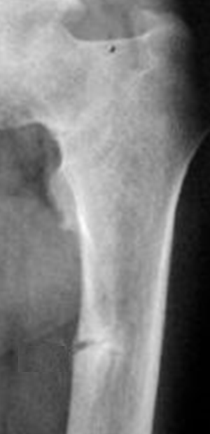
Looser Zone
Pintrest/Public Domain

Slide 21
Rickets and Osteomalacia
Causes
Vitamin D deficiency
  Maternal deficiency during pregnancy
  Reduced sun exposure
  Fat malabsorption
  Cystic fibrosis, pancreatitis, Celiac disease, IBD
  Liver and renal failure (both activate viatamin D)
Calcium deficiency (rare)
  Only seen with severe dietary deficiency
Treatment: Vitamin D and Ca supplementation

Slide 22
Rickets and Osteomalacia
Lab Findings
↓ Calcium
↓ Vitamin D

Slide 23
Vitamin D
Liver: 25-OH Vitamin D (calcidiol)
Kidney: 1,25-OH₂ Vitamin D (calcitriol; active form)
25-OH Vitamin D = storage form
  Constantly produced by liver
  Available for activation by kidney as needed
Serum 25-OH VitD best indicator vitamin D status
  Long half-life
  Liver production not regulated by PTH

Slide 24
Rickets and Osteomalacia
Lab Findings
↑ Parathyroid hormone (PTH)
  Normal response of parathyroid gland
↓ Phosphate
  Excretion promoted by PTH
↑ Bone alkaline phosphatase
  ↑ osteoblast activity

Slide 25
Paget’s Disease
Osteitis Deformans
Focal disorder
Common in older patients
  Average age at diagnosis: 70

Slide 26
Paget’s Disease
Osteitis Deformans
Excessive bone remodeling
Overgrowth of bone at focal sites of bone
New bone: abnormally large, deformed
Exact cause unknown
Believe to be due to abnormal osteoclasts

Slide 27
Paget’s Disease
Osteitis Deformans
Evolves through phases/stages
Initial phase: osteolytic
  Osteoclasts breakdown bone
  Bizarre shape, numerous
  Multi-nucleated
Mixed phase: osteolytic-osteoblastic
Final phase: Osteosclerotic
  Bone formation dominates
  Hypervascularity of bone occurs

Slide 28
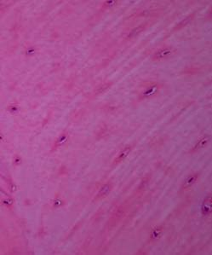
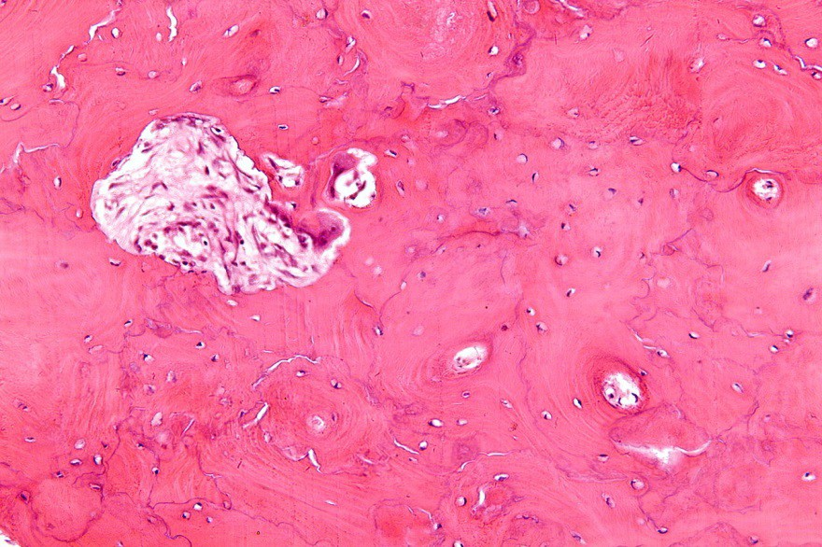
Paget’s Disease
Bone Morphology
Hallmark: mosaic pattern of lamellar bone
Cement lines
Normal
Paget’s
Nephron/Wikipedia

Slide 29
Paget’s Disease
Clinical Features
May be asymptomatic
Often affects long bones, skull, spine
Pathologic fractures (most common complication)
  “Chalkstick” fracture
Bone pain (microfractures)
Bowing of legs

Slide 30
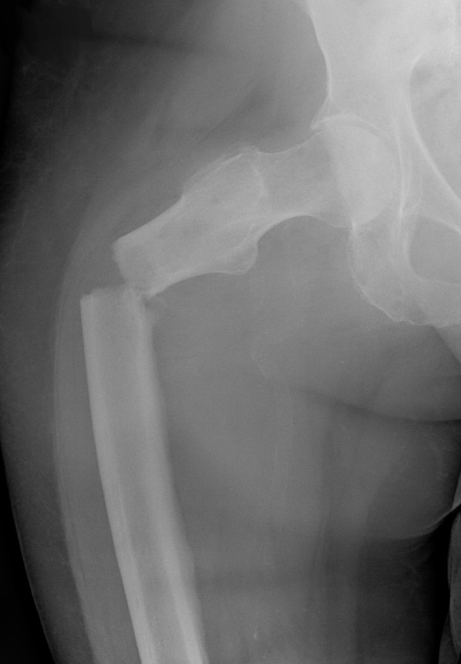
Chalkstick Fracture
Hellerhoff/Wikipedia

Slide 31
Paget’s Disease
Clinical Features
Enlarged skull (increased hat size)
Cranial nerve compression (deafness)
Radiculopathy at spine
Erythema may occur over affected bone area
  Due to hypervascularity

Slide 32
Paget’s Disease
Clinical Features
High output heart failure
  AV fistula in new bone
Osteosarcoma
  Increased risk in Paget’s disease

Slide 33
Paget’s Disease
Clinical Features
Increase bone alkaline phosphatase
Treatment: bisphosphonates and calcitonin

Slide 34
Osteitis Fibrosa Cystica
Classic bone disease of hyperparathyroidism
Clinical features: Bone pain and fractures
Parathyroid adenoma
  ↑ PTH
  Hypercalcemia
  ↓ Phosphate

Slide 35

Osteitis Fibrosa Cystica
Subperiosteal bone resorption
  Commonly seen in bones of fingers
  Irregular or indented edges to bones
Brown tumors (osteoclastoma)
  Collections of giant osteoclasts in bone
  Mixed with stromal cells and matrix proteins
  Appear as black spaces in bone on x ray
Pbroks13 /Wikipedia

Slide 36
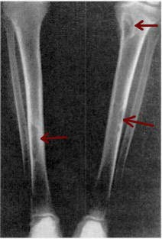
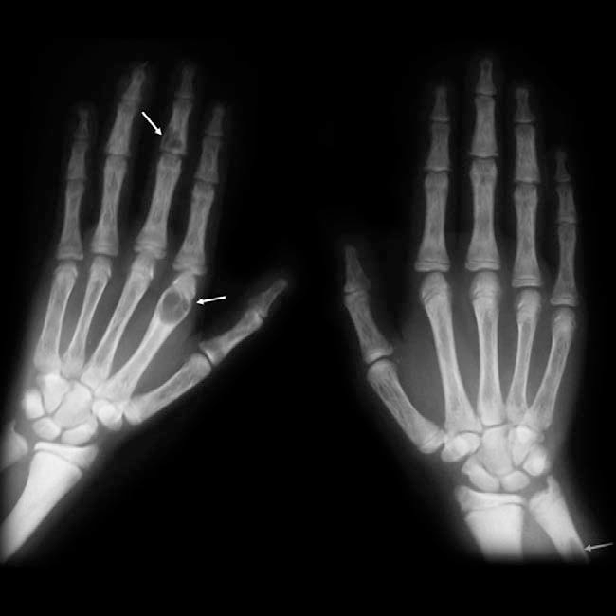
Osteitis Fibrosa Cystica
Frank Gaillard/Wikipedia

Slide 37
Renal Osteodystrophy
Bone abnormalities seen in renal failure
Hypocalcemia
Hyperparathyroidism
Osteitis Fibrosa Cystica
Rickets/osteomalacia
Osteopenia/osteoporosis
Growth retardation
Bone pain
Fractures

Slide 38
Bone Pain/Fractures
Bone Pain/Fractures
Normal Calcium Normal PTH
↓Calcium
↑PTH
↑Calcium
↑PTH
Osteoporosis Osteopetrosis Paget Disease Bone Tumors
Calcium/Vitamin D Dietary Malabsorption
Osteitis Fibrosa Cystica Parathyroid adenoma

Slide 39
Osteoporosis
Jason Ryan, MD, MPH

Slide 40
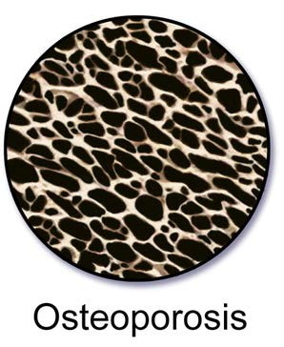
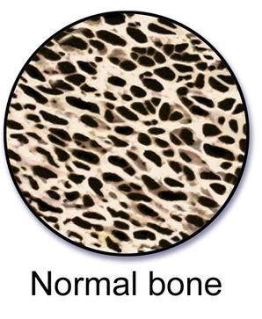
Osteoporosis
Porous bone
Weak bones prone to fracture
No clinical symptoms until fracture
BruceBlaus/Wikipedia

Slide 41
Terminology
Osteopenia: ↓ bone mass
Osteoporosis: markedly ↓ bone mass
Osteoporosis associated with ↑ fracture risk

Slide 42
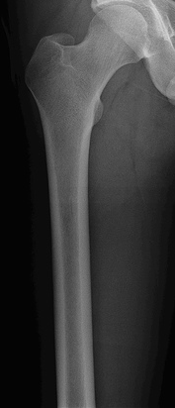
Osteoporosis
Trabecular bone > cortical bone
  Trabecular bone: high surface area
  Osteoblasts/osteoclasts found on surface
High trabecular bone content:
  Spine
  Head of femur (hip)
  Wrist (distal radius)
Pbroks13 /Wikipedia

Slide 43
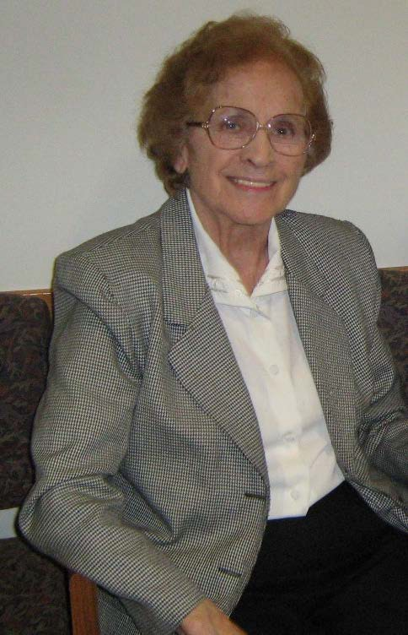
Osteoporosis
Common in elderly, white women
Dr. Ryan’s Grandmother

Slide 44
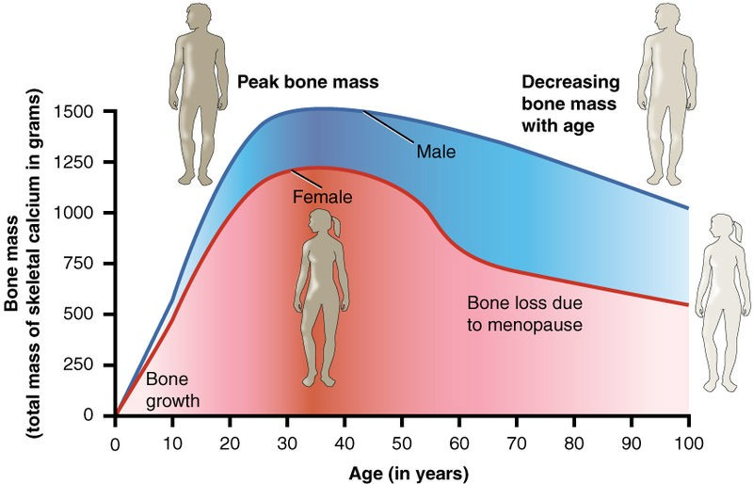
Bone Mass
Peak bone mass occurs in young adulthood
  Many influences: gender, genetics, diet
Decreases slowly thereafter
  Each resorption/formation cycle → some bone loss
OpenStax College/Wikipedia

Slide 45
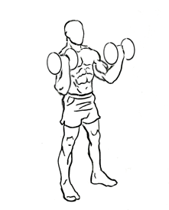
Bone Loss
Males achieve higher peak bone mass
Bone loss less likely to lead to osteoporosis
Whites > African Americans
Weight-bearing activity → ↑ bone mass
Everkinetic/Wikipedia

Slide 46
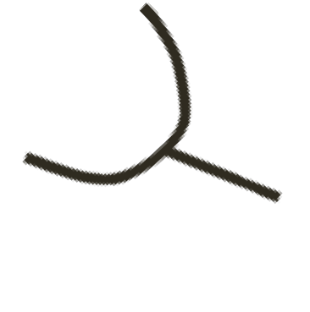
Menopause
Accelerates bone loss in women
Caused by estrogen deficiency
  Increased osteoclast activity
  Increased levels of RANK-L
  Decreased osteoprotegerin (OPG)
Osteoblast
R
RANK-L
Osteoclast
RANK
OPG

Slide 47
Osteoporosis
Most osteoporosis: senile/postmenopausal
Calcium, PTH, Alkaline phosphatase all normal
Less commonly: secondary osteoporosis

Slide 48
Osteoporosis
Secondary Causes
Glucocorticoids
  Increase bone resorption
  Reduce bone formation
  Suppress synthesis of OPG
  Increase RANK production
Osteoblast
R
RANK-L
Osteoclast
RANK
OPG

Slide 49


Osteoporosis
Secondary Causes
Alcohol
  Heavy use associated with osteoporosis
  Often leads to falls/hip fracture
  Moderate use effects not clear
Smoking
  Accelerates bone loss
Pixabay/Public Domain
Pixabay/Public Domain

Slide 50
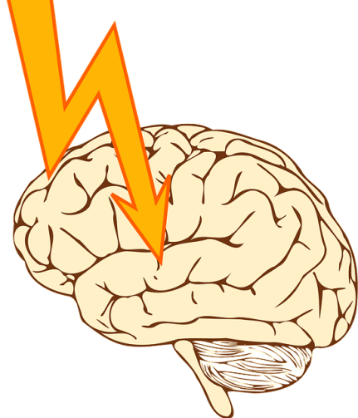
Anticonvulsants
Phenobarbital, Phenytoin, Carbamazepine
Used to treat seizures/epilepsy
Risk of osteoporosis with long term therapy
Increase activity of P450 enzymes
Increases breakdown of vitamin D
Less calcium → increased PTH → bone loss
Pixabay/Public Domain

Slide 51
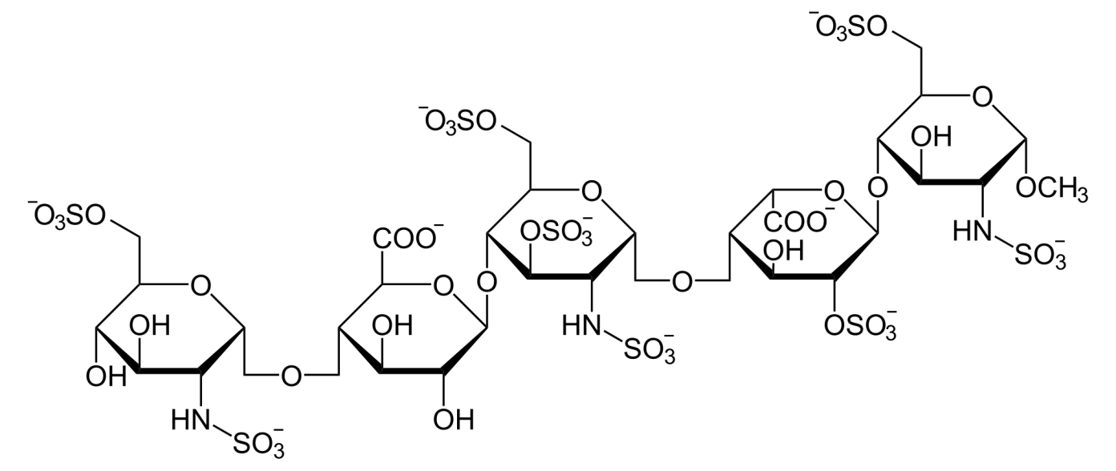
Anticoagulants
Unfractionated Heparin
  Decreases bone formation
  Increases resorption
Only with long term use
Low molecular weight heparin: unclear bone effects
Unfractionated Heparin

Slide 52
Thyroid Replacement
Hyperthyroidism → osteoporosis/fractures
Levothyroxine (T4) used in hypothyroidism
Too high dose → iatrogenic hyperthyroidism
  If mild may produce no symptoms
Key test: TSH
If TSH is low (“suppressed”) need to lower dose
Many elderly, post-menopausal women take T4

Slide 53
Osteoporosis
Secondary Causes
Hyperparathyroidism
Hyperthyroidism
Multiple myeloma
  Myeloma cells → Increase osteoclast activity
  Results in “lytic” bone lesions of MM
Malabsorption syndromes
  Celiac disease, Crohn’s, Ulcerative Colitis
  Poor absorption calcium and vitamin D

Slide 54
Osteoporosis
Diagnosis
Fragility fracture
  Fall from standing height or less
  Not from major trauma (i.e. MVA)
  Spine, hip, wrist, humerus, rib, or pelvis
  Also a spontaneous vertebral “compression” fracture
T score of -2.5 or lower

Slide 55
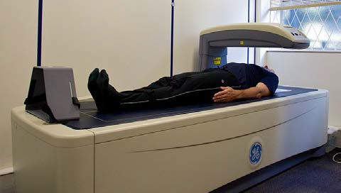
DXA
Dual-energy X-ray absorptiometry
Two X-rays of different energy levels aimed at bones
T score: patient BMD vs. healthy 30-year-old BMD
Normal: -1.0 or higher (least fractures)
Osteopenia: -1.0 to -2.5
Osteoporosis: -2.5 or lower (most fractures)
Recommended for screening in women >65
Nick Smith photography/Wikipedia

Slide 56
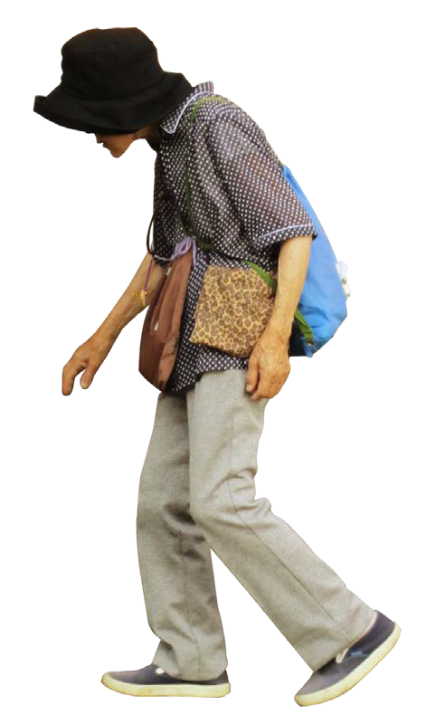
Fractures
Hip
  Weight-bearing joint
  Easily injured from fall
Spine
  Lower thoracic/lumbar spine
  “Compression” fractures
  Often occur slowly over time
  Minor trauma of daily activates
  Loss of height
  Kyphosis (forward curved spine)
  Back pain
James Heilman/Wikipedia

