Slide 1
Biochemistry of fibrous proteins (collagen and elastin)
Dr. Oday Hamad, MD

Slide 2
OVERVIEW
Collagen and elastin are examples of common, well-characterized fibrous proteins of the extracellular matrix that serve structural functions in the body.
For example, collagen and elastin are found as components of skin, connective tissue, blood vessel walls, and the sclera and cornea of the eye. Each fibrous protein exhibits special mechanical properties, resulting from its unique structure, which is obtained by combining specific amino acids into regular, secondary structural elements.

Slide 3
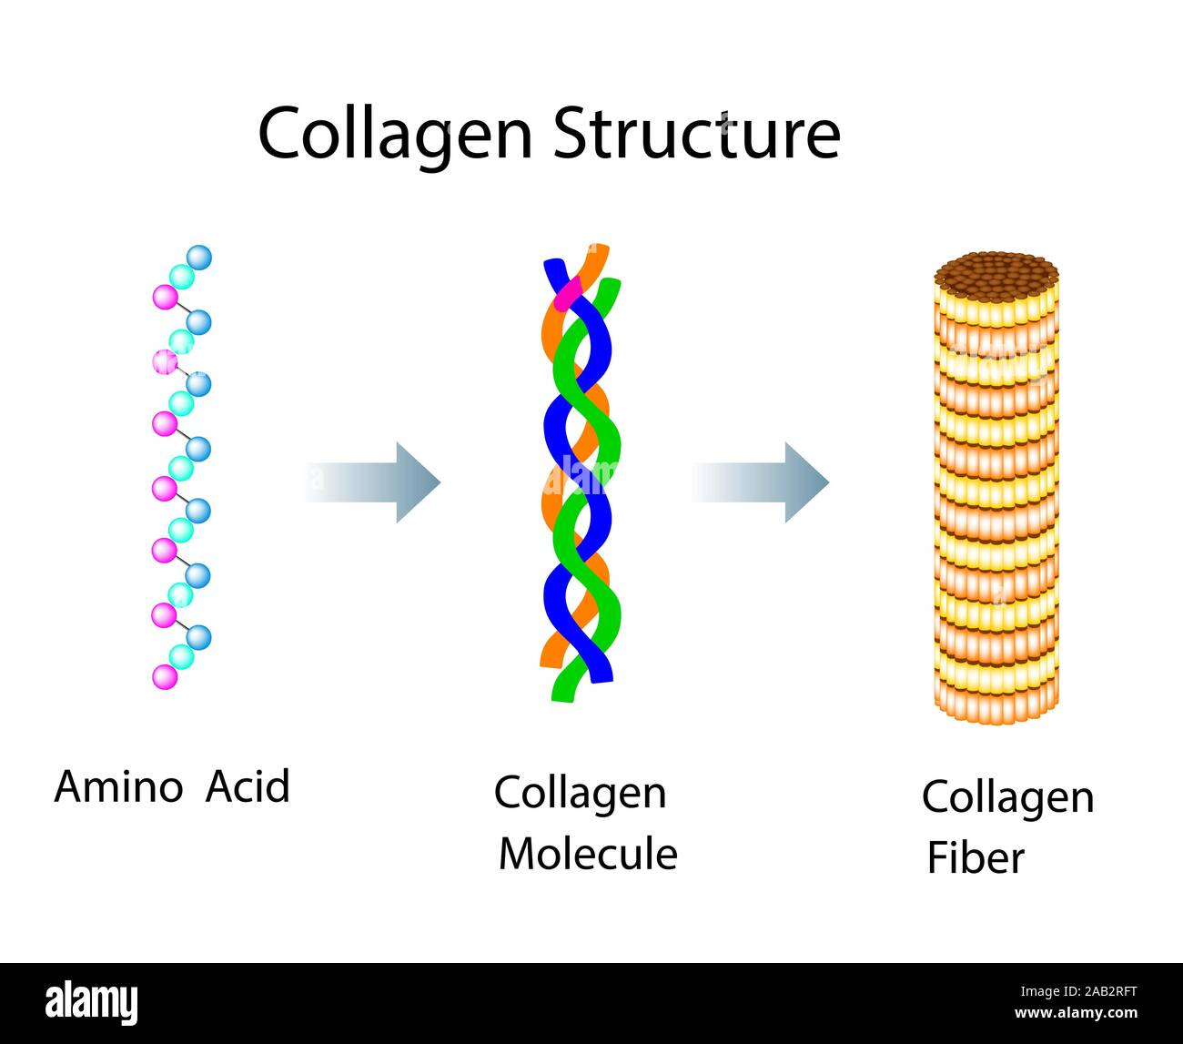
COLLAGEN
Collagen is the most abundant protein in the human body. A typical collagen molecule is a long, rigid structure in which three polypeptides (referred to as α chains) are wound around one another in a rope-like triple helix.

Slide 4
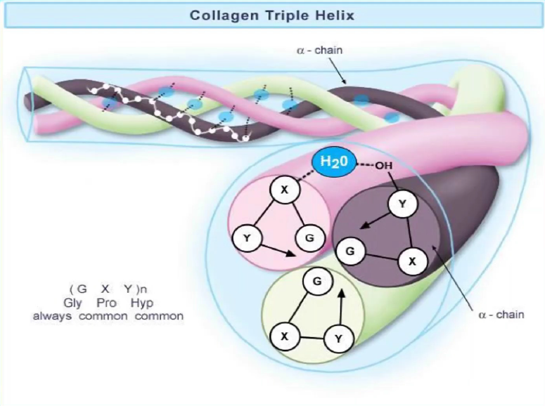

Slide 5
Although these molecules are found throughout the body, their types and organization are dictated by the structural role collagen plays in a particular organ.
In some tissues, collagen may be dispersed as a gel that gives support to the structure, as in the extracellular matrix or the vitreous humor of the eye.
In other tissues, collagen may be bundled in tight, parallel fibers that provide great strength, as in tendons.
In the cornea of the eye, collagen is stacked to transmit light with a minimum of scattering.
Collagen of bone occurs as fibers are arranged at an angle to each other to resist mechanical shear from any direction.

Slide 6
A. Types
The collagen superfamily of proteins includes more than 25 collagen types as well as additional proteins that have collagen-like domains. The three polypeptide α chains are held together by interchain hydrogen bonds.
Variations in the amino acid sequence of the α chains result in structural components that are about the same size (approximately 1,000 amino acids long) but with slightly different properties.
These α chains are combined to form the various types of collagen found in the tissues. For example, the most common collagen, type I, contains two chains called α1 and one chain called α2 (α12α2), whereas type II collagen contains three α1 chains (α13). The collagens can be organized into three groups, based on their location and functions in the body

Slide 7
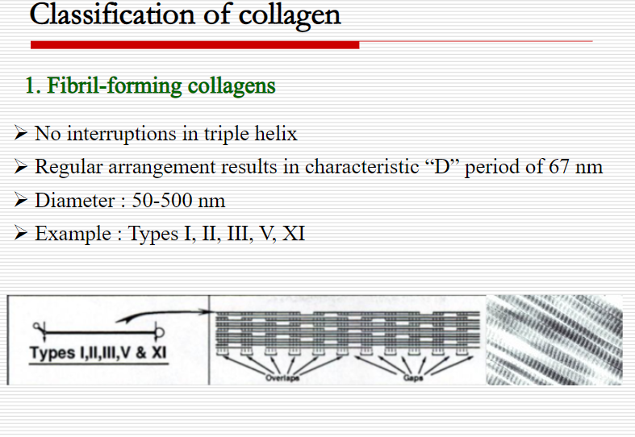
1. Fibril-forming collagens:
Types I, II, and III are the fibrillar collagens and have the rope-like structure described above for a typical collagen molecule. In the electron microscope, these linear polymers of fibrils have characteristic banding patterns, reflecting the regular staggered packing of the individual collagen molecules in the fibril.
Type I collagen fibers (composed of collagen fibrils) are found in supporting elements of the high tensile strength (for example, tendon and cornea), whereas fibers formed from type II collagen molecules are restricted to cartilaginous structures. The fibers derived from type III collagen are prevalent in more distensible tissues such as blood vessels.

Slide 8
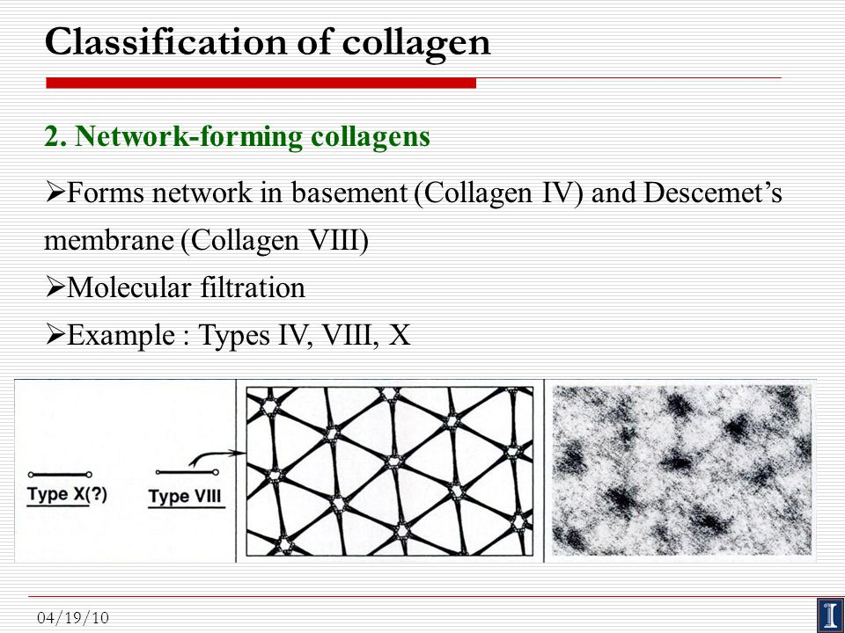
2. Network-forming collagens:
Types IV and VIII form a three-dimensional mesh, rather than distinct fibrils. For example, type IV molecules assemble into a sheet or meshwork that constitutes a major part of basement membranes.

Slide 9
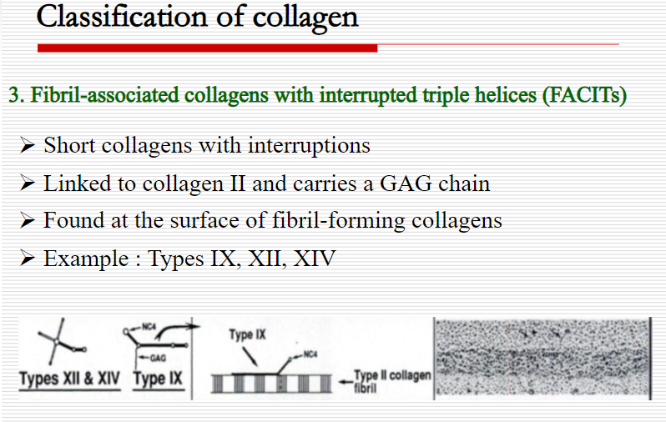
3. Fibril-associated collagens:
Types IX and XII bind to the surface of collagen fibrils, linking these fibrils to one another and to other components in the extracellular matrix

Slide 10
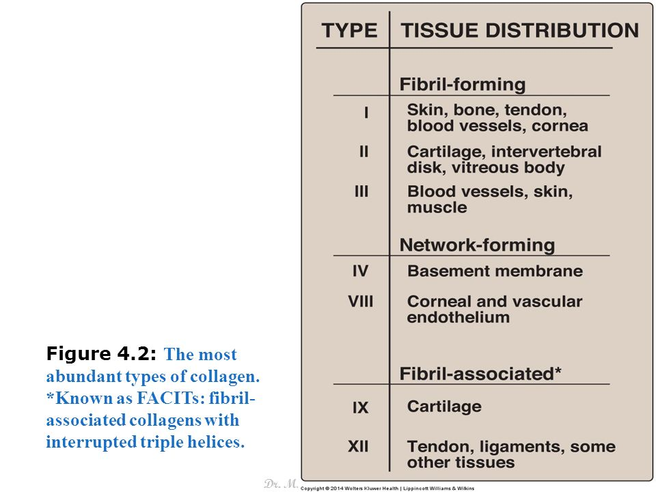

Slide 11
B. Structure
Amino acid sequence: Collagen is rich in proline and glycine, both of which are important in the formation of the triple-stranded helix. Proline facilitates the formation of the helical conformation of each α chain because its ring structure causes “kinks” in the peptide chain
Glycine, the smallest amino acid, is found in every third position of the polypeptide chain. It fits into the restricted spaces where the three chains of the helix come together. The glycine residues are part of a repeating sequence, –Gly–X–Y–, where X is frequently proline, and Y is often hydroxyproline (but can be hydroxylysine). Thus, most of the α chain can be regarded as a polytripeptide whose sequence can be represented as (–Gly–Pro–Hyp–)333.

Slide 12
2. Triple-helical structure: Unlike most globular proteins that are folded into compact structures, collagen, a fibrous protein, has an elongated, triple-helical structure that is stabilized by interchain hydrogen bonds.
3. Hydroxyproline and hydroxylysine: Collagen contains hydroxyproline and hydroxylysine, which are not present in most other proteins. These residues result from the hydroxylation of some of the proline and lysine residues after their incorporation into polypeptide chains.
Hydroxylation is, thus, an example of posttranslational modification. [Note: Generation of hydroxyproline maximizes formation of interchain hydrogen bonds that stabilize the triple-helical structure.]

Slide 13
Glycosylation: The hydroxyl group of the hydroxylysine residues of collagen may be enzymatically glycosylated. Most commonly, glucose and galactose are sequentially attached to the polypeptide chain prior to the triple-helix formation

Slide 14
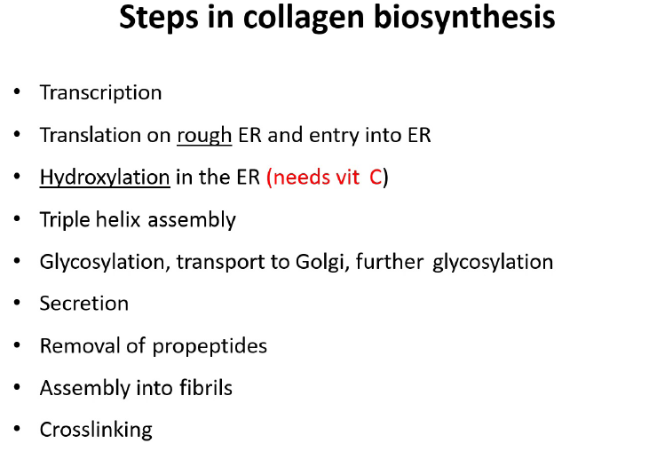

Slide 15
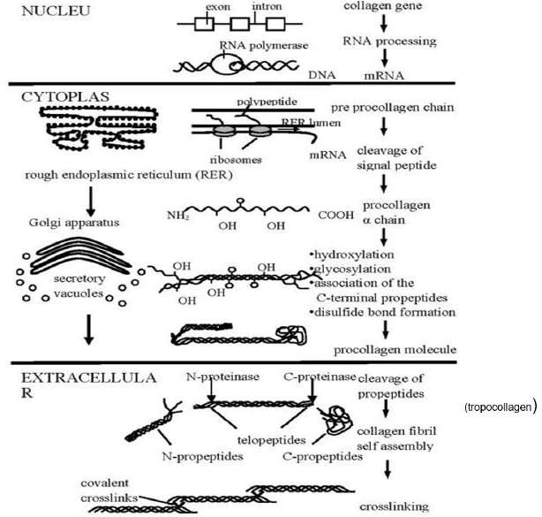

Slide 16
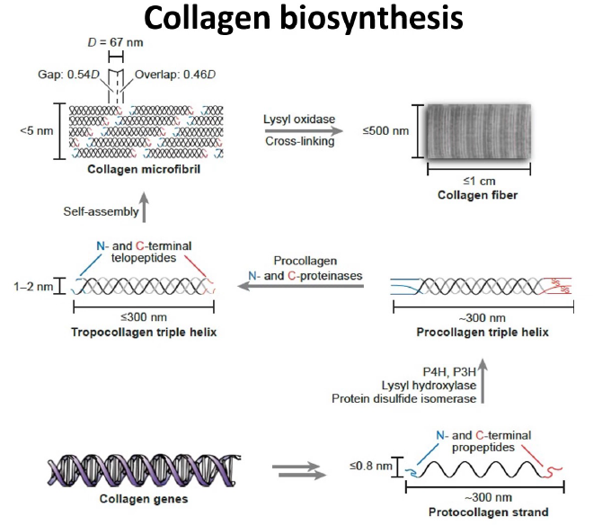

Slide 17
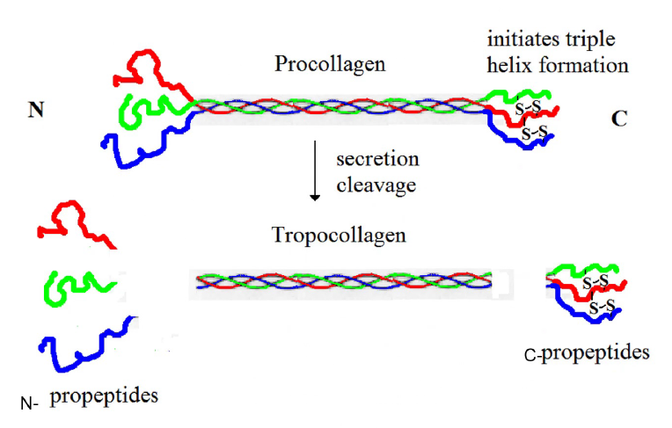

Slide 18
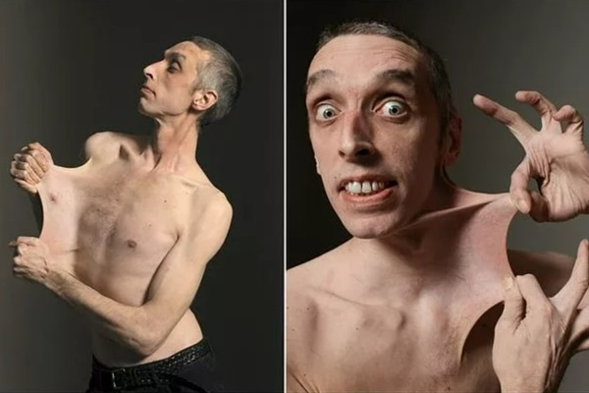
Collagen diseases: Collagenopathies
1. Ehlers-Danlos syndrome:
Ehlers-Danlos syndrome (EDS) is a heterogeneous group of connective tissue disorders that result from inheritable defects in the metabolism of fibrillar collagen molecules.
EDS can be caused by a deficiency of collagen-processing enzymes (for example, lysyl hydroxylase or N-procollagen peptidase) or from mutations in the amino acid sequences of collagen types I, III, or V.
The classic form of EDS, caused by defects in type V collagen, is characterized by skin extensibility and fragility and joint hypermobility

Slide 19
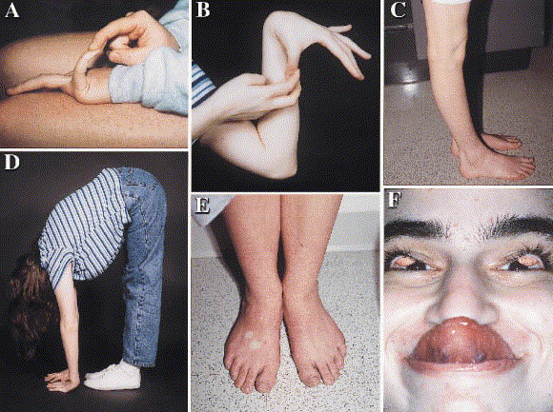

Slide 20
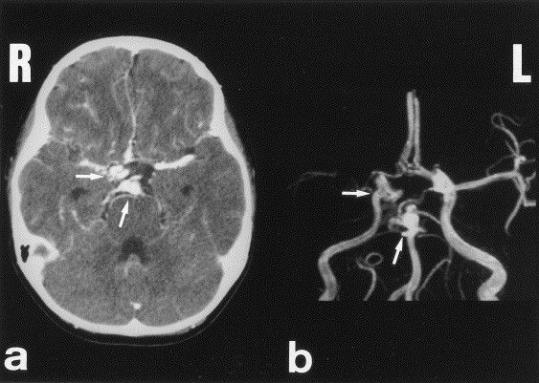
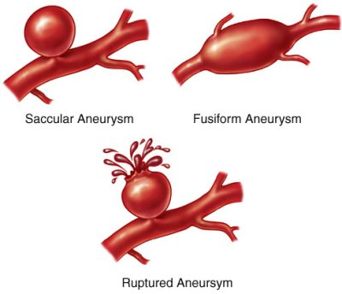
The vascular form, due to defects in type III collagen, is the most serious form of EDS because it is associated with potentially lethal arterial rupture. [Note: The classic and vascular forms show autosomal dominant inheritance.]

Slide 21
2. Osteogenesis imperfecta:
This syndrome, known as brittle bone disease, is a genetic disorder of bone fragility characterized by bones that fracture easily, with minor or no trauma. Over 80% of cases of osteogenesis imperfecta (OI) are caused by dominant mutations to the genes that code for the α1 or α2 chains in type I collagen.
The most common mutations cause the replacement of glycine (in –Gly–X–Y–) by amino acids with bulky side chains. The resultant structurally abnormal α chains prevent the formation of the required triple-helical conformation. Phenotypic severity ranges from mild to lethal.

Slide 22
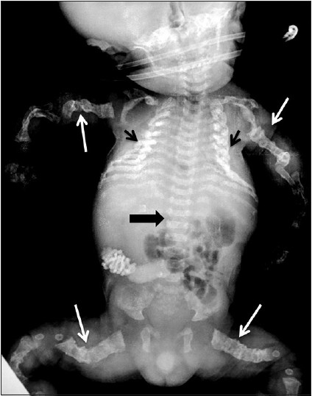
Type I OI, the most common form, is characterized by mild bone fragility, hearing loss, and blue sclerae.
Type II, the most severe form, is typically lethal in the perinatal period as a result of pulmonary complications. In utero fractures are seen.
Type III is also a severe form. It is characterized by multiple fractures at birth, short stature, spinal curvature leading to a “humped-back” (kyphotic) appearance, and blue sclerae. Dentinogenesis imperfecta, a disorder of tooth development, may be seen in OI.

Slide 23
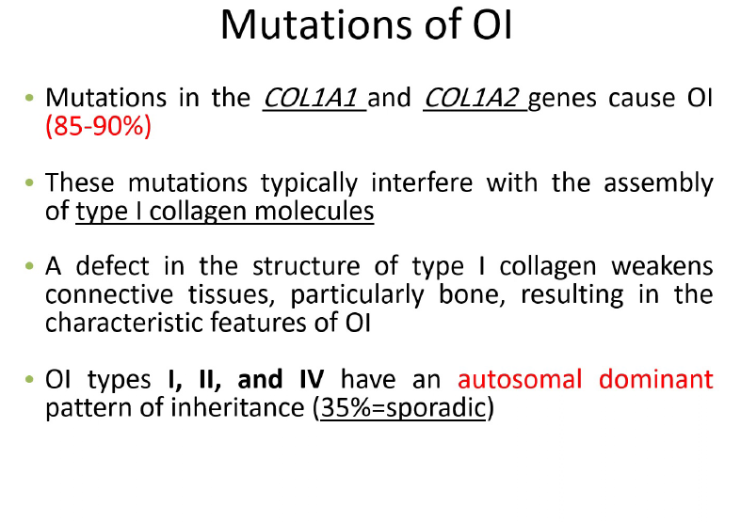

Slide 24
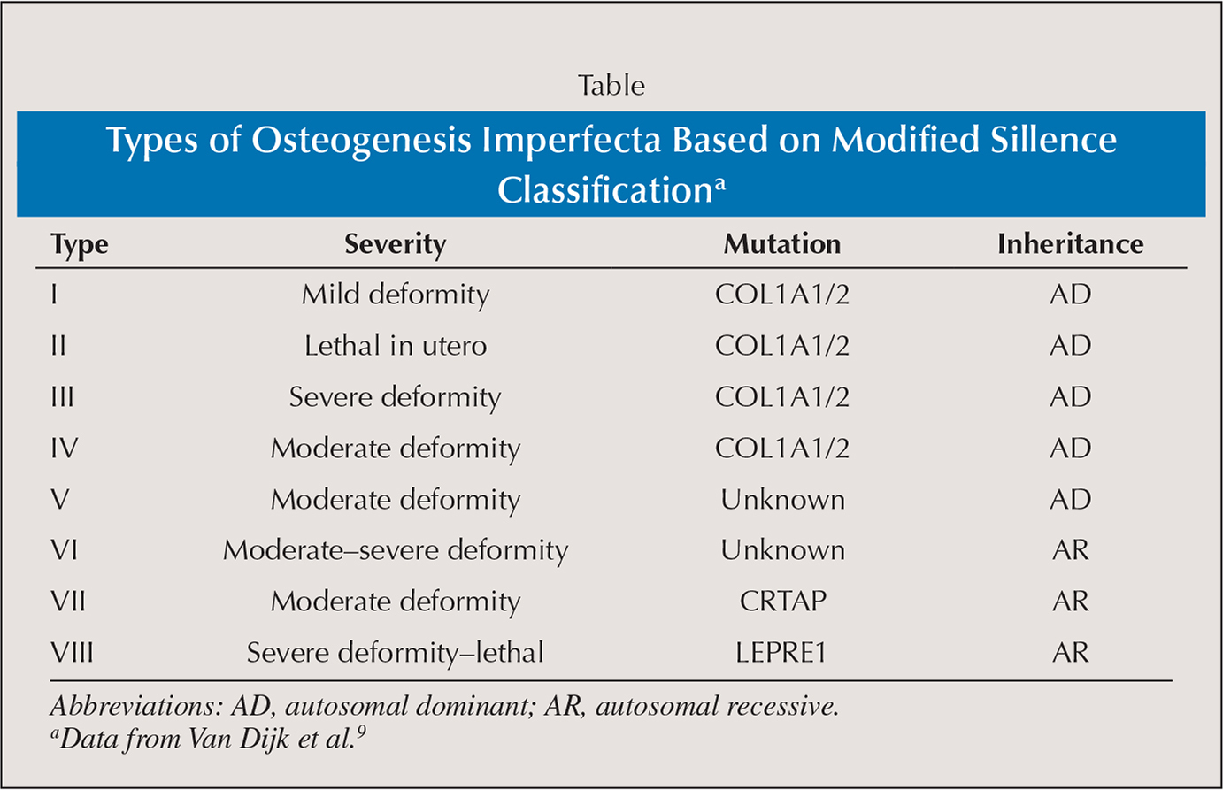

Slide 25
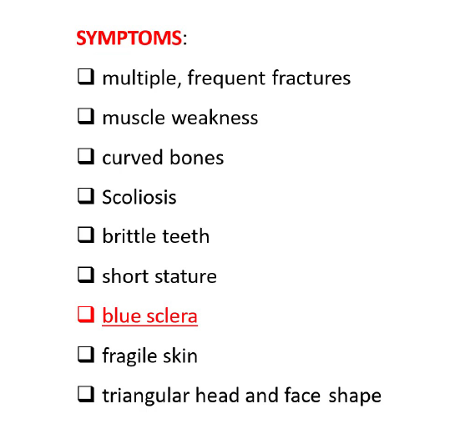

Slide 26
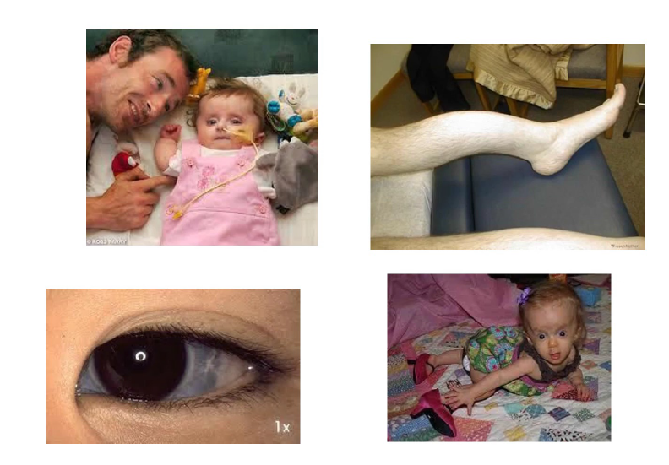

Slide 27
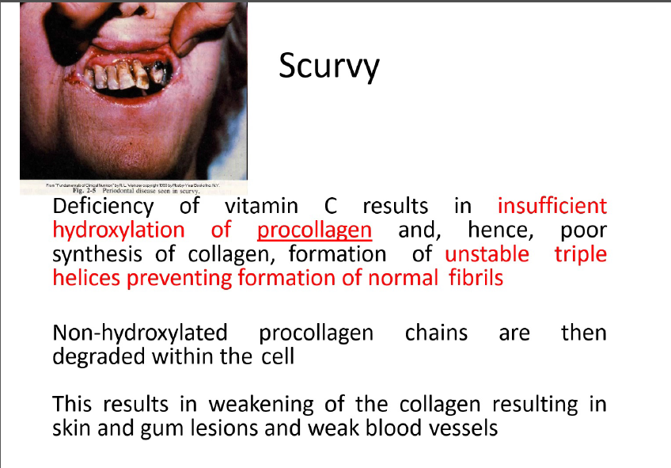

Slide 28
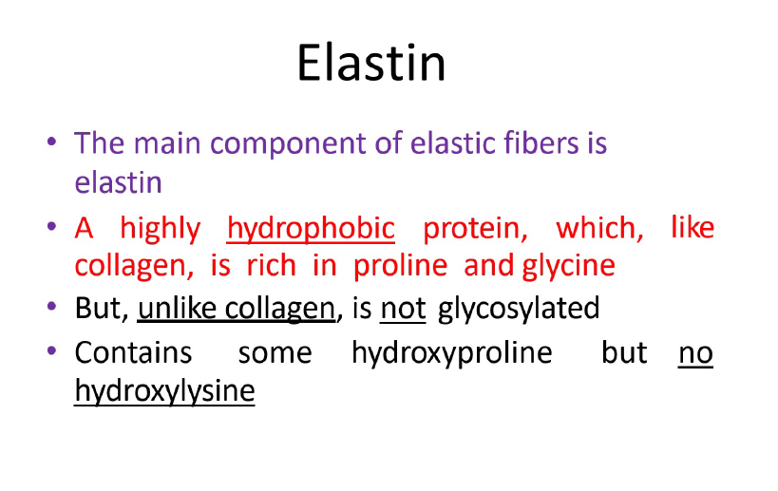

Slide 29
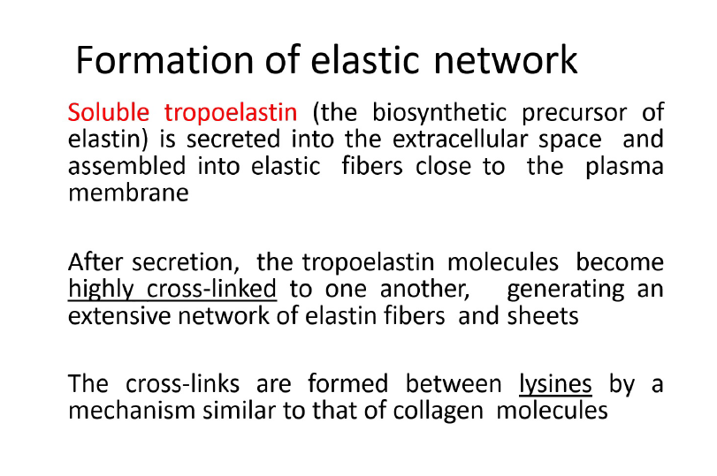

Slide 30
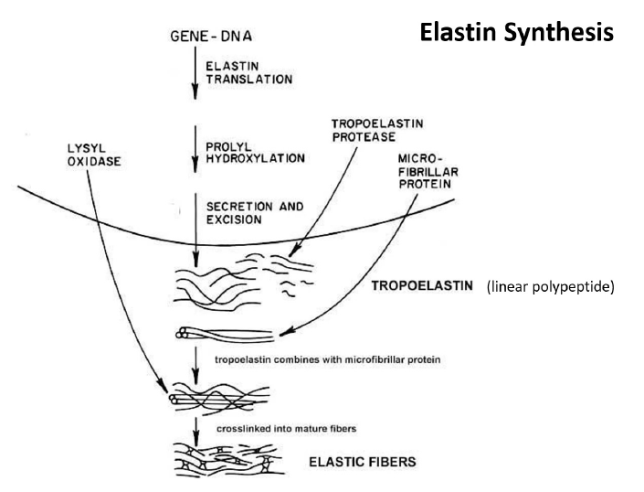

Slide 31
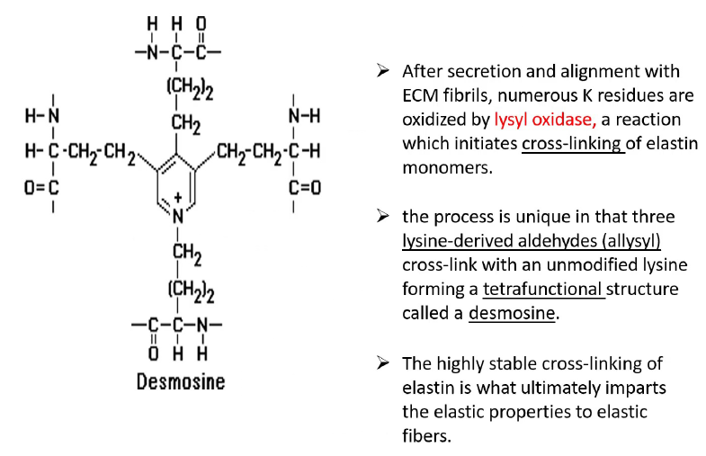

Slide 32
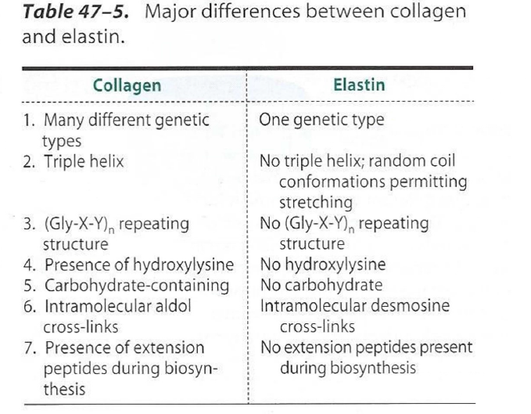

Slide 33
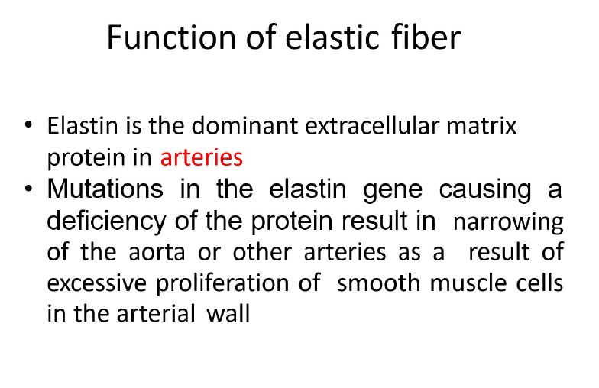

Slide 34
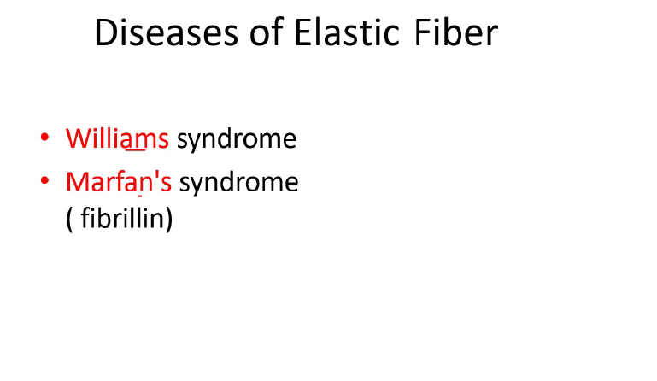

Slide 35
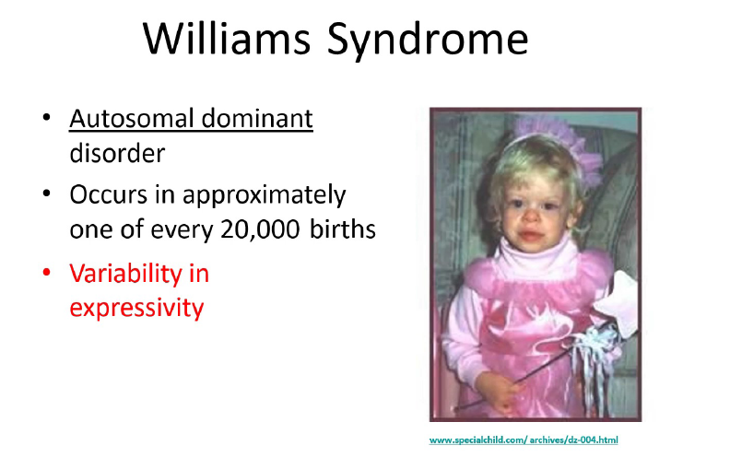

Slide 36
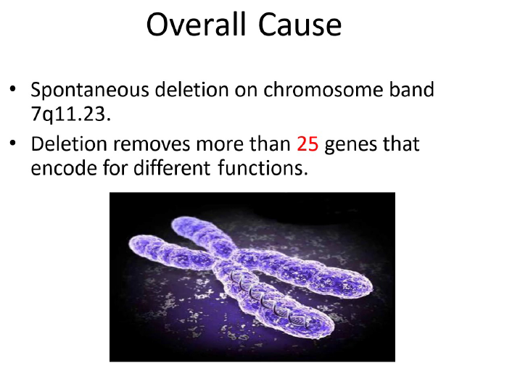

Slide 37
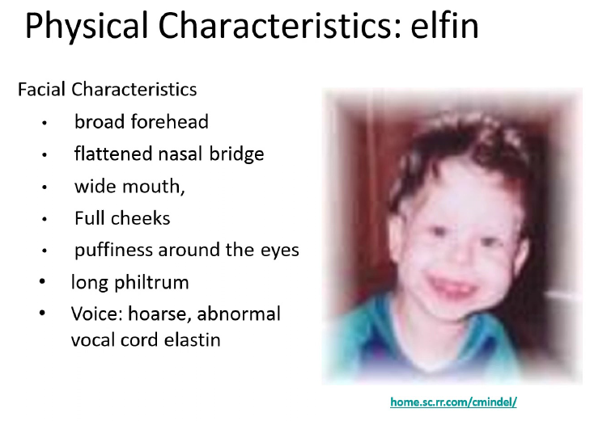

Slide 38
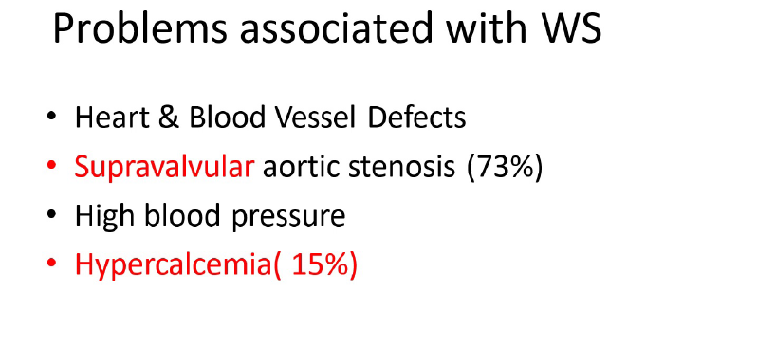

Slide 39
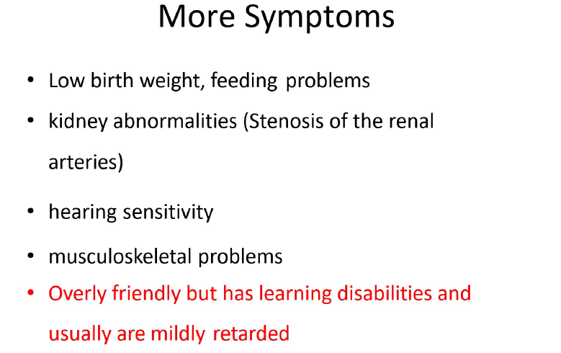

Slide 40
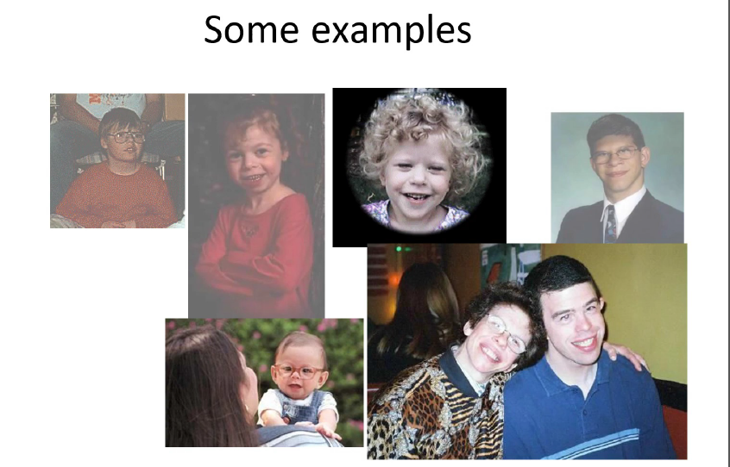

Slide 41
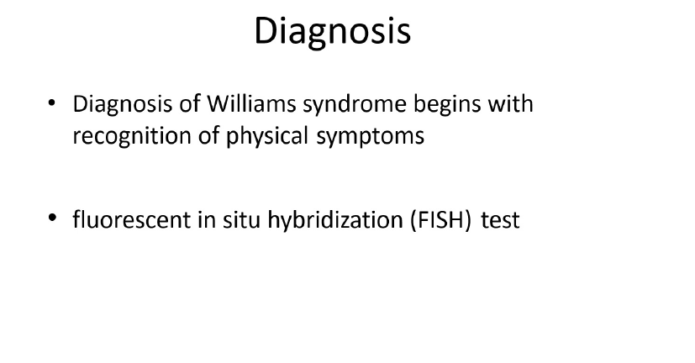

Slide 42
A 7-month-old child “fell over” while crawling and now presents with a swollen leg.
Imaging reveals a fracture of a bowed femur, secondary to minor trauma, and thin bones). Blue sclerae are also noted. At age 1 month, the infant had multiple fractures in various states of healing (right clavicle, right humerus, and right radius). A careful family history has ruled out nonaccidental trauma (child abuse) as a cause of the bone fractures. Which pairing of a defective (or deficient) molecule and the resulting pathology best fits this clinical description?
A. Elastin and emphysema
B. Fibrillin and Marfan disease
C. Type I collagen and osteogenesis imperfecta (OI)
D. Type V collagen and Ehlers-Danlos syndrome (EDS)
E. Vitamin C and scurvy

Slide 43
Correct answer = C. The child most likely has osteogenesis imperfecta.
Most cases arise from a defect in the genes encoding type I collagen.
Bones in affected patients are thin, osteoporotic, often bowed, and
extremely prone to fracture. Pulmonary problems are not seen in this
child. Individuals with Marfan syndrome have impaired structural
integrity of the skeleton, eyes, and cardiovascular system. Defects in
type V collagen cause the classic form of EDS characterized by skin
extensibility and fragility and joint hypermobility. Vitamin C deficiency
is characterized by capillary fragility.

